Slide 1
Explaining the Performance of Supervised and Semi-Supervised Methods for Automated Sparse Matrix Format Selection
Sunidhi Dhandhania, Akshay Deodhar, Konstantin Pogorelov, Swarnendu Biswas, and Johannes Langguth
International Workshop on Deployment and Use of Accelerators
ICPP Workshops 2021

Slide 2



Sparse Matrix Vector Multiplication (SpMV)
Important computation kernel
  PageRank, Conjugate Gradient, and Indirect solvers for systems of linear equations
1.0 | - | 2.0 | - | 3.0
- | 4.0 | - | 5.0 | -
- | - | 6.0 | - | -
7.0 | - | - | 8.0 | -
- | 9.0 | - | - | -
1
2
3
4
5
22
28
18
39
18
22
…
×
=
$$A$$
$$X$$
$$Y$$
J Greathouse and M Daga. Efficient Sparse Matrix-Vector Multiplication on GPUs using the CSR Storage Format. AMD Research 2014.
Notes:
To start, let’s talk about “sparse matrix vector multiplication”
On the left, you’ll see a sparse matrix. Most of the values are zero (denoted by dashes). In the middle, we have a dense vector, which we want to multiply by the matrix.
Each entry in the matrix is multiplied by the entry in the vector that corresponds to its column *click click click*, and the results from the same row are added together to produce one of the dense vector outputs.
This process is continued for every non-zero value in the matrix, until we have filled the output vector.
You may have noticed that entries in the input vector were used multiple times, while the values in the vector were only used once. This streaming access of the vector, and the small amount of mathematical operations used to produce the output *click* mean that this is considered to be a memory bandwidth-bound kernel. Its performance is primarily constrained by how fast you can load the vector from memory.

Slide 3

Performance of SpMV
Memory accesses are unstructured and have irregular access patterns unlike dense matrix operations
Limited data reuse, FLOPS/byte is very low memory-bound
Performance is sensitive to
Sparsity pattern of the input matrix
Processor microarchitecture and memory hierarchy
Kernel implementation
Other aspects like the Compiler and OS

Slide 4
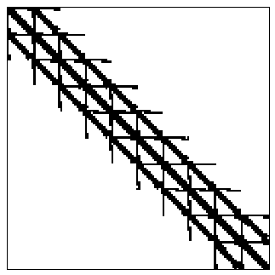
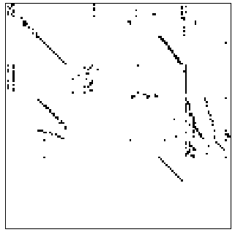
Sparse Matrix Formats
Representing matrices in a sparse format result in significant memory savings
MKL from Intel and CUSP and cuSparse from NVIDIA support many popular formats
DIA
ELL
CSR
COO
HYB
Structured
Unstructured
N. Bell and M. Garland. Sparse Matrix-Vector Multiplication on Throughput-Oriented Processors. NVIDIA Research.

Slide 5
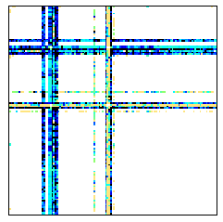
Sensitivity to Sparse Formats
 | Slowdown (relative) |  |  | Optimal Format
 | Pascal | Turing | Volta | Pascal | Turing | Volta
mawi_201512012345 | 164.8 | 194.8 | 121.3 | HYB | HYB | HYB
lp_osa_60 | 5.2 | 8.8 | 7.5 | HYB | COO | COO
CSR format is used as the default
CUSP library was used for benchmarking
mawi_201512012345
Rows | 18571154
Column | 18571154
Nonzeros | 38040320
Mean nonzeros per row | 2.04
Max nonzeros in a row | 16399896
Average std dev of nonzeros across rows | 3805.8

Slide 6
Sensitivity to Sparse Formats
 | Slowdown (relative) |  |  | Optimal Format
 | Pascal | Turing | Volta | Pascal | Turing | Volta
mawi_201512012345 | 164.8 | 194.8 | 121.3 | HYB | HYB | HYB
lp_osa_60 | 5.2 | 8.8 | 7.5 | HYB | COO | COO
No single format is the best across all input matrices and all target architectures
CSR format is used as the default
CUSP library was used for benchmarking
mawi_201512012345
Rows | 18571154
Column | 18571154
Nonzeros | 38040320
Mean nonzeros per row | 2.04
Max nonzeros in a row | 16399896
Average std dev of nonzeros across rows | 3805.8

Slide 7

Supervised ML Techniques
ML Model
Labels
Features
Train supervised
ML models
Trained ML Models
Training data set
Sparse matrix data set
Profile data
Benchmark SpMV kernels
Sparse format prediction
Target Architecture (e.g., Intel Xeon, NVIDIA Quadro)
Test data set
optimal sparse format

Slide 8


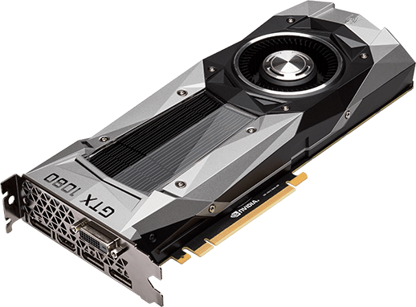
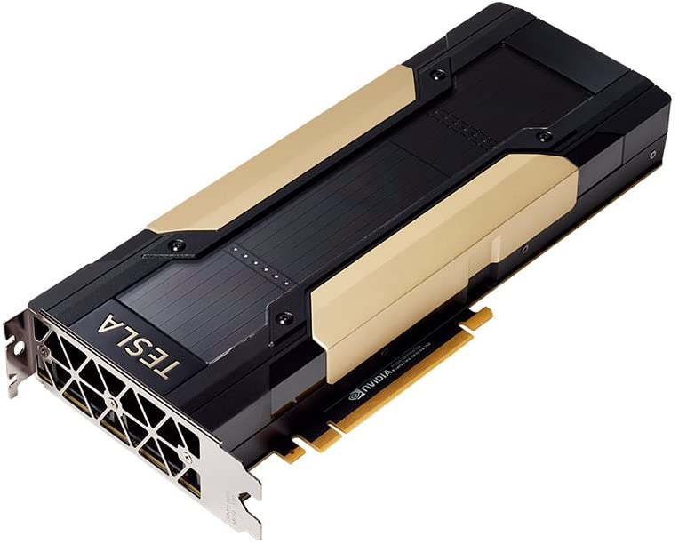

Challenges with Supervised Methods
Need representative training data and accurate feature set
Compare the size of ImageNet and SuiteSparse!
Numerical computations are being parallelized across heterogeneous compute devices
Trained models are specific to the profiled architecture, need to retrain for all possible target architectures
GeForce GTX 1080
90.65% accuracy
Volta V100
71% accuracy
1.07X speedup
0.97X speedup

Slide 9
Challenges with Supervised Methods
May need to retrain if new sparsity patterns are found or new sparse formats are proposed
Training supervised ML models require benchmarking $M$ matrices $×$ $F$ formats $×$ $N$ trials, which will often run into days
Training supervised ML models require benchmarking 𝑀 matrices × 𝐹 formats × 𝑁 trials, which will often run into days
Several new sparsity formats have been recently proposed (e.g., CVR, CSR5, CSR2, and PELLR)
Overhead comes from reading matrix files and format conversion

Slide 10
Desired Requirements for Automated
Sparse Format Selection
Solution should not be tightly coupled to the target architecture
Model should be easily portable to different target hardware
Approach should be flexible to incorporate new data
Techniques should aim for the “train once, deploy multiple times” paradigm

Slide 11
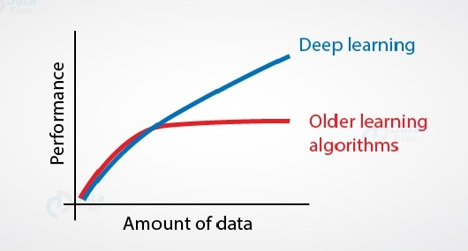
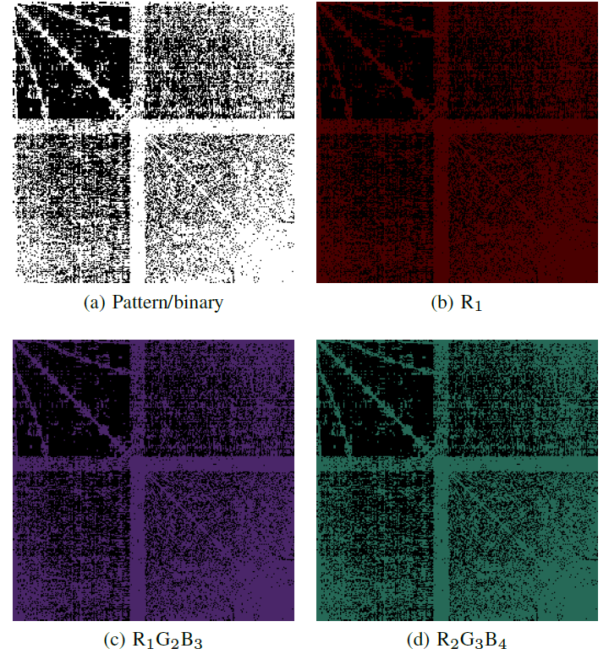
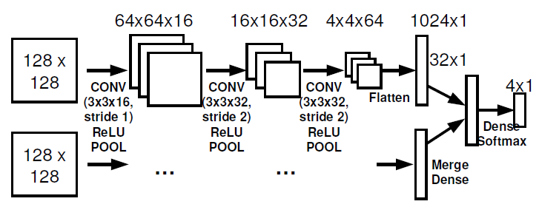
DL Techniques for Automated Format Selection
CNNs have had great success in image classification and computer vision
Why not use CNNs for classifying matrices?
Y. Zhao et al. Bridging the Gap between Deep Learning and Sparse Matrix Format Selection. PPoPP 2018.
J. Pichel and B. Pateiro-Lopez. A New Approach for Sparse Matrix Classification Based on Deep Learning Techniques. CLUSTER 2018.

Slide 12
Do the DL Techniques Address the Challenges?
DL models require even larger datasets to have good accuracy
Training and inference is very costly compared to non-DL models
W. Zhou et al. Enabling Runtime SpMV Format Selection through an Overhead Conscious Method. TPDS 2020.

Slide 13
Our Proposal
Semi-Supervised Method for Automated Sparse Matrix Format Selection

Slide 14
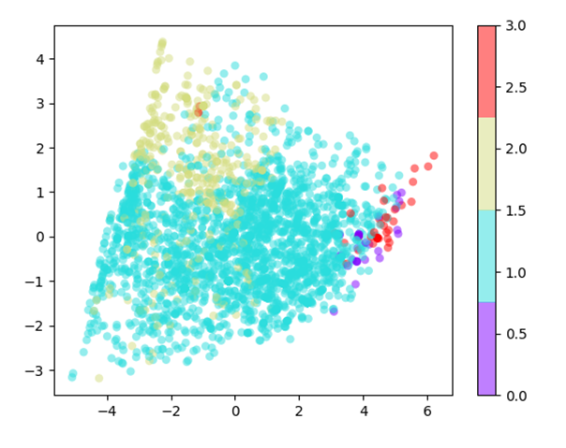
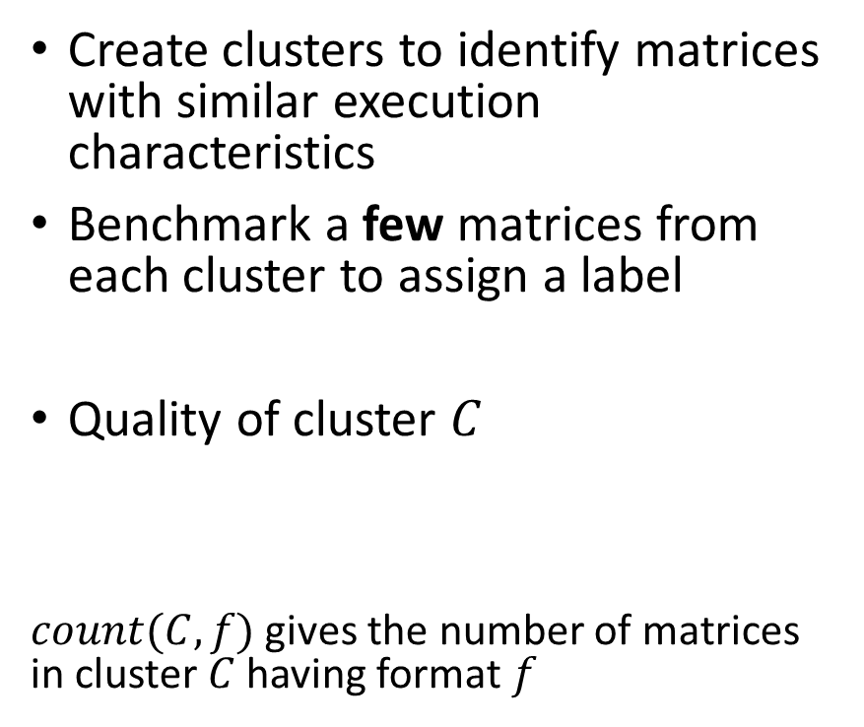

Semi-Supervised Format Selection via Clustering
Create clusters to identify matrices with similar execution characteristics
Benchmark a few matrices from each cluster to assign a label
Quality of cluster $C$
$count(C,f)$ gives the number of matrices in cluster $C$ having format $f$
$$quality\left(C\right)= \frac{\max_{f} count(C, f)}{|c|}$$

Slide 15
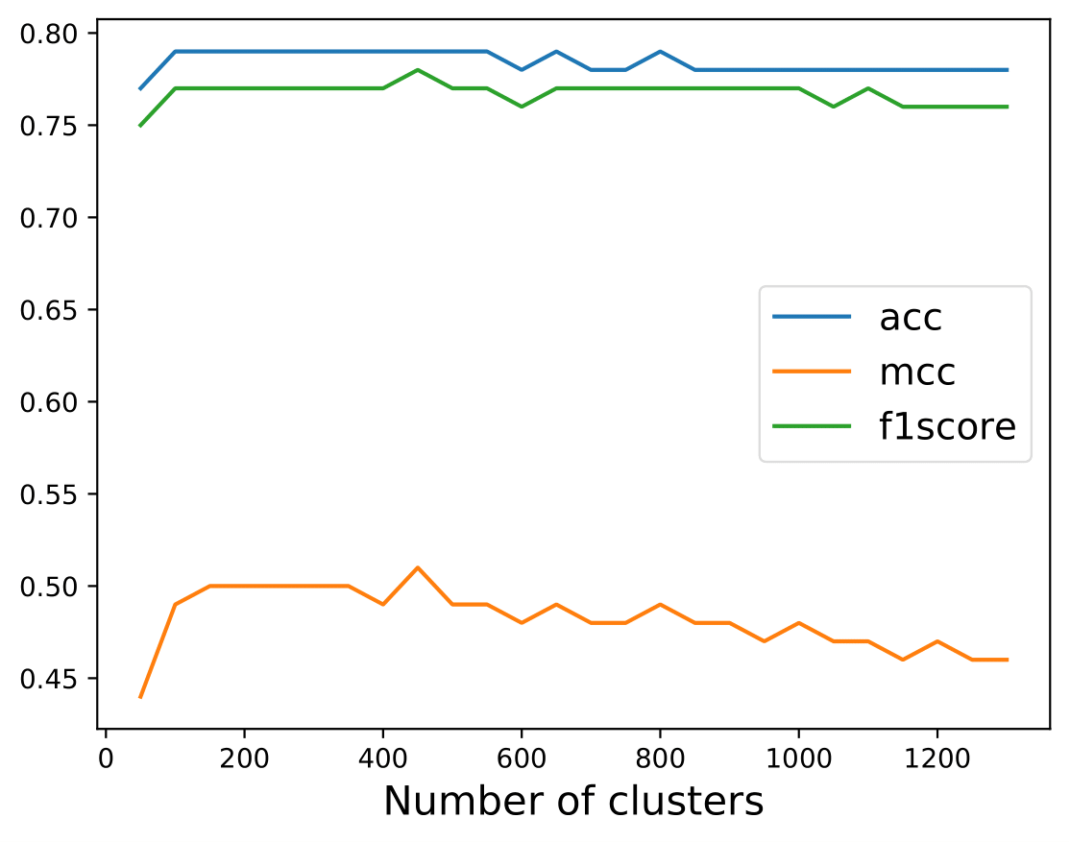
Devising an Accurate Clustering and Labeling Scheme
Naïve application of K-Means clustering gives poor results
Our pipeline
  Apply transformations (log or square root) to the feature set
  Apply Min-max scaling to scale each feature to [0,1]
  Use PCA to decompose the features to a vector of size 8
How to find K?
  More small clusters will increase accuracy
  Few large clusters reduces training time and limits
  overfitting, but can be more inaccurate
Notes:
Scaling is essential when performing classification based on a distance metric, unlike tree-based classifiers, which do not depend on such scaling.

Slide 16
Dissecting Clustering-based Format Selection
Clusters will be invariant across platforms (ideal)
Assignment of labels to clusters is platform-specific
Benefits
  Easy to port the model to a different architecture
  Easy to include new sparse formats
K-Means
Mean-Shift
BIRCH
…
Majority Vote
Logistic Regression
Random Forest
…

Slide 17


Implementation and Platforms
Implemented sparse format selection techniques with scikit-learn and TensorFlow libraries
Used CUDA Toolkit 9.2 and CUSP library from NVIDIA
 | Pascal | Volta | Turing
Model | GTX 1080 | V100 SXM3 | RTX 8000
# SMs | 20 | 80 | 72
Memory (GB) | 8 (GDDR5) | 32 (HBM2) | 48 (GDDR6)
Memory bandwidth | 320 GB/s | 897 GB/s | 672 GB/s
Notes:
Python + CUDA framework

Slide 18
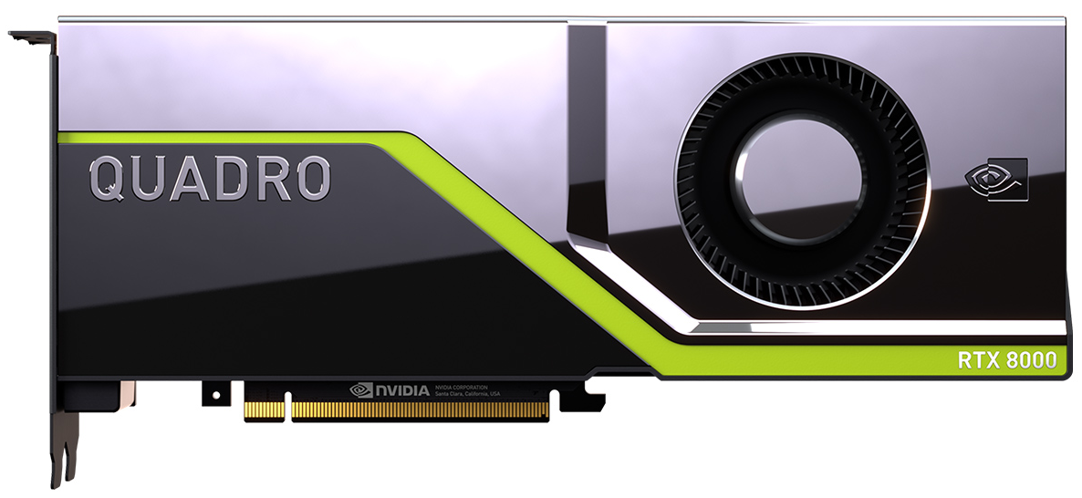
Performance of Semi-Supervised Approaches in Local Setting
 | # Clusters | MCC | ACC (%) | F1
K-Means + VOTE | 300 | 0.629 | 88.2 | 0.877
K-Means + LR | 150 | 0.537 | 86.0 | 0.845
K-Means + RF | 200 | 0.631 | 87.5 | 0.873
Mean-Shift + VOTE | 30 | 0.137 | 79.2 | 0.710
Mean-Shift + LR | 30 | 0.111 | 79.0 | 0.705
Mean-Shift + RF | 30 | 0.145 | 79.3 | 0.713
BIRCH + VOTE | 150 | 0.622 | 88.1 | 0.874
BIRCH + LR | 100 | 0.354 | 82.2 | 0.777
BIRCH + RF | 200 | 0.628 | 87.9 | 0.874

Slide 19
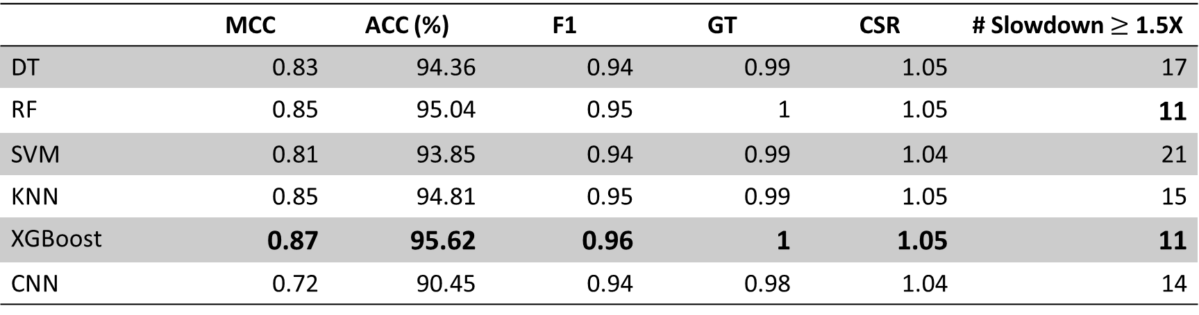
Performance of Supervised Approaches in Local Setting
 | MCC | ACC (%) | F1 | GT | CSR | # Slowdown $≥$ 1.5X
DT | 0.83 | 94.36 | 0.94 | 0.99 | 1.05 | 17
RF | 0.85 | 95.04 | 0.95 | 1 | 1.05 | 11
SVM | 0.81 | 93.85 | 0.94 | 0.99 | 1.04 | 21
KNN | 0.85 | 94.81 | 0.95 | 0.99 | 1.05 | 15
XGBoost | 0.87 | 95.62 | 0.96 | 1 | 1.05 | 11
CNN | 0.72 | 90.45 | 0.94 | 0.98 | 1.04 | 14

Slide 20
Performance of Semi-Supervised Approaches in Transfer Setting
 | # Clusters | 0% Training Data |  |  | 25% Training Data
 |  | MCC | ACC (%) | F1 | MCC | ACC (%) | F1
K-Means+VOTE | 1250 | 0.605 | 86.6 | 0.870 | 0.638 | 88.1 | 0.880
K-Means+LR | 125 | 0.582 | 87.2 | 0.861 | 0.592 | 87.5 | 0.863
K-Means+RF | 200 | 0.630 | 87.3 | 0.872 | 0.642 | 87.3 | 0.874
BIRCH+VOTE | 175 | 0.593 | 86.4 | 0.866 | 0.610 | 0.878 | 0.871
BIRCH+LR | 100 | 0.482 | 84.9 | 0.825 | 0.544 | 0.862 | 0.847
BIRCH+RF | 200 | 0.611 | 87.2 | 0.869 | 0.613 | 0.879 | 0.870

Slide 21
Performance of Supervised Approaches in Transfer Setting
 | 0% Training Data |  |  |  |  | 25% Training Data
 | MCC | ACC (%) | F1 | GT | CSR | MCC | ACC (%) | F1 | GT | CSR
DT | 0.55 | 81.06 | 0.82 | 0.97 | 1.03 | 0.65 | 86.99 | 0.87 | 0.98 | 1.04
RF | 0.63 | 84.85 | 0.86 | 0.98 | 1.04 | 0.70 | 88.94 | 0.89 | 0.96 | 1.05
SVM | 0.64 | 85.49 | 0.86 | 0.98 | 1.04 | 0.68 | 88.04 | 0.88 | 0.98 | 1.04
KNN | 0.46 | 76.23 | 0.78 | 0.95 | 1.01 | 0.54 | 81.08 | 0.83 | 0.96 | 1.02
XGBoost | 0.49 | 77.47 | 0.79 | 0.96 | 1.02 | 0.60 | 83.58 | 0.85 | 0.97 | 1.03

Slide 22
Key Takeaways
Semi-supervised approaches for sparse format selection can be competitive with supervised approaches
  Explore additional techniques to improve the performance of semi-supervised methods
  Provides several desirable benefits including easy model portability, easy to include new data, and extend to a runtime with online learning

Slide 23
Explaining the Performance of Supervised and Semi-Supervised Methods for Automated Sparse Matrix Format Selection
Sunidhi Dhandhania, Akshay Deodhar, Konstantin Pogorelov, Swarnendu Biswas, and Johannes Langguth
DUAC, ICPP Workshops 2021

