Slide 1
Privacy and Security in Online Social Media
#spsymposium13
March 2, 2013
Ponnurangam Kumaraguru (“PK”)
Assistant Professor
Hemant Bharat Ram Faculty Research Fellow
fb/ponnurangam.kumaraguru, @ponguru

Slide 2

Who am I?
Assistant Professor, IIIT-Delhi
Ph.D. from School of Computer Science, Carnegie Mellon University
Research interests
  Privacy, e-Crime, Online Social Media, Usable security
Founded and manage PreCog, precog.iiitd.edu.in
Courses that I teach @ IIITD
  Research methods / Advanced research methods
  Designing Human-Centered Systems

Slide 3
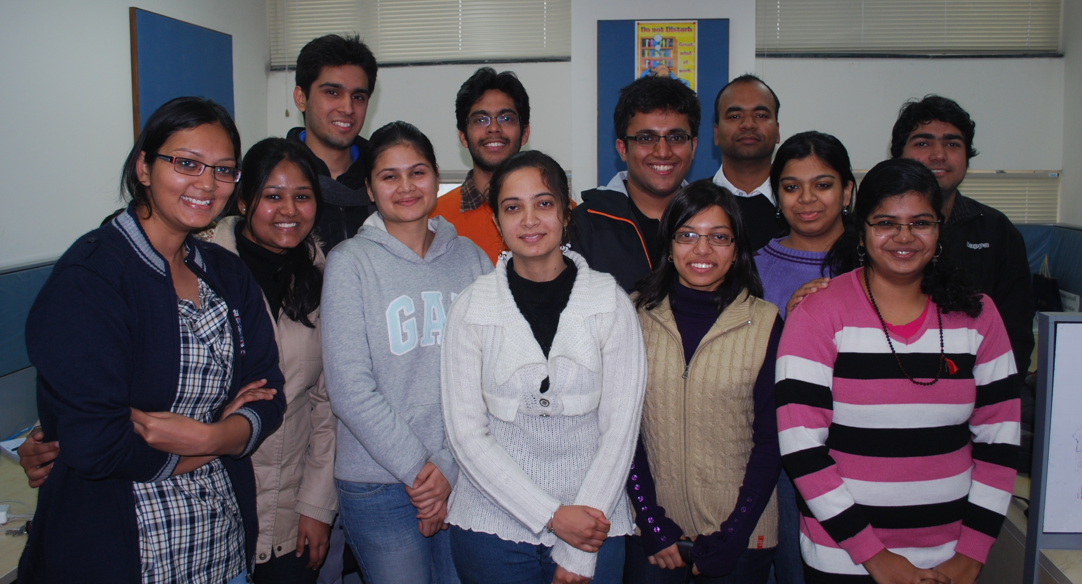
PreCogs

Slide 4
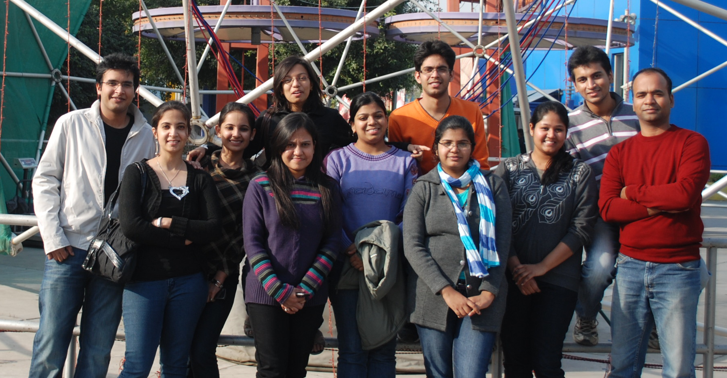
PreCogs

Slide 5

Research Areas of the Group
Privacy ( and perceptions)
e-Crime (Phishing, spam, copyright)
OSM (Credibility, digital foot print)
Usable security (CAPTCHAs, access control)
Notes:
http://www.bloggersview.com/tablet-pc-vs-smart-phone/

Slide 6
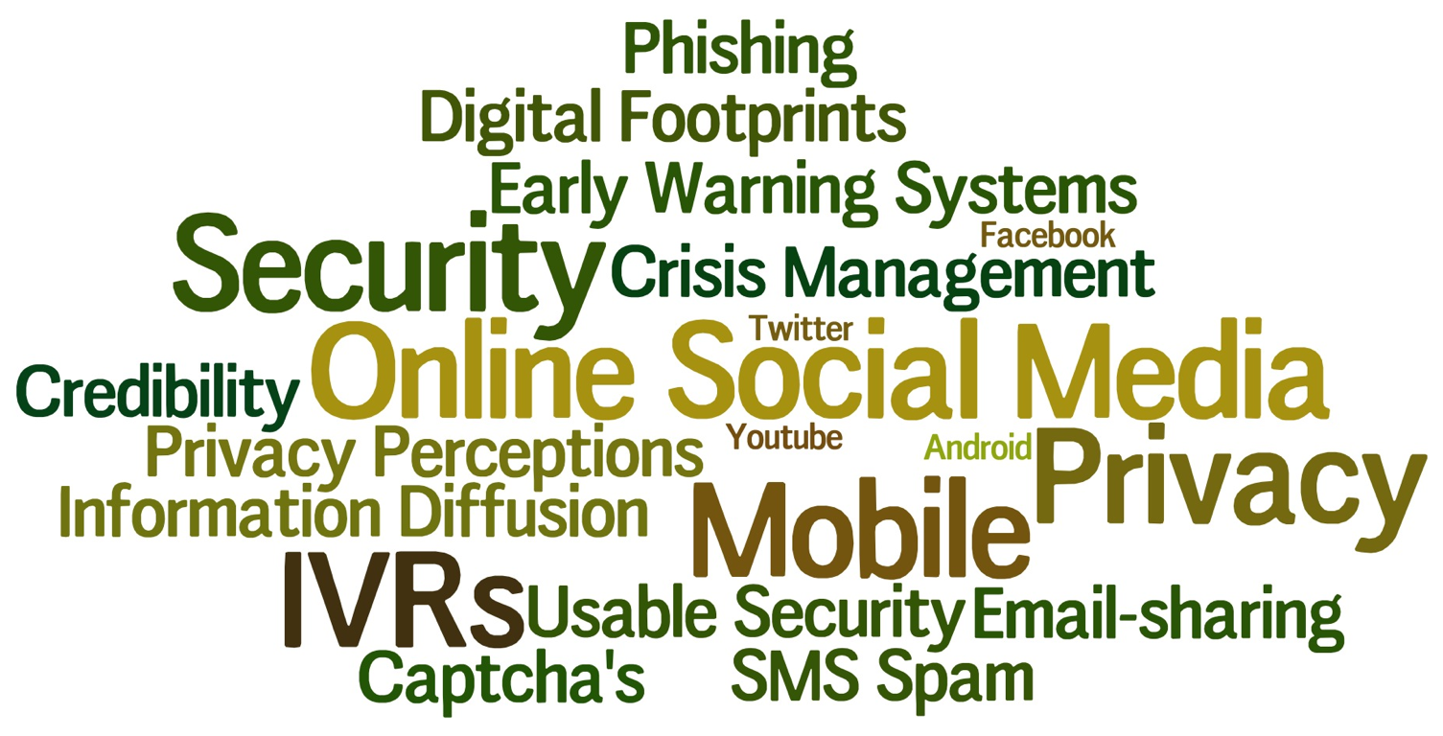






#privacyindia12

Slide 7
What will we cover today?
#privacyindia12

Slide 8
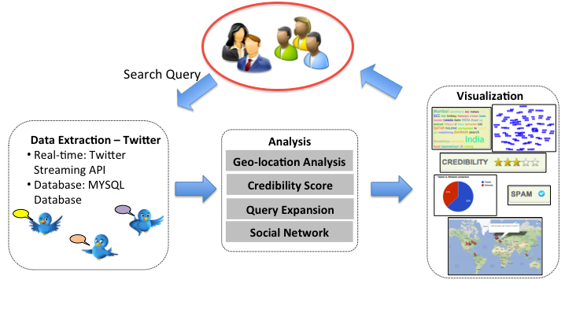
Twit-Digest

Slide 9
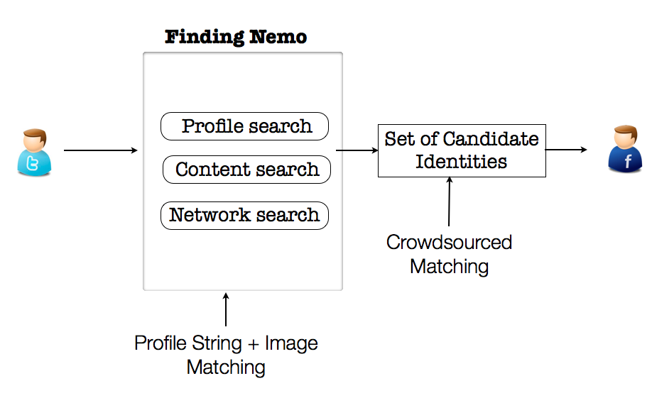
Identity Resolution
Given an identity I_{A} for user I on social network A, find her identity I_{B} on social network B
Webpage: http://precog.iiitd.edu.in/research/findingnemo

Slide 10
Privacy in India: Attitudes and Awareness V 2.0 http://precog.iiitd.edu.in/research/privacyindia
#privacyindia12

Slide 11
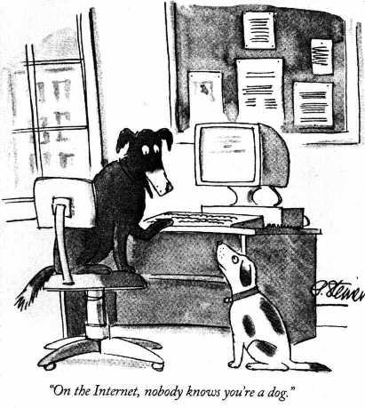
You thought that on the Internet nobody knew you were a dog…
…but then you started getting personalized ads for your favorite brand of dog food

Slide 12
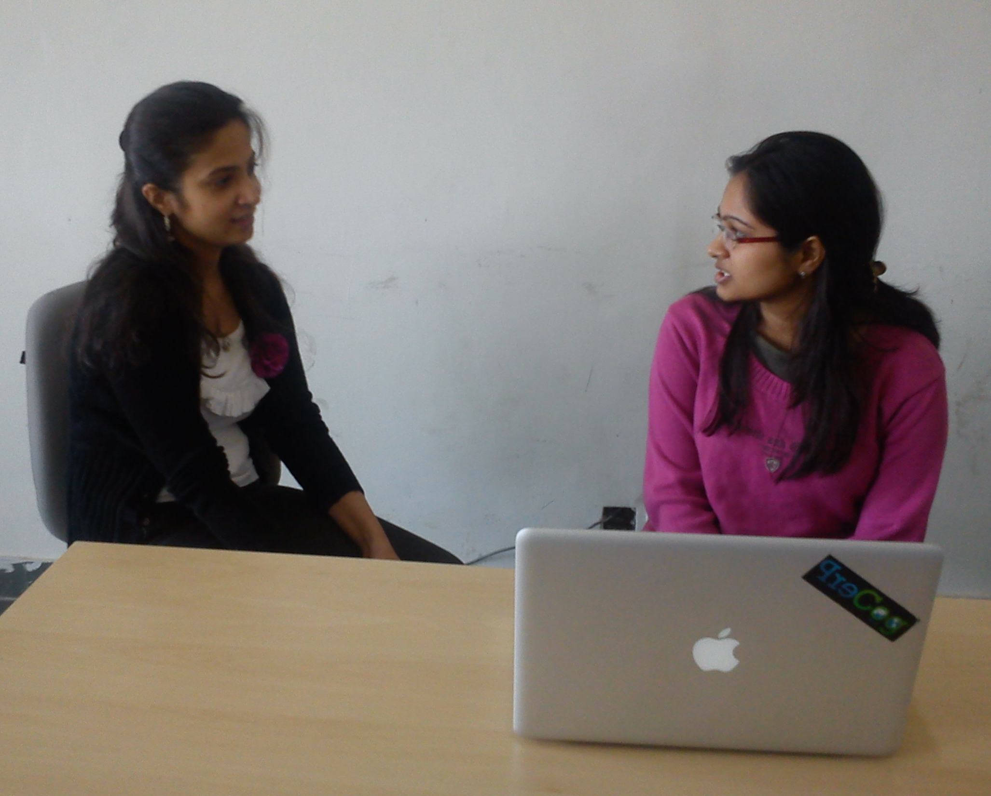
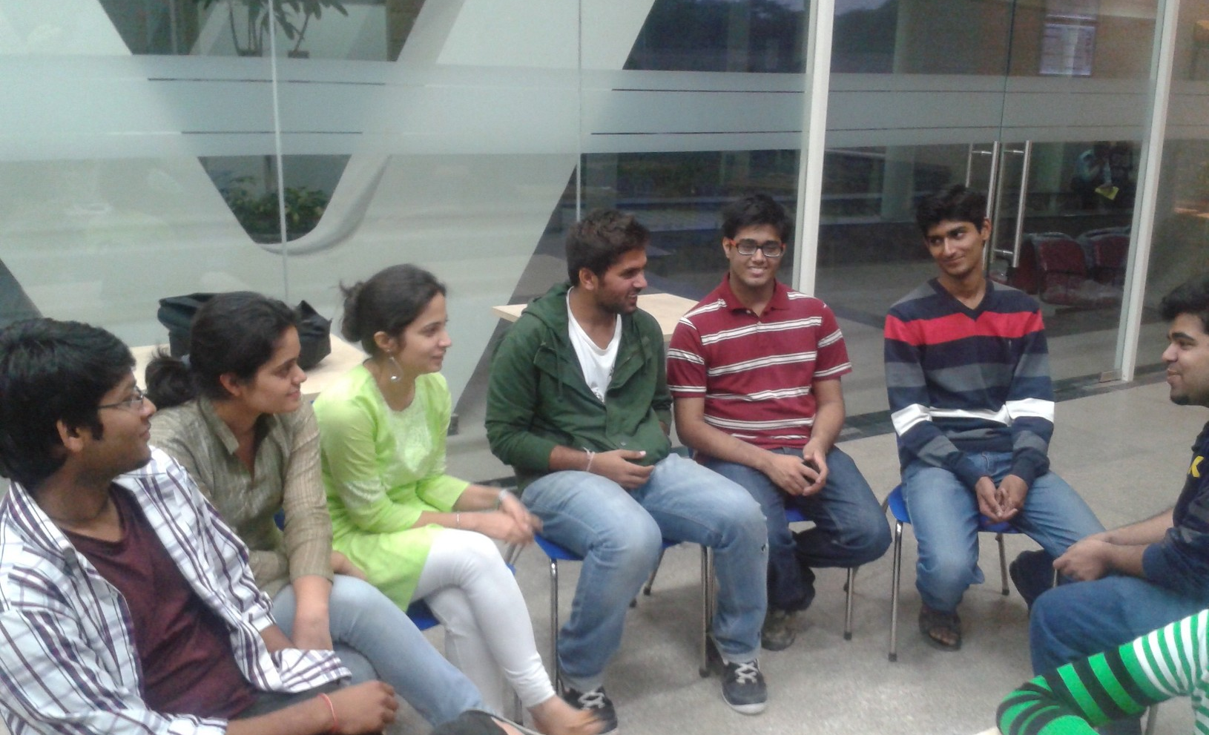




Methodology
20 Interviews
4 FGDs
10,427 Surveys
18 months!

Slide 13
Demographics
Age
Age (N=10,350)
<18 | 1.54
18-24 | 21.31
25-29 | 32.20
30-39 | 25.90
40-49 | 14.09
50-64 | 4.46
65+ | 0.50
Gender (N= 10,232)
Male | 67.57
Female | 32.43

Slide 14
Internet & Social Media
What do you feel about privacy of your personal information on your OSN?
 | Q42, N = 6,855
It is not a concern at all
Since I have specified my privacy settings, my data is secure from a privacy breach
Even though, I have specified my privacy settings, I am concerned about privacy of my data
It is a concern, but I still share personal information
It is a concern; hence I do not share personal data on OSN

Slide 15
Internet & Social Media
What do you feel about privacy of your personal information on your OSN?
 | Q42, N = 6,855
It is not a concern at all
Since I have specified my privacy settings, my data is secure from a privacy breach | 42.13
Even though, I have specified my privacy settings, I am concerned about privacy of my data
It is a concern, but I still share personal information
It is a concern; hence I do not share personal data on OSN

Slide 16
Internet & Social Media
What do you feel about privacy of your personal information on your OSN?
 | Q42, N = 6,855
It is not a concern at all | 19.30
Since I have specified my privacy settings, my data is secure from a privacy breach | 42.13
Even though, I have specified my privacy settings, I am concerned about privacy of my data | 23.84
It is a concern, but I still share personal information | 8.02
It is a concern; hence I do not share personal data on OSN | 6.71

Slide 17
Internet & Social Media
If you receive a friendship request on your most frequently used OSN, which of the following people will you add as friends?
 | Q43, N = 6,929
Person of opposite gender
People from my hometown
Person with nice profile picture
Strangers (people you do not know)
Somebody, whom you do not know or recognize but have mutual / common friends with
Anyone

Slide 18
Internet & Social Media
If you receive a friendship request on your most frequently used OSN, which of the following people will you add as friends?
 | Q43, N = 6,929
Person of opposite gender
People from my hometown
Person with nice profile picture | 10.12
Strangers (people you do not know)
Somebody, whom you do not know or recognize but have mutual / common friends with
Anyone

Slide 19
Internet & Social Media
If you receive a friendship request on your most frequently used OSN, which of the following people will you add as friends?
 | Q43, N = 6,929
Person of opposite gender | 27.39
People from my hometown
Person with nice profile picture | 10.12
Strangers (people you do not know)
Somebody, whom you do not know or recognize but have mutual / common friends with
Anyone | 2.99

Slide 20
Internet & Social Media
If you receive a friendship request on your most frequently used OSN, which of the following people will you add as friends?
 | Q43, N = 6,929
Person of opposite gender | 27.39
People from my hometown | 19.51
Person with nice profile picture | 10.12
Strangers (people you do not know) | 4.99
Somebody, whom you do not know or recognize but have mutual / common friends with | 8.31
Anyone | 2.99

Slide 21
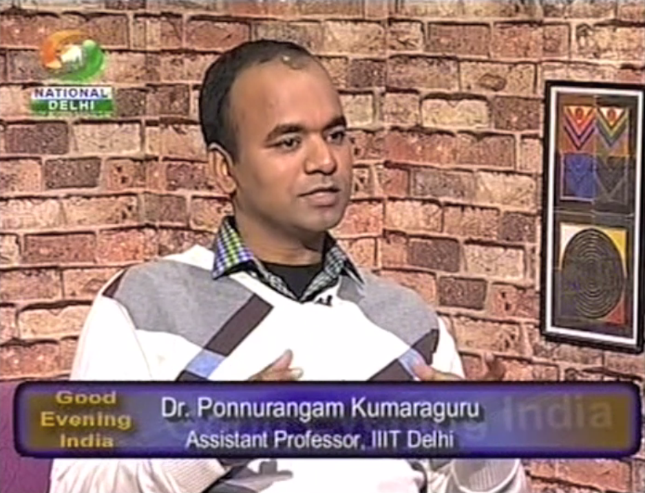
Released on Nov 22, 2012

Slide 22
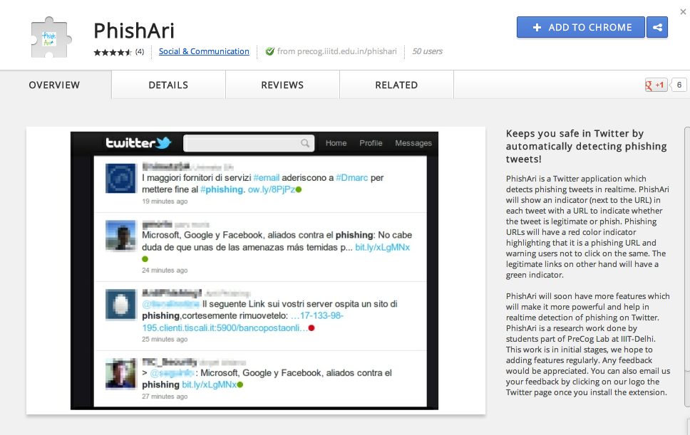
PhishAri
On Chrome https://chrome.google.com/webstore/detail/pheokmlohglcpigbnbenbimcombeoolm
URLs anywhere in Twitter
  Twitter timeline
  Search results
  Profile
  Direct messages
2 best paper awards!

Slide 23
Thank you!
pk@iiitd.ac.in
precog.iiitd.edu.in

Slide 24

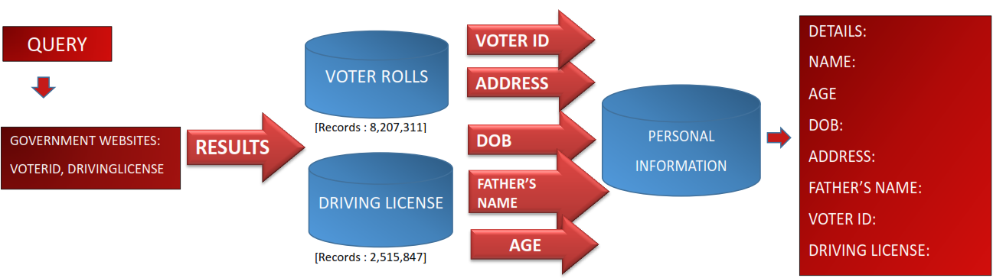
OCEAN: Open source Collation of eGovernment data and Networks
IBM Icare 2012
8 million Voter-ID
2.5 million Driving License records
253 unique users
IIT-K 2013

Slide 25
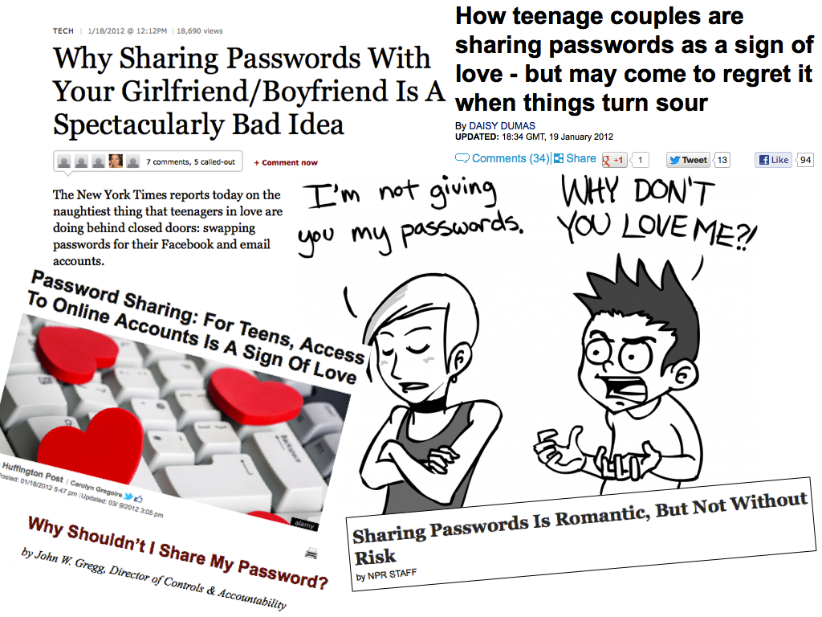
Video
accepted
at Tech2Share
IBM
I-CARE
2012!
Poster
accepted
at IIT-K
Symposium
2013!
http://precog.iiitd.edu.in/chaMAILeon
Tech. report at http://arxiv.org/abs/1301.6843

Slide 26
Discussion / Ways to collaborate
Work on some common areas of interest
Write some joint proposals
Register Infosys employee through the tri-party initiative
What more formal things to do before we kick off the activities
Will prefer to see some output soon to bootstrap the collaboration

