Slide 1

A Semantic Approach to Security and Privacy
Anupam Joshi eBiquity http://ebiquity.umbc.edu/
Joint work with Tim Finin and many students.
Support from NSF, AFOSR, NIST, Microsoft, IBM, Qualcom gratefully acknowledged!
Notes:
Good afternoon everyone.
I am Sumit More.
I am a Masters student here at the department of Computer Science & EE, and am working as a Research Assistant at the Ebiquity Research lab.
Today I'm here to defend my Master's Thesis topic titled: Situation Aware Intrusion Detection Model which was done under the guidance of Dr. Anupam Joshi.

Slide 2
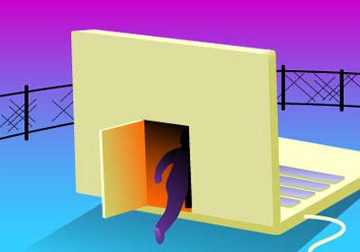


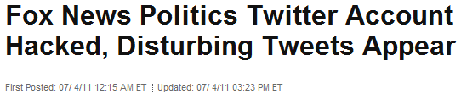
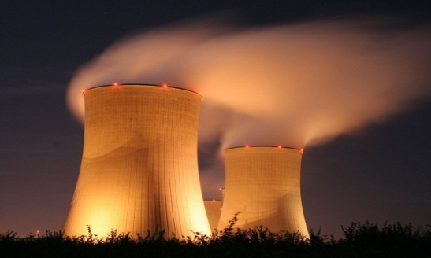
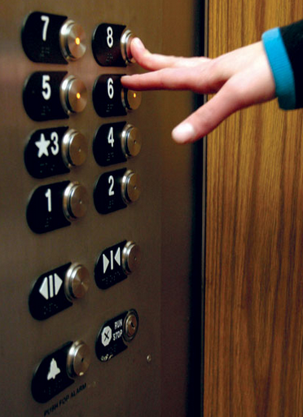
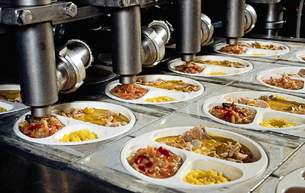

“There is a strong likelihood that the next Pearl Harbor that we confront could very well be a cyber attack.” – Defense Secretary Leon Panetta
Low-and-Slow Intrusion Patterns
Stuxnet: ‘One of the greatest technical blockbusters in malware history’
Potential Hazard to…
Situation Aware Intrusion Detection Model - Motivation
Notes:
To illustrate a few examples:
1. Shadows in the Cloud report uncovered a network of over 1,295 infected hosts in 103 countries, where high-value targets were compromised at ministries of foreign affairs, embassies, international organizations, news media, and NGOs.
2. Recently twitter Handles of many VIP personalities were compromised and used unethically.
3. Stuxnet is a very good example of a cyber-attack that could affect everything right from the heat in your home, food on your plate, to the money in your bank account
Recent intrusions follow a low-and-slow intrusion pattern, where the main intention of the attacker instead of a quick easy hit, is to remain undetected in the system for as long as possible, and as the time passes dig a little deeper into the system.

Slide 3
Big Issue in India too
"Our country's vulnerability to cyber crime is escalating as our economy and critical infrastructure become increasingly reliant on interdependent computer networks and the Internet“
Ghostnet, Munk center report, Anonymous hack of IIPM in response to court order, …

Slide 4
SoapBox
Cybersecurity is an element of national security. It is not (just) defending a particular computer or network
With the Cyber being connected to the Physical, the situation gets more complex
There is tremendous opportunity to contribute – from formal methods to PL to analytics to power systems to controls to ….. , not just systems/networking/crypto
Cybersecurity is only partially a technical discipline
  Law, politics, war, diplomacy, psychology, sociology, …

Slide 5
A Semantically Rich Approach ?
Can we make explicit the elements of security
  Assertions about the state of the world
  Assertions about Information flow and sharing
  Assertions about (AB) access control
  Assertions about Actors and Entities
  Assertions about policies governing the organization, people, or data
Given such explicit information, can we use declarative approaches to advance the state of the art in security and privacy research

Slide 6
Our work
Is grounded in W3C standards such as RDFS, OWL, …
  The new generation of KR&R
  Highly interoperable and reusable
Allows the same (set of) languages to express facts and rules
  We use our own, as well as those developed by others
Uses a scalable, open sourced infrastructure for reasoning
Is grounded in formal logics; Can be mapped to traditional security formalisms such as RBAC

Slide 7
Some Application Domains
Intrusion Detection
Mobile Device Security, especially BYOD
Cloud
BGP Security
Information Sharing

Slide 8
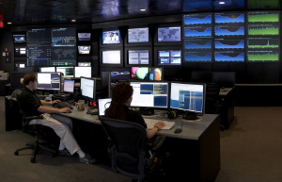

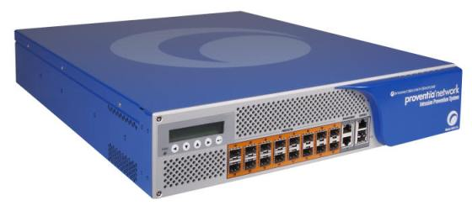
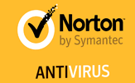
Introduction: State-of-the-Art/Practice for Intrusion Detection Systems
Limitations:
Difficulty detecting
  newly published attacks or zero-day attacks
  Low-and-slow attacks
Point based solutions
SIEMs mostly dashboards information
Alerts
(Simple) Analysis

Slide 9
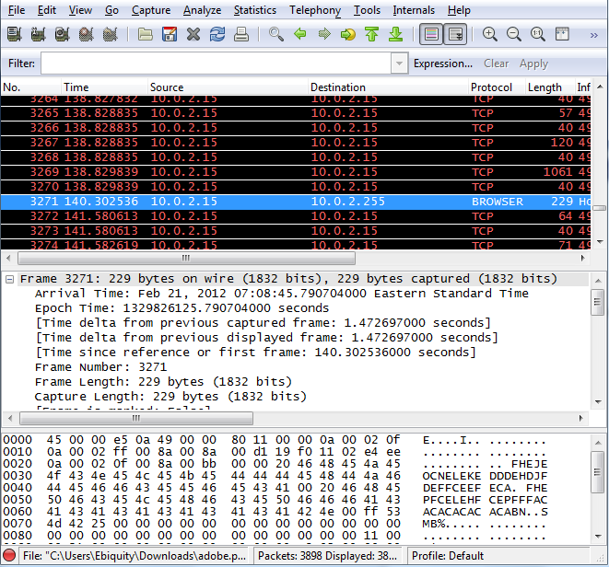

Introduction: Moving to Situational Awareness
[ a IDPS:text_entity;
IDPS:has_vulnerability_term "true";
IDPS:has_security_exploit "true";
IDPS:has_text “Internet Explorer";
IDPS:has_text “arbitrary code ";
IDPS:has_text "remote attackers".]
[ a IDPS:system;
IDPS:host_IP "130.85.93.105”.]
[ a IDPS:scannerLog
IDPS:scannerLogIP "130.85.93.105";
…]
[ a IDPS:gatewayLog
IDPS:gatewayLogIP "130.85.93.105";
…]
Context/Situation
Policies
[ IDPS:scannerLog IDPS:hasBrowser ?Browser
IDPS:gatewayLog IDPS:hasURL ?URL
?URL IDPS:hasSymantecRating “unsafe”
IDPS: scannerLog IDPS:hasOutboundConnection “true”
IDPS:WiresharkLog IDPS:isConnectedTo ?IPAddress
?IPAddress IDSP:isZombieAddress “true”]
=>
[IDPS:system IDPS:isUnderAttack “user-after-free vulnerability”
IDPS:attack IDPS:hasMeans “Backdoor”
IDPS:attack IDPS:hasConsequence “UnautorizedRemoteAccess”]
Alerts
Facts / Information
Rules
Analytics
Use-after-free vulnerability in Microsoft Internet Explorer 6 through 8 ….
Traditional Sensors
Non Traditional “Sensors”
Notes:
We thought would be great if we could come up with a way to do post-facto detection in real-time. Our idea is to take the data gathered from traditional sensors and add to that the data gained from non-traditional sensors like online forums or twitter feeds, analyze this data, create additional facts and information that will help the system infer the context or situation in which an attack can occur. This will generate policies and rules that would flag an alert during an intrusion.

Slide 10
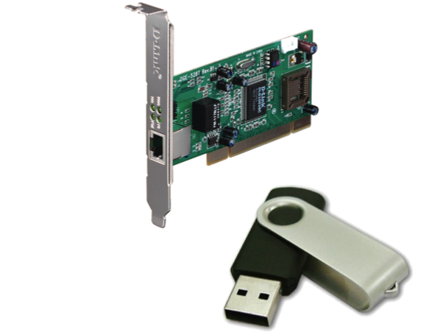
System Architecture
1
Web Text Sources
(Blogs, Forums, Feeds)
Network Activity Monitor
IDS/IPS sensors
Host Based Activity Monitor
Network Activity Logs
Entity/Concept Extractor
Security Vulnerability Entities Extractor
Reports and Logs
Hardware Security Sensors
Host Activity Logs
Security Vulnerability Terms
Security Logs
Named Entities
RDFS Knowledge
Domain Expert Knowledge
2
Knowledge Base
Reasoner
Ontology
Threat/Vulnerability Alert

Slide 11
Network Traffic Sensor
New sensor: Network Traffic Classifier
Traffic Signatures w/ stateless detectors
  Less invasive than data signatures performing Deep Packet Inspection
Classifiers
  Ports
    # unique ports: Benign -> 1.338; Malicious -> 1.004
  Timing of packets
    Average standard deviation: Benign -> 3.334 seconds; Malicious -> 0.209 seconds
  Time to Live values
    Average TTL: Benign -> 72.805 hops; Malicious -> 64.647 hops
  Combining Port, Timing, and TTL Classification
    more specific signature created for benign and malicious traffic
Notes:
These signatures can be labeled as traffic or data signatures depending on what information is extracted from a packet. Traffic signatures observe patterns in a traffic flow in order to detect anomalies using patterns that fall into two primary categories: header information and flow information. Typical elements of header information used are ports, IP addresses, and Time to Live (TTL) values. Ports and IP addresses are used to identify a flow, which is a grouping of packets that are sent or received by the same application.
Data signatures examine all of the contents of a packet to detect malicious code. This has an advantage over traffic signatures since some attacks only require very few packets or can hide by mimicking benign traffic. However, the deep packet inspection (DPI) required for these signatures to detect malicious activity is a time-consuming process involving data collection followed by string comparisons. The information produced by this type of inspection could also lead to privacy concerns.

Slide 12
System Architecture: Vulnerability Terms Extractor
{ a IDPS:text_entity;
IDPS:has_vulnerability_term "true";
IDPS:has_security_exploit "true“;
IDPS:has_text “Cross-site scripting”;
IDPS:has_text “Windows Metafile vulnerability”;
IDPS:has_text “ArbitraryCodeExecution”;
RDF Represented Data
1. Cross-site_scripting ::: Wikipedia Categories [Articles_with_Alice_and_Bob_explanations, Injection_exploits, Computer_security_exploits, Web_security_exploits]
2. Windows_Metafile_vulnerability ::: Wikipedia Categories [Computer_security_exploits, Microsoft_Windows]
3. Vulnerability_(computing) ::: Wikipedia Categories [Computer_security, Software_testing, Computer_security_exploits]
4. Cross-zone_scripting ::: Wikipedia Categories [System_administration, Web_security_exploits]
5. Arbitrary_code_execution ::: Wikipedia Categories [Articles_lacking_sources_(Erik9bot), Computer_security_exploits]
Vulnerability Detection Module
CVE-2012-2557: Use-after-free vulnerability in Microsoft Internet Explorer 6 through 8 allows remote attackers to execute arbitrary code via a crafted web site that triggers access to a deleted object, aka "cloneNode Use After Free Vulnerability.”

Slide 13


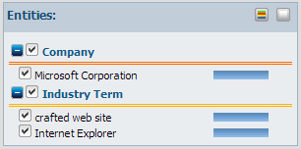
System Architecture: Named Entity/Concept Extractor
{a IDPS:text_entity;
IDPS:has_text “Internet Explorer";
IDPS:has_text “Microsoft Corporation";
IDPS:has_text “crafted web site".}
RDF Represented Data
CVE-2012-2557: Use-after-free vulnerability in Microsoft Internet Explorer 6 through 8 allows remote attackers to execute arbitrary code via a crafted web site that triggers access to a deleted object, aka "cloneNode Use After Free Vulnerability.”

Slide 14



End-to-End Example
Shadows in the Cloud – CVE-2009-0927
Stack-based buffer overflow in Adobe Reader and Adobe Acrobat 9 before 9.1, 8 before 8.1.3 , and 7 before 7.1.1 allows remote attackers to execute arbitrary code via a crafted argument to the getIcon method of a Collab object, a different vulnerability than CVE-2009-0658.
Malicious code in annots.api executed
TCP/IP Connection Set Between Host and Remote Attacker
Host System
Remote Attacker
Outbound Port Opened At Host
IDS/IPS System
Notes:
The attack takes place as follows:
The healthy host system is connected to a network to which the attacker is connected as well.
The host system has the corrupted pdf file carrying the malicious payload.
When the user at the host system opens the corrupt pdf, the malicious code which is executed via an executable named ‘annots.api’ opens up an outbound port at the host system, to which the remote attacker can connect to.
The user at host system opens the corrupt pdf
The malicious code in ‘annots.api’ of Acrobat results opening up of outbound port
Remote attacker can now directly connect to the compromised host system via the port opened up at the host system

Slide 15



End-to-End Example: Vulnerability Terms Extractor
Vulnerability Buffer_Overflow [Computer_security_exploits, Programming_bugs]
Vulnerability Stack_buffer_overflow [Computer_errors, Computer_security_exploits, Software_anomalies, Programming_bugs]
Vulnerability Detection in Text Data
Vulnerability Detection Module
Stack-based buffer overflow in Adobe Reader and Adobe Acrobat 9 before 9.1, 8 before 8.1.3 , and 7 before 7.1.1 allows remote attackers to execute arbitrary code via a crafted argument to the getIcon method of a Collab object, a different vulnerability than CVE-2009-0658.
Text Data From CVE and security bulletins

Slide 16
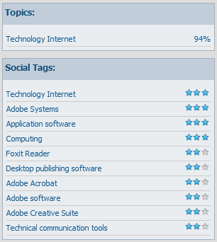
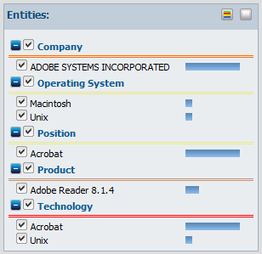
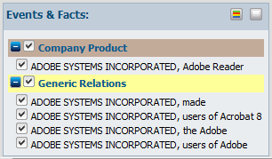
End-to-End Example: Named Entity/Concept Extractor
Extracted Terms:
Adobe Systems Incorporated
Adobe Acrobat Reader 8.x.x
annots.api
Remote attackers
Javascript
Buffer Overflow
Vulnerability
Arbitrary Code Execution
Critical vulnerabilities have been identified in Adobe Reader 9 and Acrobat 9 and earlier versions. These vulnerabilities would cause the application to crash and could potentially allow an attacker to take control of the affected system. There are reports that one of these issues is being exploited (CVE-2009-0658).
Adobe recommends users of Adobe Reader and Acrobat 9 update to Adobe Reader 9.1 and Acrobat 9.1. Adobe recommends users of Acrobat 8 update to Acrobat 8.1.4, and users of Acrobat 7 update to Acrobat 7.1.1. For Adobe Reader users who can’t update to Adobe Reader 9.1, Adobe has provided the Adobe Reader 8.1.4 and Adobe Reader 7.1.1 updates.
Acrobat and Reader are prone to a remote code-execution vulnerability because they fail to sufficiently sanitize user-supplied input before using it in the ’strncpy’ function in the ’Annots.api’ file. This issue affects the ’getIcon()’ JavaScript method of a Collab object. Specially crafted arguments can cause a stack-based buffer overflow.
Notes:
Opencalais web service API took the vulnerability description, extracted and tagged the entities and returned RDF-formatted entities, facts and events.
It takes about 0.5 to 1.0 second depending on size of the document. You can send four transactions per second and 40,000 per day.
Calais is a big initiative with a lot of components.

Slide 17
End-to-End Example: Knowledgebase, Reasoner, and Ontology Module
Models
Attack in terms of Means and Consequences
System Properties
Network Properties
Database for information to be collected, organized, and utilized
RDF triples of form <subject> <predicate> <object>
Used to infer additional information and rules
(HostA sendsPacketTo HostB) ➔
(HostB receivedPacketFrom HostA)
Knowledge Base
Reasoner
Ontology
Threat/Vulnerability Alert
Notes:
This module comprises of 3 sub-modules namely:
1. An ontology which models the intrusion behavior, system state, network state etc.
The knowledge-base which is a database that provides a unified means for intrusion information coming from variety of sources to be collected, organized, and utilized in an efficient way.
Reasoner which is a set of rules that are used to define a set of conditions for intrusion detection.
The knowledge base is a set of N3 triples of form <subject> <predicate> <object> which reflects the information retrieved from different data sources, which is used for inferencing purpose.
computer science, in the context of data storage and transmission, serialization is the process of converting a data structure or object state into a format that can be stored (for example, in afile or memory buffer, or transmitted across a network connection link) and "resurrected" later in the same or another computer environment.
In addition to the classic “Web of documents” W3C is helping to build a technology stack to support a “Web of data,” the sort of data you find in databases. The ultimate goal of the Web of data is to enable computers to do more useful work and to develop systems that can support trusted interactions over the network.
The ontology models the system behavior, the network behavior, and the attack behavior, and is used for inferencing possibility of an attack given a set of inputs from the data channels.
An ontology modeling the intrusion behavior, classifying the attack, the system under attack, means of the attack, and consequences of the attack into different classes
The reasoning logic is a set of rules composed of N3 statements.
These rules are written by domain expert, someone who understands intrusion behavior.
The data processor being used is CWM.
CWM (pronounced as ‘coom’) understandable N3 data, which the CWM rules processor uses to infer additional knowledge, given a set of data

Slide 18
End-to-End Example: Rule Creation
{ebIDS:webtext_0927 ebIDS:hasVulnerabilityTerm “true” .
ebIDS:webtext_0927 ebIDS:hasSecurityExploit “true” .
ebIDS:webtext_0927 ebIDS:hasText ?Product .
ebIDS:webtext_0927 ebIDS:hasText ?Process .
Web-Text
ebIDS:means ebIDS:maliciousProcess ?Process .
ebIDS:means ebIDS:affectedProduct ?Product}
Data from Ontology
ebIDS:scannerLog_101 ebIDS:hasProduct ?Product .
ebIDS:scannerLog_101 ebIDS:hasProcessExecuted ?Process .
ebIDS:scannerLog_101 ebIDS:hasPortOpened “true” .
ebIDS:scannerLog_101 ebIDS:hasOutboundConnection “true” .
get(ebIDS:scannerLogOutboundPortOpenTimestamp
ebIDS:scannerLogProcessExecutionTimestamp) .
Scanner Logs
[ebIDS:system_001 ebIDS:hostUnderAttack “true”.
ebIDS:webText_0927 ebIDS:hasProduct ?Product.
ebIDS:webText_0927 ebIDS:hasProcessExecute ?Process.
ebIDS:attack_121 ebIDS:hasMeans “Arbitrary Code Execution”.
ebIDS:attack_121 ebIDS:hasConsequence “Unauthorized Remote Access”]
Inferences
Notes:
The reasoning logic is an implication which uses N3 statements prepared from information using web-text, scanner logs, and data from ontology to give an inference.
Here we have an illustration which states that if the web-text comprises of some vulnerability terms, mentions some product and process, which are also captured by the scanner log, and the ontology has the process and product as part of the means of an attack, and the scanner has a log mentioning opening up of an outbound port, then there is a probable attack in progress with consequences of unauthorized remote access

Slide 19



End-to-End Example: Results
Network Scanner Logs
RDF Data
Host and Network Related Information
Protocol: TCP/IP, UDP, etc.
Source -Destination IPs, Ports
Timestamp
Packet Size and Contents
ebIDS:log a ebIDS:scanner_log;
ebIDS:scanner_log_IP "130.85.93.105";
ebIDS:scanner_log_LAN_IP "10.0.0.15";
ebIDS:scanner_log_product "adobe";
ebIDS:scanner_log_process "annots.api";
ebIDS:scanner_log_port_open "true".
Notes:
The host system activities like processes running on the system, network activity (network protocols, packets sent, ports/IPs in use), etc. is monitored by tools Snort, Wireshark, and network scanner IBM ES750. The network activity is parsed in N3 format.
For parsing of network scanner logs, we used jNetPcap library and simple file parsing.

Slide 20
Hardware Trojans and Data Exfiltration
Network layer
Change in outgoing packet patterns
Connection to an unknown address
Application layer
Hardware layer
New hardware insertion event
Change in the power consumption patterns
New device driver registration
Change in the instruction set patterns
Sensor for:
Hidden processes
Sensors to detect:
Sensors to detect:

Slide 21

Platys Project
Part of an NSF collaborative project with NC state (M. Singh & I. Rhee) and Duke (R. Choudhury)
Overall theme: enable smartphones to learn and exploit a richer notion of place
  Place is more than GPS coordinates
  Conceptual places include people, devices, activ-ities, purpose, roles, background knowledge, etc.
  Use this to provide better services and user experience

Slide 22
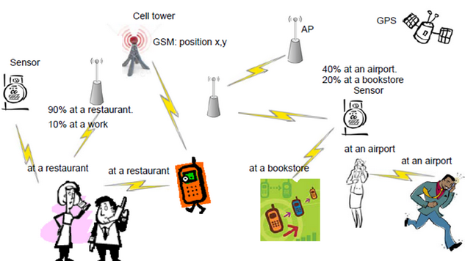
Sharing place information
Peer to peer communication
Opportunistic Gossiping
User privacy policies control sharing
Fixed devices acquire, store, share, and summarize
Notes:
Peer to peer communication among co-located nearby wireless devices based on opportunistic gossiping is used for sharing place information. Fixed devices such as sensors and access points (APs) can be used to reposit, share, and even summarize statistically the place information overheard from passing-by mobile devices.

Slide 23
The Story
Smart mobile devices know a great deal about their users including their current context
Acquiring and reasoning about this knowledge will enable them to provide better services
Sharing the information with other users, organizations and service providers can also be beneficial (Mobile Ad-Hoc Knowledge Networks)
Context-aware policies can be used to limit information sharing as well as to control the actions and information access of apps

Slide 24
I am …
at (26.54, 80.21)
vs.
In Outreach Hall, IIT Kanpur, Kalyanpur, Kanpur Dehat, UP, …
participating in #SPsymposium
With >10 people including Matt Bishop, Ravi Sandhu, PK1, PK2, Sanjeev Aggarwal, …
filling a speaker role, audience role, …
…

Slide 25
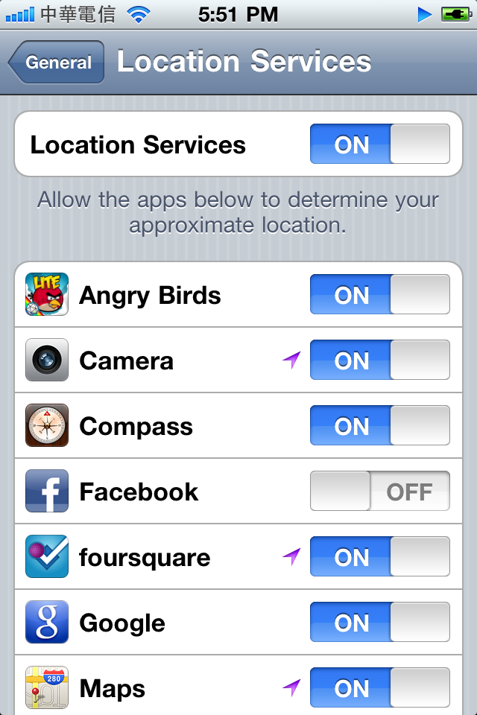
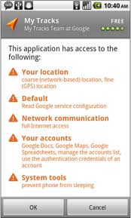
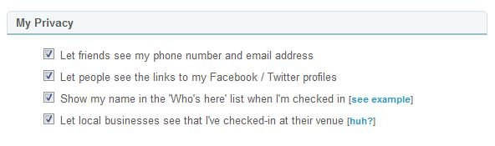
Privacy Controls Today
Privacy controls in existing location sharing applications are limited
  Friends Only and Invisible restrictions are common
  Not context-dependent but static and pre-determined
Controls for sharing other data are largely non-existent
Notes:
Temporal Restriction: Date and time interval restrictions for disclosing the context information.
Freshness: Specifies the freshness of the disclosed context information.
Timestamp: Specifies the time in which the privacy rule has been created.
AccessPolicy: Represents the access policy (Optimistic or Pessimistic) that this privacy rule is associated with.
high-level, declarative policies that describe users’ information sharing preferences under given contextual situations.
Besides being able to specify which information a user is willing to share, we can specify how that information
should be shared. A user can disclose information with different accuracy levels; for instance, she may be willing
to reveal to her close friends the exact room and building on which she is located, but only the vicinity or town to
others.
Currently the privacy controls in context aware systems are based on static information and predetermined. User can decide information sharing based on static information such as group of friends, profile information attributes. This controls are not adequate for context-aware systems.
The context-aware systems has heterogeneous and dynamic sensors which causes continuous changes in user’s context. This environment calls for better access controls with finer control over context data.
We need privacy mechanisms that consider the dynamic changes in user context relative to location and time. The user needs to be in control of the release of her personal information at different levels of granularity, from raw sensed data to high level inferred context information. The users should be able to define their privacy policies and the context-aware system should be able to protect their information regardless of application.
The context-aware system can have complex privacy policies. Consider healthcare context-aware system where sensor-enabled mobile phones can be used to collect in situ sensor data and context data about patient and caretakers. The user of such system
can have privacy policy like “In case of minor medical problems, share my recent medical records and caretaker’s city-wide location with doctor but in case of emergency, share my detailed medical data, location history and current location of caretaker”
In another case, the user can have a policy like “Do not share my GPS information with anyone if I am speeding on some highway”.
None of the existing context-aware systems allow users to specify such privacy preferences.

Slide 26
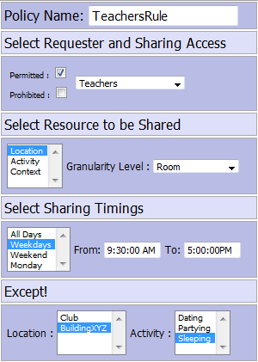
Context-aware Policies for Sharing
Need for high-level, flexible, expressive, declarative policies
    Temporal restriction, freshness, granularity, access model (optimistic/pessimistic)
    Context dependent release of information
    Obfuscation of shared information
    etc.
Static Information
Aspects of Context
Generalization of Context
Temporal Restrictions
Requester’s Context
Context Restrictions
Notes:
Temporal Restriction: Date and time interval restrictions for disclosing the context information.
Freshness: Specifies the freshness of the disclosed context information.
Timestamp: Specifies the time in which the privacy rule has been created.
AccessPolicy: Represents the access policy (Optimistic or Pessimistic) that this privacy rule is associated with.
high-level, declarative policies that describe users’ information sharing preferences under given contextual situations.
Besides being able to specify which information a user is willing to share, we can specify how that information
should be shared. A user can disclose information with different accuracy levels; for instance, she may be willing
to reveal to her close friends the exact room and building on which she is located, but only the vicinity or town to
others.

Slide 27
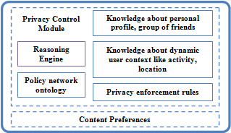
Privacy Preferences
User-defined policies : specified by the user to protect her information
  Share my context with family members all the time
System-defined policies
  Multi-level secure systems where the system-level policies must override the user-level policies
  Do not share the user’s context if she is inside BuildingXYZ

Slide 28
Ex: Context Sharing Policies
Policies using generalization for sharing
  Share my activity with friends if it has private visibility
  Share my public activity with anyone
  Share my city-level location with everyone
System-level policies
  Do not share user’s context if she is inside BuildingXYZ

Slide 29
Location Generalization
  Share my exact location with teachers on weekdays from 9am-5pm
    User’s exact location in terms of GPS co-ordinates is shared
    The user may prohibit sharing GPS co-ordinates but permit sharing city-level location
  Share my building-level location with teachers on weekdays from 9am-5pm
Notes:
This approach has its own limitations as it doesn’t allow sharing on different granularity levels of the location. In many cases the user might be interested to share the location but not in terms of GPS coordinates.

Slide 30
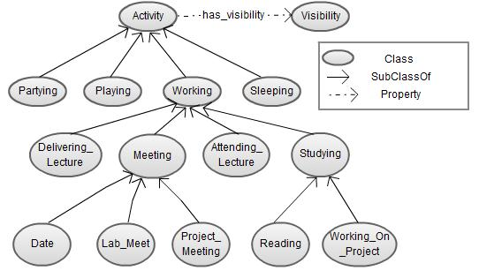
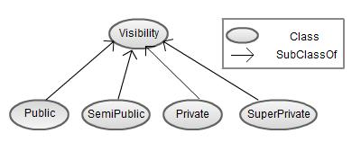
Activity Generalization

Slide 31
Ex: Sensor Data Access
Policies
Let users decide how their sensor information is released
Sample Privacy policy
  share GPS co-ordinates on weekdays from 9am-5pm only if he is in office
  Do not allow access to recorded audio but allow access to accelerometer and WiFi AP ids on weekdays

Slide 32
Some policies supported by the implementation
Share actual or mock location depending on requester
[ ShareMockGPSSimple:
(?user ex:systemUser ?someValue)
(?requester ex:shareMockGPSCoordinates ``True')
]
Policy to share mock location if user is inside BuildingABC
[ShareMockGPSComplex1:
(?user ex:systemUser ?someValue)
(?someActivity platys:occurs_at ?userPlace)
(?userPlace platys:has_location ?userLocation)
(?userLocation platys:part_of ?userBuilding)
(?userBuilding rdf:type platys:Building)
equal(?userBuilding, platys:BuildingABC)
(?requester ex:shareMockGPSCoordinates ``True')
]

Slide 33
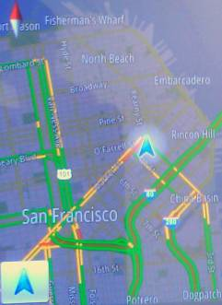
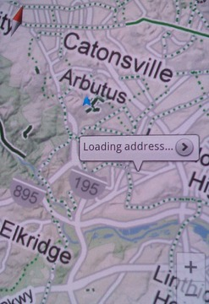
Implemented use case
Mock location as reported by Android app
Actual location reported by a different Android app

Slide 34
Reasoning Service
Platys ontology (.owl)
Static user facts (.N3)
Handles the requester queries and performs reasoning for access control decisions
Uses the Jena Semantic Web framework
  Uses both RDFS and OWL reasoner
  These reasoners are used to infer additional facts from the existing knowledge base coupled with ontology and rules
OWLReasoner
Inference Model
Save model to file
Saved Model (RDF/XML)
Load Model
Requester’s context information (.N3)
Inference Model
Dynamic knowledge about user (.N3)
System rule-set (.N3)
Generic Rule Reasoner
Inference Model
User-defined rule-set (.N3)
Generic Rule Reasoner
Inference Model
Contains user’s access levels and corresponding triples

Slide 35
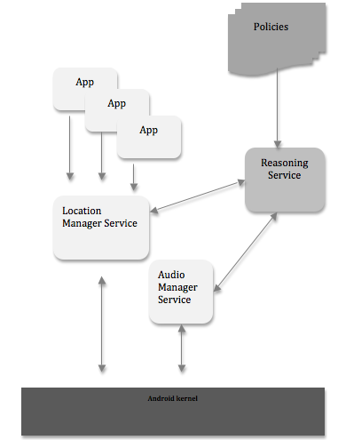
Controlling
Android
Services

Slide 36
Cloud Security
Most organizations have complex policies that govern acquisition of cloud services
They are governed by statutory requirements and legislation
Security and Confidentiality policies are a key component of such requirements

Slide 37
Privacy Policy
Privacy policies determine how information can be shared
  Sharing method
  Modalities
  Quantum
  Time period after which
  Conditions/situation under which
  With whom
Machine interpretable policies help automate
  Periodic audit particularly where information is shared with ‘after-access’ obligations
  Acquisition of services on the web or the cloud.

Slide 38
Elements of the Framework
Policies that describe the data and constraints
  Semantically rich Data
  Access rules – who can access, under what circumstances, for what use etc.
Context of the query
  Identification of the person or entity initiating the query
  Role of the person/entity
  Group(s) to which they belong
  Usage of the information.

Slide 39
Cloud Services Lifecycle
We have developed a semantically rich, policy-based framework to automate the acquisition and consumption of Cloud Services
  Negotiation for cloud service acquisition by constraint relaxation
Developed an integrated OWL ontology for the framework
Applicable on any Cloud Deployment (public, private, hybrid, community) and Cloud Service Model (SaaS, PaaS, IaaS)
Using NIST definitions of cloud computing

Slide 40
Some Policies/Constraints …
Cloud security – would like to mandate policies at the Cloud hardware level
  Virtual Machine Separation
  Specify cloud instance cores, speed , size
Data security policies
  Cloud Location, Data Encryption, Data Deletion etc.
US government compliance policies
  User authentication policy : FIPS 140-2 is a standard used to accredit cryptographic modules.
  Trusted Internet Connection mandated to optimize individual external connections.
Want to be interoperable across Cloud platforms

Slide 41
Cloud Broker Architecture
Cloud user
User Interface
<rdf>
Rfs description
</rdf>
Translate to machine process able format
Final SLA
Service
Cloud Service Procurer module
Discover service
Respond
SLA negotiation
Service URI
Cloud
Cloud Provider 1
Cloud Provider 2
<rdf>
SLA description
</rdf>
Cloud Provider 3
Joseki SPARQL endpoint
Joseki SPARQL endpoint
Joseki SPARQL endpoint
Virtual Service Instance
(Eucalyptus/Bluegrit)
Virtual Service Instance
(Eucalyptus/Bluegrit)
Virtual Service Instance
(Eucalyptus/Bluegrit)

Slide 42
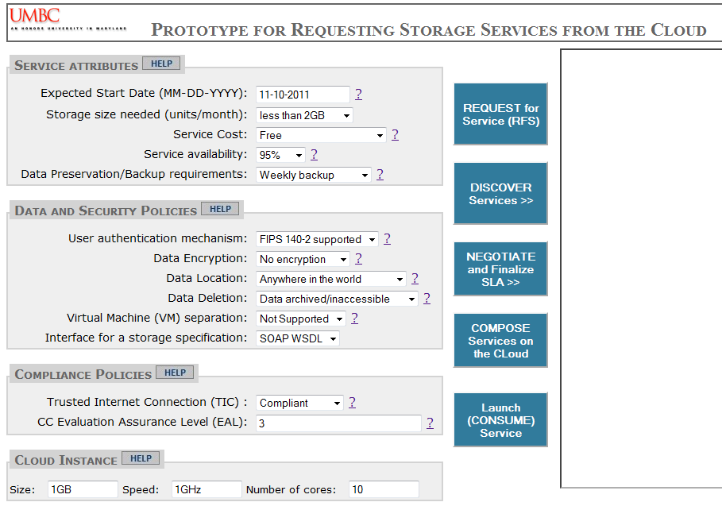
NIST prototype demo

Slide 43
Information Aggregation
Increased incidents of terrorism - national security agencies seek to access, integrate, and analyze more information to preempt attacks.
Huge amount of personal information in the public domain can be combined with classified SIGINT and HUMINT sources.
Privacy and security concerns
  “Preemptive identification” of likely plots typically needs the entire data generally referred to as ‘data dump’ for analysis.
  Organizations may be willing to share specific information about a suspect, but are normally not amenable to providing the entire dump of data for a ‘fishing operation’ due to statuatory or legal constraints

Slide 44
Introduction
The proposed model is designed for
  multi-user and
  multi-database owner environment.
The model uses machine understandable and semantically rich descriptions of the
    data,
    policies governing access and privacy, and
    the query context
provides an audit mechanism to increase the trust in the system.

Slide 45
Key Element
Analytics is done by a “trusted” fusion organization
  Trusted (TTP, TCP, …) hardware and software
  Centralized or distributed
Distinguishing between
  the query originator, and
  the analysis routine which ingests the data and responds to the query.
The data being shared by organizations can therefore be classified in two categories i.e.
    Data for processing the query
    Data for end use as result of the query

Slide 46
Key Element

Slide 47
Model Structure
Multiple Users
Multiple Database owners
Each Database owning organization has a set of Privacy Policies
Each person in the user organization has a defined set of Privileges relating to Access
Trusted Mediator and Audit Control Unit

Slide 48
P1
Mediator Machine
Human
Component
Database 1
Privileges Set Ø1
(a)Q_{1.B.G2.U3}
Privacy Policy Set P1
User 1
Compliance Node
Query Manipulator
(Splitter, Negotiator, Rewriter)
Hierarchy
A
B
C
Group
G1
G2
G3
G4
(a)R_{1.B.G2.U3}
Q_{1.B.G2.U3}
(b)Q_{1.B.G2.U3}
1
Use: U1, U2, U3
R_{1.B.G2.U3}
Database 2
3
Compliance Screen
(b)R_{1.B.G2.U3}
Privacy Policy Set P2
P3
Compliance Node
(a)Q_{2.C.G3.U1}
Privileges Set Ø2
User 2
(b)Q_{2.C.G3.U1}
Query Manipulator
(Splitter, Negotiator, Rewriter)
Q_{2.C.G3.U1}
Hierarchy
A
B
C
Group
G1
G2
G3
G4
(c)Q_{2.C.G3.U1}
Use: U1, U2, U3
Database 3
Privacy Policy Set P3
Compliance Node
(a)Q_{3.A.G1.U2}
Privileges Set Ø3
User 3
Q_{3.A.G1.U2}
Hierarchy
A
B
C
Group
G1
G2
G3
G4
Database 4
(b)Q_{3.A.G1.U2}
Query Manipulator
(Splitter, Negotiator, Rewriter)
Use: U1, U2, U3
Privacy Policy Set P4
Compliance Node

Slide 49

http://ebiquity.umbc.edu/

