Slide 1
Information security Challenges faced by a large financial services firm
By: Gaurav Gupta February 2013

Slide 2
What is the significance of http://info.cern.ch?

Slide 3
The Perfect Storm
Explosive growth and aggressive use of information technology.
Proliferation of information systems and networks with virtually unlimited connectivity.
Increasing sophistication of threat including exponential growth rate in malware (malicious code).
Resulting in an increasing number of penetrations of information systems in the public and private sectors…
Source: NIST – OWASP APPSEC DC 2010

Slide 4
FOOD FOR THOUGHT - publicly known security incidents
Latest to Previous years

Slide 5
The Newyork times atTack
For the last four months, Chinese hackers have persistently attacked The New York Times, infiltrating its computer systems and getting passwords for its reporters and other employees.
After surreptitiously tracking the intruders to study their movements and help erect better defenses to block them, The Times and computer security experts have expelled the attackers and kept them from breaking back in.
1
2
3
4
5
Phishing and zero day attack
Backdoor
Lateral Movement
Data Gathering
Exfltrate
The hackers tried to cloak the source of the attacks on The Times by first penetrating computers at United States universities and routing the attacks through them
The attackers first installed malware — malicious software — that enabled them to gain entry to any computer on The Times’s network
The hackers stole the corporate passwords for every Times employee and used those to gain access to the personal computers of 53 employees
They broke into the e-mail accounts of its Shanghai bureau chief, David Barboza, who wrote the reports on Mr. Wen’s relatives, and Jim Yardley, The Times’s South Asia bureau chief in India
Experts found ‘no’ evidence that the intruders used the passwords to seek information that was not related to the reporting on the Wen family.
No customer data was stolen from The Times, security experts said.
Source: http://www.nytimes.com/2013/01/31/technology/chinese-hackers-infiltrate-new-york-times-computers.html

Slide 6
The Stuxnet Worm
Targeting critical infrastructure companies—
  Infected industrial control systems around the world.
  Uploads payload to Programmable Logic Controllers.
  Gives attacker control of the physical system.
  Provides back door to steal data and remotely and secretly control critical plant operations.
  Found in Siemens Simatic Win CC software used to control industrial manufacturing and utilities.
Source: NIST – OWASP APPSEC DC 2010

Slide 7
The Flash Drive Incident
Targeting U.S. Department of Defense—
  Malware on flash drive infected military laptop computer at base in Middle East.
  Foreign intelligence agency was source of malware.
  Malware uploaded itself to Central Command network.
  Code spread undetected to classified and unclassified systems establishing digital beachhead.
  Rogue program poised to silently steal military secrets.
Source: NIST – OWASP APPSEC DC 2010

Slide 8
Operation Aurora
Targeting high tech, security and defense contractor companies –
  Primary goal of the attack was to gain access to and potentially modify source code repositories at these companies
  Google first publicly reported and later Adobe systems, Juniper and Rackspace publicly confirmed they were attacked
  RSA Security publicly confirmed being attacked in 2nd wave
  Attackers had exploited purported zero-day vulnerabilities
1
2
3
4
5
Phishing and zero day attack
Backdoor
Lateral Movement
Data Gathering
Exfltrate
McAfee reported that the attackers had exploited purported zero-day vulnerabilities (unfixed and previously unknown to the target system developers) in Internet Explorer and dubbed the attack "Operation Aurora"
A backdoor that masqueraded as an SSL connection made connections to command and control servers running in Illinois, Texas, and Taiwan, including machines that were running under stolen Rackspace customer accounts
The victim's machine then began exploring the protected corporate intranet that it was a part of, searching for other vulnerable systems as well as sources of intellectual property
It suggested that the attackers were interested in accessing Gmail accounts of Chinese
dissidents.
Google reported that some of it’s intellectual property was also stolen
Source: http://googleblog.blogspot.in/2010/01/new-approach-to-china.html

Slide 9
We have to do business in aN UNCERTAIN world…
Managing risk as we GO...

Slide 10
Security Challenges 2013 ->
1
Advanced persistent threats
Advanced malware
Boundless networks
Return of DDoS
Building security intelligence (Big data, Threat intelligence sharing)
Auditable risk management processes and continuous controls monitoring
2
3
4
5
6

Slide 11
Advanced Persistent Threats
1
  Capability and intent
  Nation states and threat actors are becoming more sophisticated Operators behind the threat & have a full spectrum of intelligence-gathering techniques at their disposal.
  Persistent
  One of the operator's goals is to maintain long-term access to the target, in contrast to threats who only need access to execute a specific task.
  WHAT TO DO?
  Prevent or Detect intrusion attempts
  Put tools and systems in place
  Train people to deal with such situations
  Look for command and control traffic and block
THREAT LEVEL 5 | CYBER PREP LEVEL 5
THREAT LEVEL 4 | CYBER PREP LEVEL 4
THREAT LEVEL 3 | CYBER PREP LEVEL 3
THREAT LEVEL 2 | CYBER PREP LEVEL 2
THREAT LEVEL 1 | CYBER PREP LEVEL 1
HIGH
HIGH
LOW
LOW
Adversary Capabilities
and
Intentions
Defender Security
Capability
An increasingly sophisticated and motivated threat requires increasing preparedness…
Source: NIST – OWASP APPSEC DC 2010
Notes:
We now have to face more sophisticated threat actors such as smaller nation states and terrorist elements obtaining similar capabilities. The financial services industry must fully understand the entire threat landscape and what this means in terms of employing the right people, technology and processes to ensure business continuity and proper risk management.

Slide 12
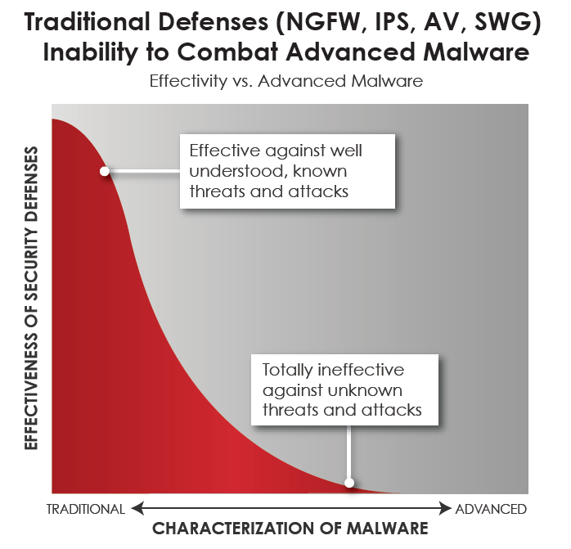
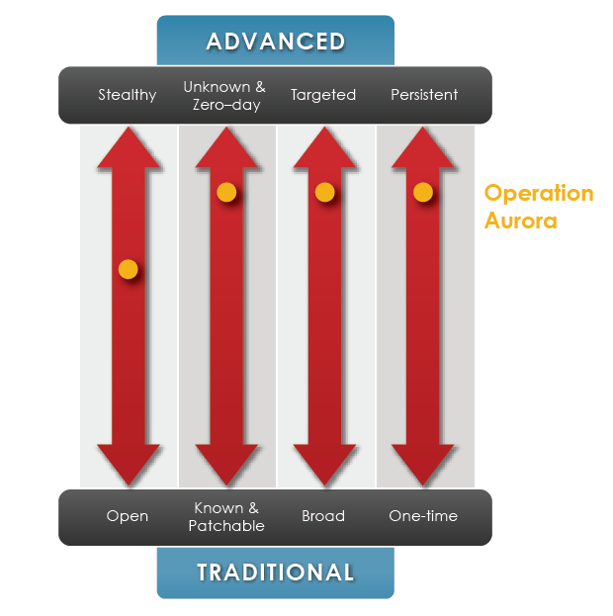
Malware – Traditional to Advanced
2
Malware is software program written for malicious behavior to do things like destroying data, stealing sensitive information or just choke network to create other problems to deal with
Source: FIRE EYE Malware Presentation

Slide 13
Advanced Malware
Difficult questions to answer?
  Which system was infected first?
  How did the malware enter the network?
  What is the extent of outbreak?
  How is it behaving? Do we know full behavior?
  What is needed to recover and stop from proliferating?
Organizations need to
  Detect and drop malwares at the trusted boundary
  Stop malwares proliferation in internal network while managing day to day enterprise functions

Slide 14
Boundless Network
3
  Explosive growth of Cloud, Social and Mobile technologies is outpacing development of proper security controls in evolution of these technologies
  Instinctive model of control over where our data is and how it flows doesn’t work in hyper-connected world anymore
  Social information about individuals allows hackers to launch spear phishing attacks targeted at individuals and companies. These are more sophisticated and damaging than conventional phishing attacks
  Entry of mobile devices at workplace
    Corporate data is being demanded to be served to application on the device
    Enforcement of corporate policy on the device is constantly challenging
Notes:
Cloud, social and mobile technologies, including "Bring Your Own Device" (BYOD), are simply too cost efficient and effective for institutions to ignore them. Security and risk professionals need to better integrate these technology trends, which will require they embrace the fact that the corporate network now has extended beyond their control. Risk management and mitigation is evolving to better control how corporate data travels these boundless networks and ensuring the education of their employees on the responsibilities they have in securing such data.

Slide 15
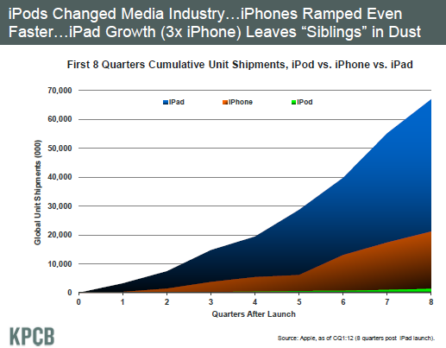
MODERN MOBILE DEVICE EVOLUTION
Source: Mary Meeker 2012 Internet Trends

Slide 16
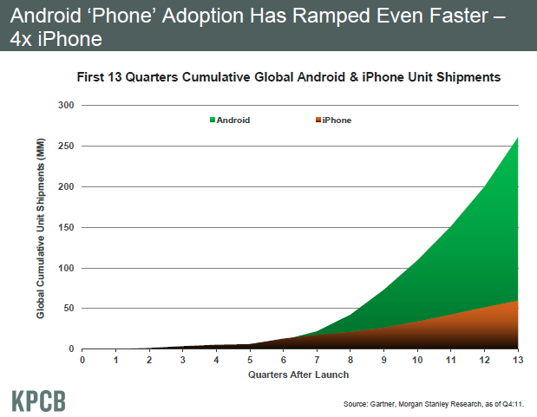
MODERN MOBILE DEVICE EVOLUTION
Source: Mary Meeker 2012 Internet Trends

Slide 17
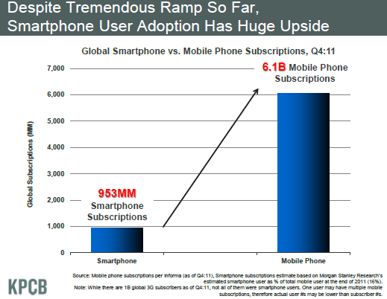
MODERN MOBILE DEVICE EVOLUTION
Source: Mary Meeker 2012 Internet Trends

Slide 18
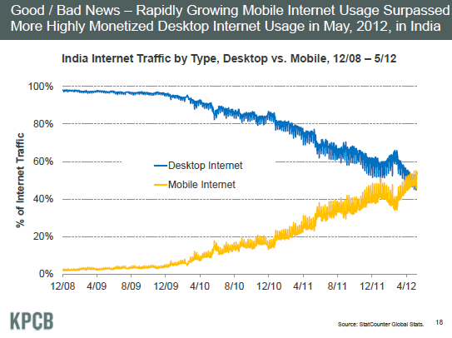
MODERN MOBILE DEVICE EVOLUTION
Source: Mary Meeker 2012 Internet Trends

Slide 19
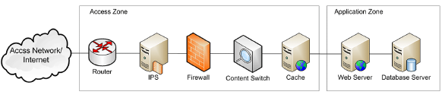
Return of DDoS
4
‘Anonymous’ hacktivist group launched generation of Gigabit Distributed DoS attacks on financial services firms
Primary objective was disruption of HTTP, DNS, SMTP Services
“The anonymous Attack” - The attack was aimed at few western financial institutions, of which Bank of America, PNC Bank and JP Morgan Chase have publicly confirmed that they were targeted.
Announce and attack- Anonymous hacktivist group announced it in advance and attacked websites of western financial institutions
Damage: It did not cause much damage in that round of attack but clearly indicated the exponential rise in capability and understanding of hacktivists to target institutions and being successful at it
Traditional ---------------------------------------------------------Advanced
Image Source: Imperva - Hacker Intelligence Initiative, Monthly Trend Report

Slide 20
Building Security Intelligence
Big Data Analytics – it’s not just for advertising!
5
Threats against the enterprise continue to evolve. Sinister, Sophisticated and Subtle
Log everything, ask questions later
Simpler is better
The Ultimate Objective: Data Finds Data!
Triage isn’t about volume – the squeaky wheel does not get the grease

Slide 21
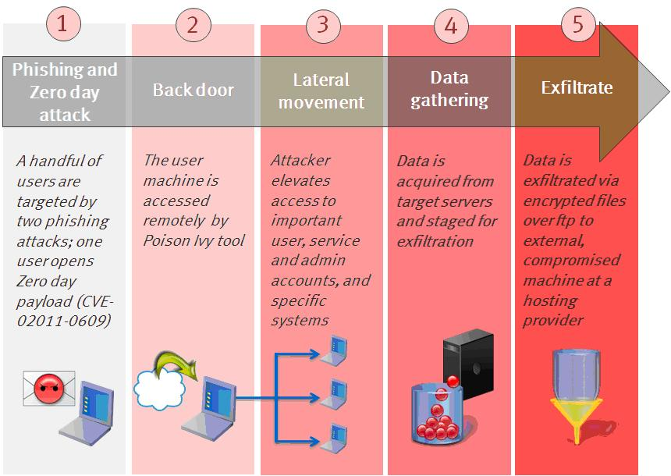
Changing Threat Landscape – Cyber Security is a complex business Issue
Operation Aurora – “The Google Attack”. The attack was aimed at dozens of other organizations, of which Adobe Systems, Juniper Networks and Rackspace have publicly confirmed that they were targeted. According to media reports, Yahoo, Symantec, Northrop Grumman, Morgan Stanley and Dow Chemical were also among the targets.
RSA - Recently, our security systems identified an extremely sophisticated cyber attack in progress being mounted against RSA…. Our investigation has led us to believe that the attack is in the category of an Advanced Persistent Threat (APT)…
Top military contractor Northrop Grumman Corp. may have been hit by a cyber assault, the latest in a string of alarming attacks against military suppliers.. Lockheed Martin said its network had been compromised last week, and defense contractor L-3 Communications was targeted recently, as well. Both intrusions involved the use of remote-access security tokens, experts say.
MISSION: Broaden Acquisition of Data from Sensory Apparatus
Apply Analytical Models to the Data to Detect “Disturbances in the Force”

Slide 22
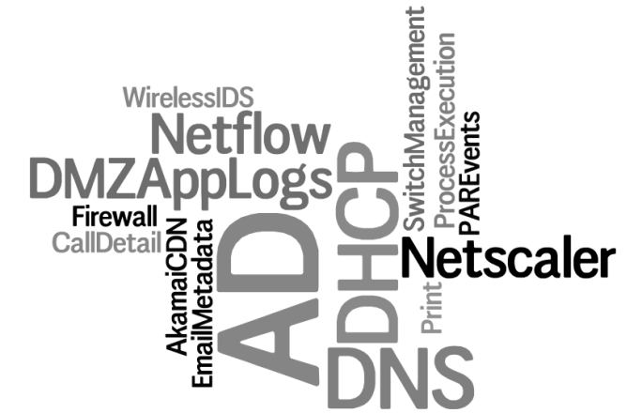
Surveillance Analytics - Big Data Vision
Eschew Traditional Vertical Solutions
Take a Layered Approach to the Problem
Data Finds Data
Delivering Actionable Security Insight
Visualization
Data Analytics
Data Store(s)
Sensory Apparatus
New Data, More Data
Demanding Increasing Complex Analytics from Data Sets
GB -> TB -> PB of Ingest Data
Store everything, ask questions later
Context develops as you analyze
Exabyte Scale Analytics and Data Store Requirements

Slide 23
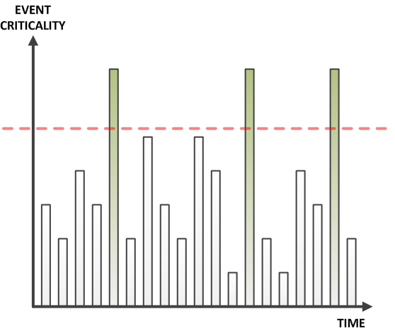
Changing Threat Landscape
Security Event Monitoring Threshold (then)
Notes:
Organizations have finite resources. With volume as the only measurement of criticality, and finite people to respond adequately to events, the noise floor is raised to address only the most critical – well, really, just the noisiest events.

Slide 24
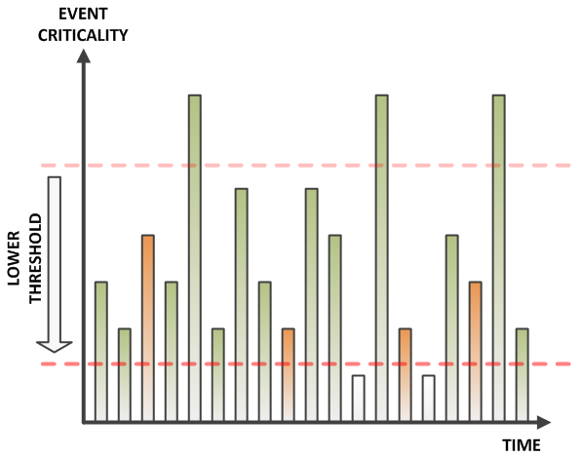
Changing Threat Landscape
Security Event Monitoring Threshold (Now)
Notes:
However, lurking deep beneath the noise floor are actual, sinister events – where the organizations resources would be better spent. But how do we get there?

Slide 25
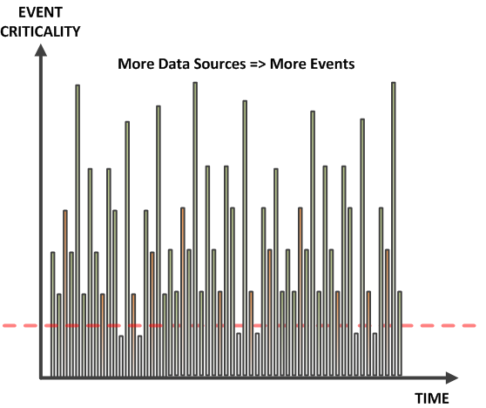
Changing Threat Landscape
Security Event Monitoring Threshold (Now)
Notes:
And as we add data, the potential for overload increases. So how do we find the events we ought to respond to? Better metrics – don’t measure volume, measure risk. It’s harder, and it means creating powerful, scalable analytics.

Slide 26

SI Prefix Primer
1,000,000,000,000,000,000,000,000 | yottabyte | YB
1,000,000,000,000,000,000,000 | zettabyte | ZB
1,000,000,000,000,000,000 | exabyte | EB
1,000,000,000,000,000 | petabyte | PB
1,000,000,000,000 | terabyte | TB
1,000,000,000 | gigabyte | GB
1,000,000 | megabyte | MB
1,000 | kilobyte | kB
Big Data
Exabyte Scale
CERN Produces 15 PB/Year
Netwitness 460 TB
Splunk Consumes
150 GB/Day
My First Computer
Notes:
So what do you mean by big?

Slide 27
Big Data Analytics
known knowns
known unknowns
unknown unknowns
Signatures
Behaviors
“Sensemaking”
Digital Exhaust Data
Data Finds Data - http://jeffjonas.typepad.com/DataFindsDataCreativeCommons.pdf
Notes:
The schema and data model changes with every question, evolves with every data source – this is not Boyce-Codd!
<quote>
Next-generation “Smart” information management systems will not rely on users dreaming up smart questions to ask computers; rather, they will automatically determine if new observations reveal something of sufficient interest to warrant some reaction, e.g., sending an automatic notification to a user or a system about an opportunity or risk.
An organization can only be as smart as the sum of its perceptions. These perceptions come in the form of observations—observations collected across the various enterprise systems, such as customer enrollment systems, financial accounting systems, and payroll systems. With each new transaction an organization learns something. It is at the moment something is learned that there exists an opportunity, in fact an obligation, to make some sense of what this new piece of data means and respond appropriately. For example, does the address change on the customer record now reveal that this customer is connected to one of your top 50 customers? If an organization cannot evaluate how new data points relate to its historical data holding in real time, the organization will miss opportunities for action.
When the “data can find the data,” there exists an opportunity for the insight to find the user.
How data finds data is a statement about discoverability, the degree to which previous information can be located and correlated with the new data. Discoverability requires the ability to recall related historical data so that an arriving piece of data can find its place, similar to the way each jigsaw puzzle piece is assessed relative to a work-in-progress puzzle. Each new puzzle piece incrementally builds upon what is knowable, at each given point in time relative to the evolving puzzle picture. Often new pieces, although important to building out the bigger picture, do not themselves bring new critical information. (On the other hand, some pieces may change the shape of the puzzle in a way that warrants ringing the bell—finding that one piece that connects the palm tree scene to the alligator scene.) It is at this moment in time, when the new puzzle piece presents the opportunity to reshape the picture, that discoveries are made. Real-time discovery replaces the need for users to think up and pose the right question at just the right time.
Organizations that are unable to switch to the “data finds data” paradigm will be less competitive and less effective.
</quote>

Slide 28
Regulatory Audit and Continuous Controls Monitoring
6
Auditable risk management processes
    Demonstrate that you are doing what you are saying you are doing
    Obtain evidence while turning the crank
    Measure once and report many
Continuous controls monitoring
    Monitoring once in a while or random sampling does not help anymore
    Automated monitoring has become necessity
    Constantly evolving business dynamics and regulatory requirements cause constant changes to scope, implementation and measurement of controls

Slide 29
Q&A

