Slide 1
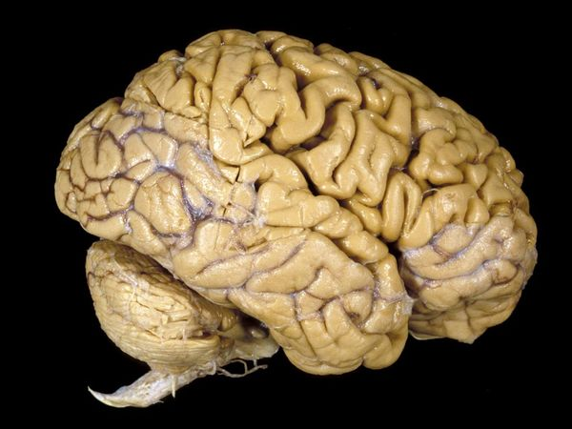
Brain circuits for spatial cognition
Nitin Gupta
5 November, 2014
All of this presentation is based on work performed by others

Slide 2
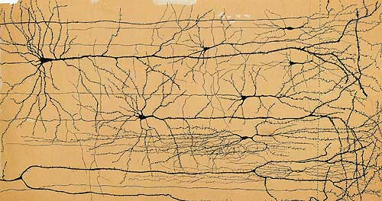
Brain is made of neurons
Cajal

Slide 3
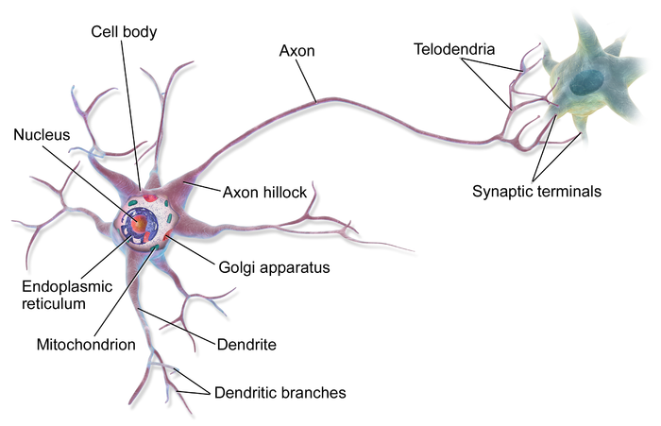
Neuron

Slide 4
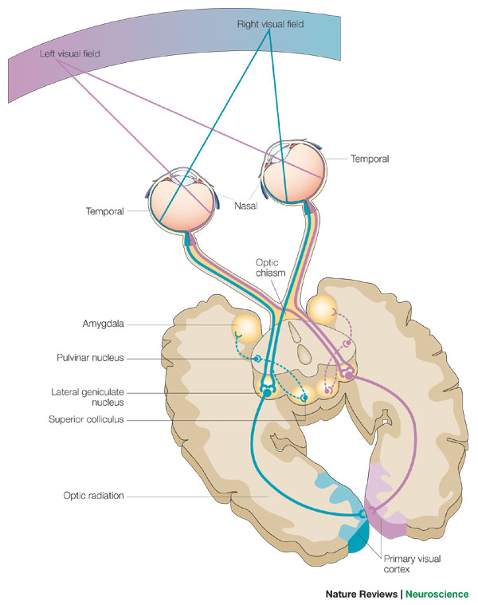
Visual System

Slide 5
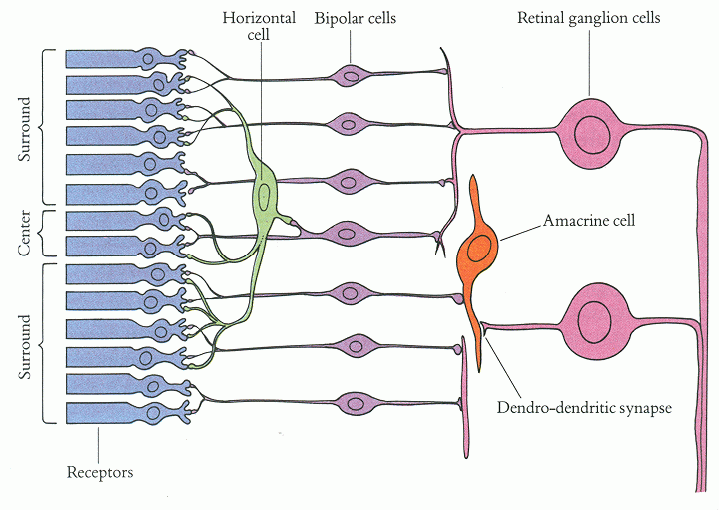
Circuits in retina
RGCs carry information to the visual cortex. Detect movement and simple visual features

Slide 6
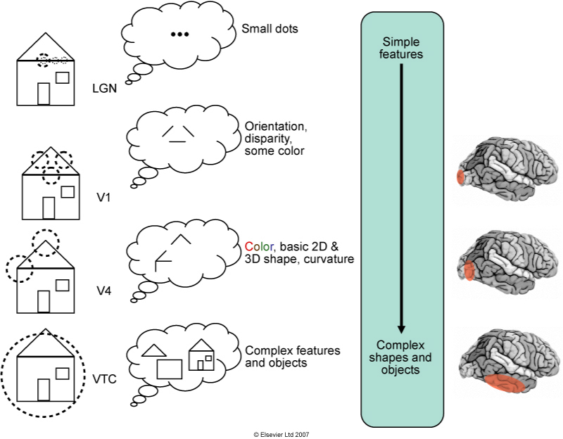

Slide 7
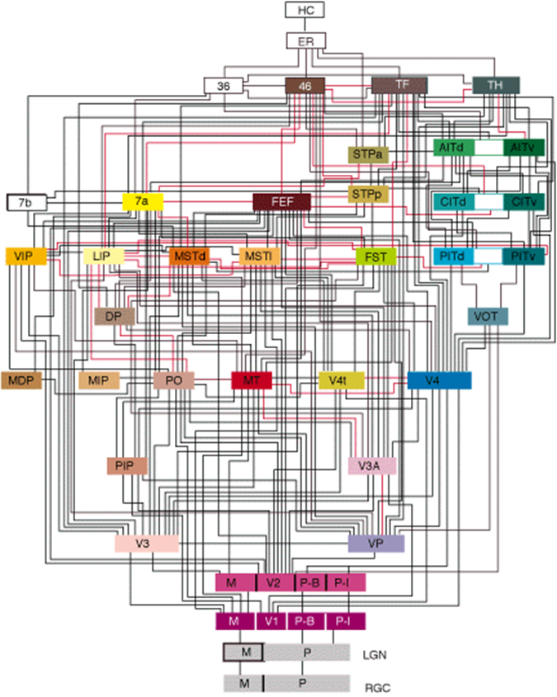
Hierarchy of visual processing
Van Essen

Slide 8
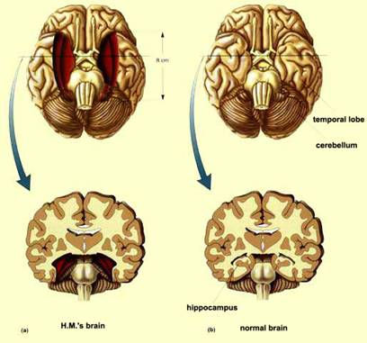

Henry Molaison: Anterograde Amnesia
Source: Suzanne Corkin

Slide 9
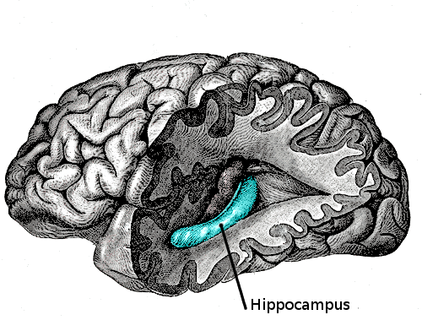
Image source: wikipedia

Slide 10
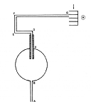
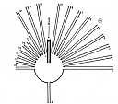
Rat also show spatial cognition
Tolman 1948 (Image via Derdikman)

Slide 11
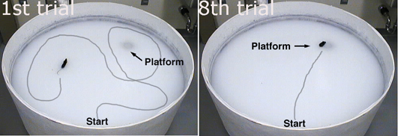
Critical role of the hippocampus in spatial cognition
Morris
Hippocampus lesions diminish performance on the maze.

Slide 12
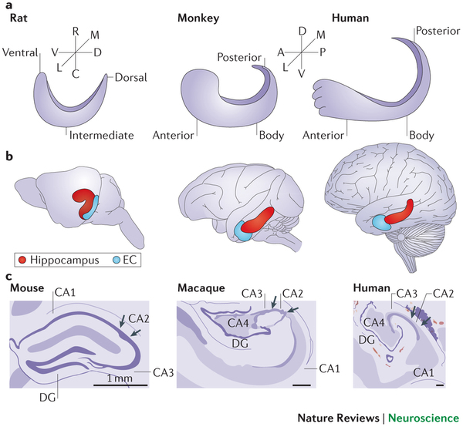
Hippocampus anatomy is similar across species

Slide 13

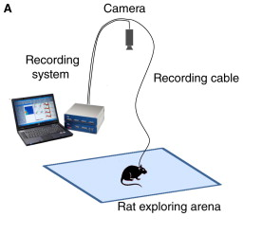
Experimental approach developed by John O’Keefe

Slide 14
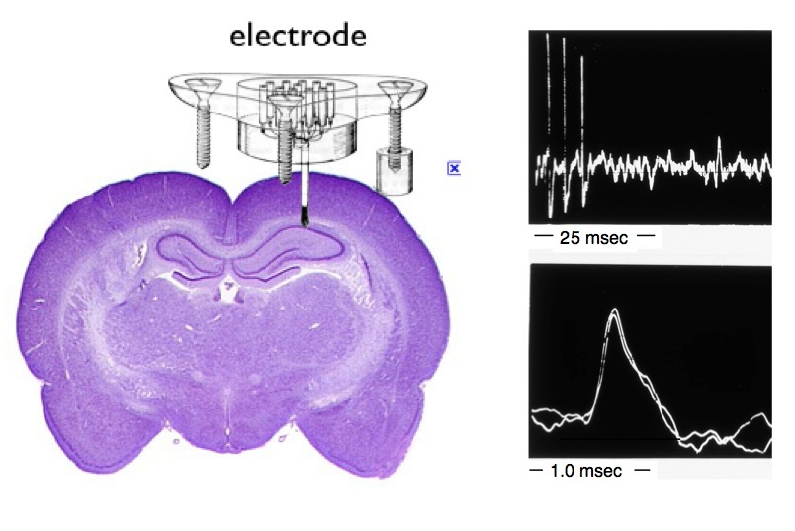
BrainFacts.org

Slide 15
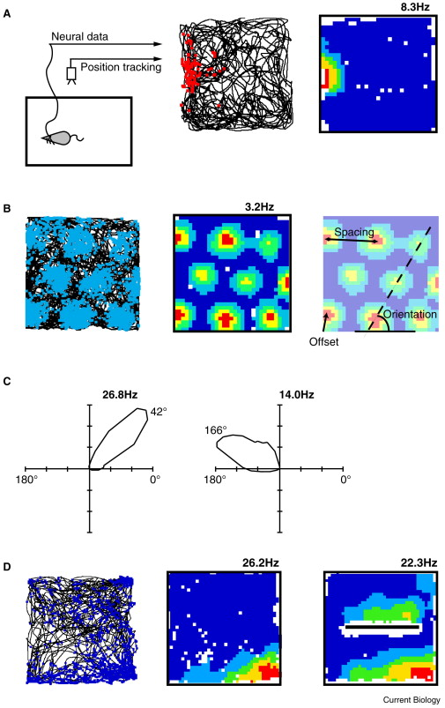
A place cell in hippocampus
John O’Keefe and Dostrovsky, 1971

Slide 16
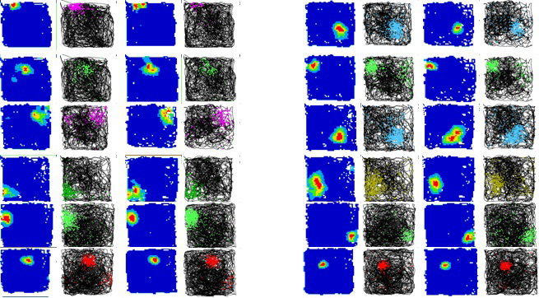
A distributed spatial map of the environment
Derdikman

Slide 17
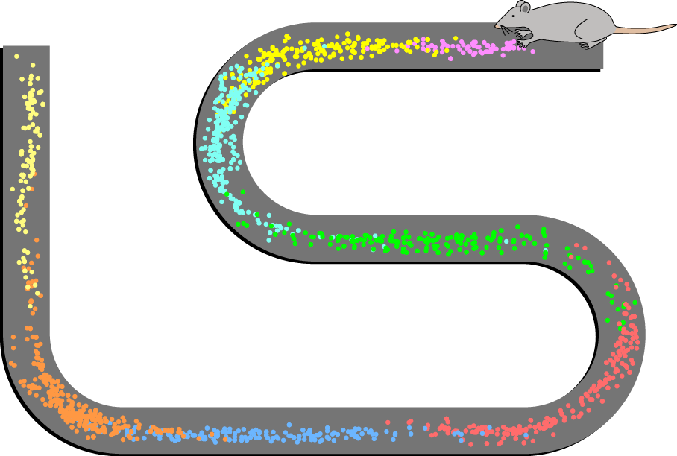

Slide 18
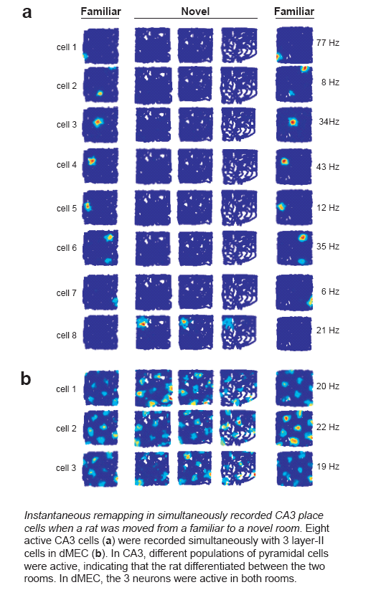
Place fields vary in different environments
The animal is moved from one room to another
Hafting et al, Nature 2005

Slide 19
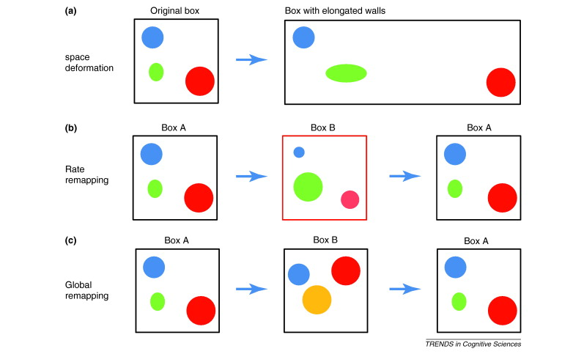
Stability of place fields
Derdikman and Moser 2010

Slide 20
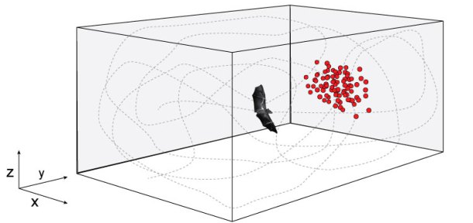
3D place cells in bats
Ulanovsky and Moss

Slide 21
Inputs to the place cells?

Slide 22
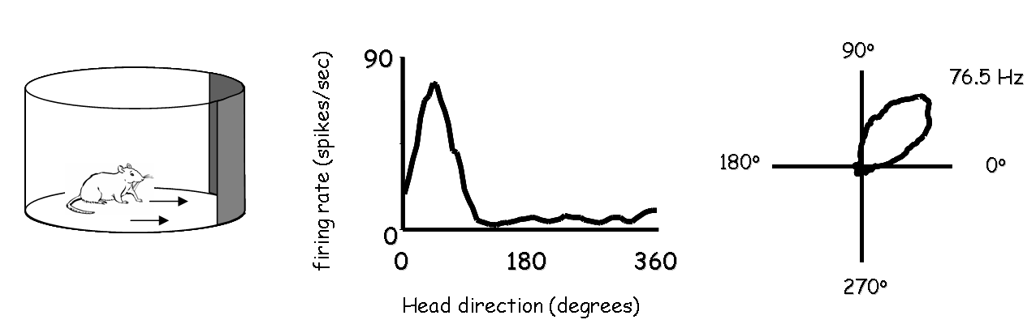
Head direction cells

Slide 23
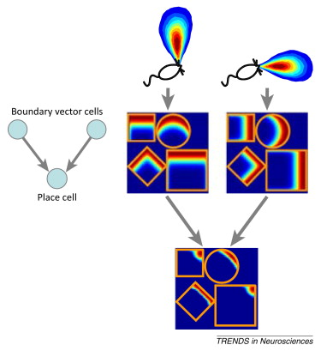
Boundary vector cells

Slide 24

Grid cells in the Medial Entorhinal Cortex
Moser and Moser

Slide 25
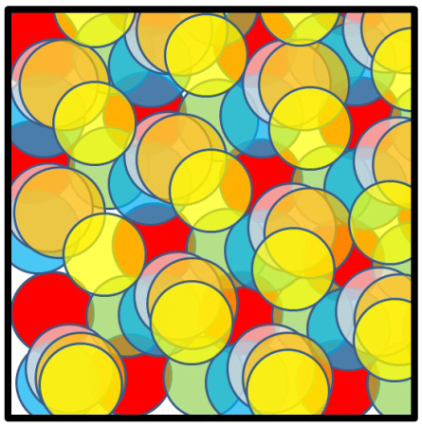
Derdikman and Moser, 2010

Slide 26


Derdikman

Slide 27
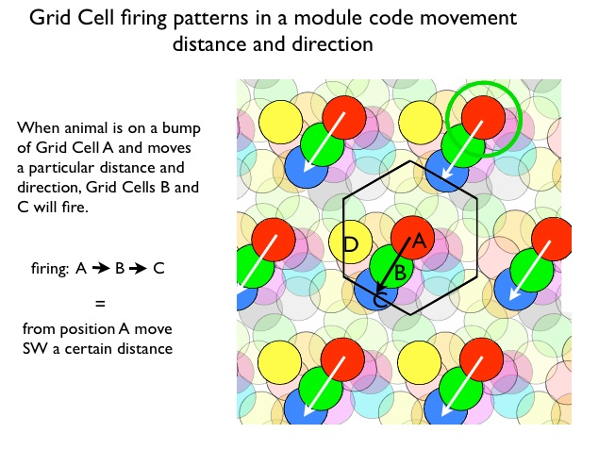
John Kubie, BrainFacts.org

Slide 28
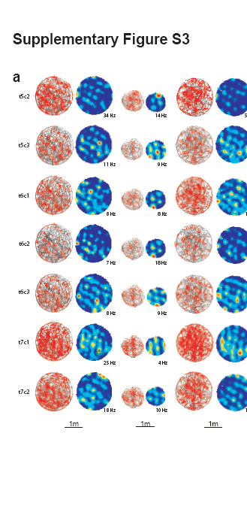
Grid cells don’t scale
Hafting et al, Nature 2005

Slide 29
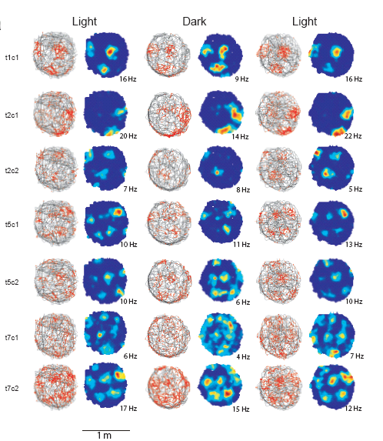
Grid cells persist in the dark
Hafting et al, Nature 2005

Slide 30
Grid cells code similarly in different environments
Place cells
Grid cells
Hafting et al, Nature 2005

Slide 31
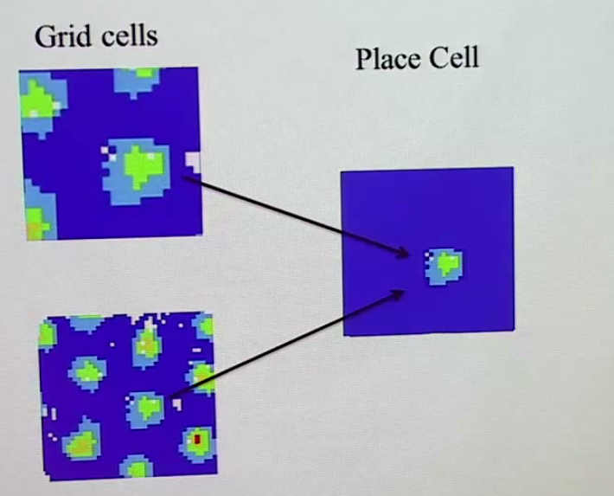
John O’Keefe

Slide 32
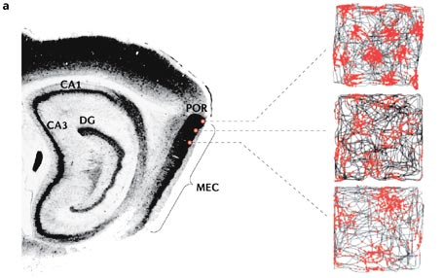
Grid sizes increase by factor of 1.4
McNaughton et al 2006

Slide 33
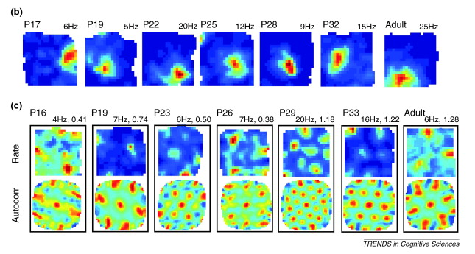
Development of the spatial map
Derdikman and Moser, 2010

Slide 34


