Slide 1
Feature Integration Theory
Project guide: Amitabha Mukerjee
Course: SE367
Presented by Harmanjit Singh

Slide 2
Feature Integration Theory
Treisman, Sykes, & Gelade, 1977
Features are registered early, automatically, and in parallel across the visual field, while objects are identified separately and only at a later stage, which requires focused attention.

Slide 3
Feature
luminance
color
orientation
motion detection
velocity
form

Slide 4

FIT domain of application
Notes:
A target defined by a single feature (e.g. red among green non-targets, or an X among OS) can be detected independently of the number of non-targets, whereas detection time for a conjunction target (e.g. a red X among green Xs and red OS) usually rises linearly with set-size (e.g. Treisman and Gelade 1980).

Slide 5
Visual search
Serial search: One item at a time.
Parallel search: processing involves allocating points to objects in order to recognize them

Slide 6
Metaphor of Human Visual Attention
Near distracters produce interference
Distant distractors fall outside spotlight => not identified.
Criticism:
Distant distracters suffer from reduced acuity. [1]
Spotlight
72127825245
Notes:
Distant distracters may produce less interference simply because they suffer from reduced acuity.

Slide 7
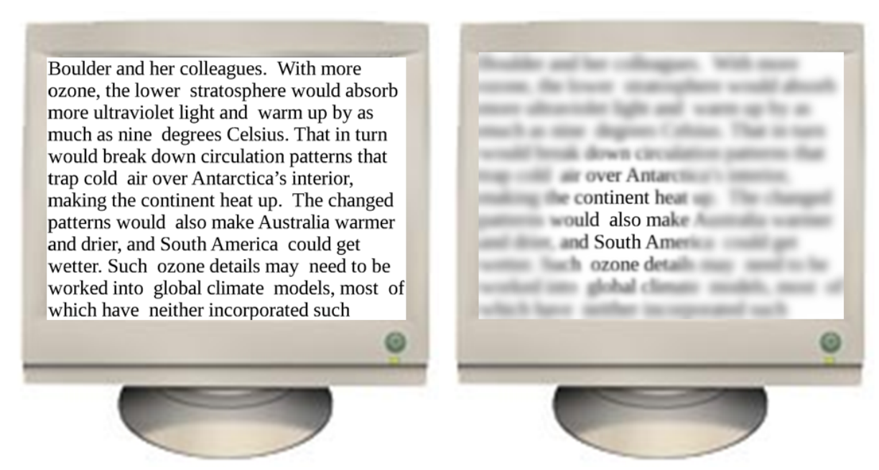
Qualitative representation of the perceived image
(a) Image of a text displayed on
a standard video monitor
(b) the simulated acuity depending on the gaze and eccentricity
Notes:
According to Treisman (e.g. 19. 86), the attentional spotlight is only required when features have to be glued together to identify an object.
isolated features are detected in parallel preattentively.

Slide 8
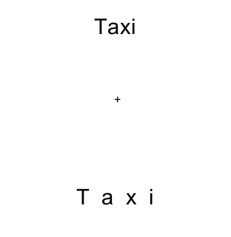
Feature extraction and integration
The taxi above fixation cross is easier to read
Feature extraction is easier in less crowding

Slide 9
Crowding
Top-Down is attentional
cued
Serial processing
Bottom-Up is pre-attentional*
un-cued
Parallel preocessing
Notes:
Cueing eliminates the effects of crowding Crowded letters look less familiar, so we must use longer internal descriptions (less compact representations) to remember them. Thus, fewer fit into working memory. The memory limit does not apply to the cued condition because the observer need remember only the cued letter.
Cued change detection is so easy that the observer can tolerate feature degradation and letter. distortion and is thus immune to crowding

Slide 10
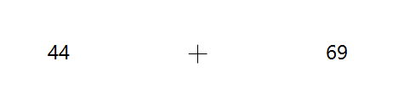
Term
Eccentricity

Slide 11
Proposed idea
Attention Zone
There is a attention spotlight
Identify the accuracy of subjects in identifying random numbers.
72125245
Notes:
Distant distracters may produce less interference simply because they suffer from reduced acuity.

Slide 12
Experiment
Cohort of collage students
Random numbers flashed
Accuracy of judgment noted
Results analyzed
Take a standard reading speed test

Slide 13
Parameters in feature extraction process
Number
Recognition
Horizontal Eccentricity
Vertical Eccentricity
Temporal crowding
Contrast

Slide 14
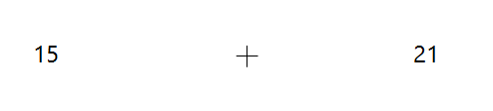
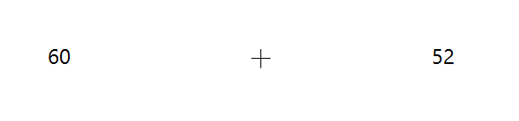
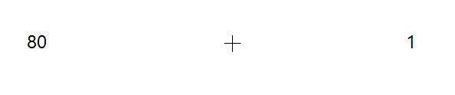
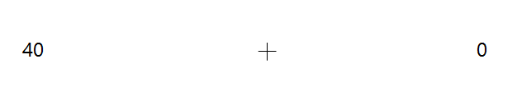
Sample screen shots
Parameter varied: eccentricity in Horizontal direction direction

Slide 15
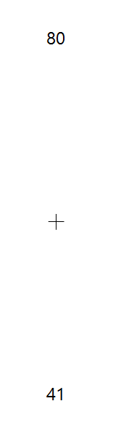
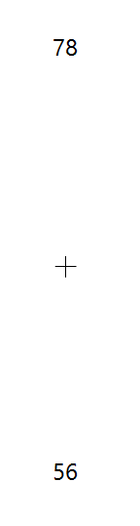

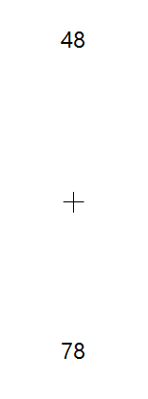
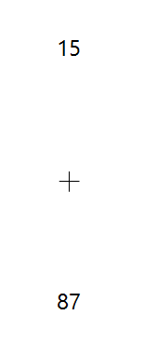
Sample screen shots
Parameter varied: eccentricity in vertical direction

Slide 16
Previous works done by
Pelli et al.
Takes into account only the contrast of the distractors.

Slide 17
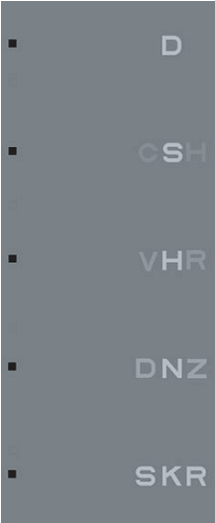
Pelli D G., Melanie Palomares, Najib J. Majaj.
Crowding is unlike ordinary masking: Distinguishing feature integration from detection.
Journal of Vision(2004)

Slide 18
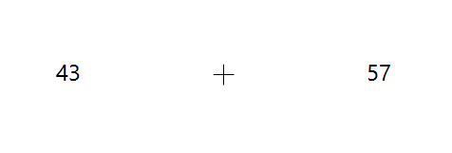


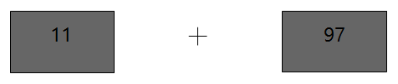
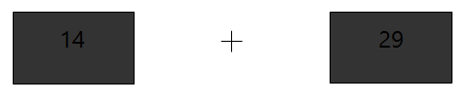
Sample screen shots
Parameter varied: Contrast as noise

Slide 19
Limitations
Expectation
Subject may not faithfully look at the Fixation cross
Subject must maintain a constant distance form the Screen
Vertical-horizontal asymmetry
Predict reading speed of the subject
Notes:
Vertical horizontal asymmetry because be have trained ourselves to be expert in reading and hence we might be better at recognizing things that are in horizontal, also our ability to discard noise would be greater in this direction.

Slide 20
References
Van den Berg R, Roerdink JBTM, Cornelissen FW (2010) A Neurophysiologically Plausible Population Code Model for Feature Integration Explains Visual Crowding. PLoS Comput Biol 6(1): e1000646. doi:10.1371/journal.pcbi.1000646
  These guys have conducted experiments that have a target and crowding is limited only to the flanker surrounding the target. Flanker’s angle, number and target eccentricity have been changed.
Freeman, J., & Pelli, D. G. (2007). An escape from crowding.Journal of Vision, 7(2):22, 1–14, http://journalofvision. org/7/2/22/, doi:10.1167/7.2.22.
  This paper is essentially an experimental study with scope being that crowding and cueing are the only two variable that have been varied across the subject’s tests. They have tested with letters and foreign language letters.
EndelPo˜der. Crowding, feature integration, and two kinds of ‘‘attention’’.Journal of Vision(2006) 6, 163–169
  In this paper the 3 experiments have been performed, each with increasing complexity of design. First has only color difference between distractors and target. Second has a unit cell of different kind spread over space crowding the target. Third has a combination of both above experiments color change and shape change.
Pelli D G., Melanie Palomares, Najib J. Majaj. Crowding is unlike ordinary masking: Distinguishing feature integration from detection. Journalof Vision(2004) 4,1136-1169
  Very through study taking into account various parameters like spacing, eccentricity, size of target and flanker, font, number of flankers, flanker contrast, identification and detecting.
Jean-Baptiste Bernard et al , Navisio: Towards an integrated reading aid system for low vision patients.
  Image credits for the image on slide 7

Slide 21
THANK YOU
QUESTIONS?
Notes:
In Slide Show mode, click the arrow to enter the PowerPoint Getting Started Center.

Slide 22
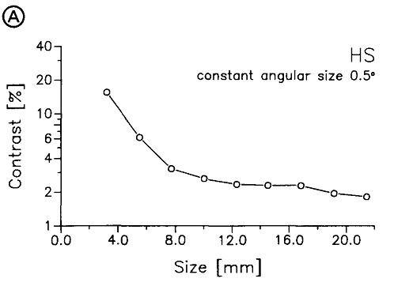
Threshold contrast

Slide 23
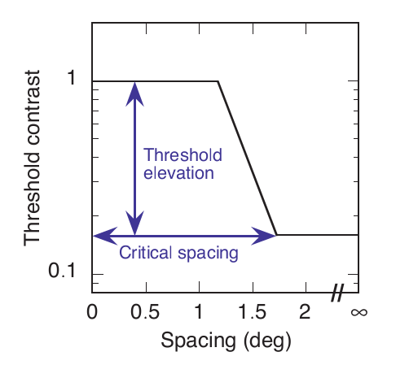
Background pictures
Clipped line fit: threshold contrast as a function of center-to-center spacing of signal and flanker
Threshold elevation is the ratio of thresholds at zero and infinite flanker spacing (i.e., ceiling: floor ratio). Critical spacingis the least spacing at which there is no threshold elevation (i.e., edge of the floor).
Pelli D G., Melanie Palomares, Najib J. Majaj. Crowding is unlike ordinary masking: Distinguishing feature integration from detection. Journalof Vision(2004) 4,1136-1169

Slide 24
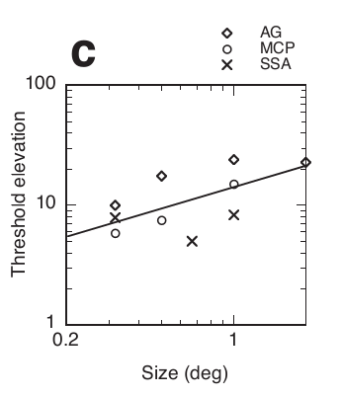
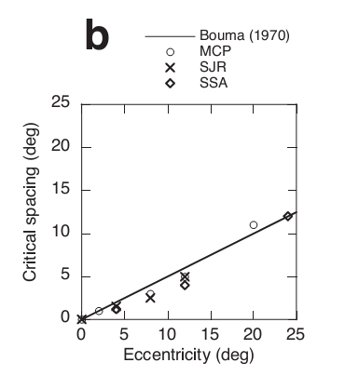
Effects of spacing and eccentricity and size
Critical spacing is proportional to eccentricity (critical spacing is roughly half of the viewing eccentricity)
Threshold elevation increases somewhat with size: log-log slope of 0.6

Slide 25
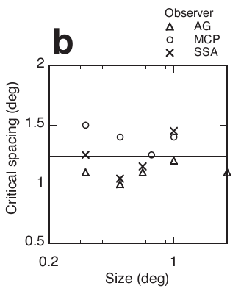
Effect of flanker size
The range (spatial extent) of crowding is independent of signal size (Figure 1) and mask size, depending solely on eccentricity (Figure b on previous page).

Slide 26
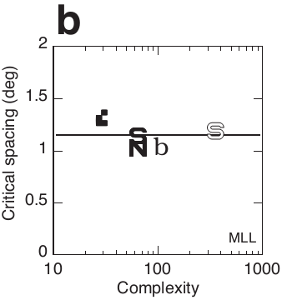
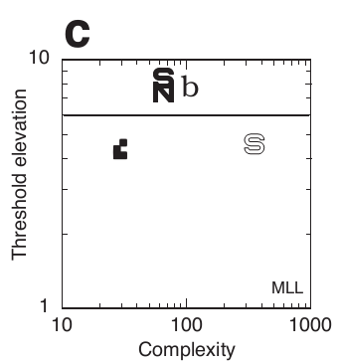
Effect of font and complexity
Figures 1 and 1 plot critical spacing and threshold elevation as a function of complexity, showing no systematic effect of complexity.
Figure 1
Figure 2

Slide 27
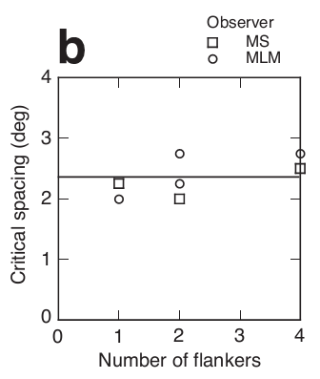
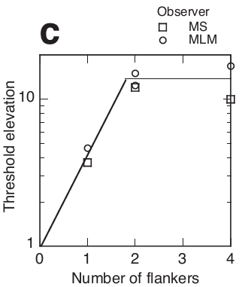
Effect of number of flankers
Figure below shows that critical spacing is independent of number of flankers.
Figure 8cshows that threshold elevation increased when flankers were increased from 1 to 2, but threshold was not further elevated when flankers were increased from 2 to 4

