Slide 1


Surrogate Functions for Maximizing Precision at the Top
Purushottam Kar*, Harikrishna Narasimhan#, Prateek Jain*
*Microsoft Research, Bangalore, INDIA
#Indian Institute of Science, Bangalore, INDIA
Notes:
In several learning applications, we are required to select a small set of relevant objects from a large universe of objects

Slide 2




Drug Discovery
Will do no more than 3 wet-lab tests!
http://www.cliparthut.com/capsule-clipart.html
http://www.isnnexus.org/bergamo/
http://www.123rf.com/
Notes:
Compounds that can potentially be biological active but since performing wet lab tests is expensive it might be better to select a small set that is more likely to be active and then conduct tests to verify

Slide 3
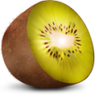



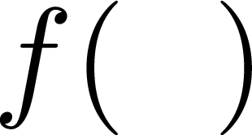




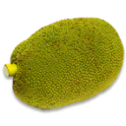


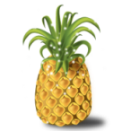
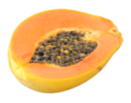

Recommendation Systems
Don’t clutter my webpage with ads
Images courtesy Manik Varma
Notes:
When a customer comes – of the million or so items up for sale, we need to
Clearly extremely high precision
A nice way addressing these problems in unified manner

Slide 4

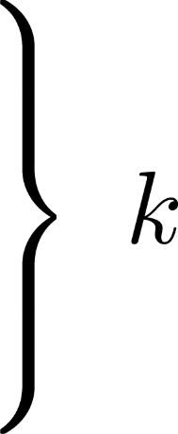
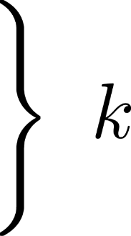

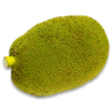


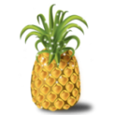
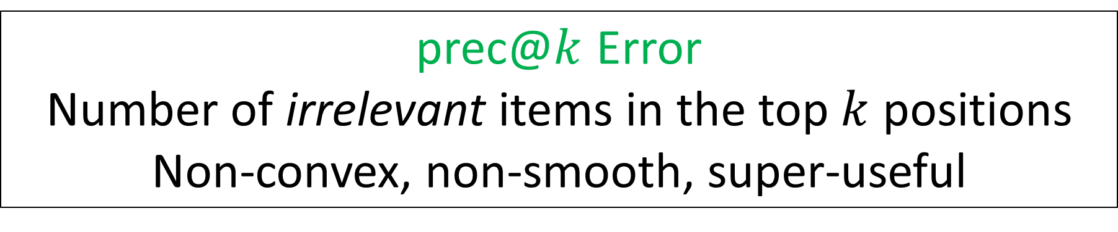
Precision at the Top Matters
This Talk
Bipartite Ranking
E.g. Drug Discovery
prec@$k$ Error
Number of irrelevant items in the top $k$ positions
Non-convex, non-smooth, super-useful
Drug Discovery
Recommendation
Notes:
Given this methodology, performance decided automatically gives perf measure
k often decided by extraneous factors like cost of wet lab testing, available real estate on a webpage etc

Slide 5
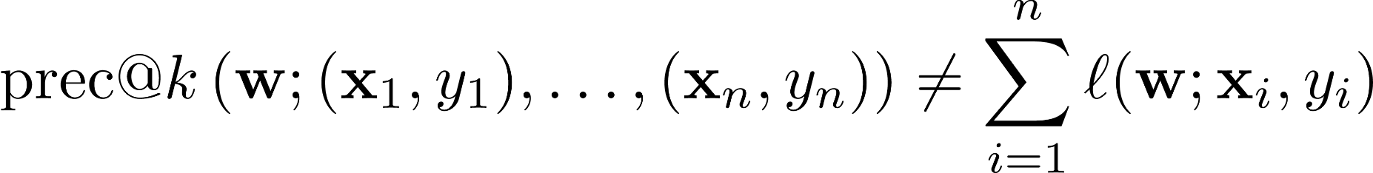
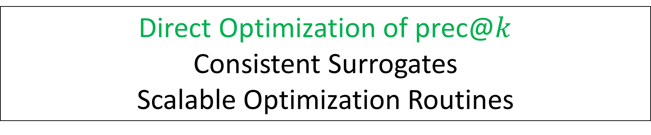

Optimizing Precision at the Top
Non additive “structured” performance measure
Several optimization techniques inapplicable
  Perceptron, Stochastic gradient descent
Direct Optimization of prec@$k$
Structural-SVM surrogates [Joachims 2005]
  Not a “satisfactory” surrogate
Cutting-plane style methods
  Not amenable for large datasets, streaming settings
Direct Optimization of prec@$k$
Consistent Surrogates
Scalable Optimization Routines
Notes:
Also some drawbacks to this approach

Slide 6




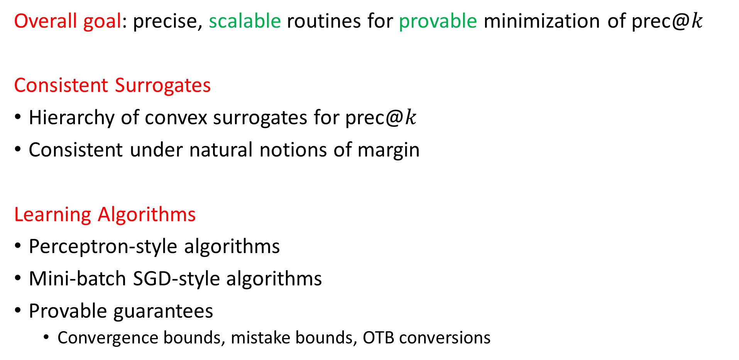
Our contributions
Overall goal: precise, scalable routines for provable minimization of prec@$k$
Consistent Surrogates
Hierarchy of convex surrogates for prec@$k$
Consistent under natural notions of margin
Learning Algorithms
Perceptron-style algorithms
Mini-batch SGD-style algorithms
Provable guarantees
  Convergence bounds, mistake bounds, OTB conversions
Notes:
To summarize our contributions in a single slide

Slide 7
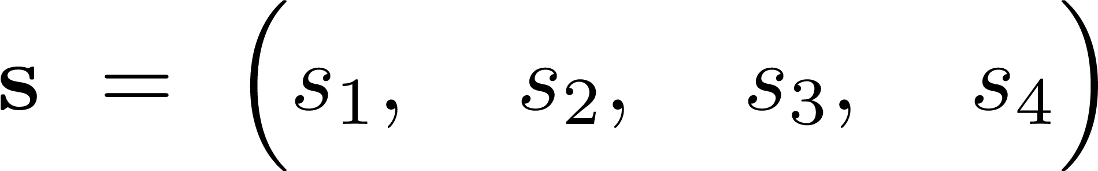
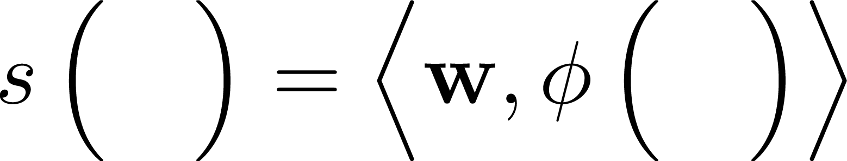
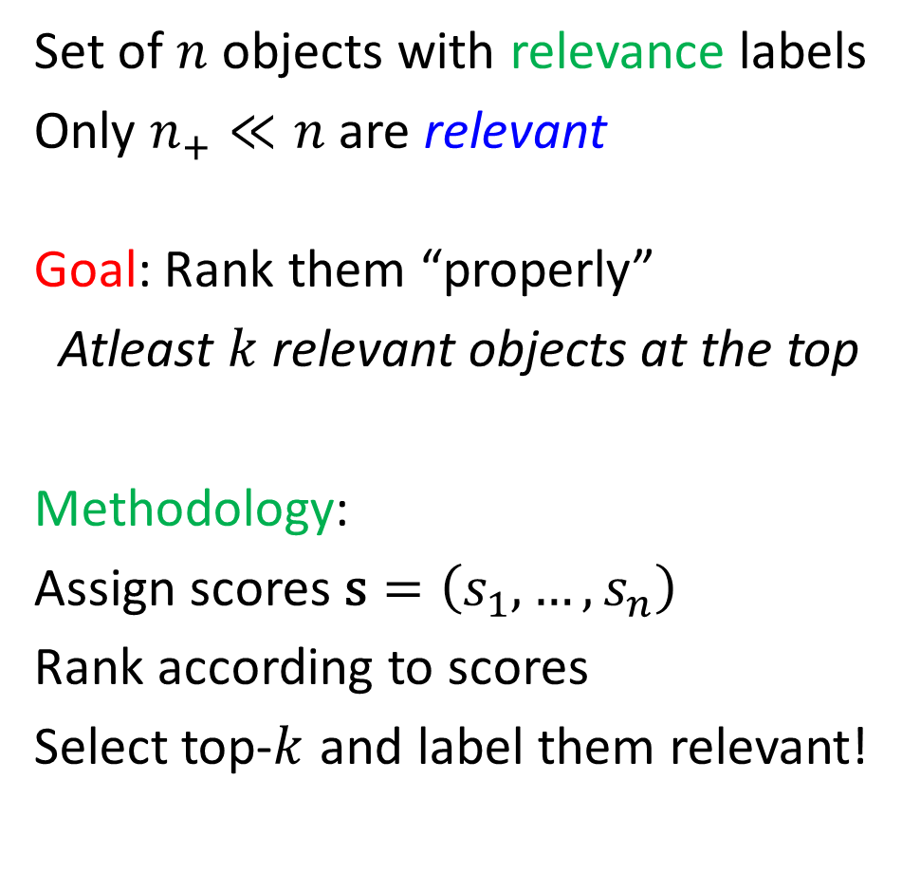
Problem Setting
Set of $n$ objects with relevance labels
Only $n_{+}≪n$ are relevant
Goal: Rank them “properly”
Atleast $k$ relevant objects at the top
Methodology:
Assign scores $\text{s}=\left(s_{1},…,s_{n}\right)$
Rank according to scores
Select top-$k$ and label them relevant!
Notes:
Data points either as a batch or in a stream
Scores predicted using, lets say, a linear model

Slide 8
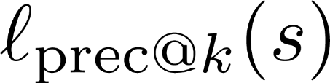

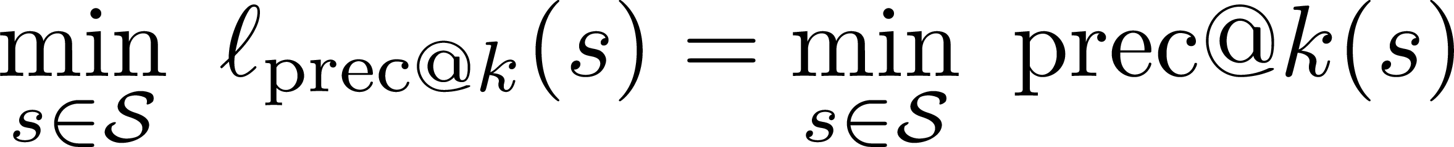
The Desiderata for a Surrogate
Convexity (CV)
Upper-bounding Property (UB)
Tight under a Margin (TuM)
For classes of score vectors satisfying an appropriate margin condition
Struct-SVM Our
CV
UB
TuM
Notes:
Want to develop a surrogate with all these desirable properties
Together the last two properties ensure recovery of an optimal model
Even if data is separable, it can be misled
The last property seems intriguing so lets look deeper into that

Slide 9


Notion of Margin
Classification Margin
Notes:
Notion of margin – led to development of SVM
If given points to classify, it would be most convenient if
Score function, say distance from the hyperplane
We say that this scoring function realizes a margin of gamma

Slide 10
Notion of prec@$k$ Margin?
Notes:
In the cases we discussed, relevant items usually a tiny minority
Now, it would be indeed be fabulous if all relevant items were to separated

Slide 11
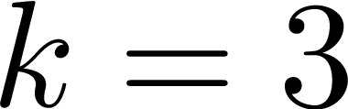
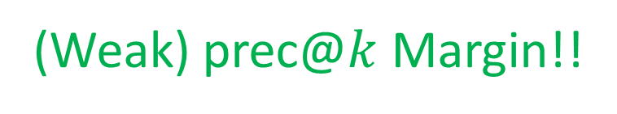
Notion of prec@$k$ Margin?
Classification Margin
Destroyed but …
(Weak) prec@$k$ Margin!!
Notes:
However, if prec@k is all we care about, for example k = 3 then even if classfn margin destroyed and minimizing misclassification loss might become NP-hard. Also, notice that SVM would work but likely give terrible results on this data whereas for us perfect
If k relevant separated then we say data has weak preck margin
We will say that this scoring function realizes a weak preck margin of gamma

Slide 12
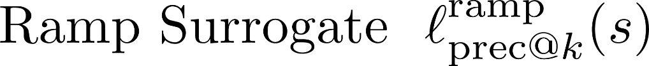
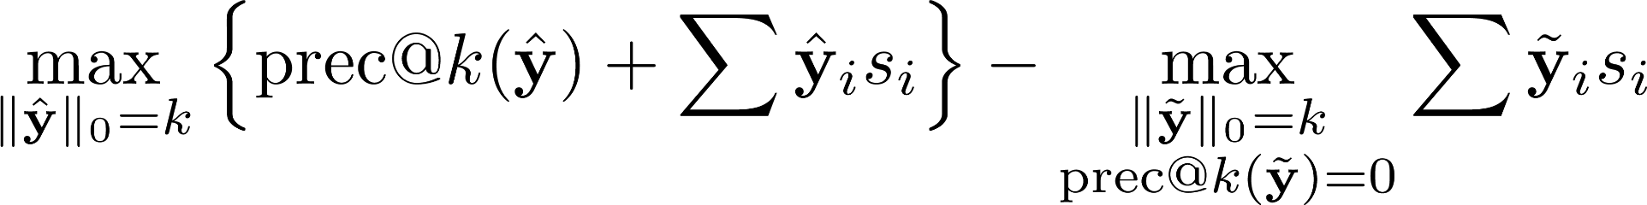
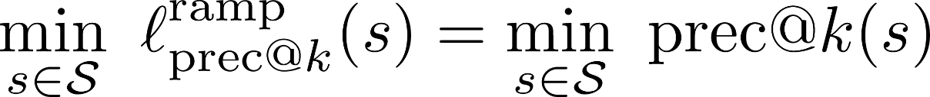

The Ramp Surrogate for prec@$k$
Key Idea: If $k$ top ranked objects are relevant $⇒\text{prec}\text{@}k\left(s\right)$ = 0
Strategy: Penalize a score vector if not so!!
Lemma: For any class of score vectors that contains a score vector realizing a unit weak prec@$k$ margin, we have
Ramp
CV
UB
TuM
Concave term

Slide 13
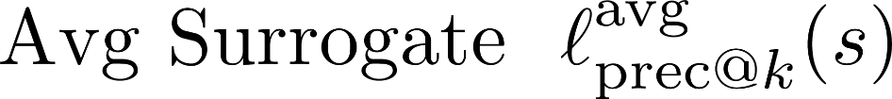
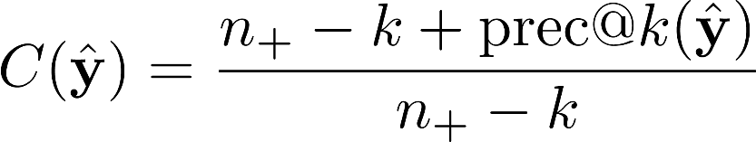
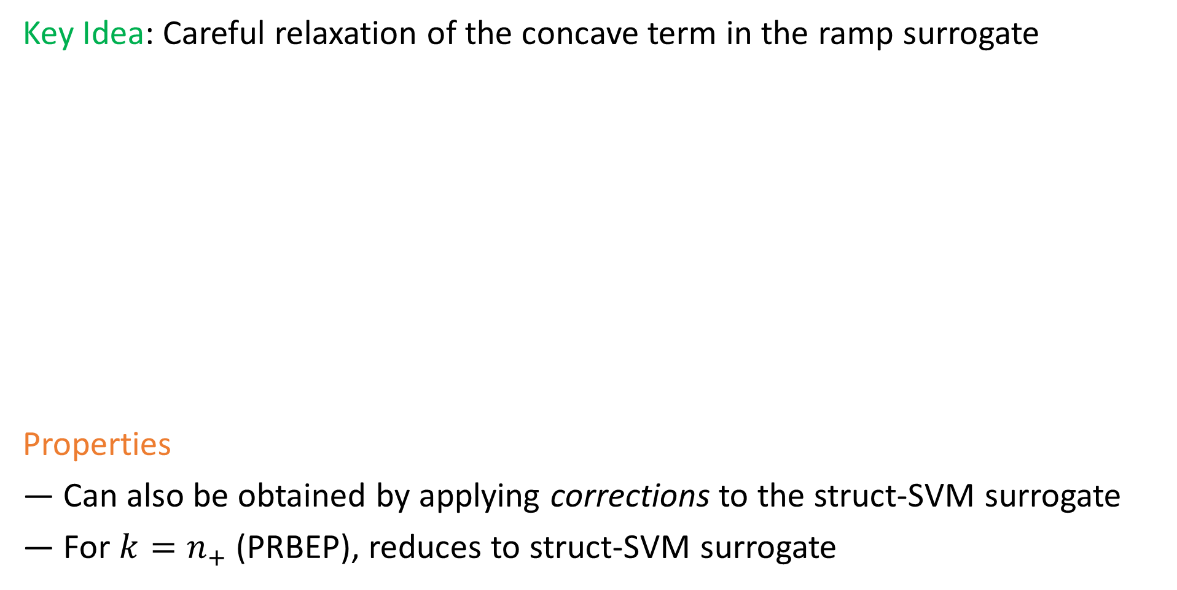
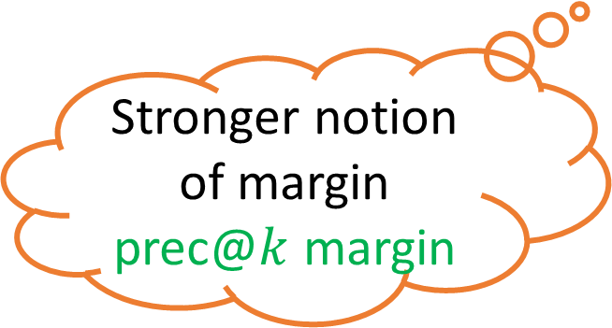
A convex, upper bounding, consistent surrogate
Key Idea: Careful relaxation of the concave term in the ramp surrogate
Properties
Can also be obtained by applying corrections to the struct-SVM surrogate
For $k=n_{+}$ (PRBEP), reduces to struct-SVM surrogate
Avg
CV
UB
TuM
Stronger notion of margin
prec@$k$ margin
Notes:
Gets all the checkboxes

Slide 14


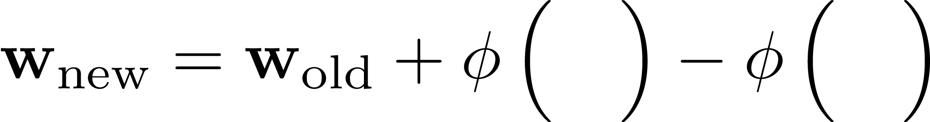

PERCEPTRON@$k$-MAX for optimizing prec@$k$
PERCEPTRON@$k$-MAX
If prec@$3\left(s\right)=0$
TERMINATE
Else
PROCESS-DATA
“Holistic” Update

Slide 15

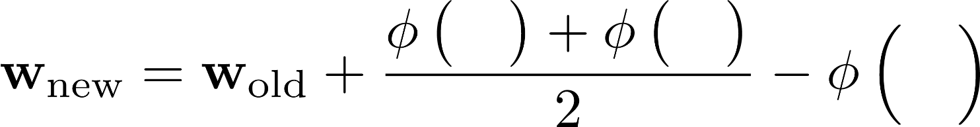


PERCEPTRON@$k$-AVG for optimizing prec@$k$
PERCEPTRON@$k$-AVG
If prec@$3\left(s\right)=0$
TERMINATE
Else
PROCESS-DATA
“Holistic” Update
Better mistake bound
Notes:
Earlier update promoted as many relevant objects as it demoted irrelevant ones
This one promotes all relevant objects that do not make it to the top

Slide 16

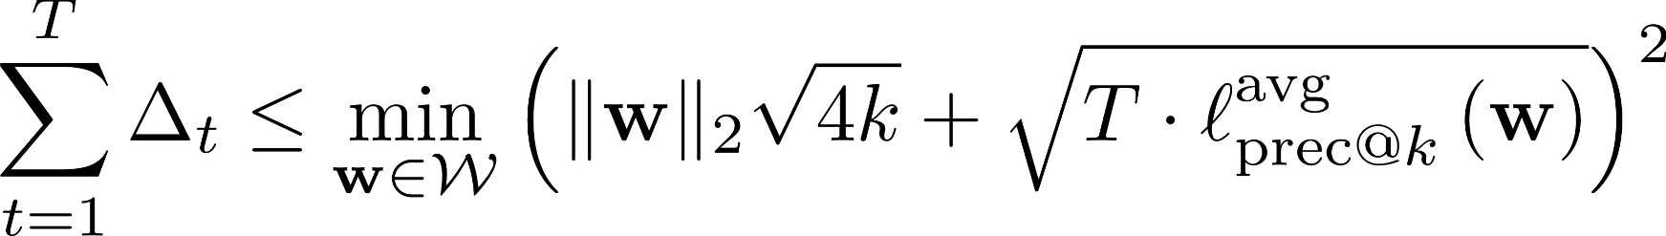
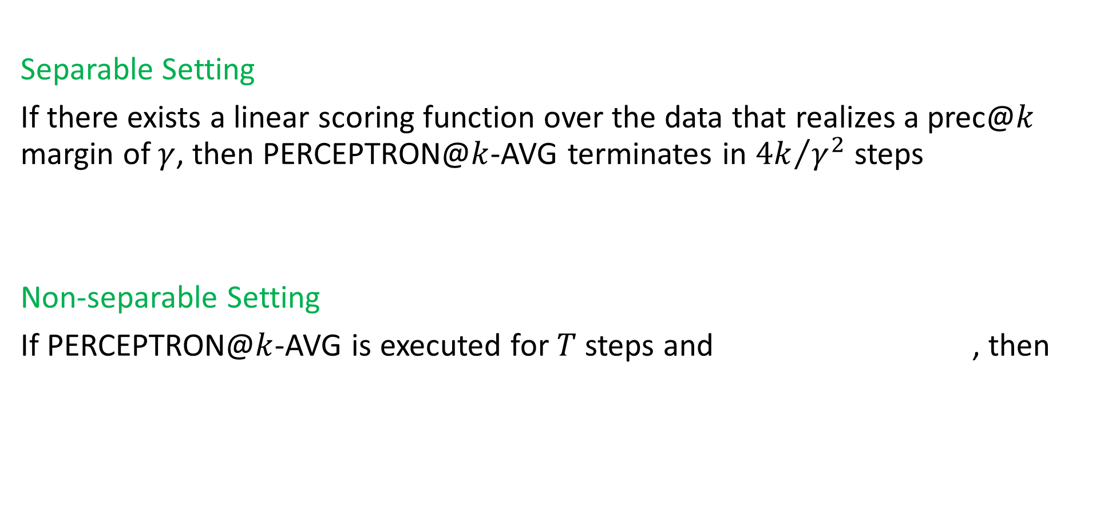
Mistake Bound
Separable Setting
If there exists a linear scoring function over the data that realizes a prec@$k$ margin of $γ$, then PERCEPTRON@$k$-AVG terminates in ${4k}/{γ^{2}}$steps
Non-separable Setting
If PERCEPTRON@$k$-AVG is executed for $T$ steps and , then
Similar to classical perceptron bound

Slide 17
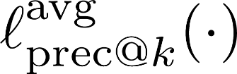

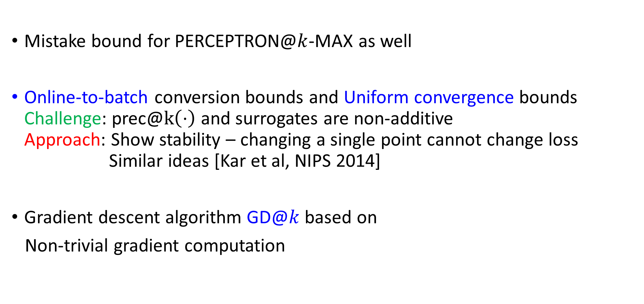
Other results
Mistake bound for PERCEPTRON@$k$-MAX as well
Online-to-batch conversion bounds and Uniform convergence bounds
Challenge: prec@$k\left(⋅\right)$ and surrogates are non-additive
Approach: Show stability – changing a single point cannot change loss
Similar ideas [Kar et al, NIPS 2014]
Gradient descent algorithm GD@$k$ based on
Non-trivial gradient computation

Slide 18
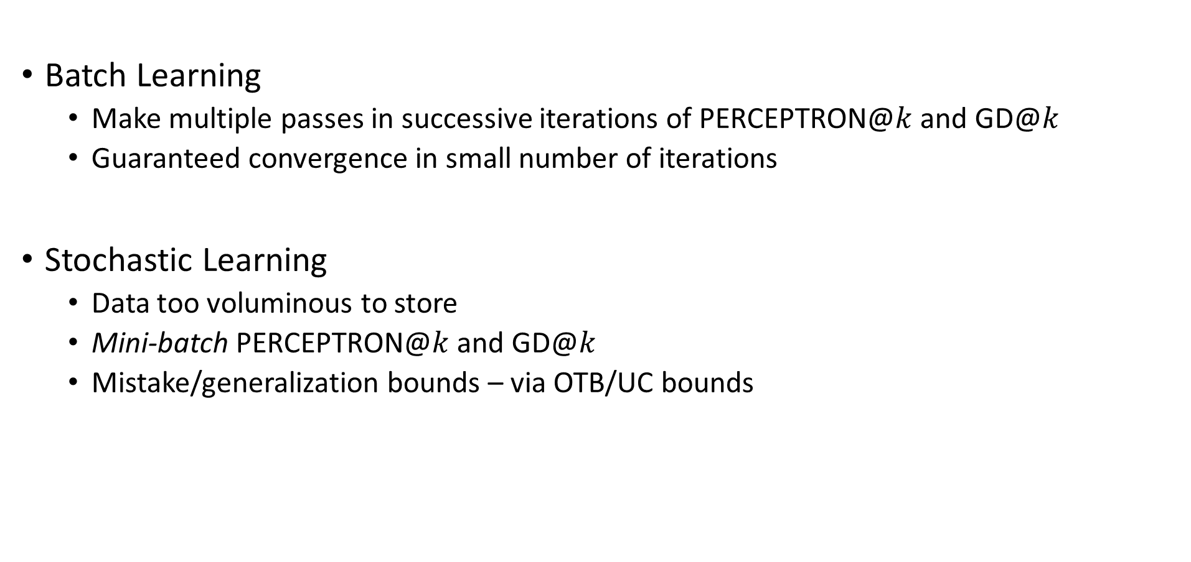
Large-scale Optimization with PERCEPTRON@$k$ and GD@$k$
Batch Learning
  Make multiple passes in successive iterations of PERCEPTRON@$k$ and GD@$k$
  Guaranteed convergence in small number of iterations
Stochastic Learning
  Data too voluminous to store
  Mini-batch PERCEPTRON@$k$ and GD@$k$
  Mistake/generalization bounds – via OTB/UC bounds
Mini Batches !!

Slide 19
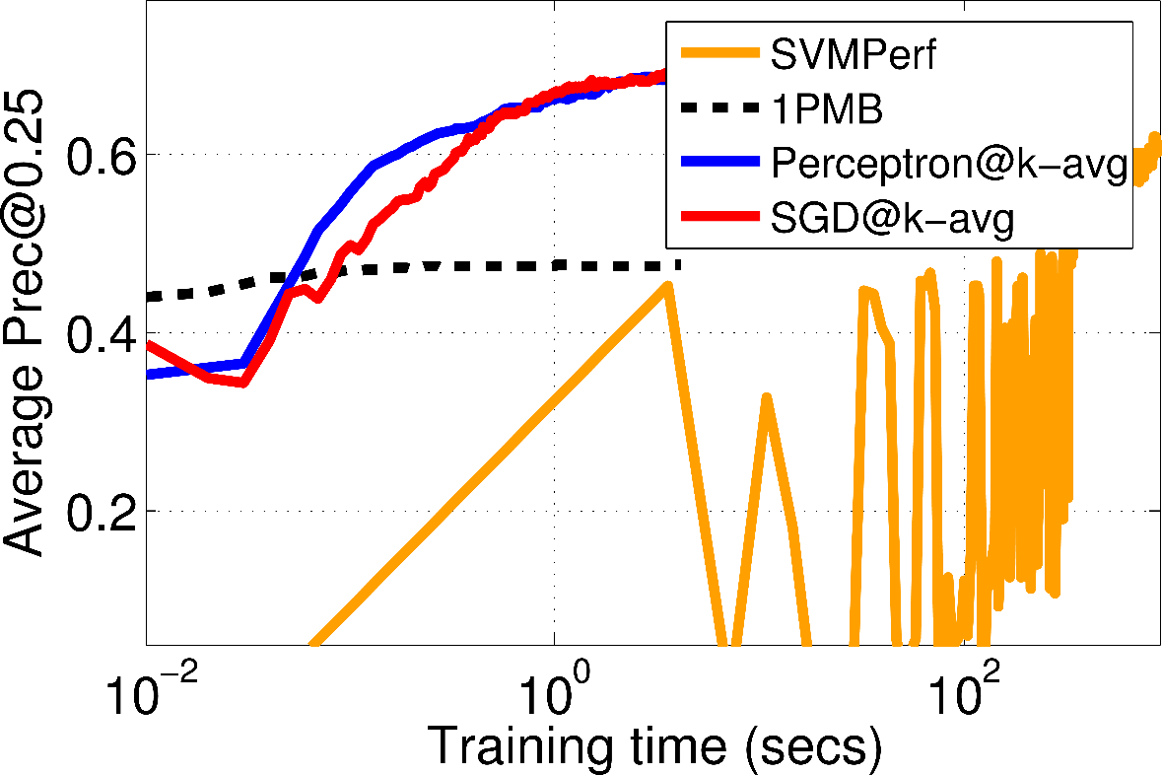
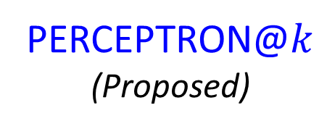
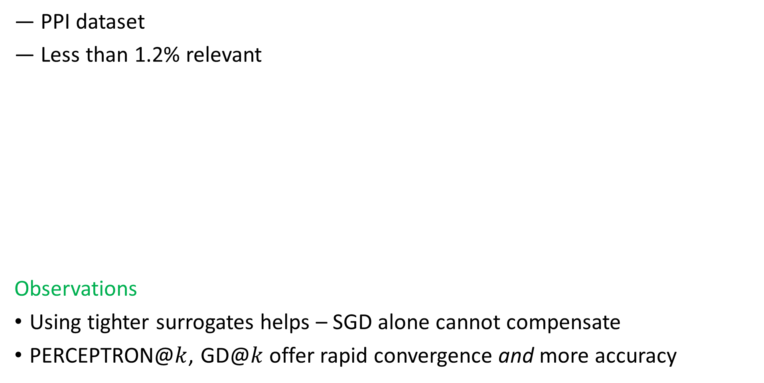
Experiments
― PPI dataset
― Less than 1.2% relevant
Observations
Using tighter surrogates helps – SGD alone cannot compensate
PERCEPTRON@$k$, GD@$k$ offer rapid convergence and more accuracy
Struct-SVM SGD
1035x
+7%
PERCEPTRON@$k$
(Proposed)
PPI
Struct-SVM
Batch
Notes:
Preliminary experiments on rare class identification tasks we find that our perceptron and SGD algorithms handily outperform both batch as well as SGD implementations of the struct-SVM surrogate.
This indicates that the use of a suboptimal surrogate was hurting these algorithms

Slide 20
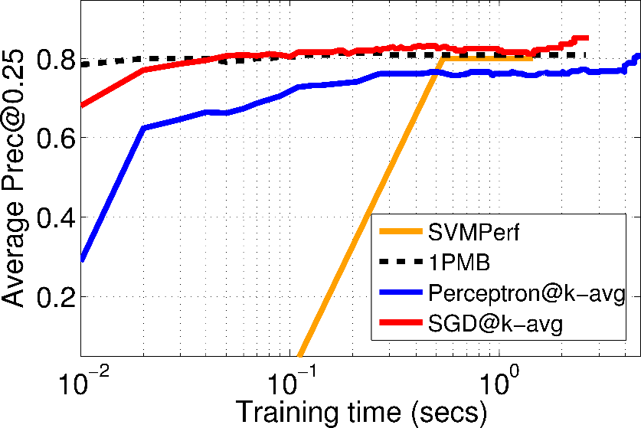
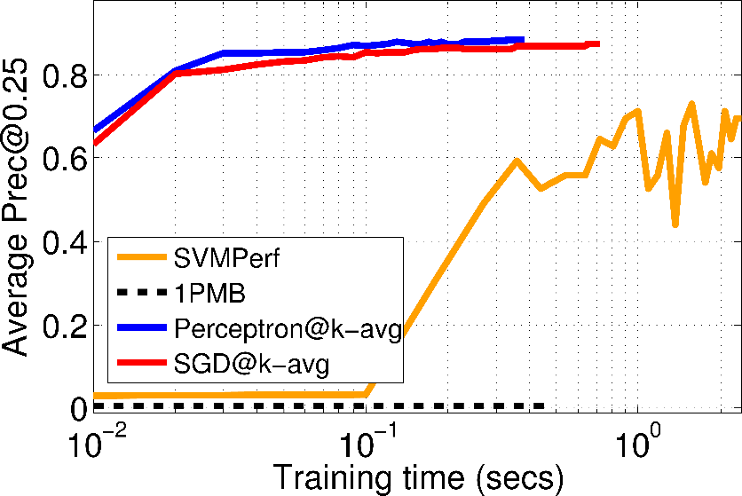
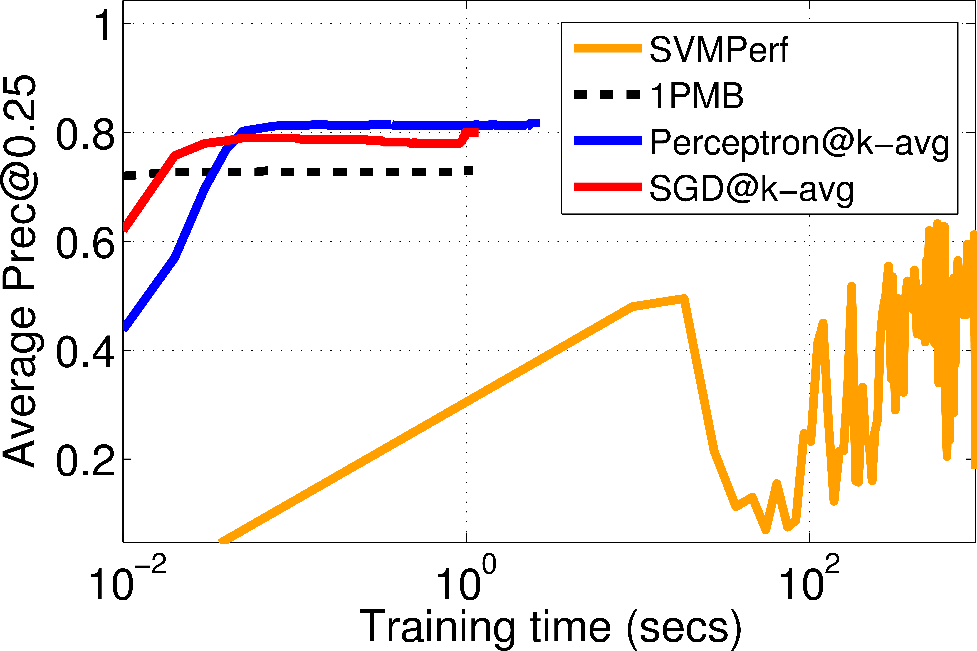
Experiments
10x
+4%
75x
+15%
25000x
+8%
KDDCup08
Letter
IJCNN
Notes:
We find these trends in most datasets that we experimented on

Slide 21
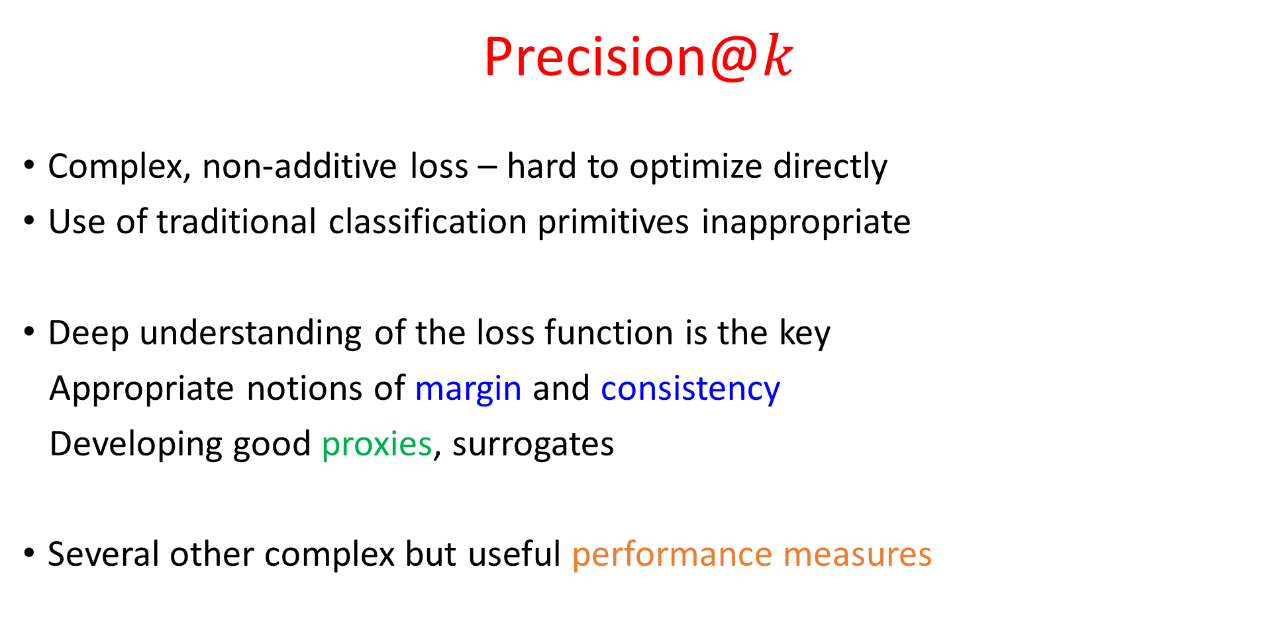
Summary
Precision@$k$
Complex, non-additive loss – hard to optimize directly
Use of traditional classification primitives inappropriate
Deep understanding of the loss function is the key
Appropriate notions of margin and consistency
Developing good proxies, surrogates
Several other complex but useful performance measures
?

Slide 22
Questions?

