Slide 1


?
?
?
?
?
Illustration adapted from
https://www.amazon.com/Delibes-Lakmé-Léo/dp/B00000C2JP/

Slide 2


?
?
?
?
?
?
Illustration adapted from
https://en.wikipedia.org/wiki/Stress_and_vowel_reduction_in_English

Slide 3
DECAF
Deep Extreme Classification with Label Features
Anshul Mittal†, Kunal Dahiya†, Sheshansh Agrawal‡, Deepak Saini‡,
Sumeet Agarwal†, Purushottam Kar*‡, Manik Varma‡†
(†: IIT Delhi, ‡: Microsoft Research India, *: IIT Kanpur)
To appear at the 14th ACM International WSDM Conference 2021

Slide 4



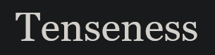

Extreme Multi-label Classification (XC)
4
Given a data point, tag it with the most relevant subset of labels from a very large set of $L$ labels
 | Data Point | Possible Labels
1 | Amazon product | Other Amazon products e.g.
2 |  | Categories e.g. “Classical”, “CDs and Vinyl”
3 | Wikipedia page | Other Wikipedia pages e.g.
4 |  | Categories e.g. “English Phonology”, “Vowels”
Images taken from
https://www.amazon.com/Delibes-Lakmé-Léo/dp/B00000C2JP/
https://en.m.wikipedia.org/wiki/Stress_and_vowel_reduction_in_English
https://en.m.wikipedia.org/wiki/Vowel_reduction
https://en.m.wikipedia.org/wiki/Schwa
https://en.m.wikipedia.org/wiki/Tenseness

Slide 5
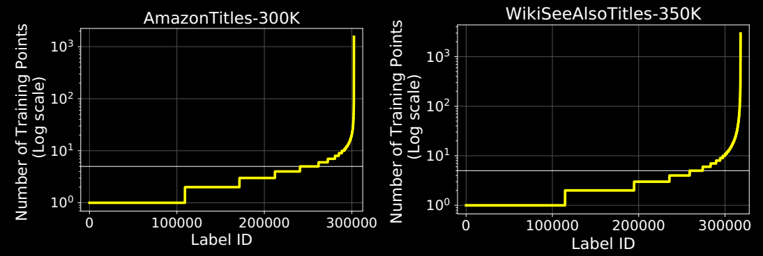

Peculiarities and Demands of XC
Set of labels very large – $L$ in the millions or more
For any data point, few e.g. $𝒪\left(\log{L}\right)$ labels relevant
    E.g. 2-3 relevant categories, 10-15 related products
Training, prediction should scale with $L$ as $𝒪\left(\log{L}\right)$, not as $Ω\left(L\right)$
    Millisecond level prediction essential to ensure real-time responses
A few labels are “head” labels, have lots of training points
    “Living people” category on Wikipedia appears in over 950K articles
Most labels are “tail” labels, very few (often < 5) training points
    “Russian poets” category on Wikipedia appears in just 18 articles
Main challenge: predict tail labels (where diversity lies) accurately
    Predicting head labels much simpler, less rewarding too

Slide 6

Notation
$L$ labels in our application, $V$ tokens or “words” in our vocabulary
Given $N$ training points to learn model and classifiers
For the $i$-th training data point $i∈\left[N\right]$, we are given
    Text (e.g. product title) presented as a sparse bag-of-words $x_{i}∈ℝ^{V}$
    Set of labels associated with this data point, given as vector $y_{i}∈{\left\{−1,1\right\}}^{L}$ where $y_{il}=1$ if label $i$ is associated with data point $i$ else $y_{il}=−1$
    Note: Most entries in $y_{i}$ are $−1$ as data points usually have few labels
Existing XC techniques usually work with just ${\left\{\left(x_{i},y_{i}\right)\right\}}_{i=1}^{N}$
    Turns out to be suboptimal for tail labels with very few training points
DECAF: each label has associated text given as bag-of-words $z_{l}∈ℝ^{V}$
    Applicable in several scenarios, product-to-product, product-to-category etc

Slide 7
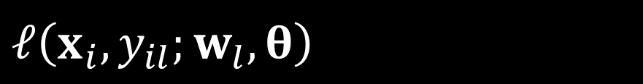

A Generic Deep XC Framework
Component 1 (embedding): a deep architecture to embed data points onto dense low-dim vectors $ℰ_{θ}:ℝ^{V}→ℝ^{d}$, $d≈100$
Component 2 (extreme classifiers): based on the simple yet effective one-vs-all principle. Learn a linear model $w_{l}∈ℝ^{d}$ per label with the hope that $w_{l}^{⊤}ℰ_{θ}\left(x_{i}\right)$ will be large if $y_{il}=+1$ and small if $y_{il}=−1$
Loss Function: several possible, e.g. logistic loss (BCE), hinge loss etc
$ℒ\left(θ,{\left\{w_{l}\right\}}_{l=1}^{L}\right)=\sum_{i∈\left[N\right]}{\sum_{l∈\left[L\right]}{\ln\left(1+\exp\left(−y_{il}⋅w_{l}^{⊤}ℰ_{θ}\left(x_{i}\right)\right)\right)}}$
    Contains $NL$ terms – even if evaluating one term takes 1$μ$s, 30 hrs to evaluate all terms in on AmazonTitles-300K, 48 days on P2PTitles-2M – too much ☹
Component 3 (hard-negative miner): a technique to obtain $𝒪\left(\log{L}\right)$ of the most challenging negative labels per data point to approximate $ℒ$
$$ℓ\left(x_{i},y_{il};w_{l},θ\right)$$

Slide 8
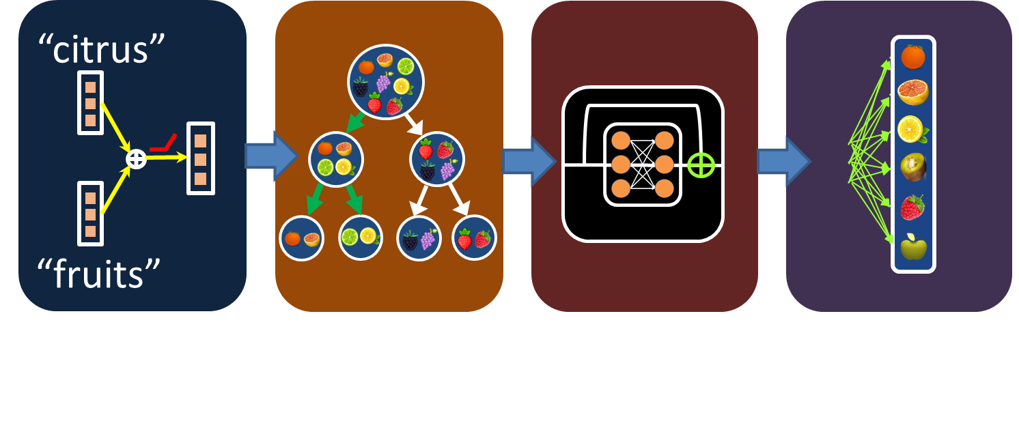

The DeepXML Pipeline
    Module 1: solve a simpler problem, say using a loss function $\tilde{ℒ}$ with $≪NL$ terms, to learn a good embedding architecture $\hat{θ}$
    Module 2: use $\hat{θ}$ to find for each $i∈\left[N\right]$, a set $𝒩_{i}⊂\left[L\right]$ of $𝒪\left(\log{L}\right)$ -ve labels $\sum_{l∈𝒩_{i}∪𝒫_{i}}{ℓ\left(x_{i},y_{il};w_{l},θ\right)}≈\sum_{l∈\left[L\right]}{ℓ\left(x_{i},y_{il};w_{l},θ\right)}$ ($𝒫_{i}$ is set of +ve labels)
    Module 3: transfer intermediate features to final features
    Module 4: learn extreme classifiers $w_{l},l=1,…,\left[L\right]$ (optionally tune $\hat{θ}$) using approx. loss $\hat{ℒ}=\sum_{i∈\left[N\right]}{\sum_{l∈𝒩_{i}∪𝒫_{i}}{ℓ\left(x_{i},y_{il};w_{l},θ\right)}}$ (only $𝒪\left(N\log{L}\right)$ terms ☺)
Module 1
Module 3
Module 4
Figure taken from Manik’s talk
Module 2

Slide 9





















Components of DECAF
Component 1: Embedding (lightweight, highly scalable)
    A deep model mapping data pts to low-dim vectors $ℰ_{E,θ}:ℝ^{V}→ℝ^{d},d=300$
    DECAF learns $d$-dim embeddings for every token $E∈ℝ^{d×V}$. Given a data pt, sum of token embeddings passed through an embedding block with params $θ=\left\{R,α,β\right\}$
Pet
$$\hat{x}$$
$$ℰ$$
$$𝒞$$
Comb
$$𝒞$$
$$…$$
$$…$$
for
$$ℰ$$
STOP
$$…$$
Flea
$$R$$
$$α$$
$$β$$
$$…$$
Removal
$${\hat{x}}^{0}$$
$$…$$
$$u$$
$$v$$
$$v$$
$\hat{x}=ℰ \left({\hat{x}}^{0}\right), {\hat{x}}^{0}=Ex$
$ℰ\left(v\right)=𝒞\left(v,R⋅ReLU\left(v\right)\right)$
$$𝒞\left(u,v\right)=σ\left(α\right)⊙u⊕σ\left(β\right)⊙v$$
Data Point Embedding
Embedding Block
Combination Block

Slide 10









Components of DECAF
Component 2: Extreme classifiers
    A linear model $w_{l}∈ℝ^{d}$ per label with hope that $w_{l}^{⊤}ℰ_{E,θ}\left(x_{i}\right)$ large if $y_{il}=+1$, small if $y_{il}=−1$
    DECAF’s extreme classifiers critically use label text
    Allow labels that share tokens to collaborate
    Label text $z_{l}$ embedded using $ℰ_{E,θ}$ to get ${\hat{z}}_{l}^{1}$
    A $d$-dim “refinement” vector ${\hat{z}}_{l}^{2}$ learnt, one per label, and combined with ${\hat{z}}_{l}^{1}$ to get $w_{l}$
    A fresh instance of combination block used for $𝒞_{L}$
$$w_{l}$$
The
STOP
Most
$$𝒞_{L}$$
Famous
$${\hat{z}}_{l}^{2}$$
$${\hat{z}}_{l}^{1}$$
Opera
Duets
$${\hat{z}}_{l}^{0}$$
$$ℰ$$
${\hat{z}}_{l}^{1}=ℰ\left({\hat{z}}_{l}^{0}\right),{\hat{z}}_{l}^{0}=Ez_{l}$
Label Text Embedding
$w_{l}=𝒞_{L}\left({\hat{z}}_{l}^{1},{\hat{z}}_{l}^{2}\right)$
Extreme Classifier

Slide 11














Components of DECAF
Component 3: Pre-ranker (hard negative miner + shortlister)
    Given test pt $x_{t}∈ℝ^{V}$, infeasible to compute $w_{l}^{⊤}ℰ_{E,θ}\left(x_{t}\right)$ for all labels $l∈\left[L\right]$
    Pre-ranker uses ${\hat{x}}_{t}=ℰ_{E,θ}\left(x_{t}\right)$ to obtain a shortlist $𝒫\left({\hat{x}}_{t}\right)$ of $𝒪\left(\log{L}\right)$ labels
    $w_{l}^{⊤}ℰ_{E,θ}\left(x_{t}\right)$ computed only for labels $l∈𝒫\left({\hat{x}}_{t}\right)$ to make final predictions
DECAF’s pre-ranker is compact
(returns$≈$ 500 labels) yet offers
high recall (85%)
DECAF upto 10x faster than Slice,
Astec at prediction time
Slice, ASTEC use generic kNN
based hard negative miners
DECAF’s learns its pre-ranker in a
novel recursive manner
$$\hat{x}$$
$$𝒫$$
$$ℛ$$
L12
$$ℰ$$
L8
L3
L11
L4
$s_{4}$ Max
$$w^{4}$$
L2
L6
$$w^{11}$$
L7
$$w^{9}$$
L15
L1
L14
$$w^{1}$$
Delibes
L5
L13
L9
Min$s_{6}$
$$w^{13}$$
Lakmé
Pre-ranker failure
L10
$$w^{6}$$
Data Pt. Embed
Pre-Ranking
(yellow $⇒$ relevant label)
Ranking

Slide 12









DECAF’s Pre-ranker Construction
Step 1: Clusters the $L$ labels into $K=2^{17}$ clusters $𝒞_{1},…,𝒞_{K}$
Step 2: Create a new (smaller) XC problem with $K$ “meta” labels
    For each data point $i∈\left[N\right]$, create a new label vector ${\tilde{y}}_{i}∈{\left\{−1,1\right\}}^{K}$ by setting ${\tilde{y}}_{ik}=1$ if for some $l∈𝒞_{k}$, we had $y_{il}=1$, else set ${\tilde{y}}_{ik}=−1$
    For each “meta” label $k∈\left[K\right]$, create new features ${\tilde{z}}_{k}=\sum_{l∈𝒞_{k}}{z_{l}}$
Step 3: Solve XC problem ${\left\{\left(x_{i},{\tilde{y}}_{i}\right)\right\}}_{i=1}^{N},{\left\{{\tilde{z}}_{k}\right\}}_{k=1}^{K}$using DECAF recursively
    Learn token embeddings $E$, model params $θ$, extreme classifiers ${\tilde{p}}_{k},k∈\left[K\right]$
Pre-ranking: Given a data point $x∈ℝ^{V}$, the pre-ranker finds $B$ clusters with highest scores i.e. ${\tilde{p}}_{k}^{⊤}ℰ_{E,θ}\left(x\right)$, returns all labels present therein
No inception ☺ recursive call doesn’t use pre-ranker or negative mining
    $K$ is chosen to be small enough that $𝒪\left(NK\right)$ computation is feasible in Step 3
$$\hat{x}$$
$$𝒫$$
$$ℛ$$
L12
$$ℰ$$
L8
L3
L11
L4
$s_{4}$ Max
$$w^{4}$$
L2
L6
$$w^{11}$$
L7
$$w^{9}$$
L15
L1
L14
$$w^{1}$$
Delibes
L5
L13
L9
Min$s_{6}$
$$w^{13}$$
Lakmé
Pre-ranker failure
L10
$$w^{6}$$

Slide 13

DECAF cast in DeepXML Pipeline
Module 1: pre-ranker learning (coarse)
    Initialize $E$ as FastText, create label centroids $c_{l}=\sum_{i:y_{il}=1}{Ex_{i}}$, cluster labels
    Perform the recursive call to DECAF to fine tune $E$, learn $θ$ and ${\tilde{p}}_{k},k∈\left[K\right]$
Module 2: pre-ranker learning (fine) + hard negative mining
    Freeze $E$, recreate label centroids as $c_{l}=\sum_{i:y_{il}=1}{ℰ_{E,θ}\left(x_{i}\right)}$, recluster labels, then redo a recursive call to DECAF to further fine tune $θ$ and ${\tilde{p}}_{k},k∈\left[K\right]$
    For all $i∈\left[N\right]$, use pre-ranker to obtain set $𝒩_{i}$ of $𝒪\left(\log{L}\right)$ labels
Module 3: get ready for final learning
    Initialize $E,θ$ to module 2 values, initialize refinement vectors ${\hat{z}}_{l}^{2}$ using label text embedding ${\hat{z}}_{l}^{1}=ℰ_{E,θ}\left(z_{l}\right)$, initialize $𝒞_{L}$ params to $α_{L}=β_{L}=0$
Module 4: extreme classifier learning using approx. loss function $\hat{ℒ}$
    Fine tune $θ,{\hat{z}}_{l}^{2}$, learn $𝒞_{L}$ params to obtain final $w_{l},l∈\left[L\right]$

Slide 14

Key Elements of DECAF
Frugal embedding model yet outperforms BERT based models
Recursively learning own pre-ranker beneficial
    Previous works often use generic shortlisters – not as effective + slower
Fine-tuning pre-ranker in module 2: upto 2% accuracy boost
    Previous works do not consider such fine-tuning
Massive fanout $K=2^{17}$ that is still computationally efficient
    Smaller fanouts e.g. $2^{13}$ used by previous works not as effective
Careful initialization e.g. ${\hat{z}}_{l}^{2}←{\hat{z}}_{l}^{1}$ critical in XC tasks
    Naïve e.g. random initialization can cause 6-8% drop in accuracy
Several other contributions e.g. ensemble learning, persistent fine-tuning $E$ in modules 2, 4, etc (please see paper)

Slide 15
Dataset Statistics
 | Dataset | # of Train Points | # of Labels | # of Test Points
Benchmark* | LF-AmazonTitles-131K | 294,805 | 131,073 | 134,835
 | LF-WikiSeeAlsoTitles-320K | 693,082 | 312,330 | 177,515
 | LF-AmazonTitles-1.3M | 2,248,619 | 1,305,265 | 970,237
Bing | LF-P2PTitles-300K | 1,366,429 | 300,000 | 585,602
 | LF-P2PTitles-2M | 2,539,009 | 1,640,898 | 1,088,146
*Datasets are available on The Extreme Classification Repository

Slide 16
Qualitative Analysis: WikiSeeAlsoTitles
Test Data Point: Stress and vowel reduction in English
DECAF: English phonology, Vowel reduction, Vowel reduction in Russian, Schwa, Initial-stress-derived noun
X-Transformer: Russian phonology, List of phonetics topics, Phonological history of the English language, List of Latin words with English derivatives, Diminutives in Australian English
MACH: Relaxed pronunciation, Bottom-up proteomics, Schwa, Restorationism, Bahamas national basketball team
Slice: Phonological history of the English language, Relaxed pronunciation, Elision, Schwa, Phonological history of English vowels
DECAF able to collaborate for labels that never co-occur but share tokens
Legend: Label: correct prediction, Label: incorrect prediction, Label: correct prediction of non co-occurring label

Slide 17
Qualitative Analysis: AmazonTitles
Test Data Point: Delibes: Lakmé
DECAF: Delibes: Lakmé (Book), Delibes: Lakmé / Bonynge, Opèra de Monte-Carlo, The Tallis Scholars Sing Thomas Tallis - including Spem in Alium, Villa-Lobos: Bachianas Brasileiras (Complete), The Most Famous Opera Duets
X-Transformer: Delibes: Lakmé / Bonynge, Opéra de Monte-Carlo, Les Annees Bechet, Leonor Greyl Huile De Palme, Francafrique, Lady Croissant
MACH: The Most Famous Opera Duets, The Tallis Scholars Sing Thomas Tallis - including Spem in Alium, Villa-Lobos: Bachianas Brasileiras (Complete), The #1 Opera Album, Delibes: Lakmé / Bonynge, Opéra de Monte-Carlo
Slice: Delibes: Lakmé / Bonynge, Opèra de Monte-Carlo, Tallis: Spem in Alium, The #1 Opera Album, The Most Famous Opera Duets, Rarities
Legend: Label: correct prediction, Label: incorrect prediction, Label: correct prediction of non co-occurring label

Slide 18
Quantitative Analysis on Benchmarks
DECAF can be 2-6% more accurate than leading deep XC models while offering prediction times that are 22x faster
LF-AmazonTitles-131K
LF-WikiSeeAlsoTitles-320K
LF-AmazonTitles-1.3M
Accuracy
(P@1)
x
x
5.19
15.38
7.08
29.53
x
x
x
x
Prediction
Time (ms)
x
x
DECAF
Astec
MACH
AttentionXML
Slice
X-Transformer

Slide 19
Product-to-product Recommendation
DECAF can be upto 3% more accurate than other methods in terms of P@1 and PSP@1 while offering 10-100x faster predictions
Precision@1
Propensity Scored
Precision @1
Prediction Time (ms)
P2PTitles-300K
P2PTitles-2M
DECAF
Astec
Parabel
Slice

Slide 20
Conclusions and Future Directions
Incorporating label text into extreme classification models yields significant improvements in prediction performance
    Benefit is more prominent on rare labels which have paucity of data
How about more powerful text embeddings e.g. BERT?
    DECAF does outperform X-Transformer but BERT+DECAF may do even better
Other forms of label metadata?
    Label trees (e.g. category taxonomies on Wikipedia, Amazon)
    Label graphs (e.g. co-bought behaviour for Amazon products)
    Initial results using an extension of DECAF that uses label co-occurrence graphs as label metadata suggests 3-5% gain in P@1 and 4-8% gain in PSP@1
    Challenging to learn using trees/graph over millions of nodes

Slide 21
The Extreme Classification Repository
Datasets, Code, Benchmarked Results, and more
http://manikvarma.org/downloads/XC/XMLRepository.html

