Slide 1
Probabilistic ML

Slide 2

Extra Classes
April 03, 2024 (Wed) 6PM L20
April 10, 2024 (Wed) 6PM L20
Timing and venue same for both
In lieu of missed classes on account of Institute and Gymkhana holidays
No extra class on April 06, 2024 (Sat)

Slide 3




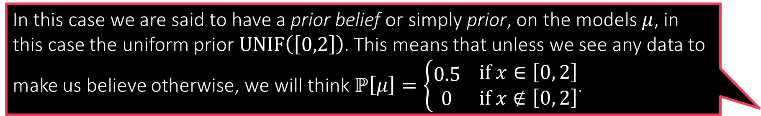
Can you Guess the Mean?
In this case we are said to have a prior belief or simply prior, on the models $μ$, in this case the uniform prior $UNIF\left(\left[0,2\right]\right)$. This means that unless we see any data to make us believe otherwise, we will think $ℙ\left[μ\right]=\left\{\begin{aligned}0.5 \\ 0\end{aligned} \begin{matrix}if x∈\left[0, 2\right] \\ if x∉\left[0, 2\right]\end{matrix}\right.$.
There is a Gaussian with unknown mean but known variance (for sake of simplicity) from which we receive $n$ independent samples
$x_{1},x_{2},…,x_{n}∼𝒩\left(μ^{∗},1\right)$
Can we estimate the “model” $μ^{∗}$ from these samples?
Likelihood function: for a candidate model $μ$ and sample $x_{i}$
$ℙ\left[x_{i} | μ,1\right]=\frac{1}{\sqrt{2π}}\exp\left(−{\left(x_{i}−μ\right)}^{2}/2\right)$
MLE: $\arg{\max_{μ∈ℝ}{\prod_{i=1}^{n}{ℙ\left[x_{i} | μ,1\right]}}}=\arg{\min_{μ∈ℝ}{\sum_{i=1}^{n}{{\left(x_{i}−μ\right)}^{2}}}}$
Suppose we believe (e.g. someone tells us) even before the samples have been presented that $μ^{∗}$ definitely lies in the interval $\left[0,2\right]$ (but could otherwise be any value within that interval)
What happens we do see some data, namely the actual samples from the distribution?
We use the samples and the rules of probability to update our beliefs about what $μ$ can and cannot be. Let us see how to do this

Slide 4
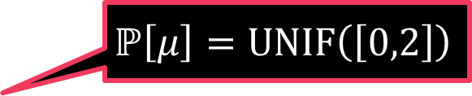
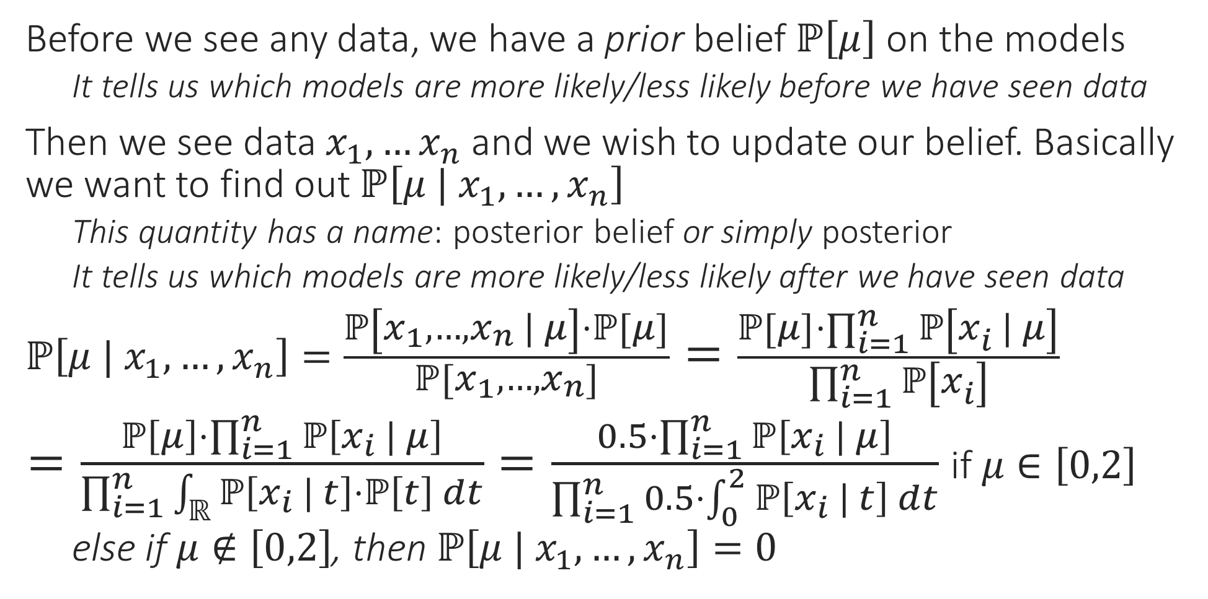
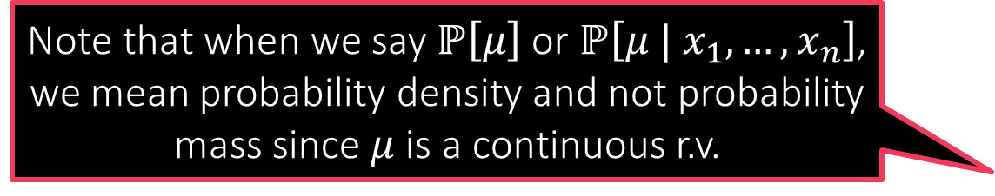
Posterior
Before we see any data, we have a prior belief $ℙ\left[μ\right]$ on the models
    It tells us which models are more likely/less likely before we have seen data
Then we see data $x_{1},…x_{n}$ and we wish to update our belief. Basically we want to find out $ℙ\left[μ | x_{1},…,x_{n}\right]$
    This quantity has a name: posterior belief or simply posterior
    It tells us which models are more likely/less likely after we have seen data
$ℙ\left[μ | x_{1},…,x_{n}\right]=\frac{ℙ\left[x_{1},…,x_{n} | μ\right]⋅ℙ\left[μ\right]}{ℙ\left[x_{1},…,x_{n}\right]}=\frac{ℙ\left[μ\right]⋅\prod_{i=1}^{n}{ℙ\left[x_{i} | μ\right]}}{\prod_{i=1}^{n}{ℙ\left[x_{i}\right]}}$
$=\frac{ℙ\left[μ\right]⋅\prod_{i=1}^{n}{ℙ\left[x_{i} | μ\right]}}{\prod_{i=1}^{n}{\int_{ℝ}{ℙ\left[x_{i} | t\right]⋅ℙ\left[t\right] dt}}}=\frac{0.5⋅\prod_{i=1}^{n}{ℙ\left[x_{i} | μ\right]}}{\prod_{i=1}^{n}{0.5⋅\int_{0}^{2}{ℙ\left[x_{i} | t\right] dt}}}$ if $μ∈\left[0,2\right]$
    else if $μ∉\left[0,2\right]$, then $ℙ\left[μ | x_{1},…,x_{n}\right]=0$
Note that when we say $ℙ\left[μ\right]$ or $ℙ\left[μ | x_{1},…,x_{n}\right]$, we mean probability density and not probability mass since $μ$ is a continuous r.v.
Bayes Rule
Samples are independent
Law of total probability
$$ℙ\left[μ\right]=UNIF\left(\left[0,2\right]\right)$$

Slide 5


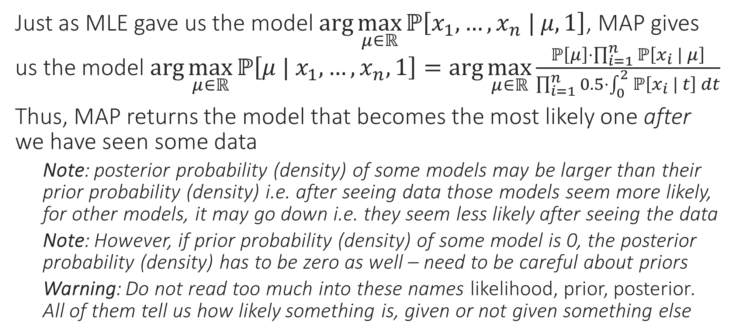

Maximum a Posteriori (MAP) Estimate
It is better to choose priors that do not completely exclude some models by giving them 0 probability (as we did)
Just as MLE gave us the model $\arg{\max_{μ∈ℝ}{ℙ\left[x_{1},…,x_{n} | μ,1\right]}}$, MAP gives us the model $\arg{\max_{μ∈ℝ}{ℙ\left[μ | x_{1},…,x_{n},1\right]}}=\arg{\max_{μ∈ℝ}}\frac{ℙ\left[μ\right]⋅\prod_{i=1}^{n}{ℙ\left[x_{i} | μ\right]}}{\prod_{i=1}^{n}{0.5⋅\int_{0}^{2}{ℙ\left[x_{i} | t\right] dt}}}$
Thus, MAP returns the model that becomes the most likely one after we have seen some data
    Note: posterior probability (density) of some models may be larger than their prior probability (density) i.e. after seeing data those models seem more likely, for other models, it may go down i.e. they seem less likely after seeing the data
    Note: However, if prior probability (density) of some model is 0, the posterior probability (density) has to be zero as well – need to be careful about priors
    Warning: Do not read too much into these names likelihood, prior, posterior. All of them tell us how likely something is, given or not given something else
True! Even in general, if your priors are bad, or too strong, then you may end up getting funny models as a result of doing MAP estimation
Indeed! For example if we were wrong and $μ^{∗}$ was actually not $∈\left[0,2\right]$ then not matter how many samples we see, we will never estimate $μ^{∗}$ correctly!!

Slide 6
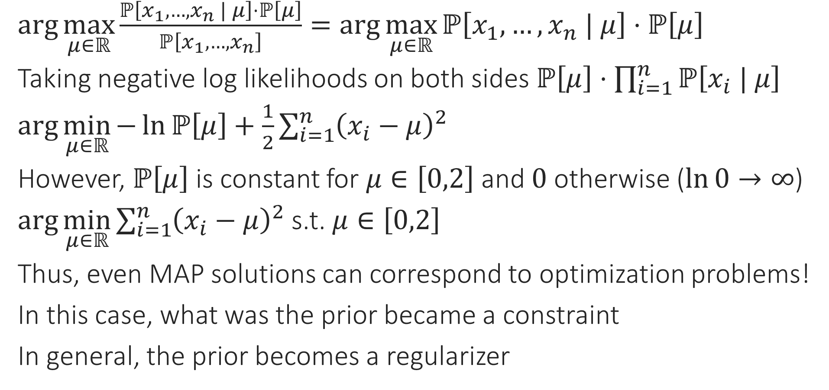
MAP vs Regularization
$\arg{\max_{μ∈ℝ}{\frac{ℙ\left[x_{1},…,x_{n} | μ\right]⋅ℙ\left[μ\right]}{ℙ\left[x_{1},…,x_{n}\right]}}}=\arg{\max_{μ∈ℝ}{ℙ\left[x_{1},…,x_{n} | μ\right]⋅ℙ\left[μ\right]}}$
Taking negative log likelihoods on both sides $ℙ\left[μ\right]⋅\prod_{i=1}^{n}{ℙ\left[x_{i} | μ\right]}$
$\arg{\min_{μ∈ℝ}{−\ln{ℙ\left[μ\right]}+\frac{1}{2}\sum_{i=1}^{n}{{\left(x_{i}−μ\right)}^{2}}}}$
However, $ℙ\left[μ\right]$ is constant for $μ∈\left[0,2\right]$ and $0$ otherwise ($\ln{0}→∞$)
$\arg{\min_{μ∈ℝ}{\sum_{i=1}^{n}{{\left(x_{i}−μ\right)}^{2}}}}$ s.t. $μ∈\left[0,2\right]$
Thus, even MAP solutions can correspond to optimization problems!
In this case, what was the prior became a constraint
In general, the prior becomes a regularizer

Slide 7


MAP vs Regularization
Similarly, had we used a Laplacian prior, we would have obtained L1 regularization instead
Consider the same problem as before but a different prior
    This time we do not believe $μ$ must have been in the interval $\left[0,2\right]$ but a much milder prior that $μ$ is not too large in magnitude
    A good way to express this is to use a Gaussian prior
    $ℙ\left[μ\right]=𝒩\left(μ ; 0,σ^{2}\right)=\frac{1}{\sqrt{2πσ^{2}}}\exp\left(−\frac{μ^{2}}{2σ^{2}}\right)$
MAP: $\arg{\min_{μ∈ℝ}{−\ln{ℙ\left[μ\right]}+\frac{1}{2}\sum_{i=1}^{n}{{\left(x_{i}−μ\right)}^{2}}}}$
$=\arg{\min_{μ∈ℝ}{\frac{μ^{2}}{{2σ}^{2}}+\frac{1}{2}\sum_{i=1}^{n}{{\left(x_{i}−μ\right)}^{2}}}}=\arg{\min_{μ∈ℝ}{\frac{μ^{2}}{σ^{2}}+\sum_{i=1}^{n}{{\left(x_{i}−μ\right)}^{2}}}}$
Thus, a Gaussian prior gave us L2 regularization!
    Note: $σ$ effecitely dictates the regularization constant – not useless!!
    Note: this is basically ridge regression except in one dimension!!
The regularization constant is dictated by the strength of the regularization. Be careful not to have strong priors (uninformed strong opinions are bad in real life too ☺)

Slide 8
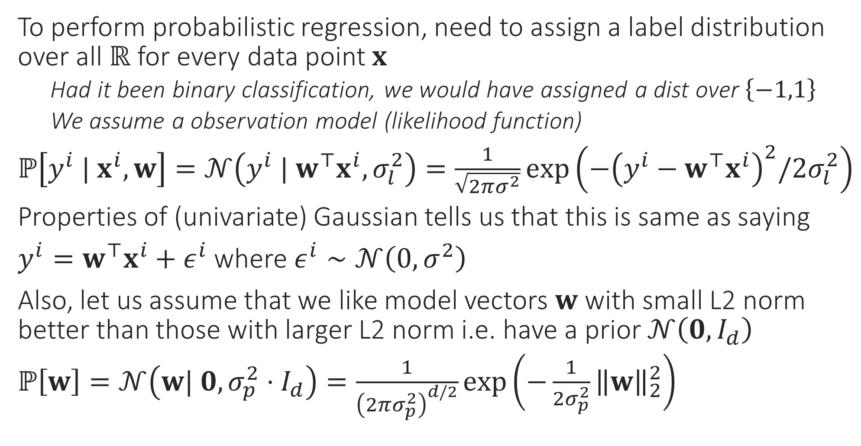
Probabilistic Regression Revisited
To perform probabilistic regression, need to assign a label distribution over all $ℝ$ for every data point $x$
    Had it been binary classification, we would have assigned a dist over $\left\{−1,1\right\}$
    We assume a observation model (likelihood function)
$ℙ\left[y^{i} | x^{i},w\right]=𝒩\left(y^{i} | w^{⊤}x^{i},σ_{l}^{2}\right)=\frac{1}{\sqrt{2πσ^{2}}}\exp\left(−{\left(y^{i}−w^{⊤}x^{i}\right)}^{2}/{2σ}_{l}^{2}\right)$
Properties of (univariate) Gaussian tells us that this is same as saying
$y^{i}=w^{⊤}x^{i}+ε^{i}$ where $ε^{i}∼𝒩\left(0,σ^{2}\right)$
Also, let us assume that we like model vectors $w$ with small L2 norm better than those with larger L2 norm i.e. have a prior $𝒩\left(0,I_{d}\right)$
$ℙ\left[w\right]=𝒩\left(w| 0,σ_{p}^{2}⋅I_{d}\right)=\frac{1}{{\left(2πσ_{p}^{2}\right)}^{d/2}}\exp\left(−\frac{1}{2σ_{p}^{2}}{\left\|w\right\|}_{2}^{2}\right)$

Slide 9

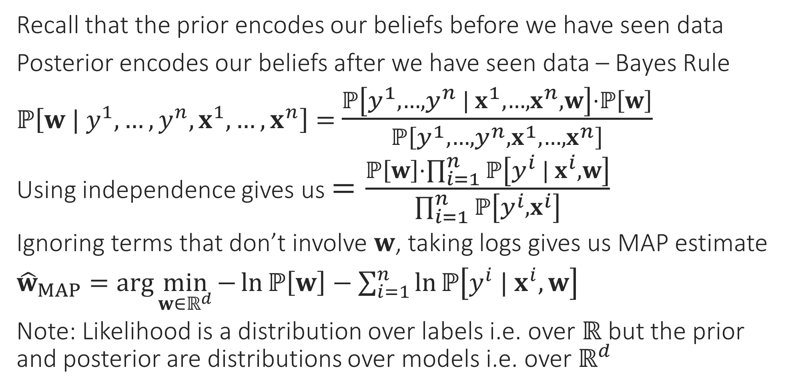
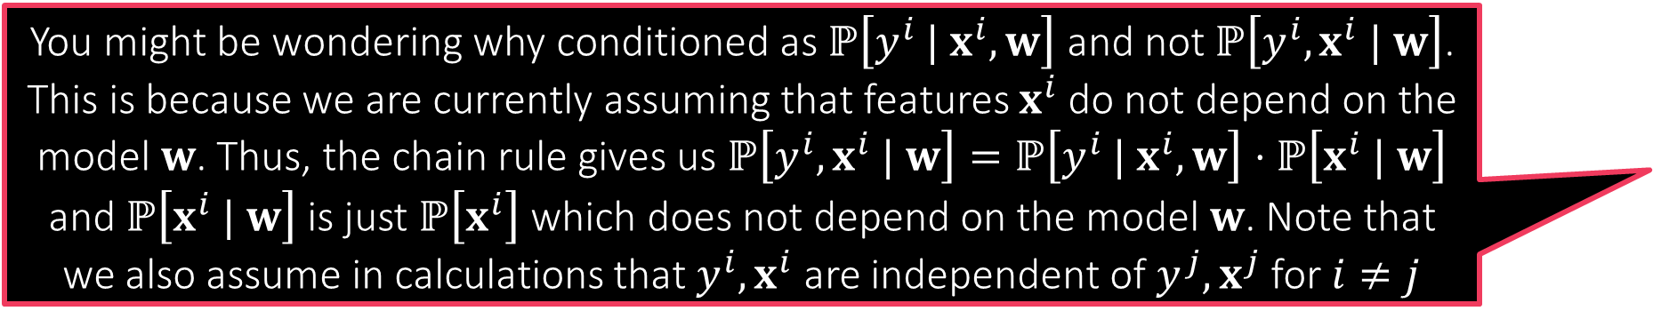
Probabilistic Regression Revisited
You might be wondering why conditioned as $ℙ\left[y^{i} | x^{i},w\right]$ and not $ℙ\left[y^{i},x^{i} | w\right]$. This is because we are currently assuming that features $x^{i}$ do not depend on the model $w$. Thus, the chain rule gives us $ℙ\left[y^{i},x^{i} | w\right]=ℙ\left[y^{i} | x^{i},w\right]⋅ℙ\left[x^{i} | w\right]$ and $ℙ\left[x^{i} | w\right]$ is just $ℙ\left[x^{i}\right]$ which does not depend on the model $w$. Note that we also assume in calculations that $y^{i},x^{i}$ are independent of $y^{j},x^{j}$ for $i≠j$
Recall that the prior encodes our beliefs before we have seen data
Posterior encodes our beliefs after we have seen data – Bayes Rule
$ℙ\left[w | y^{1},…,y^{n},x^{1},…,x^{n}\right]=$ $\frac{ℙ\left[y^{1},…,y^{n} | x^{1},…,x^{n},w\right]⋅ℙ\left[w\right]}{ℙ\left[y^{1},…,y^{n},x^{1},…,x^{n}\right]}$
Using independence gives us $=\frac{ℙ\left[w\right]⋅\prod_{i=1}^{n}{ℙ\left[y^{i} | x^{i},w\right]}}{\prod_{i=1}^{n}{ℙ\left[y^{i}, x^{i}\right]}}$
Ignoring terms that don’t involve $w$, taking logs gives us MAP estimate
${\hat{w}}_{MAP}=\arg{\min_{w∈ℝ^{d}}{−\ln{ℙ\left[w\right]}−\sum_{i=1}^{n}{\ln{ℙ\left[y^{i} | x^{i},w\right]}}}}$
Note: Likelihood is a distribution over labels i.e. over $ℝ$ but the prior and posterior are distributions over models i.e. over $ℝ^{d}$
We will soon study “generative” models where the features $x^{i}$ themselves would become random variables dependent on a (more complicated) model

Slide 10
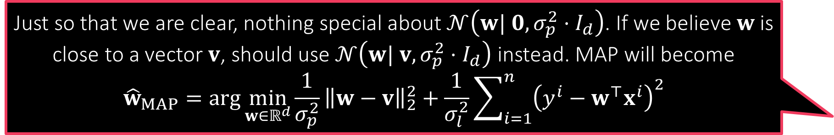

MAP for Probabilistic Regression
Just so that we are clear, nothing special about $𝒩\left(w| 0,σ_{p}^{2}⋅I_{d}\right)$. If we believe $w$ is close to a vector $v$, should use $𝒩\left(w| v,σ_{p}^{2}⋅I_{d}\right)$ instead. MAP will become
$${\hat{w}}_{MAP}=\arg{\min_{w∈ℝ^{d}}{\frac{1}{σ_{p}^{2}}}{\left\|w−v\right\|}_{2}^{2}+\frac{1}{σ_{l}^{2}}\sum_{i=1}^{n}{{\left(y^{i}−w^{⊤}x^{i}\right)}^{2}}}$$
For Gaussian likelihood $𝒩\left(y^{i} | w^{⊤}x^{i},σ_{l}^{2}\right)$ and Gaussian prior $𝒩\left(w| 0,σ_{p}^{2}⋅I_{d}\right)$ we get ${\hat{w}}_{MAP}=\arg{\min_{w∈ℝ^{d}}{\frac{1}{σ_{p}^{2}}}{\left\|w\right\|}_{2}^{2}+\frac{1}{σ_{l}^{2}}\sum_{i=1}^{n}{{\left(y^{i}−w^{⊤}x^{i}\right)}^{2}}}$
    Be careful, there are two variance terms here $σ_{l},σ_{p}$
    The above is $\arg{\min_{w∈ℝ^{d}}{{\left(\frac{σ_{l}}{σ_{p}}\right)}^{2}⋅}{\left\|w\right\|}_{2}^{2}+\sum_{i=1}^{n}{{\left(y^{i}−w^{⊤}x^{i}\right)}^{2}}}$ i.e. ridge regression
    Thus, $σ_{l},σ_{p}$ together decide the regularization constant
There is a multivariate version of the Laplace distribution too!
    Using it as a prior with $μ=0$ (the zero vector) will give us LASSO!
    Warning: expression for the Laplace PDF for general covariance is a bit tricky)
    $ℒ\left(w | μ,σ\right)=\frac{1}{{\left(2σ\right)}^{d}}\exp\left(−\frac{{\left\|w−μ\right\|}_{1}}{σ}\right)$

Slide 11
Bayesian Learning
Before we started doing probabilistic ML, we used to output a single label. With PML we started giving a distribution over labels instead
However, we still do so using a single model
    In MLE we use the model with highest likelihood function value to do so
    In MAP we use the mode of the posterior distribution to do so
In Bayesian learning, we take this philosophy further – instead of trusting a single model, we place partial trust, possibly over all models
    Models with high posterior probability (density) value get high trust
    Models with low posterior probability (density) value get low trust
We use Bayes rule yet again to perform these calculations

Slide 12
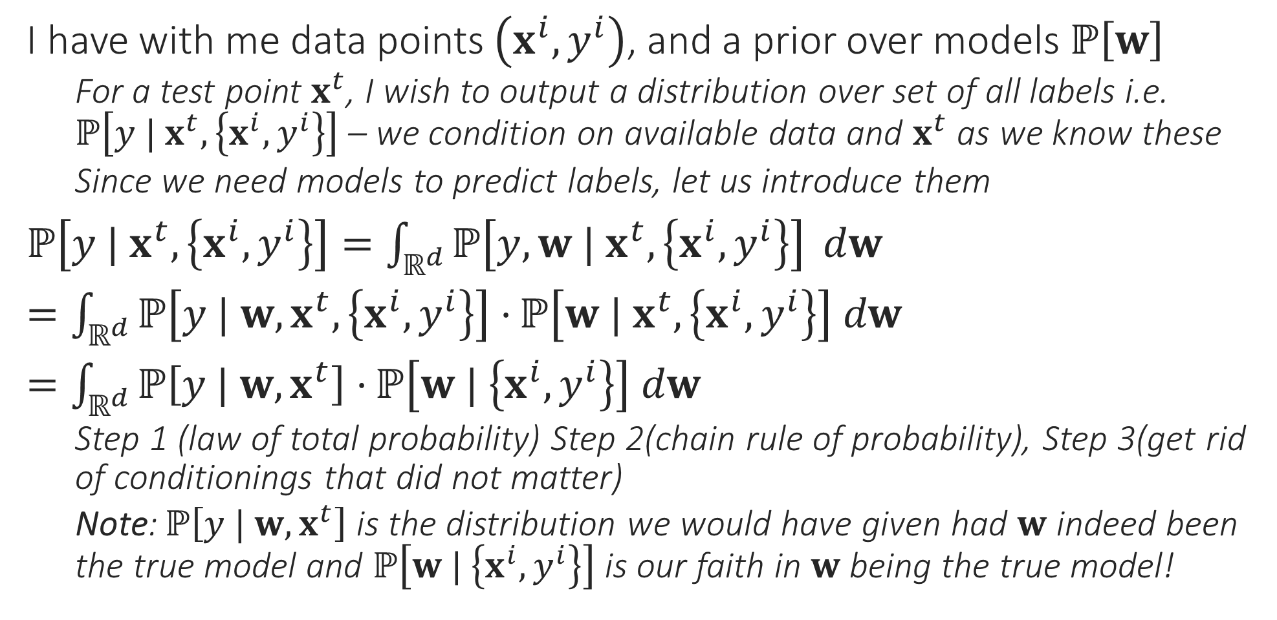
From PML to BML
I have with me data points $\left(x^{i},y^{i}\right)$, and a prior over models $ℙ\left[w\right]$
    For a test point $x^{t}$, I wish to output a distribution over set of all labels i.e. $ℙ\left[y | x^{t},\left\{x^{i},y^{i}\right\}\right]$ – we condition on available data and $x^{t}$ as we know these
    Since we need models to predict labels, let us introduce them
$ℙ\left[y | x^{t},\left\{x^{i},y^{i}\right\}\right]=\int_{ℝ^{d}}{ℙ\left[y,w | x^{t},\left\{x^{i},y^{i}\right\}\right]} dw$
$=\int_{ℝ^{d}}{ℙ\left[y | w, x^{t},\left\{x^{i},y^{i}\right\}\right]⋅}ℙ\left[w | x^{t},\left\{x^{i},y^{i}\right\}\right] dw$
$=\int_{ℝ^{d}}{ℙ\left[y | w, x^{t}\right]⋅}ℙ\left[w | \left\{x^{i},y^{i}\right\}\right] dw$
    Step 1 (law of total probability) Step 2(chain rule of probability), Step 3(get rid of conditionings that did not matter)
    Note: $ℙ\left[y | w, x^{t}\right]$ is the distribution we would have given had $w$ indeed been the true model and $ℙ\left[w | \left\{x^{i},y^{i}\right\}\right]$ is our faith in $w$ being the true model!

Slide 13
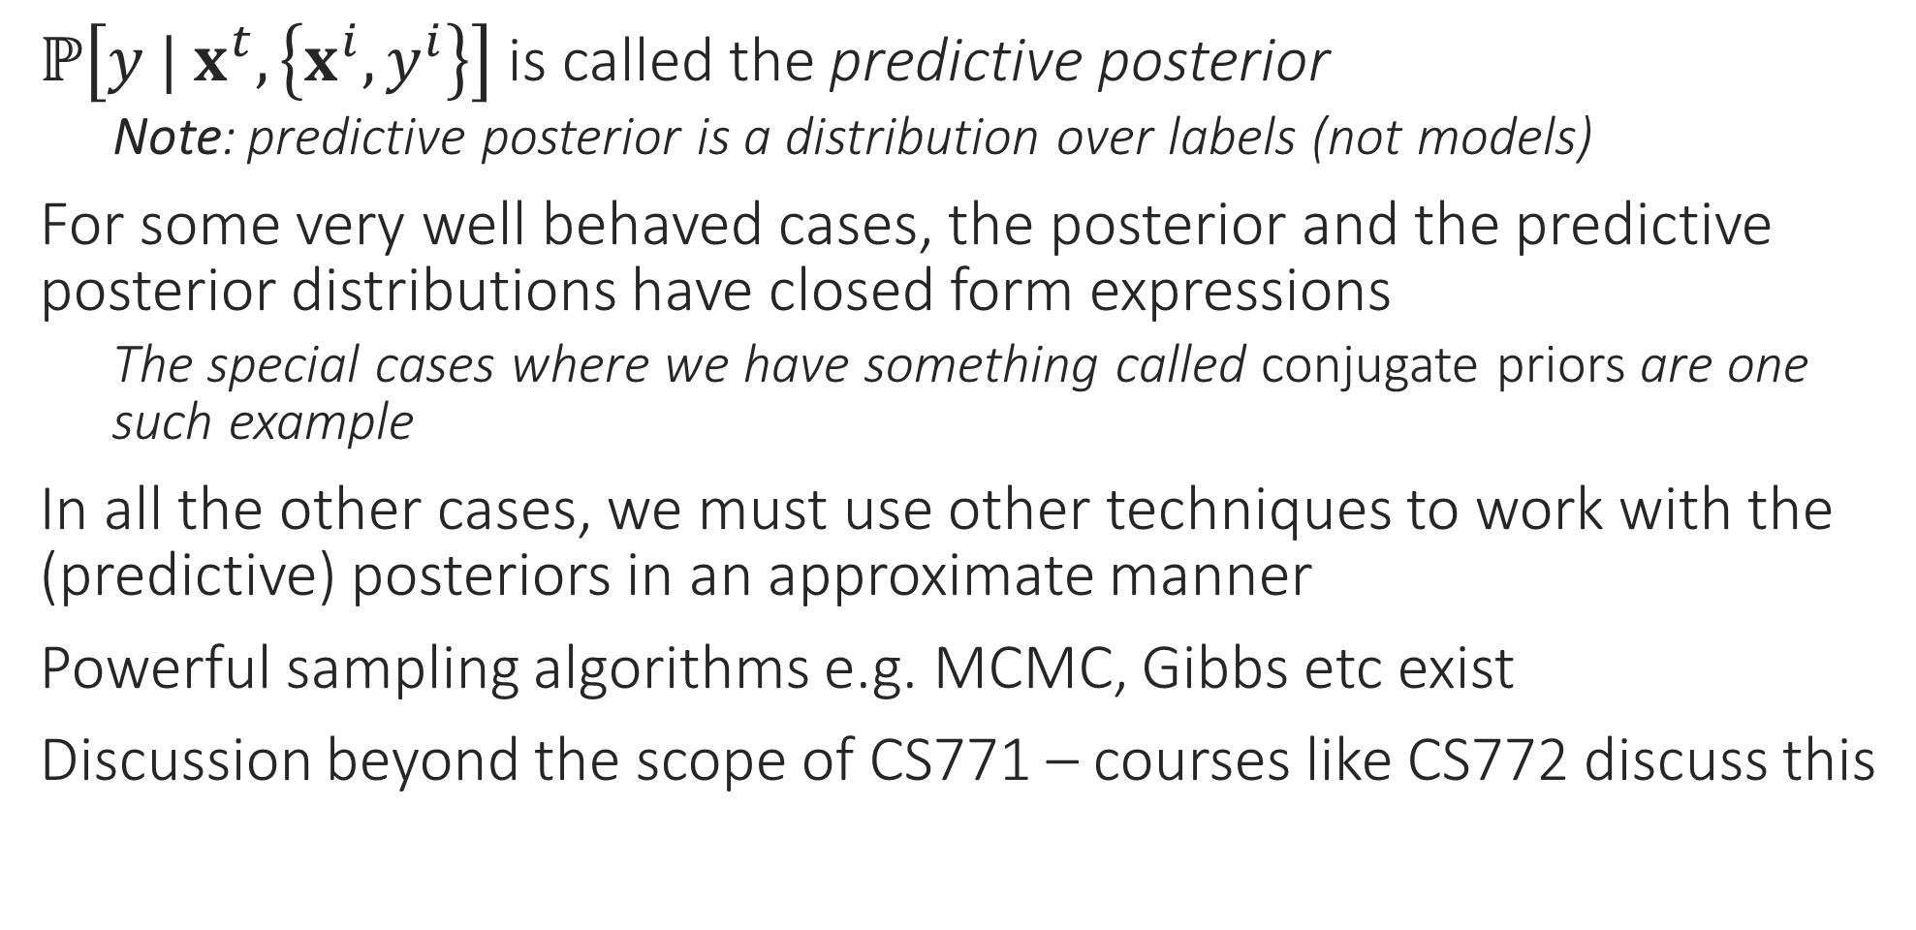
BML Trivia
$ℙ\left[y | x^{t},\left\{x^{i},y^{i}\right\}\right]$ is called the predictive posterior
    Note: predictive posterior is a distribution over labels (not models)
For some very well behaved cases, the posterior and the predictive posterior distributions have closed form expressions
    The special cases where we have something called conjugate priors are one such example
In all the other cases, we must use other techniques to work with the (predictive) posteriors in an approximate manner
Powerful sampling algorithms e.g. MCMC, Gibbs etc exist
Discussion beyond the scope of CS771 – courses like CS772 discuss this

Slide 14

Bayesian Regression
Suppose we have Gaussian likelihood $𝒩\left(y^{i} | w^{⊤}x^{i},σ_{l}^{2}\right)$ and Gaussian prior $𝒩\left(w| 0,σ_{p}^{2}⋅I_{d}\right)$, then we have $ℙ\left[w | \left\{x^{i},y^{i}\right\}\right]=𝒩\left(w;\hat{μ},\hat{Σ}\right)$
$\hat{μ}={\left(X^{⊤}X+{\left(\frac{σ_{l}}{σ_{p}}\right)}^{2}⋅I_{d}\right)}^{−1}⋅X^{⊤}y$ and $\hat{Σ}=\frac{1}{σ_{p}^{2}}{\left(X^{⊤}X+{\left(\frac{σ_{l}}{σ_{p}}\right)}^{2}⋅I_{d}\right)}^{−1}$
Note that the $\hat{μ}$ is simply the MAP solution – makes sense since MAP is the mode of the posterior and for Gaussian, mean is mode
Predictive Posterior: $ℙ\left[y | x,\left\{\left\{x^{i},y^{i}\right\}\right\}\right]=𝒩\left(y;{\hat{μ}}_{x},{\hat{σ}}_{x}^{2}\right)$ where
${\hat{μ}}_{x}={\hat{μ}}^{⊤}x$ and ${\hat{σ}}_{x}^{2}=σ_{l}^{2}+x^{⊤}\hat{Σ}x$
Note: in this case, variance of the predicted distribution ${\hat{σ}}_{x}^{2}$ depends on the point itself – can deduce if the prediction is confident or not!

Slide 15
Conjugate Priors
Bayesian Logistic Regression or Softmax Regression is not nearly as pretty – no closed form solutions for posterior or predictive posterior
However, some likelihood-prior pairs are special
    Always yield a posterior that is of the same family as the prior
    Such pairs of distributions are called conjugate pairs
    The prior in such cases is said to be conjugate to the likelihood
    Gaussian-Gaussian is one example – warning: one Gaussian is a likelihood over reals, the other Gaussian is a prior over models (i.e. vectors)
    Other conjugate pairs exist too
Discussion beyond the scope of CS771 – courses like CS772 discuss this

