Slide 1
Probability Refresher
CS771: Introduction to Machine Learning
Purushottam Kar

Slide 2
What is Probability
Depends on whom we ask this question
    A statistician may claim probability is a way of measuring how frequently does something happen
    “If I recommend an iPhone to 1000 female customers aged 25-30 years, roughly 600 of them will make a purchase”
    A logician may claim that probability is a way of measuring the amount of uncertainty in a certain statement
    “If John makes a credit card transaction worth more than ₹10,000, then there is a 70% chance it is fraudulent since he never spends so much”
    A measure theoretician may claim probability is a way of assigning positive scores in a way so that two scores can be easily compared
    “This customer is more likely to be in the 20-30 age group than the 50+ group”
Machine Learning subscribes to all these views in one way or another

Slide 3
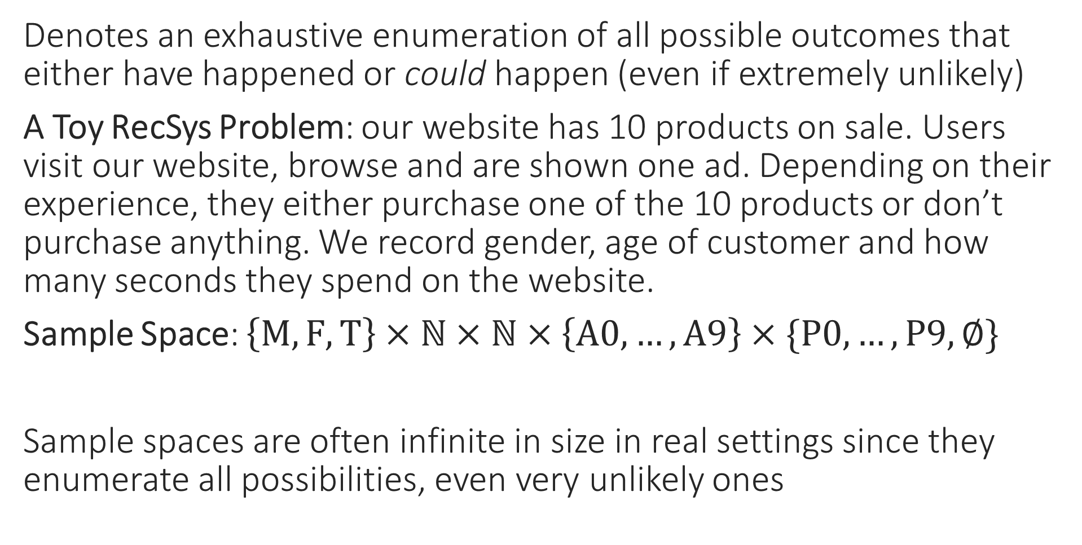
Sample Space
Denotes an exhaustive enumeration of all possible outcomes that either have happened or could happen (even if extremely unlikely)
A Toy RecSys Problem: our website has 10 products on sale. Users visit our website, browse and are shown one ad. Depending on their experience, they either purchase one of the 10 products or don’t purchase anything. We record gender, age of customer and how many seconds they spend on the website.
Sample Space: $\left\{M,F,T\right\}×ℕ×ℕ×\left\{A0,…,A9\right\}×\{P0,…,P9,∅\}$
Sample spaces are often infinite in size in real settings since they enumerate all possibilities, even very unlikely ones
Gender
Age
Time Spent
Ad Shown
Purchase

Slide 4

Events
Notice that events may choose to precisely describe certain aspects and neglect others e.g. in the events given here, some events are very specific about the gender of the user, others are not. Some are concerned about whether a purchase was made, others are merely tracking time spent etc.
An event is simply a description of useful facts about an outcome
    “A male user in age group 20-30 years visiting our website” is an event
    “A female user being shown an ad for a P2 (a laptop)” is an event
    “A user buying something that was shown as an ad” is an event
    “A user buying something that was not shown as an ad” is an event
    “A user spending more than 200 seconds on the website” is an event
ML can be used to do several useful things
    Tell us how frequently does an event occur/if one event more likely than other
        What fraction of male customers aged 35-40 purchase P6 (a phone) if shown an ad?
        What fraction of female customers purchase P2 (a laptop) whether ad shown or not?
        Is it more likely that a purchase will be made if I show a mobile ad or a laptop ad?
        Is it more likely that a 20-25 year old will purchase if I show a mobile vs laptop ad?
    Tell us how confident is the ML algorithm while giving the above replies

Slide 5

Random Variables
I could have also defined a random variable such that S = 1 if purchase made (whether or not on ad shown) and S = 0 otherwise. What I define as a random variable (or even an event) is totally up to my creativity
Random variables are simply a way to express useful facts about events as numbers so that we can do math with them
Random variables can be categorical or numerical
    Categorical: X = 1 if female, X = 2 if male, X = 3 if transgender
    Numerical (Discrete): Y = age of person in years
    Numerical (Continuous): Z = number of seconds spent on the website
    Indicator: W = 1 if purchase made on ad shown, W = 0 otherwise
Example Outcome: A male customer aged 25 years spent 18 minutes on our website but did not purchase the product whose ad was shown
X = 2, Y = 25, Z = 1080, W = 0
Can arrange many random variables as vectors too e.g. [2, 25, 1080, 0]
We had earlier seen that features for data points in ML may be categorical, numerical etc. This is no accident. Random variables can indeed be seen as giving us “features” for the outcome of the experiment

Slide 6
Probability Distribution
For starters, a 120 year old human being is almost certainly a woman not a man
For the purpose of ML, a probability distribution serves two purposes
Given an event it can tell us how likely is that event
    Given two events, this also allows us to ask which one is more likely
    Note that random variables can be used to define events too e.g. W = 1 is an event (that a purchase was made on the product whose ad was shown)
Generate a sample outcome
    We want outcomes that are more likely to be generated more often than those that are rare e.g. “120 year old man who is shown an ad for P8, spent 1000 seconds but did not purchasing anything” is not a very likely outcome
    Sometimes, we may be interested in a sample outcome with some restrictions e.g. we can request for a random “female customer who is shown an ad for P6”. In this case, we only want outcomes that satisfy the above but would like those that are more likely, to be generated more often
In this case, we are interested in getting samples of female customers who are shown an ad for P6. For example, if such customers are more likely to buy P6 then we would like W = 1 more frequently for these samples too!

Slide 7
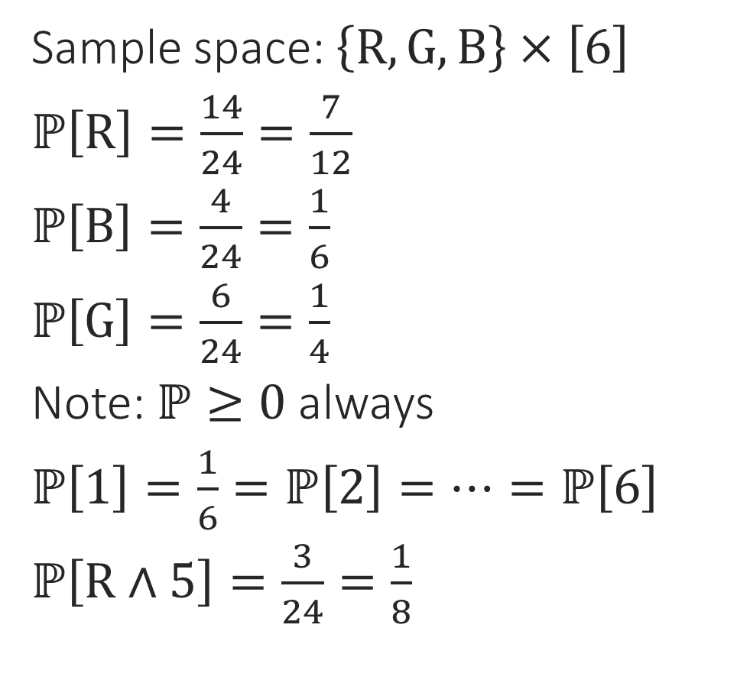
Getting Started
Sample space: $\left\{R,G,B\right\}×\left[6\right]$
$ℙ\left[R\right]=\frac{14}{24}=\frac{7}{12}$
$ℙ\left[B\right]=\frac{4}{24}=\frac{1}{6}$
$ℙ\left[G\right]=\frac{6}{24}=\frac{1}{4}$
Note: $ℙ≥0$ always
$ℙ\left[1\right]=\frac{1}{6}=ℙ\left[2\right]=…=ℙ\left[6\right]$
$ℙ\left[R∧5\right]=\frac{3}{24}=\frac{1}{8}$
1
2
3
4
5
6
1
2
3
4
5
6
1
2
3
4
5
6
1
2
3
4
5
6
Initially, to get used to things, it is good to think of probability in terms of proportions or frequency

Slide 8
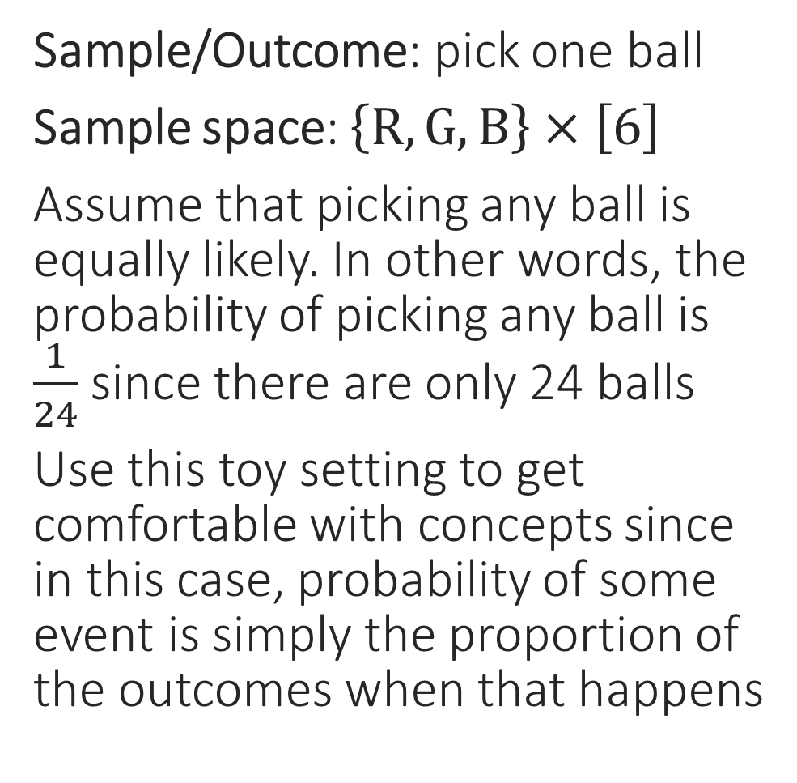
Probability as Proportions
Sample/Outcome: pick one ball
Sample space: $\left\{R,G,B\right\}×\left[6\right]$
Assume that picking any ball is equally likely. In other words, the probability of picking any ball is $\frac{1}{24}$ since there are only 24 balls
Use this toy setting to get comfortable with concepts since in this case, probability of some event is simply the proportion of the outcomes when that happens
1
2
3
4
5
6
1
2
3
4
5
6
1
2
3
4
5
6
1
2
3
4
5
6
For now, we will only look at discrete random variables (categorical/numeric)

Slide 9
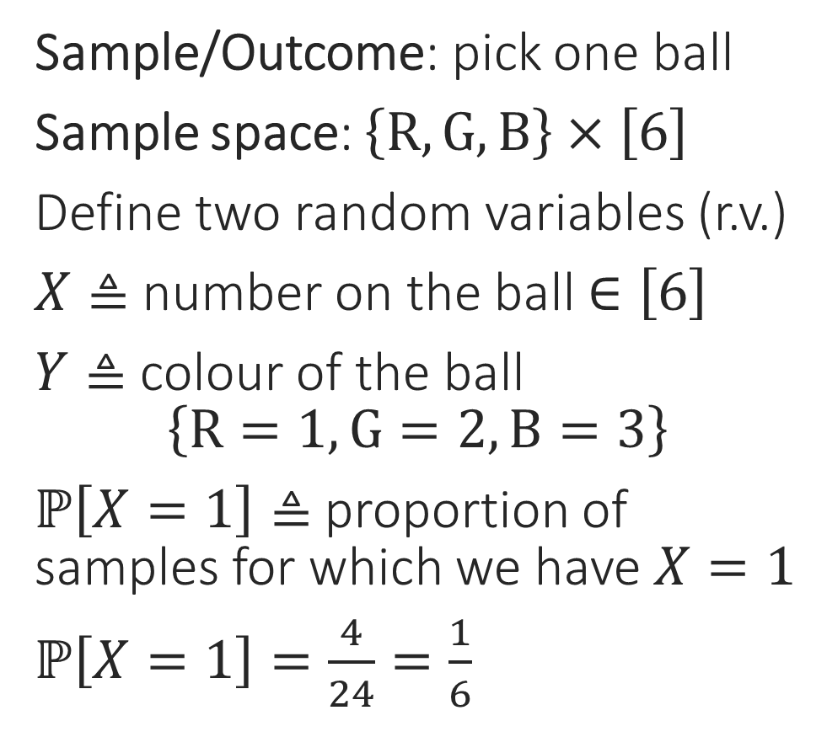
Probability as Proportions
Sample/Outcome: pick one ball
Sample space: $\left\{R,G,B\right\}×\left[6\right]$
Define two random variables (r.v.)
$X≜$ number on the ball $∈\left[6\right]$
$Y≜$ colour of the ball
$\left\{R=1,G=2,B=3\right\}$
$ℙ\left[X=1\right]≜$ proportion of samples for which we have $X=1$
$ℙ\left[X=1\right]=\frac{4}{24}=\frac{1}{6}$
1
2
3
4
5
6
1
2
3
4
5
6
1
2
3
4
5
6
1
2
3
4
5
6

Slide 10

Probability as Proportions
Sample/Outcome: pick one ball
Sample space: $\left\{R,G,B\right\}×\left[6\right]$
Define two random variables (r.v.)
$X≜$ number on the ball $∈\left[6\right]$
$Y≜$ colour of the ball
$\left\{R=1,G=2,B=3\right\}$
$ℙ\left[Y=2\right]≜$ proportion of samples for which we have $Y=2$
$ℙ\left[Y=2\right]=\frac{6}{24}=\frac{1}{4}$
1
2
3
4
5
6
1
2
3
4
5
6
1
2
3
4
5
6
1
2
3
4
5
6

Slide 11





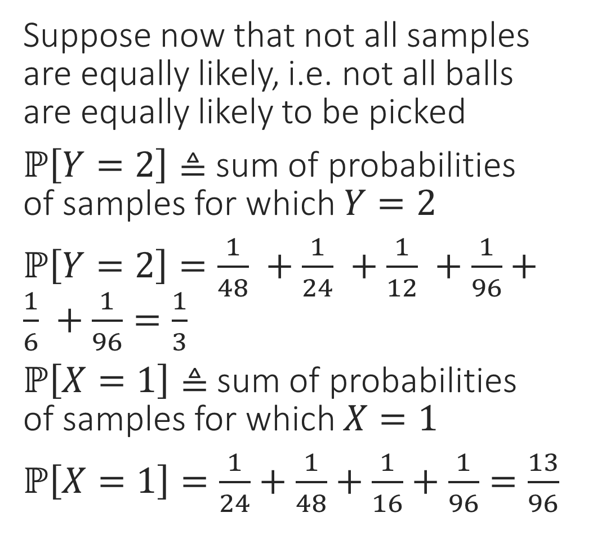









Probability beyond Proportions
Suppose now that not all samples
are equally likely, i.e. not all balls
are equally likely to be picked
$ℙ\left[Y=2\right]≜$ sum of probabilities
of samples for which $Y=2$
$ℙ\left[Y=2\right]=\frac{1}{48} +\frac{1}{24} +\frac{1}{12} +\frac{1}{96}+\frac{1}{6} +\frac{1}{96}=\frac{1}{3}$
$ℙ\left[X=1\right]≜$ sum of probabilities
of samples for which $X=1$
$ℙ\left[X=1\right]=\frac{1}{24}+\frac{1}{48}+\frac{1}{16}+\frac{1}{96}=\frac{13}{96}$
1
2
3
4
5
6
$$\frac{1}{24}$$
$$\frac{1}{24}$$
$$\frac{1}{96}$$
$$\frac{1}{24}$$
$$\frac{1}{6}$$
$$\frac{1}{96}$$
1
2
3
4
5
6
$$\frac{1}{48}$$
$$\frac{1}{24}$$
$$\frac{1}{12}$$
$$\frac{1}{96}$$
$$\frac{1}{48}$$
$$\frac{1}{24}$$
1
2
3
4
5
6
$$\frac{1}{16}$$
$$\frac{1}{24}$$
$$\frac{1}{48}$$
$$\frac{1}{96}$$
$$\frac{1}{12}$$
$$\frac{1}{96}$$
1
2
3
4
5
6
$$\frac{1}{96}$$
$$\frac{1}{24}$$
$$\frac{1}{24}$$
$$\frac{1}{48}$$
$$\frac{1}{24}$$
$$\frac{1}{12}$$

Slide 12
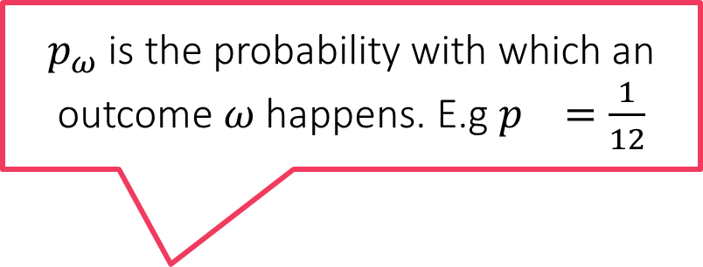
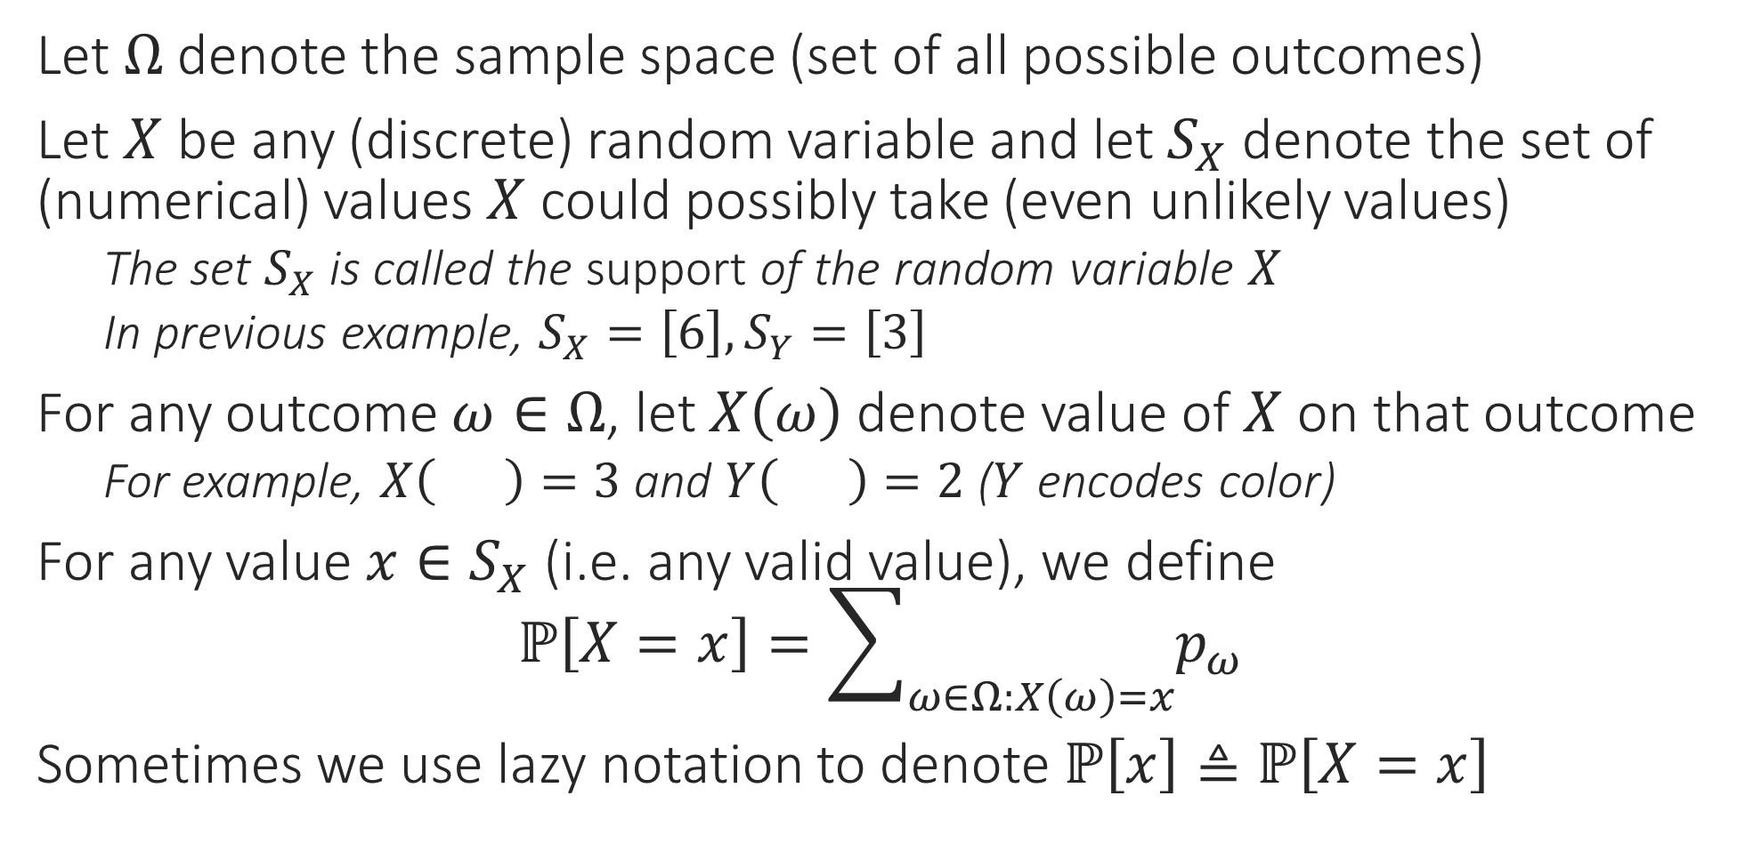
Rules of Probability
Let $Ω$ denote the sample space (set of all possible outcomes)
Let $X$ be any (discrete) random variable and let $S_{X}$ denote the set of (numerical) values $X$ could possibly take (even unlikely values)
    The set $S_{X}$ is called the support of the random variable $X$
    In previous example, $S_{X}=\left[6\right],S_{Y}=\left[3\right]$
For any outcome $ω∈Ω$, let $X\left(ω\right)$ denote value of $X$ on that outcome
    For example, $X\left( \right)=3$ and $Y\left( \right)=2$ ($Y$ encodes color)
For any value $x∈S_{X}$ (i.e. any valid value), we define
$ℙ\left[X=x\right]=\sum_{ω∈Ω:X\left(ω\right)=x}{p_{ω}}$
Sometimes we use lazy notation to denote $ℙ\left[x\right]≜ℙ\left[X=x\right]$
$p_{ω}$ is the probability with which an outcome $ω$ happens. E.g $p =\frac{1}{12}$
3
3
3

Slide 13
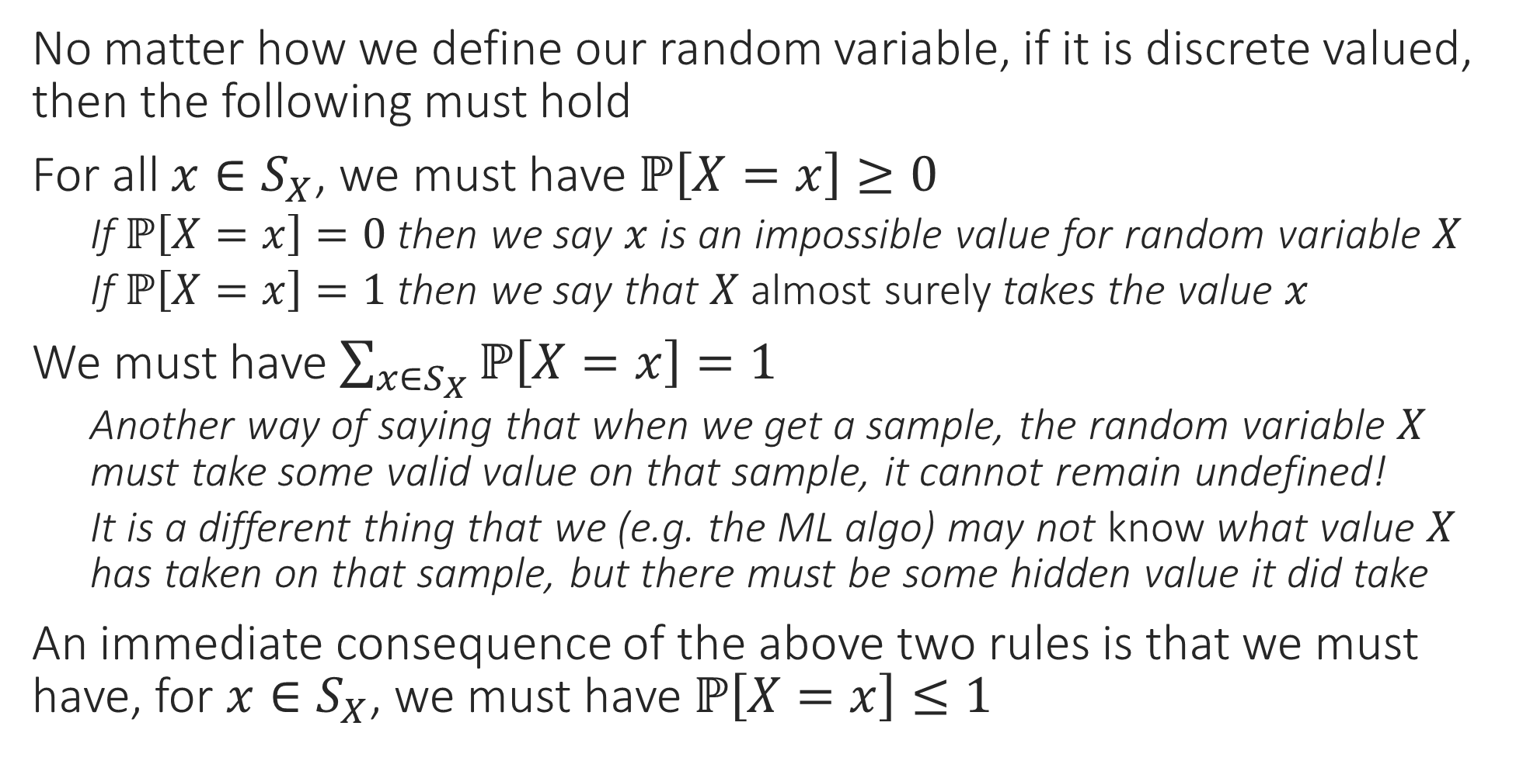
Rules of Probability
No matter how we define our random variable, if it is discrete valued, then the following must hold
For all $x∈S_{X}$, we must have $ℙ\left[X=x\right]≥0$
    If $ℙ\left[X=x\right]=0$ then we say $x$ is an impossible value for random variable $X$
    If $ℙ\left[X=x\right]=1$ then we say that $X$ almost surely takes the value $x$
We must have $\sum_{x∈S_{X}}{ℙ\left[X=x\right]}=1$
    Another way of saying that when we get a sample, the random variable $X$ must take some valid value on that sample, it cannot remain undefined!
    It is a different thing that we (e.g. the ML algo) may not know what value $X$ has taken on that sample, but there must be some hidden value it did take
An immediate consequence of the above two rules is that we must have, for $x∈S_{X}$, we must have $ℙ\left[X=x\right]≤1$

Slide 14


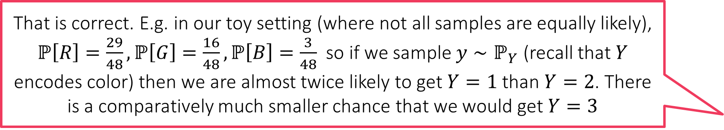
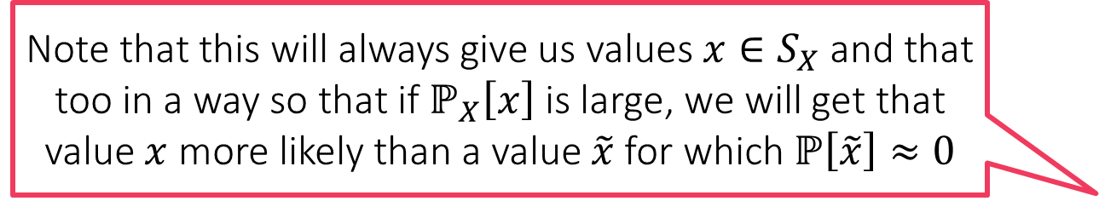
Probability Mass Function (PMF)
Note that this will always give us values $x∈S_{X}$ and that too in a way so that if $ℙ_{X}\left[x\right]$ is large, we will get that value $x$ more likely than a value $\tilde{x}$ for which $ℙ\left[\tilde{x}\right]≈0$
A fancy name for a function that tells us the probability of the random variable taking any particular value
For a discrete random variable $X$, its PMF $f\left(⋅\right)$ tells us, for any $x∈S_{X}$, what is the probability of $X$ taking the value $x$ i.e. $f\left(x\right)=ℙ\left[X=x\right]$
Warning: papers/books often use lazy or confusing notation – take care
    Often the blackboard letter P i.e. $ℙ$ used to denote PMF i.e. $ℙ\left[x\right]≜ℙ\left[X=x\right]$
    Sometimes may write $ℙ_{X}\left[⋅\right]$ to emphasize that this PMF for $X$ and not some $Y$
    Sometimes, $ℙ\left[X\right]$ is also used to refer to the PMF of the random variable $X$
Sampling from a PMF: $x∼ℙ\left[X\right]$ or $x∼ℙ_{X}$ or even $X∼ℙ\left[X\right]$ means that we generated an outcome $ω∈Ω$ , e.g. according to the probability distribution and are looking at $X\left(ω\right)$
That is correct. E.g. in our toy setting (where not all samples are equally likely), $ℙ\left[R\right]=\frac{29}{48},ℙ\left[G\right]=\frac{16}{48},ℙ\left[B\right]=\frac{3}{48}$ so if we sample $y∼ℙ_{Y}$ (recall that $Y$ encodes color) then we are almost twice likely to get $Y=1$ than $Y=2$. There is a comparatively much smaller chance that we would get $Y=3$
3

Slide 15

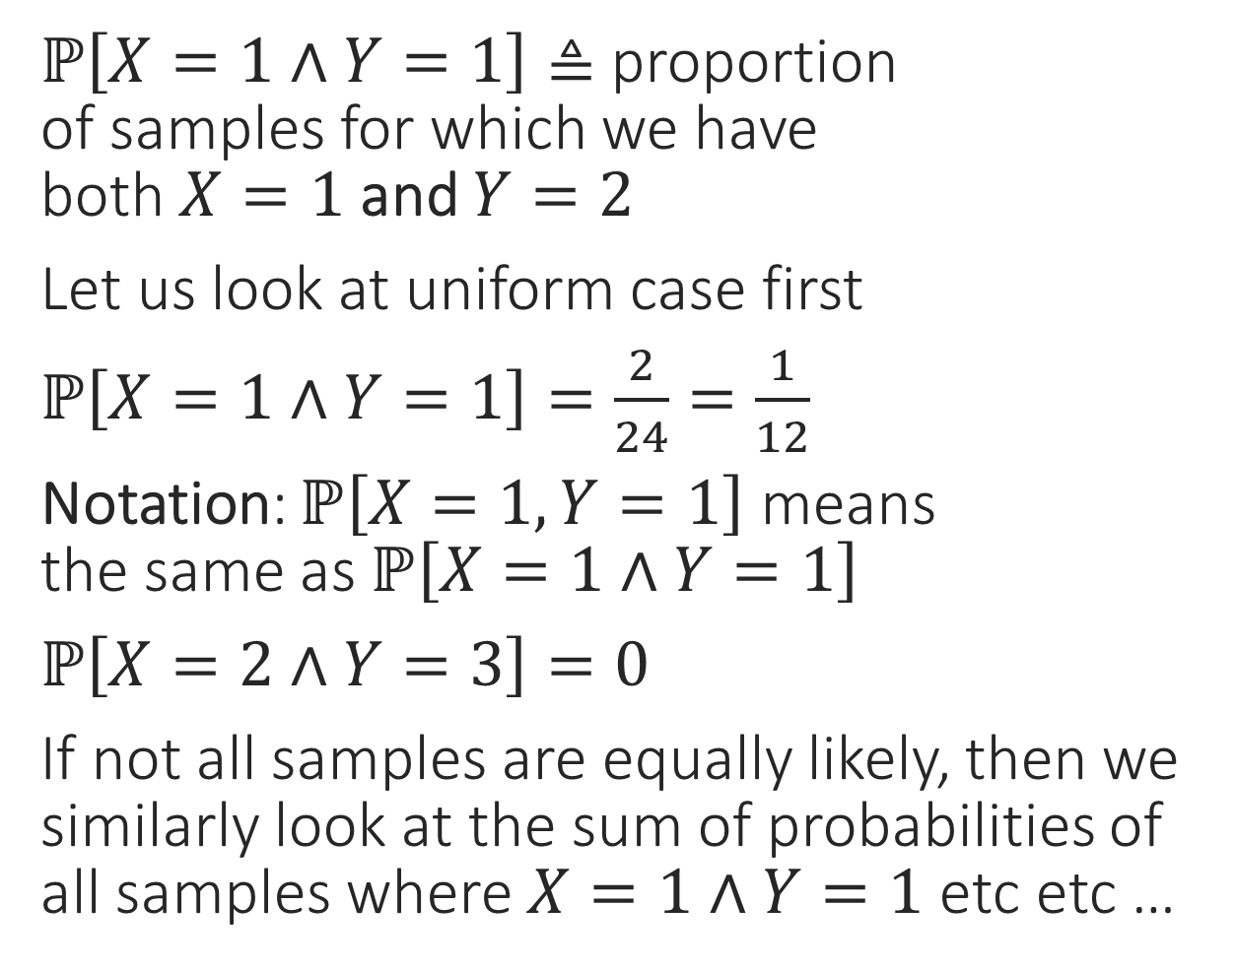
Joint Probability
$ℙ\left[X=1∧Y=1\right]≜$ proportion
of samples for which we have
both $X=1$ and $Y=2$
Let us look at uniform case first
$ℙ\left[X=1∧Y=1\right]=\frac{2}{24}=\frac{1}{12}$
Notation: $ℙ\left[X=1,Y=1\right]$ means
the same as $ℙ\left[X=1∧Y=1\right]$
$ℙ\left[X=2∧Y=3\right]=0$
If not all samples are equally likely, then we similarly look at the sum of probabilities of all samples where $X=1∧Y=1$ etc etc …
1
2
3
4
5
6
$$\frac{1}{24}$$
$$\frac{1}{24}$$
$$\frac{1}{96}$$
$$\frac{1}{24}$$
$$\frac{1}{6}$$
$$\frac{1}{96}$$
1
2
3
4
5
6
$$\frac{1}{48}$$
$$\frac{1}{24}$$
$$\frac{1}{12}$$
$$\frac{1}{96}$$
$$\frac{1}{48}$$
$$\frac{1}{24}$$
$$\frac{1}{24}+\frac{1}{16}=\frac{5}{48}$$
1
2
3
4
5
6
$$\frac{1}{16}$$
$$\frac{1}{24}$$
$$\frac{1}{48}$$
$$\frac{1}{96}$$
$$\frac{1}{12}$$
$$\frac{1}{96}$$
1
2
3
4
5
6
Still zero ☺
$$\frac{1}{96}$$
$$\frac{1}{24}$$
$$\frac{1}{24}$$
$$\frac{1}{48}$$
$$\frac{1}{24}$$
$$\frac{1}{12}$$

Slide 16
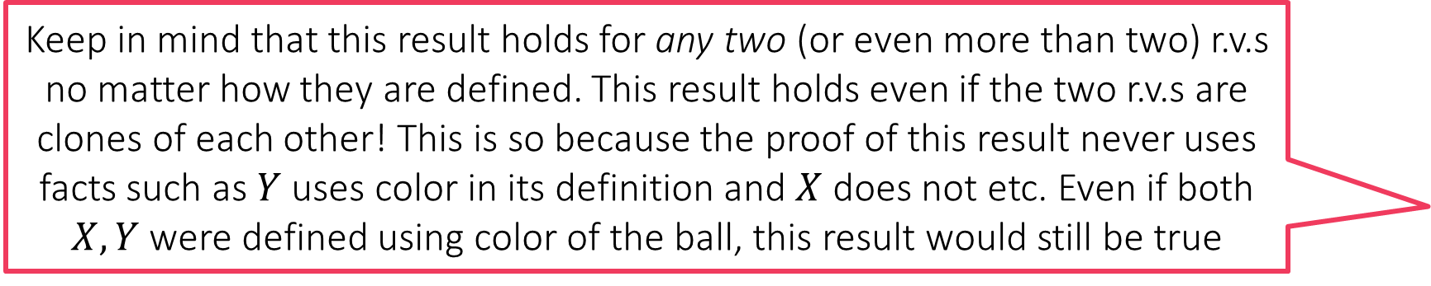

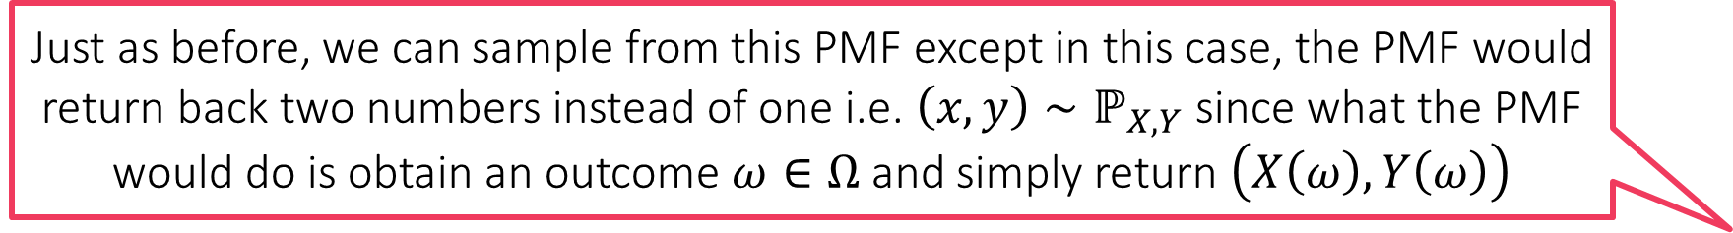
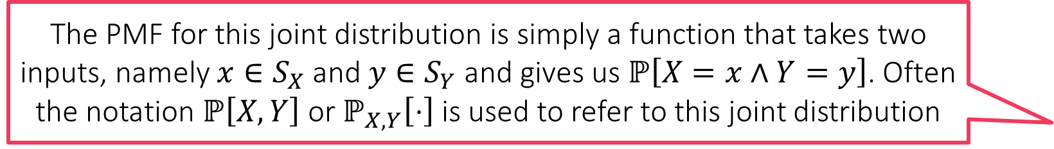
A PMF for the Joint Distribution?
Keep in mind that this result holds for any two (or even more than two) r.v.s no matter how they are defined. This result holds even if the two r.v.s are clones of each other! This is so because the proof of this result never uses facts such as $Y$ uses color in its definition and $X$ does not etc. Even if both $X,Y$ were defined using color of the ball, this result would still be true
The joint probabilities also form a valid distribution
    For any $x∈S_{X},y∈S_{Y}$, we have $ℙ\left[X=x,Y=y\right]≜ℙ\left[X=x∧Y=y\right]≥0$
    The sum of probabilities over all values of $x,y$ add up to $1$ too
    Proof: Recall that we defined $ℙ\left[X=x\right]=\sum_{ω∈Ω:X\left(ω\right)=x}{p_{ω}}$ where $p_{ω}$ is the probability with which an outcome $ω$ happens. Thus, we are interested in all samples where $X\left(ω\right)=x$. Another way of saying this is that we are interested in all samples where $X\left(ω\right)=x$ but we do not care what value $Y\left(ω\right)$ takes i.e.
    $\left\{ω∈Ω:X\left(ω\right)=x\right\}=\bigcup_{y∈S_{Y}}{\left\{ω∈Ω:X\left(ω\right)=x∧Y\left(ω\right)=y\right\}}$
    Thus, we have $\sum_{ω∈Ω:X\left(ω\right)=x}{p_{ω}}=\sum_{y∈S_{Y}}{\sum_{ω∈Ω:X\left(ω\right)=x∧Y\left(ω\right)=y}{p_{ω}}}$
    Thus, we have $ℙ\left[X=x\right]=\sum_{y∈S_{Y}}{ℙ\left[X=x,Y=y\right]}$
    However, since $\sum_{x∈S_{X}}{ℙ\left[X=x\right]}=1$, we conclude that we must also have
    $\sum_{x∈S_{X}}{\sum_{y∈S_{Y}}{ℙ\left[X=x,Y=y\right]}}=1$
The PMF for this joint distribution is simply a function that takes two inputs, namely $x∈S_{X}$ and $y∈S_{Y}$ and gives us $ℙ\left[X=x∧Y=y\right]$. Often the notation $ℙ\left[X,Y\right]$ or $ℙ_{X,Y}\left[⋅\right]$ is used to refer to this joint distribution
Just as before, we can sample from this PMF except in this case, the PMF would return back two numbers instead of one i.e. $\left(x,y\right)∼ℙ_{X,Y}$ since what the PMF would do is obtain an outcome $ω∈Ω$ and simply return $\left(X\left(ω\right),Y\left(ω\right)\right)$

Slide 17
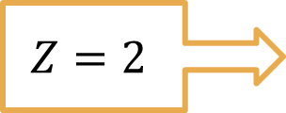
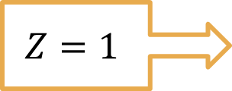
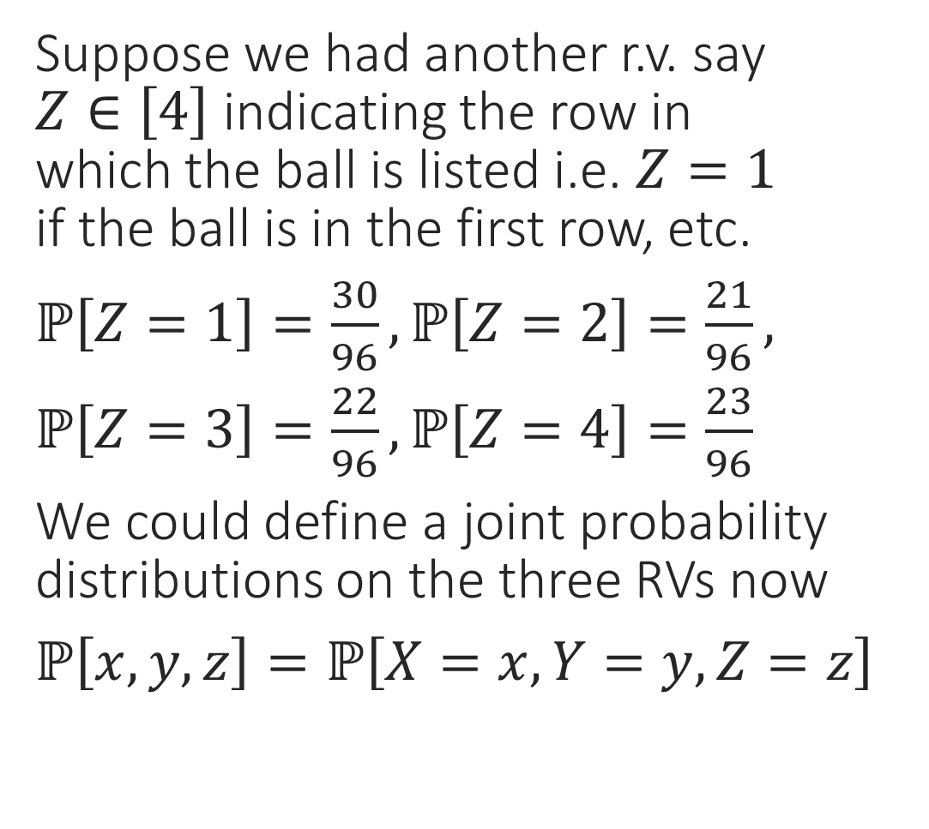

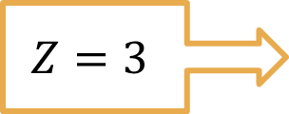
Joint Distributions on more R.V.s
Suppose we had another r.v. say
$Z∈\left[4\right]$ indicating the row in
which the ball is listed i.e. $Z=1$
if the ball is in the first row, etc.
$ℙ\left[Z=1\right]=\frac{30}{96},ℙ\left[Z=2\right]=\frac{21}{96},$
$ℙ\left[Z=3\right]=\frac{22}{96},ℙ\left[Z=4\right]=\frac{23}{96}$
We could define a joint probability distributions on the three RVs now
$ℙ\left[x,y,z\right]=ℙ\left[X=x,Y=y,Z=z\right]$
$$Z=1$$
1
2
3
4
5
6
$$\frac{1}{24}$$
$$\frac{1}{24}$$
$$\frac{1}{96}$$
$$\frac{1}{24}$$
$$\frac{1}{6}$$
$$\frac{1}{96}$$
$$Z=2$$
1
2
3
4
5
6
$$\frac{1}{48}$$
$$\frac{1}{24}$$
$$\frac{1}{12}$$
$$\frac{1}{96}$$
$$\frac{1}{48}$$
$$\frac{1}{24}$$
$$Z=3$$
1
2
3
4
5
6
$$\frac{1}{16}$$
$$\frac{1}{24}$$
$$\frac{1}{48}$$
$$\frac{1}{96}$$
$$\frac{1}{12}$$
$$\frac{1}{96}$$
$$Z=4$$
1
2
3
4
5
6
$$\frac{1}{96}$$
$$\frac{1}{24}$$
$$\frac{1}{24}$$
$$\frac{1}{48}$$
$$\frac{1}{24}$$
$$\frac{1}{12}$$

Slide 18
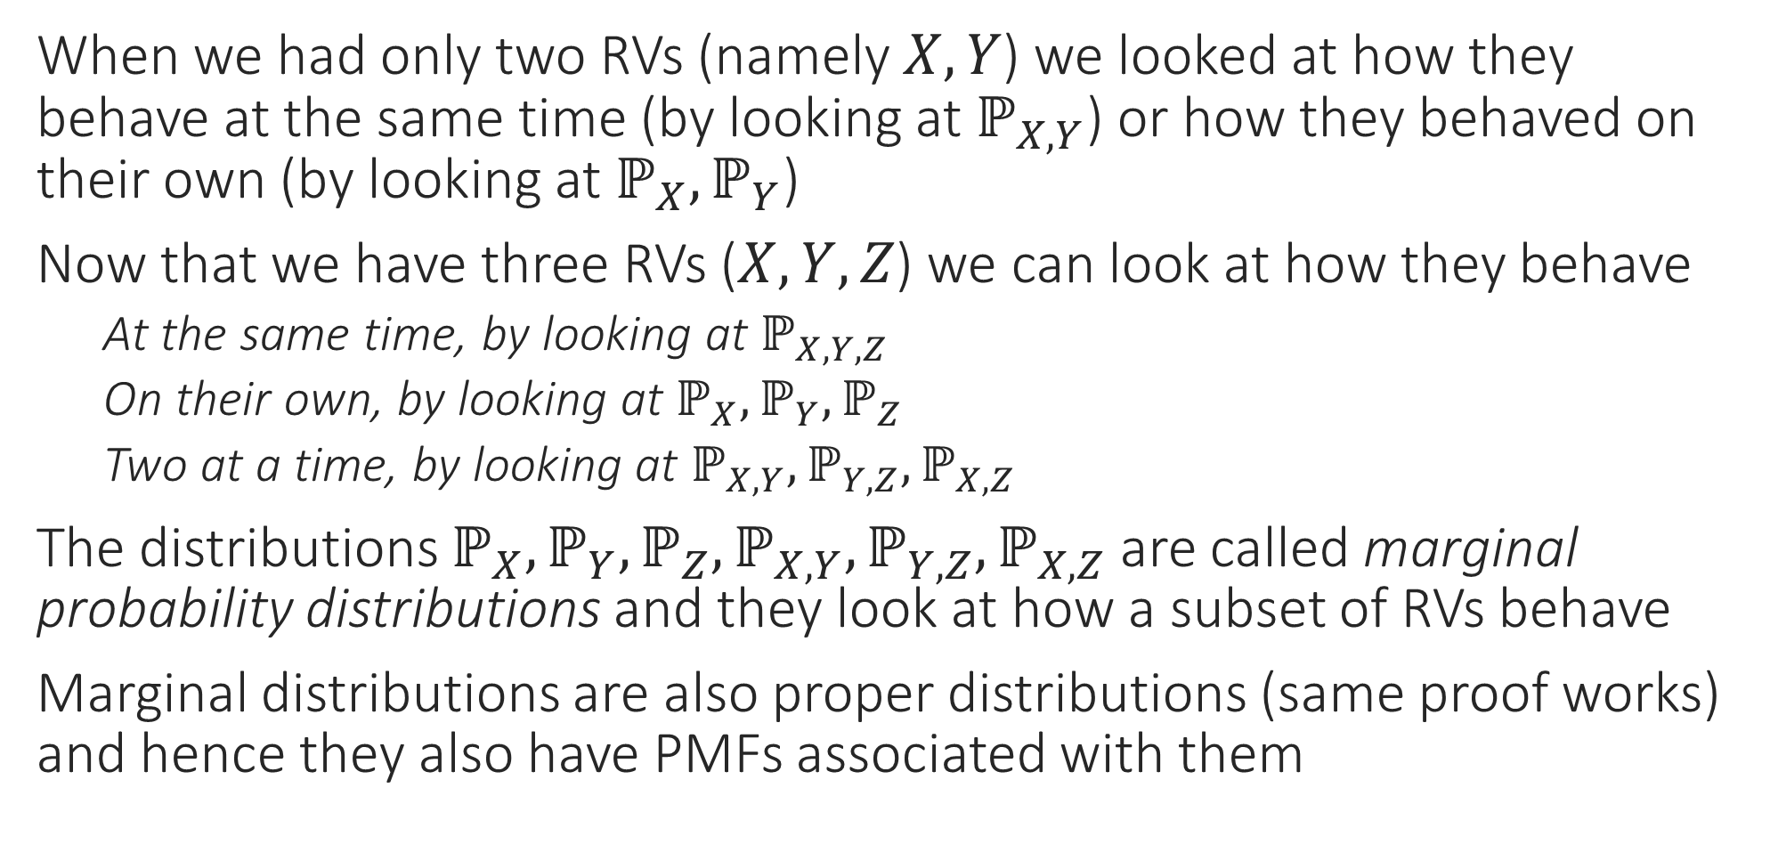
Marginal Probability
When we had only two RVs (namely $X,Y$) we looked at how they behave at the same time (by looking at $ℙ_{X,Y}$) or how they behaved on their own (by looking at $ℙ_{X},ℙ_{Y}$)
Now that we have three RVs ($X,Y,Z$) we can look at how they behave
    At the same time, by looking at $ℙ_{X,Y,Z}$
    On their own, by looking at $ℙ_{X},ℙ_{Y},ℙ_{Z}$
    Two at a time, by looking at $ℙ_{X,Y},ℙ_{Y,Z},ℙ_{X,Z}$
The distributions $ℙ_{X},ℙ_{Y},ℙ_{Z},ℙ_{X,Y},ℙ_{Y,Z},ℙ_{X,Z}$ are called marginal probability distributions and they look at how a subset of RVs behave
Marginal distributions are also proper distributions (same proof works) and hence they also have PMFs associated with them

Slide 19
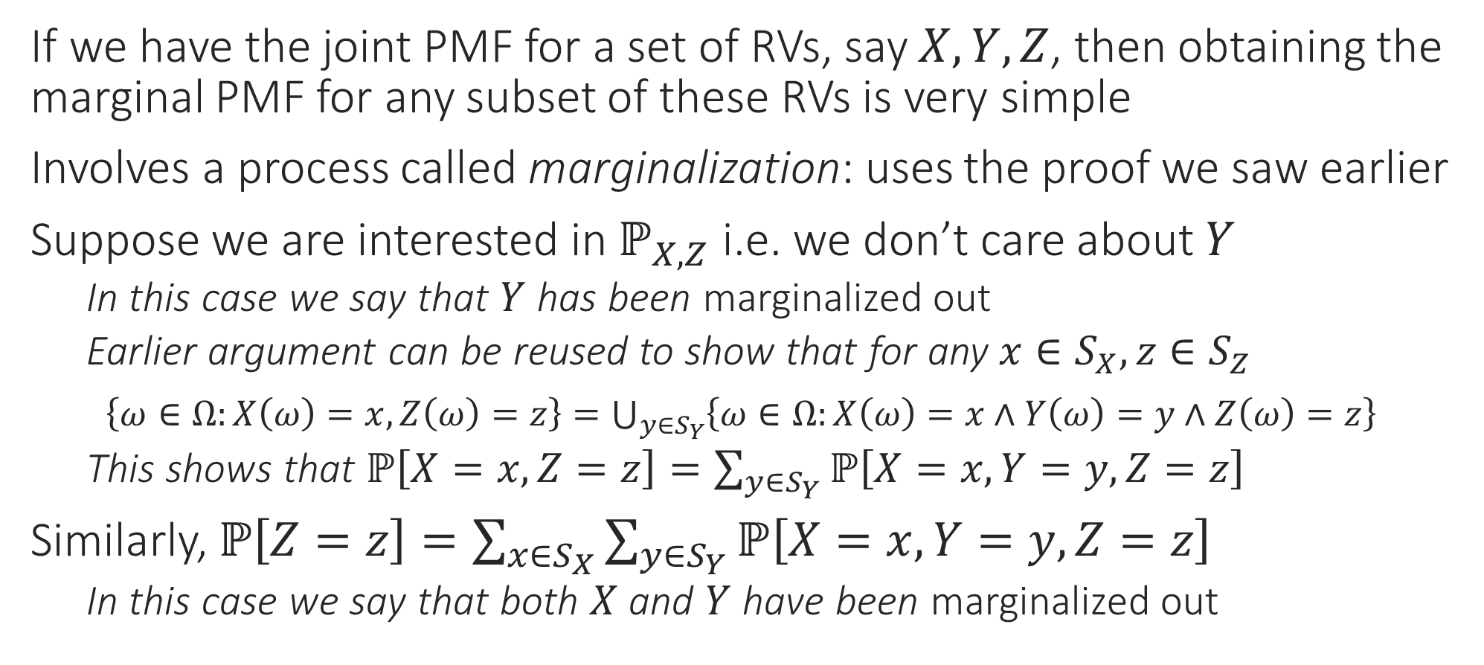
Obtaining Marginal PMF from Joint PMF
If we have the joint PMF for a set of RVs, say $X,Y,Z$, then obtaining the marginal PMF for any subset of these RVs is very simple
Involves a process called marginalization: uses the proof we saw earlier
Suppose we are interested in $ℙ_{X,Z}$ i.e. we don’t care about $Y$
    In this case we say that $Y$ has been marginalized out
    Earlier argument can be reused to show that for any $x∈S_{X},z∈S_{Z}$
$\left\{ω∈Ω:X\left(ω\right)=x,Z\left(ω\right)=z\right\}=\bigcup_{y∈S_{Y}}{\left\{ω∈Ω:X\left(ω\right)=x∧Y\left(ω\right)=y∧Z\left(ω\right)=z\right\}}$
    This shows that $ℙ\left[X=x,Z=z\right]=\sum_{y∈S_{Y}}{ℙ\left[X=x,Y=y,Z=z\right]}$
Similarly, $ℙ\left[Z=z\right]=\sum_{x∈S_{X}}{\sum_{y∈S_{Y}}{ℙ\left[X=x,Y=y,Z=z\right]}}$
    In this case we say that both $X$ and $Y$ have been marginalized out

Slide 20
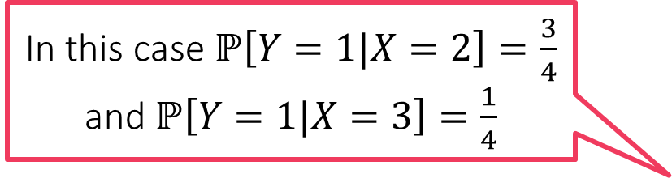
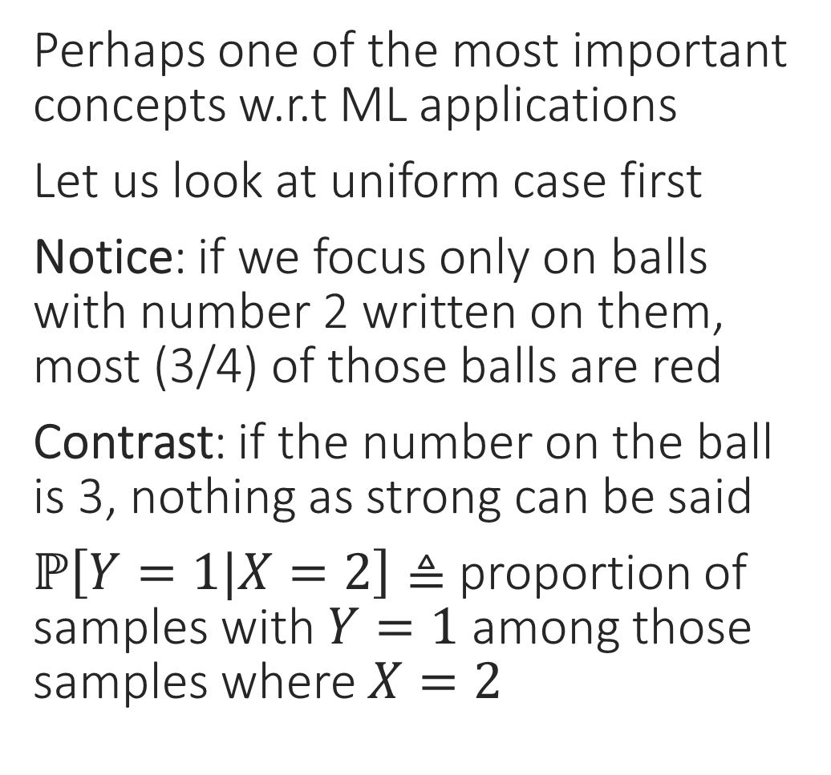
Conditional Probability
Perhaps one of the most important concepts w.r.t ML applications
Let us look at uniform case first
Notice: if we focus only on balls with number 2 written on them, most (3/4) of those balls are red
Contrast: if the number on the ball is 3, nothing as strong can be said
$ℙ\left[Y=1|X=2\right]≜$ proportion of samples with $Y=1$ among those samples where $X=2$
1
2
3
4
5
6
1
2
3
4
5
6
1
2
3
4
5
6
1
2
3
4
5
6
In this case $ℙ\left[Y=1|X=2\right]=\frac{3}{4}$ and $ℙ\left[Y=1|X=3\right]=\frac{1}{4}$

Slide 21

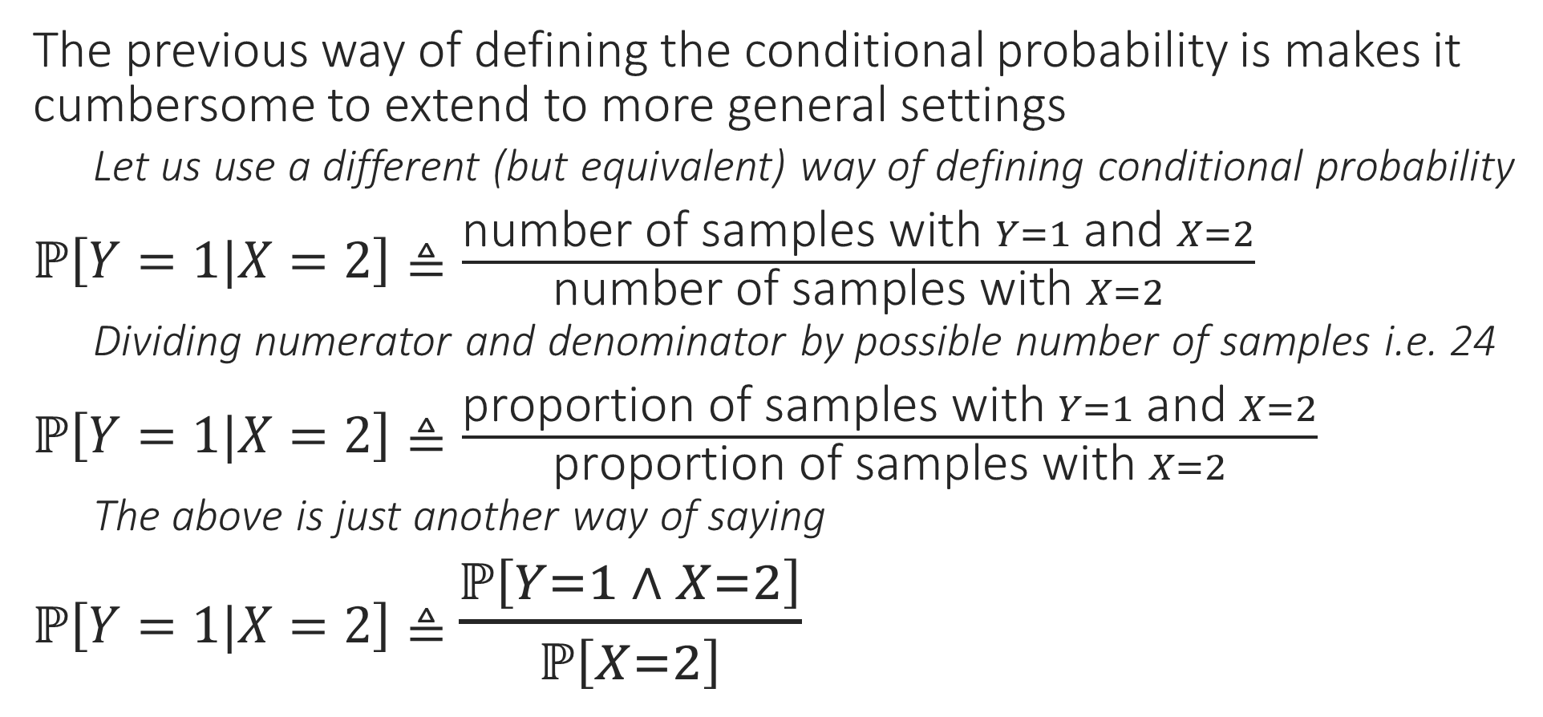

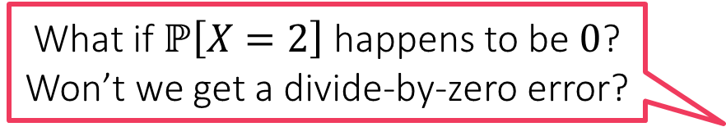
Conditional Probability
What if $ℙ\left[X=2\right]$ happens to be $0$?
Won’t we get a divide-by-zero error?
The previous way of defining the conditional probability is makes it cumbersome to extend to more general settings
    Let us use a different (but equivalent) way of defining conditional probability
$ℙ\left[Y=1|X=2\right]≜\frac{\text{number} \text{of} \text{samples} \text{with} Y=1 \text{and} X=2}{\text{number} \text{of} \text{samples} \text{with} X=2}$
    Dividing numerator and denominator by possible number of samples i.e. 24
$ℙ\left[Y=1|X=2\right]≜\frac{\text{proportion} \text{of} \text{samples} \text{with} Y=1 \text{and} X=2}{\text{proportion} \text{of} \text{samples} \text{with} X=2}$
    The above is just another way of saying
$ℙ\left[Y=1|X=2\right]≜$ $\frac{ℙ\left[Y=1 ∧ X=2\right]}{ℙ\left[X=2\right]}$
Yes, although there are ways to get around this, for this course, we will avoid such cases or else, if convenient, define $\frac{0}{0}=0$

Slide 22
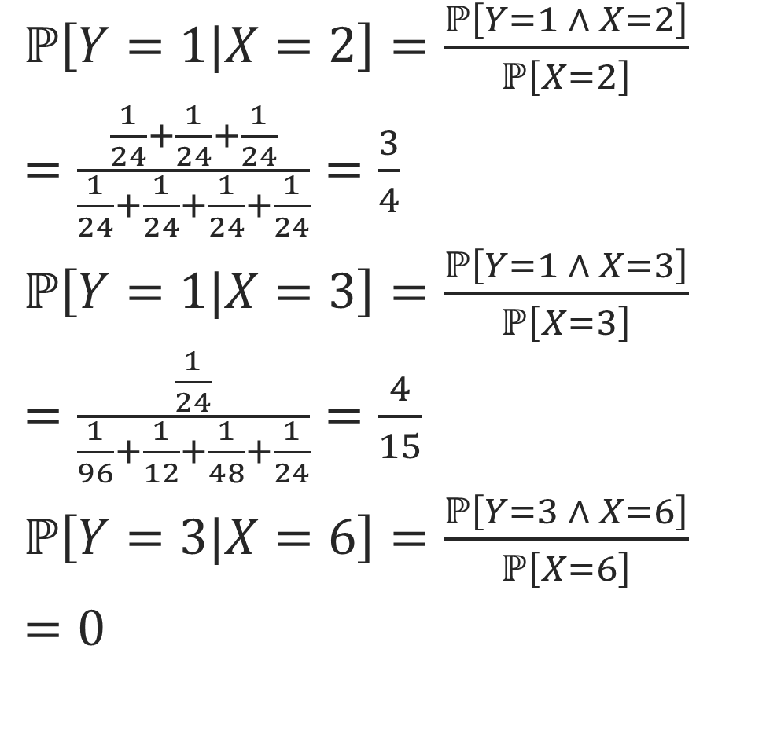
Conditional Probability
$ℙ\left[Y=1|X=2\right]=\frac{ℙ\left[Y=1 ∧ X=2\right]}{ℙ\left[X=2\right]}$
$=\frac{\frac{1}{24}+\frac{1}{24}+\frac{1}{24}}{\frac{1}{24}+\frac{1}{24}+\frac{1}{24}+\frac{1}{24}}=\frac{3}{4}$
$ℙ\left[Y=1|X=3\right]=\frac{ℙ\left[Y=1 ∧ X=3\right]}{ℙ\left[X=3\right]}$
$=\frac{\frac{1}{24}}{\frac{1}{96}+\frac{1}{12}+\frac{1}{48}+\frac{1}{24}}=\frac{4}{15}$
$ℙ\left[Y=3|X=6\right]=\frac{ℙ\left[Y=3 ∧ X=6\right]}{ℙ\left[X=6\right]}$
$=0$
1
2
3
4
5
6
$$\frac{1}{24}$$
$$\frac{1}{24}$$
$$\frac{1}{96}$$
$$\frac{1}{24}$$
$$\frac{1}{6}$$
$$\frac{1}{96}$$
1
2
3
4
5
6
$$\frac{1}{48}$$
$$\frac{1}{24}$$
$$\frac{1}{12}$$
$$\frac{1}{96}$$
$$\frac{1}{48}$$
$$\frac{1}{24}$$
1
2
3
4
5
6
$$\frac{1}{16}$$
$$\frac{1}{24}$$
$$\frac{1}{48}$$
$$\frac{1}{96}$$
$$\frac{1}{12}$$
$$\frac{1}{96}$$
1
2
3
4
5
6
$$\frac{1}{96}$$
$$\frac{1}{24}$$
$$\frac{1}{24}$$
$$\frac{1}{48}$$
$$\frac{1}{24}$$
$$\frac{1}{12}$$

Slide 23
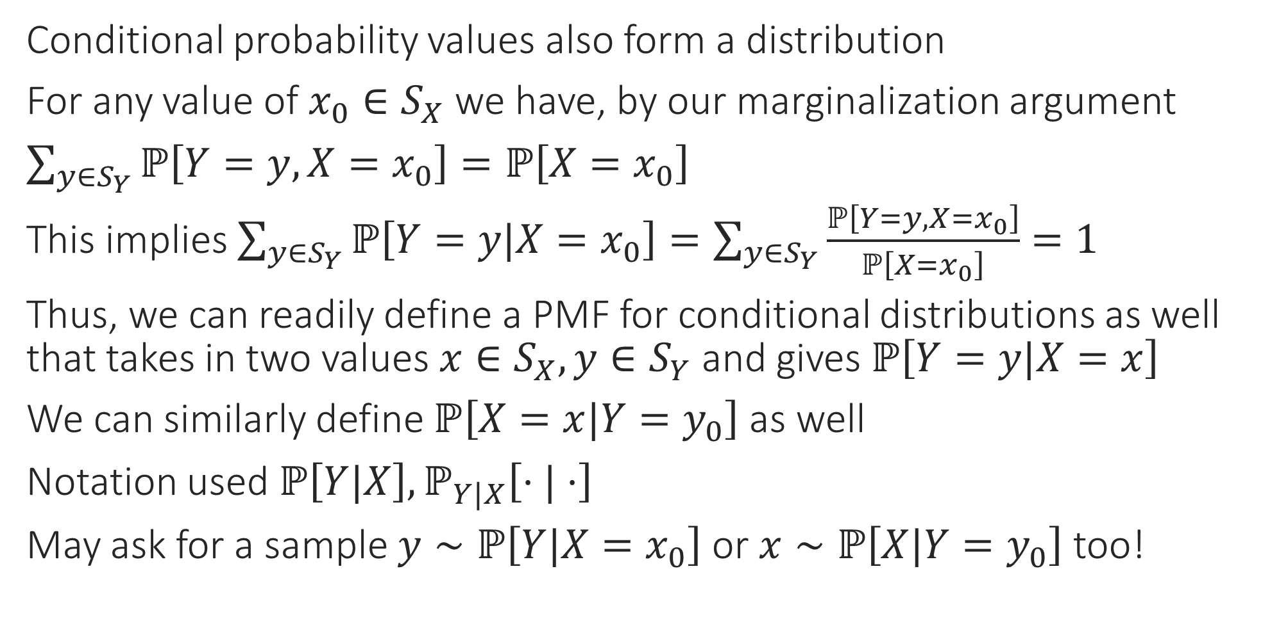
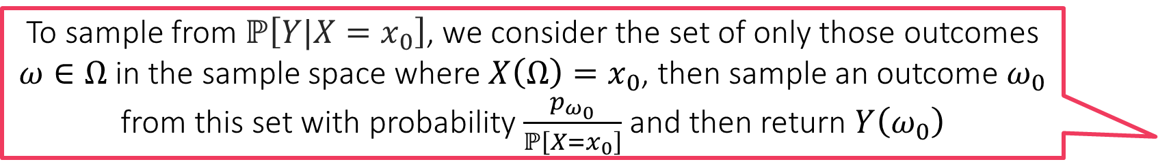
A PMF for the Conditional Distribution?
To sample from $ℙ\left[Y|X=x_{0}\right]$, we consider the set of only those outcomes $ω∈Ω$ in the sample space where $X\left(Ω\right)=x_{0}$, then sample an outcome $ω_{0}$ from this set with probability $\frac{p_{ω_{0}}}{ℙ\left[X=x_{0}\right]}$ and then return $Y\left(ω_{0}\right)$
Conditional probability values also form a distribution
For any value of $x_{0}∈S_{X}$ we have, by our marginalization argument
$\sum_{y∈S_{Y}}{ℙ\left[Y=y,X=x_{0}\right]}=ℙ\left[X=x_{0}\right]$
This implies $\sum_{y∈S_{Y}}{ℙ\left[Y=y|X=x_{0}\right]}=\sum_{y∈S_{Y}}{\frac{ℙ\left[Y=y,X=x_{0}\right]}{ℙ\left[X=x_{0}\right]}}=1$
Thus, we can readily define a PMF for conditional distributions as well that takes in two values $x∈S_{X},y∈S_{Y}$ and gives $ℙ\left[Y=y|X=x\right]$
We can similarly define $ℙ\left[X=x|Y=y_{0}\right]$ as well
Notation used $ℙ\left[Y|X\right],ℙ_{Y|X}\left[⋅|⋅\right]$
May ask for a sample $y∼ℙ\left[Y|X=x_{0}\right]$ or $x∼ℙ\left[X|Y=y_{0}\right]$ too!

Slide 24
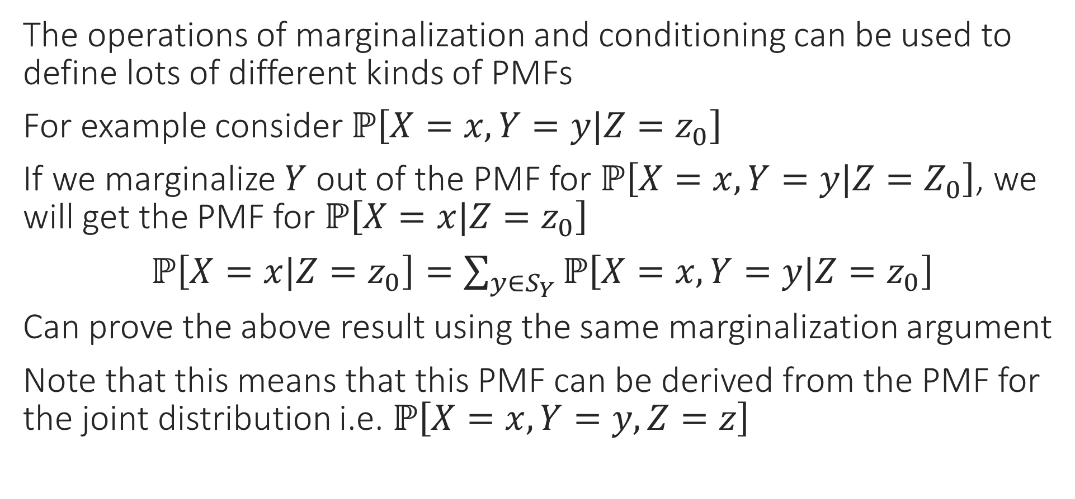
Marginal Conditional Probability????
The operations of marginalization and conditioning can be used to define lots of different kinds of PMFs
For example consider $ℙ\left[X=x,Y=y|Z=z_{0}\right]$
If we marginalize $Y$ out of the PMF for $ℙ\left[X=x,Y=y|Z=Z_{0}\right]$, we will get the PMF for $ℙ\left[X=x|Z=z_{0}\right]$
$ℙ\left[X=x|Z=z_{0}\right]=\sum_{y∈S_{Y}}{ℙ\left[X=x,Y=y|Z=z_{0}\right]}$
Can prove the above result using the same marginalization argument
Note that this means that this PMF can be derived from the PMF for the joint distribution i.e. $ℙ\left[X=x,Y=y,Z=z\right]$

Slide 25
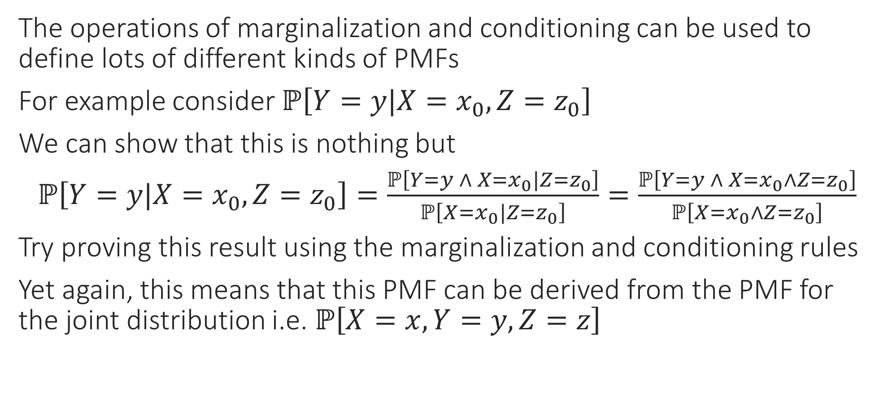
Marginal Conditional Probability????
The operations of marginalization and conditioning can be used to define lots of different kinds of PMFs
For example consider $ℙ\left[Y=y|X=x_{0},Z=z_{0}\right]$
We can show that this is nothing but
$ℙ\left[Y=y|X=x_{0},Z=z_{0}\right]=\frac{ℙ\left[Y=y ∧ X=x_{0}|Z=z_{0}\right]}{ℙ\left[X=x_{0}|Z=z_{0}\right]}=\frac{ℙ\left[Y=y ∧ X=x_{0}∧Z=z_{0}\right]}{ℙ\left[X=x_{0}∧Z=z_{0}\right]}$
Try proving this result using the marginalization and conditioning rules
Yet again, this means that this PMF can be derived from the PMF for the joint distribution i.e. $ℙ\left[X=x,Y=y,Z=z\right]$

Slide 26
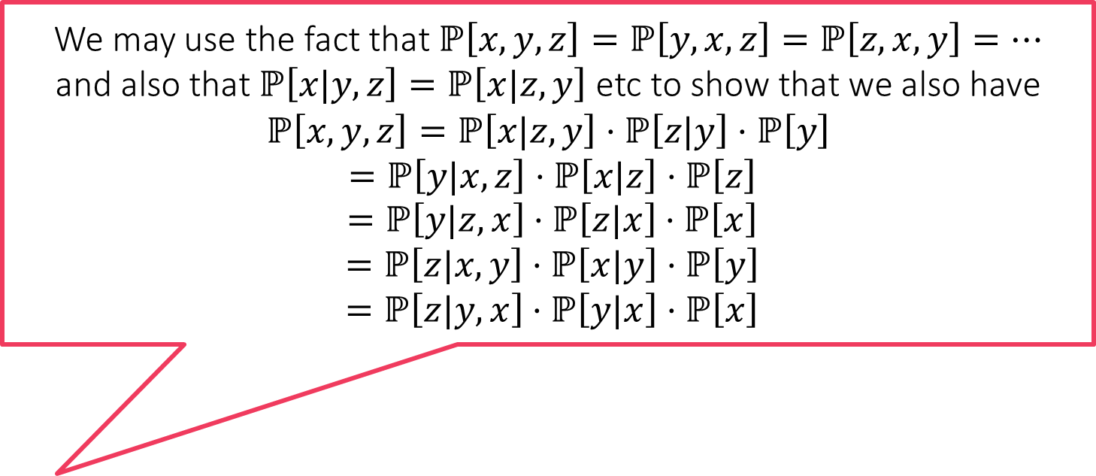

Rules of Probability
Sum Rule (Marginalization Rule) – aka Law of Total Probability
$ℙ\left[x\right]=\sum_{y∈S_{Y}}{ℙ\left[x,y\right]}$
or more explicitly, $ℙ\left[X=x\right]=\sum_{y∈S_{Y}}{ℙ\left[X=x∧Y=y\right]}$
Product Rule (Conditioning Rule)
$ℙ\left[x,y\right]=ℙ\left[x|y\right]⋅ℙ\left[y\right]$
Combine to get $ℙ\left[x\right]=\sum_{y∈S_{Y}}{ℙ\left[x,y\right]}=\sum_{y∈S_{Y}}{ℙ\left[x|y\right]⋅ℙ\left[y\right]}$
or more explicitly, $ℙ\left[X=x,Y=y\right]=ℙ\left[X=x|Y=y\right]⋅ℙ\left[Y=y\right]$
Chain rule (Iterated Conditioning Rule)
$ℙ\left[x,y,z\right]=ℙ\left[x|y,z\right]⋅ℙ\left[y|z\right]⋅ℙ\left[z\right]$
We may use the fact that $ℙ\left[x,y,z\right]=ℙ\left[y,x,z\right]=ℙ\left[z,x,y\right]=…$
and also that $ℙ\left[x|y,z\right]=ℙ\left[x|z,y\right]$ etc to show that we also have
$$ℙ\left[x,y,z\right]=ℙ\left[x|z,y\right]⋅ℙ\left[z|y\right]⋅ℙ\left[y\right]$$
$=ℙ\left[y|x,z\right]⋅ℙ\left[x|z\right]⋅ℙ\left[z\right]$
$=ℙ\left[y|z,x\right]⋅ℙ\left[z|x\right]⋅ℙ\left[x\right]$
$=ℙ\left[z|x,y\right]⋅ℙ\left[x|y\right]⋅ℙ\left[y\right]$
$=ℙ\left[z|y,x\right]⋅ℙ\left[y|x\right]⋅ℙ\left[x\right]$

Slide 27
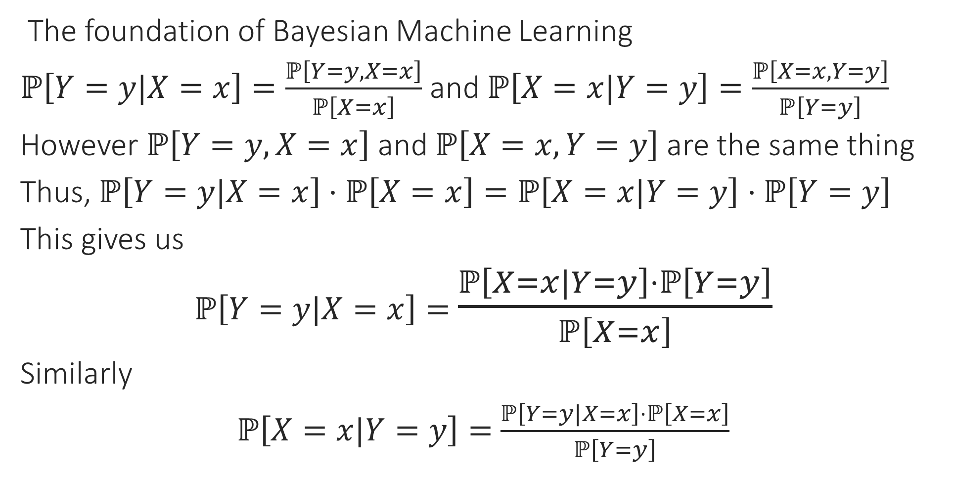
Bayes Theorem
The foundation of Bayesian Machine Learning
$ℙ\left[Y=y|X=x\right]=\frac{ℙ\left[Y=y,X=x\right]}{ℙ\left[X=x\right]}$ and $ℙ\left[X=x|Y=y\right]=\frac{ℙ\left[X=x,Y=y\right]}{ℙ\left[Y=y\right]}$
However $ℙ\left[Y=y,X=x\right]$ and $ℙ\left[X=x,Y=y\right]$ are the same thing
Thus, $ℙ\left[Y=y|X=x\right]⋅ℙ\left[X=x\right]=ℙ\left[X=x|Y=y\right]⋅ℙ\left[Y=y\right]$
This gives us
$ℙ\left[Y=y|X=x\right]=$ $\frac{ℙ\left[X=x|Y=y\right]⋅ℙ\left[Y=y\right]}{ℙ\left[X=x\right]}$
Similarly
$ℙ\left[X=x|Y=y\right]=$ $\frac{ℙ\left[Y=y|X=x\right]⋅ℙ\left[X=x\right]}{ℙ\left[Y=y\right]}$

Slide 28
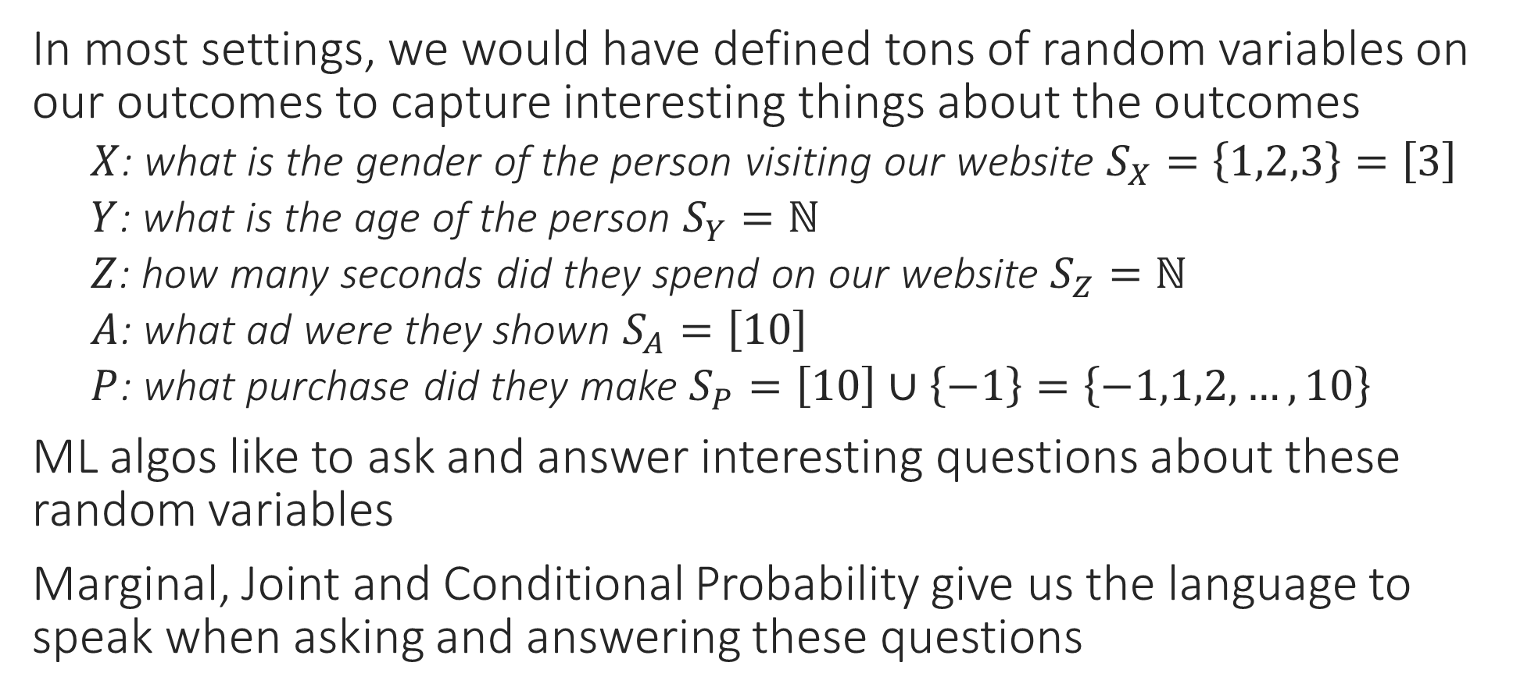
Marginal, Joint and Conditional Probability
In most settings, we would have defined tons of random variables on our outcomes to capture interesting things about the outcomes
    $X$: what is the gender of the person visiting our website $S_{X}=\left\{1,2,3\right\}=\left[3\right]$
    $Y$: what is the age of the person $S_{Y}=ℕ$
    $Z$: how many seconds did they spend on our website $S_{Z}=ℕ$
    $A$: what ad were they shown $S_{A}=\left[10\right]$
    $P$: what purchase did they make $S_{P}=\left[10\right]∪\left\{−1\right\}=\left\{−1,1,2,…,10\right\}$
ML algos like to ask and answer interesting questions about these random variables
Marginal, Joint and Conditional Probability give us the language to speak when asking and answering these questions

Slide 29
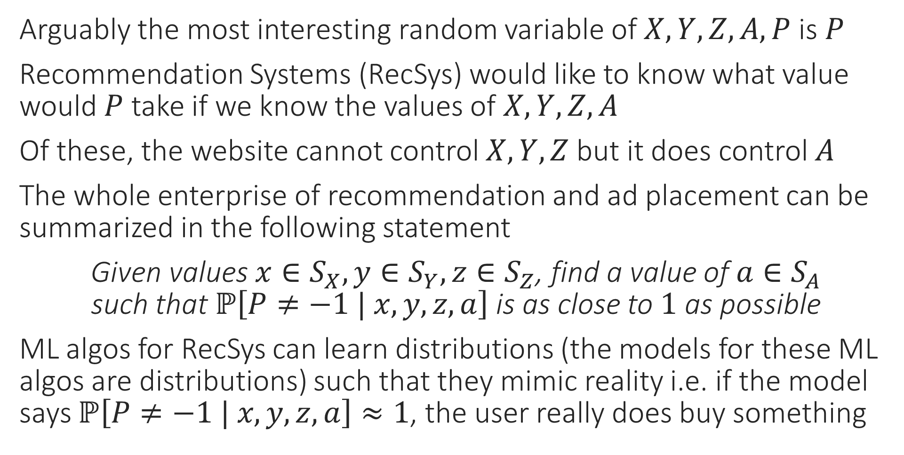
Using Probability to do ML
Arguably the most interesting random variable of $X,Y,Z,A,P$ is $P$
Recommendation Systems (RecSys) would like to know what value would $P$ take if we know the values of $X,Y,Z,A$
Of these, the website cannot control $X,Y,Z$ but it does control $A$
The whole enterprise of recommendation and ad placement can be summarized in the following statement
Given values $x∈S_{X},y∈S_{Y},z∈S_{Z}$, find a value of $a∈S_{A}$
such that $ℙ\left[P≠−1 | x, y, z,a\right]$ is as close to $1$ as possible
ML algos for RecSys can learn distributions (the models for these ML algos are distributions) such that they mimic reality i.e. if the model says $ℙ\left[P≠−1 | x, y, z,a\right]≈1$, the user really does buy something
“
“

Slide 30

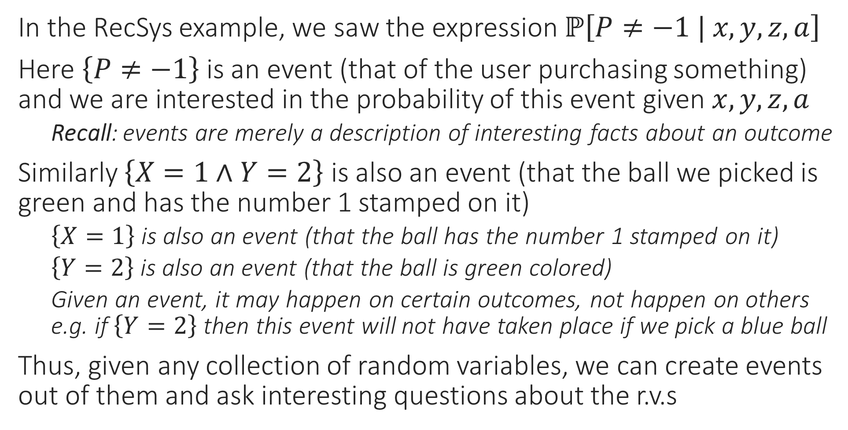
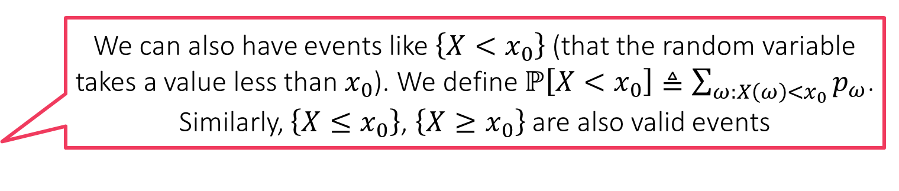
Creating Events from Random Variables??
We can also have events like $\left\{X<x_{0}\right\}$ (that the random variable takes a value less than $x_{0}$). We define $ℙ\left[X<x_{0}\right]≜\sum_{ω:X\left(ω\right)<x_{0}}{p_{ω}}$. Similarly, $\left\{X≤x_{0}\right\}$, $\left\{X≥x_{0}\right\}$ are also valid events
In the RecSys example, we saw the expression $ℙ\left[P≠−1 | x, y, z,a\right]$
Here $\left\{P≠−1\right\}$ is an event (that of the user purchasing something) and we are interested in the probability of this event given $x,y,z,a$
    Recall: events are merely a description of interesting facts about an outcome
Similarly $\left\{X=1∧Y=2\right\}$ is also an event (that the ball we picked is green and has the number 1 stamped on it)
    $\left\{X=1\right\}$ is also an event (that the ball has the number 1 stamped on it)
    $\left\{Y=2\right\}$ is also an event (that the ball is green colored)
    Given an event, it may happen on certain outcomes, not happen on others e.g. if $\left\{Y=2\right\}$ then this event will not have taken place if we pick a blue ball
Thus, given any collection of random variables, we can create events out of them and ask interesting questions about the r.v.s

Slide 31


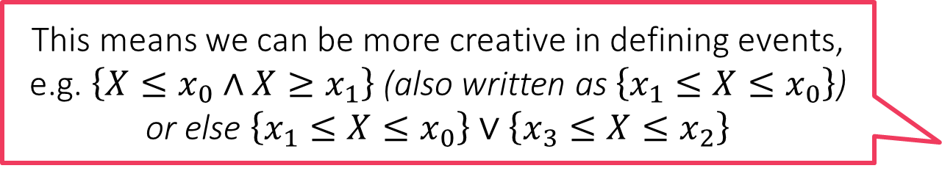

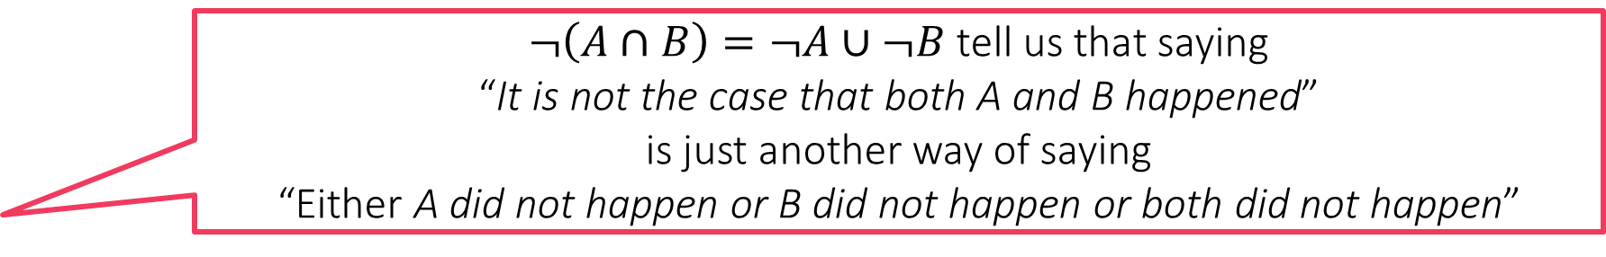
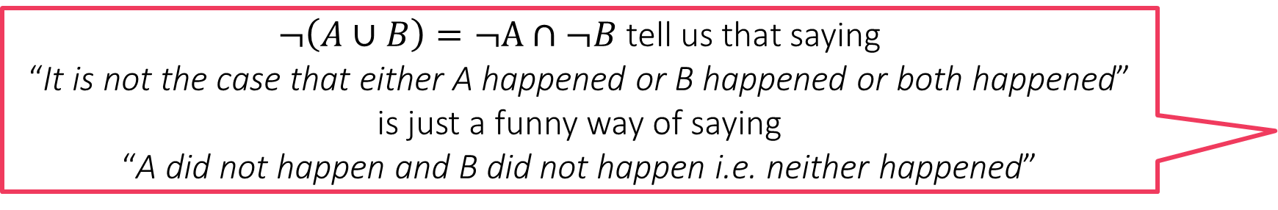
Event Calculus
The term calculus in general, means a system of rules – it does not necessarily mean differentiation or integration ☺
Let $A,B$ be events (possibly defined using same/different r.v.s etc)
$¬A$ is also an event
    Called the negation or complement of $A$ ($A$ did not happen)
$A∪B$ is also an event
    Called the union of the two events (either $A$ happened or $B$ happened or both happened)
$A∩B$ is also an event
    Called the intersection of the two events (both $A$ and $B$ happened)
De Morgan’s Laws: for any two events $A,B$, we must have
$¬\left(A∪B\right)=¬A∩¬B$ as well as $¬\left(A∩B\right)=¬A∪¬B$
$¬\left(A∪B\right)=¬A∩¬B$ tell us that saying
“It is not the case that either A happened or B happened or both happened”
is just a funny way of saying
“A did not happen and B did not happen i.e. neither happened”
$¬\left(A∩B\right)=¬A∪¬B$ tell us that saying
“It is not the case that both A and B happened”
is just another way of saying
“Either A did not happen or B did not happen or both did not happen”
This means we can be more creative in defining events, e.g. $\left\{X≤x_{0}∧X≥x_{1}\right\}$ (also written as $\left\{x_{1}≤X≤x_{0}\right\}$) or else $\left\{x_{1}≤X≤x_{0}\right\}∨\left\{x_{3}≤X≤x_{2}\right\}$

Slide 32
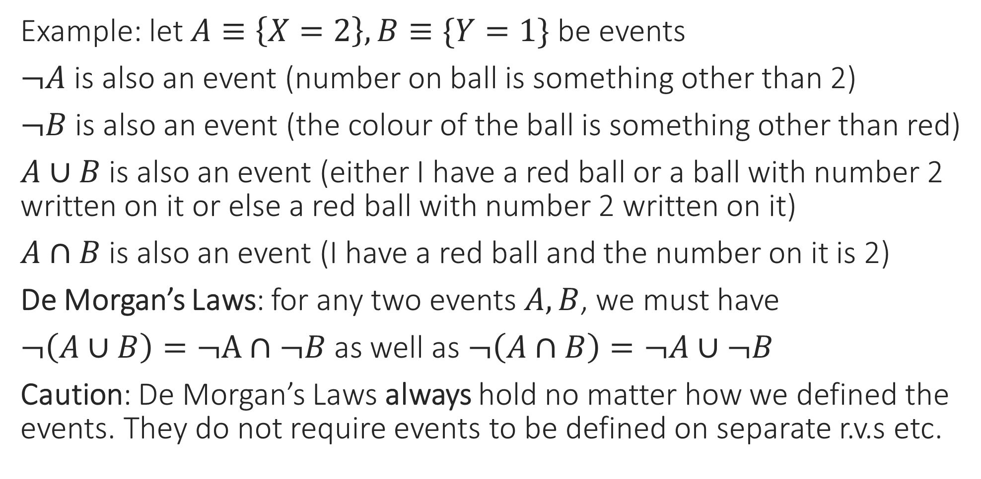
Event Calculus
Example: let $A≡\left\{X=2\right\},B≡\{Y=1\}$ be events
$¬A$ is also an event (number on ball is something other than 2)
$¬B$ is also an event (the colour of the ball is something other than red)
$A∪B$ is also an event (either I have a red ball or a ball with number 2 written on it or else a red ball with number 2 written on it)
$A∩B$ is also an event (I have a red ball and the number on it is 2)
De Morgan’s Laws: for any two events $A,B$, we must have
$¬\left(A∪B\right)=¬A∩¬B$ as well as $¬\left(A∩B\right)=¬A∪¬B$
Caution: De Morgan’s Laws always hold no matter how we defined the events. They do not require events to be defined on separate r.v.s etc.

Slide 33
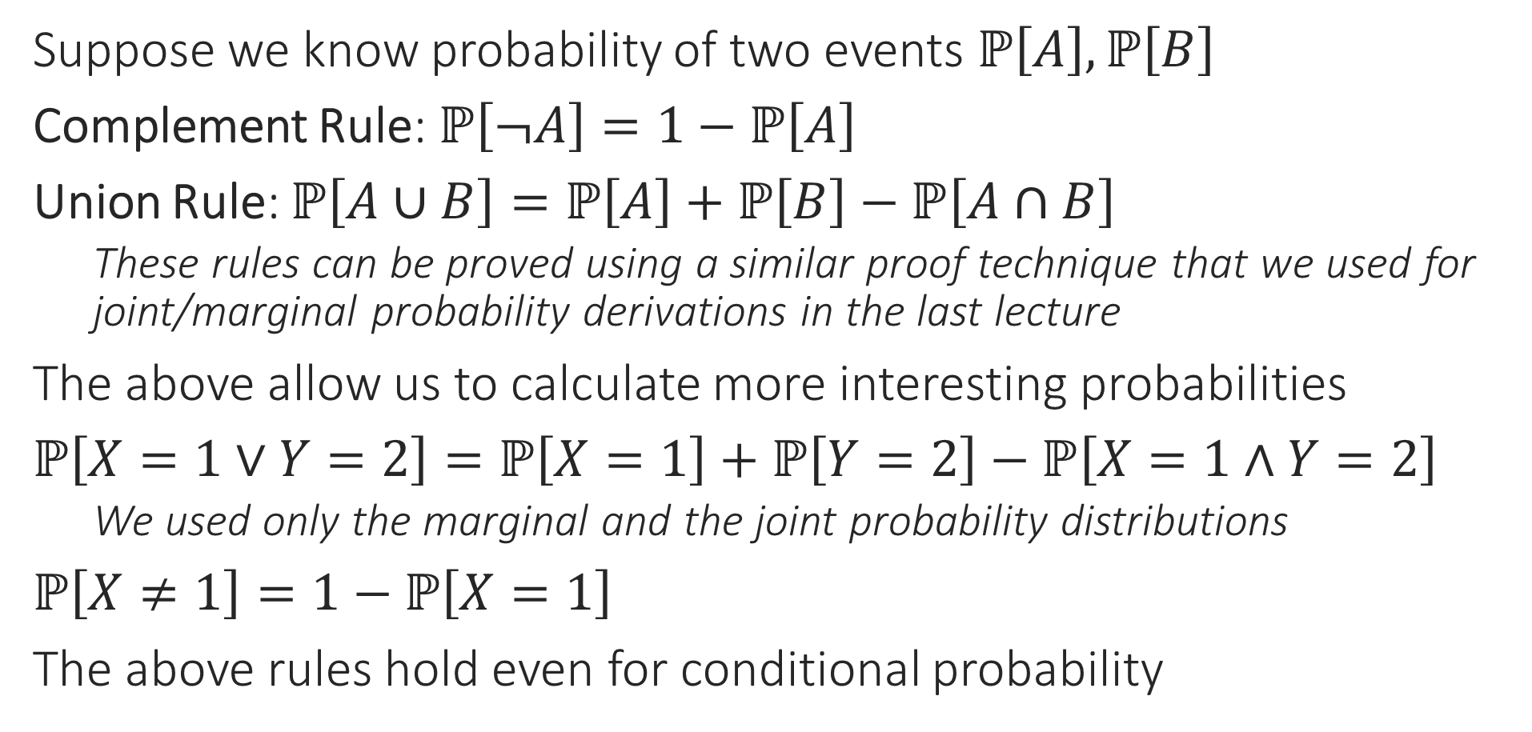
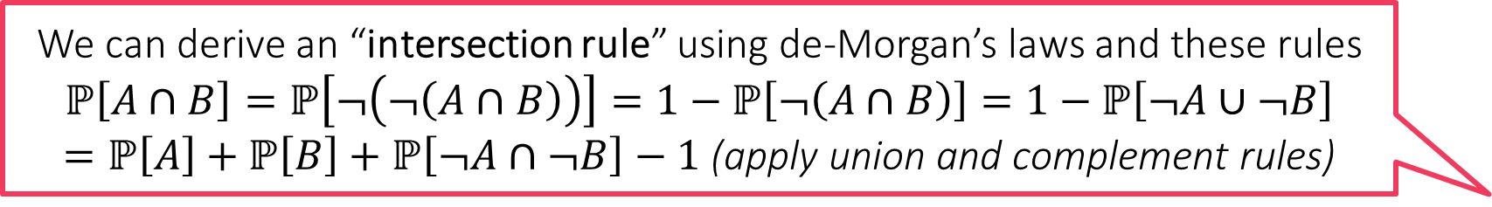
Rules of Probability for Complex Events
We can derive an “intersection rule” using de-Morgan’s laws and these rules
$$ℙ\left[A∩B\right]=ℙ\left[¬\left(¬\left(A∩B\right)\right)\right]=1−ℙ\left[¬\left(A∩B\right)\right]=1−ℙ\left[¬A∪¬B\right]$$
$=ℙ\left[A\right]+ℙ\left[B\right]+ℙ\left[¬A∩¬B\right]−1$ (apply union and complement rules)
Suppose we know probability of two events $ℙ\left[A\right],ℙ\left[B\right]$
Complement Rule: $ℙ\left[¬A\right]=1−ℙ\left[A\right]$
Union Rule: $ℙ\left[A∪B\right]=ℙ\left[A\right]+ℙ\left[B\right]−ℙ\left[A∩B\right]$
    These rules can be proved using a similar proof technique that we used for joint/marginal probability derivations in the last lecture
The above allow us to calculate more interesting probabilities
$ℙ\left[X=1∨Y=2\right]=ℙ\left[X=1\right]+ℙ\left[Y=2\right]−ℙ\left[X=1∧Y=2\right]$
    We used only the marginal and the joint probability distributions
$ℙ\left[X≠1\right]=1−ℙ\left[X=1\right]$
The above rules hold even for conditional probability

Slide 34


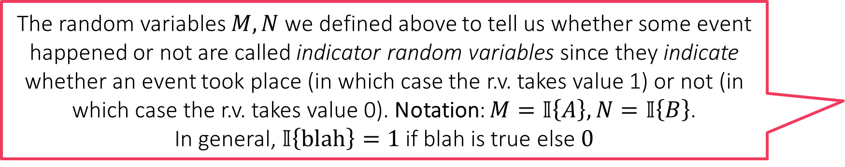
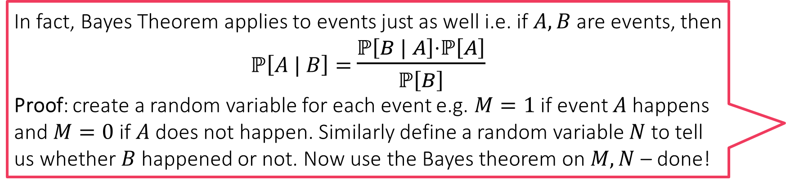
Rules of Conditional Probability
In fact, Bayes Theorem applies to events just as well i.e. if $A,B$ are events, then $ℙ\left[A | B\right]=$ $\frac{ℙ\left[B | A\right]⋅ℙ\left[A\right]}{ℙ\left[B\right]}$
Proof: create a random variable for each event e.g. $M=1$ if event $A$ happens and $M=0$ if $A$ does not happen. Similarly define a random variable $N$ to tell us whether $B$ happened or not. Now use the Bayes theorem on $M,N$ – done!
Let $C$ denote an event
    For example $C≡\left\{X=x_{0}∧Y=y_{0}∧Z=z_{0}∧A=a_{0}\right\}$
    A user with gender $x_{0}$, age $y_{0}$ spent $z_{0}$ sec on website and was shown ad $a_{0}$
Let $A,B$ denote two events
    $A, B$ may be related/unrelated to $C$ – does not matter – the rules always hold
Conditional Complement Rule: $ℙ\left[¬A | C\right]=1−ℙ\left[A | C\right]$
Conditional Union Rule: $ℙ\left[A∪B|C\right]=ℙ\left[A|C\right]+ℙ\left[B|C\right]−ℙ\left[A∩B|C\right]$
Conditional Implication Rule: If $C⇒A$, then $ℙ\left[A | C\right]=1$. On the other hand, if $C⇒¬B$, then $ℙ\left[B | C\right]=0$
    Example: $C$ defined as above and $A≡\left\{X=x_{0}\right\}$ and $B≡\left\{Z=z^{′}\right\},z^{′}≠z_{0}$
    In the above cases, we will indeed have $ℙ\left[A | C\right]=1$ and $ℙ\left[B | C\right]=0$
The random variables $M,N$ we defined above to tell us whether some event happened or not are called indicator random variables since they indicate whether an event took place (in which case the r.v. takes value 1) or not (in which case the r.v. takes value 0). Notation: $M=𝕀\left\{A\right\}, N=𝕀\left\{B\right\}$.
In general, $𝕀\left\{blah\right\}=1$ if blah is true else $0$
Caution: not a standard rule you would find in textbooks

Slide 35





Independence of Random Variables
$X \text{⫫} Y$ means that $X$ and $Y$ will both take values according to their own (marginal) PMFs, happily unmindful of the values the other r.v. is taking!
Two r.v.s $X,Y$ are said to be independent if, for all $x∈S_{X}$ and $y∈S_{Y}$, we have $ℙ\left[X=x,Y=y\right]=ℙ\left[X=x\right]⋅ℙ\left[Y=y\right]$
We can show that if two r.v.s are independent, then this means that the value one r.v. takes does not influence the other r.v. to take some value more preferentially than others in any way
Proof: $ℙ\left[X=x | Y=y\right]=\frac{ℙ\left[X=x | Y=y\right]}{ℙ\left[Y=y\right]}=\frac{ℙ\left[X=x\right]⋅ℙ\left[Y=y\right]}{ℙ\left[Y=y\right]}=ℙ\left[X=x\right]$
Similarly, we also get $ℙ\left[Y=y |X=x\right]=ℙ\left[Y=y\right]$
Independence of r.v.s makes life extremely simple in ML algorithms but is very precious – not always available
Notation: If $X,Y$ are independent, then we often write $X\text{⫫}Y$
Can you show that if $X \text{⫫} Y$ (i.e. $ℙ_{Y|X=x_{0}}=ℙ_{Y}$ for all $x_{0}∈S_{X}$) then we must always have $Y \text{⫫} X$ (i.e. $ℙ_{X|Y=y_{0}}=ℙ_{X}$ for all $y_{0}∈S_{X}$) as well?
Hint: use the definition of independence
We have $ℙ_{Y}=\left[\frac{1}{2},\frac{1}{4},\frac{1}{4}\right]$
We can verify that we have
$ℙ_{Y|X=x_{0}}=\left[\frac{1}{2},\frac{1}{4},\frac{1}{4}\right]=ℙ_{Y}$ for
all $x_{0}∈{\left[6\right]=S}_{X}$ i.e. $X \text{⫫} Y$
Similarly, we can verify that
$ℙ_{X|Y=y_{0}}=\left[\frac{1}{6},\frac{1}{6},…,\frac{1}{6}\right]=ℙ_{X}$ for
all $y_{0}∈{\left[3\right]=S}_{Y}$ i.e. $Y \text{⫫} X$
We have $ℙ_{Y}=\left[\frac{7}{12},\frac{3}{12},\frac{2}{12}\right]$
However, if we condition on
$X=1$, then we have
$ℙ_{Y|X=1}=\left[\frac{2}{4},\frac{1}{4},\frac{1}{4}\right]$ i.e. $X \text{⫫} Y$
For independence, we should
have had $ℙ_{Y|X=x_{0}}=ℙ_{Y}$ for all
$$x_{0}∈S_{X}$$
1
2
3
4
5
6
1
2
3
4
5
6
1
2
3
4
5
6
1
2
3
4
5
6
1
2
3
4
5
6
1
2
3
4
5
6
1
2
3
4
5
6
1
2
3
4
5
6

Slide 36




Conditional Independence
If $X,Y,Z$ are three r.v.s such that for all $x∈S_{X},y∈S_{Y},z∈S_{Z}$ we have
$ℙ\left[X=x,Y=y | Z=z\right]=ℙ\left[X=x | Z=z\right]⋅ℙ\left[Y=y | Z=z\right]$
then we say that $X$ and $Y$ are conditionally independent given $Z$
Notation: $X \text{⫫} Y | Z$
If $X,Y$ are independent, then it is not necessary that they continue to be independent even if conditioned on a third random variable
This is the earlier example where
we verified that $X \text{⫫} Y$ and $Y \text{⫫} X$
However it is easy to see that we
do not have $X \text{⫫} Y | Z$ since
$ℙ\left[X=2,Y=2 | Z=1\right]=0≠$
$ℙ\left[X=2 | Z=1\right]⋅ℙ\left[Y=2 | Z=1\right]$
1
2
3
4
5
6
$$Z=1$$
1
2
3
4
5
6
1
2
3
4
5
6
$$Z=2$$
1
2
3
4
5
6

Slide 37








Conditional Independence
If $X,Y,Z$ are three r.v.s such that for all $x∈S_{X},y∈S_{Y},z∈S_{Z}$ we have
$ℙ\left[X=x,Y=y | Z=z\right]=ℙ\left[X=x | Z=z\right]⋅ℙ\left[Y=y | Z=z\right]$
then we say that $X$ and $Y$ are conditionally independent given $Z$
Notation: $X \text{⫫} Y | Z$
If $X,Y$ are independent, then it is not necessary that they continue to be independent even if conditioned on a third random variable
Even if $X,Y$ are not independent, it is still possible that there may exist a third random variable $Z$ such that makes $X,Y$ conditionally independent i.e. $X \text{⫫} Y | Z$
The r.v.s number $X$ and colour $Y$ are
not independent here. To see this, note
that$ℙ\left[Y=3 | X=1\right]=0.4$
$≠0.25=ℙ\left[Y=3\right]$. However, if we
condition on a new random variable $Z$
that distinguishes the first two rows
from the last two rows, then $X$ and $Y$
become independent r.v.s i.e. $X \text{⫫} Y$
but we do have $X \text{⫫} Y | Z$
1
2
3
4
5
6
$$\frac{1}{96}$$
$$\frac{1}{96}$$
$$\frac{2}{96}$$
$$\frac{2}{96}$$
$$\frac{9}{96}$$
$$\frac{9}{96}$$
$$Z=1$$
1
2
3
4
5
6
$$\frac{1}{96}$$
$$\frac{1}{96}$$
$$\frac{2}{96}$$
$$\frac{2}{96}$$
$$\frac{9}{96}$$
$$\frac{9}{96}$$
1
2
3
4
5
6
$$\frac{1}{24}$$
$$\frac{1}{24}$$
$$\frac{1}{24}$$
$$\frac{1}{24}$$
$$\frac{1}{24}$$
$$\frac{1}{24}$$
$$Z=2$$
1
2
3
4
5
6
$$\frac{1}{24}$$
$$\frac{1}{24}$$
$$\frac{1}{24}$$
$$\frac{1}{24}$$
$$\frac{1}{24}$$
$$\frac{1}{24}$$

Slide 38

Conditional Independence
Slightly more “practical” examples
If I throw a fair dice twice, the outcome on the first throw in no way influences the second outcome i.e. two outcomes are independent of each other and each takes values in $\left[6\right]$. However, if I additionally am told that the sum of the two numbers is $8$, then the throws are no longer conditionally independent since for example we have
$ℙ\left[X=1,Y=4 | Z=8\right]=0≠ℙ\left[X=1 | Z=8\right]⋅ℙ\left[Y=4 | Z=8\right]$
In the above, $X$ is number on first throw, $Y$ denotes second, $Z$ is sum
Sample space is $\left[6\right]×\left[6\right]$ i.e. all possible outcomes of two throws
Examples where non-independent r.v.s become conditionally independent are most commonly found in a branch of ML called graphical models.

Slide 39

Random Vectors
Random vectors can be thought of as simply a collection of random variables arranged in an array $X={\left[X_{1},X_{2},…,X_{d}\right]}^{⊤}$
    No restriction on the random variables being independent or uncorrelated
PMF/PDF of $X$ is simply the joint PMF/PDF of $\left\{X_{1},X_{2},…,X_{d}\right\}$
Can talk about marginal/conditional prob among $X_{1},.. X_{d}$
    Think of $X_{1},X_{2},…,X_{d}$ as just a bunch of r.v.s
    $ℙ\left[X_{2},X_{3} | X_{1},X_{4},X_{5}\right]$
Since PMF/PDF of $X$ is simply a joint PMF/PDF, all probability laws we learnt earlier continue to hold if we apply them correctly
    Chain Rule, Sum Rule, Product Rule, Bayes Rule
    Conditional/marginal variants of all these rules

