Slide 1
Practice Problems

Slide 2

Non-differentiability is not additive
If $f,g:ℝ→ℝ$ are two non-differentiable functions, then $f+g$ is always non-differentiable as well.
$f=x−\left|x\right|,g=\left|x\right|$
$f\left(x\right)=0$ if $x≥0$
$f\left(x\right)=2x$ if $x<0$

Slide 3

Non-convexity and non-concavity
Suppose $f:ℝ→ℝ$ is a twice differentiable function that is neither convex nor concave, then $f$ must have at least two stationary points.
$\sin\left(x\right)$

Slide 4

Vase function
$f\left(x\right)=x^{2}$ if $\left|x\right|≤ε$
$f\left(x\right)=1−\exp\left(−\left|x\right|\right)$ if $\left|x\right|>ε$
$f\left(x\right)=1−\exp\left(−x^{2}\right)$

Slide 5

Drake Equation
The probability of life on a planet given that there is water on it is 80%. If there is no water on a planet, then life cannot exist on that planet. 50% of the planets in the galaxy have water on it. Consider all planets in the galaxy that have life on them. What fraction of these planets contain water? Consider all planets in the galaxy that do not have life on them. What fraction of these planets contain water?
If $N$ planets have water, then $0.8N$ of those planets have life
If $M$ planets do not have water, then $0$ of those planets have life
$N/{\left(M+N\right)}=0.5⇒M=N$
$ℙ\left[W|L\right]=1$

Slide 6
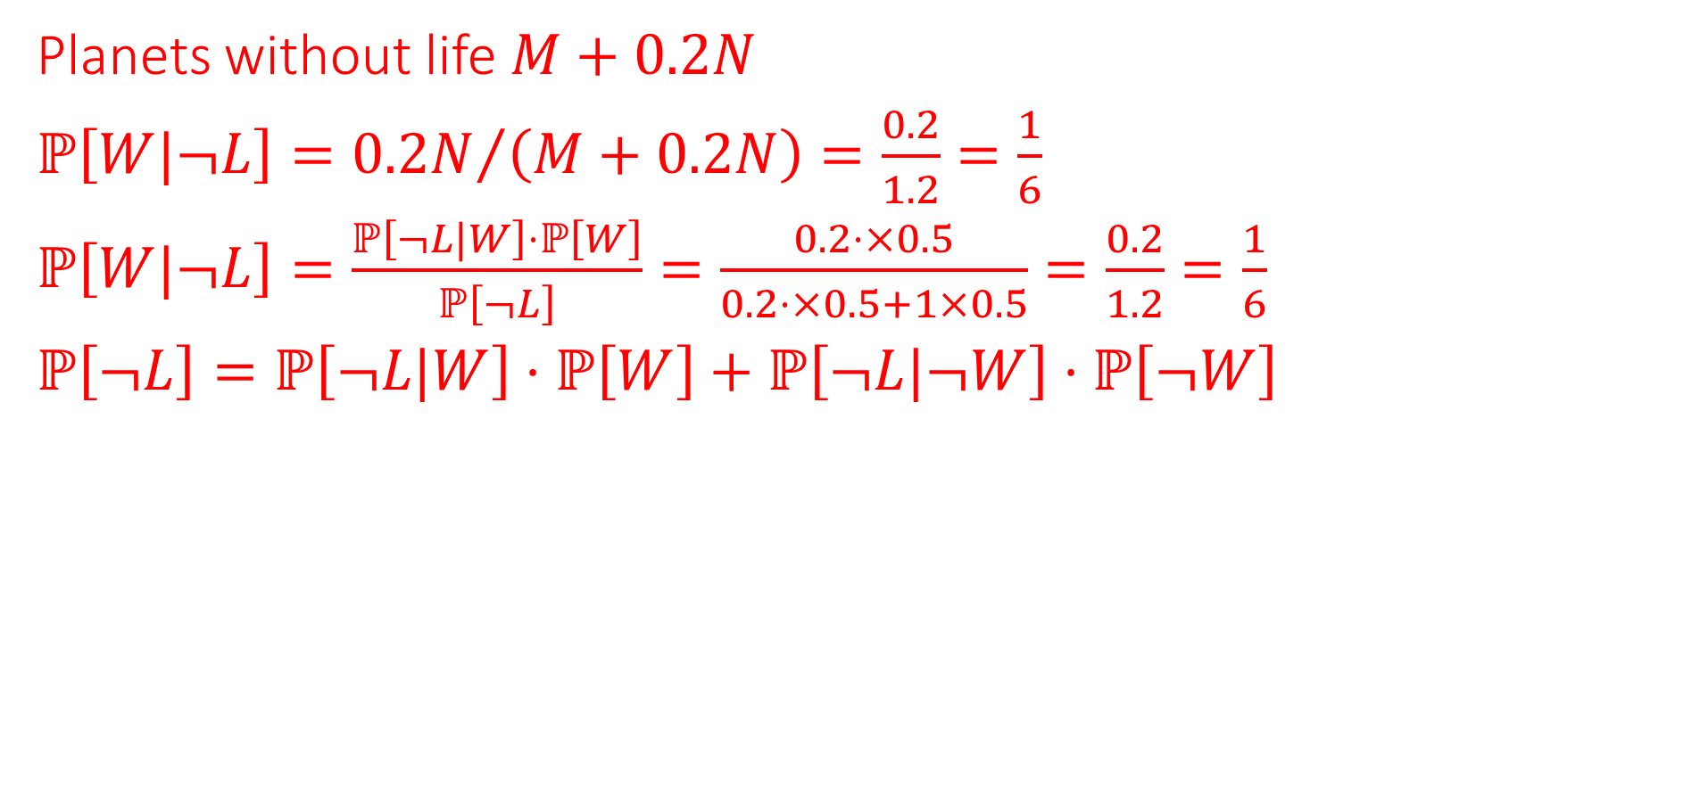
Planets without life $M+0.2N$
$ℙ\left[W|¬L\right]={0.2N}/{\left(M+0.2N\right)}=\frac{0.2}{1.2}=\frac{1}{6}$
$ℙ\left[W|¬L\right]=\frac{ℙ\left[¬L|W\right]⋅ℙ\left[W\right]}{ℙ\left[¬L\right]}=\frac{0.2⋅×0.5}{0.2⋅×0.5+1×0.5}=\frac{0.2}{1.2}=\frac{1}{6}$
$ℙ\left[¬L\right]=ℙ\left[¬L|W\right]⋅ℙ\left[W\right]+ℙ\left[¬L|¬W\right]⋅ℙ\left[¬W\right]$

Slide 7

Flopkart Family Feud
Flopkart.com has a customer who uses his account to make purchases for his entire family. There are $K$ members in the family, each indexed by a vector $u^{1},…u^{K}∈ℝ^{d}$. Each Flopkart product is indexed by vector $v∈ℝ^{d}$. The $i$^{th} member will give product $v$ a rating $r = ⟨u^{i}, v⟩+ε$ where $ε∼𝒩\left(0,1\right)$. The customer made $n$ purchases with Flopkart. In the $t$^{th} purchase, item $v^{t}$ was purchased and a rating $r^{t}$ was given to it but don’t know which member rated it. Given $\left\{\left(v^{t}, r^{t}\right)\right\} t∈[n]$, design an algorithm to estimate the user vectors for the $k$ family members.

Slide 8
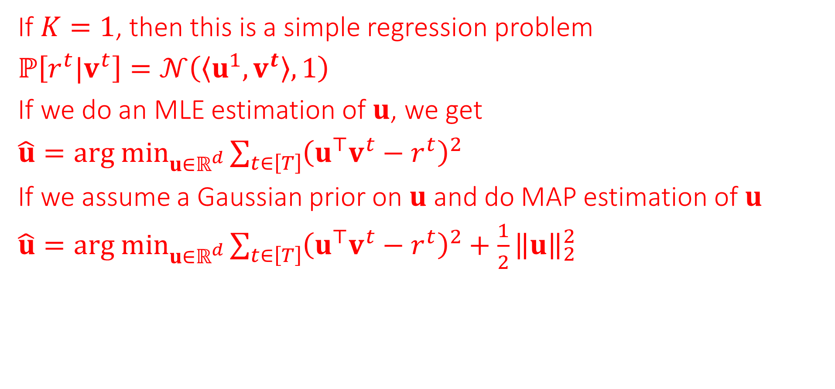
If $K=1$, then this is a simple regression problem
$ℙ\left[r^{t}|v^{t}\right]=𝒩\left(\left\langle u^{1}, v^{t}\right\rangle ,1\right)$
If we do an MLE estimation of $u$, we get
$\hat{u}={arg min}_{u∈ℝ^{d}}{\sum_{t∈\left[T\right]}{{\left(u^{⊤}v^{t}−r^{t}\right)}^{2}}}$
If we assume a Gaussian prior on $u$ and do MAP estimation of $u$
$\hat{u}={arg min}_{u∈ℝ^{d}}{\sum_{t∈\left[T\right]}{{\left(u^{⊤}v^{t}−r^{t}\right)}^{2}}}+\frac{1}{2}{\left\|u\right\|}_{2}^{2}$

Slide 9
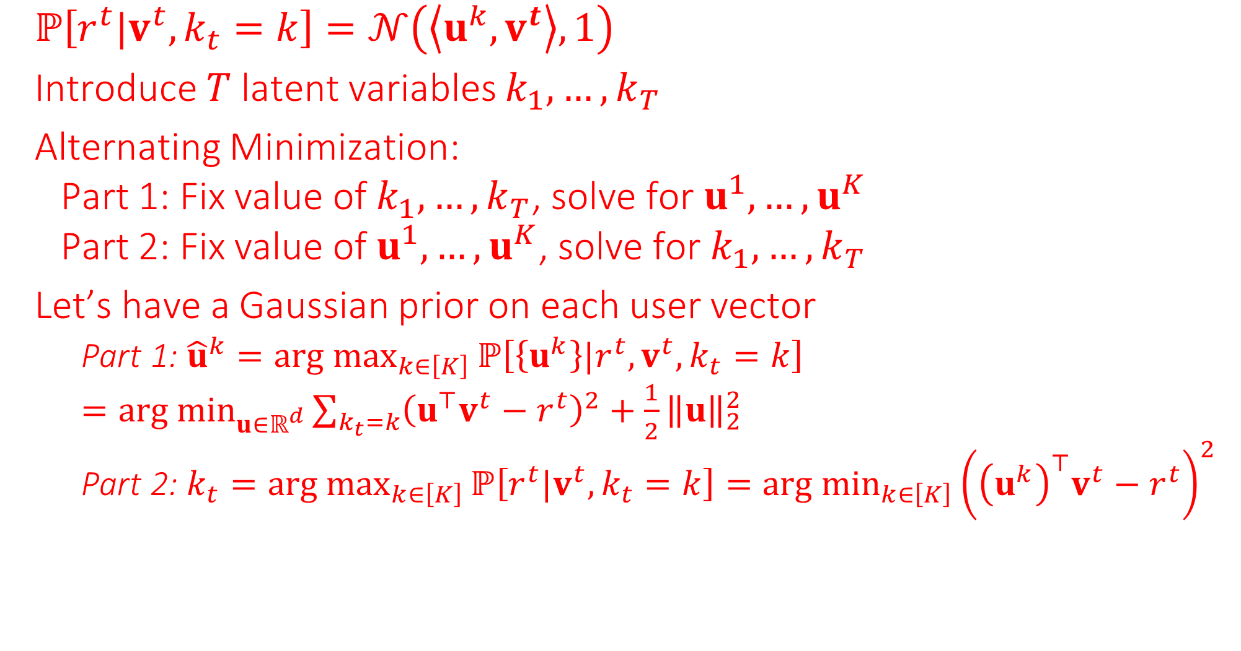
$ℙ\left[r^{t}|v^{t},k_{t}=k\right]=𝒩\left(\left\langle u^{k}, v^{t}\right\rangle ,1\right)$
Introduce $T$ latent variables $k_{1},…,k_{T}$
Alternating Minimization:
  Part 1: Fix value of $k_{1},…,k_{T}$, solve for $u^{1},…,u^{K}$
  Part 2: Fix value of $u^{1},…,u^{K}$, solve for $k_{1},…,k_{T}$
Let’s have a Gaussian prior on each user vector
    Part 1: ${\hat{u}}^{k}={arg max}_{k∈\left[K\right]}{ℙ\left[\left\{u^{k}\right\}|r^{t},v^{t},k_{t}=k\right]}$
    $={arg min}_{u∈ℝ^{d}}{\sum_{k_{t}=k}{{\left(u^{⊤}v^{t}−r^{t}\right)}^{2}}}+\frac{1}{2}{\left\|u\right\|}_{2}^{2}$
    Part 2: $k_{t}={arg max}_{k∈\left[K\right]}{ℙ\left[r^{t}|v^{t},k_{t}=k\right]}={{arg min}_{k∈\left[K\right]}\left({\left(u^{k}\right)}^{⊤}v^{t}−r^{t}\right)}^{2}$

Slide 10

Opt. to Prob.
The $ε$-insensitive regression loss used in kernel learning is defined as
$ℓ_{ε}\left(\hat{y},y\right)=\left\{\begin{matrix}\begin{matrix}0 \\ {\left(\left|\hat{y}−y\right|−ε\right)}^{2}\end{matrix} & \begin{matrix}\left|\hat{y}−y\right|≤ε \\ \left|\hat{y}−y\right|>ε\end{matrix}\end{matrix}\right.$
Consider the following $ε$-insensitive ridge regression optimization problem with $x^{i},w∈ℝ^{d},y^{i}∈ℝ$.
$\hat{w}=\underset{w∈ℝ^{d}}{arg min}{ \left\{\frac{1}{2}{\left\|w\right\|}_{2}^{2}+\sum_{i∈\left[n\right]}{ℓ_{ε}\left(w^{⊤}x^{i},y^{i}\right)}\right\}}$
Although it does not look like it, this is actually a MAP estimate. Design a likelihood distribution $ℙ\left[y^{i} | x^{i}, w\right]$ and prior $ℙ\left[w\right]$ s.t. $\hat{w}$ is the MAP estimate for your model.
$ℙ\left[w\right]=\frac{1}{{\left(\sqrt{2π}\right)}^{d}}\exp\left(−\frac{1}{2}{\left\|w\right\|}_{2}^{2}\right)$

Slide 11
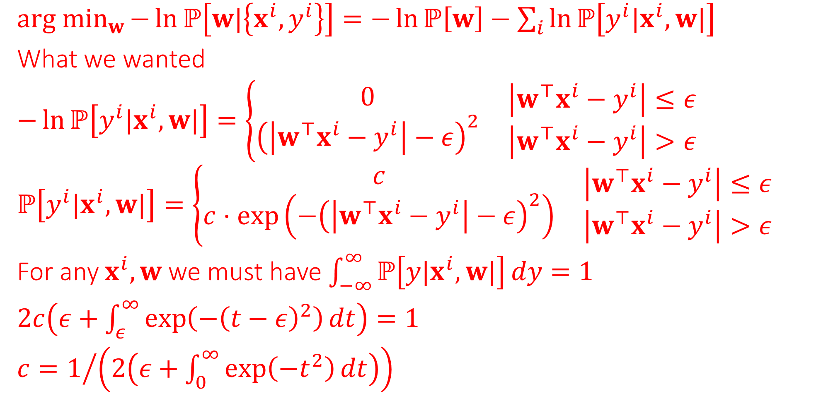
${arg min}_{w}{−\ln{ℙ\left[w|\left\{x^{i},y^{i}\right\}\right]}}=−\ln{ℙ\left[w\right]}−\sum_{i}{\ln{ℙ\left[y^{i}|x^{i},w|\right]}}$
What we wanted
$−\ln{ℙ\left[y^{i}|x^{i},w|\right]}=\left\{\begin{matrix}\begin{matrix}0 \\ {\left(\left|w^{⊤}x^{i}−y^{i}\right|−ε\right)}^{2}\end{matrix} & \begin{matrix}\left|w^{⊤}x^{i}−y^{i}\right|≤ε \\ \left|w^{⊤}x^{i}−y^{i}\right|>ε\end{matrix}\end{matrix}\right.$
$ℙ\left[y^{i}|x^{i},w|\right]=\left\{\begin{matrix}\begin{matrix}c \\ c⋅\exp\left(−{\left(\left|w^{⊤}x^{i}−y^{i}\right|−ε\right)}^{2}\right)\end{matrix} & \begin{matrix}\left|w^{⊤}x^{i}−y^{i}\right|≤ε \\ \left|w^{⊤}x^{i}−y^{i}\right|>ε\end{matrix}\end{matrix}\right.$
For any $x^{i},w$ we must have $\int_{−∞}^{∞}{ℙ\left[y|x^{i},w|\right]}dy=1$
$2c\left(ε+\int_{ε}^{∞}{\exp\left(−{\left(t−ε\right)}^{2}\right)}dt\right)=1$
$c=1/{\left(2\left(ε+\int_{0}^{∞}{\exp\left(−t^{2}\right)}dt\right)\right)}$

Slide 12
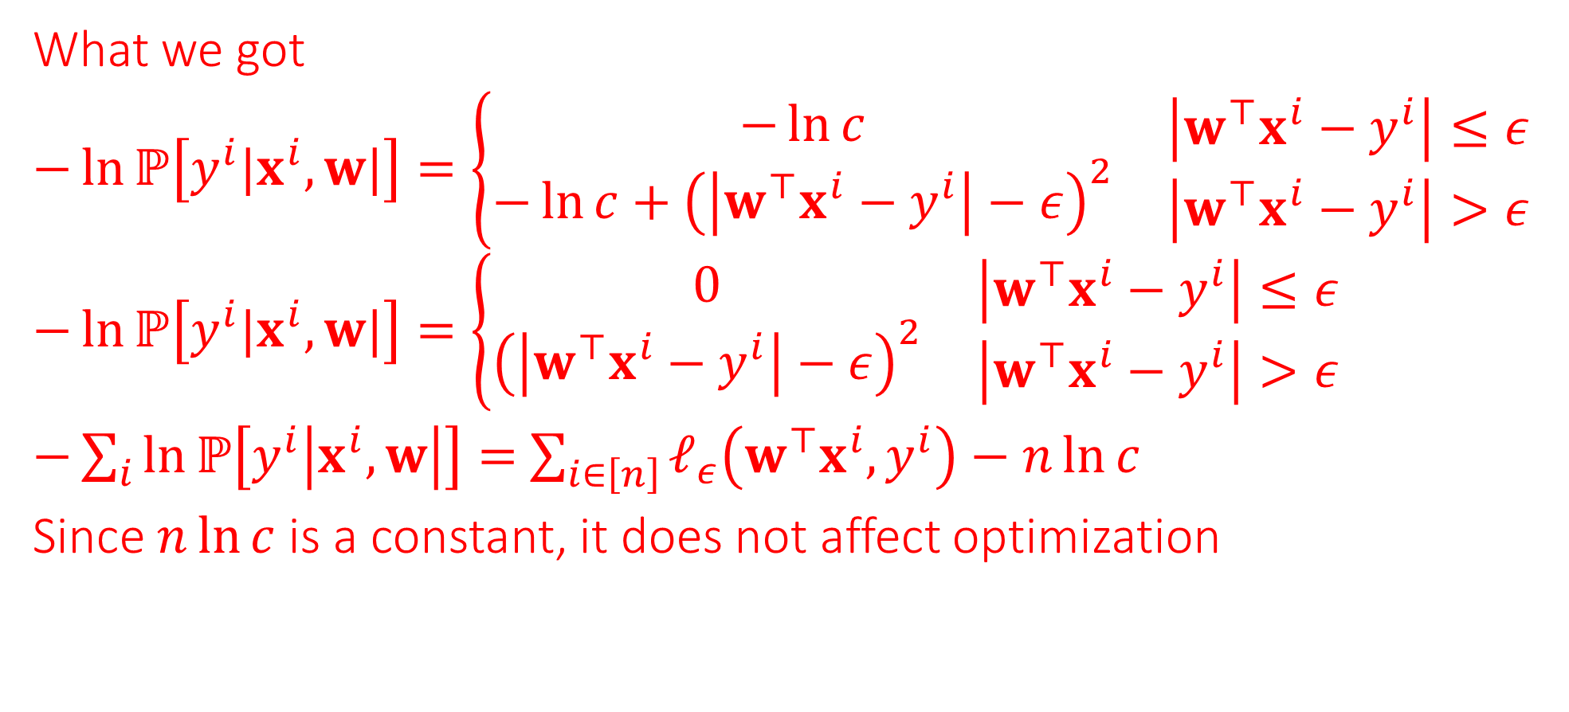
What we got
$−\ln{ℙ\left[y^{i}|x^{i},w|\right]}=\left\{\begin{matrix}\begin{matrix}−\ln{c} \\ −\ln{c}+{\left(\left|w^{⊤}x^{i}−y^{i}\right|−ε\right)}^{2}\end{matrix} & \begin{matrix}\left|w^{⊤}x^{i}−y^{i}\right|≤ε \\ \left|w^{⊤}x^{i}−y^{i}\right|>ε\end{matrix}\end{matrix}\right.$
$−\ln{ℙ\left[y^{i}|x^{i},w|\right]}=\left\{\begin{matrix}\begin{matrix}0 \\ {\left(\left|w^{⊤}x^{i}−y^{i}\right|−ε\right)}^{2}\end{matrix} & \begin{matrix}\left|w^{⊤}x^{i}−y^{i}\right|≤ε \\ \left|w^{⊤}x^{i}−y^{i}\right|>ε\end{matrix}\end{matrix}\right.$
$−\sum_{i}{\ln{ℙ\left[y^{i}\left|x^{i},w\right|\right]}}=$ $\sum_{i∈\left[n\right]}{ℓ_{ε}\left(w^{⊤}x^{i},y^{i}\right)}−n\ln{c}$
Since $n\ln{c}$ is a constant, it does not affect optimization

Slide 13




$$−ε$$
$$ε$$
$$−ε$$
$$ε$$

Slide 14
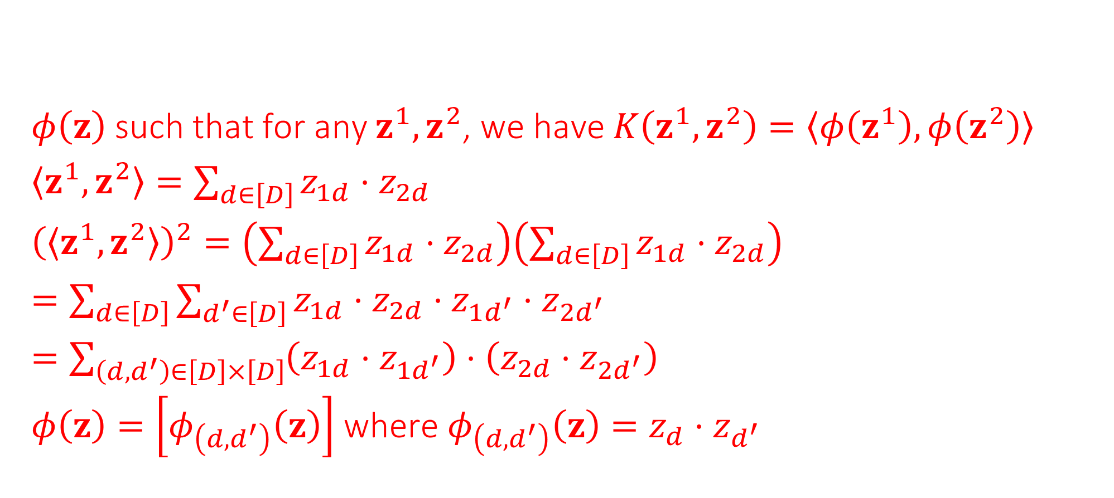
Kernel Maps
Find a feature map for the Mercer kernel $K\left(z^{1},z^{2}\right)={\left(\left\langle z^{1},z^{2}\right\rangle \right)}^{2}$ with $z^{i}=\left(z_{i1},…,z_{iD}\right)$ being $D$-dim vectors
$φ\left(z\right)$ such that for any $z^{1},z^{2}$, we have $K\left(z^{1},z^{2}\right)=\left\langle φ\left(z^{1}\right),φ\left(z^{2}\right)\right\rangle$
$\left\langle z^{1},z^{2}\right\rangle =\sum_{d∈\left[D\right]}{z_{1d}⋅z_{2d}}$
${\left(\left\langle z^{1},z^{2}\right\rangle \right)}^{2}=\left(\sum_{d∈\left[D\right]}{z_{1d}⋅z_{2d}}\right)\left(\sum_{d∈\left[D\right]}{z_{1d}⋅z_{2d}}\right)$
$=\sum_{d∈\left[D\right]}{\sum_{d^{′}∈\left[D\right]}{z_{1d}⋅z_{2d}⋅z_{1d^{′}}⋅z_{2d^{′}}}}$
$=\sum_{\left(d,d^{′}\right)∈\left[D\right]×\left[D\right]}{\left(z_{1d}⋅z_{1d^{′}}\right)⋅\left(z_{2d}⋅z_{2d^{′}}\right)}$
$φ\left(z\right)=\left[φ_{\left(d,d^{′}\right)}\left(z\right)\right]$ where $φ_{\left(d,d^{′}\right)}\left(z\right)=z_{d}⋅z_{d^{′}}$

Slide 15
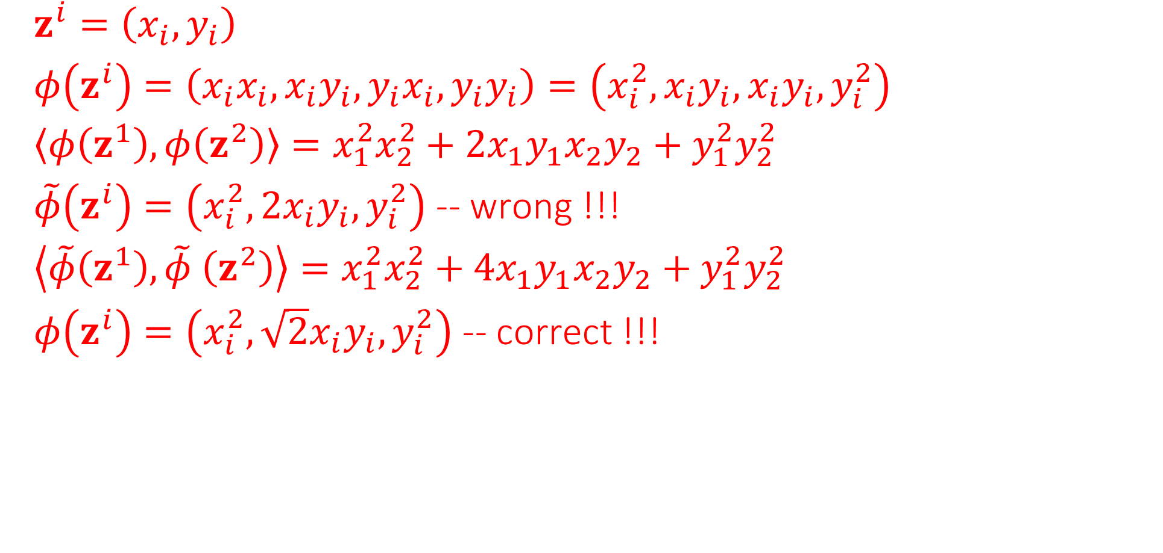
$z^{i}=\left(x_{i},y_{i}\right)$
$φ\left(z^{i}\right)=\left(x_{i}x_{i},x_{i}y_{i},y_{i}x_{i},y_{i}y_{i}\right)=\left(x_{i}^{2},x_{i}y_{i}, x_{i}y_{i},y_{i}^{2}\right)$
$\left\langle φ\left(z^{1}\right),φ\left(z^{2}\right)\right\rangle =x_{1}^{2}x_{2}^{2}+2x_{1}y_{1}x_{2}y_{2}+y_{1}^{2}y_{2}^{2}$
$\tilde{φ}\left(z^{i}\right)=\left(x_{i}^{2},2x_{i}y_{i},y_{i}^{2}\right)$ -- wrong !!!
$\left\langle \tilde{φ}\left(z^{1}\right),\tilde{φ} \left(z^{2}\right)\right\rangle =x_{1}^{2}x_{2}^{2}+4x_{1}y_{1}x_{2}y_{2}+y_{1}^{2}y_{2}^{2}$
$φ\left(z^{i}\right)=\left(x_{i}^{2},\sqrt{2}x_{i}y_{i},y_{i}^{2}\right)$ -- correct !!!

