Slide 1
Practice Session

Slide 2

Quiz 2
Mar 29 (Wed), 6:30PM, L18, L19, L20
    Only for registered students (regular + audit)
    Assigned seating – announced on Piazza
Open notes (handwritten only)
No mobile phones, tablets etc
Bring your institute ID card
    If you don’t bring it, you will have to spend precious time during the exam getting verified separately
Syllabus:
    All videos, slides, code linked on the course discussion page (link below) till 26 Mar 2023 (Sun)
    https://www.cse.iitk.ac.in/users/purushot/courses/ml/2022-23-w/discussion.html
See GitHub for practice questions

Slide 3
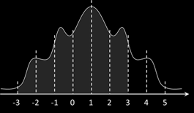









Practice Questions
Melbo has a class of symmetric $ℳ$ distrbs. with mean $μ$, std $σ$ s.t. if $X∼ℳ\left(μ,σ^{2}\right)$, then for any $c>0$, $ℙ\left[μ−cσ≤X≤μ+cσ\right]=η_{c}$ If $η_{1}=0.75,η_{2}=0.9, η_{3}=0.95,η_{4}=0.99$, and $μ=1,σ=1$, find $ℙ\left[−3≤X≤3\right]$.
$ℙ\left[−3≤X≤3\right]=ℙ\left[−3≤X≤−1\right]+ℙ\left[−1<X≤3\right]$
$=\frac{1}{2}\left(ℙ\left[−3≤X≤−1\right]+ℙ\left[3≤X≤5\right]\right)+η_{2}$
$=\frac{1}{2}\left(ℙ\left[−3≤X≤5\right]−ℙ\left[−1≤X≤3\right]\right)+η_{2}$
$=\frac{1}{2}\left(η_{4}−η_{2}\right)+η_{2}$
$=\frac{1}{2}\left(η_{4}+η_{2}\right)$

Slide 4

Practice Questions
Melbo is studying how one’s income level affects one’s reluctance to reveal one’s income publicly. $n$ people were chosen with incomes $X_{1},X_{2},…,X_{n}$. Melbo knows that the income levels $X_{i}$ are distributed as independent standard Gaussian random variables i.e., $X_{i}∼𝒩\left(0,1\right)$ for all $i$ (let us interpret positive $X_{i}$ as higher-than-median income and negative $X_{i}$ as lower-than-median income). However, not everyone wants to reveal their income. When Melbo conducts the survey, the responses are $Z_{1},Z_{2},…,Z_{n}$. If the $i$^{th} person reveals their income, then $Z_{i}=X_{i}$ else $Z_{i}=φ$. It is known that $ℙ\left[Z_{i}≠φ | X\right]=\exp\left(−\frac{α^{2}X^{2}}{2}\right)$, where $α>0$ is a known parameter.

Slide 5

Practice Questions
Is a rich person e.g., $X_{i}=100$ more likely or less likely to reveal their income than a person with close-to-median income e.g., $X_{j}=−0.01$?
$ℙ\left[Z_{i}≠φ | X\right]=\exp\left(−\frac{α^{2}X^{2}}{2}\right)$
Rich person is less likely to reveal their income
Is a poor person e.g., $X_{i}=−10$ more likely or less likely to reveal their income than a person with close-to-median income e.g., $X_{j}=0.1$?
Poor person is less likely to reveal their income

Slide 6
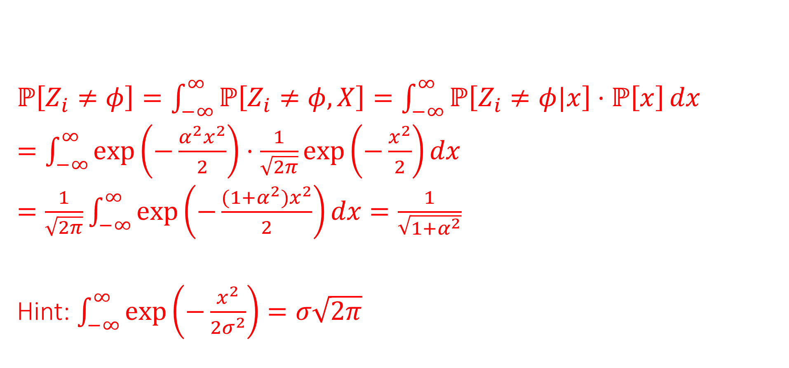
Practice Questions
Derive an expression for $ℙ\left[Z_{i}≠φ\right]$ the prior probability of a person revealing their income. Give your answer as a function $h\left(α\right)$.
$ℙ\left[Z_{i}≠φ\right]=\int_{−∞}^{∞}{ℙ\left[Z_{i}≠φ,X\right]}=\int_{−∞}^{∞}{ℙ\left[Z_{i}≠φ|x\right]⋅ℙ\left[x\right]}dx$
$=\int_{−∞}^{∞}{\exp\left(−\frac{α^{2}x^{2}}{2}\right)⋅\frac{1}{\sqrt{2π}}\exp\left(−\frac{x^{2}}{2}\right)dx}$
$=\frac{1}{\sqrt{2π}}\int_{−∞}^{∞}{\exp\left(−\frac{(1+α^{2})x^{2}}{2}\right)dx}=\frac{1}{\sqrt{1+α^{2}}}$
Hint: $\int_{−∞}^{∞}{\exp\left(−\frac{x^{2}}{2σ^{2}}\right)}=σ\sqrt{2π}$

Slide 7

Practice Questions
Melbo has samples $X_{1},…,X_{n}$ from a Gaussian with mean $μ$ and std $σ=\frac{1}{\sqrt{2π}}$ with density $f\left(X;μ\right)=\exp\left(−{π\left(X−μ\right)}^{2}\right)$. Some samples were corrupted by Melbo’s enemy Oblem. It is not known which samples did Oblem corrupt. Let $Z_{i}=1$ if $X_{i}$ is bad else $Z_{i}=0$. For any $μ∈ℝ$, $ℙ\left[Z_{i}=1 | μ\right]=η$, and that $ℙ\left[X_{i} | μ,Z_{i}=1\right]=ε$, and $ℙ\left[X_{i} | μ,Z_{i}=0\right]=f\left(X_{i};μ\right)$. Thus, we suspect that Oblem corrupted around $η$ fraction of the samples and we assume that a corrupted sample can take any value with probability $ε$. Assume $ε,η<\frac{1}{10}$ and are both known.
Find a rule to identify bad samples i.e. samples where we have $ℙ\left[Z_{i}=1 | X_{i},μ\right]>ℙ\left[Z_{i}=0 | X_{i},μ\right]$

Slide 8
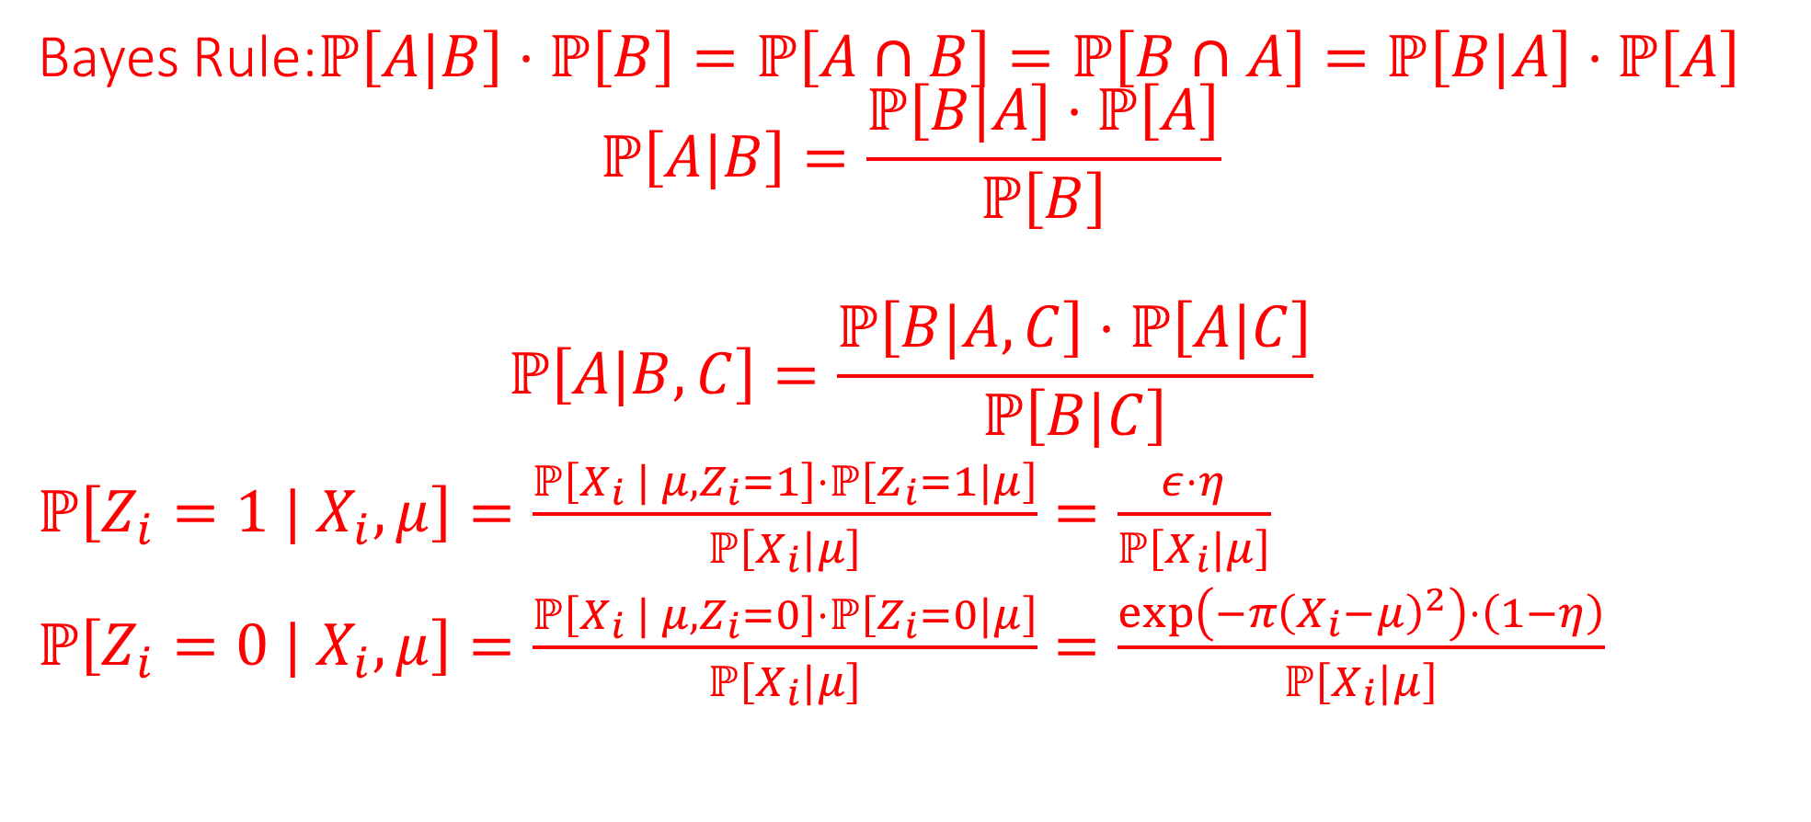
Practice Questions
Bayes Rule:$ℙ\left[A|B\right]⋅ℙ\left[B\right]=ℙ\left[A∩B\right]=ℙ\left[B∩A\right]=ℙ\left[B|A\right]⋅ℙ\left[A\right]$
$$ℙ\left[A|B\right]=\frac{ℙ\left[B|A\right]⋅ℙ\left[A\right]}{ℙ\left[B\right]}$$
$$ℙ\left[A|B,C\right]=\frac{ℙ\left[B|A,C\right]⋅ℙ\left[A|C\right]}{ℙ\left[B|C\right]}$$
$ℙ\left[Z_{i}=1 | X_{i},μ\right]=\frac{ℙ\left[X_{i} | μ,Z_{i}=1\right]⋅ℙ\left[Z_{i}=1|μ\right]}{ℙ\left[X_{i}|μ\right]}=\frac{ε⋅η}{ℙ\left[X_{i}|μ\right]}$
$ℙ\left[Z_{i}=0 | X_{i},μ\right]=\frac{ℙ\left[X_{i} | μ,Z_{i}=0\right]⋅ℙ\left[Z_{i}=0|μ\right]}{ℙ\left[X_{i}|μ\right]}=\frac{\exp\left(−{π\left(X_{i}−μ\right)}^{2}\right)⋅\left(1−η\right)}{ℙ\left[X_{i}|μ\right]}$

Slide 9

Practice Questions
We data points with features $x_{i}∈ℝ$ in a binary classfn problem. If $ℙ\left[x_{i}| y_{i}=1\right]=𝒩\left(μ_{+},1\right)$ and $ℙ\left[x_{i}| y_{i}=−1\right]=𝒩\left(μ_{−},1\right)$. Assume that $μ_{+}>μ_{−}$. We assign labels to points by thresholding features at $t$ i.e., ${\hat{y}}_{i}=1$ if $x_{i}≥t$ else we predict ${\hat{y}}_{i}=−1$. Find an expression for $ℙ\left[\hat{y}=1 | y=1\right]$.

