Slide 1

Optimal Scheduling of In-situ Analysis for Large-scale Scientific Simulations
Preeti Malakar¹, Venkatram Vishwanath¹, Todd Munson², Christopher Knight¹, Mark Hereld¹², Sven Leyffer², Michael E. Papka¹
¹Argonne Leadership Computing Facility, ²Mathematics and Computer Science, Argonne National Laboratory
pmalakar@anl.gov
18th November 2015

Slide 2
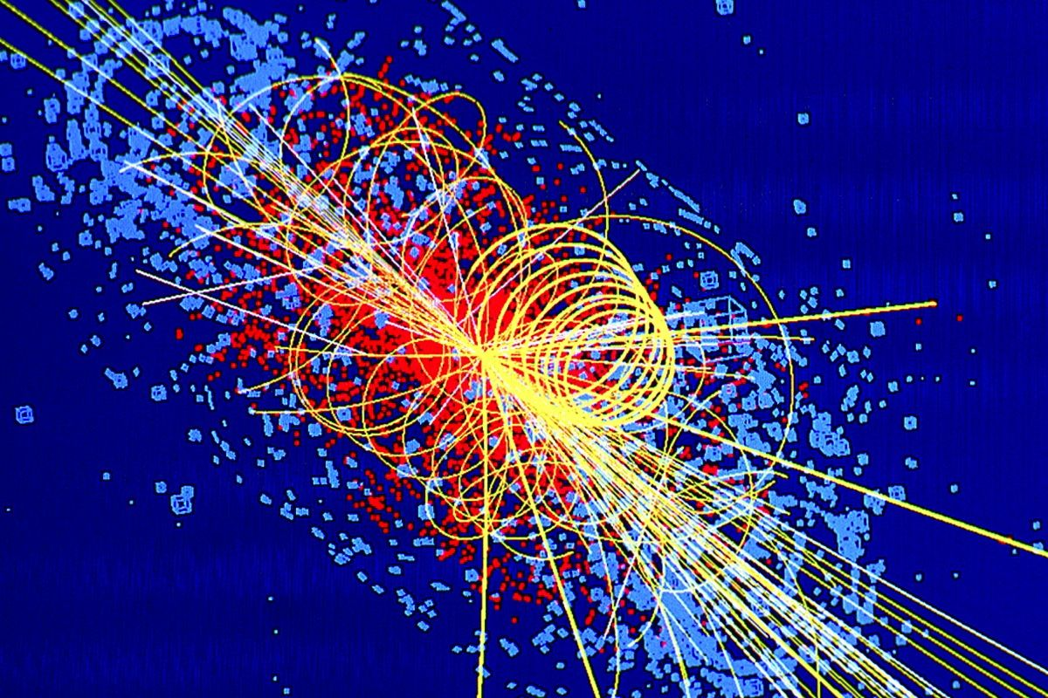
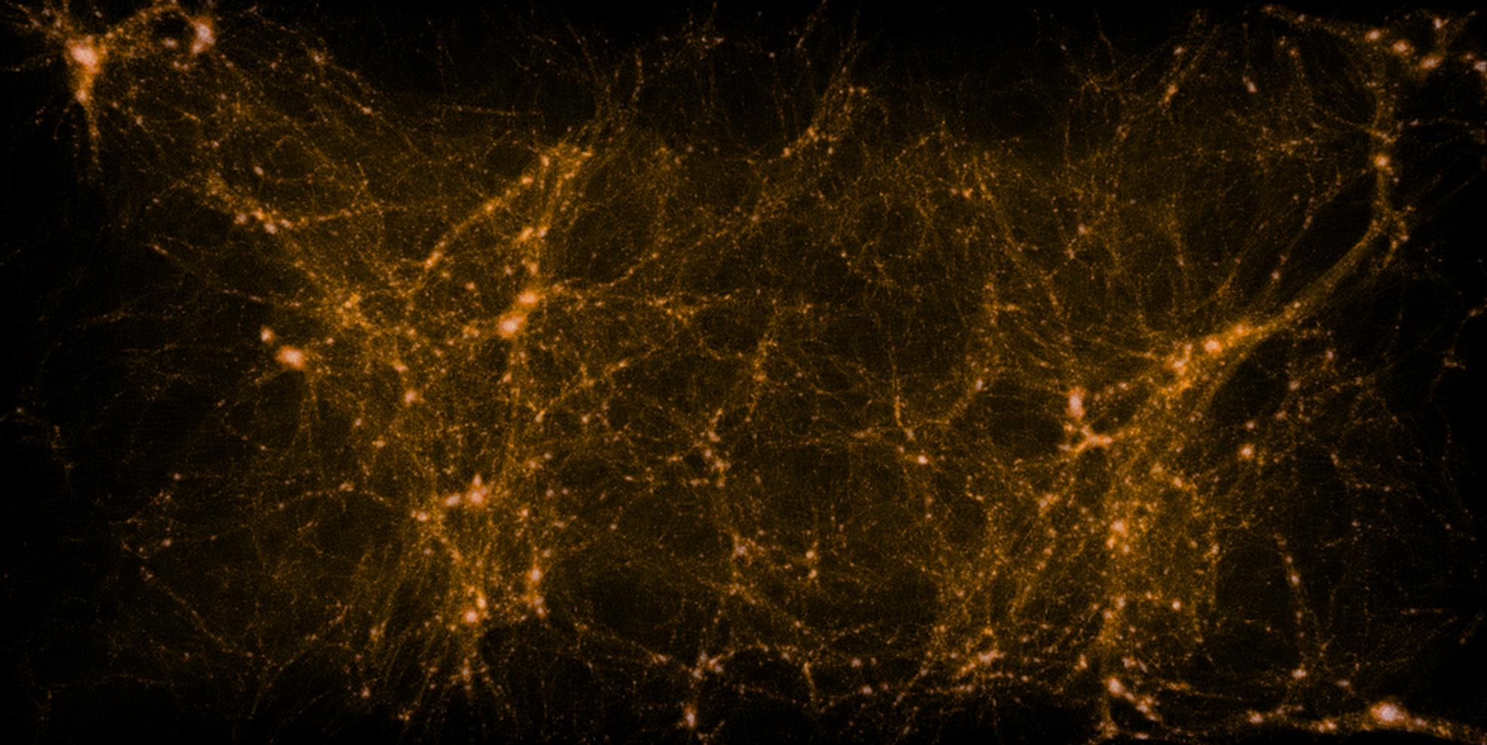
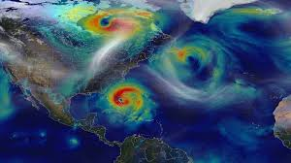
Large-scale simulations – big data
10 PB / year
2 PB / simulation
High-energy physics
Scaled to 786K cores on Mira
Higgs boson simulation
Source: CERN
240 TB / simulation
Cosmology
Q Continuum simulation
Source: Salman Habib et al.
Climate/weather
Hurricane simulation
Source: NASA

Slide 3
Simulation-analysis workflow
Compute resource
Analysis cluster
Disparate computing rate and I/O bandwidth [from TOP500 Nov ’15 list]
Rank 4, K computer: ~11 PF/s, 96 GB/s
Rank 5, Mira: ~10 PF/s, 240 GB/s
Rank 10, Stampede: ~8 PF/s, 159 GB/s
I/O bandwidth for 75% jobs on Intrepid, Mira and Edison < 1 GB/s [Luu et al. HPDC ’15]
Simulation
Analysis
Storage
Data movement for analysis of simulation output
High simulation output volume
Low I/O bandwidth
Challenges
High data movement time → Longer time to insight
Effect
Lower temporal resolution → Fewer analysis steps

Slide 4
Simulation-time analysis
Co-analysis / in-transit
In-situ analysis
Exascale data challenge
Compute resource
Analysis cluster
Compute resource
Space or time-shared
Simulation
Analysis
Simulation
Analysis
Simulation and analysis execute on same resource as different processes
Compute resource
Data movement
Time-shared
Simulation
Analysis
Simulation and analysis execute simultaneously on different resources
Simulation and analysis execute as a single process on the same resource
Advantages
Reduced I/O overhead →Faster insight
More analyses (probably!)

Slide 5
Prior work
In-situ/in-transit analysis
    Framework for analysis
    In-situ analysis for protein-folding, cosmological simulations, etc.
    Pre-selected time steps for analysis
  Bennett et al., SC 12
  Vishwanath et al., LDAV 11
  Abbasi et al., CC 10
  Dreher et al., CCGRID 14
  Zhang B. et al., IPDPS 14
  Zhang F. et al., SCC 12
  Peterka et al., SCC 12
We recommend the set of feasible analyses and their frequencies
Workflow and performance modeling
    Data-intensive applications using deep memory hierarchies
    Simulation-visualization workflow
    Prediction using interaction knowledge between two kernels
  Gamell et al., HiPC 13
  Malakar et al., SC 10
  Wu et al., IPDPS 04
We propose to predict the performance of analysis kernels oblivious of them

Slide 6
In-situ analysis
S: Simulation time step
O_{S}: Simulation output time step
A: Analysis time step
O_{A}: Analysis output time step
1
SSS
SO_{S}SS
SSO_{S}S
SSS
O_{S}
SO_{S}SS
Time
More time
2
SSS
A
SO_{S}SS
A
SSO_{S}S
A
O_{A}
SSS
O_{S} A
SO_{S}SS
3
SSS
A₁A₂
SO_{S}SS
A₁A₂
SSO_{S}S
A₁A₂
O_{A1}O_{A2}
SSS
O_{S} A₁A₂
SO_{S}SS
Simulation and in-situ analysis sequence
1
2
3
Memory
More memory
Memory consumption

Slide 7
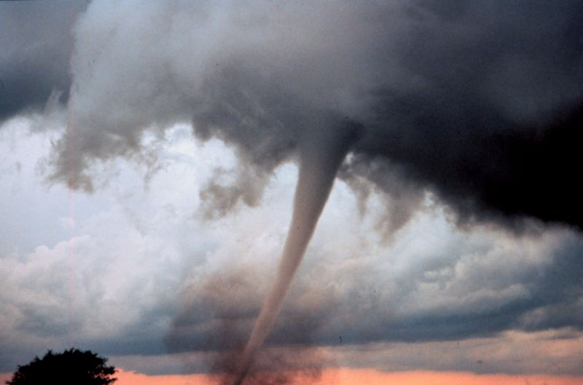
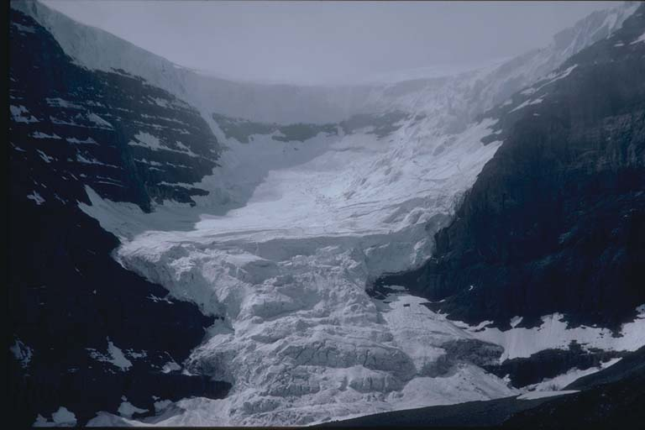
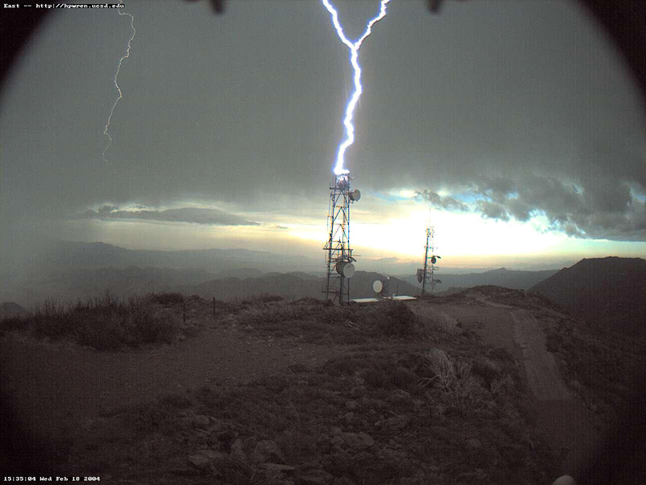
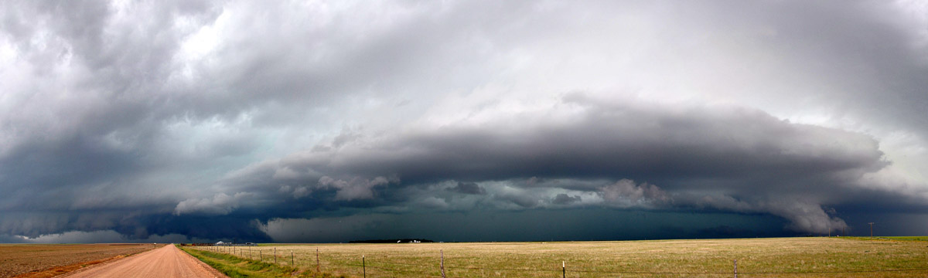

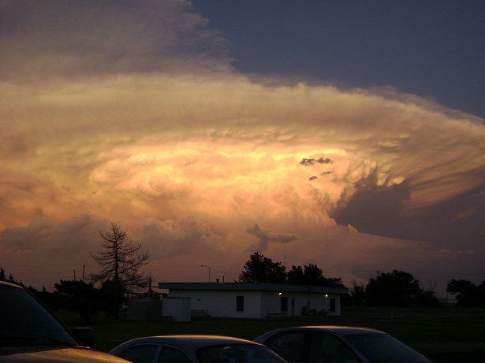
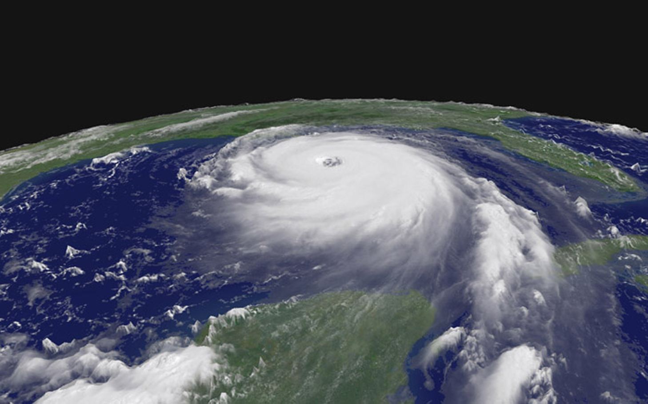
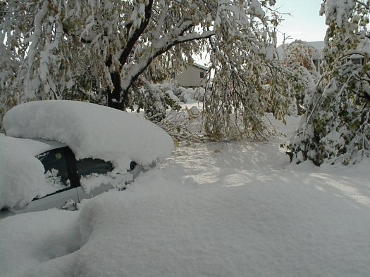
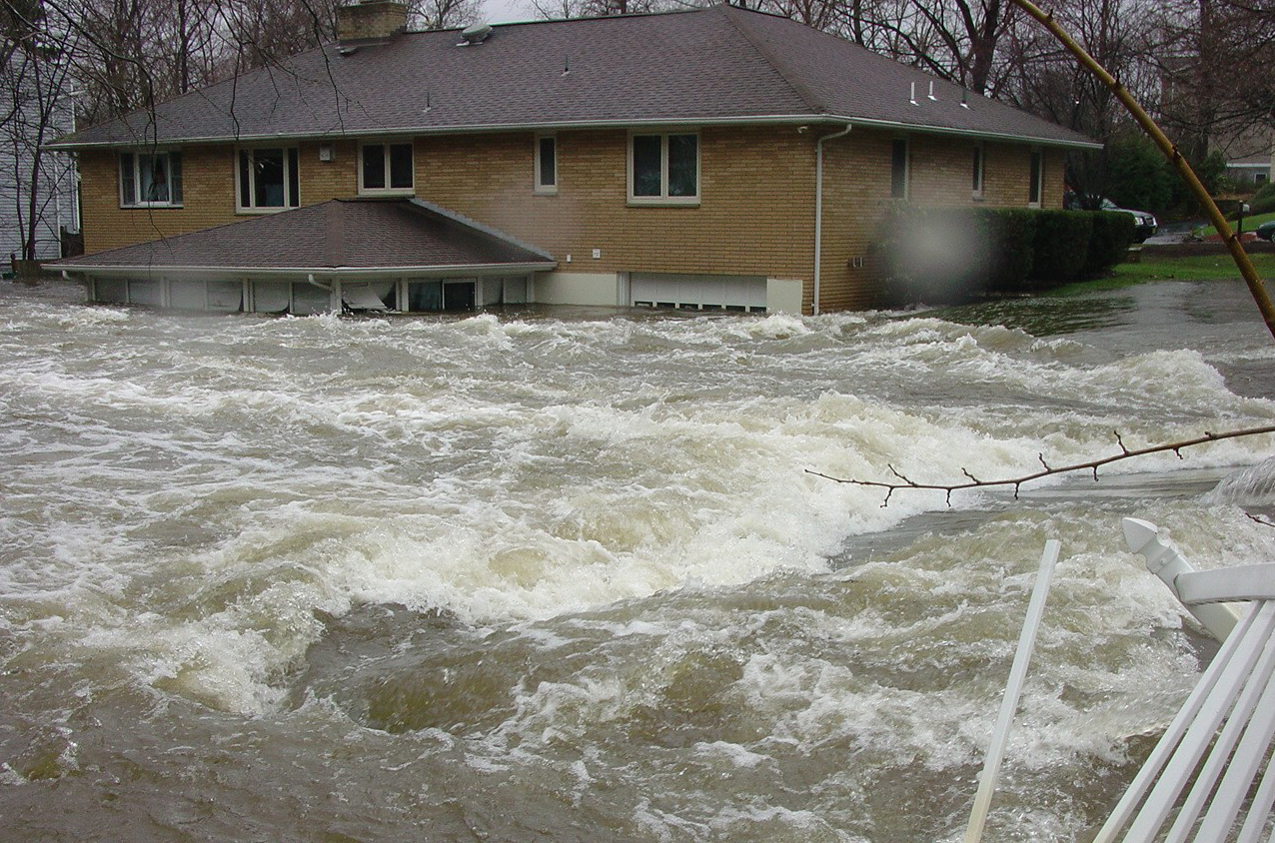
Analyzing weather simulations
Pressure
Wind velocity
Precipitation
Temperature
Water vapor
Snow
Cloud cover
Sea ice
Weather simulation
Source: NOAA

Slide 8
Problem
A₁
T₁, M₁
A₂
T₂, M₂
A₃
T₃, M₃
A₄
T₄, M₄
A₅
T₅, M₅
A₆
T₆, M₆
A₇
T₇, M₇
A₈
T₈, M₈
A₉
T₉, M₉
Analyses
Simulation
Challenge
Many desirable analyses (> 10)
Large number of time steps (> 10,000)
Different features of analyses
Threshold on analyses time
Infeasible to manually decide
Requires a systematic way

Slide 9
In-situ analysis scheduling
How often and what analyses are feasible to compute and output within given resource constraints given the features of desirable analyses ?
Modeling in-situ analysis
Performance prediction

Slide 10
Modeling in-situ analysis
Time
I/O bandwidth
Memory
Analyses features
System parameters
Compute capacity
Minimum interval
Available memory
Importance
Model

Slide 11
Solution – Linear program
Objective: Maximize the total weight (importance) of feasible analyses and the number of different analyses
w_{i} | Weight of i^{th} analysis (Integer input)
|C_{i}| | Frequency of i^{th} analysis (0-1 integer output)
Maximize
Set of analyses
Total weight of i^{th} analysis
Subject to:
Time constraint
Memory constraint
Interval constraint
Mixed integer linear program formulation

Slide 12
Modeling time
Time
Various possible times required by each analysis at various time steps
First time step
Time
Fixed setup time/initialization time
Auxiliary time per simulation step
Output time for writing analysis output
Computation time
Allocation time
Every time step
Time to copy data
Analysis frequency
Analysis output frequency

Slide 13
Time constraint
Fixed setup time/initialization time
Auxiliary time per simulation step
Output time for writing analysis output
Computation time
Time
Setup + computation + output time < Threshold
(1) tAnalyze_{i,t} = tAnalyze_{i,t-1}
  + it_{i}
  + ct_{i} (if C=1)
  + ot_{i} (if O=1)
  (2) tAnalyze_{i,0} = ft_{i}
(3) tAnalyze_{i,Steps} < Threshold
it | Time required per simulation time step
ct | Compute time required
ot | Output time required
ft | Fixed setup time
C | Compute step
O | Output step

Slide 14
Modeling memory
Various possible memory allocations required by each analysis at various time steps
Initial memory allocation
First time step
Memory
Fixed memory allocation
Auxiliary memory required every time step
Memory required for storing analysis output
Memory to copy data
Every time step

Slide 15
Memory constraint
Fixed memory allocation
Auxiliary memory required every time step
Memory required for storing analysis output
Memory
Fixed + auxiliary + output memory < Available free memory
(1) mStart_{i,j} = mEnd_{i,j-1}
  + im_{i}
  + cm_{i} (if C=1)
  + om_{i} (if O=1)
  (2) mEnd_{i,j} = fm_{i} (if O=1)
  mStart_{i,j}
  (3) mEnd_{i,0} = fm_{i}
(4) mStart_{i,j} < Free memory
im | Input memory allocated for analysis per simulation step
cm | Memory allocated per analysis step
om | Memory allocated for output
fm | Fixed memory allocated

Slide 16
Interval constraint
Interval 1
Interval 2
SSSA₁A₂SO_{S}SSA₁A₂SSO_{S}SA₁A₂O_{A1}O_{A2}SSSA₁A₂SSS
Simulation and in-situ analysis sequence
S: Simulation time step
O_{S}: Simulation output time step
A: Analysis time step
O_{A}: Analysis output time step
    Interval_{i} > Minimum interval_{i}
User-defined
Analysis-dependent

Slide 17
In-situ analysis scheduling
How often and what analyses are feasible to compute and output within given resource constraints given the features of desirable analyses ?
Modeling in-situ analysis
Performance prediction

Slide 18
Performance prediction
2048
Time the analyses kernels
      MPI timers
      Profilers
Interpolate
< 8% prediction error
512
Process count/
Network diameter
128
32
800K
6M
25M
1B
Problem Size
Any other performance model can also be used.

Slide 19
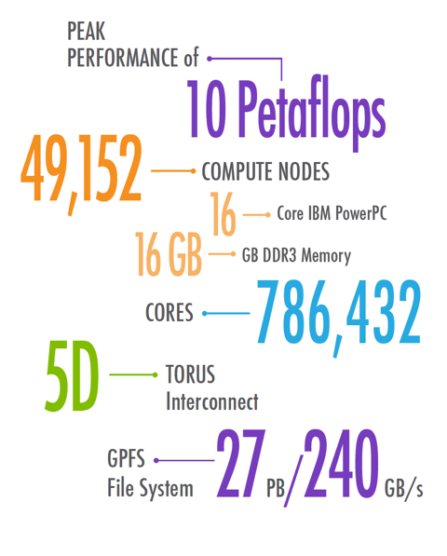
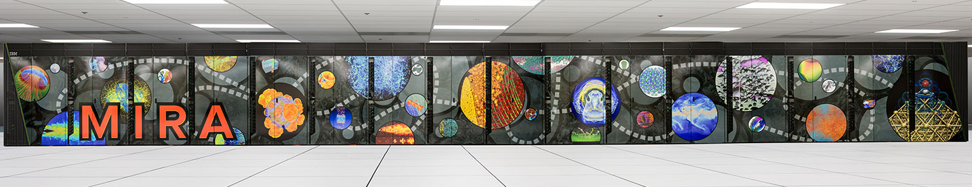
Experiments
    Experiments
    IBM Blue Gene/Q system, Mira, at Argonne National Laboratory
    Maximum of 2048 nodes (32768 cores)
Mira supercomputer
    MILP Solution
    GAMS modeling language, IBM CPLEX v12.6.1
    Time to solve: 0.17 – 1.36 s

Slide 20
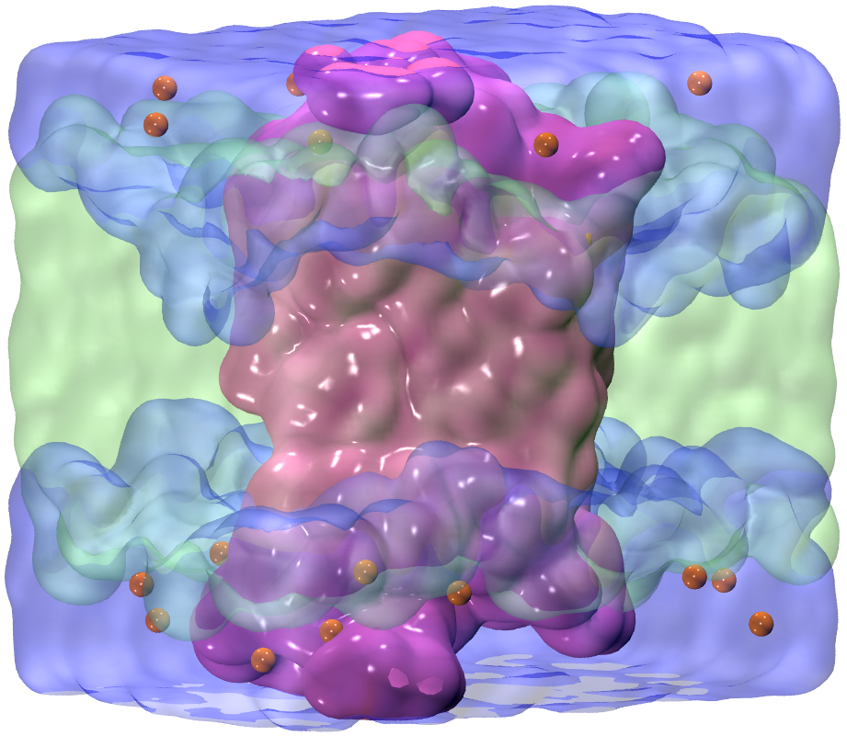
Applications - LAMMPS
    Analyses for simulation of water and ions
      Radial distribution function
      Velocity auto-correlation function
      Mean-square displacements
    Analyses for rhodopsin protein benchmark
      Radius of gyration
      Histogram
Snapshot of the LAMMPS rhodopsin benchmark (32,000 atoms): protein (solid purple; center) is embedded in membrane (translucent green; middle) and solvated with water (translucent blue; top and bottom) and ions (orange spheres).

Slide 21
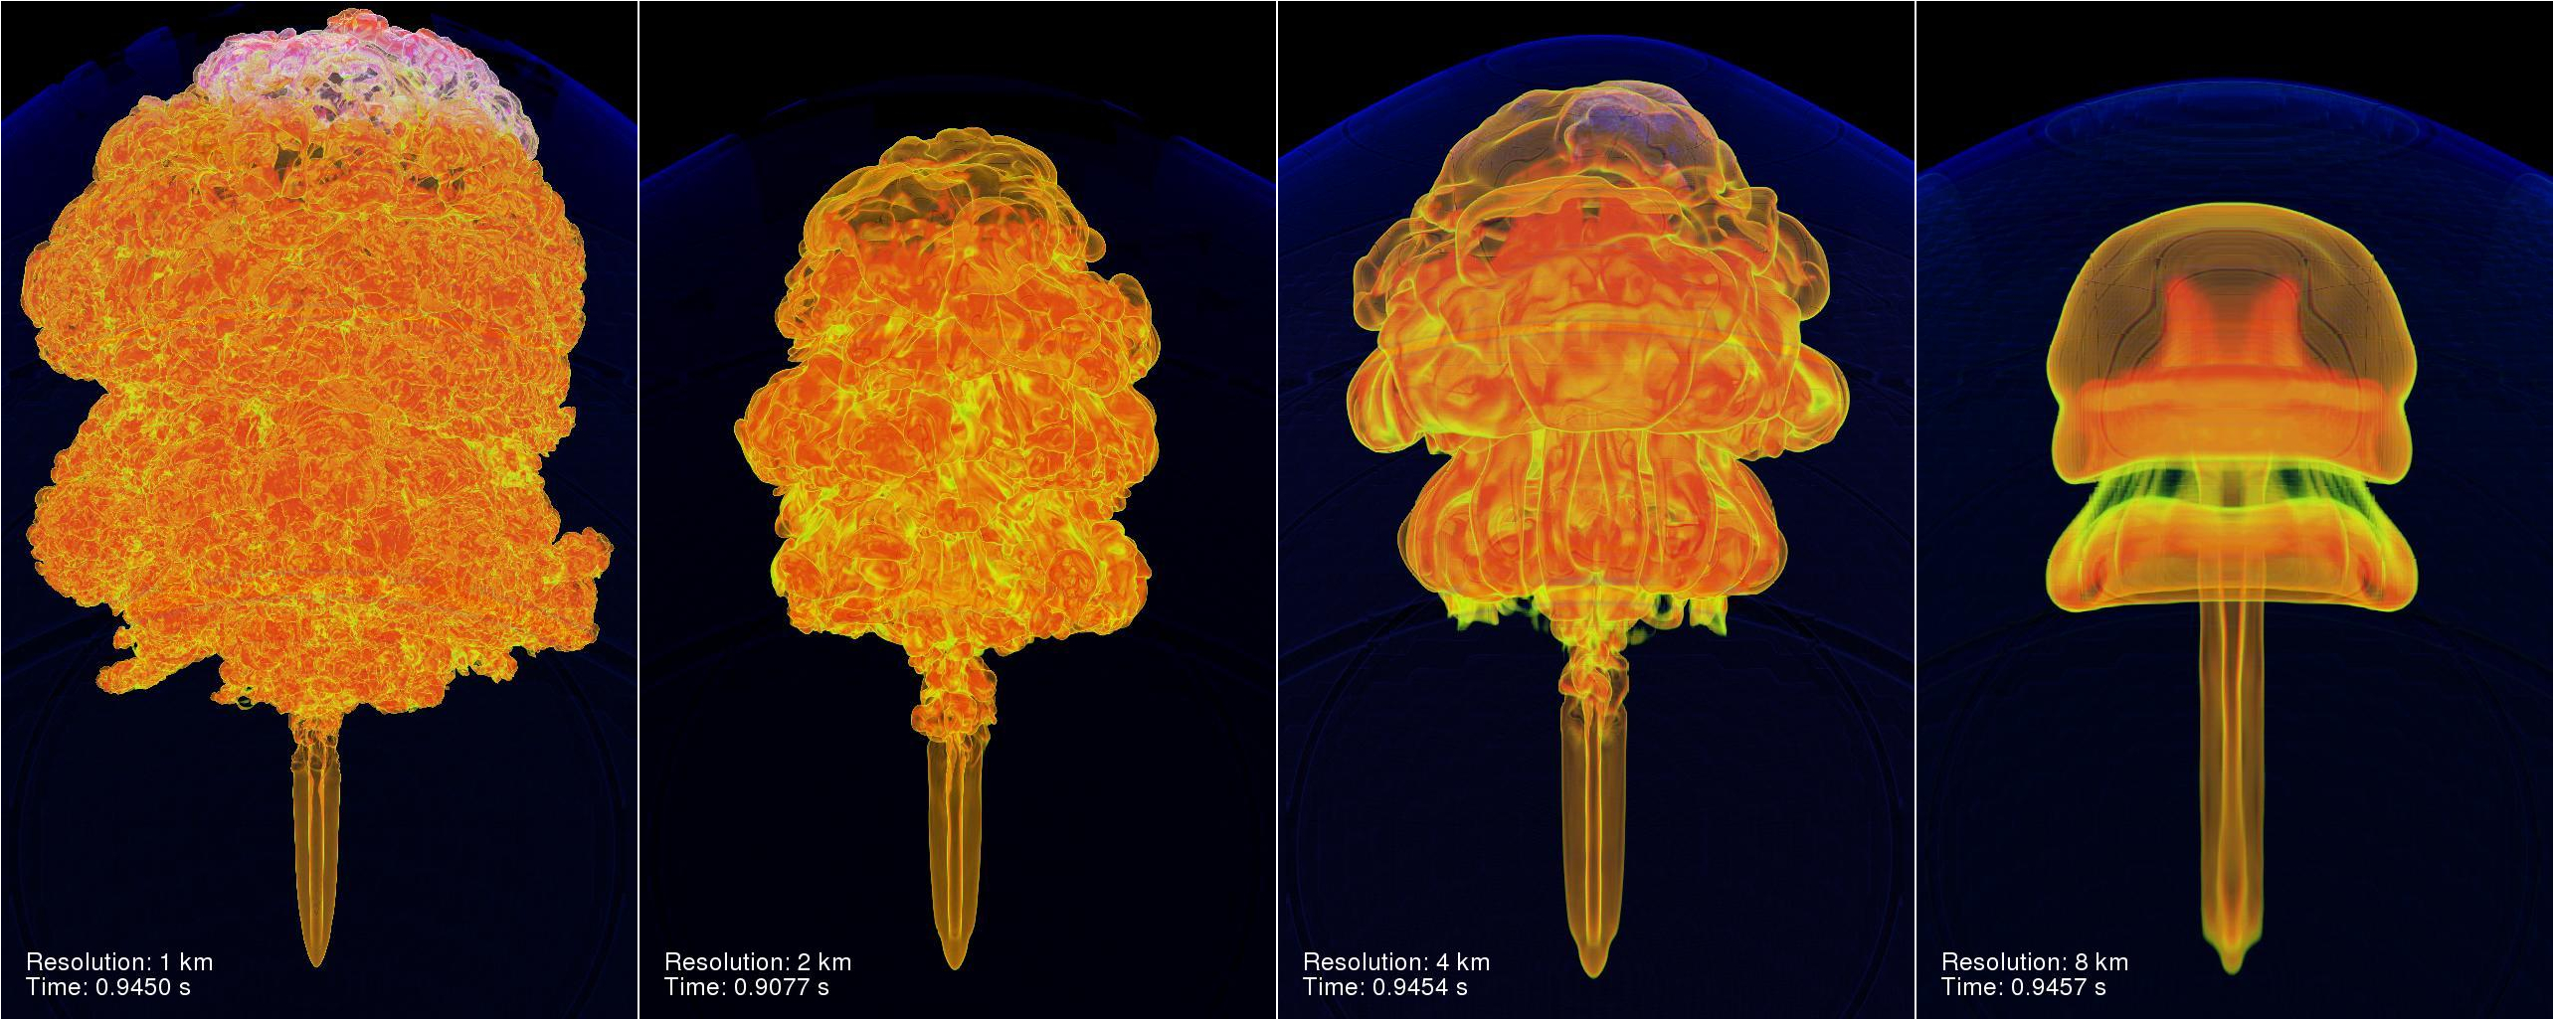
Applications - FLASH
    Analyses for Sedov simulation
    Vorticity
    L1 and L2 error norms
Thermonuclear flame plume rising in a column
^{Credit:flash.uchicago.edu}

Slide 22
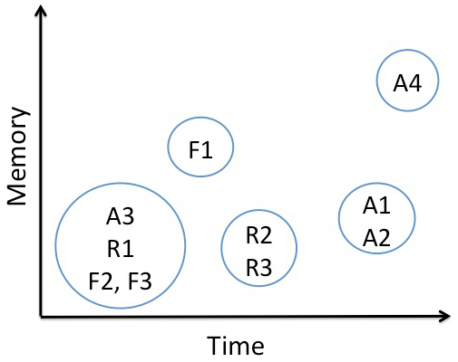
LAMMPS and FLASH analyses signatures
Ai: LAMMPS water+ions
Ri: LAMMPS Rhodopson
Fi: FLASH Sedov
Compute-intensive and/or memory-intensive kernels
Time and memory profiles of analyses kernels.

Slide 23
Results (Scheduling)
Simulation: Rhodopsin protein benchmark, which consists of a protein embedded in a membrane and solvated with water and ions using LAMMPS.
Memory
R1
R2 R3
Time
Total Threshold (sec) | R1 (Radius of gyration) | R2 (Membrane density profile 2D histogram) | R3 (Protein density profile 2D histogram) | % within threshold
200 | 10 | 4 | 7 | 94.59
100 | 10 | 2 | 3 | 85.99
20 | 10 | 1 | 0 | 86.11
10 | 10 | 0 | 0 | 0.3
Analysis frequencies, analysis times, and corresponding thresholds for 1 billion atoms rhodopsin simulation (1000 steps) in LAMMPS on 32768 cores (2048 nodes) of Mira.
Model recommends optimal frequencies for analyses within the given threshold.

Slide 24
Results (Effect of output time)
Simulation: Rhodopsin protein benchmark using LAMMPS.
Sim output + threshold | Simulation output time (s) | Analyses threshold (s) | Number of analyses
250 sec | 200 | 50 | 12
 | 100 | 150 | 18
 | 50 | 200 | 21
Output times, thresholds, and number of analyses for 1 billion atoms rhodopsin simulation (1000 steps) in LAMMPS on 32768 cores of Mira.
Lesser data stored → More number of in-situ analyses

Slide 25
Results (Varying importance)
F1
Simulation: FLASH simulation for Sedov simulation, evolves a blast wave from a delta-function initial pressure perturbation.
Memory
F2 F3
Time
 | F1 (Vorticity) | F2 (L1 error norm for density and pressure) | F3 (L2 error norm for x, y, z velocity variables)
Importance (I1) | 1 | 1 | 1
Frequency | 1 | 10 | 10
Importance (I2) | 2 | 1 | 2
Frequency | 5 | 0 | 10
Analyses frequencies for varying importance of analyses for Sedov simulation (1000 steps) in FLASH on 16384 cores (1024 nodes) of Mira.
Analysis with more importance is assigned higher frequency.

Slide 26
Conclusions
Modeled in-situ analyses considering the application and system parameters
Our model recommends frequency and number of feasible analyses under given resource and application constraints
Presented an efficient model for the scientists to plan in-situ analyses feasibility
In future
Model co-analysis (analysis on a different resource)
More applications

Slide 27
ACKNOWLEDGEMENTS
This research has been funded in part and used resources of the Argonne Leadership Computing Facility at Argonne National Laboratory, which is supported by the Office of Science of the U.S. Department of Energy under contract DE-AC02-06CH11357. This work was supported in part by the DOE Office of Science, Advanced Scientific Computing Research, under award number 57L38, 57L32, 57K07 and 57K50.

Slide 28
SUMMARY
Presented an efficient model that recommends frequency and number of feasible analyses under given resource and application constraints.
Contact: pmalakar@anl.gov
THANK YOU
QUESTIONS?

Slide 29
RESULTS – Post-processing vs. in situ
Analysis time (post-processing and in-situ) for MSD calculation of water+ions simulation in LAMMPS. Post-processing one time step on single node, in-situ on 16K cores of Mira.
In-situ analysis incurs significantly lower cost than post-processing.

Slide 30
RESULTS - Strong scaling
Strong scaling for analyses in 100 million atom water+ions LAMMPS simulation on 2048 – 32768 cores of Mira. Allowed threshold was 10%.

Slide 31
RESULTS – Effect of decreasing threshold
Threshold (%) and analyses frequencies of 4 analyses for 100 million-atom water+ions simulation in LAMMPS on 16384 cores of Mira.

Slide 32
GAMS model (partial)
binary variable on_chip(Analyses);
binary variable compute(Analyses, Steps);
binary variable output(Analyses, Steps);
compute(Analyses, Steps) =l= on_chip(Analyses);
sum(Steps, compute(Analyses, Steps)) =l= n_a_insitu(Analyses);
sum(Steps_Prime$((ord(Steps_Prime) >= ord(Steps)) and (ord(Steps_Prime) < ord(Steps) + min_a_insitu(Analyses))), compute(Analyses,Steps_Prime)) =l= 1;
compute.fx(Analyses,Steps)$(ord(Steps) < min_a_insitu(Analyses)) = 0;
output(Analyses, Steps) =l= compute(Analyses,Steps);

