Slide 1


Hierarchical Read-write Optimizations for Scientific Applications with Multi-variable Structured Datasets
Preeti Malakar and Venkatram Vishwanath
Argonne National Laboratory
NPC 2015

Slide 2
Outline
Introduction
I/O Bottlenecks
Application and System Parameters
HieRO
Two-stage
Three-stage
Results
S3D and WRF
I/O and file open times

Slide 3
Introduction

Slide 4
Storage vs. Computing Trends
Widening gap between I/O and computing rates
Figure: Trend of I/O bandwidth relative to FLOPS in the top supercomputer (from top500.org) over the last few years.
Faster I/O → Improved application performance

Slide 5
I/O Paradigms
I/O Methods
POSIX I/O
MPI-IO
I/O libraries e.g. PnetCDF, HDF etc.
Application Requirements
FOCUS
Block-structured data
  Multi-dimensional arrays
  E.g. Weather, combustion etc.
Unstructured mesh
  E.g. Aerospace, CFD etc.

Slide 6
I/O Bottlenecks
High-level libraries use MPI-IO which can be:
  Independent I/O (Each MPI rank writes/reads)
  Collective I/O (Two-phase I/O using aggregators)
Phase 1 time increases with more ranks
Figure: Collective I/O performance on Blue Gene/Q

Slide 7
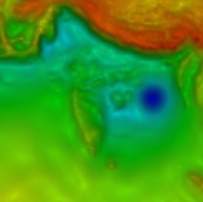
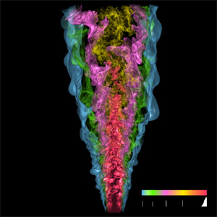
I/O in Practice
Two applications
Weather Research and Forecast model (WRF)
  Used for operational forecasting
  Reads lateral boundary conditions
  2D domain decomposition
Credit: Malakar et al. SC10
S3D
  Turbulent combustion simulation
  3D domain decomposition
Credit: Yu and Chen
Notes:
DNS

Slide 8
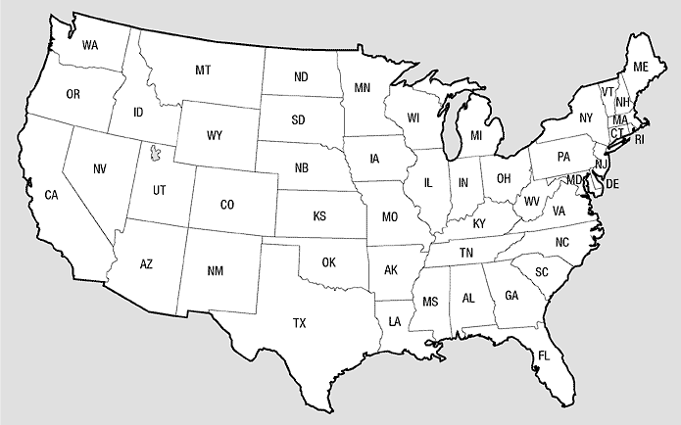
Weather Research and Forecast Model
bdy_width (boundary width)
Longitudinal extent: west_east
Latitudinal extent: south_north
Vertical extent: bottom_top
Boundary width: bdy_width
south_north
Map courtesy: NOAA
west_east
Figure: Weather domain with longitudinal and latitudinal extents and boundary width (bdy_width)
Top and bottom: bdy_width × bottom_top × west_east
Left and right: bdy_width × bottom_top × south_north

Slide 9
Data Access Pattern in WRF
we/px
Column processes read top and bottom boundary
Row processes read left and right boundary
Boundary data
Redundant reads
Network congestion
Boundary data
south_north (sn)
sn/py
west_east (we)
Figure: Boundary reads from px × py processes

Slide 10
Data Access Pattern in S3D
Each rank reads/writes its own data (sub-block)
pz
py
px
Figure: I/O from px × py × pz processes

Slide 11
Common I/O Features
Row-order mapping results in contiguous data being accessed from ranks in the same node or neighboring node
0
1
2
3
4
5
south_north (sn)
Figure: I/O from processes in 3D
west_east (we)
Figure: I/O from processes in 2D
0
1
2
3
4
5
6

Slide 12
Effect of Mapping
NODE 0
NODE 1
ROW 0
C0
C1
C2
C3
C0
C1
C2
C3
. . .
0
1
2
3
7
Row-order mapping of consecutive ranks
NODE 2
NODE 3
ROW 1
C0
C1
C2
C3
C0
C1
C2
C3
. . .
8
9
10
11
15
Figure: Placement of consecutive ranks in two rows in 4-core nodes
Consecutive ranks in a row are ranks on the same or neighboring node

Slide 13
Effect of System Architecture
Compute Nodes
GPFS filesystem
Bridge Node
I/O Nodes
Multiple requests on same links
➔Congested interconnect
Bridge Node
Figure: Blue Gene/Q compute and I/O nodes

Slide 14
Hierarchical Read-write Optimizations (HieRO)

Slide 15
HieRO Overview
Objective
Reduce interconnect contention
Reduce intra-node congestion
Minimize number of I/O requests
Figure: Network contention for I/O
Approach
Select few processes (ranks) as leaders
  Primary leaders: Processes in a row/column
  Secondary leaders: Processes in a node
Perform I/O through leader processes
Leverage the high-bandwidth low-latency interconnect to scatter/gather from leaders

Slide 16
Hierarchical Read-write Optimizations
Two-stage optimization
  Write
    Leaders gather data from row/column
    Leaders write on behalf of all processes
  Read
    Leaders read on behalf of all processes
    Leaders scatter the data to all processes
Three-stage optimization
  Write
    Secondary leaders gather data from ranks in a node
    Primary leaders gather data from secondary leaders
    Primary leaders issue the write requests
  Read
    Primary leaders issue the read requests
    Primary leaders distribute data to secondary leaders
    Secondary leaders scatter data to ranks in a node

Slide 17
Two-stage Optimization
Leaders
Distribute
I/O only from a few ranks
No I/O from consecutive ranks in a row
Reduced congestion
Data scattered on the high-bandwidth network
Row 0
Row 1
Row 2
. . .
Figure: Two-stage optimization for reads through row leaders and subsequent distribution to all processes in each row

Slide 18
Three-stage Optimization
Primary Leaders
C0 – Core 0
C1 – Core 1
…
C0
C1
C2
C3
Row 0
Node 0
Node 1
Node 2
Stage 1: Primary leaders read data
Stage 2: Primary leaders scatter to secondary leaders
Row 1
Row 2
Few I/O requests: from primary leaders
More reduced network contention
. . .
Figure: Primary leaders on 0th core of 0th row distribute the data read along their columns

Slide 19
Three-stage Optimization
Secondary Leaders
Stage 3: Secondary leaders scatter to ranks in a node
Row 0
Row 1
Row 2
Data scattered using intra-node network
Eliminate interconnect contention
. . .
Figure: Secondary leaders distribute data read to other ranks in the same node

Slide 20
Advantages of HieRO
Figure: Reduced network contention
HieRO leads to lesser
network contention due to decrease in the number of I/O messages
synchronization overhead because of fewer I/O calls
interconnect contention
node-level contention
file system contention because of fewer requests

Slide 21
Results

Slide 22

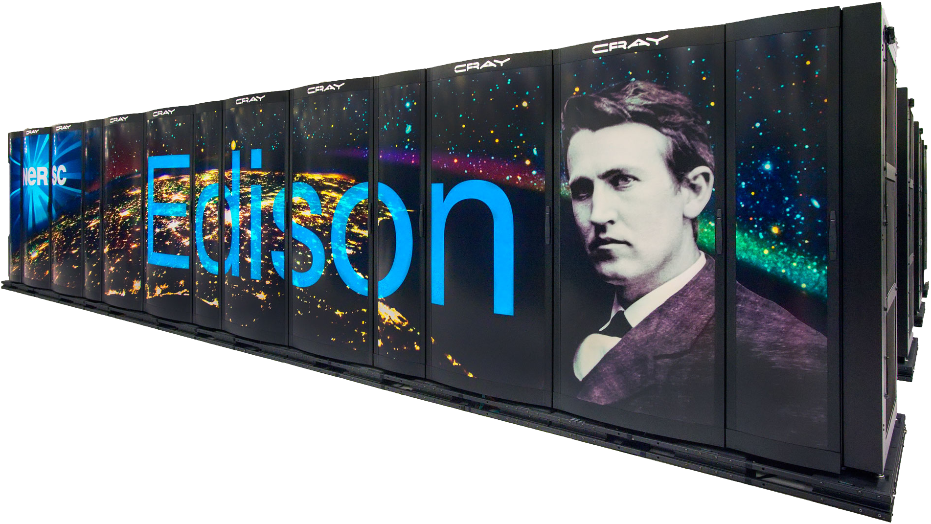
Experiment Setup
Mira (Currently ranked 5 in top500.org)
10 PF, 49152 16-core nodes
Power BQC 1.6 GHz processor
16 GB RAM per node
5D torus interconnect
GPFS filesystem
Maximum cores used - 524288
Edison (Currently ranked 34 in top500.org)
2.7 PF, 5576 24-core nodes
Cray XC30, Intel Xeon E5, 2.4 GHz processor
64 GB RAM per node
Aries interconnect with dragonfly topology
Lustre filesystem
Maximum cores used - 30240
Courtesy: ALCF@ANL
Courtesy: NERSC@LBL

Slide 23
I/O Benchmarks
S3D-IO
Developed at Northwestern
I/O benchmark for combustion code S3D, developed at Sandia
PnetCDF blocking and non-blocking, collective and independent reads and writes
11 – 100 species, 16 – 256 MB per variable data
WRF-IO
Developed at Argonne
Boundary read benchmark for Weather Research & Forecast model
PnetCDF blocking and non-blocking, collective and independent reads
1100×800×37 domain, boundary width 10, 136 boundary variables

Slide 24
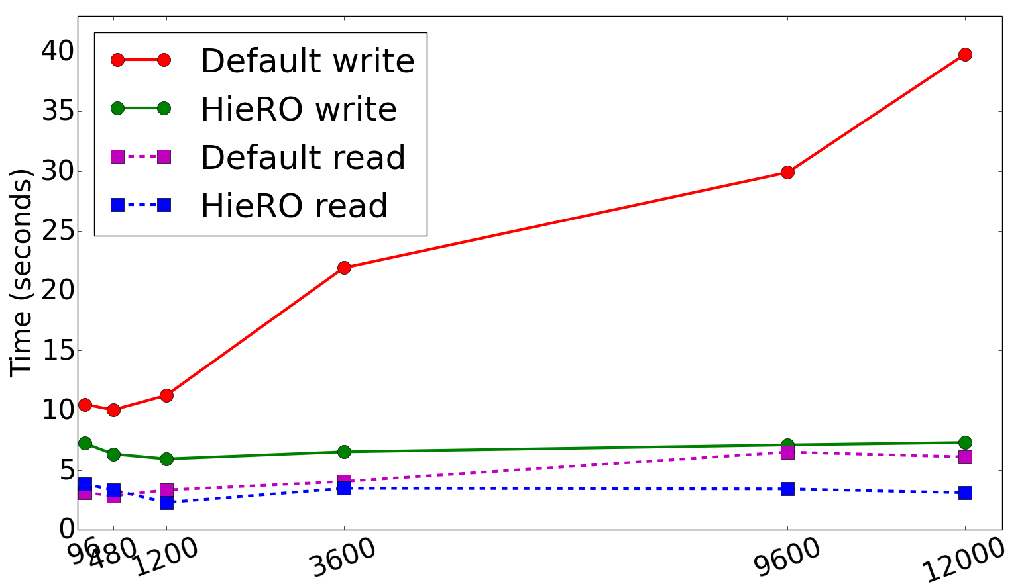
Results 1: S3D-IO time on Edison
Fewer I/O requests → Lesser congestion at higher number of ranks
Increasing due to higher file system contention
Nearly constant
Figure: Read and write times for 11 species, domain size of 240×300×160 on 96 - 12000 processes

Slide 25
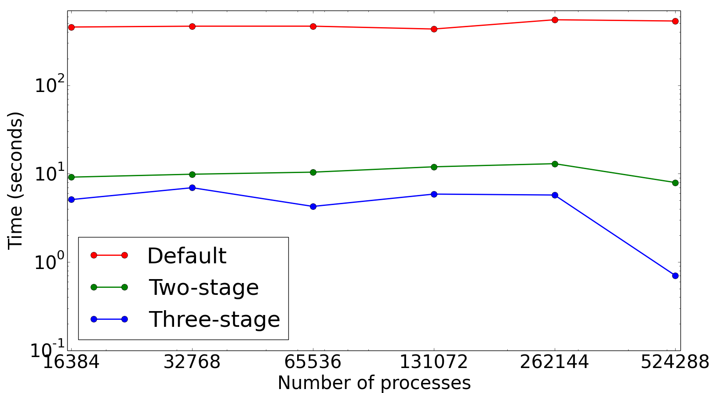
Results 2: WRF-IO time on Mira
Fewer leaders in three-stage optimization → Fewer I/O requests
Lower file system contention
Lower contention from other jobs
Reduced contention by > 500x
Reduced contention by > 8000x
Figure: Collective read times for 136 variables, domain size of 1100×800×37 on 16K- 512K processes

Slide 26
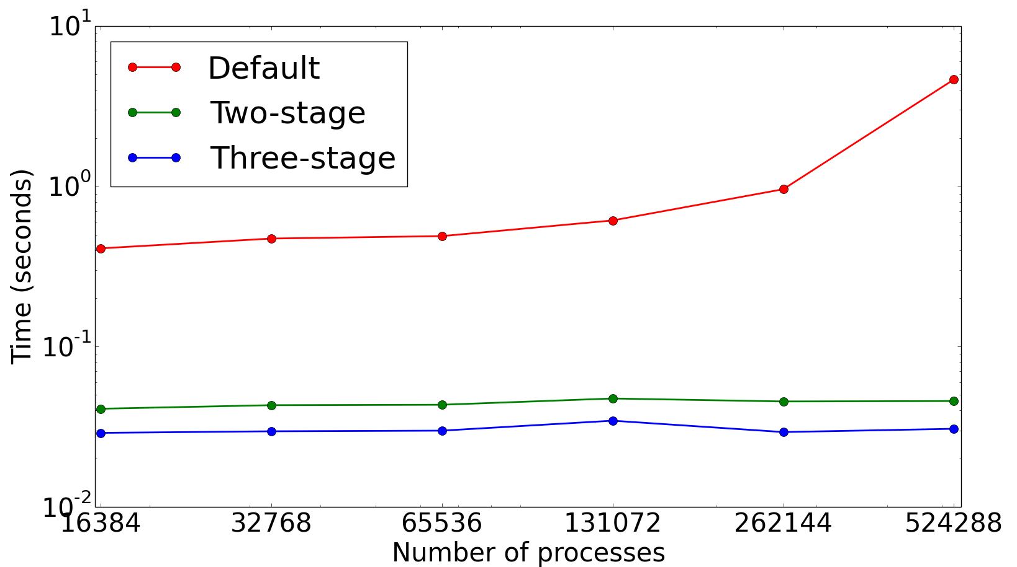
Results 3: WRF open time on Mira
HieRO reduces open times by 100x at higher process counts
4.6 s
Increasing open time
0.04 s
0.03 s
Figure: Open times for 136 variables, domain size of 1100×800×37 on 16K-512K processes

Slide 27
Summary
Proposed HieRO
    Reduced number of I/O requests have huge impact on I/O
    Two-stage and three-stage optimizations
    Experimented with two different access patterns
    Showed results on IBM and Cray systems
    40x read time improvements for WRF
    Up to 40x read and 13x write time improvements for S3D on 524288 cores

Slide 28
Acknowledgements
Argonne Leadership Computing Facility, Argonne National Laboratory, which is supported by the Office of Science of the U.S. DOE
National Energy Research Scientific Computing Facility (NERSC), Lawrence Berkeley National Laboratory.
Jiali Wang and V. Rao Kotamarthi, Environmental Science Division, Argonne National Laboratory
Thank You !!
Questions ?
pmalakar@anl.gov
venkat@anl.gov

Slide 29
Backup slides

Slide 30
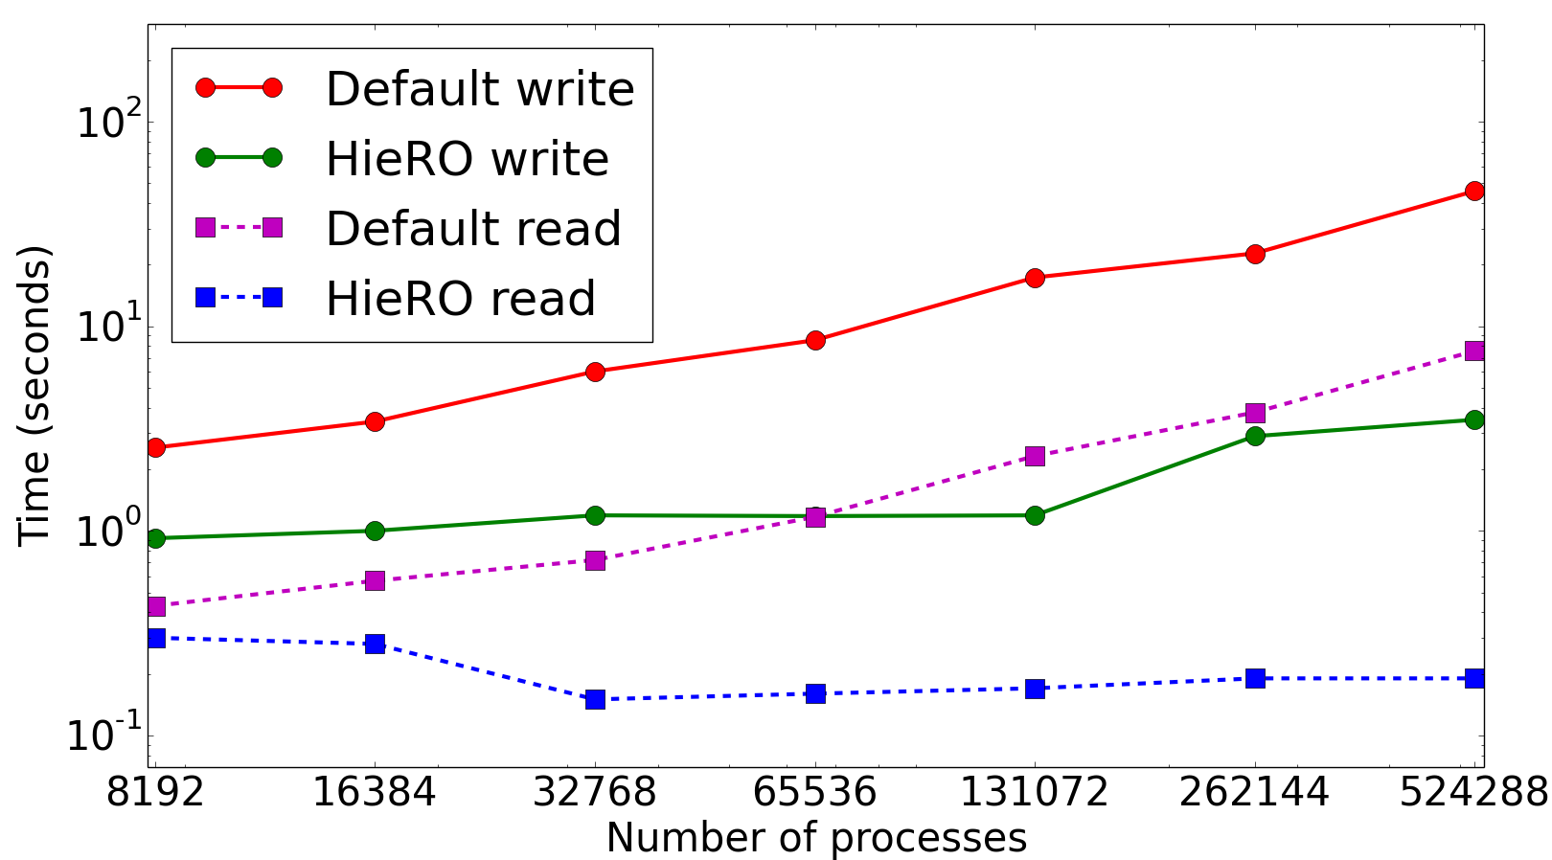
Results 1: S3D-IO time on Mira
Fewer I/O requests → Lesser network contention
Increasing
Nearly constant
Figure: Read and write times for 11 species, domain size of 128×128×128 on 8K- 512K processes

Slide 31
Two-stage Optimization
. . .
Col 0
Col 1
Col 2
Leaders
Reduced I/O requests
Reduced contention
Distribute
Figure: Two-stage optimization for reads through column leaders and subsequent distribution to all processes in each column

Slide 32
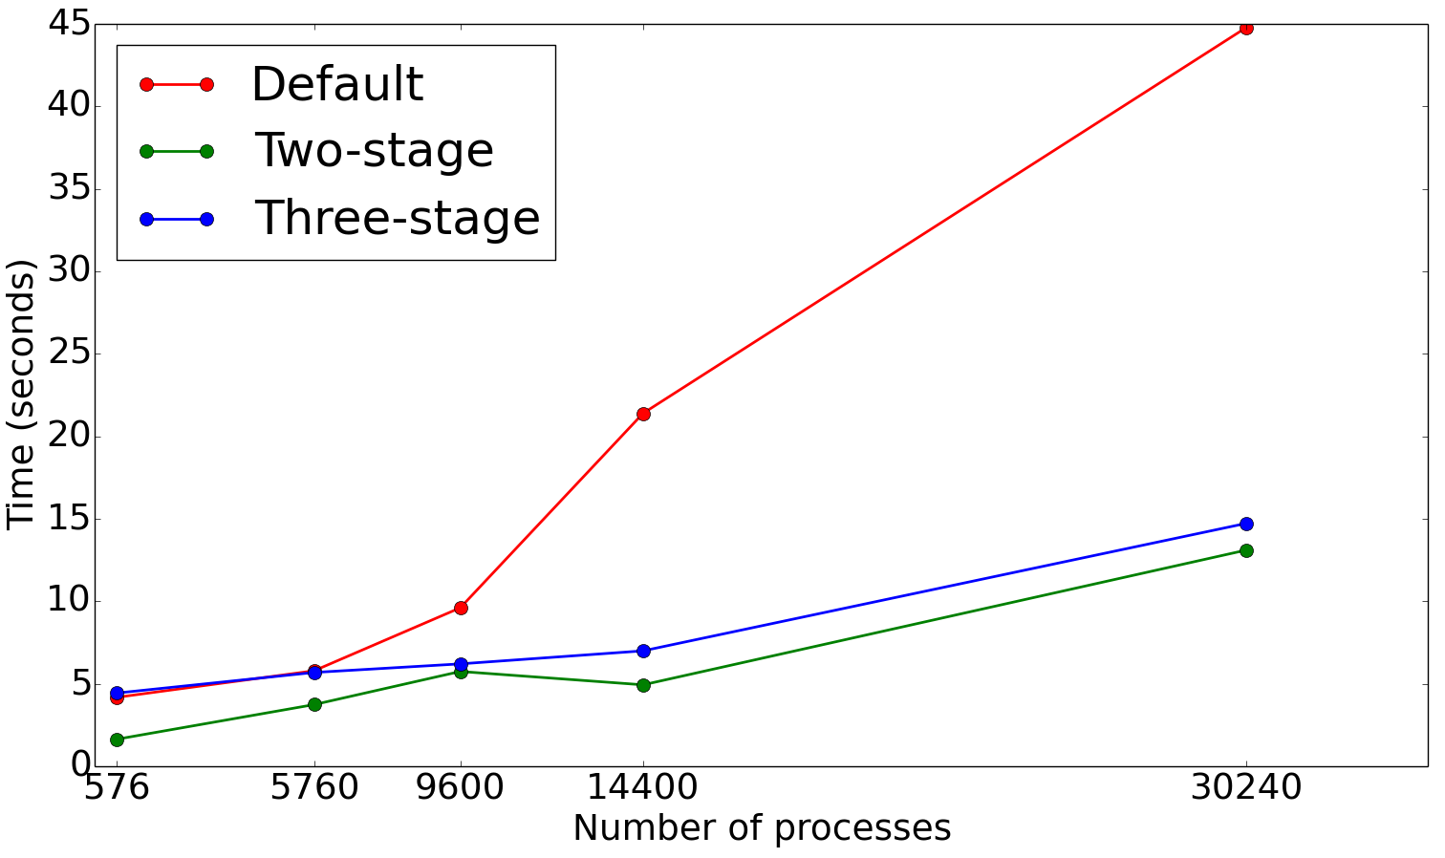
Results 4: WRF-IO time on Edison
HieRO performs better in the case of independent reads as well
Increasing read time
Figure: Independent read times for 136 variables, domain size of 1100×800×37 on 576- 30240 processes

