Slide 1
Generative Supervised Learning
CS772A: Probabilistic Machine Learning
Piyush Rai

Slide 2
Announcement
Students facing issues with marking biometric attendance: Please visit Biometrics office (located below L-16) to get the issue fixed.

Slide 3








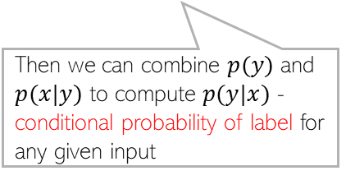

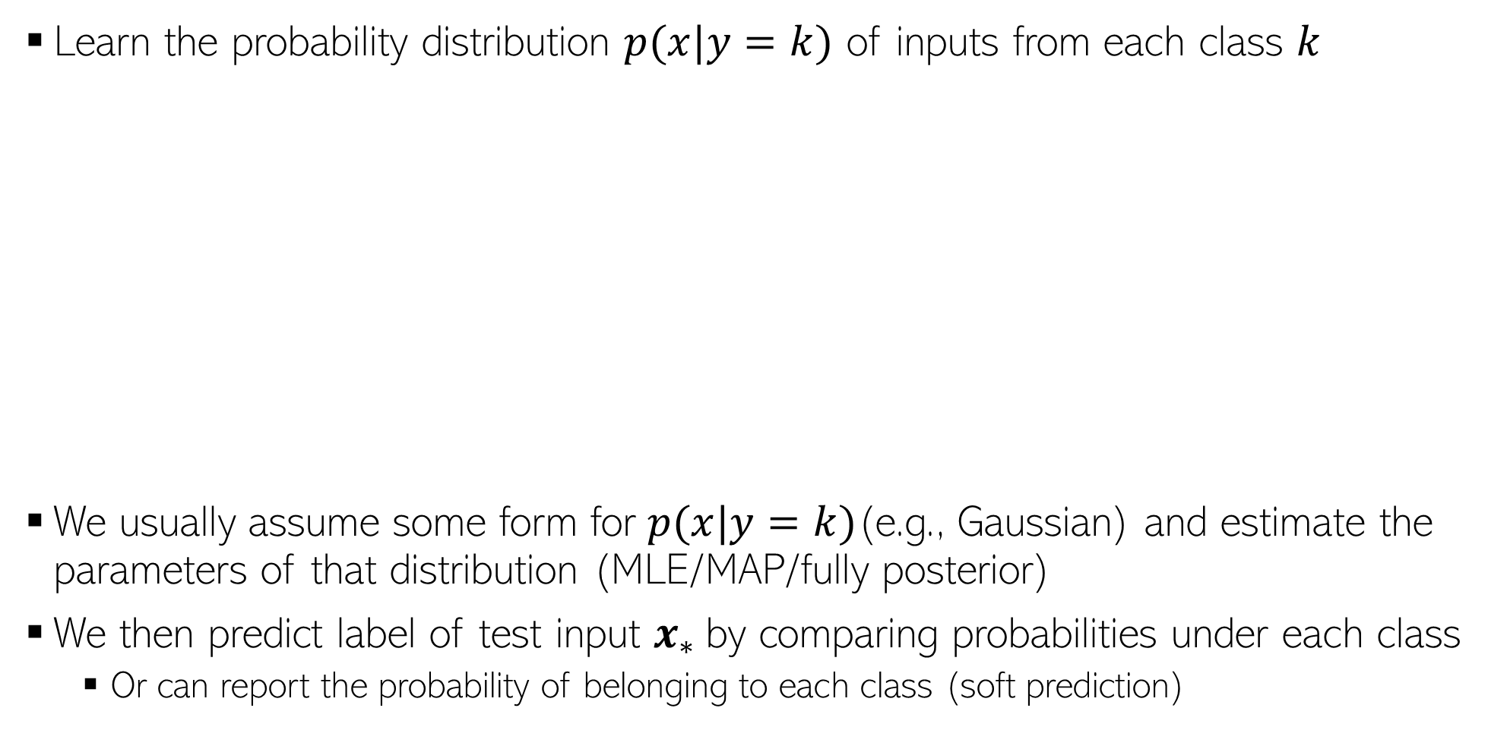


Generative Classification: A Basic Idea
Learn the probability distribution $p(x|y=k)$ of inputs from each class $k$
We usually assume some form for $p(x|y=k)$(e.g., Gaussian) and estimate the parameters of that distribution (MLE/MAP/fully posterior)
We then predict label of test input $x_{∗}$by comparing probabilities under each class
Or can report the probability of belonging to each class (soft prediction)
Yes. Possible with generative model. We can do it by estimating class marginal probabilities $p(y)$ (class proportions in the training data) in our model
What if I expect that the green class is more likely for a test input because the training data also had more green examples?
$$p(x|"red")$$
Then we can combine $p(y)$ and $p(x|y)$ to compute $p(y|x)$ - conditional probability of label for any given input
$$p(x_{∗}|class)$$
$$p(x_{∗}|class)$$
Can I incorporate this knowledge?
$$p(x|"green")$$
$$p(x_{∗}|class)$$
Going to talk about this next
$$x_{∗}$$
$$x_{∗}$$
$$x_{∗}$$

Slide 4
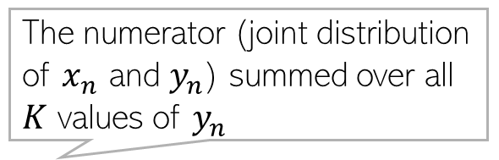
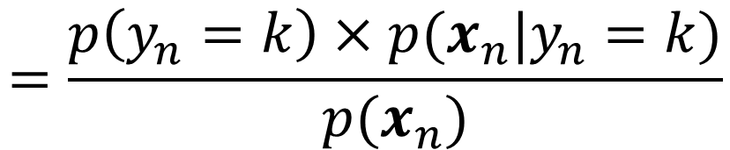
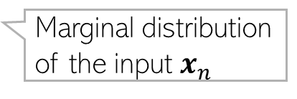
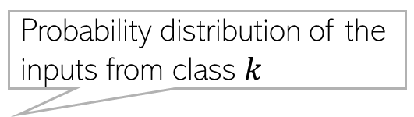
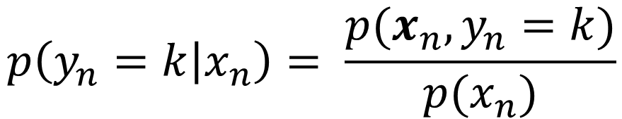

Generative Classification
Suppose we have training data $\{{\left(x_{n},y_{n}\right)\}}_{n=1}^{N}$ from $K$ classes
The conditional probability of label $y_{n}$ given the input $x_{n}$
We use the training data to estimate the class-marginal and class-conditionals
Known as the “class-conditional” distribution
$$p\left(y_{n}=k | x_{n}\right)= \frac{p(x_{n},y_{n}=k)}{p(x_{n})}$$
Probability distribution of the inputs from class $k$
Known as “class-marginal” or “class-prior” distribution
The numerator (joint distribution of $x_{n}$ and $y_{n}$) summed over all $K$ values of $y_{n}$
$$=\frac{p\left(y_{n}=k\right)×p(x_{n}|y_{n}=k)}{p(x_{n})}$$
Marginal distribution of just the labels (not looking at the inputs) – Bernoulli/multinoulli
Marginal distribution of the input $x_{n}$

Slide 5
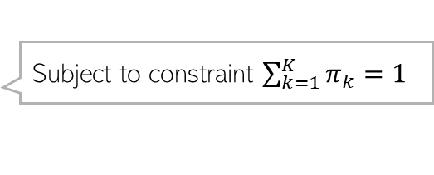
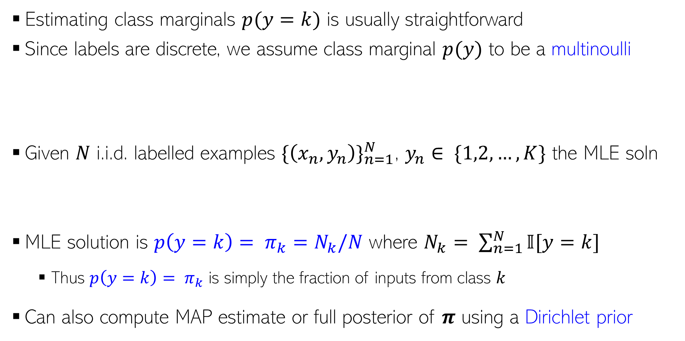
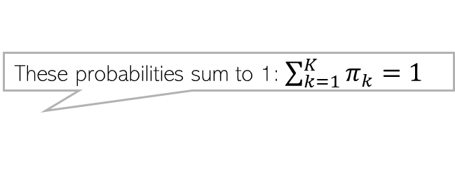
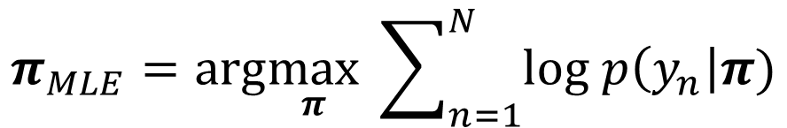

Estimating Class Marginals
If only two classes, assume Bernoulli
Estimating class marginals $p(y=k)$ is usually straightforward
Since labels are discrete, we assume class marginal $p(y)$ to be a multinoulli
Given $N$ i.i.d. labelled examples ${\{\left(x_{n},y_{n}\right)\}}_{n=1}^{N}$, $y_{n}∈ \{1,2,…,K\}$ the MLE soln
MLE solution is ${p\left(y=k\right)= π}_{k}=N_{k}/N$ where $N_{k}= \sum_{n=1}^{N}{𝕀[y=k]}$
Thus ${p\left(y=k\right)= π}_{k}$ is simply the fraction of inputs from class $k$
Can also compute MAP estimate or full posterior of $π$ using a Dirichlet prior
These probabilities sum to 1: $\sum_{k=1}^{K}{π_{k}=1}$
$$π_{k} = p(y=k)$$
$p\left(y | π\right)=multinoulli(y|π_{1},π_{2},…,π_{K})= \prod_{k=1}^{K}{π_{k}^{𝕀[y=k]}}$
$$π_{MLE}=arg\max_{π} \sum_{n=1}^{N}{log p\left(y_{n}\right|π)}$$
Subject to constraint $\sum_{k=1}^{K}{π_{k}=1}$

Slide 6
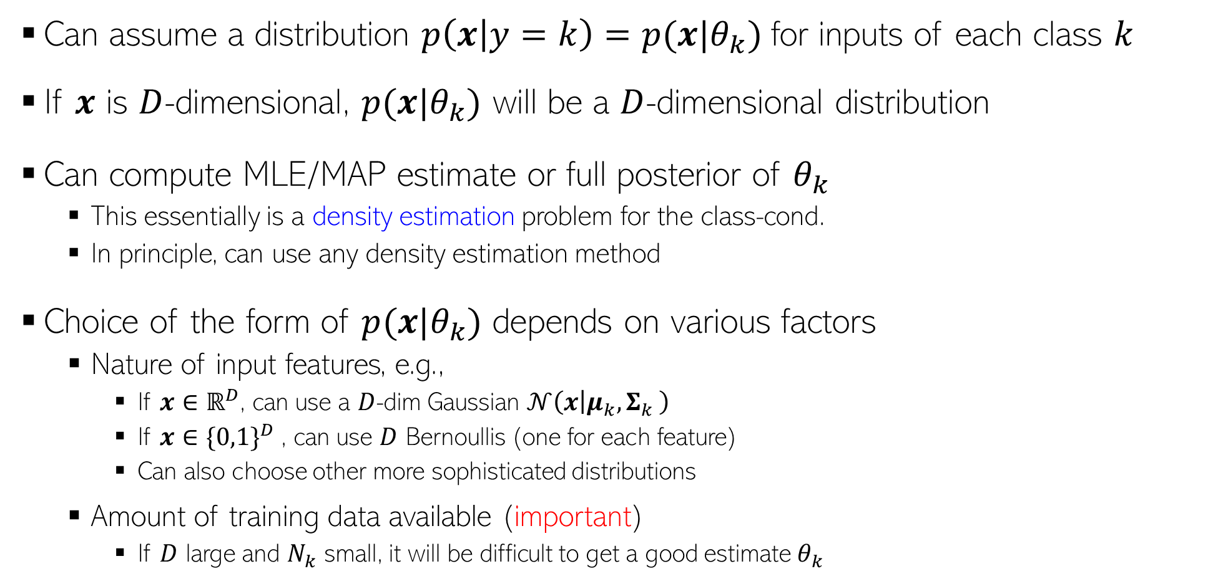
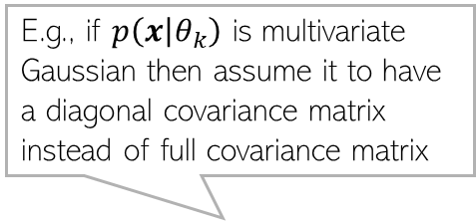

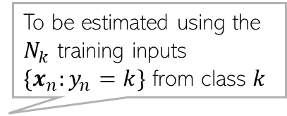
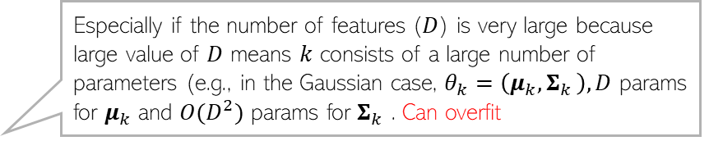
Estimating Class-Conditionals
To be estimated using the $N_{k}$ training inputs $\{x_{n}:y_{n}=k\}$ from class $k$
Can assume a distribution $p\left(x | y=k\right)=p(x|θ_{k})$for inputs of each class $k$
If $x$ is $D$-dimensional, $p(x|θ_{k})$ will be a $D$-dimensional distribution
Can compute MLE/MAP estimate or full posterior of $θ_{k}$
This essentially is a density estimation problem for the class-cond.
In principle, can use any density estimation method
Choice of the form of $p(x|θ_{k})$ depends on various factors
Nature of input features, e.g.,
If $x∈ℝ^{D}$, can use a $D$-dim Gaussian $𝒩\left(x | μ_{k}{,Σ}_{k}\right)$
If $x∈{\{0,1\}}^{D}$, can use $D$ Bernoullis (one for each feature)
Can also choose other more sophisticated distributions
Amount of training data available (important)
If $D$ large and $N_{k}$ small, it will be difficult to get a good estimate $θ_{k}$
E.g., if $p\left(x | θ_{k}\right)$ is multivariate Gaussian then assume it to have a diagonal covariance matrix instead of full covariance matrix
Such assumptions greatly reduce the number of parameters to be estimated
In such cases, we may need to regularize $θ_{k}$ or make some simplifying assumptions on $p\left(x | θ_{k}\right)$, such as features being conditionally independent given class e.g., $p\left(x | θ_{k}\right)= \prod_{d=1}^{D}{p(x_{d}|θ_{kd})}$ - naïve Bayes
Especially if the number of features ($D$) is very large because large value of $D$ means $k$ consists of a large number of parameters (e.g., in the Gaussian case, $θ_{k}=\left(μ_{k}{,Σ}_{k}\right), D$ params for $μ_{k}$ and $O(D^{2})$ params for $Σ_{k}$ . Can overfit

Slide 7

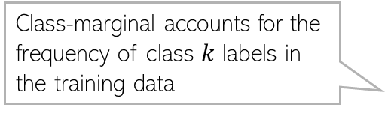
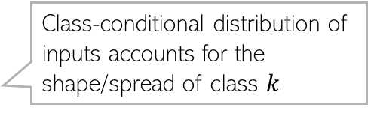

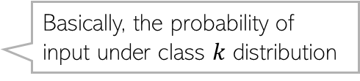
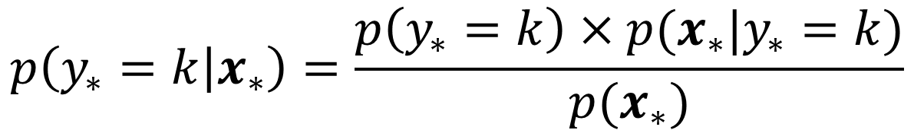
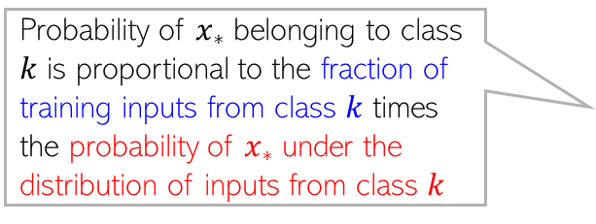
Generative Classification: At Test Time
Recall the form of the conditional distribution of the label
If we assume the class-marginal to be uniform ($p\left(y_{∗}=k\right)=1/K)$ then
The most likely label is $y_{∗}= {argmax}_{k∈\{1,2,…,K\}} p\left(y_{∗}=k | x_{∗}\right)$
Class-marginal accounts for the frequency of class $k$ labels in the training data
Class-conditional distribution of inputs accounts for the shape/spread of class $k$
$$p\left(y_{∗}=k | x_{∗}\right)=\frac{p\left(y_{∗}=k\right)×p(x_{∗}|y_{∗}=k)}{p(x_{∗})}$$
Probability of $x_{∗}$ belonging to class $k$ is proportional to the fraction of training inputs from class $k$ times the probability of $x_{∗}$ under the distribution of inputs from class $k$
$$∝p\left(y_{∗}=k\right)×p(x_{∗}|y_{∗}=k)$$
$$p\left(y_{∗}=k | x_{∗}\right)∝p(x_{∗}|y_{∗}=k)$$
Basically, the probability of input under class $k$ distribution

Slide 8




Generative Classification: At Test Time
Prediction rule is
If we have point estimates for $π$and ${\{θ_{k}\}}_{k=1}^{K}$, say $\hat{π}$ and ${\{{\hat{θ}}_{k}\}}_{k=1}^{K}$
If we have posteriors for $π$and ${\{θ_{k}\}}_{k=1}^{K}$ then
$$p\left(y_{∗}=k | x_{∗}\right)∝p\left(y_{∗}=k\right)×p(x_{∗}|y_{∗}=k)$$
$$p\left(y_{∗}=k\right)=p\left(y_{∗}=k | \hat{π}\right)={\hat{π}}_{k}$$
$$p\left(x_{∗} | y_{∗}=k\right)=p(x_{∗}|{\hat{θ}}_{k})$$
PPD of $y_{∗}$
$$p(y_{∗}=k)= p\left(y_{∗}=k | y\right)=∫p\left(y_{∗}=k | π\right)p\left(π | y\right)dπ$$
$$p\left(x_{∗} | y_{∗}=k\right)= p\left(x_{∗} | X_{k}\right)=∫p\left(x_{∗} | θ_{k}\right)p\left(θ_{k} | X_{k}\right)dθ_{k}$$
PPD of $x_{∗}$

Slide 9
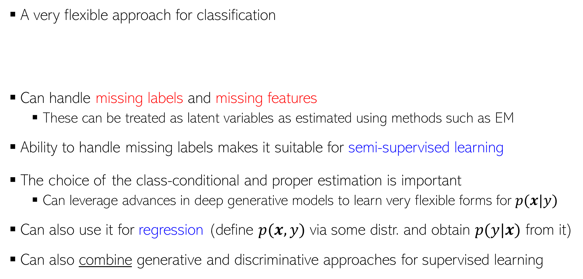
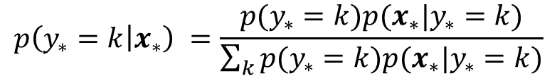
Generative Sup. Learning: Some Comments
9
A very flexible approach for classification
Can handle missing labels and missing features
These can be treated as latent variables as estimated using methods such as EM
Ability to handle missing labels makes it suitable for semi-supervised learning
The choice of the class-conditional and proper estimation is important
Can leverage advances in deep generative models to learn very flexible forms for $p(x|y)$
Can also use it for regression (define $p(x,y)$ via some distr. and obtain $p(y|x)$ from it)
Can also combine generative and discriminative approaches for supervised learning
Consequently, can naturally learn nonlinear boundaries, too (without using kernel methods or deep learning)
Incorporate info about how frequent each class is in the training data (“class prior”)
Incorporate info about the shape of each class
$$p\left(y_{∗}=k | x_{∗}\right) =\frac{p(y_{∗}=k)p(x_{∗}|y_{∗}=k)}{\sum_{k}{p(y_{∗}=k)p(x_{∗}|y_{∗}=k)}}$$
Will discuss this later

Slide 10

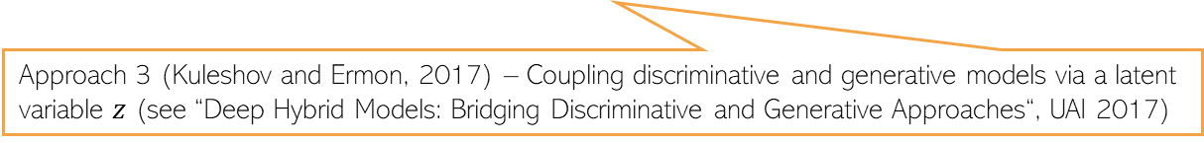
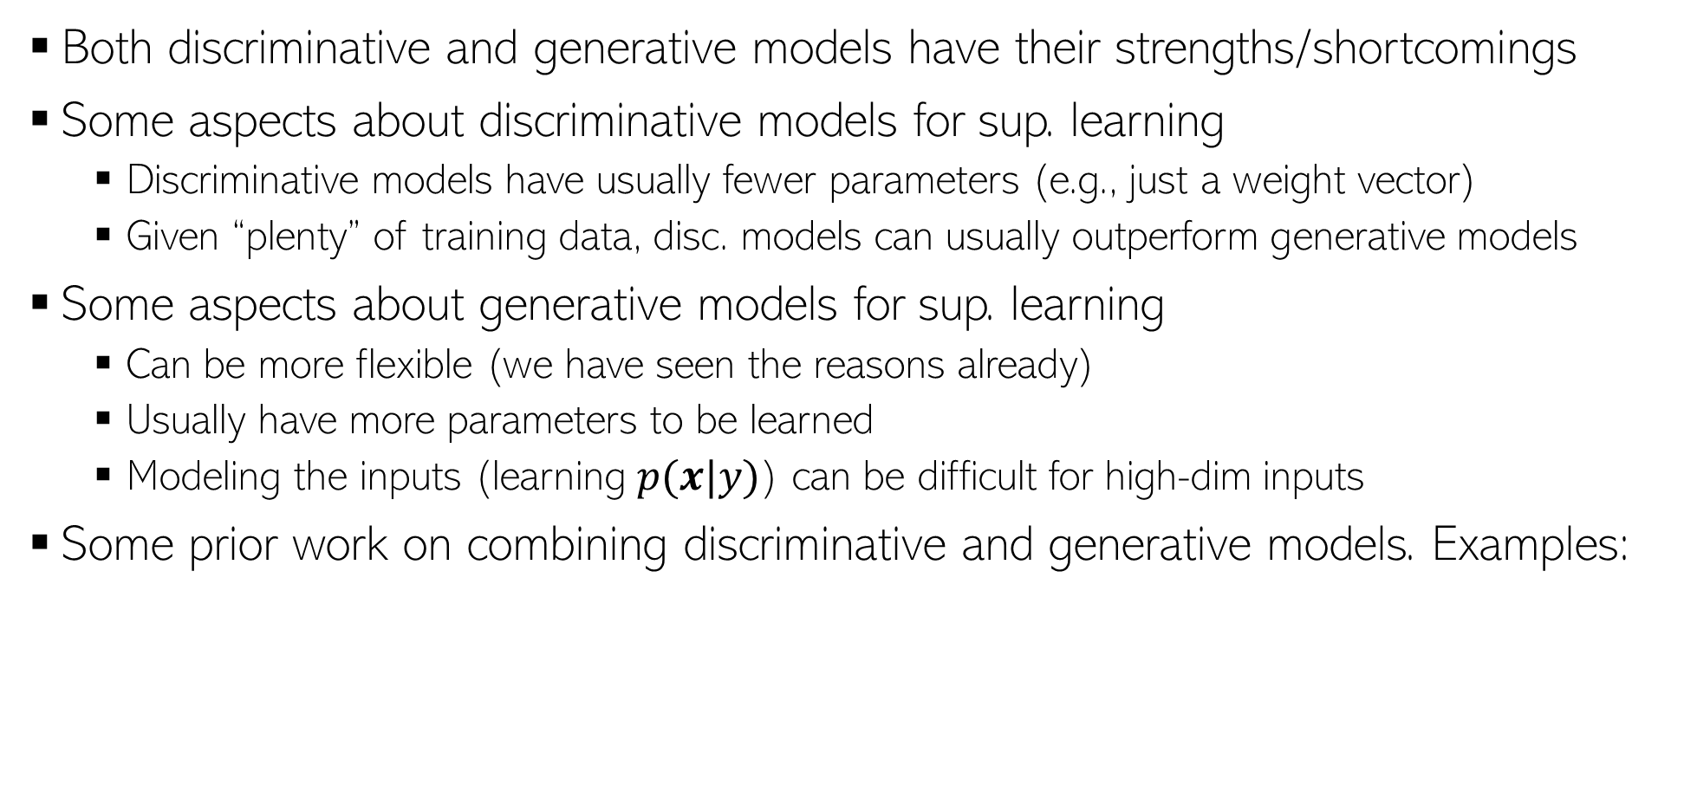
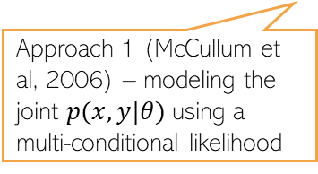
Hybrids of Discriminative and Generative Models
10
Both discriminative and generative models have their strengths/shortcomings
Some aspects about discriminative models for sup. learning
Discriminative models have usually fewer parameters (e.g., just a weight vector)
Given “plenty” of training data, disc. models can usually outperform generative models
Some aspects about generative models for sup. learning
Can be more flexible (we have seen the reasons already)
Usually have more parameters to be learned
Modeling the inputs (learning $p(x|y)$) can be difficult for high-dim inputs
Some prior work on combining discriminative and generative models. Examples:
Recall prob linear regression and logistic reg
Approach 1 (McCullum et al, 2006) – modeling the joint $p(x,y|θ)$using a multi-conditional likelihood
Approach 2 (Lasserre et al, 2006) – Coupled parameters between discriminative and generative models
Approach 3 (Kuleshov and Ermon, 2017) – Coupling discriminative and generative models via a latent variable $z$ (see “Deep Hybrid Models: Bridging Discriminative and Generative Approaches“, UAI 2017)

