Slide 1
Probabilistic Supervised Learning: Linear Regression
CS772A: Probabilistic Machine Learning
Piyush Rai

Slide 2
Plan Today
2
Quick overview of parameter estimation and predictive distributions for
  Multinoulli observation model
  Gaussian (univariate) observation model
Probabilistic Supervised Learning
  (Probabilistic) Linear Regression

Slide 3
Multinoulli Observation Model
3

Slide 4
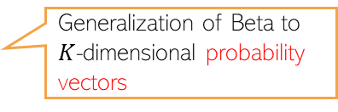
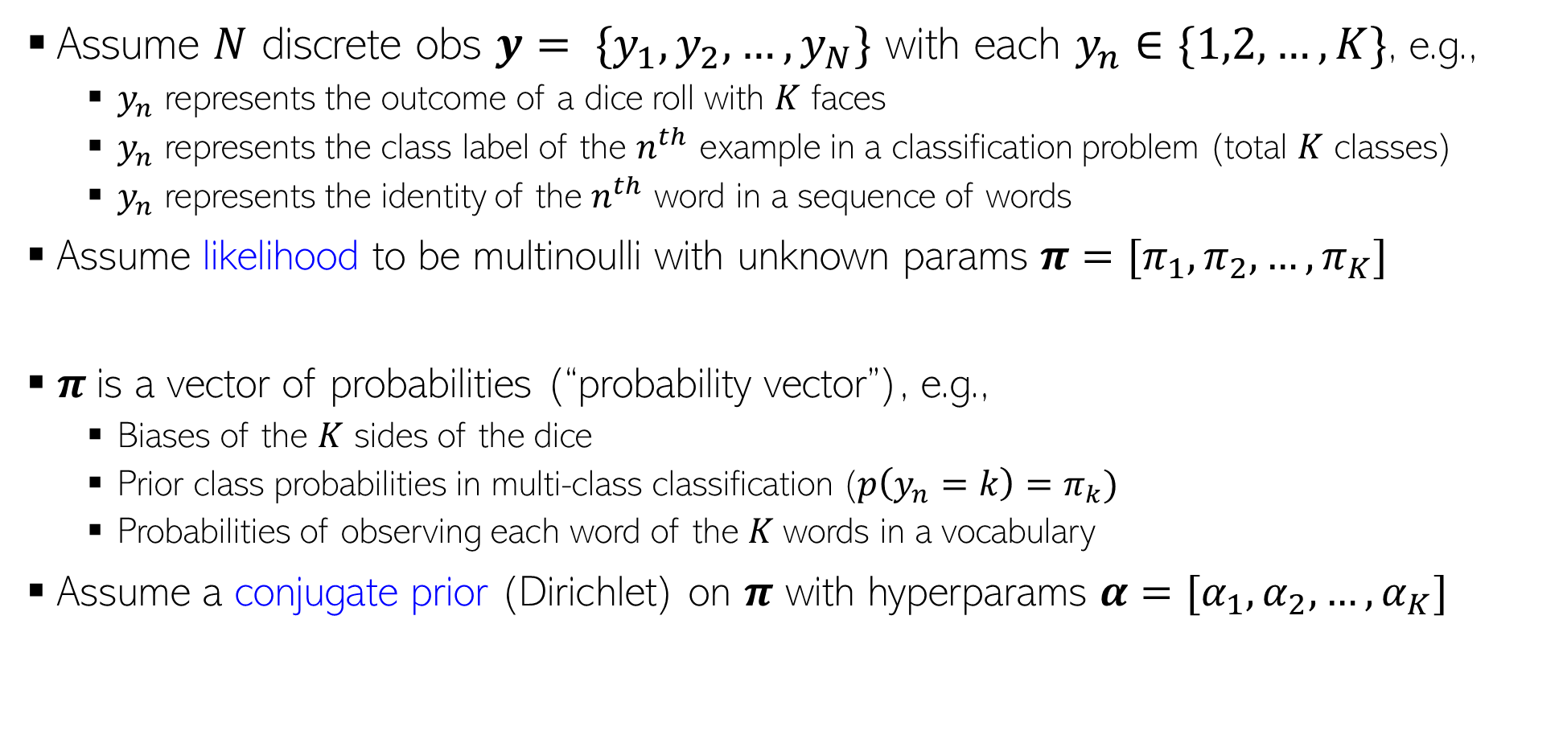


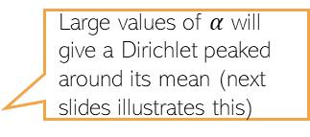
The Posterior Distribution
MLE/MAP left as an exercise
4
Assume $N$ discrete obs $y= \{y_{1},y_{2},…, y_{N}\}$ with each $y_{n}∈\{1,2,…, K\}$, e.g.,
  $y_{n}$ represents the outcome of a dice roll with $K$ faces
  $y_{n}$ represents the class label of the $n^{th}$ example in a classification problem (total $K$ classes)
  $y_{n}$ represents the identity of the $n^{th}$ word in a sequence of words
Assume likelihood to be multinoulli with unknown params $π=[π_{1},π_{2},…, π_{K}]$
$π$is a vector of probabilities (“probability vector”), e.g.,
  Biases of the $K$ sides of the dice
  Prior class probabilities in multi-class classification ($p\left(y_{n}=k\right)=π_{k})$
  Probabilities of observing each word of the $K$words in a vocabulary
Assume a conjugate prior (Dirichlet) on $π$ with hyperparams $α=[α_{1},α_{2},…, α_{K}]$
These sum to 1
$$p\left(y_{n} | π\right)= multinoulli\left(y_{n} | π\right)=\prod_{k=1}^{K}{π_{k}^{𝕀[y_{n}=k]}}$$
Generalization of Bernoulli to $K>2$ discrete outcomes
Large values of $α$ will give a Dirichlet peaked around its mean (next slides illustrates this)
Called the concentration parameter of the Dirichlet (assumed known for now)
Each $α_{k}≥0$
Generalization of Beta to $K$-dimensional probability vectors

Slide 5





Brief Detour: Dirichlet Distribution
5
Basically, probability vectors
An important distribution. Models non-neg. vectors $π$ that also sum to one
A random draw from $K$-dim Dirich. will be a point under ($K$-1)-dim probability simplex
(1,0,0)
The probability simplex of a 2-dim simplex (representing a 3-dim Dirichlet) and the coordinates of various points on the simplex
(1/2,1/4,1/4)
(1/2,1/2,0)
(1/2,0,1/2)
(3/8,3/8,1/4)
(3/8,1/4,3/8)
(1/4,1/2,1/4)
(1/4,3/8,3/8)
(1/4,1/4,1/2)
(0,1,0)
(0,0,1)
(0,1/2,1/2)

Slide 6
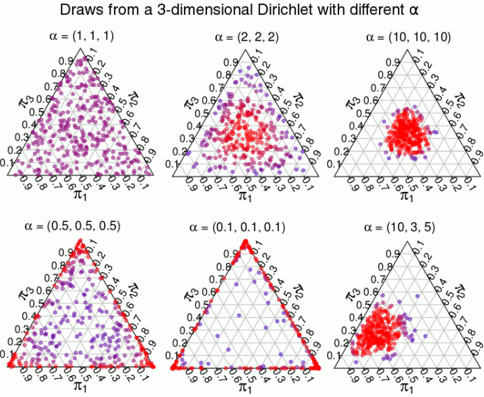
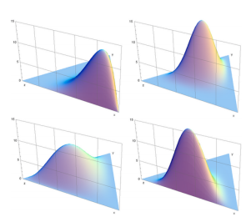


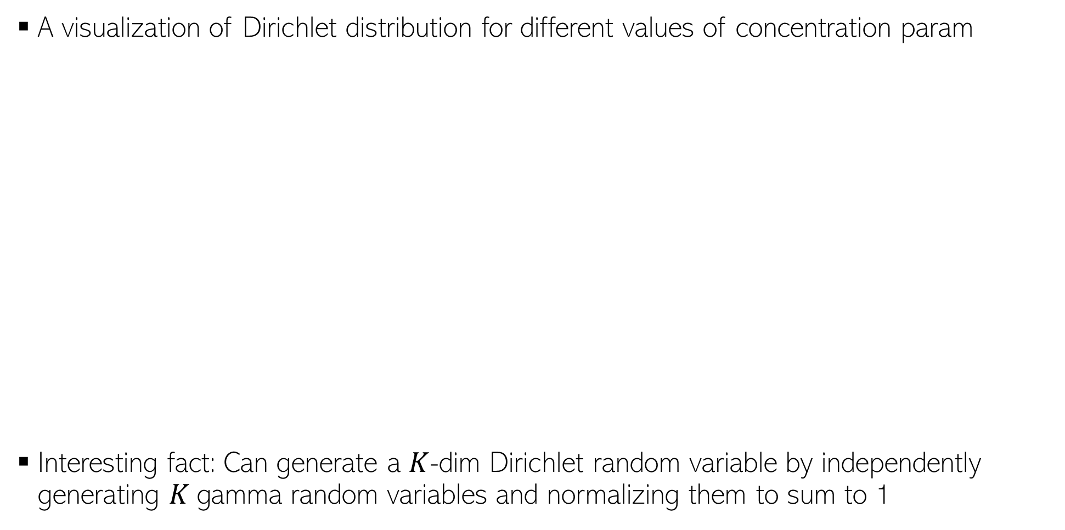
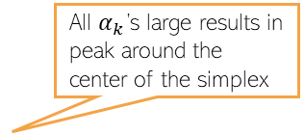




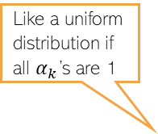


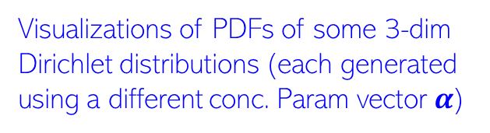


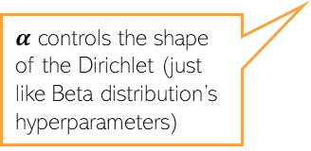


Brief Detour: Dirichlet Distribution
6
A visualization of Dirichlet distribution for different values of concentration param
Interesting fact: Can generate a $K$-dim Dirichlet random variable by independently generating $K$gamma random variables and normalizing them to sum to 1
Like a uniform distribution if all $α_{k}$’s are 1
Visualizations of PDFs of some 3-dim Dirichlet distributions (each generated using a different conc. Param vector $α$)
All $α_{k}$’s large results in peak around the center of the simplex
$α$ controls the shape of the Dirichlet (just like Beta distribution’s hyperparameters)
$$π_{2}$$
$$π_{2}$$
$$π_{3}$$
$$π_{3}$$
$$π_{1}$$
$$π_{1}$$
$$π_{2}$$
$$π_{2}$$
$$π_{3}$$
$$π_{3}$$
$$π_{1}$$
$$π_{1}$$

Slide 7

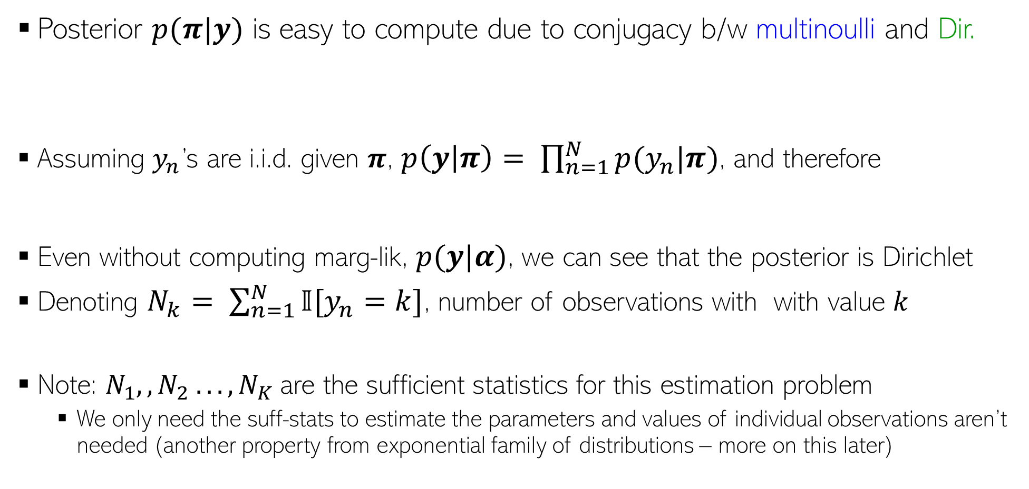

The Posterior Distribution
7
Likelihood
Prior
Posterior $p(π|y)$ is easy to compute due to conjugacy b/w multinoulli and Dir.
Assuming $y_{n}$’s are i.i.d. given $π$, $p\left(y | π\right)= \prod_{n=1}^{N}{p(y_{n}|π)}$, and therefore
Even without computing marg-lik, $p(y|α)$, we can see that the posterior is Dirichlet
Denoting $N_{k}= \sum_{n=1}^{N}{𝕀[y_{n}=k]}$, number of observations with with value $k$
Note: $N_{1},,N_{2} . . . , N_{K}$are the sufficient statistics for this estimation problem
  We only need the suff-stats to estimate the parameters and values of individual observations aren’t needed (another property from exponential family of distributions – more on this later)
$$p\left(π | y,α\right)=\frac{p(π,y|α)}{p(y|α)}= \frac{p(π|α)p\left(y | π,α\right)}{p(y|α)}=\frac{p(π|α)p\left(y | π\right)}{p(y|α)}$$
Don’t need to compute for this case because of conjugacy
Marg-lik $=∫p(π|α)p\left(y | π\right)dπ$
$p\left(π | y,α\right)∝\prod_{k=1}^{K}{π_{k}^{α_{k}−1}}×\prod_{n=1}^{N}{\prod_{k=1}^{K}{π_{k}^{𝕀[y_{n}=k]}}}$
$=\prod_{k=1}^{K}{π_{k}^{α_{k}+\sum_{n=1}^{N}{𝕀[y_{n}=k]} −1}}$
$p\left(π | y,α\right)= Dirichlet\left(π\right|α_{1}+N_{1},α_{2}+N_{2},…, α_{K}+N_{K})$
Similar to number of heads and tails for the coin bias estimation problem

Slide 8
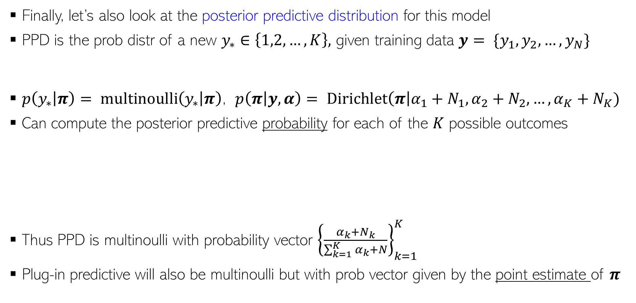
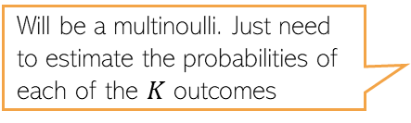


The Predictive Distribution
8
Finally, let’s also look at the posterior predictive distribution for this model
PPD is the prob distr of a new $y_{∗}∈\left\{1,2,…, K\right\},$ given training data $y= \{y_{1},y_{2},…, y_{N}\}$
$p\left(y_{∗} | π\right)= multinoulli\left(y_{∗} | π\right)$, $p\left(π | y,α\right)= Dirichlet\left(π\right|α_{1}+N_{1},α_{2}+N_{2},…, α_{K}+N_{K})$
Can compute the posterior predictive probability for each of the $K$ possible outcomes
Thus PPD is multinoulli with probability vector ${\left\{\frac{α_{k}+N_{k}}{\sum_{k=1}^{K}{α_{k}}+N}\right\}}_{k=1}^{K}$
Plug-in predictive will also be multinoulli but with prob vector given by the point estimate of $π$
Will be a multinoulli. Just need to estimate the probabilities of each of the $K$ outcomes
$$p\left(y_{∗} | y,α\right)=∫p\left(y_{∗} | π\right)p\left(π | y,α\right)dπ$$
$$p\left(y_{∗}=k | y,α\right)=∫p\left(y_{∗}=k | π\right)p\left(π | y,α\right)dπ$$
$$=∫π_{k}×Dirichlet\left(π\right|α_{1}+N_{1},α_{2}+N_{2},…, α_{K}+N_{K})dπ$$
$$=\frac{α_{k}+N_{k}}{\sum_{k=1}^{K}{α_{k}}+N}$$
(Expectation of $π_{k}$ w.r.t the Dirichlet posterior)
A similar effect was achieved in the Beta-Bernoulli model, too
Note how these probabilities have been “smoothened” due to the use of the prior + the averaging over the posterior

Slide 9
Gaussian Observation Model
9

Slide 10
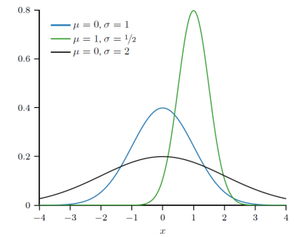

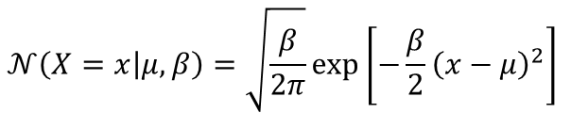
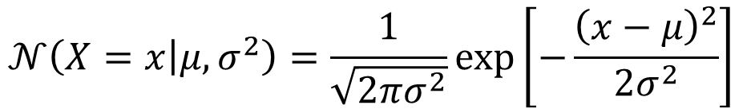
Gaussian Distribution (Univariate)
Distribution over real-valued scalar random variables $X∈ℝ$, e.g., height of students in a class
Defined by a scalar mean $μ$and a scalar variance $σ^{2}$
Mean: $𝔼\left[X\right]=μ$
Variance: var[$X$] $=σ^{2}$
Inverse of variance is called precision: $β=\frac{1}{σ^{2}}$.
$$𝒩\left(X=x | μ,σ^{2}\right)=\frac{1}{\sqrt{2πσ^{2}}}exp\left[−\frac{{\left(x−μ\right)}^{2}}{2σ^{2}}\right]$$
Gaussian PDF in terms of precision
$$𝒩\left(X=x | μ,β\right)=\sqrt{\frac{β}{2π}}exp\left[−\frac{β}{2}{\left(x−μ\right)}^{2}\right]$$

Slide 11
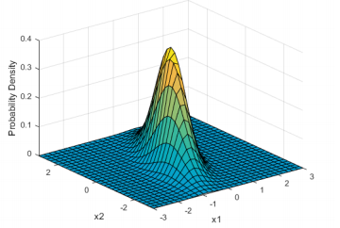

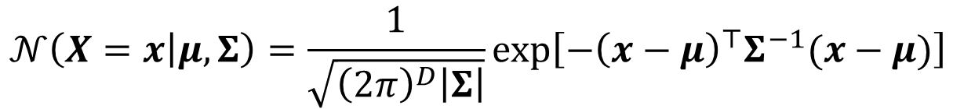
Gaussian Distribution (Multivariate)
Distribution over real-valued vector random variables $X∈ℝ^{D}$
Defined by a mean vector $μ∈ℝ^{D}$and a covariance matrix $Σ$
Note: The cov. matrix $Σ$ must be symmetric and PSD
  All eigenvalues are positive
  $z^{⊤}Σz≥0$ for any real vector $z$
The covariance matrix also controls the shape of the Gaussian
A two-dimensional Gaussian
$$𝒩\left(X=x | μ,Σ\right)=\frac{1}{\sqrt{{\left(2π\right)}^{D}\left|Σ\right|}}exp\left[−{\left(x−μ\right)}^{⊤}Σ^{−1}(x−μ)\right]$$

Slide 12


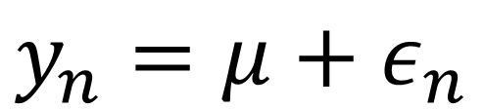
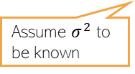
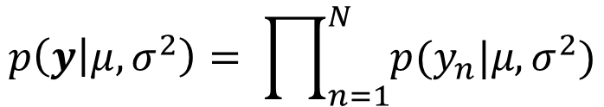

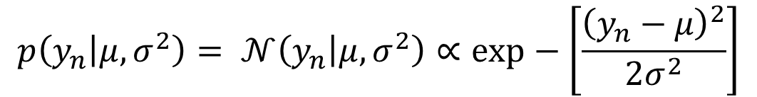

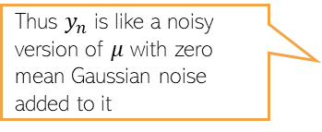
Posterior Distribution for Gaussian’s Mean
Its MLE/MAP estimation left as an exercise
12
Given: $N$ i.i.d. scalar observations $y= \{y_{1},y_{2},…, y_{N}\}$ assumed drawn from $𝒩(y|μ, σ^{2})$
Note: Easy to see that each $y_{n}$drawn from $𝒩(y|μ, σ^{2})$ is equivalent to the following
Let’s estimate mean $μ$ given $y$ using fully Bayesian inference (not point estimation)
Likelihood
$$p\left(y_{n} | μ,σ^{2}\right)= 𝒩\left(y_{n} | μ,σ^{2}\right)∝exp−\left[\frac{{\left(y_{n}−μ\right)}^{2}}{2σ^{2}}\right]$$
$$𝒩(y|μ, σ^{2})$$
Assume $σ^{2}$ to be known
Overall Likelihood
$$p\left(y | μ,σ^{2}\right)= \prod_{n=1}^{N}{p(y_{n}|μ,σ^{2})}$$
$$μ$$
Thus $y_{n}$ is like a noisy version of $μ$ with zero mean Gaussian noise added to it
$$y_{n}=μ+ε_{n}$$
$$\text{where} ε_{n}∼𝒩(0,σ^{2})$$

Slide 13
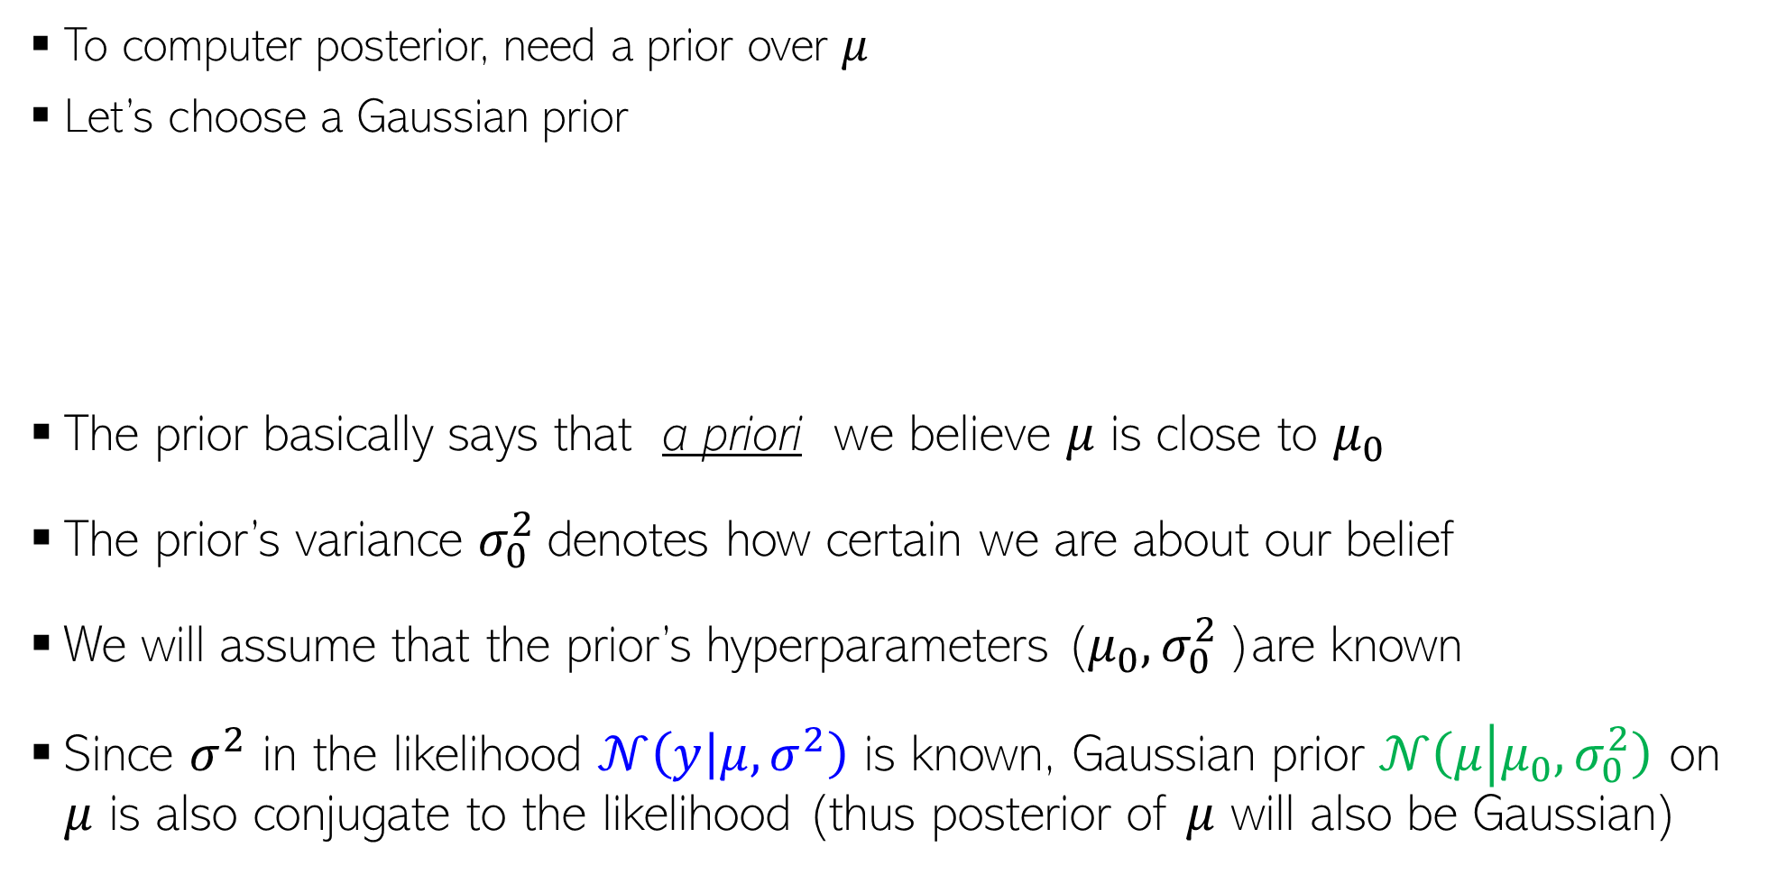
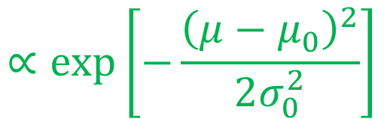

A prior distribution for the mean
13
To computer posterior, need a prior over $μ$
Let’s choose a Gaussian prior
The prior basically says that a priori we believe 𝜇 is close to $μ_{0}$
The prior’s variance $σ_{0}^{2}$denotes how certain we are about our belief
We will assume that the prior’s hyperparameters ($μ_{0}, σ_{0}^{2}$)are known
Since $σ^{2}$ in the likelihood $𝒩\left(y | μ, σ^{2}\right)$ is known, Gaussian prior $𝒩\left(μ | μ_{0}, σ_{0}^{2}\right)$ on $μ$ is also conjugate to the likelihood (thus posterior of $μ$ will also be Gaussian)
$$p\left(μ|μ_{0},σ_{0}^{2}\right)$$
$$p\left(μ|μ_{0},σ_{0}^{2}\right)= 𝒩\left(μ | μ_{0}, σ_{0}^{2}\right)$$
$$∝exp\left[−\frac{{\left(μ−μ_{0}\right)}^{2}}{2σ_{0}^{2}}\right]$$
$$μ_{0}$$

Slide 14
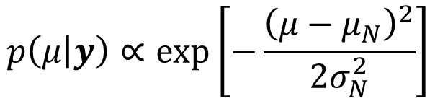
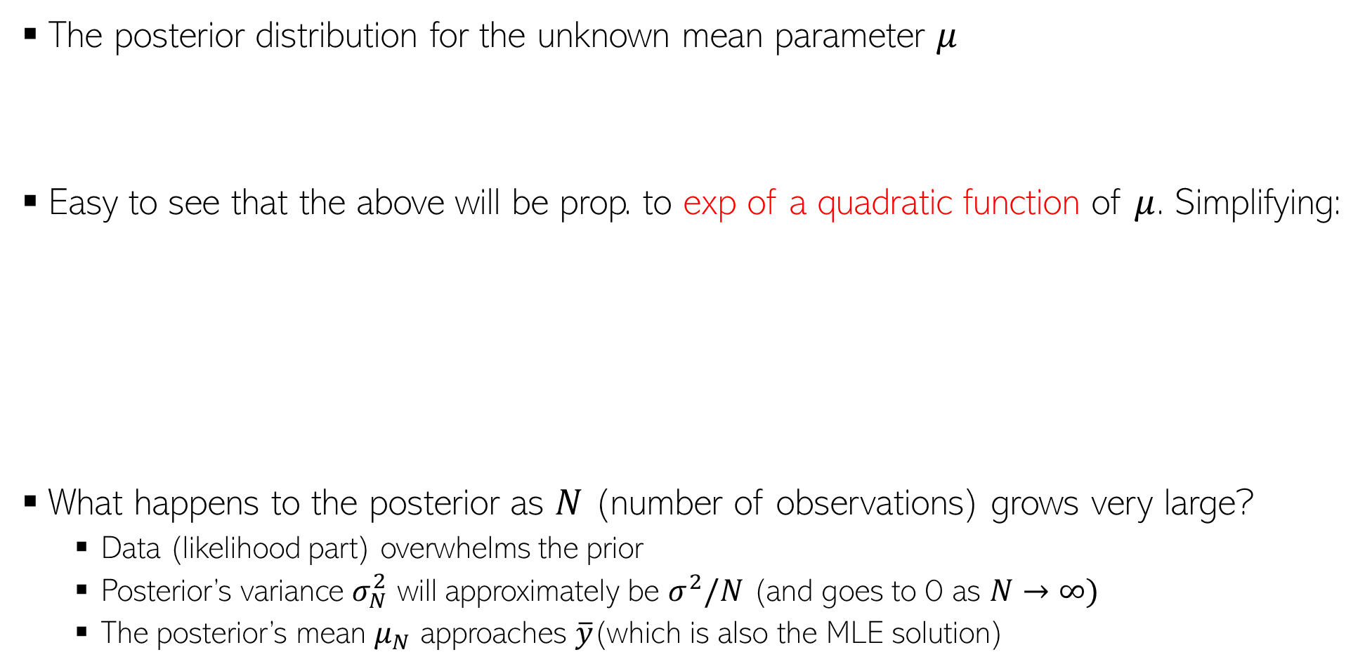
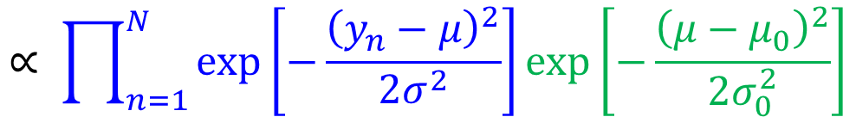
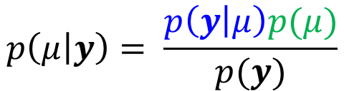


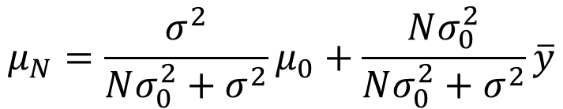


The posterior distribution for the mean
14
The posterior distribution for the unknown mean parameter $μ$
Easy to see that the above will be prop. to exp of a quadratic function of $μ$. Simplifying:
What happens to the posterior as $N$ (number of observations) grows very large?
  Data (likelihood part) overwhelms the prior
  Posterior’s variance $σ_{N}^{2}$ will approximately be $σ^{2}/N$ (and goes to 0 as $N→∞)$
  The posterior’s mean $μ_{N}$ approaches $\overline{y}$(which is also the MLE solution)
On conditioning side, skipping all fixed params and hyperparams from the notation
$$p\left(μ | y\right)= \frac{p\left(y | μ\right)p(μ)}{p(y)}$$
$$∝ \prod_{n=1}^{N}{exp\left[−\frac{{\left(y_{n}−μ\right)}^{2}}{2σ^{2}}\right]}exp\left[−\frac{{\left(μ−μ_{0}\right)}^{2}}{2σ_{0}^{2}}\right]$$
$$p\left(μ | y\right)∝exp\left[−\frac{{\left(μ−μ_{N}\right)}^{2}}{2σ_{N}^{2}}\right]$$
Gaussian posterior (not a surprise since the chosen prior was conjugate to the likelihood)
Gaussian posterior’s precision is the sum of the prior’s precision and sum of the noise precisions of all the observations
$$\frac{1}{σ_{N}^{2}}= \frac{1}{σ_{0}^{2}}+ \frac{N}{σ^{2}}$$
Also the MLE solution for $μ$
Contribution from the prior
Contribution from the data
Gaussian posterior’s mean is a convex combination of prior’s mean and the MLE solution
$$μ_{N}=\frac{σ^{2}}{Nσ_{0}^{2}+σ^{2}}μ_{0}+\frac{Nσ_{0}^{2}}{Nσ_{0}^{2}+σ^{2}}\overline{y}$$
$(where \overline{y}= \frac{\sum_{n=1}^{N}{y_{n}}}{N})$
Meaning, we become very-very certain about the estimate of $μ$

Slide 15





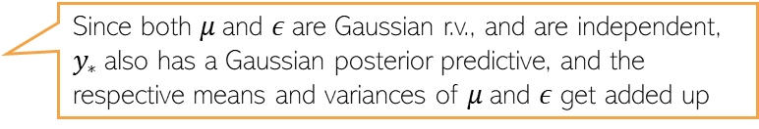






The Predictive Distribution
15
If given a point estimate $\hat{μ}$, the plug-in predictive distribution for a test $y_{∗}$would be
On the other hand, the posterior predictive distribution of $y_{∗}$would be
For an alternative way to get the above result, note that, for test data
The best point estimate
This is an approximation of the true PPD $p\left(y_{∗} | y\right)$
$$p\left(y_{∗}\right|\hat{μ},σ^{2})=𝒩(y_{∗}|\hat{μ}, σ^{2})$$
$$p\left(y_{∗} | y\right)=∫p\left(y_{∗}\right|μ,σ^{2})p(µ\left|y\right)dμ$$
A useful fact: When we have conjugacy, the posterior predictive distribution also has a closed form (will see this result more formally when talking about exponential family distributions)
$$=∫𝒩(y_{∗}|μ, σ^{2})𝒩\left(μ | μ_{N}, σ_{N}^{2}\right)dμ$$
This “extra” variance $σ_{N}^{2}$in PPD is due to the averaging over the posterior’s uncertainty
$$=𝒩(y_{∗}|μ_{N}, σ^{2}+σ_{N}^{2})$$
If conditional is Gaussian then marginal is also Gaussian
PRML [Bis 06], 2.115, and also mentioned in prob-stats refresher slides
$$y_{∗}=μ+ε$$
$$μ∼𝒩\left(μ_{N}, σ_{N}^{2}\right)$$
$$ε∼𝒩\left(0, σ^{2}\right)$$
Using the posterior of $μ$ since we are at test stage now
$$⇒ p(y_{∗}|y)=𝒩(y_{∗}|μ_{N}, σ^{2}+σ_{N}^{2})$$
Since both $μ$and $ε$are Gaussian r.v., and are independent, $y_{∗}$also has a Gaussian posterior predictive, and the respective means and variances of $μ$and $ε$ get added up

Slide 16
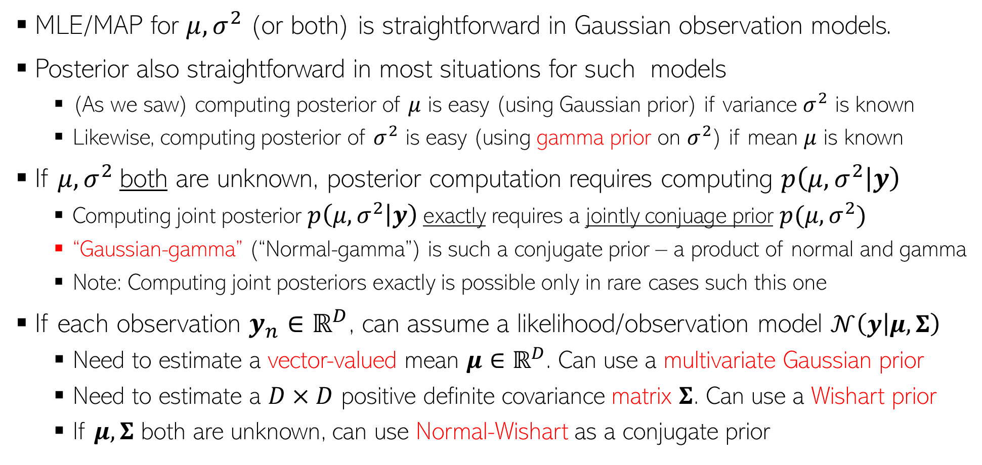
Gaussian Observation Model: Some Other Facts
16
MLE/MAP for $μ,σ^{2}$ (or both) is straightforward in Gaussian observation models.
Posterior also straightforward in most situations for such models
  (As we saw) computing posterior of $μ$ is easy (using Gaussian prior) if variance $σ^{2}$ is known
  Likewise, computing posterior of $σ^{2}$ is easy (using gamma prior on $σ^{2}$) if mean $μ$ is known
If $μ,σ^{2}$both are unknown, posterior computation requires computing $p\left(μ,σ^{2} | y\right)$
  Computing joint posterior $p\left(μ,σ^{2} | y\right)$exactly requires a jointly conjuage prior $p(μ,σ^{2})$
  “Gaussian-gamma” (“Normal-gamma”) is such a conjugate prior – a product of normal and gamma
  Note: Computing joint posteriors exactly is possible only in rare cases such this one
If each observation $y_{n}∈ℝ^{D}$, can assume a likelihood/observation model $𝒩\left(y | μ, Σ\right)$
  Need to estimate a vector-valued mean $μ∈ℝ^{D}$. Can use a multivariate Gaussian prior
  Need to estimate a $D×D$ positive definite covariance matrix $Σ$. Can use a Wishart prior
  If $μ, Σ$ both are unknown, can use Normal-Wishart as a conjugate prior

Slide 17
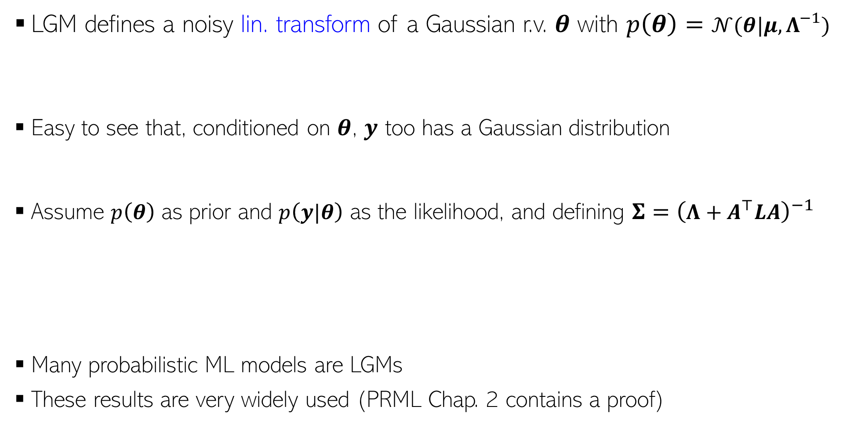
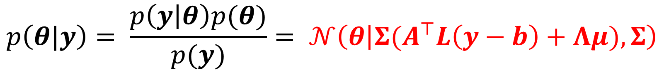
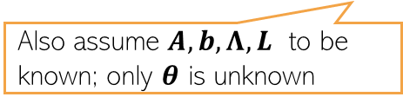
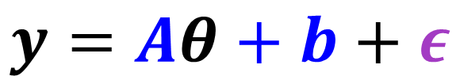
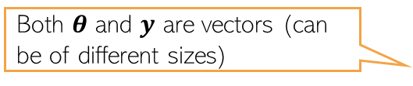
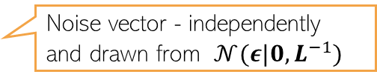

Linear Gaussian Model (LGM)
17
LGM defines a noisy lin. transform of a Gaussian r.v. $θ$ with $p\left(θ\right)=𝒩(θ|μ,Λ^{−1})$
Easy to see that, conditioned on $θ$, $y$ too has a Gaussian distribution
Assume $p\left(θ\right)$ as prior and $p\left(y|θ\right)$ as the likelihood, and defining $Σ={\left(Λ+A^{⊤}LA\right)}^{−1}$
Many probabilistic ML models are LGMs
These results are very widely used (PRML Chap. 2 contains a proof)
Both $θ$ and $y$ are vectors (can be of different sizes)
$$y=Aθ+b+ε$$
Noise vector - independently and drawn from $𝒩(ε|0,L^{−1})$
Also assume $A, b, Λ, L$ to be known; only $θ$ is unknown
Conditional distribution
$$p\left(y|θ\right)=𝒩\left(y | Aθ+b,L^{−1}\right)$$
Posterior of $θ$
$$p\left(θ|y\right)= \frac{p\left(y | θ\right)p(θ)}{p(y)}= 𝒩\left(θ | Σ(A^{⊤}L\left(y−b\right)+Λμ),Σ\right)$$
Marginal distribution
$$p\left(y\right)=∫p\left(y | θ\right)p\left(θ\right)dθ= 𝒩(y|Aμ+b,AΛ^{−1}A^{⊤}+L^{−1})$$

Slide 18
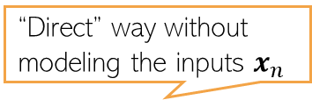
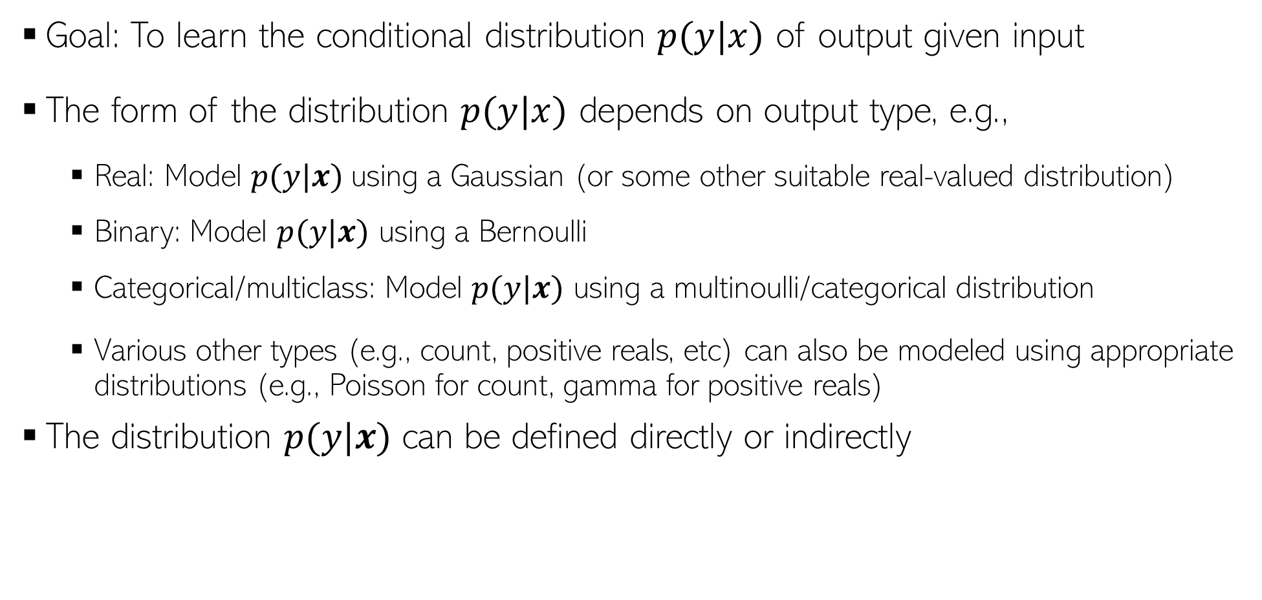
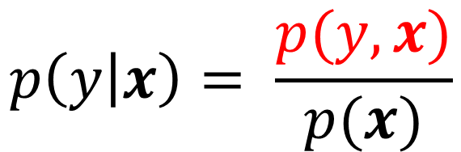



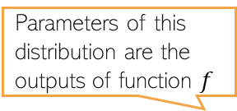
Probabilistic Supervised Learning
18
Goal: To learn the conditional distribution $p(y|x)$ of output given input
The form of the distribution $p(y|x)$ depends on output type, e.g.,
  Real: Model $p(y|x)$using a Gaussian (or some other suitable real-valued distribution)
  Binary: Model $p(y|x)$ using a Bernoulli
  Categorical/multiclass: Model $p(y|x)$ using a multinoulli/categorical distribution
  Various other types (e.g., count, positive reals, etc) can also be modeled using appropriate distributions (e.g., Poisson for count, gamma for positive reals)
The distribution $p(y|x)$ can be defined directly or indirectly
$$p(y|x)$$
$$y$$
“Indirect” way requires first learning the joint distribution of inputs and outputs
“Direct” way without modeling the inputs $x_{n}$
Parameters of this distribution are the outputs of function $f$
“Indirect” way by modeling the outputs as well as the inputs
$$p\left(y | x\right)= \frac{p(y,x)}{p(x)}$$
$$p\left(y | x\right)=p(y|f\left(x,w\right))$$

Slide 19
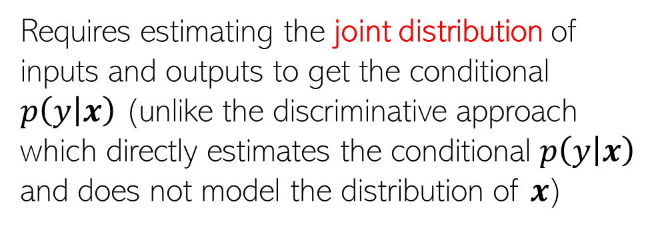




Discriminative vs Generative Sup. Learning
Non-probabilistic supervised learning approaches (e.g., SVM) are usually considered discriminative since $p(x)$ is never modeled
Direct way of sup. learning is discriminative, indirect way is generative
Note: Generative approach can also be used for other settings too, such as unsupervised learning and semi-supervised learning (will see later)
Discriminative Approach
Generative Approach
$$p\left(y | x\right)=p(y|f\left(x,w\right))$$
$$p\left(y | x\right)= \frac{p(y,x)}{p(x)}$$
$f$ can be any function which uses inputs and weights $w$ to defines parameters of distr. $p$
Requires estimating the joint distribution of inputs and outputs to get the conditional $p\left(y | x\right)$ (unlike the discriminative approach which directly estimates the conditional $p\left(y | x\right)$ and does not model the distribution of $x$)
Some examples
$$p\left(y | x\right)=𝒩(y|w^{⊤}x,β^{−1})$$
$$p\left(y | x\right)=Bernoulli(y|σ(w^{⊤}x))$$

Slide 20








Probabilistic Linear Regression
20
A discriminative model for regression problems
Assume training data ${\{x_{n},y_{n}\}}_{n=1}^{N}$, with features $x_{n}∈ℝ^{D}$ and responses $y_{n}∈ℝ$
Assume $y_{n}$ generated by a noisy linear model with wts $w=\left[w_{1},…, w_{D}\right]∈ℝ^{D}$
Notation alert: $β$ is the precision of Gaussian noise (and $β^{−1}$ the variance)
Unknown to be estimated
Each weight assumed real-valued
$$y_{n}=w^{⊤}x_{n}+ε_{n}$$
Gaussian noise drawn from $𝒩(ε_{n}|0,β^{−1})$
Likelihood model
The line represents the mean $w^{⊤}x_{n}$of the output random variable $y_{n}$
$$p\left(y_{n} | x_{n},w,β\right)=𝒩\left(y_{n}\right|w^{⊤}x_{n},β^{−1})$$
The zero mean Gaussian noise perturbs the output from its mean
Input $x_{n}$ being treated as given and not modeled by any probability distribution
$$y$$
Gaussian
Thus NLL is like squared loss
$$w^{⊤}x_{n}$$
Will later study models in which both input and output are modeled by distributions
$$x$$

Slide 21








Probabilistic Linear Regression
21
For all the training data, we can write the above model in matrix-vector notation
This is a linear Gaussian model with $w$ being the unknown Gaussian r.v.
A simple “plate diagram” for this model would look like this (hyperparameters not shown in the diagram)
𝒚 $=[y_{1};y_{2};…;y_{N}]$ is the 𝑁×1 response vector
$X=[x_{1}^{⊤};$ $x_{2}^{⊤};…;x_{N}^{⊤}]$
is the $N×D$ input matrix
$ε$ $=[ε_{1};ε_{2};…;ε_{N}]$ is the 𝑁×1 noise vector drawn from $𝒩(0,β^{−1}I_{N})$
Same as writing
$$p\left(y | X,w,β\right)=𝒩(y|Xw,β^{−1}I_{N})$$
$$y=Xw+ε$$
White nodes denote unknown quantities, grey nodes denote observed quantities (training input-output pairs)
Direction of arrow show dependency
The plate/box with number $N$ shows that we have $N$ such i.i.d. observations

Slide 22



On compact notations..
22
When writing the likelihood (assuming $y_{n}$’s are i.i.d. given $w$ and $x_{n}$)
Thus a product of $N$ univariate Gaussians here (not always) is equivalent to an $N$-dim Gaussian over the vector $y=[y_{1},y_{2},…, y_{N}]$
We will prefer to use this equivalence at other places too whenever we have multiple i.i.d. random variables, each having a univariate Gaussian distribution
$$p\left(y | X,w,β\right)=\prod_{n=1}^{N}{𝒩\left(y_{n}\right|w^{⊤}x_{n},β^{−1})}$$
$$=𝒩(y|Xw,β^{−1}I_{N})$$

Slide 23













Prior on weights
23
May also use a non-zero mean Gaussian prior, e.g., $𝒩(w_{d}|μ,λ^{−1})$ if we expect weights to be close to some value $μ$
Assume a zero-mean Gaussian prior on $w$
Zero-mean Gaussian prior corresponds to $ℓ_{2}$ regularizer
This prior assumes that a priori each weight has a small value (close to zero)
$$p\left(w|λ\right)=\prod_{d=1}^{D}{p\left(w_{d}|λ\right)=\prod_{d=1}^{D}{𝒩(w_{d}|0,λ^{−1})}}$$
In zero-mean case, $λ$ sort of denotes each feature’s importance. Think why?
$λ$ controls the uncertainty around our prior belief about value of $w_{d}$
Can also use a full covariance matrix $Λ^{−1}$ for the prior to impose a priori correlations among different weights
Large $λ$ means more aggressive push towards zero
$$=𝒩(w|0,λ^{−1}I_{D})$$
$$∝{\left(\frac{λ}{2π}\right)}^{\frac{D}{2}}exp\left[−\frac{λ}{2} w^{⊤}w\right]$$
Prior’s hyperparameters ($λ$/$Λ/μ$) etc can be learned as well using point estimation (e.g., MLE-II) or fully Bayesian inference
The precision $λ$controls how aggressively the prior pushes $w_{d}$ towards mean (0)
Reason: The negative log prior $−log p(w)∝\frac{λ}{2} w^{⊤}w$

Slide 24





The Posterior
24
MLE/MAP left as an exercise
The posterior over $w$ (for now, assume hyperparams $β$ and $λ$ to be known)
Using the “completing the squares” trick (or linear Gaussian model results)
Marginal likelihood for this regression model. Note that it is conditioned on $X$ too which is assumed given and not being modeled
Must be a Gaussian due to conjugacy
Note that $λ$ and $β$ can be learned under the probabilistic set-up(though assumed fixed as of now)
The form is also similar to the solution to ridge regression ${argmin}_{w}{\left|\left|y−Xw\right|\right|}^{2}+λw^{⊤}w=$ ${\left(X^{⊤}X+λI\right)}^{−1}X^{⊤}y$
MAP solution turns out to be exactly the same (reason: Gaussian’s mean and mode are the same)

Slide 25






The Posterior: A Visualization
25
Assume a lin. reg. problem with true $w = \left[w_{0},w_{1}\right],w_{0} = −0.3,w_{1} = 0.5$
Assume data generated by a linear regression model $y = w_{0} + w_{1}x + "noise"$
  Note: It’s actually 1-D regression ($w_{0}$ is just a bias term), or 2-D reg. with feature $[1, x]$
Figures below show the “data space” and posterior of $w$ for different number of observations (note: with no observations, the posterior = prior)
Each red line represents the “data” generated for a randomly drawn $w$ from the current posterior

Slide 26








Posterior Predictive Distribution
26
To get the prediction $y_{∗}$for a new input $x_{∗}$, we can compute its PPD
The above is the marginalization of $w$ from $𝒩(y_{∗}|w^{⊤}x_{∗},β^{−1})$. Using LGM results
So we have a predictive mean $μ_{N}^{⊤}x_{∗}$ as well as an input-specific predictive variance
In contrast, MLE and MAP make “plug-in” predictions (using the point estimate of $w$)
Unlike MLE/MAP, variance of $y_{∗}$ also depends on the input $x_{∗}$(this, as we will see later, will be very useful in sequential decision-making problems such as active learning)
Only $w$ is unknown with a posterior distribution so only $w$ has to be integrated out
$$𝒩(y_{∗}|w^{⊤}x_{∗},β^{−1})$$
$$𝒩(w|μ_{N},Σ_{N})$$
Can also derive it by writing $y_{∗}=w^{⊤}x_{∗}+ε$ where $w∼𝒩(μ_{N},Σ_{N})$ and $ε∼𝒩(0,β^{−1})$
Since PPD also takes into account the uncertainty in $w$, the predictive variance is larger

Slide 27


Posterior Predictive Distribution: An Illustration
27
Black dots are training examples
Width of the shaded region at any $x$ denotes the predictive uncertainty at that $x$ (+/- one std-dev)
Regions with more training examples have smaller predictive variance

Slide 28




Nonlinear Regression
28
Can extend the linear regression model to handle nonlinear regression problems
One way is to replace the feature vectors $x$ by a nonlinear mapping $φ(x)$
Alternatively, a kernel function can be used to implicitly define the nonlinear mapping
More on nonlinear regression when we discuss Gaussian Processes
Can be pre-defined (e.g., replace a scalar $x$ by polynomial mapping $[1,x,x^{2}]$) or extracted by a pretrained deep neural net

Slide 29


More on Visualization of Uncertainty
29
Figures below: Green curve is the true function and blue circles are observations
Posterior of the nonlinear regression model: Some curves drawn from the posterior
PPD: Red curve is predictive mean, shaded region denotes predictive uncertainty

Slide 30






Estimating Hyperparameters via MLE-II
30
The probabilistic linear reg. model we saw had two hyperparams ($β, λ$)
  Thus total three unknowns ($w,β, λ$)
Posterior and PPD computation is intractable.
If we just want point estimates for ($β, λ$) then MLE-II is an option
Need posterior over all the 3 unknowns
PPD would require integrating out all 3 unknowns
Called “MLE-II” because we are maximizing marginal likelihood, not the likelihood
And then compute $p(w|X,y,\hat{β},\hat{λ})$ treating $\hat{β},\hat{λ}$ as given
$$\left(\hat{β},\hat{λ}\right)= {argmax}_{β, λ} log p(y|X,β, λ)$$
Will see various other methods like EM, variational inference, MCMC, etc later
For regression with Gaussian likelihood and Gaussian prior on $w$, the marginal likelihood has an exact expression

Slide 31







Prob. Linear Regression: Some Other Variations
31
Can use other likelihoods $p\left(y_{n}\right|x_{n}, w)$ and/or prior distribution $p(w)$
Laplace distribution for the likelihood
Heteroskedastic noise in the likelihood, e.g.,
Feature-specific variances in the prior for $w$
$$p\left(y_{n}\right|x_{n}, w)= Lap\left(y_{n}\right|w^{⊤}x_{n}, b)$$
More robust to outliers than squared loss
$$p\left(y_{n}\right|x_{n}, w)= 𝒩(y_{n}|w^{⊤}x_{n}, β_{n}^{−1})$$
Can even assume $β_{n}$ to depend on input $x_{n}$
Different noise distribution $𝒩(0,β_{n}^{−1})$ for each $y_{n}$
Gives rise to “absolute loss” instead of squared loss
$$p\left(w\right)= \prod_{d=1}^{D}{𝒩(w_{d}|0,λ_{d}^{−1}})=𝒩(w|0,Λ^{−1})$$
Diagonal precision/covariance matrix with $λ_{d}$’s along the columns of $Λ$
Since we can also learn these precisions (e.g., using MLE-II), using such a prior, we can learn the importance of different features (feature selection) which isn’t possible with a $𝒩(w|0,λ^{−1}I)$ prior with spherical covariance
This has the effect of having feature-specific regularization

