Slide 1
NPBayes (wrap-up), Topic Modeling, and Simulation based Inference
CS772A: Probabilistic Machine Learning
Piyush Rai

Slide 2
Plan today
2
Wrap-up of nonparametric Bayesian models
  Shrinkage-based construction
    Stick-breaking process
    Multiplicative gamma Process
Simulation based inference
A classic latent variable model: Topic Model (Latent Dirichlet Allocation)

Slide 3
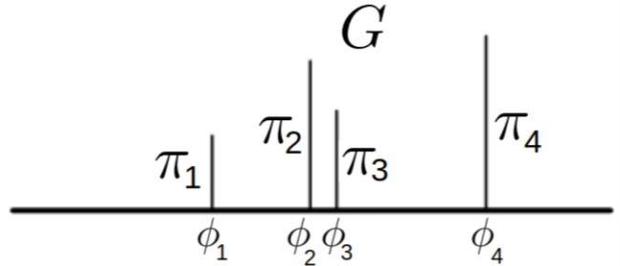

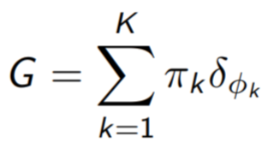
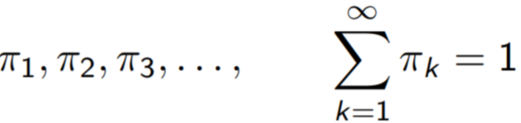


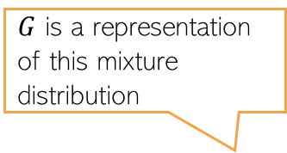
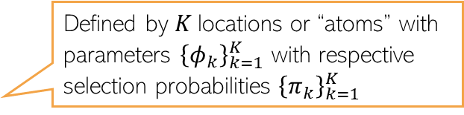
Mixture Models
3
Consider a finite mixture model with $K$ components with params ${\left(μ_{k},Σ_{k}\right)}_{k=1}^{K}$
In the finite case, we can assume $π=[π_{1},…, π_{K}]$ and $π∼Dirichlet\left(\frac{α}{K},…,\frac{α}{K}\right)$
We can make it a nonparametric model by making $π$ an infinite-dimensional vector
How to construct such a vector? Is there an infinite dimensional Dirichlet distribution?
Defined by $K$locations or “atoms” with parameters ${\left\{φ_{k}\right\}}_{k=1}^{K}$ with respective selection probabilities ${\left\{π_{k}\right\}}_{k=1}^{K}$
$G$ is a representation of this mixture distribution
In practice, only a finite of these will have nonzero values, and others will shrink to very small (or zero), as we will see
Indeed. Called a “Dirichlet Process”
Related: “Stick-breaking Process”

Slide 4
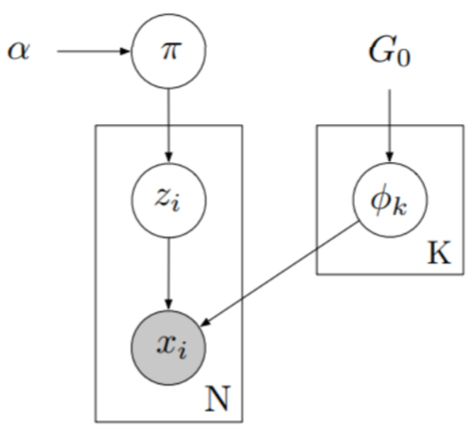
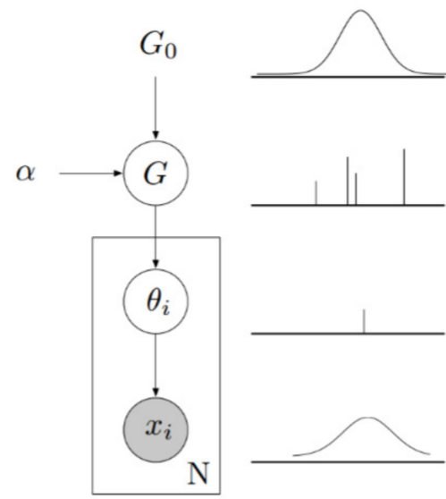
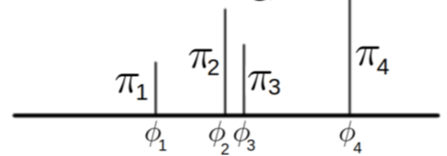

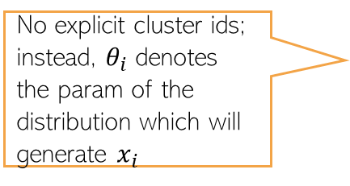
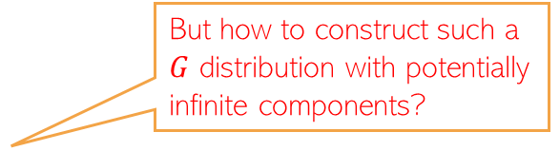

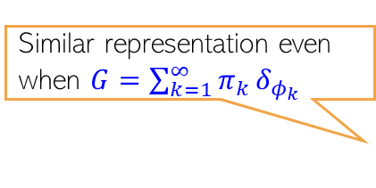

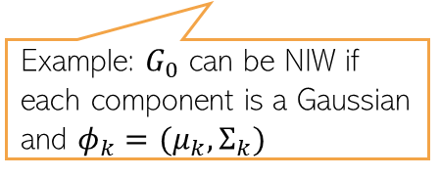

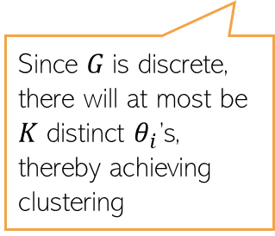
Mixture Models: Two Equivalent Views
4
But how to construct such a $G$ distribution with potentially infinite components?
Prior (a.k.a. “base distribution” for the parameters of each mixture component
Similar representation even when $G=\sum_{k=1}^{∞}{π_{k}}δ_{φ_{k}}$
Example: $G_{0}$ can be NIW if each component is a Gaussian and $φ_{k}=(μ_{k},Σ_{k})$
No explicit cluster ids; instead, $θ_{i}$ denotes the param of the distribution which will generate $x_{i}$
Typical way of showing the plate notation of a mixture model
Since $G$is discrete, there will at most be $K$ distinct $θ_{i}$’s, thereby achieving clustering
$$π∼Dirichlet\left(\frac{α}{K},…,\frac{α}{K}\right)$$
$$π∼Dirichlet\left(\frac{α}{K},…,\frac{α}{K}\right)$$
$φ_{k}∼G_{0}$ $k=1,2,…, K$
$φ_{k}∼G_{0}$ $k=1,2,…, K$
$$G=\sum_{k=1}^{K}{π_{k}}δ_{φ_{k}}$$
$$z_{i}∼multinoulli\left(π\right) i=1,2,…, N$$
$$x_{i}∼p\left(x | φ_{z_{i}}\right) i=1,2,…, N$$
$$θ_{i}∼G i=1,2,…, N$$
$$x_{i}∼p\left(x | θ_{i}\right) i=1,2,…, N$$

Slide 5

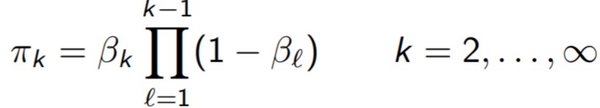
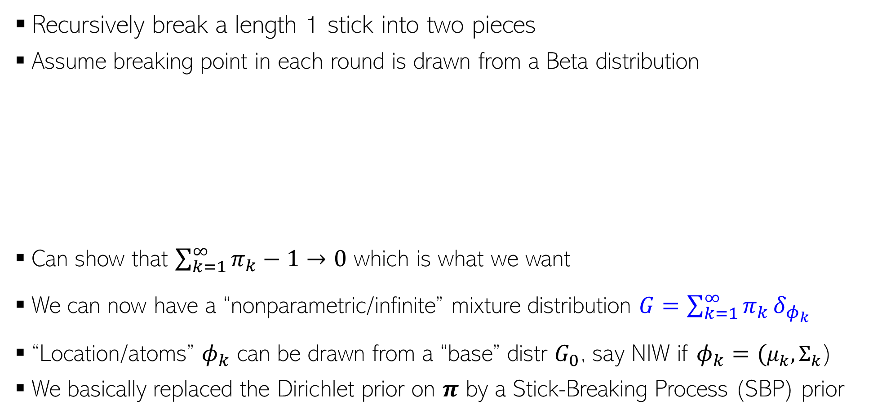
Stick-Breaking Process (Sethuraman’94)
SBP gives us a way to construct infinite dimensional Dirichlet distribution known as the “Dirichlet Process”
5
Recursively break a length 1 stick into two pieces
Assume breaking point in each round is drawn from a Beta distribution
Can show that $\sum_{k=1}^{∞}{π_{k}}−1→0$ which is what we want
We can now have a “nonparametric/infinite” mixture distribution $G=\sum_{k=1}^{∞}{π_{k}}δ_{φ_{k}}$
“Location/atoms” $φ_{k}$ can be drawn from a “base” distr $G_{0}$, say NIW if $φ_{k}=(μ_{k},Σ_{k}$)
We basically replaced the Dirichlet prior on $π$ by a Stick-Breaking Process (SBP) prior

Slide 6
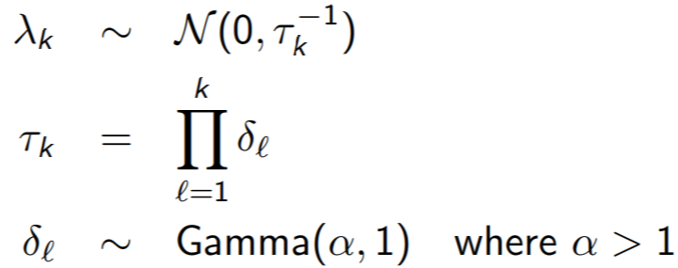
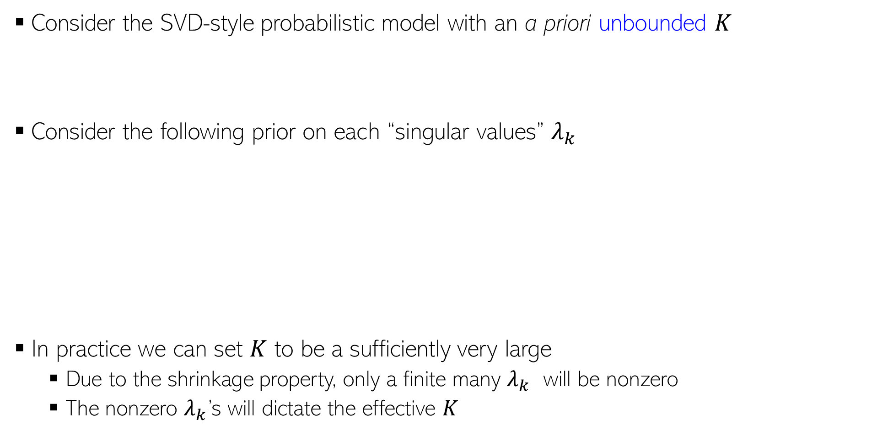
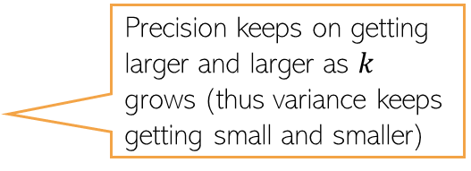
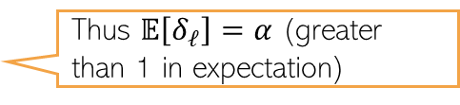
Another NPBayes Prior: Multiplicative Gamma Process
6
Consider the SVD-style probabilistic model with an a priori unbounded $K$
Consider the following prior on each “singular values” $λ_{k}$
In practice we can set $K$ to be a sufficiently very large
  Due to the shrinkage property, only a finite many $λ_{k}$ will be nonzero
  The nonzero $λ_{k}$’s will dictate the effective $K$
$$X= \sum_{k=1}^{∞}{λ_{k}u_{k}v_{k}^{⊤}}$$
Precision keeps on getting larger and larger as $k$ grows (thus variance keeps getting small and smaller)
Thus $𝔼\left[δ_{ℓ}\right]=α$ (greater than 1 in expectation)

Slide 7
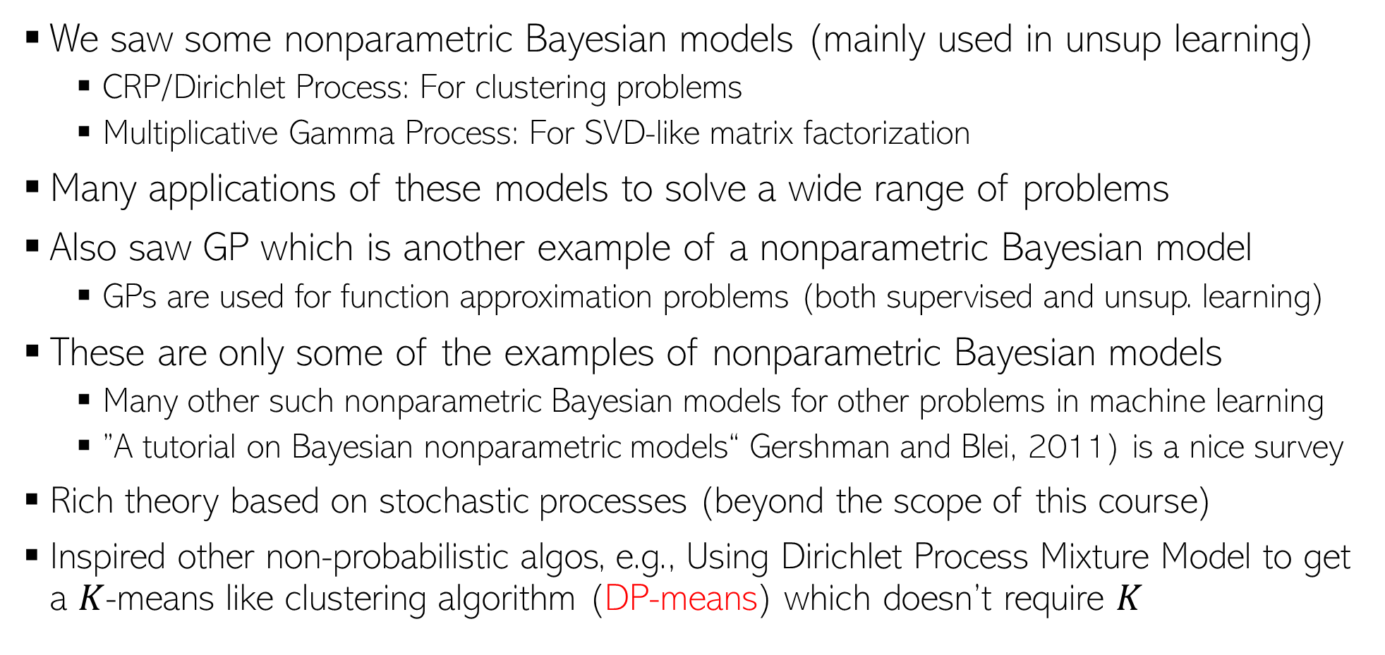
Summary of NPBayes
7
We saw some nonparametric Bayesian models (mainly used in unsup learning)
  CRP/Dirichlet Process: For clustering problems
  Multiplicative Gamma Process: For SVD-like matrix factorization
Many applications of these models to solve a wide range of problems
Also saw GP which is another example of a nonparametric Bayesian model
  GPs are used for function approximation problems (both supervised and unsup. learning)
These are only some of the examples of nonparametric Bayesian models
  Many other such nonparametric Bayesian models for other problems in machine learning
  ”A tutorial on Bayesian nonparametric models“ Gershman and Blei, 2011) is a nice survey
Rich theory based on stochastic processes (beyond the scope of this course)
Inspired other non-probabilistic algos, e.g., Using Dirichlet Process Mixture Model to get a $K$-means like clustering algorithm (DP-means) which doesn’t require $K$

Slide 8
Simulation-based Inference
8

Slide 9
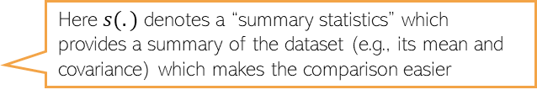

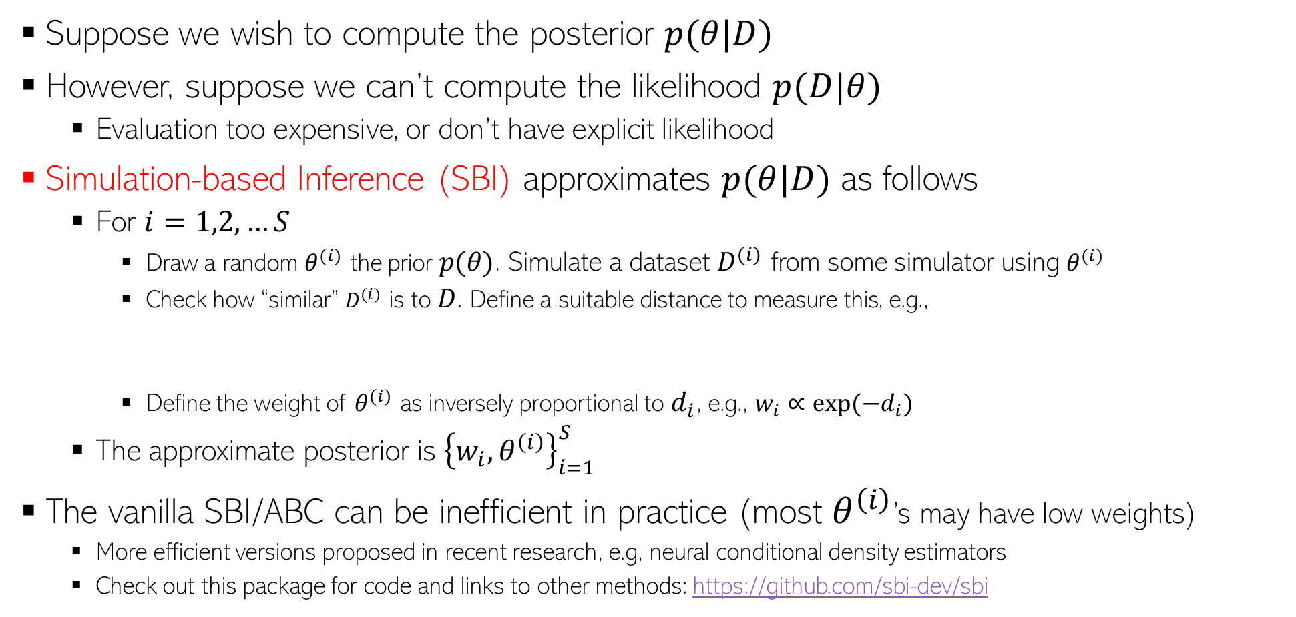
Simulation-based Inference
9
Suppose we wish to compute the posterior $p(θ|D)$
However, suppose we can’t compute the likelihood $p(D|θ)$
  Evaluation too expensive, or don’t have explicit likelihood
Simulation-based Inference (SBI) approximates $p(θ|D)$ as follows
  For $i=1,2,…S$
    Draw a random $θ^{(i)}$ the prior $p(θ)$. Simulate a dataset $D^{(i)}$ from some simulator using $θ^{(i)}$
    Check how “similar” $D^{(i)}$ is to $D$. Define a suitable distance to measure this, e.g.,
    Define the weight of $θ^{(i)}$ as inversely proportional to $d_{i}$, e.g., $w_{i}∝exp(−d_{i})$
  The approximate posterior is ${\left\{w_{i},θ^{\left(i\right)}\right\}}_{i=1}^{S}$
The vanilla SBI/ABC can be inefficient in practice (most $θ^{\left(i\right)}$’s may have low weights)
  More efficient versions proposed in recent research, e.g, neural conditional density estimators
  Check out this package for code and links to other methods: https://github.com/sbi-dev/sbi
SBI is also known as “Approximate Bayesian Computation” (ABC)
This simulator may be some domain-specific model of the data generation process (e.g., a physics engine, robotics/control simulator, etc)
Here $s(.)$ denotes a “summary statistics” which provides a summary of the dataset (e.g., its mean and covariance) which makes the comparison easier
$d_{i}= \left\|s\left(D^{\left(i\right)}\right)−s(D)\right\|$

Slide 10
Latent Dirichlet Allocation (LDA) a.k.a. “Topic Model”
10

Slide 11






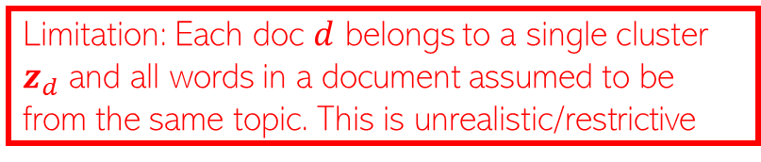
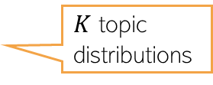





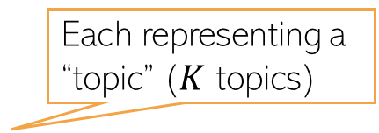
Motivation: Multinomial Mixture Model for Text
11
Assume $D$ documents, and document $d$ has $N_{d}$ words in it
We can represent doc $d$ by a word count vector $w_{d}$
Assuming a vocab of $V$ unique words, $w_{d}$ is a $V×1$ vector of counts
  $w_{dv}$ = no of times word $v$ appears in doc $d$
Let’s model the docs by a mixture of $K$ multinomial distributions, each $V$-dim
  The $k^{th}$ multinomial modeled by a $V$-dim prob vector $φ_{k}$ (sums to 1)
  $φ_{k}$ can be thought of as a “topic vector” (or just “topic”), $φ_{kv}$: prob of word $v$ in topic $k$
Generative model and plate diagram below
Each topic is a prob. distribution over word tokens
Each representing a “topic” ($K$ topics)
Limitation: Each doc $d$ belongs to a single cluster $z_{d}$ and all words in a document assumed to be from the same topic. This is unrealistic/restrictive
Topic Mixing proportion vector
Cluster/topic of document $d$
$$z_{d}∼multinoulli(π)$$
$$π$$
$$z_{d}$$
$$w_{d}$$
$$φ_{k}$$
$K$ topic distributions
$$w_{d}∼multinomial(φ_{z_{d}},N_{d})$$
$$D$$
$$K$$
Counts will sum to $N_{d}$

Slide 12
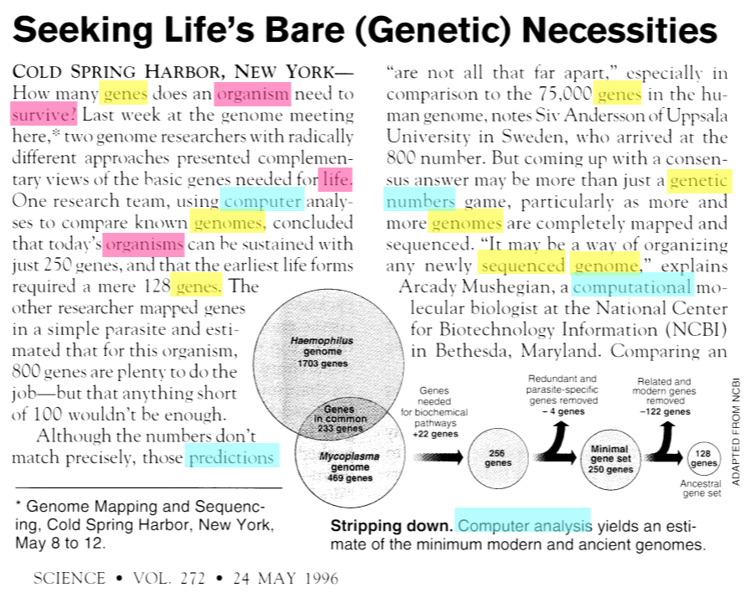
Documents can be about multiple topics
12
How do we find the word-topic associations in each document?
How do we use them to learn topics in the given text collection?
How do we learn low-dim document representations in terms of the topics they represent?

Slide 13













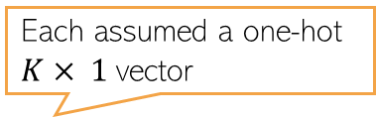

A More Fine-Grained Mixture Model for Text
13
Assume a corpus-level topic mixing proportions $α$ ($K× 1$prob vector)
Also assume doc-level topic mixing props $θ_{d}$ ($K× 1$prob vector)
Instead of assuming a single cluster $z_{d}$ for doc $d$, cluster each word in it
  $z_{d,n}∈\{1,2,…, K\}$ denotes the cluster/topic of word $w_{d,n}∈\{1,2,…, V\}$
Can obtain the “average” clustering for doc $d$ using $θ_{d}$ or ${\overline{z}}_{d}= \frac{1}{N_{d}}\sum_{n=1}^{N_{d}}{z_{d,n}}$
The generative model is as follows
Each assumed a one-hot $K× 1$vector
Locally-conjugate. Easy Gibbs sampling, VI, etc
Somewhat similar to Dir-Mult PCA model
Latent Dirichlet Allocation* (LDA) Topic Model
$$φ_{k}∼Dirichlet\left(η\right) k=1,2,…, K$$
($V$-dim Dirichlet)
$$η$$
$$θ_{d}∼Dirichlet\left(α\right) d=1,2,…, D$$
($K$-dim Dirichlet)
$$z_{d,n}∼multinoulli(θ_{d})$$
$$α$$
$$θ_{d}$$
$$z_{d,n}$$
$$w_{d,n}$$
$$φ_{k}$$
$$w_{d,n}∼multinoulli(φ_{z_{d,n}})$$
$$N_{d}$$
$$K$$
$$D$$

Slide 14
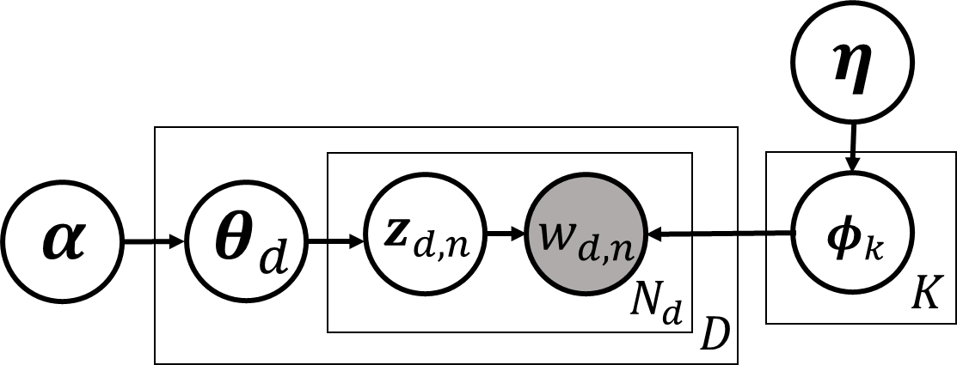
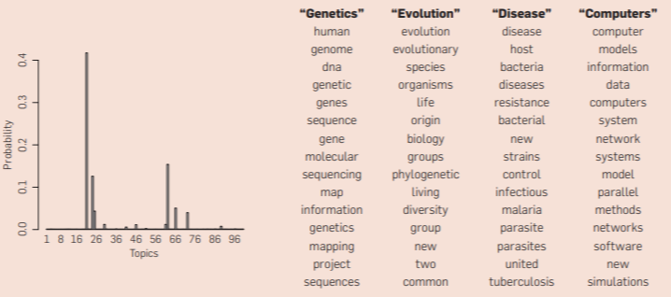





Latent Dirichlet Allocation (LDA)
14
A very widely used probabilistic model for text data
Nice and easy insights into the text collection
  Each $φ_{k}=[φ_{k1},…, φ_{kV}]$ can be interpreted as topic ($φ_{kv}=$ prob. of word $v$ in topic $k$)
  $θ_{d}=[θ_{d1},…, θ_{dK}]$: how much each topic is present in document $d$ (topic distribution)
  ${\overline{z}}_{d}= \frac{1}{N_{d}}\sum_{n=1}^{N_{d}}{z_{d,n}}$ also has a similar interpretation as $θ_{d}$
15 most frequent (most probable) words from four most prominent topics in this doc
A topic is a set of words that tend to co-occur together
$$φ_{1}$$
$$φ_{2}$$
Distribution over topics
$$φ_{3}$$
Word-topic assignments
$$φ_{4}$$
Topic distribution for the document on left

Slide 15
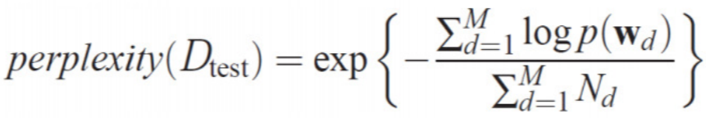
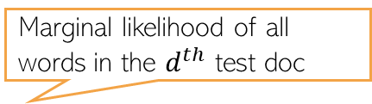
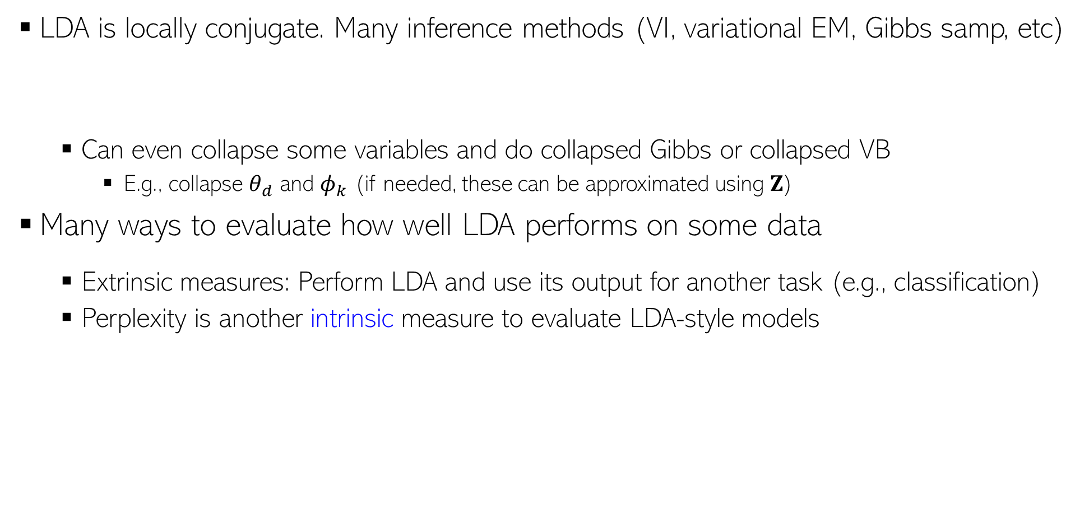

LDA: Inference and Evaluation
15
LDA is locally conjugate. Many inference methods (VI, variational EM, Gibbs samp, etc)
  Can even collapse some variables and do collapsed Gibbs or collapsed VB
    E.g., collapse $θ_{d}$ and $φ_{k}$ (if needed, these can be approximated using $Z$)
Many ways to evaluate how well LDA performs on some data
  Extrinsic measures: Perform LDA and use its output for another task (e.g., classification)
  Perplexity is another intrinsic measure to evaluate LDA-style models
Marginal likelihood of all words in the $d^{th}$ test doc
Test set with $M$ docs
Lower is better

Slide 16
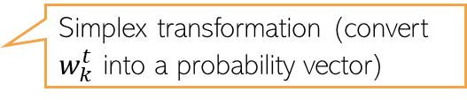



LDA: Limitations and Extensions
16
LDA assumes topics remain static over time (improvement: Dynamic Topic Model)
LDA assumes topics are uncorrelated (improvement: Corr-LDA)
  Use a logistic normal distribution on $θ_{d}$ (cov matrix of log-normal makes component correlated)
LDA ignores the sequential structure in the text (improvement: HMM-LDA)
Assume a first-order Markov evolution for each topic w.r.t. time
$$w_{k}^{t}∼𝒩(w_{k}^{t−1},σ^{2}I)$$
$$φ_{k}^{t}= 𝒮(w_{k}^{t})$$
Simplex transformation (convert $w_{k}^{t}$ into a probability vector)
Evolution of topic “Neuroscience”
(learned from the journal Science)
Fig courtesy: Dynamic Topic Models (Blei and Lafferty, 2006)

Slide 17
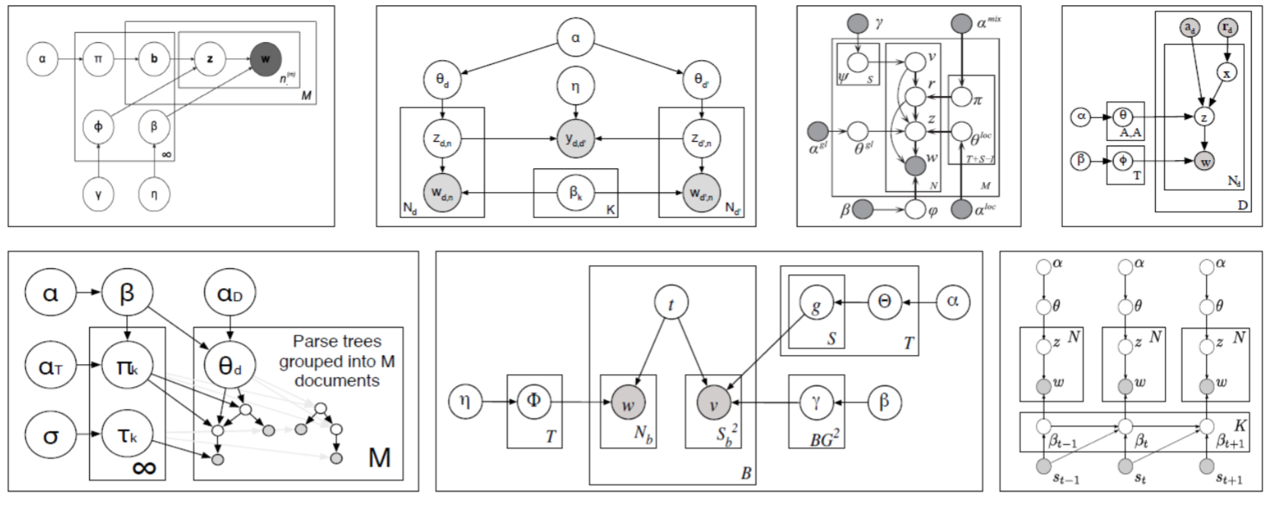
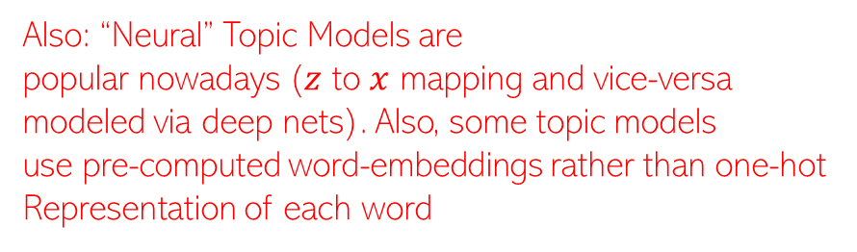


LDA Extensions (Contd)
Also: “Neural” Topic Models are
popular nowadays ($z$ to $x$ mapping and vice-versa
modeled via deep nets). Also, some topic models
use pre-computed word-embeddings rather than one-hot
Representation of each word
17
LDA for non-text data, e.g., images
  Each image can be represented as a bag of “visual words” and LDA can be applied
Supervised/Labeled LDA (when we have have a label for each document)
LDA for paired/multimodality data (e.g., images and text caption)
LDA for graph-structured data instead of documents
LDA is also equivalent to doing a non-negative matrix fact. of the $V× D$word-document matrix $X$ using a Poisson likelihood model*
$Φ$ $(V×K)$and $Θ$ $(K×D)$can be given any non-negative priors (Dirichlet/gamma)
This can be extended to “deep” matrix factorization** (modeling $Θ$ using many layers)
Plate diagrams for some LDA extensions
$$X∼Poisson(ΦΘ)$$
*Sec 4 and 5 of “Beta-Negative Binomial Process and Poisson Factor Analysis” (Zhou et al, 2012)
** Poisson-gamma belief networks” (Zhou et al, 2015)

Slide 18
Conclusion
18
Probabilistic modeling provides a natural way to think about models of data
Many benefits as compared to non-probabilistic approaches
  Easier to model and leverage uncertainty in data/parameters
  Principle of marginalization while making prediction
  Easier to encode prior knowledge about the problem (via prior/likelihood distributions)
  Easier to handle missing data (by marginalizing it out if possible, or by treating as latent variable)
  Easier to build complex models can be neatly combining/extending simpler probabilistic models
  Easier to learn the “right model” (hyperparameter estimation, nonparametric Bayesian models)
Bayesian approaches as well as single model based uncertainty
Uncertainty is important but proper calibration of uncertainty is also important
Fast-moving field, lots of recent advances on new models and inference methods

Slide 19
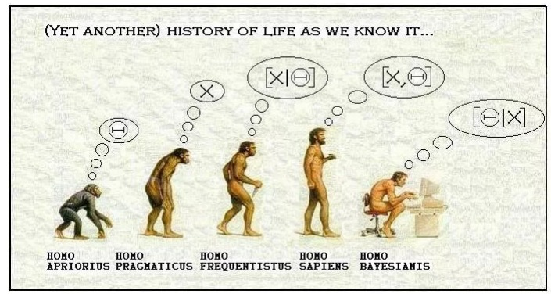
Thank You!
19

