Slide 1
Nonparametric Bayesian Models
CS772A: Probabilistic Machine Learning
Piyush Rai

Slide 2
Nonparametric Bayesian Methods
2
Need for nonparametric Bayesian modeling
Some motivating problems
NPBayes modeling mixture models (clustering)
Some standard ways of constructing NPBayes models
Stick-breaking process, Dirichlet process
Some metaphors: Chinese Restaurant Process

Slide 3
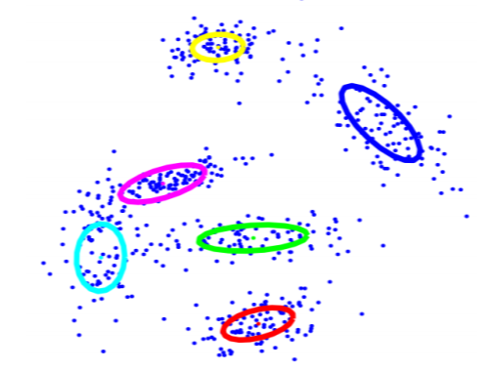
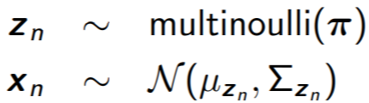

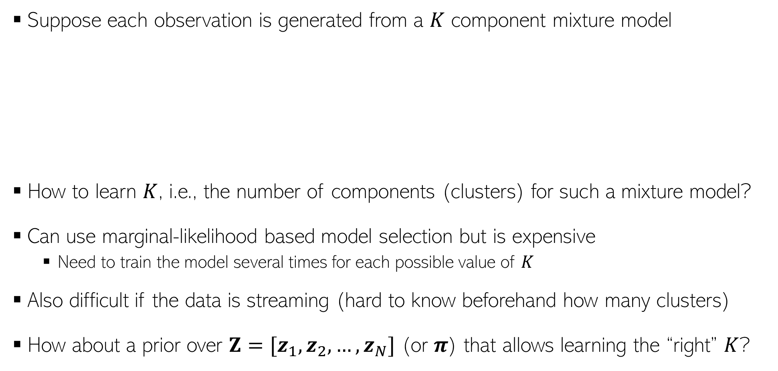
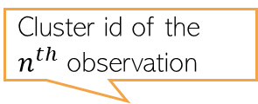
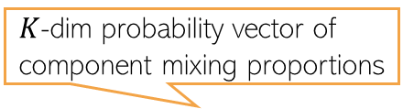
Motivating Problem: Mixture Models
3
Suppose each observation is generated from a $K$ component mixture model
How to learn $K$, i.e., the number of components (clusters) for such a mixture model?
Can use marginal-likelihood based model selection but is expensive
Need to train the model several times for each possible value of $K$
Also difficult if the data is streaming (hard to know beforehand how many clusters)
How about a prior over $Z=[z_{1}, z_{2}, …, z_{N}]$ (or $π$) that allows learning the “right” $K$?
Cluster id of the $n^{th}$ observation
$K$-dim probability vector of component mixing proportions
$n^{th}$ observation

Slide 4
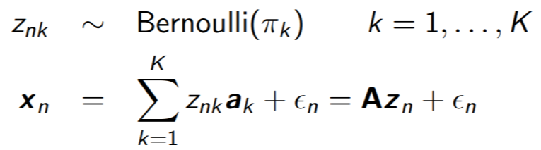
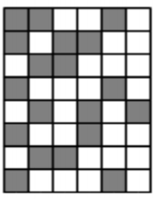




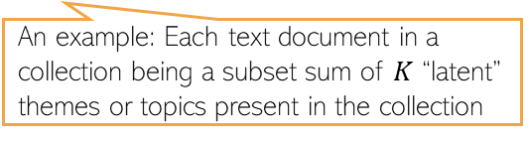
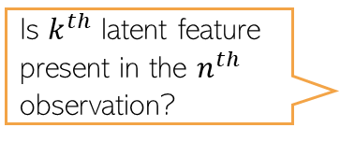


Motivating Problem: Latent Feature Models
4
Suppose each observation is a subset sum of $K$ “basis vectors” (or “latent features”*)
This can also be seen as special type of matrix factorization $X=ZA^{⊤}+E$
How about a prior over $Z$(or $A$ or $π=[π_{1}, …, π_{K}]$) that allows learning the “right” $K$?
Is $k^{th}$ latent feature present in the $n^{th}$ observation?
An example: Each text document in a collection being a subset sum of $K$ “latent” themes or topics present in the collection
The $n^{th}$ observation ($D× 1$) expressed as a subset sum of the $K$ latent features (each $D× 1$), plus some noise
Noise (e.g., zero mean Gaussian)
The $k^{th}$ latent feature ($D× 1$)
A binary sparse matrix
$$D$$
$$K$$
$$D$$
$n^{th}$ row is $x_{n}$
$n^{th}$ row is $z_{n}$, a binary vector
$k^{th}$ row is $a_{k}^{⊤}$
$$A^{⊤}$$
$$X$$
$$≈$$
$$Z$$
$$K$$
$$N$$
$$N$$
Just like mixture models, selecting it based on marg-lik will be expensive
* Indian Buffet Process: An Introduction and Review (Griffiths and Ghahramani, 2011)

Slide 5
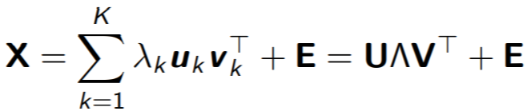
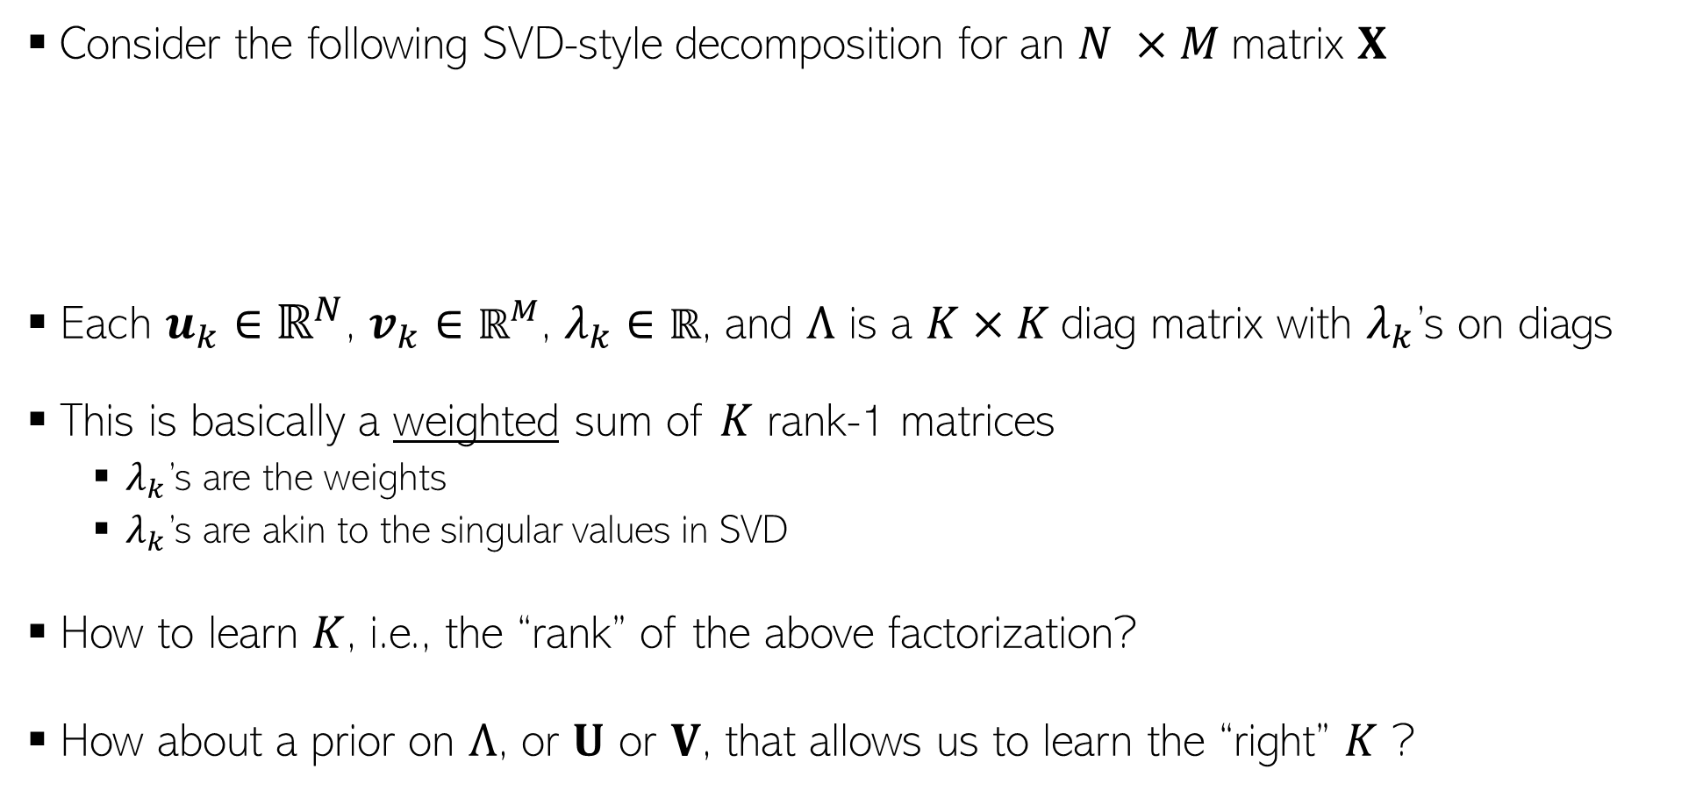
Motivating Problem: SVD-style Matrix Factorization
5
Consider the following SVD-style decomposition for an $N ×M$matrix $X$
Each $u_{k}∈ℝ^{N}$, $v_{k}∈ℝ^{M}$, $λ_{k}∈$ $ℝ$, and $Λ$ is a $K×K$diag matrix with $λ_{k}$’s on diags
This is basically a weighted sum of $K$ rank-1 matrices
$λ_{k}$’s are the weights
$λ_{k}$’s are akin to the singular values in SVD
How to learn $K$, i.e., the “rank” of the above factorization?
How about a prior on $Λ$, or $U$ or $V$, that allows us to learn the “right” $K$ ?
Rank 1 matrix
Zero mean Gaussian noise
*Sparse Bayesian infinite factor models (Bhattacharya and Dunson, 2011)

Slide 6
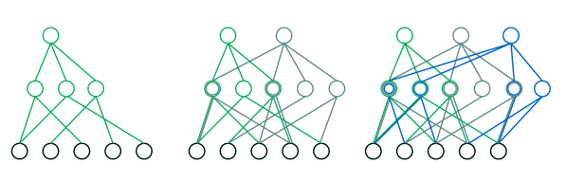
Motivating Problem: “Lifelong” Learning
6
In many scenarios, we want models that can learn in a “lifelong” fashion
Also known as “continual learning”
Goal is to learn new knowledge but also to not forget previously acquired knowledge
In such cases we want models that do not have a fixed size decided beforehand
Instead we prefer models with size that can grow/adapt with time as it
Sees more training data
Sees new tasks
Task 1
Task 1 + Task 2
Task 1 + Task 2 + Task 3

Slide 7

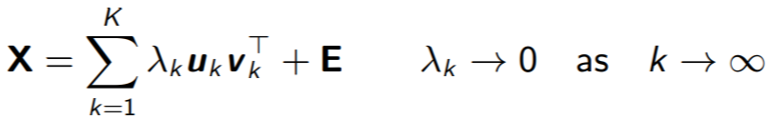
Nonparametric Bayesian Modeling
A vast area of research in ML and statistics. We will only be looking at a basic flavor of some approaches
7
Enables constructing models that do not have an a priori fixed size
Nonparametric does not mean no parameters
Instead, have a possibly infinite (unbounded) number of parameters
Note: We’ve already seen Gaussian Processes which is a nonparametric Bayesian model
Usually constructed via one of the following ways
Take a finite model (e.g., a finite mixture model) and consider its “infinite limit”
Have a model that allows very large number of params but has a “shrinkage” effect, e.g.,
We will look at some examples of both these approaches
And can potentially grow as we see more and more data (actual number will depend on the amount/properties of data)
A tutorial on Bayesian nonparametric models (Gershman and Blei, 2012)

Slide 8
Being Nonparametric by Taking Infinite Limit of Finite Models
8

Slide 9
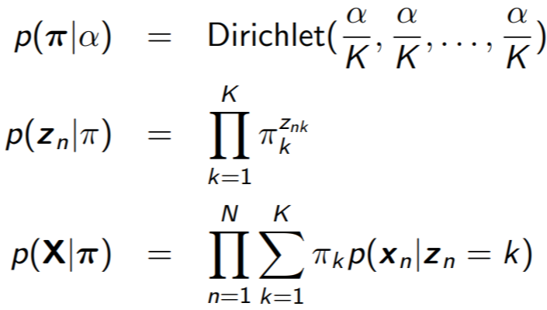


A Finite Mixture Model
9
Data $X=\left[x_{1},x_{2},…,x_{N}\right]$, cluster assignments $Z=\left[z_{1},z_{2},…,z_{N}\right]$, $K$clusters
Denote the mixing proportion by a vector $π=[π_{1},…, π_{K}]$, $\sum_{k=1}^{K}{π_{k}}=1$
Integrating out $π$, the marginal prior probability of cluster assignments
a.k.a. “collapsing” a variable; one less variable to infer now
Number of points with $z_{n}=k$

Slide 10
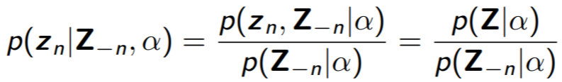

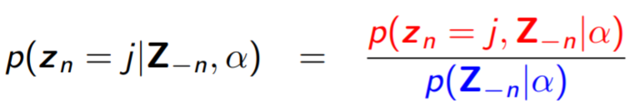
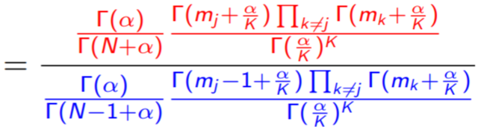

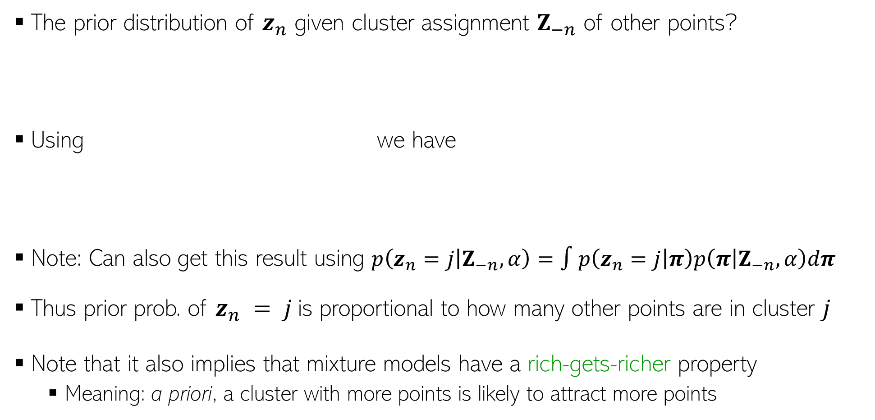
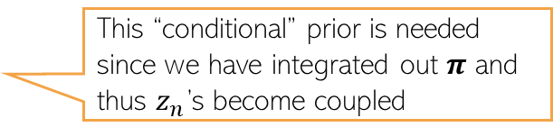
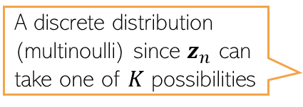
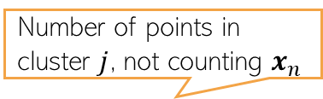
A Finite Mixture Model
10
The prior distribution of $z_{n}$ given cluster assignment $Z_{−n}$ of other points?
Using we have
Note: Can also get this result using $p\left(z_{n}=j | Z_{−n},α\right)=∫p\left(z_{n}=j | π\right)p\left(π | Z_{−n},α\right)dπ$
Thus prior prob. of $z_{n} = j$is proportional to how many other points are in cluster $j$
Note that it also implies that mixture models have a rich-gets-richer property
Meaning: a priori, a cluster with more points is likely to attract more points
A discrete distribution (multinoulli) since $z_{n}$ can take one of $K$ possibilities
This “conditional” prior is needed since we have integrated out $π$ and thus $z_{n}$’s become coupled
Number of points in cluster $j$, not counting $x_{n}$

Slide 11




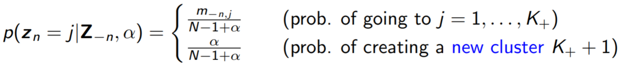
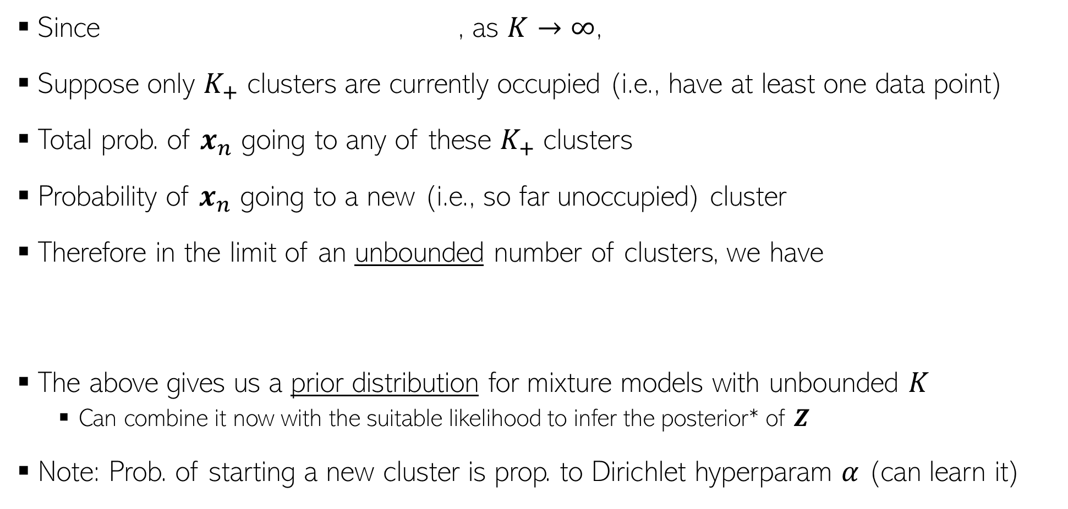
Taking the Infinite Limit..
11
Since , as $K→∞$,
Suppose only $K_{+}$ clusters are currently occupied (i.e., have at least one data point)
Total prob. of $x_{n}$ going to any of these $K_{+}$ clusters
Probability of $x_{n}$ going to a new (i.e., so far unoccupied) cluster
Therefore in the limit of an unbounded number of clusters, we have
The above gives us a prior distribution for mixture models with unbounded $K$
Can combine it now with the suitable likelihood to infer the posterior* of $Z$
Note: Prob. of starting a new cluster is prop. to Dirichlet hyperparam $α$ (can learn it)
*Markov chain sampling methods for Dirichlet process mixture models, (Neal, 2000), Variational inference for Dirichlet process mixtures (Blei and Jordan, 2006)

Slide 12


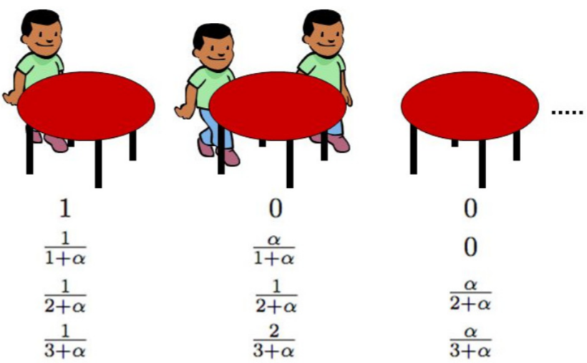
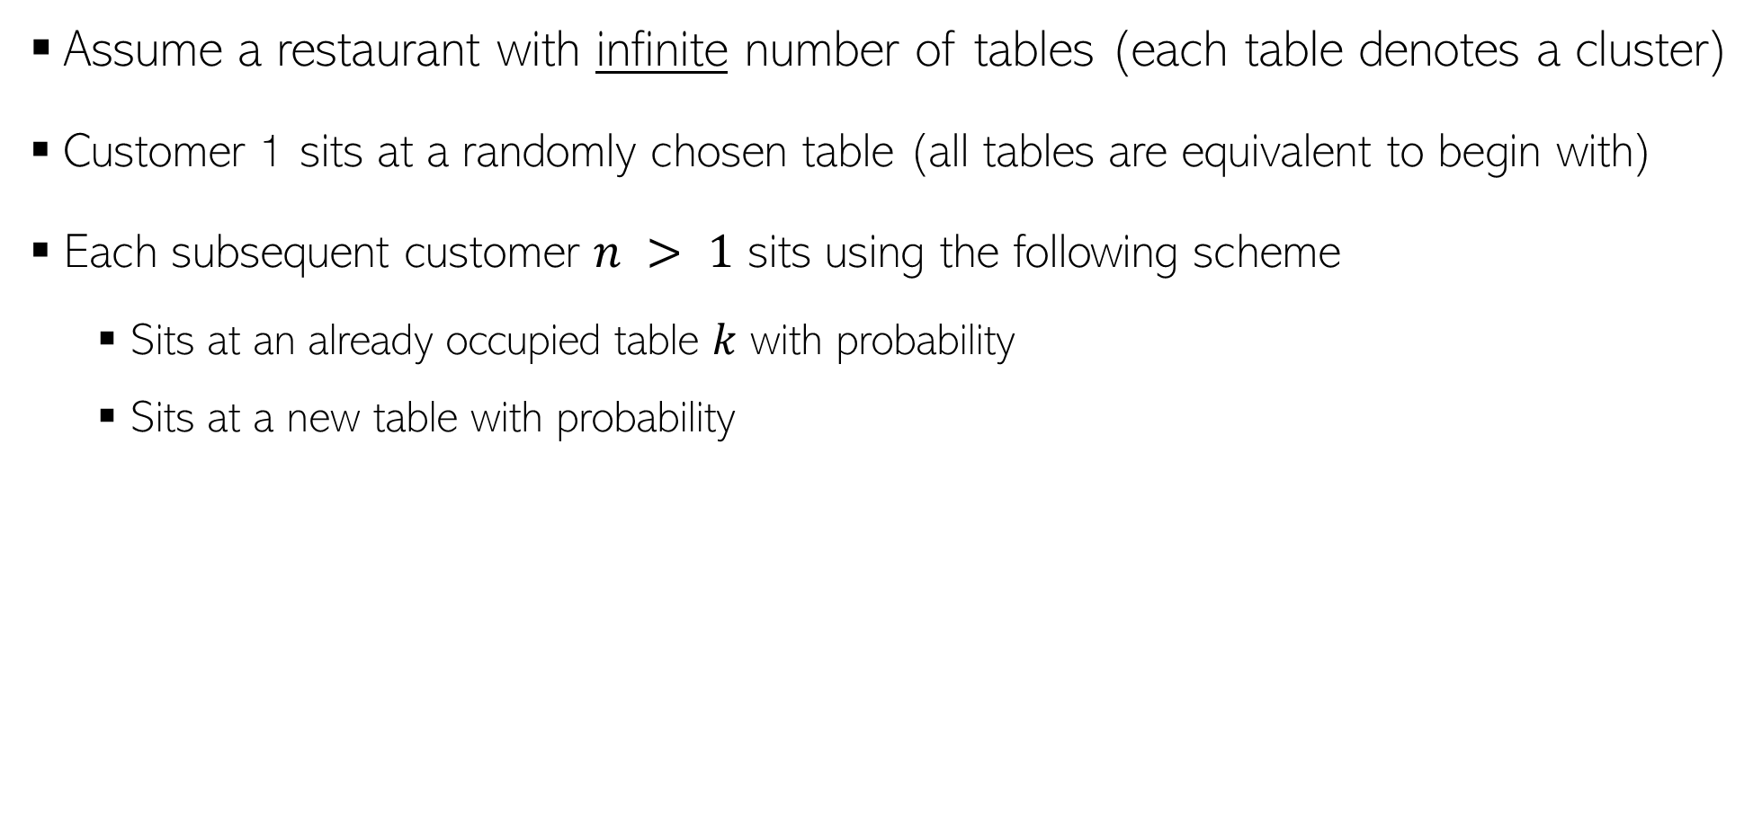
A Metaphor: Chinese Restaurant Process (CRP)
12
Assume a restaurant with infinite number of tables (each table denotes a cluster)
Customer 1 sits at a randomly chosen table (all tables are equivalent to begin with)
Each subsequent customer $n > 1$ sits using the following scheme
Sits at an already occupied table $k$ with probability
Sits at a new table with probability
When customer 1 comes
When customer 2 comes after customer 1 chose table
When customer 3 comes after customer 1 and 2 chose table
When customer 4 comes after customer 1,2 and 3 chose table

Slide 13
Being Nonparametric using Models that have a Shrinkage Effect
13

Slide 14
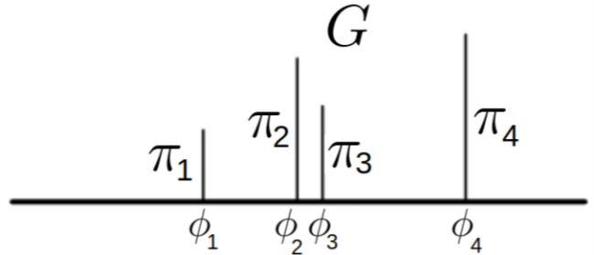

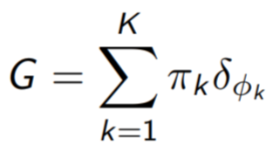
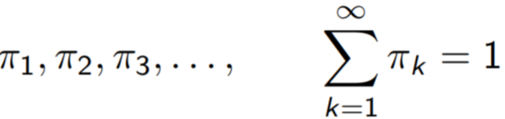

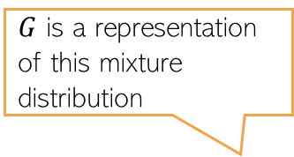
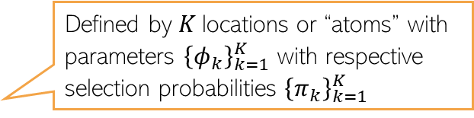
Mixture Models: Another Construction
14
Consider a finite mixture model with $K$ components with params ${\left(μ_{k},Σ_{k}\right)}_{k=1}^{K}$
In the finite case, we can assume $π=[π_{1},…, π_{K}]$ and $π∼Dirichlet\left(\frac{α}{K},…,\frac{α}{K}\right)$
We can make it a nonparametric model by making $π$ an infinite-dimensional vector
How to construct such a vector? Is there an infinite dimensional Dirichlet distribution?
Defined by $K$locations or “atoms” with parameters ${\left\{φ_{k}\right\}}_{k=1}^{K}$ with respective selection probabilities ${\left\{π_{k}\right\}}_{k=1}^{K}$
$G$ is a representation of this mixture distribution
In practice, only a finite of these will have nonzero values, and others will shrink to very small (or zero), as we will see
Indeed. Called a “Dirichlet Process”
Related: “Stick-breaking Process”

Slide 15
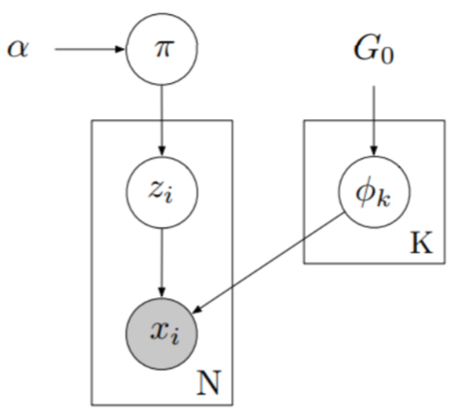
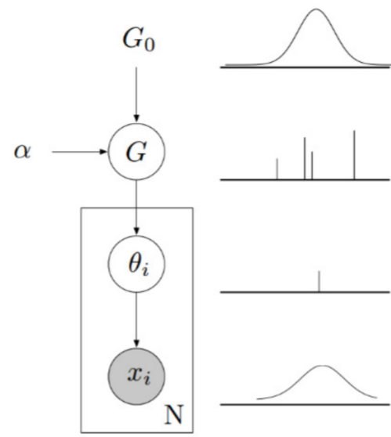
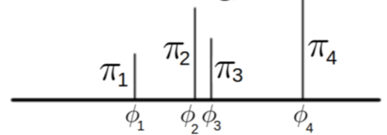

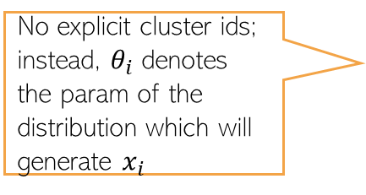
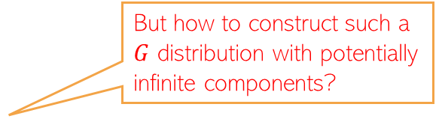

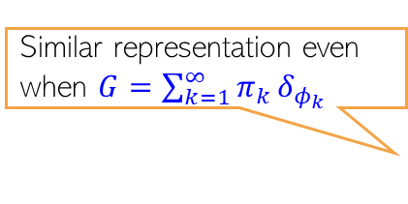

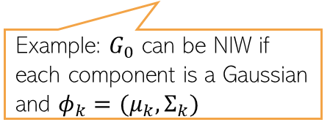

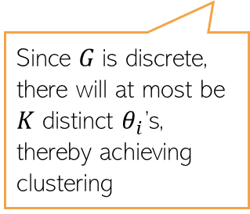
Mixture Models: Two Equivalent Views
15
But how to construct such a $G$ distribution with potentially infinite components?
Prior (a.k.a. “base distribution” for the parameters of each mixture component
Similar representation even when $G=\sum_{k=1}^{∞}{π_{k}}δ_{φ_{k}}$
Example: $G_{0}$ can be NIW if each component is a Gaussian and $φ_{k}=(μ_{k},Σ_{k})$
No explicit cluster ids; instead, $θ_{i}$ denotes the param of the distribution which will generate $x_{i}$
Typical way of showing the plate notation of a mixture model
Since $G$is discrete, there will at most be $K$ distinct $θ_{i}$’s, thereby achieving clustering
$$π∼Dirichlet\left(\frac{α}{K},…,\frac{α}{K}\right)$$
$$π∼Dirichlet\left(\frac{α}{K},…,\frac{α}{K}\right)$$
$φ_{k}∼G_{0}$ $k=1,2,…, K$
$φ_{k}∼G_{0}$ $k=1,2,…, K$
$$G=\sum_{k=1}^{K}{π_{k}}δ_{φ_{k}}$$
$$z_{i}∼multinoulli\left(π\right) i=1,2,…, N$$
$$x_{i}∼p\left(x | φ_{z_{i}}\right) i=1,2,…, N$$
$$θ_{i}∼G i=1,2,…, N$$
$$x_{i}∼p\left(x | θ_{i}\right) i=1,2,…, N$$

Slide 16

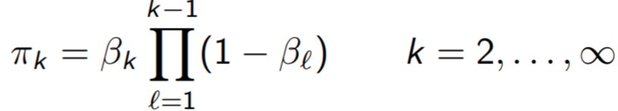
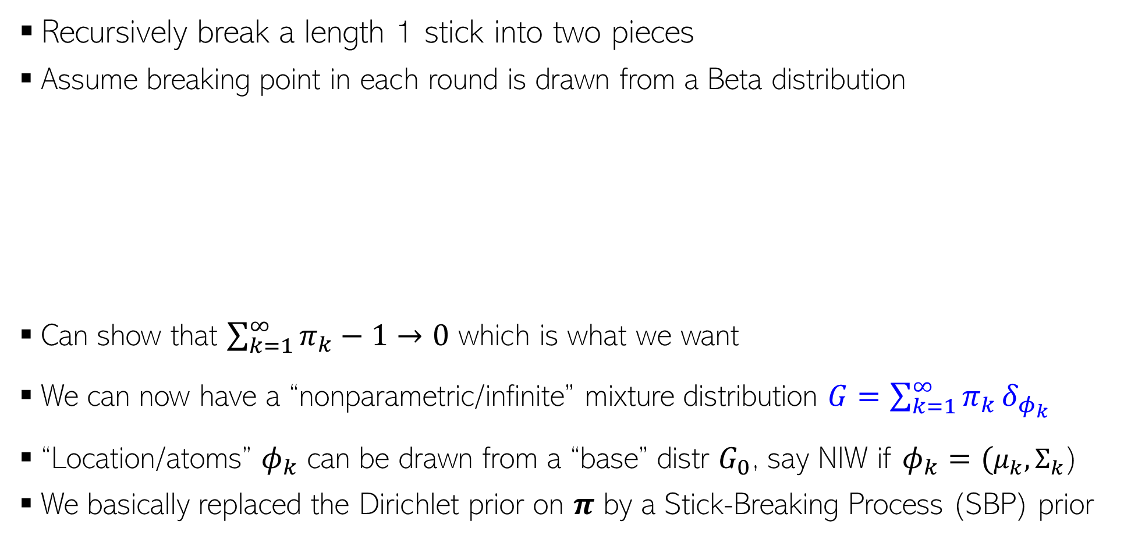
Stick-Breaking Process (Sethuraman’94)
SBP gives us a way to construct infinite dimensional Dirichlet distribution known as the “Dirichlet Process”
16
Recursively break a length 1 stick into two pieces
Assume breaking point in each round is drawn from a Beta distribution
Can show that $\sum_{k=1}^{∞}{π_{k}}−1→0$ which is what we want
We can now have a “nonparametric/infinite” mixture distribution $G=\sum_{k=1}^{∞}{π_{k}}δ_{φ_{k}}$
“Location/atoms” $φ_{k}$ can be drawn from a “base” distr $G_{0}$, say NIW if $φ_{k}=(μ_{k},Σ_{k}$)
We basically replaced the Dirichlet prior on $π$ by a Stick-Breaking Process (SBP) prior

Slide 17
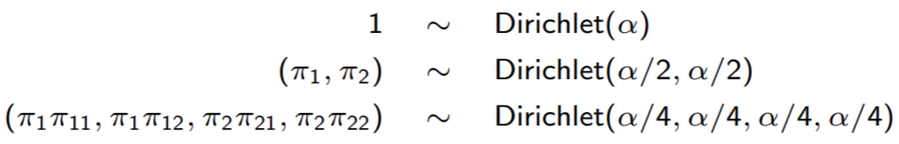
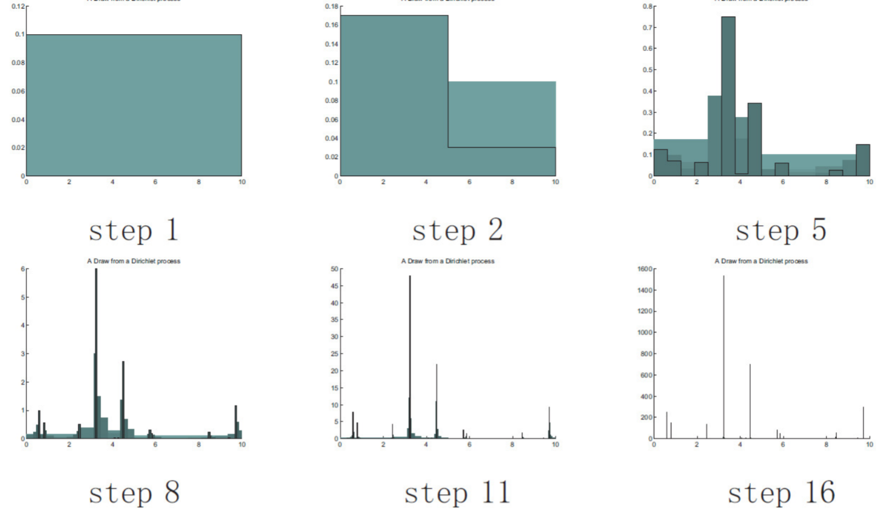
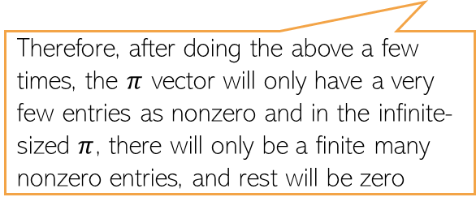

Infinite Dimensional Dirichlet
17
Drawing from an infinite-dim Dirichlet would give an infinite-dim prob. vector
We can construct this vector to have very few entries as nonzero
Consider recursively drawing from a Dirichlet as defined below
$$π=[π_{1},π_{2},π_{3},…]$$
As the concentration parameter gets smaller and smaller, the split of values in LHS get more and more skewed
Therefore, after doing the above a few times, the $π$ vector will only have a very few entries as nonzero and in the infinite-sized $π$, there will only be a finite many nonzero entries, and rest will be zero
This is basically what happens in the case of Dirichlet Process / Stick-Breaking Process

Slide 18
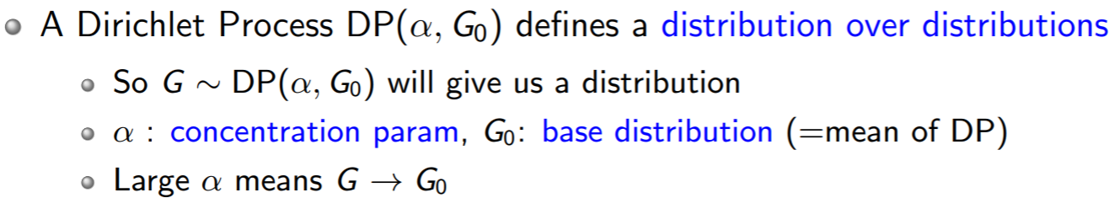

Dirichlet Process - Formally
18
SBP gives an explicit way to construct “Dirichlet Process”

Slide 19




Another NPBayes Prior: Multiplicative Gamma Process
19
Consider the SVD-style probabilistic model with an a priori unbounded $K$
Consider the following prior on each “singular values” $λ_{k}$
In practice we can set $K$ to be a sufficiently very large
Due to the shrinkage property, only a finite many $λ_{k}$ will be nonzero
The nonzero $λ_{k}$’s will dictate the effective $K$
$$X= \sum_{k=1}^{∞}{λ_{k}u_{k}v_{k}^{⊤}}$$
Precision keeps on getting larger and larger as $k$ grows (thus variance keeps getting small and smaller)
Thus $𝔼\left[δ_{ℓ}\right]=α$ (greater than 1 in expectation)

Slide 20

Summary of NPBayes
20
We saw some nonparametric Bayesian models (mainly used in unsup learning)
CRP/Dirichlet Process: For clustering problems
Multiplicative Gamma Process: For SVD-like matrix factorization
Many applications of these models to solve a wide range of problems
Also saw GP which is another example of a nonparametric Bayesian model
GPs are used for function approximation problems (both supervised and unsup. learning)
These are only some of the examples of nonparametric Bayesian models
Many other such nonparametric Bayesian models for other problems in machine learning
”A tutorial on Bayesian nonparametric models“ Gershman and Blei, 2011) is a nice survey
Rich theory based on stochastic processes (beyond the scope of this course)
Inspired other non-probabilistic algos, e.g., Using Dirichlet Process Mixture Model to get a $K$-means like clustering algorithm (DP-means) which doesn’t require $K$

