Slide 1
Assorted Topics (2)
CS772A: Probabilistic Machine Learning
Piyush Rai

Slide 2
Plan Today
2
Some other non-Bayesian ways to get uncertainty estimates
  Frequentist statistics
  Conformal Prediction
Latent variable models for sequential data

Slide 3

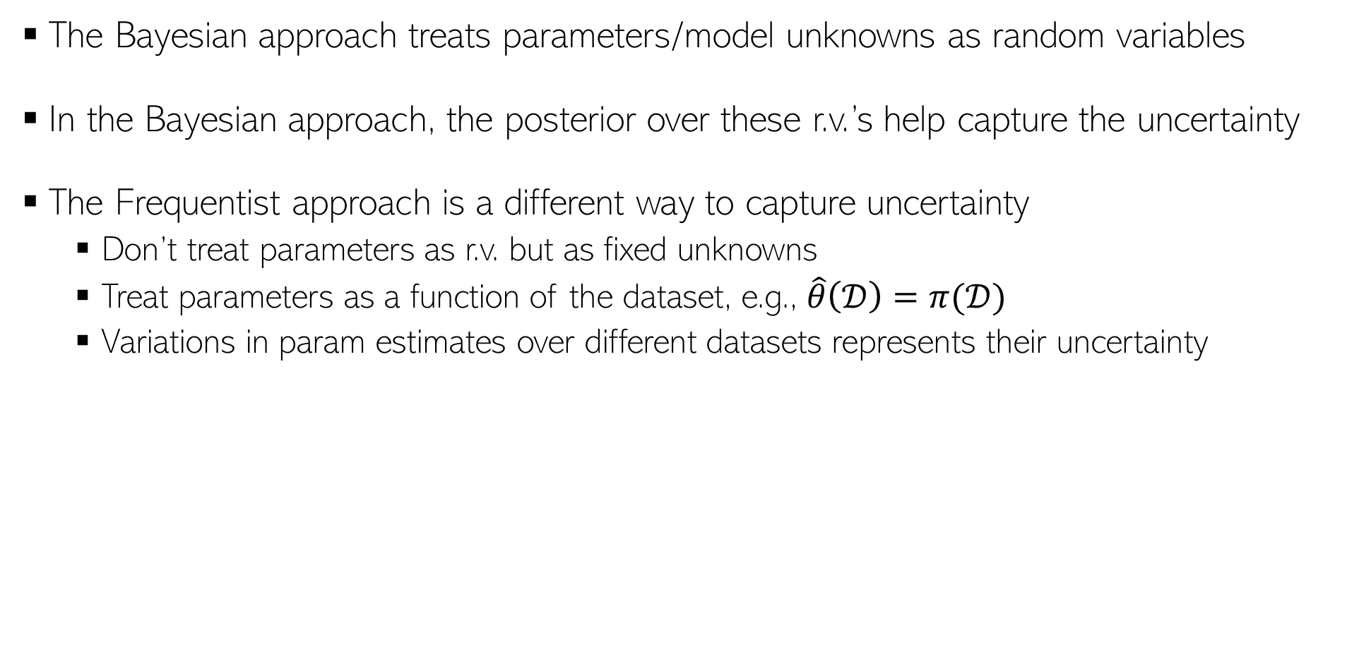
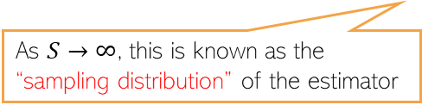

Frequentist Statistics
3
The Bayesian approach treats parameters/model unknowns as random variables
In the Bayesian approach, the posterior over these r.v.’s help capture the uncertainty
The Frequentist approach is a different way to capture uncertainty
  Don’t treat parameters as r.v. but as fixed unknowns
  Treat parameters as a function of the dataset, e.g., $\hat{θ}\left(𝒟\right)=π(𝒟)$
  Variations in param estimates over different datasets represents their uncertainty
This can be some point estimate, e.g., MLE, MAP, method of moments, etc.
A random dataset drawn from the true data distribution
True unknown value of the parameter
$$(s=1, 2, …, S)$$
The estimated distribution of the parameters given any randomly drawn dataset from the true data distribution
Param estimate using the $s$-th sampled dataset
As $S→∞$, this is known as the “sampling distribution” of the estimator
Note that sampling distribution is different from a posterior distribution we infer in Bayesian learning (there, we condition on a fixed training set)
But if the estimator is MLE and Bayesian method’s prior is uniform, then both distributions are very similar (sampling distribution is often called “poor man’s posterior”

Slide 4






Approximating the sampling distribution
4
Since the true $θ^{∗}$ is not known, we can’t compute the sampling distribution exactly
Bootstrap is a popular method to approximate the sampling distribution
Two types of bootstrap methods: parametric and nonparametric bootstrap
$$(s=1, 2, …, S)$$
Parametric Bootstrap
Nonparametric Bootstrap
Get a point est. of $θ$ using training data
Generate multiple datasets using $\hat{θ}$ as
Now compute the approximation as
Use sampling with replacement on original training set to generate $S$ datasets with $N$ datapoints in each
Now compute the approximation as
$$\hat{θ}=π(𝒟)$$
Each dataset will contain roughly 63% unique datapoints from original training set
$$(s=1, 2, …, S)$$

Slide 5
Conformal Prediction
5

Slide 6
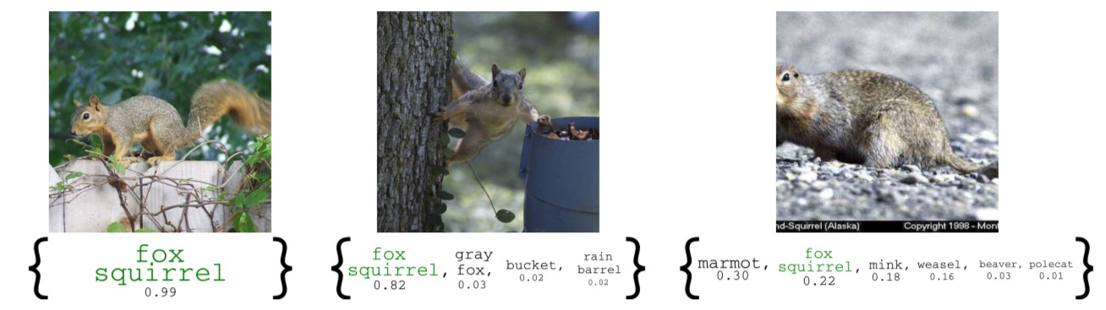
Conformal Prediction
6
A simple technique to easily obtain confidence intervals
  In classification, such an interval may refer to the set of highly likely classes for a test input
  For more difficult test inputs, the set would typically be larger
In a way, conformal prediction gives predictive uncertainty
  However, unlike Bayesian ML, we don’t get model uncertainty
  Only one model is learned in the standard way and we construct the set of likely classes
  It’s like a black-box method; no change to training procedure for the model

Slide 7

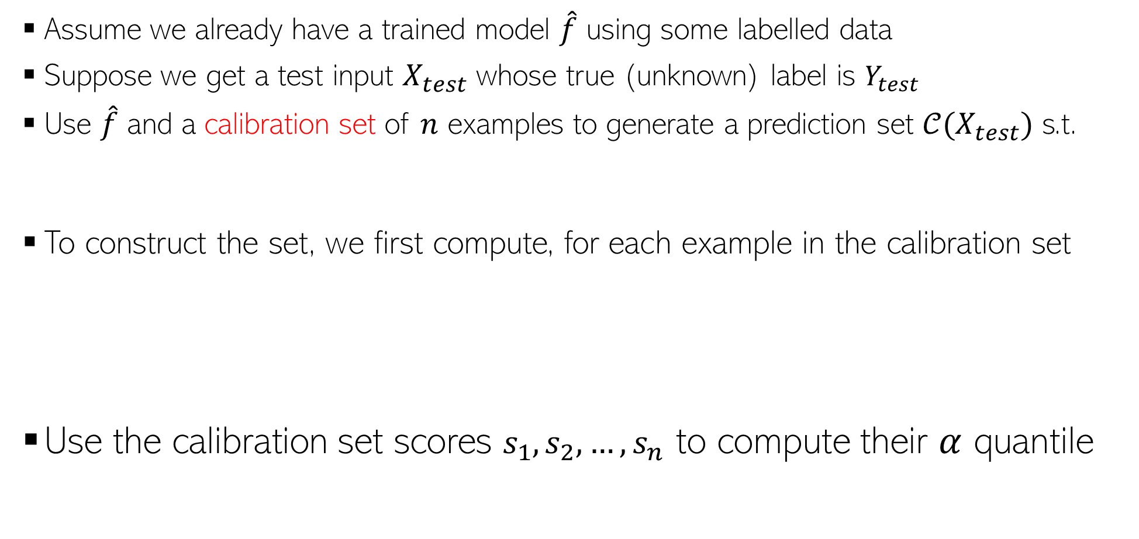
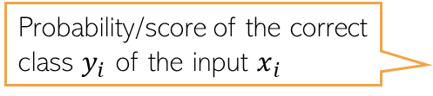

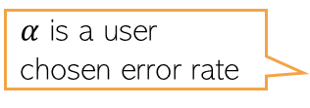
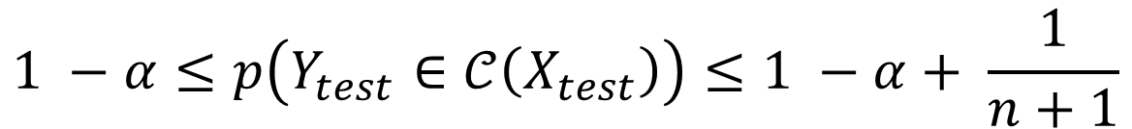
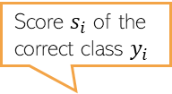
Conformal Prediction
7
Assume it’s a classification model which produces softmax scores
Conformal prediction can be used for regression problems too*
Assume we already have a trained model $\hat{f}$ using some labelled data
Suppose we get a test input $X_{test}$ whose true (unknown) label is $Y_{test}$
Use $\hat{f}$ and a calibration set of $n$ examples to generate a prediction set $𝒞(X_{test})$ s.t.
To construct the set, we first compute, for each example in the calibration set
Use the calibration set scores $s_{1},s_{2},…, s_{n}$ to compute their $α$ quantile
$α$ is a user chosen error rate
$$1 −α≤p\left(Y_{test}∈𝒞\left(X_{test}\right)\right)≤1 −α+ \frac{1}{n+1}$$
Probability/score of the correct class $y_{i}$ of the input $x_{i}$
Class probabilities
Score $s_{i}$ of the correct class $y_{i}$
$$s_{i}=\hat{f}{\left(x_{i}\right)}_{y_{i}}$$
classes
$$y_{i}$$
*A Gentle Introduction to Conformal Prediction and Distribution-Free Uncertainty Quantification (Angelopoulos and Bates, 2022)

Slide 8


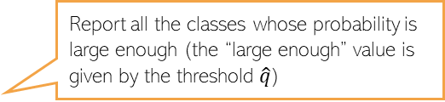

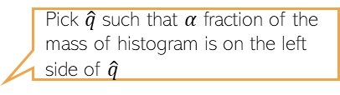
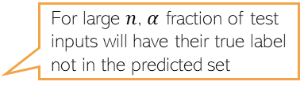

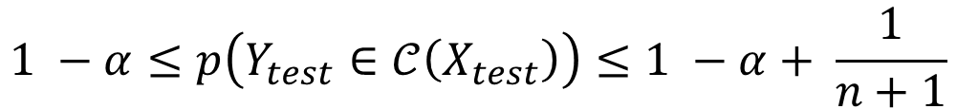
Conformal Prediction
8
Assume the $α$ (say 0.1) quantile of the calibration set scores is equal to $\hat{q}$ (“threshold”)
Given a test input $X_{test}$, whose label is is unknown, we compute the class probabilities
Define the prediction set for $X_{test}$ as: $𝒞\left(X_{test}\right)=\{y:\hat{f}{\left(X_{test}\right)}_{y}≥\hat{q}\}$
The above ensures that
Pick $\hat{q}$ such that $α$ fraction of the mass of histogram is on the left side of $\hat{q}$
If many scores are high, the threshold $\hat{q}$ will also be high
Frequency
scores
$$\hat{q}$$
Class probabilities
Prediction set for this test input includes classes 1,2,5
$$\hat{q}$$
Report all the classes whose probability is large enough (the “large enough” value is given by the threshold $\hat{q}$)
classes
For large $n$, $α$ fraction of test inputs will have their true label not in the predicted set
$$1 −α≤p\left(Y_{test}∈𝒞\left(X_{test}\right)\right)≤1 −α+ \frac{1}{n+1}$$

Slide 9
Conformal Prediction
9
A generic black-box method
Can be easily applied to any already trained classifier
Predicted set has some nice guarantees
Does not make any assumptions on the distribution of the data
  Thus considered a “distribution-free” approach to uncertainty quantification
Can also be applied to regression problems*
$$1 −α≤p\left(Y_{test}∈𝒞\left(X_{test}\right)\right)≤1 −α+ \frac{1}{n+1}$$
*A Gentle Introduction to Conformal Prediction and Distribution-Free Uncertainty Quantification (Angelopoulos and Bates, 2022)

Slide 10
Latent Variable Models for Sequential Data
10

Slide 11
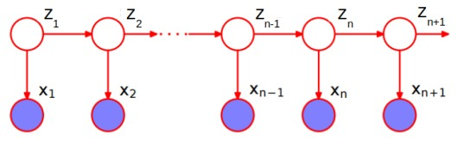
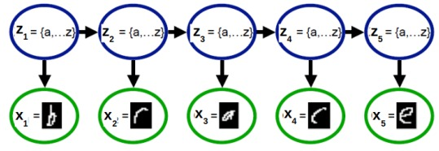
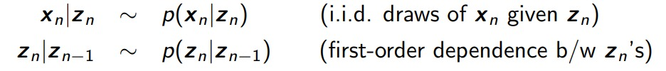



Latent Variable Models for Sequential Data
11
Task: Given a sequence of observations, infer the latent state of each observation
If $z_{n}$’s are discrete, we have a hidden Markov model (HMM)
If $z_{n}$’s are real-valued, we have a state-space model(SSM)
Observation model
State-transition model

Slide 12
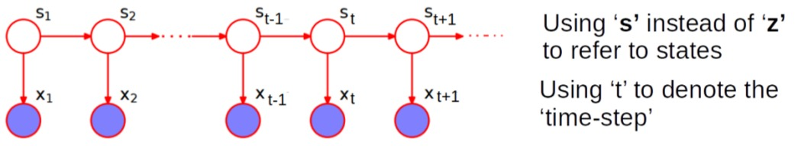
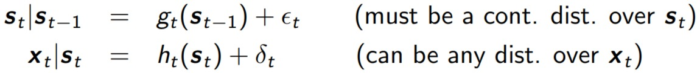
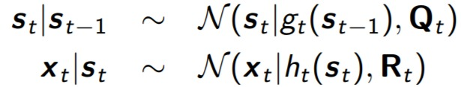
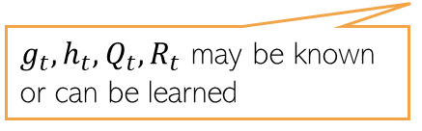

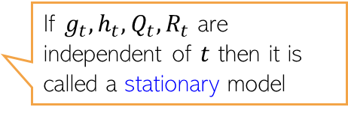
State-Space Models
12
In the most general form, the state-transition and observation models of an SSM
Assuming Gaussian noise in the state-transition and observation models
HMM is similar to SSM except the state-transition model is a discrete distribution
$g_{t}, h_{t}$ can be linear or nonlinear functions
If $g_{t}, h_{t}, Q_{t}, R_{t}$ are independent of $t$ then it is called a stationary model
This is a Gaussian SSM
$g_{t}, h_{t}, Q_{t}, R_{t}$ may be known or can be learned

Slide 13


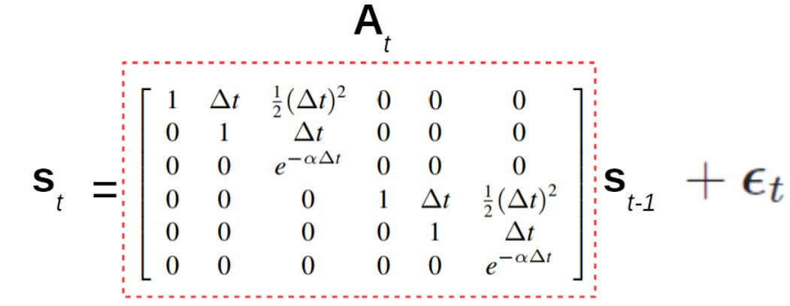
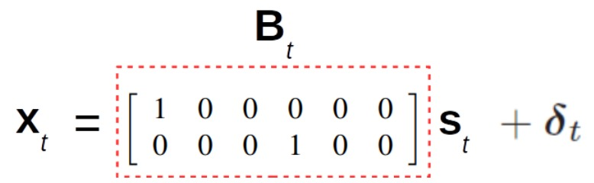

State-Space Models: A Simple Example
13
Consider the linear Gaussian SSM
Suppose $x_{t}∈ℝ^{2}$ denotes the (noisy) observed 2D location of an object
Suppose $s_{t}∈ℝ^{6}$ denotes the “state” vector
Here is an example SSM for this problem with pre-defined $A_{t}$ and $B_{t}$ matrices
$s_{t}$ $\text{= [}\text{pos}\text{1, }\text{vel}\text{1, }\text{accel}\text{1, }\text{pos}\text{2, }\text{vel}\text{2, }\text{accel}\text{2]}$

Slide 14
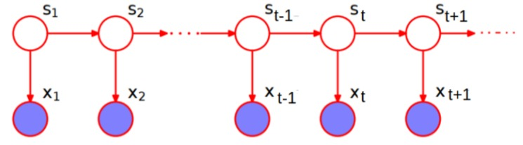
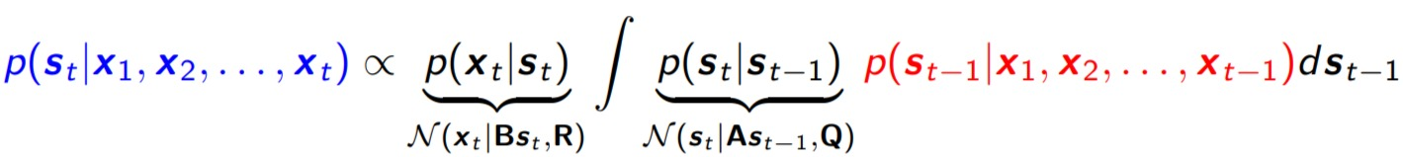
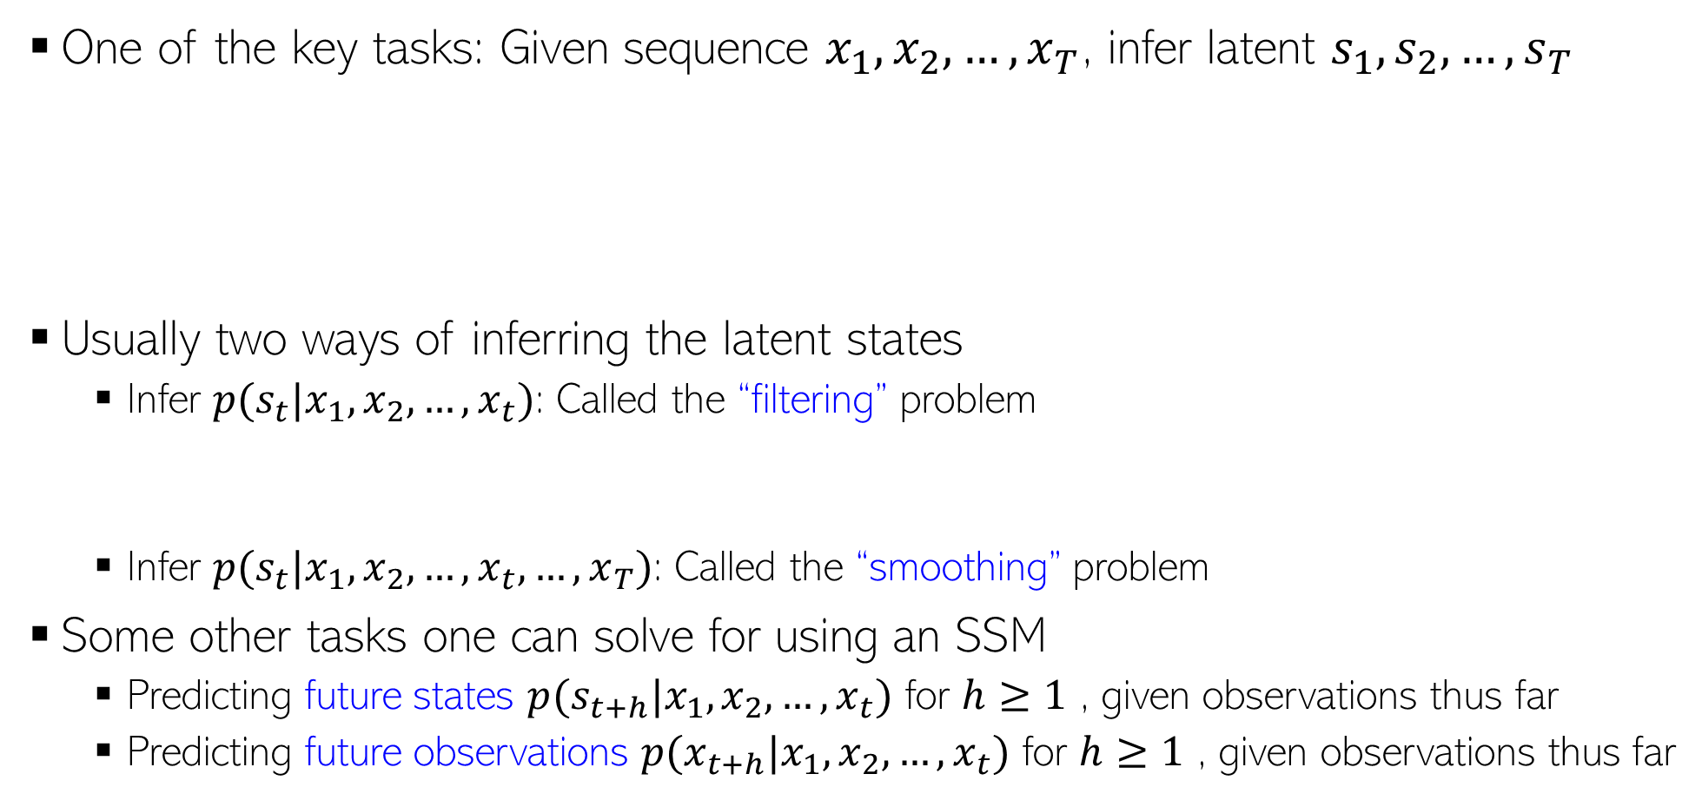
Typical Inference Task for Gaussian SSM
14
One of the key tasks: Given sequence $x_{1},x_{2},…, x_{T}$, infer latent $s_{1},s_{2},…, s_{T}$
Usually two ways of inferring the latent states
  Infer $p(s_{t}|x_{1},x_{2},…, x_{t})$: Called the “filtering” problem
  Infer $p(s_{t}|x_{1},x_{2},…, x_{t}, …, x_{T})$: Called the “smoothing” problem
Some other tasks one can solve for using an SSM
  Predicting future states $p(s_{t+h}|x_{1},x_{2},…, x_{t})$ for $h≥1$ , given observations thus far
  Predicting future observations $p(x_{t+h}|x_{1},x_{2},…, x_{t})$ for $h≥1$ , given observations thus far
Kalman Filtering is a popular algorithm for a linear Gaussian SSM
A Gaussian
Turns out to be another Gaussian

Slide 15
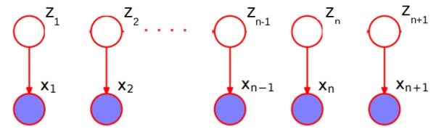
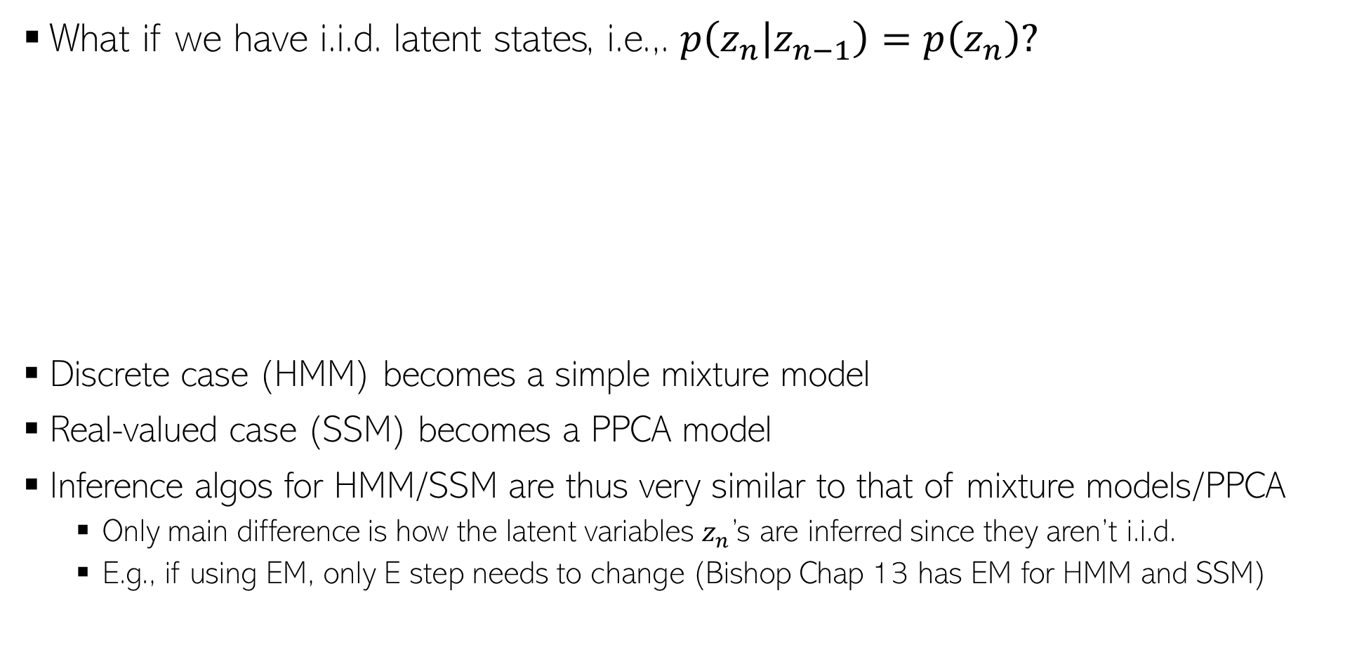
A Special Case
15
What if we have i.i.d. latent states, i.e.,. $p\left(z_{n} | z_{n−1}\right)=p\left(z_{n}\right)?$
Discrete case (HMM) becomes a simple mixture model
Real-valued case (SSM) becomes a PPCA model
Inference algos for HMM/SSM are thus very similar to that of mixture models/PPCA
  Only main difference is how the latent variables $z_{n}$’s are inferred since they aren’t i.i.d.
  E.g., if using EM, only E step needs to change (Bishop Chap 13 has EM for HMM and SSM)

