Slide 1
Assorted Topics (1)
CS772A: Probabilistic Machine Learning
Piyush Rai

Slide 2
Plan Today
2
Some other deep generative models
Large Language Models
Diffusion Models for text
Model Calibration
How to prevent models from being “overconfident”
Frequentist statistics
Another way to get a distribution over parameters without being Bayesian

Slide 3

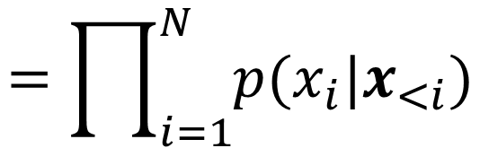

Large Language Models (LLM)
3
An LLM defines a probability distribution over sequences of tokens
Autoregressive modeling is a popular way to define this distribution
Params $θ$ of distribution $p(x_{i}|x_{<i})$ defined using a neural net (e.g., transformer)
$$x=\{x_{1},x_{2},…, x_{N}\}$$
$$=\prod_{i=1}^{N}{p(x_{i}|x_{<i})}$$
$$p\left(x\right)=p\left(x_{1}\right)p\left(x_{2} | x_{1}\right)p\left(x_{3} | x_{1},x_{2}\right)…$$
$$p_{θ}\left(x_{i} | x_{<i}\right)=softmax\left(f_{θ}(x_{<i})\right)$$
Vector of probabilities of all possible values of the next token
A neural net

Slide 4
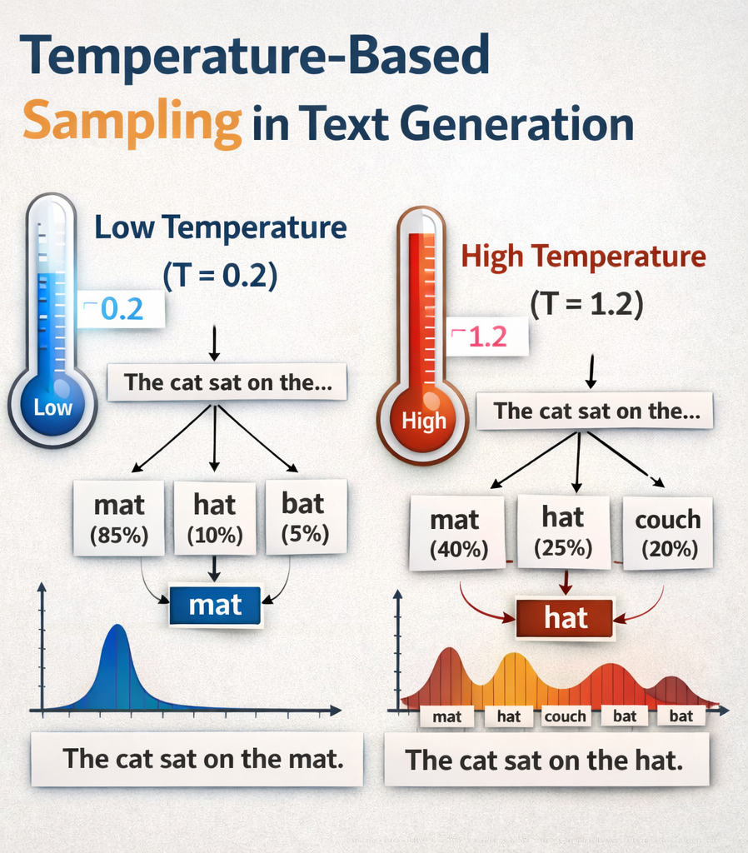
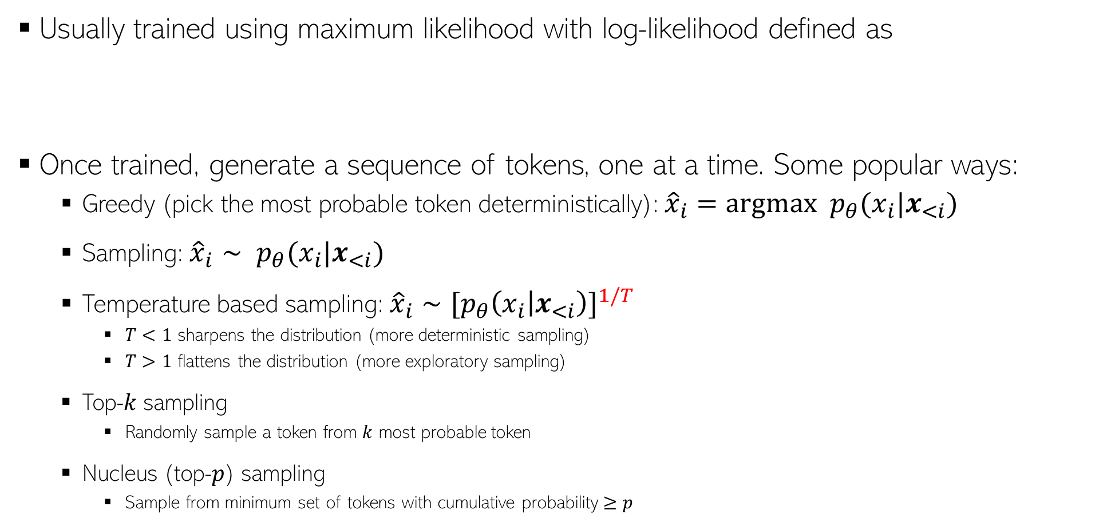
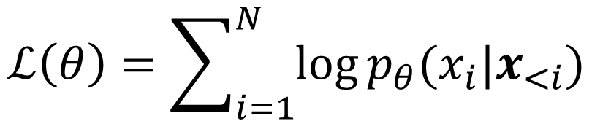
Training of LLMs and Sequence Generation
4
Usually trained using maximum likelihood with log-likelihood defined as
Once trained, generate a sequence of tokens, one at a time. Some popular ways:
Greedy (pick the most probable token deterministically): ${\hat{x}}_{i}=argmax p_{θ}(x_{i}|x_{<i})$
Sampling: ${\hat{x}}_{i}∼ p_{θ}(x_{i}|x_{<i})$
Temperature based sampling: ${\hat{x}}_{i}∼[p_{θ}{\left(x_{i} | x_{<i}\right)]}^{1/T}$
$T<1$ sharpens the distribution (more deterministic sampling)
$T>1$ flattens the distribution (more exploratory sampling)
Top-$k$ sampling
Randomly sample a token from $k$ most probable token
Nucleus (top-$p$) sampling
Sample from minimum set of tokens with cumulative probability $≥p$
$$ℒ\left(θ\right)=\sum_{i=1}^{N}{\log{p_{θ}(x_{i}|x_{<i})}}$$

Slide 5
Some Limitations of Autoregressive LLMs
5
Sequential Generation: Inherently slow due to token-by-token decoding
Low Output Diversity: Because of the decoding techniques used
Locally greedy generation and lacks long-term coherence control.
Token-Level Objectives: Next-token prediction doesn’t align well with task-level goals (e.g., factual consistency).
Difficulty Handling Edits/Rewrites: Inefficient for tasks requiring partial edits or structured generation.

Slide 6
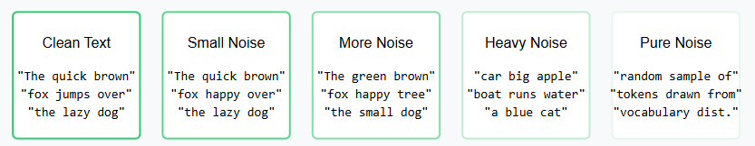
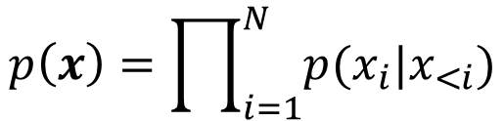
Diffusion based LLM*
6
Autoregressive LLMs generate each token conditioned on earlier tokens
In contrast, diffusion based LLM generate all tokens in parallel
Diffusion LLM consist of a forward and a reverse process
Forward process corrupts the token sequence gradually till it becomes pure noise
Reverse process starts with pure noise and gradually denoises it to generates a token sequence
$$p\left(x\right)=\prod_{i=1}^{N}{p(x_{i}|x_{<i})}$$
*Structured Denoising Diffusion Models in Discrete State-Spaces (Austin et al, NeurIPS 2021)
*Argmax Flows and Multinomial Diffusion: Learning Categorical Distributions (Hoogeboom et al, NeurIPS 2021)

Slide 7


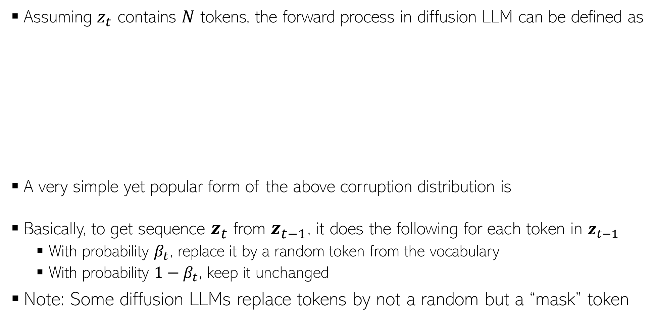




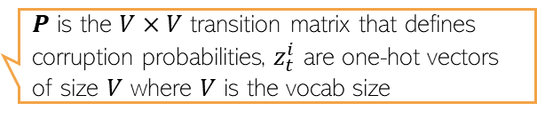


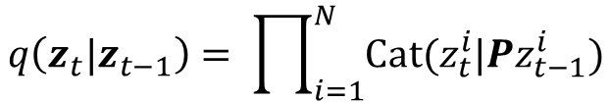
Forward Process
7
Assuming $z_{t}$ contains $N$ tokens, the forward process in diffusion LLM can be defined as
A very simple yet popular form of the above corruption distribution is
Basically, to get sequence $z_{t}$ from $z_{t−1}$, it does the following for each token in $z_{t−1}$
With probability $β_{t}$, replace it by a random token from the vocabulary
With probability ${1−β}_{t}$, keep it unchanged
Note: Some diffusion LLMs replace tokens by not a random but a “mask” token
$$q\left(z_{t}|z_{t−1}\right)= \prod_{i=1}^{N}{Cat(z_{t}^{i}|{Pz}_{t−1}^{i})}$$
$P$ is the $V×V$ transition matrix that defines corruption probabilities, $z_{t}^{i}$ are one-hot vectors of size $V$ where $V$ is the vocab size
$$x=z_{0}$$
$$z_{1}$$
$$z_{2}$$
$$z_{T−1}$$
$$z_{T}$$
$$β_{1} (small)$$
$β_{2}$ $(larger)$
$β_{T}$ $(close to 1)$
$$q\left(z_{t}|z_{t−1}\right)=\left(1−β_{t}\right)𝕀\left[z_{t}=z_{t−1}\right]+β_{t}/V$$

Slide 8





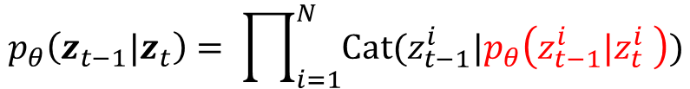

Reverse Process
8
Takes noisy text and produces less noisy text (basically opposite of forward process)
The training objective is similar to the one used in continuous data LLM
Basically we want to match $p_{θ}\left(z_{t−1}|z_{t}\right)$ and $q\left(z_{t−1}|z_{t},x\right)$
$$p_{θ}\left(z_{t−1}|z_{t}\right)= \prod_{i=1}^{N}{Cat(z_{t−1}^{i}|p_{θ}\left(z_{t−1}^{i}|z_{t}^{i} \right))}$$
$$x=z_{0}$$
$$z_{1}$$
$$z_{2}$$
$$z_{T−1}$$
$$z_{T}$$
$$ℒ= 𝔼_{t,x,z_{t}}\left[{\left\|p_{θ}\left(z_{t−1}|z_{t}\right) −q\left(z_{t−1}|z_{t},x\right)\right\|}^{2}\right]$$

Slide 9
Diffusion LLMs: Some Pros and Cons
9
Some pros
Parallel Decoding → Faster inference potential via non-sequential generation
Better Output Diversity → Naturally handles multi-modal distributions
Improved Controllability → Supports classifier-free guidance and conditioning
Resilience to Exposure Bias → Trained via denoising, not next-token prediction
Flexible Objectives → Enables structured generation, editing, and planning
Some cons
Slower Training → Iterative denoising steps can increase training cost
Complex Architecture → Needs noise schedule, denoising network, sampling strategy
High Inference Cost (currently) → Requires multiple denoising steps at test time
Less Mature → Fewer benchmarks and toolkits compared to autoregressive LLMs
Tokenization Challenges → Needs careful handling of discrete text representations

Slide 10
Model Calibration
10

Slide 11
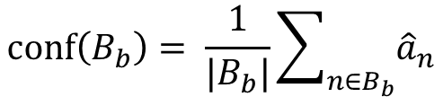
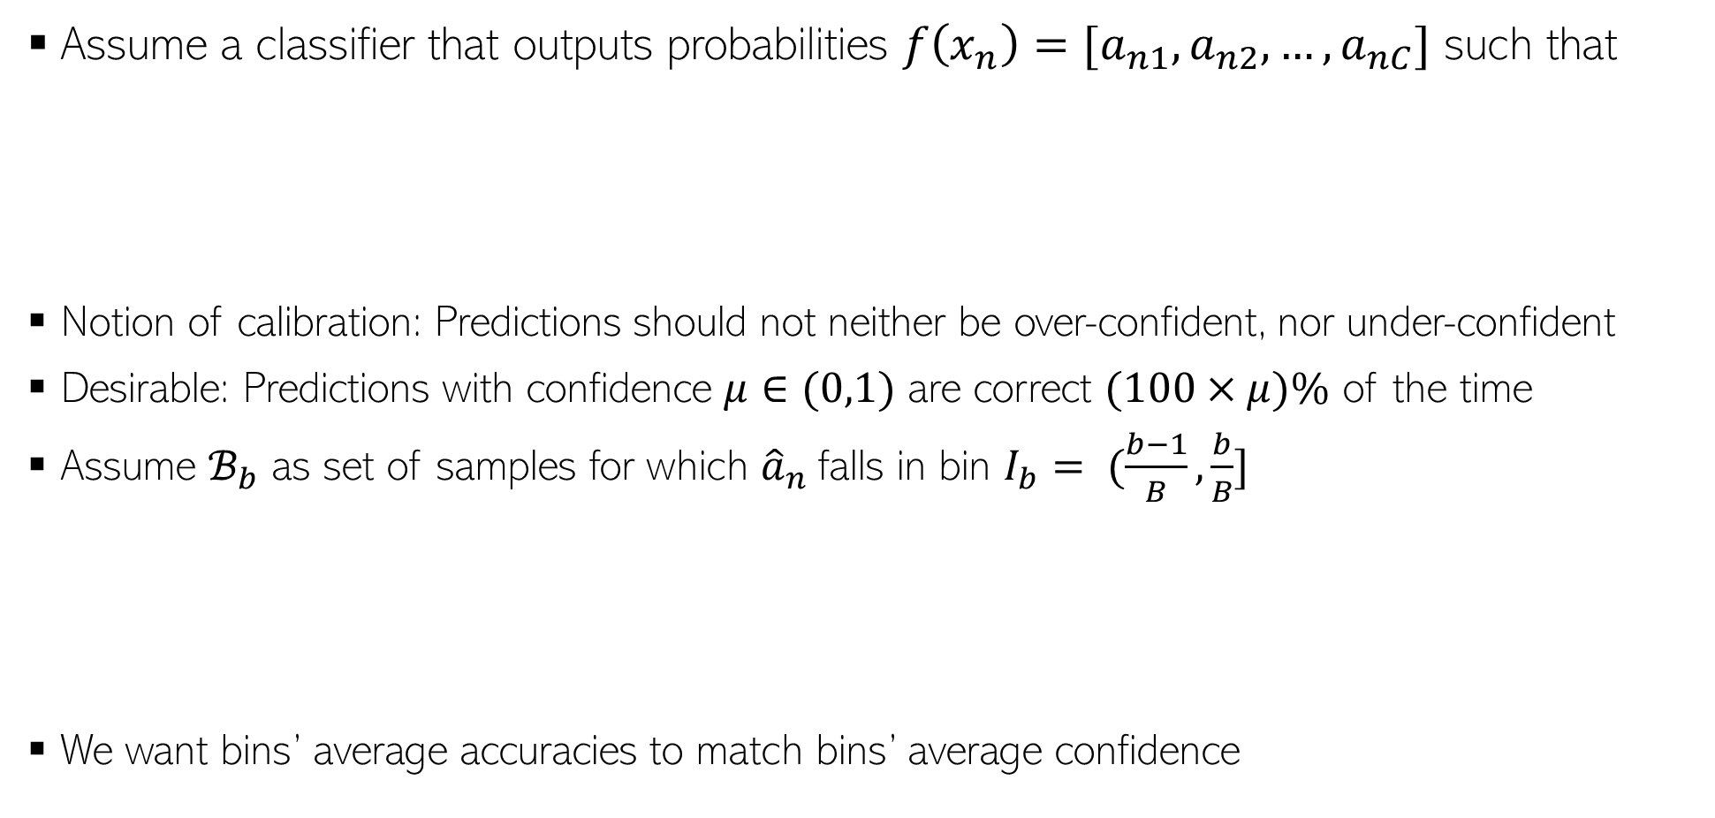
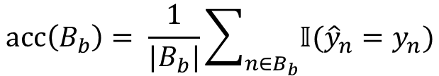
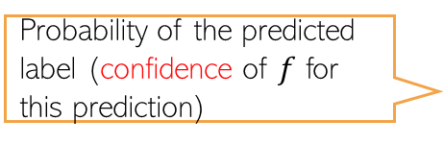

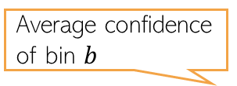

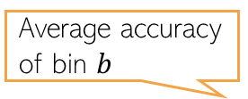
Calibration
11
Assume a classifier that outputs probabilities $f\left(x_{n}\right)=[a_{n1},a_{n2},…, a_{nC}]$ such that
Notion of calibration: Predictions should not neither be over-confident, nor under-confident
Desirable: Predictions with confidence $μ∈(0,1)$ are correct $(100×μ)\%$ of the time
Assume $ℬ_{b}$ as set of samples for which ${\hat{a}}_{n}$falls in bin $I_{b}= (\frac{b−1}{B},\frac{b}{B}]$
We want bins’ average accuracies to match bins’ average confidence
Predicted label
$${\hat{y}}_{n}= {argmax}_{c=\{1,2,…,C\}} a_{nc}$$
Probability of the predicted label (confidence of $f$ for this prediction)
$${\hat{a}}_{n}= \max_{c=\{1,2,…,C\}} a_{nc}$$
Average accuracy of bin $b$
Average confidence of bin $b$
$$acc\left(B_{b}\right)= \frac{1}{|B_{b}|}\sum_{n∈B_{b}}{𝕀({\hat{y}}_{n}=y_{n})}$$
$$conf\left(B_{b}\right)= \frac{1}{|B_{b}|}\sum_{n∈B_{b}}{{\hat{a}}_{n}}$$

Slide 12
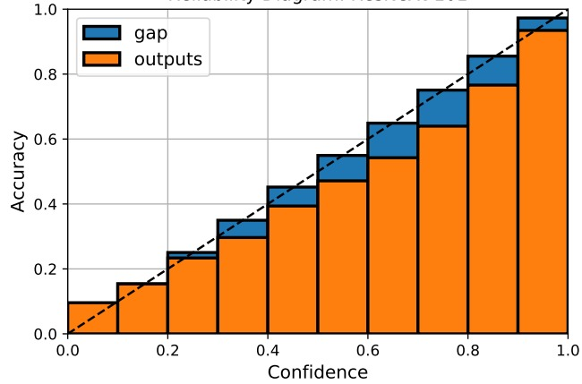
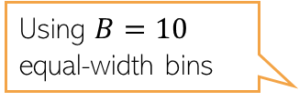
Reliability Diagrams and A Calibration Metric
12
Reliability diagrams are plots of accuracy vs confidence
Several metrics exist to measure how well-calibrated the model’s predictions are
Expected Calibration Error (ECE) is one such popular metric
Using $B=10$ equal-width bins
It’s just one simple way; other ways also possible to construct the bins
Should be small for a well-calibrated model
ECE is the average “gap” area in the reliability diagram

Slide 13

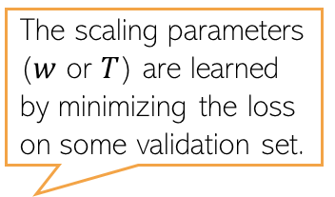



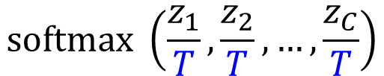
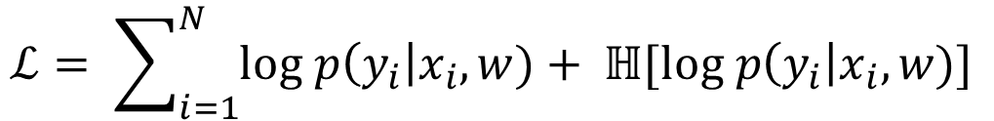
Calibration Methods (contd)
13
Parameters of the trained model are kept frozen in this process
The scaling parameters ($w$ or $T$) are learned by minimizing the loss on some validation set.
Method 1: Calibrate an already trained model in a post-hoc manner, e.g.,
Requires learning to scale the logits produced by the model, e.g.,
Method 2: Change the training procedure, e.g.,
Add a regularizer which avoids overconfident predictions
Trained with smoothed labels instead of one-hot labels
$$softmax(z_{1},z_{2},…, z_{C})$$
$$softmax \left({w_{1}z}_{1}+b_{1},{w_{2}z}_{2}+b_{2},…, {w_{C}z}_{C}+b_{c}\right)$$
T=100
T=2
T=1
$$softmax(z_{1},z_{2},…, z_{C})$$
$$softmax \left(\frac{z_{1}}{T},\frac{z_{2}}{T},…,\frac{z_{C}}{T}\right)$$
Maximize the entropy of the predictive distribution to reduce overconfidence
Maximize the likelihood
$$ℒ= \sum_{i=1}^{N}{log p\left(y_{i}\right|x_{i}, w)+ ℍ[log p\left(y_{i}\right|x_{i}, w)] }$$
$$[0, 0, 1, 0]$$
$$[0.05, 0.05, 0.85, 0.05]$$

Slide 14
Frequentist Statistics (vs Bayesian Statistics)
14

Slide 15

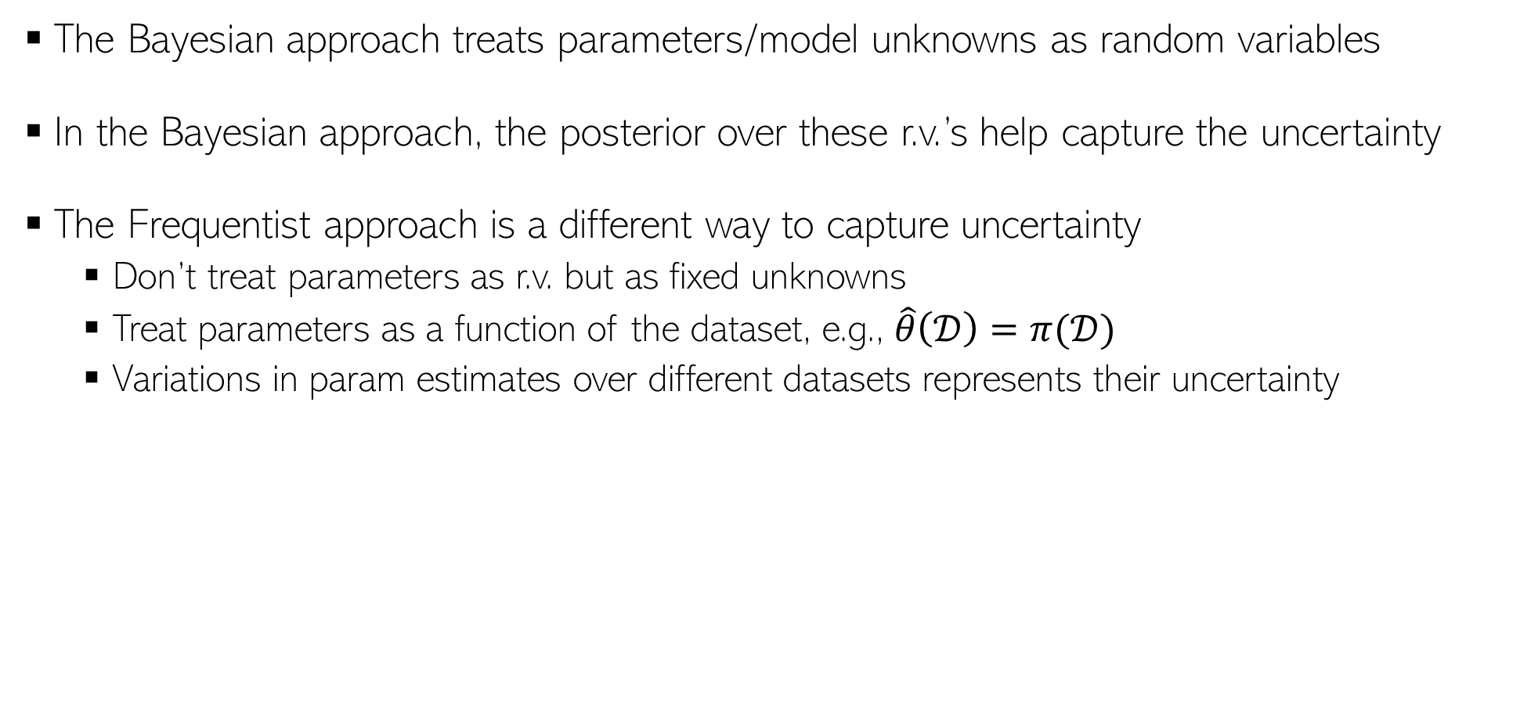
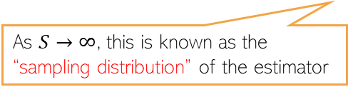

Frequentist Statistics
15
The Bayesian approach treats parameters/model unknowns as random variables
In the Bayesian approach, the posterior over these r.v.’s help capture the uncertainty
The Frequentist approach is a different way to capture uncertainty
Don’t treat parameters as r.v. but as fixed unknowns
Treat parameters as a function of the dataset, e.g., $\hat{θ}\left(𝒟\right)=π(𝒟)$
Variations in param estimates over different datasets represents their uncertainty
This can be some point estimate, e.g., MLE, MAP, method of moments, etc.
A random dataset drawn from the true data distribution
True unknown value of the parameter
$$(s=1, 2, …, S)$$
The estimated distribution of the parameters given any randomly drawn dataset from the true data distribution
Param estimate using the $s$-th sampled dataset
As $S→∞$, this is known as the “sampling distribution” of the estimator
Note that sampling distribution is different from a posterior distribution we infer in Bayesian learning (there, we condition on a fixed training set)
But if the estimator is MLE and Bayesian method’s prior is uniform, then both distributions are very similar (sampling distribution is often called “poor man’s posterior”

Slide 16






Approximating the sampling distribution
16
Since the true $θ^{∗}$ is not known, we can’t compute the sampling distribution exactly
Bootstrap is a popular method to approximate the sampling distribution
Two types of bootstrap methods: parametric and nonparametric bootstrap
$$(s=1, 2, …, S)$$
Parametric Bootstrap
Nonparametric Bootstrap
Get a point est. of $θ$ using training data
Generate multiple datasets using $\hat{θ}$ as
Now compute the approximation as
Use sampling with replacement on original training set to generate $S$ datasets with $N$ datapoints in each
Now compute the approximation as
$$\hat{θ}=π(𝒟)$$
Each dataset will contain roughly 63% unique datapoints from original training set
$$(s=1, 2, …, S)$$

