Slide 1
Deep Generative Models (contd)
CS772A: Probabilistic Machine Learning
Piyush Rai

Slide 2

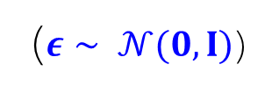







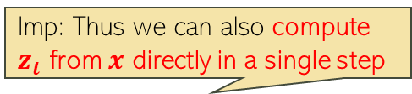




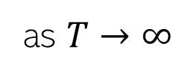
Denoising Diffusion Models
2
Consider gradually corrupting an image ($z_{0}=x)$ till it becomes pure noise ($z_{T}$)
Each step $z_{t−1}→z_{t}$ is a pre-defined Gaussian perturbation (forward process)
$$x$$
$$z_{1}$$
$$z_{2}$$
$$z_{t}$$
$$z_{T−1}$$
$$z_{T}$$
Imp: Thus we can also compute $z_{t}$ from $x$ directly in a single step
$$q\left(z_{t} | z_{t−1}\right)= 𝒩(z_{t}|\sqrt{1−β_{t}}z_{t−1},β_{t}I)$$
$$q\left(z_{t} | x\right)= 𝒩(z_{t}|\sqrt{α_{t}}x,{(1−α}_{t})I)$$
$z_{t}=\sqrt{1−β_{t}}z_{t−1}+\sqrt{β_{t}}ε$
($ε∼ 𝒩(0,I)$)
implies
where $α_{t}= \prod_{τ=1}^{t}{(1−β_{τ})}$
$$β_{t}∈\left(0,1\right) and β_{1}<β_{2}<…β_{T−1} <β_{T}$$
$z_{t}=\sqrt{α_{t}}x+\sqrt{{1−α}_{t}}ε$
Usually pre-defined but can also be learned
$$q\left(z_{T} | x\right)= 𝒩(z_{T}|0,I)$$
as $T→∞$

Slide 3
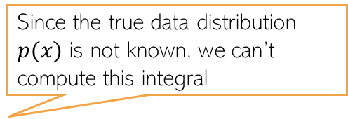

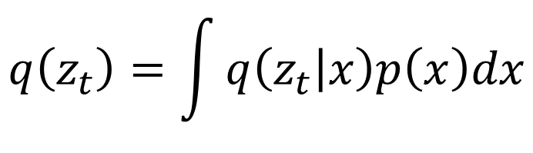
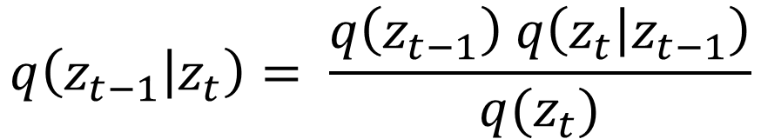
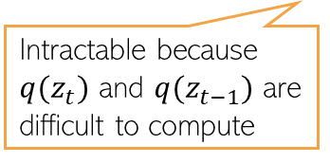
Generating Data by Reversing Diffusion
3
Reversing the diffusion(red arrows) would enable generating data from pure noise
To reverse the diffusion, we need the distribution of $z_{t−1}$ given $z_{t}$, i.e., $q(z_{t−1}|z_{t})$
$$x$$
$$z_{1}$$
$$z_{2}$$
$$z_{t}$$
$$z_{T−1}$$
$$z_{T}$$
The denoising distribution
$$q\left(z_{t−1} | z_{t}\right)= \frac{q\left(z_{t−1}\right) q\left(z_{t} | z_{t−1}\right)}{q(z_{t})}$$
Intractable because $q(z_{t})$ and $q(z_{t−1})$ are difficult to compute
Since the true data distribution $p(x)$ is not known, we can’t compute this integral
$$q\left(z_{t}\right)=\int{q\left(z_{t} | x\right)p\left(x\right)dx}$$

Slide 4
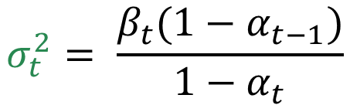

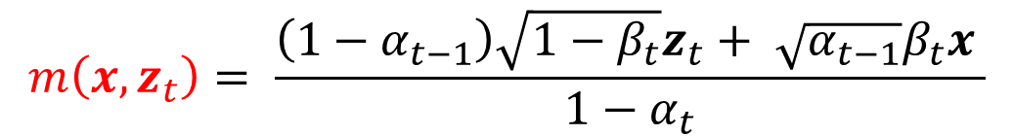
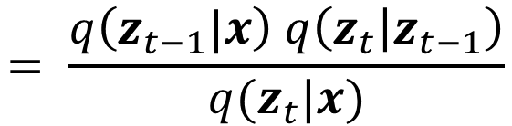
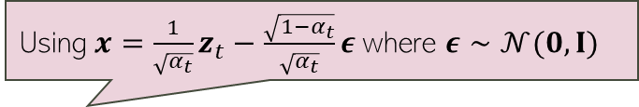
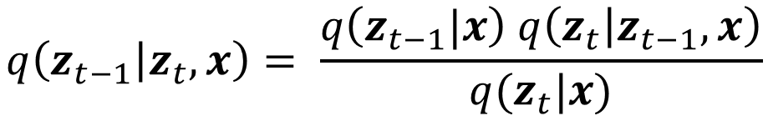
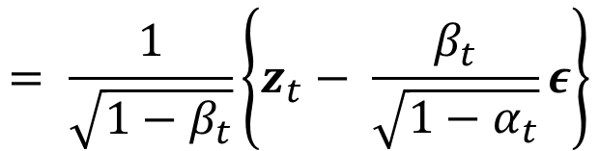
Towards a Tractable Reverse Diffusion
4
Although $q\left(z_{t−1} | z_{t}\right)$ isn’t tractable, the following distribution is tractable
Reason: $q\left(z_{t−1}|x\right)$ and $q\left(z_{t} | z_{t−1}\right)$ are Gaussians, so $q\left(z_{t−1} | z_{t},x\right)$ is Gaussian
$$q\left(z_{t−1} | z_{t},x\right)= \frac{q\left(z_{t−1}|x\right) q\left(z_{t} | z_{t−1},x\right)}{q(z_{t}|x)}$$
$$= \frac{q\left(z_{t−1}|x\right) q\left(z_{t} | z_{t−1}\right)}{q(z_{t}|x)}$$
$$q\left(z_{t−1} | z_{t},x\right)= 𝒩(z_{t−1}|m\left(x,z_{t}\right),σ_{t}^{2}I)$$
Using $x=\frac{1}{\sqrt{α_{t}}}z_{t}−\frac{\sqrt{1−α_{t}}}{\sqrt{α_{t}}}ε$ where $ε∼𝒩(0,I)$
$$m\left(x,z_{t}\right)= \frac{\left(1−α_{t−1}\right)\sqrt{1−β_{t}}z_{t}+ \sqrt{α_{t−1}}β_{t}x }{1−α_{t}}$$
$$= \frac{1}{\sqrt{1−β_{t}}}\left\{z_{t}− \frac{β_{t}}{\sqrt{1−α_{t}}}ε\right\}$$
$$σ_{t}^{2}= \frac{β_{t}(1−α_{t−1})}{1−α_{t}}$$

Slide 5


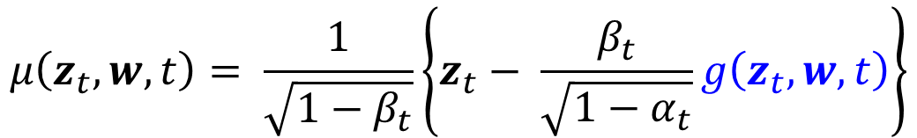
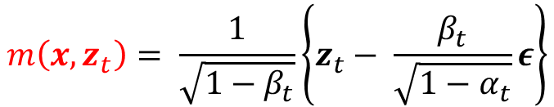
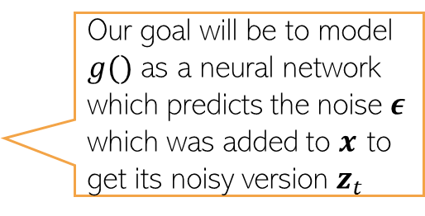

Towards a Tractable Reverse Diffusion
5
We saw that the reverse diffusion distribution is the Gaussian
Let’s approximate $q\left(z_{t−1} | z_{t},x\right)$ by another Gaussian that doesn’t depend on $x$
Usually, $Σ(z_{t}, w,t)$ is chosen to be spherical. A popular choice: $Σ\left(z_{t}, w,t\right)=β_{t}I$
The mean $μ\left(z_{t},w,t\right)$ is defined to mimic the form of $m\left(x,z_{t}\right)$
$$q\left(z_{t−1} | z_{t},x\right)= 𝒩(z_{t−1}|m\left(x,z_{t}\right),σ_{t}^{2}I)$$
Issue: At generation time, we don’t have $x$(the goal is to generate $x$ which is only available for training data) so we can’t use $m\left(x,z_{t}\right)$ at generation time since it depends on $x$
$$m\left(x,z_{t}\right)= \frac{1}{\sqrt{1−β_{t}}}\left\{z_{t}− \frac{β_{t}}{\sqrt{1−α_{t}}}ε\right\}$$
where
$$p\left(z_{t−1} | z_{t},w\right)= 𝒩(z_{t−1}|μ\left(z_{t},w,t\right),Σ(z_{t}, w,t))$$
Our goal will be to model $g()$ as a neural network which predicts the noise $ε$ which was added to $x$ to get its noisy version $z_{t}$
$$μ\left(z_{t},w,t\right)= \frac{1}{\sqrt{1−β_{t}}}\left\{z_{t}− \frac{β_{t}}{\sqrt{1−α_{t}}}g\left(z_{t},w,t\right)\right\}$$

Slide 6
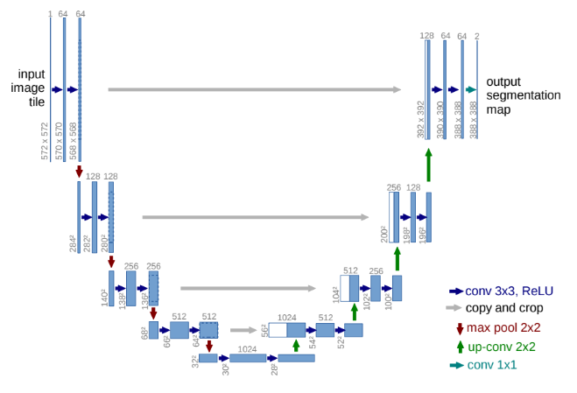



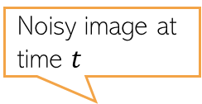
Noise Predictor Network
6
A “U-net” model (a neural net) is commonly used as the noise predictor network
An embedding (positional embedding) of the time-step $t$ is fed into the residual blocks of the U-net architecture
A typical U-net
Noisy image at time $t$
U-net used in a diffusion model
Predicted noise
$$z_{t}$$
$$g(z_{t}, w,t)$$
Figure source: Arash Vahdat

Slide 7
Denoising Diffusion Model: The Training Algo
7
The overall training algo is as follows
Pseudo-code from Bishop & Bishop (2023)

Slide 8
Denoising Diffusion Model: Generation
8
Using the training model, we can now generate data as follows
Generation can be slow because it requires several steps
Reducing the number of steps is an active area of research
One such approach is DDIM (denoising diffusion implicit model) which relaxes the Markov assumption in the noise process
Pseudo-code from Bishop & Bishop (2023)

Slide 9
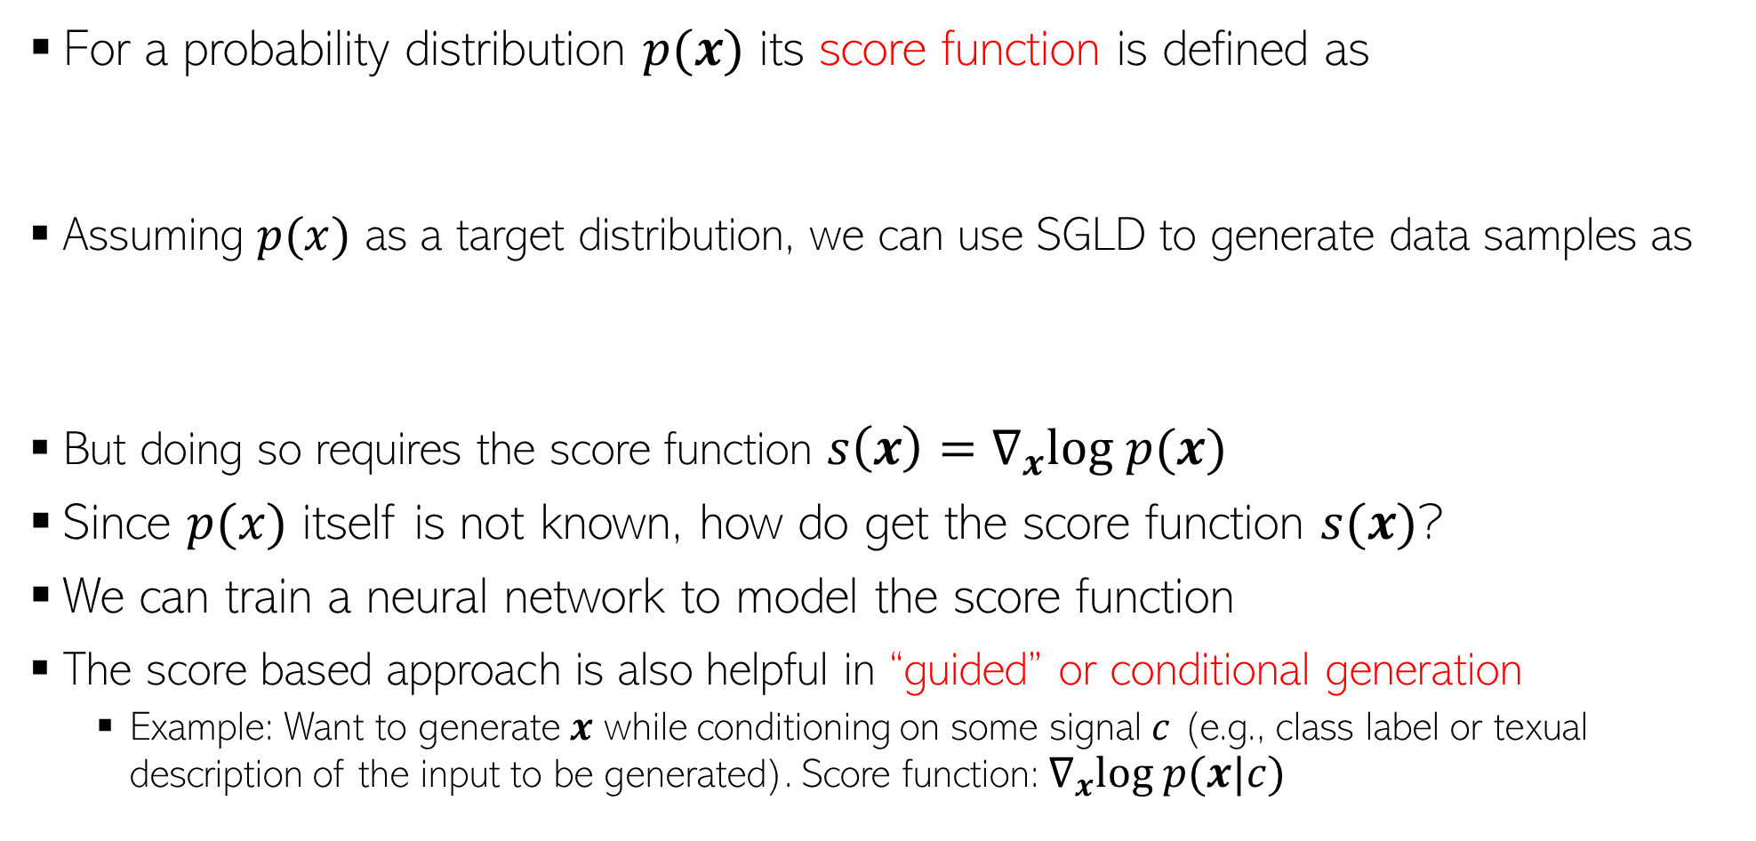
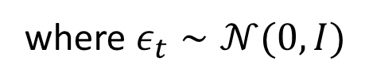
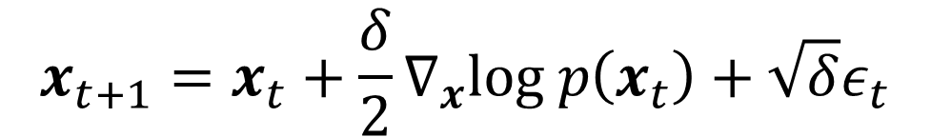
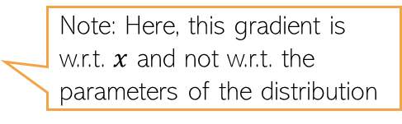

Score based deep generative models
9
For a probability distribution $p(x)$ its score function is defined as
Assuming $p(x)$ as a target distribution, we can use SGLD to generate data samples as
But doing so requires the score function $s\left(x\right)=∇_{x}log p(x)$
Since $p(x)$ itself is not known, how do get the score function $s(x)$?
We can train a neural network to model the score function
The score based approach is also helpful in “guided” or conditional generation
  Example: Want to generate $x$ while conditioning on some signal $c$ (e.g., class label or texual description of the input to be generated). Score function: $∇_{x}log p(x|c)$
Note: Here, this gradient is w.r.t. $x$ and not w.r.t. the parameters of the distribution
$$s\left(x\right)=∇_{x}log p(x)$$
$$x_{t+1}=x_{t}+\frac{δ}{2}∇_{x}log p\left(x_{t}\right)+\sqrt{δ}ε_{t}$$
where $ε_{t}∼𝒩(0,I)$

Slide 10
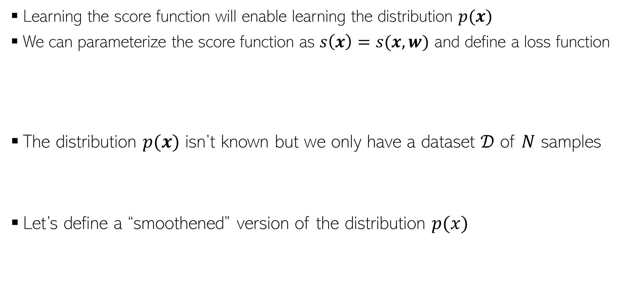
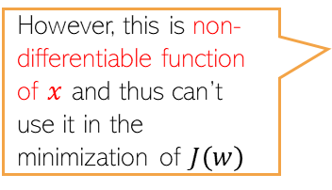
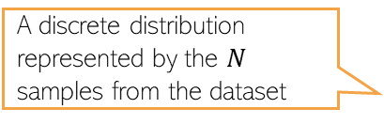


Diffusion Models via Score Matching
10
Learning the score function will enable learning the distribution $p(x)$
We can parameterize the score function as $s\left(x\right)=s(x,w)$ and define a loss function
The distribution $p(x)$ isn’t known but we only have a dataset $𝒟$ of $N$ samples
Let’s define a “smoothened” version of the distribution $p(x)$
Can define it as a neural network
However, this is non-differentiable function of $x$ and thus can’t use it in the minimization of $J\left(w\right)$
A discrete distribution represented by the $N$ samples from the dataset
Basically a convolution of $p(x)$ by a kernel $q(z|x,σ)$
One option is to define $q(z|x,σ)$ as a Gaussian $𝒩(z|x,σ^{2}I)$

Slide 11
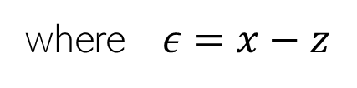
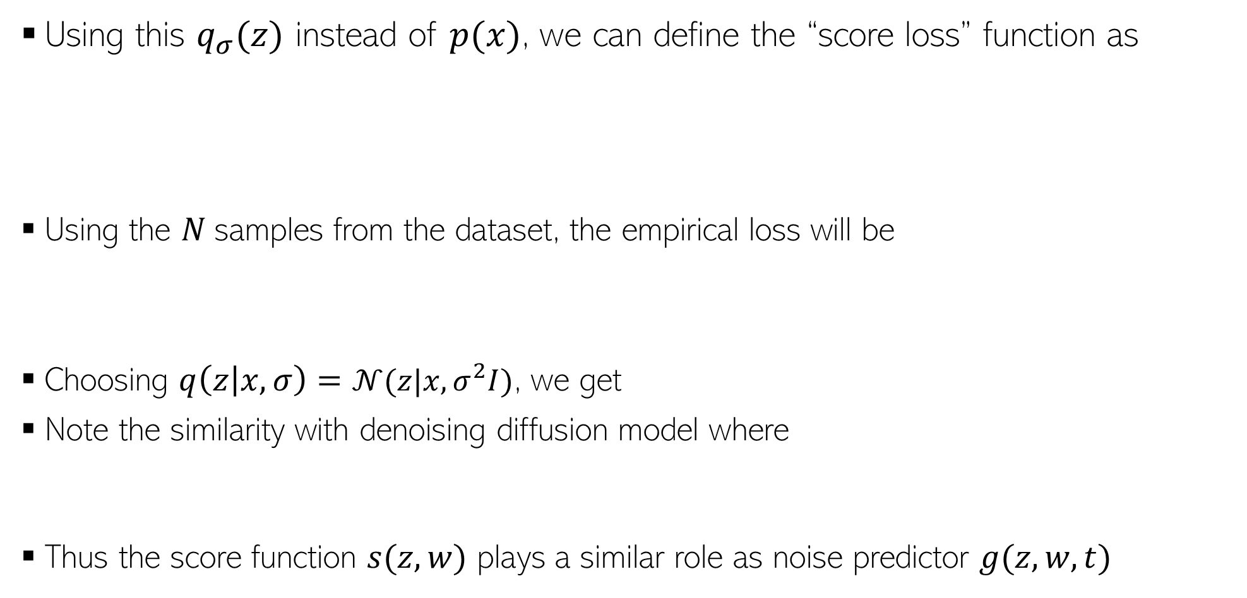


Score Matching
11
Using this $q_{σ}(z)$ instead of $p(x)$, we can define the “score loss” function as
Using the $N$samples from the dataset, the empirical loss will be
Choosing $q\left(z | x,σ\right)=𝒩(z|x,σ^{2}I)$, we get
Note the similarity with denoising diffusion model where
Thus the score function $s(z,w)$ plays a similar role as noise predictor $g(z,w,t)$
Thus the score function $s(z,w)$ is also like a noise predictor
where $ε=x−z$
$$q\left(z_{t} | x\right)=𝒩(z|\sqrt{α_{t}}x,(1−α_{t})I)$$

Slide 12

Guided Diffusion
12
Often we want to generate data based on some “reference” conditioning signal, e.g.,
  Images of a specific class (class-conditional generation)
  Images based on some textual description
  High resolution image using a low-resolution image (image “super-resolution”)
Denoting the data as $x$ and the conditioning signal as $c$, we want to learn $p(x|c)$
Conditioning signal: “stained glass window of a panda eating bamboo”
Conditioning signal: Low-res image on the left
Figure source: DLFC (Bishop and Bishop, 2023)

Slide 13
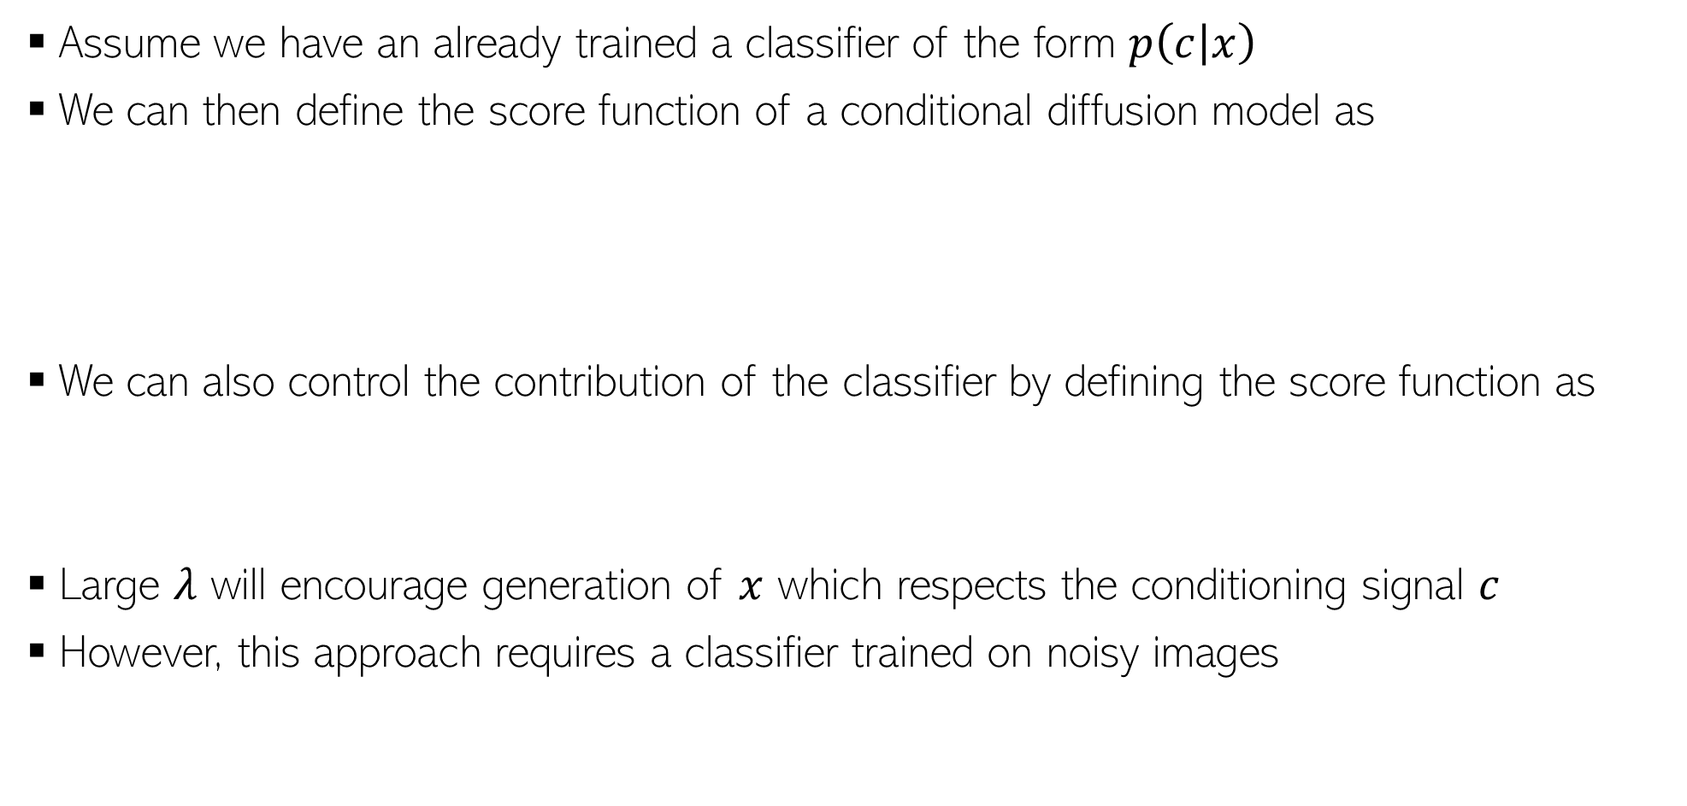
Classifier Guidance
13
Assume we have an already trained a classifier of the form $p\left(c | x\right)$
We can then define the score function of a conditional diffusion model as
We can also control the contribution of the classifier by defining the score function as
Large $λ$ will encourage generation of $x$ which respects the conditioning signal $c$
However, this approach requires a classifier trained on noisy images
Score function of unconditional diffusion model
Classifier guidance term

Slide 14
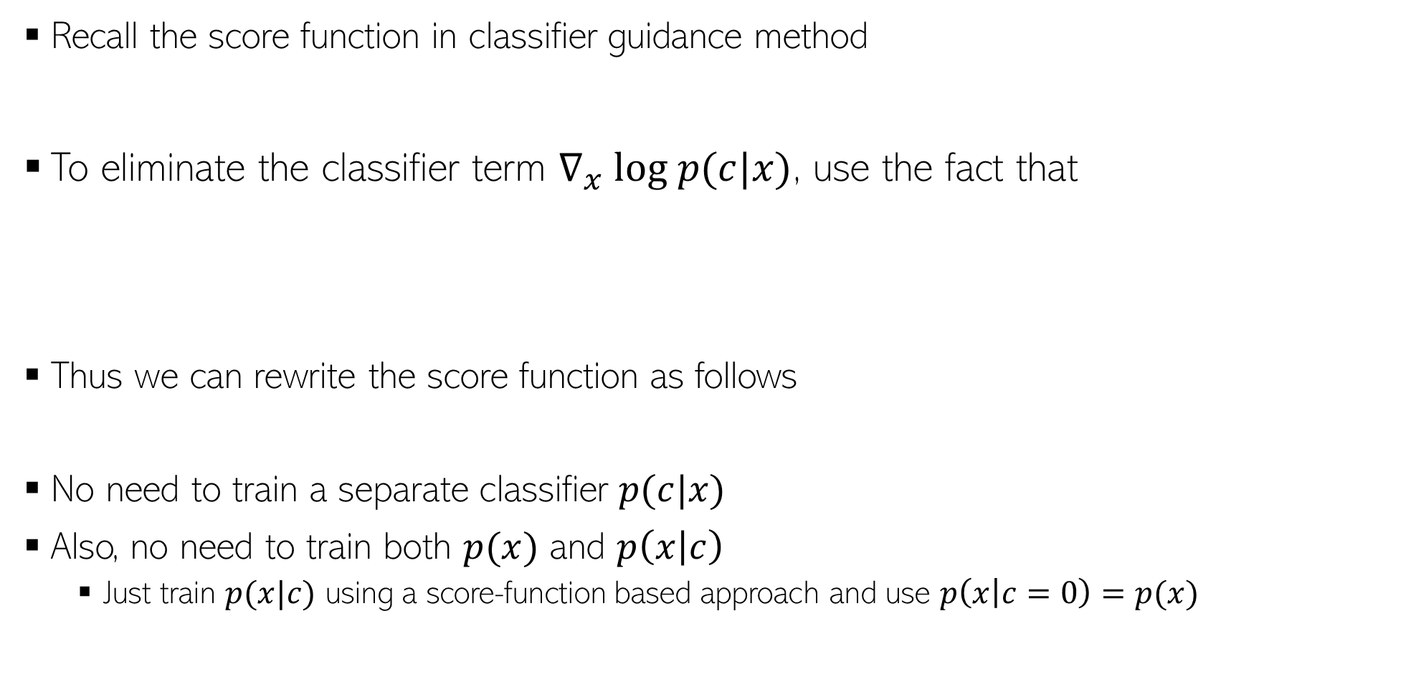
Classifier-free Guidance
14
Recall the score function in classifier guidance method
To eliminate the classifier term $∇_{x} log p(c|x)$, use the fact that
Thus we can rewrite the score function as follows
No need to train a separate classifier $p(c|x)$
Also, no need to train both $p(x)$ and $p\left(x | c\right)$
  Just train $p(x|c)$ using a score-function based approach and use $p\left(x | c=0\right)=p(x)$

Slide 15
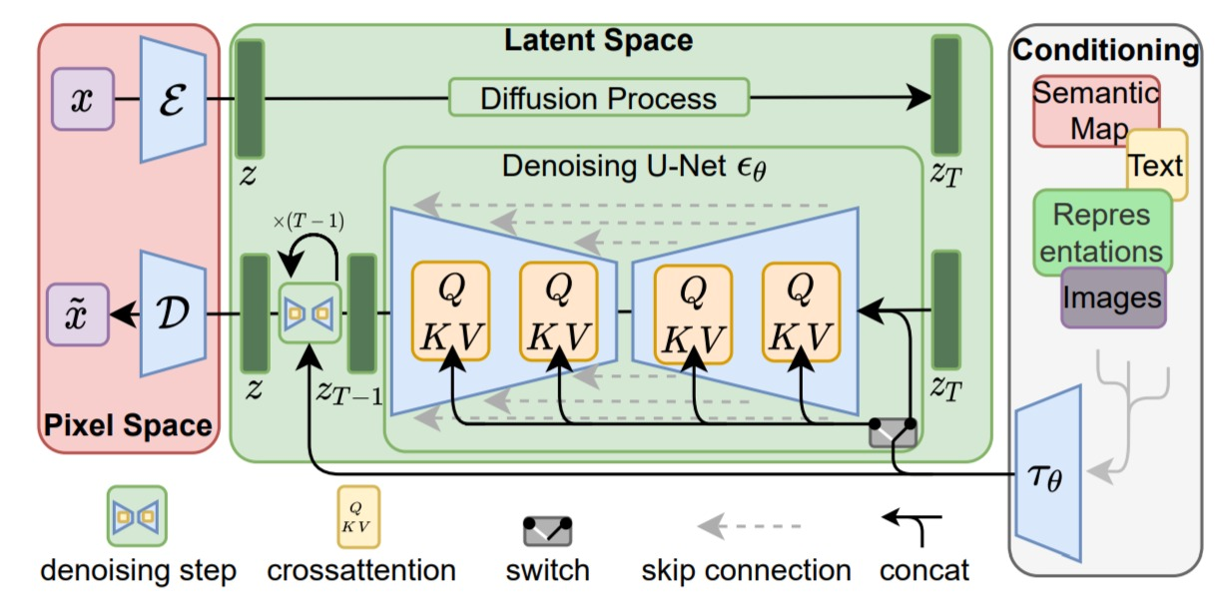
Latent Diffusion Models (LDM)
15
Defines diffusion process in a latent space instead of in data (e.g., pixel) space
The popular “Stable Diffusion” is based on LDM
Diffusion process in a low-dim latent space is also more efficient computationally
Can also condition the generation on other modalities such as text
*High-Resolution Image Synthesis with Latent Diffusion Models (Rombach et al, 2022)

Slide 16
Summary
16
Diffusion Models (denoising diffusion models, score based models, etc) are currently the best performing methods
A lot of ongoing work on diffusion models, e.g.,
  Improving quality of generation
  Speeding-up generation
  Combining them with other generative models (e.g., large language models)

