Slide 1
Deep Generative Models
CS772A: Probabilistic Machine Learning
Piyush Rai

Slide 2
Plan today
2
Variational Auto-encoder (VAE)
Generative Adversarial Network (GAN)
Denoising Diffusion Model

Slide 3
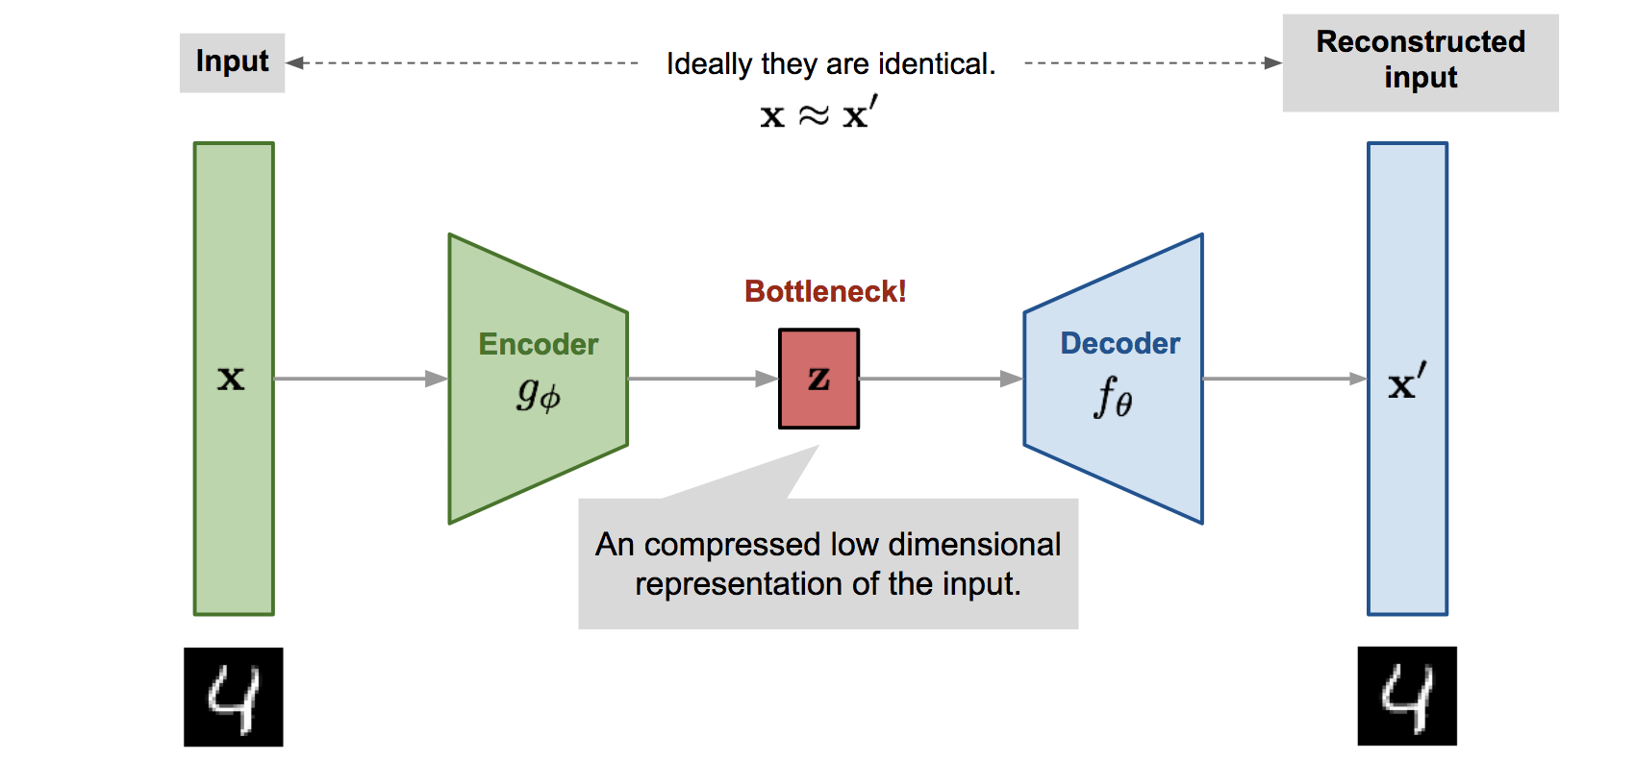


Variational Auto-encoder (VAE)
3
VAE* is a probabilistic extension of autoencoders (AE). An AE is shown below
The basic difference is that VAE assumes a prior $p(z)$ on the latent code $z$
This enables it to not just compress the data but also generate synthetic data
How: Sample $z$ from a prior and pass it through the decoder
Thus VAE can learn good latent representation + generate novel synthetic data
The name has “Variational” in it since it is learned using VI principles
*Autoencoding Variational Bayes (Kingma and Welling, 2013)
Pic source: https://lilianweng.github.io/lil-log/2018/08/12/from-autoencoder-to-beta-vae.html

Slide 4
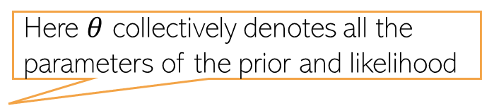
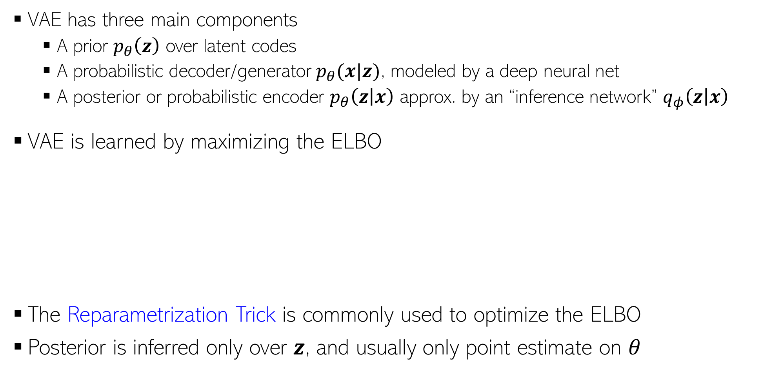
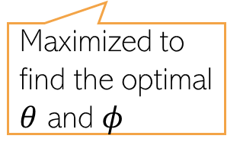
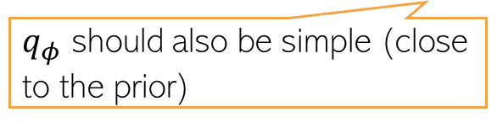
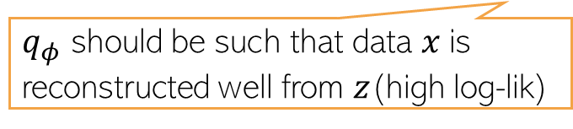
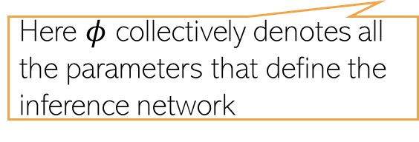
Variational Autoencoder (VAE)
4
VAE has three main components
A prior $p_{θ}\left(z\right)$ over latent codes
A probabilistic decoder/generator $p_{θ}(x|z)$, modeled by a deep neural net
A posterior or probabilistic encoder $p_{θ}\left(z | x\right)$ approx. by an “inference network” $q_{φ}\left(z | x\right)$
VAE is learned by maximizing the ELBO
The Reparametrization Trick is commonly used to optimize the ELBO
Posterior is inferred only over $z$, and usually only point estimate on $θ$
Here $θ$ collectively denotes all the parameters of the prior and likelihood
Using the idea of “Amortized Inference”
Here $φ$ collectively denotes all the parameters that define the inference network
ELBO for a single data point
$$−$$
Maximized to find the optimal $θ$ and $φ$
$q_{φ}$ should be such that data $x$is reconstructed well from $z$(high log-lik)
$q_{φ}$ should also be simple (close to the prior)

Slide 5
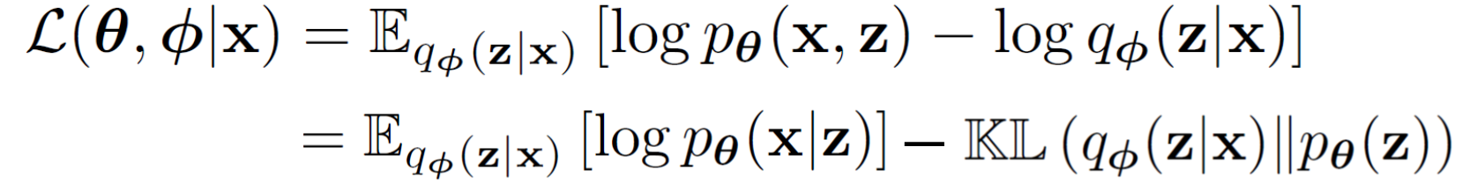
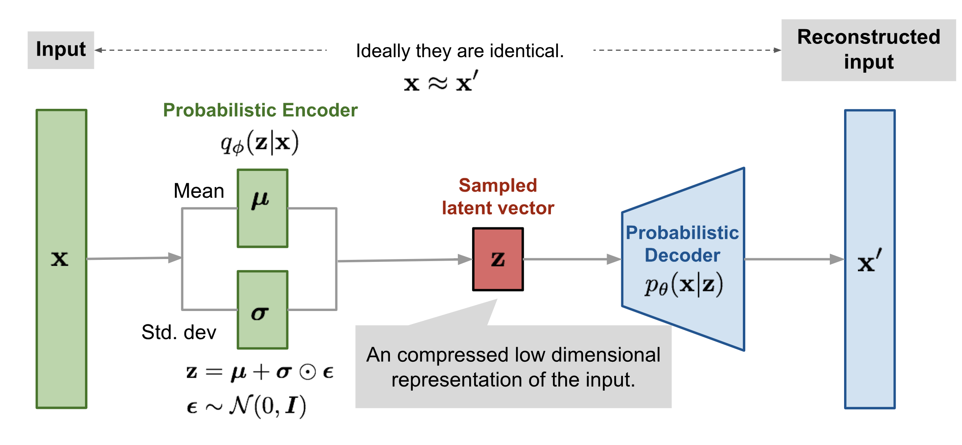
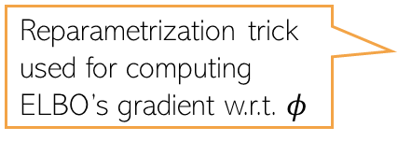
Variational Autoencoder: The Complete Pipeline
5
Both probabilistic encoder and decoder learned jointly by maximizing the ELBO
Reparametrization trick used for computing ELBO’s gradient w.r.t. $φ$
Pic source: https://lilianweng.github.io/lil-log/2018/08/12/from-autoencoder-to-beta-vae.html

Slide 6
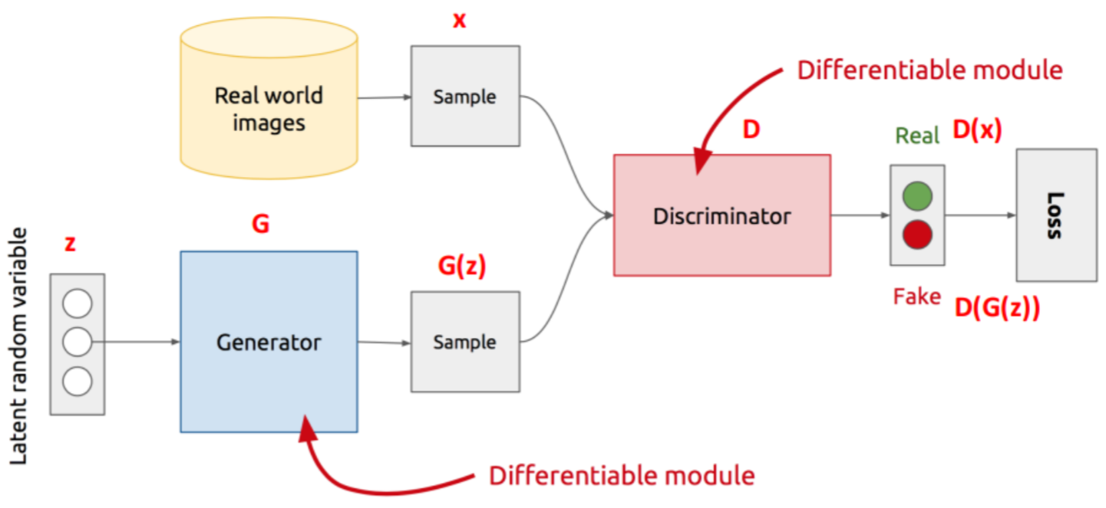
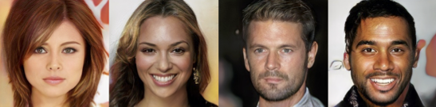
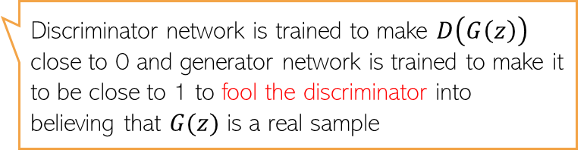

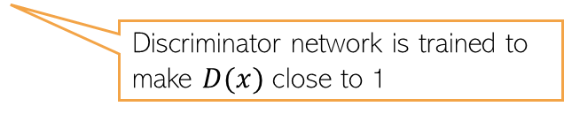
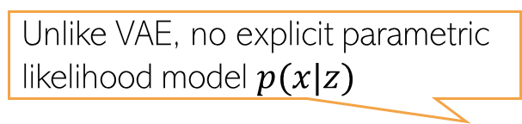
Generative Adversarial Network (GAN)
6
Unlike VAE, no explicit parametric likelihood model $p(x|z)$
GAN is an implicit generative latent variable model
Can generate from it but can’t compute $p(x)$ - the model doesn’t define it explicitly
GAN is trained using an adversarial way (Goodfellow et al, 2013)
Thus can’t train using methods that require likelihood (MLE, VI, etc)
Assuming data is images
The discriminator can be a binary classifier or any method that can compare b/w two distributions (real and fake here)
Discriminator network is trained to make $D(x)$ close to 1
Discriminator network is trained to make $D\left(G\left(z\right)\right)$ close to 0 and generator network is trained to make it to be close to 1 to fool the discriminator into believing that $G(z)$ is a real sample
Min-max optimization

Slide 7
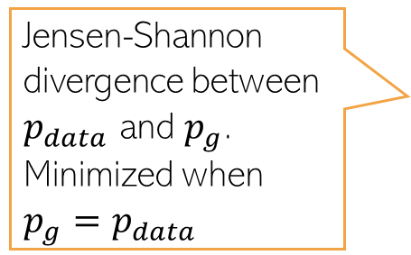

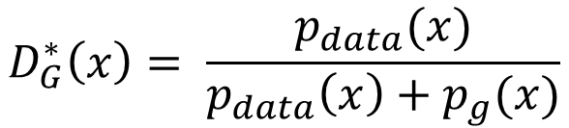
Generative Adversarial Network (GAN)
7
The GAN training criterion was
With 𝐺 fixed, the optimal 𝐷 (exercise)
Given the optimal $D$, The optimal generator $G$ is found by minimizing
Distribution of real data
$$D_{G}^{∗}\left(x\right)= \frac{p_{data}(x)}{p_{data}\left(x\right)+p_{g}(x)}$$
Distribution of synthetic data
$$V\left(D_{G}^{∗},G\right)= 𝔼_{x∼p_{data}}\left[log\frac{p_{data}(x)}{p_{data}\left(x\right)+p_{g}(x)}\right]+𝔼_{x∼p_{g}}\left[log\frac{p_{g}(x)}{p_{data}\left(x\right)+p_{g}(x)}\right]$$
Jensen-Shannon divergence between $p_{data}$ and $p_{g}$. Minimized when $p_{g}=p_{data}$
$$= KL\left[p_{data}\left(x\right) \frac{p_{data}\left(x\right)+p_{g}(x)}{2}\right]+KL\left[p_{g}\left(x\right) \frac{p_{data}\left(x\right)+p_{g}(x)}{2}\right]−log 4$$
Thus GAN can learn the true data distribution if the generator and discriminator have enough modeling power

Slide 8
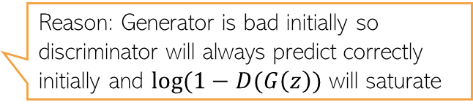
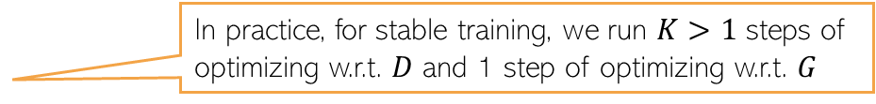
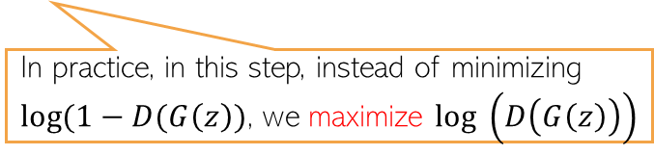
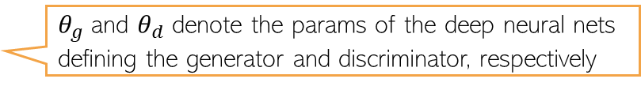
GAN Optimization
8
The GAN training procedure can be summarized as
$θ_{g}$ and $θ_{d}$ denote the params of the deep neural nets defining the generator and discriminator, respectively
In practice, for stable training, we run $K>1$ steps of optimizing w.r.t. $D$ and 1 step of optimizing w.r.t. $G$
Reason: Generator is bad initially so discriminator will always predict correctly initially and $log(1−D(G\left(z\right))$ will saturate
In practice, in this step, instead of minimizing $log(1−D(G\left(z\right))$, we maximize $log \left(D\left(G\left(z\right)\right)\right)$

Slide 9
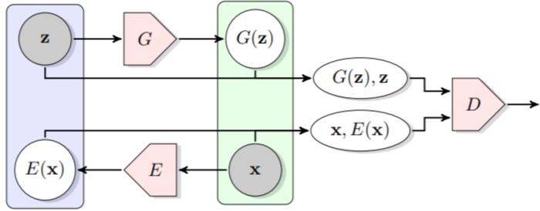

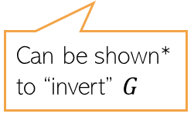
GANs that also learn latent representations
9
The standard GAN can only generate data. Can’t learn the latent $z$ from $x$
Bidirectional GAN* (BiGAN) is a GAN variant that allows this
Consists of an encoder as well
Real pair/fake pair?
Can be shown* to “invert” $G$
*Adversarial Feature Learning (Donahue et a Dumoulin l, 2017)
#Adversarially Learned Inference (Dumoulin et al, 2017)

Slide 10
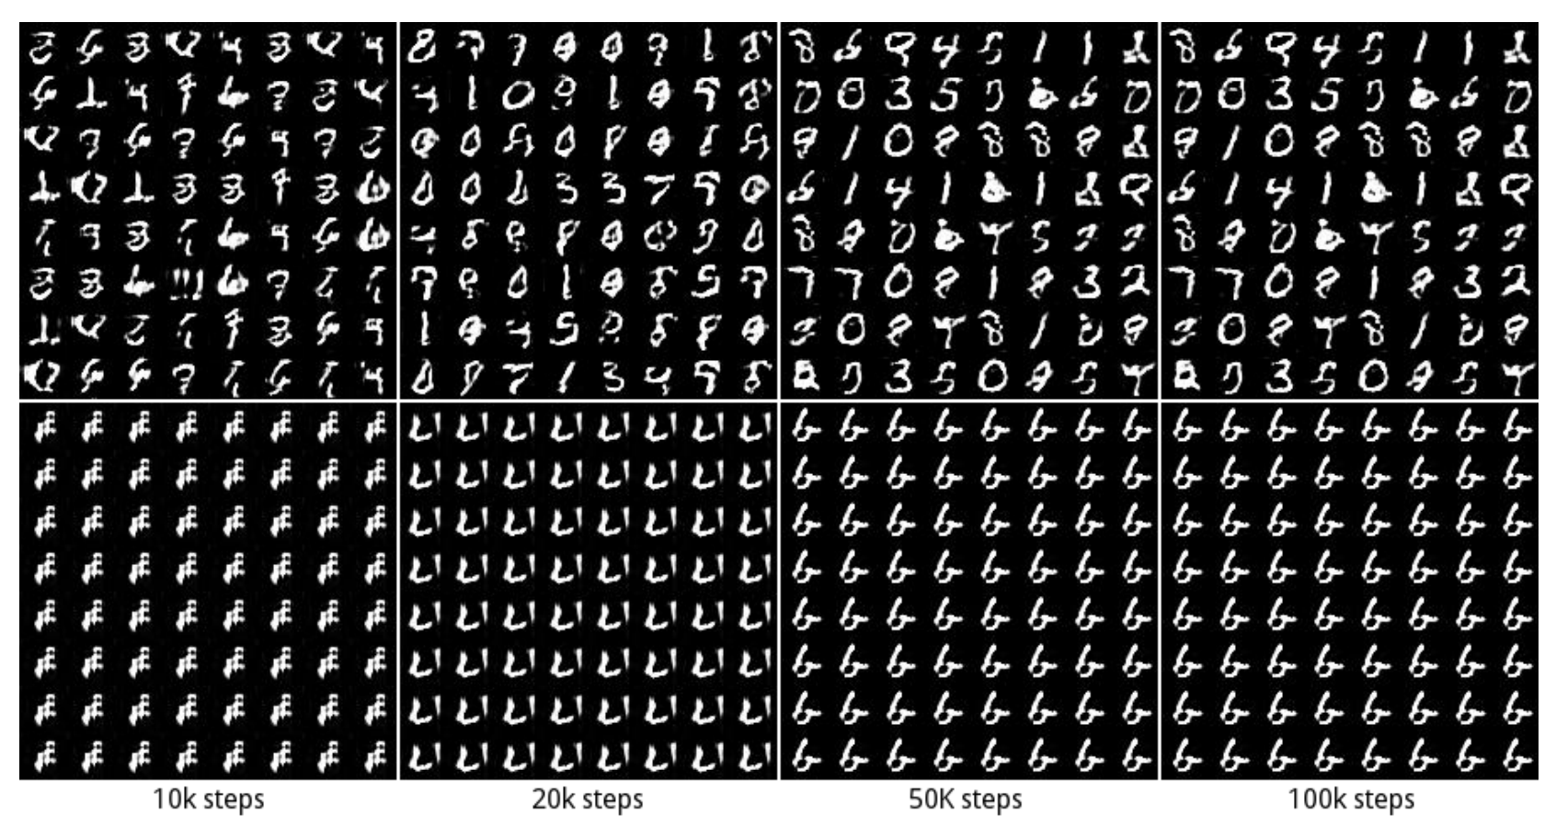
GAN: Some Issues/Comments
10
GAN training can be hard and the basic GAN suffers from several issues
Instability of training procedure
Mode Collapse problem: Lack of diversity in generated samples
Generator may find some data that can easily fool the discriminator
It will stuck at that mode of the data distribution and keep generating data like that
Some work on addressing these issues (e.g., Wasserstein GAN, Least Squares GAN, etc)
GAN 1: No mode collapse (all 10 modes captured in generation)
GAN 2: Mode collapse (stuck on one of the modes)

Slide 11
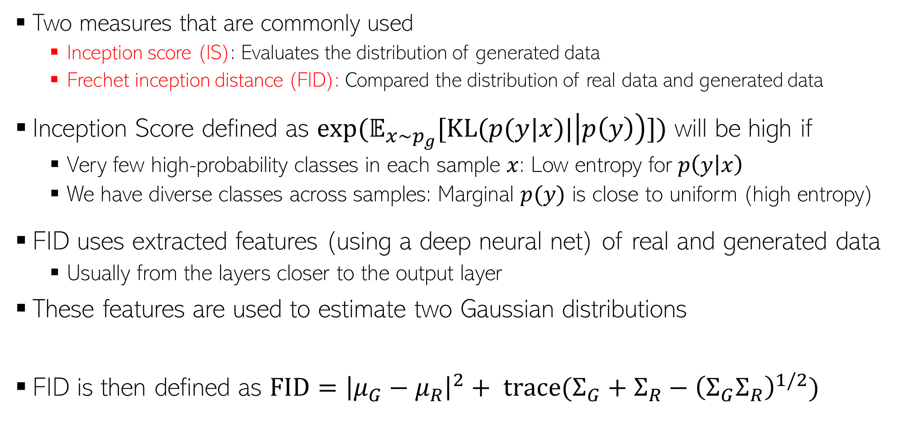


Evaluating Generation Quality
11
High IS and low FID is desirable
Two measures that are commonly used
Inception score (IS): Evaluates the distribution of generated data
Frechet inception distance (FID): Compared the distribution of real data and generated data
Inception Score defined as $exp(𝔼_{x∼p_{g}}[KL(p(y|x)|\left|p\left(y\right)\right)])$ will be high if
Very few high-probability classes in each sample $x$: Low entropy for $p\left(y | x\right)$
We have diverse classes across samples: Marginal $p(y)$ is close to uniform (high entropy)
FID uses extracted features (using a deep neural net) of real and generated data
Usually from the layers closer to the output layer
These features are used to estimate two Gaussian distributions
FID is then defined as $FID={\left|μ_{G}−μ_{R}\right|}^{2}+ trace(Σ_{G}+Σ_{R}−{\left(Σ_{G}Σ_{R}\right)}^{1/2})$
Both IS and FID measure how realistic the generated data is
Using real data
$$𝒩(μ_{R}, Σ_{R})$$
$$𝒩(μ_{G}, Σ_{G})$$
Using generated data

Slide 12

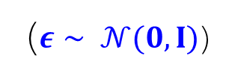







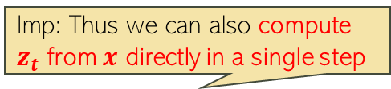




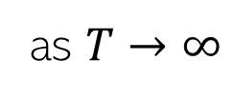
Denoising Diffusion Models
12
Consider gradually corrupting an image ($z_{0}=x)$ till it becomes pure noise ($z_{T}$)
Each step $z_{t−1}→z_{t}$ is a pre-defined Gaussian perturbation (forward process)
$$x$$
$$z_{1}$$
$$z_{2}$$
$$z_{t}$$
$$z_{T−1}$$
$$z_{T}$$
Imp: Thus we can also compute $z_{t}$ from $x$ directly in a single step
$$q\left(z_{t} | z_{t−1}\right)= 𝒩(z_{t}|\sqrt{1−β_{t}}z_{t−1},β_{t}I)$$
$$q\left(z_{t} | x\right)= 𝒩(z_{t}|\sqrt{α_{t}}x,{(1−α}_{t})I)$$
$z_{t}=\sqrt{1−β_{t}}z_{t−1}+\sqrt{β_{t}}ε$
($ε∼ 𝒩(0,I)$)
implies
where $α_{t}= \prod_{τ=1}^{t}{(1−β_{τ})}$
$$β_{t}∈\left(0,1\right) and β_{1}<β_{2}<…β_{T−1} <β_{T}$$
$z_{t}=\sqrt{α_{t}}x+\sqrt{{1−α}_{t}}ε$
Usually pre-defined but can also be learned
$$q\left(z_{T} | x\right)= 𝒩(z_{T}|0,I)$$
as $T→∞$

Slide 13
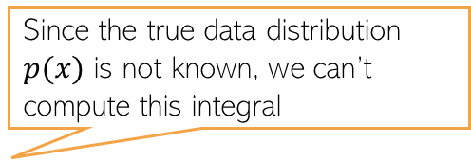

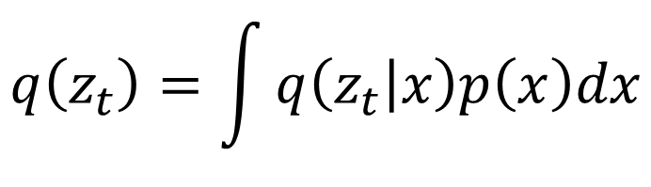
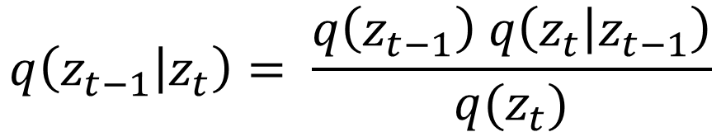
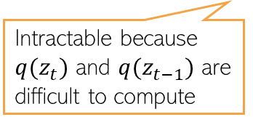
Generating Data by Reversing Diffusion
13
Reversing the diffusion(red arrows) would enable generating data from pure noise
To reverse the diffusion, we need the distribution of $z_{t−1}$ given $z_{t}$, i.e., $q(z_{t−1}|z_{t})$
$$x$$
$$z_{1}$$
$$z_{2}$$
$$z_{t}$$
$$z_{T−1}$$
$$z_{T}$$
The denoising distribution
$$q\left(z_{t−1} | z_{t}\right)= \frac{q\left(z_{t−1}\right) q\left(z_{t} | z_{t−1}\right)}{q(z_{t})}$$
Intractable because $q(z_{t})$ and $q(z_{t−1})$ are difficult to compute
Since the true data distribution $p(x)$ is not known, we can’t compute this integral
$$q\left(z_{t}\right)=\int{q\left(z_{t} | x\right)p\left(x\right)dx}$$

Slide 14
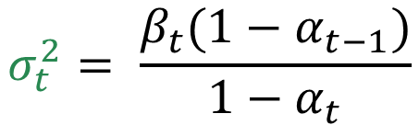

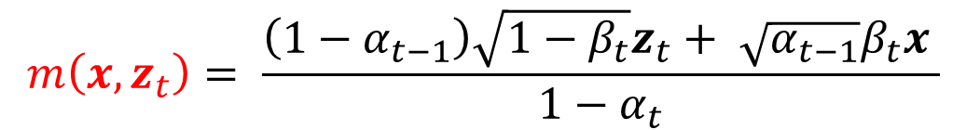
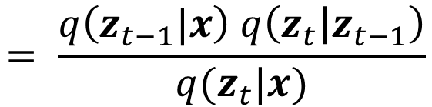
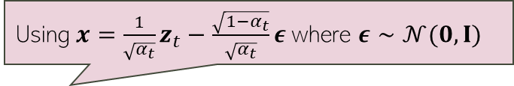
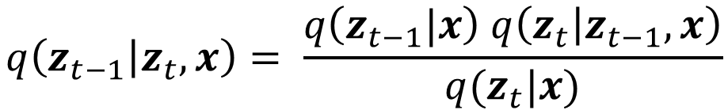
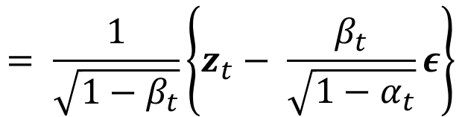
Towards a Tractable Reverse Diffusion
14
Although $q\left(z_{t−1} | z_{t}\right)$ isn’t tractable, the following distribution is tractable
Reason: $q\left(z_{t−1}|x\right)$ and $q\left(z_{t} | z_{t−1}\right)$ are Gaussians, so $q\left(z_{t−1} | z_{t},x\right)$ is Gaussian
$$q\left(z_{t−1} | z_{t},x\right)= \frac{q\left(z_{t−1}|x\right) q\left(z_{t} | z_{t−1},x\right)}{q(z_{t}|x)}$$
$$= \frac{q\left(z_{t−1}|x\right) q\left(z_{t} | z_{t−1}\right)}{q(z_{t}|x)}$$
$$q\left(z_{t−1} | z_{t},x\right)= 𝒩(z_{t−1}|m\left(x,z_{t}\right),σ_{t}^{2}I)$$
Using $x=\frac{1}{\sqrt{α_{t}}}z_{t}−\frac{\sqrt{1−α_{t}}}{\sqrt{α_{t}}}ε$ where $ε∼𝒩(0,I)$
$$m\left(x,z_{t}\right)= \frac{\left(1−α_{t−1}\right)\sqrt{1−β_{t}}z_{t}+ \sqrt{α_{t−1}}β_{t}x }{1−α_{t}}$$
$$= \frac{1}{\sqrt{1−β_{t}}}\left\{z_{t}− \frac{β_{t}}{\sqrt{1−α_{t}}}ε\right\}$$
$$σ_{t}^{2}= \frac{β_{t}(1−α_{t−1})}{1−α_{t}}$$

Slide 15


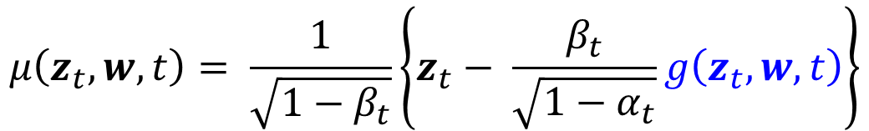
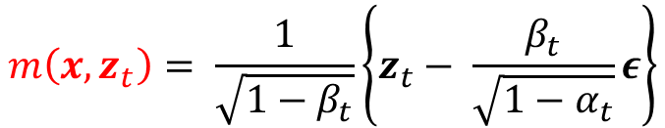
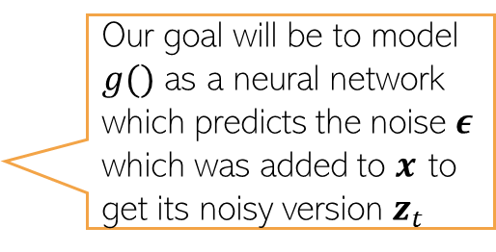

Towards a Tractable Reverse Diffusion
15
We saw that the reverse diffusion distribution is the Gaussian
Let’s approximate $q\left(z_{t−1} | z_{t},x\right)$ by another Gaussian that doesn’t depend on $x$
Usually, $Σ(z_{t}, w,t)$ is chosen to be spherical. A popular choice: $Σ\left(z_{t}, w,t\right)=β_{t}I$
The mean $μ\left(z_{t},w,t\right)$ is defined to mimic the form of $m\left(x,z_{t}\right)$
$$q\left(z_{t−1} | z_{t},x\right)= 𝒩(z_{t−1}|m\left(x,z_{t}\right),σ_{t}^{2}I)$$
Issue: At generation time, we don’t have $x$(the goal is to generate $x$ which is only available for training data) so we can’t use $m\left(x,z_{t}\right)$ at generation time since it depends on $x$
$$m\left(x,z_{t}\right)= \frac{1}{\sqrt{1−β_{t}}}\left\{z_{t}− \frac{β_{t}}{\sqrt{1−α_{t}}}ε\right\}$$
where
$$p\left(z_{t−1} | z_{t},w\right)= 𝒩(z_{t−1}|μ\left(z_{t},w,t\right),Σ(z_{t}, w,t))$$
Our goal will be to model $g()$ as a neural network which predicts the noise $ε$ which was added to $x$ to get its noisy version $z_{t}$
$$μ\left(z_{t},w,t\right)= \frac{1}{\sqrt{1−β_{t}}}\left\{z_{t}− \frac{β_{t}}{\sqrt{1−α_{t}}}g\left(z_{t},w,t\right)\right\}$$

Slide 16





Noise Predictor Network
16
A “U-net” model (a neural net) is commonly used as the noise predictor network
An embedding (positional embedding) of the time-step $t$ is fed into the residual blocks of the U-net architecture
A typical U-net
Noisy image at time $t$
U-net used in a diffusion model
Predicted noise
$$z_{t}$$
$$g(z_{t}, w,t)$$
Figure source: Arash Vahdat

Slide 17
Denoising Diffusion Model: The Training Algo
17
The overall training algo is as follows
Pseudo-code from Bishop & Bishop (2023)

Slide 18
Denoising Diffusion Model: Generation
18
Using the training model, we can now generate data as follows
Generation can be slow because it requires several steps
Reducing the number of steps is an active area of research
One such approach is DDIM (denoising diffusion implicit model) which relaxes the Markov assumption in the noise process
Pseudo-code from Bishop & Bishop (2023)

