Slide 1
Getting Started: PML Basics
CS772A: Probabilistic Machine Learning
Piyush Rai

Slide 2
Plan Today
Quick refresher of basics of probability/statistics ideas for PML
Basics of probability modeling of data
Parameter estimation in probabilistic models
Prediction in probabilistic models

Slide 3
Prob/Stats Refresher

Slide 4
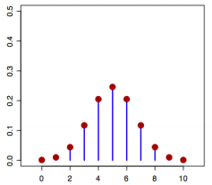
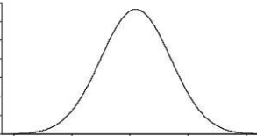
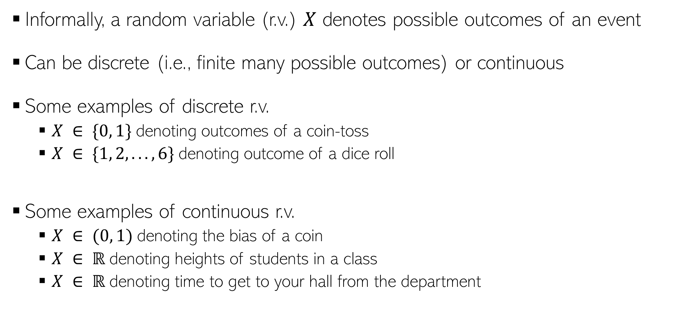
Random Variables
Informally, a random variable (r.v.) $X$ denotes possible outcomes of an event
Can be discrete (i.e., finite many possible outcomes) or continuous
Some examples of discrete r.v.
$X ∈ \{0, 1\}$denoting outcomes of a coin-toss
$X ∈ \{1, 2, . . . , 6\}$denoting outcome of a dice roll
Some examples of continuous r.v.
$X ∈ (0, 1)$denoting the bias of a coin
$X ∈ ℝ$denoting heights of students in a class
$X ∈ ℝ$denoting time to get to your hall from the department
$$p(X)$$
$X$(a discrete r.v.)
$$p(X)$$
$X$(a continuous r.v.)

Slide 5
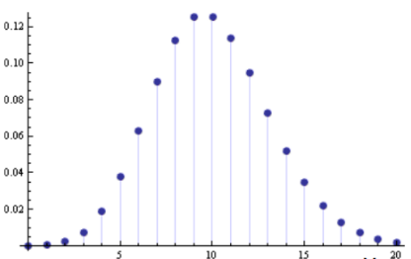

Discrete Random Variables
For a discrete r.v. $X$, $p(x)$ denotes $p(X = x)$ - probability that $X = x$
$p(X)$ is called the probability mass function (PMF) of r.v. $X$
$p(x)$ or $p(X = x)$ is the value of the PMF at $x$
$$p\left(x\right)≥0$$
$$p\left(x\right)≤ 1$$
$$\sum_{x}{p\left(x\right)=1}$$
$$p(X)$$
$$X$$

Slide 6
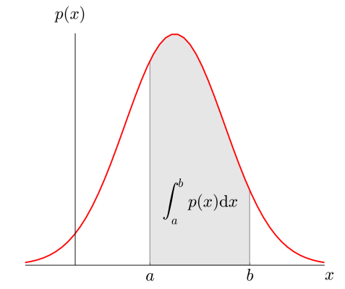



Continuous Random Variables
For a continuous r.v. $X$, a probability $p(X = x)$ or $p(x)$ is meaningless
For cont. r.v., we talk in terms of prob. within an interval $X ∈(x,x+δx)$
$p(x)δx$ is the prob. that $X ∈(x,x+δx)$as $δx→0$
$p(x)$ is the probability density at $X= x$
Yes, probability density at a point $x$ can very well be larger than 1. The integral however must be equal to 1
$$p\left(x\right)≥0$$
$$p\left(x\right)≤ 1$$
$$\int{p\left(x\right)dx=1}$$

Slide 7
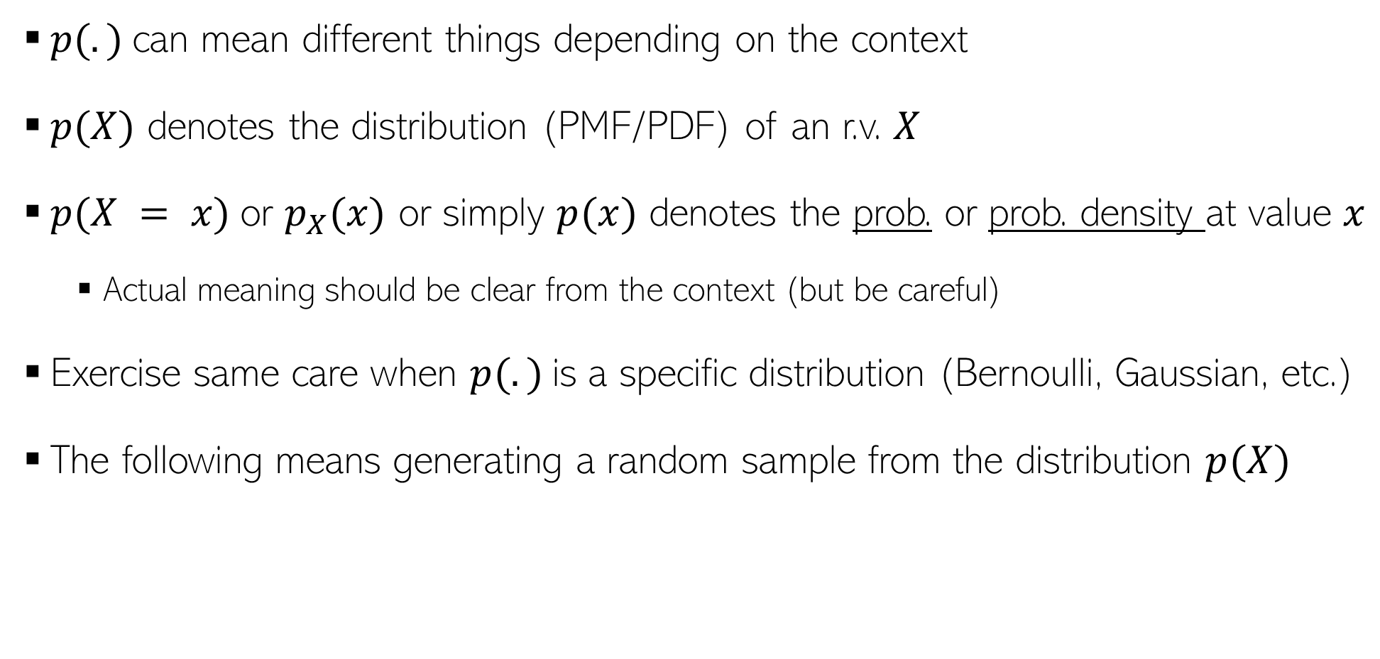
A word about notation
$p(.)$can mean different things depending on the context
$p(X)$ denotes the distribution (PMF/PDF) of an r.v. $X$
$p(X = x)$or $p_{X}(x)$ or simply $p(x)$ denotes the prob. or prob. density at value $x$
Actual meaning should be clear from the context (but be careful)
Exercise same care when $p(.)$is a specific distribution (Bernoulli, Gaussian, etc.)
The following means generating a random sample from the distribution $p(X)$
$$x∼p(X)$$

Slide 8
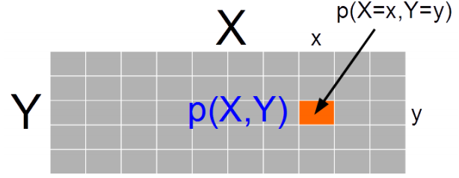
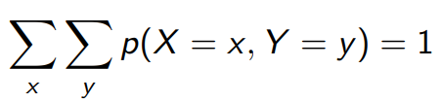
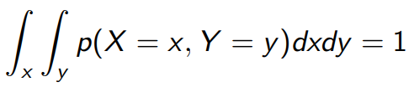

Joint Probability Distribution
Joint prob. dist. $p(X, Y)$ models probability of co-occurrence of two r.v. $X, Y$
For discrete r.v., the joint PMF $p(X, Y )$is like a table (that sums to 1)
For two continuous r.v.’s $X$ and $Y$, we have joint PDF $p(X, Y)$
For 3 r.v.’s, we will likewise have a “cube” for the PMF. For more than 3 r.v.’s too, similar analogy holds
For more than two r.v.’s, we will likewise have a multi-dim integral for this property

Slide 9
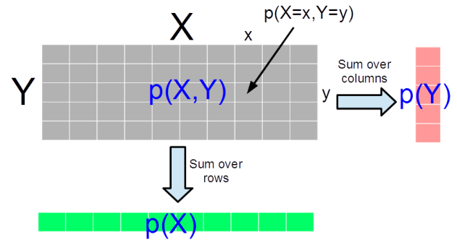

Marginal Probability Distribution
Consider two r.v.’s X and Y (discrete/continuous – both need not of same type)
Marg. Prob. is PMF/PDF of one r.v. accounting for all possibilities of the other r.v.
For discrete r.v.’s, $p\left(X\right)= \sum_{y}{p(X,Y=y)}$ and $p\left(Y\right)=\sum_{x}{p(X=x,Y)}$
For discrete r.v. it is the sum of the PMF table along the rows/columns
For continuous r.v.’s,
The definition also applied for two sets of r.v.’s and marginal of one set of r.v.’s is obtained by summing over all possibilities of the second set of r.v.’s
For discrete r.v.’s, marginalization is called summing over, for continuous r.v.’s, it is called “integrating out”

Slide 10
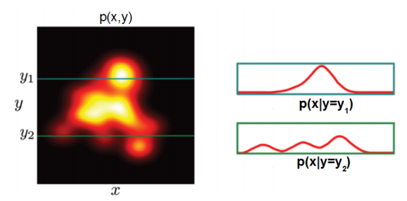
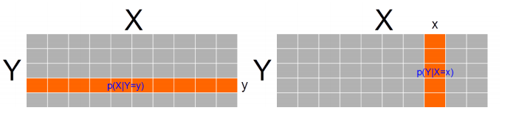
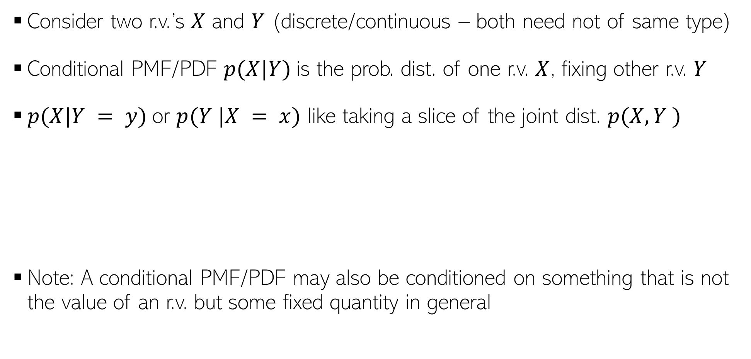
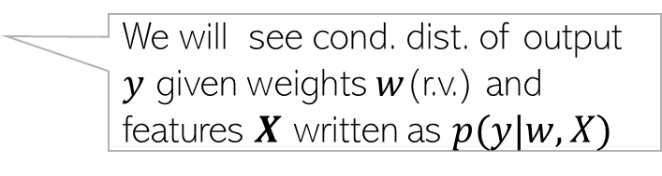
Conditional Probability Distribution
Consider two r.v.’s $X$ and $Y$ (discrete/continuous – both need not of same type)
Conditional PMF/PDF $p(X|Y)$is the prob. dist. of one r.v. $X$, fixing other r.v. $Y$
$p(X|Y = y)$or $p(Y |X = x)$ like taking a slice of the joint dist. $p(X, Y )$
Note: A conditional PMF/PDF may also be conditioned on something that is not the value of an r.v. but some fixed quantity in general
Continuous Random Variables
Discrete Random Variables
We will see cond. dist. of output $y$ given weights $w$(r.v.) and features $X$ written as $p(y|w,X)$

Slide 11
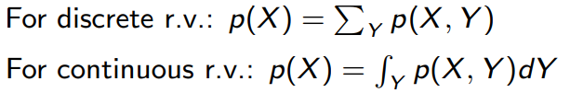
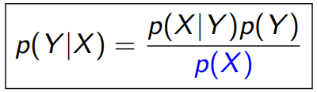
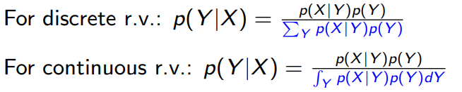
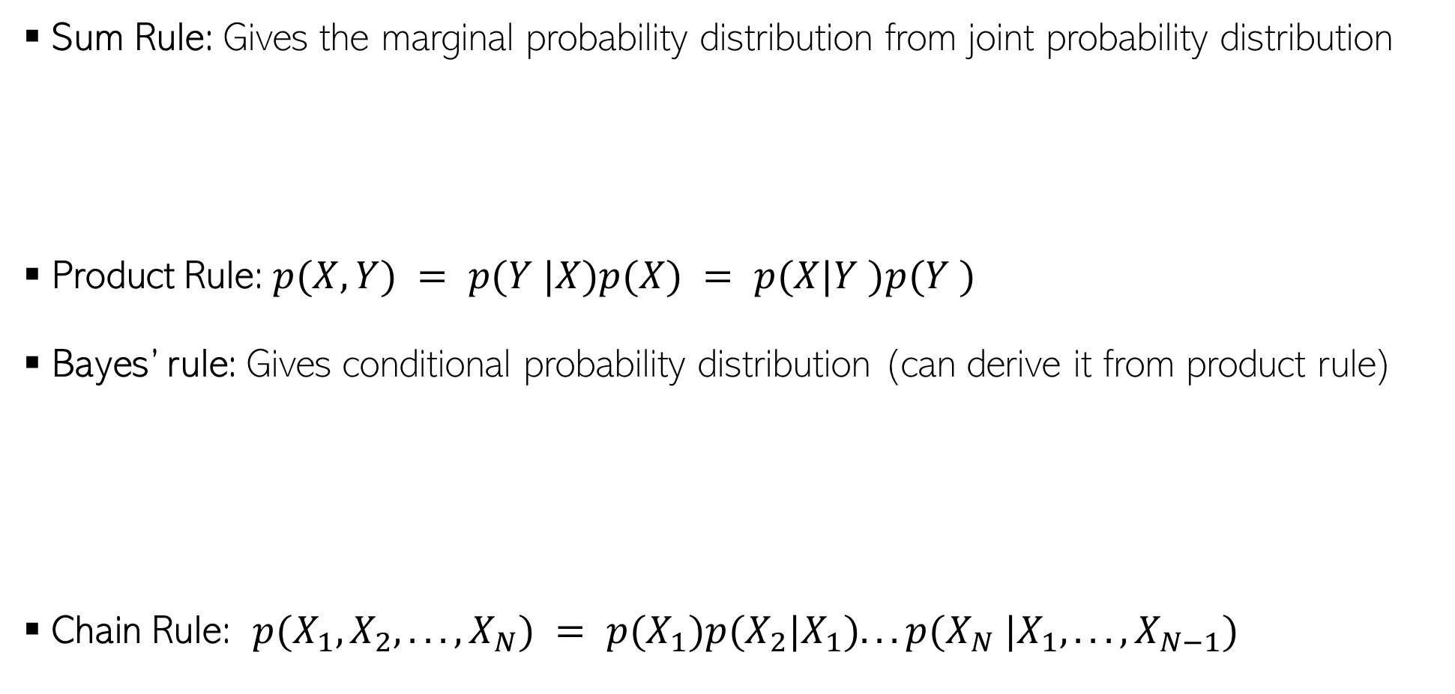
Some Basic Rules
Sum Rule: Gives the marginal probability distribution from joint probability distribution
Product Rule: $p(X, Y) = p(Y |X)p(X) = p(X|Y )p(Y )$
Bayes’ rule: Gives conditional probability distribution (can derive it from product rule)
Chain Rule: $p(X_{1}, X_{2}, . . . , X_{N}) = p(X_{1})p(X_{2}|X_{1}). . . p(X_{N} |X_{1}, . . . , X_{N−1})$

Slide 12

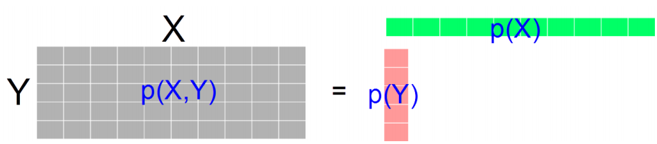


Independence
$X$ and $Y$ are independent when knowing one tells nothing about the other
The above is the marginal independence $(X ⫫ Y)$
Two r.v.’s $X$ and $Y$ may not be marginally indep but may be given the value of another r.v. $Z$

Slide 13

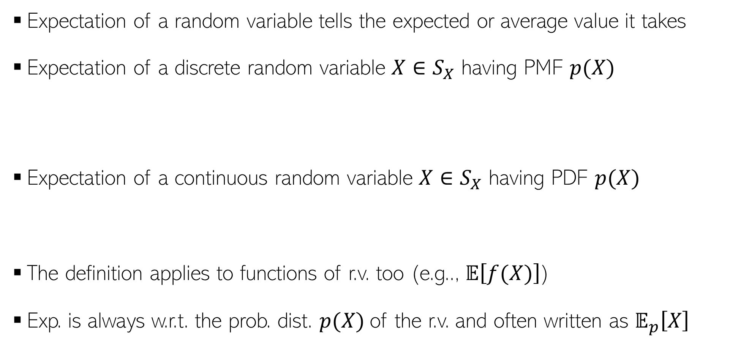
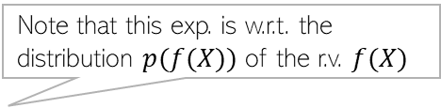

Expectation
Expectation of a random variable tells the expected or average value it takes
Expectation of a discrete random variable $X∈S_{X}$ having PMF $p(X)$
Expectation of a continuous random variable $X$ $∈S_{X}$ having PDF $p(X)$
The definition applies to functions of r.v. too (e.g.., $𝔼\left[f(X)\right]$)
Exp. is always w.r.t. the prob. dist. $p(X)$of the r.v. and often written as $𝔼_{p}\left[X\right]$
$$𝔼[X] = \sum_{x∈S_{X}}{xp(x)}$$
Probability that $X = x$
$$𝔼\left[X\right]=\int{xp\left(x\right)dx}$$
Probability density at $X = x$
Note that this exp. is w.r.t. the distribution $p(f(X))$ of the r.v. $f(X)$
$$x∈S_{X}$$
Often the subscript is omitted but do keep in mind the underlying distribution

Slide 14
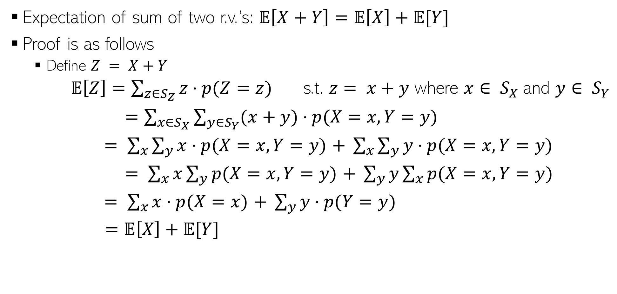
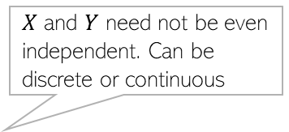
Expectation: A Few Rules
$X$ and $Y$ need not be even independent. Can be discrete or continuous
Expectation of sum of two r.v.’s: $𝔼\left[X+Y\right]=𝔼\left[X\right]+𝔼[Y]$
Proof is as follows
Define $Z = X+Y$
$𝔼\left[Z\right]=\sum_{z∈S_{Z}}{z⋅p(Z=z)}$ s.t. $z= x+y$ where $x∈ S_{X}$and $y∈ S_{Y}$
$=\sum_{x∈S_{X}}{\sum_{y∈S_{Y}}{(x+y)⋅p(X=x,Y=y)}}$
$= \sum_{x}{\sum_{y}{x⋅p(X=x,Y=y)}}$ $+ \sum_{x}{\sum_{y}{y⋅p(X=x,Y=y)}}$
$= \sum_{x}{x\sum_{y}{p(X=x,Y=y)}}$ $+ \sum_{y}{y\sum_{x}{p(X=x,Y=y)}}$
$= \sum_{x}{x⋅p(X=x)}$ $+ \sum_{y}{y⋅p(Y=y)}$
$=𝔼\left[X\right]+𝔼[Y]$
Used the rule of marginalization of joint dist. of two r.v.’s

Slide 15

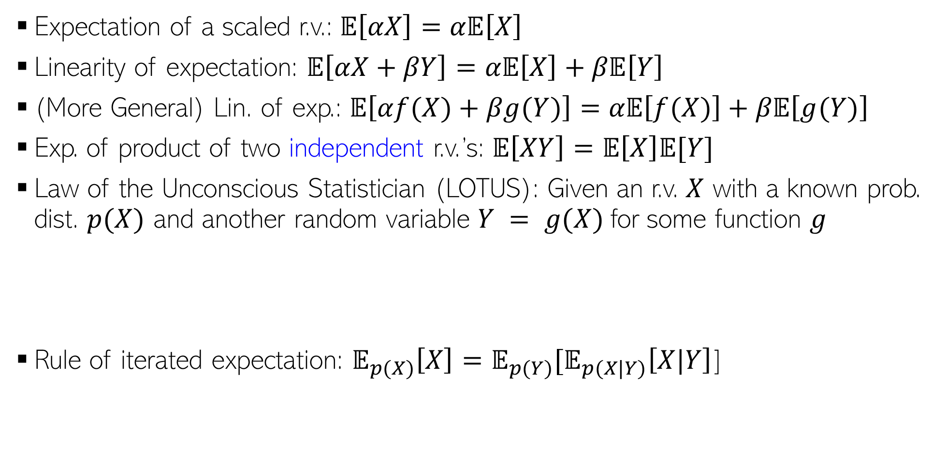



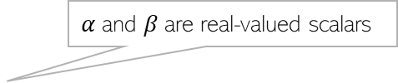
Expectation: A Few Rules (Contd)
$α$is a real-valued scalar
$α$and $β$are real-valued scalars
Expectation of a scaled r.v.: $𝔼\left[αX\right]=α𝔼\left[X\right]$
Linearity of expectation: $𝔼\left[αX+βY\right]=α𝔼\left[X\right]+β𝔼\left[Y\right]$
(More General) Lin. of exp.: $𝔼\left[αf(X)+βg(Y)\right]=α𝔼\left[f(X)\right]+β𝔼\left[g(Y)\right]$
Exp. of product of two independent r.v.’s: $𝔼\left[XY\right]=𝔼\left[X\right]𝔼[Y]$
Law of the Unconscious Statistician (LOTUS): Given an r.v. $X$ with a known prob. dist. $p(X)$ and another random variable $Y = g(X)$for some function $g$
Rule of iterated expectation: $𝔼_{p(X)}\left[X\right]=𝔼_{p(Y)}[𝔼_{p(X|Y)}\left[X|Y\right]$]
$f$ and $g$ are arbitrary functions.
Requires finding $p(Y)$
Requires only $p(X)$ which we already have
$$𝔼\left[Y\right]=𝔼\left[g\left(X\right)\right]=\sum_{y∈S_{Y}}{yp\left(y\right) }$$
$$=\sum_{x∈S_{X}}{g\left(x\right)p(x)}$$
LOTUS also applicable for continuous r.v.’s

Slide 16
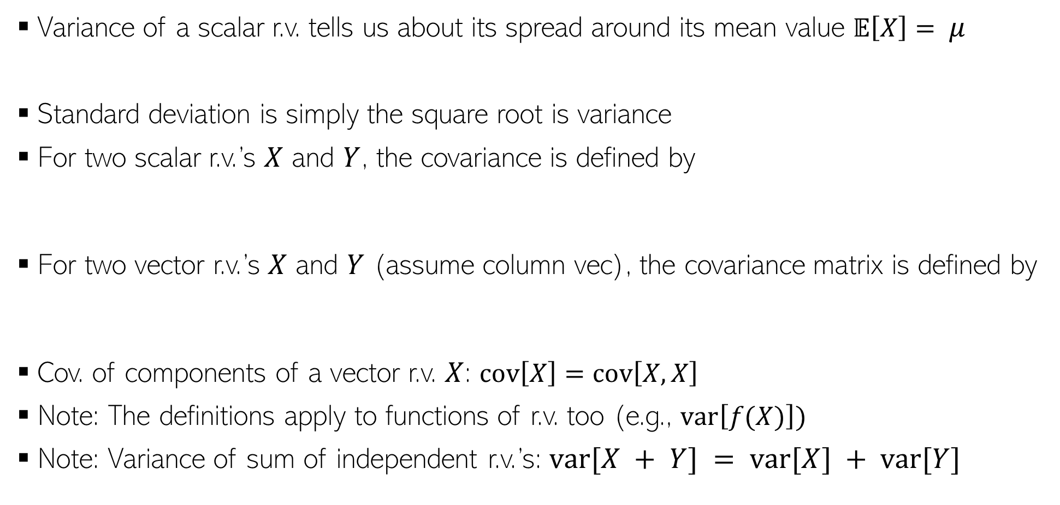
Variance and Covariance
Variance of a scalar r.v. tells us about its spread around its mean value $𝔼\left[X\right]= μ$
Standard deviation is simply the square root is variance
For two scalar r.v.’s $X$ and $Y$, the covariance is defined by
For two vector r.v.’s $X$ and $Y$ (assume column vec), the covariance matrix is defined by
Cov. of components of a vector r.v. $X$: $cov\left[X\right]=cov\left[X,X\right]$
Note: The definitions apply to functions of r.v. too (e.g., $var\left[f(X)\right])$
Note: Variance of sum of independent r.v.’s: $var[X + Y] = var[X] + var[Y]$
$$var\left[X\right]=𝔼\left[{\left(X−μ\right)}^{2}\right]=𝔼\left[X^{2}\right] −μ^{2}$$
$$cov\left[X,Y\right]=𝔼\left[\{X−𝔼[X]\}\{Y−𝔼[Y]\}\right]=𝔼\left[XY\right]−𝔼[X]𝔼[Y]$$
$$cov\left[X,Y\right]=𝔼\left[\{X−𝔼[X]\}\{Y^{⊤}−𝔼[Y^{⊤}]\}\right]=𝔼\left[XY^{⊤}\right]−𝔼[X]𝔼[Y^{⊤}]$$
Important result

Slide 17
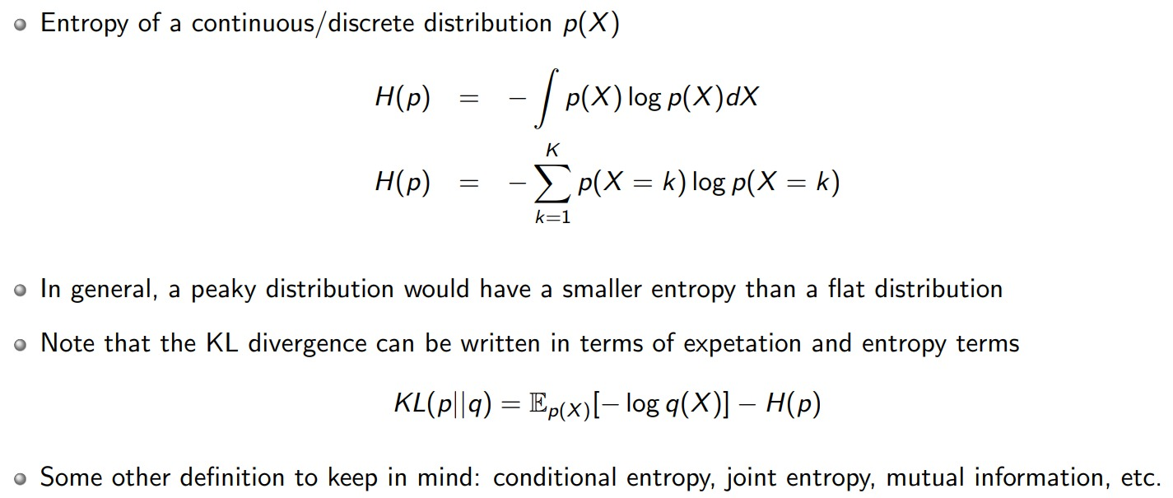
Entropy

Slide 18
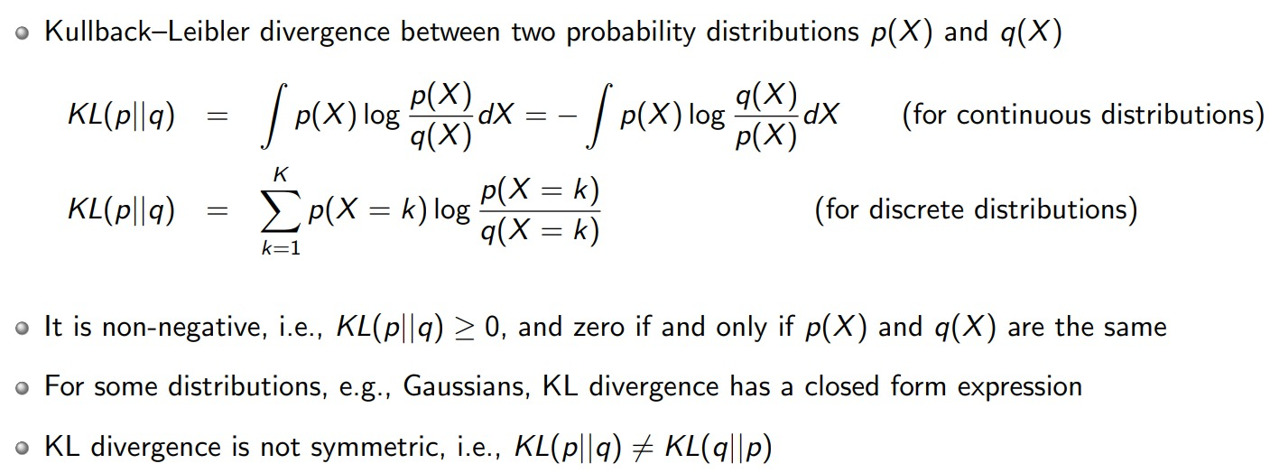
KL Divergence

Slide 19
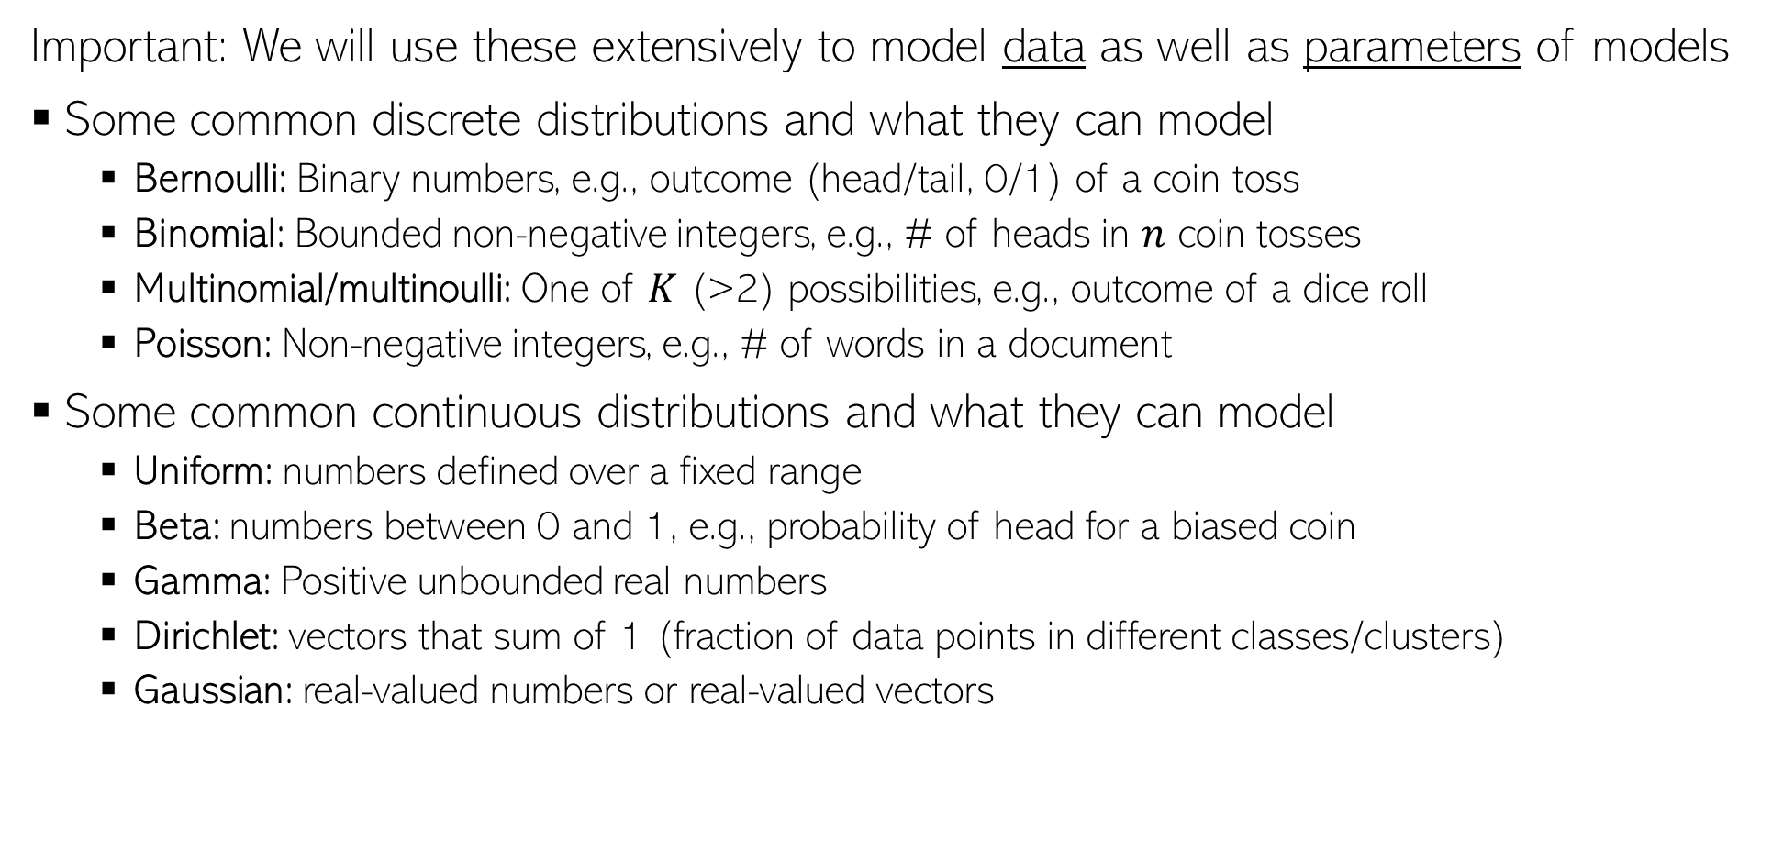
Common Probability Distributions
Important: We will use these extensively to model data as well as parameters of models
Some common discrete distributions and what they can model
Bernoulli: Binary numbers, e.g., outcome (head/tail, 0/1) of a coin toss
Binomial: Bounded non-negative integers, e.g., # of heads in $n$ coin tosses
Multinomial/multinoulli: One of $K$ (>2) possibilities, e.g., outcome of a dice roll
Poisson: Non-negative integers, e.g., # of words in a document
Some common continuous distributions and what they can model
Uniform: numbers defined over a fixed range
Beta: numbers between 0 and 1, e.g., probability of head for a biased coin
Gamma: Positive unbounded real numbers
Dirichlet: vectors that sum of 1 (fraction of data points in different classes/clusters)
Gaussian: real-valued numbers or real-valued vectors

Slide 20
Discrete Distributions

Slide 21
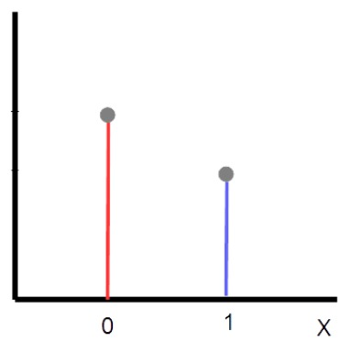



Bernoulli Distribution
Distribution over a binary random variable $X∈\{0,1\}$, e.g., outcome of a coin-toss
Defined by probability parameter $μ∈(0,1)$ s.t. $μ= p(X=1)$
The probability mass function (PMF) of Bernoulli is
Expectation: $𝔼\left[X\right]=μ$
Variance: var[$X$] $=μ(1−μ)$
$$1−μ$$
$$μ$$
$$p(X=x|μ)=μ^{x}{\left(1−μ\right)}^{1−x}$$

Slide 22
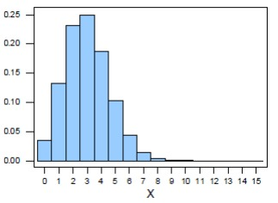



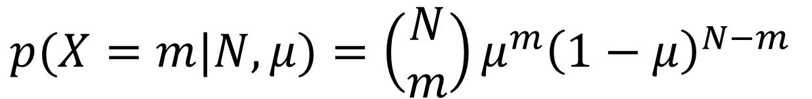
Binomial Distribution
Distribution over number of successes $m$ in $N$ trials, e.g., number of heads in $N$ coin tosses
Defined by a parameter $μ∈\left(0,1\right)$ , probability of success of each trial
The probability mass function (PMF) of Binomial is
Expectation: $𝔼\left[X\right]=Nμ$
Variance: var[$X$] $=Nμ(1−μ)$
$$p(X=m|N,μ)=\left(\begin{aligned}N \\ m\end{aligned}\right)μ^{m}{\left(1−μ\right)}^{N−m}$$
Binomial with $N=15, μ=0.2$
Probability of $X=m$

Slide 23
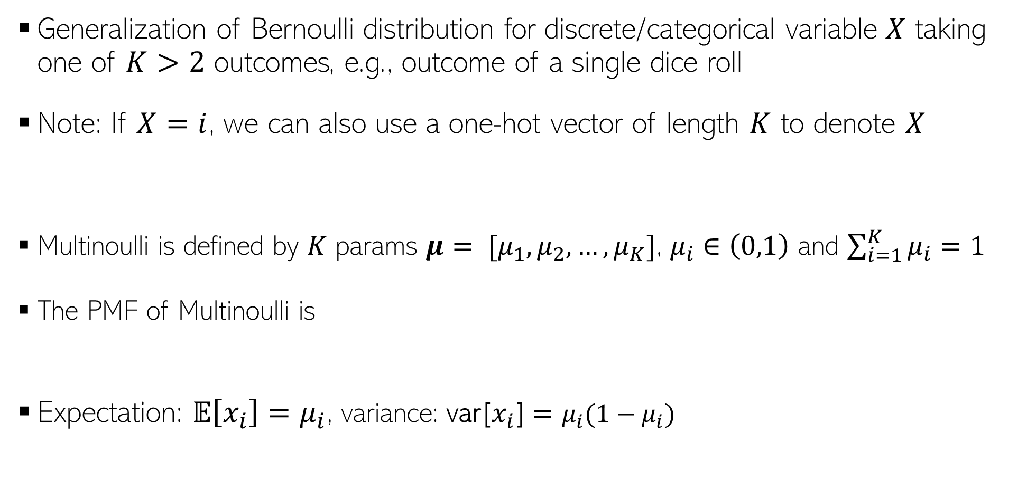


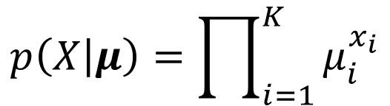
Multinoulli Distribution
Generalization of Bernoulli distribution for discrete/categorical variable $X$ taking one of $K>2$ outcomes, e.g., outcome of a single dice roll
Note: If $X=i$, we can also use a one-hot vector of length $K$ to denote $X$
Multinoulli is defined by $K$ params $μ= [μ_{1},μ_{2},…, μ_{K}]$, $μ_{i}∈\left(0,1\right)$ and $\sum_{i=1}^{K}{μ_{i}}=1$
The PMF of Multinoulli is
Expectation: $𝔼\left[x_{i}\right]=μ_{i}$, variance: var[$x_{i}$] $=μ_{i}(1−μ_{i})$
$$X=[0, 0, …, 0, 1, 0, …, 0, 0]$$
Vector of all zeros except the $i^{th}$ entry $x_{i}$ which is 1; all other $x_{j}$, for $j≠i$ are 0
Probability of the $i^{th}$ outcome
$$p\left(X | μ\right)=\prod_{i=1}^{K}{μ_{i}^{x_{i}}}$$

Slide 24

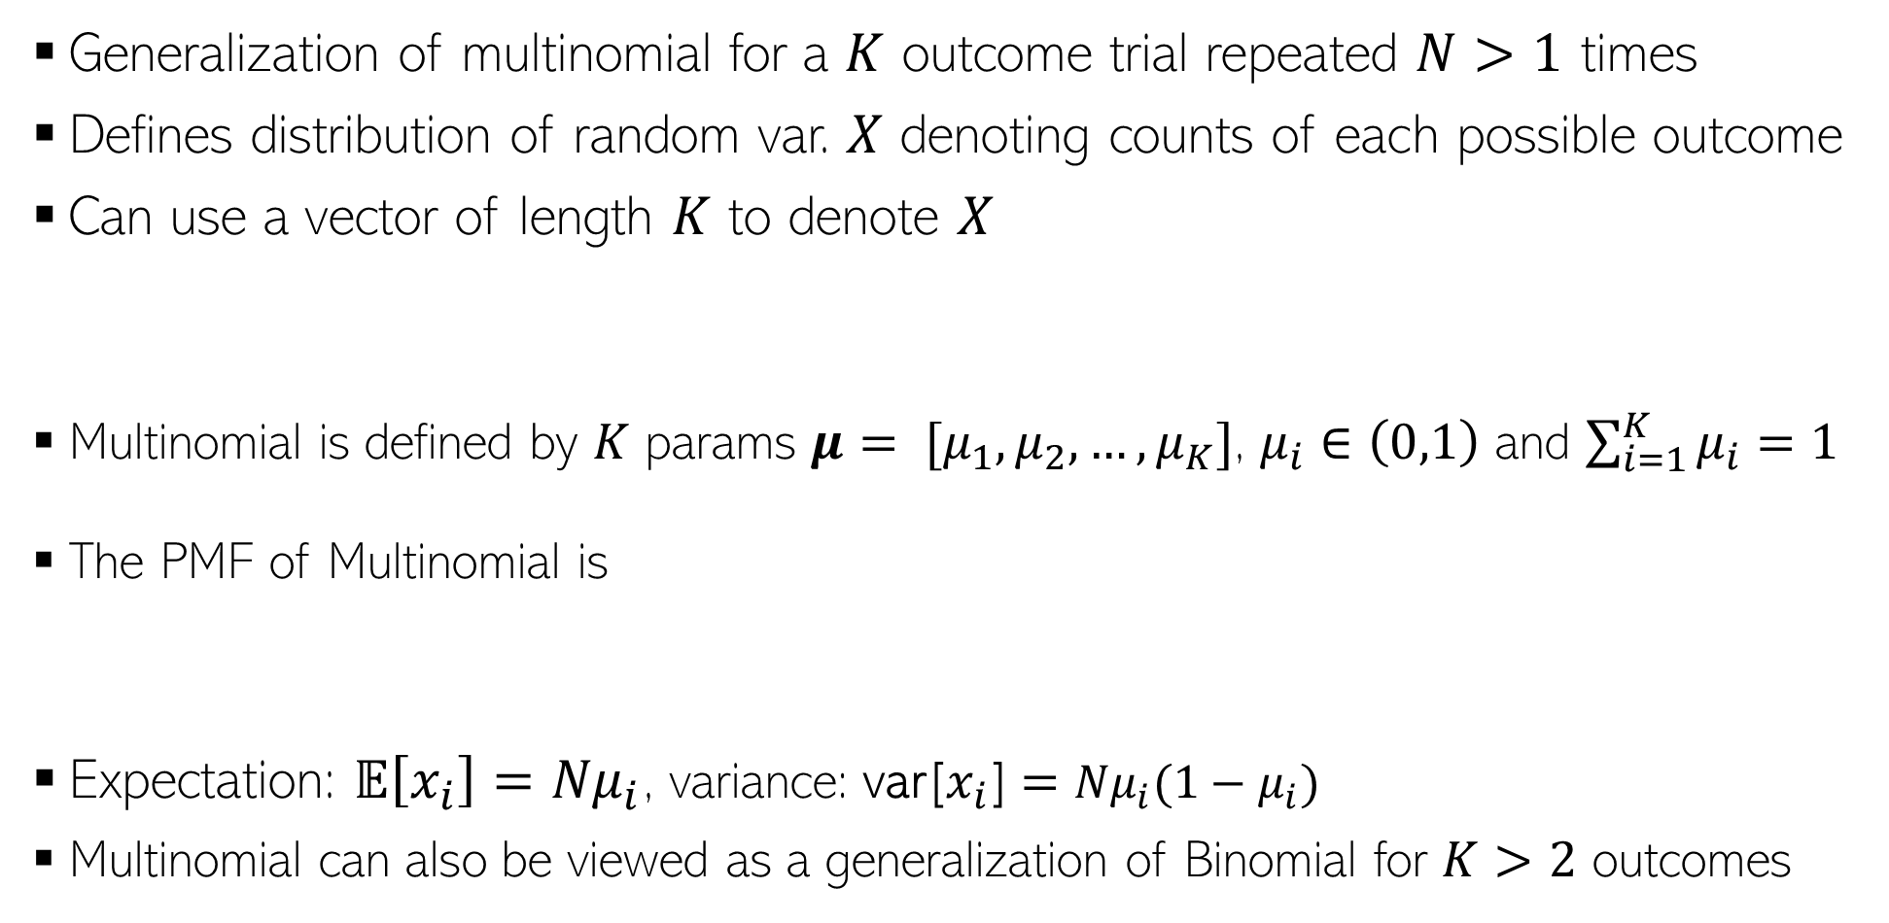
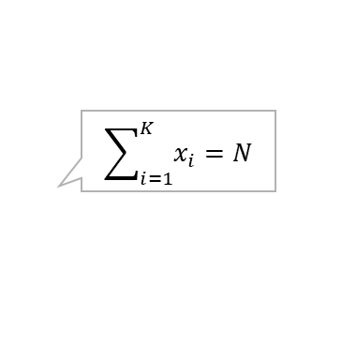
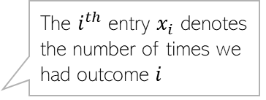
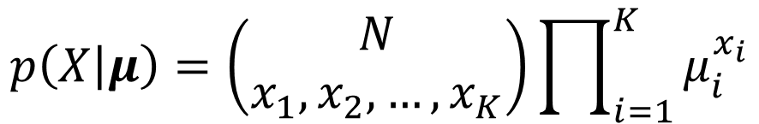
Multinomial Distribution
E.g., same dice rolled $N$ times
Generalization of multinomial for a $K$ outcome trial repeated $N>1$ times
Defines distribution of random var. $X$ denoting counts of each possible outcome
Can use a vector of length $K$ to denote $X$
Multinomial is defined by $K$ params $μ= [μ_{1},μ_{2},…, μ_{K}]$, $μ_{i}∈\left(0,1\right)$ and $\sum_{i=1}^{K}{μ_{i}}=1$
The PMF of Multinomial is
Expectation: $𝔼\left[x_{i}\right]={Nμ}_{i}$, variance: var[$x_{i}$] $={Nμ}_{i}(1−μ_{i})$
Multinomial can also be viewed as a generalization of Binomial for $K>2$ outcomes
The $i^{th}$ entry $x_{i}$ denotes the number of times we had outcome $i$
$$\sum_{i=1}^{K}{x_{i}}=N$$
$$X=[x_{1}, x_{2}, …, x_{i}, …, x_{K−1}, x_{K}]$$
$$p\left(X | μ\right)=\left(\begin{aligned}N \\ x_{1},x_{2},…, x_{K}\end{aligned}\right)\prod_{i=1}^{K}{μ_{i}^{x_{i}}}$$

Slide 25
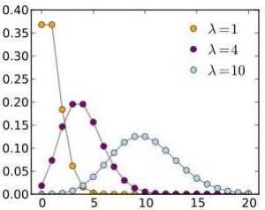




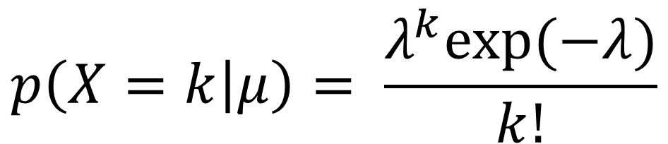
Poisson Distribution
Distribution a non-negative integer (count) random variable $X$, e.g., number of events in a fixed interval of time
Defined by a non-negative rate parameter $λ$
The PMF of Poisson is
Expectation: $𝔼\left[X\right]=λ$, variance: var[$X$] $=λ$
$$p(X=k|λ)$$
$$p\left(X=k | μ\right)= \frac{λ^{k}exp(−λ)}{k!}$$
$$X$$
$$(k=0,1,2,…)$$

Slide 26
Continuous Distributions

Slide 27
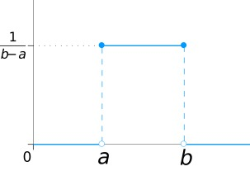





Uniform Distribution
Distribution over a uniformly distributed random variable in interval $[a,b]$
The probability density function (PDF) is
Expectation: $𝔼\left[X\right]= \frac{(a+b)}{2}$
Variance: var[$X]= \frac{{\left(b−a\right)}^{2}}{12}$
Recall that since $X$ is continuous, this is not the probability of $X=x$ but probability of $X∈(x,x+δx)$ where $δx$ is very small
$$p\left(X=x | μ\right)= \frac{1}{(b−a)}$$
$$p(X=x)$$
$$X$$

Slide 28







Beta Distribution
Distribution over a random var. $π∈(0,1)$, e.g., probability of head for a coin
Defined by two parameters $α, β>0$. They control the shape of the distribution
The probability density function (PDF) is
Expectation: $𝔼\left[π\right]= \frac{α}{α+β}$
Variance: var[$π]= \frac{α+β}{{\left(α+β\right)}^{2}(α+β+1)}$
$$p\left(π | α,β\right)= \frac{Γ(α+β)}{Γ\left(α\right)Γ\left(β\right)} π^{α−1}{\left(1−π\right)}^{β−1 }$$
$Γ$ denotes the gamma function: $Γ\left(α\right)= \int_{0}^{∞}{t^{α−1}exp\left(−t\right)dt}$
$$p(μ)$$
Also equivalent to a uniform distribution for $α=1, β=1$
$$μ$$

Slide 29





Dirichlet Distribution
Distribution over a random non-neg vector $π=[π_{1},π_{2},…, π_{K}]$ that sums to 1, e.g., vector of probabilities of a dice roll showing each of the $K$ faces
Equivalent to a distribution over the $K − 1$ dimensional simplex
Defined by $K$ non-negative parameters $α=\left[α_{1},α_{2},…, α_{K}\right]$
The PDF is
Expectation: $𝔼\left[π_{i}\right]= \frac{α_{i}}{\sum_{i=1}^{K}{α_{i}}}$, variance: var[$π_{i}]= \frac{ {\hat{α}}_{i}(1−{\hat{α}}_{i})}{ (α_{0}+1)}$ where $α_{0}= \sum_{i=1}^{K}{α_{i}}$
$$0≤π_{i}≤1, ∀i=1,2,…, K, \sum_{i=1}^{K}{π_{i}=1}$$
These parameters control the shape of the Dirichlet distribution
$$p\left(π | α\right)= \frac{Γ(\sum_{i=1}^{K}{α_{i}})}{\prod_{i=1}^{K}{Γ\left(α_{i}\right)}} π_{i}^{α_{i}−1}$$
Dirichlet is like a $K$-dimensional generalization of the Beta distribution
$${\hat{α}}_{i}= \frac{α_{i}}{α_{0}}$$

Slide 30




















Dirichlet Distribution (contd)
Shape of the Dirichlet distribution ($K=3)$, as $α=\left[α_{1},α_{2},…, α_{K}\right]$ varies
Each point within the two-dim ($K−1)$, simplices (triangles) below is a random probability vector $π=[π_{1},π_{2},π_{3}]$ of length 3, drawn from the Dirichlet
Like a uniform distribution if all $α_{k}$’s are 1
Visualizations of PDFs of some 3-dim Dirichlet distributions (each generated using a different conc. Param vector $α$)
All $α_{k}$’s large results in peak around the center of the simplex
$α$ controls the shape of the Dirichlet (just like Beta distribution’s hyperparameters)
More red means we will get more points from that region when drawing random $π$ vectors from the Dirichlet
$$π_{2}$$
$$π_{2}$$
$$π_{3}$$
$$π_{3}$$
$$π_{1}$$
$$π_{1}$$
$$π_{2}$$
$$π_{2}$$
$$π_{3}$$
$$π_{3}$$
$$π_{1}$$
$$π_{1}$$

Slide 31





Gamma Distribution
Distribution over non-negative random variable $X>0$, e.g., time between phone-calls at a call center
Defined by a shape parameters $k$ and a scale parameter $θ$
The PDF is
Expectation: $𝔼\left[X\right]=kθ$, variance: var[$X]=kθ^{2}$
Note: Sometimes, the gamma distribution can also be defined in another parameterization (shape and inverse scale ($1/θ)$)
$$p\left(X=x | k,θ\right)= \frac{x^{k−1}exp(−\frac{x}{θ})}{θ^{k}Γ(k) }$$
$$p(X=x)$$
$$X$$

Slide 32




Gaussian Distribution (Univariate)
Distribution over real-valued scalar random variables $X∈ℝ$, e.g., height of students in a class
Defined by a scalar mean $μ$and a scalar variance $σ^{2}$
Mean: $𝔼\left[X\right]=μ$
Variance: var[$X$] $=σ^{2}$
Inverse of variance is called precision: $β=\frac{1}{σ^{2}}$.
$$𝒩\left(X=x | μ,σ^{2}\right)=\frac{1}{\sqrt{2πσ^{2}}}exp\left[−\frac{{\left(x−μ\right)}^{2}}{2σ^{2}}\right]$$
Gaussian PDF in terms of precision
$$𝒩\left(X=x | μ,β\right)=\sqrt{\frac{β}{2π}}exp\left[−\frac{β}{2}{\left(x−μ\right)}^{2}\right]$$

Slide 33



Gaussian Distribution (Multivariate)
Distribution over real-valued vector random variables $X∈ℝ^{D}$
Defined by a mean vector $μ∈ℝ^{D}$and a covariance matrix $Σ$
Note: The cov. matrix $Σ$ must be symmetric and PSD
All eigenvalues are positive
$z^{⊤}Σz≥0$ for any real vector $z$
The covariance matrix also controls the shape of the Gaussian
A two-dimensional Gaussian
$$𝒩\left(X=x | μ,Σ\right)=\frac{1}{\sqrt{{\left(2π\right)}^{D}\left|Σ\right|}}exp\left[−{\left(x−μ\right)}^{⊤}Σ^{−1}(x−μ)\right]$$

Slide 34






Covariance Matrix for Multivariate Gaussian
Spherical Covariance
Diagonal Covariance
Full Covariance
5
5
5
Spherical: Equal spreads (variances) along all dimensions
Diagonal: Unequal spreads (variances) along all directions but still axis-parallel
-5
5
-5
5
-5
5
5
5
5
Full: Unequal spreads (variances) along all directions and also spreads along oblique directions
-5
5
-5
5
-5
5

Slide 35

Multivariate Gaussian: Marginals and Conditionals

Slide 36

Transformation of Random Variables
Suppose $Y = f(X) = AX + b$be a linear function of a vector-valued r.v. $X$ ($A$ is a matrix and $b$ is a vector, both constants)
Suppose $𝔼\left[X\right]=μ$ and $cov\left[X\right]=Σ$, then for the vector-valued r.v. $Y$
Likewise, if $Y = f\left(X\right)=a^{⊤}X + b$ be a linear function of a vector-valued r.v. $X$ ($a$ is a vector and $b$ is a scalar, both constants)
Suppose $𝔼\left[X\right]=μ$ and $cov\left[X\right]=Σ$, then for the scalar-valued r.v. $Y$
$$𝔼\left[Y\right]=𝔼\left[AX+b\right]=Aμ+b$$
$$cov\left[Y\right]=cov\left[AX+b\right]=AΣA^{⊤}$$
$$𝔼\left[Y\right]=𝔼\left[a^{⊤}X + b\right]=a^{⊤}μ+b$$
$$var\left[Y\right]=var\left[a^{⊤}X + b\right]=a^{⊤}Σa$$

Slide 37
Probabilistic Modeling

Slide 38

Probabilistic Modeling of Data: The Setup
38
We are given some training data $𝒟$
For supervised learning, $𝒟$contains $N$ input-label pairs ${\left(x_{i}, y_{i}\right)}_{i=1}^{N}$
For unsupervised learning, $𝒟$ contains $N$ inputs ${\left(x_{i}\right)}_{i=1}^{N}$
Other settings are also possible (e.g., semi-sup., reinforcement learning, etc)
Our goal is to estimate the distribution (and thus $θ$) using training data
Once the distribution is estimated, we can do things such as
Predict labels of new inputs, along with our confidence in these predictions
Generate new data with similar properties as training data
.. and a lot of other useful tasks, e.g., detecting outliers

Slide 39





Data/Observation Model
39
Observation model is usually defined by a suitable probability distribution
The distribution’s parameters $θ$ are unknown and need to be estimated
The quantity $p(𝒟|θ)$ is also referred to as the “likelihood”
Likelihood gives us the probability of the observed data $𝒟$ as a function of $θ$
$$p(𝒟|θ)$$
It’s a function of $θ$, not a distribution over $θ$
$$p(𝒟|θ)$$
$$θ$$

Slide 40





Parameter Estimation: A Simple Approach
40
Likelihood itself is a useful quantity to estimate the parameters $θ$
Maximum Likelihood (ML) is a popular method
MLE is akin to minimizing a loss function. Negative log likelihood (NLL) = Loss
MLE however as a few issues
Provides only a point estimate of $θ$ (thus no uncertainty estimate)
Does not allow incorporating prior knowledge about $θ$
Using a prior distribution $p(θ)$ over $θ$ can help address these issues
$$p(𝒟|θ)$$
$${\hat{θ}}_{ML}=arg\max_{θ} log p(𝒟|θ)$$
$$θ$$
$${\hat{θ}}_{ML}$$

Slide 41


The Prior
41
The prior $p(θ|α)$ plays an important role in probabilistic/Bayesian modeling
Here $α$ denotes the parameters (“hyperparameters”) of the prior distribution
Reflects our prior beliefs about possible parameter values before seeing the data
Can be “subjective” or “objective”
Subjective: Prior (our beliefs) derived from past experiments
Objective: Prior represents “neutral knowledge” (e.g.. uniform, vague prior)
Can also be seen as a regularizer (we will see the reason soon)

Slide 42









Using Prior in Parameter Estimation
Posterior can be seen as a “compromise” between likelihood and the prior
42
Can use prior in following ways during parameter estimation
Computing the distribution of the parameters conditioned on data
Computing the (MAP) maximum-a-posteriori estimate (report maxima of the posterior)
The posterior distribution
$$p\left(θ | 𝒟,α\right)= \frac{p\left(𝒟,θ | α\right)}{p\left(𝒟 | α\right)}=\frac{p(𝒟|θ,α)p\left(θ|α\right)}{∫p(𝒟|θ,α)p\left(θ|α\right)dθ}$$
$${\hat{θ}}_{MAP}$$
$${\hat{θ}}_{ML}$$
Assuming $α$ is known so the posterior is conditioned on $α$ as well
$$=\frac{p(𝒟|θ)p\left(θ|α\right)}{∫p(𝒟|θ)p\left(θ|α\right)dθ}$$
$$=\frac{likelihood×prior}{marginal likelihood}$$
Given $θ,$the data is conditionally independent of the prior’s hyperparameters $α$ so $p(𝒟|θ,α)$ = $p(𝒟|θ)$
An important quantity. More on this later
$${\hat{θ}}_{MAP}=arg\max_{θ} log p\left(θ | 𝒟,α\right)=arg\max_{θ} [log p\left(𝒟 | θ\right)+log p\left(θ|α\right)]$$
$$=arg\min_{θ} [NLL\left(θ\right)−log p\left(θ|α\right)]$$
We only need to find the maxima of the posterior
Note that computing MAP estimate does not require computing the posterior ☺
The regularizer hyperparameter is part of prior
Akin to a regularizer added to the loss

Slide 43












Parameter Estimation: Summary of approaches
43
Usually one of the following approach taken
A single “best” point estimate of the parameters by optimizing an objective function
A distribution over the parameters (conditioned on observed data $𝒟$)
A set/ensemble of point estimates of parameters (applying approach 1 multiple times)
$$\hat{θ}= {argmax}_{θ} f(𝒟;θ)$$
$f$can be log-likelihood (for MLE) or log-posterior (for MAP)
$${θ=[θ_{1},θ}_{2}]$$
The posterior distribution
$$p(θ|𝒟)$$
$$θ_{2}$$
$$θ_{1}$$
Computing multiple point estimates, each using a different subset of the training data
Ensemble (e.g., training a deep neural net with multiple different initializations)
$$θ^{(1)}$$
$$θ^{(2)}$$
$$θ^{(S)}$$

Slide 44

An Important Aspect: Posterior Updates
44
Posterior updates in Bayesian inference can naturally be done in an online fashion
Also, the posterior’s spread/variance gets smaller as we use more and more data to infer it

Slide 45








Making Predictions: The Predictive Distribution
45
If we have computed $p(θ|𝒟)$ then the predictive distribution can be defined as
If we don’t have $p(θ|𝒟)$ but a set/ensemble of estimates ${\left\{θ^{(i)}\right\}}_{i=1}^{S}$ then
If we only have a single point estimate $\hat{θ}$ then
$$p\left(𝒟_{∗} | 𝒟\right)=∫p(𝒟_{∗},θ|𝒟) dθ$$
$$=∫p\left(𝒟_{∗} | θ,𝒟\right)p(θ|𝒟) dθ$$
$$=∫p\left(𝒟_{∗} | θ\right)p(θ|𝒟) dθ$$
$$=𝔼_{p(θ|𝒟)}[p\left(𝒟_{∗} | θ\right)]$$
$$p\left(𝒟_{∗} | 𝒟\right)≈ \frac{1}{S}\sum_{i=1}^{S}{p\left(𝒟_{∗} | θ^{(i)}\right)}$$
Faster to compute since no expectation/averaging required but less robust because it only considers a single best estimate of $θ$
$$p\left(𝒟_{∗} | 𝒟\right)≈p\left(𝒟_{∗} | \hat{θ}\right)$$

