Slide 1
Sampling (wrap-up)
CS772A: Probabilistic Machine Learning
Piyush Rai

Slide 2
Plan Today
2
Wrapping up sampling methods and posterior approximation
  Hamiltonian Monte Carlo
  Some other methods for posterior approximation for Bayesian neural nets
  Parallel/Distributed MCMC

Slide 3
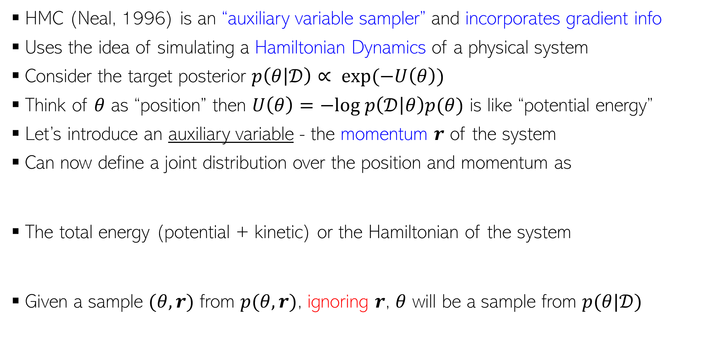
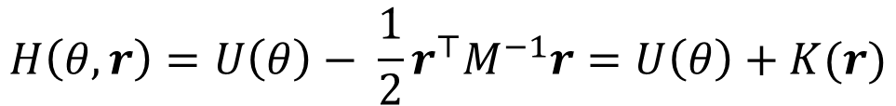
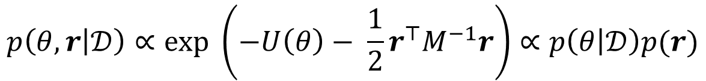
Hamiltonian/Hybrid Monte Carlo (HMC)
3
HMC (Neal, 1996) is an “auxiliary variable sampler” and incorporates gradient info
Uses the idea of simulating a Hamiltonian Dynamics of a physical system
Consider the target posterior $p\left(θ | 𝒟\right)∝ exp(−U\left(θ\right))$
Think of $θ$ as “position” then $U\left(θ\right)=−log p\left(𝒟 | θ\right)p(θ)$ is like “potential energy”
Let’s introduce an auxiliary variable - the momentum $r$ of the system
Can now define a joint distribution over the position and momentum as
The total energy (potential + kinetic) or the Hamiltonian of the system
Given a sample $(θ,r)$ from $p(θ,r)$, ignoring $r$, $θ$ will be a sample from $p(θ|𝒟)$
$$p\left(θ, r | 𝒟\right)∝exp \left(−U\left(θ\right)− \frac{1}{2}r^{⊤}M^{−1}r\right)∝p\left(θ | 𝒟\right)p(r)$$
Constant w.r.t. time
$$H\left(θ,r\right)=U\left(θ\right)− \frac{1}{2}r^{⊤}M^{−1}r=U\left(θ\right)+K(r)$$

Slide 4
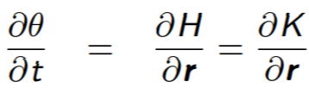



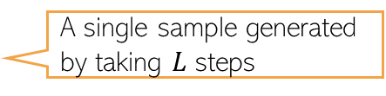
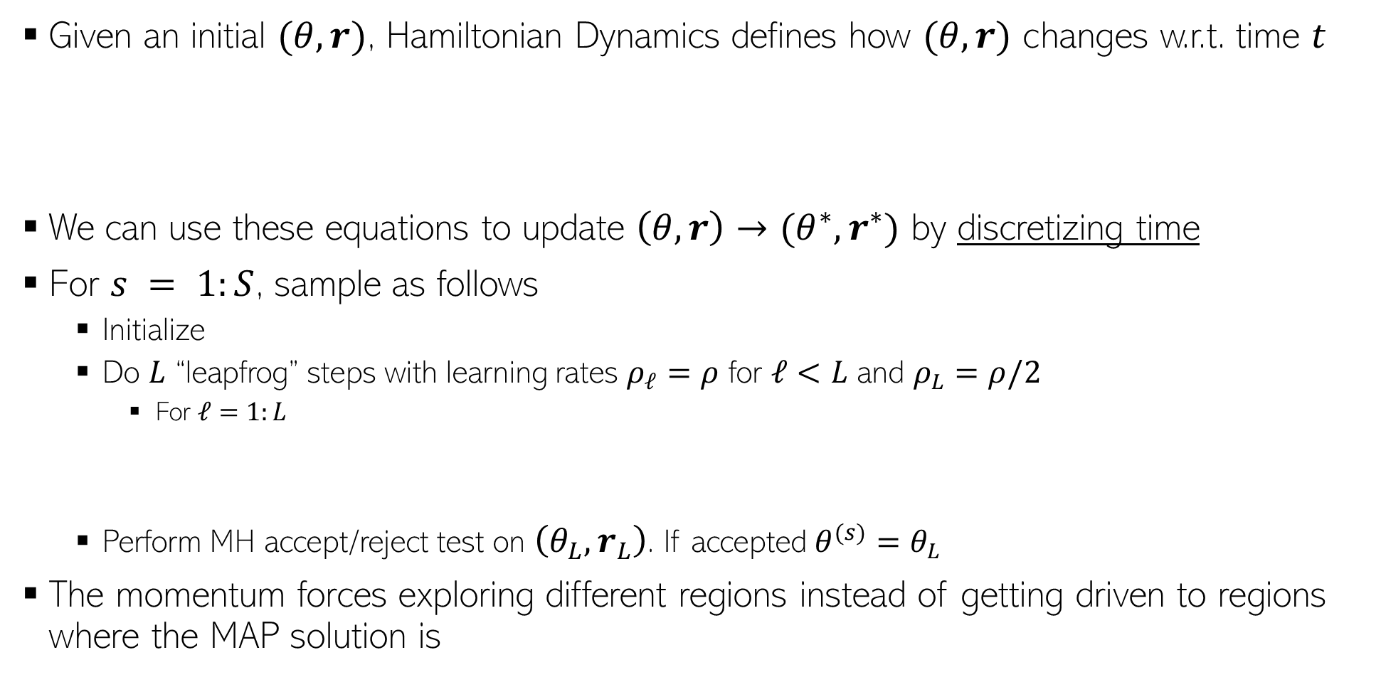
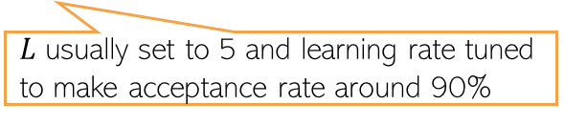
Generating Samples in HMC
4
Given an initial $(θ,r)$, Hamiltonian Dynamics defines how $(θ,r)$ changes w.r.t. time $t$
We can use these equations to update $\left(θ,r\right)→(θ^{∗},r^{∗})$ by discretizing time
For $s = 1:S$, sample as follows
  Initialize
  Do $L$ “leapfrog” steps with learning rates $ρ_{ℓ}=ρ$ for $ℓ<L$ and $ρ_{L}=ρ/2$
    For $ℓ=1:L$
  Perform MH accept/reject test on $\left(θ_{L},r_{L}\right)$. If accepted $θ^{(s)}=θ_{L}$
The momentum forces exploring different regions instead of getting driven to regions where the MAP solution is
Reason: Getting analytical solutions for the above requires integrals which is in general intractable
$L$ usually set to 5 and learning rate tuned to make acceptance rate around 90%
A single sample generated by taking $L$ steps

Slide 5
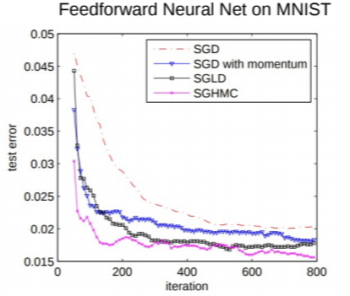
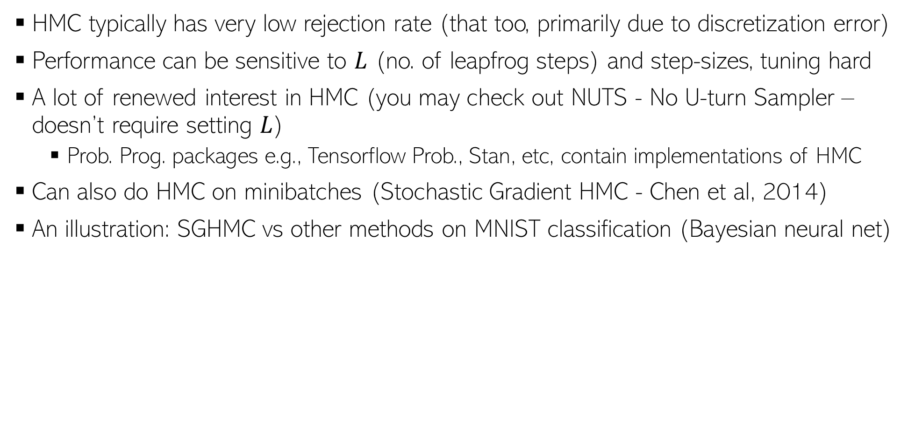
HMC in Practice
5
HMC typically has very low rejection rate (that too, primarily due to discretization error)
Performance can be sensitive to $L$ (no. of leapfrog steps) and step-sizes, tuning hard
A lot of renewed interest in HMC (you may check out NUTS - No U-turn Sampler – doesn’t require setting $L$)
  Prob. Prog. packages e.g., Tensorflow Prob., Stan, etc, contain implementations of HMC
Can also do HMC on minibatches (Stochastic Gradient HMC - Chen et al, 2014)
An illustration: SGHMC vs other methods on MNIST classification (Bayesian neural net)

Slide 6
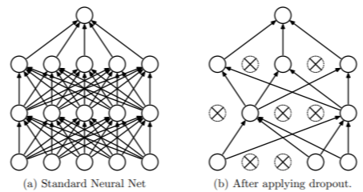
Efficient Posterior approx. for Bayesian Neural Nets
6
Monte Carlo Dropout is another popular and efficient way
Standard Dropout
  Drop some weights randomly (with some “drop” probability) during training
  At test time, multiply each weight by the “keep” probability
  Note: Dropout applied only at training time
Monte Carlo Dropout* (dropout also at test time)
Can be seen as learning a variational approximation of the weights (see paper for details, if interested)
$$p\left(y_{∗} | x_{∗},𝒟\right)≈ \frac{1}{S}\sum_{s=1}^{S}{p(y_{∗}|x_{∗},θ^{\left(s\right)}})$$
$$p\left(y_{∗} | x_{∗},𝒟\right)≈ \frac{1}{S}\sum_{s=1}^{S}{p(y_{∗}|x_{∗},θ^{\left(s\right)}})$$
where $θ^{(s)}=ε^{(s)}⊙ \hat{θ}$
where $θ^{(s)}∼p(θ|𝒟)$
Vector of Bernoulli or Gaussian noise
Point estimate
Elementwise product
*Dropout as a Bayesian Approximation: Representing Model Uncertainty in Deep Learning (Gal and Ghahramani, 2016)

Slide 7
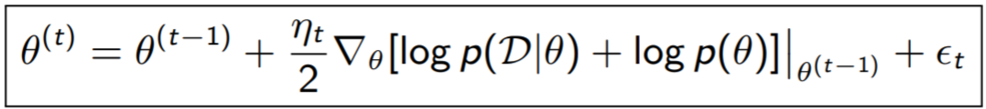
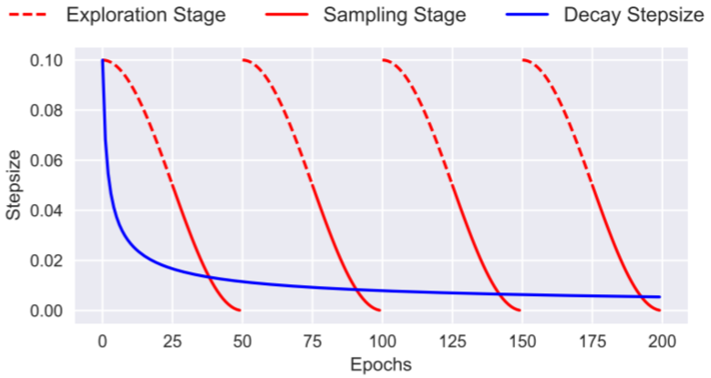
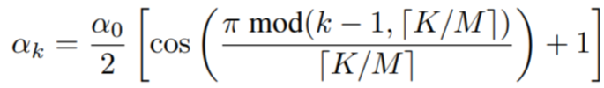
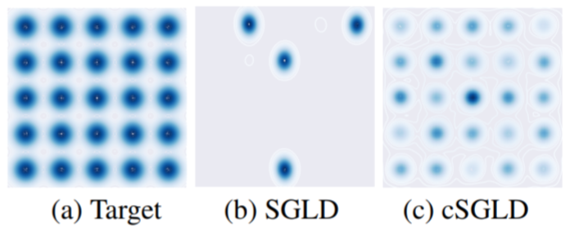
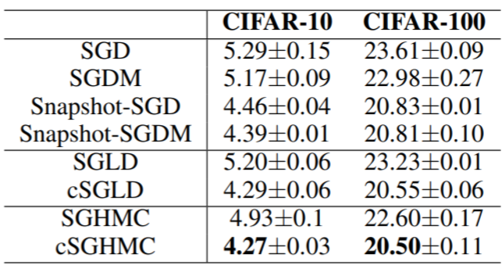
Efficient Posterior approx. for Bayesian Neural Nets
7
SGMCMC methods like SGLD and SGHMC are also used nowadays (very efficient)
Recently, SGMCMC with cyclic step sizes (cSGLD) was proposed (Zhang et al, 2020)
  Use big steps to explore different modes
  Use small steps later to sample once a mode is localized
Step size in iteration $k$
$K$ is the total number of iterations and $M$ is the number of cycles
A complex mixture of Gaussian distributions
Pic from: *Cyclical Stochastic Gradient MCMC for Bayesian Deep Learning (Zhang et al, 2020)

Slide 8
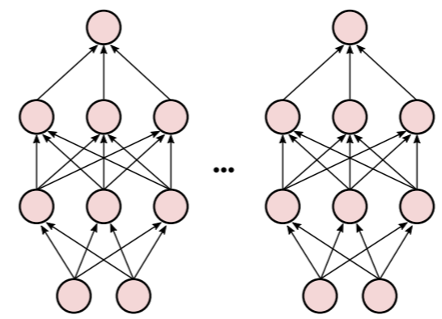
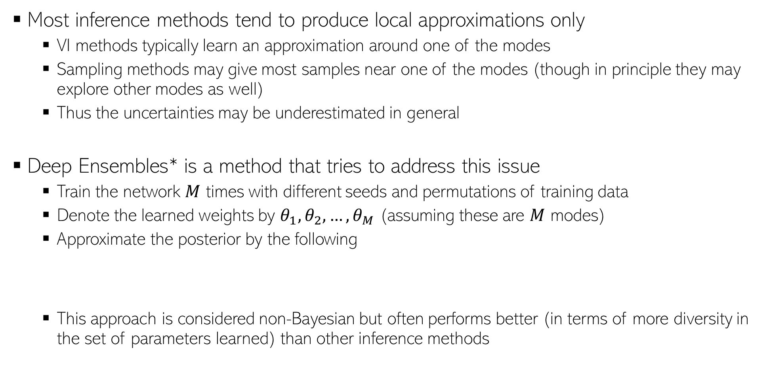
Deep Ensembles
8
Both VI and Sampling may be prone to capturing only a single “Basin of attraction”
Most inference methods tend to produce local approximations only
  VI methods typically learn an approximation around one of the modes
  Sampling methods may give most samples near one of the modes (though in principle they may explore other modes as well)
  Thus the uncertainties may be underestimated in general
Deep Ensembles* is a method that tries to address this issue
  Train the network $M$ times with different seeds and permutations of training data
  Denote the learned weights by $θ_{1},θ_{2},…, θ_{M}$ (assuming these are $M$ modes)
  Approximate the posterior by the following
  This approach is considered non-Bayesian but often performs better (in terms of more diversity in the set of parameters learned) than other inference methods
$$p\left(θ | 𝒟\right)= \frac{1}{M}\sum_{m=1}^{M}{δ_{θ_{m}}(θ)}$$
Akin to Bayesian Model Averaging using $M$ models
*Simple and Scalable Predictive Uncertainty Estimation using Deep Ensembles (Lakshminarayanan, 2017)

Slide 9
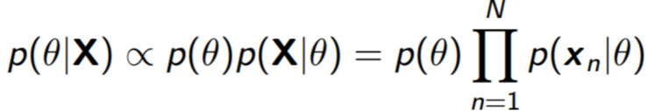
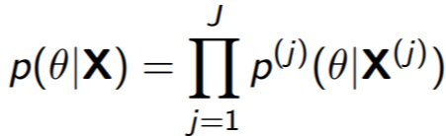

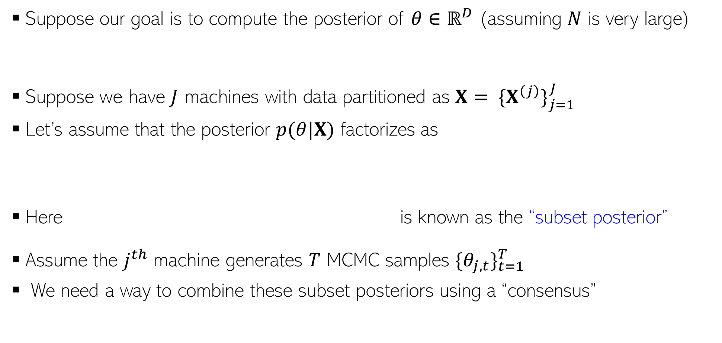
Parallel/Distributed MCMC
9
Suppose our goal is to compute the posterior of $θ∈ℝ^{D}$ (assuming $N$ is very large)
Suppose we have $J$ machines with data partitioned as $X= {\{X^{\left(j\right)}\}}_{j=1}^{J}$
Let’s assume that the posterior $p(θ|X)$ factorizes as
Here is known as the “subset posterior”
Assume the $j^{th}$ machine generates $T$ MCMC samples ${\{θ_{j,t}\}}_{t=1}^{T}$
We need a way to combine these subset posteriors using a “consensus”

Slide 10
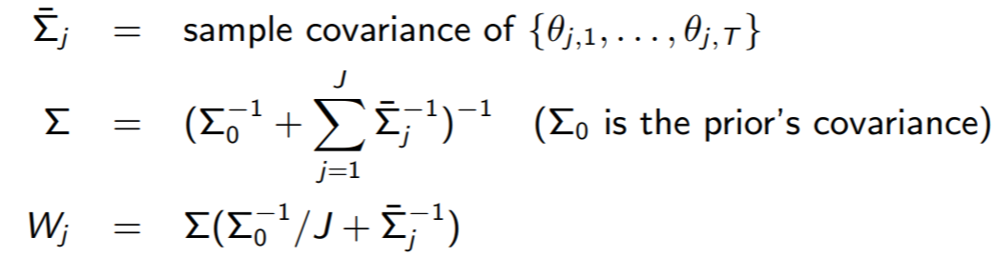

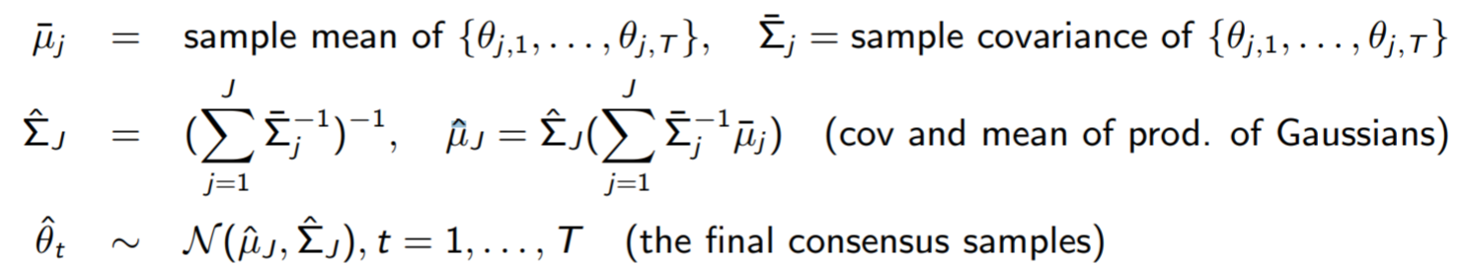
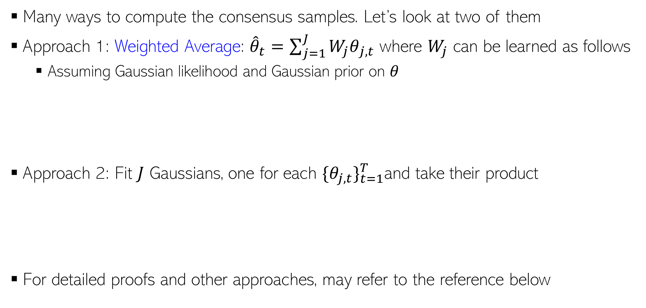
Parallel/Distributed MCMC
10
Many ways to compute the consensus samples. Let’s look at two of them
Approach 1: Weighted Average: ${\hat{θ}}_{t}=\sum_{j=1}^{J}{{W_{j}θ}_{j,t}}$ where $W_{j}$ can be learned as follows
  Assuming Gaussian likelihood and Gaussian prior on $θ$
Approach 2: Fit $J$ Gaussians, one for each ${\{θ_{j,t}\}}_{t=1}^{T}$and take their product
For detailed proofs and other approaches, may refer to the reference below
These approaches can also be used to make VI parallel/distributed
Patterns of Scalable Bayesian Inference (Angelino et al, 2016)

Slide 11
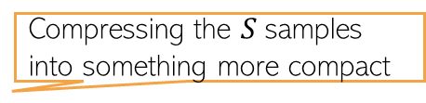
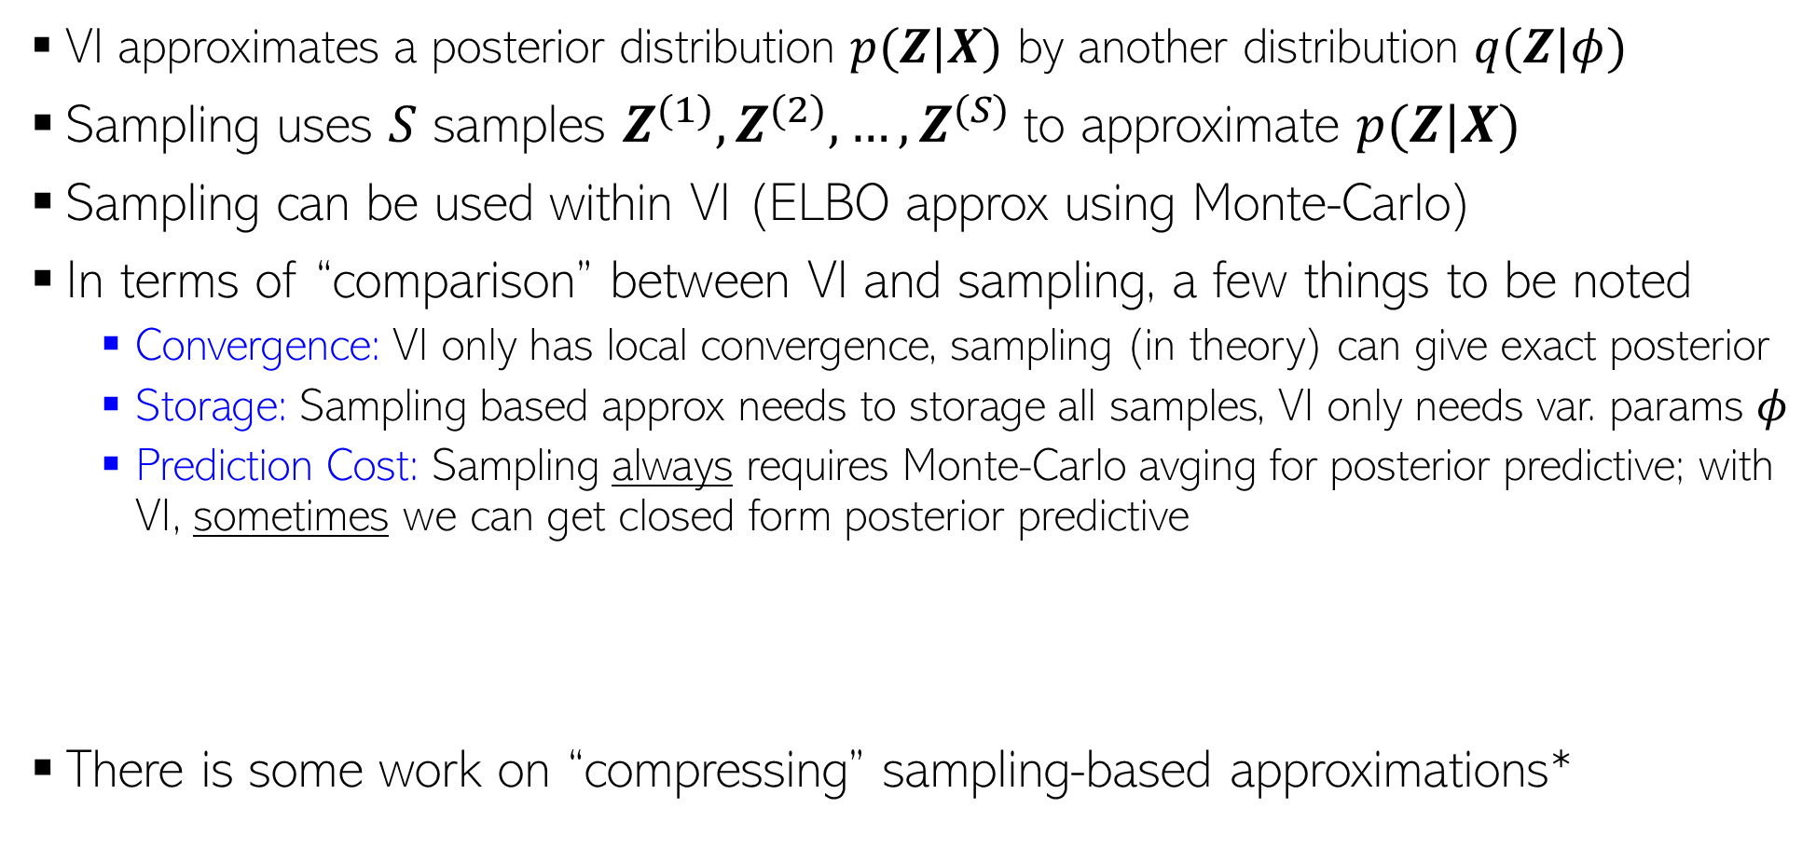

Approximate Inference: VI vs Sampling
11
VI approximates a posterior distribution $p(Z|X)$ by another distribution $q(Z|φ)$
Sampling uses $S$ samples $Z^{(1)},Z^{(2)},…,Z^{(S)}$to approximate $p(Z|X)$
Sampling can be used within VI (ELBO approx using Monte-Carlo)
In terms of “comparison” between VI and sampling, a few things to be noted
  Convergence: VI only has local convergence, sampling (in theory) can give exact posterior
  Storage: Sampling based approx needs to storage all samples, VI only needs var. params $φ$
  Prediction Cost: Sampling always requires Monte-Carlo avging for posterior predictive; with VI, sometimes we can get closed form posterior predictive
There is some work on “compressing” sampling-based approximations*
Closed form if integral is tractable (otherwise Monte Carlo avg still needed for PPD)
PPD if using sampling:
$$p\left(x_{∗} | X\right)=∫p\left(x_{∗} | Z\right)p\left(Z | X\right)dZ≈\frac{1}{S}\sum_{s=1}^{S}{p\left(x_{∗} | Z^{\left(s\right)}\right)}$$
PPD if using VI:
$$p\left(x_{∗} | X\right)=∫p\left(x_{∗} | Z\right)p\left(Z | X\right)dZ≈∫p\left(x_{∗} | Z\right)q\left(Z | φ\right)dZ$$
Compressing the $S$samples into something more compact
*”Compact approximations to Bayesian predictive distributions” by Snelson and Ghaharamani, 2005; and “Bayesian Dark Knowledge” by Korattikara et al, 2015

Slide 12
Inference Methods: Summary
12
MLE/MAP: Straightforward for differentiable models (can even use automatic diff.)
Conjugate models with one “main” parameter: Straightforward posterior updates
MLE-II/MAP-II: Often useful for estimating the hyperparameters
EM: If we want to do MLE/MAP for models with latent variables
  Very general algorithm, can also be made online
  Used when we want point estimates for some unknowns and posterior over others
  Can use it for hyperparameter estimation as well
  Often better than using direct gradient methods
VI and sampling methods can be used to get full posterior for complex models
  Quite easy if we have local conjugacy (VI has closed form updates, Gibbs sampler is easy to derive)
  In other cases, we have general VI with Monte-Carlo gradients, MH sampling
  MCMC can also make use of gradient info (LD/SGLD)
For large-scale problems, online/distributed VI/MCMC, or SGD based posterior approx

