Slide 1
Approximating Distributions via Sampling (contd)
CS772A: Probabilistic Machine Learning
Piyush Rai

Slide 2
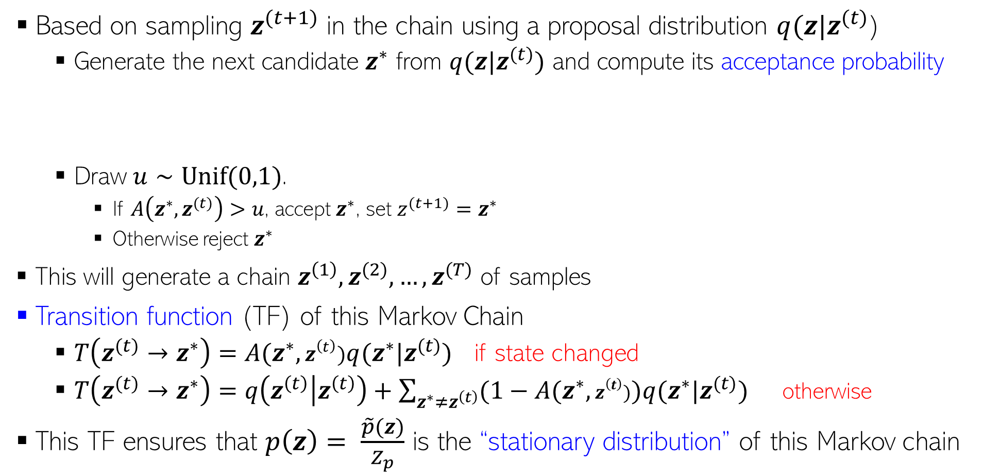
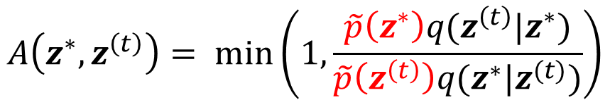
Recap: Metropolis-Hastings Sampling
2
Based on sampling $z^{(t+1)}$ in the chain using a proposal distribution $q(z|z^{(t)}$)
Generate the next candidate $z^{∗}$ from $q(z|z^{(t)})$ and compute its acceptance probability
Draw $u∼Unif(0,1)$.
If $A\left(z^{∗},z^{(t)}\right)>u$, accept $z^{∗}$, set $z^{(t+1)}=z^{∗}$
Otherwise reject $z^{∗}$
This will generate a chain $z^{\left(1\right)},z^{(2)}, …, z^{(T)}$ of samples
Transition function (TF) of this Markov Chain
$T\left(z^{(t)}→z^{∗}\right)=A(z^{∗},z^{\left(t\right)})q(z^{∗}|z^{(t)})$ if state changed
$T\left(z^{(t)}→z^{∗}\right)=q\left(z^{\left(t\right)} | z^{\left(t\right)}\right)+\sum_{z^{∗}≠z^{\left(t\right)}}{(1−A(z^{∗},z^{\left(t\right)}))q(z^{∗}|z^{(t)}) }$ otherwise
This TF ensures that $p\left(z\right)= \frac{\tilde{p}\left(z\right)}{Z_{p}}$ is the “stationary distribution” of this Markov chain
$$A\left(z^{∗},z^{\left(t\right)}\right)= min\left(1,\frac{\tilde{p}\left(z^{∗}\right)q(z^{\left(t\right)}|z^{∗})}{\tilde{p}\left(z^{\left(t\right)}\right)q(z^{∗}|z^{(t)})}\right)$$

Slide 3
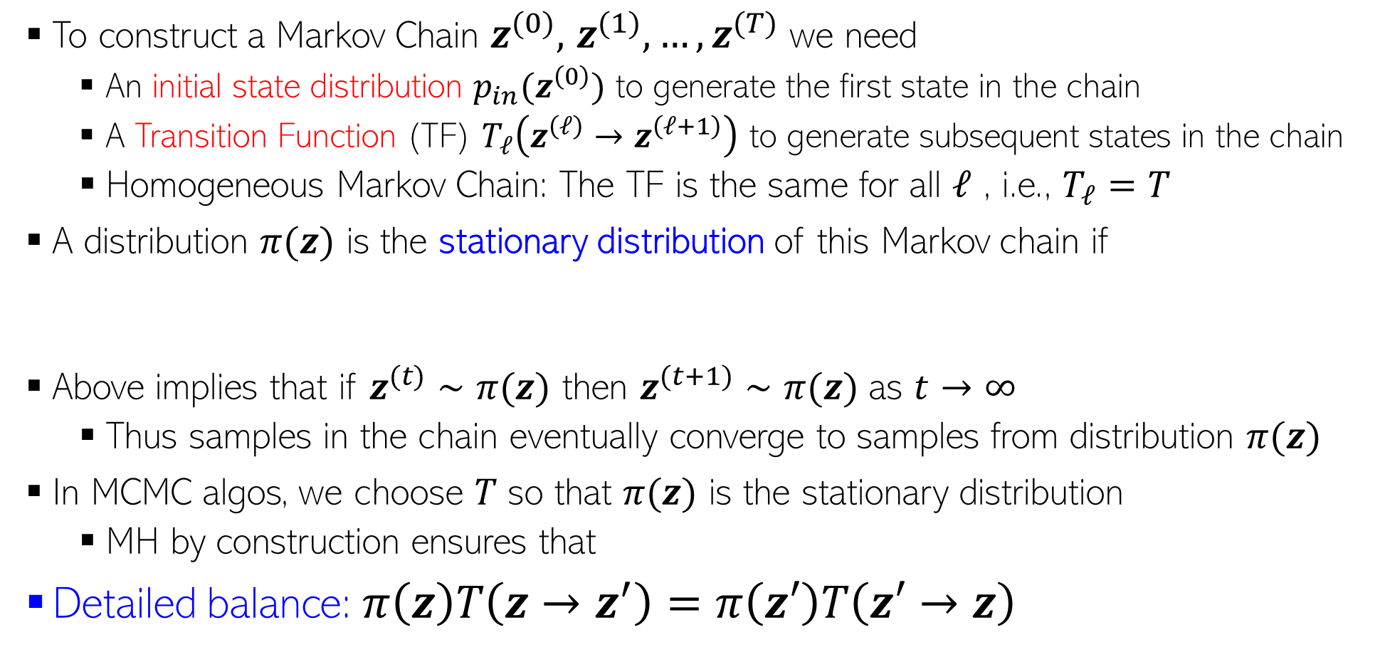

MCMC: A Little Bit of Theory
3
To construct a Markov Chain $z^{(0)},$ $z^{(1)},…,z^{(T)}$ we need
An initial state distribution $p_{in}(z^{\left(0\right)})$ to generate the first state in the chain
A Transition Function (TF) $T_{ℓ}\left(z^{\left(ℓ\right)}→z^{\left(ℓ+1\right)}\right)$ to generate subsequent states in the chain
Homogeneous Markov Chain: The TF is the same for all $ℓ$ , i.e., $T_{ℓ}=T$
A distribution $π(z)$ is the stationary distribution of this Markov chain if
Above implies that if $z^{(t)}∼π(z)$ then $z^{(t+1)}∼π(z)$ as $t→∞$
Thus samples in the chain eventually converge to samples from distribution $π(z)$
In MCMC algos, we choose 𝑇 so that $π(z)$ is the stationary distribution
MH by construction ensures that
Detailed balance: $π\left(z\right)T\left(z→z^{′}\right)=π\left(z′\right)T\left(z′→z\right)$
$$π\left(z^{′}\right)=∫π\left(z\right)T\left(z→z^{′}\right)dz$$
MH transition function ensures detailed balance too
Note: Detailed balance is a sufficient but not necessary for stationary distribution to exist

Slide 4
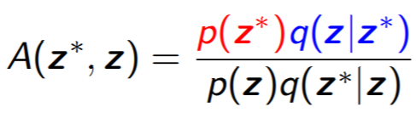
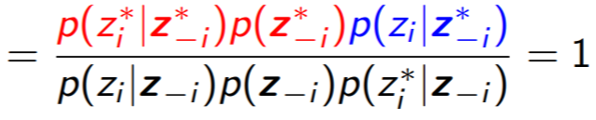
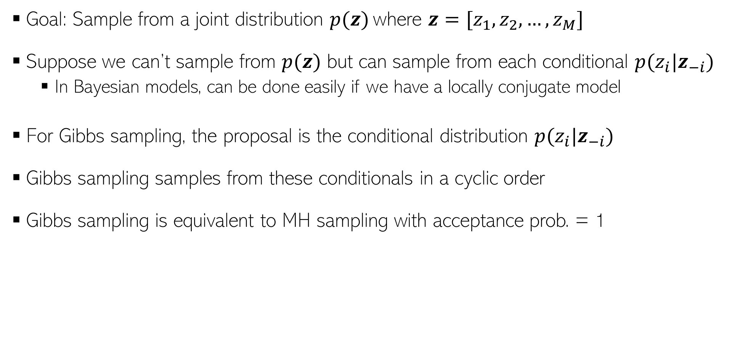
A Special Case of MH: Gibbs Sampling
4
Goal: Sample from a joint distribution $p(z)$ where $z=[z_{1},z_{2},…, z_{M}]$
Suppose we can’t sample from $p(z)$ but can sample from each conditional $p(z_{i}|z_{−i})$
In Bayesian models, can be done easily if we have a locally conjugate model
For Gibbs sampling, the proposal is the conditional distribution $p(z_{i}|z_{−i})$
Gibbs sampling samples from these conditionals in a cyclic order
Gibbs sampling is equivalent to MH sampling with acceptance prob. = 1
Hence no need to compute it
Since only one component is changed at a time

Slide 5
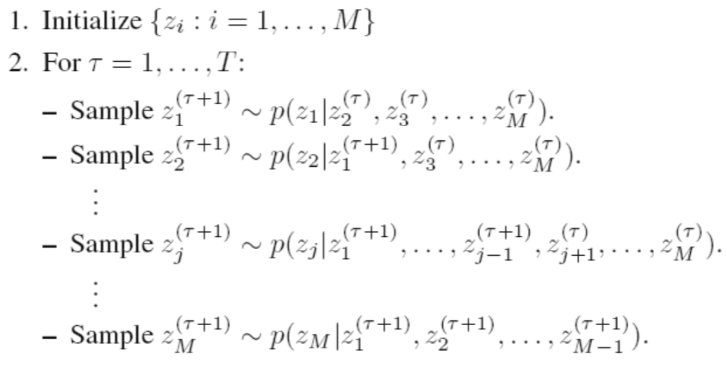

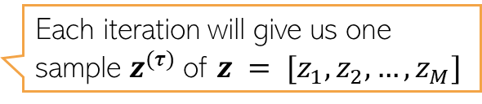

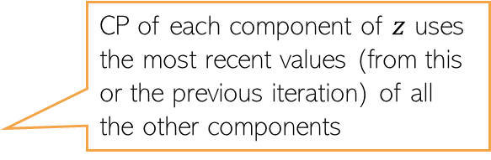
Gibbs Sampling: Sketch of the Algorithm
5
$M$: Total number of variables, $T$: number of Gibbs sampling iterations
Note: Order of updating the variables usually doesn’t matter (but see “Scan Order in Gibbs Sampling: Models in Which it Matters and Bounds on How Much” from NIPS 2016)
Assuming $z = [z_{1}, z_{2}, …, z_{M}]$
CP of each component of $z$ uses the most recent values (from this or the previous iteration) of all the other components
Each iteration will give us one sample $z^{(τ)}$of $z = [z_{1}, z_{2}, …, z_{M}]$

Slide 6
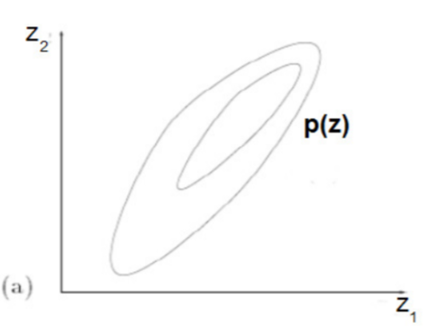
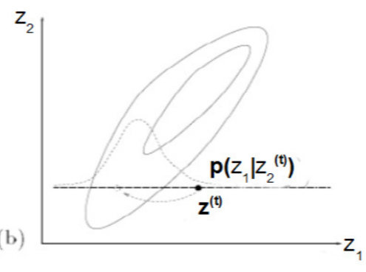
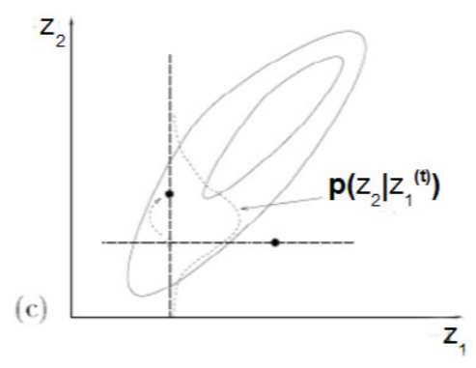
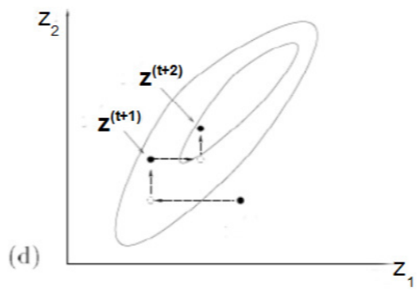
Gibbs Sampling: A Simple Example
6
Can sample from a 2-D Gaussian using 1-D Gaussians
Contours of a 2-D Gaussian
Conditional distribution of $z_{1}$ given $z_{2}$ is Gaussian
Conditional distribution of $z_{2}$ given $z_{1}$ is Gaussian
Gibbs sampling looks like doing a co-ordinate-wise update to generate each successive sample of $z=[z_{1},z_{2}]$

Slide 7
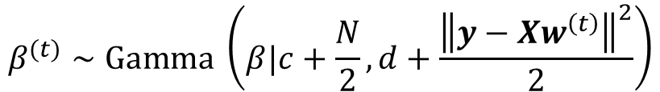
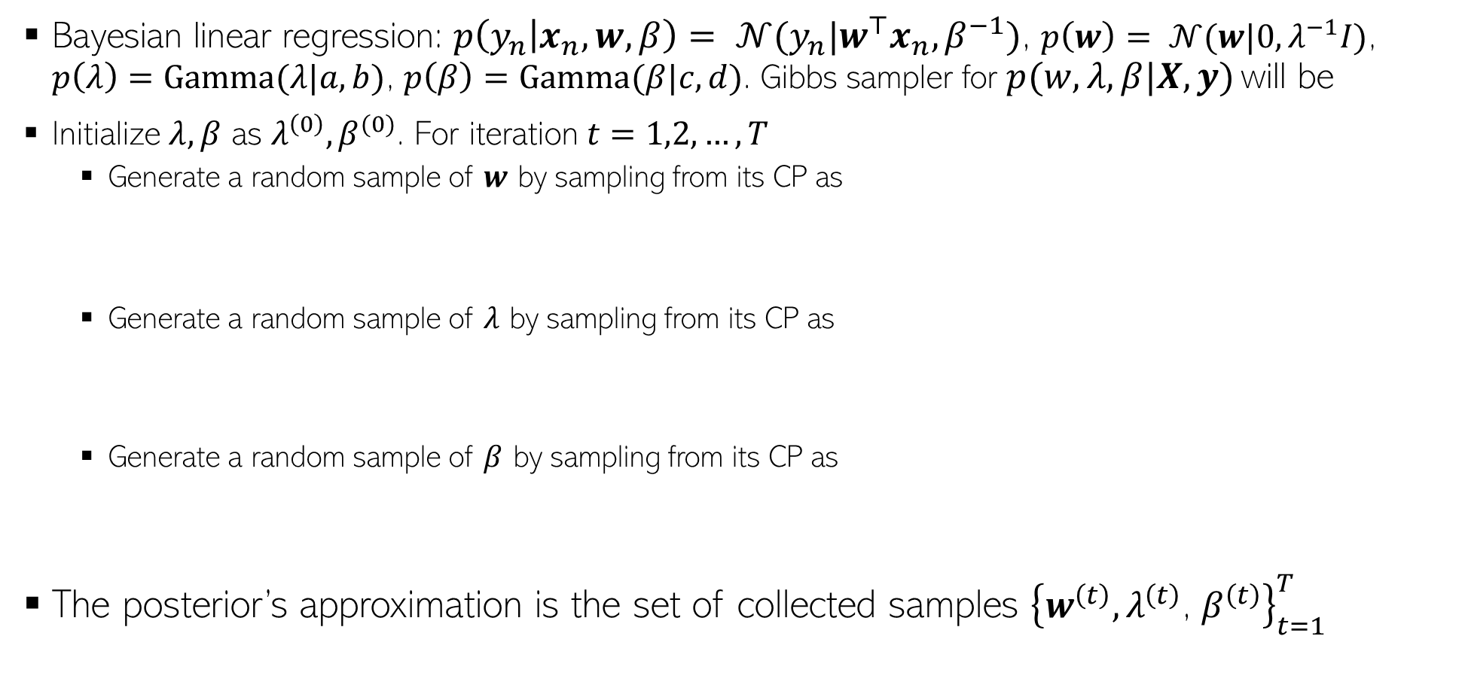
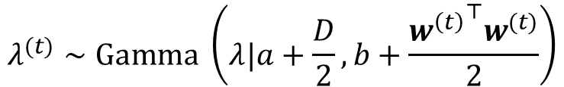
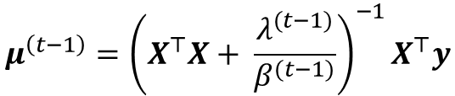


Gibbs Sampling: Another Example
7
Bayesian linear regression: $p\left(y_{n} | x_{n},w,β\right)= 𝒩(y_{n}|w^{⊤}x_{n},β^{−1})$, $p\left(w\right)= 𝒩(w|0,λ^{−1}I)$, $p\left(λ\right)=Gamma(λ|a,b)$, $p\left(β\right)=Gamma(β|c,d)$. Gibbs sampler for $p(w,λ, β|X,y)$ will be
Initialize $λ, β$ as $λ^{\left(0\right)},β^{(0)}$. For iteration $t=1,2,…, T$
Generate a random sample of $w$ by sampling from its CP as
Generate a random sample of $λ$ by sampling from its CP as
Generate a random sample of $β$ by sampling from its CP as
The posterior’s approximation is the set of collected samples ${\left\{w^{\left(t\right)},λ^{\left(t\right)}\text{,} β^{\left(t\right)}\right\}}_{t=1}^{T}$
$$Σ^{\left(t−1\right)}={\left(β^{(t−1)}X^{⊤}X+λ^{(t−1)}\right)}^{−1}$$
$$w^{(t)}∼𝒩(w|μ^{\left(t−1\right)},Σ^{(t−1)})$$
where
$$μ^{\left(t−1\right)}={\left(X^{⊤}X+ \frac{λ^{(t−1)}}{β^{(t−1)}}\right)}^{−1}X^{⊤}y$$
$$λ^{(t)}∼Gamma \left(λ|a+\frac{D}{2},b+\frac{{w^{\left(t\right)}}^{⊤}w^{(t)}}{2}\right)$$
$$β^{(t)}∼Gamma \left(β|c+\frac{N}{2},d+\frac{{\left\|y−Xw^{\left(t\right)}\right\|}^{2}}{2}\right)$$
Note: Assuming these are post-burn-in samples and thinning (if any) is also considered

Slide 8
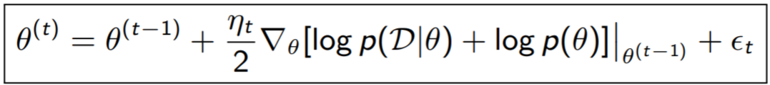

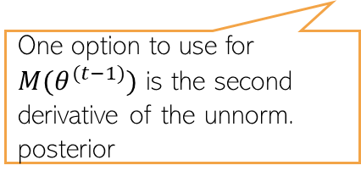



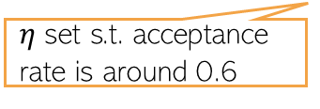

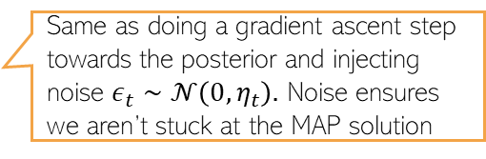
Using Gradients in MCMC: Langevin Dynamics
8
MCMC uses a random-walk based proposal to generate the next sample, e.g.,
Langevin dynamics: Use (unnormalized) posterior’s gradient info in the proposal as
Note that the above is equivalent to
After some waiting period $T_{0}$, iterates ${\left\{θ^{(t)}\right\}}_{t=T_{0}+1}^{T_{0}+S}$ are MCMC samples from $p(θ|𝒟)$
Will use $θ$ to denote all the unknowns
Can use automatic differentiation methods for this
And then accept/reject (MH)
$$θ^{(t)}∼𝒩(θ^{\left(t−1\right)},η_{t})$$
Likelihood
Prior
Move towards the mode of the posterior (like finding MAP est)
And then accept/reject (MH)
$$θ^{(t)}∼𝒩(θ^{∗},η_{t})$$
Same as doing a gradient ascent step towards the posterior and injecting noise $ε_{t}∼𝒩\left(0,η_{t}\right).$ Noise ensures we aren’t stuck at the MAP solution
Using gradient info in the proposal helps us move faster towards high-prob regions
$η$ set s.t. acceptance rate is around 0.6
Helps also incorporate the curvature info of the posterior
If gradient is pre-multiplied by a preconditioner matrix $M(θ^{(t−1)})$: Simplified Manifold MALA
And then accept/reject (MH)
One option to use for $M(θ^{(t−1)})$ is the second derivative of the unnorm. posterior
Known as Metropolis-Adjusted Langevin Algorithm (MALA)
“Bayesian Learning via Stochastic Gradient Langevin Dynamics” by Welling and Teh (2011)

Slide 9
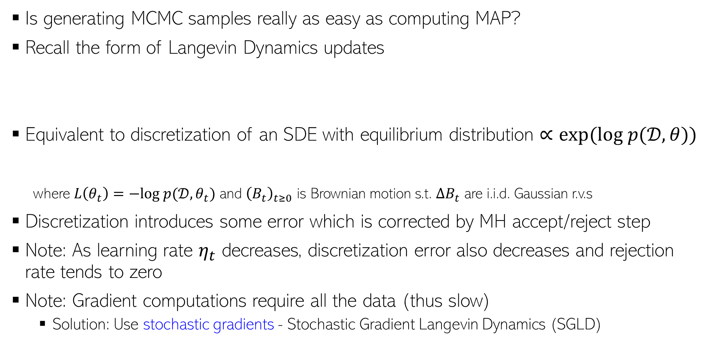

Langevin Dynamics: A Closer Look
9
Is generating MCMC samples really as easy as computing MAP?
Recall the form of Langevin Dynamics updates
Equivalent to discretization of an SDE with equilibrium distribution $∝exp(log p(𝒟,θ))$
where $L\left(θ_{t}\right)=−log p(𝒟,θ_{t})$ and ${\left(B_{t}\right)}_{t≥0}$ is Brownian motion s.t. $ΔB_{t}$ are i.i.d. Gaussian r.v.s
Discretization introduces some error which is corrected by MH accept/reject step
Note: As learning rate $η_{t}$ decreases, discretization error also decreases and rejection rate tends to zero
Note: Gradient computations require all the data (thus slow)
Solution: Use stochastic gradients - Stochastic Gradient Langevin Dynamics (SGLD)
And then accept/reject (MH)
Same as our target posterior
Above update is its discretization
Note that this is continuous time
$$dθ_{t}=−∇L\left(θ_{t}\right)dt+ \sqrt{2}dB_{t}$$

Slide 10
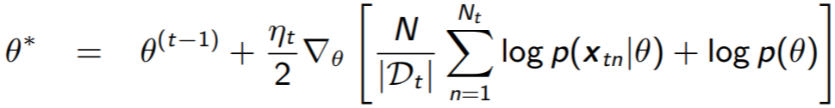
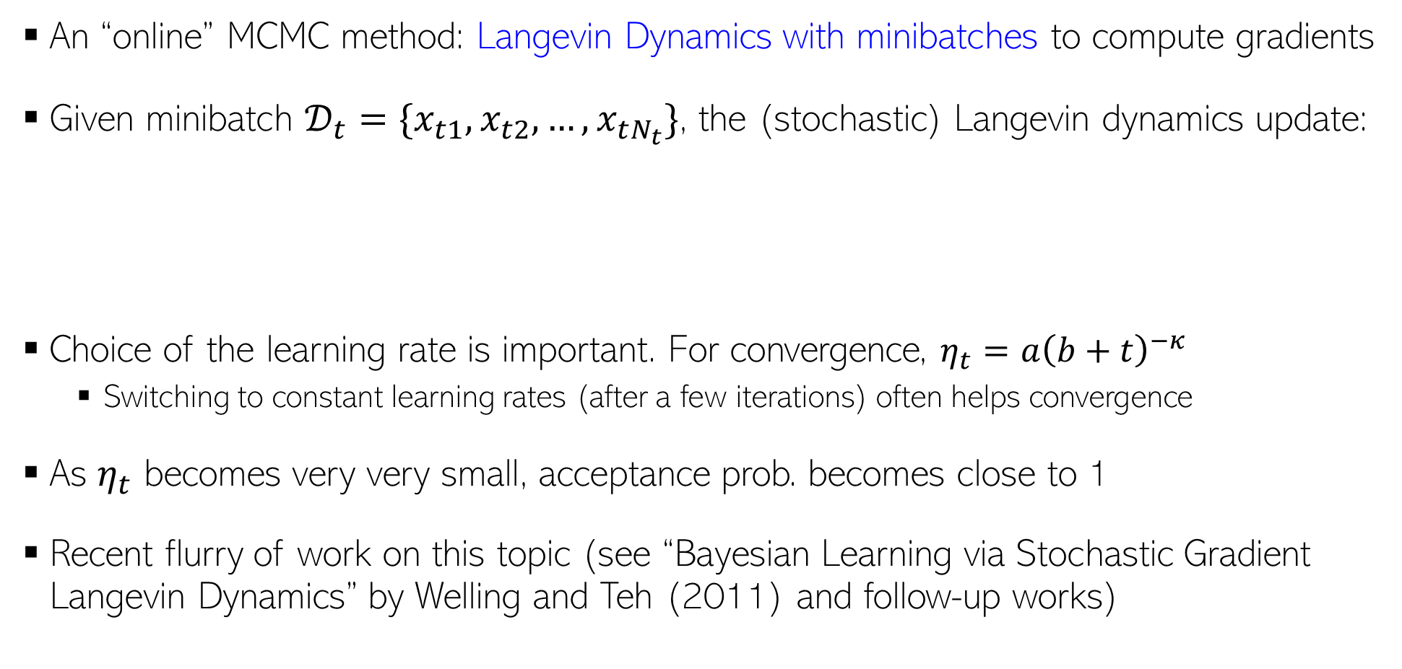

Stochastic Gradient Langevin Dynamics (SGLD)
10
An “online” MCMC method: Langevin Dynamics with minibatches to compute gradients
Given minibatch $𝒟_{t}=\{x_{t1},x_{t2}, …, x_{tN_{t}}\}$, the (stochastic) Langevin dynamics update:
Choice of the learning rate is important. For convergence, $η_{t}=a{\left(b+t\right)}^{−κ}$
Switching to constant learning rates (after a few iterations) often helps convergence
As $η_{t}$ becomes very very small, acceptance prob. becomes close to 1
Recent flurry of work on this topic (see “Bayesian Learning via Stochastic Gradient Langevin Dynamics” by Welling and Teh (2011) and follow-up works)
Almost as fast as doing SGD updates ☺
And then accept/reject (MH)
$$θ^{(t)}∼𝒩(θ^{∗},η_{t})$$
No need for accept/reject (MH)

Slide 11
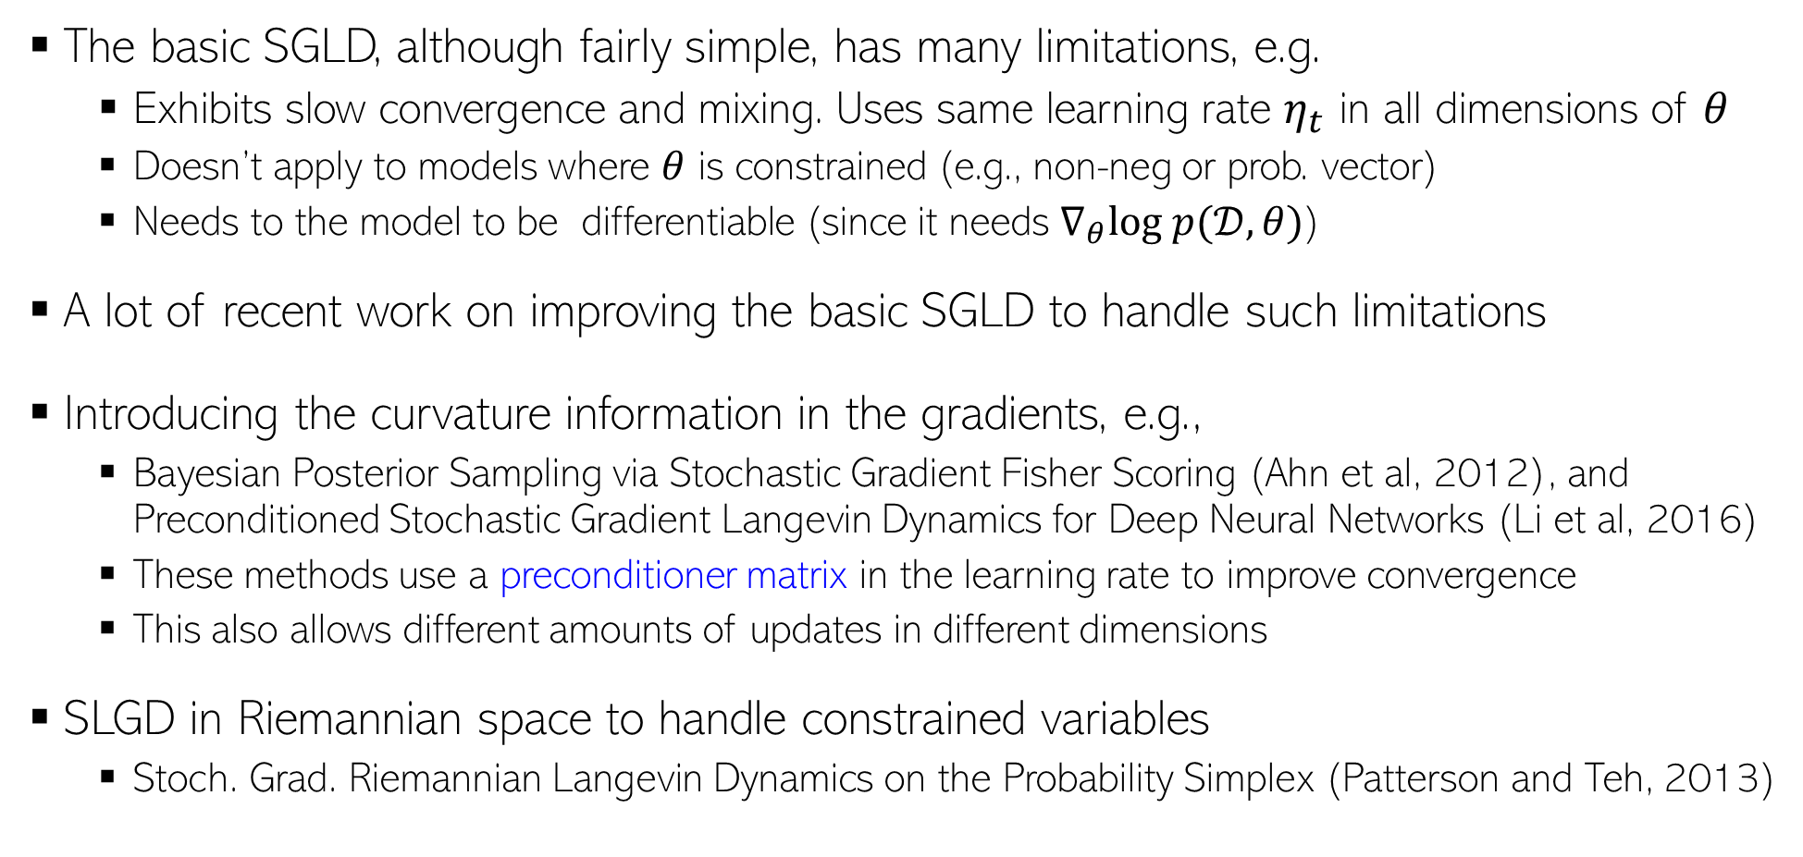
Improvements to SGLD
11
The basic SGLD, although fairly simple, has many limitations, e.g.
Exhibits slow convergence and mixing. Uses same learning rate $η_{t}$ in all dimensions of $θ$
Doesn’t apply to models where $θ$ is constrained (e.g., non-neg or prob. vector)
Needs to the model to be differentiable (since it needs $∇_{θ}log p(𝒟,θ)$)
A lot of recent work on improving the basic SGLD to handle such limitations
Introducing the curvature information in the gradients, e.g.,
Bayesian Posterior Sampling via Stochastic Gradient Fisher Scoring (Ahn et al, 2012), and Preconditioned Stochastic Gradient Langevin Dynamics for Deep Neural Networks (Li et al, 2016)
These methods use a preconditioner matrix in the learning rate to improve convergence
This also allows different amounts of updates in different dimensions
SLGD in Riemannian space to handle constrained variables
Stoch. Grad. Riemannian Langevin Dynamics on the Probability Simplex (Patterson and Teh, 2013)
Based on reparametrizing the constrained variables to make them unconstrainted

Slide 12
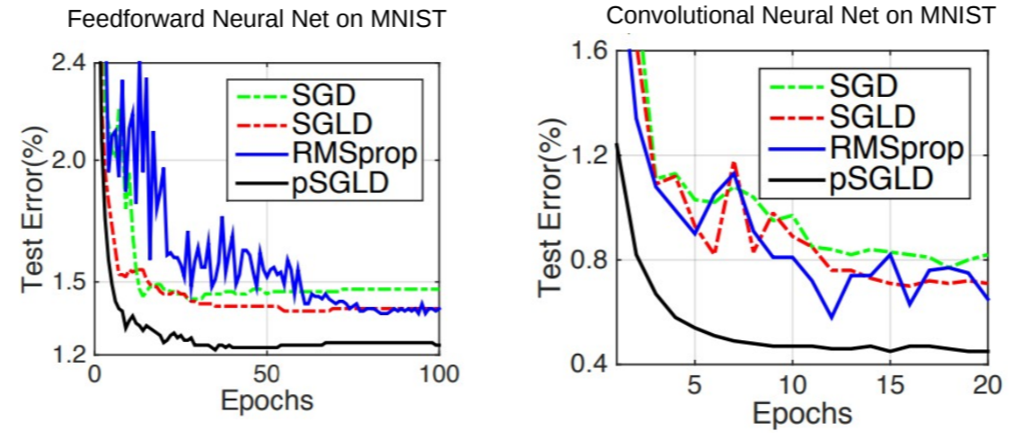
Applications of SGLD
12
Popular for Bayesian neural networks and other complex Bayesian models
Reason: SGLD = backprop based updates + Gaussian noise

Slide 13
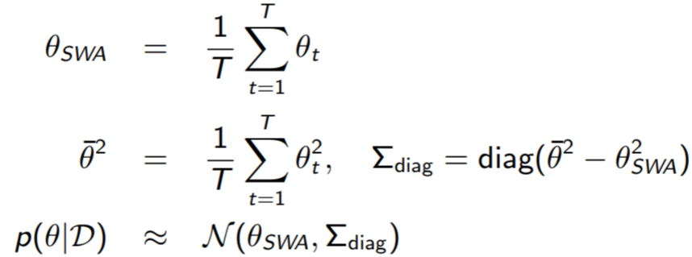
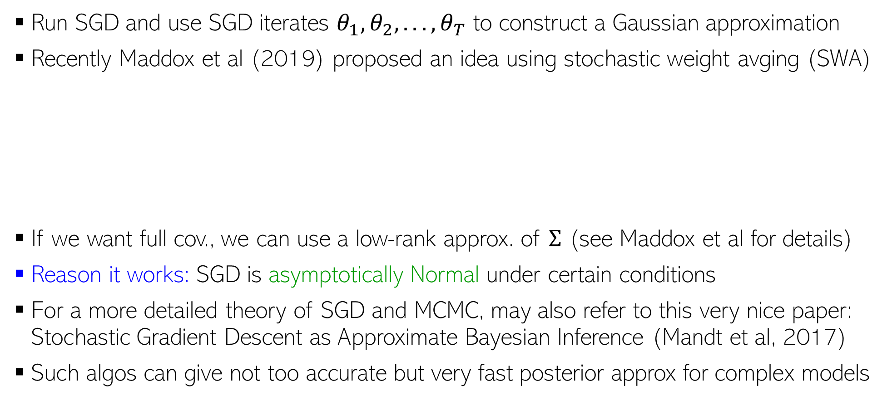
Other Recent “SGD-inspired” Sampling Algorithms
13
Run SGD and use SGD iterates $θ_{1}, θ_{2}, . . . , θ_{T}$ to construct a Gaussian approximation
Recently Maddox et al (2019) proposed an idea using stochastic weight avging (SWA)
If we want full cov., we can use a low-rank approx. of $Σ$ (see Maddox et al for details)
Reason it works: SGD is asymptotically Normal under certain conditions
For a more detailed theory of SGD and MCMC, may also refer to this very nice paper: Stochastic Gradient Descent as Approximate Bayesian Inference (Mandt et al, 2017)
Such algos can give not too accurate but very fast posterior approx for complex models
Approach known as SWA-Gaussian (SWAG)
A Simple Baseline for Bayesian Uncertainty in Deep Learning, Maddox et al (2019)

Slide 14
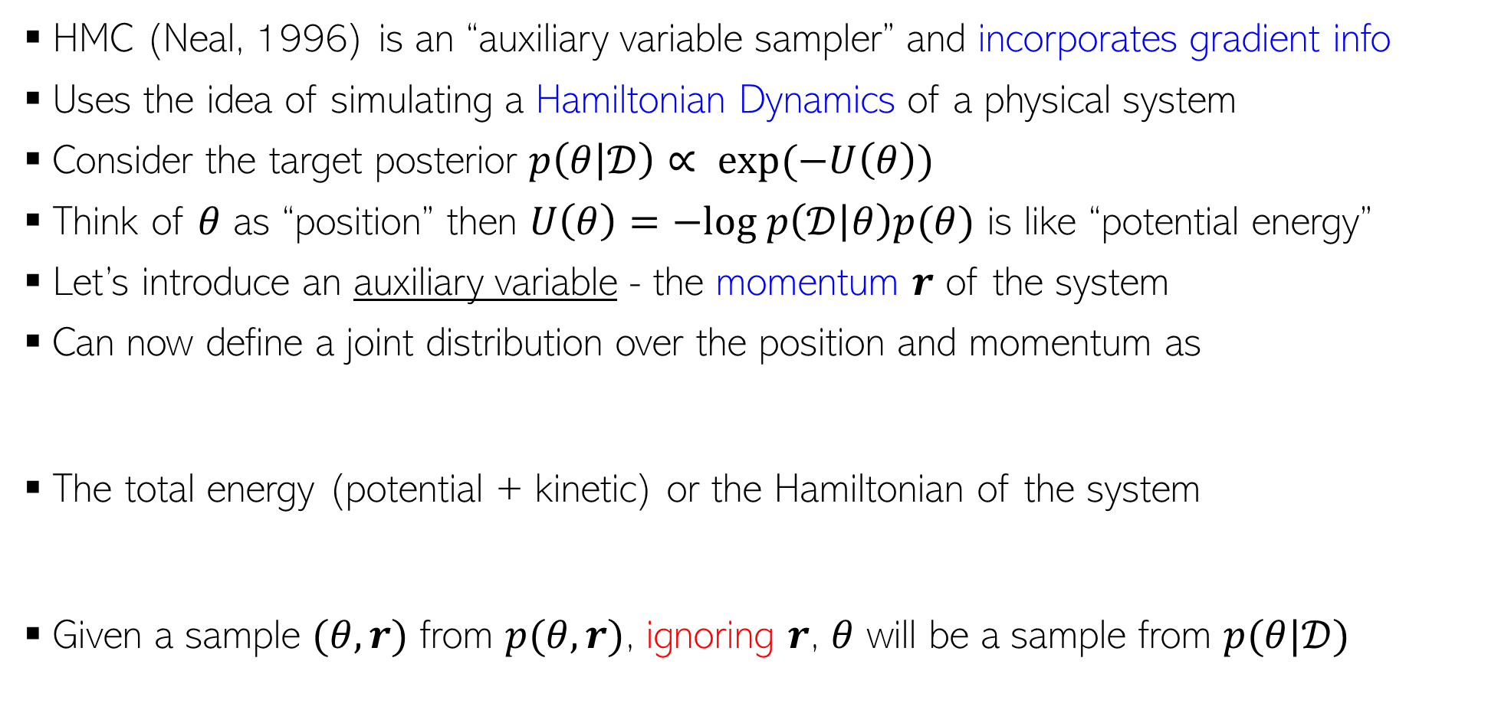
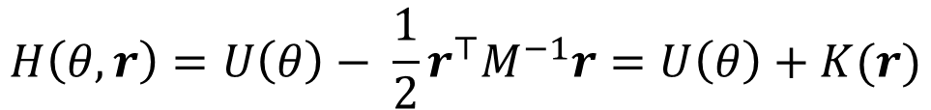
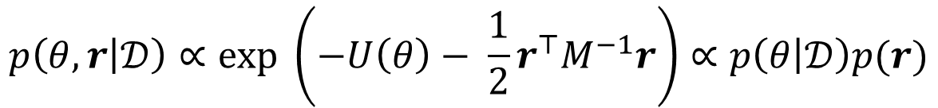
Hamiltonian/Hybrid Monte Carlo (HMC)
14
HMC (Neal, 1996) is an “auxiliary variable sampler” and incorporates gradient info
Uses the idea of simulating a Hamiltonian Dynamics of a physical system
Consider the target posterior $p\left(θ | 𝒟\right)∝ exp(−U\left(θ\right))$
Think of $θ$ as “position” then $U\left(θ\right)=−log p\left(𝒟 | θ\right)p(θ)$ is like “potential energy”
Let’s introduce an auxiliary variable - the momentum $r$ of the system
Can now define a joint distribution over the position and momentum as
The total energy (potential + kinetic) or the Hamiltonian of the system
Given a sample $(θ,r)$ from $p(θ,r)$, ignoring $r$, $θ$ will be a sample from $p(θ|𝒟)$
$$p\left(θ, r | 𝒟\right)∝exp \left(−U\left(θ\right)− \frac{1}{2}r^{⊤}M^{−1}r\right)∝p\left(θ | 𝒟\right)p(r)$$
Constant w.r.t. time
$$H\left(θ,r\right)=U\left(θ\right)− \frac{1}{2}r^{⊤}M^{−1}r=U\left(θ\right)+K(r)$$

Slide 15
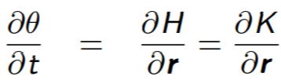



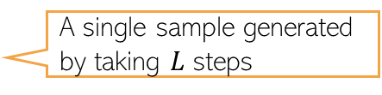
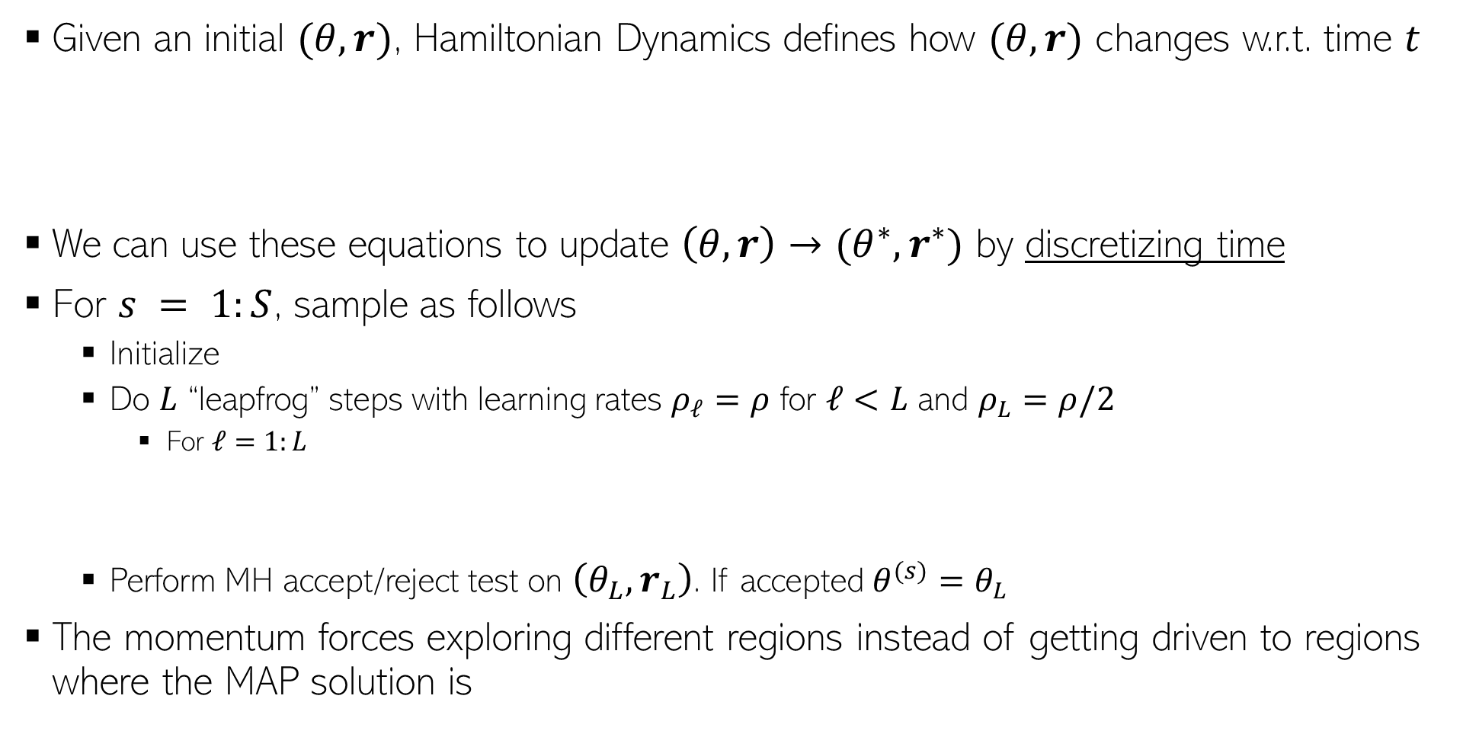
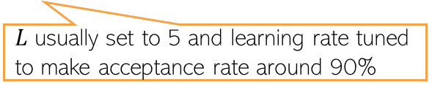
Generating Samples in HMC
15
Given an initial $(θ,r)$, Hamiltonian Dynamics defines how $(θ,r)$ changes w.r.t. time $t$
We can use these equations to update $\left(θ,r\right)→(θ^{∗},r^{∗})$ by discretizing time
For $s = 1:S$, sample as follows
Initialize
Do $L$ “leapfrog” steps with learning rates $ρ_{ℓ}=ρ$ for $ℓ<L$ and $ρ_{L}=ρ/2$
For $ℓ=1:L$
Perform MH accept/reject test on $\left(θ_{L},r_{L}\right)$. If accepted $θ^{(s)}=θ_{L}$
The momentum forces exploring different regions instead of getting driven to regions where the MAP solution is
Reason: Getting analytical solutions for the above requires integrals which is in general intractable
$L$ usually set to 5 and learning rate tuned to make acceptance rate around 90%
A single sample generated by taking $L$ steps

Slide 16
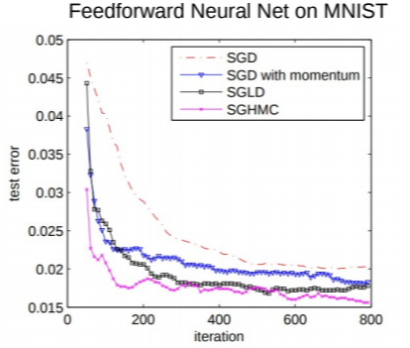
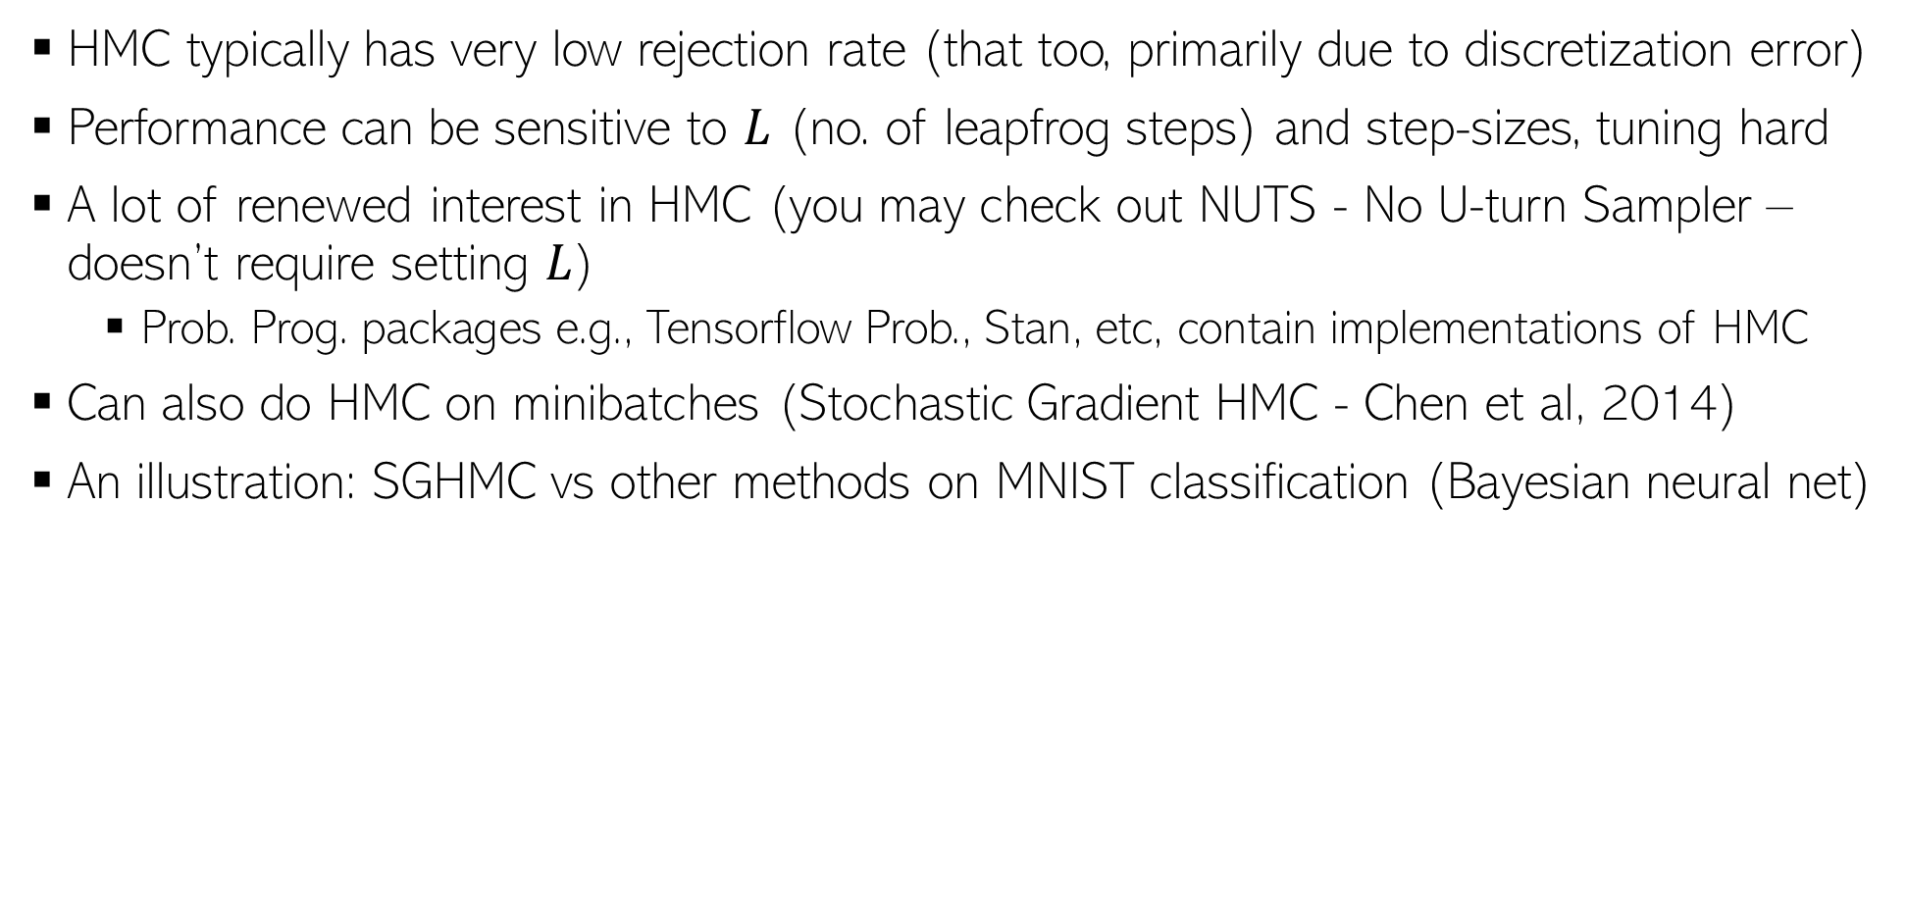
HMC in Practice
16
HMC typically has very low rejection rate (that too, primarily due to discretization error)
Performance can be sensitive to $L$ (no. of leapfrog steps) and step-sizes, tuning hard
A lot of renewed interest in HMC (you may check out NUTS - No U-turn Sampler – doesn’t require setting $L$)
Prob. Prog. packages e.g., Tensorflow Prob., Stan, etc, contain implementations of HMC
Can also do HMC on minibatches (Stochastic Gradient HMC - Chen et al, 2014)
An illustration: SGHMC vs other methods on MNIST classification (Bayesian neural net)

Slide 17
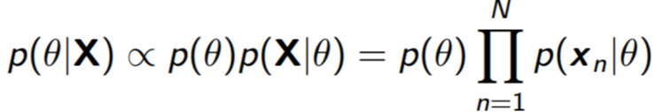
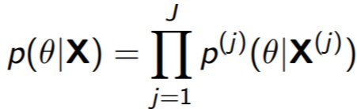

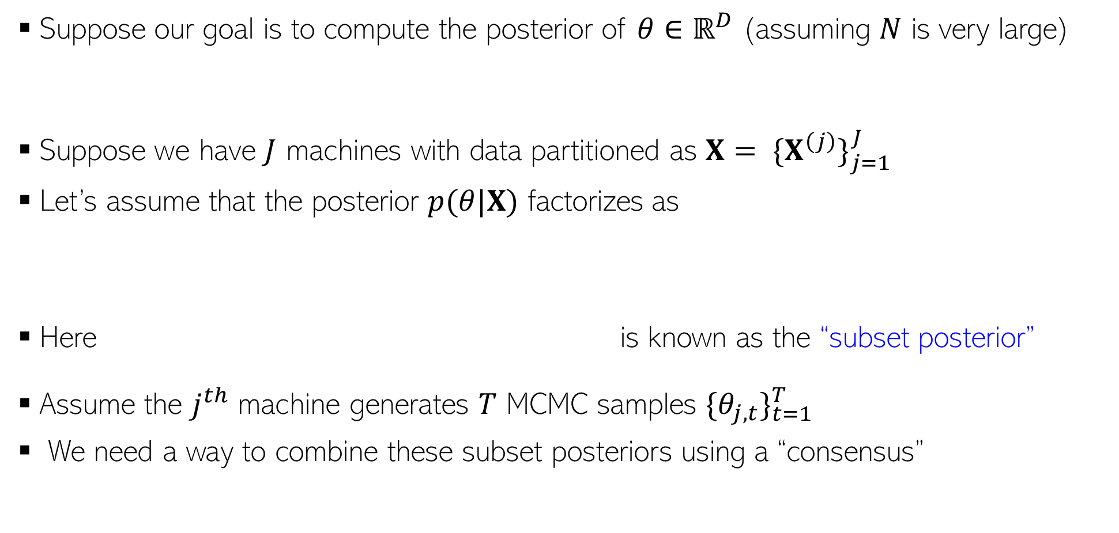
Parallel/Distributed MCMC
17
Suppose our goal is to compute the posterior of $θ∈ℝ^{D}$ (assuming $N$ is very large)
Suppose we have $J$ machines with data partitioned as $X= {\{X^{\left(j\right)}\}}_{j=1}^{J}$
Let’s assume that the posterior $p(θ|X)$ factorizes as
Here is known as the “subset posterior”
Assume the $j^{th}$ machine generates $T$ MCMC samples ${\{θ_{j,t}\}}_{t=1}^{T}$
We need a way to combine these subset posteriors using a “consensus”

Slide 18
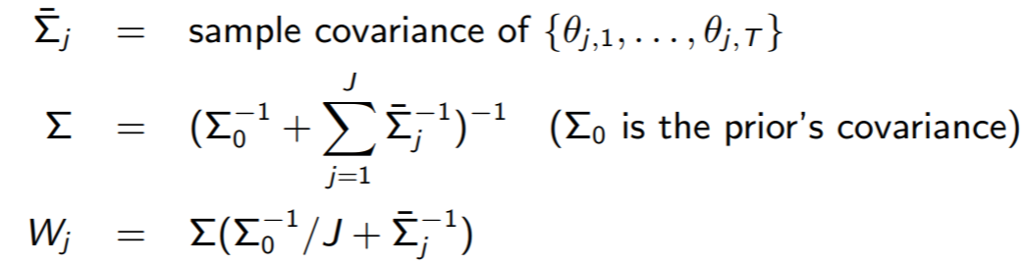

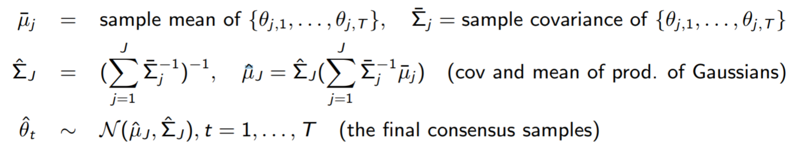
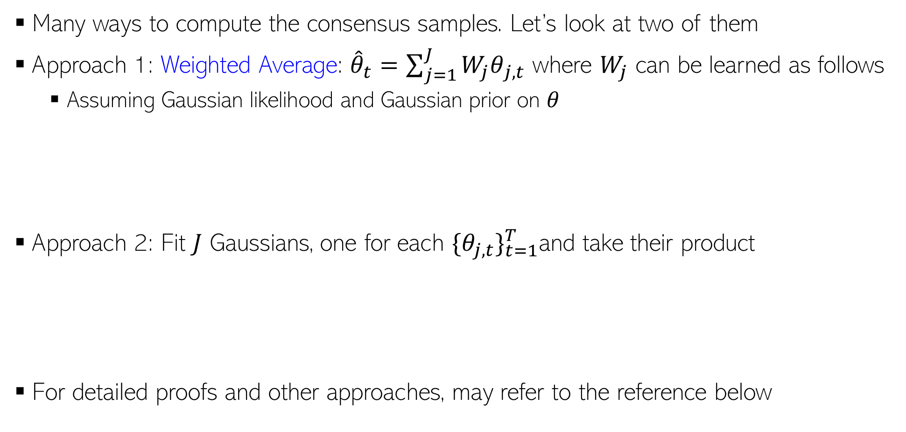
Parallel/Distributed MCMC
18
Many ways to compute the consensus samples. Let’s look at two of them
Approach 1: Weighted Average: ${\hat{θ}}_{t}=\sum_{j=1}^{J}{{W_{j}θ}_{j,t}}$ where $W_{j}$ can be learned as follows
Assuming Gaussian likelihood and Gaussian prior on $θ$
Approach 2: Fit $J$ Gaussians, one for each ${\{θ_{j,t}\}}_{t=1}^{T}$and take their product
For detailed proofs and other approaches, may refer to the reference below
These approaches can also be used to make VI parallel/distributed
Patterns of Scalable Bayesian Inference (Angelino et al, 2016)

Slide 19
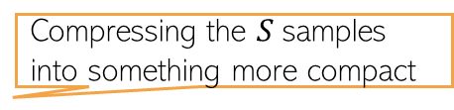
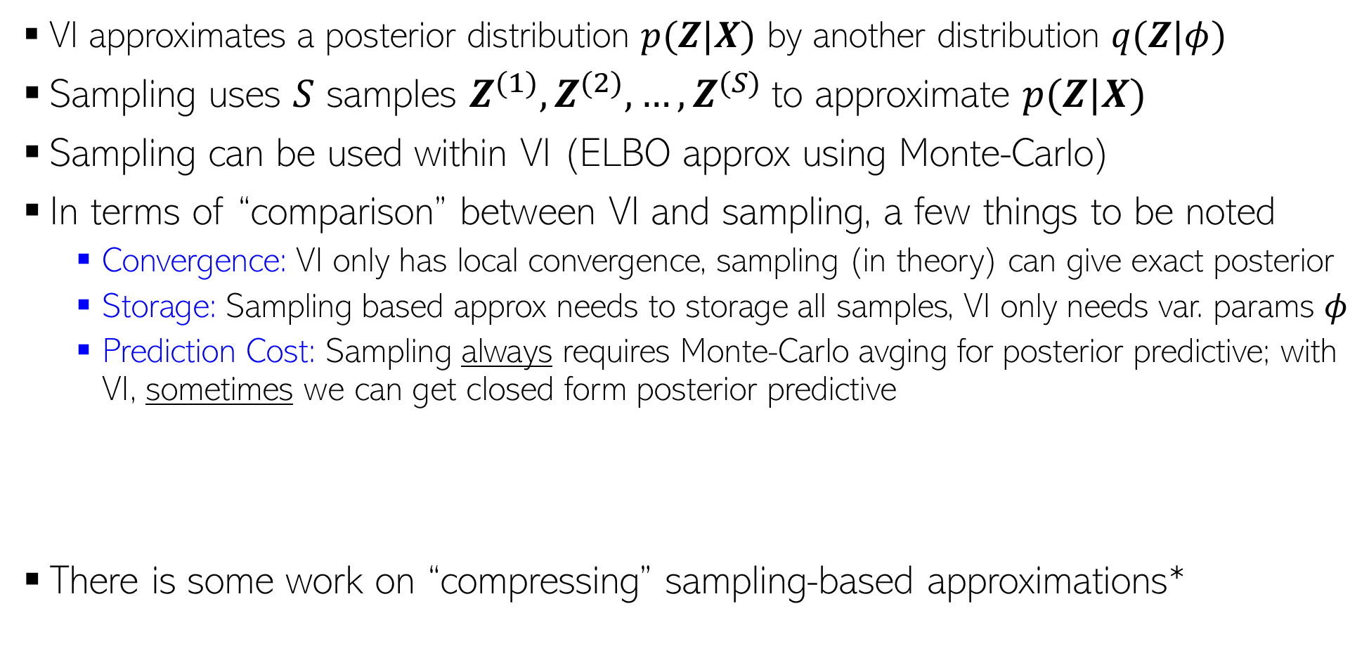

Approximate Inference: VI vs Sampling
19
VI approximates a posterior distribution $p(Z|X)$ by another distribution $q(Z|φ)$
Sampling uses $S$ samples $Z^{(1)},Z^{(2)},…,Z^{(S)}$to approximate $p(Z|X)$
Sampling can be used within VI (ELBO approx using Monte-Carlo)
In terms of “comparison” between VI and sampling, a few things to be noted
Convergence: VI only has local convergence, sampling (in theory) can give exact posterior
Storage: Sampling based approx needs to storage all samples, VI only needs var. params $φ$
Prediction Cost: Sampling always requires Monte-Carlo avging for posterior predictive; with VI, sometimes we can get closed form posterior predictive
There is some work on “compressing” sampling-based approximations*
Closed form if integral is tractable (otherwise Monte Carlo avg still needed for PPD)
PPD if using sampling:
$$p\left(x_{∗} | X\right)=∫p\left(x_{∗} | Z\right)p\left(Z | X\right)dZ≈\frac{1}{S}\sum_{s=1}^{S}{p\left(x_{∗} | Z^{\left(s\right)}\right)}$$
PPD if using VI:
$$p\left(x_{∗} | X\right)=∫p\left(x_{∗} | Z\right)p\left(Z | X\right)dZ≈∫p\left(x_{∗} | Z\right)q\left(Z | φ\right)dZ$$
Compressing the $S$samples into something more compact
*”Compact approximations to Bayesian predictive distributions” by Snelson and Ghaharamani, 2005; and “Bayesian Dark Knowledge” by Korattikara et al, 2015

Slide 20
Inference Methods: Summary
20
MLE/MAP: Straightforward for differentiable models (can even use automatic diff.)
Conjugate models with one “main” parameter: Straightforward posterior updates
MLE-II/MAP-II: Often useful for estimating the hyperparameters
EM: If we want to do MLE/MAP for models with latent variables
Very general algorithm, can also be made online
Used when we want point estimates for some unknowns and posterior over others
Can use it for hyperparameter estimation as well
Often better than using direct gradient methods
VI and sampling methods can be used to get full posterior for complex models
Quite easy if we have local conjugacy (VI has closed form updates, Gibbs sampler is easy to derive)
In other cases, we have general VI with Monte-Carlo gradients, MH sampling
MCMC can also make use of gradient info (LD/SGLD)
For large-scale problems, online/distributed VI/MCMC, or SGD based posterior approx

