Slide 1
Approximating Distributions via Sampling
CS772A: Probabilistic Machine Learning
Piyush Rai

Slide 2
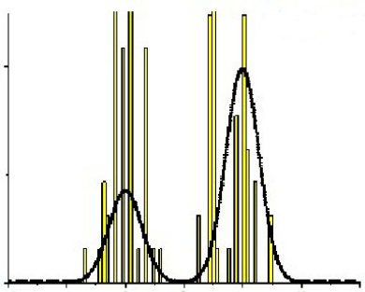
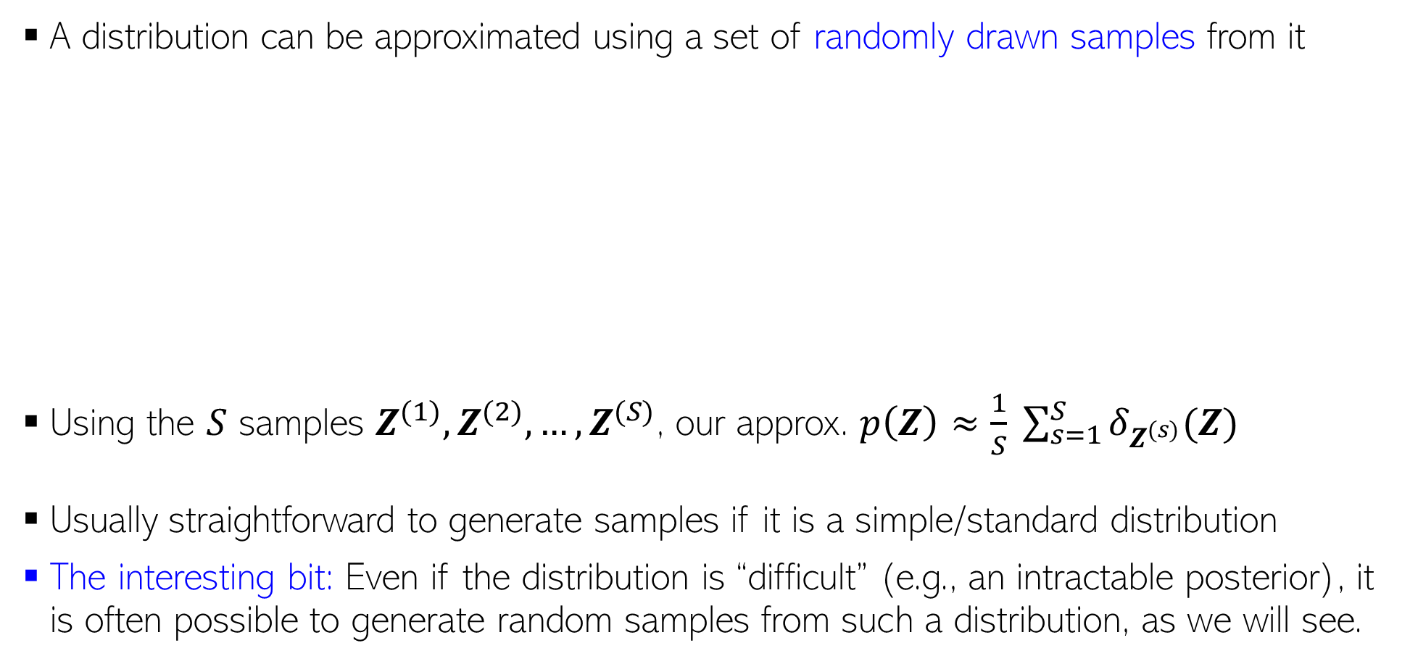
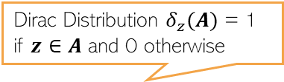

Approximating a Prob. Distribution using Samples
2
A distribution can be approximated using a set of randomly drawn samples from it
Using the $S$ samples $Z^{(1)},Z^{(2)},…,Z^{(S)}$, our approx. $p\left(Z\right)≈\frac{1}{S} \sum_{s=1}^{S}{δ_{Z^{(s)}}(Z)}$
Usually straightforward to generate samples if it is a simple/standard distribution
The interesting bit: Even if the distribution is “difficult” (e.g., an intractable posterior), it is often possible to generate random samples from such a distribution, as we will see.
Samples can thought of as a histogram-based approximation of a distribution
Given large-enough samples, it is proportional to the probability density at that location
Height of each bar denotes how many times that location/interval was sampled
$$p(z)$$
Dirac Distribution $δ_{z}(A)$ = 1 if $z∈A$ and 0 otherwise

Slide 3


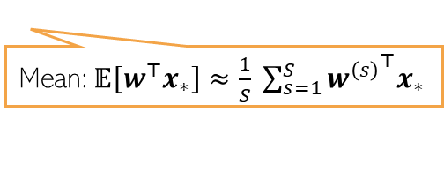

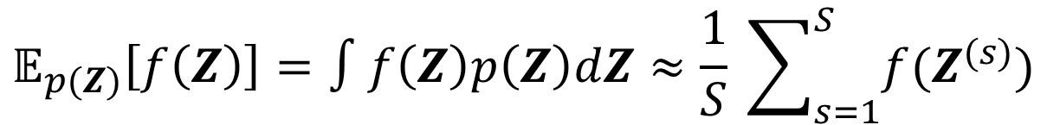
Using samples to compute expectations/predictions
3
Given $S$ i.i.d. samples $Z^{(1)},Z^{(2)},…,Z^{(S)}$ from a distribution $p(Z)$
For Bayesian lin. reg., assuming $w,β, λ$ to be unknown, PPD approximation will be
Sampling based approx. for PPD of other models can also be obtained likewise
$$𝔼_{p(Z)}\left[f\left(Z\right)\right]=∫f\left(Z\right)p\left(Z\right)dZ≈\frac{1}{S} \sum_{s=1}^{S}{f(Z^{(s)})}$$
Joint posterior over all unknowns
Thus, in this case, the PPD is a sum of $S$ Gaussians
$$∫p\left(y_{∗} | x_{∗},w,β\right)p\left(w,β,λ | X,y\right)dwdβdλ≈\frac{1}{S} \sum_{s=1}^{S}{p\left(y_{∗} | x_{∗},w^{\left(s\right)},β^{(s)}\right)}$$
Sampling based approximation of PPD
Mean:$𝔼\left[w^{⊤}x_{∗}\right]≈\frac{1}{S} \sum_{s=1}^{S}{{w^{\left(s\right)}}^{⊤}x_{∗}}$
Can also think of it as an ensemble consisting of $S$ members
Variance: Exercise! Use definition of variance and use Monte-Carlo approximation

Slide 4
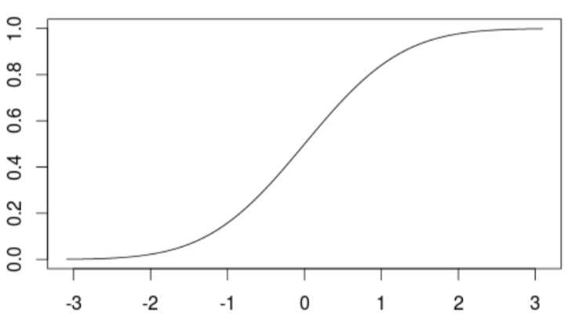
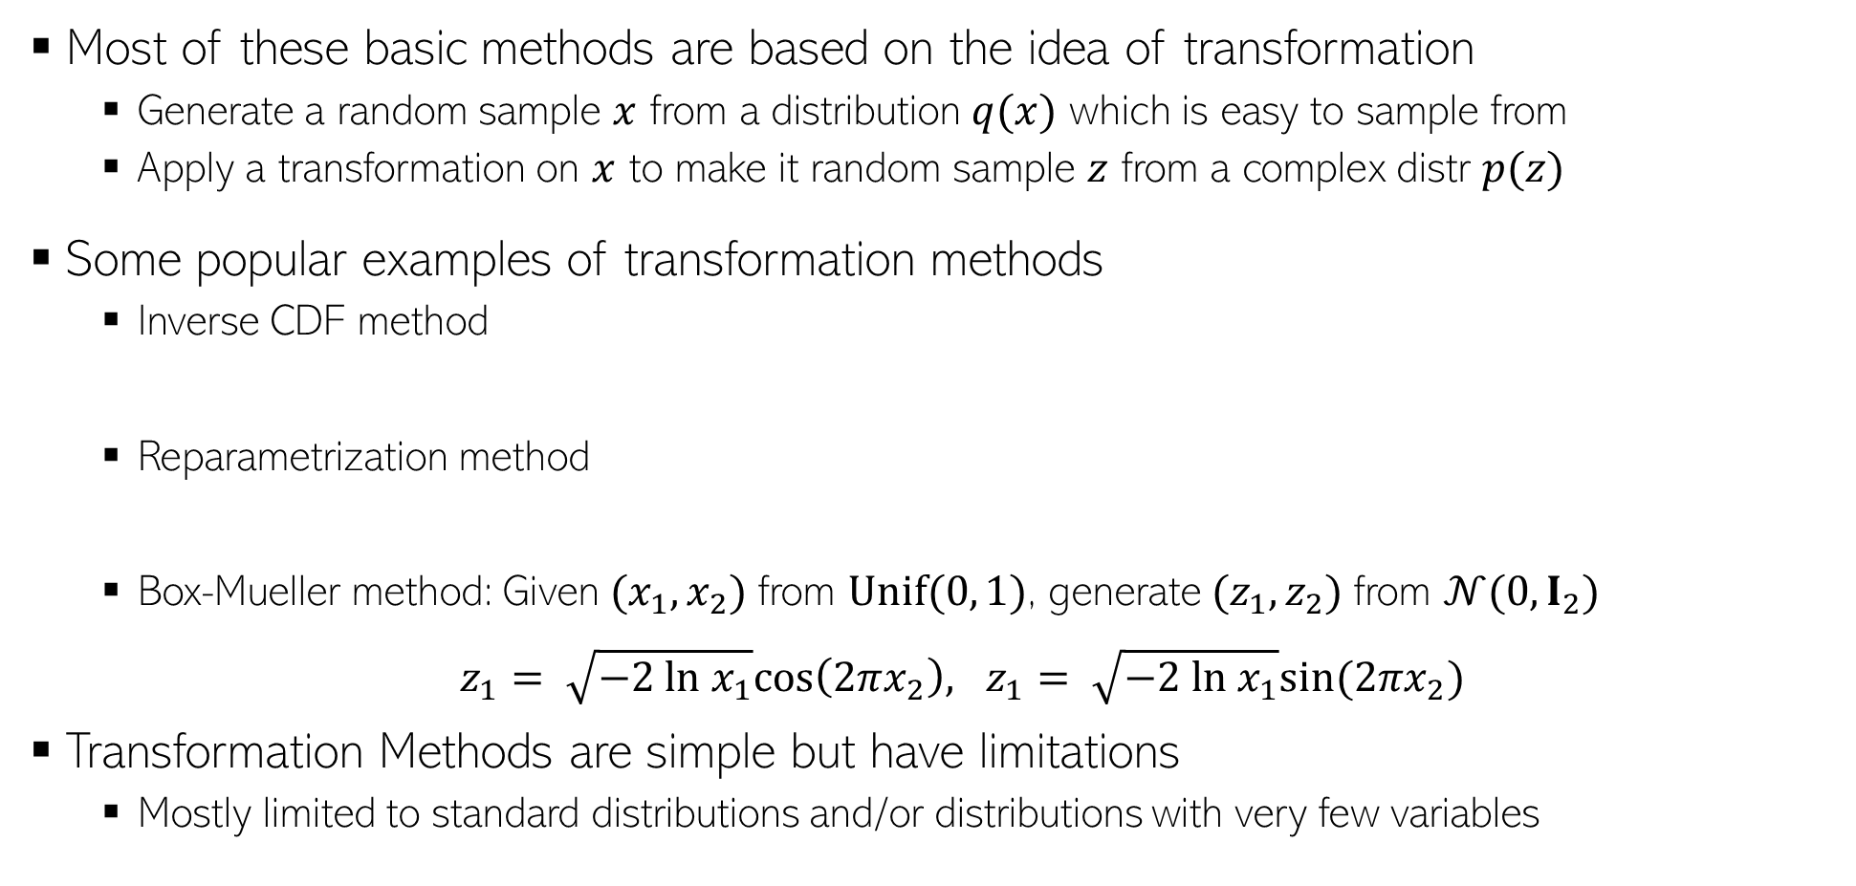




Sampling: Some Basic Methods
$$p\left(z\right)=q(x)\left|\frac{∂x}{∂z}\right|$$
4
Most of these basic methods are based on the idea of transformation
Generate a random sample $x$ from a distribution $q(x)$ which is easy to sample from
Apply a transformation on $x$ to make it random sample $z$ from a complex distr $p(z)$
Some popular examples of transformation methods
Inverse CDF method
Reparametrization method
Box-Mueller method: Given $(x_{1}, x_{2})$from $Unif(0, 1)$, generate $(z_{1}, z_{2})$from $𝒩(0,I_{2})$
$z_{1}= \sqrt{−2 ln x_{1}}cos\left(2πx_{2}\right), z_{1}= \sqrt{−2 ln x_{1}}sin(2πx_{2})$
Transformation Methods are simple but have limitations
Mostly limited to standard distributions and/or distributions with very few variables
Determinant of Jacobian
$F(z)$: CDF of $p(z)$
$$x$$
$$z=F^{−1}(x)$$

Slide 5
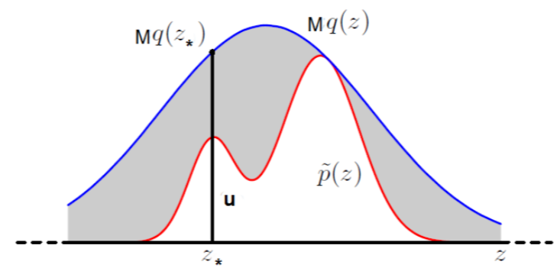
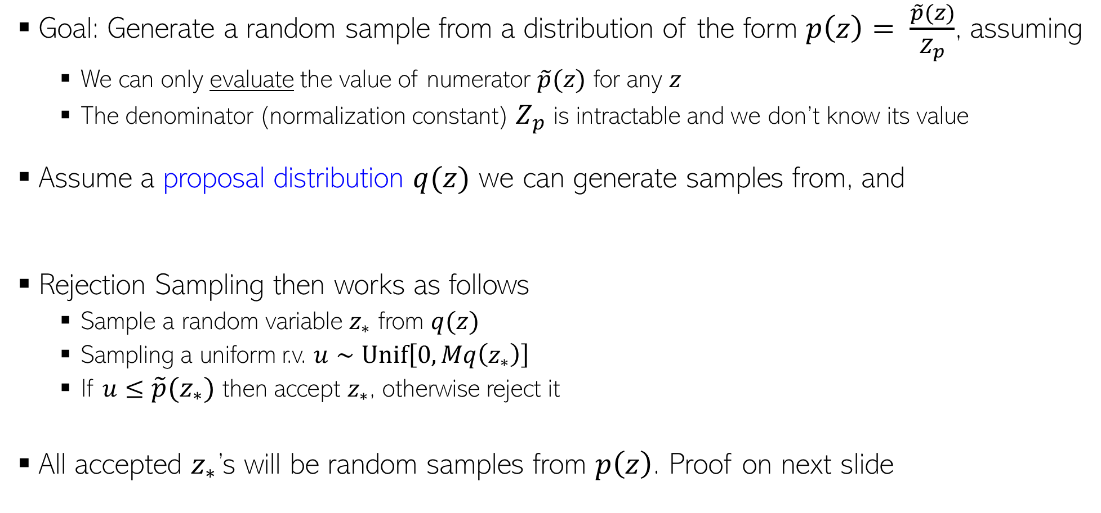

Rejection Sampling
5
Goal: Generate a random sample from a distribution of the form $p\left(z\right)= \frac{\tilde{p}(z)}{Z_{p}}$, assuming
We can only evaluate the value of numerator $\tilde{p}(z)$ for any $z$
The denominator (normalization constant) $Z_{p}$ is intractable and we don’t know its value
Assume a proposal distribution $q(z)$ we can generate samples from, and
Rejection Sampling then works as follows
Sample a random variable $z_{∗}$ from $q(z)$
Sampling a uniform r.v. $u∼Unif\left[0,Mq\left(z_{∗}\right)\right]$
If $u≤\tilde{p}(z_{∗})$ then accept $z_{∗}$, otherwise reject it
All accepted $z_{∗}$’s will be random samples from $p\left(z\right)$. Proof on next slide
Should have the same support as $p(z)$

Slide 6





Rejection Sampling
6
Why $z ∼ q(z)$+ accept/reject rule is equivalent to $z ∼ p(z)$?
Let’s look at the pdf of the $z$’s that were accepted, i.e., $p(z|accept)$

Slide 7

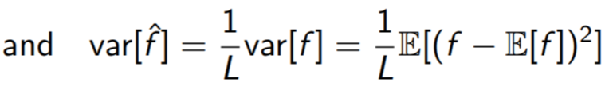
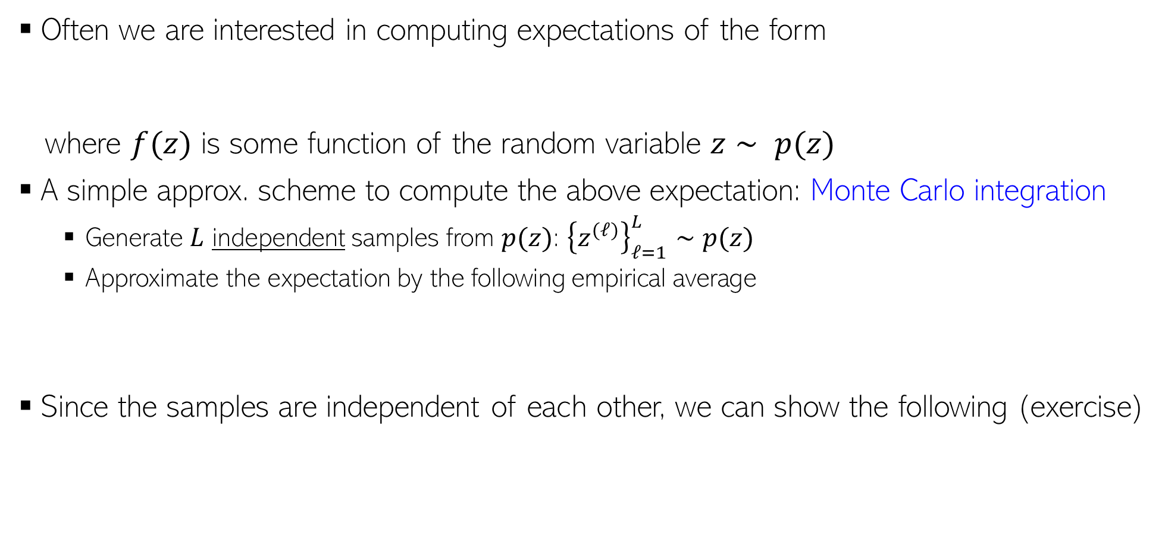
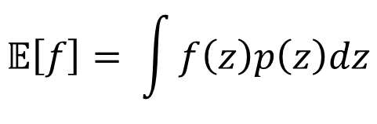
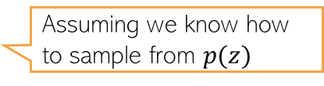
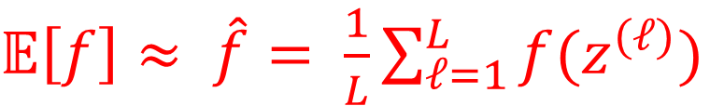

Computing Expectations via Monte Carlo Sampling
7
Often we are interested in computing expectations of the form
where $f(z)$ is some function of the random variable $z∼ p(z)$
A simple approx. scheme to compute the above expectation: Monte Carlo integration
Generate $L$ independent samples from $p(z)$: ${\left\{z^{(ℓ)}\right\}}_{ℓ=1}^{L}∼p(z)$
Approximate the expectation by the following empirical average
Since the samples are independent of each other, we can show the following (exercise)
$$𝔼\left[f\right]= \int{f\left(z\right)p\left(z\right)dz}$$
Assuming we know how to sample from $p(z)$
$𝔼\left[f\right]≈ \hat{f}= \frac{1}{L}\sum_{ℓ=1}^{L}{f(z^{(ℓ)})}$
Variance in our estimate decreases as $L$increases
Unbiased expectation

Slide 8
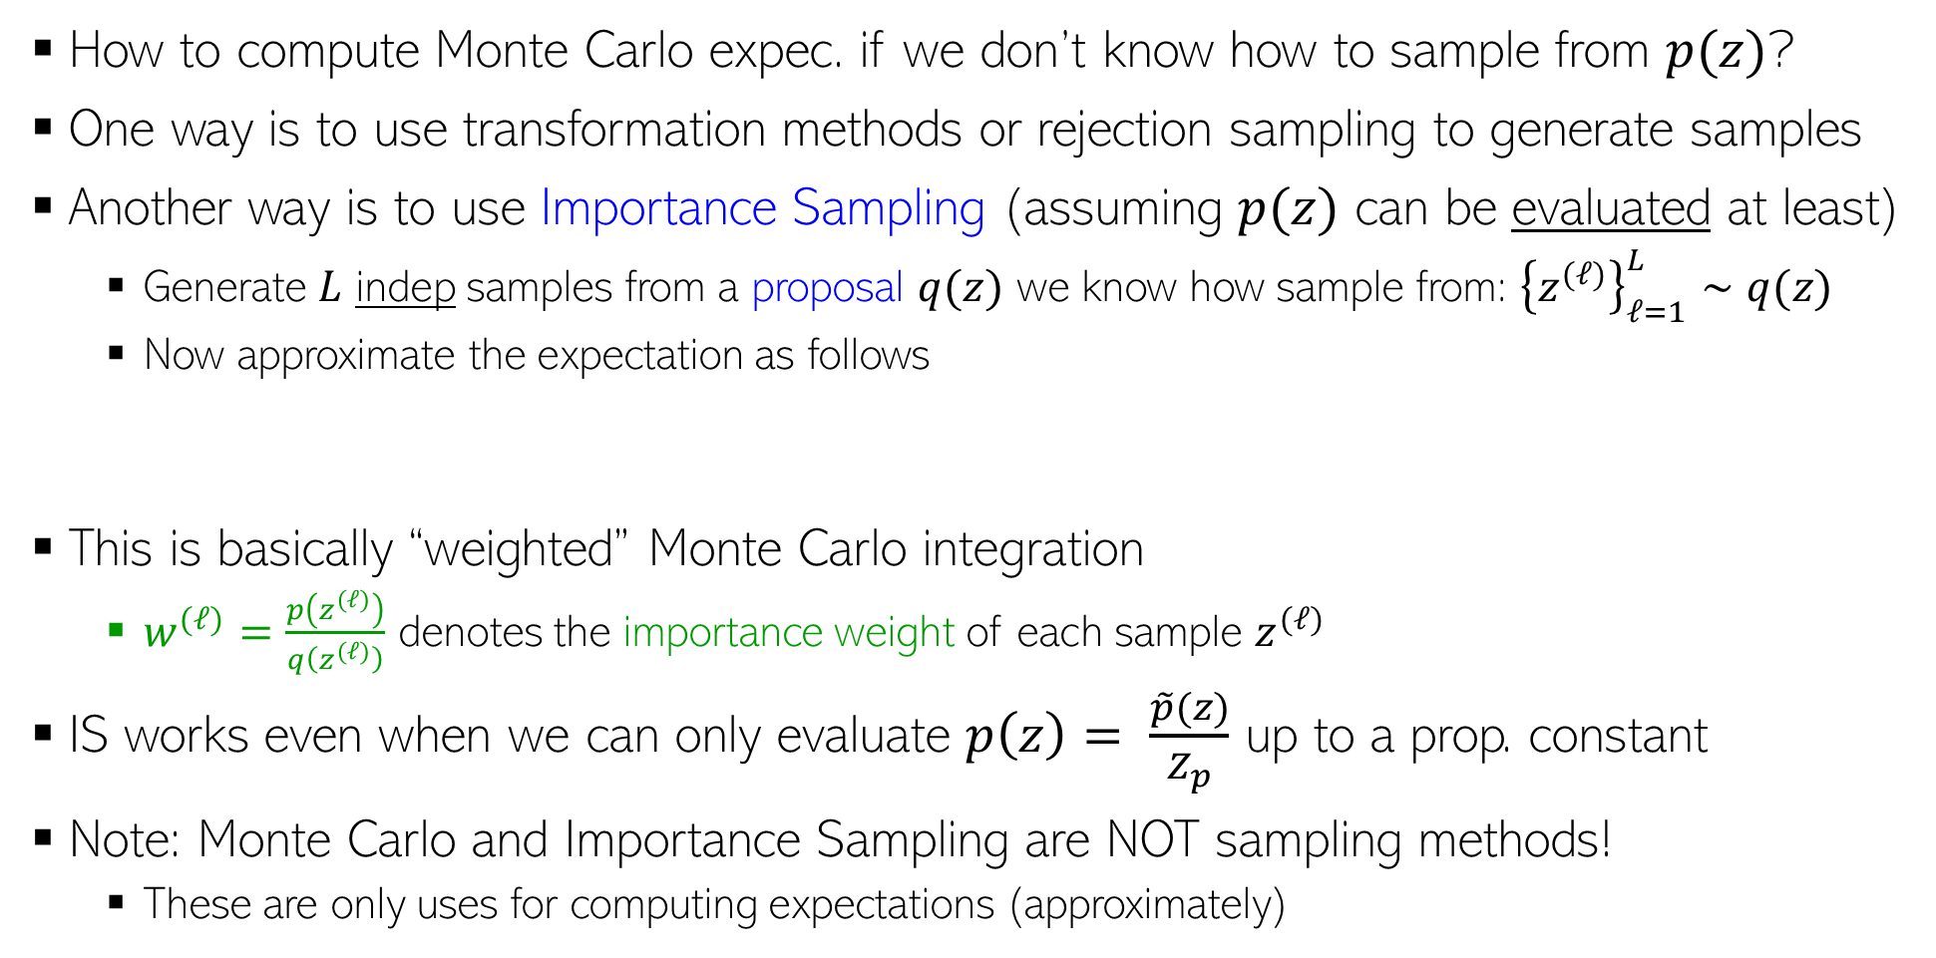
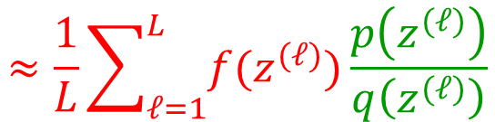
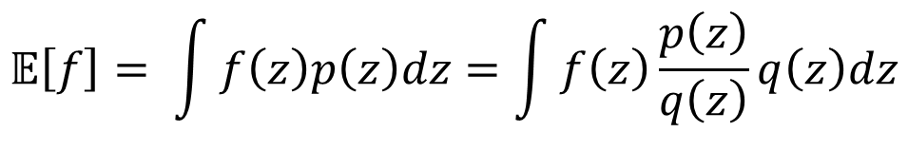
Computing Expectations via Importance Sampling
8
How to compute Monte Carlo expec. if we don’t know how to sample from $p(z)$?
One way is to use transformation methods or rejection sampling to generate samples
Another way is to use Importance Sampling (assuming $p(z)$ can be evaluated at least)
Generate $L$ indep samples from a proposal $q(z)$ we know how sample from: ${\left\{z^{(ℓ)}\right\}}_{ℓ=1}^{L}∼q(z)$
Now approximate the expectation as follows
This is basically “weighted” Monte Carlo integration
$w^{(ℓ)}=\frac{p\left(z^{(ℓ)}\right)}{q\left(z^{(ℓ)}\right)}$ denotes the importance weight of each sample $z^{(ℓ)}$
IS works even when we can only evaluate $p\left(z\right)= \frac{\tilde{p}(z)}{Z_{p}}$ up to a prop. constant
Note: Monte Carlo and Importance Sampling are NOT sampling methods!
These are only uses for computing expectations (approximately)
$$𝔼\left[f\right]= \int{f\left(z\right)p\left(z\right)dz}=\int{f\left(z\right)\frac{p\left(z\right)}{q\left(z\right)}q\left(z\right)dz}$$
$$≈\frac{1}{L}\sum_{ℓ=1}^{L}{f(z^{(ℓ)})}\frac{p\left(z^{(ℓ)}\right)}{q\left(z^{(ℓ)}\right)}$$
See PRML 11.1.4

Slide 9
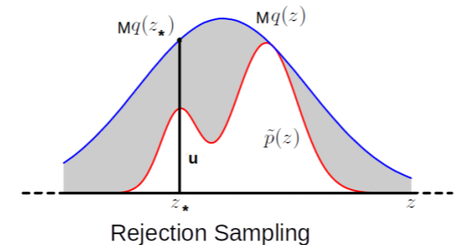
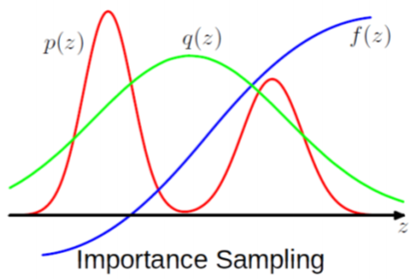


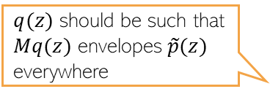
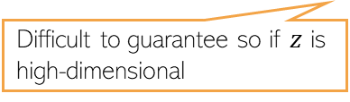
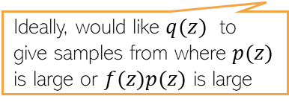
Limitations of the Basic Methods
9
Transformation based methods: Usually limited to drawing from standard distributions
Rejection Sampling and Importance Sampling: Require good proposal distributions
In general, difficult to find good prop. distr. especially when $z$ is high-dim
More sophisticated sampling methods like MCMC work well in such high-dim spaces
$$𝔼\left[f\right]≈\frac{1}{L}\sum_{ℓ=1}^{L}{f(z^{(ℓ)})}\frac{p\left(z^{(ℓ)}\right)}{q\left(z^{(ℓ)}\right)}$$
$q(z)$ should be such that $Mq(z)$ envelopes $\tilde{p}(z)$ everywhere
Ideally, would like $q(z)$ to give samples from where $p(z)$ is large or $f(z)p(z)$ is large
Difficult to guarantee so if $z$ is high-dimensional

Slide 10
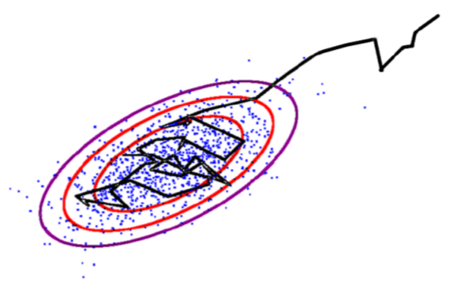
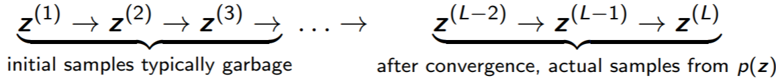
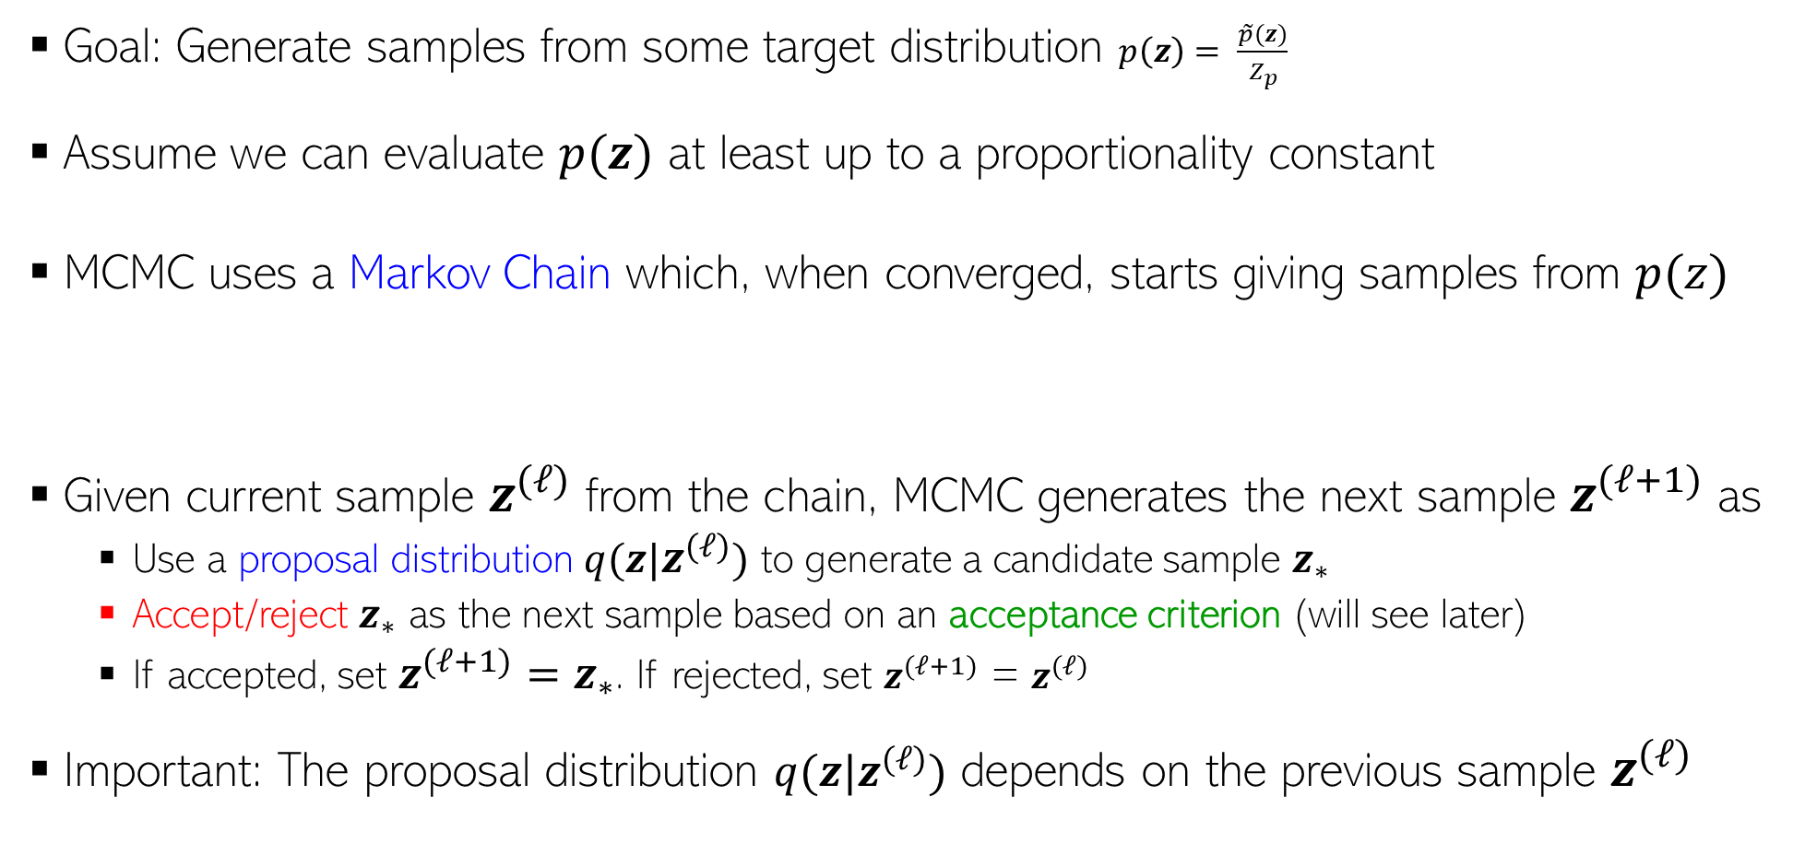
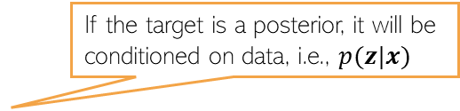



Markov Chain Monte Carlo (MCMC)
10
If the target is a posterior, it will be conditioned on data, i.e., $p(z|x)$
Goal: Generate samples from some target distribution $p\left(z\right)= \frac{\tilde{p}(z)}{Z_{p}}$
Assume we can evaluate $p(z)$ at least up to a proportionality constant
MCMC uses a Markov Chain which, when converged, starts giving samples from $p(z)$
Given current sample $z^{(ℓ)}$ from the chain, MCMC generates the next sample $z^{(ℓ+1)}$ as
Use a proposal distribution $q(z|z^{(ℓ)})$ to generate a candidate sample $z_{∗}$
Accept/reject $z_{∗}$ as the next sample based on an acceptance criterion (will see later)
If accepted, set $z^{(ℓ+1)}=z_{∗}$. If rejected, set $z^{(ℓ+1)}$ = $z^{(ℓ)}$
Important: The proposal distribution $q(z|z^{(ℓ)})$ depends on the previous sample $z^{(ℓ)}$
$z$ usually is high-dim
Means we can at least evaluate $\tilde{p}(z)$
Should also have the same support as $p(z)$

Slide 11


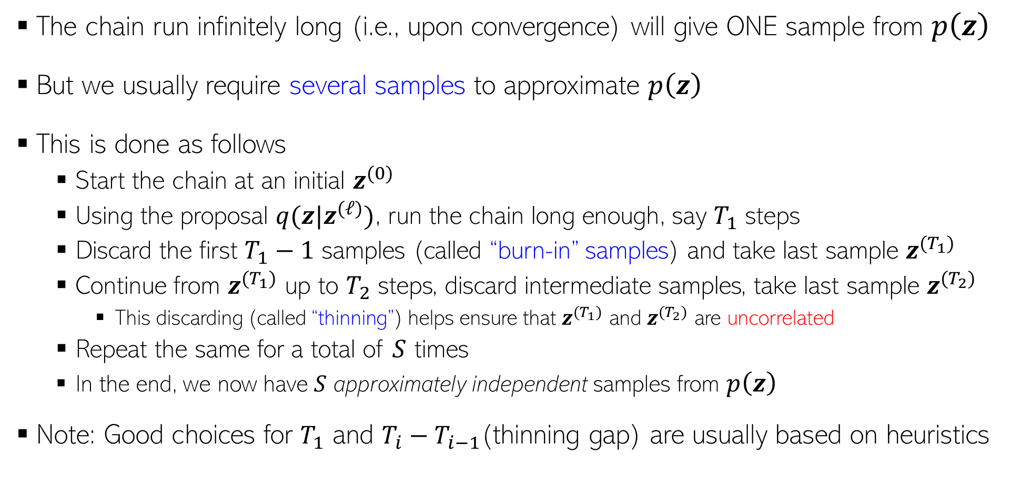
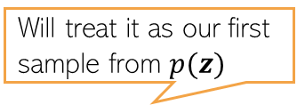
MCMC: The Basic Scheme
11
The chain run infinitely long (i.e., upon convergence) will give ONE sample from $p\left(z\right)$
But we usually require several samples to approximate $p\left(z\right)$
This is done as follows
Start the chain at an initial $z^{(0)}$
Using the proposal $q(z|z^{(ℓ)})$, run the chain long enough, say $T_{1}$ steps
Discard the first $T_{1}−1$ samples (called “burn-in” samples) and take last sample $z^{(T_{1})}$
Continue from $z^{(T_{1})}$ up to $T_{2}$ steps, discard intermediate samples, take last sample $z^{(T_{2})}$
This discarding (called “thinning”) helps ensure that $z^{(T_{1})}$ and $z^{(T_{2})}$ are uncorrelated
Repeat the same for a total of $S$ times
In the end, we now have $S$ approximately independent samples from $p\left(z\right)$
Note: Good choices for $T_{1}$ and $T_{i}−T_{i−1}$(thinning gap) are usually based on heuristics
MCMC is exact in theory but approximate in practice since we can’t run the chain for infinitely long in practice
Thus we say that the samples are approximately from the target distribution
Will treat it as our first sample from $p(z)$
Requirement for Monte Carlo approximation

Slide 12
Some MCMC Algorithms
12

Slide 13

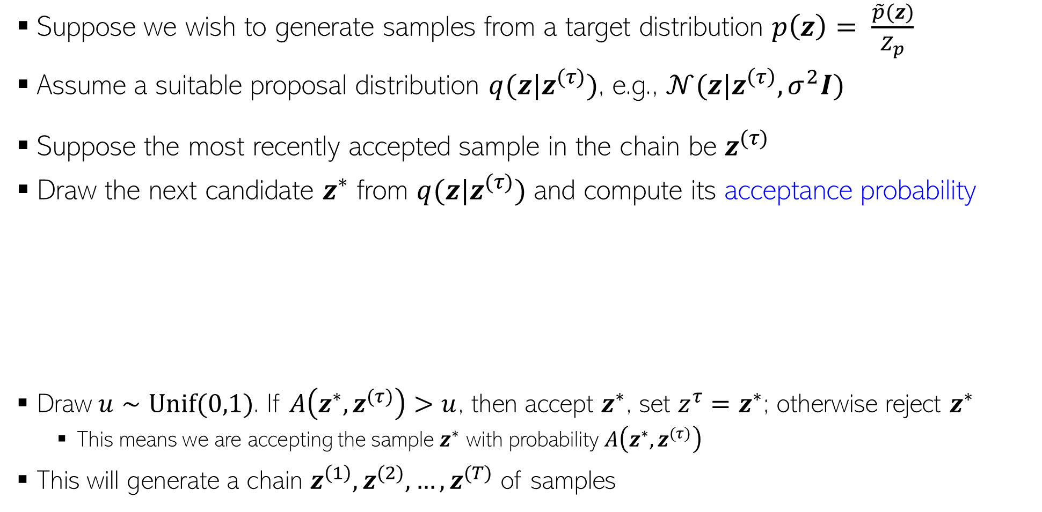
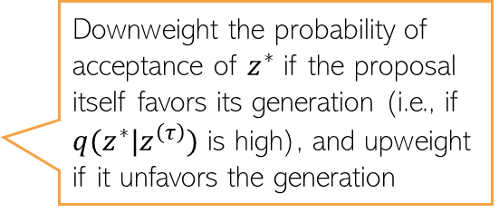

Metropolis-Hastings (MH) Sampling (1960)
13
Suppose we wish to generate samples from a target distribution $p\left(z\right)= \frac{\tilde{p}(z)}{Z_{p}}$
Assume a suitable proposal distribution $q(z|z^{(τ)})$, e.g., $𝒩(z|z^{\left(τ\right)},σ^{2}I)$
Suppose the most recently accepted sample in the chain be $z^{(τ)}$
Draw the next candidate $z^{∗}$ from $q(z|z^{(τ)})$ and compute its acceptance probability
Draw $u∼Unif(0,1)$. If $A\left(z^{∗},z^{(τ)}\right)>u$, then accept $z^{∗}$, set $z^{τ}=z^{∗}$; otherwise reject $z^{∗}$
This means we are accepting the sample $z^{∗}$ with probability $A\left(z^{∗},z^{(τ)}\right)$
This will generate a chain $z^{\left(1\right)},z^{(2)}, …, z^{(T)}$ of samples
Favors acceptance of $z^{∗}$ if it is more probable than $z^{(τ)}$ (under $p(z)$)
Downweight the probability of acceptance of $z^{∗}$ if the proposal itself favors its generation (i.e., if $q(z^{∗}|z^{\left(τ\right)})$ is high), and upweight if it unfavors the generation

Slide 14
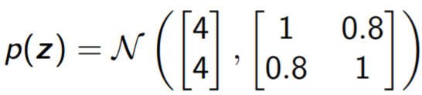
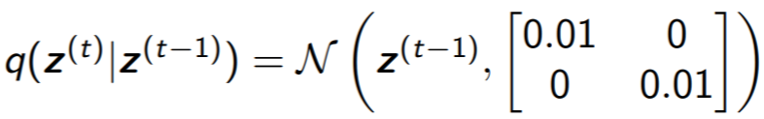
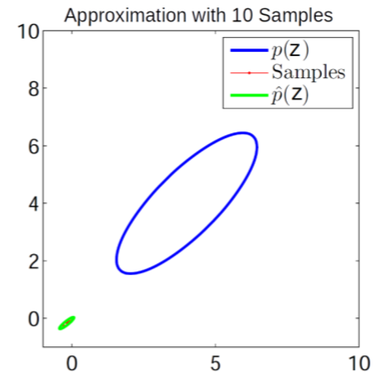
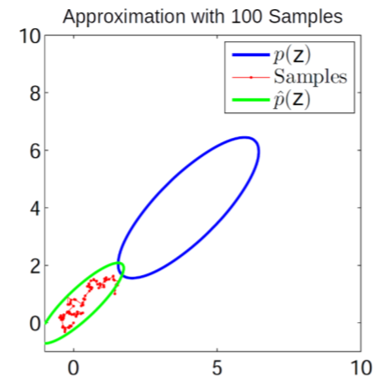
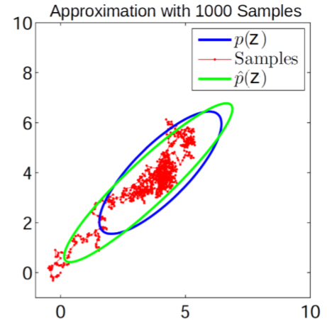
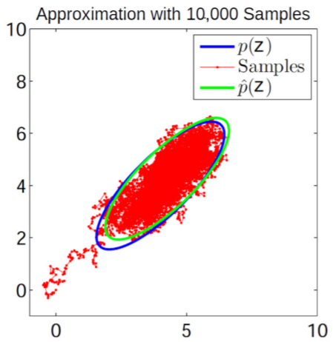
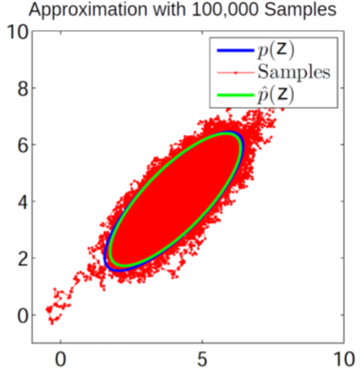
MH Sampling in Action: A Toy Example..
14
Target distribution
Proposal distribution

Slide 15
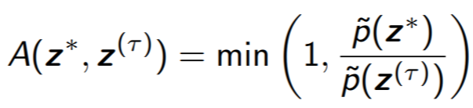
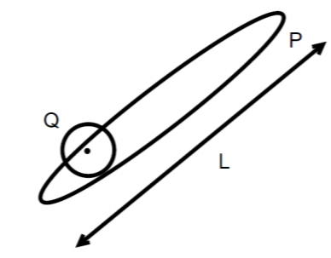
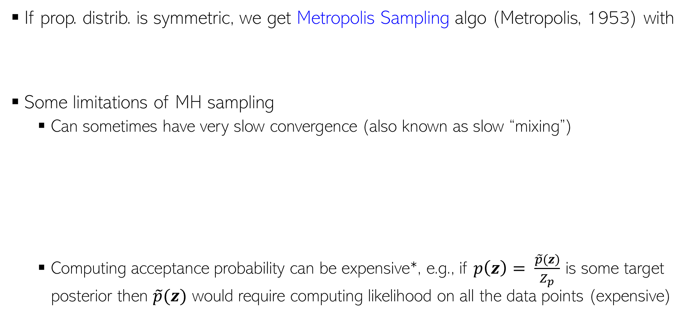
MH Sampling: Some Comments
15
If prop. distrib. is symmetric, we get Metropolis Sampling algo (Metropolis, 1953) with
Some limitations of MH sampling
Can sometimes have very slow convergence (also known as slow “mixing”)
Computing acceptance probability can be expensive*, e.g., if $p\left(z\right)= \frac{\tilde{p}(z)}{Z_{p}}$ is some target posterior then $\tilde{p}(z)$ would require computing likelihood on all the data points (expensive)
$$Q\left(z | z^{\left(τ\right)}\right)=𝒩(z|z^{\left(τ\right)},σ^{2}I)$$
$$∼{\left(\frac{L}{σ}\right)}^{2}iterations required for convergence$$
$$σ large⇒many rejections$$
$$σ small⇒slow diffusion$$
*Austerity in MCMC Land: Cutting the Metropolis-Hastings Budget (Korattikara et al, 2014), Firefly Monte Carlo: Exact MCMC with Subsets of Data {(Maclaurin and Adams, 2015)

