Slide 1
Gaussian Process
(Bayesian Learning meets Kernels)
CS772A: Probabilistic Machine Learning
Piyush Rai

Slide 2
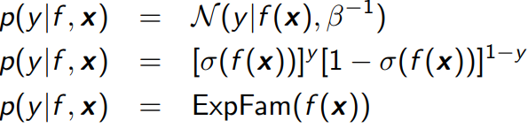
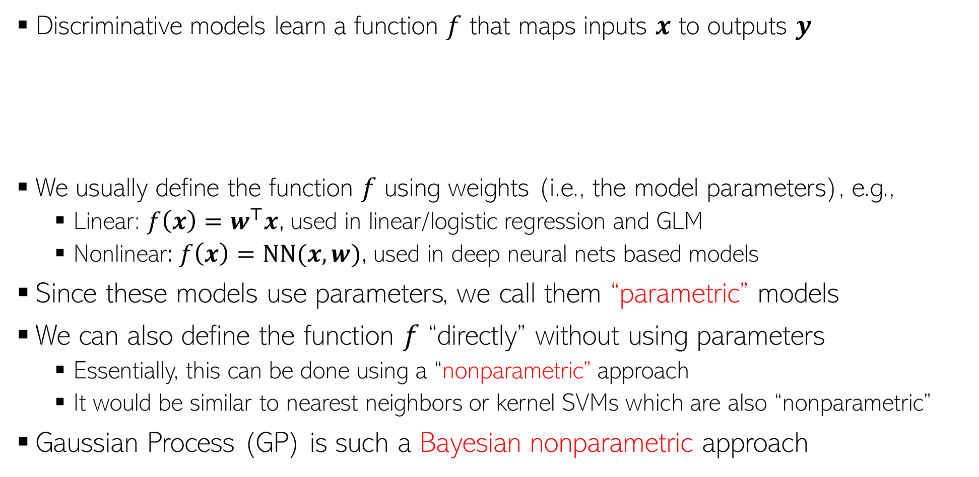
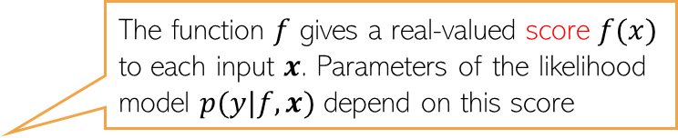
Discriminative Models
2
The function $f$ gives a real-valued score $f(x)$ to each input $x$. Parameters of the likelihood model $p(y|f,x)$ depend on this score
Discriminative models learn a function $f$ that maps inputs $x$ to outputs $y$
We usually define the function $f$ using weights (i.e., the model parameters), e.g.,
  Linear: $f\left(x\right)=w^{⊤}x$, used in linear/logistic regression and GLM
  Nonlinear: $f\left(x\right)=NN(x,w)$, used in deep neural nets based models
Since these models use parameters, we call them “parametric” models
We can also define the function $f$ “directly” without using parameters
  Essentially, this can be done using a “nonparametric” approach
  It would be similar to nearest neighbors or kernel SVMs which are also “nonparametric”
Gaussian Process (GP) is such a Bayesian nonparametric approach

Slide 3
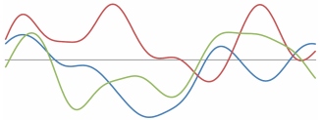

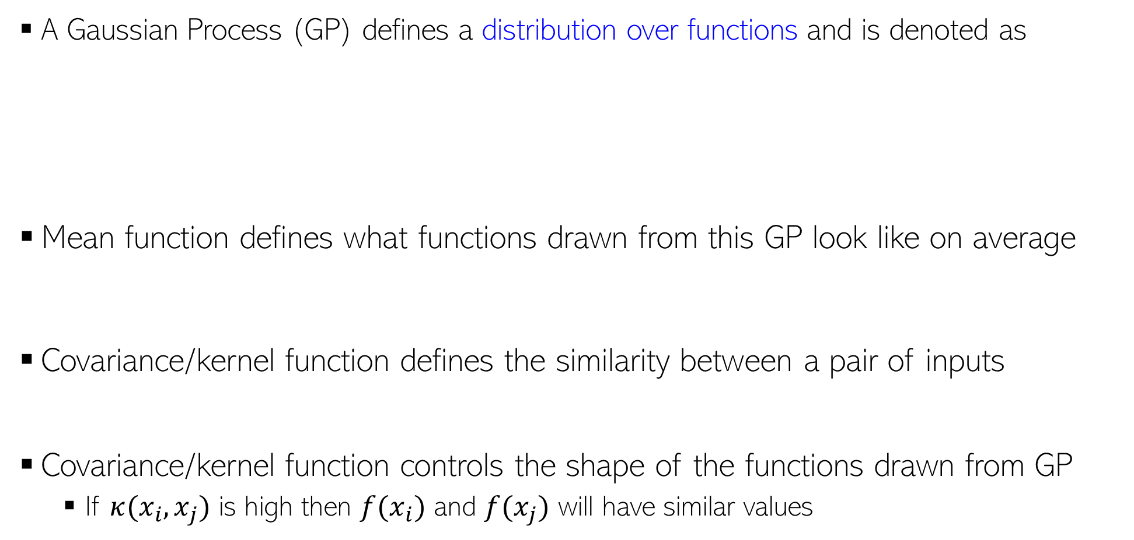


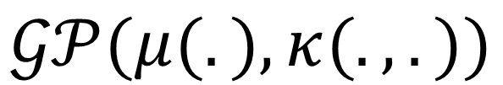

Gaussian Process (GP)
3
A Gaussian Process (GP) defines a distribution over functions and is denoted as
Mean function defines what functions drawn from this GP look like on average
Covariance/kernel function defines the similarity between a pair of inputs
Covariance/kernel function controls the shape of the functions drawn from GP
  If $κ(x_{i}, x_{j})$ is high then $f(x_{i})$ and $f(x_{j})$ will have similar values
Functions drawn from a GP
Mean Function
Covariance Function
$$f(x)$$
$$𝒢𝒫(μ(.), κ(.,.))$$
Should be a positive definite function
$$x$$
$$μ\left(x\right)= 𝔼_{f∼𝒢𝒫(μ,κ)}[f\left(x\right)]$$
$$K_{ij}=κ(x_{i}, x_{j})$$

Slide 4
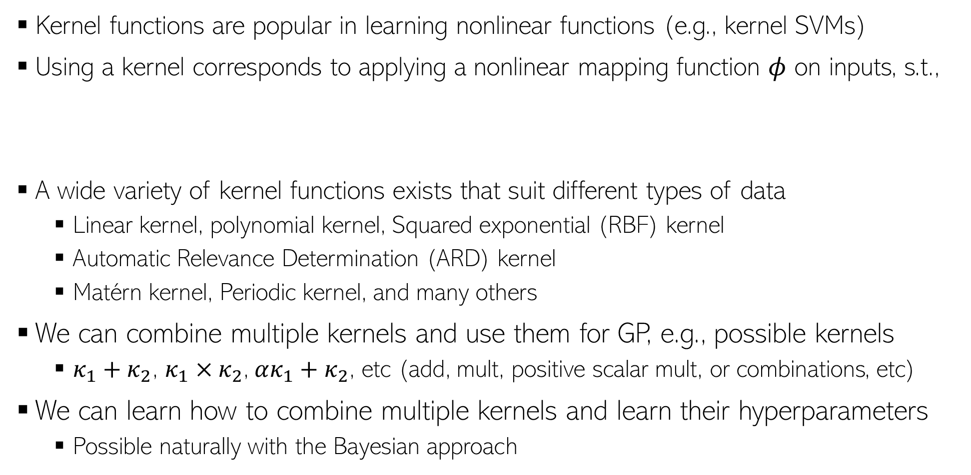
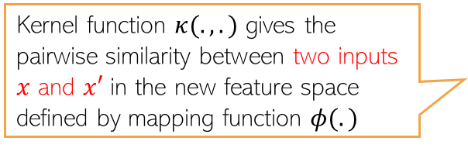

Covariance/kernel functions
4
Kernel functions are popular in learning nonlinear functions (e.g., kernel SVMs)
Using a kernel corresponds to applying a nonlinear mapping function $φ$ on inputs, s.t.,
A wide variety of kernel functions exists that suit different types of data
  Linear kernel, polynomial kernel, Squared exponential (RBF) kernel
  Automatic Relevance Determination (ARD) kernel
  Matérn kernel, Periodic kernel, and many others
We can combine multiple kernels and use them for GP, e.g., possible kernels
  $κ_{1}+κ_{2}$, $κ_{1}×κ_{2}$, $ακ_{1}+κ_{2}$, etc (add, mult, positive scalar mult, or combinations, etc)
We can learn how to combine multiple kernels and learn their hyperparameters
  Possible naturally with the Bayesian approach
Kernel function $κ(.,.)$ gives the pairwise similarity between two inputs $x$ and $x′$ in the new feature space defined by mapping function $φ(.)$
$$κ\left(x,x^{′}\right)=φ{\left(x\right)}^{⊤}φ(x^{′})$$

Slide 5
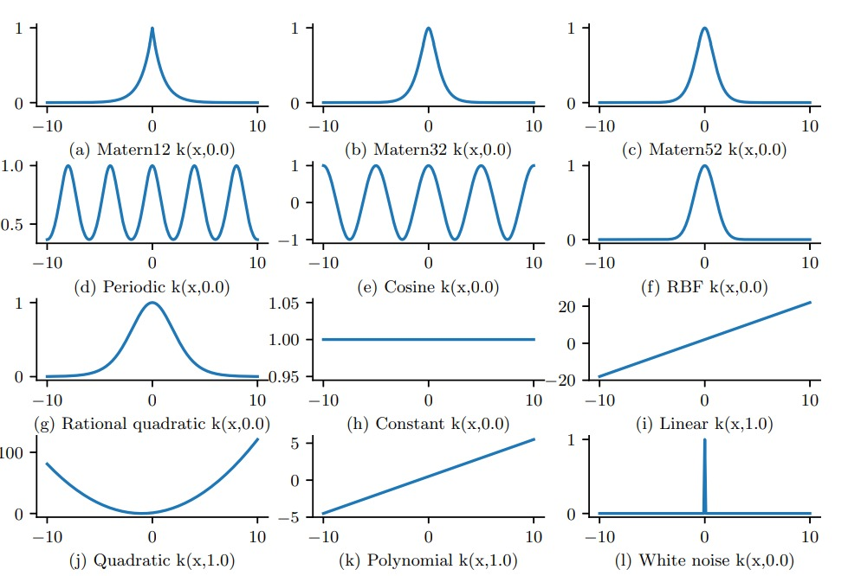
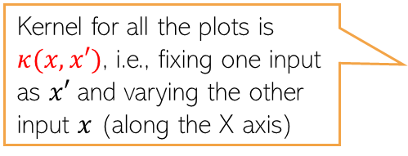
Covariance/kernel functions
5
Visualization of some kernel functions (how similarity changes with “distance”)
Kernel for all the plots is $κ(x,x′)$, i.e., fixing one input as $x′$ and varying the other input $x$ (along the X axis)
Fig source: Probabilistic Machine Learning - Advanced Topics (Murphy, 2023)

Slide 6
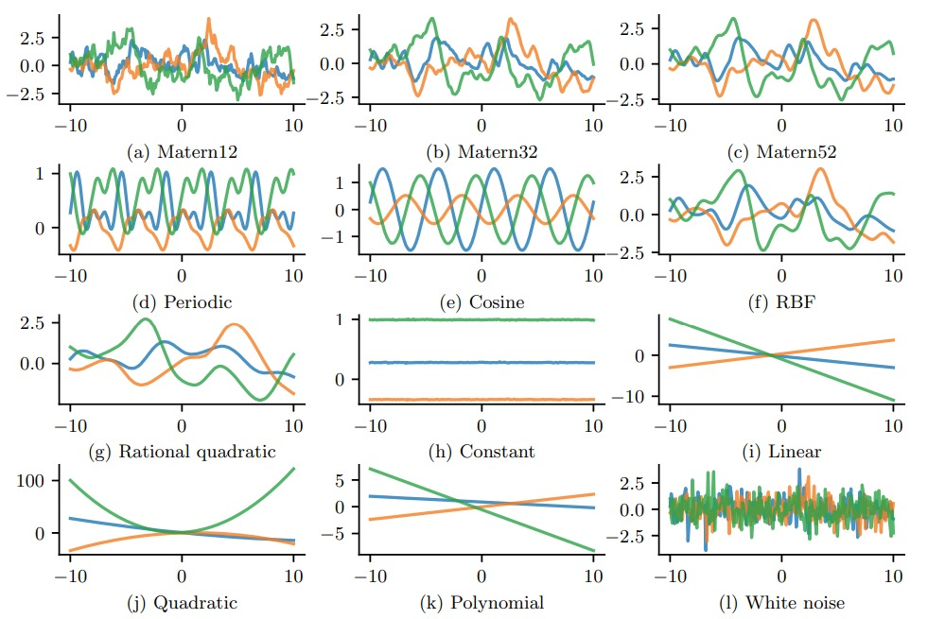

Covariance/kernel functions
6
Examples of functions $f∼GP(μ, κ)$ drawn from a GP using some standard kernels
Each plot shows 3 random functions drawn from the corresponding GP with the specified kernel function
Fig source: Probabilistic Machine Learning - Advanced Topics (Murphy, 2023)

Slide 7
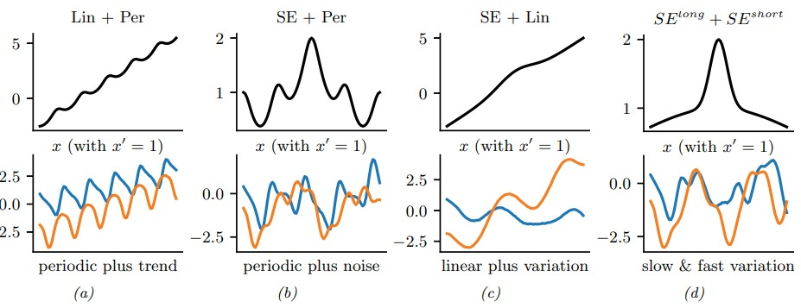

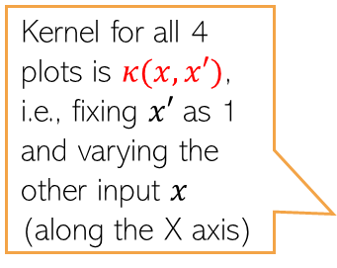
Combining two (or more) covariance/kernel functions
7
Adding two kernels and its effect on the function $f$ defined by the resulting kernel
Kernel for all 4 plots is $κ(x,x′)$, i.e., fixing $x′$ as 1 and varying the other input $x$ (along the X axis)
Two randomly drawn functions from the GP with this kernel combination
Fig source: Probabilistic Machine Learning - Advanced Topics (Murphy, 2023)

Slide 8
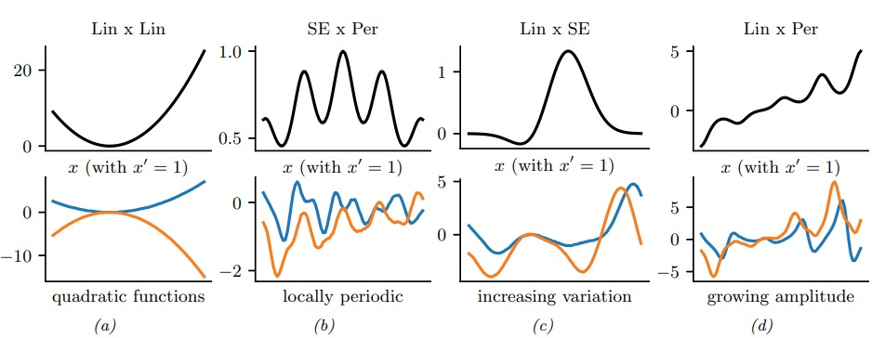

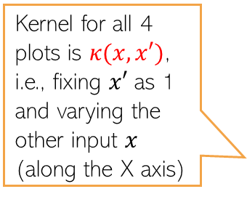
Combining two (or more) covariance/kernel functions
8
Multiplying two kernels and its effect on the function $f$ defined by the resulting kernel
Kernel for all 4 plots is $κ(x,x′)$, i.e., fixing $x′$ as 1 and varying the other input $x$ (along the X axis)
Two randomly drawn functions from the GP with this kernel combination
Fig source: Probabilistic Machine Learning - Advanced Topics (Murphy, 2023)

Slide 9

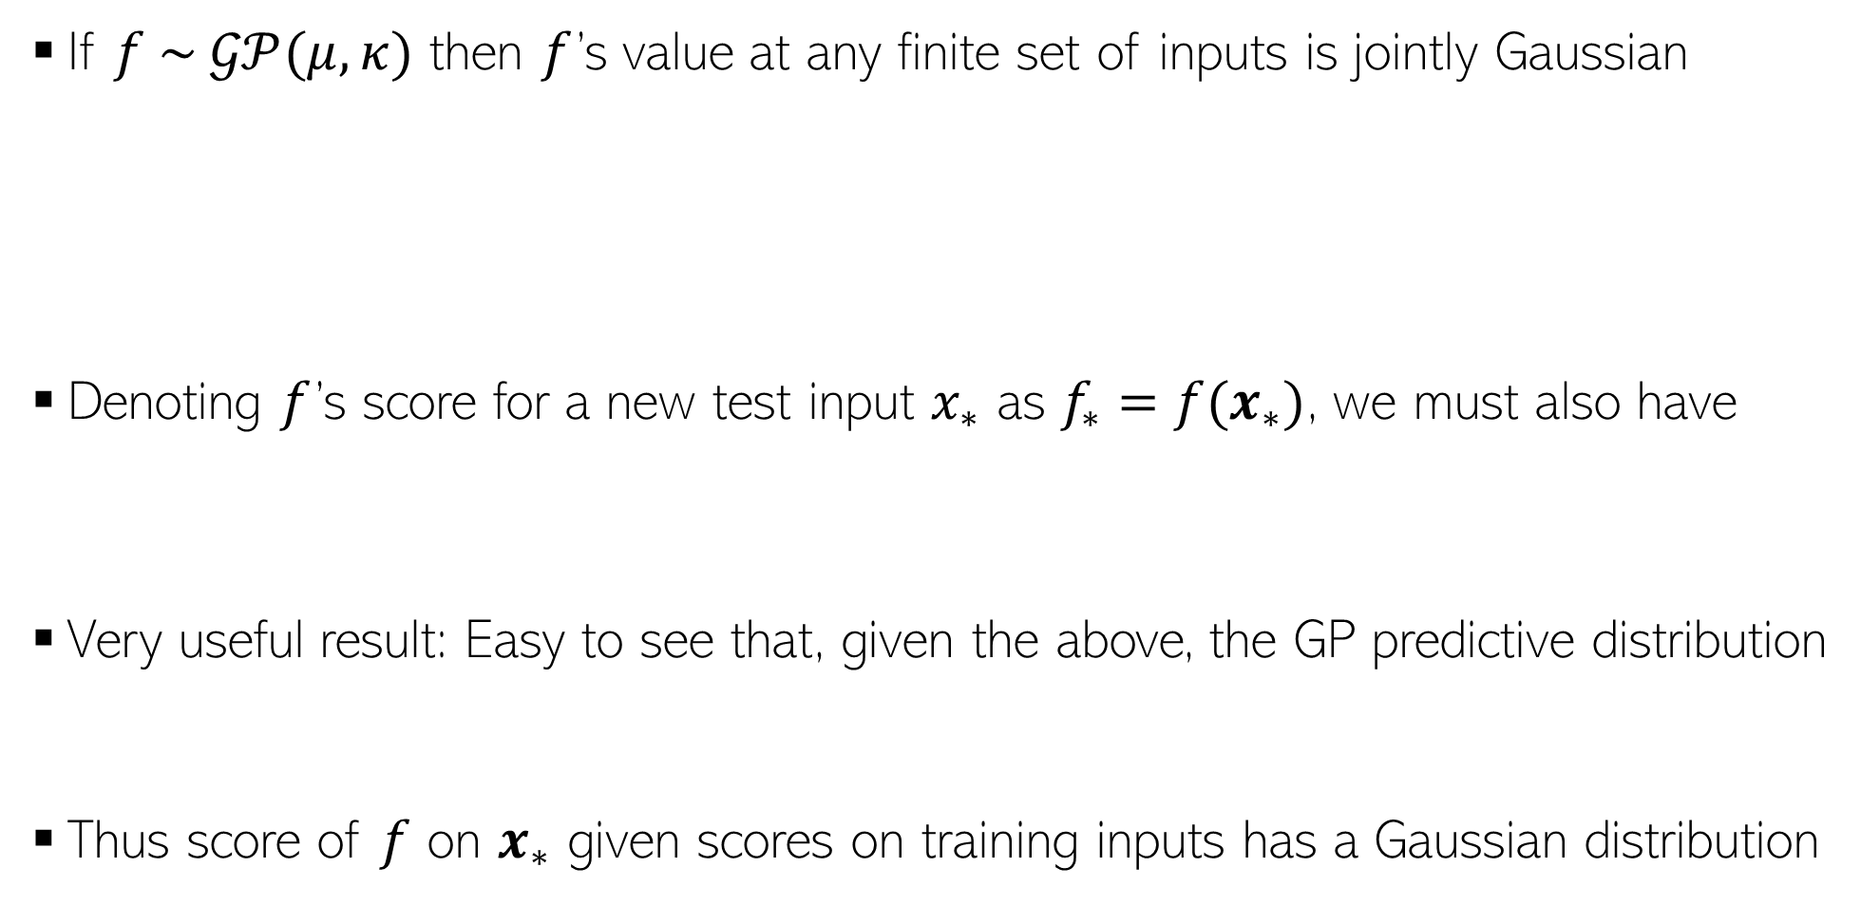




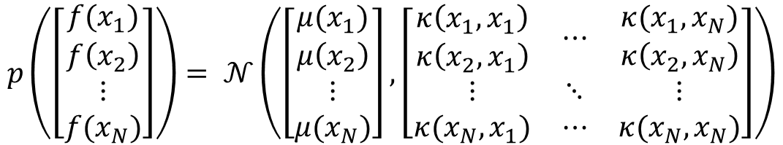
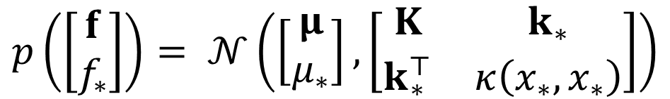
Gaussian Process: The Predictive Model
9
If $f \sim 𝒢𝒫(μ, κ)$ then $f$’s value at any finite set of inputs is jointly Gaussian
Denoting $f$’s score for a new test input $x_{∗}$ as $f_{∗}=f(x_{∗})$, we must also have
Very useful result: Easy to see that, given the above, the GP predictive distribution
Thus score of $f$ on $x_{∗}$ given scores on training inputs has a Gaussian distribution
$$p\left(\left[\begin{aligned}f(x_{1}) \\ f\left(x_{2}\right) \\ ⋮ \\ f(x_{N})\end{aligned}\right]\right)= 𝒩\left(\left[\begin{aligned}μ(x_{1}) \\ μ\left(x_{2}\right) \\ ⋮ \\ μ(x_{N})\end{aligned}\right],\left[\begin{matrix}\begin{aligned}κ\left(x_{1},x_{1}\right) \\ κ\left(x_{2},x_{1}\right)\end{aligned} & ⋯ & \begin{aligned}κ(x_{1},x_{N}) \\ κ\left(x_{2},x_{N}\right)\end{aligned} \\ ⋮ & ⋱ & ⋮ \\ κ(x_{N},x_{1}) & ⋯ & κ(x_{N},x_{N})\end{matrix}\right]\right)$$
$$N×1$$
$$N×1$$
$$N×N$$
$$\text{p}\text{(}\text{f}\text{)= }\text{𝒩}\text{(}\text{f}\text{|}\text{μ}\text{,}\text{K}\text{)}$$
$$p\left(\left[\begin{aligned}f \\ f_{∗}\end{aligned}\right]\right)= 𝒩\left(\left[\begin{aligned}μ \\ μ_{∗}\end{aligned}\right],\left[\begin{matrix}K & k_{∗} \\ k_{∗}^{⊤} & κ\left(x_{∗},x_{∗}\right)\end{matrix}\right]\right)$$
$$k_{∗}= {[κ\left(x_{1},x_{∗}\right), κ\left(x_{2},x_{∗}\right),…,κ\left(x_{N},x_{∗}\right)]}^{⊤}$$
$N+1$ dim Gaussian
$$p\left(f_{∗} | f\right)=𝒩\left(f_{∗}| μ_{∗}+k_{∗}^{⊤}K^{−1}(f−μ),κ\left(x_{∗},x_{∗}\right)−k_{∗}^{⊤}K^{−1}k_{∗}\right)$$

Slide 10
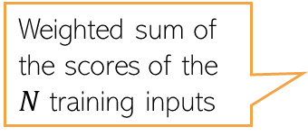
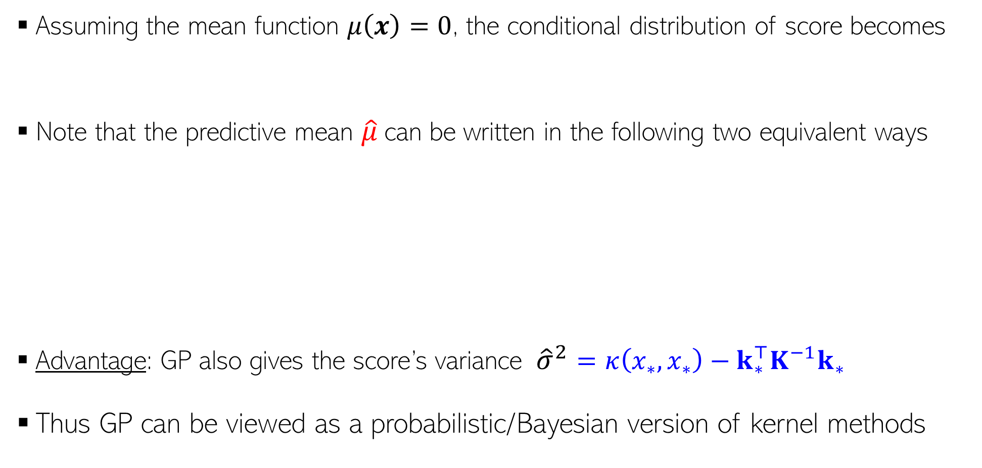
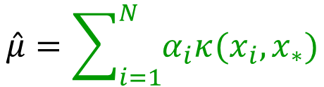


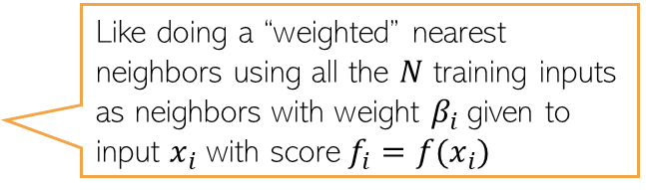
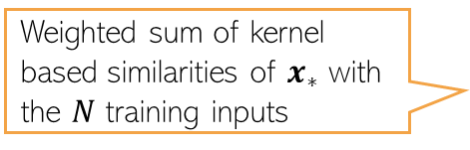
Gaussian Process: The Predictive Model
10
Assuming the mean function $μ\left(x\right)=0$, the conditional distribution of score becomes
Note that the predictive mean $\hat{μ}$can be written in the following two equivalent ways
Advantage: GP also gives the score’s variance ${\hat{σ}}^{2}=κ\left(x_{∗},x_{∗}\right)−k_{∗}^{⊤}K^{−1}k_{∗}$
Thus GP can be viewed as a probabilistic/Bayesian version of kernel methods
$$p\left(f_{∗} | f\right)=𝒩\left(f_{∗}|k_{∗}^{⊤}K^{−1}f,κ\left(x_{∗},x_{∗}\right)−k_{∗}^{⊤}K^{−1}k_{∗}\right)$$
$$=𝒩(f_{∗}|\hat{μ},{\hat{σ}}^{2})$$
Weighted sum of the scores of the $N$ training inputs
Like doing a “weighted” nearest neighbors using all the $N$ training inputs as neighbors with weight $β_{i}$given to input $x_{i}$ with score $f_{i}=f(x_{i})$
$$\hat{μ}= \sum_{i=1}^{N}{β_{i}f_{i}}$$
Weighted sum of kernel based similarities of $x_{∗}$ with the $N$ training inputs
$$\hat{μ}=\sum_{i=1}^{N}{α_{i}κ(x_{i}, x_{∗})}$$
Methods like kernel regression or kernel SVM have their predictions in this form

Slide 11



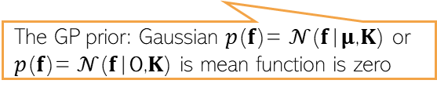



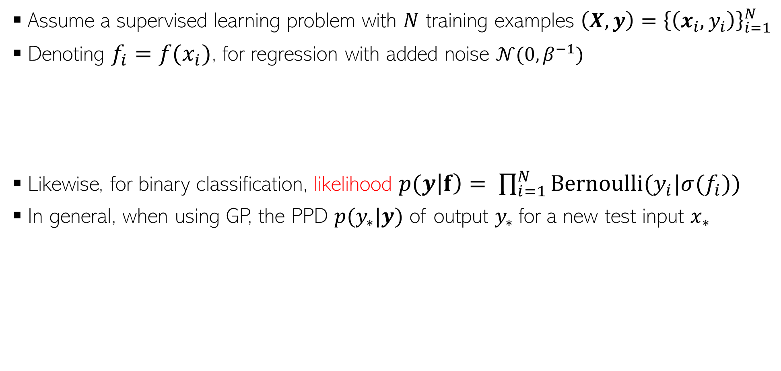
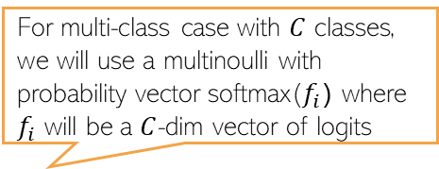
From GP Scores ($f$) to Actual Outputs ($y$)
11
Assume a supervised learning problem with $N$ training examples ${\left(X,y\right)=\left\{\left(x_{i},y_{i}\right)\right\}}_{i=1}^{N}$
Denoting $f_{i}=f(x_{i})$, for regression with added noise $𝒩(0,β^{−1})$
Likewise, for binary classification, likelihood $p(y\left|f\right)= \prod_{i=1}^{N}{Bernoulli(y_{i}|σ(f_{i}))}$
In general, when using GP, the PPD $p(y_{∗}|y)$ of output $y_{∗}$for a new test input $x_{∗}$
This GP score $f_{i}=f(x_{i})$ is the mean of this Gaussian likelihood
$$y_{i}=f_{i}+ε_{i}$$
$${p(y}_{i}\left|f_{i}\right)=𝒩(y_{i}|f_{i},β^{−1})$$
The likelihood function for all the training outputs (assuming i.i.d.)
For multi-class case with $C$ classes, we will use a multinoulli with probability vector softmax($f_{i}$) where $f_{i}$ will be a $C$-dim vector of logits
$$p(y\left|f\right)=𝒩(y|f,β^{−1}I_{N})$$
Averaging over $f$
Likelihood function for training output
$$p\left(y_{∗} | y\right)=∫p\left(y_{∗} | f_{∗}\right)p\left(f_{∗},f\right|y)dfdf_{∗}$$
The GP posterior
GP predictive: Always a Gaussian
$$p\left(f | y\right)∝p\left(f\right)p(y|f)$$
Skipping the training and test inputs from the PPD notation
Likelihood
The GP posterior
$$=∫p\left(y_{∗} | f_{∗}\right)p\left(f_{∗} | f\right)p\left(f | y\right)dfdf_{∗}$$
The GP prior: Gaussian $\text{p}\text{(}\text{f}\text{)= }\text{𝒩}\text{(}\text{f}\text{|}\text{μ}\text{,}\text{K}\text{)}$ or $\text{p}\text{(}\text{f}\text{)= }\text{𝒩}\text{(}\text{f}\text{|}\text{0}\text{,}\text{K}\text{)}$ is mean function is zero

Slide 12


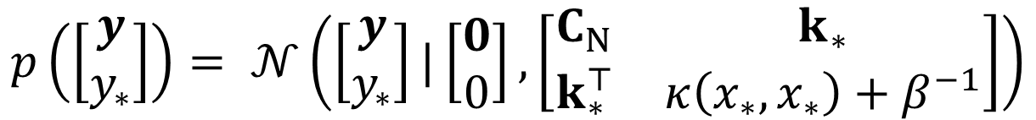
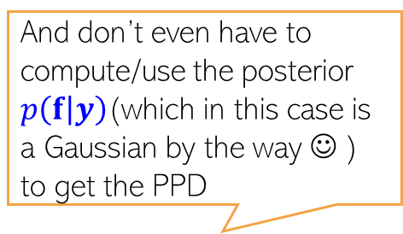



GP Prediction with Gaussian Likelihood
12
And don’t even have to compute/use the posterior $p\left(f | y\right)$(which in this case is a Gaussian by the way ☺ ) to get the PPD
In general, the PPD when using GP is defined as
For Gaussian likelihood (and fixed hyperparams), we don’t need to do above integral
Reason: The marginal likelihood is Gaussian
$p\left(y_{∗} | y\right)$is almost identical to $p\left(f_{∗} | f\right)$ with $K$ replaced by $C_{N}$ + extra $β^{−1}$ noise variance
$$p\left(y_{∗} | y\right)=∫p\left(y_{∗} | f_{∗}\right)p\left(f_{∗} | f\right)p\left(f | y\right)dfdf_{∗}$$
Assuming zero mean function
GP prior
Gaussian likelihood (assuming $β$ is fixed)
$$p(y\left|f\right)=𝒩(y|f,β^{−1}I_{N})$$
$$\text{p}\text{(}\text{f}\text{)= }\text{𝒩}\text{(}\text{f}\text{|}0\text{,}\text{K}\text{)}$$
Marginal likelihood of training outputs
$$p\left(y\right)=∫p\left(y | f\right)p\left(f\right)df$$
$$=𝒩\left(y | 0,K+β^{−1}I_{N}\right)=𝒩\left(y | 0,C_{N}\right)$$
Marginal likelihood of training and test outputs
$$p\left(\left[\begin{aligned}y \\ y_{∗}\end{aligned}\right]\right)= 𝒩\left(\left[\begin{aligned}y \\ y_{∗}\end{aligned}\right]|\left[\begin{aligned}0 \\ 0\end{aligned}\right],\left[\begin{matrix}C_{N} & k_{∗} \\ k_{∗}^{⊤} & κ\left(x_{∗},x_{∗}\right)+β^{−1}\end{matrix}\right]\right)$$
PPD obtained using joint to conditional results of Gaussians
$$p\left(y_{∗} | y\right)=𝒩\left(y_{∗}|k_{∗}^{⊤}C_{N}^{−1}y,κ\left(x_{∗},x_{∗}\right)−k_{∗}^{⊤}C_{N}^{−1}k_{∗}+β^{−1}\right)$$

Slide 13

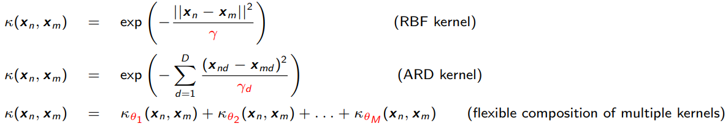
Learning Hyperparameters in GP based Models
13
Can learn the hyperparameters of the GP prior as well as of the likelihood model
Assuming $μ=0$, the hyperparams of GP are cov/kernel function hyperparams
MLE-II is a popular choice for learning these hyperparams (otherwise MCMC, VI, etc)
Denoting the covariance/kernel matrix as $K_{θ}$, for Gaussian likelihood case, the marg-lik
This can be maximized to learn $θ$ and $β$
For non-Gaussian likelihoods, the marg-lik itself will need to be approximated
Ability to learn kernel hyperparams (without cross-valid) is another very appealing property of GP
Can help in feature selection (irrelevant features will tend to have very large $γ_{d}$)
Different RBF kernel bandwidth $γ_{d}$ for each feature
$$p\left(y|θ,β^{−1}\right)=𝒩\left(y | 0,K_{θ}+β^{−1}I_{N}\right)$$

Slide 14
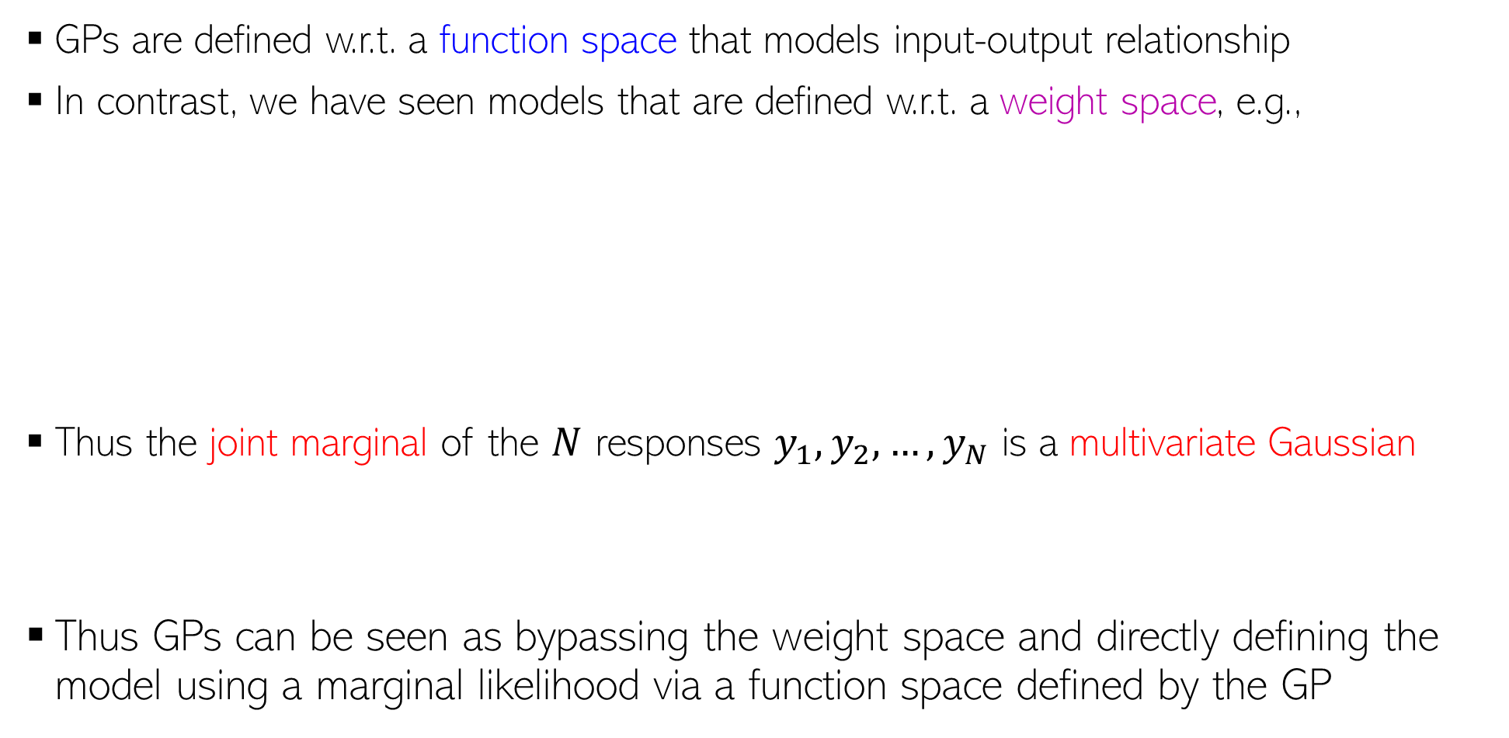
Weight Space View vs Function Space View
14
GPs are defined w.r.t. a function space that models input-output relationship
In contrast, we have seen models that are defined w.r.t. a weight space, e.g.,
Thus the joint marginal of the $N$ responses $y_{1},y_{2},…,y_{N}$ is a multivariate Gaussian
Thus GPs can be seen as bypassing the weight space and directly defining the model using a marginal likelihood via a function space defined by the GP
$$p\left(y | X,w\right)= 𝒩(y|Xw,β^{−1}I_{N})$$
Likelihood
Marginal likelihood after integrating out the weights
$$p(w)= 𝒩(w|μ_{0},Σ_{0})$$
Prior over weight vector
$$p\left(y | X\right)=∫p\left(y | X,w\right)p\left(w\right)dw=𝒩(y|Xμ_{0},β^{−1}I_{N}+XΣ_{0}X^{⊤})$$
$$p\left(y | X\right)=𝒩(y|0,β^{−1}I_{N}+XX^{⊤})$$
Marginal likelihood assuming $μ_{0}=0$ and $Σ_{0}=I$
$$p\left(y | X\right)=𝒩(y|0, XX^{⊤})$$
Assuming noise-free likelihood
This equivalence also shows that Bayesian linear regression is a special case of GP with linear kernel
$$p\left(\left[\begin{aligned}y_{1} \\ y_{2} \\ ⋮ \\ y_{N}\end{aligned}\right]\right)= 𝒩\left(\left[\begin{aligned}0 \\ 0 \\ ⋮ \\ 0\end{aligned}\right],\left[\begin{matrix}\begin{aligned}x_{1}^{⊤}x_{1} \\ x_{2}^{⊤}x_{1}\end{aligned} & ⋯ & \begin{aligned}x_{1}^{⊤}x_{N} \\ x_{2}^{⊤}x_{N}\end{aligned} \\ ⋮ & ⋱ & ⋮ \\ x_{N}^{⊤}x_{1} & ⋯ & x_{N}^{⊤}x_{N}\end{matrix}\right]\right)$$
Same as a GP $f(x_{i}) = y_{i}$, $μ\left(x\right)=0$ and linear covariance/kernel function ${κ\left(x_{i}, x_{j}\right)= x}_{i}^{⊤}x_{j}$

Slide 15



Scalability of GPs
15
Computational costs in some steps of GP models scale in the size of training data
For example, prediction cost is $O(N)$
GP models often require matrix inversions (e.g., in marg-lik computation when estimating hyperparameters) – takes $O(N^{3})$
Storage also requires $O(N^{2})$ since need to store the covariance matrix
A lot of work on speeding up GPs¹. Some prominent approaches include
  Inducing Point Methods (condition predictions only on a small set of “learnable” points)
  Divide-and-Conquer (learn GP on small subsets of data and aggregate predictions)
  Kernel approximations
Note that nearest neighbor methods and kernel methods also face similar issues
  Many tricks to speed up kernel methods can be used for speeding up GPs too
$O(N)$ cost assuming $C_{N}$ is already inverted
$$p\left(y_{∗} | y\right)=𝒩(y_{∗}|\hat{μ},{\hat{σ}}^{2})$$
$$\hat{μ}=k_{∗}^{⊤}C_{N}^{−1}y$$
$${\hat{σ}}^{2}=κ\left(x_{∗},x_{∗}\right)−k_{∗}^{⊤}C_{N}^{−1}k_{∗}+β^{−1}$$
$M≪N$ pseudo-inputs and pseudo-outputs
¹When Gaussian Process Meets Big Data: A Review of Scalable GPs - Liu et al, 2018

Slide 16
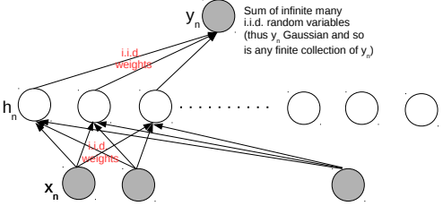
Neural Networks and Gaussian Process
16
An infinitely-wide single hidden layer NN with i.i.d. priors on weights = GP
Shown formally by (Neal², 1994). Based on applying the central limit theorem
This equivalence is useful for several reasons
  Can use a GP instead of an infinitely wide Bayesian NN (which is impractical anyway)
  With GPs, inference is easy (at least for regression and with known hyperparams)
  A proof that GPs can also learn any function (just like infinitely wide neural nets - Hornik’s theorem)
Connection generalized to infinitely wide multiple hidden layer NN (Lee et al³, 2018)
²Priors for infinite networks, Tech Report, 1994
³Deep Neural Networks as Gaussian Processes (ICLR 2018)

Slide 17
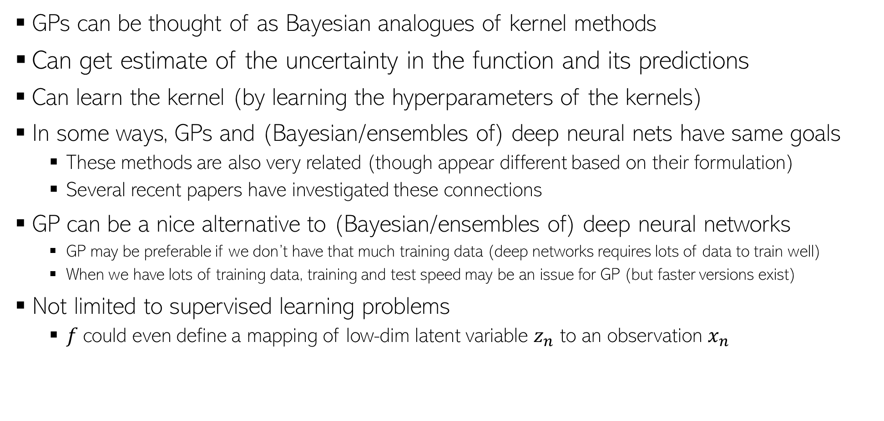

GP: Some other comments
17
GPs can be thought of as Bayesian analogues of kernel methods
Can get estimate of the uncertainty in the function and its predictions
Can learn the kernel (by learning the hyperparameters of the kernels)
In some ways, GPs and (Bayesian/ensembles of) deep neural nets have same goals
  These methods are also very related (though appear different based on their formulation)
  Several recent papers have investigated these connections
GP can be a nice alternative to (Bayesian/ensembles of) deep neural networks
  GP may be preferable if we don’t have that much training data (deep networks requires lots of data to train well)
  When we have lots of training data, training and test speed may be an issue for GP (but faster versions exist)
Not limited to supervised learning problems
  $f$could even define a mapping of low-dim latent variable $z_{n}$ to an observation $x_{n}$
$$x_{n}=f\left(z_{n}\right)+"noise"$$
GP latent variable model for dimensionality reduction (like a kernel version of probabilistic PCA)

Slide 18

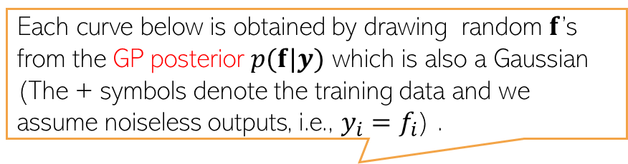

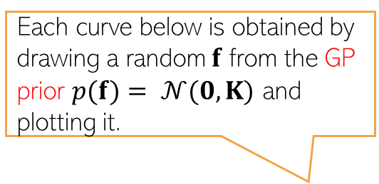
GP: A Visualization
18
Assumed zero mean function and a squared exponential kernel
Shaded area shows the predictive uncertainty for each of the test inputs (+/- 2 std)
Each curve below is obtained by drawing a random $f$ from the GP prior $p(f)= 𝒩(0,K)$ and plotting it.
Each curve below is obtained by drawing random $f$’s from the GP posterior $p(f|y)$ which is also a Gaussian (The + symbols denote the training data and we assume noiseless outputs, i.e., $y_{i}=f_{i}$) .
$K$is the kernel matrix of a finite number of inputs represented on the x axis (say 100 equi-spaced points between -5 and 5). $f$ will be a vector of $f$’s values at these inputs
$$f$$
$$y=f$$
$$x$$
$$x$$
Figure courtesy: MLAPP (Murphy)

Slide 19
GP packages
19
Many mature implementations of GP exist. You may check out
  GPyTorch (PyTorch), GPFlow (Tensorflow)
  sklearn (Python with some basic GP implementations)
  GPML (MATLAB), GPsuff (MATLAB/Octave)
  Many others such as Stan, GPJax
A comparison of the various packages: https://en.wikipedia.org/wiki/Comparison_of_Gaussian_process_software

