Slide 1
Logistic/Softmax Classification, Laplace’s Approximation
CS772A: Probabilistic Machine Learning
Piyush Rai

Slide 2
Plan today
Logistic and Softmax Classification, Generalized Linear Models
Laplace’s approximation: A method to approximate posterior for non-conjugate cases

Slide 3
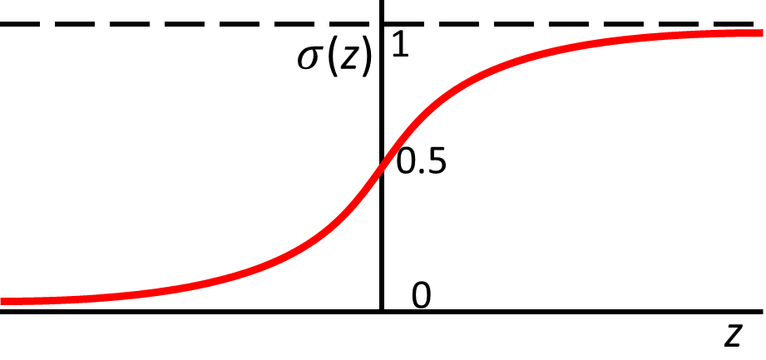
Logistic Regression
There are other ways too that can convert the score into a probability, such as a CDF:
$p\left(y=1 | x,w\right)=μ=Φ\left(w^{⊤}x\right)$ where $Φ$ is the CDF of $𝒩(0,1)$. This model is known as “Probit Regression”.
3
A discriminative model for binary classification ($y∈\{0,1\}$)
A linear model with parameters $w∈ℝ^{D}$ computes a score $w^{⊤}x$ for input $x$
A sigmoid function maps this real-valued score into probability of label being $1$
Thus conditional distribution of label $y∈\{0,1\}$given $x$is the following Bernoulli
NLL is the binary cross-entropy loss: $−[y_{n}log μ_{n}+\left(1−y_{n}\right)log \left(1−μ_{n}\right)]$
NLL is convex in $w$. Can also use a prior $p\left(w | λ\right)=𝒩\left(w|0,λ^{−1}I\right)$ if interested in MAP or full posterior on $w$
Also used as a nonlinear “activation function” in deep neural networks
$$σ\left(z\right)= \frac{1}{1+exp(−z)}=\frac{exp(z)}{1+exp(z)}$$
$$p\left(y=1 | x,w\right)=μ=σ\left(w^{⊤}x\right)$$
Large positive score $w^{⊤}x$ means large prob of label being 1, and large negative score means low prob
real-valued score
Likelihood
$$p\left(y | x,w\right)= Bernoulli\left[y | μ\right]=μ^{y}{\left(1−μ\right)}^{1−y}={\left[\frac{\exp\left(w^{⊤}x\right)}{1+\exp\left(w^{⊤}x\right)}\right]}^{y}{\left[\frac{1}{1+\exp\left(w^{⊤}x\right)}\right]}^{1−y}$$

Slide 4
Multiclass Logistic (a.k.a. Softmax) Regression
4
Also called multinoulli/multinomial regression: Basically, LR for $K > 2$classes
In this case, $y_{n}∈\left\{1,2,…,K\right\}$ and label probabilities are defined as
$K$ weight vecs $w_{1},w_{2},…,w_{K}$(one per class), each $D$-dim, and $W=[w_{1},w_{2},…,w_{K}]$
Each likelihood $p\left(y_{n} | x_{n},W\right)$is a multinoulli distribution. Therefore total likelihood
Softmax function
Real-valued scores $w_{k}^{⊤}x_{n}$ are also known as “logits” (thus $K$ logits for each input)
$$p\left(y_{n}=k | x_{n},W\right)= \frac{exp(w_{k}^{⊤}x_{n})}{\sum_{ℓ=1}^{K}{exp(w_{ℓ}^{⊤}x_{n})}}=μ_{nk}$$
Also note that $\sum_{ℓ=1}^{K}{μ_{nℓ}}$ =1 for any input $x_{n}$
$$p\left(y|X,W\right)= \prod_{n=1}^{N}{\prod_{ℓ=1}^{K}{μ_{nℓ}^{y_{nℓ}}}}$$
Notation: $y_{nℓ}$ = 1 if true class of $x_{n}$ is $ℓ$ and $y_{nℓ^{′}}$ = 0 $∀ ℓ^{′}$ $≠ℓ$

Slide 5
Generalized Linear Models
5
(Probabilistic) Linear Regression: when response $y$ is real-valued
Logistic Regression: when response $y$ is binary (0/1)
Both are examples of a Generalized Linear Model (GLM)
The model depends on the inputs $x$ via a linear model $w^{⊤}x$
GLM is defined using an exponential family distribution
ExpFam can be any suitable distribution depending on the nature of outputs, e.g.,
Gaussian for reals, Bernoulli for binary, Poisson for Count, gamma for positive reals
ExpFam distributions are more generally useful in other contexts as well
$$p\left(y | x,w\right)= 𝒩(y|w^{⊤}x, β^{−1})$$
$$p\left(y | x,w\right)= Bernoulli\left[y | σ(w^{⊤}x)\right]={\left[\frac{\exp\left(w^{⊤}x\right)}{1+\exp\left(w^{⊤}x\right)}\right]}^{y}{\left[\frac{1}{1+\exp\left(w^{⊤}x\right)}\right]}^{1−y}$$
MLE/MAP of $w$ is easy for GLMs (due to convex objective, thanks to exp-family). Posterior usually requires approximations if likelihood and prior are not conjugate pairs (Laplace approximation or other methods used)
$$p\left(y | x,w\right)=ExpFam[y|f\left(w^{⊤}x\right)]$$

Slide 6
Logistic Regression: MAP and Posterior
6
The posterior will be
MAP estimation is easy. $−log p\left(w | X,y\right)$ is convex for LR. Unique minima
Can use first or second order optimization with gradient and Hessian being
Full posterior is intractable because of non-conjugacy
A popular option is to use the Laplace’s approximation (other methods like MCMC and variational inference can also be used; will see them later)
Gaussian
Bernoulli
$$p\left(w | X,y\right)= \frac{p\left(w\right)p(y|X,w)}{p(y|X)}=\frac{p\left(w\right)\prod_{n=1}^{N}{p(y_{n}|w,x_{n})}}{\int{p\left(w\right)\prod_{n=1}^{N}{p(y_{n}|w,x_{n})}dw}}$$
$$μ_{n}=σ(w^{⊤}x_{n})$$

Slide 7
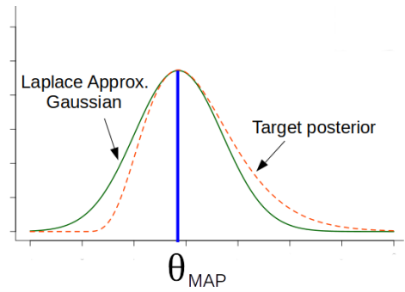
Laplace’s Approximation
7
Consider a posterior distribution that is intractable to compute
Laplace approximation approximates the above using a Gaussian distribution
Laplace’s approx. is based on a second-order Taylor approx. of the posterior
$$p\left(θ | 𝒟\right)= \frac{p(𝒟,θ)}{p(𝒟)}=\frac{p(𝒟|θ)p\left(θ\right)}{p(𝒟)}$$
Tells us about the space (curvature) of the true posterior around $θ_{MAP}$
Related to the Fisher Information Matrix (FIM); will see shortly
$$p\left(θ | 𝒟\right)≈𝒩(θ|θ_{MAP},Λ^{−1})$$
Negative of the Hessian, i.e., the second derivative of the log joint, at $θ_{MAP}$
$$θ_{MAP}= {argmax}_{θ} log p(θ|𝒟)$$
$$Λ=− ∇_{θ}^{2} log p\left(θ | 𝒟\right){\left.​\right|}_{θ=θ_{MAP}}=−∇_{θ}^{2} log p(𝒟,θ){\left.​\right|}_{θ=θ_{MAP}}$$

Slide 8
Derivation of the Laplace’s Approximation
$$p\left(𝒟\right)≈ exp\left(log p\left(𝒟,θ_{MAP}\right)\right){×\left(2π\right)}^{D/2}det{\left(Λ\right)}^{1/2}$$
Let’s write the Bayes rule as
Consider second-order Taylor approximation of a function $f\left(θ\right)$ around some $θ_{0}$
Assuming $f\left(θ\right)= log p(𝒟,θ)$ and $θ_{0}=θ_{MAP}$
,
We also get a Laplace approximation of the marginal likelihood (for free!)
$$p\left(θ | 𝒟\right)= \frac{p(𝒟,θ)}{p(𝒟)}=\frac{p(𝒟,θ)}{∫p\left(𝒟,θ\right)dθ}$$
$$=\frac{exp[log p\left(𝒟,θ\right)]}{∫exp[log p\left(𝒟,θ\right)]dθ}$$
Note: Sometimes marginal likelihood is also called model evidence
$$f\left(θ\right)≈f\left(θ_{0}\right)+{\left(θ−θ_{0}\right)}^{⊤}∇_{θ}f\left(θ_{0}\right)+ \frac{1}{2}{\left(θ−θ_{0}\right)}^{⊤}∇_{θ}^{2}f(θ_{0})\left(θ−θ_{0}\right)$$
Purely quadratic in $θ$
Same as $∇^{2}log p(θ_{MAP}|𝒟)$
Constant w.r.t. $θ$
$$log p(𝒟,θ)≈log p(𝒟,θ_{MAP})+ \frac{1}{2}{\left(θ−θ_{MAP}\right)}^{⊤}∇_{θ}^{2}log p(𝒟,θ_{MAP})\left(θ−θ_{MAP}\right)$$
$$p\left(θ | 𝒟\right)∝ exp\left[−\frac{1}{2}{\left(θ−θ_{MAP}\right)}^{⊤}(−∇_{θ}^{2}log p\left(𝒟,θ_{MAP}\right))\left(θ−θ_{MAP}\right)\right]$$
$$= 𝒩(θ|θ_{MAP},Λ^{−1})$$
$$(where Λ= −∇_{θ}^{2}log p\left(𝒟,θ_{MAP}\right)=−H)$$

Slide 9
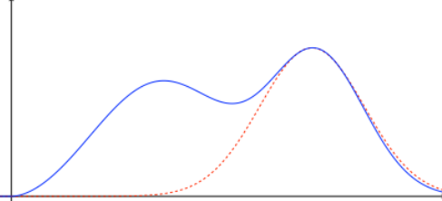
Properties of Laplace’s Approximation
9
Straightforward if posterior’s derivatives (first/second) can be computed easily
Expensive if parameter $θ$ is very high dimensional
Reason: We need to compute and invert Hessian of size $D×D$ ($D$ is the # of params)
Can do badly if the (true) posterior is multimodal
Used only when $θ$ is a real-valued vector (because of Gaussian approximation)
Note: Even if we have a non-probabilistic model (loss function + regularization), we can obtain an approx “posterior” for that model using the Laplace’s approximation
Optima of the regularized loss function will be Gaussian’s mean
Inverse of the second derivative of the regularized loss function will be covariance matrix
E.g., a deep neural network, or even in simpler models (e.g., logistic reg with a very large number of features
If $K$ local modes, then define the approx. posterior as a mixture of $K$ Gaussians
$$p\left(θ | D\right)≈\sum_{k=1}^{K}{π^{(k)}𝒩(θ|θ_{MAP}^{\left(k\right)}, H^{{\left(k\right)}^{−1}})}$$
(see paper cited below for details)
For multimodal posteriors, can use a mixture of Laplace approximations*
Useful for deep learning models
True posterior
Gaussian approximation
*Mixtures of Laplace Approximations for Improved Post-Hoc Uncertainty in Deep Learning (Eschenhagen et al, 2021)

Slide 10
Detour: Hessian and Fisher Information Matrix
10
Hessian is related to the Fisher Information Matrix (FIM)
Gradient of the log likelihood is also called score function: $s\left(θ\right)=∇_{θ} log p(y|θ)$
Note: At some places (some generative models) $∇_{y} log p(y|θ)$ also called score function
Expectation of score function is zero: $𝔼_{p(y|θ)}\left[s\left(θ\right)\right]=0$ (exercise)
Fisher Information Matrix (FIM) is covariance matrix of score function
$F=−$ $𝔼_{p(y|θ)} \left[∇_{θ}^{2}log p\left(y | θ\right)\right]$, i.e., negative of expected Hessian (exercise)
Each entry $F_{ij}$ tells us how “sensitive” the model is w.r.t. the pair ($θ_{i}, θ_{j}$)
Each diagonal entry $F_{ii}={(∇}_{θ_{i}} log p{\left(y | θ\right))}^{2}$ tells “important” $θ_{i}$ is by itself
Can compute empirical FIM using data: $\hat{F}=\frac{1}{N}\sum_{n=1}^{N}{\left[∇_{θ} log p(y_{n}|θ){∇_{θ} log p(y_{n}|θ)}^{⊤}\right]}$
$$F=𝔼_{p(y|θ)}\left[\left(s\left(θ\right)−0\right){\left(s\left(θ\right)−0\right)}^{⊤}\right]$$
$$=𝔼_{p(y|θ)}\left[∇_{θ} log p(y|θ){∇_{θ} log p(y|θ)}^{⊤}\right]$$
Note: If we have a prior $p\left(θ\right)$ too, then also add the second derivative of $log p(θ)$

Slide 11
Laplace Approx. for High-Dimensional Problems
11
For high-dim $θ$, Laplace’s approx $p\left(θ | 𝒟\right)≈𝒩(θ|θ_{MAP},Λ^{−1})$ can be expensive
Many methods to address this, e.g.,
Use a diagonal of (empirical) Fisher as the precision
Use a block-diagonal approximation* of $Λ$ (better than diagonal approx)
For deep nets, use LA only for some weights + point estimates for others
Option 1: Use LA only for last layer weights - “last layer Laplace’s approximation” (LLLA)
Option 2: Use LA for weights from an identified “subnetwork”
See the “Laplace Redux” paper for more options and discussion on scalability of LA
Diagonal approximation assumes that the weights are all independent whereas block-diagonal assumes that the weights within each block may have correlations
$$Λ≈diag(F)$$
*KFAC paper: “A Scalable Laplace Approximation for Neural Networks” (Ritter et al, ICLR 2018)
*Laplace Redux -- Effortless Bayesian Deep Learning ” (Daxberger et al, NeurIPS 2021)

Slide 12
PPD when using Laplace’s Approximation
12
The PPD when using the Laplace’s approximation of the posterior
PPD may be intractable depending on the form of $p\left(y_{∗} | x_{∗},θ\right)=p(y_{∗}|f\left(x_{∗}, θ\right))$
We can use further approximations if the integral is intractable. Two options:
Generate $M$ samples ${\left\{θ^{\left(i\right)}\right\}}_{i=1}^{M}$from $𝒩\left(θ | θ_{MAP},Λ^{−1}\right)$ and compute a Monte Carlo approx.
Use the GGN approximation of LA. Equivalent to using a “linearlized” model for $p\left(y_{∗} | x_{∗},θ\right)$, using which we can easily compute PPD using linear Gaussian model results
$$p\left(y_{∗} | x_{∗},𝒟\right)=∫p(y_{∗}|x_{∗},θ)p\left(θ | 𝒟\right)dθ$$
This PPD is an approximation because we are using an approximation of the posterior
$$≈∫p(y_{∗}|x_{∗},θ)𝒩(θ|θ_{MAP},Λ^{−1})dθ$$
$$∫p\left(y_{∗} | x_{∗},θ\right)𝒩\left(θ | θ_{MAP},Λ^{−1}\right)dθ≈ \frac{1}{M}\sum_{i=1}^{M}{p\left(y_{∗} | x_{∗},θ^{(i)}\right)}$$
Using MC approximation is the general purpose option when computing intractable PPD
Generalized Gauss-Newton method

Slide 13
Detour: Gradient and Hessian
13
For LA (and for optimization general), we need $∇_{θ} log p(𝒟,θ)$ and $∇_{θ}^{2} log p(𝒟,θ)$
These depend on the likelihood function, $p(y|x,θ)=p(y|f\left(x,θ\right))$
The form of the function $f$ depends on the likelihood model. Some examples:
Assume $y$ and $f= f\left(x,θ\right)$ both to be vectors of size $C$, $θ∈ℝ^{P}$ and define
$$p(y|x,θ)=𝒩(y|θ^{⊤}x, σ^{2})$$
$$p(y|x,θ)=multinoulli(y|softmax(θ^{⊤}x))$$
$$p(y|x,θ)=𝒩(y|NN(x,θ), σ^{2})$$
$$p(y|x,θ)=multinoulli(y|softmax(NN(x,θ)))$$
Jacobian of size $C×P$ with ${\left[𝒥_{θ}\left(x\right)\right]}_{ci}=∇_{θ_{i}}f_{c}(x,θ)$
Hessian of size $C×P×P$ with ${\left[ℋ_{θ}\left(x\right)\right]}_{cij}=∇_{θ_{i}}∇_{θ_{j}}f_{c}(x,θ)$
$r\left(y;f\right)=∇_{f}$ $log p\left(y | f\right)$
$$𝒥_{θ}\left(x\right)=∇_{θ}f$$
$$ℋ_{θ}\left(x\right)=∇_{θ}^{2}f$$
$$L\left(y;f\right)={−∇}_{f}^{2}log p\left(y | f\right)$$
$$∇_{θ} log p\left(y | f\left(x,θ\right)\right)=𝒥_{θ}{\left(x\right)}^{⊤} r(y;f)$$
$$∇_{θ}^{2} log p\left(y | f\left(x,θ\right)\right)=ℋ_{θ}{\left(x\right)}^{⊤} r\left(y;f\right)−𝒥_{θ}{\left(x\right)}^{⊤} L(y;f)𝒥_{θ}\left(x\right)$$

Slide 14
Generalized Gauss-Newton (GGN) Approximation
14
The Hessian of the log-likelihood turned out to be
Ignoring the term involving $ℋ_{θ}\left(x\right)=∇_{θ}^{2}f$, we have an approximation
This is called the Generalized Gauss-Newton (GGN) approximation* of the precision matrix used in Laplace Approximation
We can further apply diagonal or block-diagonal approximations for efficiency*
GGN is also equivalent to approximating $f= f\left(x,θ\right)$ by a linear function of $θ$
$$∇_{θ}^{2} log p\left(y | f\left(x,θ\right)\right)=ℋ_{θ}{\left(x\right)}^{⊤} r\left(y;f\right)−𝒥_{θ}{\left(x\right)}^{⊤} L(y;f)𝒥_{θ}\left(x\right)$$
This approximation of the Hessian is guaranteed to be positive semi-definite unlike the original Hessian because $−log p(y|f(x,θ))$ may not be convex in $θ$
$$∇_{θ}^{2} log p\left(y | f\left(x,θ\right)\right)≈−𝒥_{θ}{\left(x\right)}^{⊤} L(y;f)𝒥_{θ}\left(x\right)$$
Reason: $ℋ_{θ}\left(x\right)$ will be 0 for a linear function
Gradient vector acting as “features” in this linear model
Gradient of $f$ at $θ=θ_{MAP}$
Not the gradient of the (log)likelihood – that gradient is zero at $θ_{MAP}$
A linear function of $θ$
Makes PPD easy to compute when using Laplace approximation
A nonlinear function, e.g., a neural net, approximated by a linear function
$$f\left(x_{∗}, θ\right)≈f\left(x_{∗},θ_{MAP}\right)+∇_{θ_{MAP}}f^{⊤}\left(θ−θ_{MAP}\right)=f_{lin}(x_{∗}, θ)$$
*Improving predictions of Bayesian neural nets via local linearization (Immer et al, 2021)

Slide 15
PPD with GGN/Linearized Laplace’s Approximation
15
Assuming $p(y|x,θ)=p(y|f\left(x,θ\right))$, LA based PPD is
We can use GGN and Linearized Laplace idea in two ways for the above PPD
Use $f\left(x_{∗},θ\right)$ but use $𝒩(θ|θ_{MAP},Λ_{GGN}^{−1})$ as approx post instead $𝒩(θ|θ_{MAP},Λ^{−1})$
May require Monte Carlo integration if PPD integral is intractable (e.g., if $f$ is a neural net or non-lin func)
Less commonly used and is less accurate*
Use $f_{lin}(x_{∗}, θ)$ instead of $f\left(x_{∗},θ\right)$ and also use $𝒩(θ|θ_{MAP},Λ_{GGN}^{−1})$ as approx. post.
Assuming $p\left(y_{∗} | f\left(x_{∗},θ\right)\right)= 𝒩\left(y_{∗} | f_{lin}(x_{∗}, θ),β^{−1}\right)$ for scalar-valued regression
$$p\left(y_{∗} | x_{∗},𝒟\right)=∫p(y_{∗}|f\left(x_{∗},θ\right))p\left(θ | 𝒟\right)dθ$$
$$≈∫p(y_{∗}|f\left(x_{∗},θ\right))𝒩(θ|θ_{MAP},Λ^{−1})dθ$$
Linear transformation of $θ$ with $p\left(θ|𝒟\right)= 𝒩(θ|θ_{MAP},Λ_{GGN}^{−1})$ and Gaussian noise $ε∼𝒩(0,β^{−1})$
Even though $f\left(x_{∗},θ\right)$ is a complex function like neural net, using linearlized Laplace approx, we get PPD in closed form
$$y_{∗}≈ f_{lin}(x_{∗}, θ)+ε$$
$$p\left(y_{∗} | x_{∗},𝒟\right)≈ 𝒩\left(y_{∗} | f\left(x_{∗}, θ_{MAP}\right), {∇_{θ_{MAP}}f^{⊤}Λ_{GGN}^{−1}∇_{θ_{MAP}}f+β}^{−1}\right)$$
*‘In-Between’ Uncertainty in Bayesian Neural Networks (Foong et al, 2019),
*Improving predictions of Bayesian neural nets via local linearization (Immer et al, 2021)

Slide 16
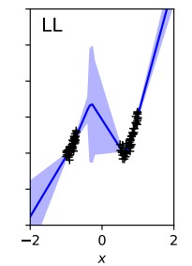
Standard Laplace vs Linearlized Laplace
16
Standard LA based PPD is usually computed using Monte Carlo sampling
If the samples $θ^{\left(i\right)}$ don’t come from high-prob regions of the posterior, the above PPD may have poor accuracy (often happens for high-dim posteriors)
Linearlized Laplace based PPD is computed as
Linearlized Laplace based PPD typically is reasonably accurate and sometimes even more accurate than standard LA with PPD computed using MC sampling*
$$p\left(y_{∗} | x_{∗},𝒟\right)≈∫p\left(y_{∗} | f(x_{∗},θ)\right)𝒩\left(θ | θ_{MAP},Λ^{−1}\right)dθ≈ \frac{1}{M}\sum_{i=1}^{M}{p\left(y_{∗} | f(x_{∗},θ^{\left(i\right)})\right)}$$
$$p\left(y_{∗} | x_{∗},𝒟\right)≈ 𝒩\left(y_{∗} | f\left(x_{∗}, θ_{MAP}\right), {∇_{θ_{MAP}}f^{⊤}Λ_{GGN}^{−1}∇_{θ_{MAP}}f+β}^{−1}\right)$$
‘In-Between’ Uncertainty in Bayesian Neural Networks (Foong et al, 2019),
Improving predictions of Bayesian neural nets via local linearization (Immer et al, 2021)

Slide 17
Logistic Regression PPD using Monte Carlo
17
The posterior predictive distribution can be computed as
Monte-Carlo approximation of this integral is one possible way
Draw 𝑀 samples $w_{1}, w_{2}, …, w_{M}$, from the approx. of posterior
Approximate the PPD as follows
In contrast, when using MLE/MAP solution ${\hat{w}}_{opt}$, the plug-in pred. distribution
$p\left(y_{∗}=1 | x_{∗},X,y\right)=\int{p\left(y_{∗}=1 | {w,x}_{∗}\right)p\left(w | X,y\right)dw}$
Integral not tractable and must be approximated
sigmoid
Gaussian (if using Laplace approx.)
$$p\left(y_{∗}=1 | x_{∗},X,y\right)≈\frac{1}{M}\sum_{m=1}^{M}{p\left(y_{∗}=1 | {w_{m},x}_{∗}\right)}= \frac{1}{M}\sum_{m=1}^{M}{σ(w_{m}^{⊤}x_{n})}$$
$p\left(y_{∗}=1 | x_{∗},X,y\right)=\int{p\left(y_{∗}=1 | {w,x}_{∗}\right)p\left(w | X,y\right)dw}$
$$≈p\left(y_{∗}=1 | {{\hat{w}}_{opt},x}_{∗}\right)=σ({{\hat{w}}_{opt}}^{⊤}x_{n})$$

Slide 18
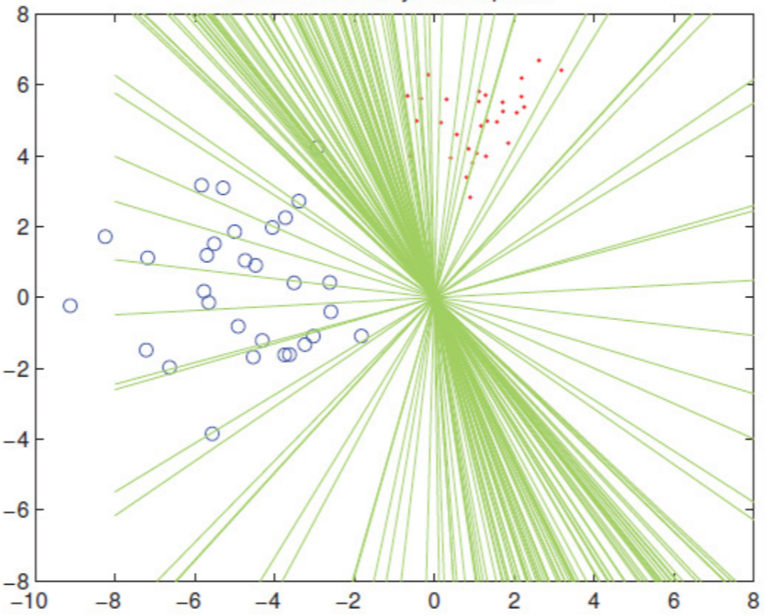
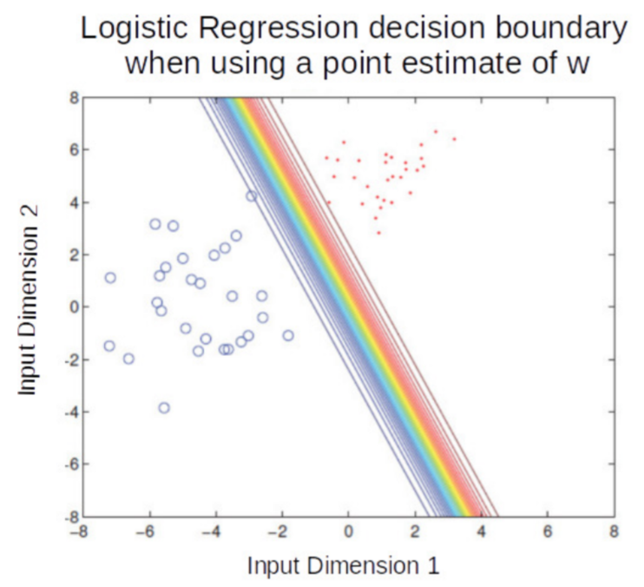
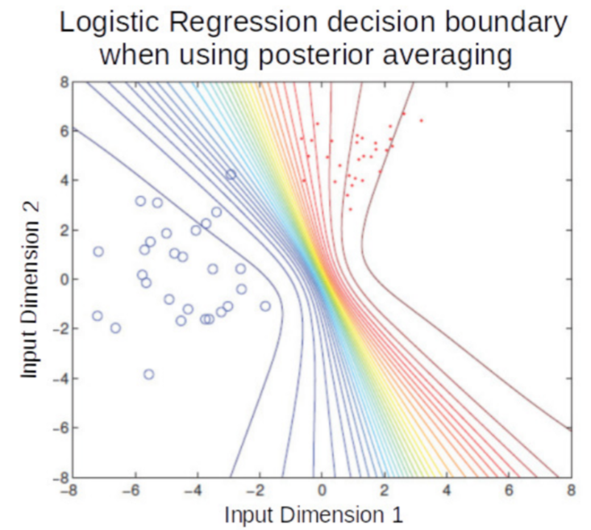
LR: Plug-in Prediction vs Bayesian Averaging
18
Plug-in prediction uses a single $w$ (point est) to make prediction
PPD does an averaging using all possible $w$’s from the posterior
Color transitions (red to blue) in both plots denote how the probability of an input changes from belonging to red class to belonging to blue class. All inputs on a line (or curve on RHS plot)have the same probability of belonging to the red/blue class
Posterior averaging is like using an ensemble of models. In this example, each model is a linear classifier but the ensemble-like effect resulted in nonlinear boundaries
$$p\left(y_{∗}=1 | x_{∗},X,y\right)≈σ({{\hat{w}}_{opt}}^{⊤}x_{n})$$
$$p\left(y_{∗}=1 | x_{∗},X,y\right)≈ \frac{1}{M}\sum_{m=1}^{M}{σ(w_{m}^{⊤}x_{n})}$$

