Slide 1
Linear and Generalized Linear Models for Supervised Learning
CS772A: Probabilistic Machine Learning
Piyush Rai

Slide 2

Plan today
Probabilistic Linear Models for supervised learning (learning $p\left(y | x\right)$)
Focus will be the “discriminative” setting (assume a form and learn $p\left(y | x\right)$ directly)
  Probabilistic Linear Regression
  Logistic and Softmax Classification
  Generalized Linear Models for supervised learning

Slide 3
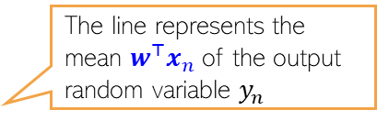


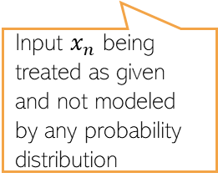
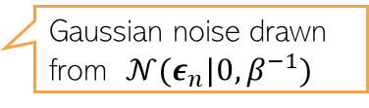



Probabilistic Linear Regression
3
A discriminative model for regression problems
Assume training data ${\{x_{n},y_{n}\}}_{n=1}^{N}$, with features $x_{n}∈ℝ^{D}$ and responses $y_{n}∈ℝ$
Assume $y_{n}$ generated by a noisy linear model with wts $w=\left[w_{1},…, w_{D}\right]∈ℝ^{D}$
Notation alert: $β$ is the precision of Gaussian noise (and $β^{−1}$ the variance)
Unknown to be estimated
Each weight assumed real-valued
$$y_{n}=w^{⊤}x_{n}+ε_{n}$$
Gaussian noise drawn from $𝒩(ε_{n}|0,β^{−1})$
Likelihood model
The line represents the mean $w^{⊤}x_{n}$of the output random variable $y_{n}$
$$p\left(y_{n} | x_{n},w,β\right)=𝒩\left(y_{n}\right|w^{⊤}x_{n},β^{−1})$$
The zero mean Gaussian noise perturbs the output from its mean
Input $x_{n}$ being treated as given and not modeled by any probability distribution
$$y$$
Gaussian
Thus NLL is like squared loss
$$w^{⊤}x_{n}$$
Will later study models in which both input and output are modeled by distributions
$$x$$

Slide 4

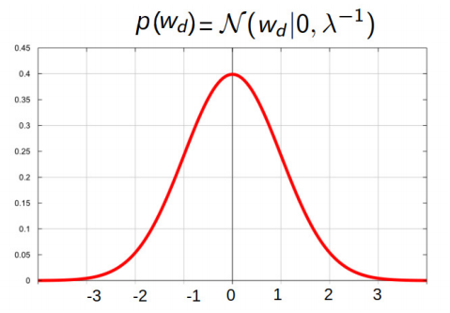
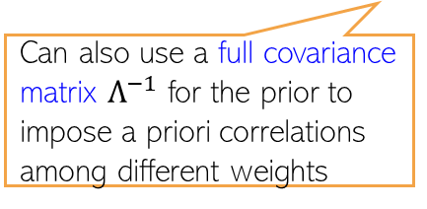

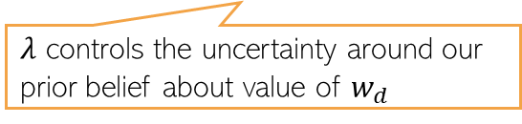
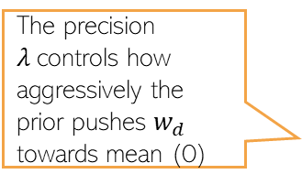

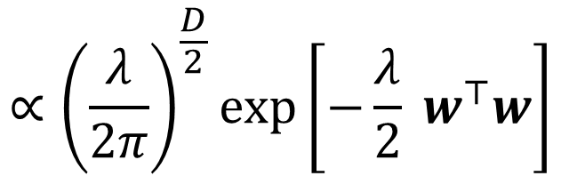
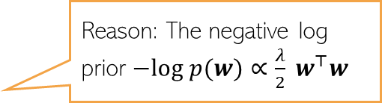

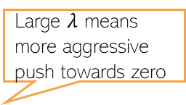
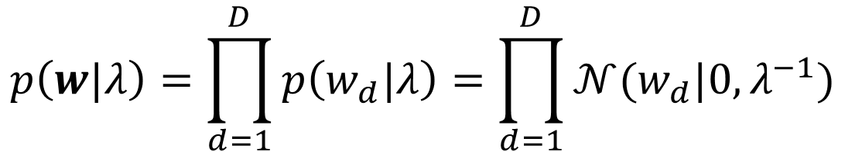
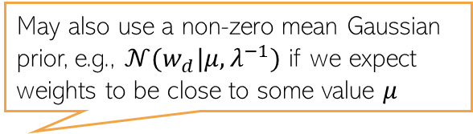
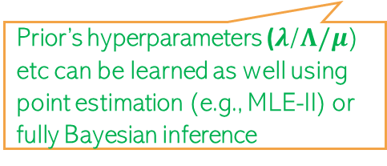
Prior on weights
4
May also use a non-zero mean Gaussian prior, e.g., $𝒩(w_{d}|μ,λ^{−1})$ if we expect weights to be close to some value $μ$
Assume a zero-mean Gaussian prior on $w$
Zero-mean Gaussian prior corresponds to $ℓ_{2}$ regularizer
This prior assumes that a priori each weight has a small value (close to zero)
$$p\left(w|λ\right)=\prod_{d=1}^{D}{p\left(w_{d}|λ\right)=\prod_{d=1}^{D}{𝒩(w_{d}|0,λ^{−1})}}$$
In zero-mean case, $λ$ sort of denotes each feature’s importance. Think why?
$λ$ controls the uncertainty around our prior belief about value of $w_{d}$
Can also use a full covariance matrix $Λ^{−1}$ for the prior to impose a priori correlations among different weights
Large $λ$ means more aggressive push towards zero
$$=𝒩(w|0,λ^{−1}I_{D})$$
$$∝{\left(\frac{λ}{2π}\right)}^{\frac{D}{2}}exp\left[−\frac{λ}{2} w^{⊤}w\right]$$
Prior’s hyperparameters ($λ$/$Λ/μ$) etc can be learned as well using point estimation (e.g., MLE-II) or fully Bayesian inference
The precision $λ$controls how aggressively the prior pushes $w_{d}$ towards mean (0)
Reason: The negative log prior $−log p(w)∝\frac{λ}{2} w^{⊤}w$

Slide 5
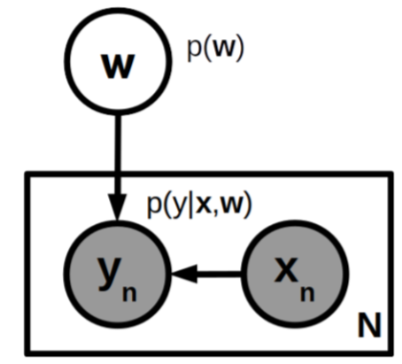
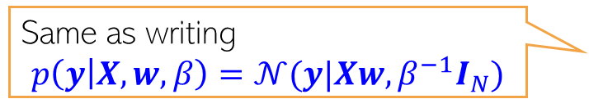

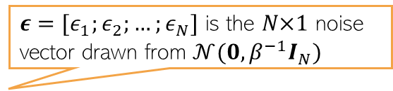
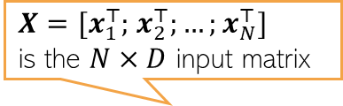
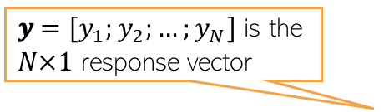
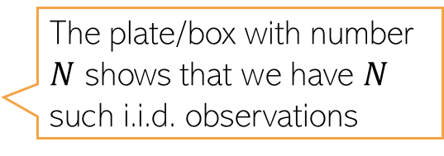
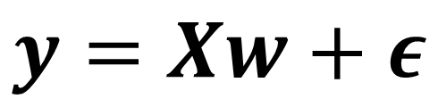
Probabilistic Linear Regression
5
For all the training data, we can write the above model in matrix-vector notation
Linear Gaussian model and $w$ is the Gaussian r.v. with $p\left(w|λ\right)=𝒩(w|0,λ^{−1}I_{D})$
A simple “plate diagram” for this model would look like this (hyperparameters not shown in the diagram)
𝒚 $=[y_{1};y_{2};…;y_{N}]$ is the 𝑁×1 response vector
$X=[x_{1}^{⊤};$ $x_{2}^{⊤};…;x_{N}^{⊤}]$
is the $N×D$ input matrix
$ε$ $=[ε_{1};ε_{2};…;ε_{N}]$ is the 𝑁×1 noise vector drawn from $𝒩(0,β^{−1}I_{N})$
Same as writing
$$p\left(y | X,w,β\right)=𝒩(y|Xw,β^{−1}I_{N})$$
$$y=Xw+ε$$
White nodes denote unknown quantities, grey nodes denote observed quantities (training input-output pairs)
Direction of arrow show dependency
The plate/box with number $N$ shows that we have $N$ such i.i.d. observations

Slide 6
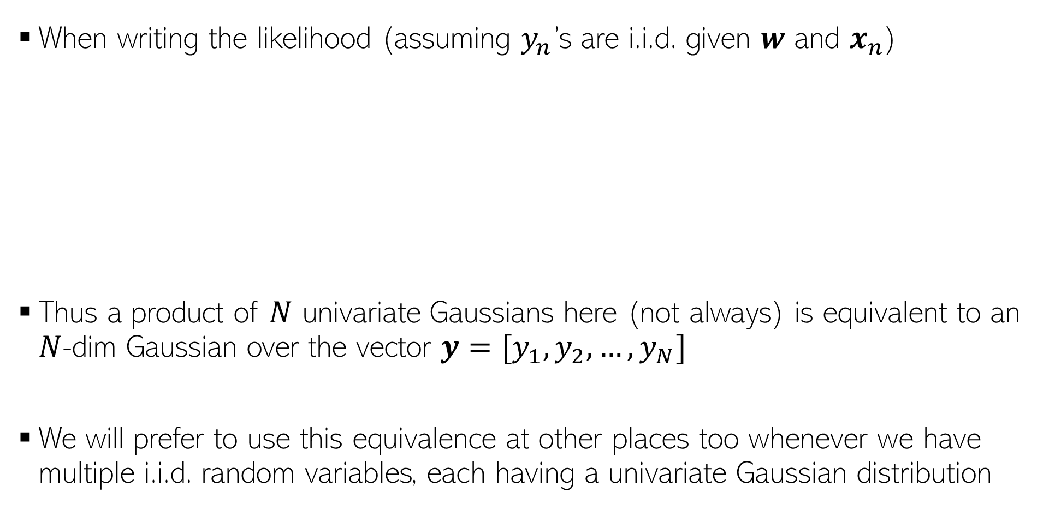

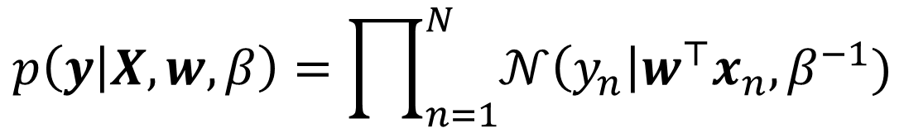
On compact notations..
6
When writing the likelihood (assuming $y_{n}$’s are i.i.d. given $w$ and $x_{n}$)
Thus a product of $N$ univariate Gaussians here (not always) is equivalent to an $N$-dim Gaussian over the vector $y=[y_{1},y_{2},…, y_{N}]$
We will prefer to use this equivalence at other places too whenever we have multiple i.i.d. random variables, each having a univariate Gaussian distribution
$$p\left(y | X,w,β\right)=\prod_{n=1}^{N}{𝒩\left(y_{n}\right|w^{⊤}x_{n},β^{−1})}$$
$$=𝒩(y|Xw,β^{−1}I_{N})$$

Slide 7


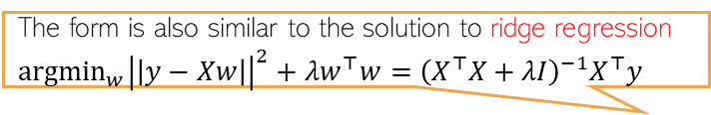
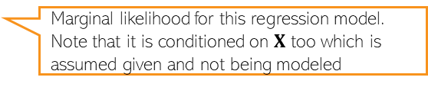
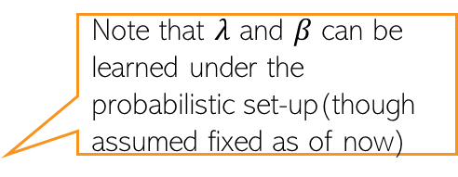
The Posterior
7
MLE/MAP left as an exercise
The posterior over $w$ (for now, assume hyperparams $β$ and $λ$ to be known)
Using the “completing the squares” trick (or linear Gaussian model results)
Marginal likelihood for this regression model. Note that it is conditioned on $X$ too which is assumed given and not being modeled
Must be a Gaussian due to conjugacy
Note that $λ$ and $β$ can be learned under the probabilistic set-up(though assumed fixed as of now)
The form is also similar to the solution to ridge regression ${argmin}_{w}{\left|\left|y−Xw\right|\right|}^{2}+λw^{⊤}w=$ ${\left(X^{⊤}X+λI\right)}^{−1}X^{⊤}y$
MAP solution turns out to be exactly the same (reason: Gaussian’s mean and mode are the same)

Slide 8
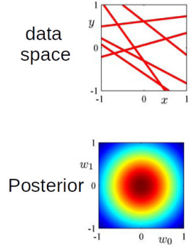
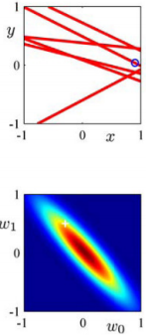
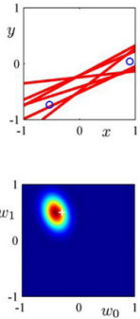
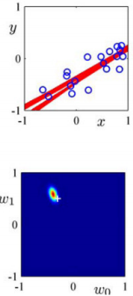
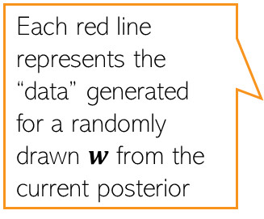

The Posterior: A Visualization
8
Assume a lin. reg. problem with true $w = \left[w_{0},w_{1}\right],w_{0} = −0.3,w_{1} = 0.5$
Assume data generated by a linear regression model $y = w_{0} + w_{1}x + "noise"$
  Note: It’s actually 1-D regression ($w_{0}$ is just a bias term), or 2-D reg. with feature $[1, x]$
Figures below show the “data space” and posterior of $w$ for different number of observations (note: with no observations, the posterior = prior)
Each red line represents the “data” generated for a randomly drawn $w$ from the current posterior

Slide 9
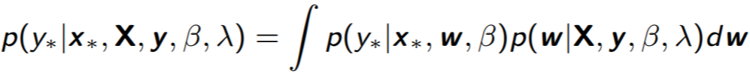
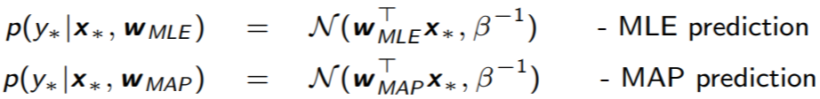
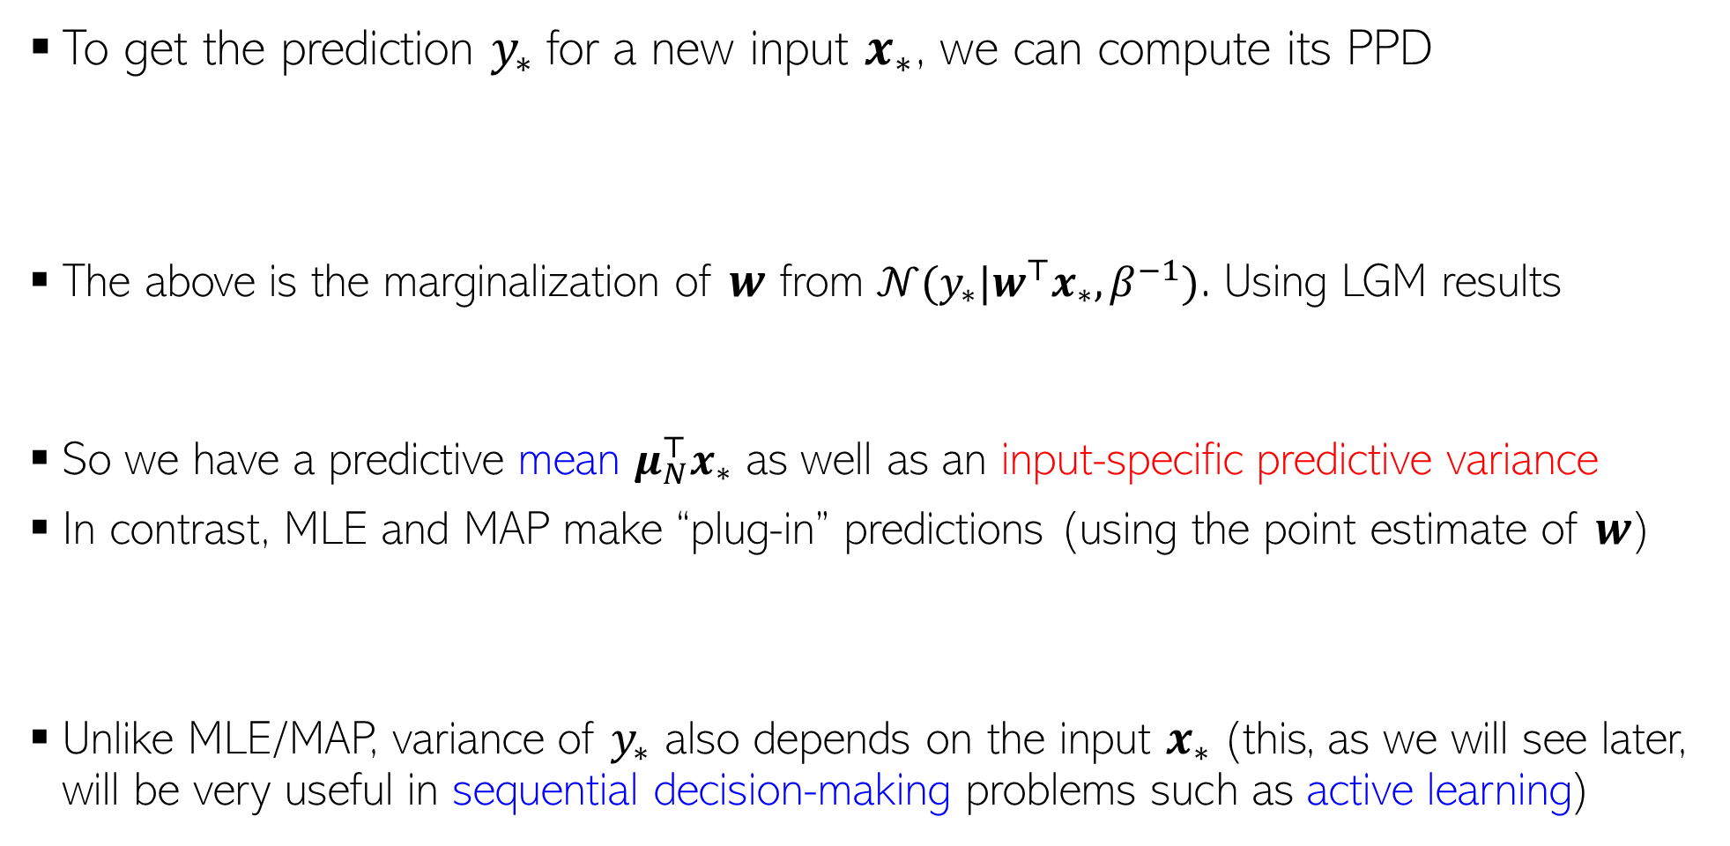


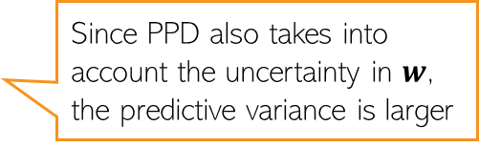
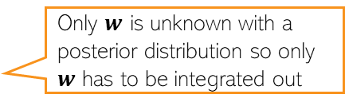
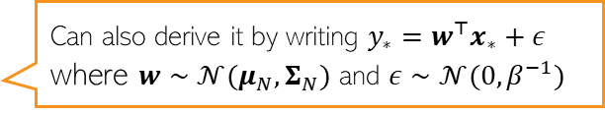
Posterior Predictive Distribution
9
To get the prediction $y_{∗}$for a new input $x_{∗}$, we can compute its PPD
The above is the marginalization of $w$ from $𝒩(y_{∗}|w^{⊤}x_{∗},β^{−1})$. Using LGM results
So we have a predictive mean $μ_{N}^{⊤}x_{∗}$ as well as an input-specific predictive variance
In contrast, MLE and MAP make “plug-in” predictions (using the point estimate of $w$)
Unlike MLE/MAP, variance of $y_{∗}$ also depends on the input $x_{∗}$(this, as we will see later, will be very useful in sequential decision-making problems such as active learning)
Only $w$ is unknown with a posterior distribution so only $w$ has to be integrated out
$$𝒩(y_{∗}|w^{⊤}x_{∗},β^{−1})$$
$$𝒩(w|μ_{N},Σ_{N})$$
Can also derive it by writing $y_{∗}=w^{⊤}x_{∗}+ε$ where $w∼𝒩(μ_{N},Σ_{N})$ and $ε∼𝒩(0,β^{−1})$
Since PPD also takes into account the uncertainty in $w$, the predictive variance is larger

Slide 10
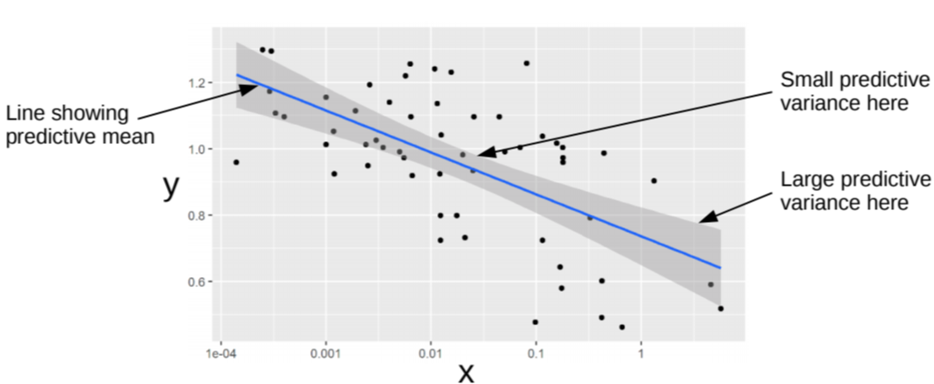

Posterior Predictive Distribution: An Illustration
10
Black dots are training examples
Width of the shaded region at any $x$ denotes the predictive uncertainty at that $x$ (+/- one std-dev)
Regions with more training examples have smaller predictive variance

Slide 11
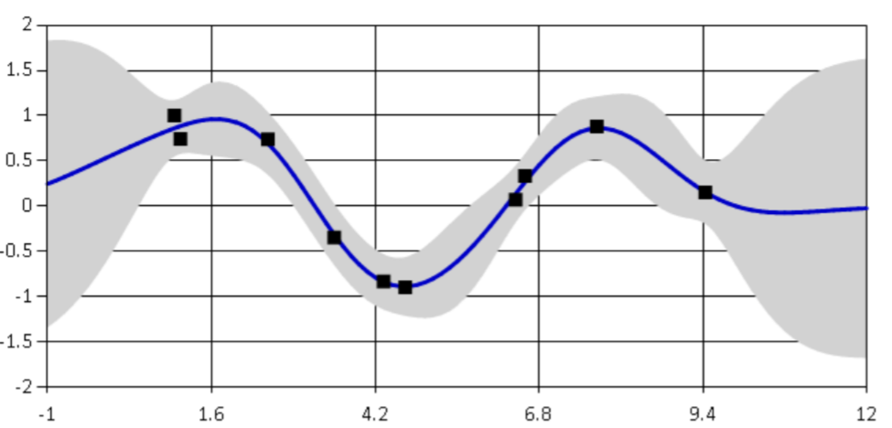

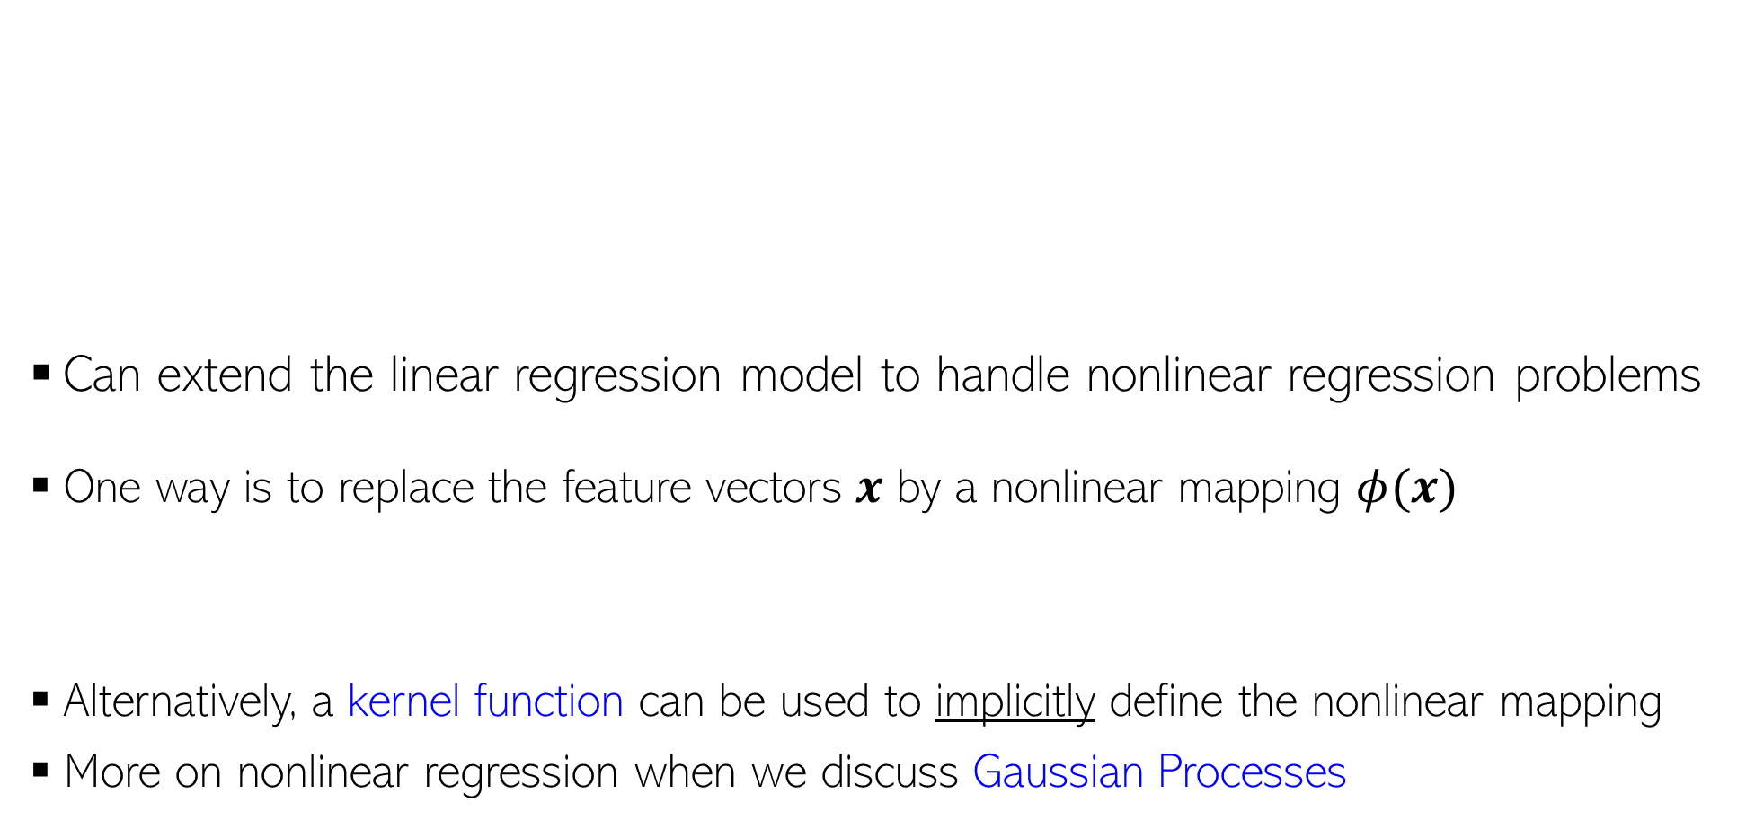
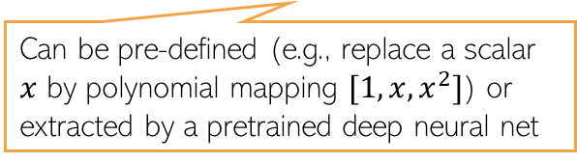
Nonlinear Regression
11
Can extend the linear regression model to handle nonlinear regression problems
One way is to replace the feature vectors $x$ by a nonlinear mapping $φ(x)$
Alternatively, a kernel function can be used to implicitly define the nonlinear mapping
More on nonlinear regression when we discuss Gaussian Processes
Can be pre-defined (e.g., replace a scalar $x$ by polynomial mapping $[1,x,x^{2}]$) or extracted by a pretrained deep neural net

Slide 12
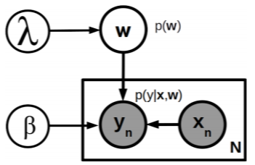
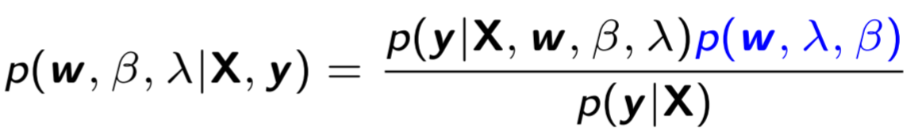




Estimating Hyperparameters via MLE-II
12
The probabilistic linear reg. model we saw had two hyperparams ($β, λ$)
  Thus total three unknowns ($w,β, λ$)
Posterior and PPD computation is intractable.
If we just want point estimates for ($β, λ$) then MLE-II is an option
Need posterior over all the 3 unknowns
PPD would require integrating out all 3 unknowns
Called “MLE-II” because we are maximizing marginal likelihood, not the likelihood
And then compute $p(w|X,y,\hat{β},\hat{λ})$ treating $\hat{β},\hat{λ}$ as given
$$\left(\hat{β},\hat{λ}\right)= {argmax}_{β, λ} log p(y|X,β, λ)$$
Will see various other methods like EM, variational inference, MCMC, etc later
For regression with Gaussian likelihood and Gaussian prior on $w$, the marginal likelihood has an exact expression

Slide 13







Prob. Linear Regression: Some Other Variations
13
Can use other likelihoods $p\left(y_{n}\right|x_{n}, w)$ and/or prior distribution $p(w)$
Laplace distribution for the likelihood
Heteroskedastic noise in the likelihood, e.g.,
Feature-specific variances in the prior for $w$
$$p\left(y_{n}\right|x_{n}, w)= Lap\left(y_{n}\right|w^{⊤}x_{n}, b)$$
More robust to outliers than squared loss
$$p\left(y_{n}\right|x_{n}, w)= 𝒩(y_{n}|w^{⊤}x_{n}, β_{n}^{−1})$$
Can even assume $β_{n}$ to depend on input $x_{n}$
Different noise distribution $𝒩(0,β_{n}^{−1})$ for each $y_{n}$
Gives rise to “absolute loss” instead of squared loss
$$p\left(w\right)= \prod_{d=1}^{D}{𝒩(w_{d}|0,λ_{d}^{−1}})=𝒩(w|0,Λ^{−1})$$
Diagonal precision/covariance matrix with $λ_{d}$’s along the columns of $Λ$
Since we can also learn these precisions (e.g., using MLE-II), using such a prior, we can learn the importance of different features (feature selection) which isn’t possible with a $𝒩(w|0,λ^{−1}I)$ prior with spherical covariance
This has the effect of having feature-specific regularization

Slide 14






Logistic Regression
There are other ways too that can convert the score into a probability, such as a CDF:
$p\left(y=1 | x,w\right)=μ=Φ\left(w^{⊤}x\right)$ where $Φ$ is the CDF of $𝒩(0,1)$. This model is known as “Probit Regression”.
14
A discriminative model for binary classification ($y∈\{0,1\}$)
A linear model with parameters $w∈ℝ^{D}$ computes a score $w^{⊤}x$ for input $x$
A sigmoid function maps this real-valued score into probability of label being $1$
Thus conditional distribution of label $y∈\{0,1\}$given $x$is the following Bernoulli
NLL is the binary cross-entropy loss: $−[y_{n}log μ_{n}+\left(1−y_{n}\right)log \left(1−μ_{n}\right)]$
NLL is convex in $w$. Can also use a prior $p\left(w | λ\right)=𝒩\left(w|0,λ^{−1}I\right)$ if interested in MAP or full posterior on $w$
Also used as a nonlinear “activation function” in deep neural networks
$$σ\left(z\right)= \frac{1}{1+exp(−z)}=\frac{exp(z)}{1+exp(z)}$$
$$p\left(y=1 | x,w\right)=μ=σ\left(w^{⊤}x\right)$$
Large positive score $w^{⊤}x$ means large prob of label being 1, and large negative score means low prob
real-valued score
Likelihood
$$p\left(y | x,w\right)= Bernoulli\left[y | μ\right]=μ^{y}{\left(1−μ\right)}^{1−y}={\left[\frac{\exp\left(w^{⊤}x\right)}{1+\exp\left(w^{⊤}x\right)}\right]}^{y}{\left[\frac{1}{1+\exp\left(w^{⊤}x\right)}\right]}^{1−y}$$

Slide 15




Logistic Regression: MAP and Posterior
15
The posterior will be
MAP estimation is easy. $−log p\left(w | X,y\right)$ is convex for LR. Unique minima
  Can use first or second order optimization with gradient and Hessian being
Full posterior is intractable because of non-conjugacy
  A popular option is to use the Laplace’s approximation (other methods like MCMC and variational inference can also be used; will see them later)
Gaussian
Bernoulli
$$p\left(w | X,y\right)= \frac{p\left(w\right)p(y|X,w)}{p(y|X)}=\frac{p\left(w\right)\prod_{n=1}^{N}{p(y_{n}|w,x_{n})}}{\int{p\left(w\right)\prod_{n=1}^{N}{p(y_{n}|w,x_{n})}dw}}$$
$$μ_{n}=σ(w^{⊤}x_{n})$$

Slide 16






Laplace’s (or Gaussian) Approximation
16
Consider a posterior distribution that is intractable to compute
Laplace approximation approximates the above using a Gaussian distribution
Laplace’s approx. is based on a second-order Taylor approx. of the posterior (will see the proof and details later)
$$p\left(θ | 𝒟\right)= \frac{p(𝒟,θ)}{p(𝒟)}=\frac{p(𝒟|θ)p\left(θ\right)}{p(𝒟)}$$
Tells us about the space (curvature) of the true posterior around $θ_{MAP}$
Related to the Fisher Information Matrix (FIM); will see shortly
$$p\left(θ | 𝒟\right)≈𝒩(θ|θ_{MAP},Λ^{−1})$$
Negative of the Hessian, i.e., the second derivative of the log joint, at $θ_{MAP}$
$$θ_{MAP}= {argmax}_{θ} log p(θ|𝒟)$$
$$Λ=− ∇_{θ}^{2} log p\left(θ | 𝒟\right){\left.​\right|}_{θ=θ_{MAP}}=−∇_{θ}^{2} log p(𝒟,θ){\left.​\right|}_{θ=θ_{MAP}}$$

Slide 17







Derivation of the Laplace’s Approximation
$$p\left(𝒟\right)≈ exp\left(log p\left(𝒟,θ_{MAP}\right)\right){×\left(2π\right)}^{D/2}det{\left(Λ\right)}^{1/2}$$
Let’s write the Bayes rule as
Consider second-order Taylor approximation of a function $f\left(θ\right)$ around some $θ_{0}$
Assuming $f\left(θ\right)= log p(𝒟,θ)$ and $θ_{0}=θ_{MAP}$
,
We also get a Laplace approximation of the marginal likelihood (for free!)
$$p\left(θ | 𝒟\right)= \frac{p(𝒟,θ)}{p(𝒟)}=\frac{p(𝒟,θ)}{∫p\left(𝒟,θ\right)dθ}$$
$$=\frac{exp[log p\left(𝒟,θ\right)]}{∫exp[log p\left(𝒟,θ\right)]dθ}$$
Note: Sometimes marginal likelihood is also called model evidence
$$f\left(θ\right)≈f\left(θ_{0}\right)+{\left(θ−θ_{0}\right)}^{⊤}∇_{θ}f\left(θ_{0}\right)+ \frac{1}{2}{\left(θ−θ_{0}\right)}^{⊤}∇_{θ}^{2}f(θ_{0})\left(θ−θ_{0}\right)$$
Purely quadratic in $θ$
Same as $∇^{2}log p(θ_{MAP}|𝒟)$
Constant w.r.t. $θ$
$$log p(𝒟,θ)≈log p(𝒟,θ_{MAP})+ \frac{1}{2}{\left(θ−θ_{MAP}\right)}^{⊤}∇_{θ}^{2}log p(𝒟,θ_{MAP})\left(θ−θ_{MAP}\right)$$
$$p\left(θ | 𝒟\right)∝ exp\left[−\frac{1}{2}{\left(θ−θ_{MAP}\right)}^{⊤}(−∇_{θ}^{2}log p\left(𝒟,θ_{MAP}\right))\left(θ−θ_{MAP}\right)\right]$$
$$= 𝒩(θ|θ_{MAP},Λ^{−1})$$
$$(where Λ= −∇_{θ}^{2}log p\left(𝒟,θ_{MAP}\right)=−H)$$

Slide 18




Properties of Laplace’s Approximation
18
Straightforward if posterior’s derivatives (first/second) can be computed easily
Expensive if parameter $θ$ is very high dimensional
  Reason: We need to compute and invert Hessian of size $D×D$ ($D$ is the # of params)
Can do badly if the (true) posterior is multimodal
Used only when $θ$ is a real-valued vector (because of Gaussian approximation)
Note: Even if we have a non-probabilistic model (loss function + regularization), we can obtain an approx “posterior” for that model using the Laplace’s approximation
  Optima of the regularized loss function will be Gaussian’s mean
  Inverse of the second derivative of the regularized loss function will be covariance matrix
E.g., a deep neural network, or even in simpler models (e.g., logistic reg with a very large number of features
If $K$ local modes, then define the approx. posterior as a mixture of $K$ Gaussians
$$p\left(θ | D\right)≈\sum_{k=1}^{K}{π^{(k)}𝒩(θ|θ_{MAP}^{\left(k\right)}, H^{{\left(k\right)}^{−1}})}$$
(see paper cited below for details)
For multimodal posteriors, can use a mixture of Laplace approximations*
Useful for deep learning models
True posterior
Gaussian approximation
*Mixtures of Laplace Approximations for Improved Post-Hoc Uncertainty in Deep Learning (Eschenhagen et al, 2021)

Slide 19


LR: Posterior Predictive Distribution
19
The posterior predictive distribution can be computed as
Monte-Carlo approximation of this integral is one possible way
  Draw 𝑀 samples $w_{1}, w_{2}, …, w_{M}$, from the approx. of posterior
  Approximate the PPD as follows
In contrast, when using MLE/MAP solution ${\hat{w}}_{opt}$, the plug-in pred. distribution
$p\left(y_{∗}=1 | x_{∗},X,y\right)=\int{p\left(y_{∗}=1 | {w,x}_{∗}\right)p\left(w | X,y\right)dw}$
Integral not tractable and must be approximated
sigmoid
Gaussian (if using Laplace approx.)
$$p\left(y_{∗}=1 | x_{∗},X,y\right)≈\frac{1}{M}\sum_{m=1}^{M}{p\left(y_{∗}=1 | {w_{m},x}_{∗}\right)}= \frac{1}{M}\sum_{m=1}^{M}{σ(w_{m}^{⊤}x_{n})}$$
$p\left(y_{∗}=1 | x_{∗},X,y\right)=\int{p\left(y_{∗}=1 | {w,x}_{∗}\right)p\left(w | X,y\right)dw}$
$$≈p\left(y_{∗}=1 | {{\hat{w}}_{opt},x}_{∗}\right)=σ({{\hat{w}}_{opt}}^{⊤}x_{n})$$

Slide 20






LR: Plug-in Prediction vs Bayesian Averaging
20
Plug-in prediction uses a single $w$ (point est) to make prediction
PPD does an averaging using all possible $w$’s from the posterior
Color transitions (red to blue) in both plots denote how the probability of an input changes from belonging to red class to belonging to blue class. All inputs on a line (or curve on RHS plot)have the same probability of belonging to the red/blue class
Posterior averaging is like using an ensemble of models. In this example, each model is a linear classifier but the ensemble-like effect resulted in nonlinear boundaries
$$p\left(y_{∗}=1 | x_{∗},X,y\right)≈σ({{\hat{w}}_{opt}}^{⊤}x_{n})$$
$$p\left(y_{∗}=1 | x_{∗},X,y\right)≈ \frac{1}{M}\sum_{m=1}^{M}{σ(w_{m}^{⊤}x_{n})}$$

Slide 21






Multiclass Logistic (a.k.a. Softmax) Regression
21
Also called multinoulli/multinomial regression: Basically, LR for $K > 2$classes
In this case, $y_{n}∈\left\{1,2,…,K\right\}$ and label probabilities are defined as
$K$ weight vecs $w_{1},w_{2},…,w_{K}$(one per class), each $D$-dim, and $W=[w_{1},w_{2},…,w_{K}]$
Each likelihood $p\left(y_{n} | x_{n},W\right)$is a multinoulli distribution. Therefore total likelihood
Can do MLE/MAP/fully Bayesian estimation for $W$ similar to LR model
Softmax function
Real-valued scores $w_{k}^{⊤}x_{n}$ are also known as “logits” (thus $K$ logits for each input)
$$p\left(y_{n}=k | x_{n},W\right)= \frac{exp(w_{k}^{⊤}x_{n})}{\sum_{ℓ=1}^{K}{exp(w_{ℓ}^{⊤}x_{n})}}=μ_{nk}$$
Also note that $\sum_{ℓ=1}^{K}{μ_{nℓ}}$ =1 for any input $x_{n}$
$$p\left(y|X,W\right)= \prod_{n=1}^{N}{\prod_{ℓ=1}^{K}{μ_{nℓ}^{y_{nℓ}}}}$$
Notation: $y_{nℓ}$ = 1 if true class of $x_{n}$ is $ℓ$ and $y_{nℓ^{′}}$ = 0 $∀ ℓ^{′}$ $≠ℓ$

Slide 22


Generalized Linear Models
22
(Probabilistic) Linear Regression: when response $y$ is real-valued
Logistic Regression: when response $y$ is binary (0/1)
Both are examples of a Generalized Linear Model (GLM)
  The model depends on the inputs $x$ via a linear model $w^{⊤}x$
GLM is defined using an exponential family distribution
ExpFam can be any suitable distribution depending on the nature of outputs, e.g.,
  Gaussian for reals, Bernoulli for binary, Poisson for Count, gamma for positive reals
ExpFam distributions are more generally useful in other contexts as well
$$p\left(y | x,w\right)= 𝒩(y|w^{⊤}x, β^{−1})$$
$$p\left(y | x,w\right)= Bernoulli\left[y | σ(w^{⊤}x)\right]={\left[\frac{\exp\left(w^{⊤}x\right)}{1+\exp\left(w^{⊤}x\right)}\right]}^{y}{\left[\frac{1}{1+\exp\left(w^{⊤}x\right)}\right]}^{1−y}$$
MLE/MAP of $w$ is easy for GLMs (due to convex objective, thanks to exp-family). Posterior usually requires approximations if likelihood and prior are not conjugate pairs (Laplace approximation or other methods used)
$$p\left(y | x,w\right)=ExpFam[y|f\left(w^{⊤}x\right)]$$

