Slide 1
Assorted Topics (2)
CS772A: Probabilistic Machine Learning
Piyush Rai

Slide 2
Plan today
2
Some classical probabilistic models for sequential data
Hidden Markov Models (HMM) and State-Space Models (SSM)
Another non-Bayesian way to get uncertainty estimates:
Conformal Prediction
Simulation based inference

Slide 3
Probabilistic Models for Sequential Data
3

Slide 4
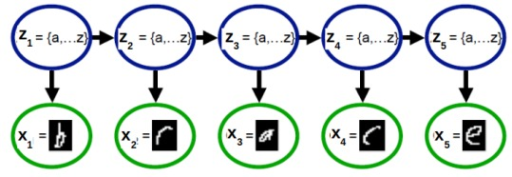
Latent Variable Models for Sequential Data
4
Task: Given a sequence of observations, infer the latent state of each observation
If $z_{n}$’s are discrete, we have a hidden Markov model (HMM)
If $z_{n}$’s are real-valued, we have a state-space model(SSM)
Observation model
State-transition model

Slide 5
State-Space Models
5
In the most general form, the state-transition and observation models of an SSM
Assuming Gaussian noise in the state-transition and observation models
HMM is similar to SSM except the state-transition model is a discrete distribution
$g_{t}, h_{t}$ can be linear or nonlinear functions
If $g_{t}, h_{t}, Q_{t}, R_{t}$ are independent of $t$ then it is called a stationary model
This is a Gaussian SSM
$g_{t}, h_{t}, Q_{t}, R_{t}$ may be known or can be learned

Slide 6
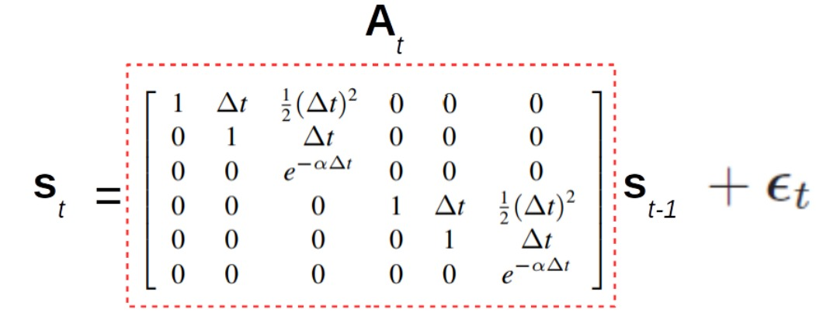
State-Space Models: A Simple Example
6
Consider the linear Gaussian SSM
Suppose $x_{t}∈ℝ^{2}$ denotes the (noisy) observed 2D location of an object
Suppose $s_{t}∈ℝ^{6}$ denotes the “state” vector
Here is an example SSM for this problem with pre-defined $A_{t}$ and $B_{t}$ matrices
$s_{t}$ $\text{= [}\text{pos}\text{1, }\text{vel}\text{1, }\text{accel}\text{1, }\text{pos}\text{2, }\text{vel}\text{2, }\text{accel}\text{2]}$

Slide 7
Typical Inference Task for Gaussian SSM
7
One of the key tasks: Given sequence $x_{1},x_{2},…, x_{T}$, infer latent $s_{1},s_{2},…, s_{T}$
Usually two ways of inferring the latent states
Infer $p(s_{t}|x_{1},x_{2},…, x_{t})$: Called the “filtering” problem
Infer $p(s_{t}|x_{1},x_{2},…, x_{t}, …, x_{T})$: Called the “smoothing” problem
Some other tasks one can solve for using an SSM
Predicting future states $p(s_{t+h}|x_{1},x_{2},…, x_{t})$ for $h≥1$ , given observations thus far
Predicting future observations $p(x_{t+h}|x_{1},x_{2},…, x_{t})$ for $h≥1$ , given observations thus far
Kalman Filtering is a popular algorithm for a linear Gaussian SSM
A Gaussian
Turns out to be another Gaussian

Slide 8
A Special Case
8
What if we have i.i.d. latent states, i.e.,. $p\left(z_{n} | z_{n−1}\right)=p\left(z_{n}\right)?$
Discrete case (HMM) becomes a simple mixture model
Real-valued case (SSM) becomes a PPCA model
Inference algos for HMM/SSM are thus very similar to that of mixture models/PPCA
Only main difference is how the latent variables $z_{n}$’s are inferred since they aren’t i.i.d.
E.g., if using EM, only E step needs to change (Bishop Chap 13 has EM for HMM and SSM)

Slide 9
Conformal Prediction
9

Slide 10
Conformal Prediction
10
A simple technique to easily obtain confidence intervals
In classification, such an interval may refer to the set of highly likely classes for a test input
For more difficult test inputs, the set would typically be larger
In a way, conformal prediction gives predictive uncertainty
However, unlike Bayesian ML, we don’t get model uncertainty
Only one model is learned in the standard way and we construct the set of likely classes
It’s like a black-box method; no change to training procedure for the model

Slide 11
Conformal Prediction
11
Assume it’s a classification model which produces softmax scores
Conformal prediction can be used for regression problems too*
Assume we already have a trained model $\hat{f}$ using some labelled data
Suppose we get a test input $X_{test}$ whose true (unknown) label is $Y_{test}$
Use $\hat{f}$ and a calibration set of $n$ examples to generate a prediction set $𝒞(X_{test})$ s.t.
To construct the set, we first compute, for each example in the calibration set
Use the calibration set scores $s_{1},s_{2},…, s_{n}$ to compute their $α$ quantile
$α$ is a user chosen error rate
$$1 −α≤p\left(Y_{test}∈𝒞\left(X_{test}\right)\right)≤1 −α+ \frac{1}{n+1}$$
Probability/score of the correct class $y_{i}$ of the input $x_{i}$
Class probabilities
Score $s_{i}$ of the correct class $y_{i}$
$$s_{i}=\hat{f}{\left(x_{i}\right)}_{y_{i}}$$
classes
$$y_{i}$$
*A Gentle Introduction to Conformal Prediction and Distribution-Free Uncertainty Quantification (Angelopoulos and Bates, 2022)

Slide 12
Conformal Prediction
12
Assume the $α$ (say 0.1) quantile of the calibration set scores is equal to $\hat{q}$
Assuming $n$ is very large, roughly $\left(1−α\right)$ fraction of inputs will have score higher than $\hat{q}$
Given a test input $X_{test}$, whose label is is unknown, we compute the class probabilities
Define the prediction set for $X_{test}$ as
Pick $\hat{q}$ such that $α$ fraction of the mass of histogram is on the left side of $\hat{q}$
Frequency
scores
$$\hat{q}$$
Probability of true class
Class probabilities
Prediction set for this test input includes classes 1,2,5
$$\hat{q}$$
classes
Report all the classes whose probability is large enough (the “large enough” value is given by the $α$ quantile $\hat{q}$)
$$𝒞\left(X_{test}\right)=\{y:\hat{f}{\left(X_{test}\right)}_{y}≥\hat{q}\}$$

Slide 13
Conformal Prediction
13
A generic black-box method
Can be easily applied to any already trained classifier
Predicted set has some nice guarantees
Does not make any assumptions on the distribution of the data
Thus considered a “distribution-free” approach to uncertainty quantification
Can also be applied to regression problems*
$$1 −α≤p\left(Y_{test}∈𝒞\left(X_{test}\right)\right)≤1 −α+ \frac{1}{n+1}$$
*A Gentle Introduction to Conformal Prediction and Distribution-Free Uncertainty Quantification (Angelopoulos and Bates, 2022)

Slide 14
Simulation-based Inference
14

Slide 15
Simulation-based Inference
15
Suppose we wish to compute the posterior $p(θ|D)$
However, suppose we can’t compute the likelihood $p(D|θ)$
Evaluation too expensive, or don’t have explicit likelihood
Simulation-based Inference (SBI) approximates $p(θ|D)$ as follows
For $i=1,2,…S$
Draw a random $θ^{(i)}$ the prior $p(θ)$. Simulate a dataset $D^{(i)}$ from some simulator using $θ^{(i)}$
Check how “similar” $D^{(i)}$ is to $D$. Define a suitable distance to measure this, e.g.,
Define the weight of $θ^{(i)}$ as inversely proportional to $d_{i}$, e.g., $w_{i}∝exp(−d_{i})$
The approximate posterior is ${\left\{w_{i},θ^{\left(i\right)}\right\}}_{i=1}^{S}$
The vanilla SBI/ABC can be inefficient in practice (most $θ^{\left(i\right)}$’s may have low weights)
More efficient versions proposed in recent research, e.g, neural conditional density estimators
Check out this package for code and links to other methods: https://github.com/sbi-dev/sbi
SBI is also known as “Approximate Bayesian Computation” (ABC)
This simulator may be some domain-specific model of the data generation process (e.g., a physics engine, robotics/control simulator, etc)
Here $s(.)$ denotes a “summary statistics” which provides a summary of the dataset (e.g., its mean and covariance) which makes the comparison easier
$d_{i}= \left\|s\left(D^{\left(i\right)}\right)−s(D)\right\|$

Slide 16
Conclusion
16
Probabilistic modeling provides a natural way to think about models of data
Many benefits as compared to non-probabilistic approaches
Easier to model and leverage uncertainty in data/parameters
Principle of marginalization while making prediction
Easier to encode prior knowledge about the problem (via prior/likelihood distributions)
Easier to handle missing data (by marginalizing it out if possible, or by treating as latent variable)
Easier to build complex models can be neatly combining/extending simpler probabilistic models
Easier to learn the “right model” (hyperparameter estimation, nonparametric Bayesian models)
Bayesian approaches as well as single model based uncertainty
Uncertainty is important but proper calibration of uncertainty is also important
Fast-moving field, lots of recent advances on new models and inference methods

Slide 17
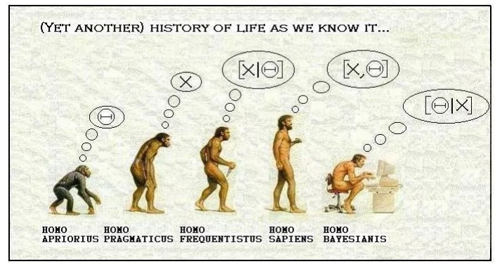
Thank You!
17

