Slide 1
Assorted Topics (1)
CS772A: Probabilistic Machine Learning
Piyush Rai

Slide 2
Plan today
2
Calibration
Frequentist approach for estimating uncertainty
Some classical probabilistic models for sequential data
  HMM and State-Space Models (SSM)

Slide 3
Calibration
3

Slide 4
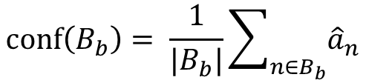
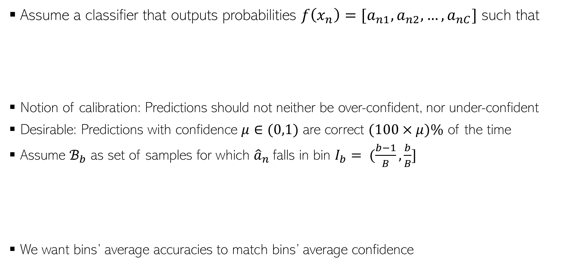
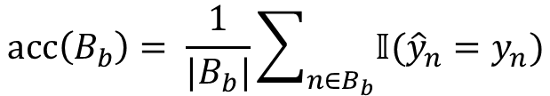
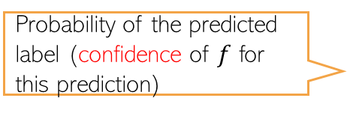

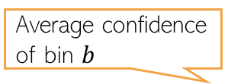

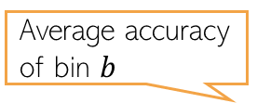
Calibration
4
Assume a classifier that outputs probabilities $f\left(x_{n}\right)=[a_{n1},a_{n2},…, a_{nC}]$ such that
Notion of calibration: Predictions should not neither be over-confident, nor under-confident
Desirable: Predictions with confidence $μ∈(0,1)$ are correct $(100×μ)\%$ of the time
Assume $ℬ_{b}$ as set of samples for which ${\hat{a}}_{n}$falls in bin $I_{b}= (\frac{b−1}{B},\frac{b}{B}]$
We want bins’ average accuracies to match bins’ average confidence
Predicted label
$${\hat{y}}_{n}= {argmax}_{c=\{1,2,…,C\}} a_{nc}$$
Probability of the predicted label (confidence of $f$ for this prediction)
$${\hat{a}}_{n}= \max_{c=\{1,2,…,C\}} a_{nc}$$
Average accuracy of bin $b$
Average confidence of bin $b$
$$acc\left(B_{b}\right)= \frac{1}{|B_{b}|}\sum_{n∈B_{b}}{𝕀({\hat{y}}_{n}=y_{n})}$$
$$conf\left(B_{b}\right)= \frac{1}{|B_{b}|}\sum_{n∈B_{b}}{{\hat{a}}_{n}}$$

Slide 5
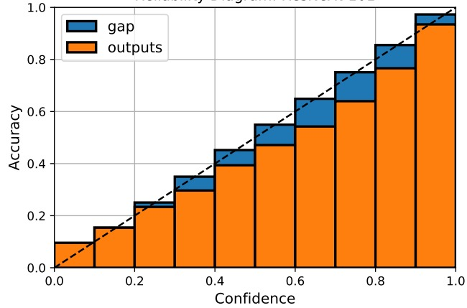
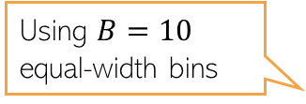
Reliability Diagrams and A Calibration Metric
5
Reliability diagrams are plots of accuracy vs confidence
Several metrics exist to measure how well-calibrated the model’s predictions are
Expected Calibration Error (ECE) is one such popular metric
Using $B=10$ equal-width bins
It’s just one simple way; other ways also possible to construct the bins
Should be small for a well-calibrated model
ECE is the average “gap” area in the reliability diagram

Slide 6

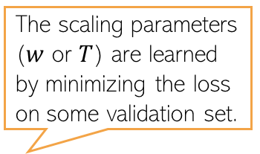



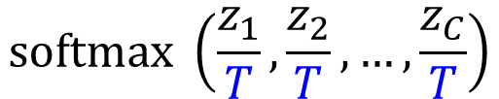
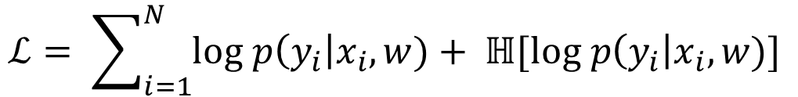
Calibration Methods (contd)
6
Parameters of the trained model are kept frozen in this process
The scaling parameters ($w$ or $T$) are learned by minimizing the loss on some validation set.
Method 1: Calibrate an already trained model in a post-hoc manner, e.g.,
  Requires learning to scale the logits produced by the model, e.g.,
Method 2: Change the training procedure, e.g.,
  Add a regularizer which avoids overconfident predictions
  Trained with smoothed labels instead of one-hot labels
$$softmax(z_{1},z_{2},…, z_{C})$$
$$softmax \left({w_{1}z}_{1}+b_{1},{w_{2}z}_{2}+b_{2},…, {w_{C}z}_{C}+b_{c}\right)$$
T=100
T=2
T=1
$$softmax(z_{1},z_{2},…, z_{C})$$
$$softmax \left(\frac{z_{1}}{T},\frac{z_{2}}{T},…,\frac{z_{C}}{T}\right)$$
Maximize the entropy of the predictive distribution to reduce overconfidence
Maximize the likelihood
$$ℒ= \sum_{i=1}^{N}{log p\left(y_{i}\right|x_{i}, w)+ ℍ[log p\left(y_{i}\right|x_{i}, w)] }$$
$$[0, 0, 1, 0]$$
$$[0.05, 0.05, 0.85, 0.05]$$

Slide 7
Frequentist Statistics
(vs Bayesian Statistics)
7

Slide 8

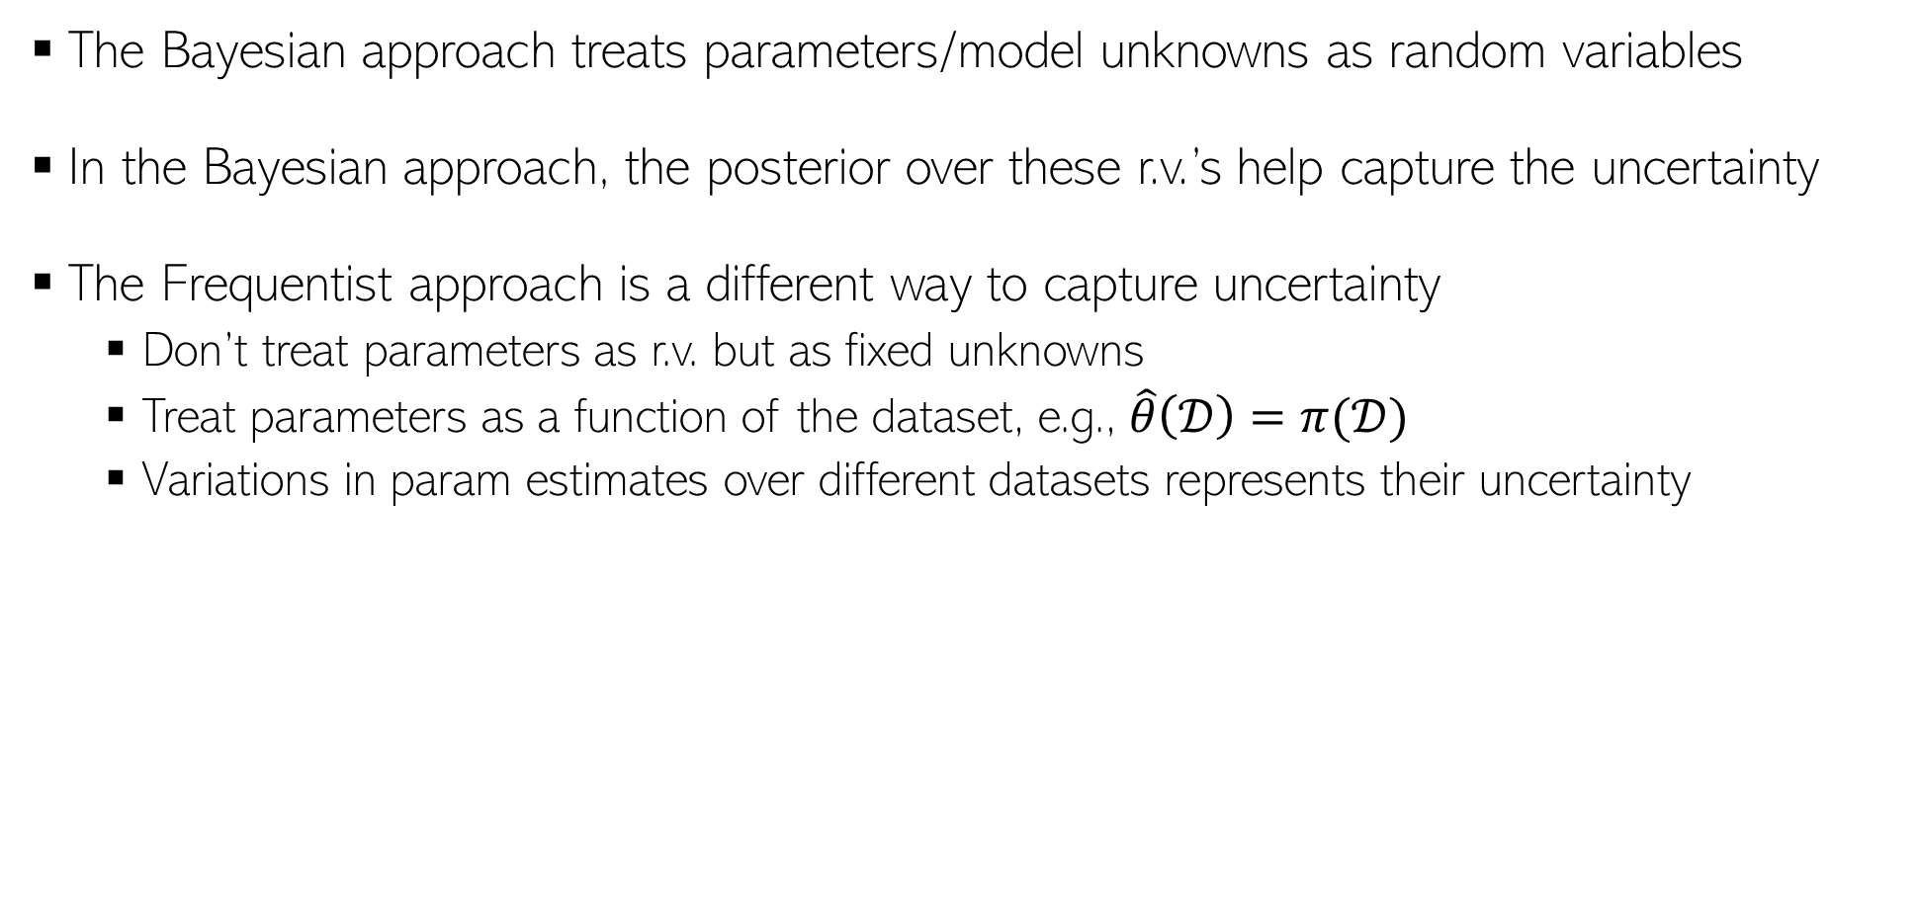
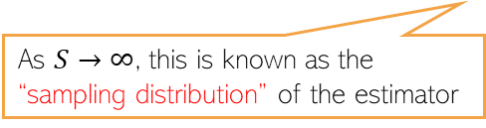

Frequentist Statistics
8
The Bayesian approach treats parameters/model unknowns as random variables
In the Bayesian approach, the posterior over these r.v.’s help capture the uncertainty
The Frequentist approach is a different way to capture uncertainty
  Don’t treat parameters as r.v. but as fixed unknowns
  Treat parameters as a function of the dataset, e.g., $\hat{θ}\left(𝒟\right)=π(𝒟)$
  Variations in param estimates over different datasets represents their uncertainty
This can be some point estimate, e.g., MLE, MAP, method of moments, etc.
A random dataset drawn from the true data distribution
True unknown value of the parameter
$$(s=1, 2, …, S)$$
The estimated distribution of the parameters given any randomly drawn dataset from the true data distribution
Param estimate using the $s$-th sampled dataset
As $S→∞$, this is known as the “sampling distribution” of the estimator
Note that sampling distribution is different from a posterior distribution we infer in Bayesian learning (there, we condition on a fixed training set)
But if the estimator is MLE and Bayesian method’s prior is uniform, then both distributions are very similar (sampling distribution is often called “poor man’s posterior”

Slide 9






Approximating the sampling distribution
9
Since the true $θ^{∗}$ is not known, we can’t compute the sampling distribution exactly
Bootstrap is a popular method to approximate the sampling distribution
Two types of bootstrap methods: parametric and nonparametric bootstrap
$$(s=1, 2, …, S)$$
Parametric Bootstrap
Nonparametric Bootstrap
Get a point est. of $θ$ using training data
Generate multiple datasets using $\hat{θ}$ as
Now compute the approximation as
Use sampling with replacement on original training set to generate $S$ datasets with $N$ datapoints in each
Now compute the approximation as
$$\hat{θ}=π(𝒟)$$
Each dataset will contain roughly 63% unique datapoints from original training set
$$(s=1, 2, …, S)$$

Slide 10
Probabilistic Models for Sequential Data
10

Slide 11
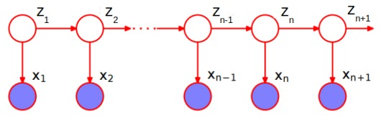
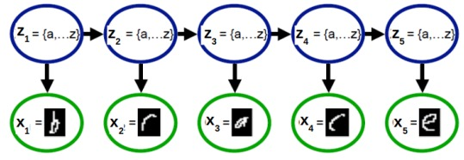
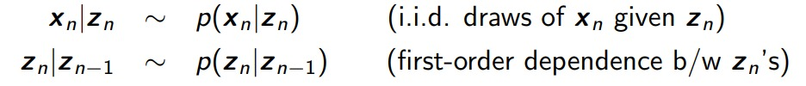


Latent Variable Models for Sequential Data
11
Task: Given a sequence of observations, infer the latent state of each observation
If $z_{n}$’s are discrete, we have a hidden Markov model (HMM)
If $z_{n}$’s are real-valued, we have a state-space model(SSM)
Observation model
State-transition model

Slide 12
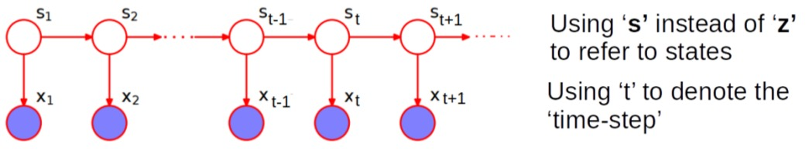
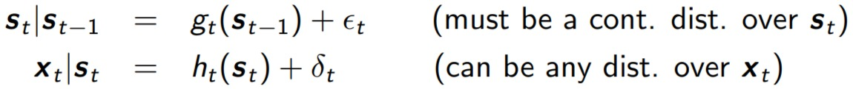
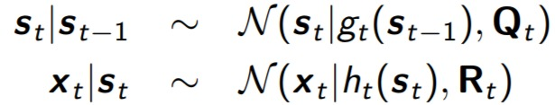
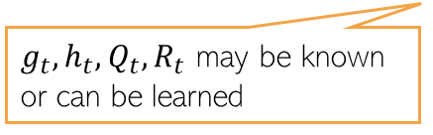

State-Space Models
12
In the most general form, the state-transition and observation models of an SSM
Assuming Gaussian noise in the state-transition and observation models
HMM is similar to SSM except the state-transition model is a discrete distribution
$g_{t}, h_{t}$ can be linear or nonlinear functions
If $g_{t}, h_{t}, Q_{t}, R_{t}$ are independent of $t$ then it is called a stationary model
This is a Gaussian SSM
$g_{t}, h_{t}, Q_{t}, R_{t}$ may be known or can be learned

Slide 13


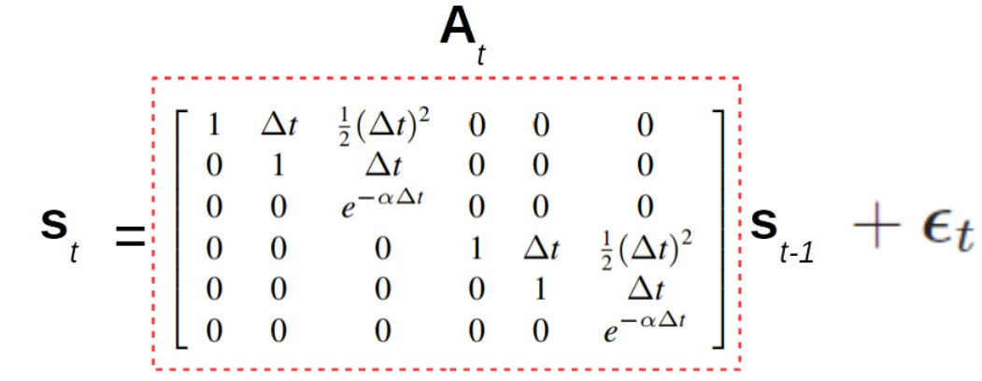
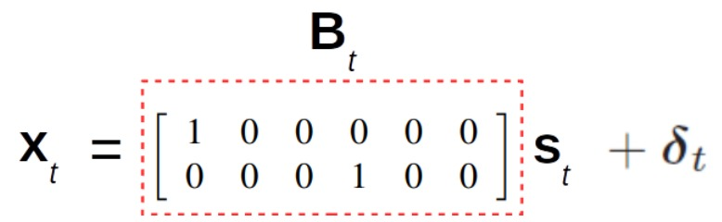

State-Space Models: A Simple Example
13
Consider the linear Gaussian SSM
Suppose $x_{t}∈ℝ^{2}$ denotes the (noisy) observed 2D location of an object
Suppose $s_{t}∈ℝ^{6}$ denotes the “state” vector
Here is an example SSM for this problem with pre-defined $A_{t}$ and $B_{t}$ matrices
$s_{t}$ $\text{= [}\text{pos}\text{1, }\text{vel}\text{1, }\text{accel}\text{1, }\text{pos}\text{2, }\text{vel}\text{2, }\text{accel}\text{2]}$

Slide 14
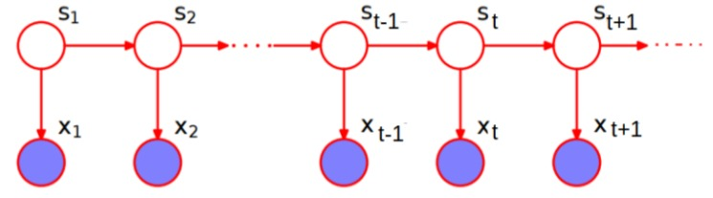
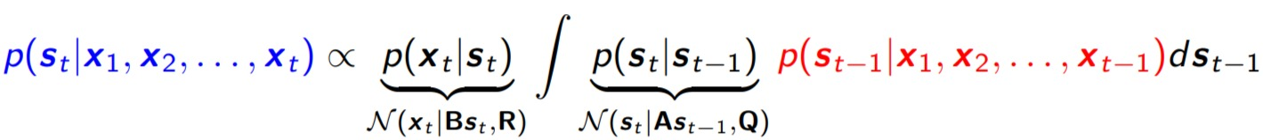
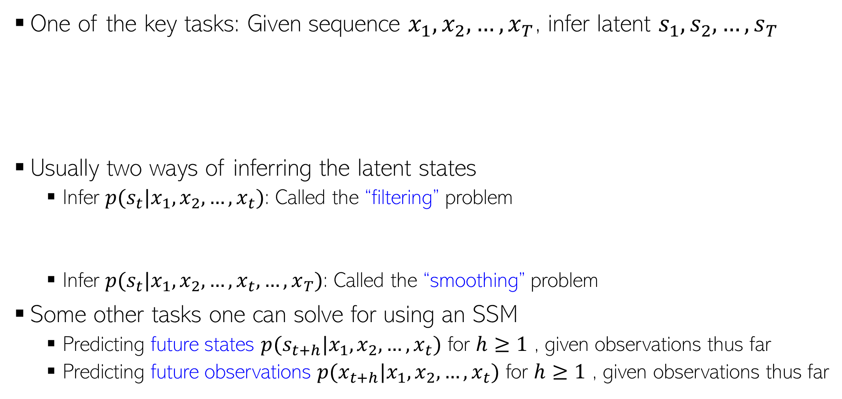
Typical Inference Task for Gaussian SSM
14
One of the key tasks: Given sequence $x_{1},x_{2},…, x_{T}$, infer latent $s_{1},s_{2},…, s_{T}$
Usually two ways of inferring the latent states
  Infer $p(s_{t}|x_{1},x_{2},…, x_{t})$: Called the “filtering” problem
  Infer $p(s_{t}|x_{1},x_{2},…, x_{t}, …, x_{T})$: Called the “smoothing” problem
Some other tasks one can solve for using an SSM
  Predicting future states $p(s_{t+h}|x_{1},x_{2},…, x_{t})$ for $h≥1$ , given observations thus far
  Predicting future observations $p(x_{t+h}|x_{1},x_{2},…, x_{t})$ for $h≥1$ , given observations thus far
Kalman Filtering is a popular algorithm for a linear Gaussian SSM
A Gaussian
Turns out to be another Gaussian

Slide 15
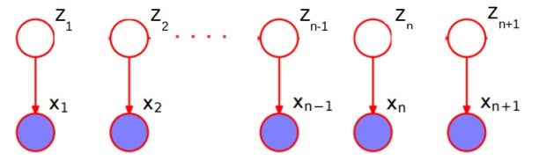
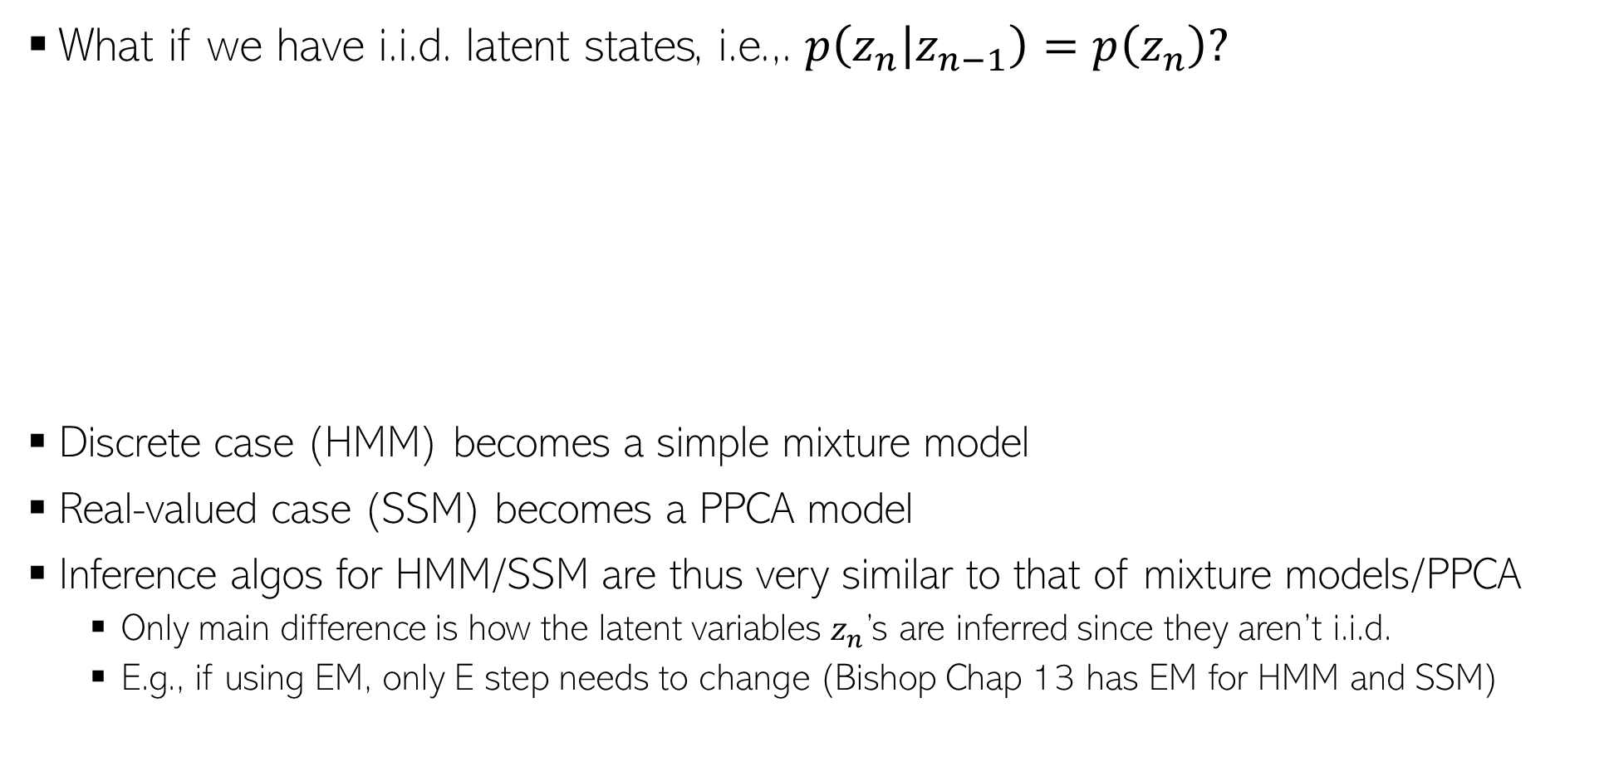
A Special Case
15
What if we have i.i.d. latent states, i.e.,. $p\left(z_{n} | z_{n−1}\right)=p\left(z_{n}\right)?$
Discrete case (HMM) becomes a simple mixture model
Real-valued case (SSM) becomes a PPCA model
Inference algos for HMM/SSM are thus very similar to that of mixture models/PPCA
  Only main difference is how the latent variables $z_{n}$’s are inferred since they aren’t i.i.d.
  E.g., if using EM, only E step needs to change (Bishop Chap 13 has EM for HMM and SSM)

