Slide 1
Large Language Models
(Auto-regressive and Diffusion-based)
CS772A: Probabilistic Machine Learning
Piyush Rai

Slide 2

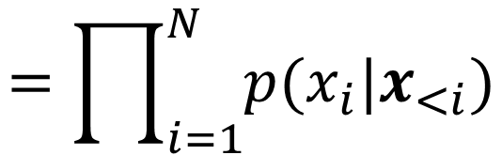

Large Language Models (LLM)
2
An LLM defines a probability distribution over sequences of tokens
Autoregressive modeling is a popular way to define this distribution
Params $θ$ of each conditional $p(x_{i}|x_{<i})$ defined using neural nets (e.g., transformer)
$$x=\{x_{1},x_{2},…, x_{N}\}$$
$$=\prod_{i=1}^{N}{p(x_{i}|x_{<i})}$$
$$p\left(x\right)=p\left(x_{1}\right)p\left(x_{2} | x_{1}\right)p\left(x_{3} | x_{1},x_{2}\right)…$$
$$p_{θ}\left(x_{i} | x_{<i}\right)=softmax\left(f_{θ}(x_{<i})\right)$$
Vector of probabilities of all possible values of the next token
A neural net

Slide 3
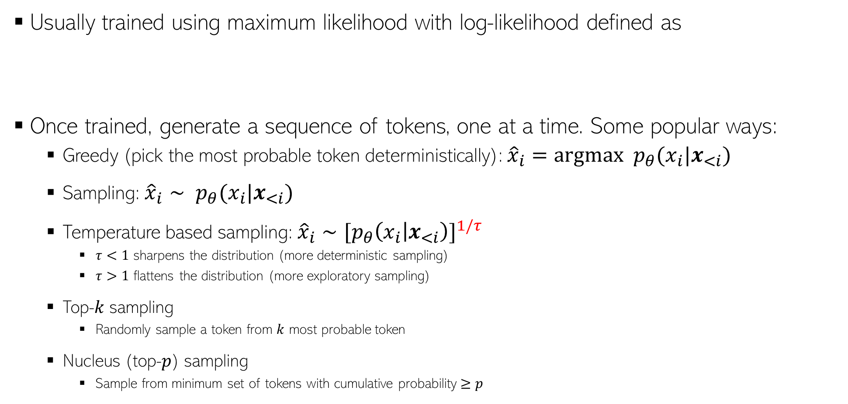
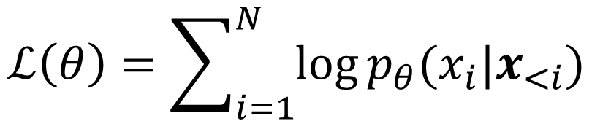
Training of LLMs and Sequence Generation
3
Usually trained using maximum likelihood with log-likelihood defined as
Once trained, generate a sequence of tokens, one at a time. Some popular ways:
  Greedy (pick the most probable token deterministically): ${\hat{x}}_{i}=argmax p_{θ}(x_{i}|x_{<i})$
  Sampling: ${\hat{x}}_{i}∼ p_{θ}(x_{i}|x_{<i})$
  Temperature based sampling: ${\hat{x}}_{i}∼[p_{θ}{\left(x_{i} | x_{<i}\right)]}^{1/τ}$
    $τ<1$ sharpens the distribution (more deterministic sampling)
    $τ>1$ flattens the distribution (more exploratory sampling)
  Top-$k$ sampling
    Randomly sample a token from $k$ most probable token
  Nucleus (top-$p$) sampling
    Sample from minimum set of tokens with cumulative probability $≥p$
$$ℒ\left(θ\right)=\sum_{i=1}^{N}{\log{p_{θ}(x_{i}|x_{<i})}}$$

Slide 4
Some Limitations of Autoregressive LLMs
4
Sequential Generation: Inherently slow due to token-by-token decoding
Low Output Diversity: Because of the decoding techniques used
Locally greedy generation and lacks long-term coherence control.
Token-Level Objectives: Next-token prediction doesn’t align well with task-level goals (e.g., factual consistency).
Difficulty Handling Edits/Rewrites: Inefficient for tasks requiring partial edits or structured generation.

Slide 5
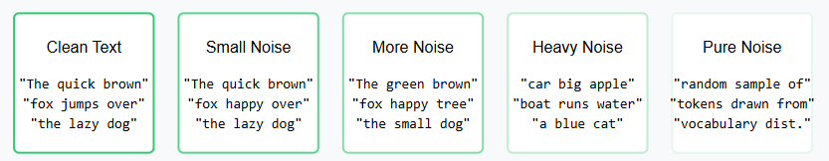
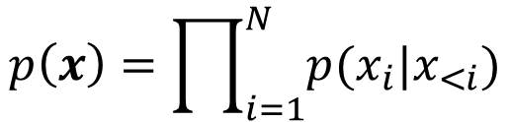
Diffusion based LLM*
5
Autoregressive LLMs generate each token conditioned on earlier tokens
In contrast, diffusion based LLM generate all tokens in parallel
Diffusion LLM consist of a forward and a reverse process
Forward process corrupts the token sequence gradually till it becomes pure noise
Reverse process starts with pure noise and gradually denoises it to generates a token sequence
$$p\left(x\right)=\prod_{i=1}^{N}{p(x_{i}|x_{<i})}$$
*Structured Denoising Diffusion Models in Discrete State-Spaces (Austin et al, NeurIPS 2021)
*Argmax Flows and Multinomial Diffusion: Learning Categorical Distributions (Hoogeboom et al, NeurIPS 2021)

Slide 6


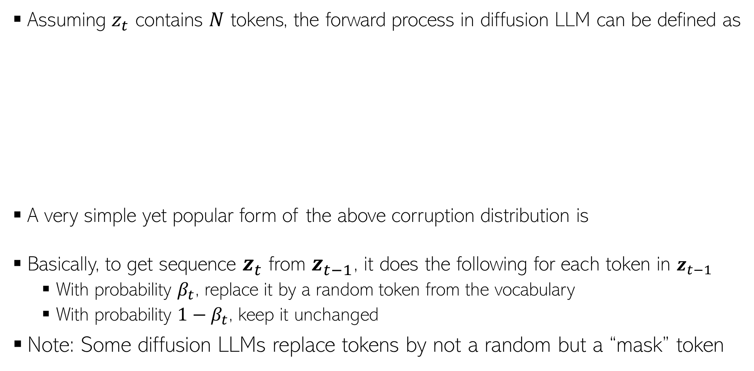




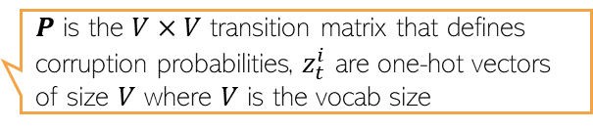


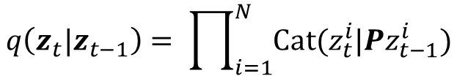
Forward Process
6
Assuming $z_{t}$ contains $N$ tokens, the forward process in diffusion LLM can be defined as
A very simple yet popular form of the above corruption distribution is
Basically, to get sequence $z_{t}$ from $z_{t−1}$, it does the following for each token in $z_{t−1}$
  With probability $β_{t}$, replace it by a random token from the vocabulary
  With probability ${1−β}_{t}$, keep it unchanged
Note: Some diffusion LLMs replace tokens by not a random but a “mask” token
$$q\left(z_{t}|z_{t−1}\right)= \prod_{i=1}^{N}{Cat(z_{t}^{i}|{Pz}_{t−1}^{i})}$$
$P$ is the $V×V$ transition matrix that defines corruption probabilities, $z_{t}^{i}$ are one-hot vectors of size $V$ where $V$ is the vocab size
$$x=z_{0}$$
$$z_{1}$$
$$z_{2}$$
$$z_{T−1}$$
$$z_{T}$$
$$β_{1} (small)$$
$β_{2}$ $(larger)$
$β_{T}$ $(close to 1)$
$$q\left(z_{t}|z_{t−1}\right)=\left(1−β_{t}\right)𝕀\left[z_{t}=z_{t−1}\right]+β_{t}/V$$

Slide 7





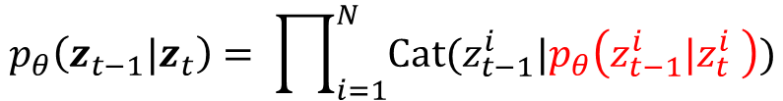

Reverse Process
7
Takes noisy text and produces less noisy text (basically opposite of forward process)
The training objective is similar to the one used in continuous data LLM
  Basically we want to match $p_{θ}\left(z_{t−1}|z_{t}\right)$ and $q\left(z_{t−1}|z_{t},x\right)$
$$p_{θ}\left(z_{t−1}|z_{t}\right)= \prod_{i=1}^{N}{Cat(z_{t−1}^{i}|p_{θ}\left(z_{t−1}^{i}|z_{t}^{i} \right))}$$
$$x=z_{0}$$
$$z_{1}$$
$$z_{2}$$
$$z_{T−1}$$
$$z_{T}$$
$$ℒ= 𝔼_{t,x,z_{t}}\left[{\left\|p_{θ}\left(z_{t−1}|z_{t}\right) −q\left(z_{t−1}|z_{t},x\right)\right\|}^{2}\right]$$

Slide 8
Diffusion LLMs: Some Pros and Cons
8
Some pros
  Parallel Decoding → Faster inference potential via non-sequential generation
  Better Output Diversity → Naturally handles multi-modal distributions
  Improved Controllability → Supports classifier-free guidance and conditioning
  Resilience to Exposure Bias → Trained via denoising, not next-token prediction
  Flexible Objectives → Enables structured generation, editing, and planning
Some cons
  Slower Training → Iterative denoising steps can increase training cost
  Complex Architecture → Needs noise schedule, denoising network, sampling strategy
  High Inference Cost (currently) → Requires multiple denoising steps at test time
  Less Mature → Fewer benchmarks and toolkits compared to autoregressive LLMs
  Tokenization Challenges → Needs careful handling of discrete text representations

