Slide 1
Denoising Diffusion Models (contd)
CS772A: Probabilistic Machine Learning
Piyush Rai

Slide 2

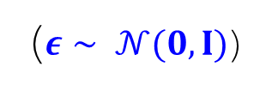











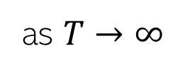
Denoising Diffusion Models
2
Consider gradually corrupting an image ($z_{0}=x)$ till it becomes pure noise ($z_{T}$)
Each step $z_{t−1}→z_{t}$ is a pre-defined Gaussian perturbation (forward process)
$$x$$
$$z_{1}$$
$$z_{2}$$
$$z_{t}$$
$$z_{T−1}$$
$$z_{T}$$
$$q\left(z_{t} | z_{t−1}\right)= 𝒩(z_{t}|\sqrt{1−β_{t}}z_{t−1},β_{t}I)$$
$$q\left(z_{t} | x\right)= 𝒩(z_{t}|\sqrt{α_{t}}x,{(1−α}_{t})I)$$
$z_{t}=\sqrt{1−β_{t}}z_{t−1}+\sqrt{β_{t}}ε$
($ε∼ 𝒩(0,I)$)
implies
where $α_{t}= \prod_{τ=1}^{t}{(1−β_{τ})}$
$$β_{t}∈\left(0,1\right) and β_{1}<β_{2}<…β_{T−1} <β_{T}$$
$z_{t}=\sqrt{α_{t}}x+\sqrt{{1−α}_{t}}ε$
Usually pre-defined but can also be learned
$$q\left(z_{T} | x\right)= 𝒩(z_{T}|0,I)$$
as $T→∞$

Slide 3

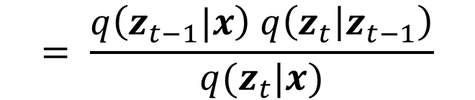


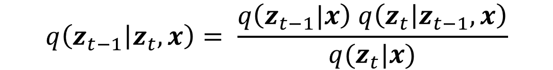
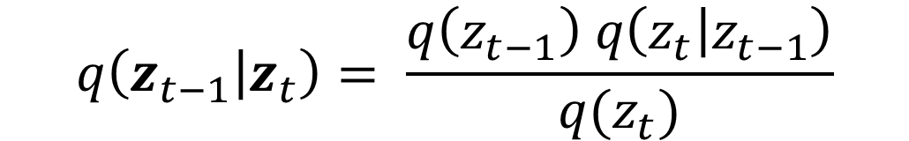





Generating Data by Reversing Diffusion
3
Reversing the diffusion(red arrows) would enable generating data from pure noise
To reverse the diffusion, we need the distribution of $z_{t−1}$ given $z_{t}$, i.e., $q(z_{t−1}|z_{t})$
$$x$$
$$z_{1}$$
$$z_{2}$$
$$z_{t}$$
$$z_{T−1}$$
$$z_{T}$$
$$q\left(z_{t−1} | z_{t}\right)= \frac{q\left(z_{t−1}\right) q\left(z_{t} | z_{t−1}\right)}{q(z_{t})}$$
Intractable
Tractable but valid only for training images (i.e., need to know $x$)
$$q\left(z_{t−1} | z_{t},x\right)= \frac{q\left(z_{t−1}|x\right) q\left(z_{t} | z_{t−1},x\right)}{q(z_{t}|x)}$$
$$= \frac{q\left(z_{t−1}|x\right) q\left(z_{t} | z_{t−1}\right)}{q(z_{t}|x)}$$

Slide 4


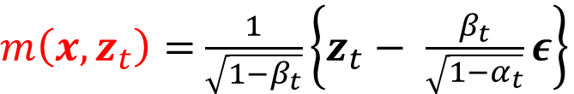
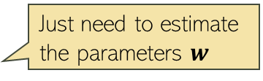
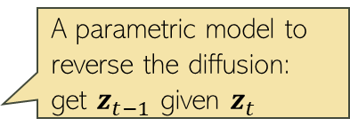

Generating Data by Reversing Diffusion
4
Reversing the diffusion(red arrows) would enable generating data from pure noise
ELBO maximization reduces to minimization of ${\left\|m\left(x,z_{t}\right)−μ\left(z_{t},w,t\right)\right\|}^{2}$
Equivalent to minimization of ${\left\|g\left(z_{t},w,t\right)−ε\right\|}^{2}$which we can do using SGD
$$q\left(z_{t−1} | z_{t},x\right)= 𝒩(z_{t−1}|m\left(x,z_{t}\right),σ_{t}^{2}I)$$
Image
Pure Noise
$m\left(x,z_{t}\right)=$ $\frac{1}{\sqrt{1−β_{t}}}\left\{z_{t}− \frac{β_{t}}{\sqrt{1−α_{t}}}ε\right\}$
A proxy for $q\left(z_{t−1} | z_{t},x\right)$
A parametric model to reverse the diffusion: get $z_{t−1}$ given $z_{t}$
Just need to estimate the parameters $w$
Assume a form that mimics the form of $m\left(x,z_{t}\right)$

Slide 5

Denoising Diffusion Model: The Training Algo
5
The overall training algo is as follows
Can think of $g\left(z_{t},w,t\right)$ as a noise predictor network
Pseudo-code from Bishop & Bishop (2023)

Slide 6
Denoising Diffusion Model: Generation
6
Using the training model, we can now generate data as follows
Generation can be slow because it requires several steps
Reducing the number of steps is an active area of research
One such approach is DDIM (denoising diffusion implicit model) which relaxes the Markov assumption in the noise process
Pseudo-code from Bishop & Bishop (2023)

Slide 7
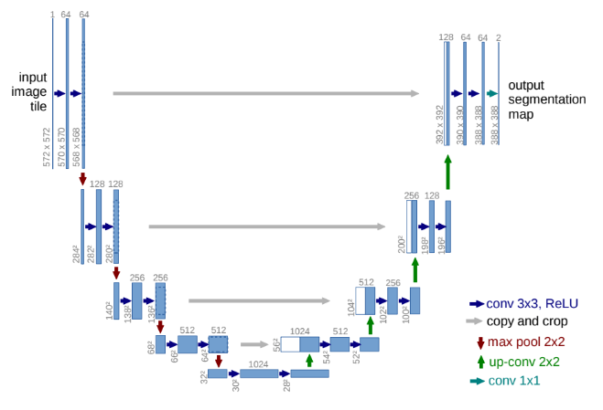



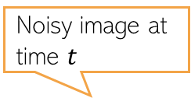
Noise Predictor Network
7
A “U-net” model (a neural net) is commonly used as the noise predictor network
An embedding (positional embedding) of the time-step $t$ is fed into the residual blocks of the U-net architecture
A typical U-net
Noisy image at time $t$
U-net used in a diffusion model
Predicted noise
$$z_{t}$$
$$g(z_{t}, w,t)$$
Figure source: Arash Vahdat

Slide 8
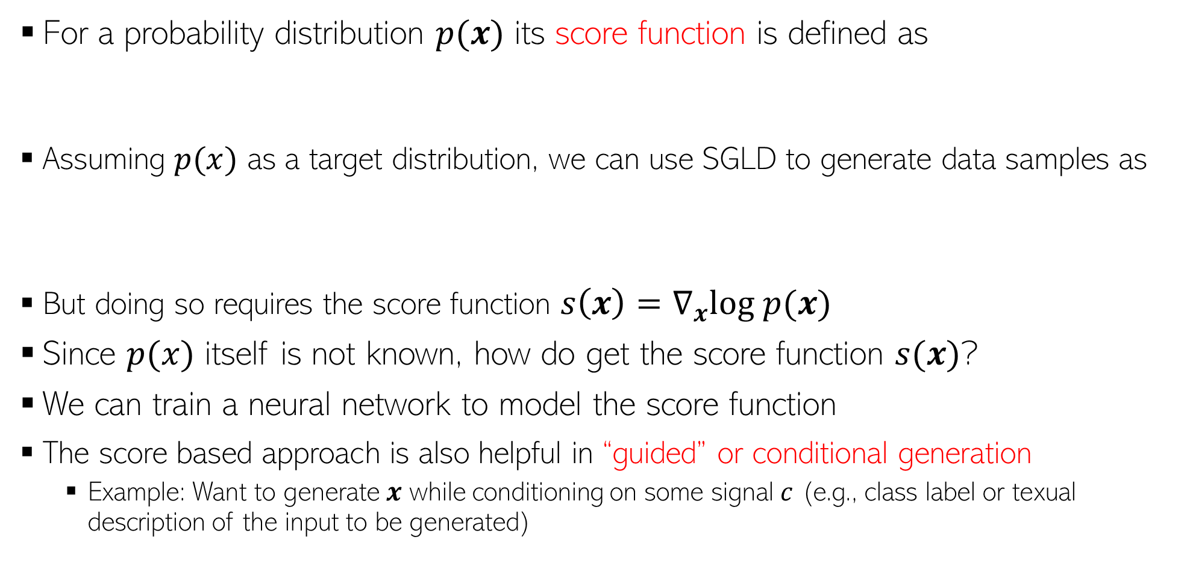
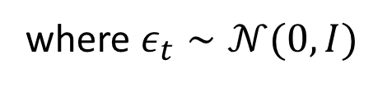
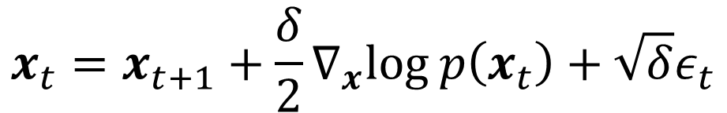
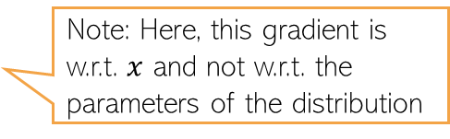

Score based deep generative models
8
For a probability distribution $p(x)$ its score function is defined as
Assuming $p(x)$ as a target distribution, we can use SGLD to generate data samples as
But doing so requires the score function $s\left(x\right)=∇_{x}log p(x)$
Since $p(x)$ itself is not known, how do get the score function $s(x)$?
We can train a neural network to model the score function
The score based approach is also helpful in “guided” or conditional generation
  Example: Want to generate $x$ while conditioning on some signal $c$ (e.g., class label or texual description of the input to be generated)
Note: Here, this gradient is w.r.t. $x$ and not w.r.t. the parameters of the distribution
$$s\left(x\right)=∇_{x}log p(x)$$
$$x_{t}=x_{t+1}+\frac{δ}{2}∇_{x}log p\left(x_{t}\right)+\sqrt{δ}ε_{t}$$
where $ε_{t}∼𝒩(0,I)$

Slide 9
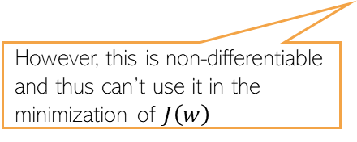
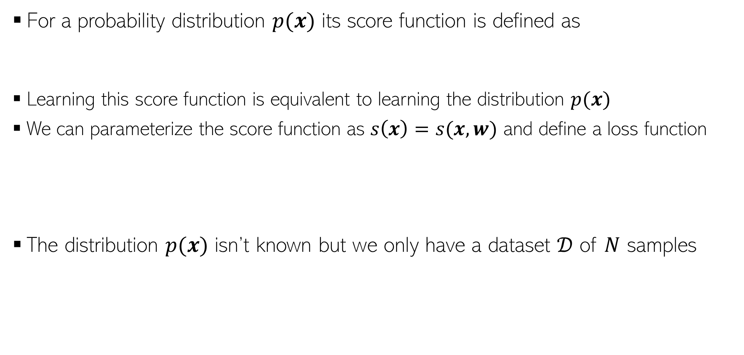
Diffusion Models via Score Matching
9
For a probability distribution $p(x)$ its score function is defined as
Learning this score function is equivalent to learning the distribution $p(x)$
We can parameterize the score function as $s\left(x\right)=s(x,w)$ and define a loss function
The distribution $p(x)$ isn’t known but we only have a dataset $𝒟$ of $N$ samples
Note: Here, this gradient is w.r.t. $x$ and not w.r.t. the parameters of the distribution
$$s\left(x\right)=∇_{x}log p(x)$$
Can define it as a neural network
A discrete distribution represented by the N samples from the dataset
However, this is non-differentiable and thus can’t use it in the minimization of $J\left(w\right)$

Slide 10


Score Matching
10
Instead of $p_{𝒟}(x)$, we define a smooth distribution
Using this $q_{σ}(z)$ instead of $p_{𝒟}(x)$, we can define the “score loss” function as
Using the $N$samples from the dataset, the empirical loss will be
One option is to define it as a Gaussian $𝒩(z|x,σ^{2}I)$

Slide 11

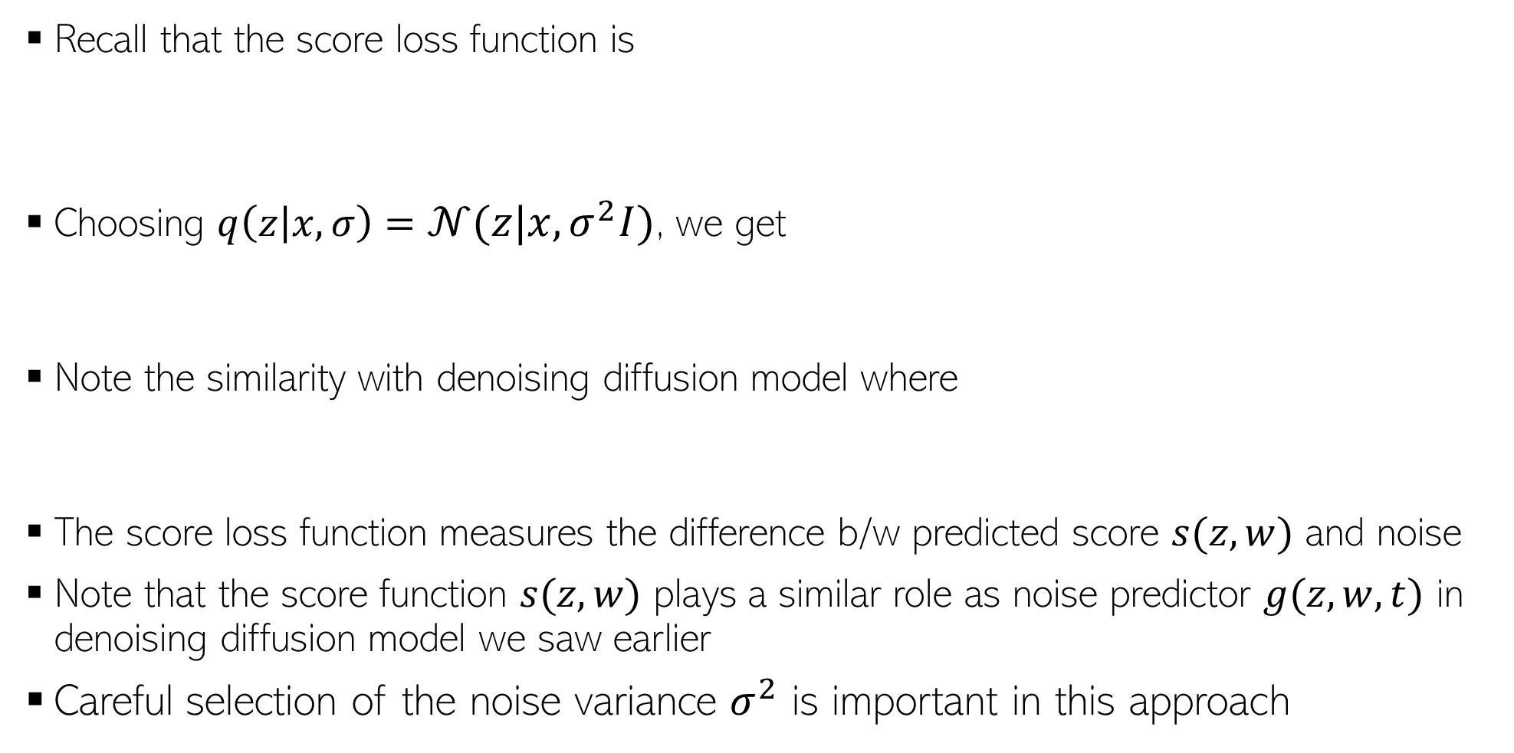
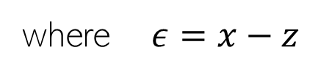
Score Matching
11
Recall that the score loss function is
Choosing $q\left(z | x,σ\right)=𝒩(z|x,σ^{2}I)$, we get
Note the similarity with denoising diffusion model where
The score loss function measures the difference b/w predicted score $s(z,w)$ and noise
Note that the score function $s(z,w)$ plays a similar role as noise predictor $g(z,w,t)$ in denoising diffusion model we saw earlier
Careful selection of the noise variance $σ^{2}$ is important in this approach
where $ε=x−z$
$$q\left(z_{t} | x\right)=𝒩(z|\sqrt{α_{t}}x,(1−α_{t})I)$$

Slide 12
Diffusion Models and SDE
12
Stochastic Differential Equations (SDE) define a continuous-time process
Denoising diffusion model and score matching models are like discretization of the continuous-time SDE
The forward SDE is written as
The corresponding reverse SDE can be written as
We can solve SDE by discretizing time
  For equal-size time steps, we get the Langevin dynamics based equations for the updates
SDE connection is helpful in designing fast reverse process for diffusion models
  For example, we can leverage the ODE corresponding to the SDE for faster sampling
The corresponding ODE for the SDE reverse process
This is like the score function

Slide 13

Guided Diffusion
13
Often we want to generate data based on some “reference” conditioning signal, e.g.,
  Images of a specific class (class-conditional generation)
  Images based on some textual description
  High resolution image using a low-resolution image (image “super-resolution”)
Denoting the data as $x$ and the conditioning signal as $c$, we want to learn $p(x|c)$
Conditioning signal: “stained glass window of a panda eating bamboo”
Conditioning signal: Low-res image on the left
Figure source: DLFC (Bishop and Bishop, 2023)

Slide 14
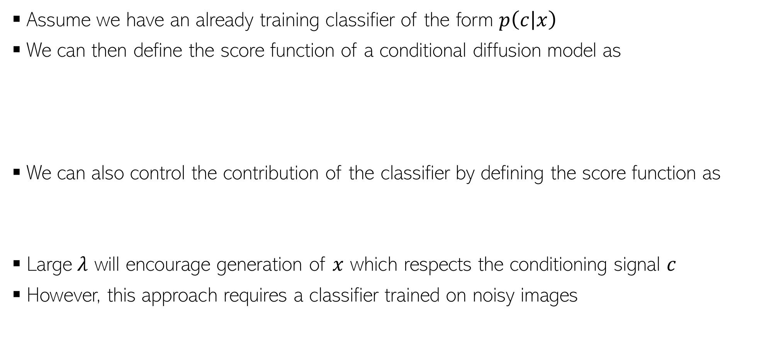
Classifier Guidance
14
Assume we have an already training classifier of the form $p\left(c | x\right)$
We can then define the score function of a conditional diffusion model as
We can also control the contribution of the classifier by defining the score function as
Large $λ$ will encourage generation of $x$ which respects the conditioning signal $c$
However, this approach requires a classifier trained on noisy images
Score function of unconditional diffusion model
Classifier guidance term

Slide 15
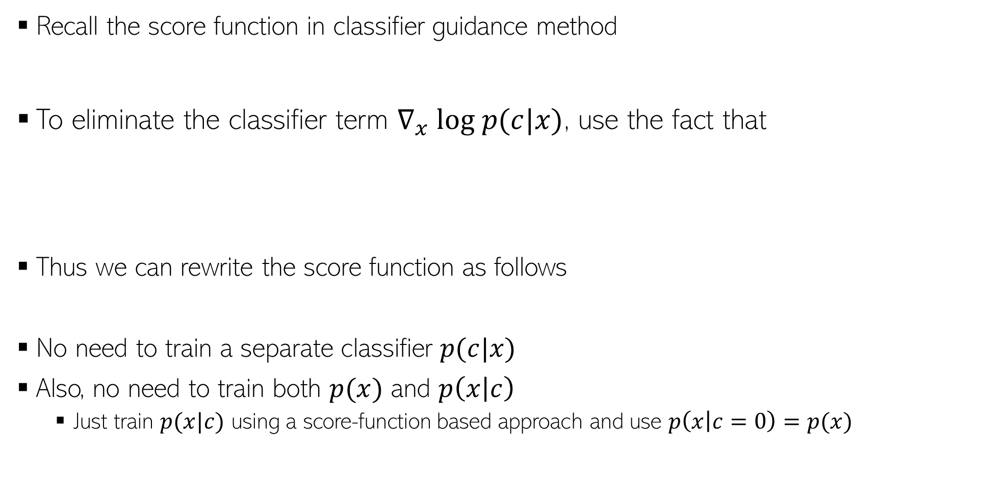
Classifier-free Guidance
15
Recall the score function in classifier guidance method
To eliminate the classifier term $∇_{x} log p(c|x)$, use the fact that
Thus we can rewrite the score function as follows
No need to train a separate classifier $p(c|x)$
Also, no need to train both $p(x)$ and $p\left(x | c\right)$
  Just train $p(x|c)$ using a score-function based approach and use $p\left(x | c=0\right)=p(x)$

Slide 16
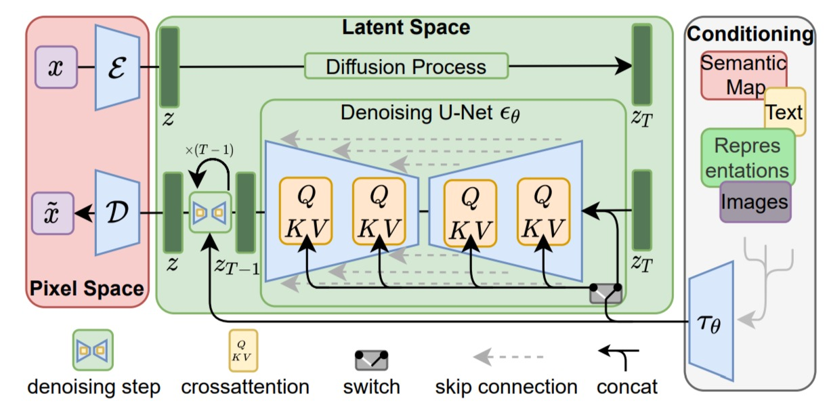
Latent Diffusion Models (LDM)
16
Defines diffusion process in a latent space instead of in data (e.g., pixel) space
The popular “Stable Diffusion” is based on LDM
Diffusion process in a low-dim latent space is also more efficient computationally
Can also condition the generation on other modalities such as text
*High-Resolution Image Synthesis with Latent Diffusion Models (Rombach et al, 2022)

Slide 17
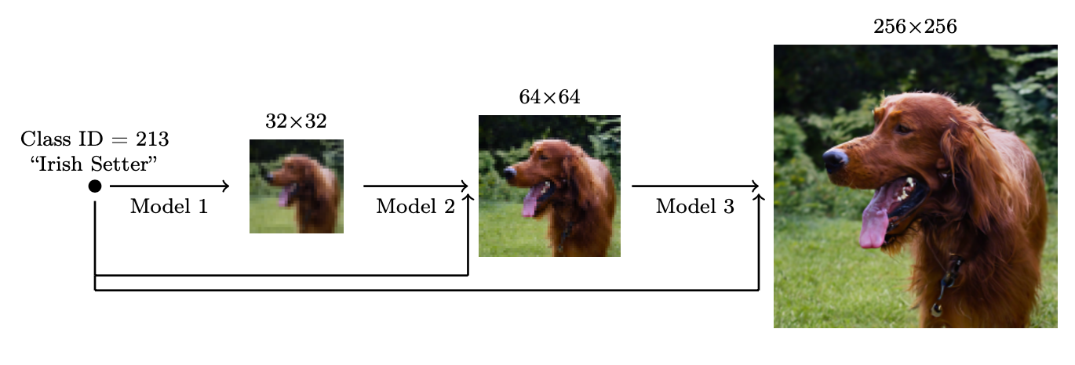
Cascaded Diffusion Models
17
Useful for generating high-resolution images using conditioning
Cascaded approach is usually better than a direct generation of high-resolution image
  Smaller model size
  Learning gradual transformations is easier than a direct transformation

Slide 18
Summary
18
Diffusion Models (denoising diffusion models, score based models, etc) are currently the best performing methods
A lot of ongoing work on diffusion models, e.g.,
  Improving quality of generation
  Speeding-up generation
  Combining them with other generative models (e.g., large language models)

