Slide 1
Denoising Diffusion Models
CS772A: Probabilistic Machine Learning
Piyush Rai

Slide 2
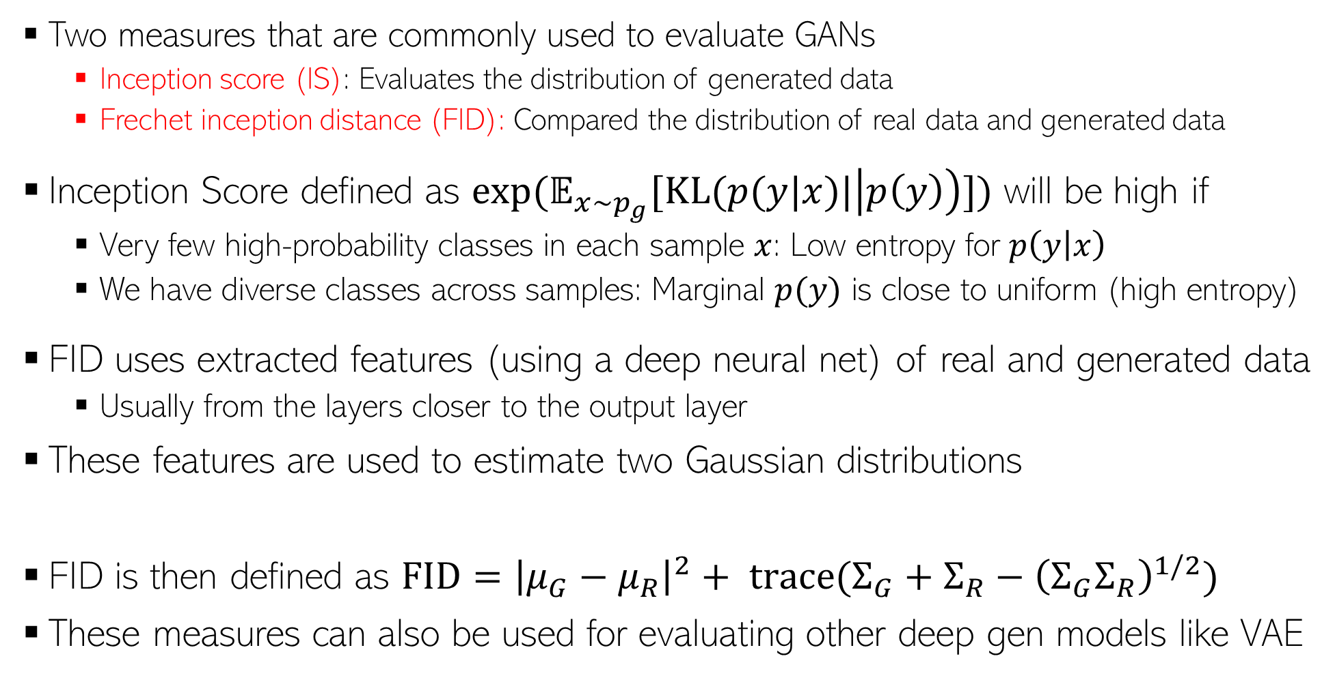


Evaluating GANs
2
High IS and low FID is desirable
Two measures that are commonly used to evaluate GANs
  Inception score (IS): Evaluates the distribution of generated data
  Frechet inception distance (FID): Compared the distribution of real data and generated data
Inception Score defined as $exp(𝔼_{x∼p_{g}}[KL(p(y|x)|\left|p\left(y\right)\right)])$ will be high if
  Very few high-probability classes in each sample $x$: Low entropy for $p\left(y | x\right)$
  We have diverse classes across samples: Marginal $p(y)$ is close to uniform (high entropy)
FID uses extracted features (using a deep neural net) of real and generated data
  Usually from the layers closer to the output layer
These features are used to estimate two Gaussian distributions
FID is then defined as $FID={\left|μ_{G}−μ_{R}\right|}^{2}+ trace(Σ_{G}+Σ_{R}−{\left(Σ_{G}Σ_{R}\right)}^{1/2})$
These measures can also be used for evaluating other deep gen models like VAE
Both IS and FID measure how realistic the generated data is
Using real data
$$𝒩(μ_{R}, Σ_{R})$$
$$𝒩(μ_{G}, Σ_{G})$$
Using generated data

Slide 3
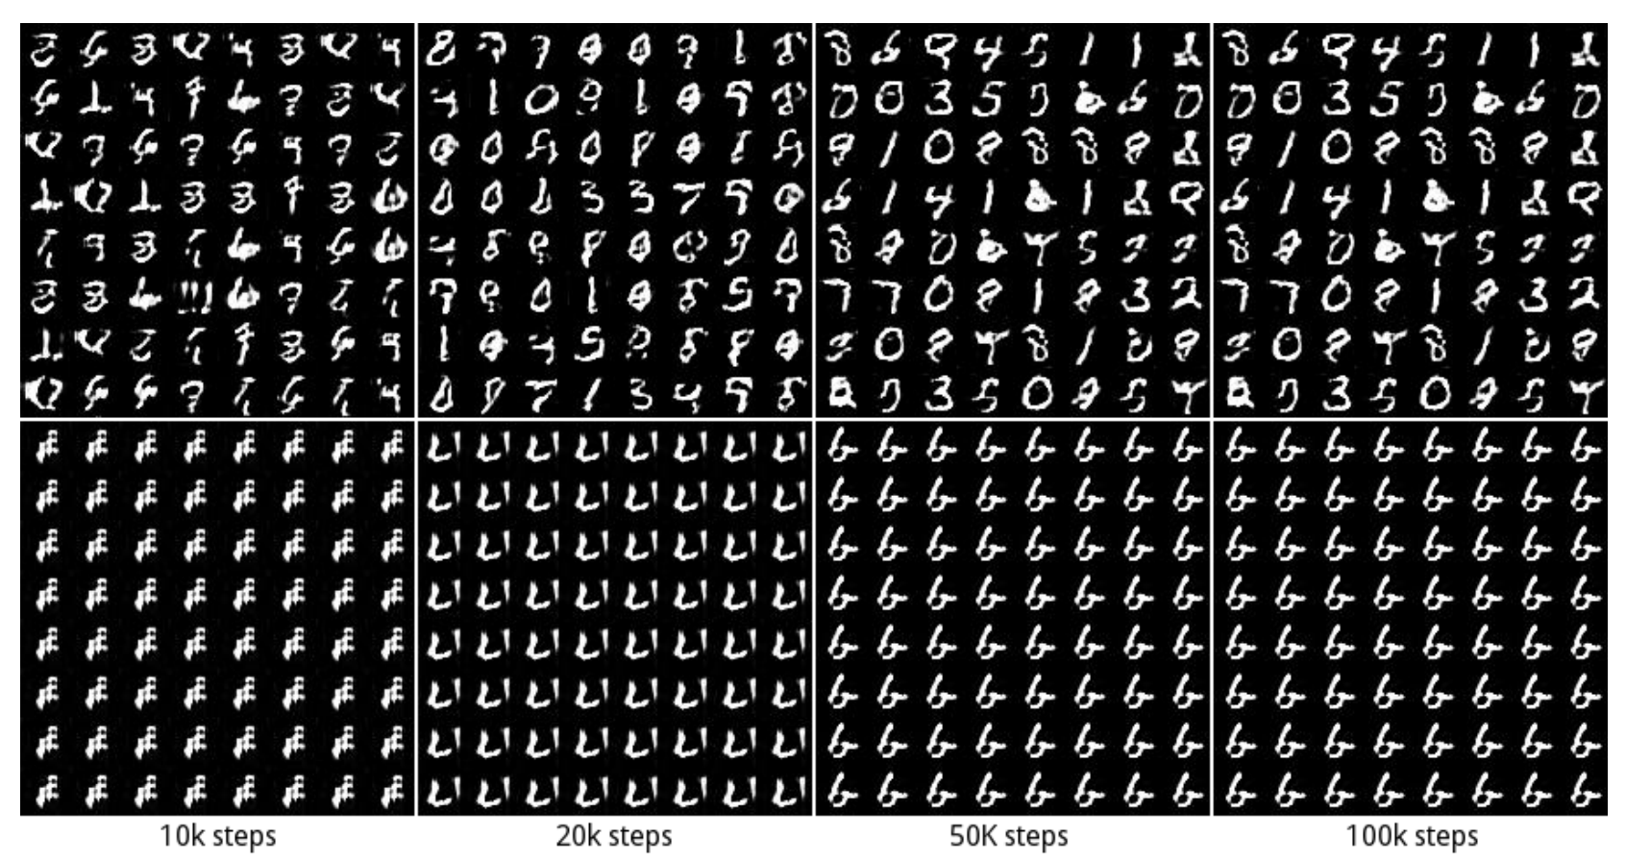
GAN: Some Issues/Comments
3
GAN training can be hard and the basic GAN suffers from several issues
Instability of training procedure
Mode Collapse problem: Lack of diversity in generated samples
  Generator may find some data that can easily fool the discriminator
  It will stuck at that mode of the data distribution and keep generating data like that
Some work on addressing these issues (e.g., Wasserstein GAN, Least Squares GAN, etc)
GAN 1: No mode collapse (all 10 modes captured in generation)
GAN 2: Mode collapse (stuck on one of the modes)

Slide 4

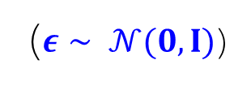







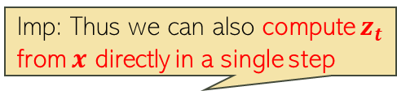




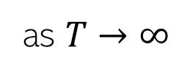
Denoising Diffusion Models
4
Consider gradually corrupting an image ($z_{0}=x)$ till it becomes pure noise ($z_{T}$)
Each step $z_{t−1}→z_{t}$ is a pre-defined Gaussian perturbation (forward process)
$$x$$
$$z_{1}$$
$$z_{2}$$
$$z_{t}$$
$$z_{T−1}$$
$$z_{T}$$
Imp: Thus we can also compute $z_{t}$ from $x$ directly in a single step
$$q\left(z_{t} | z_{t−1}\right)= 𝒩(z_{t}|\sqrt{1−β_{t}}z_{t−1},β_{t}I)$$
$$q\left(z_{t} | x\right)= 𝒩(z_{t}|\sqrt{α_{t}}x,{(1−α}_{t})I)$$
$z_{t}=\sqrt{1−β_{t}}z_{t−1}+\sqrt{β_{t}}ε$
($ε∼ 𝒩(0,I)$)
implies
where $α_{t}= \prod_{τ=1}^{t}{(1−β_{τ})}$
$$β_{t}∈\left(0,1\right) and β_{1}<β_{2}<…β_{T−1} <β_{T}$$
$z_{t}=\sqrt{α_{t}}x+\sqrt{{1−α}_{t}}ε$
Usually pre-defined but can also be learned
$$q\left(z_{T} | x\right)= 𝒩(z_{T}|0,I)$$
as $T→∞$

Slide 5
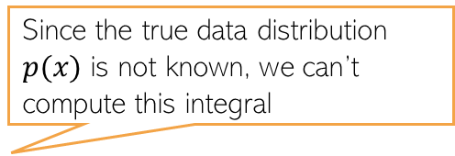

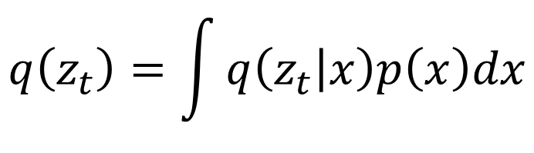
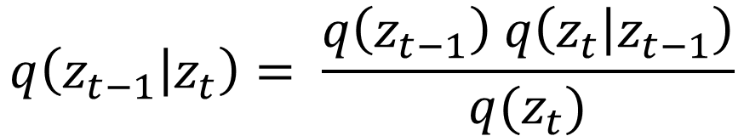
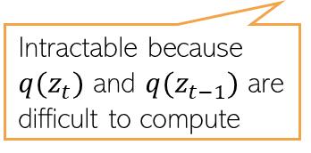
Generating Data by Reversing Diffusion
5
Reversing the diffusion(red arrows) would enable generating data from pure noise
To reverse the diffusion, we need the distribution of $z_{t−1}$ given $z_{t}$, i.e., $q(z_{t−1}|z_{t})$
$$x$$
$$z_{1}$$
$$z_{2}$$
$$z_{t}$$
$$z_{T−1}$$
$$z_{T}$$
The denoising distribution
$$q\left(z_{t−1} | z_{t}\right)= \frac{q\left(z_{t−1}\right) q\left(z_{t} | z_{t−1}\right)}{q(z_{t})}$$
Intractable because $q(z_{t})$ and $q(z_{t−1})$ are difficult to compute
Since the true data distribution $p(x)$ is not known, we can’t compute this integral
$$q\left(z_{t}\right)=\int{q\left(z_{t} | x\right)p\left(x\right)dx}$$

Slide 6
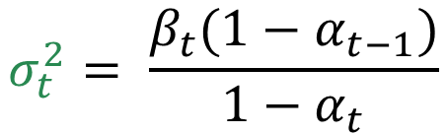

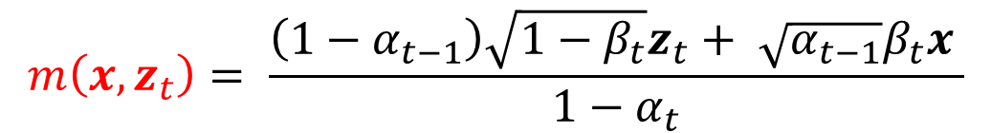
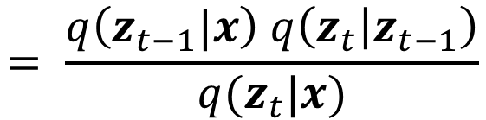
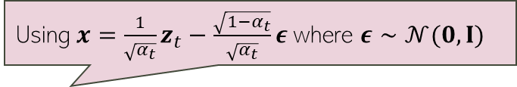
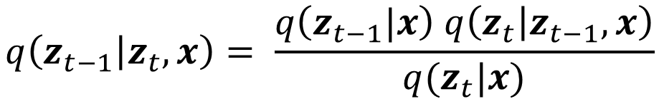
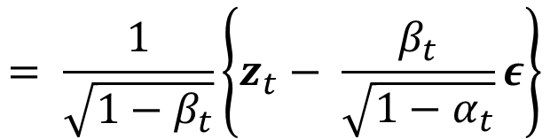
Towards a Tractable Reverse Diffusion
6
Although $q\left(z_{t−1} | z_{t}\right)$ isn’t tractable, the following distribution is tractable
Reason: $q\left(z_{t−1}|x\right)$ and $q\left(z_{t} | z_{t−1}\right)$ are Gaussians, so $q\left(z_{t−1} | z_{t},x\right)$ is Gaussian
$$q\left(z_{t−1} | z_{t},x\right)= \frac{q\left(z_{t−1}|x\right) q\left(z_{t} | z_{t−1},x\right)}{q(z_{t}|x)}$$
$$= \frac{q\left(z_{t−1}|x\right) q\left(z_{t} | z_{t−1}\right)}{q(z_{t}|x)}$$
$$q\left(z_{t−1} | z_{t},x\right)= 𝒩(z_{t−1}|m\left(x,z_{t}\right),σ_{t}^{2}I)$$
Using $x=\frac{1}{\sqrt{α_{t}}}z_{t}−\frac{\sqrt{1−α_{t}}}{\sqrt{α_{t}}}ε$ where $ε∼𝒩(0,I)$
$$m\left(x,z_{t}\right)= \frac{\left(1−α_{t−1}\right)\sqrt{1−β_{t}}z_{t}+ \sqrt{α_{t−1}}β_{t}x }{1−α_{t}}$$
$$= \frac{1}{\sqrt{1−β_{t}}}\left\{z_{t}− \frac{β_{t}}{\sqrt{1−α_{t}}}ε\right\}$$
$$σ_{t}^{2}= \frac{β_{t}(1−α_{t−1})}{1−α_{t}}$$

Slide 7


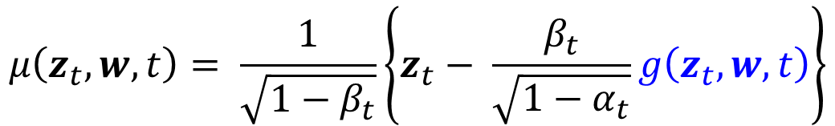
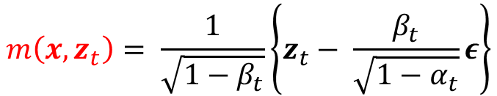

Towards a Tractable Reverse Diffusion
7
We saw that the reverse diffusion distribution is the Gaussian
Let’s approximate $q\left(z_{t−1} | z_{t},x\right)$ by another Gaussian that doesn’t depend on $x$
Usually, $Σ(z_{t}, w,t)$ is chosen to be spherical. A popular choice: $Σ\left(z_{t}, w,t\right)=β_{t}I$
The mean $μ\left(z_{t},w,t\right)$ is defined to mimic the form of $m\left(x,z_{t}\right)$
$$q\left(z_{t−1} | z_{t},x\right)= 𝒩(z_{t−1}|m\left(x,z_{t}\right),σ_{t}^{2}I)$$
Issue: At generation time, we don’t have $x$(the goal is to generate $x$ which is only available for training data) so we can’t use $m\left(x,z_{t}\right)$ at generation time since it depends on $x$
$$m\left(x,z_{t}\right)= \frac{1}{\sqrt{1−β_{t}}}\left\{z_{t}− \frac{β_{t}}{\sqrt{1−α_{t}}}ε\right\}$$
where
$$p\left(z_{t−1} | z_{t},w\right)= 𝒩(z_{t−1}|μ\left(z_{t},w,t\right),Σ(z_{t}, w,t))$$
$$μ\left(z_{t},w,t\right)= \frac{1}{\sqrt{1−β_{t}}}\left\{z_{t}− \frac{β_{t}}{\sqrt{1−α_{t}}}g\left(z_{t},w,t\right)\right\}$$

Slide 8
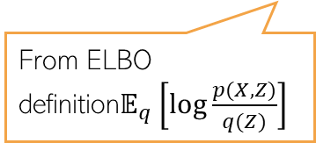

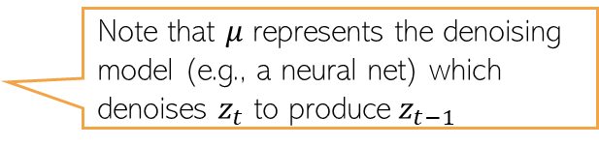
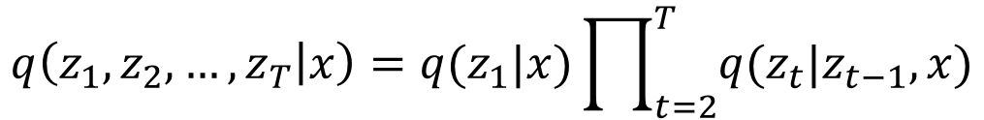
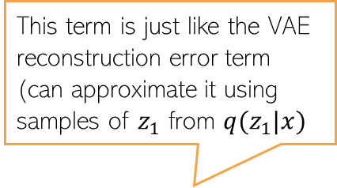
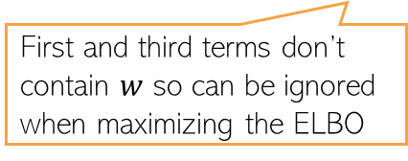
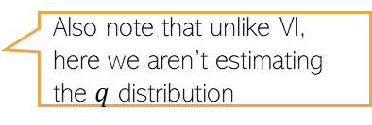
Reversing the Diffusion
8
Image
Pure Noise
The joint distribution of data and latents
Let’s assume
The true joint distribution of the latents given $x$
To estimate $w$, we can maximize the ELBO defined as
Note that $μ$ represents the denoising model (e.g., a neural net) which denoises $z_{t}$ to produce $z_{t−1}$
$$q\left(z_{1},z_{2},…, z_{T} | x\right)=q(z_{1}|x)\prod_{t=2}^{T}{q(z_{t}|z_{t−1},x)}$$
This term is just like the VAE reconstruction error term (can approximate it using samples of $z_{1}$ from $q(z_{1}|x)$
From ELBO definition$𝔼_{q}\left[log\frac{p(X,Z)}{q(Z)}\right]$
First and third terms don’t contain $w$ so can be ignored when maximizing the ELBO
Also note that unlike VI, here we aren’t estimating the $q$ distribution

Slide 9

ELBO (contd)
9
9
Image
Pure Noise
Recall the ELBO for the denoising diffusion model
Ignoring terms that don’t depend on $w$ and using
The ELBO becomes
Since both distributions in the KL divergence term are Gaussians, it becomes

Slide 10
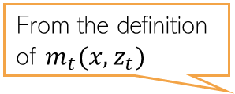

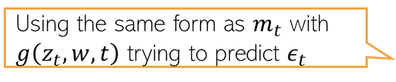
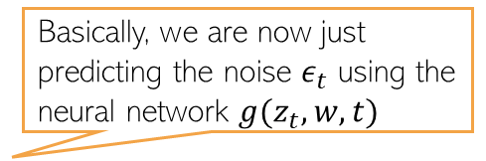
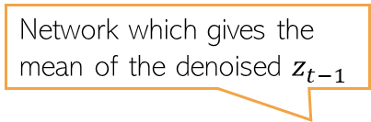
Predicting the noise
10
Network which gives the mean of the denoised $z_{t−1}$
The KL terms in the ELBO are of the form
Note that
Instead of learning $μ(z_{t}, w,t)$, we will learn a noise predictor $g\left(z_{t}, w,t\right)$ s.t.
Therefore
From the definition of $m_{t}(x,z_{t})$
Using the same form as $m_{t}$ with $g\left(z_{t}, w,t\right)$ trying to predict $ε_{t}$
Basically, we are now just predicting the noise $ε_{t}$ using the neural network $g(z_{t}, w,t)$

Slide 11
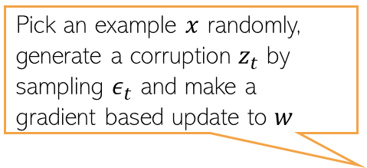
Predicting the noise
11
We basically had the following
The reconstruction error part in the ELBO can also be written as noise prediction
Ignoring the constants in front of the squared error terms above, the ELBO becomes
Empirically found to give improved performance
Pick an example $x$ randomly, generate a corruption $z_{t}$ by sampling $ε_{t}$ and make a gradient based update to $w$
Can optimize using stochastic optimization

Slide 12
Denoising Diffusion Model: The Training Algo
12
The overall training algo is as follows
Pseudo-code from Bishop & Bishop (2023)

Slide 13
Denoising Diffusion Model: Generation
13
Using the training model, we can now generate data as follows
Generation can be slow because it requires several steps
Reducing the number of steps is an active area of research
One such approach is DDIM (denoising diffusion implicit model) which relaxes the Markov assumption in the noise process
Pseudo-code from Bishop & Bishop (2023)

Slide 14
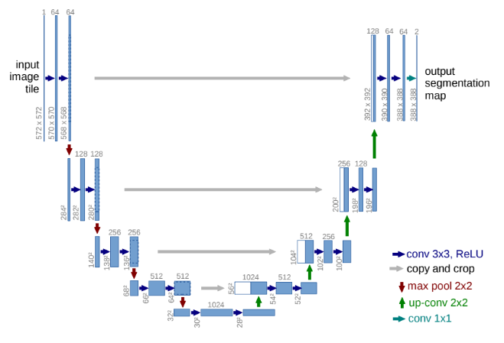



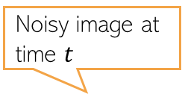
Noise Predictor Network
14
A “U-net” model (a neural net) is commonly used as the noise predictor network
An embedding (positional embedding) of the time-step $t$ is fed into the residual blocks of the U-net architecture
A typical U-net
Noisy image at time $t$
U-net used in a diffusion model
Predicted noise
$$z_{t}$$
$$g(z_{t}, w,t)$$
Figure source: Arash Vahdat

Slide 15
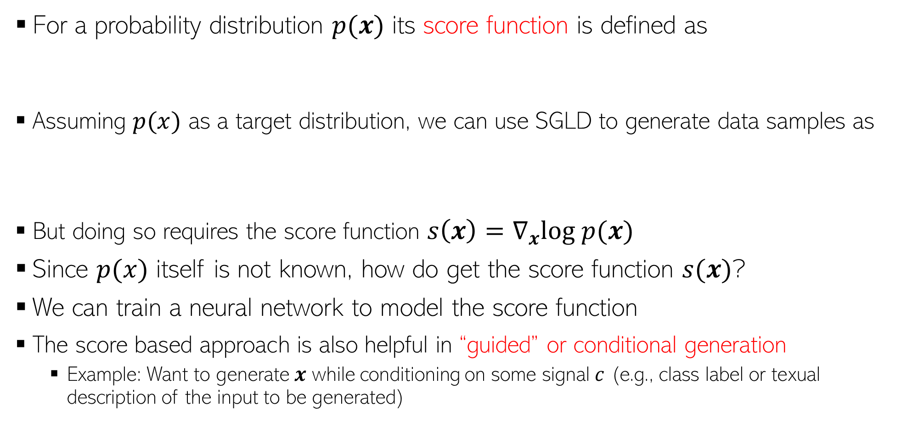
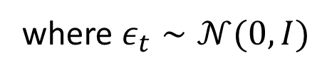
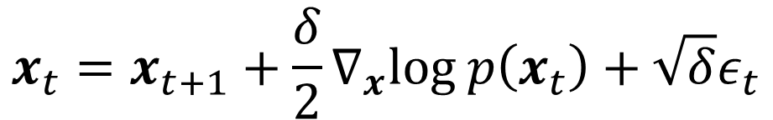
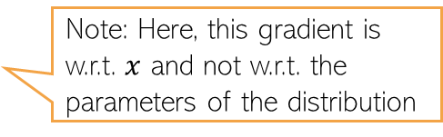

Score based deep generative models
15
For a probability distribution $p(x)$ its score function is defined as
Assuming $p(x)$ as a target distribution, we can use SGLD to generate data samples as
But doing so requires the score function $s\left(x\right)=∇_{x}log p(x)$
Since $p(x)$ itself is not known, how do get the score function $s(x)$?
We can train a neural network to model the score function
The score based approach is also helpful in “guided” or conditional generation
  Example: Want to generate $x$ while conditioning on some signal $c$ (e.g., class label or texual description of the input to be generated)
Note: Here, this gradient is w.r.t. $x$ and not w.r.t. the parameters of the distribution
$$s\left(x\right)=∇_{x}log p(x)$$
$$x_{t}=x_{t+1}+\frac{δ}{2}∇_{x}log p\left(x_{t}\right)+\sqrt{δ}ε_{t}$$
where $ε_{t}∼𝒩(0,I)$

Slide 16
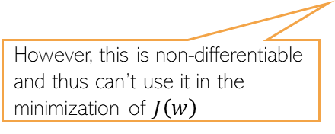
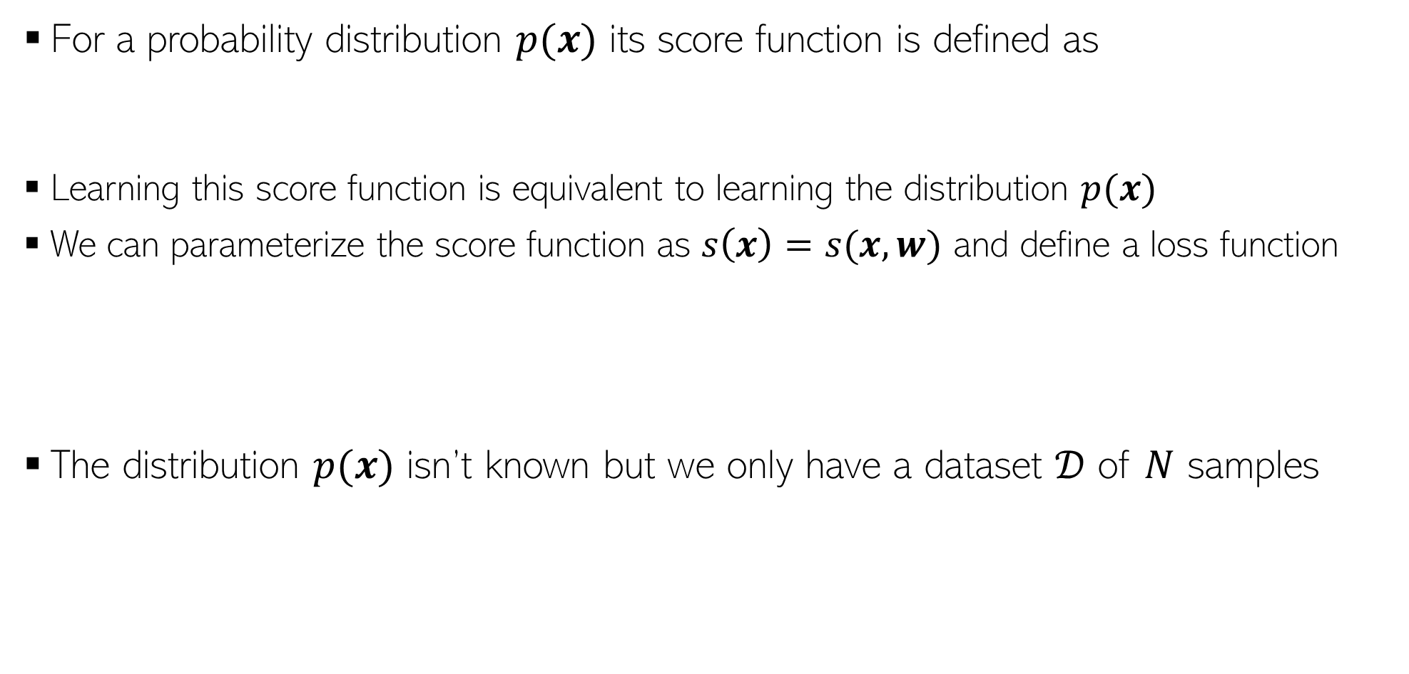
Diffusion Models via Score Matching
16
For a probability distribution $p(x)$ its score function is defined as
Learning this score function is equivalent to learning the distribution $p(x)$
We can parameterize the score function as $s\left(x\right)=s(x,w)$ and define a loss function
The distribution $p(x)$ isn’t known but we only have a dataset $𝒟$ of $N$ samples
Note: Here, this gradient is w.r.t. $x$ and not w.r.t. the parameters of the distribution
$$s\left(x\right)=∇_{x}log p(x)$$
Can define it as a neural network
A discrete distribution represented by the N samples from the dataset
However, this is non-differentiable and thus can’t use it in the minimization of $J\left(w\right)$

Slide 17


Score Matching
17
Instead of $p_{𝒟}(x)$, we define a smooth distribution
Using this $q_{σ}(z)$ instead of $p_{𝒟}(x)$, we can define the “score loss” function as
Using the $N$samples from the dataset, the empirical loss will be
One option is to define it as a Gaussian $𝒩(z|x,σ^{2}I)$

Slide 18

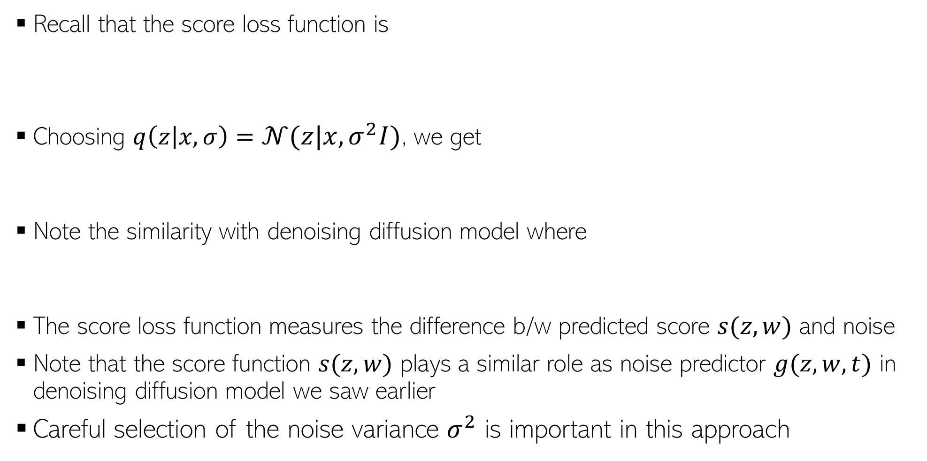
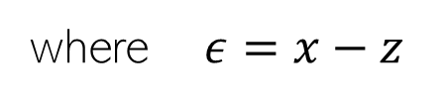
Score Matching
18
Recall that the score loss function is
Choosing $q\left(z | x,σ\right)=𝒩(z|x,σ^{2}I)$, we get
Note the similarity with denoising diffusion model where
The score loss function measures the difference b/w predicted score $s(z,w)$ and noise
Note that the score function $s(z,w)$ plays a similar role as noise predictor $g(z,w,t)$ in denoising diffusion model we saw earlier
Careful selection of the noise variance $σ^{2}$ is important in this approach
where $ε=x−z$
$$q\left(z_{t} | x\right)=𝒩(z|\sqrt{α_{t}}x,(1−α_{t})I)$$

Slide 19
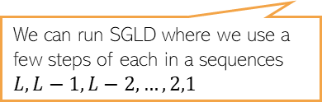



Noise Variance in Score Matching
19
Success of score matching depends on the estimate of score function $s\left(x\right)=∇_{x}log p(x)$
In regions where $p(x)$ is small/zero, the estimate $s\left(z,w\right)$ may not be reliable
Recall that, in score matching, we typically use $q\left(z | x,σ\right)=𝒩(z|x,σ^{2}I)$
Using the appropriate $σ^{2}$ is critical
  Using large $σ^{2}$ means we won’t have small/zero values for $q(z|x)$ but also high distortion
  Very small $σ^{2}$ means $q\left(z|x\right)$ is close to $p(x)$
  We can choose a series of variances $σ_{1}^{2}<σ_{2}^{2}<…<σ_{L}^{2}$ and use the following loss function
This gives us $L$ score matching based diffusion models with different variances
$λ(i)$ is the weighting coefficient for model $i$
We can run SGLD where we use a few steps of each in a sequences $L,L−1,L−2,…, 2,1$

Slide 20
Diffusion Models and SDE
20
Stochastic Differential Equations (SDE) define a continuous-time process
Denoising diffusion model and score matching models are like discretization of the continuous-time SDE
The forward SDE is written as
The corresponding reverse SDE can be written as
We can solve SDE by discretizing time
  For equal-size time steps, we get the Langevin dynamics based equations for the updates
SDE connection is helpful in designing fast reverse process for diffusion models
  For example, we can leverage the ODE corresponding to the SDE for faster sampling
The corresponding ODE for the SDE reverse process
This is like the score function

Slide 21

Guided Diffusion
21
Often we want to generate data based on some “reference” conditioning signal, e.g.,
  Images of a specific class (class-conditional generation)
  Images based on some textual description
  High resolution image using a low-resolution image (image “super-resolution”)
Denoting the data as $x$ and the conditioning signal as $c$, we want to learn $p(x|c)$
Conditioning signal: “stained glass window of a panda eating bamboo”
Conditioning signal: Low-res image on the left
Figure source: DLFC (Bishop and Bishop, 2023)

Slide 22

Classifier Guidance
22
Assume we have an already training classifier of the form $p\left(c | x\right)$
We can then define the score function of a conditional diffusion model as
We can also control the contribution of the classifier by defining the score function as
Large $λ$ will encourage generation of $x$ which respects the conditioning signal $c$
However, this approach requires a classifier trained on noisy images
Score function of unconditional diffusion model
Classifier guidance term

Slide 23

Classifier-free Guidance
23
Recall the score function in classifier guidance method
To eliminate the classifier term $∇_{x} log p(c|x)$, use the fact that
Thus we can rewrite the score function as follows
No need to train a separate classifier $p(c|x)$
Also, no need to train both $p(x)$ and $p\left(x | c\right)$
  Just train $p(x|c)$ using a score-function based approach and use $p\left(x | c=0\right)=p(x)$

Slide 24

Latent Diffusion Models (LDM)
24
Defines diffusion process in a latent space instead of in data (e.g., pixel) space
The popular “Stable Diffusion” is based on LDM
Diffusion process in a low-dim latent space is also more efficient computationally
Can also condition the generation of other modalities such as text
*High-Resolution Image Synthesis with Latent Diffusion Models (Rombach et al, 2022)

Slide 25

Cascaded Diffusion Models
25
Useful for generating high-resolution images using conditioning
Cascaded approach is usually better than a direct generation of high-resolution image
  Smaller model size
  Learning gradual transformations is easier than a direct transformation

Slide 26
Summary
26
Diffusion Models (denoising diffusion models, score based models, etc) are currently the best performing methods
A lot of ongoing work on diffusion models, e.g.,
  Improving quality of generation
  Speeding-up generation
  Combining them with other generative models (e.g., large language models)

