Slide 1
Deep Generative Models
CS772A: Probabilistic Machine Learning
Piyush Rai

Slide 2
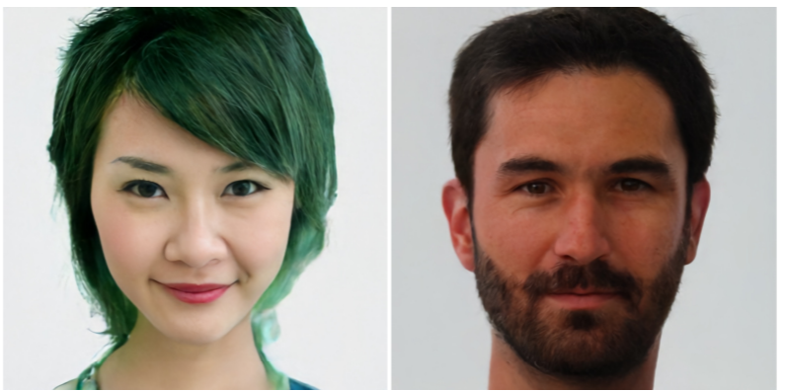
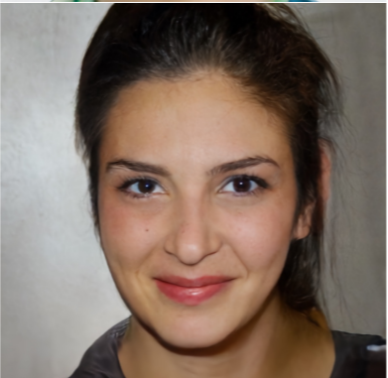
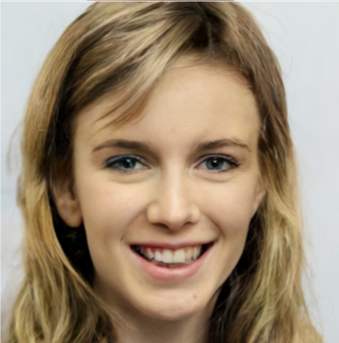
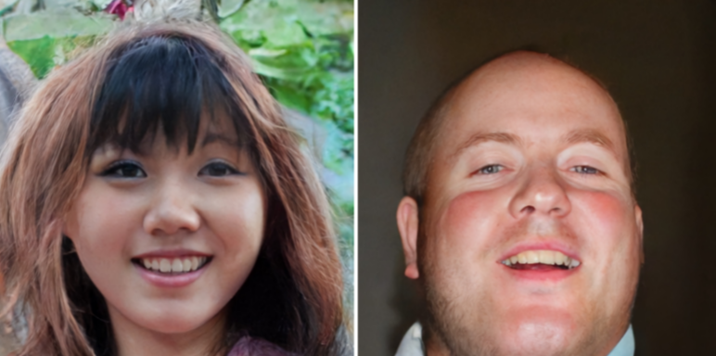
Latent Variable Models for Generation Tasks
2
Assume a $K$-dim latent variable $z_{n}$ is transformed to generate to $D$-dim observation $x_{n}$
It is common to use a Gaussian prior for $z_{n}$ (though other priors can be used)
If we use a neural net or GP, such models can generate very high-quality data
  Take the trained network, generate a random $z$ from prior, pass it through the model to generate $x$
Also possible to use a GP to model $f$
$$p(z)$$
$$p(x|f\left(z;W\right))$$
$$z_{n}$$
$$x_{n}$$
f can be some linear or nonlinear model which defines the parameters of the distribution of $p(x|z)$ and $W$ denotes the parameters of this model
Some sample images generated by Vector Quantized Variational Auto-Encoder (VQ-VAE), a state-of-the-art latent variable model for generation

Slide 3
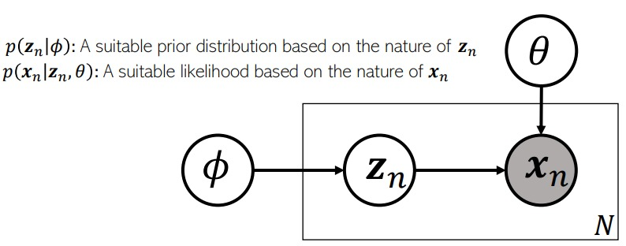
Factor Analysis and Probabilistic PCA
3
FA and PPCA assume $f$ to be a linear model
In FA/PPCA, latent variables $z_{n}∈ℝ^{K}$ typically assumed to have a Gaussian prior
  If we want sparse latent variabled, can use Laplace or spike-and-slab prior on $z_{n}$
  More complex extensions of FA/PPCA use a mixture of Gaussians prior on $z_{n}$
Assumption: Observations $x_{n}∈ℝ^{D}$ typically assumed to have a Gaussian likelihood
  Other likelihood models (e.g., exp-family) can also be used if data not real-valued
Relationship between $z_{n}$ and $x_{n}$ modeled by a noisy linear mapping
Linear Gaussian Model. $W$, $z_{n}$’s, and $Ψ$ can be learned (e.g, using EM, VI, MCMC)
$$x_{n}=Wz_{n}+ε_{n}=\sum_{k=1}^{K}{w_{k}z_{nk}}+ε_{n}$$
$$p\left(z_{n}\right)= 𝒩\left(z_{n} | 0,I\right)$$
$$p\left({x_{n}|z}_{n}\right)= 𝒩\left(x_{n} | Wz_{n},Ψ\right)$$
Zero-mean and diagonal or spherical Gaussian noise
Linear combination of the columns of $W$
Diagonal for FA, spherical for PPCA

Slide 4
Some Variants of FA/PPCA
4
Non-negative priors often give a nice interpretability to such latent variable models (will see some more examples of such models shortly)
Popular for modeling count-valued data (in text analysis, recommender systems, etc)
Gamma-Poisson latent factor model
  Assumes $K$-dim non-negative latent variable $z_{n}$ and $D$-dim count-valued observations $x_{n}$
  An example: Each $x_{n}$ is the word-count vector representing a document
  This can be thought of as a probabilistic non-negative matrix factorization model
Dirichlet-Multinomial/Multinoulli PCA
  Assumes $K$-dim non-negative latent variable $z_{n}$ and $D$ categorical obs $x_{n}={\{x_{nd}\}}_{d=1}^{D}$
  An example: Each $x_{n}$ is a document with $D$ words in it (each word is a categorical value)
$p\left(z_{n}\right)= \prod_{k=1}^{K}{Gamma(z_{nk}|a_{k}, b_{k}))}$
This is the rate of the Poisson. It should be non-negative, $exp⁡(w_{d}^{⊤}z_{n})$, or simply $w_{d}^{⊤}z_{n}$ if $w_{d}$ is also non-negative (e.g., using a gamma/Dirichlet prior on it)
$p\left(x_{n}|z_{n}\right)= \prod_{d=1}^{D}{Poisson(x_{nd}|f({w_{d}, z}_{n}))}$
Also sums to 1
This should give the probability vector of the multinoulli over $x_{nd}$. It should be non-negative and should sums to 1
$p\left(z_{n}\right)= Dirichlet(z_{n}|α)$
$p\left(x_{n}|z_{n}\right)= \prod_{d=1}^{D}{Multinoulli(x_{nd}|f({w_{d}, z}_{n}))}$

Slide 5
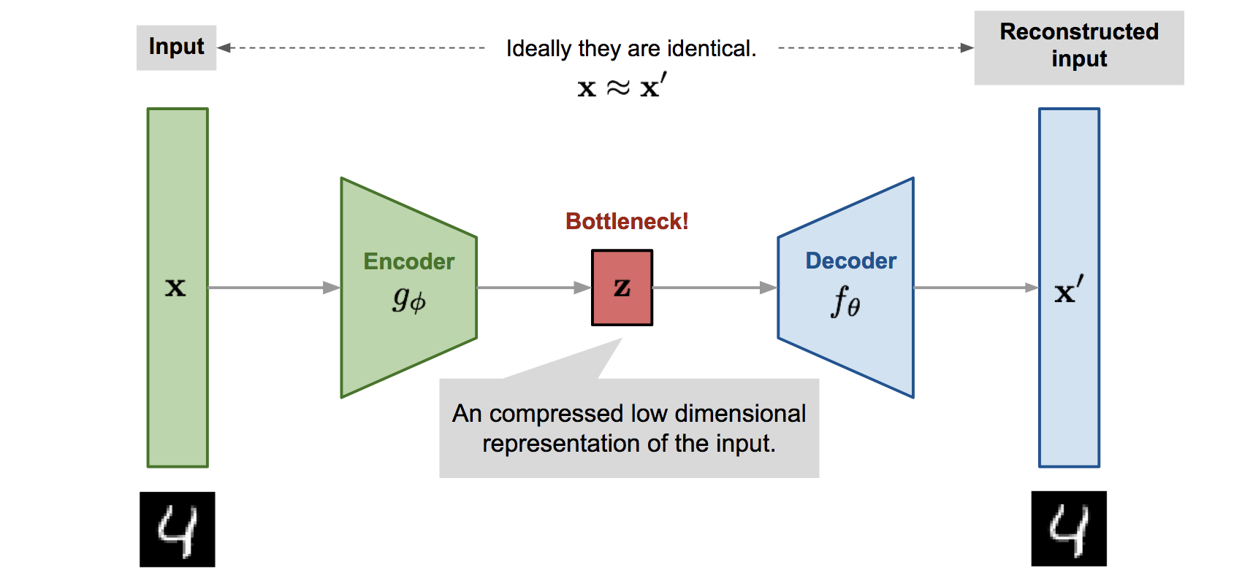


A Deep Generative Model: Variational Auto-encoder (VAE)
5
VAE* is a probabilistic extension of autoencoders (AE). An AE is shown below
The basic difference is that VAE assumes a prior $p(z)$ on the latent code $z$
  This enables it to not just compress the data but also generate synthetic data
  How: Sample $z$ from a prior and pass it through the decoder
Thus VAE can learn good latent representation + generate novel synthetic data
The name has “Variational” in it since it is learned using VI principles
*Autoencoding Variational Bayes (Kingma and Welling, 2013)
Pic source: https://lilianweng.github.io/lil-log/2018/08/12/from-autoencoder-to-beta-vae.html

Slide 6
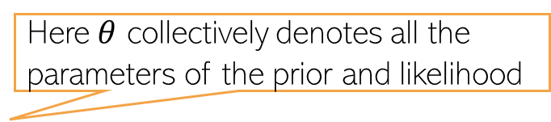
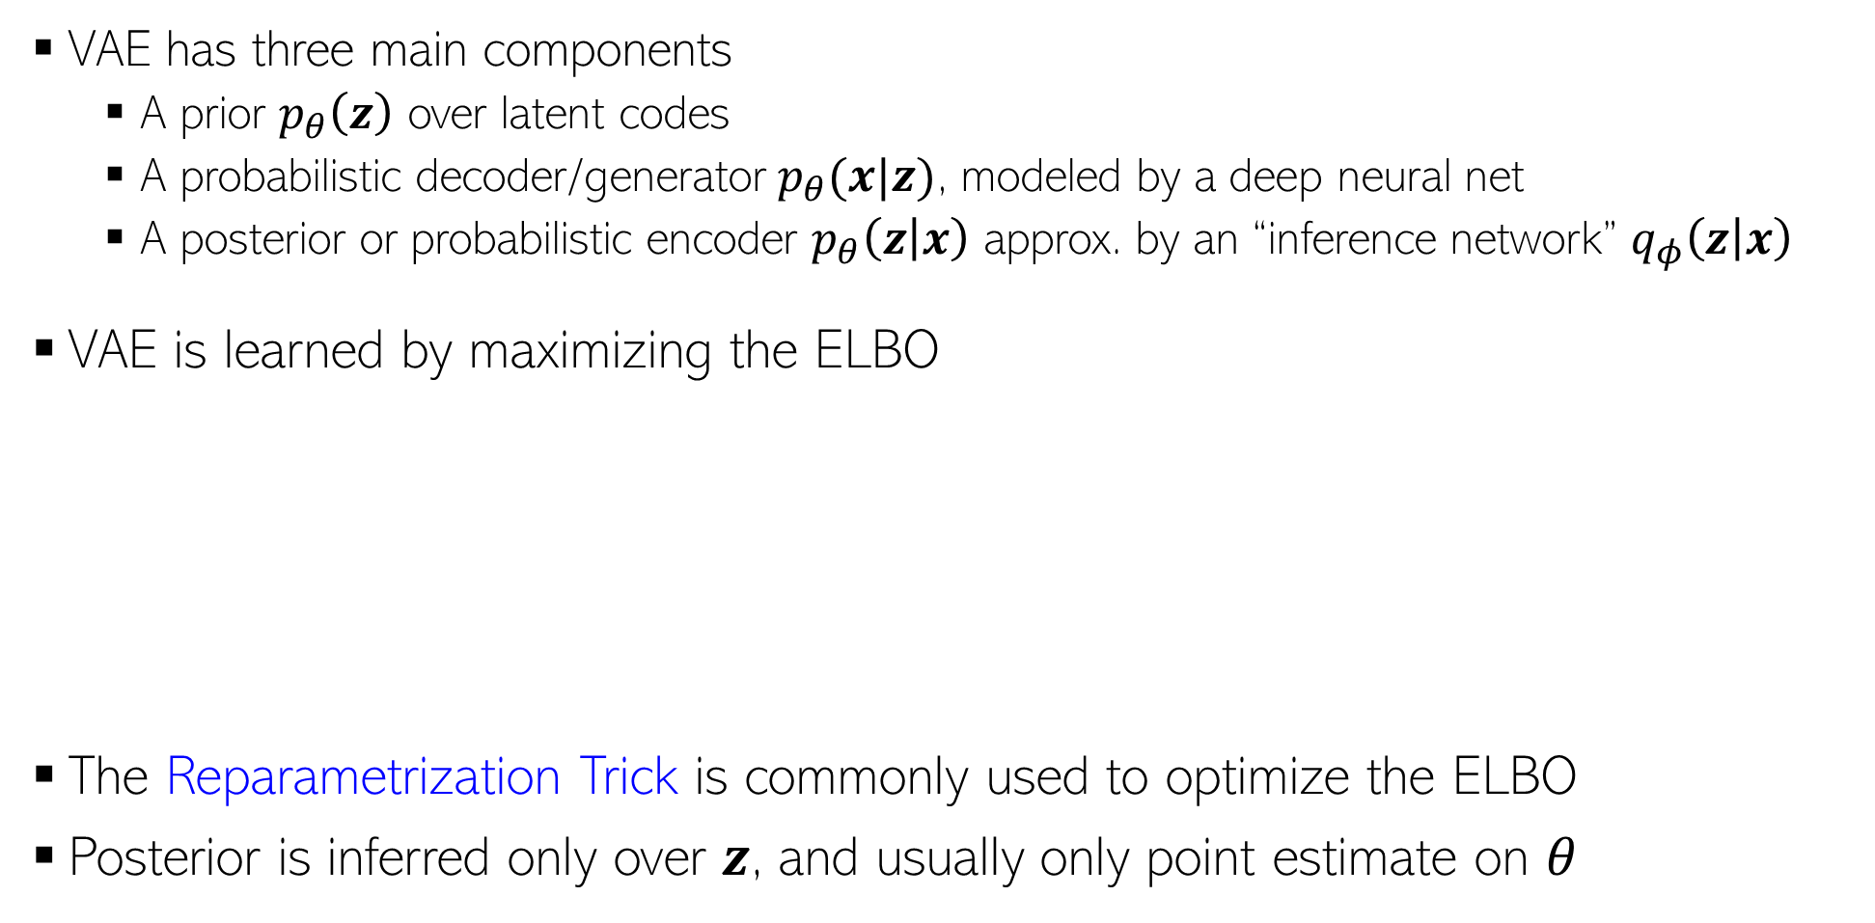
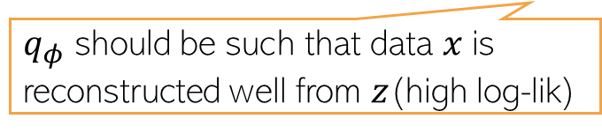
Variational Autoencoder (VAE)
6
VAE has three main components
  A prior $p_{θ}\left(z\right)$ over latent codes
  A probabilistic decoder/generator $p_{θ}(x|z)$, modeled by a deep neural net
  A posterior or probabilistic encoder $p_{θ}\left(z | x\right)$ approx. by an “inference network” $q_{φ}\left(z | x\right)$
VAE is learned by maximizing the ELBO
The Reparametrization Trick is commonly used to optimize the ELBO
Posterior is inferred only over $z$, and usually only point estimate on $θ$
Here $θ$ collectively denotes all the parameters of the prior and likelihood
Using the idea of “Amortized Inference” (next slide)
Here $φ$ collectively denotes all the parameters that define the inference network
ELBO for a single data point
$$−$$
Maximized to find the optimal $θ$ and $φ$
$q_{φ}$ should be such that data $x$is reconstructed well from $z$(high log-lik)
$q_{φ}$ should also be simple (close to the prior)

Slide 7
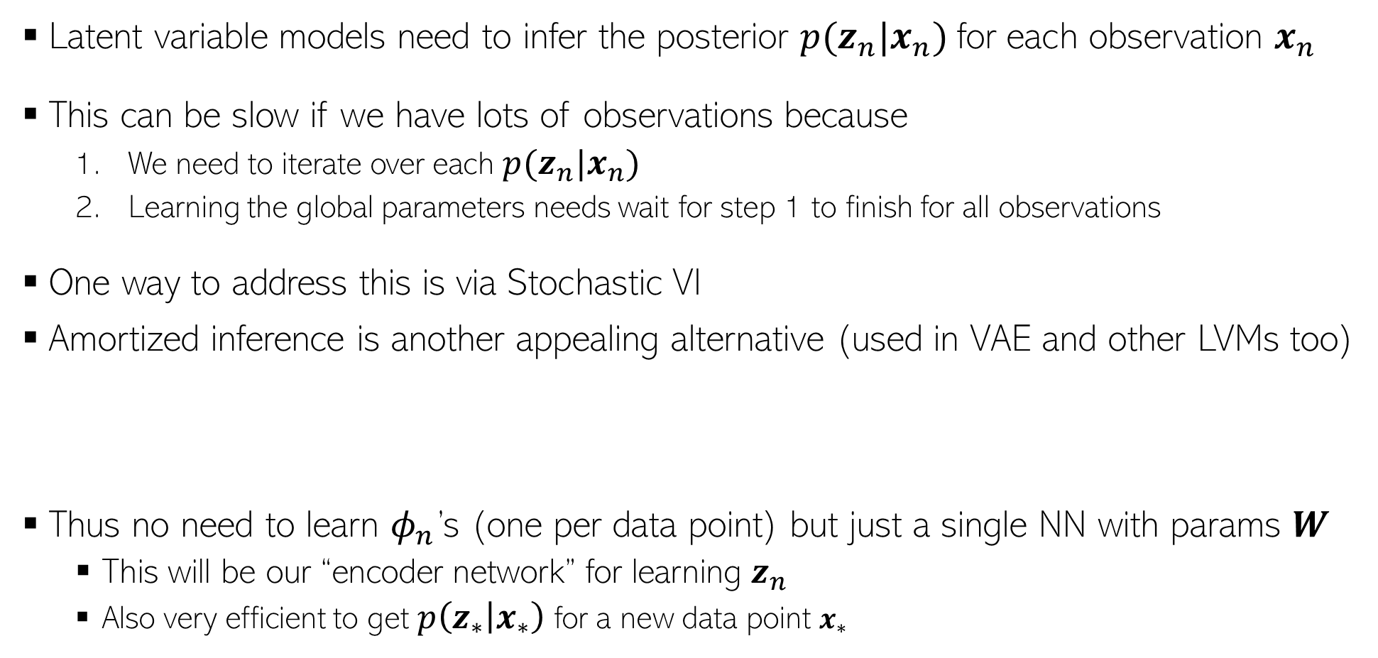
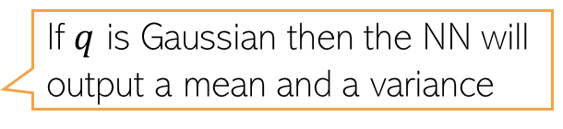
Amortized Inference
7
Latent variable models need to infer the posterior $p(z_{n}|x_{n})$for each observation $x_{n}$
This can be slow if we have lots of observations because
  We need to iterate over each $p(z_{n}|x_{n})$
  Learning the global parameters needs wait for step 1 to finish for all observations
One way to address this is via Stochastic VI
Amortized inference is another appealing alternative (used in VAE and other LVMs too)
Thus no need to learn $φ_{n}$’s (one per data point) but just a single NN with params $W$
  This will be our “encoder network” for learning $z_{n}$
  Also very efficient to get $p\left(z_{∗} | x_{∗}\right)$ for a new data point $x_{∗}$
If $q$ is Gaussian then the NN will output a mean and a variance
$$p\left(z_{n} | x_{n}\right)≈q\left(z_{n} | φ_{n}\right)=q\left(z_{n}\right|NN(x_{n};W))$$

Slide 8
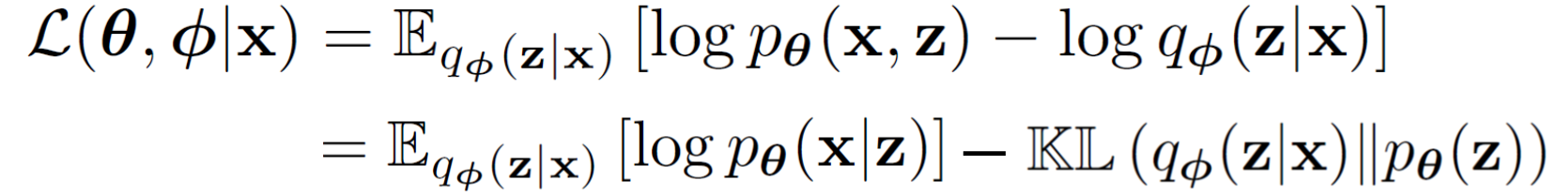
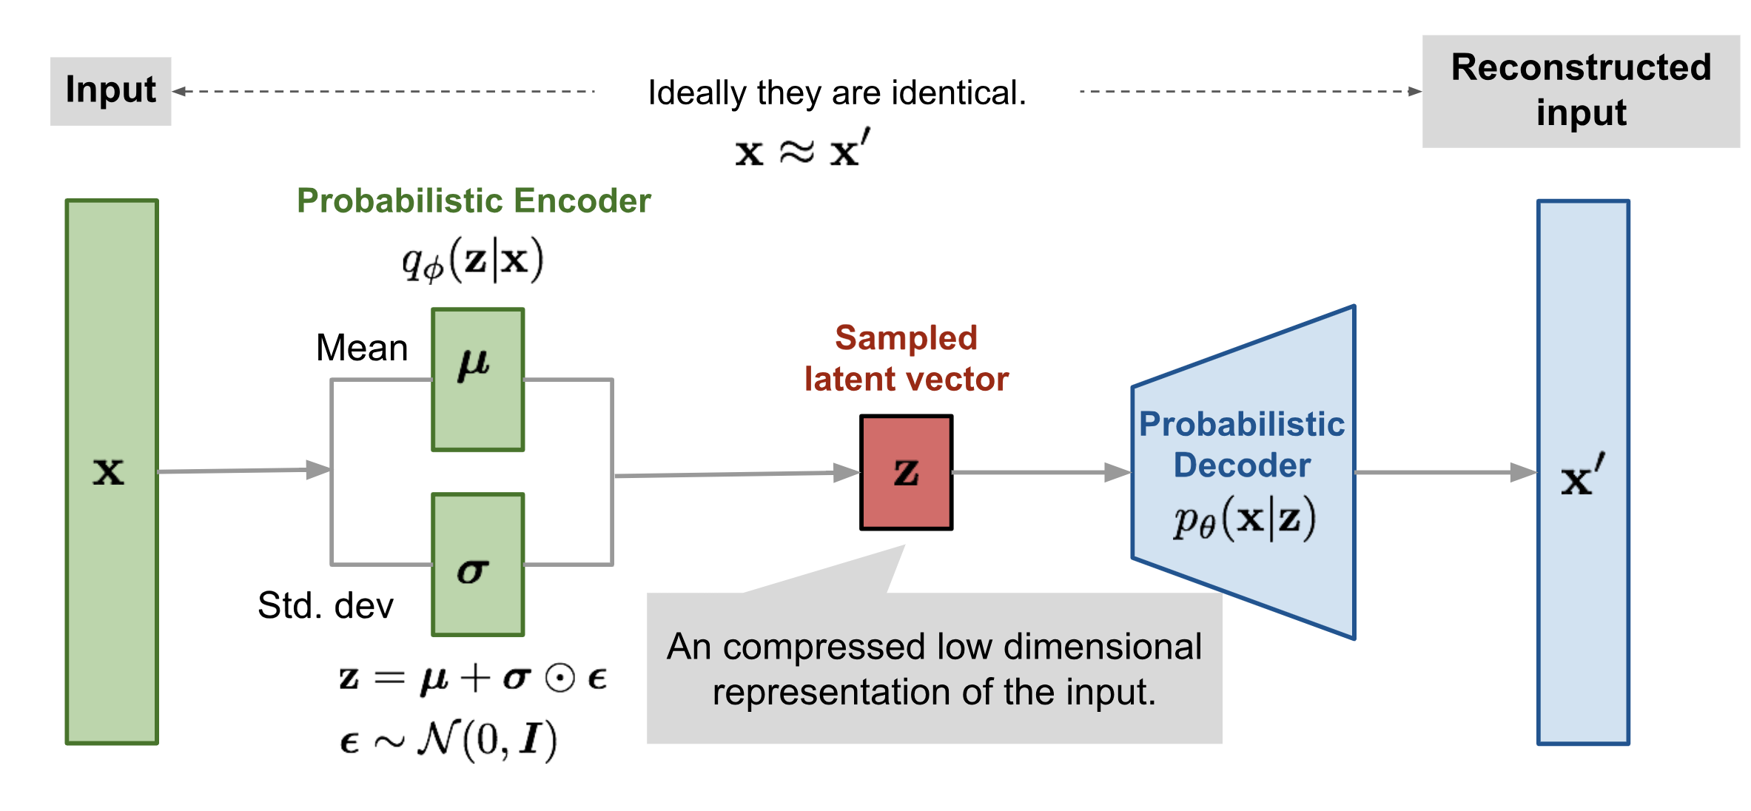
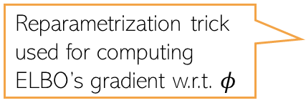
Variational Autoencoder: The Complete Pipeline
8
Both probabilistic encoder and decoder learned jointly by maximizing the ELBO
Reparametrization trick used for computing ELBO’s gradient w.r.t. $φ$
Pic source: https://lilianweng.github.io/lil-log/2018/08/12/from-autoencoder-to-beta-vae.html

Slide 9
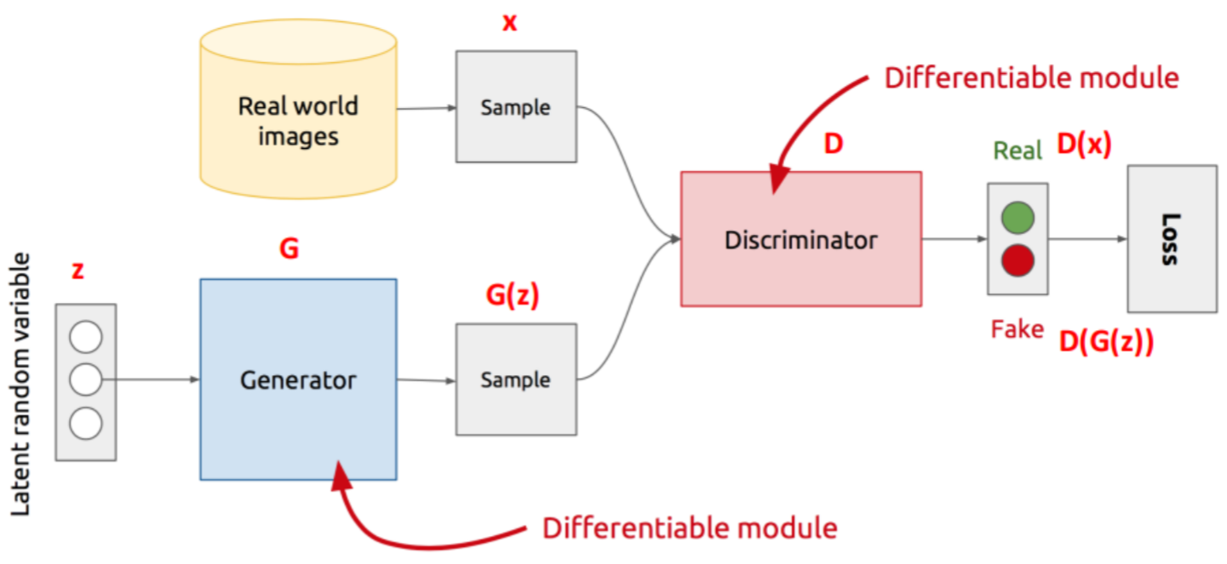
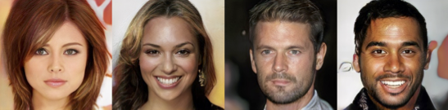
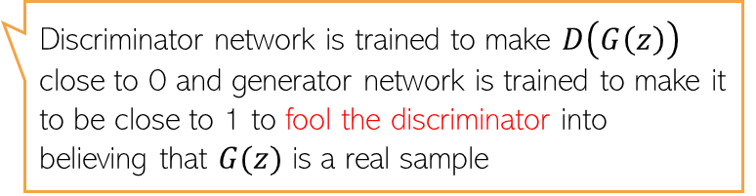

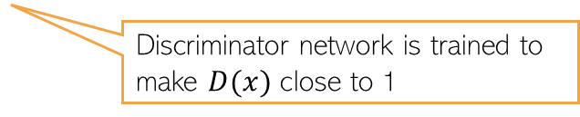
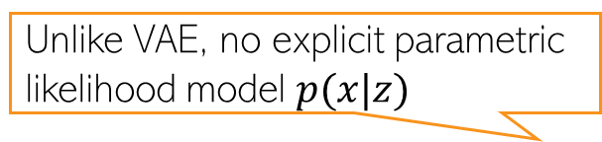
Generative Adversarial Network (GAN)
9
Unlike VAE, no explicit parametric likelihood model $p(x|z)$
GAN is an implicit generative latent variable model
Can generate from it but can’t compute $p(x)$ - the model doesn’t define it explicitly
GAN is trained using an adversarial way (Goodfellow et al, 2013)
Thus can’t train using methods that require likelihood (MLE, VI, etc)
Assuming data is images
The discriminator can be a binary classifier or any method that can compare b/w two distributions (real and fake here)
Discriminator network is trained to make $D(x)$ close to 1
Discriminator network is trained to make $D\left(G\left(z\right)\right)$ close to 0 and generator network is trained to make it to be close to 1 to fool the discriminator into believing that $G(z)$ is a real sample
Min-max optimization

Slide 10
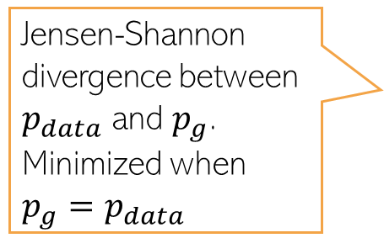

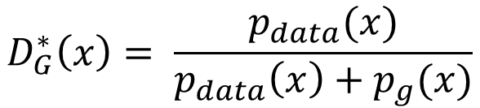
Generative Adversarial Network (GAN)
10
The GAN training criterion was
With 𝐺 fixed, the optimal 𝐷 (exercise)
Given the optimal $D$, The optimal generator $G$ is found by minimizing
Distribution of real data
$$D_{G}^{∗}\left(x\right)= \frac{p_{data}(x)}{p_{data}\left(x\right)+p_{g}(x)}$$
Distribution of synthetic data
$$V\left(D_{G}^{∗},G\right)= 𝔼_{x∼p_{data}}\left[log\frac{p_{data}(x)}{p_{data}\left(x\right)+p_{g}(x)}\right]+𝔼_{x∼p_{g}}\left[log\frac{p_{g}(x)}{p_{data}\left(x\right)+p_{g}(x)}\right]$$
Jensen-Shannon divergence between $p_{data}$ and $p_{g}$. Minimized when $p_{g}=p_{data}$
$$= KL\left[p_{data}\left(x\right) \frac{p_{data}\left(x\right)+p_{g}(x)}{2}\right]+KL\left[p_{g}\left(x\right) \frac{p_{data}\left(x\right)+p_{g}(x)}{2}\right]−log 4$$
Thus GAN can learn the true data distribution if the generator and discriminator have enough modeling power

Slide 11
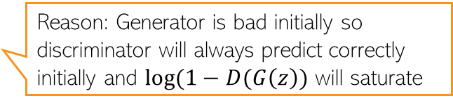
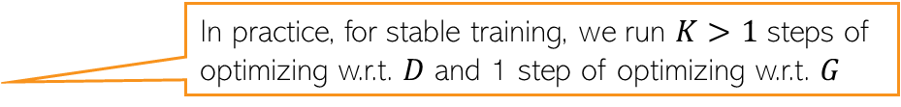
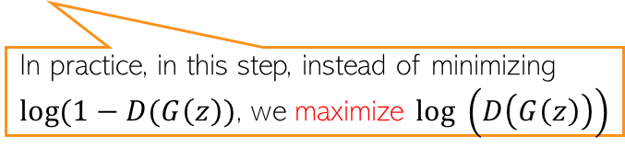
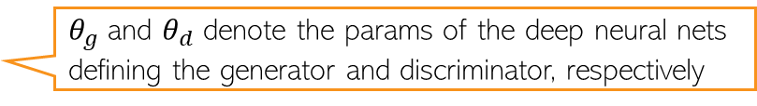
GAN Optimization
11
The GAN training procedure can be summarized as
$θ_{g}$ and $θ_{d}$ denote the params of the deep neural nets defining the generator and discriminator, respectively
In practice, for stable training, we run $K>1$ steps of optimizing w.r.t. $D$ and 1 step of optimizing w.r.t. $G$
Reason: Generator is bad initially so discriminator will always predict correctly initially and $log(1−D(G\left(z\right))$ will saturate
In practice, in this step, instead of minimizing $log(1−D(G\left(z\right))$, we maximize $log \left(D\left(G\left(z\right)\right)\right)$

Slide 12
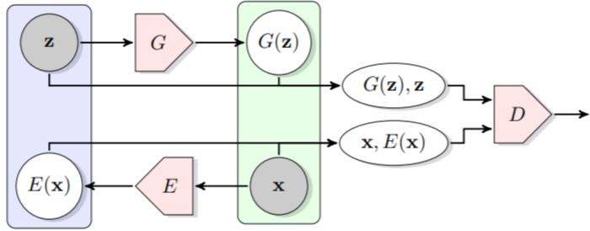

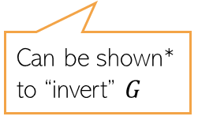
GANs that also learn latent representations
12
The standard GAN can only generate data. Can’t learn the latent $z$ from $x$
Bidirectional GAN* (BiGAN) is a GAN variant that allows this
Consists of an encoder as well
Real pair/fake pair?
Can be shown* to “invert” $G$
*Adversarial Feature Learning (Donahue et a Dumoulin l, 2017)
#Adversarially Learned Inference (Dumoulin et al, 2017)

Slide 13
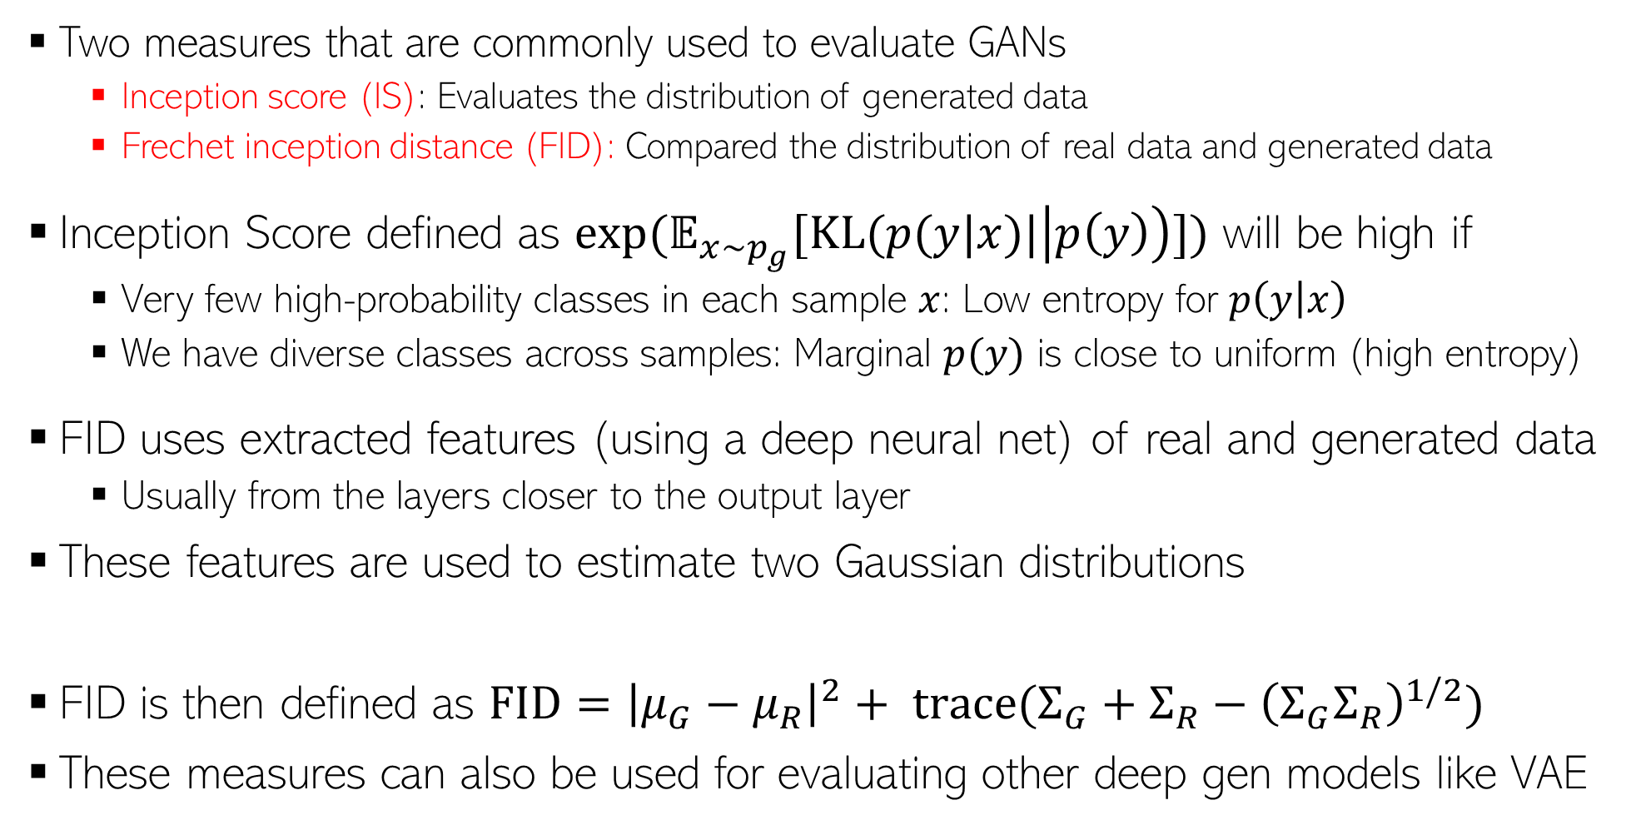


Evaluating GANs
13
High IS and low FID is desirable
Two measures that are commonly used to evaluate GANs
  Inception score (IS): Evaluates the distribution of generated data
  Frechet inception distance (FID): Compared the distribution of real data and generated data
Inception Score defined as $exp(𝔼_{x∼p_{g}}[KL(p(y|x)|\left|p\left(y\right)\right)])$ will be high if
  Very few high-probability classes in each sample $x$: Low entropy for $p\left(y | x\right)$
  We have diverse classes across samples: Marginal $p(y)$ is close to uniform (high entropy)
FID uses extracted features (using a deep neural net) of real and generated data
  Usually from the layers closer to the output layer
These features are used to estimate two Gaussian distributions
FID is then defined as $FID={\left|μ_{G}−μ_{R}\right|}^{2}+ trace(Σ_{G}+Σ_{R}−{\left(Σ_{G}Σ_{R}\right)}^{1/2})$
These measures can also be used for evaluating other deep gen models like VAE
Both IS and FID measure how realistic the generated data is
Using real data
$$𝒩(μ_{R}, Σ_{R})$$
$$𝒩(μ_{G}, Σ_{G})$$
Using generated data

Slide 14
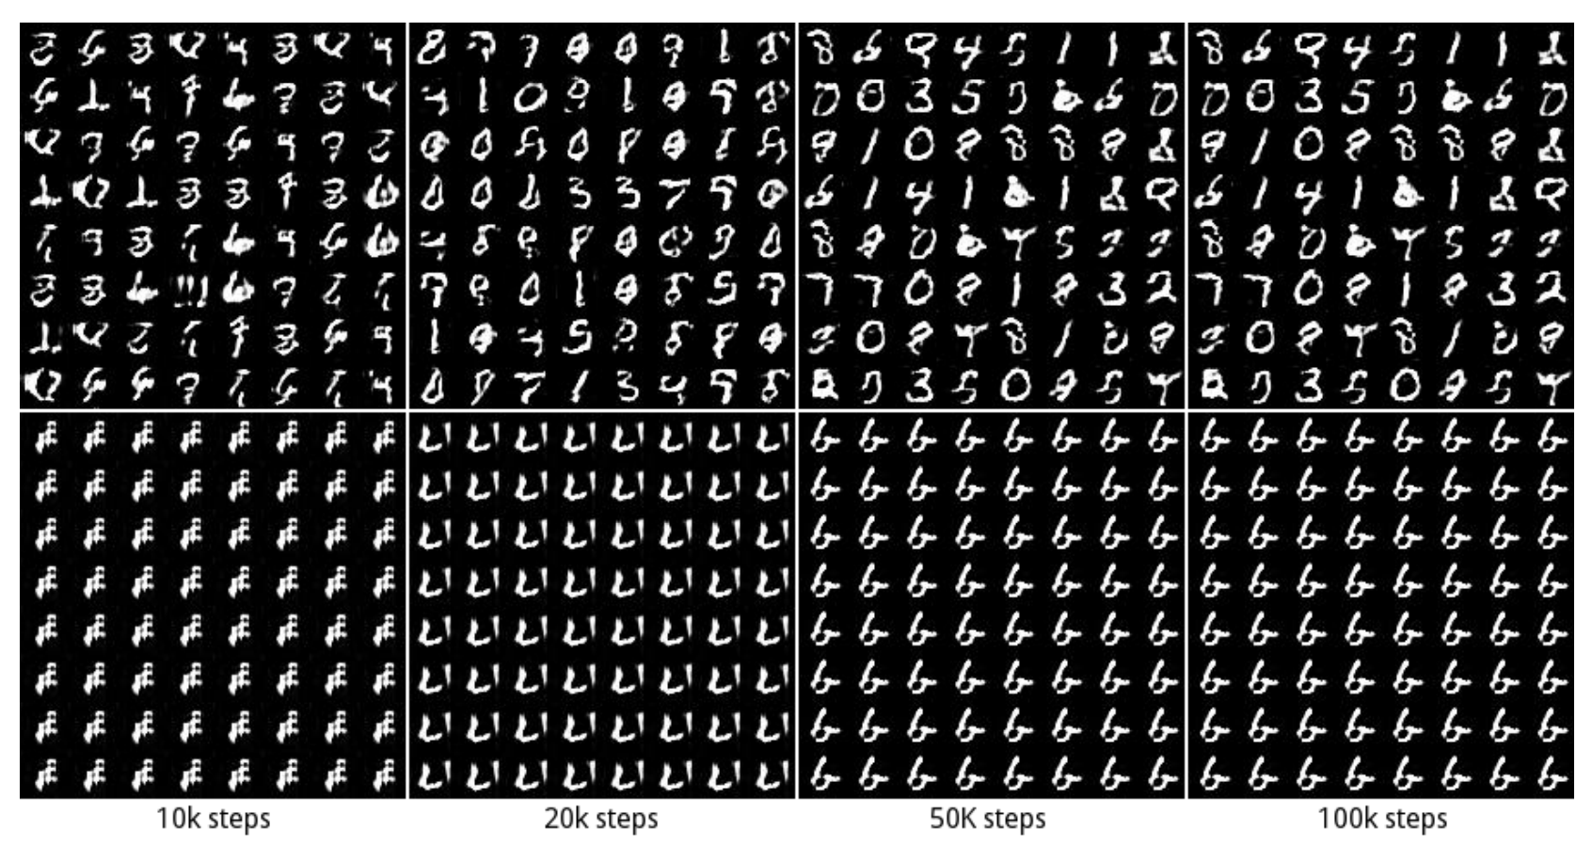
GAN: Some Issues/Comments
14
GAN training can be hard and the basic GAN suffers from several issues
Instability of training procedure
Mode Collapse problem: Lack of diversity in generated samples
  Generator may find some data that can easily fool the discriminator
  It will stuck at that mode of the data distribution and keep generating data like that
Some work on addressing these issues (e.g., Wasserstein GAN, Least Squares GAN, etc)
GAN 1: No mode collapse (all 10 modes captured in generation)
GAN 2: Mode collapse (stuck on one of the modes)

