Slide 1
MCMC Sampling (wrap-up), Deep Generative Models
CS772A: Probabilistic Machine Learning
Piyush Rai

Slide 2
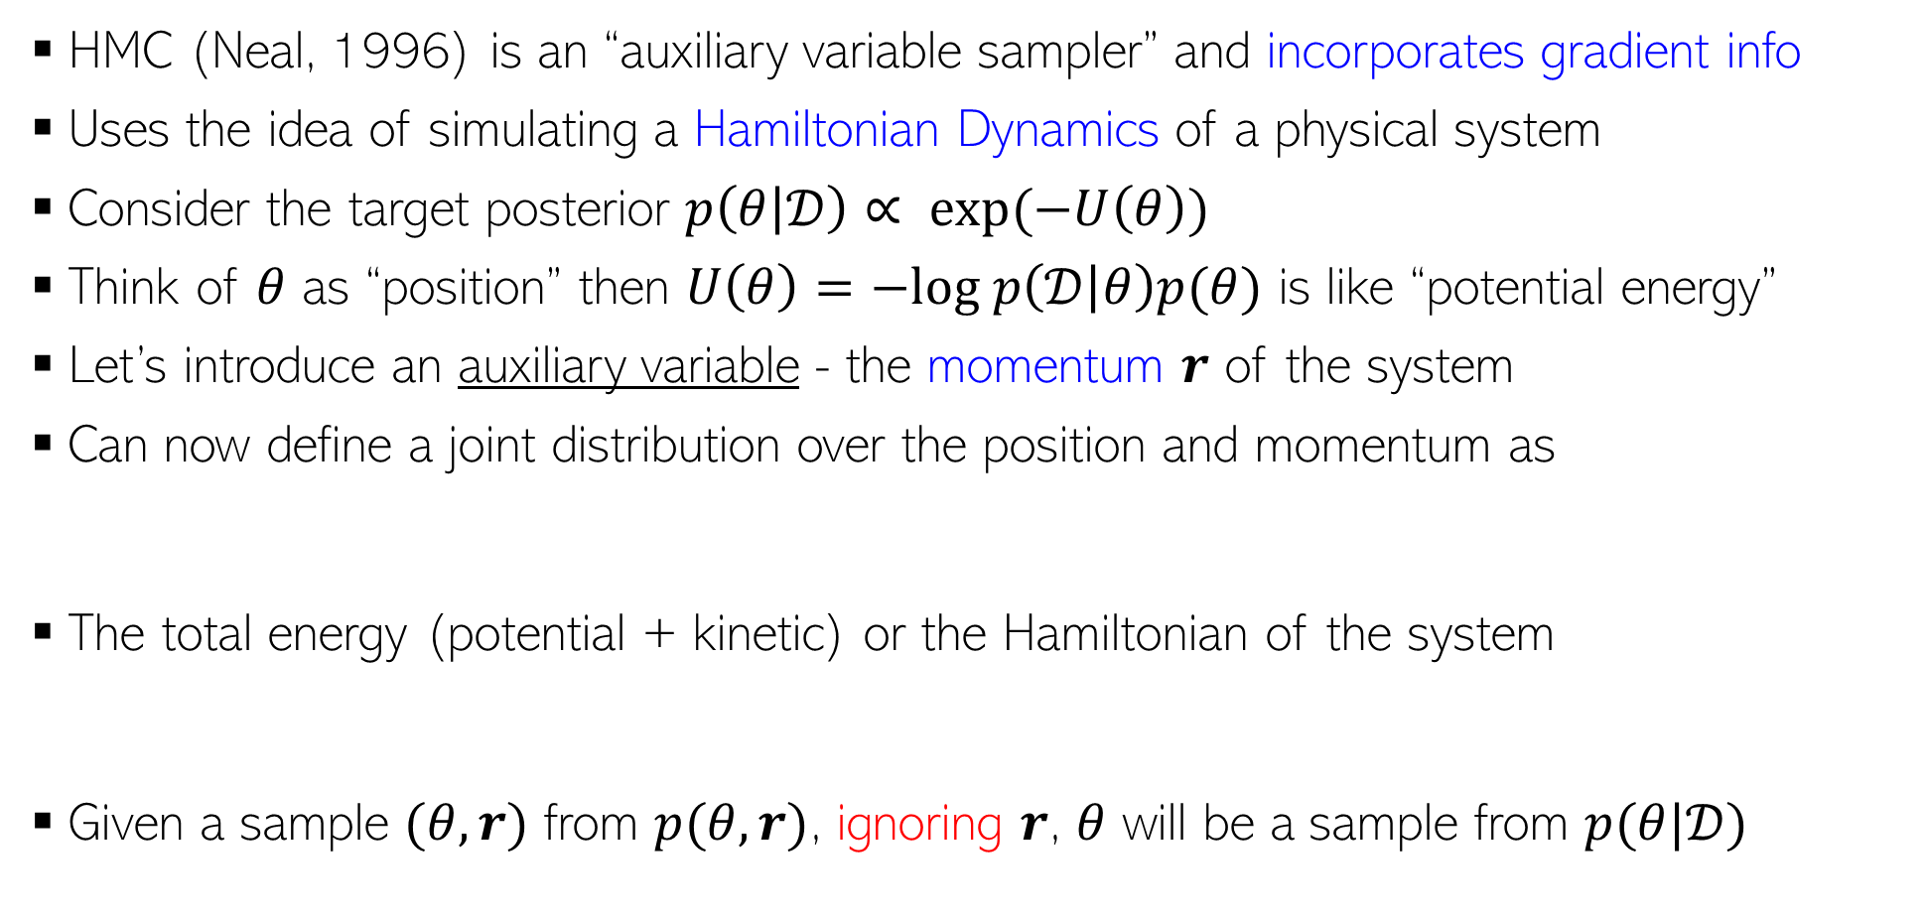
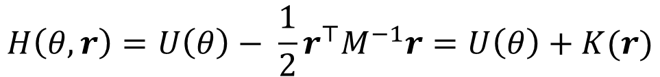
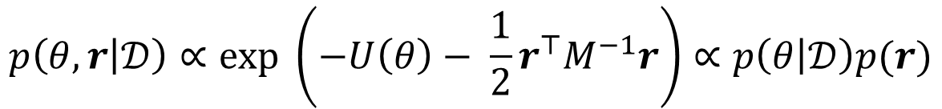
Hamiltonian/Hybrid Monte Carlo (HMC)
2
HMC (Neal, 1996) is an “auxiliary variable sampler” and incorporates gradient info
Uses the idea of simulating a Hamiltonian Dynamics of a physical system
Consider the target posterior $p\left(θ | 𝒟\right)∝ exp(−U\left(θ\right))$
Think of $θ$ as “position” then $U\left(θ\right)=−log p\left(𝒟 | θ\right)p(θ)$ is like “potential energy”
Let’s introduce an auxiliary variable - the momentum $r$ of the system
Can now define a joint distribution over the position and momentum as
The total energy (potential + kinetic) or the Hamiltonian of the system
Given a sample $(θ,r)$ from $p(θ,r)$, ignoring $r$, $θ$ will be a sample from $p(θ|𝒟)$
$$p\left(θ, r | 𝒟\right)∝exp \left(−U\left(θ\right)− \frac{1}{2}r^{⊤}M^{−1}r\right)∝p\left(θ | 𝒟\right)p(r)$$
Constant w.r.t. time
$$H\left(θ,r\right)=U\left(θ\right)− \frac{1}{2}r^{⊤}M^{−1}r=U\left(θ\right)+K(r)$$

Slide 3
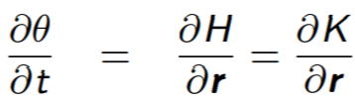



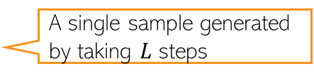
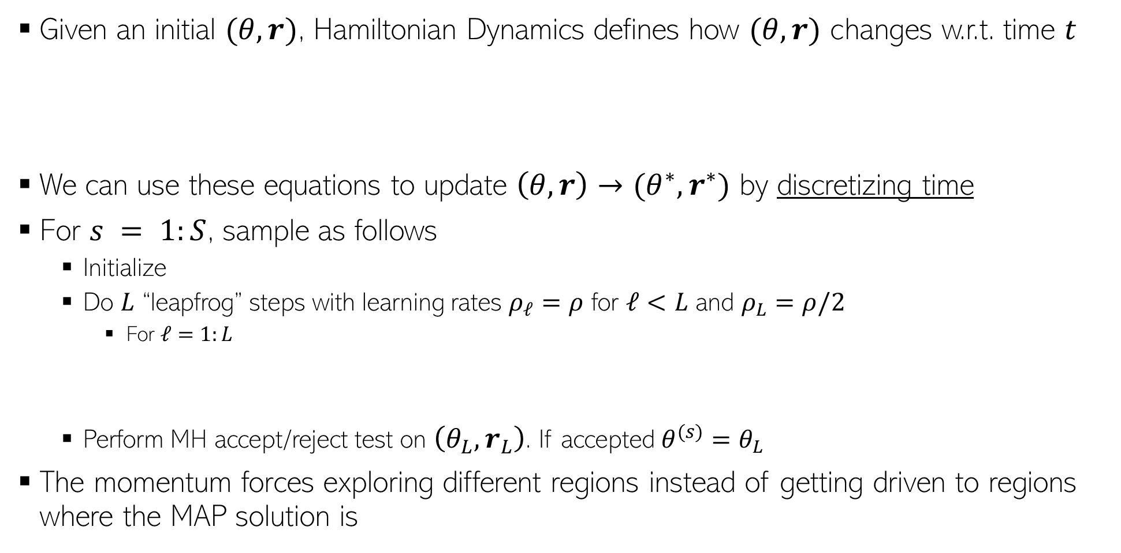
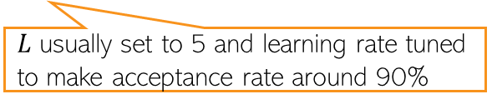
Generating Samples in HMC
3
Given an initial $(θ,r)$, Hamiltonian Dynamics defines how $(θ,r)$ changes w.r.t. time $t$
We can use these equations to update $\left(θ,r\right)→(θ^{∗},r^{∗})$ by discretizing time
For $s = 1:S$, sample as follows
  Initialize
  Do $L$ “leapfrog” steps with learning rates $ρ_{ℓ}=ρ$ for $ℓ<L$ and $ρ_{L}=ρ/2$
    For $ℓ=1:L$
  Perform MH accept/reject test on $\left(θ_{L},r_{L}\right)$. If accepted $θ^{(s)}=θ_{L}$
The momentum forces exploring different regions instead of getting driven to regions where the MAP solution is
Reason: Getting analytical solutions for the above requires integrals which is in general intractable
$L$ usually set to 5 and learning rate tuned to make acceptance rate around 90%
A single sample generated by taking $L$ steps

Slide 4
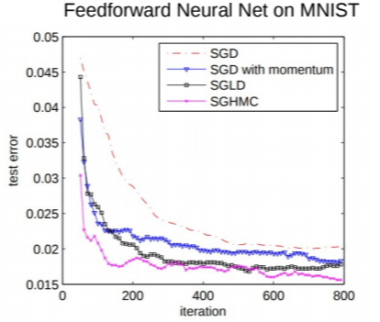
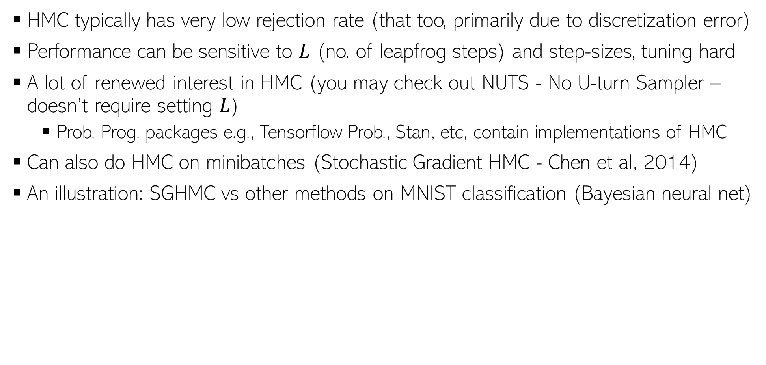
HMC in Practice
4
HMC typically has very low rejection rate (that too, primarily due to discretization error)
Performance can be sensitive to $L$ (no. of leapfrog steps) and step-sizes, tuning hard
A lot of renewed interest in HMC (you may check out NUTS - No U-turn Sampler – doesn’t require setting $L$)
  Prob. Prog. packages e.g., Tensorflow Prob., Stan, etc, contain implementations of HMC
Can also do HMC on minibatches (Stochastic Gradient HMC - Chen et al, 2014)
An illustration: SGHMC vs other methods on MNIST classification (Bayesian neural net)

Slide 5
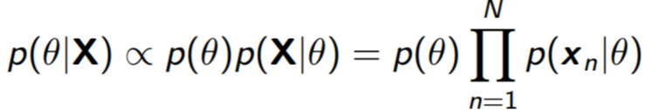
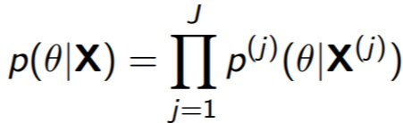

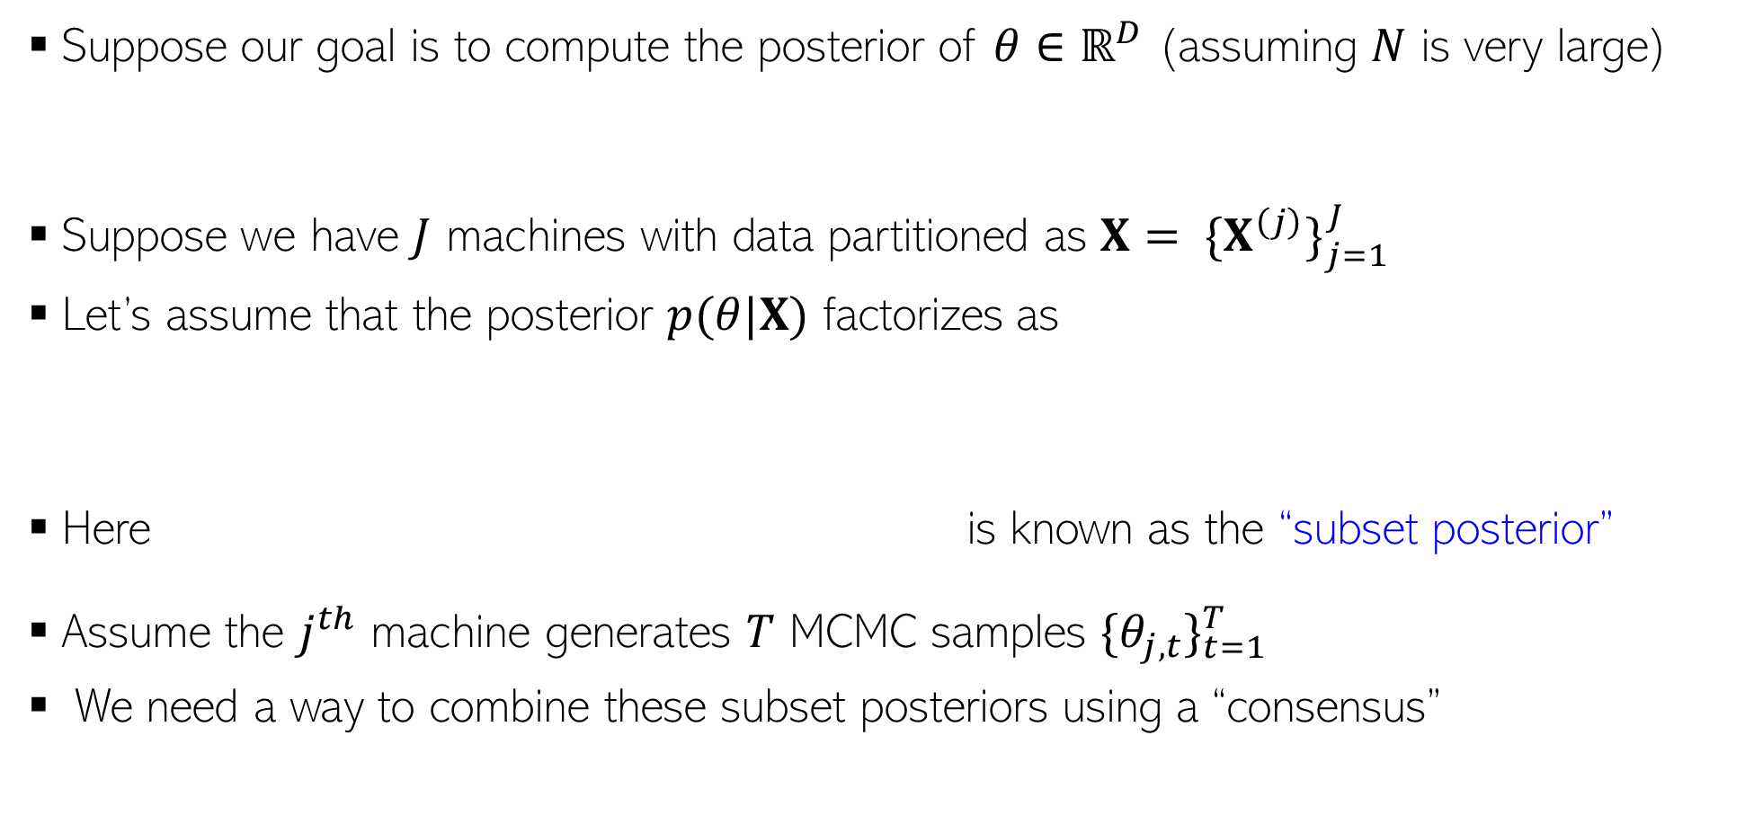
Parallel/Distributed MCMC
5
Suppose our goal is to compute the posterior of $θ∈ℝ^{D}$ (assuming $N$ is very large)
Suppose we have $J$ machines with data partitioned as $X= {\{X^{\left(j\right)}\}}_{j=1}^{J}$
Let’s assume that the posterior $p(θ|X)$ factorizes as
Here is known as the “subset posterior”
Assume the $j^{th}$ machine generates $T$ MCMC samples ${\{θ_{j,t}\}}_{t=1}^{T}$
We need a way to combine these subset posteriors using a “consensus”

Slide 6
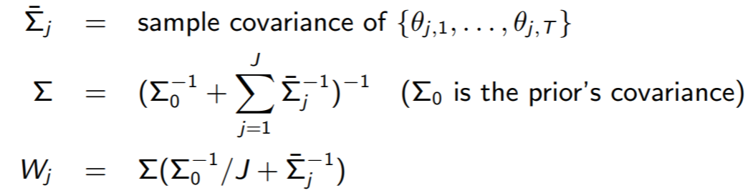

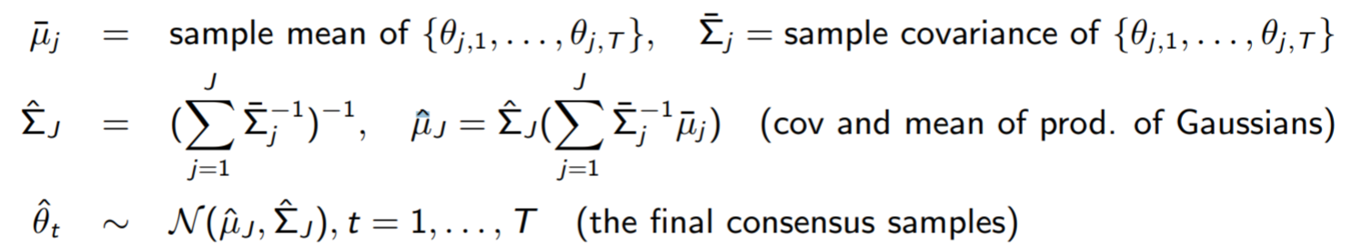
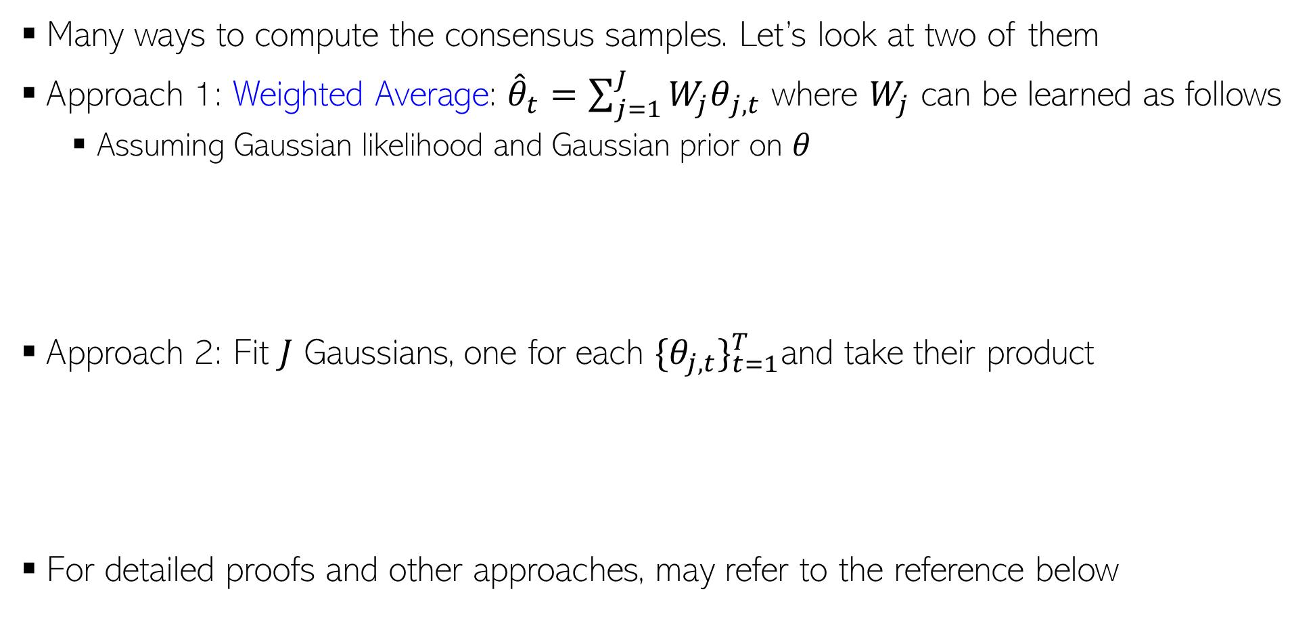
Parallel/Distributed MCMC
6
Many ways to compute the consensus samples. Let’s look at two of them
Approach 1: Weighted Average: ${\hat{θ}}_{t}=\sum_{j=1}^{J}{{W_{j}θ}_{j,t}}$ where $W_{j}$ can be learned as follows
  Assuming Gaussian likelihood and Gaussian prior on $θ$
Approach 2: Fit $J$ Gaussians, one for each ${\{θ_{j,t}\}}_{t=1}^{T}$and take their product
For detailed proofs and other approaches, may refer to the reference below
These approaches can also be used to make VI parallel/distributed
Patterns of Scalable Bayesian Inference (Angelino et al, 2016)

Slide 7
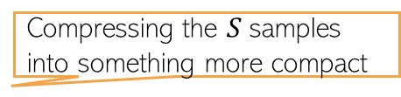
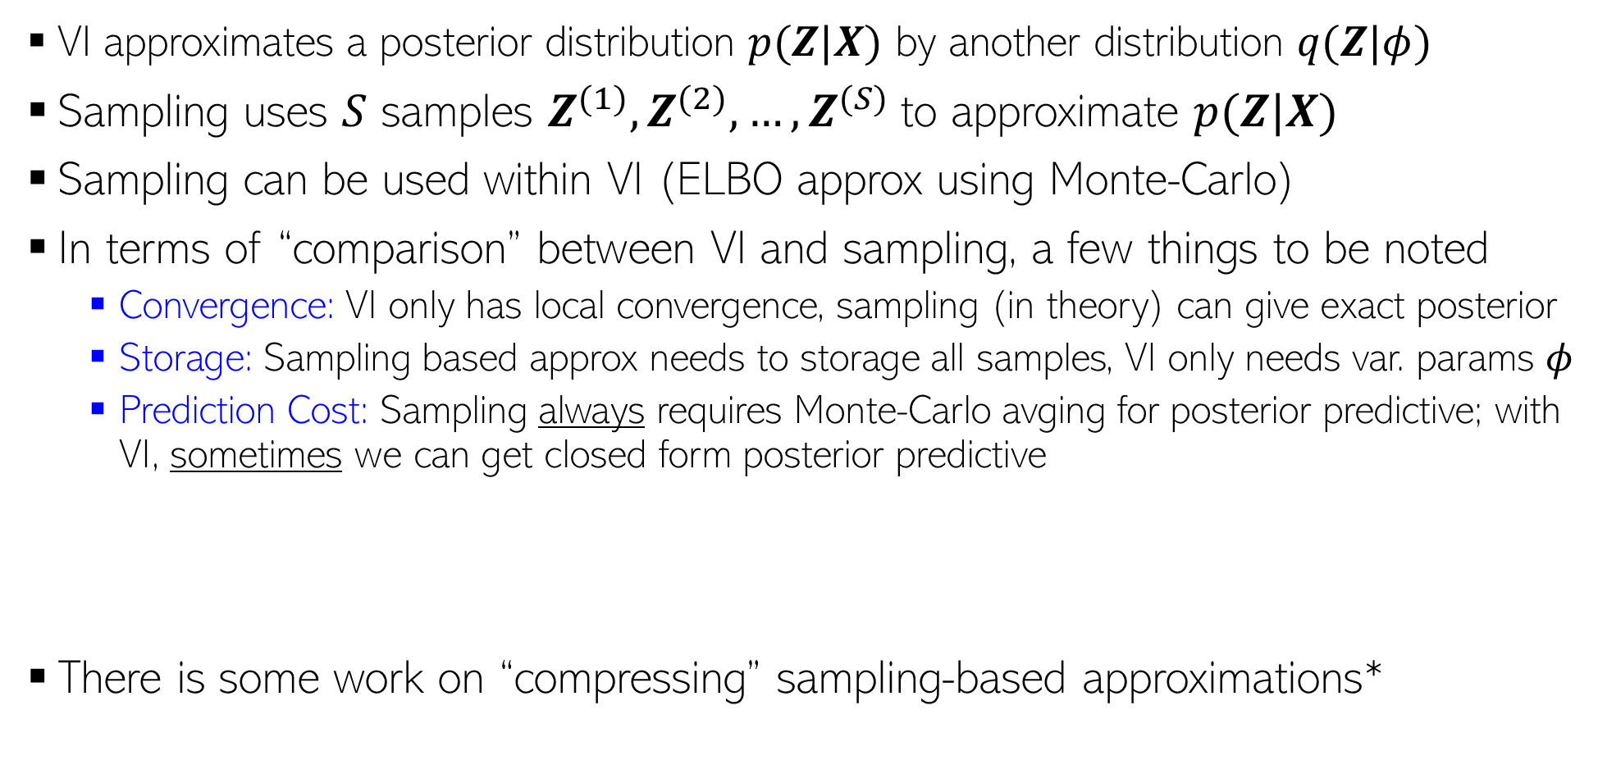

Approximate Inference: VI vs Sampling
7
VI approximates a posterior distribution $p(Z|X)$ by another distribution $q(Z|φ)$
Sampling uses $S$ samples $Z^{(1)},Z^{(2)},…,Z^{(S)}$to approximate $p(Z|X)$
Sampling can be used within VI (ELBO approx using Monte-Carlo)
In terms of “comparison” between VI and sampling, a few things to be noted
  Convergence: VI only has local convergence, sampling (in theory) can give exact posterior
  Storage: Sampling based approx needs to storage all samples, VI only needs var. params $φ$
  Prediction Cost: Sampling always requires Monte-Carlo avging for posterior predictive; with VI, sometimes we can get closed form posterior predictive
There is some work on “compressing” sampling-based approximations*
Closed form if integral is tractable (otherwise Monte Carlo avg still needed for PPD)
PPD if using sampling:
$$p\left(x_{∗} | X\right)=∫p\left(x_{∗} | Z\right)p\left(Z | X\right)dZ≈\frac{1}{S}\sum_{s=1}^{S}{p\left(x_{∗} | Z^{\left(s\right)}\right)}$$
PPD if using VI:
$$p\left(x_{∗} | X\right)=∫p\left(x_{∗} | Z\right)p\left(Z | X\right)dZ≈∫p\left(x_{∗} | Z\right)q\left(Z | φ\right)dZ$$
Compressing the $S$samples into something more compact
*”Compact approximations to Bayesian predictive distributions” by Snelson and Ghaharamani, 2005; and “Bayesian Dark Knowledge” by Korattikara et al, 2015

Slide 8
Inference Methods: Summary
8
MLE/MAP: Straightforward for differentiable models (can even use automatic diff.)
Conjugate models with one “main” parameter: Straightforward posterior updates
MLE-II/MAP-II: Often useful for estimating the hyperparameters
EM: If we want to do MLE/MAP for models with latent variables
  Very general algorithm, can also be made online
  Used when we want point estimates for some unknowns and posterior over others
  Can use it for hyperparameter estimation as well
  Often better than using direct gradient methods
VI and sampling methods can be used to get full posterior for complex models
  Quite easy if we have local conjugacy (VI has closed form updates, Gibbs sampler is easy to derive)
  In other cases, we have general VI with Monte-Carlo gradients, MH sampling
  MCMC can also make use of gradient info (LD/SGLD)
For large-scale problems, online/distributed VI/MCMC, or SGD based posterior approx

Slide 9
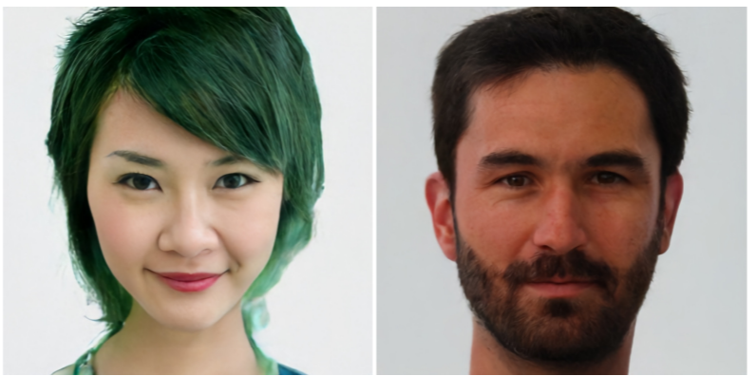
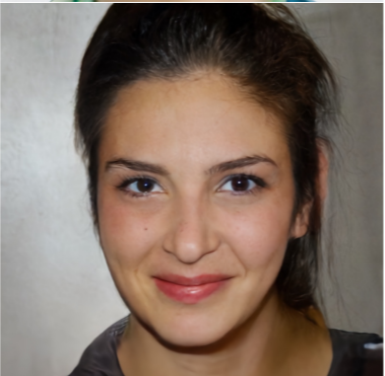
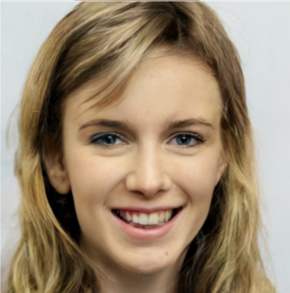

Latent Variable Models for Generation Tasks
9
Assume a $K$-dim latent variable $z_{n}$ is transformed to generate to $D$-dim observation $x_{n}$
It is common to use a Gaussian prior for $z_{n}$ (though other priors can be used)
If we use a neural net or GP, such models can generate very high-quality data
  Take the trained network, generate a random $z$ from prior, pass it through the model to generate $x$
Also possible to use a GP to model $f$
$$p(z)$$
$$p(x|f\left(z;W\right))$$
$$z_{n}$$
$$x_{n}$$
f can be some linear or nonlinear model which defines the parameters of the distribution of $p(x|z)$ and $W$ denotes the parameters of this model
Some sample images generated by Vector Quantized Variational Auto-Encoder (VQ-VAE), a state-of-the-art latent variable model for generation

Slide 10
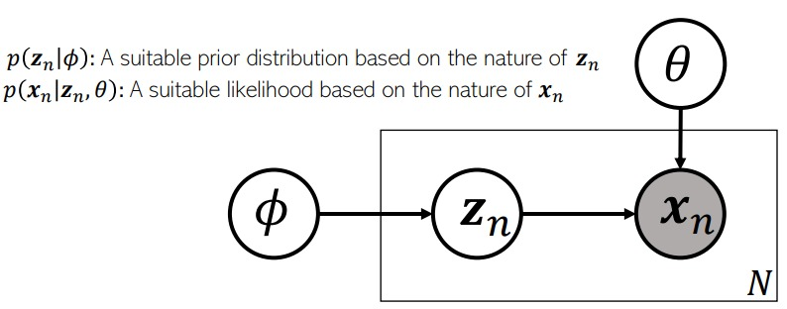
Factor Analysis and Probabilistic PCA
10
FA and PPCA assume $f$ to be a linear model
In FA/PPCA, latent variables $z_{n}∈ℝ^{K}$ typically assumed to have a Gaussian prior
  If we want sparse latent variabled, can use Laplace or spike-and-slab prior on $z_{n}$
  More complex extensions of FA/PPCA use a mixture of Gaussians prior on $z_{n}$
Assumption: Observations $x_{n}∈ℝ^{D}$ typically assumed to have a Gaussian likelihood
  Other likelihood models (e.g., exp-family) can also be used if data not real-valued
Relationship between $z_{n}$ and $x_{n}$ modeled by a noisy linear mapping
Linear Gaussian Model. $W$, $z_{n}$’s, and $Ψ$ can be learned (e.g, using EM, VI, MCMC)
$$x_{n}=Wz_{n}+ε_{n}=\sum_{k=1}^{K}{w_{k}z_{nk}}+ε_{n}$$
$$p\left(z_{n}\right)= 𝒩\left(z_{n} | 0,I\right)$$
$$p\left({x_{n}|z}_{n}\right)= 𝒩\left(x_{n} | Wz_{n},Ψ\right)$$
Zero-mean and diagonal or spherical Gaussian noise
Linear combination of the columns of $W$
Diagonal for FA, spherical for PPCA

Slide 11
Some Variants of FA/PPCA
11
Non-negative priors often give a nice interpretability to such latent variable models (will see some more examples of such models shortly)
Popular for modeling count-valued data (in text analysis, recommender systems, etc)
Gamma-Poisson latent factor model
  Assumes $K$-dim non-negative latent variable $z_{n}$ and $D$-dim count-valued observations $x_{n}$
  An example: Each $x_{n}$ is the word-count vector representing a document
  This can be thought of as a probabilistic non-negative matrix factorization model
Dirichlet-Multinomial/Multinoulli PCA
  Assumes $K$-dim non-negative latent variable $z_{n}$ and $D$ categorical obs $x_{n}={\{x_{nd}\}}_{d=1}^{D}$
  An example: Each $x_{n}$ is a document with $D$ words in it (each word is a categorical value)
$p\left(z_{n}\right)= \prod_{k=1}^{K}{Gamma(z_{nk}|a_{k}, b_{k}))}$
This is the rate of the Poisson. It should be non-negative, $exp⁡(w_{d}^{⊤}z_{n})$, or simply $w_{d}^{⊤}z_{n}$ if $w_{d}$ is also non-negative (e.g., using a gamma/Dirichlet prior on it)
$p\left(x_{n}|z_{n}\right)= \prod_{d=1}^{D}{Poisson(x_{nd}|f({w_{d}, z}_{n}))}$
Also sums to 1
This should give the probability vector of the multinoulli over $x_{nd}$. It should be non-negative and should sums to 1
$p\left(z_{n}\right)= Dirichlet(z_{n}|α)$
$p\left(x_{n}|z_{n}\right)= \prod_{d=1}^{D}{Multinoulli(x_{nd}|f({w_{d}, z}_{n}))}$

Slide 12
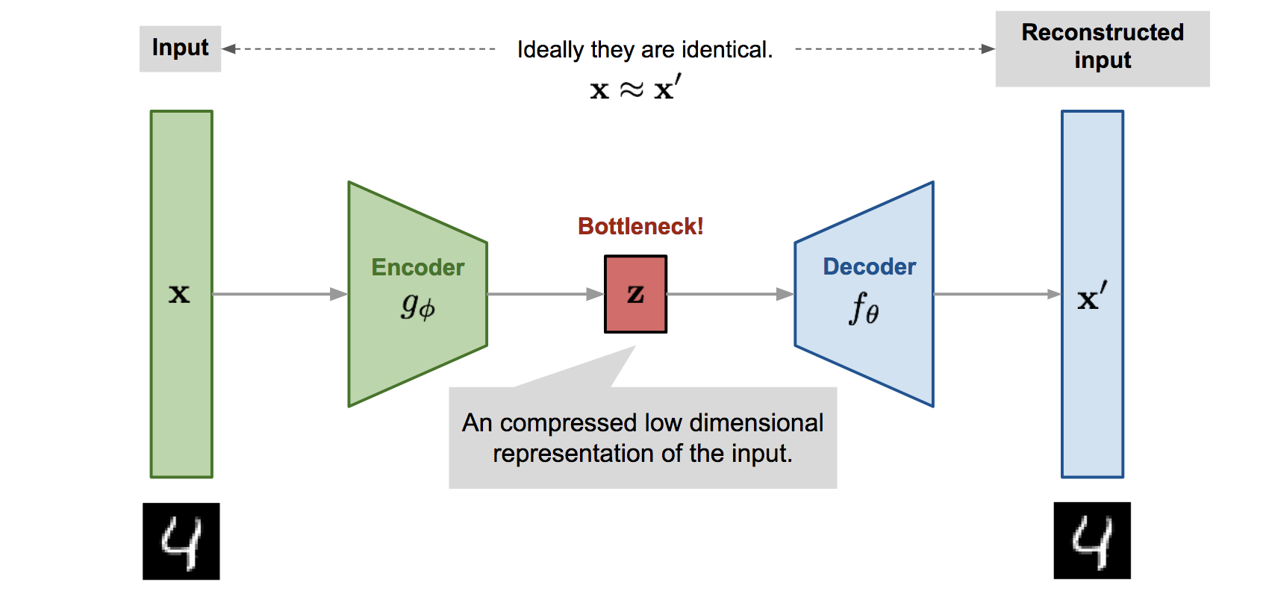


A Deep Generative Model: Variational Auto-encoder (VAE)
12
VAE* is a probabilistic extension of autoencoders (AE). An AE is shown below
The basic difference is that VAE assumes a prior $p(z)$ on the latent code $z$
  This enables it to not just compress the data but also generate synthetic data
  How: Sample $z$ from a prior and pass it through the decoder
Thus VAE can learn good latent representation + generate novel synthetic data
The name has “Variational” in it since it is learned using VI principles
*Autoencoding Variational Bayes (Kingma and Welling, 2013)
Pic source: https://lilianweng.github.io/lil-log/2018/08/12/from-autoencoder-to-beta-vae.html

Slide 13
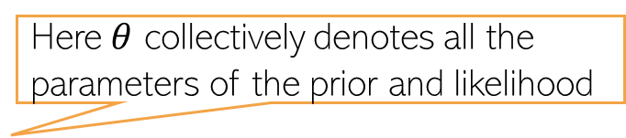
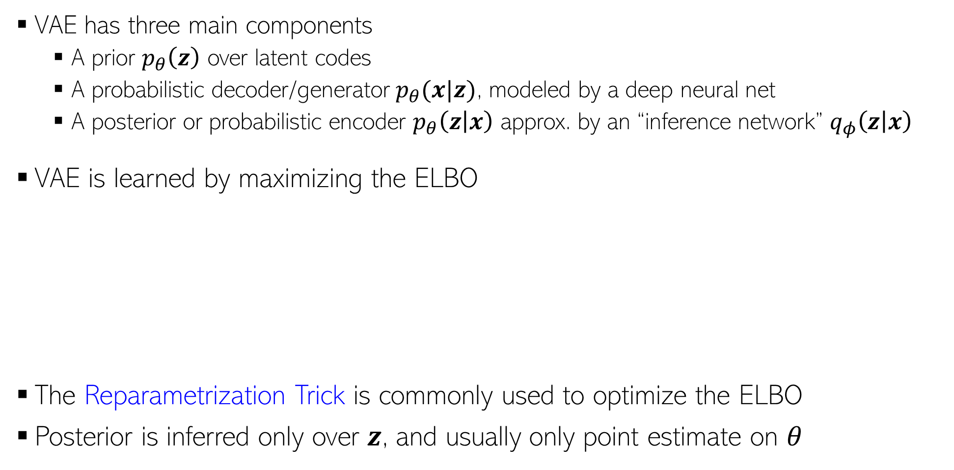
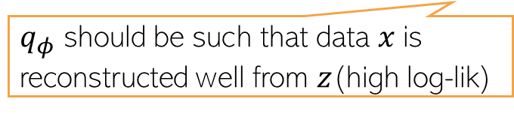
Variational Autoencoder (VAE)
13
VAE has three main components
  A prior $p_{θ}\left(z\right)$ over latent codes
  A probabilistic decoder/generator $p_{θ}(x|z)$, modeled by a deep neural net
  A posterior or probabilistic encoder $p_{θ}\left(z | x\right)$ approx. by an “inference network” $q_{φ}\left(z | x\right)$
VAE is learned by maximizing the ELBO
The Reparametrization Trick is commonly used to optimize the ELBO
Posterior is inferred only over $z$, and usually only point estimate on $θ$
Here $θ$ collectively denotes all the parameters of the prior and likelihood
Using the idea of “Amortized Inference” (next slide)
Here $φ$ collectively denotes all the parameters that define the inference network
ELBO for a single data point
$$−$$
Maximized to find the optimal $θ$ and $φ$
$q_{φ}$ should be such that data $x$is reconstructed well from $z$(high log-lik)
$q_{φ}$ should also be simple (close to the prior)

Slide 14
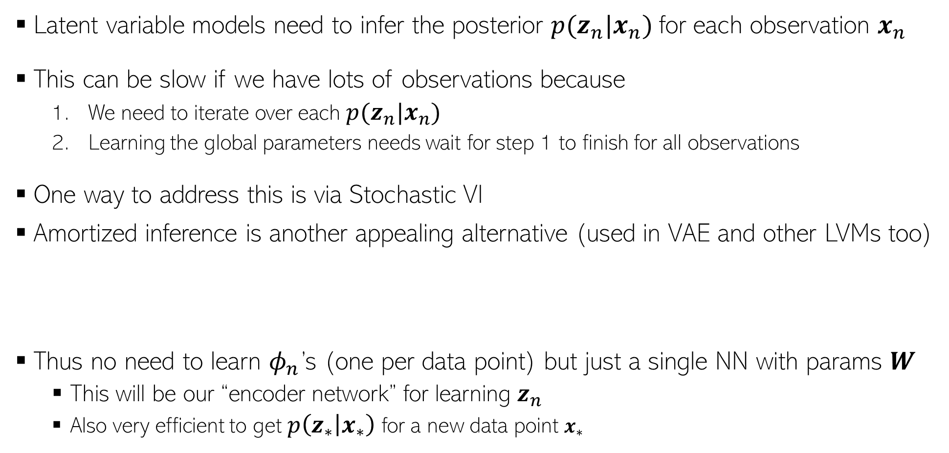
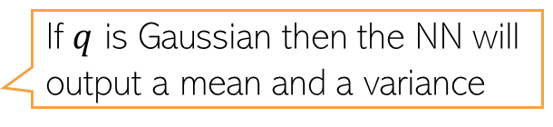
Amortized Inference
14
Latent variable models need to infer the posterior $p(z_{n}|x_{n})$for each observation $x_{n}$
This can be slow if we have lots of observations because
  We need to iterate over each $p(z_{n}|x_{n})$
  Learning the global parameters needs wait for step 1 to finish for all observations
One way to address this is via Stochastic VI
Amortized inference is another appealing alternative (used in VAE and other LVMs too)
Thus no need to learn $φ_{n}$’s (one per data point) but just a single NN with params $W$
  This will be our “encoder network” for learning $z_{n}$
  Also very efficient to get $p\left(z_{∗} | x_{∗}\right)$ for a new data point $x_{∗}$
If $q$ is Gaussian then the NN will output a mean and a variance
$$p\left(z_{n} | x_{n}\right)≈q\left(z_{n} | φ_{n}\right)=q\left(z_{n}\right|NN(x_{n};W))$$

Slide 15
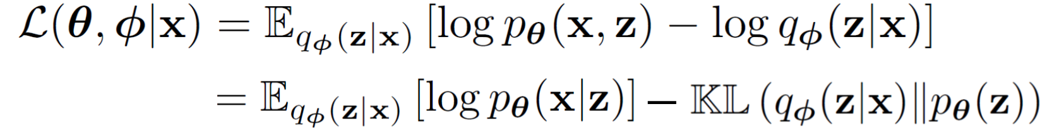
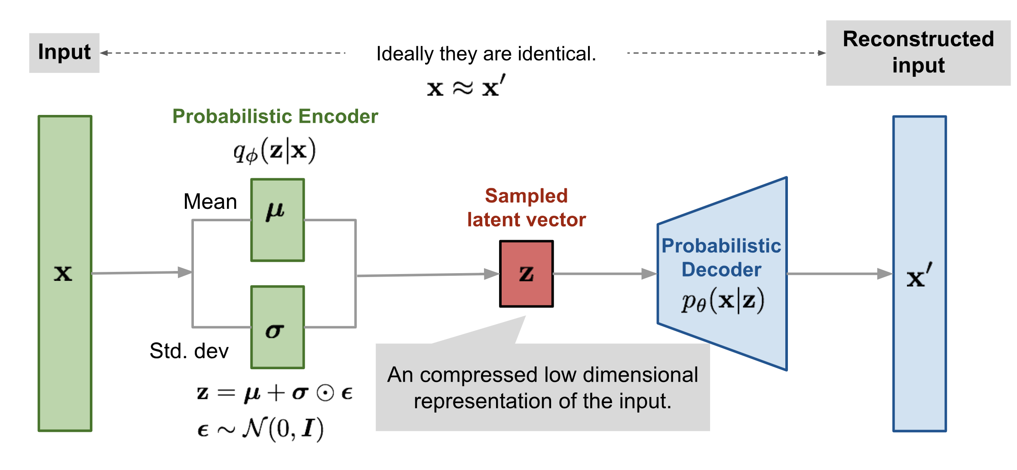
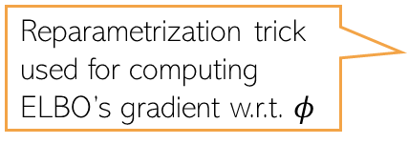
Variational Autoencoder: The Complete Pipeline
15
Both probabilistic encoder and decoder learned jointly by maximizing the ELBO
Reparametrization trick used for computing ELBO’s gradient w.r.t. $φ$
Pic source: https://lilianweng.github.io/lil-log/2018/08/12/from-autoencoder-to-beta-vae.html

Slide 16
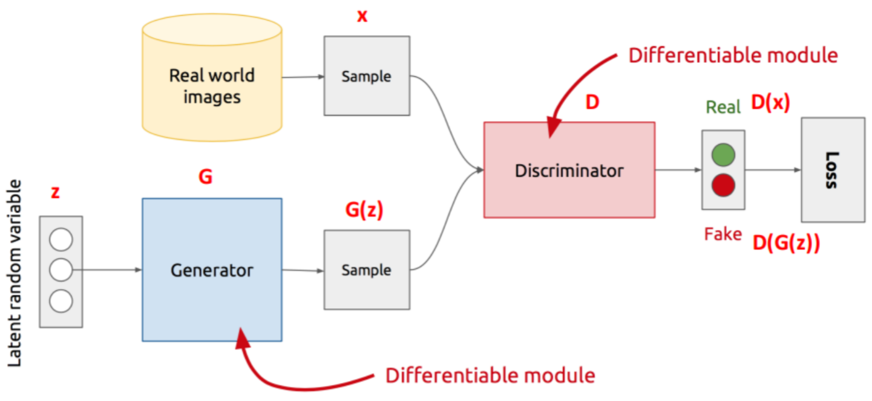
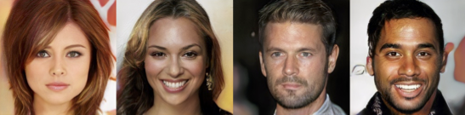
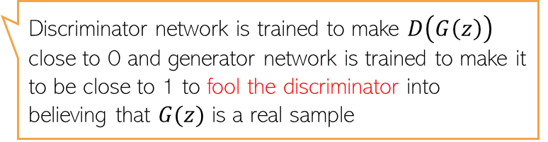

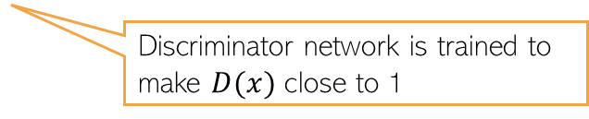
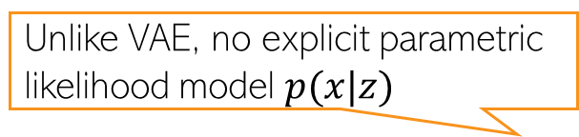
Generative Adversarial Network (GAN)
16
Unlike VAE, no explicit parametric likelihood model $p(x|z)$
GAN is an implicit generative latent variable model
Can generate from it but can’t compute $p(x)$ - the model doesn’t define it explicitly
GAN is trained using an adversarial way (Goodfellow et al, 2013)
Thus can’t train using methods that require likelihood (MLE, VI, etc)
Assuming data is images
The discriminator can be a binary classifier or any method that can compare b/w two distributions (real and fake here)
Discriminator network is trained to make $D(x)$ close to 1
Discriminator network is trained to make $D\left(G\left(z\right)\right)$ close to 0 and generator network is trained to make it to be close to 1 to fool the discriminator into believing that $G(z)$ is a real sample
Min-max optimization

Slide 17
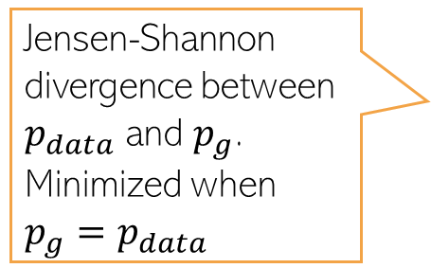

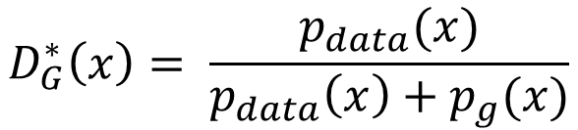
Generative Adversarial Network (GAN)
17
The GAN training criterion was
With 𝐺 fixed, the optimal 𝐷 (exercise)
Given the optimal $D$, The optimal generator $G$ is found by minimizing
Distribution of real data
$$D_{G}^{∗}\left(x\right)= \frac{p_{data}(x)}{p_{data}\left(x\right)+p_{g}(x)}$$
Distribution of synthetic data
$$V\left(D_{G}^{∗},G\right)= 𝔼_{x∼p_{data}}\left[log\frac{p_{data}(x)}{p_{data}\left(x\right)+p_{g}(x)}\right]+𝔼_{x∼p_{g}}\left[log\frac{p_{g}(x)}{p_{data}\left(x\right)+p_{g}(x)}\right]$$
Jensen-Shannon divergence between $p_{data}$ and $p_{g}$. Minimized when $p_{g}=p_{data}$
$$= KL\left[p_{data}\left(x\right) \frac{p_{data}\left(x\right)+p_{g}(x)}{2}\right]+KL\left[p_{g}\left(x\right) \frac{p_{data}\left(x\right)+p_{g}(x)}{2}\right]−log 4$$
Thus GAN can learn the true data distribution if the generator and discriminator have enough modeling power

Slide 18
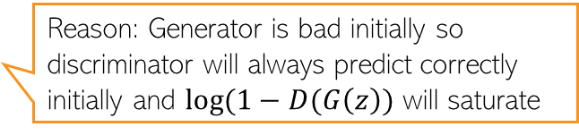
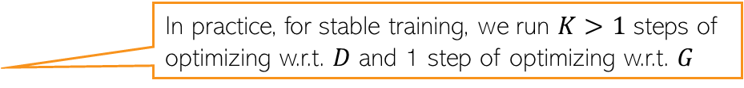
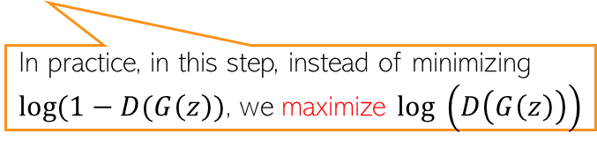
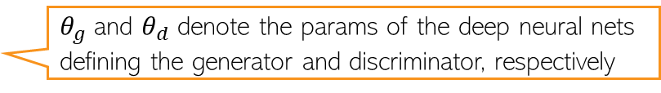
GAN Optimization
18
The GAN training procedure can be summarized as
$θ_{g}$ and $θ_{d}$ denote the params of the deep neural nets defining the generator and discriminator, respectively
In practice, for stable training, we run $K>1$ steps of optimizing w.r.t. $D$ and 1 step of optimizing w.r.t. $G$
Reason: Generator is bad initially so discriminator will always predict correctly initially and $log(1−D(G\left(z\right))$ will saturate
In practice, in this step, instead of minimizing $log(1−D(G\left(z\right))$, we maximize $log \left(D\left(G\left(z\right)\right)\right)$

Slide 19
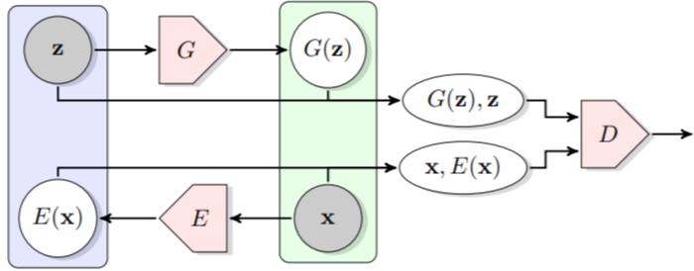

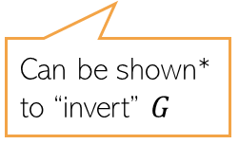
GANs that also learn latent representations
19
The standard GAN can only generate data. Can’t learn the latent $z$ from $x$
Bidirectional GAN* (BiGAN) is a GAN variant that allows this
Consists of an encoder as well
Real pair/fake pair?
Can be shown* to “invert” $G$
*Adversarial Feature Learning (Donahue et a Dumoulin l, 2017)
#Adversarially Learned Inference (Dumoulin et al, 2017)

Slide 20
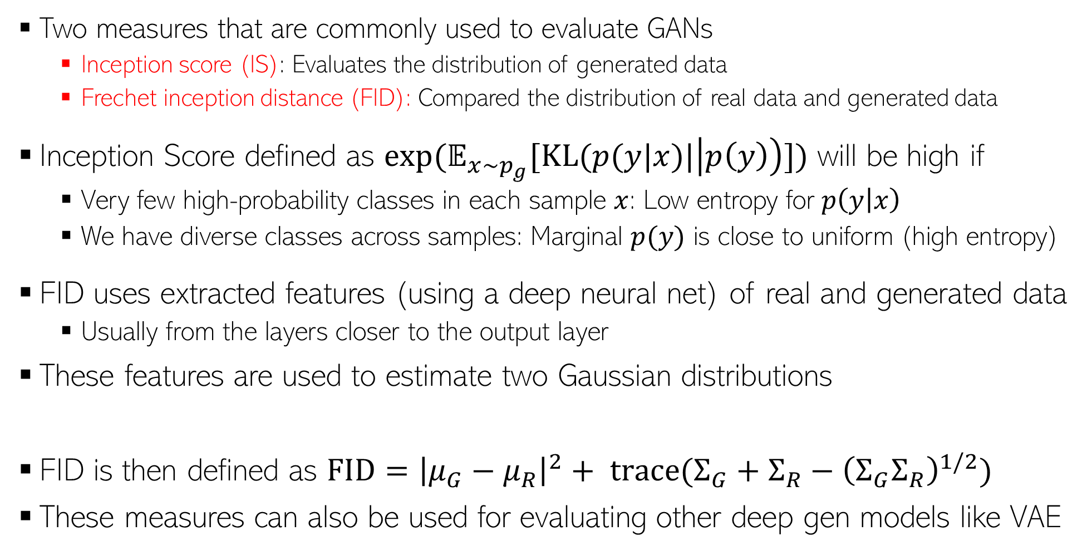


Evaluating GANs
20
High IS and low FID is desirable
Two measures that are commonly used to evaluate GANs
  Inception score (IS): Evaluates the distribution of generated data
  Frechet inception distance (FID): Compared the distribution of real data and generated data
Inception Score defined as $exp(𝔼_{x∼p_{g}}[KL(p(y|x)|\left|p\left(y\right)\right)])$ will be high if
  Very few high-probability classes in each sample $x$: Low entropy for $p\left(y | x\right)$
  We have diverse classes across samples: Marginal $p(y)$ is close to uniform (high entropy)
FID uses extracted features (using a deep neural net) of real and generated data
  Usually from the layers closer to the output layer
These features are used to estimate two Gaussian distributions
FID is then defined as $FID={\left|μ_{G}−μ_{R}\right|}^{2}+ trace(Σ_{G}+Σ_{R}−{\left(Σ_{G}Σ_{R}\right)}^{1/2})$
These measures can also be used for evaluating other deep gen models like VAE
Both IS and FID measure how realistic the generated data is
Using real data
$$𝒩(μ_{R}, Σ_{R})$$
$$𝒩(μ_{G}, Σ_{G})$$
Using generated data

Slide 21
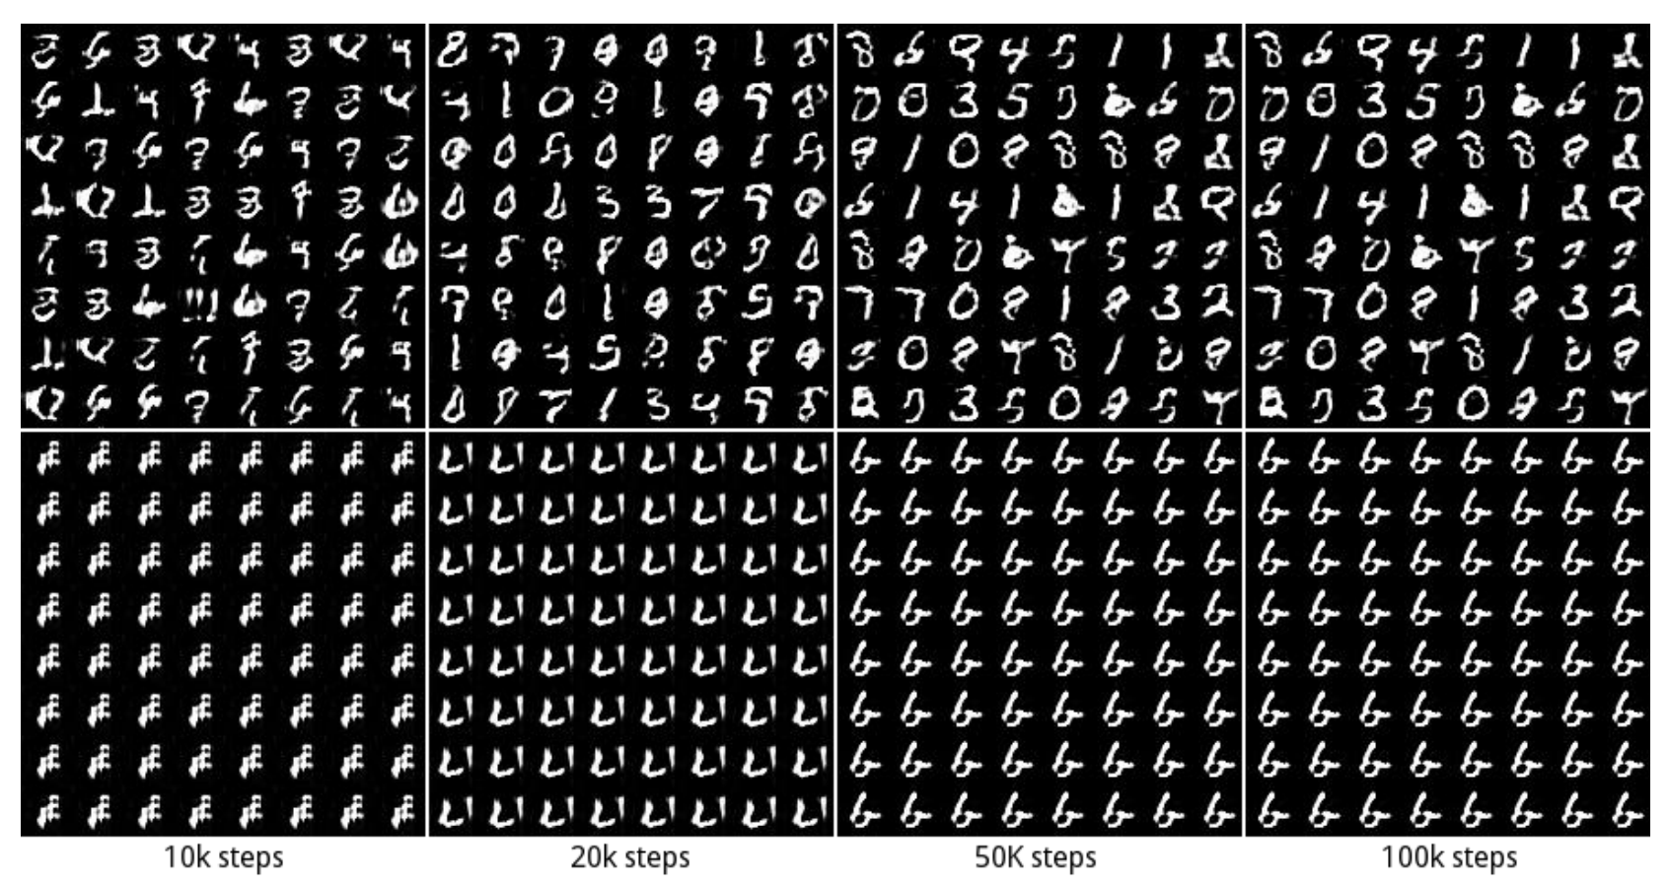
GAN: Some Issues/Comments
21
GAN training can be hard and the basic GAN suffers from several issues
Instability of training procedure
Mode Collapse problem: Lack of diversity in generated samples
  Generator may find some data that can easily fool the discriminator
  It will stuck at that mode of the data distribution and keep generating data like that
Some work on addressing these issues (e.g., Wasserstein GAN, Least Squares GAN, etc)
GAN 1: No mode collapse (all 10 modes captured in generation)
GAN 2: Mode collapse (stuck on one of the modes)

