Slide 1
Sampling Methods (contd)
CS772A: Probabilistic Machine Learning
Piyush Rai

Slide 2
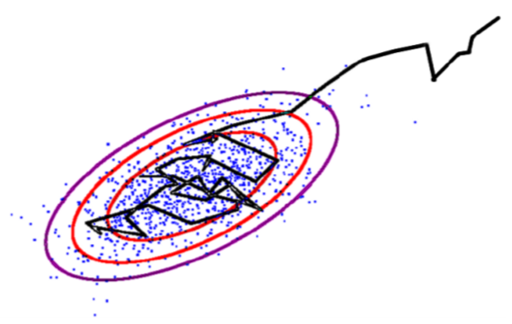
Markov Chain Monte Carlo (MCMC)
2
If the target is a posterior, it will be conditioned on data, i.e., $p(z|x)$
Goal: Generate samples from some target distribution $p\left(z\right)= \frac{\tilde{p}(z)}{Z_{p}}$
Assume we can evaluate $p(z)$ at least up to a proportionality constant
MCMC uses a Markov Chain which, when converged, starts giving samples from $p(z)$
Given current sample $z^{(ℓ)}$ from the chain, MCMC generates the next sample $z^{(ℓ+1)}$ as
Use a proposal distribution $q(z|z^{(ℓ)})$ to generate a candidate sample $z_{∗}$
Accept/reject $z_{∗}$ as the next sample based on an acceptance criterion (will see later)
If accepted, set $z^{(ℓ+1)}=z_{∗}$. If rejected, set $z^{(ℓ+1)}$ = $z^{(ℓ)}$
Important: The proposal distribution $q(z|z^{(ℓ)})$ depends on the previous sample $z^{(ℓ)}$
$z$ usually is high-dim
Means we can at least evaluate $\tilde{p}(z)$
Should also have the same support as $p(z)$

Slide 3
MCMC: The Basic Scheme
3
The chain run infinitely long (i.e., upon convergence) will give ONE sample from $p\left(z\right)$
But we usually require several samples to approximate $p\left(z\right)$
This is done as follows
Start the chain at an initial $z^{(0)}$
Using the proposal $q(z|z^{(ℓ)})$, run the chain long enough, say $T_{1}$ steps
Discard the first $T_{1}−1$ samples (called “burn-in” samples) and take last sample $z^{(T_{1})}$
Continue from $z^{(T_{1})}$ up to $T_{2}$ steps, discard intermediate samples, take last sample $z^{(T_{2})}$
This discarding (called “thinning”) helps ensure that $z^{(T_{1})}$ and $z^{(T_{2})}$ are uncorrelated
Repeat the same for a total of $S$ times
In the end, we now have $S$ approximately independent samples from $p\left(z\right)$
Note: Good choices for $T_{1}$ and $T_{i}−T_{i−1}$(thinning gap) are usually based on heuristics
MCMC is exact in theory but approximate in practice since we can’t run the chain for infinitely long in practice
Thus we say that the samples are approximately from the target distribution
Will treat it as our first sample from $p(z)$
Requirement for Monte Carlo approximation

Slide 4
MCMC: Some Basic Theory
4
A first order Markov Chain assumes $p\left(z^{(ℓ+1)}|z^{\left(1\right)},…,z^{(ℓ)}\right)=p(z^{\left(ℓ+1\right)}|z^{(ℓ)})$
A 1st order Markov Chain $z^{(0)},$ $z^{(1)},…,z^{(L)}$ is a sequence of r.v.’s and is defined by
An initial state distribution $p(z^{\left(0\right)})$
A Transition Function (TF): $T_{ℓ}\left(z^{\left(ℓ\right)}→z^{\left(ℓ+1\right)}\right)=p(z^{\left(ℓ+1\right)}|z^{(ℓ)})$ – the proposal distribution
TF is a distribution over the values of next state given the value of the current state
Assuming $z$ is discrete with $K$ possible values, the TF will be $K × K$probability table
Homogeneous Markov Chain: The TF is the same for all $ℓ$ , i.e., $T_{ℓ}=T$

Slide 5
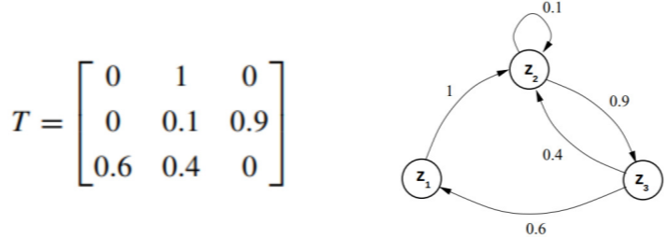
MCMC: Some Basic Theory
5
Consider the following Markov Chain to sample a discrete r.v. $z$ with 3 possible values
$p(z)$ being Stationary means no matter what $p\left(z^{\left(0\right)}\right)$is, we will reach $p(z)$
Such transition functions are desirable in MCMC
The initial state distribution for $z$
$$p\left(z^{\left(0\right)}\right)=p\left(z_{1}^{\left(0\right)},z_{2}^{\left(0\right)},z_{3}^{\left(0\right)}\right)$$
Probabilities of the initial state taking each of the 3 possible values
$$=[0.5,0.2,0.3]$$
Distribution of $z$ after taking the first step
$$p\left(z^{\left(1\right)}\right)= p\left(z^{\left(0\right)}\right)×T=[0.2,0.6,0.2]$$
$$(rounded to single digit after decimal)$$
After doing it a few more (say some $m$) times
Stationary/Invariant Distribution $p(z)$ of this Markov Chain
$p(z)$ is multinoulli with $π=[0.2,0.4,0.4]$
$$p\left(z^{\left(0\right)}\right)×T^{m}=[0.2,0.4,0.4]$$
$$(rounded to single digit after decimal)$$

Slide 6
MCMC: Some Basic Theory
6
A Markov Chain with transition function $T$ has stationary distribution $p(z)$ if $T$ satisfies
Detailed Balance ensures “reversibility”
Integrating out (or summing over) detailed balanced condition on both sides w.r.t. $z^{′}$
Thus a Markov Chain with detailed balance always converges to a stationary distribution
Detailed balance is sufficient but not necessary condition for having a stationary distr.
Here $T\left(b | a\right)$ denotes the transition probability of going from state $a$ to state $b$
Known as the Detailed Balance condition
$$p\left(z\right)T\left(z^{′}|z\right)=p\left(z^{′}\right)T(z|z^{′})$$
$$p\left(z\right)=\int{p\left(z^{′}\right)T\left(z | z^{′}\right)dz^{′}}$$
Thus $p(z)$ is the stationary distribution of this Markov Chain

Slide 7
Some MCMC Algorithms
7

Slide 8
Metropolis-Hastings (MH) Sampling (1960)
8
Suppose we wish to generate samples from a target distribution $p\left(z\right)= \frac{\tilde{p}(z)}{Z_{p}}$
Assume a suitable proposal distribution $q(z|z^{(τ)})$, e.g., $𝒩(z|z^{\left(τ\right)},σ^{2}I)$
In each step, draw $z^{∗}$ from $q(z|z^{(τ)})$ and accept $z^{∗}$ with probability
Transition function of this Markov Chain
$T\left(z^{∗}|z^{(τ)}\right)=A(z^{∗},z^{\left(τ\right)})q(z^{∗}|z^{(τ)})$ if state changed
$T\left(z^{∗}|z^{(τ)}\right)=q\left(z^{\left(τ\right)} | z^{\left(τ\right)}\right)+\sum_{z^{∗}≠z^{\left(τ\right)}}{(1−A(z^{∗},z^{\left(τ\right)}))q(z^{∗}|z^{(τ)}) }$ otherwise
Favors acceptance of $z^{∗}$ if it is more probable than $z^{(τ)}$ (under $p(z)$)
Downweight the probability of acceptance of $z^{∗}$ if the proposal itself favors its generation (i.e., if $q(z^{∗}|z^{\left(τ\right)})$ is high), and upweight if it unfavors the generation
Can Show that this TF satisfied detailed balance

Slide 9
The MH Sampling Algorithm
9
Initialize $z^{(1)}$ randomly
For $ℓ=1,2,…, L$
Sample $z^{∗}∼q(z^{∗}|z^{(ℓ)})$ and $u∼Unif(0,1)$
Compute acceptance probability
If $A\left(z^{∗},z^{(ℓ)}\right)>u$
Else
Meaning accepting $z^{∗}$ with probability $A\left(z^{∗},z^{(ℓ)}\right)$
$$z^{(ℓ+1)}=z^{∗}$$
$$z^{(ℓ+1)}=z^{(ℓ)}$$

Slide 10
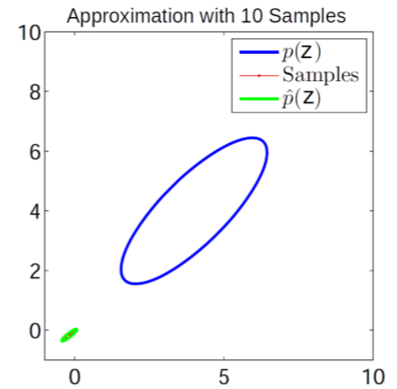
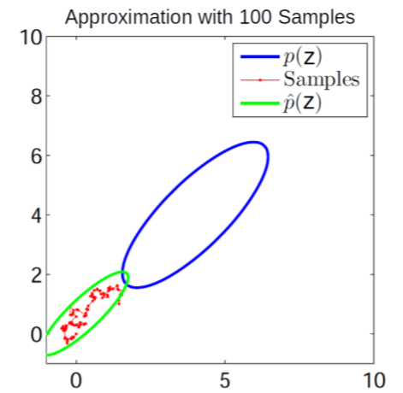
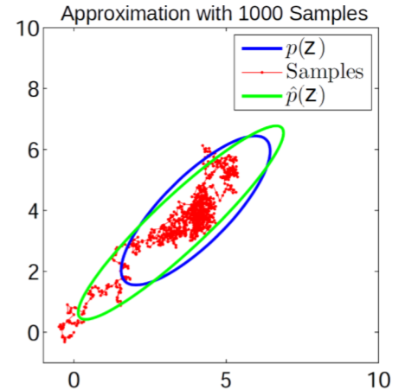
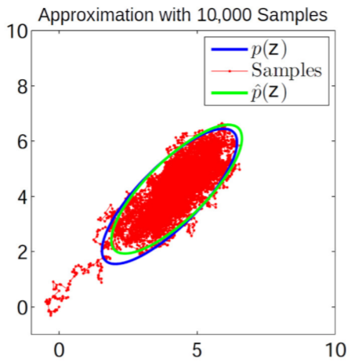
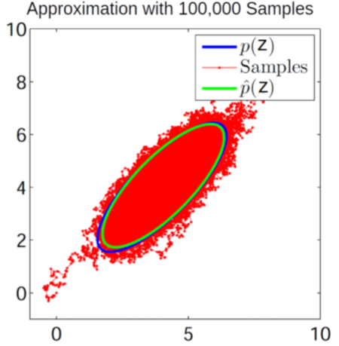
MH Sampling in Action: A Toy Example..
10
Target distribution
Proposal distribution

Slide 11
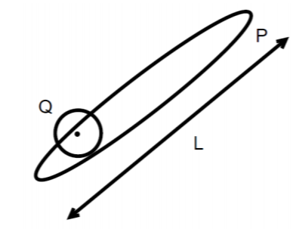
MH Sampling: Some Comments
11
If prop. distrib. is symmetric, we get Metropolis Sampling algo (Metropolis, 1953) with
Some limitations of MH sampling
Can sometimes have very slow convergence (also known as slow “mixing”)
Computing acceptance probability can be expensive*, e.g., if $p\left(z\right)= \frac{\tilde{p}(z)}{Z_{p}}$ is some target posterior then $\tilde{p}(z)$ would require computing likelihood on all the data points (expensive)
$$Q\left(z | z^{\left(τ\right)}\right)=𝒩(z|z^{\left(τ\right)},σ^{2}I)$$
$$∼{\left(\frac{L}{σ}\right)}^{2}iterations required for convergence$$
$$σ large⇒many rejections$$
$$σ small⇒slow diffusion$$
*Austerity in MCMC Land: Cutting the Metropolis-Hastings Budget (Korattikara et al, 2014), Firefly Monte Carlo: Exact MCMC with Subsets of Data {(Maclaurin and Adams, 2015)

Slide 12
Gibbs Sampling (Geman & Geman, 1984)
12
Goal: Sample from a joint distribution $p(z)$ where $z=[z_{1},z_{2},…, z_{M}]$
Suppose we can’t sample from $p(z)$ but can sample from each conditional $p(z_{i}|z_{−i})$
In Bayesian models, can be done easily if we have a locally conjugate model
For Gibbs sampling, the proposal is the conditional distribution $p(z_{i}|z_{−i})$
Gibbs sampling samples from these conditionals in a cyclic order
Gibbs sampling is equivalent to MH sampling with acceptance prob. = 1
Hence no need to compute it
Since only one component is changed at a time

Slide 13
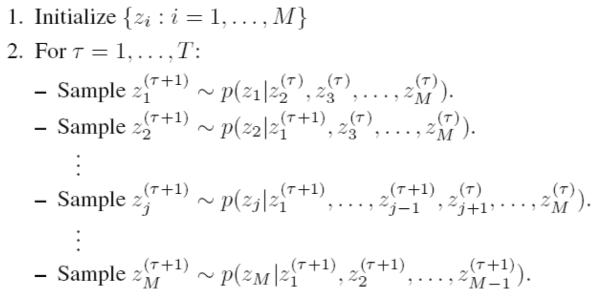
Gibbs Sampling: Sketch of the Algorithm
13
$M$: Total number of variables, $T$: number of Gibbs sampling iterations
Note: Order of updating the variables usually doesn’t matter (but see “Scan Order in Gibbs Sampling: Models in Which it Matters and Bounds on How Much” from NIPS 2016)
Assuming $z = [z_{1}, z_{2}, …, z_{M}]$
CP of each component of $z$ uses the most recent values (from this or the previous iteration) of all the other components
Each iteration will give us one sample $z^{(τ)}$of $z = [z_{1}, z_{2}, …, z_{M}]$

Slide 14
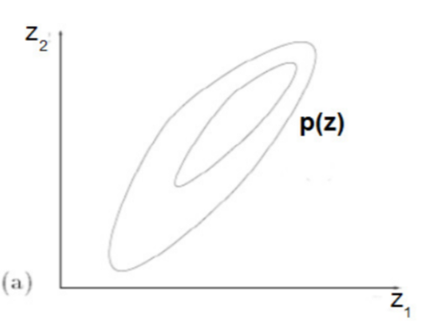
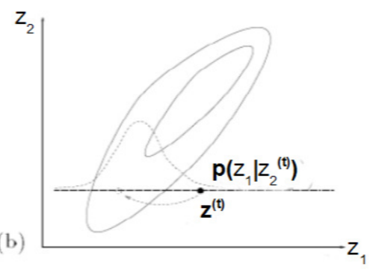
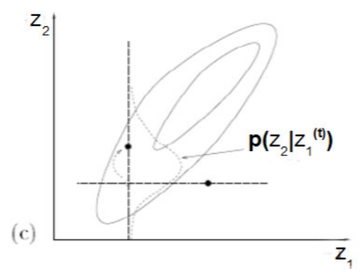
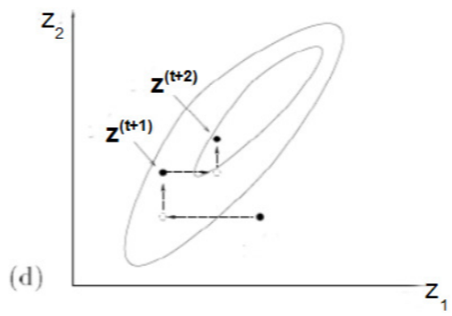
Gibbs Sampling: A Simple Example
14
Can sample from a 2-D Gaussian using 1-D Gaussians
Contours of a 2-D Gaussian
Conditional distribution of $z_{1}$ given $z_{2}$ is Gaussian
Conditional distribution of $z_{2}$ given $z_{1}$ is Gaussian
Gibbs sampling looks like doing a co-ordinate-wise update to generate each successive sample of $z=[z_{1},z_{2}]$

Slide 15
Gibbs Sampling: Another Simple Example
15
Bayesian linear regression: $p\left(y_{n} | x_{n},w,β\right)= 𝒩(y_{n}|w^{⊤}x_{n},β^{−1})$, $p\left(w\right)= 𝒩(w|0,λ^{−1}I)$, $p\left(λ\right)=Gamma(λ|a,b)$, $p\left(β\right)=Gamma(β|c,d)$. Gibbs sampler for $p(w,λ, β|X,y)$ will be
Initialize $λ, β$ as $λ^{\left(0\right)},β^{(0)}$. For iteration $t=1,2,…, T$
Generate a random sample of $w$ by sampling from its CP as
Generate a random sample of $λ$ by sampling from its CP as
Generate a random sample of $β$ by sampling from its CP as
The posterior’s approximation is the set of collected samples ${\left\{w^{\left(t\right)},λ^{\left(t\right)}\text{,} β^{\left(t\right)}\right\}}_{t=1}^{T}$
$$Σ^{\left(t−1\right)}={\left(β^{(t−1)}X^{⊤}X+λ^{(t−1)}\right)}^{−1}$$
$$w^{(t)}∼𝒩(w|μ^{\left(t−1\right)},Σ^{(t−1)})$$
where
$$μ^{\left(t−1\right)}={\left(X^{⊤}X+ \frac{λ^{(t−1)}}{β^{(t−1)}}\right)}^{−1}X^{⊤}y$$
$$λ^{(t)}∼Gamma \left(λ|a+\frac{D}{2},b+\frac{{w^{\left(t\right)}}^{⊤}w^{(t)}}{2}\right)$$
$$β^{(t)}∼Gamma \left(β|c+\frac{N}{2},d+\frac{{\left\|y−Xw^{\left(t\right)}\right\|}^{2}}{2}\right)$$
Note: Assuming these are post-burnin samples and thinning (if any) is also considered

