Slide 1
Sampling Methods to Approximate Distributions and Expectations
CS772A: Probabilistic Machine Learning
Piyush Rai

Slide 2
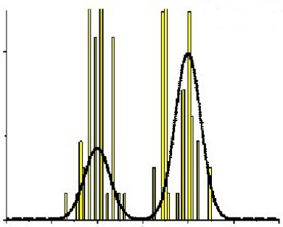
Approximating a Prob. Distribution using Samples
2
Can approximate any distribution using a set of randomly drawn samples from it
The samples can also be used for computing expectations (Monte-Carlo averaging)
Usually straightforward to generate samples if it is a simple/standard distribution
The interesting bit: Even if the distribution is “difficult” (e.g., an intractable posterior), it is often possible to generate random samples from such a distribution, as we will see.
Samples can thought of as a histogram-based approximation of a distribution
Given large-enough samples, it is proportional to the probability density at that location
Height of each bar denotes how many times that location was sampled
$$p(z)$$

Slide 3
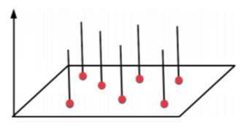
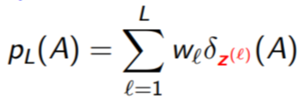
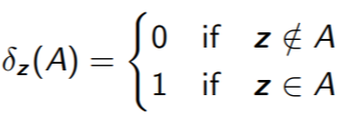
The Empirical Distribution
3
Sampling based approx. can be formally represented using an empirical distribution
Given $L$ points/samples $z^{(1)},z^{(2)},…,z^{(L)}$, empirical distr. defined by these is
Weights sum to 1
Dirac Distribution with finite support at $z^{(1)},z^{(2)},…,z^{(L)}$
Weight of point $z^{(ℓ)}$
Can think of $A$ as being the area over which we want to evaluate the distribution
Dirac Distribution

Slide 4
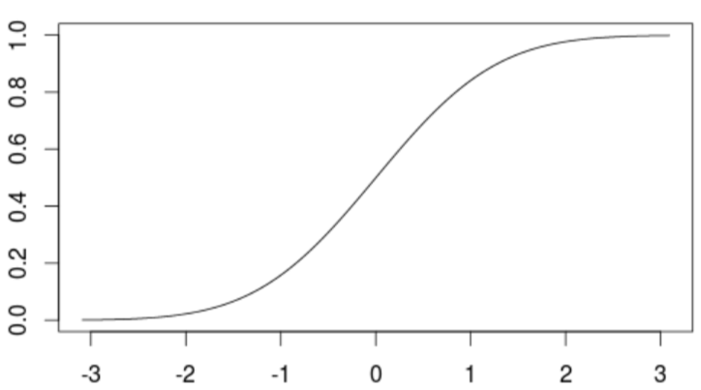
Sampling: Some Basic Methods
$$p\left(z\right)=q(x)\left|\frac{∂x}{∂z}\right|$$
4
Most of these basic methods are based on the idea of transformation
Generate a random sample $x$ from a distribution $q(x)$ which is easy to sample from
Apply a transformation on $x$ to make it random sample $z$ from a complex distr $p(z)$
Some popular examples of transformation methods
Inverse CDF method
Reparametrization method
Box-Mueller method: Given $(x_{1}, x_{2})$from $Unif(0, 1)$, generate $(z_{1}, z_{2})$from $𝒩(0,I_{2})$
$z_{1}= \sqrt{−2 ln x_{1}}cos\left(2πx_{2}\right), z_{1}= \sqrt{−2 ln x_{1}}sin(2πx_{2})$
Transformation Methods are simple but have limitations
Mostly limited to standard distributions and/or distributions with very few variables
Determinant of Jacobian
$F(z)$: CDF of $p(z)$
$$x$$
$$z=F^{−1}(x)$$

Slide 5
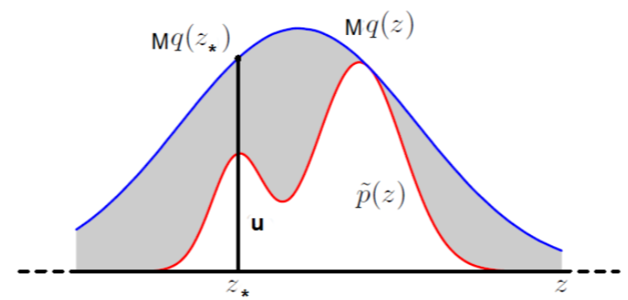
Rejection Sampling
5
Goal: Generate a random sample from a distribution of the form $p\left(z\right)= \frac{\tilde{p}(z)}{Z_{p}}$, assuming
We can only evaluate the value of numerator $\tilde{p}(z)$ for any $z$
The denominator (normalization constant) $Z_{p}$ is intractable and we don’t know its value
Assume a proposal distribution $q(z)$ we can generate samples from, and
Rejection Sampling then works as follows
Sample a random variable $z_{∗}$ from $q(z)$
Sampling a uniform r.v. $u∼Unif\left[0,Mq\left(z_{∗}\right)\right]$
If $u≤\tilde{p}(z_{∗})$ then accept $z_{∗}$, otherwise reject it
All accepted $z_{∗}$’s will be random samples from $p\left(z\right)$. Proof on next slide
Should have the same support as $p(z)$

Slide 6
Rejection Sampling
6
Why $z ∼ q(z)$+ accept/reject rule is equivalent to $z ∼ p(z)$?
Let’s look at the pdf of the $z$’s that were accepted, i.e., $p(z|accept)$

Slide 7
Computing Expectations via Monte Carlo Sampling
7
Often we are interested in computing expectations of the form
where $f(z)$ is some function of the random variable $z∼ p(z)$
A simple approx. scheme to compute the above expectation: Monte Carlo integration
Generate $L$ independent samples from $p(z)$: ${\left\{z^{(ℓ)}\right\}}_{ℓ=1}^{L}∼p(z)$
Approximate the expectation by the following empirical average
Since the samples are independent of each other, we can show the following (exercise)
$$𝔼\left[f\right]= \int{f\left(z\right)p\left(z\right)dz}$$
Assuming we know how to sample from $p(z)$
$𝔼\left[f\right]≈ \hat{f}= \frac{1}{L}\sum_{ℓ=1}^{L}{f(z^{(ℓ)})}$
Variance in our estimate decreases as $L$increases
Unbiased expectation

Slide 8
Computing Expectations via Importance Sampling
8
How to compute Monte Carlo expec. if we don’t know how to sample from $p(z)$?
One way is to use transformation methods or rejection sampling to generate samples
Another way is to use Importance Sampling (assuming $p(z)$ can be evaluated at least)
Generate $L$ indep samples from a proposal $q(z)$ we know how sample from: ${\left\{z^{(ℓ)}\right\}}_{ℓ=1}^{L}∼q(z)$
Now approximate the expectation as follows
This is basically “weighted” Monte Carlo integration
$w^{(ℓ)}=\frac{p\left(z^{(ℓ)}\right)}{q\left(z^{(ℓ)}\right)}$ denotes the importance weight of each sample $z^{(ℓ)}$
IS works even when we can only evaluate $p\left(z\right)= \frac{\tilde{p}(z)}{Z_{p}}$ up to a prop. constant
Note: Monte Carlo and Importance Sampling are NOT sampling methods!
These are only uses for computing expectations (approximately)
$$𝔼\left[f\right]= \int{f\left(z\right)p\left(z\right)dz}=\int{f\left(z\right)\frac{p\left(z\right)}{q\left(z\right)}q\left(z\right)dz}$$
$$≈\frac{1}{L}\sum_{ℓ=1}^{L}{f(z^{(ℓ)})}\frac{p\left(z^{(ℓ)}\right)}{q\left(z^{(ℓ)}\right)}$$
See PRML 11.1.4

Slide 9
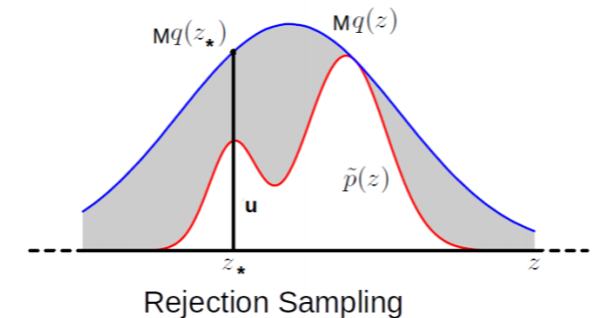
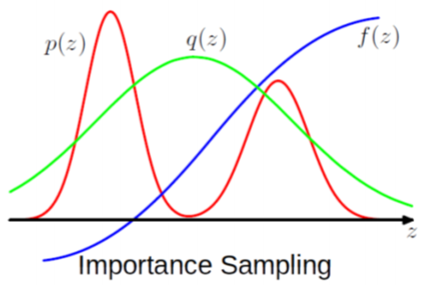
Limitations of the Basic Methods
9
Transformation based methods: Usually limited to drawing from standard distributions
Rejection Sampling and Importance Sampling: Require good proposal distributions
In general, difficult to find good prop. distr. especially when $z$ is high-dim
More sophisticated sampling methods like MCMC work well in such high-dim spaces
$$𝔼\left[f\right]≈\frac{1}{L}\sum_{ℓ=1}^{L}{f(z^{(ℓ)})}\frac{p\left(z^{(ℓ)}\right)}{q\left(z^{(ℓ)}\right)}$$
$q(z)$ should be such that $Mq(z)$ envelopes $\tilde{p}(z)$ everywhere
Ideally, would like $q(z)$ to give samples from where $p(z)$ is large or $f(z)p(z)$ is large
Difficult to guarantee so if $z$ is high-dimensional

Slide 10
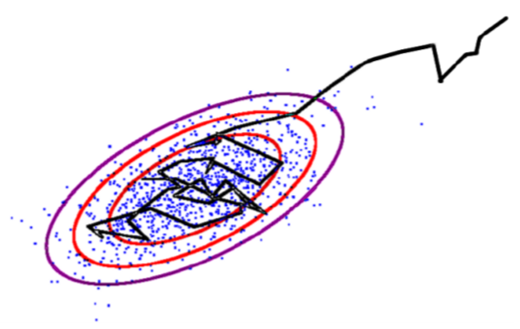
Markov Chain Monte Carlo (MCMC)
10
If the target is a posterior, it will be conditioned on data, i.e., $p(z|x)$
Goal: Generate samples from some target distribution $p\left(z\right)= \frac{\tilde{p}(z)}{Z_{p}}$
Assume we can evaluate $p(z)$ at least up to a proportionality constant
MCMC uses a Markov Chain which, when converged, starts giving samples from $p(z)$
Given current sample $z^{(ℓ)}$ from the chain, MCMC generates the next sample $z^{(ℓ+1)}$ as
Use a proposal distribution $q(z|z^{(ℓ)})$ to generate a candidate sample $z_{∗}$
Accept/reject $z_{∗}$ as the next sample based on an acceptance criterion (will see later)
If accepted, set $z^{(ℓ+1)}=z_{∗}$. If rejected, set $z^{(ℓ+1)}$ = $z^{(ℓ)}$
Important: The proposal distribution $q(z|z^{(ℓ)})$ depends on the previous sample $z^{(ℓ)}$
$z$ usually is high-dim
Means we can at least evaluate $\tilde{p}(z)$
Should also have the same support as $p(z)$

Slide 11
MCMC: The Basic Scheme
11
The chain run infinitely long (i.e., upon convergence) will give ONE sample from $p\left(z\right)$
But we usually require several samples to approximate $p\left(z\right)$
This is done as follows
Start the chain at an initial $z^{(0)}$
Using the proposal $q(z|z^{(ℓ)})$, run the chain long enough, say $T_{1}$ steps
Discard the first $T_{1}−1$ samples (called “burn-in” samples) and take last sample $z^{(T_{1})}$
Continue from $z^{(T_{1})}$ up to $T_{2}$ steps, discard intermediate samples, take last sample $z^{(T_{2})}$
This discarding (called “thinning”) helps ensure that $z^{(T_{1})}$ and $z^{(T_{2})}$ are uncorrelated
Repeat the same for a total of $S$ times
In the end, we now have $S$ approximately independent samples from $p\left(z\right)$
Note: Good choices for $T_{1}$ and $T_{i}−T_{i−1}$(thinning gap) are usually based on heuristics
MCMC is exact in theory but approximate in practice since we can’t run the chain for infinitely long in practice
Thus we say that the samples are approximately from the target distribution
Will treat it as our first sample from $p(z)$
Requirement for Monte Carlo approximation

Slide 12
MCMC: Some Basic Theory
12
A first order Markov Chain assumes $p\left(z^{(ℓ+1)}|z^{\left(1\right)},…,z^{(ℓ)}\right)=p(z^{\left(ℓ+1\right)}|z^{(ℓ)})$
A 1st order Markov Chain $z^{(0)},$ $z^{(1)},…,z^{(L)}$ is a sequence of r.v.’s and is defined by
An initial state distribution $p(z^{\left(0\right)})$
A Transition Function (TF): $T_{ℓ}\left(z^{\left(ℓ\right)}→z^{\left(ℓ+1\right)}\right)=p(z^{\left(ℓ+1\right)}|z^{(ℓ)})$ – the proposal distribution
TF is a distribution over the values of next state given the value of the current state
Assuming $z$ is discrete with $K$ possible values, the TF will be $K × K$probability table
Homogeneous Markov Chain: The TF is the same for all $ℓ$ , i.e., $T_{ℓ}=T$

