Slide 1
Variational Inference (wrap-up), Approximate Inference via Sampling
CS772A: Probabilistic Machine Learning
Piyush Rai

Slide 2
VI using ELBO’s gradients
2
For simple locally conjugate models, VI updates are usually easy
Sometimes, can find the optimal $q$ even without taking the ELBO’s gradients
For complex models, we have to use the more general gradient-based approach
Consider the setting when we have latent variables $Z$ and parameters $Θ$
The ELBO’s gradient w.r.t. $Θ$
The ELBO’s gradient w.r.t. $φ$
$$∇_{Θ}ℒ\left(φ, Θ\right)=∇_{Θ} 𝔼_{q_{φ}(Z)}[log p\left(𝓓,Z | Θ\right)−log q_{φ}\left(Z\right)]$$
Gradient can go inside expectation since $q(Z)$ doesn’t depend on $Θ$
Monte-Carlo approximation using samples of $q_{φ}(Z)$ is straightforward here
$$=𝔼_{q_{φ}(Z)}\left[∇_{Θ} \left\{log p\left(𝓓,Z | Θ\right)−log q_{φ}\left(Z\right)\right\}\right]$$
$$∇_{φ}ℒ\left(φ, Θ\right)=∇_{φ} 𝔼_{q_{φ}(Z)}[log p\left(𝓓,Z | Θ\right)−log q_{φ}\left(Z\right)]$$
Gradient can’t go inside expectation since $q(Z)$ depends on $φ$
Monte-Carlo approximation using samples of $q_{φ}(Z)$ is NOT as straightforward
$$≠𝔼_{q_{φ}(Z)}\left[∇_{φ} \left\{log p\left(𝓓,Z | Θ\right)−log q_{φ}\left(Z\right)\right\}\right]$$

Slide 3
Black-Box Variational Inference (BBVI)
3
Black-box Var. Inference* (BBVI) approximates ELBO derivatives using Monte-Carlo
Uses the following identity for the ELBO’s derivative
Thus ELBO gradient can be written solely in terms of expec. of gradient of $log q(Z|φ)$
Required gradients don’t depend on the model; only on chosen var. distribution (hence “black-box”)
Given $S$ samples ${\left\{Z_{s}\right\}}_{s=1}^{S}$ from $q(Z|φ)$, we can get (noisy) gradient as follows
Above is also called the “score function” based gradient (also REINFORCE method)
Gradient of a log-likelihood or log-probability function w.r.t. its params is called score function; hence the name
∗Black Box Variational Inference - Ranganath et al (2014)

Slide 4
Reparametrization Trick
4
Another Monte-Carlo approx. of ELBO grad (with often lower var than BBVI gradient)
Suppose we want to compute ELBO’s gradient
Assume a deterministic transformation $g$
With this reparametrization, and using LOTUS rule, the ELBO’s gradient would be
Given $S$ i.i.d. random samples ${\left\{ε_{s}\right\}}_{s=1}^{S}$ from $p(ε)$, we can get a Monte-Carlo approx.
Such gradients are called pathwise gradients* (since we took a “path” from $ε$ to $Z$)
Assumed to not depend on $φ$
$$Z=g(ε, φ)$$
where
$$ε∼p(ε)$$
*Autoencoding Variational Bayes - Kingma and Welling (2013), Stochastic Backpropagation and Approximate Inference in Deep Generative Models- Rezende et al (2014)

Slide 5
Reparametrization Trick: An Example
5
Suppose our variational distribution is $q\left(w|φ\right)= 𝒩(w|μ,Σ)$, so $φ=\{μ, Σ\}$
Suppose our ELBO has a difficult expectation term $𝔼_{q}[f\left(w\right)]$
However, note that we need ELBO gradient, not ELBO itself. Let’s use the trick
Reparametrize $w$ as $w=μ+Lv$ where $v \sim 𝒩(0,I)$
The above is now straightforward
Easily take derivatives of $f(w)$ w.r.t. variational params $μ, L$
Replace exp. by Monte-Carlo averaging using samples of $v$ from $𝒩(0,I)$
Std. reparam. trick assumes differentiability (recent work on removing this req).
Or $φ=\{μ, L\}$ where $L= chol(Σ)$
Note that we will still have $q\left(w|φ\right)= 𝒩(w|μ,Σ)$
Often even one or very few samples suffice
$$\frac{∂f}{∂w}\frac{∂w}{∂μ}$$
Chain Rule
$$\frac{∂f}{∂w}\frac{∂w}{∂L}$$
*Autoencoding Variational Bayes - Kingma and Welling (2013), Stochastic Backpropagation and Approximate Inference in Deep Generative Models- Rezende et al (2014)

Slide 6
Reparametrization Trick: Some Comments
6
Standard Reparametrization Trick assumes the model to be differentiable
In contrast, BBVI (score function gradients) only required $q(Z)$ to be differentiable
Thus rep. trick often isn’t applicable, e.g., when $Z$ is discrete (e.g., binary /categorical)
Recent work on continuous relaxation† of discrete variables†(e.g., Gumbel Softmax for categorical)
The transformation function $g$ may be difficult to find for general distributions
Recent work on generalized reparametrizations*
Also, the transformation function $g$ needs to be invertible (difficult/expensive)
Recent work on implicit reparametrized gradients#
Assumes that we can directly draw samples from $p(ε)$. If not, then rep. trick isn’t valid@
†Categorical Reparameterization with Gumbel-Softmax (Jang et al, 2017), ∗ The Generalized Reparameterization Gradient (Ruiz et al, 2016), # Implicit Reparameterization Gradients (Figurnov et al, 2018), @ Reparameterization Gradients through Acceptance-Rejection Sampling Algorithms (Naesseth et al, 2016)

Slide 7
Automatic Differentiation Variational Inference
7
Suppose $Z$ is $D$-dim r.v. with constraints (e.g., non-negativity) and distribution $q(Z|φ)$
Assume a transformation $T$ such that $u=T(Z)$ s.t. $u∈ℝ^{D}$ (unconstrained) then
Recall the original ELBO expression $ℒ\left(φ\right)= 𝔼_{q(Z|φ)}\left[log\frac{p(D,Z)}{q(Z|φ)}\right]$
Assuming $q\left(u | ψ\right)= 𝒩(u|μ,Σ)$and using $Z=T^{−1}(u)$, the ELBO becomes
Optimize $ℒ\left(ψ\right)$ w.r.t. $ψ$ to get $q\left(u | ψ\right)$ as a Gaussian and use distribution transformation equation to get $q(Z|φ)$
$$q\left(u\right)=q(Z)\left|det\left(\frac{∂Z}{∂u}\right)\right|$$
$$ℒ\left(ψ\right)= 𝔼_{q\left(u | ψ\right)}\left[log \frac{p(D,T^{−1}(u))\left|det\left(∂Z/∂u\right)\right|}{q\left(u | ψ\right)}\right]$$
$$=𝔼_{q\left(u | ψ\right)}\left[log p(D,T^{−1}(u))+ log\left|det\left(∂Z/∂u\right)\right|\right]+H(q(u|ψ))$$

Slide 8
Structured Variational Inference
8
Here “structured” may refer to anything that makes VI approx. more expressive, e.g.,
Removing the independence assumption of mean-field VI
In general, learning more complex forms for the variational approximation family $q\left(Z | φ\right)$
To remove the mean-field assumption in VI, various approaches exist
Structured mean-field (Saul et al, 1996)
Hierarchical VI (Ranganath et al, 2016): Variational params $φ_{1},φ_{2},…, φ_{M}$ “tied” via a shared prior
Recent work on learning more expressive variational approx. for general VI
Boosting or mixture of simpler distributions, e.g., $q\left(Z\right)= \sum_{c=1}^{C}{ρ_{c}q_{c}(Z)}$
Normalizing flows*: Turn a simple var. distr. into a complex one via series of invertible transfor.
Even simple unimodal components will give a multimodal $q\left(Z\right)$
A much more complex(e.g., multimodal) variational distribution obtained via the flow idea
A simple unimodal variational distribution (e.g.. $𝒩(0,I)$
∗Variational Inference with Normalizing Flows (Rezende and Mohamed, 2015)

Slide 9
Other Divergence Measures
9
VI minimizes $KL(q||p)$but other divergences can be minimized as well
Recall that VI with minimization of $KL(q||p)$ leads to underestimated variances
A general form of divergence is Renyi’s $α$-divergence defined as
$KL(p||q)$ is a special case with $α→1$(can verify using L’Hopital rule of taking limits)
An even more general form of divergence is $f$-Divergence
Many recent variational inference algorithms are based on minimizing such divergences
$$D_{α}^{R}(p(Z)|\left|q\left(Z\right)\right)= \frac{1}{α−1} log \int{p{\left(Z\right)}^{α}q{\left(Z\right)}^{1−α}dZ}$$
$$D_{f}(p(Z)|\left|q\left(Z\right)\right)= \int{q\left(Z\right)f\left(\frac{p(Z)}{q(Z)}\right)dZ}$$

Slide 10
Variational Inference: Some Comments
10
Many probabilistic models nowadays rely on VI to do approx. inference
Even mean-field with locally-conjugacy used in lots of models
This + SVI gives excellent scalability as well on large datasets
Progress in various areas has made VI very popular and widely applicable
Stochastic Optimization (e.g., SGD)
Automatic Differentiation
Monte-Carlo gradient of ELBO
Note: Most of these ideas apply also to Variational EM
Many VI and advanced VI algos are implemented in probabilistic prog. packages (e.g., Tensorflow Probability, PyTorch, etc), making VI easy even for complex models
Still a very active area of research, especially for doing VI in complex models
Models with discrete latent variables
Reducing the variance in Monte-Carlo estimate of ELBO gradients
More expressive variational distribution for better approximation
We covered many of the threads being explored in recent work but a lot of work still being done in this area

Slide 11
Sampling for Approximate Inference
11
Some typical tasks that we have to solve in probabilistic/fully-Bayesian inference
Sampling methods provide a general way to (approximately) solve these problems
More general than VI methods which only approximate the posterior distribution
Posterior distribution
Posterior predictive distribution
Needed for model selection (and in computing posterior too)
Marginal likelihood
Needed in EM
Expected complete data log-likelihood
Evidence lower bound (ELBO)
]
Needed in VI

Slide 12
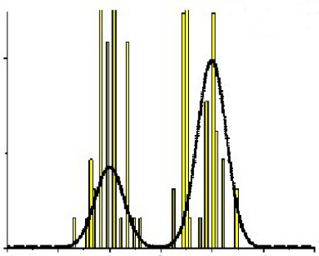
Approximating a Prob. Distribution using Samples
12
Can approximate any distribution using a set of randomly drawn samples from it
The samples can also be used for computing expectations (Monte-Carlo averaging)
Usually straightforward to generate samples if it is a simple/standard distribution
The interesting bit: Even if the distribution is “difficult” (e.g., an intractable posterior), it is often possible to generate random samples from such a distribution, as we will see.
Samples can thought of as a histogram-based approximation of a distribution
Given large-enough samples, it is proportional to the probability density at that location
Height of each bar denotes how many times that location was sampled
$$p(z)$$

Slide 13
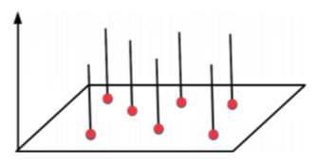
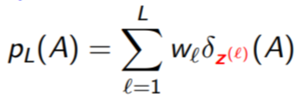
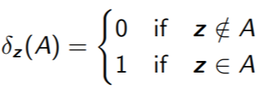
The Empirical Distribution
13
Sampling based approx. can be formally represented using an empirical distribution
Given $L$ points/samples $z^{(1)},z^{(2)},…,z^{(L)}$, empirical distr. defined by these is
Weights sum to 1
Dirac Distribution with finite support at $z^{(1)},z^{(2)},…,z^{(L)}$
Weight of point $z^{(ℓ)}$
Can think of $A$ as being the area over which we want to evaluate the distribution
Dirac Distribution

Slide 14
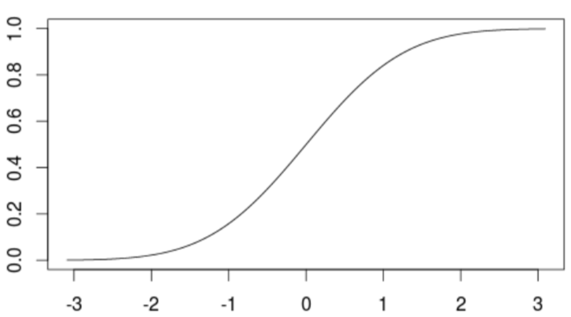
Sampling: Some Basic Methods
$$p\left(z\right)=q(x)\left|\frac{∂x}{∂z}\right|$$
14
Most of these basic methods are based on the idea of transformation
Generate a random sample $x$ from a distribution $q(x)$ which is easy to sample from
Apply a transformation on $x$ to make it random sample $z$ from a complex distr $p(z)$
Some popular examples of transformation methods
Inverse CDF method
Reparametrization method
Box-Mueller method: Given $(x_{1}, x_{2})$from $Unif(0, 1)$, generate $(z_{1}, z_{2})$from $𝒩(0,I_{2})$
$z_{1}= \sqrt{−2 ln x_{1}}cos\left(2πx_{2}\right), z_{1}= \sqrt{−2 ln x_{1}}sin(2πx_{2})$
Transformation Methods are simple but have limitations
Mostly limited to standard distributions and/or distributions with very few variables
Determinant of Jacobian
$F(z)$: CDF of $p(z)$
$$x$$
$$z=F^{−1}(x)$$

Slide 15
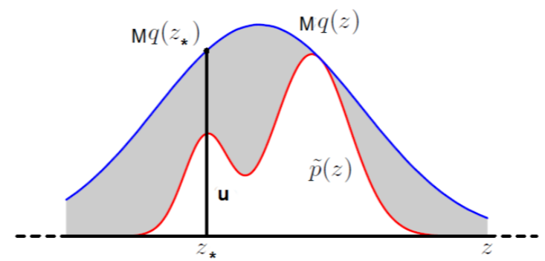
Rejection Sampling
15
Goal: Generate a random sample from a distribution of the form $p\left(z\right)= \frac{\tilde{p}(z)}{Z_{p}}$, assuming
We can only evaluate the value of numerator $\tilde{p}(z)$ for any $z$
The denominator (normalization constant) $Z_{p}$ is intractable and we don’t know its value
Assume a proposal distribution $q(z)$ we can generate samples from, and
Rejection Sampling then works as follows
Sample a random variable $z_{∗}$ from $q(z)$
Sampling a uniform r.v. $u∼Unif\left[0,Mq\left(z_{∗}\right)\right]$
If $u≤\tilde{p}(z_{∗})$ then accept $z_{∗}$, otherwise reject it
All accepted $z_{∗}$’s will be random samples from $p\left(z\right)$. Proof on next slide
Should have the same support as $p(z)$

Slide 16
Rejection Sampling
16
Why $z ∼ q(z)$+ accept/reject rule is equivalent to $z ∼ p(z)$?
Let’s look at the pdf of the $z$’s that were accepted, i.e., $p(z|accept)$

Slide 17
Computing Expectations via Monte Carlo Sampling
17
Often we are interested in computing expectations of the form
where $f(z)$ is some function of the random variable $z∼ p(z)$
A simple approx. scheme to compute the above expectation: Monte Carlo integration
Generate $L$ independent samples from $p(z)$: ${\left\{z^{(ℓ)}\right\}}_{ℓ=1}^{L}∼p(z)$
Approximate the expectation by the following empirical average
Since the samples are independent of each other, we can show the following (exercise)
$$𝔼\left[f\right]= \int{f\left(z\right)p\left(z\right)dz}$$
Assuming we know how to sample from $p(z)$
$𝔼\left[f\right]≈ \hat{f}= \frac{1}{L}\sum_{ℓ=1}^{L}{f(z^{(ℓ)})}$
Variance in our estimate decreases as $L$increases
Unbiased expectation

Slide 18
Computing Expectations via Importance Sampling
18
How to compute Monte Carlo expec. if we don’t know how to sample from $p(z)$?
One way is to use transformation methods or rejection sampling
Another way is to use Importance Sampling (assuming $p(z)$ can be evaluated at least)
Generate $L$ indep samples from a proposal $q(z)$ we know how sample from: ${\left\{z^{(ℓ)}\right\}}_{ℓ=1}^{L}∼q(z)$
Now approximate the expectation as follows
This is basically “weighted” Monte Carlo integration
$w^{(ℓ)}=\frac{p\left(z^{(ℓ)}\right)}{q\left(z^{(ℓ)}\right)}$ denotes the importance weight of each sample $z^{(ℓ)}$
IS works even when we can only evaluate $p\left(z\right)= \frac{\tilde{p}(z)}{Z_{p}}$ up to a prop. constant
Note: Monte Carlo and Importance Sampling are NOT sampling methods!
These are only uses for computing expectations (approximately)
$$𝔼\left[f\right]= \int{f\left(z\right)p\left(z\right)dz}=\int{f\left(z\right)\frac{p\left(z\right)}{q\left(z\right)}q\left(z\right)dz}$$
$$≈\frac{1}{L}\sum_{ℓ=1}^{L}{f(z^{(ℓ)})}\frac{p\left(z^{(ℓ)}\right)}{q\left(z^{(ℓ)}\right)}$$
See PRML 11.1.4

Slide 19
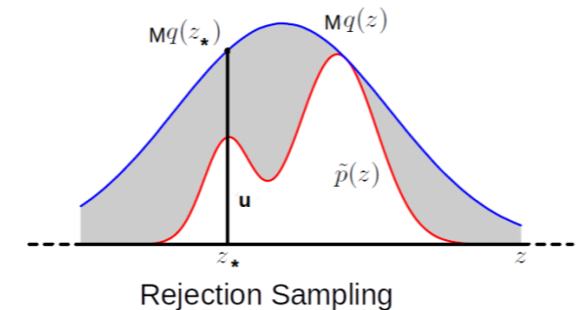
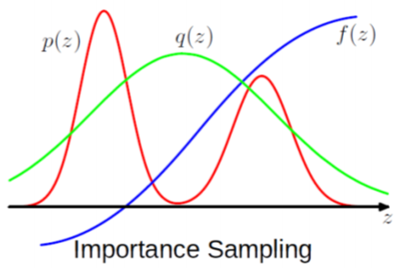
Limitations of the Basic Methods
19
Transformation based methods: Usually limited to drawing from standard distributions
Rejection Sampling and Importance Sampling: Require good proposal distributions
In general, difficult to find good prop. distr. especially when $z$ is high-dim
More sophisticated sampling methods like MCMC work well in such high-dim spaces
$$𝔼\left[f\right]≈\frac{1}{L}\sum_{ℓ=1}^{L}{f(z^{(ℓ)})}\frac{p\left(z^{(ℓ)}\right)}{q\left(z^{(ℓ)}\right)}$$
$q(z)$ should be such that $Mq(z)$ envelopes $\tilde{p}(z)$ everywhere
Ideally, would like $q(z)$ to give samples from where $p(z)$ is large or $f(z)p(z)$ is large
Difficult to guarantee so if $z$ is high-dimensional

Slide 20
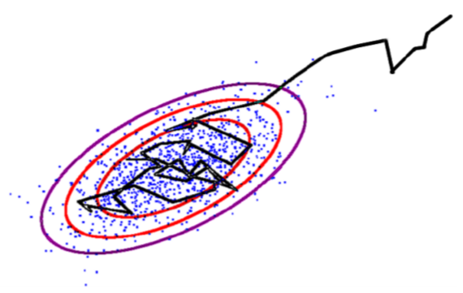
Markov Chain Monte Carlo (MCMC)
20
If the target is a posterior, it will be conditioned on data, i.e., $p(z|x)$
Goal: Generate samples from some target distribution $p\left(z\right)= \frac{\tilde{p}(z)}{Z_{p}}$
Assume we can evaluate $p(z)$ at least up to a proportionality constant
MCMC uses a Markov Chain which, when converged, starts giving samples from $p(z)$
Given current sample $z^{(ℓ)}$ from the chain, MCMC generates the next sample $z^{(ℓ+1)}$ as
Use a proposal distribution $q(z|z^{(ℓ)})$ to generate a candidate sample $z_{∗}$
Accept/reject $z_{∗}$ as the next sample based on an acceptance criterion (will see later)
If accepted, set $z^{(ℓ+1)}=z_{∗}$. If rejected, set $z^{(ℓ+1)}$ = $z^{(ℓ)}$
Important: The proposal distribution $q(z|z^{(ℓ)})$ depends on the previous sample $z^{(ℓ)}$
$z$ usually is high-dim
Means we can at least evaluate $\tilde{p}(z)$
Should also have the same support as $p(z)$

Slide 21
MCMC: The Basic Scheme
21
The chain run infinitely long (i.e., upon convergence) will give ONE sample from $p\left(z\right)$
But we usually require several samples to approximate $p\left(z\right)$
This is done as follows
Start the chain at an initial $z^{(0)}$
Using the proposal $q(z|z^{(ℓ)})$, run the chain long enough, say $T_{1}$ steps
Discard the first $T_{1}−1$ samples (called “burn-in” samples) and take last sample $z^{(T_{1})}$
Continue from $z^{(T_{1})}$ up to $T_{2}$ steps, discard intermediate samples, take last sample $z^{(T_{2})}$
This discarding (called “thinning”) helps ensure that $z^{(T_{1})}$ and $z^{(T_{2})}$ are uncorrelated
Repeat the same for a total of $S$ times
In the end, we now have $S$ approximately independent samples from $p\left(z\right)$
Note: Good choices for $T_{1}$ and $T_{i}−T_{i−1}$(thinning gap) are usually based on heuristics
MCMC is exact in theory but approximate in practice since we can’t run the chain for infinitely long in practice
Thus we say that the samples are approximately from the target distribution
Will treat it as our first sample from $p(z)$
Requirement for Monte Carlo approximation

