Slide 1
Variational Inference (contd)
CS772A: Probabilistic Machine Learning
Piyush Rai

Slide 2
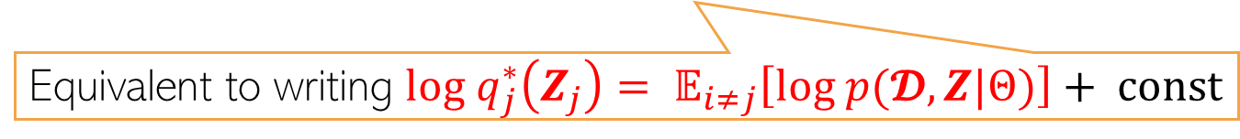
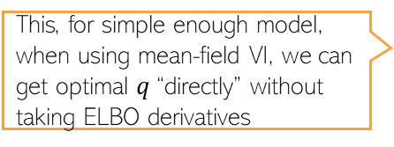

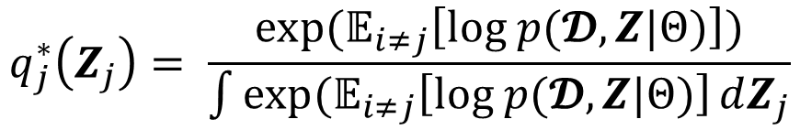
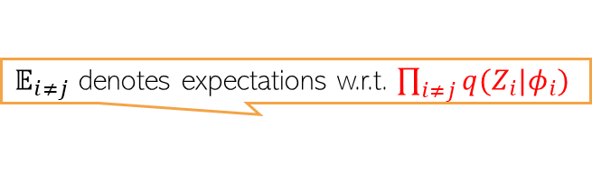
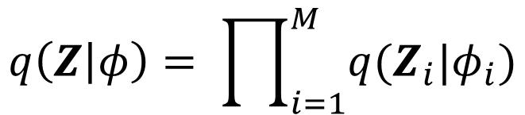


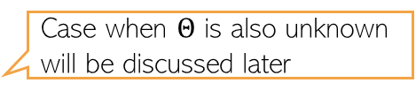
Recap: Variational Inference (VI)
2
Variational distribution
Variational parameters
Assuming $p(Z|𝓓,Θ)$ is intractable, VI approximates it by a distr $q(Z|φ)$ or $q_{φ}(Z)$
KL minimization
$$φ^{∗}= {argmin}_{φ} KL[q_{φ}(Z)||p(Z|𝓓,Θ)]$$
ELBO maximization
$$φ^{∗}={argmax}_{φ}𝔼_{q_{φ}(Z)}[log p(𝓓|Z,Θ)]−KL[q_{φ}\left(Z\right)||p\left(Z | Θ\right)]$$
$$={argmax}_{φ}𝔼_{q_{φ}(Z)}\left[log p\left(𝓓,Z | Θ\right)−log q_{φ}\left(Z\right)\right]$$
$={argmax}_{φ}$ $ℒ\left(φ, Θ\right)$
Can use gradient-based optimization to learn the parameters of the variational distribution
$$φ_{t+1}=φ_{t}+η_{t} ∇_{φ=φ_{t}}ℒ\left(φ, Θ\right)$$
Case when $Θ$ is also unknown will be discussed later
$𝔼_{i≠j}$ denotes expectations w.r.t. $\prod_{i≠j}{q(Z_{i}|φ_{i})}$
Mean-field assumption on the variational distribution
$$q\left(Z | φ\right)= \prod_{i=1}^{M}{q(Z_{i}|φ_{i})}$$
$$q_{j}^{∗}\left(Z_{j}\right)= \frac{exp(𝔼_{i≠j}\left[log p(𝓓,Z|Θ)\right])}{\int{exp(𝔼_{i≠j}\left[log p(𝓓,Z|Θ)\right]}dZ_{j}}$$
This, for simple enough model, when using mean-field VI, we can get optimal $q$“directly” without taking ELBO derivatives
Equivalent to writing $log q_{j}^{∗}\left(Z_{j}\right)= 𝔼_{i≠j}\left[log p(𝓓,Z|Θ)\right]+ const$
“simple enough” means the cases where these expectations can be analytically computed

Slide 3
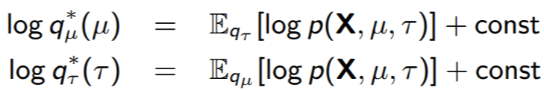
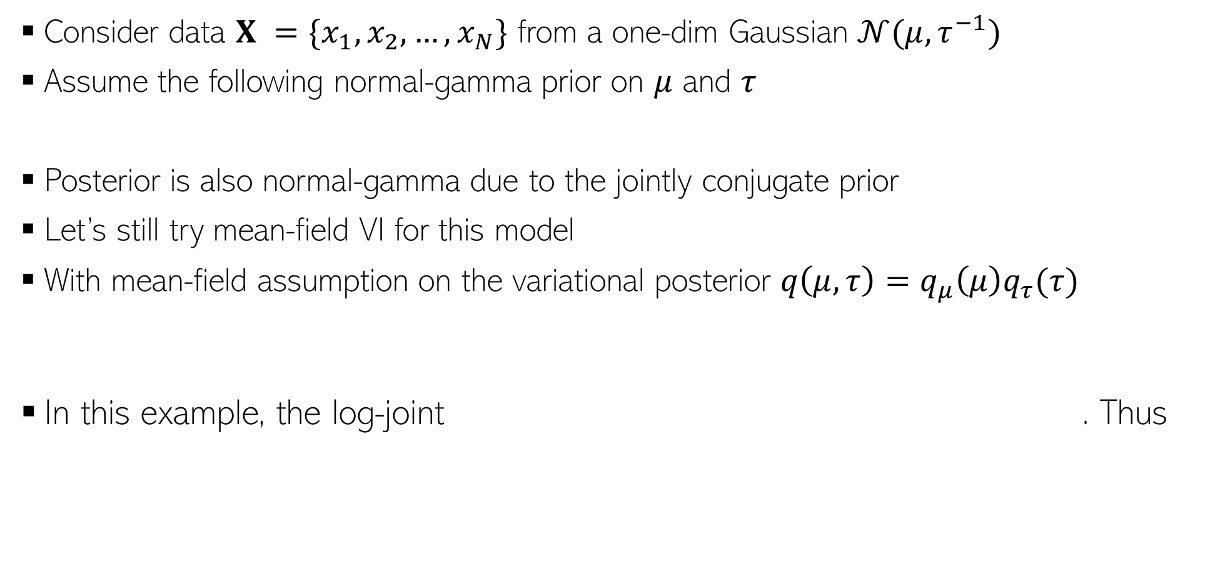
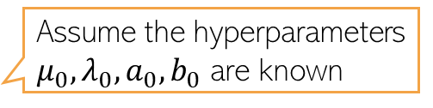
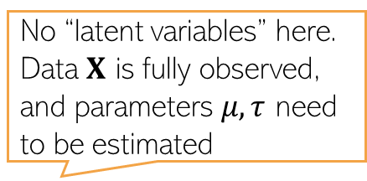
Example: Mean-field VI without ELBO Derivatives
No “latent variables” here. Data $X$ is fully observed, and parameters $μ, τ$ need to be estimated
3
Consider data $X =\{x_{1},x_{2},…, x_{N}\}$ from a one-dim Gaussian $𝒩(μ, τ^{−1})$
Assume the following normal-gamma prior on $μ$ and $τ$
Posterior is also normal-gamma due to the jointly conjugate prior
Let’s still try mean-field VI for this model
With mean-field assumption on the variational posterior $q\left(μ, τ\right)=q_{μ}\left(μ\right)q_{τ}(τ)$
In this example, the log-joint . Thus
Assume the hyperparameters $μ_{0},λ_{0},a_{0},b_{0}$ are known
Note that we aren’t even specifying the forms of these two distributions! We’ll be able identify the forms in a few steps after working with the expectations

Slide 4
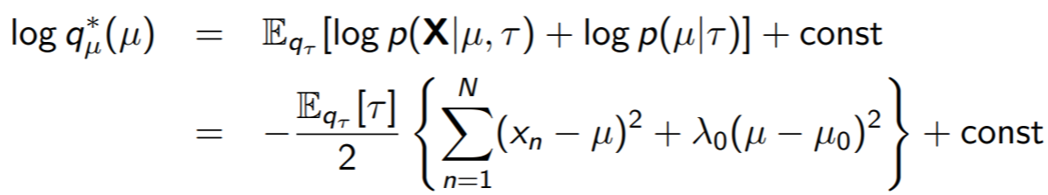
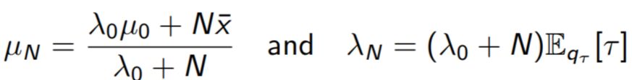
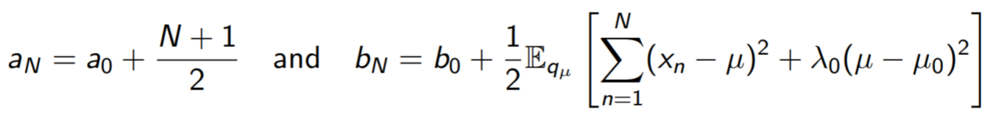



Example: Mean-field VI without ELBO Derivatives
4
Substituting $p\left(X | μ, τ\right)= \prod_{n=1}^{N}{p(x_{n}|μ, τ)}$ and $p(μ|τ)$, we get
(Verify) The above is log of a Gaussian. This $q_{μ}^{∗}=𝒩(μ|μ_{N},λ_{N}^{−1})$ with
Proceeding in a similar way (verify), we can show that $q_{τ}^{∗}=Gamma(τ|a_{N},b_{N})$
Note: Updates of $q_{μ}^{∗}$ and $q_{τ}^{∗}$ depend on each other (hence alternating updates needed)
This update depends on $q_{τ}$
This update depends on $q_{μ}$

Slide 5
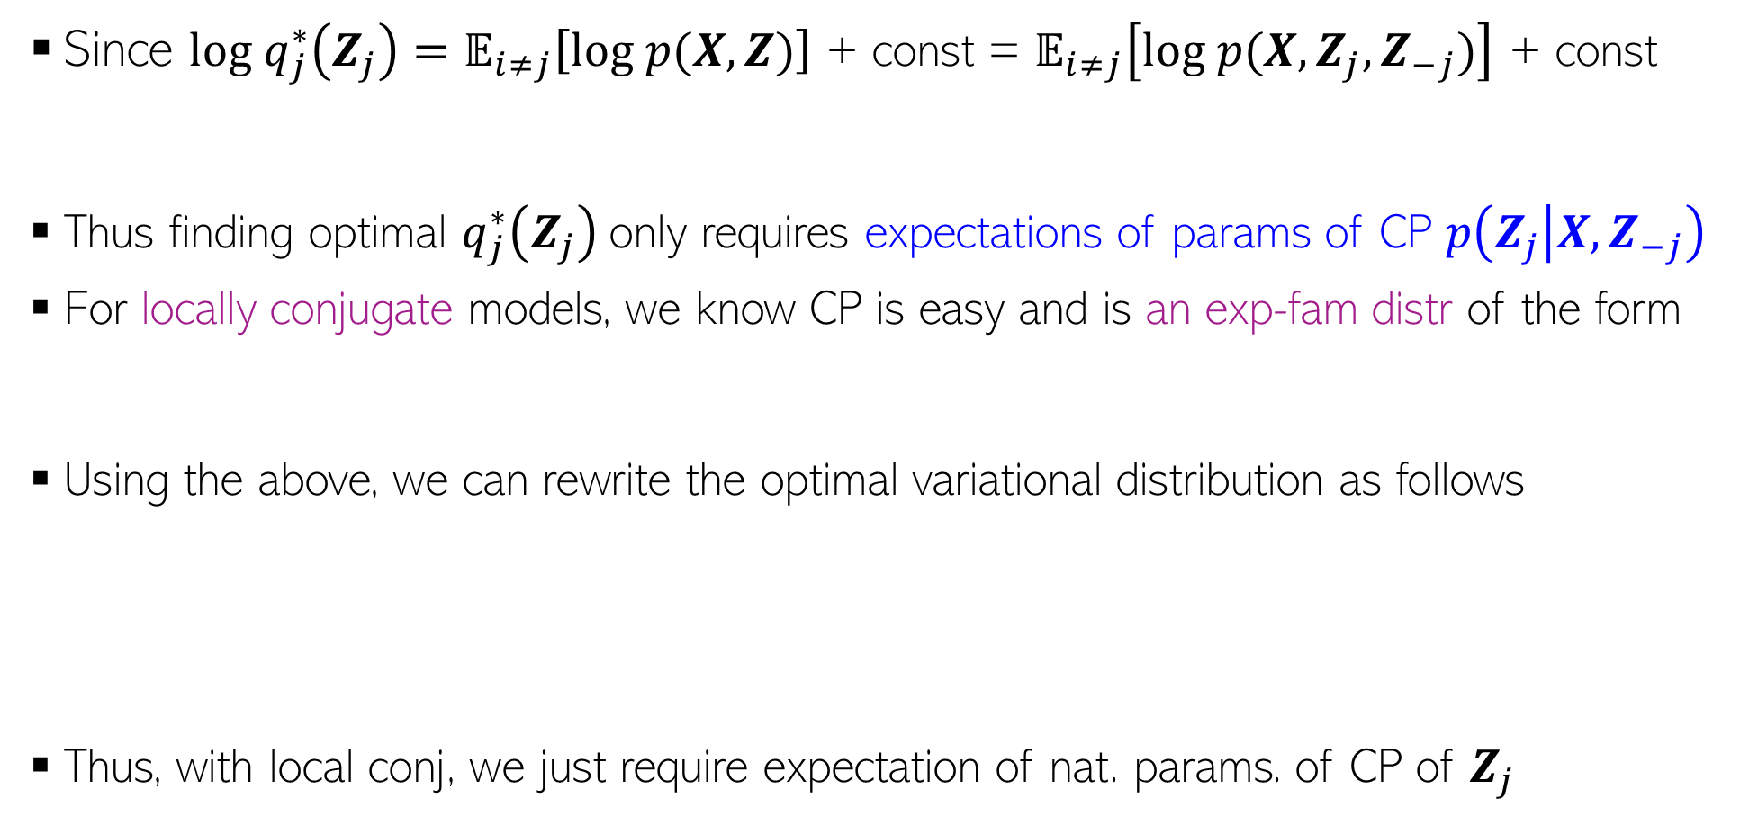
Mean-Field VI for Locally Conjugate Models
5
Since $log q_{j}^{∗}\left(Z_{j}\right)=𝔼_{i≠j}\left[log p(X,Z)\right]$ + const = $𝔼_{i≠j}\left[log p(X,Z_{j},Z_{−j})\right]$ + const
Thus finding optimal $q_{j}^{∗}\left(Z_{j}\right)$only requires expectations of params of CP $p\left(Z_{j} | X,Z_{−j}\right)$
For locally conjugate models, we know CP is easy and is an exp-fam distr of the form
Using the above, we can rewrite the optimal variational distribution as follows
Thus, with local conj, we just require expectation of nat. params. of CP of $Z_{j}$
For any model

Slide 6
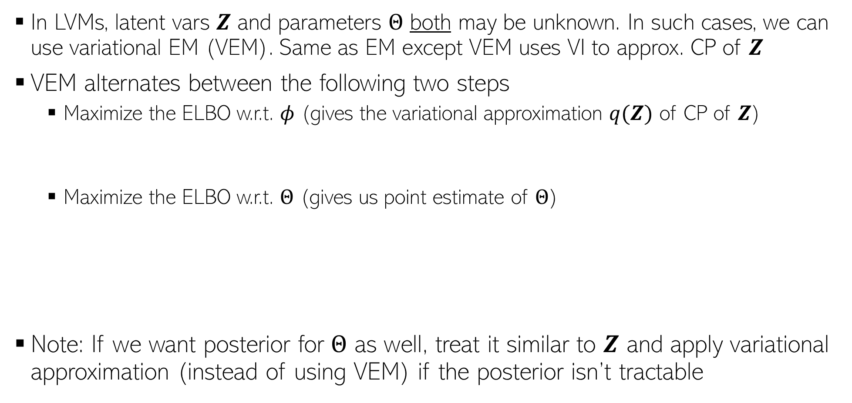

Variational EM
6
In LVMs, latent vars $Z$ and parameters $Θ$ both may be unknown. In such cases, we can use variational EM (VEM). Same as EM except VEM uses VI to approx. CP of $Z$
VEM alternates between the following two steps
  Maximize the ELBO w.r.t. $φ$ (gives the variational approximation $q(Z)$ of CP of $Z$)
  Maximize the ELBO w.r.t. $Θ$ (gives us point estimate of $Θ$)
Note: If we want posterior for $Θ$ as well, treat it similar to $Z$ and apply variational approximation (instead of using VEM) if the posterior isn’t tractable
$$φ^{(t)}= {argmax}_{φ} 𝔼_{q_{φ}(Z)}\left[log p\left(𝓓,Z | Θ^{(t−1)}\right)−log q_{φ}\left(Z\right)\right]$$
$$Θ^{(t)}= {argmax}_{Θ} 𝔼_{q_{φ^{(t)}}(Z)}\left[log p\left(𝓓,Z | Θ\right)−log q_{φ^{(t)}}\left(Z\right)\right]$$
$$= {argmax}_{Θ} 𝔼_{q_{φ^{(t)}}(Z)}\left[log p\left(𝓓,Z | Θ\right)\right]$$
This looks very similar to the expected CLL with the CP replaced by its variational approximation

Slide 7
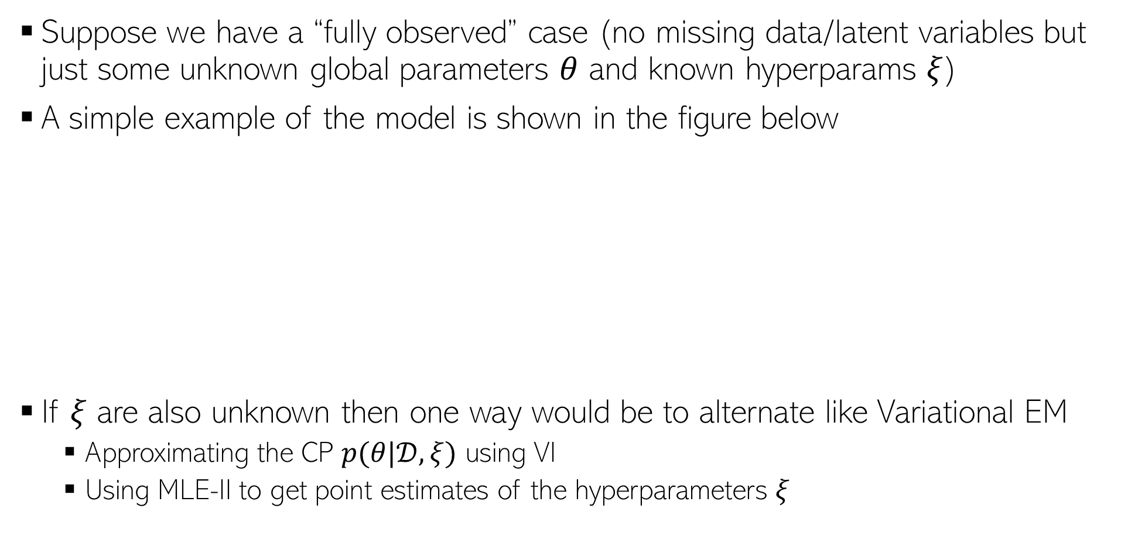

VI for models without “latent variables”
7
Recall the Gaussian mean and variance estimation problem
Suppose we have a “fully observed” case (no missing data/latent variables but just some unknown global parameters $θ$ and known hyperparams $ξ$)
A simple example of the model is shown in the figure below
If $ξ$ are also unknown then one way would be to alternate like Variational EM
  Approximating the CP $p(θ|𝒟,ξ)$ using VI
  Using MLE-II to get point estimates of the hyperparameters $ξ$
Even supervised learning problems may have this form with $θ$ being the weights of the generative/discriminative models and the models may not have any missing data or latent variables
If this CP is intractable, we can use VI to approximate this

Slide 8
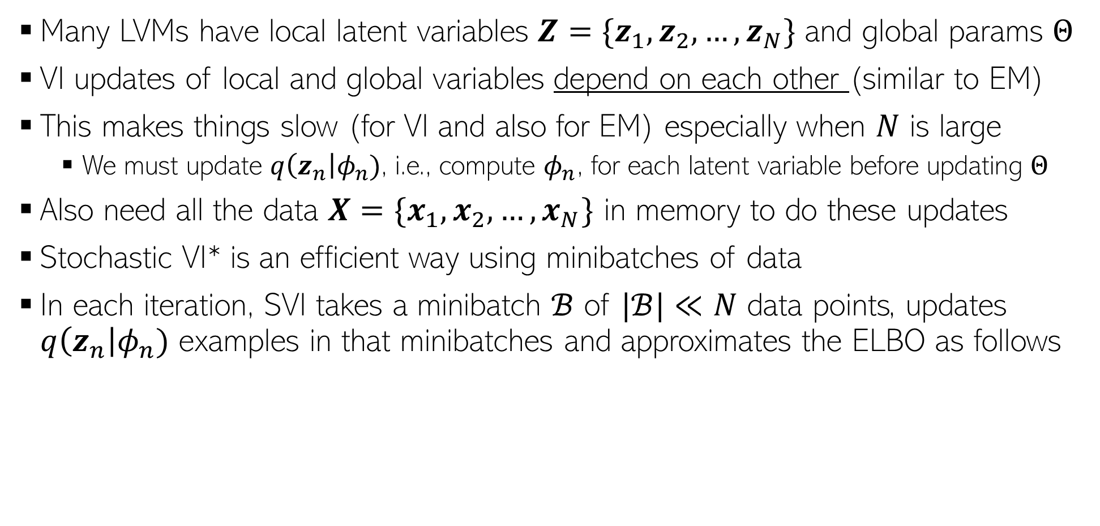
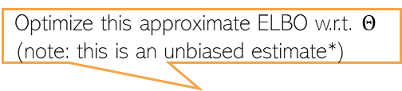
Making VI Faster for LVMs: Stochastic VI (SVI)
8
Many LVMs have local latent variables $Z=\{z_{1},z_{2},…, z_{N}\}$ and global params $Θ$
VI updates of local and global variables depend on each other (similar to EM)
This makes things slow (for VI and also for EM) especially when $N$ is large
  We must update $q\left(z_{n}\right|φ_{n})$, i.e., compute $φ_{n}$, for each latent variable before updating $Θ$
Also need all the data $X=\{x_{1},x_{2},…, x_{N}\}$ in memory to do these updates
Stochastic VI* is an efficient way using minibatches of data
In each iteration, SVI takes a minibatch $ℬ$ of $|ℬ|≪N$ data points, updates $q\left(z_{n}\right|φ_{n})$ examples in that minibatches and approximates the ELBO as follows
Optimize this approximate ELBO w.r.t. $Θ$ (note: this is an unbiased estimate*)
$$\tilde{ℒ}\left(φ, Θ\right)= \frac{N}{B}\sum_{x_{i}∈ℬ}{𝔼_{q(z_{i}|φ_{i})}[log p(x_{i}|z_{i},Θ)]−KL[q_{φ}\left(z_{i}\right)||p\left(z_{i} | Θ\right)]}$$
*Stochastic Variational Inference (Hoffman et al, 2013)

Slide 9
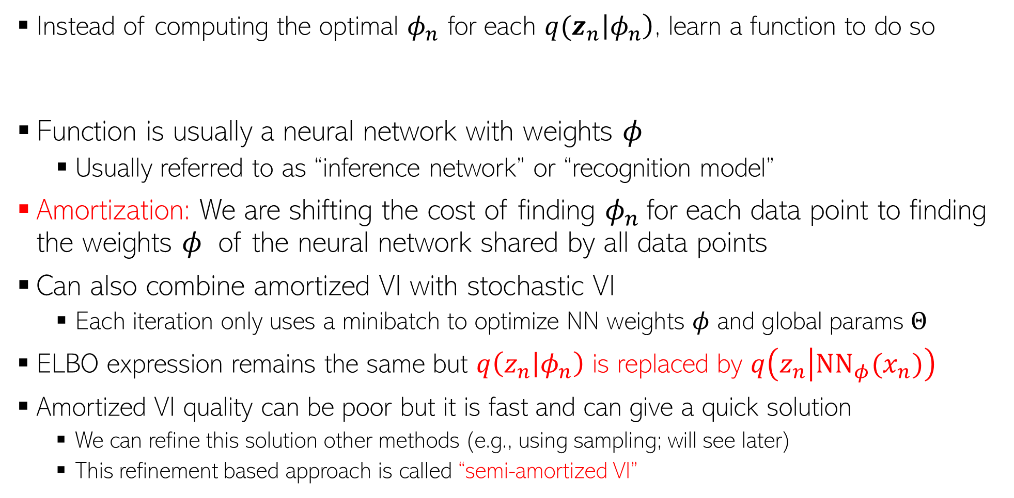
Making VI Faster for LVMs: Amortized VI
9
Instead of computing the optimal $φ_{n}$ for each ${q(z}_{n}\left|φ_{n}\right)$, learn a function to do so
Function is usually a neural network with weights $φ$
  Usually referred to as “inference network” or “recognition model”
Amortization: We are shifting the cost of finding $φ_{n}$for each data point to finding the weights $φ$ of the neural network shared by all data points
Can also combine amortized VI with stochastic VI
  Each iteration only uses a minibatch to optimize NN weights $φ$ and global params $Θ$
ELBO expression remains the same but $q\left(z_{n} | φ_{n}\right)$ is replaced by $q\left(z_{n} | {NN}_{φ}(x_{n})\right)$
Amortized VI quality can be poor but it is fast and can give a quick solution
  We can refine this solution other methods (e.g., using sampling; will see later)
  This refinement based approach is called “semi-amortized VI”

Slide 10
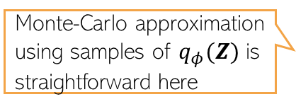
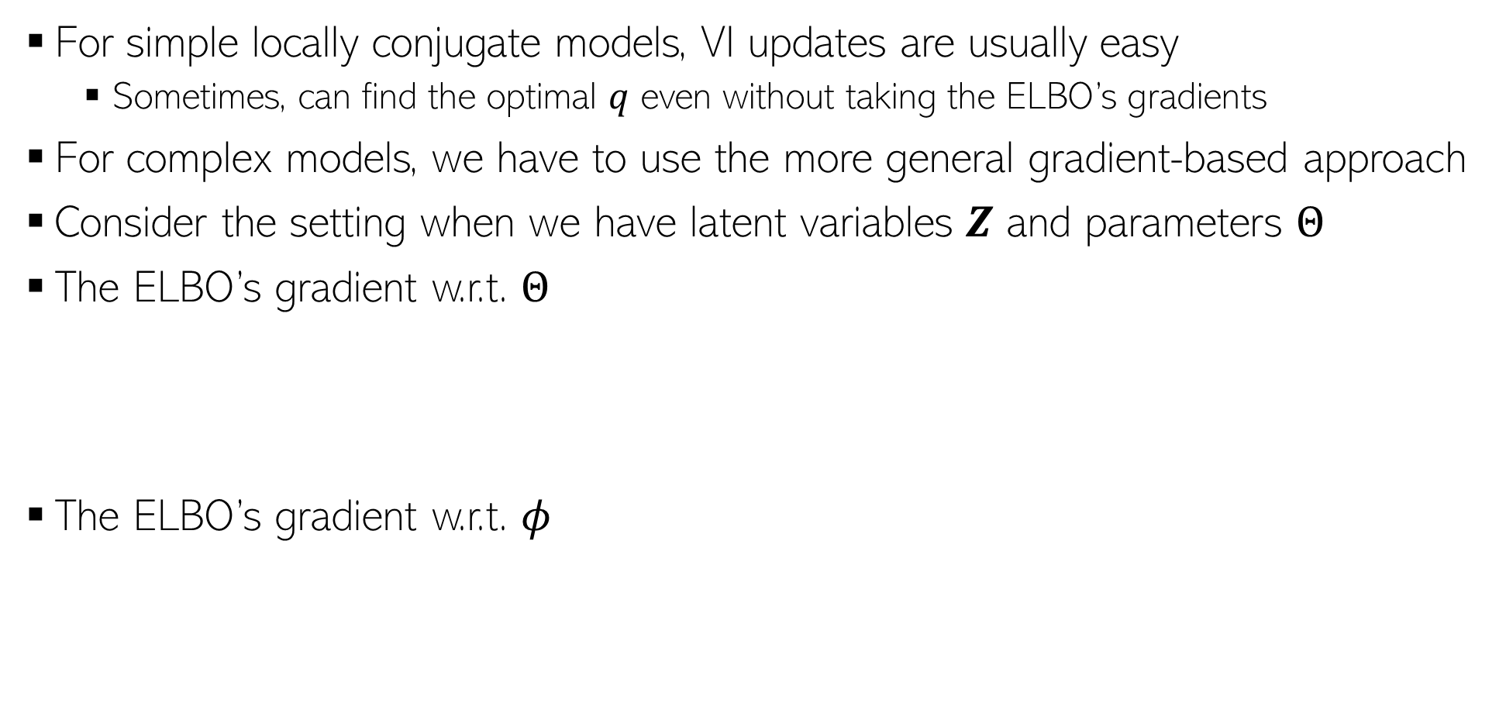
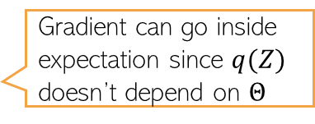
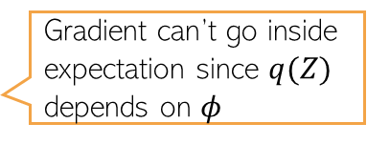
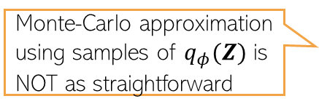
VI using ELBO’s gradients
10
For simple locally conjugate models, VI updates are usually easy
  Sometimes, can find the optimal $q$ even without taking the ELBO’s gradients
For complex models, we have to use the more general gradient-based approach
Consider the setting when we have latent variables $Z$ and parameters $Θ$
The ELBO’s gradient w.r.t. $Θ$
The ELBO’s gradient w.r.t. $φ$
$$∇_{Θ}ℒ\left(φ, Θ\right)=∇_{Θ} 𝔼_{q_{φ}(Z)}[log p\left(𝓓,Z | Θ\right)−log q_{φ}\left(Z\right)]$$
Gradient can go inside expectation since $q(Z)$ doesn’t depend on $Θ$
Monte-Carlo approximation using samples of $q_{φ}(Z)$ is straightforward here
$$=𝔼_{q_{φ}(Z)}\left[∇_{Θ} \left\{log p\left(𝓓,Z | Θ\right)−log q_{φ}\left(Z\right)\right\}\right]$$
$$∇_{φ}ℒ\left(φ, Θ\right)=∇_{φ} 𝔼_{q_{φ}(Z)}[log p\left(𝓓,Z | Θ\right)−log q_{φ}\left(Z\right)]$$
Gradient can’t go inside expectation since $q(Z)$ depends on $φ$
Monte-Carlo approximation using samples of $q_{φ}(Z)$ is NOT as straightforward
$$≠𝔼_{q_{φ}(Z)}\left[∇_{φ} \left\{log p\left(𝓓,Z | Θ\right)−log q_{φ}\left(Z\right)\right\}\right]$$

Slide 11
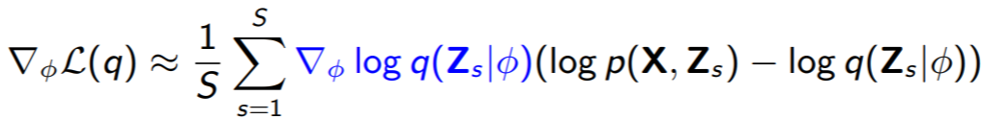
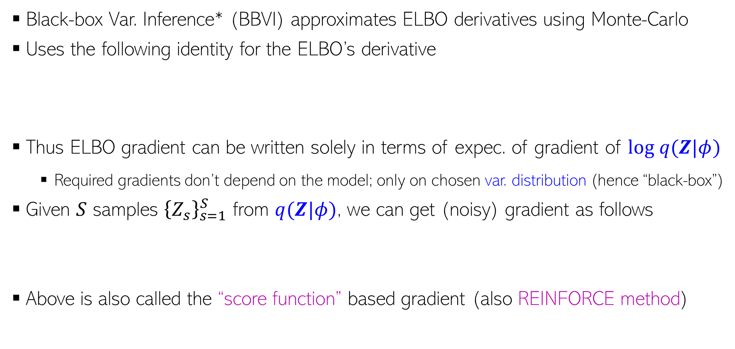
Black-Box Variational Inference (BBVI)
11
Black-box Var. Inference* (BBVI) approximates ELBO derivatives using Monte-Carlo
Uses the following identity for the ELBO’s derivative
Thus ELBO gradient can be written solely in terms of expec. of gradient of $log q(Z|φ)$
  Required gradients don’t depend on the model; only on chosen var. distribution (hence “black-box”)
Given $S$ samples ${\left\{Z_{s}\right\}}_{s=1}^{S}$ from $q(Z|φ)$, we can get (noisy) gradient as follows
Above is also called the “score function” based gradient (also REINFORCE method)
Gradient of a log-likelihood or log-probability function w.r.t. its params is called score function; hence the name
∗Black Box Variational Inference - Ranganath et al (2014)

Slide 12
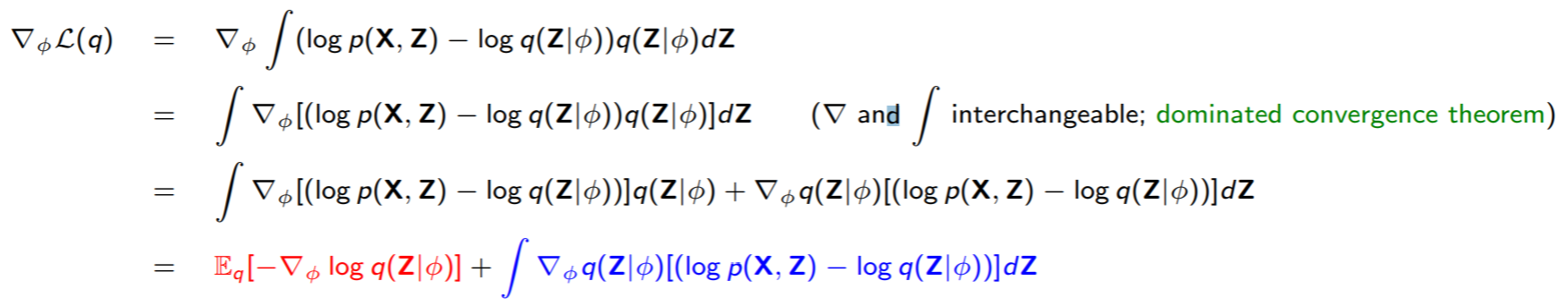

Proof of BBVI Identity
12
The ELBO gradient can be written as
Note that
Also note that , using which
Therefore

Slide 13
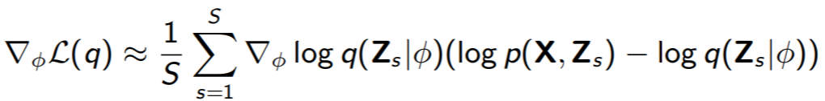
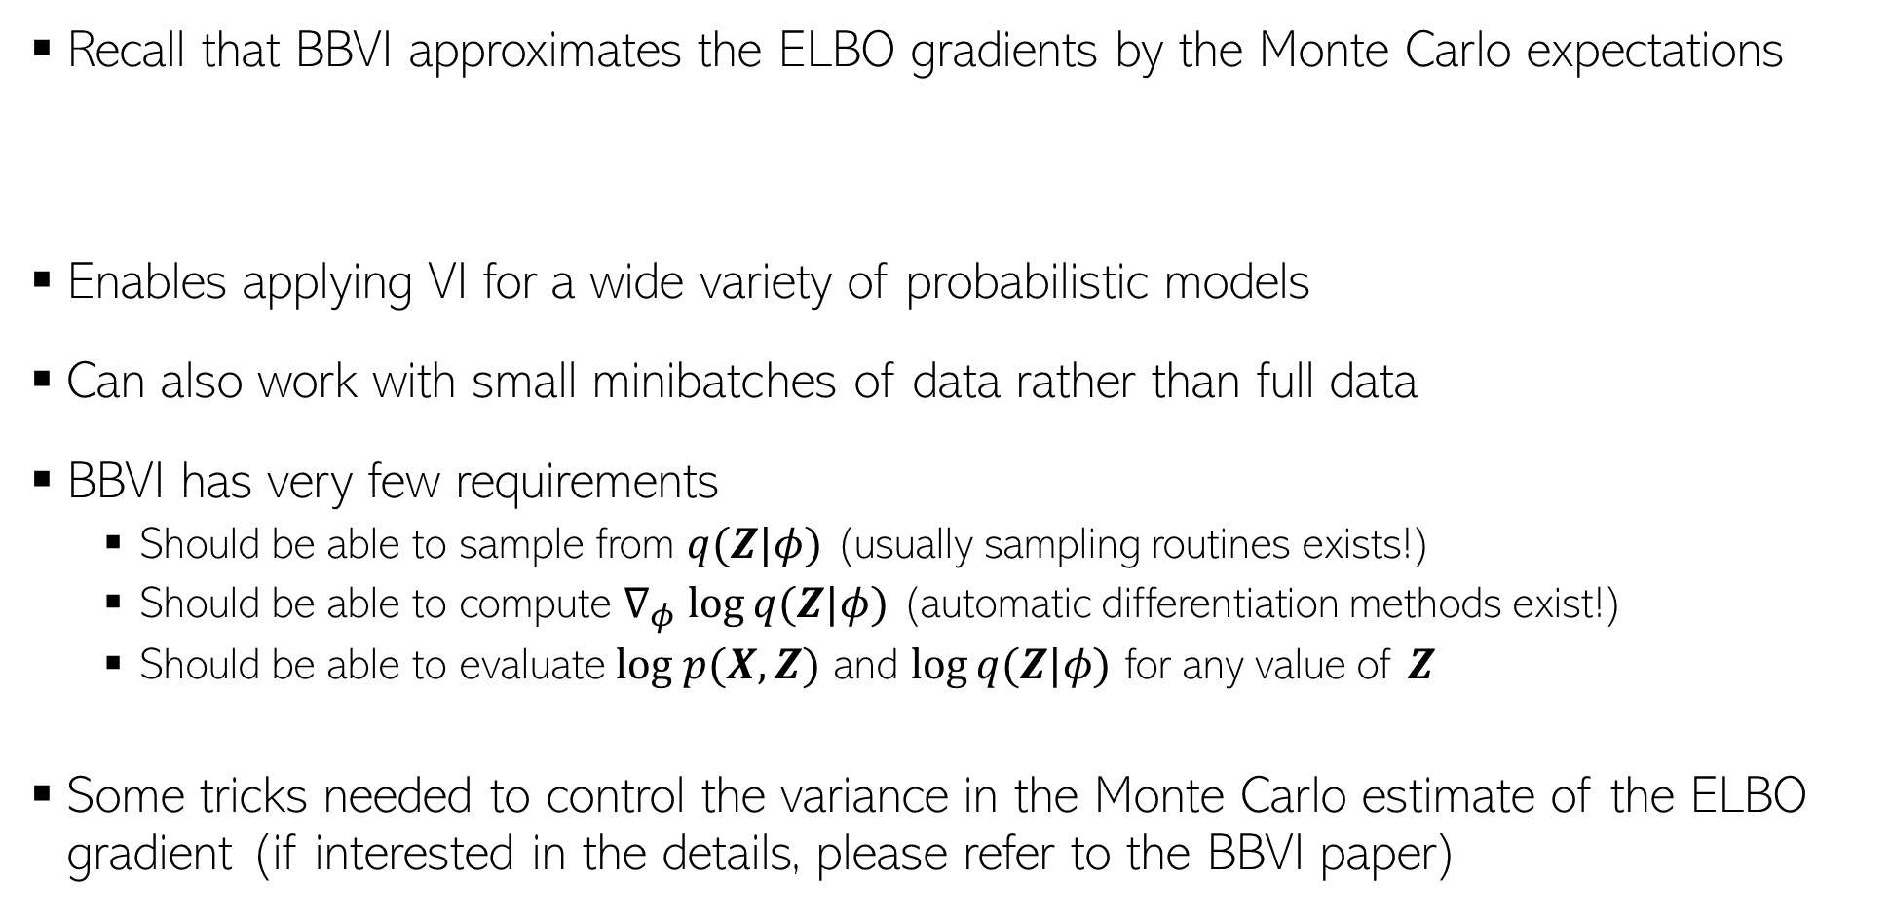
Benefits of BBVI
13
Recall that BBVI approximates the ELBO gradients by the Monte Carlo expectations
Enables applying VI for a wide variety of probabilistic models
Can also work with small minibatches of data rather than full data
BBVI has very few requirements
  Should be able to sample from $q(Z|φ)$ (usually sampling routines exists!)
  Should be able to compute $∇_{φ} log⁡q(Z|φ)$ (automatic differentiation methods exist!)
  Should be able to evaluate $log p(X, Z)$ and $log⁡q(Z|φ)$ for any value of $Z$
Some tricks needed to control the variance in the Monte Carlo estimate of the ELBO gradient (if interested in the details, please refer to the BBVI paper)

Slide 14


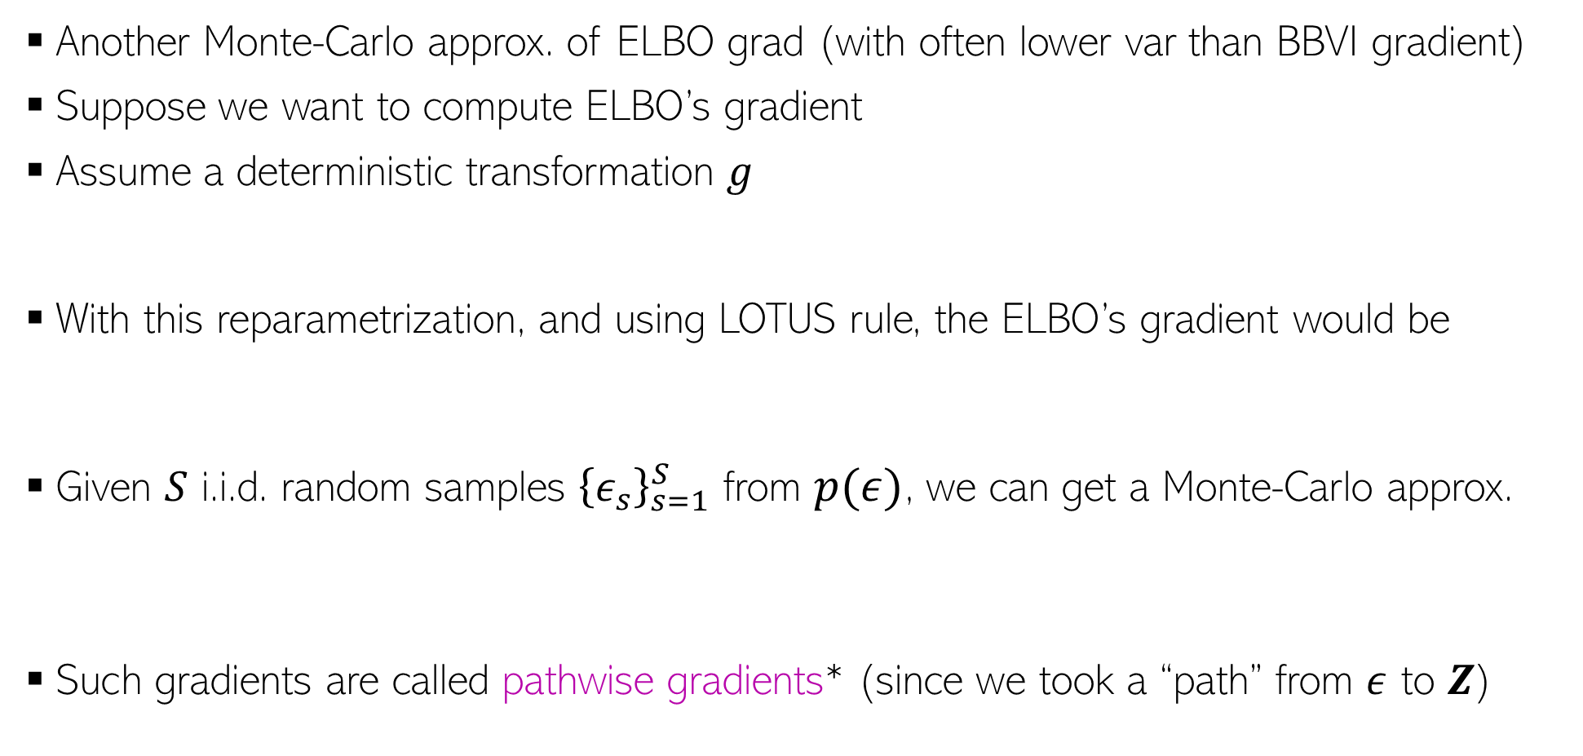
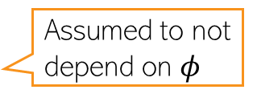
Reparametrization Trick
14
Another Monte-Carlo approx. of ELBO grad (with often lower var than BBVI gradient)
Suppose we want to compute ELBO’s gradient
Assume a deterministic transformation $g$
With this reparametrization, and using LOTUS rule, the ELBO’s gradient would be
Given $S$ i.i.d. random samples ${\left\{ε_{s}\right\}}_{s=1}^{S}$ from $p(ε)$, we can get a Monte-Carlo approx.
Such gradients are called pathwise gradients* (since we took a “path” from $ε$ to $Z$)
Assumed to not depend on $φ$
$$Z=g(ε, φ)$$
where
$$ε∼p(ε)$$
*Autoencoding Variational Bayes - Kingma and Welling (2013), Stochastic Backpropagation and Approximate Inference in Deep Generative Models- Rezende et al (2014)

Slide 15
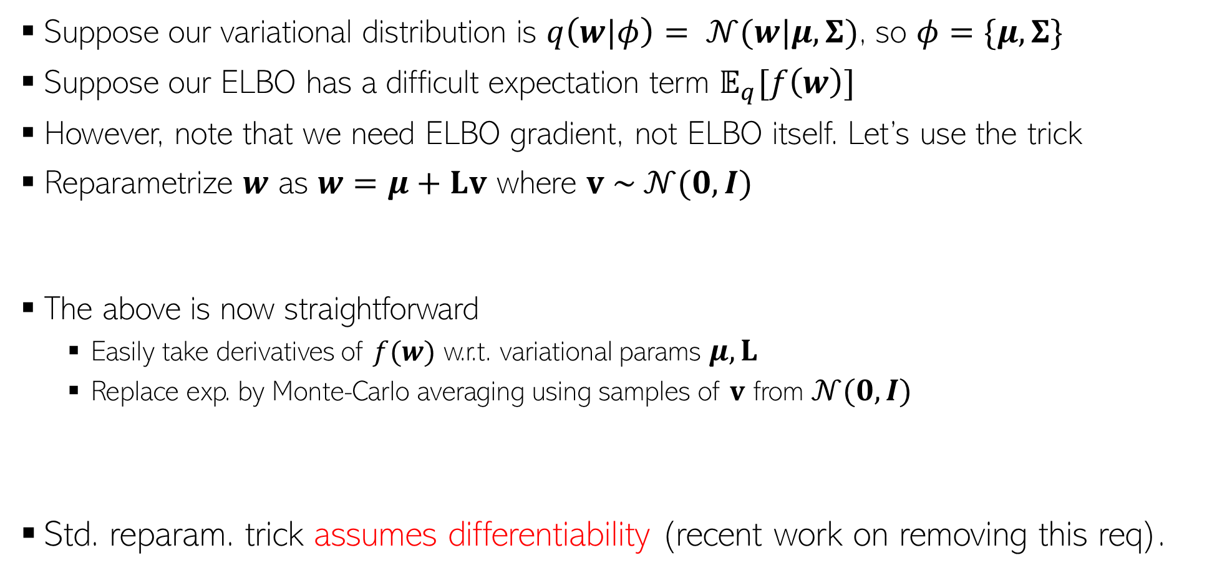
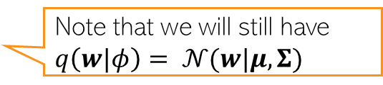

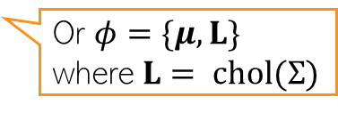

Reparametrization Trick: An Example
15
Suppose our variational distribution is $q\left(w|φ\right)= 𝒩(w|μ,Σ)$, so $φ=\{μ, Σ\}$
Suppose our ELBO has a difficult expectation term $𝔼_{q}[f\left(w\right)]$
However, note that we need ELBO gradient, not ELBO itself. Let’s use the trick
Reparametrize $w$ as $w=μ+Lv$ where $v \sim 𝒩(0,I)$
The above is now straightforward
  Easily take derivatives of $f(w)$ w.r.t. variational params $μ, L$
  Replace exp. by Monte-Carlo averaging using samples of $v$ from $𝒩(0,I)$
Std. reparam. trick assumes differentiability (recent work on removing this req).
Or $φ=\{μ, L\}$ where $L= chol(Σ)$
Note that we will still have $q\left(w|φ\right)= 𝒩(w|μ,Σ)$
Often even one or very few samples suffice
$$\frac{∂f}{∂w}\frac{∂w}{∂μ}$$
Chain Rule
$$\frac{∂f}{∂w}\frac{∂w}{∂L}$$
*Autoencoding Variational Bayes - Kingma and Welling (2013), Stochastic Backpropagation and Approximate Inference in Deep Generative Models- Rezende et al (2014)

Slide 16
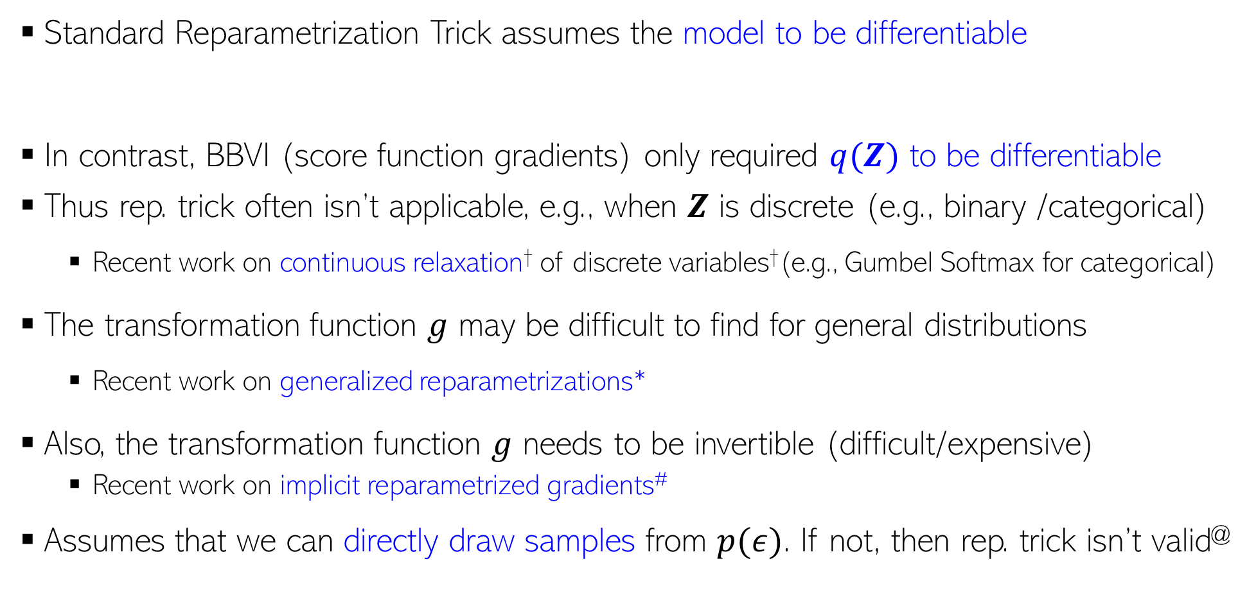
Reparametrization Trick: Some Comments
16
Standard Reparametrization Trick assumes the model to be differentiable
In contrast, BBVI (score function gradients) only required $q(Z)$ to be differentiable
Thus rep. trick often isn’t applicable, e.g., when $Z$ is discrete (e.g., binary /categorical)
  Recent work on continuous relaxation† of discrete variables†(e.g., Gumbel Softmax for categorical)
The transformation function $g$ may be difficult to find for general distributions
  Recent work on generalized reparametrizations*
Also, the transformation function $g$ needs to be invertible (difficult/expensive)
  Recent work on implicit reparametrized gradients#
Assumes that we can directly draw samples from $p(ε)$. If not, then rep. trick isn’t valid@
†Categorical Reparameterization with Gumbel-Softmax (Jang et al, 2017), ∗ The Generalized Reparameterization Gradient (Ruiz et al, 2016), # Implicit Reparameterization Gradients (Figurnov et al, 2018), @ Reparameterization Gradients through Acceptance-Rejection Sampling Algorithms (Naesseth et al, 2016)

Slide 17
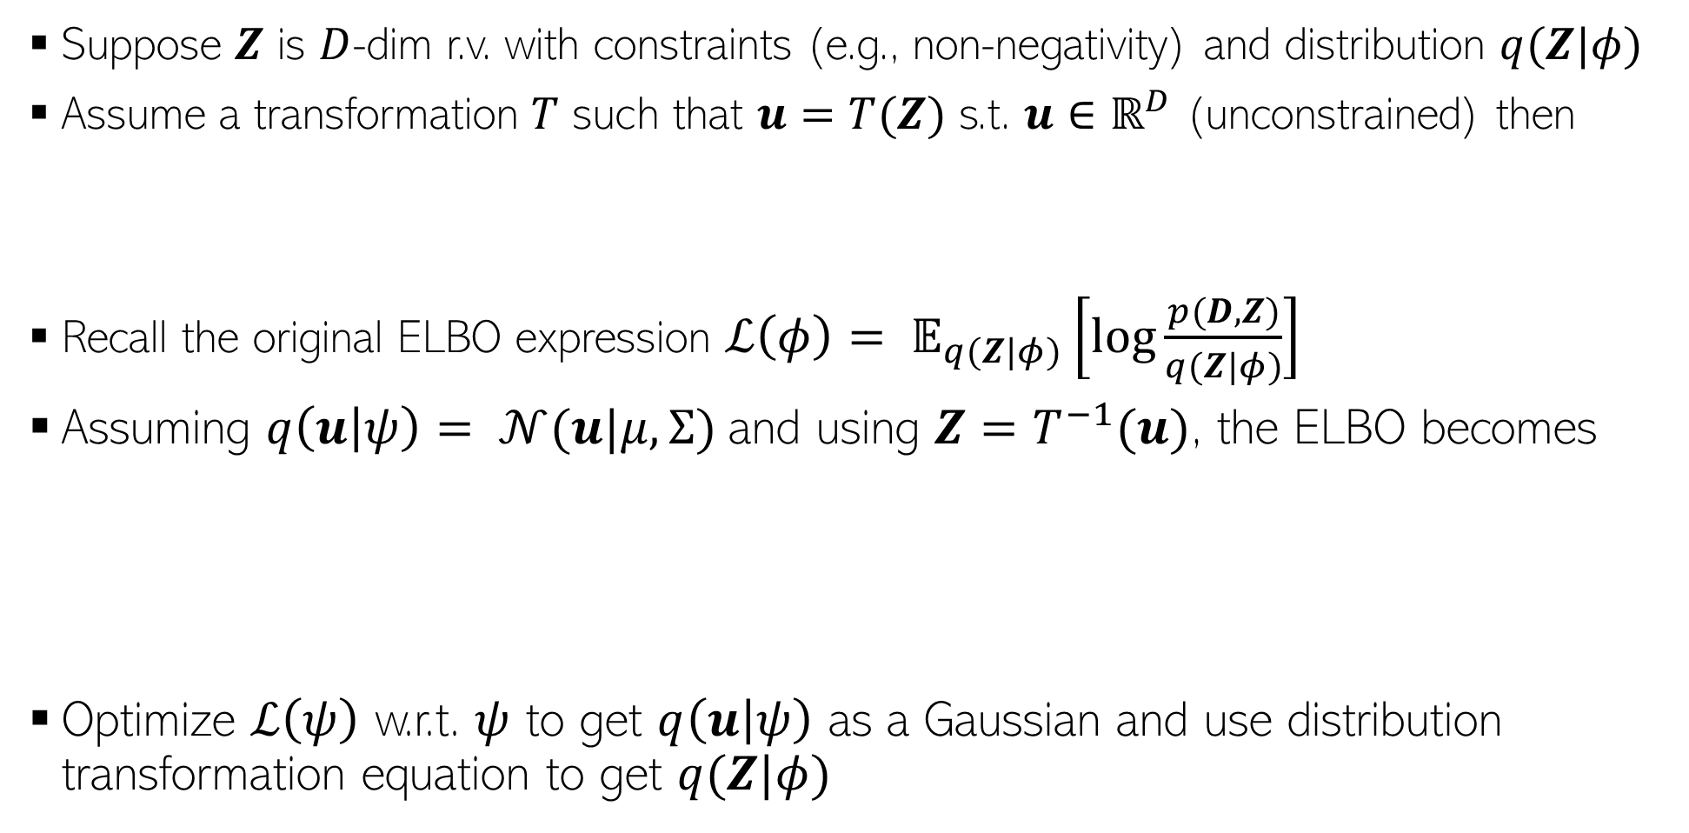
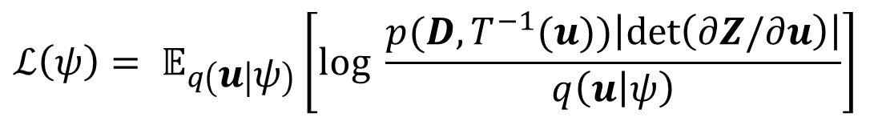
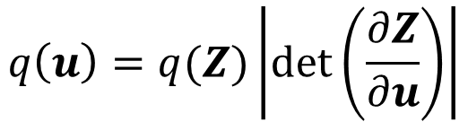
Automatic Differentiation Variational Inference
17
Suppose $Z$ is $D$-dim r.v. with constraints (e.g., non-negativity) and distribution $q(Z|φ)$
Assume a transformation $T$ such that $u=T(Z)$ s.t. $u∈ℝ^{D}$ (unconstrained) then
Recall the original ELBO expression $ℒ\left(φ\right)= 𝔼_{q(Z|φ)}\left[log\frac{p(D,Z)}{q(Z|φ)}\right]$
Assuming $q\left(u | ψ\right)= 𝒩(u|μ,Σ)$and using $Z=T^{−1}(u)$, the ELBO becomes
Optimize $ℒ\left(ψ\right)$ w.r.t. $ψ$ to get $q\left(u | ψ\right)$ as a Gaussian and use distribution transformation equation to get $q(Z|φ)$
$$q\left(u\right)=q(Z)\left|det\left(\frac{∂Z}{∂u}\right)\right|$$
$$ℒ\left(ψ\right)= 𝔼_{q\left(u | ψ\right)}\left[log \frac{p(D,T^{−1}(u))\left|det\left(∂Z/∂u\right)\right|}{q\left(u | ψ\right)}\right]$$
$$=𝔼_{q\left(u | ψ\right)}\left[log p(D,T^{−1}(u))+ log\left|det\left(∂Z/∂u\right)\right|\right]+H(q(u|ψ))$$

Slide 18
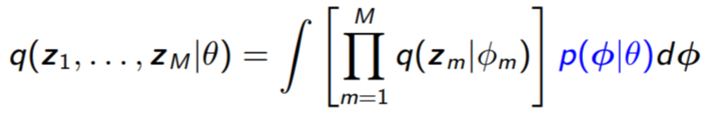
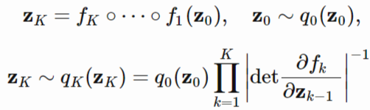
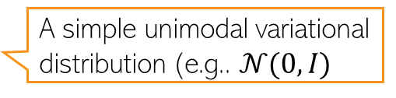
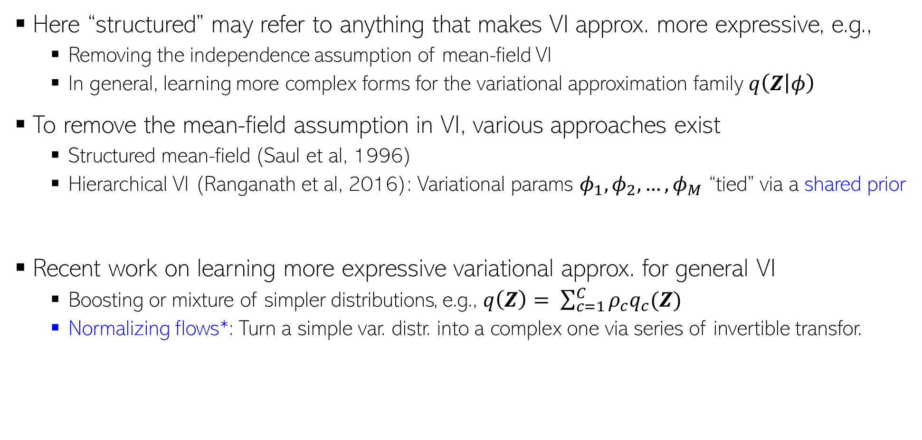
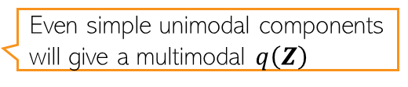
Structured Variational Inference
18
Here “structured” may refer to anything that makes VI approx. more expressive, e.g.,
  Removing the independence assumption of mean-field VI
  In general, learning more complex forms for the variational approximation family $q\left(Z | φ\right)$
To remove the mean-field assumption in VI, various approaches exist
  Structured mean-field (Saul et al, 1996)
  Hierarchical VI (Ranganath et al, 2016): Variational params $φ_{1},φ_{2},…, φ_{M}$ “tied” via a shared prior
Recent work on learning more expressive variational approx. for general VI
  Boosting or mixture of simpler distributions, e.g., $q\left(Z\right)= \sum_{c=1}^{C}{ρ_{c}q_{c}(Z)}$
  Normalizing flows*: Turn a simple var. distr. into a complex one via series of invertible transfor.
Even simple unimodal components will give a multimodal $q\left(Z\right)$
A much more complex(e.g., multimodal) variational distribution obtained via the flow idea
A simple unimodal variational distribution (e.g.. $𝒩(0,I)$
∗Variational Inference with Normalizing Flows (Rezende and Mohamed, 2015)

Slide 19
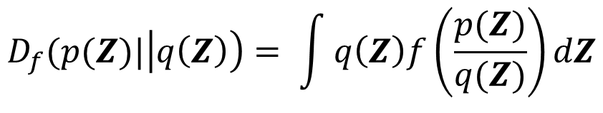
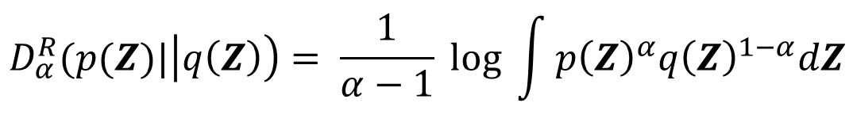
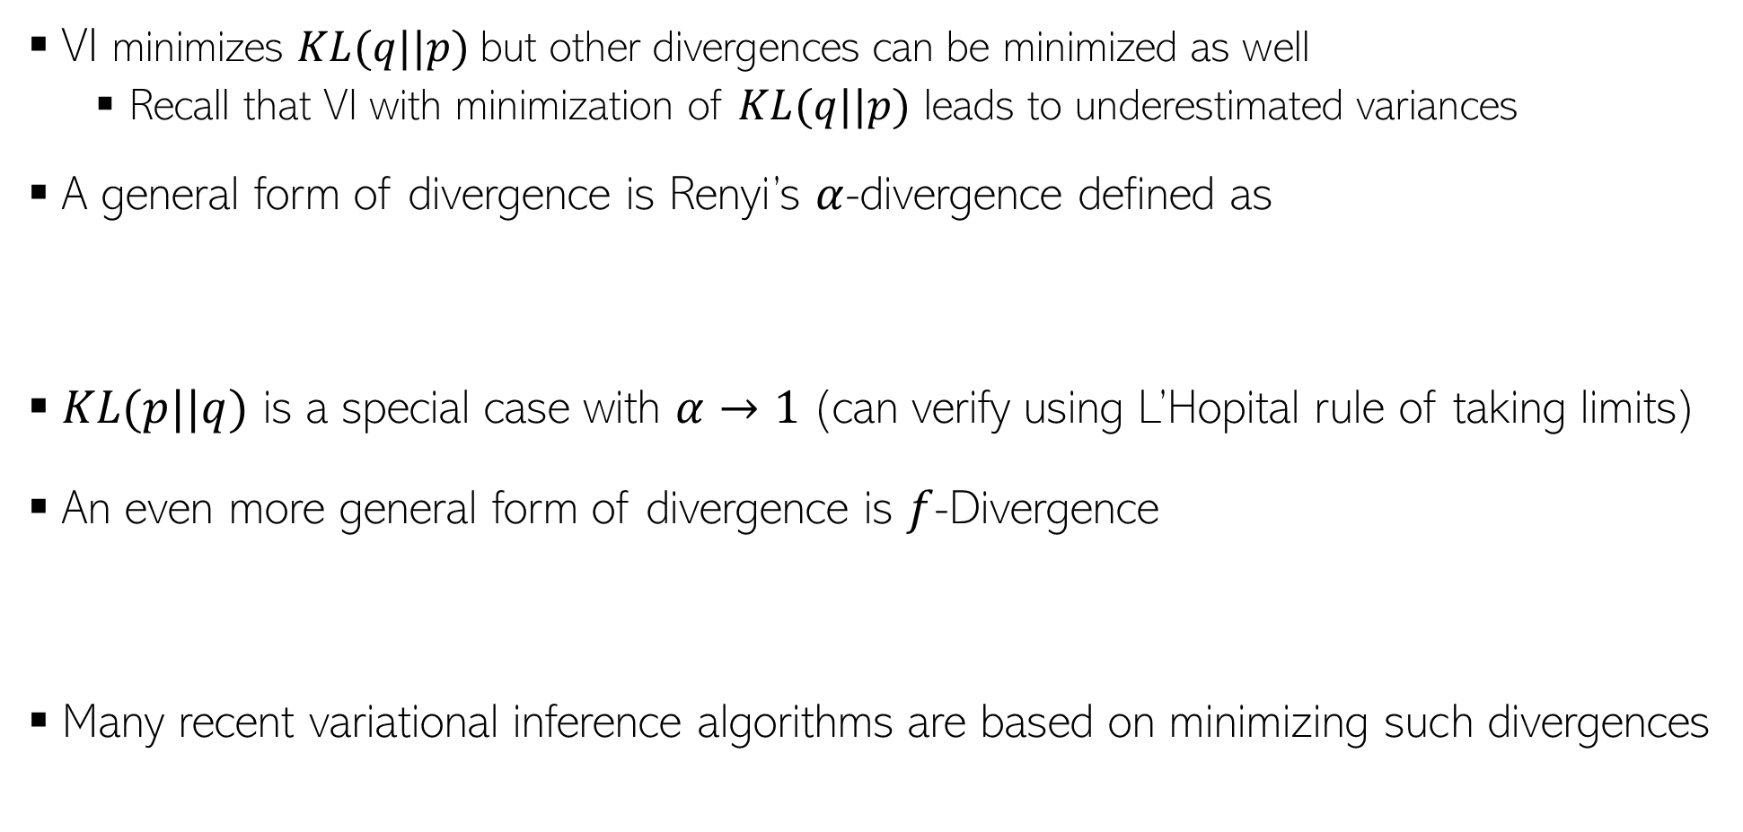
Other Divergence Measures
19
VI minimizes $KL(q||p)$but other divergences can be minimized as well
  Recall that VI with minimization of $KL(q||p)$ leads to underestimated variances
A general form of divergence is Renyi’s $α$-divergence defined as
$KL(p||q)$ is a special case with $α→1$(can verify using L’Hopital rule of taking limits)
An even more general form of divergence is $f$-Divergence
Many recent variational inference algorithms are based on minimizing such divergences
$$D_{α}^{R}(p(Z)|\left|q\left(Z\right)\right)= \frac{1}{α−1} log \int{p{\left(Z\right)}^{α}q{\left(Z\right)}^{1−α}dZ}$$
$$D_{f}(p(Z)|\left|q\left(Z\right)\right)= \int{q\left(Z\right)f\left(\frac{p(Z)}{q(Z)}\right)dZ}$$

Slide 20

Variational Inference: Some Comments
20
Many probabilistic models nowadays rely on VI to do approx. inference
Even mean-field with locally-conjugacy used in lots of models
  This + SVI gives excellent scalability as well on large datasets
Progress in various areas has made VI very popular and widely applicable
  Stochastic Optimization (e.g., SGD)
  Automatic Differentiation
  Monte-Carlo gradient of ELBO
Note: Most of these ideas apply also to Variational EM
Many VI and advanced VI algos are implemented in probabilistic prog. packages (e.g., Tensorflow Probability, PyTorch, etc), making VI easy even for complex models
Still a very active area of research, especially for doing VI in complex models
  Models with discrete latent variables
  Reducing the variance in Monte-Carlo estimate of ELBO gradients
  More expressive variational distribution for better approximation
We covered many of the threads being explored in recent work but a lot of work still being done in this area

