Slide 1
Variational Inference
CS772A: Probabilistic Machine Learning
Piyush Rai

Slide 2

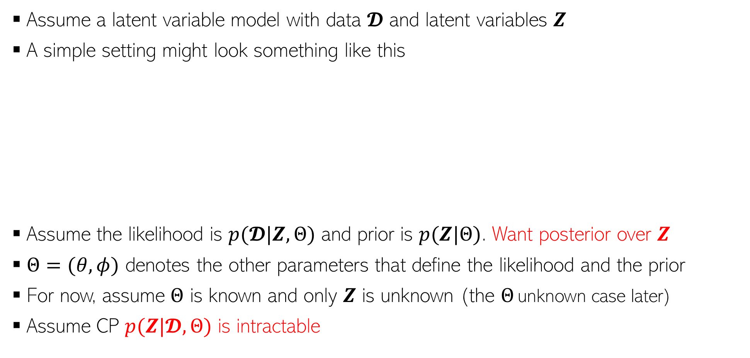




Variational Inference (VI)
2
Assume a latent variable model with data $𝓓$ and latent variables $Z$
A simple setting might look something like this
Assume the likelihood is $p(𝓓|Z,Θ)$ and prior is $p(Z|Θ)$. Want posterior over $Z$
$Θ=(θ, φ)$ denotes the other parameters that define the likelihood and the prior
For now, assume $Θ$ is known and only $Z$ is unknown (the $Θ$ unknown case later)
Assume CP $p(Z|𝓓,Θ)$ is intractable
$$θ$$
This setting is just one example. VI is applicable in more general and more complex probabilistic models with and without latent variables
$$φ$$
$$z_{n}$$
$$x_{n}$$
$$N$$

Slide 3
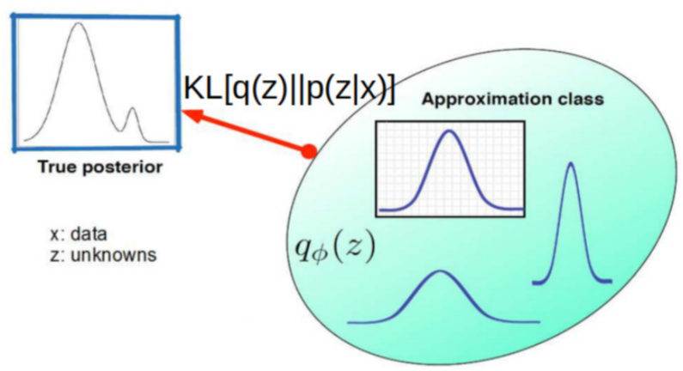


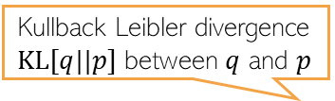
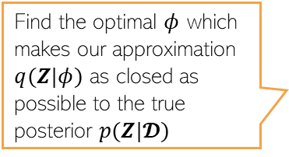
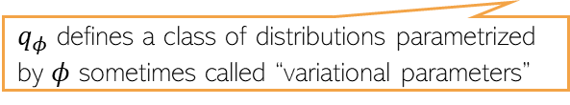
Variational Inference (VI)
3
Assuming $p(Z|𝓓,Θ)$ is intractable, VI approximates it by a distr $q(Z|φ)$ or $q_{φ}(Z)$
Kullback Leibler divergence $KL[q||p]$ between $q$ and $p$
Also possible to use $KL[p||q]$ or divergences other than KL
Find the optimal $φ$ which makes our approximation $q(Z|φ)$ as closed as possible to the true posterior $p(Z|𝓓)$
$$φ^{∗}= {argmin}_{φ} KL[q_{φ}(Z)||p(Z|𝓓,Θ)]$$
$q_{φ}$ defines a class of distributions parametrized by $φ$ sometimes called “variational parameters”
Name “variational” comes from Physics and refers to problems where we are optimizing functions of distributions (here the function is the KL divergence)

Slide 4

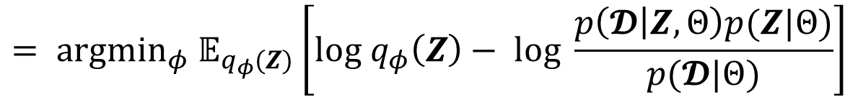
Variational Inference (VI)
4
The optimization problem
Since $log p(𝓓|Θ)$ is independent of $φ$, the optimization problem becomes
Note that $ℒ\left(φ, Θ\right)≤log p(𝓓|Θ)$ and is called “Evidence Lower Bound” (ELBO)
$$φ^{∗}= {argmin}_{φ} KL[q_{φ}(Z)||p(Z|𝓓,Θ)]$$
$$= {argmin}_{φ} 𝔼_{q_{φ}(Z)}\left[log q_{φ}\left(Z\right)− log \frac{p\left(𝓓 | Z,Θ\right)p(Z|Θ)}{p(𝓓|Θ)}\right]$$
$$= {argmin}_{φ} 𝔼_{q_{φ}(Z)}\left[log q_{φ}\left(Z\right)− log p\left(𝓓 | Z,Θ\right) − log p(Z|Θ)\right]+ log p(𝓓|Θ)$$
$$φ^{∗}= {argmin}_{φ} 𝔼_{q_{φ}(Z)}\left[log q_{φ}\left(Z\right)− log p\left(𝓓 | Z,Θ\right) − log p(Z|Θ)\right]$$
$$φ^{∗}= {argmin}_{φ} 𝔼_{q_{φ}(Z)}\left[log q_{φ}\left(Z\right)− log p(𝓓,Z|Θ)\right]$$
$$φ^{∗}= {argmax}_{φ} 𝔼_{q_{φ}(Z)}\left[log p\left(𝓓,Z | Θ\right)−log q_{φ}\left(Z\right)\right]= argmax ℒ(φ, Θ)$$

Slide 5
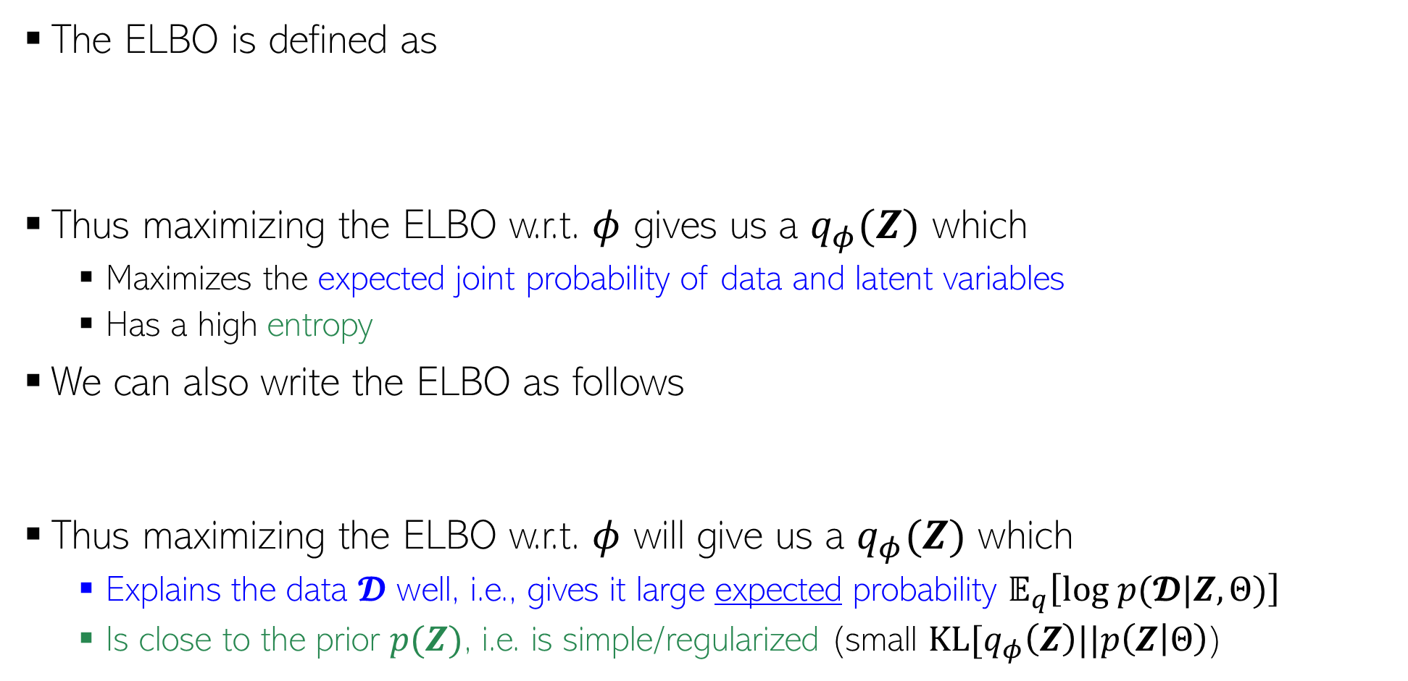
The ELBO
5
The ELBO is defined as
Thus maximizing the ELBO w.r.t. $φ$ gives us a $q_{φ}(Z)$ which
  Maximizes the expected joint probability of data and latent variables
  Has a high entropy
We can also write the ELBO as follows
Thus maximizing the ELBO w.r.t. $φ$ will give us a $q_{φ}(Z)$ which
  Explains the data $𝓓$ well, i.e., gives it large expected probability $𝔼_{q}\left[log p(𝓓|Z,Θ)\right]$
  Is close to the prior $p(Z)$, i.e. is simple/regularized (small $KL[q_{φ}\left(Z\right)||p\left(Z | Θ\right)$)
$$ℒ\left(φ, Θ\right)= 𝔼_{q_{φ}(Z)}\left[log p\left(𝓓,Z | Θ\right)−log q_{φ}\left(Z\right)\right]$$
$$= 𝔼_{q_{φ}(Z)} \left[log p\left(𝓓,Z | Θ\right)\right]+H[q_{φ}\left(Z\right)]$$
$$ℒ\left(φ, Θ\right)=𝔼_{q_{φ}(Z)}[log p(𝓓|Z,Θ)]−KL[q_{φ}\left(Z\right)||p\left(Z | Θ\right)]$$

Slide 6
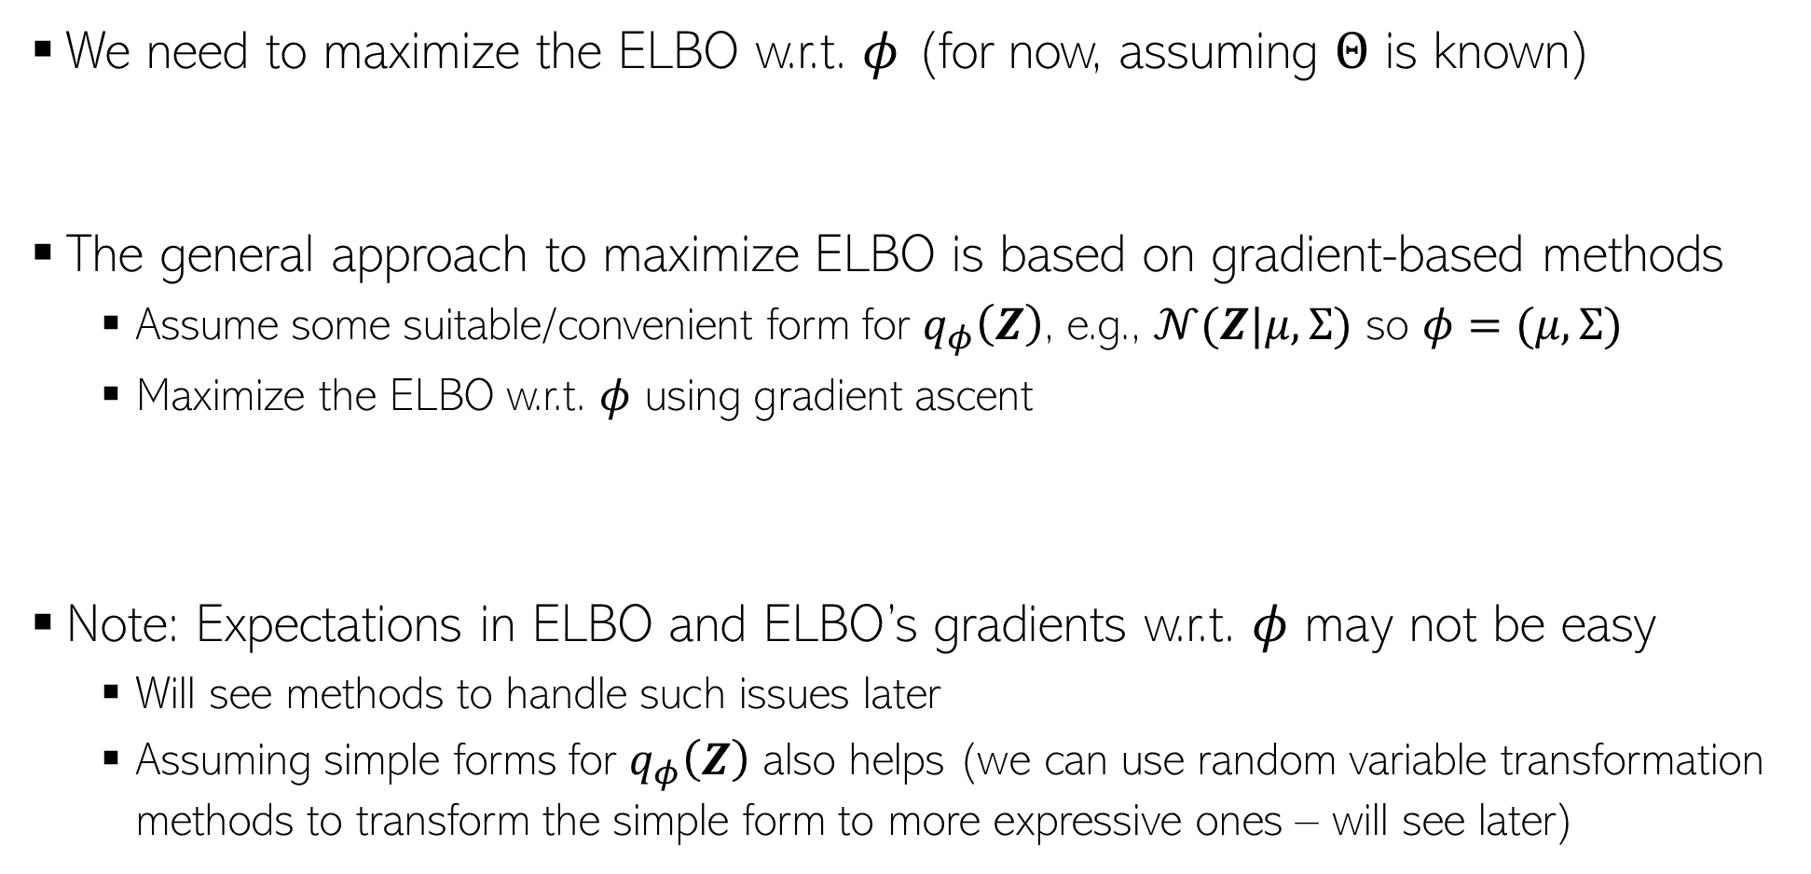


Maximizing the ELBO
6
Unknown $Θ$ case later
We need to maximize the ELBO w.r.t. $φ$ (for now, assuming $Θ$ is known)
The general approach to maximize ELBO is based on gradient-based methods
  Assume some suitable/convenient form for $q_{φ}\left(Z\right)$, e.g., $𝒩(Z|μ,Σ)$ so $φ=(μ,Σ)$
  Maximize the ELBO w.r.t. $φ$ using gradient ascent
Note: Expectations in ELBO and ELBO’s gradients w.r.t. $φ$ may not be easy
  Will see methods to handle such issues later
  Assuming simple forms for $q_{φ}\left(Z\right)$ also helps (we can use random variable transformation methods to transform the simple form to more expressive ones – will see later)
$$ℒ\left(φ, Θ\right)=𝔼_{q_{φ}(Z)}[log p(𝓓|Z,Θ)]−KL[q_{φ}\left(Z\right)||p\left(Z | Θ\right)]$$
$$φ_{t+1}=φ_{t}+η_{t} ∇_{φ_{t}}ℒ\left(φ, Θ\right)$$

Slide 7
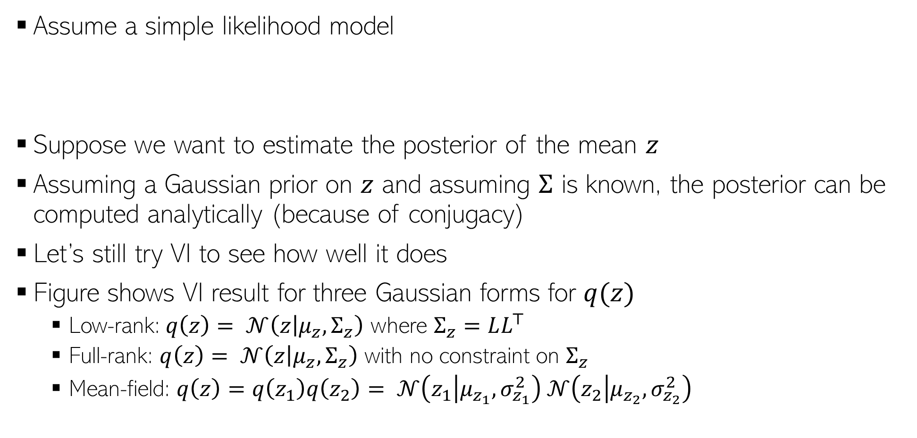
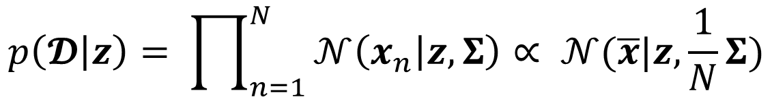
A Simple Illustration for VI
7
Assume a simple likelihood model
Suppose we want to estimate the posterior of the mean $z$
Assuming a Gaussian prior on $z$ and assuming $Σ$ is known, the posterior can be computed analytically (because of conjugacy)
Let’s still try VI to see how well it does
Figure shows VI result for three Gaussian forms for $q(z)$
  Low-rank: $q\left(z\right)= 𝒩\left(z | μ_{z},Σ_{z}\right)$ where $Σ_{z}=LL^{⊤}$
  Full-rank: $q\left(z\right)= 𝒩\left(z | μ_{z},Σ_{z}\right)$ with no constraint on $Σ_{z}$
  Mean-field: $q\left(z\right)=q\left(z_{1}\right)q\left(z_{2}\right)= 𝒩\left(z_{1} | μ_{z_{1}},σ_{z_{1}}^{2}\right)$ $𝒩\left(z_{2} | μ_{z_{2}},σ_{z_{2}}^{2}\right)$
$$p\left(𝓓 | z\right)= \prod_{n=1}^{N}{𝒩\left(x_{n} | z,Σ\right)∝ 𝒩(\overline{x}|z,\frac{1}{N}Σ)}$$
(Example courtesy: PML-2 (Murphy))

Slide 8
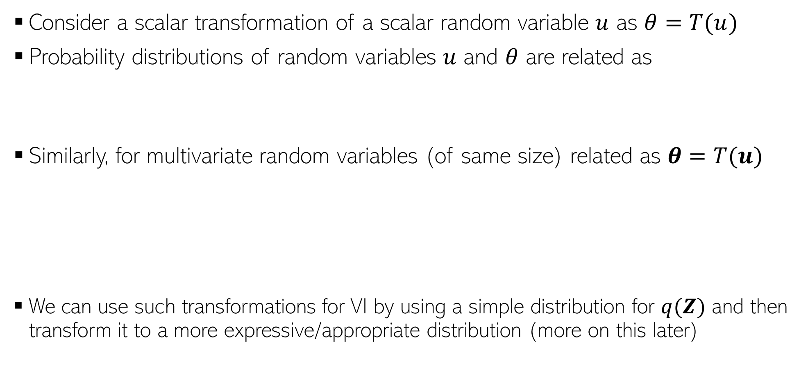
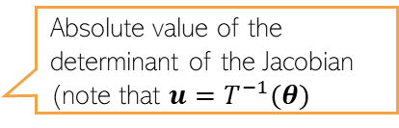

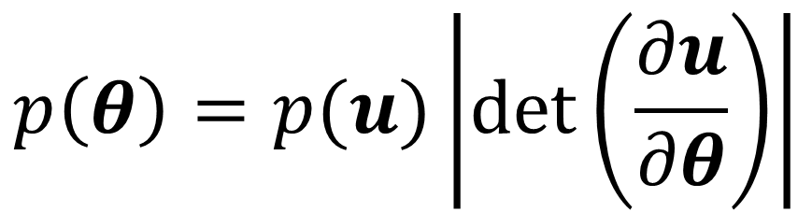
Detour
8
Transformed random variable
A one-to-one transformation function
Consider a scalar transformation of a scalar random variable $u$ as $θ=T(u)$
Probability distributions of random variables $u$ and $θ$ are related as
Similarly, for multivariate random variables (of same size) related as $θ=T(u)$
We can use such transformations for VI by using a simple distribution for $q(Z)$ and then transform it to a more expressive/appropriate distribution (more on this later)
$$p\left(θ\right)=p(u)\left|\frac{du}{dθ}\right|$$
$$p\left(θ\right)=p(u)\left|det\left(\frac{∂u}{∂θ}\right)\right|$$
Absolute value of the determinant of the Jacobian (note that $u=T^{−1}(θ)$

Slide 9

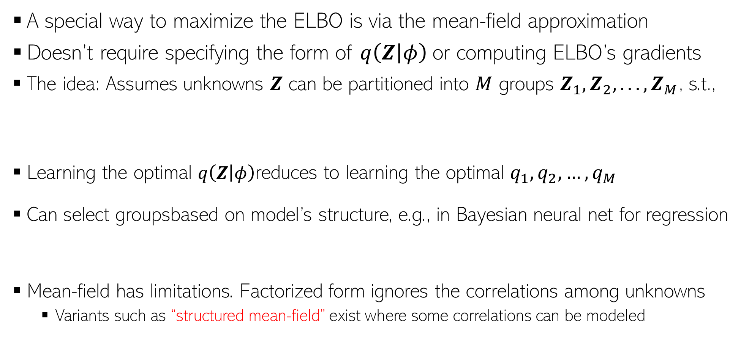
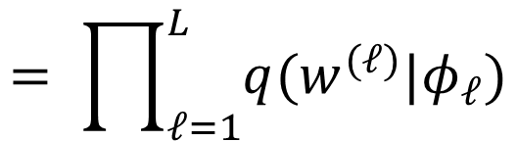

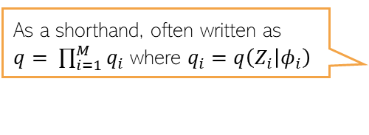
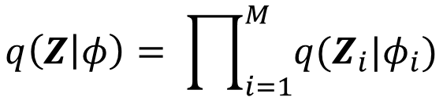
Mean-Field VI
9
A special way to maximize the ELBO is via the mean-field approximation
Doesn’t require specifying the form of $q\left(Z | φ\right)$or computing ELBO’s gradients
The idea: Assumes unknowns $Z$ can be partitioned into $M$ groups $Z_{1}, Z_{2},. . . , Z_{M}$, s.t.,
Learning the optimal $q\left(Z | φ\right)$reduces to learning the optimal $q_{1},q_{2},…, q_{M}$
Can select groupsbased on model’s structure, e.g., in Bayesian neural net for regression
Mean-field has limitations. Factorized form ignores the correlations among unknowns
  Variants such as “structured mean-field” exist where some correlations can be modeled
As a shorthand, often written as $q= \prod_{i=1}^{M}{q_{i}}$ where $q_{i}=q\left(Z_{i} | φ_{i}\right)$
$$q\left(Z | φ\right)= \prod_{i=1}^{M}{q(Z_{i}|φ_{i})}$$
For models with local conjugacy, it becomes super easy!
$$= \prod_{ℓ=1}^{L}{q(w^{(ℓ)}|φ_{ℓ})}$$
$$p\left(w | X,y,λ, β\right)≈q\left(w | φ\right)$$
Assuming a network with $L$ layers, mean-field across layers

Slide 10



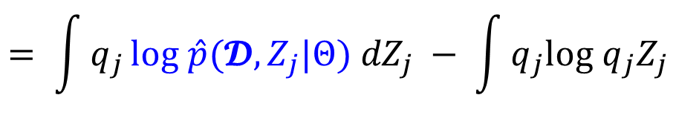
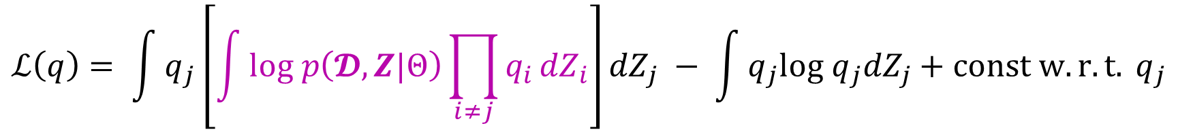
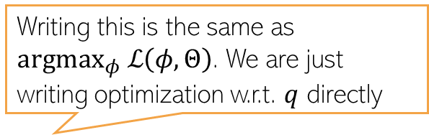
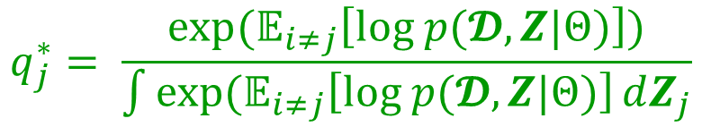
Deriving Mean-Field VI Updates
Writing this is the same as ${argmax}_{φ} ℒ\left(φ, Θ\right)$. We are just writing optimization w.r.t. $q$ directly
10
With $q= \prod_{i=1}^{M}{q_{i}}$, what’s the optimal $q_{i}$ when we do ${argmax}_{q} ℒ\left(q\right)$?
Note that under this mean-field assumption, the ELBO simplifies to
Suppose we wish to find the optimal $q_{j}$ given all other $q_{i}$’s ($i≠j$) as fixed, then
Thus $q_{j}^{∗}$ = ${argmax}_{q_{j}} ℒ\left(q\right)$= ${argmin}_{q_{j}}KL(q_{j}||\hat{p}) =\hat{p}(𝓓,Z_{j}|Θ)$
$$ℒ\left(q\right)= \int{q\left(Z\right)log \left[\frac{p(𝓓,Z|Θ)}{q(Z)}\right]dZ}= \int{\prod_{i}{q_{i}}}\left[log p\left(𝓓,Z|Θ\right)−\sum_{i}{log q_{i}}\right]dZ$$
$$ℒ\left(q\right)= \int{q_{j}}\left[\int{log p\left(𝓓,Z|Θ\right)\prod_{i≠j}{q_{i}}{dZ}_{i}}\right]{dZ}_{j} − \int{q_{j}log q_{j}{dZ}_{j}}+const w.r.t. q_{j}$$
$$= \int{q_{j}}log \hat{p}(𝓓,Z_{j}|Θ) {dZ}_{j} − \int{q_{j}log q_{j}Z_{j}}$$
$$q_{j}^{∗}= \frac{exp(𝔼_{i≠j}\left[log p(𝓓,Z|Θ)\right])}{\int{exp(𝔼_{i≠j}\left[log p(𝓓,Z|Θ)\right]}dZ_{j}}$$
$$=−KL(q_{j}||\hat{p})$$
$log \hat{p}\left(𝓓,Z_{j}|Θ\right)=𝔼_{i≠j}\left[log p(𝓓,Z|Θ)\right]$ + const

Slide 11
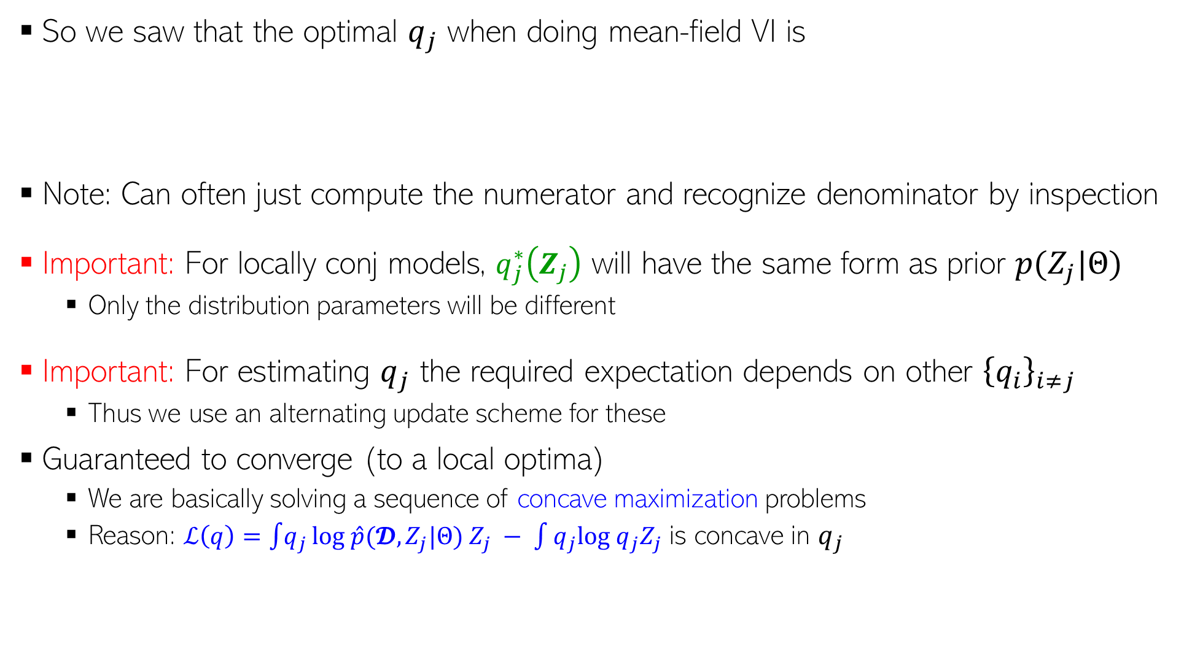
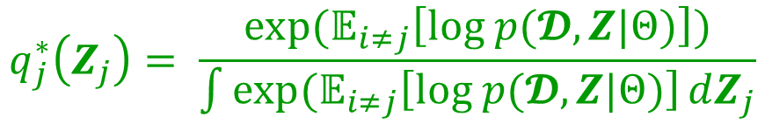
Deriving Mean-Field VI Updates
11
So we saw that the optimal $q_{j}$ when doing mean-field VI is
Note: Can often just compute the numerator and recognize denominator by inspection
Important: For locally conj models, $q_{j}^{∗}\left(Z_{j}\right)$ will have the same form as prior $p(Z_{j}|Θ)$
  Only the distribution parameters will be different
Important: For estimating $q_{j}$ the required expectation depends on other ${\left\{q_{i}\right\}}_{i≠j}$
  Thus we use an alternating update scheme for these
Guaranteed to converge (to a local optima)
  We are basically solving a sequence of concave maximization problems
  Reason: $ℒ\left(q\right)=\int{q_{j}}log \hat{p}(𝓓,Z_{j}|Θ) Z_{j} − \int{q_{j}log q_{j}Z_{j}}$ is concave in $q_{j}$
$$q_{j}^{∗}\left(Z_{j}\right)= \frac{exp(𝔼_{i≠j}\left[log p(𝓓,Z|Θ)\right])}{\int{exp(𝔼_{i≠j}\left[log p(𝓓,Z|Θ)\right]}dZ_{j}}$$

Slide 12
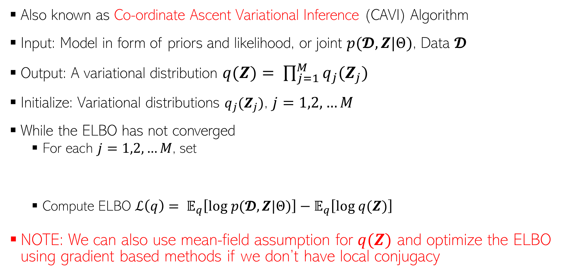
The Mean-Field VI Algorithm
12
Also known as Co-ordinate Ascent Variational Inference (CAVI) Algorithm
Input: Model in form of priors and likelihood, or joint $p(𝓓,Z|Θ)$, Data $𝓓$
Output: A variational distribution $q(Z)= \prod_{j=1}^{M}{q_{j}(Z_{j})}$
Initialize: Variational distributions $q_{j}(Z_{j})$, $j=1,2,…M$
While the ELBO has not converged
  For each $j=1,2,…M$, set
  Compute ELBO $ℒ\left(q\right)= 𝔼_{q}\left[log p(𝓓,Z|Θ)\right]−𝔼_{q}\left[log q(Z)\right]$
NOTE: We can also use mean-field assumption for $q(Z)$ and optimize the ELBO using gradient based methods if we don’t have local conjugacy
$$q_{j}\left(Z_{j}\right)∝ exp(𝔼_{i≠j}\left[log p(𝓓,Z|Θ)\right])$$

Slide 13
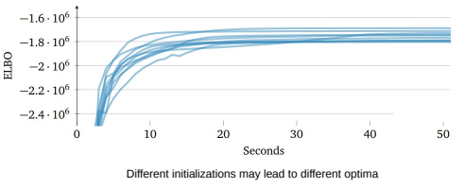
VI and Convergence
13
VI is guaranteed to converge to a local optima (just like EM)
Therefore proper initialization is important (just like EM)
  Can sometimes run multiple times with different initializations and choose the best run
ELBO increases monotonically with iterations
  Can thus monitor the ELBO to assess convergence

Slide 14
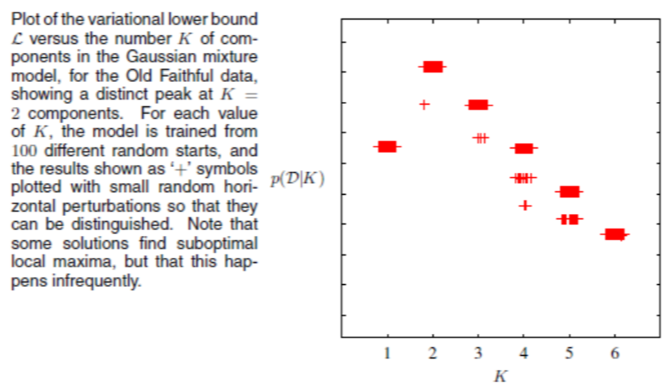

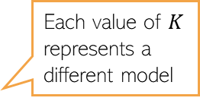
ELBO for Model Selection
14
Recall that ELBO is a lower bound on log of model evidence $log p(X|m)$
Can compute ELBO for each model $m$ and choose the one with largest ELBO
Some criticism since we are using a lower-bound but often works well in practice
Each value of $K$ represents a different model

Slide 15
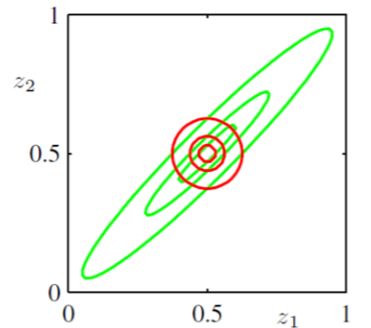
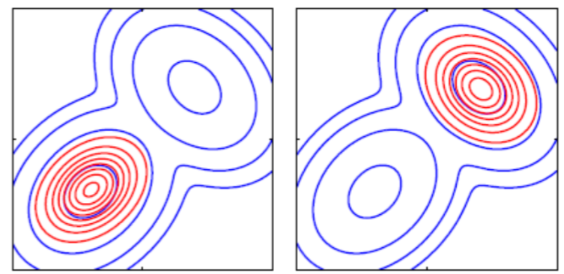
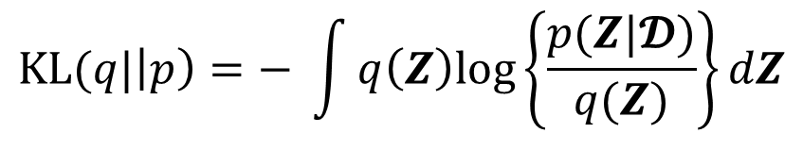


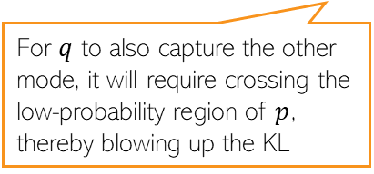

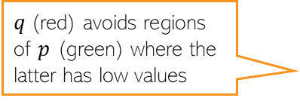
VI might under-estimate posterior’s variance
15
Recall that VI approximates a posterior $p$ by finding $q$ that minimizes $KL(q||p)$
$q(Z)$ will be small where $p(Z|𝓓)$ is small otherwise KL will blow up
Thus $q(Z)$ avoids low-probability regions of the true posterior
Some methods, e.g., Expectation Propagation (EP), can avoid this behavior
$$KL(q|\left|p\right)=− \int{q\left(Z\right)log\left\{\frac{p(Z|𝓓)}{q(Z)}\right\}dZ}$$
$q$(red) avoids regions of $p$ (green) where the latter has low values
$q$(red) concentrated on one of the modes of $p$ (blue)
For $q$ to also capture the other mode, it will require crossing the low-probability region of $p$, thereby blowing up the KL
EP minimizes $KL(p||q)$

Slide 16
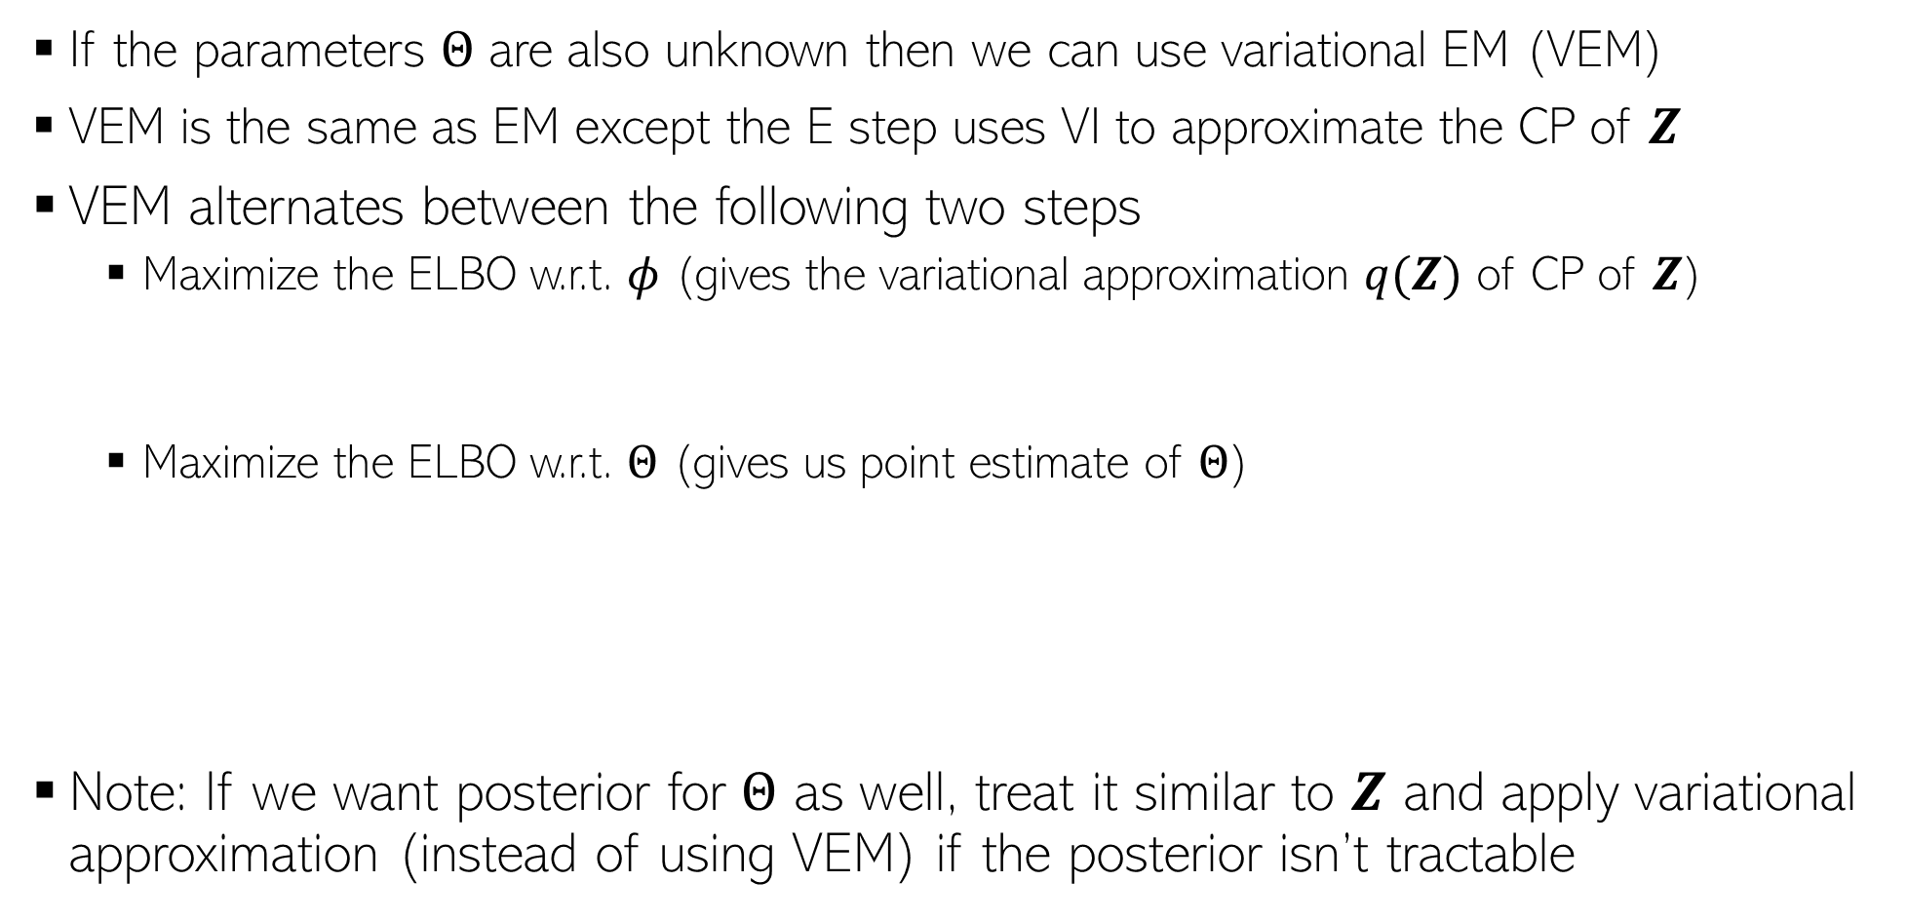

Variational EM
16
If the parameters $Θ$ are also unknown then we can use variational EM (VEM)
VEM is the same as EM except the E step uses VI to approximate the CP of $Z$
VEM alternates between the following two steps
  Maximize the ELBO w.r.t. $φ$ (gives the variational approximation $q(Z)$ of CP of $Z$)
  Maximize the ELBO w.r.t. $Θ$ (gives us point estimate of $Θ$)
Note: If we want posterior for $Θ$ as well, treat it similar to $Z$ and apply variational approximation (instead of using VEM) if the posterior isn’t tractable
$$φ^{(t)}= {argmax}_{φ} 𝔼_{q_{φ}(Z)}\left[log p\left(𝓓,Z | Θ^{(t−1)}\right)−log q_{φ}\left(Z\right)\right]$$
$$Θ^{(t)}= {argmax}_{Θ} 𝔼_{q_{φ^{(t)}}(Z)}\left[log p\left(𝓓,Z | Θ\right)−log q_{φ^{(t)}}\left(Z\right)\right]$$
$$= {argmax}_{Θ} 𝔼_{q_{φ^{(t)}}(Z)}\left[log p\left(𝓓,Z | Θ\right)\right]$$
This looks very similar to the expected CLL with the CP replaced by its variational approximation

Slide 17
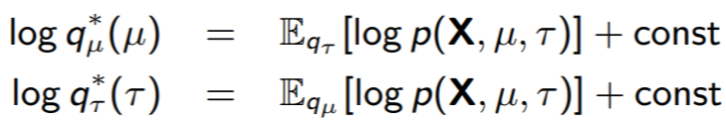
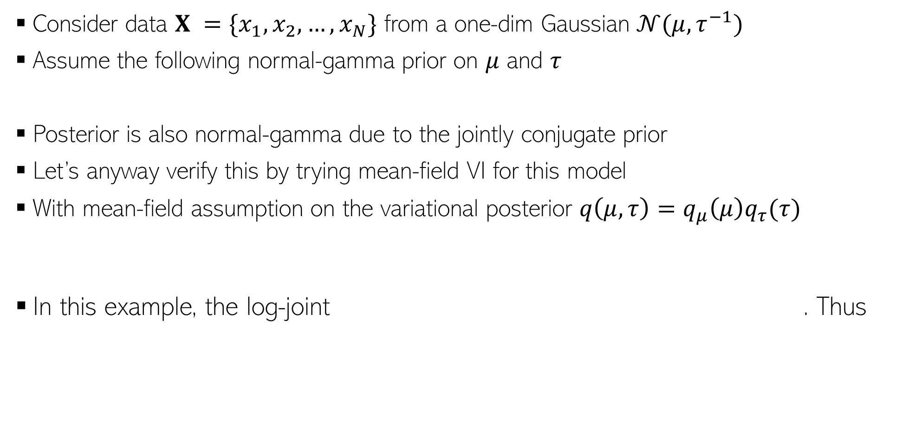
Extra Slides - Mean-Field VI: A Simple Example
17
Consider data $X =\{x_{1},x_{2},…, x_{N}\}$ from a one-dim Gaussian $𝒩(μ, τ^{−1})$
Assume the following normal-gamma prior on $μ$ and $τ$
Posterior is also normal-gamma due to the jointly conjugate prior
Let’s anyway verify this by trying mean-field VI for this model
With mean-field assumption on the variational posterior $q\left(μ, τ\right)=q_{μ}\left(μ\right)q_{τ}(τ)$
In this example, the log-joint . Thus

Slide 18
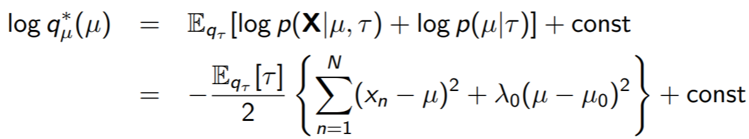
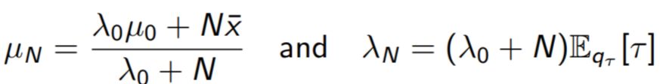
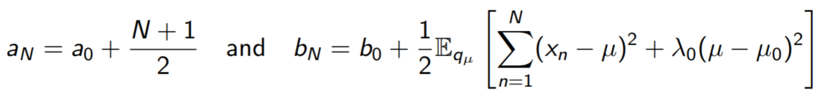



Extra Slides - Mean-Field VI: A Simple Example
18
Substituting $p\left(X | μ, τ\right)= \prod_{n=1}^{N}{p(x_{n}|μ, τ)}$ and $p(μ|τ)$, we get
(Verify) The above is log of a Gaussian. This $q_{μ}^{∗}=𝒩(μ|μ_{N},λ_{N})$ with
Proceeding in a similar way (verify), we can show that $q_{τ}^{∗}=Gamma(τ|a_{N},b_{N})$
Note: Updates of $q_{μ}^{∗}$ and $q_{τ}^{∗}$ depend on each other (hence alternating updates needed)
This update depends on $q_{τ}$
This update depends on $q_{μ}$

