Slide 1
GP (contd), Latent Variable Models and EM Algorithm
CS772A: Probabilistic Machine Learning
Piyush Rai

Slide 2


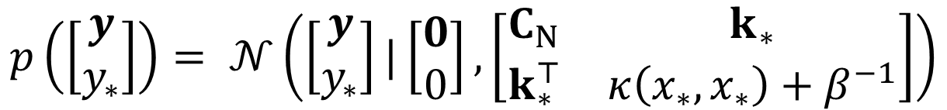
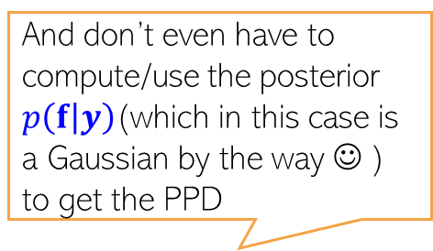



GP Prediction with Gaussian Likelihood
2
And don’t even have to compute/use the posterior $p\left(f | y\right)$(which in this case is a Gaussian by the way ☺ ) to get the PPD
In general, the PPD when using GP is defined as
For Gaussian likelihood (and fixed hyperparams), we don’t need to do above integral
Reason: The marginal likelihood is Gaussian
$p\left(y_{∗} | y\right)$is almost identical to $p\left(f_{∗} | f\right)$ with $K$ replaced by $C_{N}$ + extra $β^{−1}$ noise variance
$$p\left(y_{∗} | y\right)=∫p\left(y_{∗} | f_{∗}\right)p\left(f_{∗} | f\right)p\left(f | y\right)dfdf_{∗}$$
Assuming zero mean function
GP prior
Gaussian likelihood (assuming $β$ is fixed)
$$p(y\left|f\right)=𝒩(y|f,β^{−1}I_{N})$$
$$\text{p}\text{(}\text{f}\text{)= }\text{𝒩}\text{(}\text{f}\text{|}0\text{,}\text{K}\text{)}$$
Marginal likelihood of training outputs
$$p\left(y\right)=∫p\left(y | f\right)p\left(f\right)df$$
$$=𝒩\left(y | 0,K+β^{−1}I_{N}\right)=𝒩\left(y | 0,C_{N}\right)$$
Marginal likelihood of training and test outputs
$$p\left(\left[\begin{aligned}y \\ y_{∗}\end{aligned}\right]\right)= 𝒩\left(\left[\begin{aligned}y \\ y_{∗}\end{aligned}\right]|\left[\begin{aligned}0 \\ 0\end{aligned}\right],\left[\begin{matrix}C_{N} & k_{∗} \\ k_{∗}^{⊤} & κ\left(x_{∗},x_{∗}\right)+β^{−1}\end{matrix}\right]\right)$$
PPD obtained using joint to conditional results of Gaussians
$$p\left(y_{∗} | y\right)=𝒩\left(y_{∗}|k_{∗}^{⊤}C_{N}^{−1}y,κ\left(x_{∗},x_{∗}\right)−k_{∗}^{⊤}C_{N}^{−1}k_{∗}+β^{−1}\right)$$

Slide 3

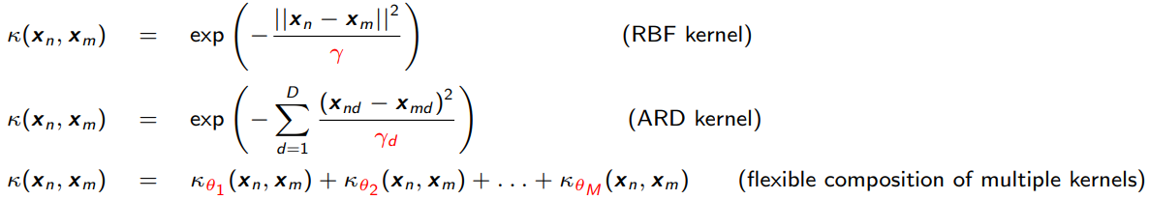
Learning Hyperparameters in GP based Models
3
Can learn the hyperparameters of the GP prior as well as of the likelihood model
Assuming $μ=0$, the hyperparams of GP are cov/kernel function hyperparams
MLE-II is a popular choice for learning these hyperparams (otherwise MCMC, VI, etc)
Denoting the covariance/kernel matrix as $K_{θ}$, for Gaussian likelihood case, the marg-lik
This can be maximized to learn $θ$ and $β$
For non-Gaussian likelihoods, the marg-lik itself will need to be approximated
Ability to learn kernel hyperparams (without cross-valid) is another very appealing property of GP
Can help in feature selection (irrelevant features will tend to have very large $γ_{d}$)
Different RBF kernel bandwidth $γ_{d}$ for each feature
$$p\left(y|θ,β^{−1}\right)=𝒩\left(y | 0,K_{θ}+β^{−1}I_{N}\right)$$

Slide 4
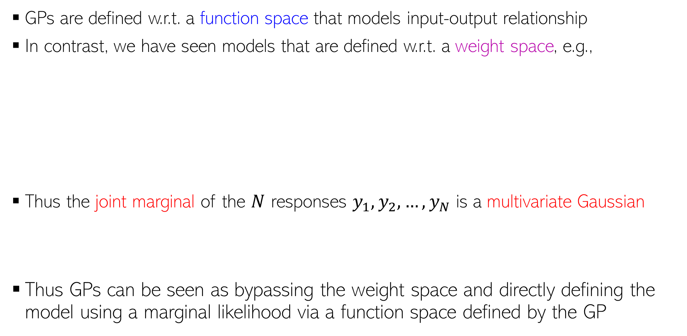
Weight Space View vs Function Space View
4
GPs are defined w.r.t. a function space that models input-output relationship
In contrast, we have seen models that are defined w.r.t. a weight space, e.g.,
Thus the joint marginal of the $N$ responses $y_{1},y_{2},…,y_{N}$ is a multivariate Gaussian
Thus GPs can be seen as bypassing the weight space and directly defining the model using a marginal likelihood via a function space defined by the GP
$$p\left(y | X,w\right)= 𝒩(y|Xw,β^{−1}I_{N})$$
Likelihood
Marginal likelihood after integrating out the weights
$$p(w)= 𝒩(w|μ_{0},Σ_{0})$$
Prior over weight vector
$$p\left(y | X\right)=∫p\left(y | X,w\right)p\left(w\right)dw=𝒩(y|Xμ_{0},β^{−1}I_{N}+XΣ_{0}X^{⊤})$$
$$p\left(y | X\right)=𝒩(y|0,β^{−1}I_{N}+XX^{⊤})$$
Marginal likelihood assuming $μ_{0}=0$ and $Σ_{0}=I$
$$p\left(y | X\right)=𝒩(y|0, XX^{⊤})$$
Assuming noise-free likelihood
This equivalence also shows that Bayesian linear regression is a special case of GP with linear kernel
$$p\left(\left[\begin{aligned}y_{1} \\ y_{2} \\ ⋮ \\ y_{N}\end{aligned}\right]\right)= 𝒩\left(\left[\begin{aligned}0 \\ 0 \\ ⋮ \\ 0\end{aligned}\right],\left[\begin{matrix}\begin{aligned}x_{1}^{⊤}x_{1} \\ x_{2}^{⊤}x_{1}\end{aligned} & ⋯ & \begin{aligned}x_{1}^{⊤}x_{N} \\ x_{2}^{⊤}x_{N}\end{aligned} \\ ⋮ & ⋱ & ⋮ \\ x_{N}^{⊤}x_{1} & ⋯ & x_{N}^{⊤}x_{N}\end{matrix}\right]\right)$$
Same as a GP $f(x_{i}) = y_{i}$, $μ\left(x\right)=0$ and linear covariance/kernel function ${κ\left(x_{i}, x_{j}\right)= x}_{i}^{⊤}x_{j}$

Slide 5



Scalability of GPs
5
Computational costs in some steps of GP models scale in the size of training data
For example, prediction cost is $O(N)$
GP models often require matrix inversions (e.g., in marg-lik computation when estimating hyperparameters) – takes $O(N^{3})$
Storage also requires $O(N^{2})$ since need to store the covariance matrix
A lot of work on speeding up GPs¹. Some prominent approaches include
  Inducing Point Methods (condition predictions only on a small set of “learnable” points)
  Divide-and-Conquer (learn GP on small subsets of data and aggregate predictions)
  Kernel approximations
Note that nearest neighbor methods and kernel methods also face similar issues
  Many tricks to speed up kernel methods can be used for speeding up GPs too
$O(N)$ cost assuming $C_{N}$ is already inverted
$$p\left(y_{∗} | y\right)=𝒩(y_{∗}|\hat{μ},{\hat{σ}}^{2})$$
$$\hat{μ}=k_{∗}^{⊤}C_{N}^{−1}y$$
$${\hat{σ}}^{2}=κ\left(x_{∗},x_{∗}\right)−k_{∗}^{⊤}C_{N}^{−1}k_{∗}+β^{−1}$$
$M≪N$ pseudo-inputs and pseudo-outputs
¹When Gaussian Process Meets Big Data: A Review of Scalable GPs - Liu et al, 2018

Slide 6
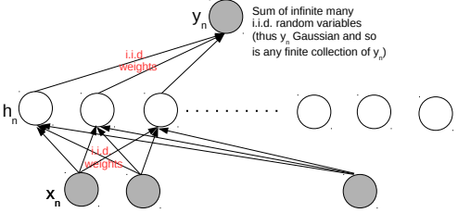
Neural Networks and Gaussian Process
6
An infinitely-wide single hidden layer NN with i.i.d. priors on weights = GP
Shown formally by (Neal², 1994). Based on applying the central limit theorem
This equivalence is useful for several reasons
  Can use a GP instead of an infinitely wide Bayesian NN (which is impractical anyway)
  With GPs, inference is easy (at least for regression and with known hyperparams)
  A proof that GPs can also learn any function (just like infinitely wide neural nets - Hornik’s theorem)
Connection generalized to infinitely wide multiple hidden layer NN (Lee et al³, 2018)
²Priors for infinite networks, Tech Report, 1994
³Deep Neural Networks as Gaussian Processes (ICLR 2018)

Slide 7
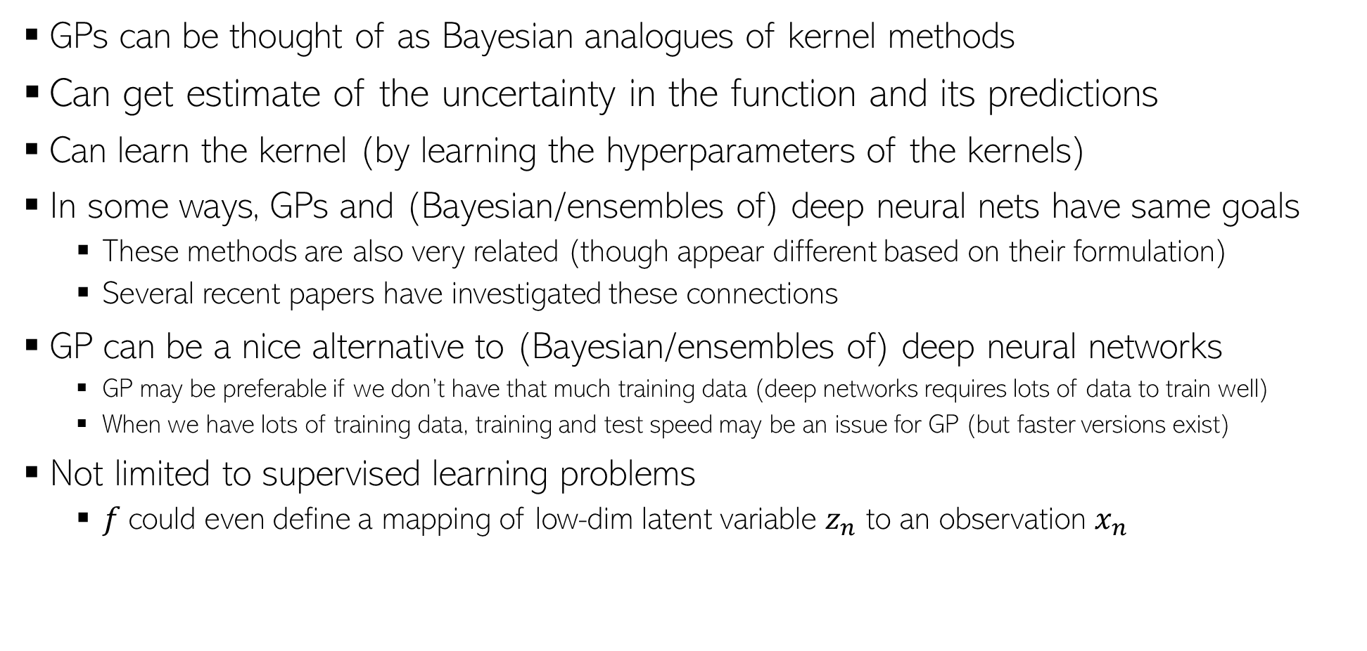

GP: Some other comments
7
GPs can be thought of as Bayesian analogues of kernel methods
Can get estimate of the uncertainty in the function and its predictions
Can learn the kernel (by learning the hyperparameters of the kernels)
In some ways, GPs and (Bayesian/ensembles of) deep neural nets have same goals
  These methods are also very related (though appear different based on their formulation)
  Several recent papers have investigated these connections
GP can be a nice alternative to (Bayesian/ensembles of) deep neural networks
  GP may be preferable if we don’t have that much training data (deep networks requires lots of data to train well)
  When we have lots of training data, training and test speed may be an issue for GP (but faster versions exist)
Not limited to supervised learning problems
  $f$could even define a mapping of low-dim latent variable $z_{n}$ to an observation $x_{n}$
$$x_{n}=f\left(z_{n}\right)+"noise"$$
GP latent variable model for dimensionality reduction (like a kernel version of probabilistic PCA)

Slide 8

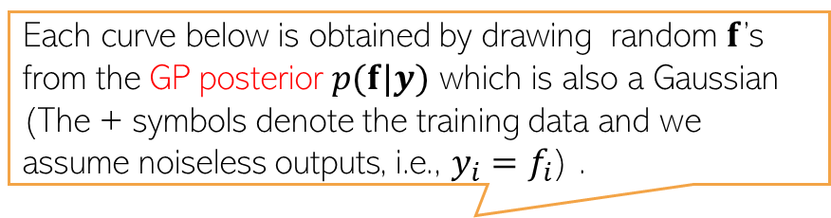

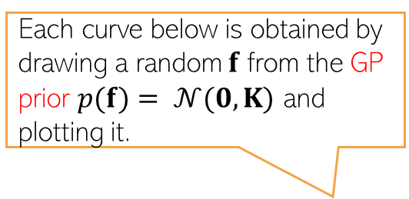
GP: A Visualization
8
Assumed zero mean function and a squared exponential kernel
Shaded area shows the predictive uncertainty for each of the test inputs (+/- 2 std)
Each curve below is obtained by drawing a random $f$ from the GP prior $p(f)= 𝒩(0,K)$ and plotting it.
Each curve below is obtained by drawing random $f$’s from the GP posterior $p(f|y)$ which is also a Gaussian (The + symbols denote the training data and we assume noiseless outputs, i.e., $y_{i}=f_{i}$) .
$K$is the kernel matrix of a finite number of inputs represented on the x axis (say 100 equi-spaced points between -5 and 5). $f$ will be a vector of $f$’s values at these inputs
$$f$$
$$y=f$$
$$x$$
$$x$$
Figure courtesy: MLAPP (Murphy)

Slide 9
GP packages
9
Many mature implementations of GP exist. You may check out
  GPyTorch (PyTorch), GPFlow (Tensorflow)
  sklearn (Python with some basic GP implementations)
  GPML (MATLAB), GPsuff (MATLAB/Octave)
  Many others such as Stan, GPJax
A comparison of the various packages: https://en.wikipedia.org/wiki/Comparison_of_Gaussian_process_software

Slide 10
Conditional Posterior
10
Consider a model with $K$ unknown params/hyperparams $Θ= (θ_{1},θ_{2},…, θ_{K})$
We can however compute conditional posteriors (CP)which for each $θ_{i}$ looks like
To compute each CP, look at the joint distribution $p\left(X,Θ\right)$
CP of $θ_{i}$ will be proportional to the product of all the terms involving $θ_{i}$
  If those terms are conjugate to each other, it is called local conjugacy. CP is then easy to compute
Many algorithms for computing point estimate/full posterior use the CPs
  Expectation Maximization, Variational Inference , MCMC (especially Gibbs sampling)
Joint posterior
$$p\left(Θ | X\right)= \frac{p\left(Θ\right)p(X|Θ)}{p(X)}=\frac{p\left(Θ\right)p(X|Θ)}{\int{p\left(Θ\right)p\left(X | Θ\right)dθ_{1}dθ_{2}…dθ_{K}}}$$
Usually intractable integral so the full posterior can’t be computed exactly
$$p(θ_{i}|whatever θ_{i} depends on)$$
Can be data and/or other params/hyperparams given their fixed values (or current estimates)
$$p\left(X,Θ\right)=p(X,θ_{1},θ_{2},…, θ_{K})$$
$$=p\left(X | θ_{1},θ_{2},…, θ_{K}\right)p\left(θ_{1}\right|θ_{2},…, θ_{K})p(θ_{2}\left|θ_{3},…, θ_{K}\right)…p(θ_{K})$$

Slide 11
Latent Variable Models
11
Application 1: Can use latent variables to learn latent properties/features of data, e.g.,
  Cluster assignment of each observation (in mixture models)
  Low-dim rep. or “code” of each observation (e.g., prob. PCA, variational autoencoders, etc)
In such apps, latent variables ($z_{n}$’s) are called “local variables” (specific to individual obs.)and other unknown parameters/hyperparams ($θ, φ$above) are called “global var”
Plate notation of a generic LVM
$p\left(z_{n} | φ\right):$ A suitable prior distribution based on the nature of $z_{n}$
$$θ$$
$p\left(x_{n} | z_{n},θ\right):$ A suitable likelihood based on the nature of $x_{n}$
$$φ$$
$$z_{n}$$
$$x_{n}$$
$$N$$

Slide 12
Latent Variable Models
12
Application 2: Sometimes, augmenting a model by latent variables simplifies inference
  These latent variables aren’t part of the original model definition
Some of the popular examples of such augmentation include
  In Probit regression for binary classification, we can model each label $y_{n}∈\{0,1\}$ as
  .. and use EM etc, to infer the unknowns $w$ and $z_{n}$’s (PML-2, Sec 15.4)
  Many sparse priors on weights can be thought of as Gaussian “scale-mixtures”
  .. where $τ_{d}$’s are latent vars. Can use EM to infer $w$, $τ$ (MLAPP 13.4.4 - EM for LASSO)
Such augmentations can often make a non-conjugate model a locally conjugate one
  Conditional posteriors of the unknowns often have closed form in such cases
$$y_{n}= 𝕀[z_{n}>0]$$
where $z_{n}∼𝒩(w^{⊤}x_{n},1)$ is an auxiliary latent variable

Slide 13
Nomenclature/Notation Alert
13
Why call some unknowns as parameters and others as latent variables?
Well, no specific reason. Sort of a convention adopted by some algorithms
  EM: Unknowns estimated in E step referred to as latent vars; those in M step as params
  Usually: Latent vars – (Conditional) posterior computed; parameters – point estimation
Some algos won’t make such distinction and will infer posterior over all unknowns
Sometimes the “global” or “local” unknown distinction makes it clear
  Local variables = latent variables, global variables = parameters
But remember that this nomenclature isn’t really cast in stone, no need to be confused so long as you are clear as to what the role of each unknown is, and how we want to estimate it (posterior or point estimate) and using what type of inference algorithm

Slide 14
Hybrid Inference (posterior infer. + point est.)
14
In many models, we infer posterior on some unknowns and do point est. for others
We have already seen MLE-II for lin reg. which alternates between
  Inferring CP over the main parameter given the point estimates of hyperparams
  Maximizing the marginal lik. to do point estimation for hyperparams
The Expectation-Maximization algorithm (will see today) also does something similar
  In E step, the CP of latent variables is inferred, given current point-est of params
  M step maximizes expected complete data log-lik. to get point estimates of params
If we can’t (due to computational or other reasons) infer posterior over all unknowns, how to decide which variables to infer posterior on, and for which to do point-est?
Usual approach: Infer posterior over local vars and point estimates for global vars
  Reason: We typically have plenty of data to reliably estimate the global variables so it is okay even if we just do point estimation for those
CP of $w$: $p(w|X,y,\hat{λ},\hat{β})$
$$\left\{\hat{λ},\hat{β}\right\}= {argmax}_{λ,β} p(y|X,λ, β)$$

Slide 15
Inference/Parameter Estimation in Latent Variable Models using Expectation-Maximization (EM)
15

Slide 16
Parameter Estimation in Latent Variable Models
16
Assume each observation $x_{n}$ to be associated with a “local” latent variable $z_{n}$
Although we can do fully Bayesian inference for all the unknowns, suppose we only want a point estimate of the “global” parameters $Θ = (θ, φ)$ via MLE/MAP
Such MLE/MAP problems in LVMs are difficult to solve in a “clean” way
  Would typically re quire gradient based methods with no closed form updates for $Θ$
  However, EM gives a clean way to obtain closed form updates for $Θ$
$p\left(z_{n} | φ\right):$ A suitable prior distribution based on the nature of $z_{n}$
$$θ$$
$p\left(x_{n} | z_{n},θ\right):$ A suitable likelihood based on the nature of $x_{n}$
$$φ$$
$$z_{n}$$
$$x_{n}$$
$$N$$

Slide 17
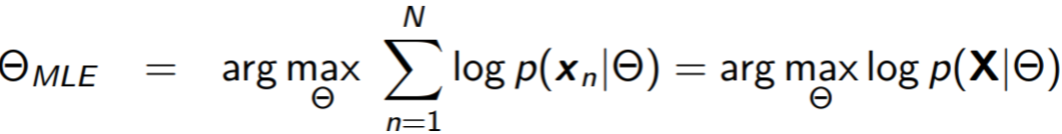
Why MLE/MAP of Params is Hard for LVMs?
17
Suppose we want to estimate $Θ = (θ, φ)$ via MLE. If we knew $z_{n}$, we could solve
Easy. Usually closed form if $p\left(z_{n} | φ\right)$ and $p\left(x_{n} | z_{n},θ\right)$ have simple forms
However, since in LVMs, $z_{n}$ is hidden, the MLE problem for $Θ$ will be the following
$log⁡p(x_{n}|Θ)$will not have a simple expression since $p(x_{n}|Θ)$ requires sum/integral
MLE now becomes difficult (basically MLE-II now), no closed form expression for $Θ$.
Can we maximize some other quantity instead of $log⁡p(x_{n}|Θ)$for this MLE?
Easy to solve
In particular, if they are exp-fam distributions
Basically, the marginal likelihood after integrating out $z_{n}$

Slide 18
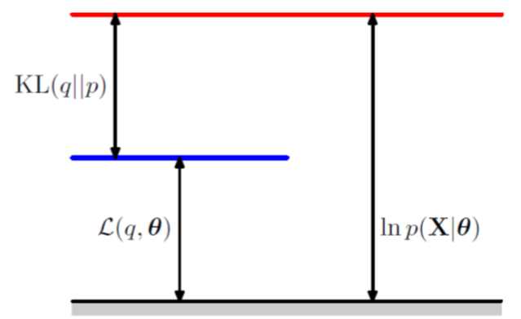
An Important Identity
18
Assume $p_{z} = p(Z|X,Θ)$ and $q(Z)$ to be some prob distribution over $Z,$ then
In the above $ℒ\left(q,Θ\right)= \sum_{Z}{q\left(Z\right)log\left\{\frac{p(X,Z|Θ)}{q(Z)}\right\}}$
$KL(q|\left|p_{z}\right)=−\sum_{Z}{q\left(Z\right)log\left\{\frac{p(Z|X,Θ)}{q(Z)}\right\}}$
KL is always non-negative, so $log p\left(X | Θ\right)≥$ $ℒ\left(q,Θ\right)$
Thus $ℒ\left(q,Θ\right)$ is a lower-bound on $log p\left(X | Θ\right)$
Thus if we maximize $ℒ\left(q,Θ\right)$, it will also improve $log p\left(X | Θ\right)$
Also, as we’ll see, it’s easier to maximize $ℒ\left(q,Θ\right)$
$$log p\left(X | Θ\right)= ℒ\left(q,Θ\right)+KL(q||p_{z})$$
Verify the identity
Assume $Z$ discrete

Slide 19
Maximizing $ℒ\left(q,Θ\right)$
19
19
Basically, log of marginal likelihood w.r.t. $Θ$ with $Z$ integrated out
$log p\left(X | Θ\right)$ is called Incomplete-Data Log Likelihood (ILL)
$ℒ\left(q,Θ\right)$ depends on $q$ and $Θ$. We’ll use ALT-OPT to maximize it
Let’s maximize $ℒ\left(q,Θ\right)$ w.r.t. $q$ with $Θ$ fixed at some $Θ^{old}$
Now let’s maximize $ℒ\left(q,Θ\right)$ w.r.t. $Θ$ with $q$ fixed at $\hat{q}=p_{z}=p(Z|X,Θ^{old})$
Since $log p\left(X | Θ\right)= ℒ\left(q,Θ\right)+KL(q||p_{z})$ is constant when $Θ$ is held fixed at $Θ^{old}$
$$\hat{q}= {argmax}_{q}ℒ\left(q,Θ^{old}\right)= {argmin}_{q}KL(q|\left|p_{z}\right)=p_{z}=p(Z|X,Θ^{old})$$
The posterior distribution of $Z$ given current parameters $Θ^{old}$
$$Θ^{new}= {argmax}_{Θ}ℒ\left(\hat{q},Θ\right)= {argmax}_{Θ}\sum_{Z}{p(Z|X,Θ^{old}) log\left\{\frac{p(X,Z|Θ)}{p(Z|X,Θ^{old}) }\right\}}$$
Maximization of expected CLL where the expectation is w.r.t. the posterior distribution of $Z$ given current parameters $Θ^{old}$
$$= {argmax}_{Θ}\sum_{Z}{p\left(Z | X,Θ^{old}\right) log p(X,Z|Θ)}$$
Complete-Data Log Likelihood (CLL)
$$= {argmax}_{Θ} 𝔼_{p\left(Z | X,Θ^{old}\right)}[log p(X,Z|Θ)]$$
Much easier than maximizing ILL since CLL will have simple expressions (since it is akin to knowing $Z$)
$$= {argmax}_{Θ} 𝒬(Θ,Θ^{old})$$

Slide 20
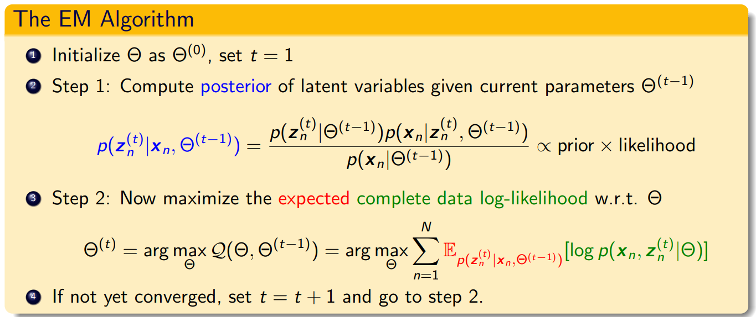
The Expectation-Maximization (EM) Algorithm
20
ALT-OPT of $ℒ\left(q,Θ\right)$ w.r.t. $q$ and $Θ$ gives the EM algorithm (Dempster, Laird, Rubin, 1977)
Note: If we can take the MAP estimate ${\hat{z}}_{n}$ of $z_{n}$ (not full posterior) in Step 1 and maximize the CLL in Step 2 using that, i.e., do ${argmax}_{Θ}\sum_{n=1}^{N}{\left[log p\left(x_{n}, {{\hat{z}}_{n}}^{(t)} | Θ\right)\right]}$ this will be ALT-OPT
Primarily designed for doing point estimation of the parameters $Θ$ but also gives (CP of) latent variables $z_{n}$
Usually computing CP + expected CLL is referred to as the E step, and max. of exp-CLL w.r.t. $Θ$ as the M step
Conditional posterior of each latent variable $z_{n}$
Latent variables also assumed indep. a priori
Assuming the (expected) CLL $𝔼_{p\left(Z | X,Θ^{old}\right)}[log p(X,Z|Θ)]$ factorizes over all observations

Slide 21
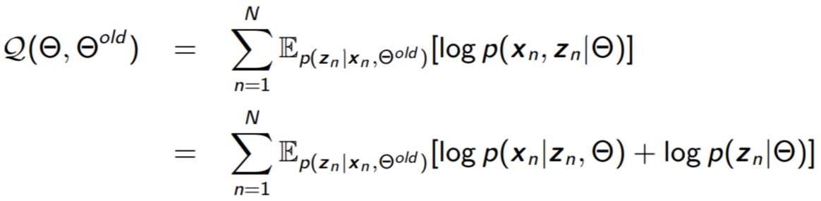
The Expected CLL
Expected CLL in EM is given by (assume observations are i.i.d.)
If $p\left(z_{n} | Θ\right)$ and $p\left(x_{n} | z_{n},Θ\right)$ are exp-family distributions, $𝒬(Θ,Θ^{old})$ has a very simple form
In resulting expressions, replace terms containing $z_{n}$’s by their respective expectations, e.g.,
  $z_{n}$ replaced by $𝔼_{p\left(z_{n} | x_{n},\hat{Θ}\right)}[z_{n}]$
  $z_{n}{z_{n}}^{⊤}$ replaced by $𝔼_{p\left(z_{n} | x_{n},\hat{Θ}\right)}[z_{n}{z_{n}}^{⊤}]$
However, in some LVMs, these expectations are intractable to compute and need to be approximated (will see some examples later)

Slide 22
22
What’s Going On?
Alternating between them until convergence to some local optima
KL becomes zero and $ℒ\left(q,Θ\right)$ becomes equal to $log p\left(X | Θ\right)$; thus their curves touch at current $Θ$
As we saw, the maximization of lower bound $ℒ\left(q,Θ\right)$ had two steps
Step 1 finds the optimal $q$ (call it $\hat{q}$) by setting it as the posterior of $Z$ given current $Θ$
Step 2 maximizes $ℒ\left(\hat{q},Θ\right)$ w.r.t. $Θ$which gives a new $Θ$.
Note that $Θ$only changes in Step 2 so the objective $log p\left(X | Θ\right)$
can only change in Step 2
Local optima found for $Θ_{MLE}$
Green curve: $ℒ\left(\hat{q},Θ\right)$ after setting $q$ to $\hat{q}$
$$log p\left(X | Θ\right)$$
Also kind of similar to Newton’s method (and has second order like convergence behavior in some cases)
Good initialization matters; otherwise would converge to a poor local optima
Unlike Newton’s method, we don’t construct and optimize a quadratic approximation, but a lower bound
Even though original MLE problem ${argmax}_{Θ}log p\left(X | Θ\right)$ could be solved using gradient methods, EM often works faster and has cleaner updates
$$Θ^{(0)}$$
$$Θ^{(1)}$$
$$Θ^{(2)}$$
$$Θ^{(3)}$$
$$Θ^{(MLE)}$$

Slide 23

EM vs Gradient-based Methods
23
Can also estimate params using gradient-based optimization instead of EM
  We can usually explicitly sum over or integrate out the latent variables $Z$, e.g.,
  Now we can optimize $ℒ(Θ)$ using first/second order optimization to find the optimal $Θ$
EM is usually preferred over this approach because
  The M step has often simple closed-form updates for the parameters $Θ$
  Often constraints (e.g., PSD matrices) are automatically satisfied due to form of updates
  In some cases†, EM usually converges faster (and often like second-order methods)
    E.g., Example: Mixture of Gaussians with when the data is reasonably well-clustered
  EM applies even when the explicit summing over/integrating out is expensive/intractable
  EM also provides the conditional posterior over the latent variables Z (from E step)
†Optimization with EM and Expectation-Conjugate-Gradient (Salakhutdinov et al, 2003), On Convergence Properties of the EM Algorithm for Gaussian Mixtures (Xu and Jordan, 1996), Statistical guarantees for the EM algorithm: From population to sample-based analysis (Balakrishnan et al, 2017)

Slide 24
Some Applications of EM
24
Mixture Models and Dimensionality Reduction/Representation Learning
  Mixture Models: Mixture of Gaussians, Mixture of Experts, etc
  Dim. Reduction/Representation Learning: Probabilistic PCA, Variational Autoencoders
Problems with missing features or missing labels (which are treated as latent variables)
  $\hat{Θ}= {argmax}_{Θ} log p\left(x^{obs} | Θ\right)={argmax}_{Θ} log ∫p\left(\left[x^{obs},x^{miss}\right] | Θ\right)dx^{miss}$
  $\hat{Θ}= {argmax}_{Θ} \sum_{n=1}^{N}{log p\left(x_{n}, y_{n} | Θ\right)+\sum_{n=N+1}^{N+M}{log \sum_{c=1}^{K}{p\left(x_{n}, y_{n}=c | Θ\right)} }}$
Hyperparameter estimation in probabilistic models (an alternative to MLE-II)
  MLE-II estimates hyperparams by maximizing the marginal likelihood, e.g.,
  With EM, can treat $w$ as latent var, and $λ, β$ as “parameters”
    E step will estimate the CP of $w$ given current estimates of $λ, β$
    M step will re-estimate $λ, β$ by maximizing the expected CLL
$$\left\{\hat{λ},\hat{β}\right\}= {argmax}_{λ,β} p\left(y | X,λ, β\right)={argmax}_{λ,β}\int{p\left(y | w,X, β\right)p\left(w | λ\right)dw}$$
For a Bayesian linear regression model
Expectations w.r.t. the CP of $w$

Slide 25
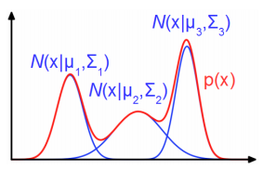
An Example: Mixture Models
If the $z_{n}$ were known, it just becomes generative classification, for which which we know how to estimate $θ$ and $φ$, given training data
25
Assume $K$ probability distributions (e.g., Gaussians), one for each cluster
The log-likelihood will be
$p(x)$ is a Gaussian mixture model (GMM)
$$p\left(z_{n} | φ\right)=multinoulli(π)$$
Parameters of the $K$ distributions, e.g,. ${θ= \left\{μ_{k}, Σ_{k}\right\}}_{k=1}^{K}$
(also means $p\left(z_{n}=k | φ\right)=π_{k})$
$$θ$$
Discrete latent variable (with $K$ possible values) or a one-hot vector of length $K$. Modeled by a multinoulli distribution as prior
Assumed generated from one of the $K$ distributions depending on the true (but unknown) value of $z_{n}$(which clustering will find))
The likelihood distributions
The parameter vector $π=\left[π_{1},π_{2},…,π_{K}\right]$ of the multinoulli distribution
$$φ$$
$$z_{n}$$
$$x_{n}$$
$$N$$
$$p\left(x_{n} | z_{n}=k,θ\right)= 𝒩\left(μ_{k},Σ_{k}\right)$$
MLE on this objective won’t give closed form solution for the parameters
$$log p\left(x_{n} | Θ\right)= log\sum_{k=1}^{K}{p\left(x_{n},z_{n}=k | Θ\right)}$$
$$= log\sum_{k=1}^{K}{p\left(z_{n}=k | φ\right)p(x_{n}|z_{n}=k,θ)}=log\sum_{k=1}^{K}{π_{k}𝒩\left({x_{n}|μ}_{k},Σ_{k}\right)}$$

Slide 26
Detour: MLE for Generative Classification
Assume a $K$ class generative classification model with Gaussian class-conditionals
Assume class $k=1,2,…,K$ is modeled by a Gaussian with mean $μ_{k}$ and cov matrix $Σ_{k}$
The labels $z_{n}$ (known) are one-hot vecs. Also, $z_{nk}=1$if $z_{n}= k$, and $z_{nk}=0$, o/w
Assuming class prior as $p$($z_{n}=k)=π_{k}$, the model has params $Θ={\{π_{k},μ_{k},Σ_{k}\} }_{k=1}^{K}$
Given training data ${\{x_{n}, z_{n}\} }_{n=1}^{N}$, the MLE solution will be
$${\hat{π}}_{k}= \frac{1}{N}\sum_{n=1}^{N}{z_{nk}}$$
Same as $\frac{N_{k}}{N}$ where $N_{k}$ is # of training ex. for which $y_{n}= k$
$${\hat{μ}}_{k}= \frac{1}{N_{k}}\sum_{n=1}^{N}{z_{nk}x_{n}}$$
Same as $\frac{1}{N_{k}}\sum_{n:z_{n}=k}^{N}{x_{n}}$
$${\hat{Σ}}_{k}= \frac{1}{N_{k}}\sum_{n=1}^{N}{z_{nk}{(x}_{n}−{\hat{μ}}_{k}){{(x}_{n}−{\hat{μ}}_{k})}^{⊤}}$$
Same as $\frac{1}{N_{k}}\sum_{n:z_{n}=k}^{N}{{(x}_{n}−{\hat{μ}}_{k}){{(x}_{n}−{\hat{μ}}_{k})}^{⊤} }$

Slide 27
Detour: MLE for Generative Classification
Here is a formal derivation of the MLE solution for $Θ={\{π_{k},μ_{k},Σ_{k}\} }_{k=1}^{K}$
$$\hat{Θ}= {argmax}_{Θ} p(X,Z|Θ)$$
$= {argmax}_{Θ} \prod_{n=1}^{N}{p(x_{n},z_{n}|Θ)}$
multinoulli
Gaussian
$= {argmax}_{Θ} \prod_{n=1}^{N}{p(z_{n}|Θ)}$ $p({x_{n}|z}_{n},Θ)$
In general, in models with probability distributions from the exponential family, the MLE problem will usually have a simple analytic form
$= {argmax}_{Θ} \prod_{n=1}^{N}{\prod_{k=1}^{K}{π_{k}^{z_{nk}}}}$ $\prod_{k=1}^{K}{{p({x_{n}|z}_{n}=k,Θ)}^{z_{nk}}}$
Also, due to the form of the likelihood (Gaussian) and prior (multinoulli), the MLE problem had a nice separable structure after taking the log
$$= {argmax}_{Θ} \prod_{n=1}^{N}{\prod_{k=1}^{K}{{{[π}_{k}p({x_{n}|z}_{n}=k,Θ)]}^{z_{nk}}}}$$
$$= {argmax}_{Θ} log\prod_{n=1}^{N}{\prod_{k=1}^{K}{{{[π}_{k}p({x_{n}|z}_{n}=k,Θ)]}^{z_{nk}}}}$$
Can see that, when estimating the parameters of the $k^{th}$Gaussian ($π_{k},μ_{k},Σ_{k}$), we only will only need training examples from the $k^{th}$class, i.e., examples for which $z_{nk}=1$
$$= {argmax}_{Θ} \sum_{n=1}^{N}{\sum_{k=1}^{K}{z_{nk}[log π_{k}+ log 𝒩\left({x_{n}|μ}_{k},Σ_{k}\right)]}}$$
The form of this expression is important; will encounter this in GMM too

Slide 28

EM for Mixture Models
28
So how do we estimate the parameters of a GMM where $z_{n}$’s are unknown?
The guess about $z_{n}$ can be in one of the two forms
  A “hard” guess – a single best value ${\hat{z}}_{n}$(some “optimal” value of the random variable $z_{n}$)
  The “expected” value $𝔼\left[z_{n}\right]$ of the random variable $z_{n}$
Using the hard guess ${\hat{z}}_{n}$ of $z_{n}$ will result in an ALT-OPT like algorithm
Using the expected value of $z_{n}$ will give the so-called Expectation-Maximization (EM) algo
Well, you kind of already know how to do this. ☺ Remember generative classification?
Hmmmm.. So can we make a guess what the value of each $z_{n}$ and then estimate $θ$ and $φ$ as we do in case of generative classification??
$$θ$$
Yes, exactly. ☺ However, just like in gen-class, you will need to repeat the guess and estimate them a few times until you converge
$$φ$$
$$z_{n}$$
$$x_{n}$$
$$N$$
EM is pretty much like ALT-OPT but with soft/expected values of the latent variables

Slide 29
EM for Gaussian Mixture Model (GMM)
Expectation of CLL
EM finds $Θ_{MLE}$ by maximizing $𝔼\left[log p\left(X,Z | Θ\right)\right]$ rather than $log p\left(X,\hat{Z} | Θ\right)$
Note: Expectation will be w.r.t. the conditional posterior distribution of $Z$, i.e., $p(Z|X,Θ)$
The EM algorithm for GMM operates as follows
  Initialize $Θ= {\{π_{k}, μ_{k}, Σ_{k}\}}_{k=1}^{K}$ as $\hat{Θ}$
  Repeat until convergence
    Compute conditional posterior $p(Z|X,\hat{Θ})$. Since obs are i.i.d, compute separately for each $n$ (and for $k=1,2,..K$)
    Update $Θ$ by maximizing the expected complete data log-likelihood
It is “conditional” posterior because it is also conditioned on $Θ$, not just data $X$
Requires knowing $Θ$
Needed to get the expected CLL
Same as $p(z_{nk}=1| x_{n},\hat{Θ}),$just a different notation
$$p\left(z_{n}=k | x_{n},\hat{Θ}\right)∝p\left(z_{n}=k | \hat{Θ}\right) p\left(x_{n} | z_{n}=k,\hat{Θ}\right)\text{ =} {\hat{π}}_{k}𝒩\left(x_{n}|{\hat{μ}}_{k},{\hat{Σ}}_{k}\right)$$
Solution has a similar form as ALT-OPT (or gen. class.), except we now have the expectation of $z_{nk}$being used
$${\hat{Θ}={argmax}_{Θ}𝔼}_{p(Z|X,\hat{Θ})}\left[log p\left(X,Z | Θ\right)\right]= \sum_{n=1}^{N}{𝔼_{p(z_{n}|x_{n},\hat{Θ})}\left[log p\left(x_{n},z_{n} | Θ\right)\right]}$$
$${=argmax}_{Θ}𝔼\left[\sum_{n=1}^{N}{\sum_{k=1}^{K}{ z_{nk}[log π_{k}+ log 𝒩\left({x_{n}|μ}_{k},Σ_{k}\right)]}}\right]$$
$${\hat{π}}_{k}= \frac{1}{N}\sum_{n=1}^{N}{𝔼[z_{nk}]}$$
$${\hat{μ}}_{k}= \frac{1}{N_{k}}\sum_{n=1}^{N}{𝔼[z_{nk}]x_{n}}$$
$N_{k}$ : Effective number of points in cluster k
$${=argmax}_{Θ}\sum_{n=1}^{N}{\sum_{k=1}^{K}{𝔼[z_{nk}][log π_{k}+ log 𝒩\left({x_{n}|μ}_{k},Σ_{k}\right)]}}$$
$${\hat{Σ}}_{k}= \frac{1}{N_{k}}\sum_{n=1}^{N}{𝔼[z_{nk}]{(x}_{n}−{\hat{μ}}_{k}){{(x}_{n}−{\hat{μ}}_{k})}^{⊤}}$$

Slide 30
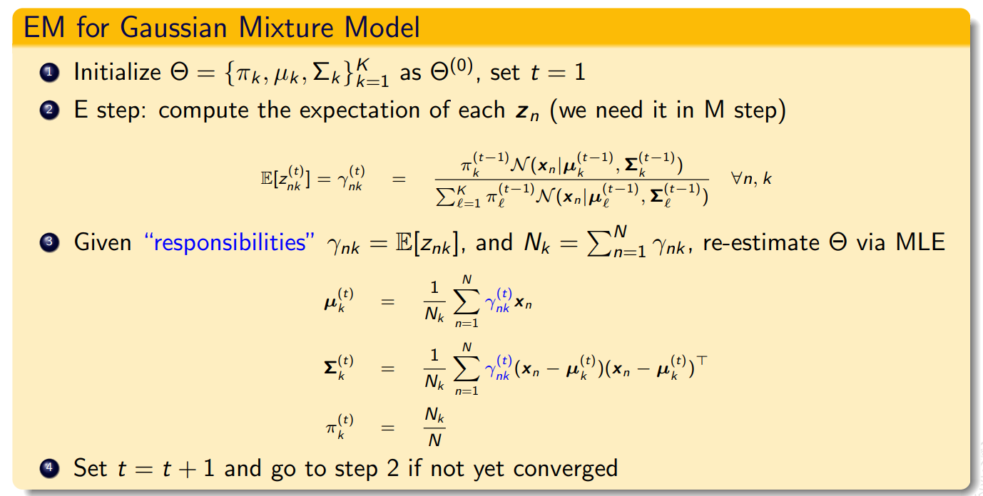
EM for GMM (Contd)
Reason: $\sum_{k=1}^{K}{γ_{nk}=1}$
Need to normalize: $𝔼\left[z_{nk}\right]= \frac{{\hat{π}}_{k}𝒩\left(x_{n}|{\hat{μ}}_{k},{\hat{Σ}}_{k}\right)}{\sum_{ℓ=1}^{K}{{\hat{π}}_{ℓ}𝒩\left(x_{n}|{\hat{μ}}_{ℓ},{\hat{Σ}}_{ℓ}\right)}}$
The EM algo for GMM required $𝔼[z_{nk}]$. Note $z_{nk}∈\{0,1\}$
$𝔼\left[z_{nk}\right]=γ_{nk}= 0×p(z_{nk}=0|x_{n},$ $\hat{Θ})+1×$ $p(z_{nk}=1|x_{n},$ $\hat{Θ})$
$= p(z_{nk}=1|x_{n},$ $\hat{Θ})$
$∝$ ${\hat{π}}_{k}𝒩\left(x_{n}|{\hat{μ}}_{k},{\hat{Σ}}_{k}\right)$
Accounts for fraction of points in each cluster
Accounts for cluster shapes (since each cluster is a Gaussian
Soft $K$-means, which is more of a heuristic to get soft-clustering, also gave us probabilities but doesn’t account for cluster shapes or fraction of points in each cluster
Effective number of points in the $k^{th}$cluster
M-step:

Slide 31

EM: Some Final Comments
31
The E and M steps may not always be possible to perform exactly. Some reasons
  The conditional posterior of latent variables $p(Z|X,Θ)$ may not be easy to compute
    Will need to approximate $p(Z|X,Θ)$ using methods such as MCMC or variational inference
  Even if $p(Z|X,Θ)$ is easy, the expected CLL may not be easy to compute
  Maximization of the expected CLL may not be possible in closed form
EM works even if the M step is only solved approximately (Generalized EM)
If M step has multiple parameters whose updates depend on each other, they are updated in an alternating fashion - called Expectation Conditional Maximization (ECM)
Other advanced probabilistic inference algos are based on ideas similar to EM
  E.g., Variational EM, Variational Bayes (VB) inference, a.k.a. Variational Inference (VI)
Results in Monte-Carlo EM
Can often be approximated by Monte-Carlo using sample from the CP of $Z$

