Slide 1
Course Logistics and Introduction to Probabilistic Machine Learning
CS772A: Probabilistic Machine Learning
Piyush Rai

Slide 2
Course Logistics
2
Course Name: Probabilistic Machine Learning – CS772A
2 classes each week
  Mon/Thur 18:00-19:15
  Venue: RM-101
Attendance policy: None but biometric attendance will be taken
All material (readings etc) will be posted on course webpage (internal access)
  URL: https://web.cse.iitk.ac.in/users/piyush/courses/pml_spring25/pml.html
Q/A and announcements on Piazza. Please sign up
  URL: https://piazza.com/iitk.ac.in/secondsemester2025/cs772
  If need to contact me by email (piyush@cse.iitk.ac.in), prefix subject line with “CS772”
Unofficial auditors are welcome

Slide 3
Workload and Grading Policy
3
3 quizzes: 30%
  In class, closed-book
Mid-sem exam: 20% (date as per DOAA schedule). Closed book
End-sem exam: 30% (date as per DOAA schedule). Closed book
Research project (to be done in groups of 4-5): 20%
  Some topics will be suggested (research papers)
  You can propose your own topic (but must be related to probabilistic ML)
  More details will be shared soon
Proration: If you miss any quiz/mid-sem, we can prorate it using end-sem marks
  Proration only allowed on limited grounds (e.g., health related)

Slide 4
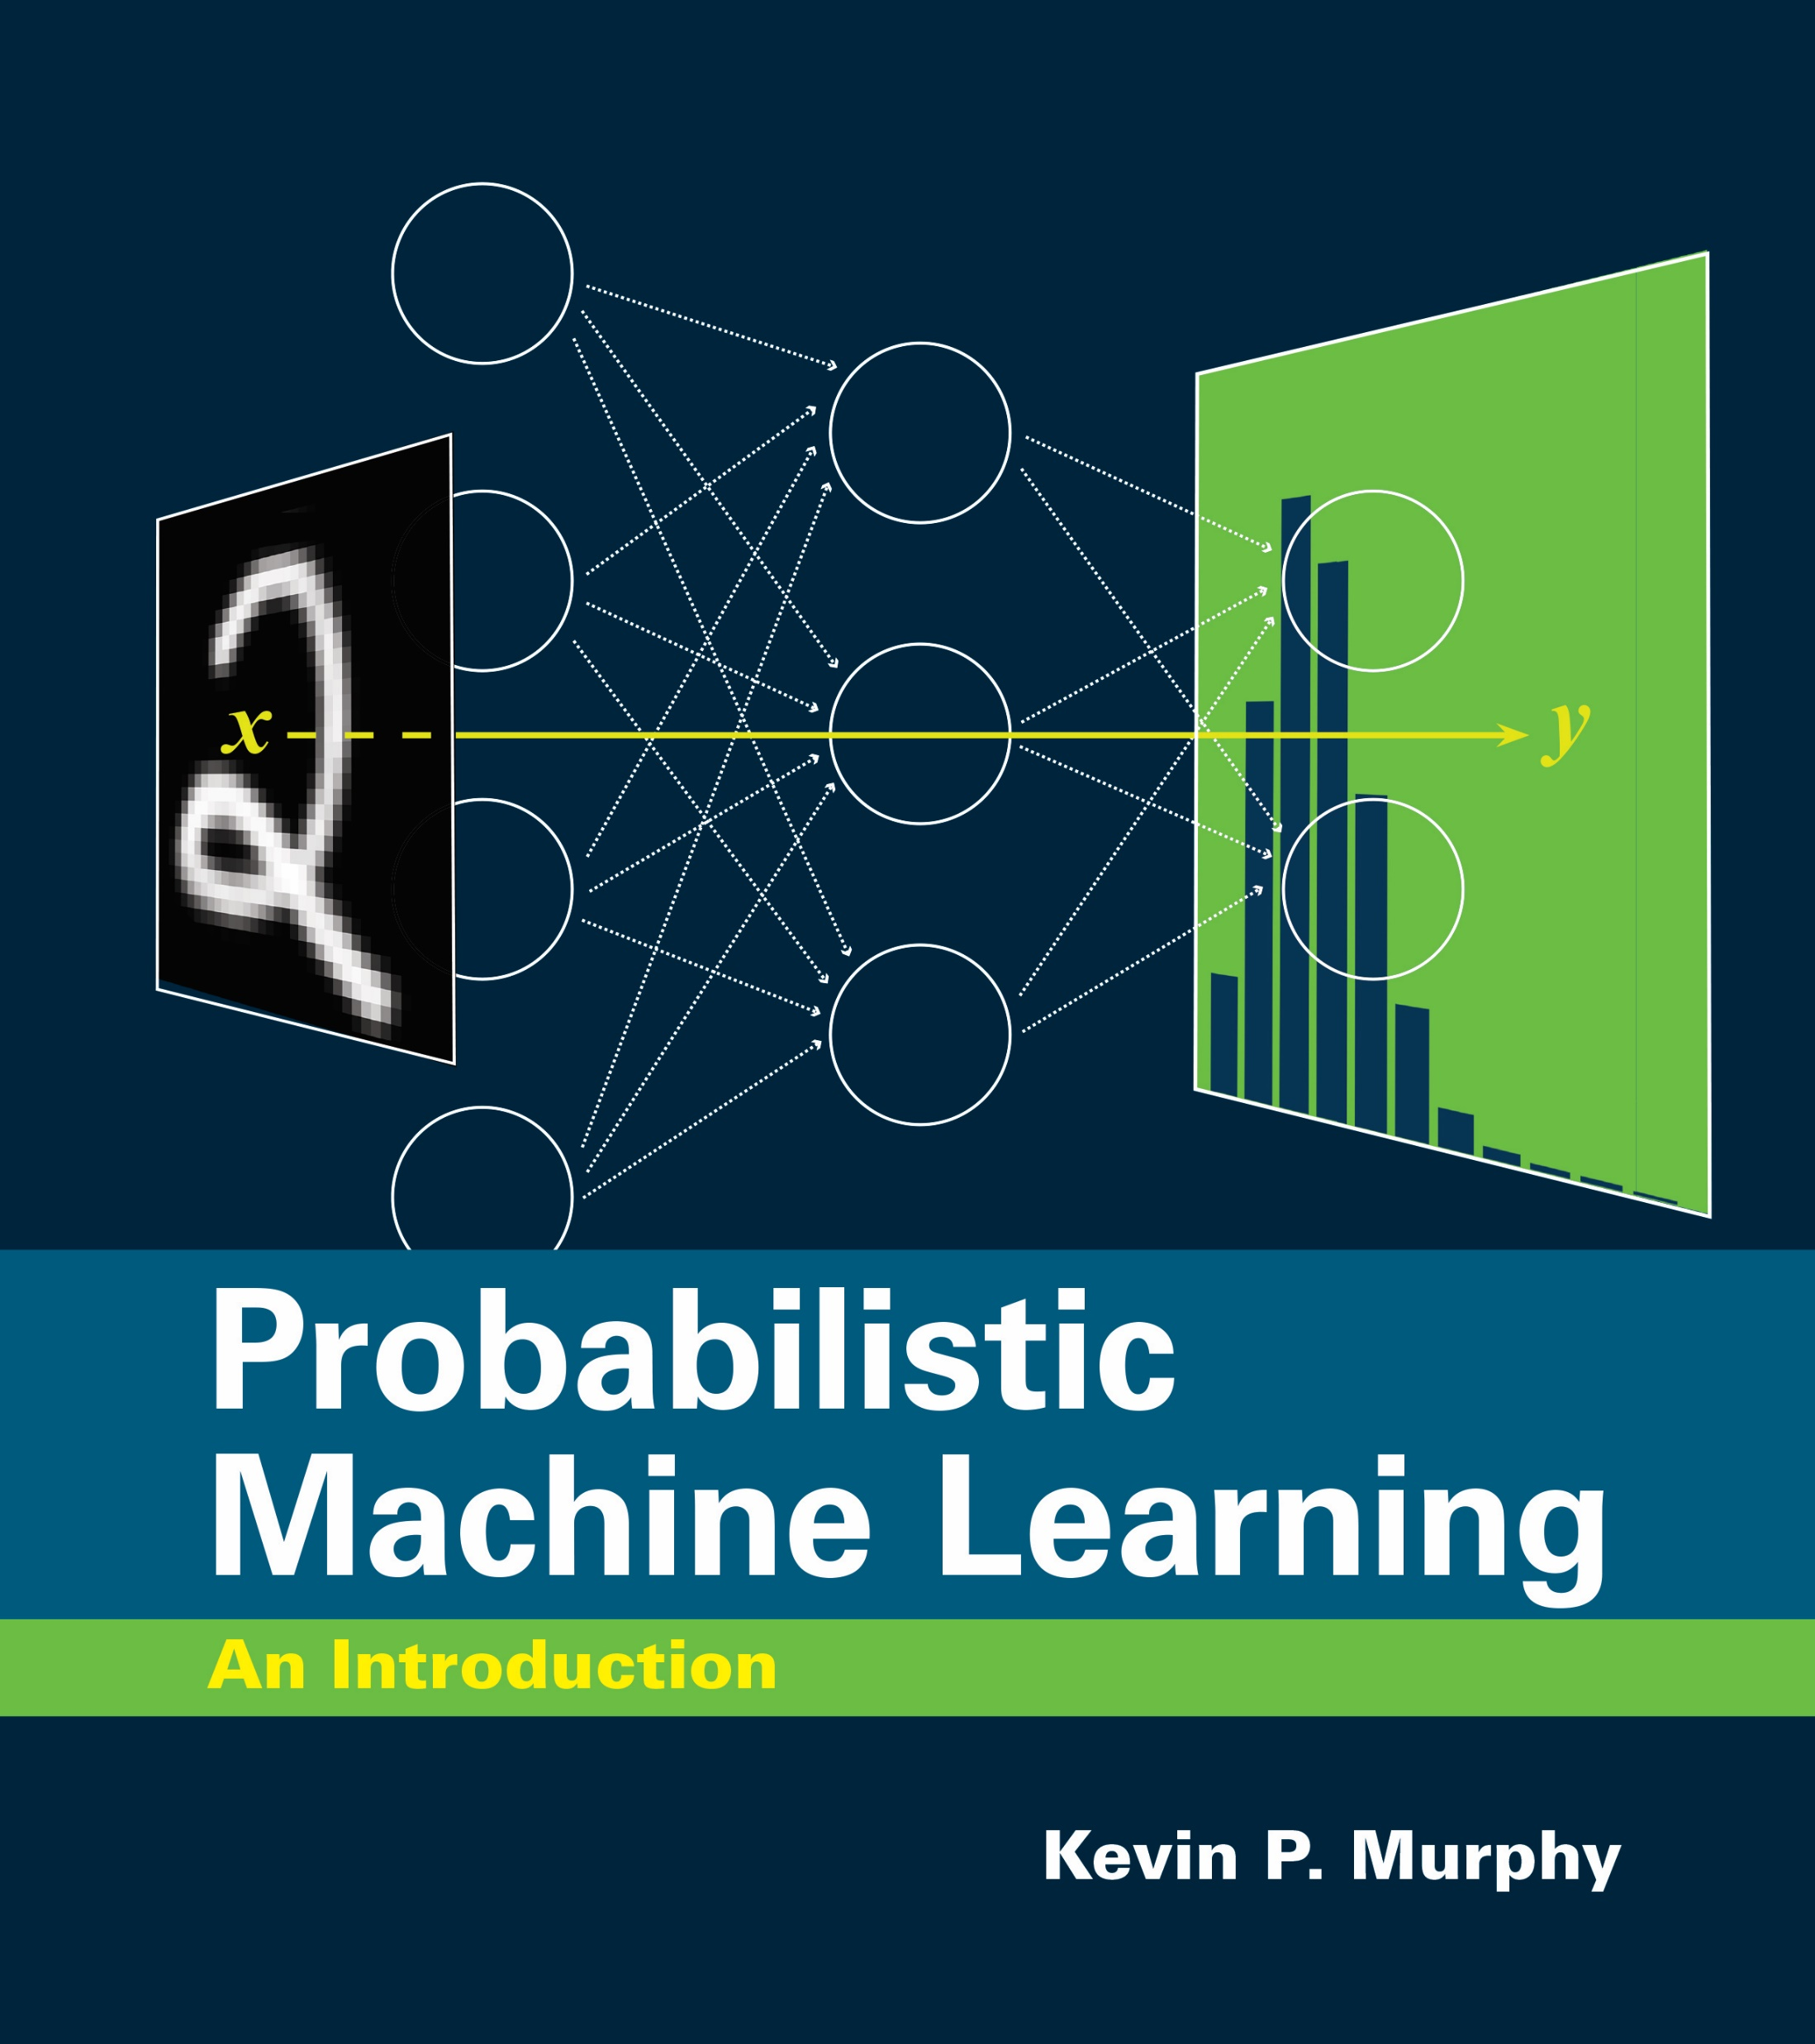
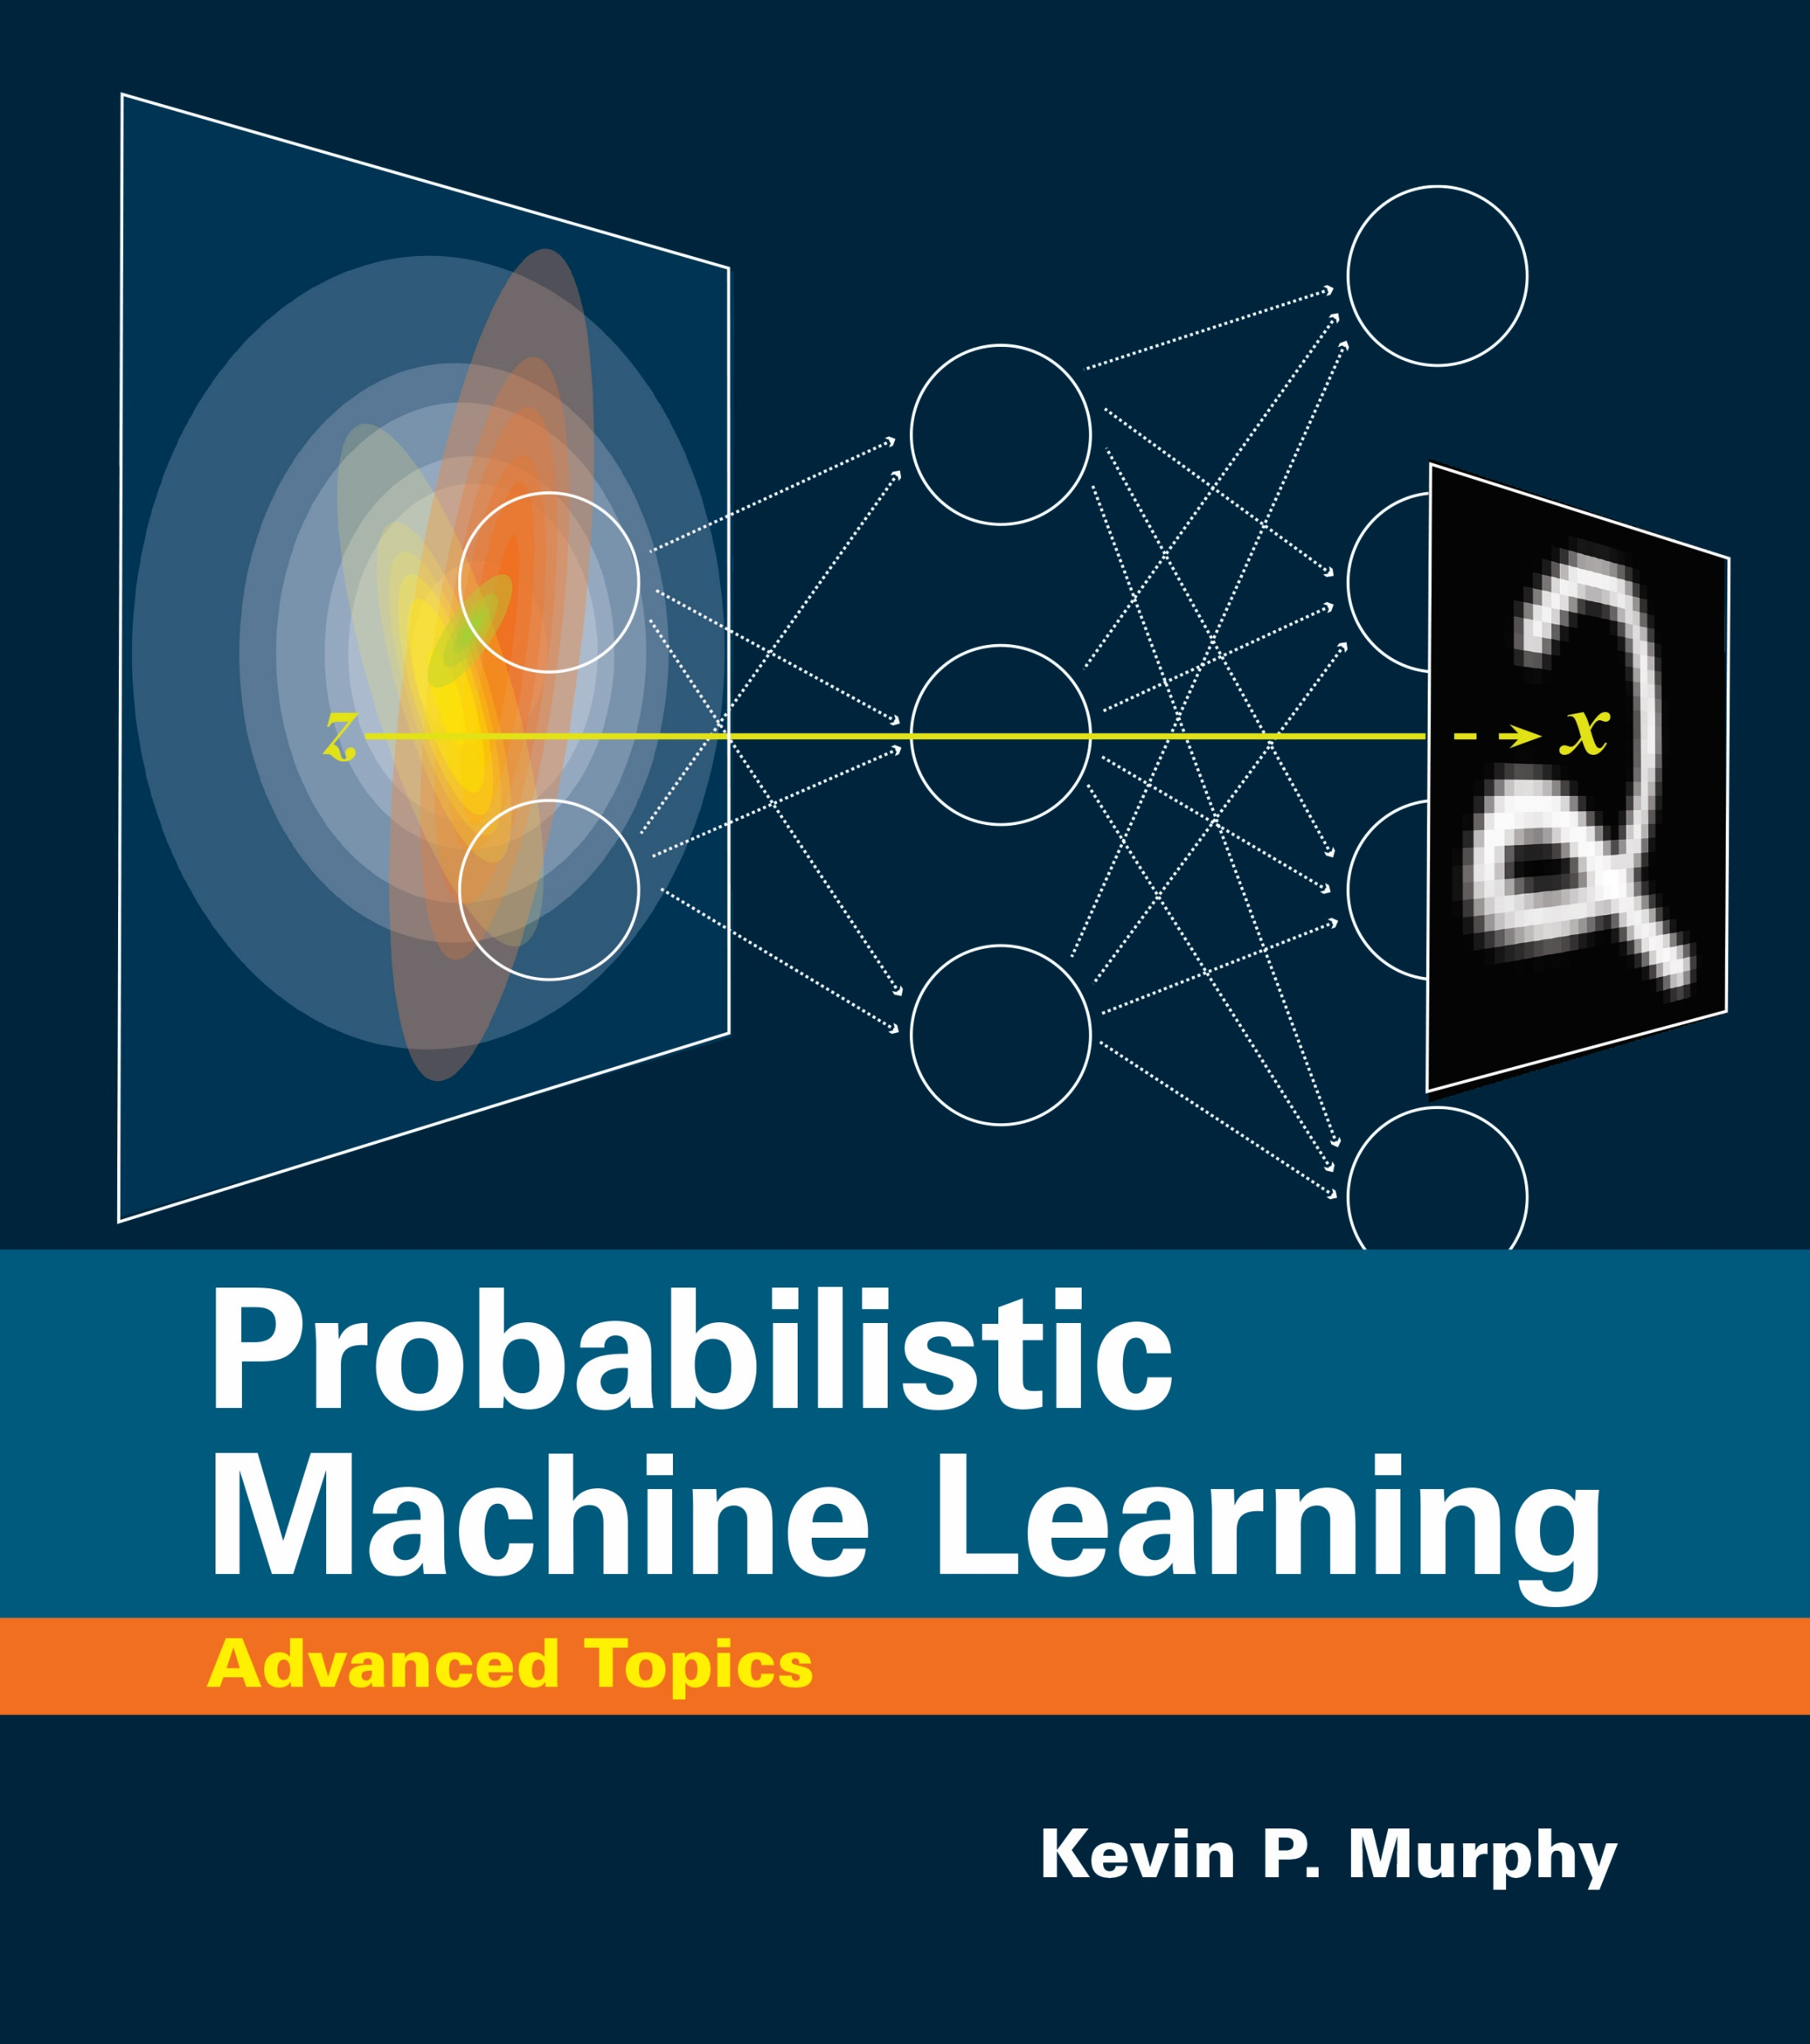
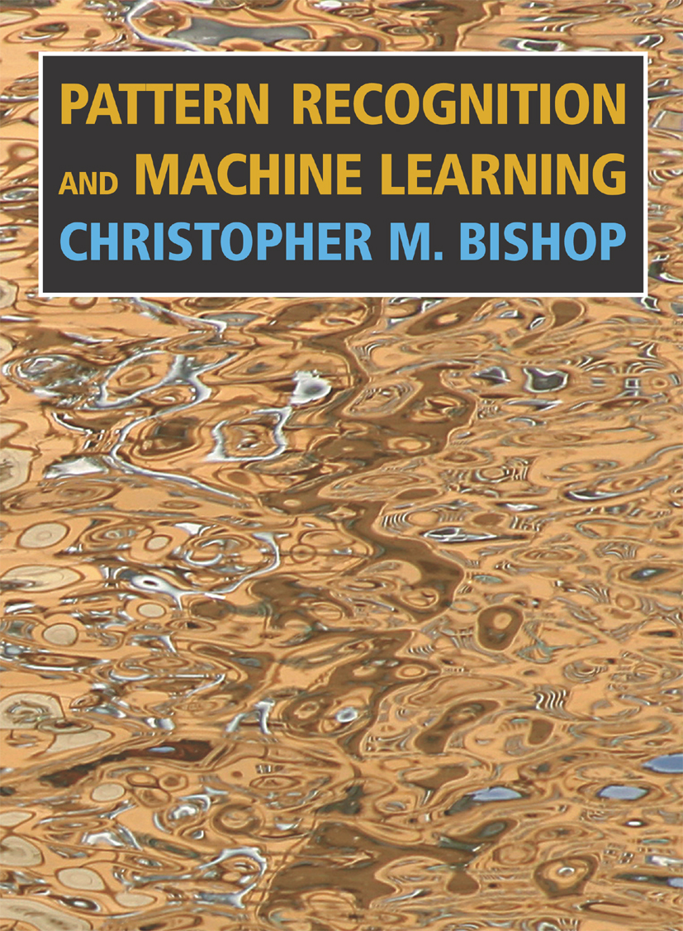
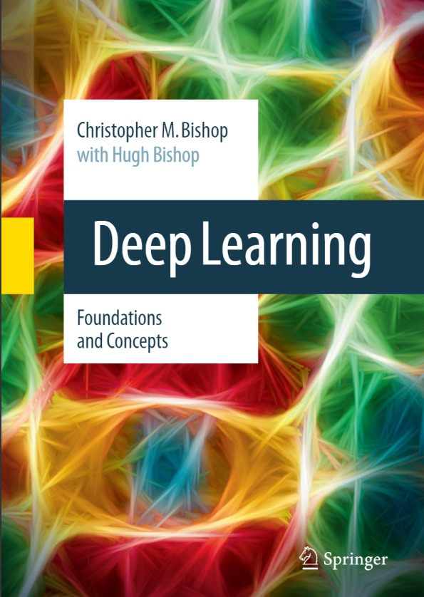
Textbooks and Readings
4
Some books that you may use as reference (freely available online)
  Kevin P. Murphy, Probabilistic Machine Learning: An Introduction (PML-1), The MIT Press, 2022.
  Kevin P. Murphy, Probabilistic Machine Learning: Advanced Topics(PML-2), The MIT Press, 2022.
  Chris Bishop, Pattern Recognition and Machine Learning (PRML), Springer, 2007.
  Chris Bishop and Hugh Bishop, Deep Learning: Foundations and Concepts (DLFC), Springer, 2023.
Follow the suggested readings for each lecture (may also include some portions from these books), rather than trying to read these books in a linear fashion

Slide 5

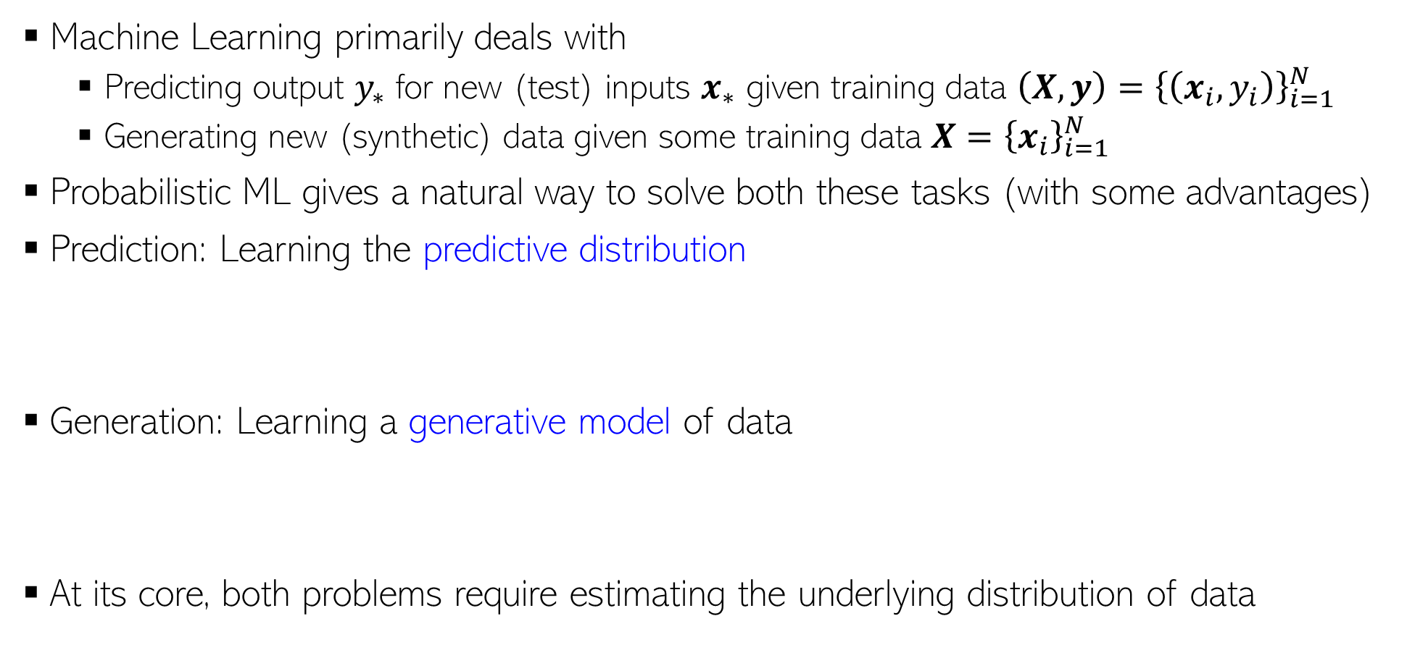
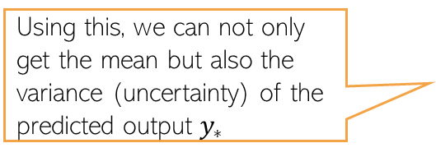

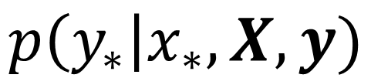
Probabilistic Machine Learning
5
Machine Learning primarily deals with
  Predicting output $y_{∗}$ for new (test) inputs $x_{∗}$ given training data $\left(X,y\right)={\left\{\left(x_{i}, y_{i}\right)\right\}}_{i=1}^{N}$
  Generating new (synthetic) data given some training data $X={\left\{x_{i}\right\}}_{i=1}^{N}$
Probabilistic ML gives a natural way to solve both these tasks (with some advantages)
Prediction: Learning the predictive distribution
Generation: Learning a generative model of data
At its core, both problems require estimating the underlying distribution of data
PML is about estimating these distributions accurately and efficiently
Using this, we can not only get the mean but also the variance (uncertainty) of the predicted output $y_{∗}$
$$p\left(y_{∗}\right|x_{∗}, X,y)$$
Estimating them exactly is hard in general but we can use approximations
Can “sample” (simulate) from this distribution to generate new data
$$p\left(x_{∗}\right|X)$$
Both are conditional distributions

Slide 6
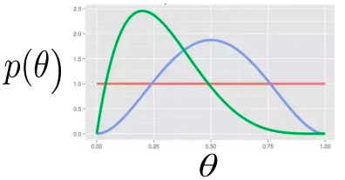
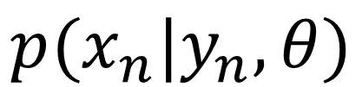
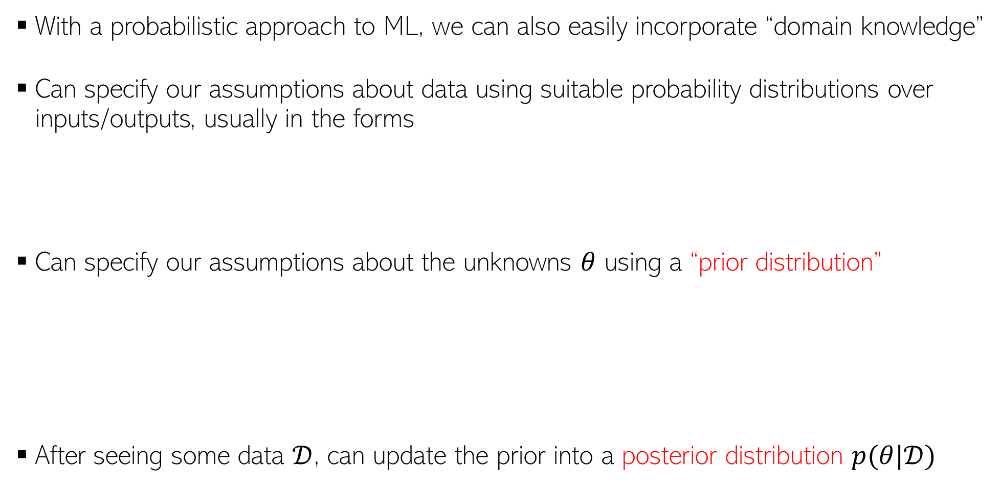


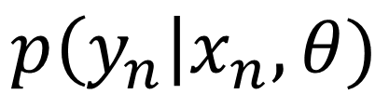
Probabilistic Machine Learning
6
With a probabilistic approach to ML, we can also easily incorporate “domain knowledge”
Can specify our assumptions about data using suitable probability distributions over inputs/outputs, usually in the forms
Can specify our assumptions about the unknowns $θ$ using a “prior distribution”
After seeing some data $𝒟$, can update the prior into a posterior distribution $p(θ|𝒟)$
$$p(x_{n}|y_{n},θ)$$
Distribution of the input conditioned on its “label/output”
Probability distribution of the output as a function of input
$$p\left(y_{n}\right|x_{n}, θ)$$
$$p(x_{n}|θ)$$
Distribution of the inputs
Unknown parameters of this distribution
Represents our belief about the unknown parameters before we see the data
$$p(θ)$$

Slide 7






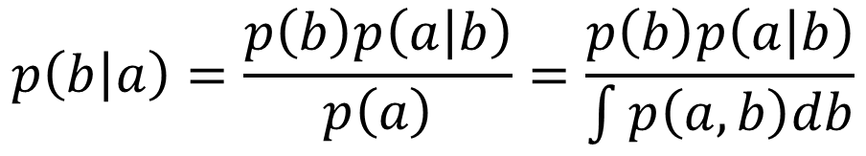
The Core of PML: Two Basic Rules of Probability
7
Sum Rule (marginalization): Distribution of $a$ considering for all possibilities of $b$
Product Rule
These two rules are the core of most of probabilistic/Bayesian ML
  Bayes rule easily derived from the sum and product rules
$$p\left(a\right)=\sum_{b}{p(a,b)}$$
$$p\left(a\right)= \int{p\left(a,b\right)db}$$
If $b$ is a discrete r.v.
If $b$ is a continuous r.v.
or
$$p\left(a,b\right)=p\left(a\right)p\left(b | a\right)=p\left(b\right)p\left(a | b\right)$$
$$p\left(b | a\right)=\frac{p\left(b\right)p\left(a | b\right)}{p\left(a\right)}=\frac{p\left(b\right)p\left(a | b\right)}{\int{p\left(a,b\right)db}}$$
Assuming $b$ is a continuous r.v.

Slide 8
ML and Uncertainty
(and how PML handles uncertainty)
8

Slide 9
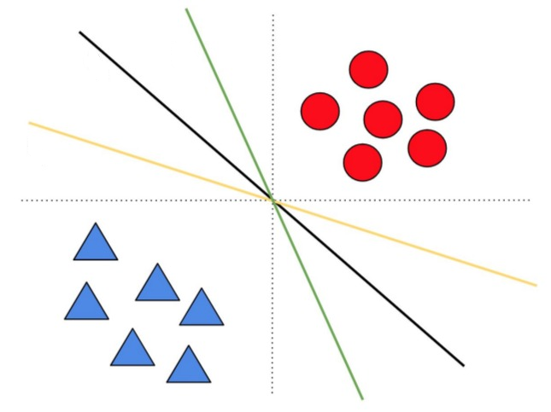
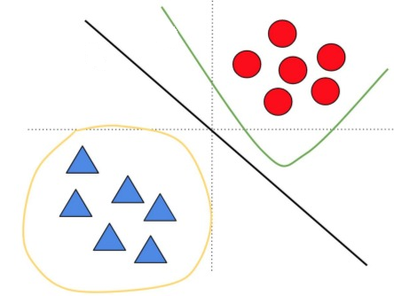
Uncertainty due to Limited Training Data
9
Model/parameter uncertainty is due to not having enough training data
Also called epistemic uncertainty. Usually reducible
  Vanishes with “sufficient” training data
Same model class (linear models)
but uncertainty about the weights
Uncertainty not just about the weights but also the model class
3 different model classes considered here (with linear, polynomial, circular decision boundaries)
Each model class itself will have uncertainty(like left fig) since there isn’t enough training data
Image credit: Balaji L, Dustin T, Jasper N. (NeurIPS 2020 tutorial)

Slide 10
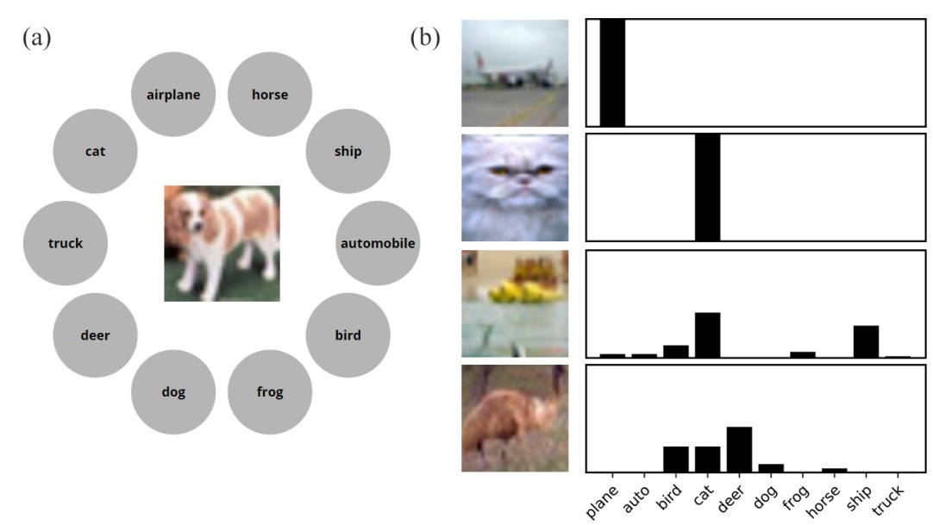
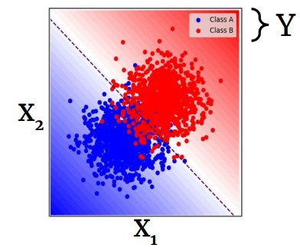
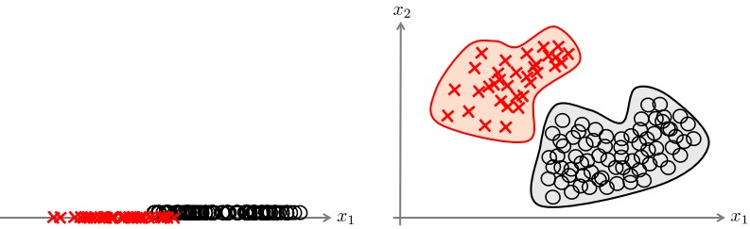
Uncertainty due to Inherent Noise in Training Data
10
Data uncertainty can be due to various reasons, e.g.,
  Intrinsic hardness of labeling, class overlap
  Labeling errors/disagreements (for difficult training inputs)
  Noisy or missing features
Also called aleatoric uncertainty. Usually irreducible
  Won’t vanish even with infinite training data
  Note: Can sometimes vanish by adding more features
  (figure on the right) or switching to a more complex model
Image credit: Eric Nalisnick
Image source: “Improving machine classification using human uncertainty measurements” (Battleday et al, 2021)
Image source: “Aleatoric and epistemic uncertainty in machine learning: an introduction to concepts and methods” (H&W 2021)

Slide 11
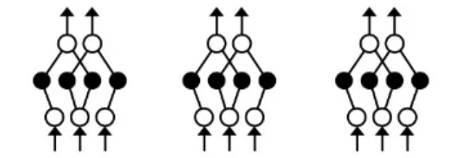
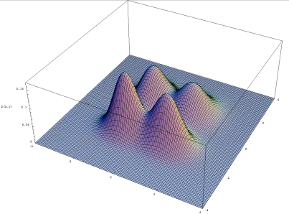
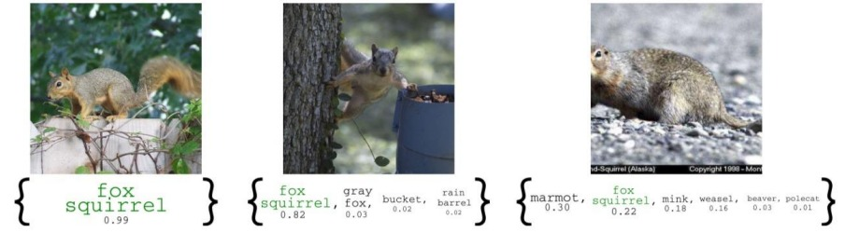
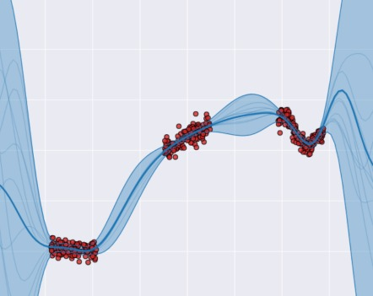









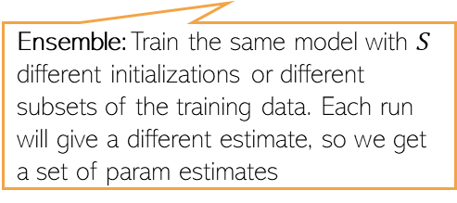

How to Estimate Uncertainty?
11
11
In this course, we will mostly focus on the Bayesian approach but other two approaches are also popular and will also be discussed
Uncertainty in parameters: This can be estimated/quantified via mainly three ways:
Uncertainty in predictions: Usually estimated by computing and reporting the mean and variance of predictions made using many possible values of $θ$. Commonly reported as:
Sampling multiple training sets and estimating the parameters from each training set
$$θ^{(1)}$$
$$θ^{(2)}$$
$$θ^{(S)}$$
$$p(θ|𝒟)$$
A case of 2-dim $θ$
Bayesian way: Treat params as random variables and estimate their distribution conditioned on the given training data (a.k.a. posterior distribution)
$$θ_{2}$$
Frequentist way: Treat params as fixed unknowns and estimate them using multiple datasets. This yields a set/distribution over the params(not a “posterior” but a distribution nevertheless!)
Ensemble: Train the same model with $S$ different initializations or different subsets of the training data. Each run will give a different estimate, so we get a set of param estimates
$$θ_{1}$$
Predictive Distribution
Can get both mean and variance/quantiles of the prediction
$$p(y_{∗}|x_{∗},𝒟)$$
Sets/intervals of possible predictions

Slide 12
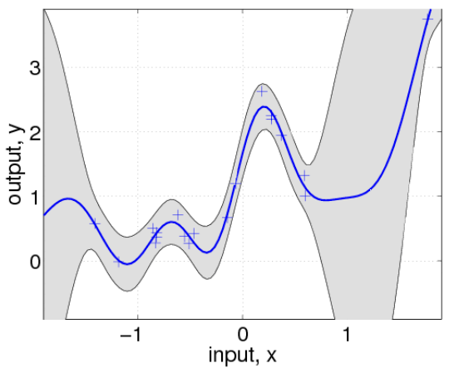

Predictive Uncertainty
12
Information about uncertainty gives an idea about how much to trust a prediction
It can also “guide” us in sequential decision-making:
Applications in active learning, reinforcement learning, Bayesian optimization, etc
Test output
Test input
Given our current estimate of the regression function, which training input(s) should we add next to improve its estimate the most?
$$p\left(y_{∗}\right|x_{∗}, D)= 𝒩(y_{∗}|μ_{∗}, σ_{∗}^{2})$$
Training data
Blue curve is the mean of the function (learned so far using the available data), shaded region denotes the current predictive uncertainty
Uncertainty can help here: Acquire training inputs from regions where the function is most uncertain about its current predictions

Slide 13
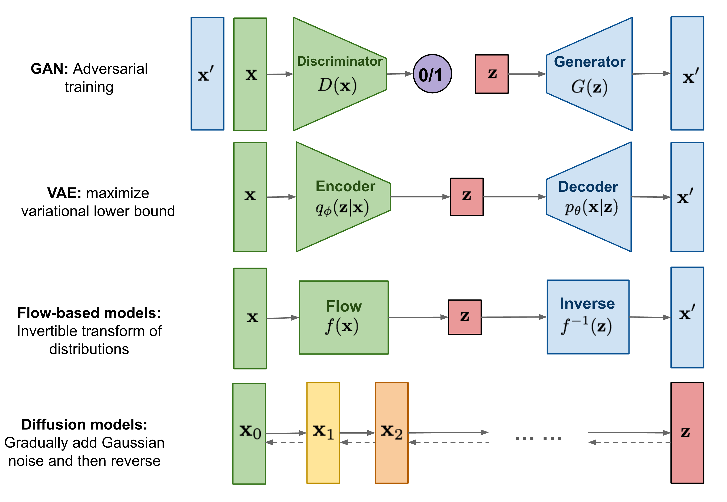
Generative Models
13
PML is not just about parameter/predictive uncertainty
Generative models invariably are also probabilistic models
Learning such models will also be a topic of study in this course
Figure credit: Lilian Weng

Slide 14
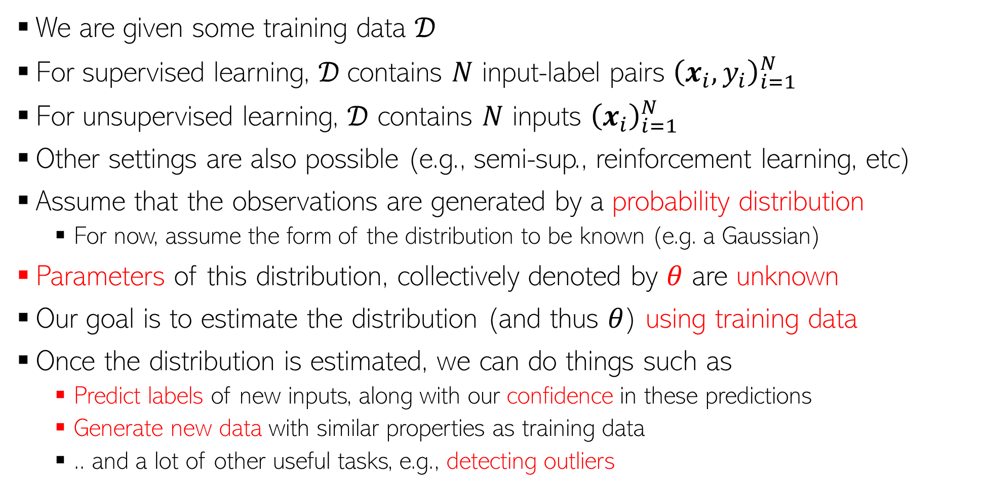
Probabilistic Modeling of Data: The Setup
14
We are given some training data $𝒟$
For supervised learning, $𝒟$contains $N$ input-label pairs ${\left(x_{i}, y_{i}\right)}_{i=1}^{N}$
For unsupervised learning, $𝒟$ contains $N$ inputs ${\left(x_{i}\right)}_{i=1}^{N}$
Other settings are also possible (e.g., semi-sup., reinforcement learning, etc)
Assume that the observations are generated by a probability distribution
  For now, assume the form of the distribution to be known (e.g. a Gaussian)
Parameters of this distribution, collectively denoted by $θ$ are unknown
Our goal is to estimate the distribution (and thus $θ$) using training data
Once the distribution is estimated, we can do things such as
  Predict labels of new inputs, along with our confidence in these predictions
  Generate new data with similar properties as training data
  .. and a lot of other useful tasks, e.g., detecting outliers

Slide 15
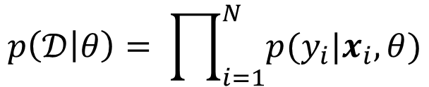

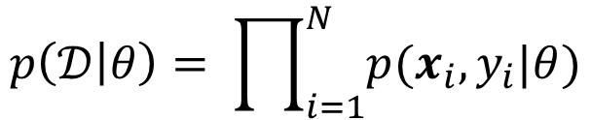



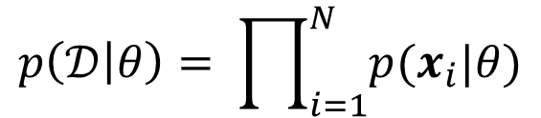
Probabilistic Modeling of Data: The Setup
15
We will denote the data distribution as $p_{θ}(𝒟)$ or $p(𝒟|θ)$
Assume that, conditioned on $θ$, observations are independently and identically distributed (i.i.d. assumption). Depending on the problem, this may look like:
Assume that both training and test data come from the same distribution
  This assumption, although standard, may be violated in real-world applications of ML and there are “adaptation” methods to handle that
Supervised generative model (both inputs and output are modeled using a distribution)
i.i.d.
$$p\left(𝒟 | θ\right)= \prod_{i=1}^{N}{p(x_{i},y_{i}|θ)}$$
$$(x_{n},y_{n})∼p(x,y|θ)$$
Supervised discriminative model (only the output is modeled using a distribution); input is assumed “given” and not modeled
i.i.d.
$$p\left(𝒟 | θ\right)= \prod_{i=1}^{N}{p(y_{i}|x_{i},θ)}$$
$$y_{n}∼p(y|x,θ)$$
i.i.d.
$$p\left(𝒟 | θ\right)= \prod_{i=1}^{N}{p(x_{i}|θ)}$$
Unsupervised generative model (there are only inputs; no labels)
$$x_{n}∼p(x|θ)$$

