Slide 1
Introduction to Gaussian Processes
(Kernel Methods meet Bayesian Learning)
CS772A: Probabilistic Machine Learning
Piyush Rai

Slide 2
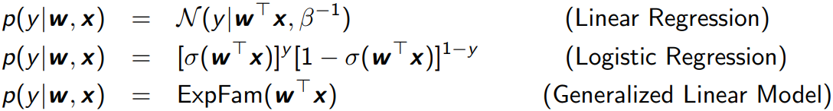
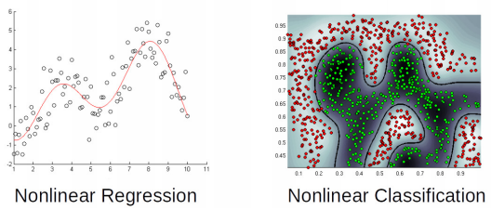
Linear Models and Their Limitations
2
Consider learning to map an input $x$ to the output $y$
We’ve seen various discriminative models (linear and generalized linear models)
These have limited expressive power – can’t learn nonlinear patterns
Natural param of canonical GLM

Slide 3
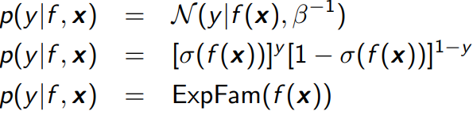

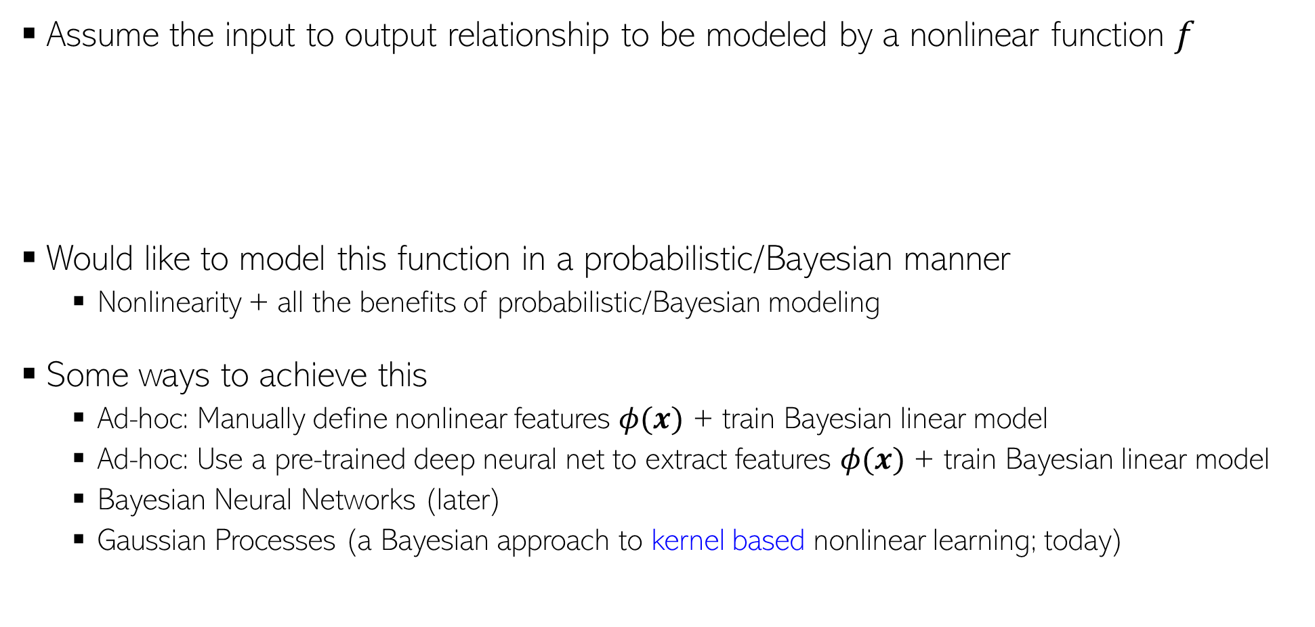
Learning Nonlinear Functions
3
Assume the input to output relationship to be modeled by a nonlinear function $f$
Would like to model this function in a probabilistic/Bayesian manner
  Nonlinearity + all the benefits of probabilistic/Bayesian modeling
Some ways to achieve this
  Ad-hoc: Manually define nonlinear features $φ(x)$ + train Bayesian linear model
  Ad-hoc: Use a pre-trained deep neural net to extract features $φ(x)$ + train Bayesian linear model
  Bayesian Neural Networks (later)
  Gaussian Processes (a Bayesian approach to kernel based nonlinear learning; today)
In all of these, the linear score $w^{⊤}x$ has been replaced by a nonlinear function $f(x)$
Example: Assuming $x$ is scalar, $φ\left(x\right)=[1,x,x^{2},…, x^{k}]$, for some $k$

Slide 4

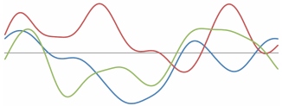
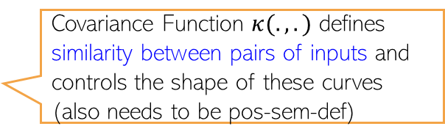
Gaussian Process
Hmmm.. So GPs look like kernel methods with all the benefits of probabilistic/Bayesian modeling
4
Any choice of the GP covariance function has an associated feature map $φ(x)$ for the inputs $x$
A Gaussian Process (GP) defines a distribution over functions and is denoted as
Every draw/sample from $𝒢𝒫(μ, κ)$ will give a random function $f$
IMP: If $f \sim 𝒢𝒫(μ, κ)$ then $f$’s value at any finite set of inputs is jointly Gaussian
Akin to how we define a Gaussian distribution over scalars/vectors, defined by a mean and variance/covariance matrix
Mean Function
Covariance Function
Can also think of a function as an infinite dimensional vector of function’s values at different inputs ($x$), i.e.,
$$f=[f\left(x_{1}\right), f\left(x_{2}\right),f\left(x_{3}\right),…]$$
$$𝒢𝒫(μ(.), κ(.,.))$$
$μ$ and $κ$ can be pre-defined or can even be learned
$$f(x)$$
Each of these curves is a random function drawn from the GP
$$x$$
Mean Function $μ(.)$ defines the “average” function looks like:
$$μ\left(x\right)= 𝔼[f\left(x\right)]$$
Covariance Function $κ(.,.)$ defines similarity between pairs of inputs and controls the shape of these curves (also needs to be pos-sem-def)
Can concisely write it as
$$p\left(f\right)= 𝒩(μ,K)$$
$$p\left(\left[\begin{aligned}f(x_{1}) \\ f\left(x_{2}\right) \\ ⋮ \\ f(x_{N})\end{aligned}\right]\right)= 𝒩\left(\left[\begin{aligned}μ(x_{1}) \\ μ\left(x_{2}\right) \\ ⋮ \\ μ(x_{N})\end{aligned}\right],\left[\begin{matrix}\begin{aligned}κ\left(x_{1},x_{1}\right) \\ κ\left(x_{2},x_{1}\right)\end{aligned} & ⋯ & \begin{aligned}κ(x_{1},x_{N}) \\ κ\left(x_{2},x_{N}\right)\end{aligned} \\ ⋮ & ⋱ & ⋮ \\ κ(x_{N},x_{1}) & ⋯ & κ(x_{N},x_{N})\end{matrix}\right]\right)$$
Very useful property for making predictions: Knowing $f$’s value at some $N$ “training” inputs, say, $x_{1},x_{2},…,x_{N}$, we can easily compute its value at a new test input $x_{∗}$, using the Gaussian joint-to-conditional formula
$N×1$vector of $f$’s values: $f$
$N×1$mean vector: $μ$
$N× N$cov/kernel matrix (PSD): $K$

Slide 5
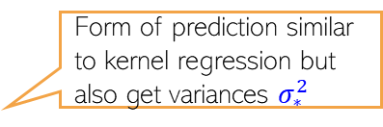
Predicting using GP
The results we saw here relating the score $f_{∗}$to $f$ will still hold ☺
5
We just need to use a likelihood model for $y_{n}$to handle such “noisy settings (will see soon)
For example
$$p\left(y_{n} | f_{n}\right)= 𝒩({y_{n}|f}_{n},β^{−1})$$
$$p\left(y_{n} | f_{n}\right)= Bernoulli(y_{n}|{σ(f}_{n}))$$
The setting considered on this slide is the “noiseless” setting where the response $y_{n}$ is simply given by $y_{n} =f_{n}= f\left(x_{n}\right)$. More realistic settings with have each output $y_{n}$ as a transformation of a “score” given by GP: $f_{n} = f\left(x_{n}\right)$
We have already seen that
Let’s assume the mean function $μ\left(x\right)=0$, thus $μ=0$ and $p\left(f\right)= 𝒩(0,K)$
Assume we know $f=\left[f\left(x_{1}\right),f\left(x_{2}\right),…, f\left(x_{N}\right)\right]$ and want to compute $f(x_{∗})$
Due to the GP property, joint distribution of $f$’s values will always be Gaussian
Exercise: Show that predictive mean $μ_{∗}= \sum_{i=1}^{N}{β_{i}f_{i}}=\sum_{i=1}^{N}{α_{i}κ(x_{i}, x_{∗})}$
$$p\left(\left[\begin{aligned}f(x_{1}) \\ f\left(x_{2}\right) \\ ⋮ \\ f(x_{N})\end{aligned}\right]\right)= 𝒩\left(\left[\begin{aligned}μ(x_{1}) \\ μ\left(x_{2}\right) \\ ⋮ \\ μ(x_{N})\end{aligned}\right],\left[\begin{matrix}\begin{aligned}κ\left(x_{1},x_{1}\right) \\ κ\left(x_{2},x_{1}\right)\end{aligned} & ⋯ & \begin{aligned}κ(x_{1},x_{N}) \\ κ\left(x_{2},x_{N}\right)\end{aligned} \\ ⋮ & ⋱ & ⋮ \\ κ(x_{N},x_{1}) & ⋯ & κ(x_{N},x_{N})\end{matrix}\right]\right)$$
concisely
$$p\left(f\right)= 𝒩(μ,K)$$
$$p\left(\left[\begin{aligned}f \\ f_{∗}\end{aligned}\right]\right)= 𝒩\left(\left[\begin{aligned}0 \\ 0\end{aligned}\right],\left[\begin{matrix}K & k_{∗} \\ k_{∗}^{⊤} & κ\left(x_{∗},x_{∗}\right)\end{matrix}\right]\right)$$
where $k_{∗}= {[κ\left(x_{1},x_{∗}\right), κ\left(x_{2},x_{∗}\right),…,κ\left(x_{N},x_{∗}\right)]}^{⊤}$
PPD without computing posterior ☺
$N× 1$vector of similarities of $x_{∗}$with each of the $N$ training inputs
$(N+1)×1$vector
$(N+1)×(N+1)$ matrix
$$p\left(f_{∗} | f\right)=𝒩\left(k_{∗}^{⊤}K^{−1}f,κ\left(x_{∗},x_{∗}\right)−k_{∗}^{⊤}K^{−1}k_{∗}\right)=𝒩(μ_{∗},σ_{∗}^{2})$$
Form of prediction similar to kernel regression but also get variances $σ_{∗}^{2}$

Slide 6

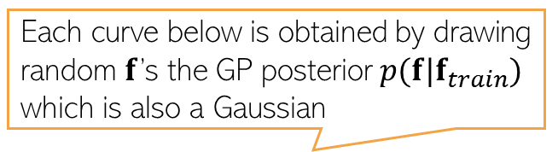
GP: A Visualization
6
Assumed zero mean function and a squared exponential kernel
Each curve below is obtained by drawing a random $f$ from the GP “prior” $p(f)= 𝒩(0,K)$ and plotting it.
Shaded area shows the predictive uncertainty for each of the test inputs (+/- 2 std)
Each curve below is obtained by drawing random $f$’s the GP posterior $p(f|f_{train})$ which is also a Gaussian
$K$is the kernel matrix of a finite number of inputs represented on the x axis (say 100 equi-spaced points between -5 and 5). $f$ will be a vector of $f$’s values at these inputs
$$f$$
$$f$$
$$x$$
$$x$$
Figure courtesy: MLAPP (Murphy)

Slide 7



GP for Noisy Setting: Regression (Gaussian Lik.)
7
For Gaussian lik, we can get PPD $p\left(y_{∗} | y\right)$without computing the GP posterior $p(f|y)$
Note that, in this case, the marginal likelihood is also a Gaussian
The joint distribution of the training $y$and test response $y_{∗}$is also a Gaussian
Using the above, we can easily obtain $p\left(y_{∗} | y\right)$ using Gaussian properties
This is almost identical to the expression of $p\left(f_{∗} | f\right)$ from the noiseless case except $K$ there is replaced by $C_{N}$ and extra $β^{−1}$ term in variance
Also useful when learning hyperparams of the GP covariance/kernel
$$p\left(y\right)=∫p\left(y | f\right)p\left(f\right)df$$
$$=𝒩\left(y | 0,K+β^{−1}I_{N}\right)=𝒩\left(y | 0,C_{N}\right)$$
$$𝒩(y|f,β^{−1}I_{N})$$
$$𝒩(f|0,K)$$
$$p\left(\left[\begin{aligned}y \\ y_{∗}\end{aligned}\right]\right)= 𝒩\left(\left[\begin{aligned}y \\ y_{∗}\end{aligned}\right]|\left[\begin{aligned}0 \\ 0\end{aligned}\right],\left[\begin{matrix}C_{N} & k_{∗} \\ k_{∗}^{⊤} & κ\left(x_{∗},x_{∗}\right)+β^{−1}\end{matrix}\right]\right)$$
Identical to the noiseless case except the additional $β^{−1}$ term on the diagonal
Note: All hyperparams assumed to be known
Weighted average of the training responses
$$p\left(y_{∗} | y\right)=𝒩\left(k_{∗}^{⊤}C_{N}^{−1}y,κ\left(x_{∗},x_{∗}\right)−k_{∗}^{⊤}C_{N}^{−1}k_{∗}+β^{−1}\right)=𝒩(μ_{∗},σ_{∗}^{2})$$
$μ_{∗}$has a similar interpretation as in the noiseless case

Slide 8
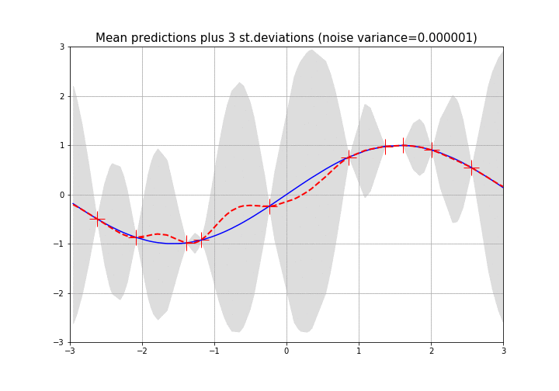
GP Regression: An Illustration
8
The figure below shows GP predictive mean and variance as noise variance changes
As expected, the predictive mean worsens and predictive variance increases as the noise variance increases
Blue curve: True function
Red point: Training inputs (noisy)
Red curve: Learned predictive mean
Shaded region: +/- 3 std-dev
y
x
Figure courtesy: https://sandipandey.wixsite.com/simplydatascience/post/gaussian-process-regression-with-python

Slide 9
Weight Space View vs Function Space View
9
GPs are defined w.r.t. a function space that models input-output relationship
In contrast, we have seen models that are defined w.r.t. a weight space, e.g.,
Thus the joint distribution of the $N$ responses $y_{1},y_{2},…,y_{N}$ is a multivariate Gaussian
Thus GPs can be seen as bypassing the weight space and directly defining the model using a marginal likelihood via a function space defined by the GP
$$p\left(y | X,w\right)= 𝒩(y|Xw,β^{−1}I_{N})$$
Likelihood
Marginal likelihood after integrating out the weights
$$p(w)= 𝒩(w|μ_{0},Σ_{0})$$
Prior over weight vector
$$p\left(y | X\right)=∫p\left(y | X,w\right)p\left(w\right)dw=𝒩(y|Xμ_{0},β^{−1}I_{N}+XΣ_{0}X^{⊤})$$
$$p\left(y | X\right)=𝒩(y|0,β^{−1}I_{N}+XX^{⊤})$$
Marginal likelihood assuming $μ_{0}=0$ and $Σ_{0}=I$
$$p\left(y | X\right)=𝒩(y|0, XX^{⊤})$$
Assuming noise-free likelihood
This equivalence also shows that Bayesian linear regression is a special case of GP with linear kernel
$$p\left(\left[\begin{aligned}y_{1} \\ y_{2} \\ ⋮ \\ y_{N}\end{aligned}\right]\right)= 𝒩\left(\left[\begin{aligned}0 \\ 0 \\ ⋮ \\ 0\end{aligned}\right],\left[\begin{matrix}\begin{aligned}x_{1}^{⊤}x_{1} \\ x_{2}^{⊤}x_{1}\end{aligned} & ⋯ & \begin{aligned}x_{1}^{⊤}x_{N} \\ x_{2}^{⊤}x_{N}\end{aligned} \\ ⋮ & ⋱ & ⋮ \\ x_{N}^{⊤}x_{1} & ⋯ & x_{N}^{⊤}x_{N}\end{matrix}\right]\right)$$
Same as a GP $f(x_{i}) = y_{i}$, $μ\left(x\right)=0$ and linear covariance/kernel function ${κ\left(x_{i}, x_{j}\right)= x}_{i}^{⊤}x_{j}$

Slide 10
GP for Noisy Setting: Classification and GLM
10
Binary classification: Now likelihood will be Bernoulli: $p\left(y_{n} | f_{n}\right)= Bernoulli(y_{n}|σ(f_{n}))$
For multi-class ($K>2$) GP, $p\left(y_{n} | f_{n}\right)$ will be multinoulli and $f_{n}$ will be a $K×1$vector
For GP based GLM, $p\left(y_{n} | f_{n}\right)$will be some exp-family distribution
The prior $p(f)$ will still be a GP. Assuming a zero-mean GP prior $p\left(f\right)= 𝒩(f|0,K)$
The posterior predictive $p\left(y_{∗} | y\right)$ can again be written as
This in general is not as easy to compute unlike the case of GP regression we saw
  $p\left(f_{∗} | f\right)$ is still not a problem (will be Gaussian due to the GP property)
  GP posterior $p\left(f | y\right)∝p\left(f\right)p(y|f)$ will require approximation (Laplace, MCMC, variational, etc)
  The overall integral will require approximation as well
$$p\left(y_{∗} | y\right)=∫p\left(y_{∗} | f_{∗}\right)p\left(f_{∗}\right|y)df_{∗}$$
$$=∫p\left(y_{∗} | f_{∗}\right)p\left(f_{∗} | f\right)p\left(f | y\right)dfdf_{∗}$$

Slide 11
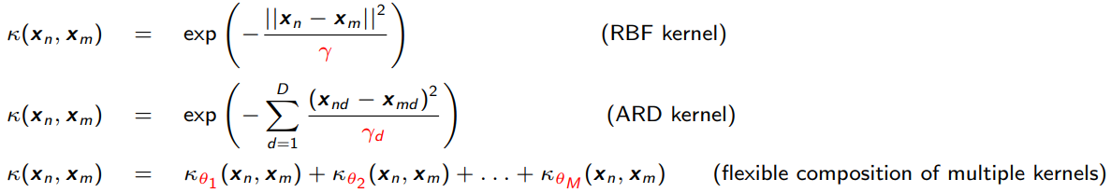
Learning Hyperparameters in GP based Models
11
Can learn the hyperparameters of the GP prior as well as of the likelihood model
Assuming $μ=0$, the hyperparams of GP are cov/kernel function hyperparams
MLE-II is a popular choice for learning these hyperparams (otherwise MCMC, VI, etc)
Denoting the covariance/kernel matrix as $K_{θ}$, for Gaussian likelihood case, the marg-lik
This can be maximized to learn $θ$ and $β$
For non-Gaussian likelihoods, the marg-lik itself will need to be approximated
Ability to learn kernel hyperparams (without cross-valid) is another very appealing property of GP
Can help in feature selection (irrelevant features will tend to have very large $γ_{d}$)
Different RBF kernel bandwidth $γ_{d}$ for each feature
$$p\left(y|θ,β^{−1}\right)=𝒩\left(y | 0,K_{θ}+β^{−1}I_{N}\right)$$

Slide 12
Coming Up
12
Some aspects of GPs
  Scalability
  Connections with neural nets
  Some recent advances

Slide 13
Scalability of GPs
13
Computational costs in some steps of GP models scale in the size of training data
For example, prediction cost is $O(N)$
GP models often require matrix inversions (e.g., in marg-lik computation when estimating hyperparameters) – takes $O(N^{3})$
Storage also requires $O(N^{2})$ since need to store the covariance matrix
A lot of work on speeding up GPs¹. Some prominent approaches include
  Inducing Point Methods (condition predictions only on a small set of “learnable” points)
  Divide-and-Conquer (learn GP on small subsets of data and aggregate predictions)
  Kernel approximations
Note that nearest neighbor methods and kernel methods also face similar issues
  Many tricks to speed up kernel methods can be used for speeding up GPs too
$O(N)$ cost assuming $C_{N}$ is already inverted
$$p\left(y_{∗} | y\right)=𝒩(μ_{∗},σ_{∗}^{2})$$
$$μ_{∗}=k_{∗}^{⊤}C_{N}^{−1}y$$
$$σ_{∗}^{2}=κ\left(x_{∗},x_{∗}\right)−k_{∗}^{⊤}C_{N}^{−1}k_{∗}+β^{−1}$$
$M≪N$ pseudo-inputs and pseudo-outputs
¹When Gaussian Process Meets Big Data: A Review of Scalable GPs - Liu et al, 2018

Slide 14


GP: Some Comments
14
GP is sometimes referred to as a nonparametric model because
  Complexity (representation size) of the function $f$ grows in the size of training data
  To see this, note the form of the GP predictions, e.g., predictive mean in GP regression
  It implies that which means $f$ is written in terms of all training examples
  Thus the representation size of $f$ depends on the number of training examples
In contrast, a parametric model has a size that doesn’t grow with training data
  E.g., a linear model learns a weight vector $w∈ℝ^{D}$ ($D$ parameters, size independent of $N$)
Nonparametric models more flexible since their complexity is not limited beforehand
  Note: Methods like nearest neighbors and kernel SVMs are also nonparametric (but not Bayesian)

Slide 15
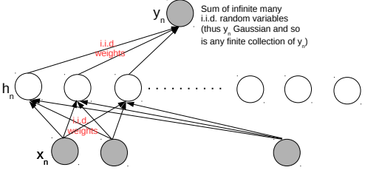
Neural Networks and Gaussian Process
15
An infinitely-wide single hidden layer NN with i.i.d. priors on weights = GP
Shown formally by (Neal², 1994). Based on applying the central limit theorem
This equivalence is useful for several reasons
  Can use a GP instead of an infinitely wide Bayesian NN (which is impractical anyway)
  With GPs, inference is easy (at least for regression and with known hyperparams)
  A proof that GPs can also learn any function (just like infinitely wide neural nets - Hornik’s theorem)
Connection generalized to infinitely wide multiple hidden layer NN (Lee et al³, 2018)
²Priors for infinite networks, Tech Report, 1994
³Deep Neural Networks as Gaussian Processes (ICLR 2018)

Slide 16
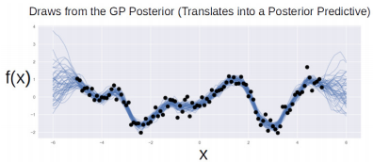
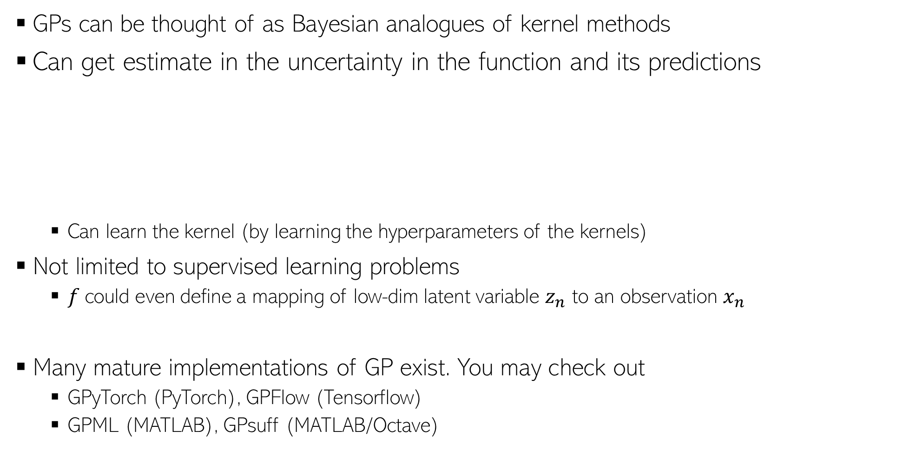
GP: A Few Other Comments
16
GPs can be thought of as Bayesian analogues of kernel methods
Can get estimate in the uncertainty in the function and its predictions
  Can learn the kernel (by learning the hyperparameters of the kernels)
Not limited to supervised learning problems
  $f$could even define a mapping of low-dim latent variable $z_{n}$ to an observation $x_{n}$
Many mature implementations of GP exist. You may check out
  GPyTorch (PyTorch), GPFlow (Tensorflow)
  GPML (MATLAB), GPsuff (MATLAB/Octave)
$$x_{n}=f\left(z_{n}\right)+"noise"$$
GP latent variable model for dimensionality reduction (like a kernel version of probabilistic PCA)

Slide 17
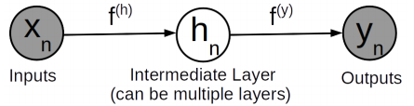
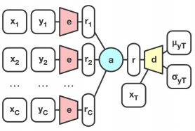

GP: Some Other Recent Advances
17
Deep Gaussian Processes (DGP)
  Akin to a deep neural network where each hidden node is modeled by a GP
  A nice alternative to linear transform + nonlinearity in neural nets, e.g., $h= tanh(Wx)$
GPs with deep kernels defined by neural nets
Neural Processes (GP + neural nets): Faster way to do GPs
A neural net based encoder
Aggregating the training data (instead of storing it)

