Slide 1
GLMs (wrap-up) and
Generative Models for Supervised Learning
CS772A: Probabilistic Machine Learning
Piyush Rai

Slide 2
Plan for today and announcements
2
Wrap up GLM
Testing conditional independence in directed graphical models
Generative models for supervised learning
Also, Quiz 1 on Monday (Sept 5) at 7pm
Rescheduled class on Saturday (Sept 3) at 6pm
Mid-sem exam on Sept 19 in L17 (18:00-20:00), ERES seating arrangement

Slide 3


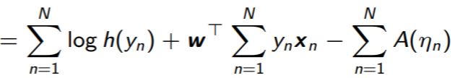

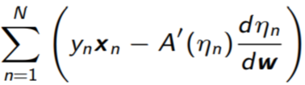
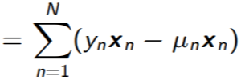
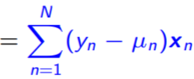

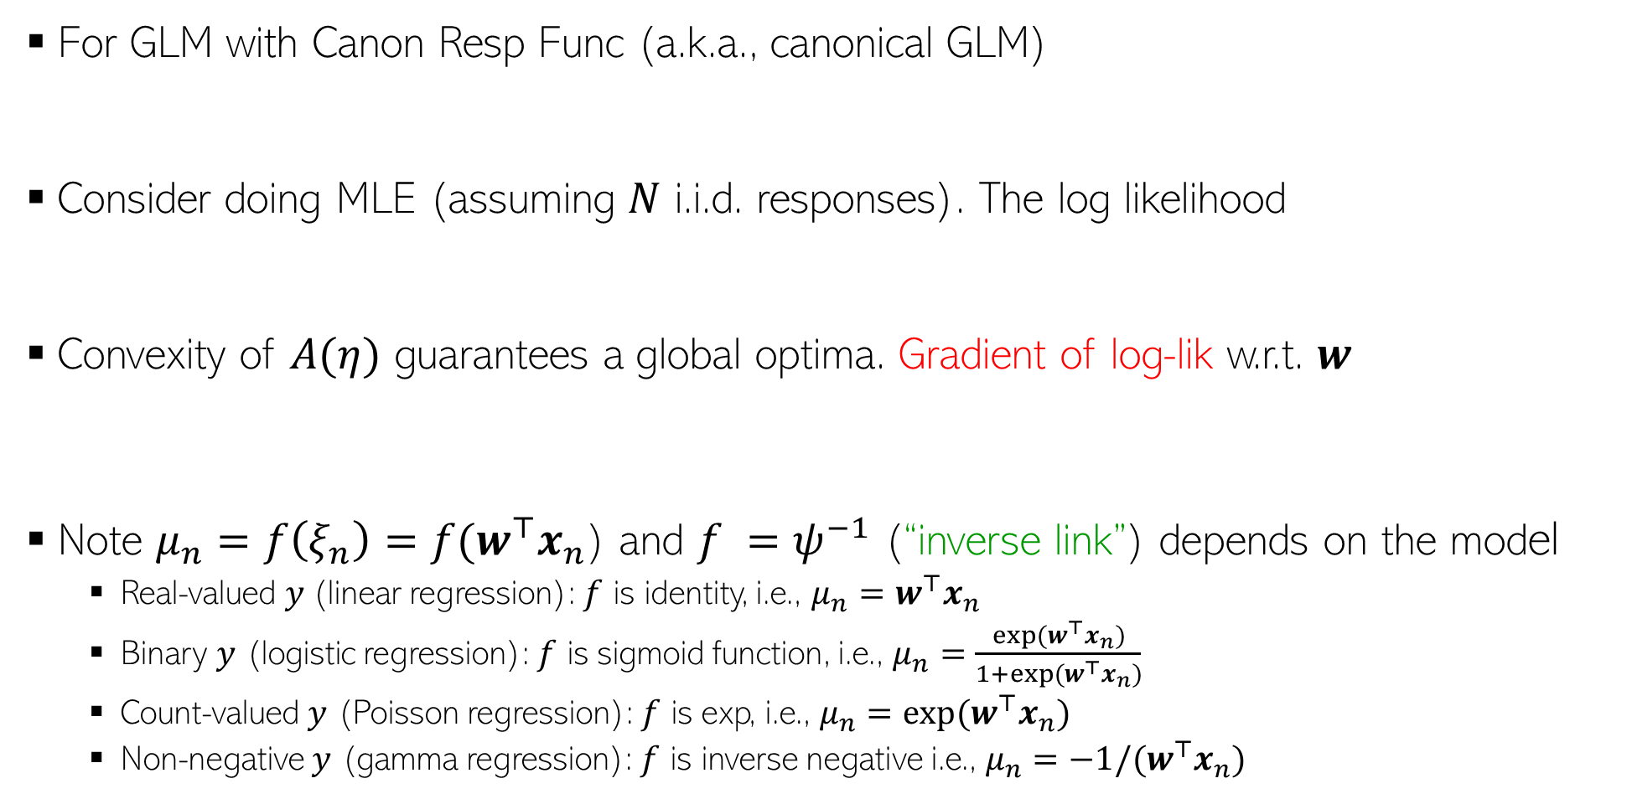



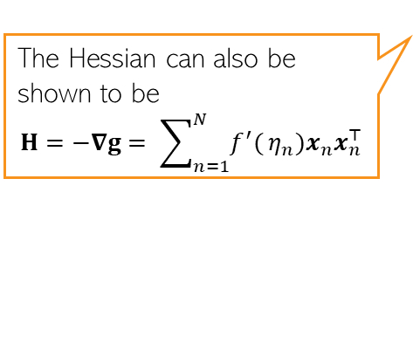
GLM with Canonical Response Function
3
The simple form of canonical GLM (nat. param just a linear function $w^{⊤}x$ ) makes parameter estimation via MLE/MAP easy since gradient and Hessian have simple expressions (though the Hessian may be expensive to compute/invert)
For GLM with Canon Resp Func (a.k.a., canonical GLM)
Consider doing MLE (assuming $N$ i.i.d. responses). The log likelihood
Convexity of $A(η)$ guarantees a global optima. Gradient of log-lik w.r.t. $w$
Note $μ_{n}=f\left(ξ_{n}\right)=f(w^{⊤}x_{n}$) and $f =ψ^{−1}$ (“inverse link”) depends on the model
  Real-valued $y$(linear regression): $f$ is identity, i.e., $μ_{n}=w^{⊤}x_{n}$
  Binary $y$ (logistic regression): $f$ is sigmoid function, i.e., $μ_{n}=\frac{exp(w^{⊤}x_{n})}{1+exp(w^{⊤}x_{n})}$
  Count-valued $y$ (Poisson regression): $f$ is exp, i.e., $μ_{n}={exp(w}^{⊤}x_{n})$
  Non-negative $y$ (gamma regression): $f$ is inverse negative i.e., $μ_{n}={−1/(w}^{⊤}x_{n})$
Exp of suff-stats$𝔼[y_{n}]$
Corrective updates for $w$
The Hessian can also be shown to be
$$H=−∇g= \sum_{n=1}^{N}{f^{′}(}η_{n})x_{n}x_{n}^{⊤}$$
$$g=$$

Slide 4
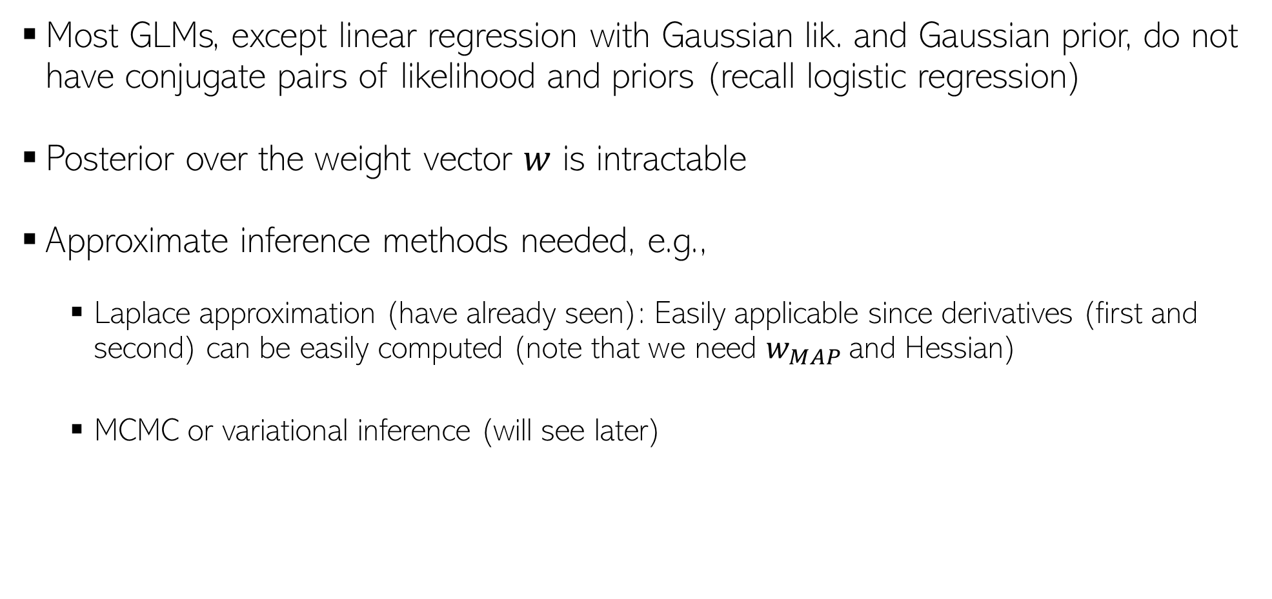
Fully Bayesian Inference for GLMs
4
Most GLMs, except linear regression with Gaussian lik. and Gaussian prior, do not have conjugate pairs of likelihood and priors (recall logistic regression)
Posterior over the weight vector $w$ is intractable
Approximate inference methods needed, e.g.,
  Laplace approximation (have already seen): Easily applicable since derivatives (first and second) can be easily computed (note that we need $w_{MAP}$and Hessian)
  MCMC or variational inference (will see later)

Slide 5
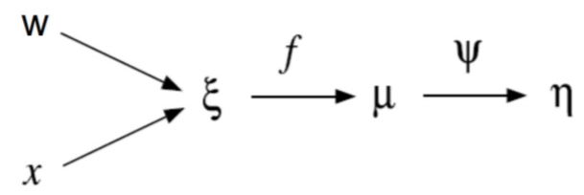
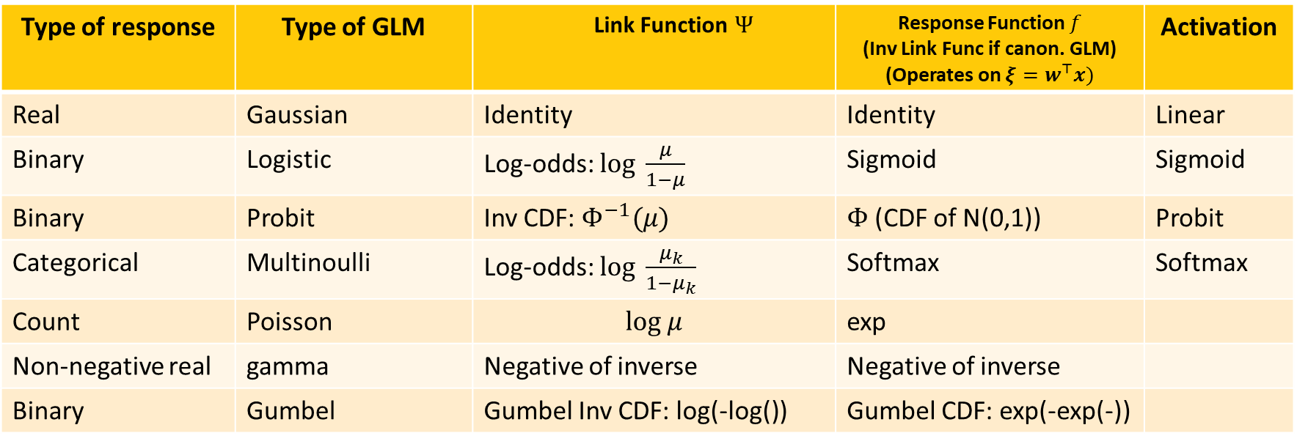
Various Types of GLMs
5
Type of response | Type of GLM | Link Function $Ψ$ | Response Function $f$ (Inv Link Func if canon. GLM) (Operates on $ξ=w^{⊤}x)$ | Activation
Real | Gaussian | Identity | Identity | Linear
Binary | Logistic | Log-odds: $log \frac{μ}{1−μ}$ | Sigmoid | Sigmoid
Binary | Probit | Inv CDF: $Φ^{−1}(μ)$ | $Φ$(CDF of N(0,1)) | Probit
Categorical | Multinoulli | Log-odds: $log \frac{μ_{k}}{1−μ_{k}}$ | Softmax | Softmax
Count | Poisson | $$log μ$$ | exp
Non-negative real | gamma | Negative of inverse | Negative of inverse
Binary | Gumbel | Gumbel Inv CDF: log(-log()) | Gumbel CDF: exp(-exp(-))
.. and several others (exponential, inverse Gaussian, Binomial, Tweedie, etc)

Slide 6
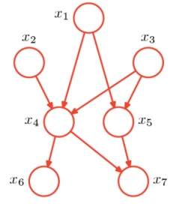
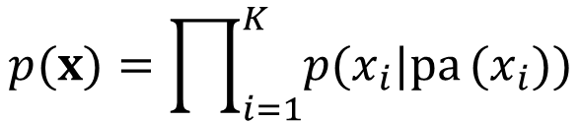









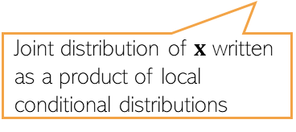

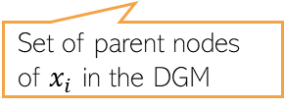

(Directed) Graphical Models
6
Most models we study can be represented via directed graphical models (DGMs)
A DGM is a graph with nodes denoting random variables and edges their dependences
Plate notation is a compact way of representing DGMs, e.g.,
$$x={(x}_{1},x_{2},…,x_{K})$$
$$p(x_{1},x_{2},x_{3},x_{4},x_{5},x_{6},x_{7})$$
$$p(x)=\prod_{i=1}^{K}{p(x_{i}|pa}(x_{i}))$$
$$=p\left(x_{1}\right)p\left(x_{2}\right)p\left(x_{3}\right)p(x_{4}|x_{2},x_{3})$$
$$p\left(x_{5} | x_{1},x_{3}\right)p\left(x_{6}\right|x_{4})p(x_{7}|x_{4},x_{5})$$
Set of parent nodes of $x_{i}$ in the DGM
Joint distribution of $x$ written as a product of local conditional distributions
$$θ$$
$$θ$$
Also remember: shaded = observed, unshaded = unknown
$$x_{1}$$
$$x_{2}$$
$$x_{N}$$
$$x_{n}$$
$$N$$

Slide 7












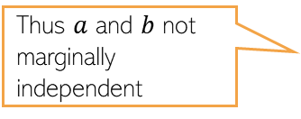









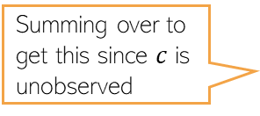














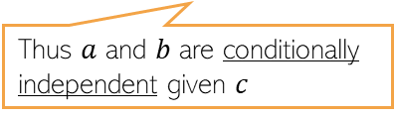





DGMs and Independence
7
Goal: Test if two nodes $a$ and $b$ are independent in presence of a third node $c$
Summing over to get this since $c$ is unobserved
$$p\left(a,b,c\right)=p\left(a | c\right)p\left(b | c\right)p(c)$$
$$c$$
$$p\left(a,b|c\right)=p\left(a,b,c\right)|p(c)$$
$$c$$
$$p\left(a,b\right)=\sum_{c}{p\left(a | c\right)p\left(b | c\right)p(c)}$$
$$=p\left(a | c\right)p\left(b | c\right)$$
$$a$$
$$b$$
$$a$$
$$b$$
Thus $a$ and $b$ not marginally independent
$$≠p(a)p(b)$$
Thus $a$ and $b$ are conditionally independent given $c$
$$p\left(a,b,c\right)=p(a) p(b,c|a)$$
$$p\left(a,b,c\right)=p(a,c) p(b|c)$$
$$a$$
$$c$$
$$b$$
$$a$$
$$c$$
$$b$$
$$p\left(a,b\right)=p(a)\sum_{c}{p(b,c|a)}$$
$$p\left(a,b|c\right)= \frac{p(a,c) p(b|c)}{p(c)}$$
Thus $a$ and $b$ not marginally independent
$$=p\left(a\right)p(b|a)$$
Thus $a$ and $b$ are conditionally independent given $c$
$$=p(a|c) p(b|c)$$
$$p\left(a,b,c\right)=p(a)p(b)p(c|a,b)$$
$$a$$
$$b$$
$$p\left(a,b,c\right)=p(a)p(b)p(c|a,b)$$
$$a$$
$$b$$
$$p\left(a,b\right)=p(a)p(b)\sum_{c}{p(c|a,b)}$$
$$p\left(a,b|c\right)= \frac{p(a)p(b)p(c|a,b)}{p(c)}$$
Thus $a$ and $b$ are independent
$$c$$
Conditionally NOT independent given $c$
$$c$$
$$=p\left(a\right)p(b)$$
$$≠p\left(a | c\right)p(b|c)$$

Slide 8

DGMs and Independence
8
A node in a DGM is independent of all other nodes given its Markov Blanket
Markov Blanket (MB) consists of a nodes parents, children, and co-parents
Whenever we write the conditional/posterior distribution of a node, any node that is not in MB would not appear in the conditioned side
MB of a node is the minimum set of nodes that separate it from the rest of the graph
$$x_{n}$$

Slide 9
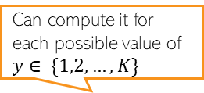
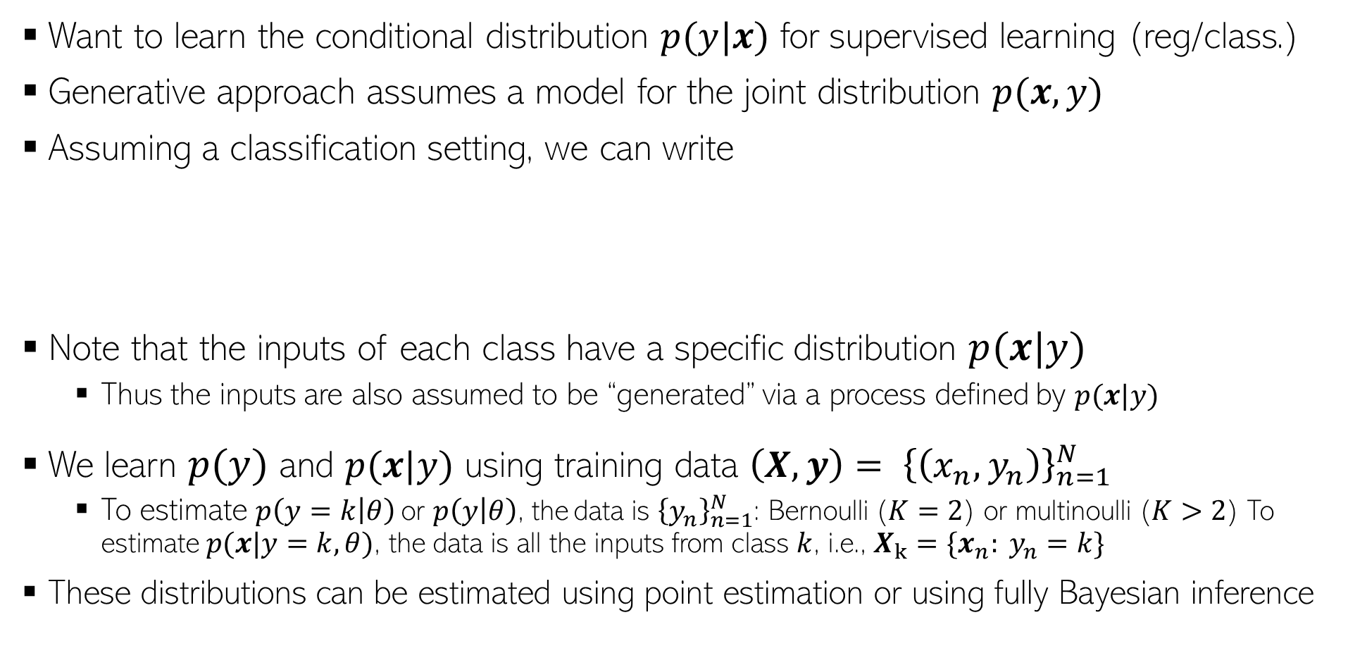
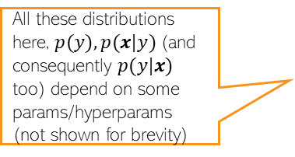
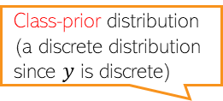

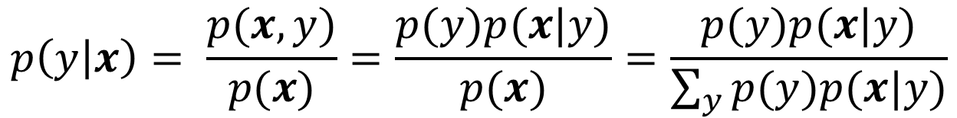

Generative Supervised Learning
9
Have already seen the discriminative approach to learn $p(y|x)$ (prob linear regression, logistic regression, and also GLM)
Want to learn the conditional distribution $p(y|x)$ for supervised learning (reg/class.)
Generative approach assumes a model for the joint distribution $p(x,y)$
Assuming a classification setting, we can write
Note that the inputs of each class have a specific distribution $p(x|y)$
  Thus the inputs are also assumed to be “generated” via a process defined by $p(x|y)$
We learn $p(y)$ and $p(x|y)$ using training data ${\left(X,y\right)= \left\{\left(x_{n},y_{n}\right)\right\}}_{n=1}^{N}$
  To estimate $p\left(y=k | θ\right)$ or $p\left(y | θ\right)$, the data is ${\left\{y_{n}\right\}}_{n=1}^{N}$: Bernoulli ($K=2$) or multinoulli ($K>2$) To estimate $p(x|y=k,θ)$, the data is all the inputs from class $k$, i.e., $X_{k}=\{x_{n}: y_{n}=k\}$
These distributions can be estimated using point estimation or using fully Bayesian inference
Class-prior distribution (a discrete distribution since $y$ is discrete)
Class-conditional distribution of inputs from class $y$
Can compute it for each possible value of $y∈ \{1,2,…,K\}$
All these distributions here, $p(y), p(x|y)$(and consequently $p(y|x)$ too) depend on some params/hyperparams (not shown for brevity)
$$p\left(y | x\right)= \frac{p(x,y)}{p(x)}=\frac{p(y)p(x|y)}{p(x)}=\frac{p(y)p(x|y)}{\sum_{y}{p(y)p(x|y)}}$$

Slide 10

Generative Supervised Learning: Classification
10
Training: Fit an appropriate probability distribution for data from each class
Test time: Evaluate under which class, the test input has largest probability $p(x|y=k)$ or largest class posterior probability $p\left(y=k | x\right)∝p\left(y=k\right)p(x|y=k)$

Slide 11
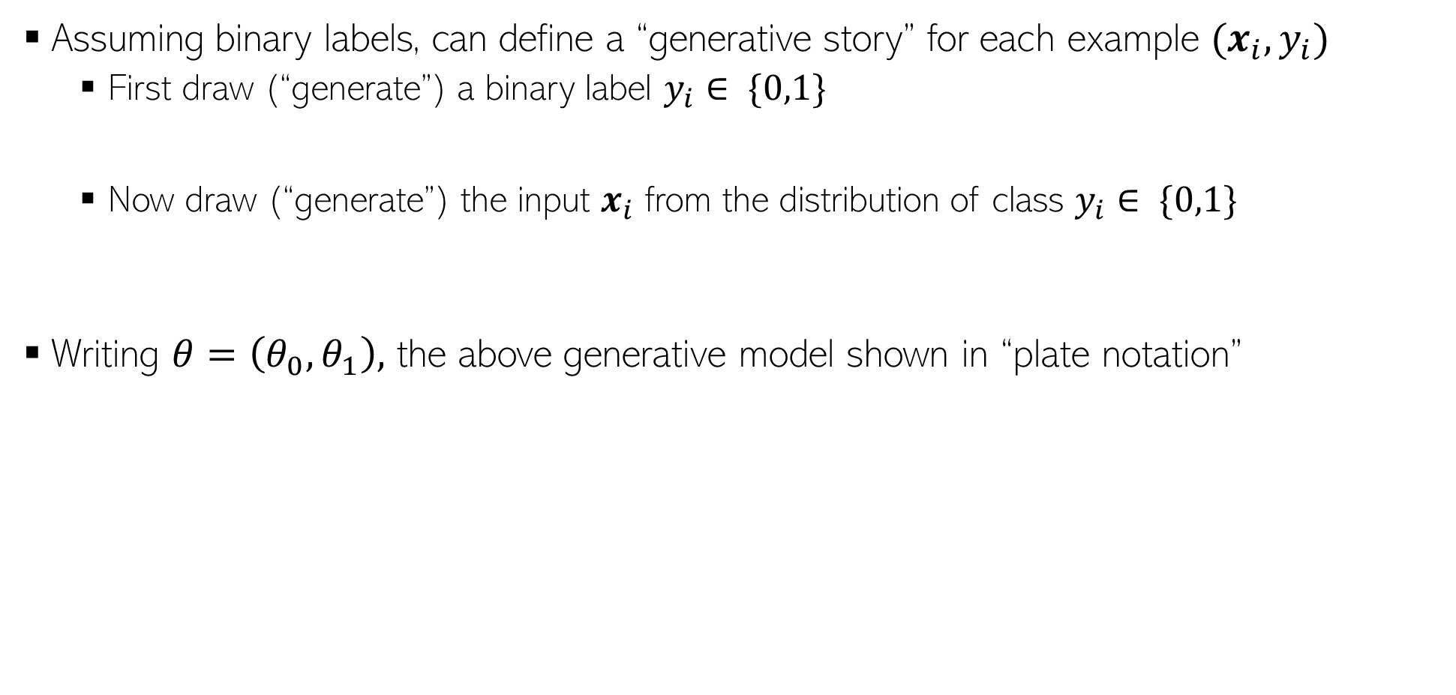
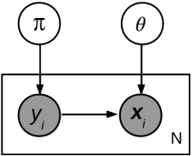
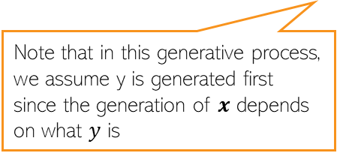
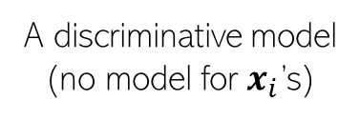







Generative Classification: A Generative Story
11
Assuming binary labels, can define a “generative story” for each example $(x_{i},y_{i})$
  First draw (“generate”) a binary label $y_{i}∈ \{0,1\}$
  Now draw (“generate”) the input $x_{i}$ from the distribution of class $y_{i}∈ \{0,1\}$
Writing $θ=\left(θ_{0},θ_{1}\right),$ the above generative model shown in “plate notation”
For multi-class problems, we will have a multinoulli instead
$$y_{i}∼Bernoulli\left(π\right)$$
$${x_{i}|y}_{i}∼p\left(x|θ_{y_{i}}\right)$$
Most generative models (supervised as well as unsupervised/semi-supervised) can be expressed via such a story
Compare this with the plate notation diagram of a discriminative model such as prob linear regression or logistic regression
Order of generation in this story depends on what part of the data/parameters depend on what data/params
Note that in this generative process, we assume y is generated first since the generation of $x$ depends on what $y$ is
$$θ$$
Often we also show the generation of parameters/unknowns as well (via their respective distributions)
Note that in this generative process, we assume y is generated first since the generation of $x$ depends on what $y$ is
$$y_{i}$$
$$x_{i}$$
$$N$$
A discriminative model
(no model for $x_{i}$’s)

Slide 12

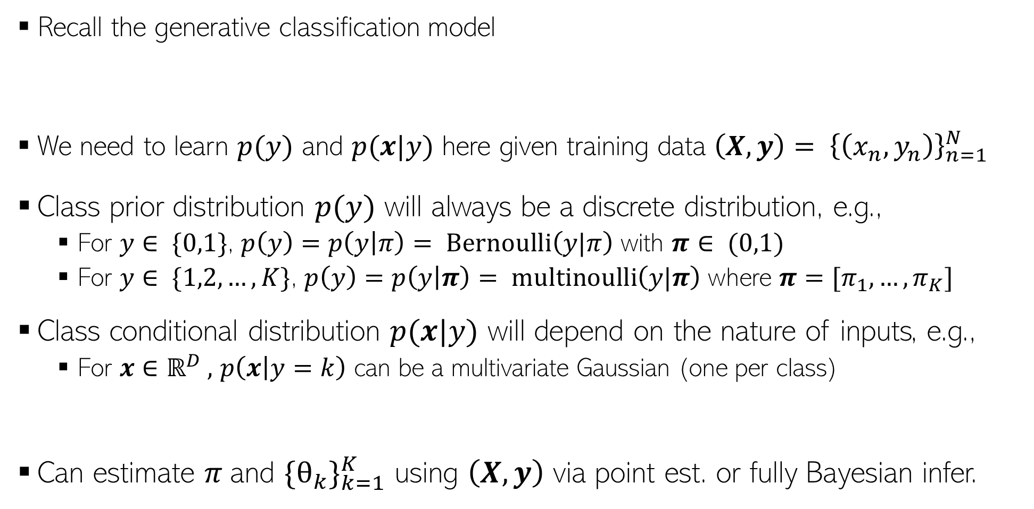
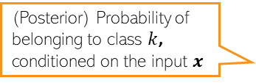
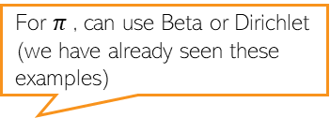
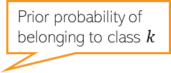
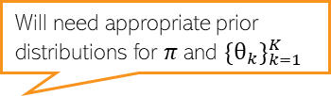
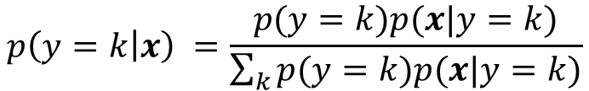
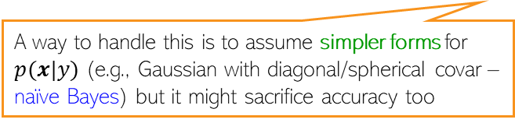
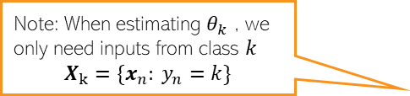
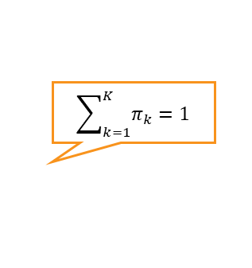
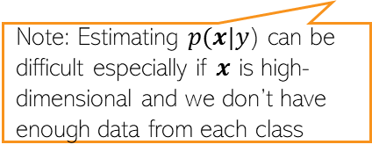
Generative Classification: Learning Procedure
12
Note: Estimating $p(x|y$) can be difficult especially if $x$ is high-dimensional and we don’t have enough data from each class
Prior probability of belonging to class $k$
Probability (density) of input $x$ under class $k$
Recall the generative classification model
We need to learn $p(y)$ and $p(x|y)$ here given training data ${\left(X,y\right)= \left\{\left(x_{n},y_{n}\right)\right\}}_{n=1}^{N}$
Class prior distribution $p(y)$ will always be a discrete distribution, e.g.,
  For $y∈ \{0,1\}$, $p\left(y\right)=p\left(y | π\right)= Bernoulli\left(y|π\right)$ with $π∈ (0,1)$
  For $y∈ \{1,2,…,K\}$, $p\left(y\right)=p\left(y | π\right)= multinoulli\left(y|π\right)$ where $π=[π_{1},…, π_{K}]$
Class conditional distribution $p(x|y)$ will depend on the nature of inputs, e.g.,
  For $x∈ℝ^{D} ,$ $p\left(x | y=k\right)$ can be a multivariate Gaussian (one per class)
Can estimate $π$and ${\{θ_{k}\}}_{k=1}^{K}$ using $\left(X,y\right)$ via point est. or fully Bayesian infer.
(Posterior) Probability of belonging to class $k$, conditioned on the input $x$
$$p\left(y=k | x\right) =\frac{p(y=k)p(x|y=k)}{\sum_{k}{p(y=k)p(x|y=k)}}$$
A way to handle this is to assume simpler forms for $p(x|y)$ (e.g., Gaussian with diagonal/spherical covar – naïve Bayes) but it might sacrifice accuracy too
$$\sum_{k=1}^{K}{π_{k}=1}$$
For $π$, can use Beta or Dirichlet (we have already seen these examples)
Note: When estimating $θ_{k}$ , we only need inputs from class $k$
$$X_{k}=\{x_{n}: y_{n}=k\}$$
$p\left(x | y=k\right)=p\left(x | θ_{k}\right)= 𝒩(x|μ_{k}, Σ_{k})$
Will need appropriate prior distributions for $π$and ${\{θ_{k}\}}_{k=1}^{K}$

Slide 13

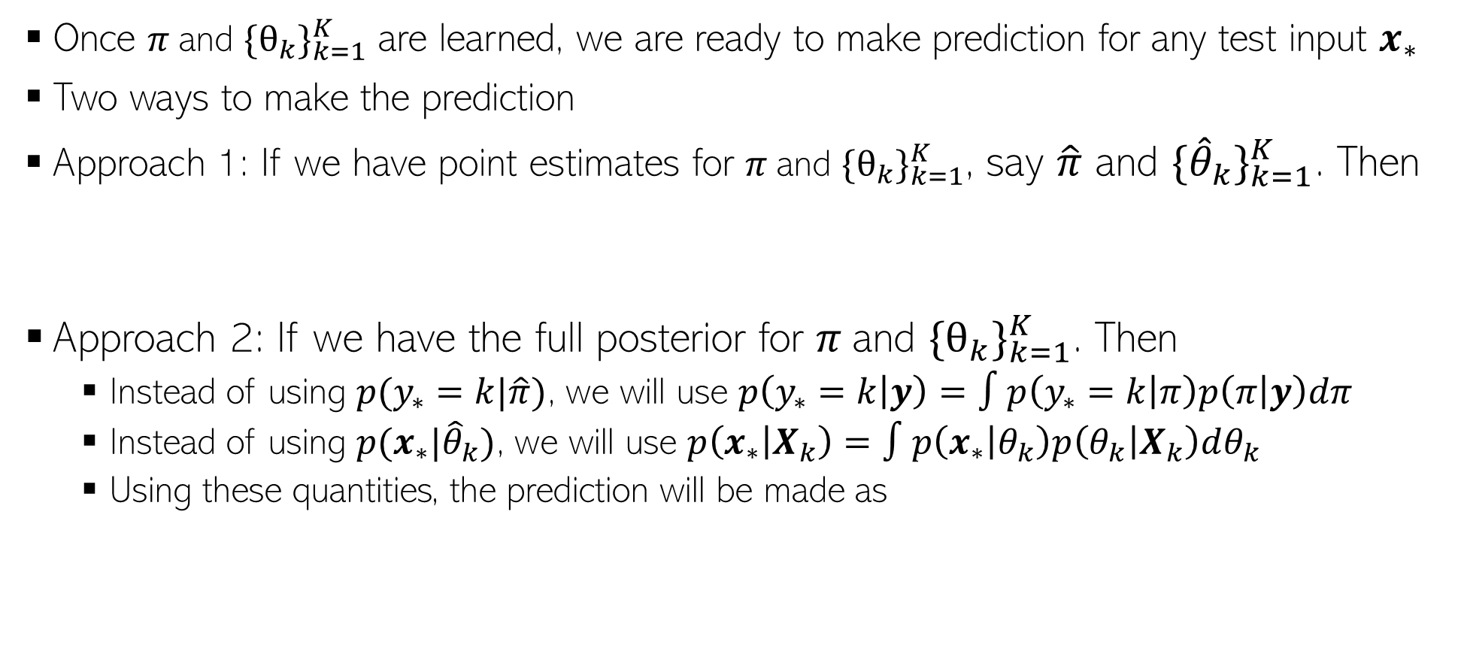

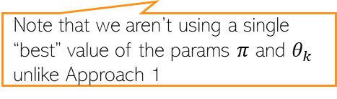


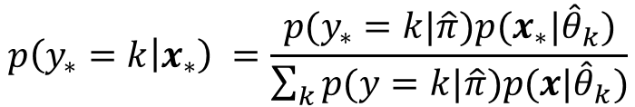

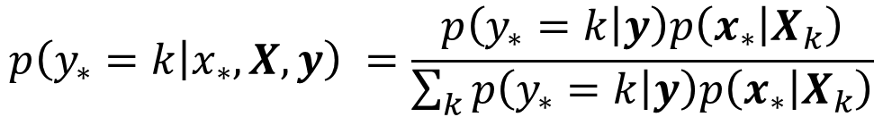

Generative Classification: Making Predictions
13
Once $π$and ${\{θ_{k}\}}_{k=1}^{K}$ are learned, we are ready to make prediction for any test input $x_{∗}$
Two ways to make the prediction
Approach 1: If we have point estimates for $π$and ${\{θ_{k}\}}_{k=1}^{K}$, say $\hat{π}$ and ${\{{\hat{θ}}_{k}\}}_{k=1}^{K}$. Then
Approach 2: If we have the full posterior for $π$and ${\{θ_{k}\}}_{k=1}^{K}$. Then
  Instead of using $p(y_{∗}=k|\hat{π})$, we will use $p\left(y_{∗}=k | y\right)=∫p\left(y_{∗}=k | π\right)p\left(π | y\right)dπ$
  Instead of using $p(x_{∗}|{\hat{θ}}_{k})$, we will use $p\left(x_{∗} | X_{k}\right)=∫p\left(x_{∗} | θ_{k}\right)p\left(θ_{k} | X_{k}\right)dθ_{k}$
  Using these quantities, the prediction will be made as
$$p\left(y_{∗}=k | x_{∗}\right) =\frac{p(y_{∗}=k|\hat{π})p(x_{∗}|{\hat{θ}}_{k})}{\sum_{k}{p(y=k|\hat{π})p(x|{\hat{θ}}_{k})}}$$
Compute for every value of $k$ and normalize
$$∝ {\hat{π}}_{k}p(x_{∗}|{\hat{θ}}_{k})$$
PPD of $y_{∗}$
PPD of $x_{∗}$
Compute for every value of $k$ and normalize
$$p\left(y_{∗}=k | x_{∗},X,y\right) =\frac{p\left(y_{∗}=k | y\right)p\left(x_{∗} | X_{k}\right)}{\sum_{k}{p\left(y_{∗}=k | y\right)p\left(x_{∗} | X_{k}\right)}}$$
$$∝p\left(y_{∗}=k | y\right)p\left(x_{∗} | X_{k}\right)$$
Note that we aren’t using a single “best” value of the params $π$ and $θ_{k}$ unlike Approach 1

Slide 14
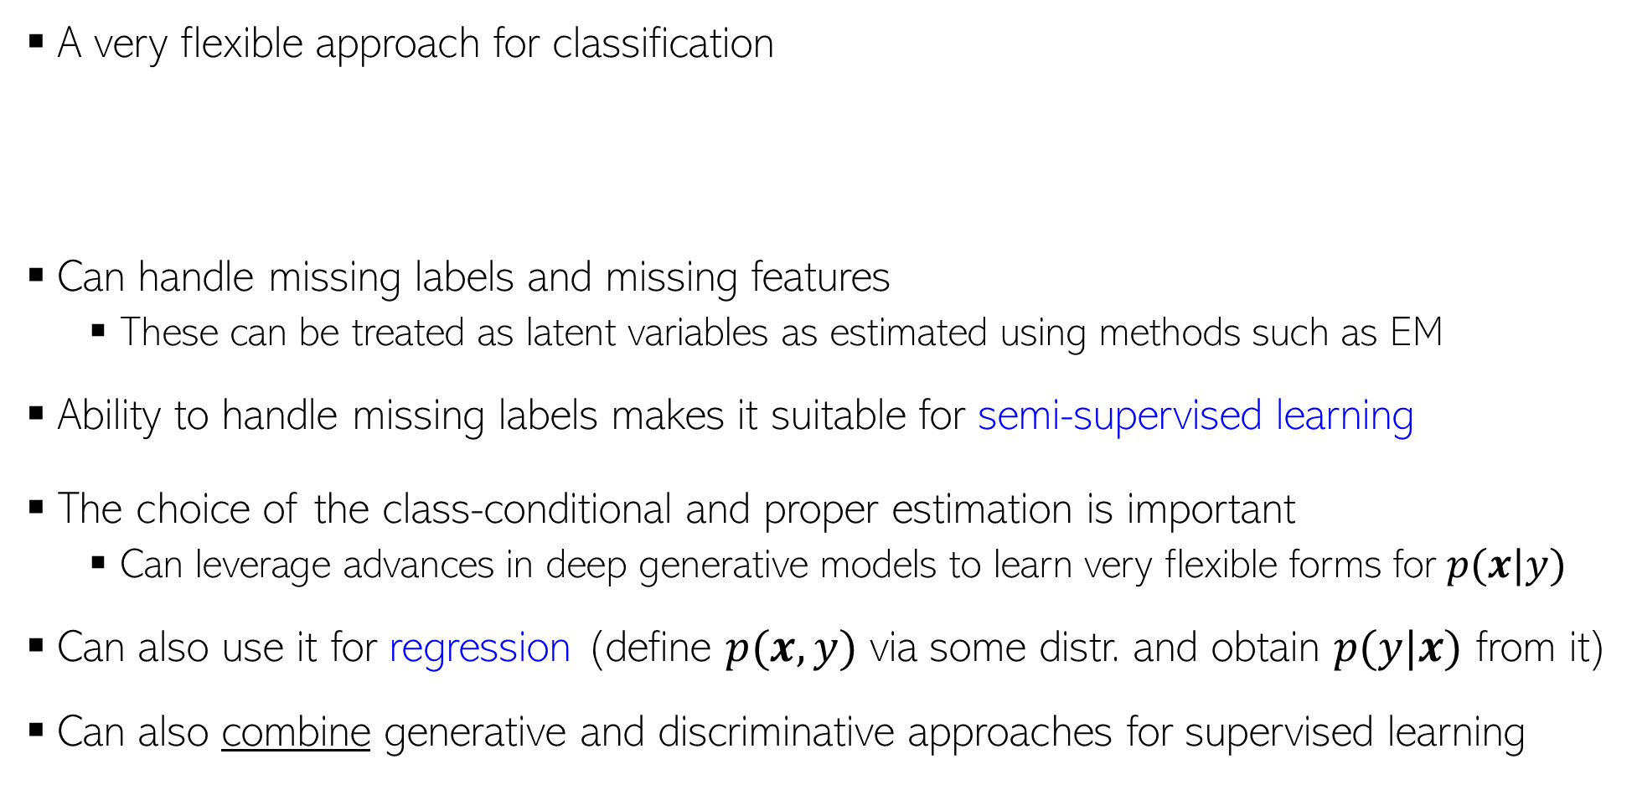
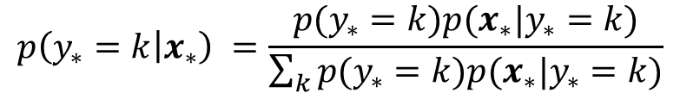
Generative Sup. Learning: Some Comments
14
A very flexible approach for classification
Can handle missing labels and missing features
  These can be treated as latent variables as estimated using methods such as EM
Ability to handle missing labels makes it suitable for semi-supervised learning
The choice of the class-conditional and proper estimation is important
  Can leverage advances in deep generative models to learn very flexible forms for $p(x|y)$
Can also use it for regression (define $p(x,y)$ via some distr. and obtain $p(y|x)$ from it)
Can also combine generative and discriminative approaches for supervised learning
Consequently, can naturally learn nonlinear boundaries, too (without using kernel methods or deep learning)
Incorporate info about how frequent each class is in the training data (“class prior”)
Incorporate info about the shape of each class
$$p\left(y_{∗}=k | x_{∗}\right) =\frac{p(y_{∗}=k)p(x_{∗}|y_{∗}=k)}{\sum_{k}{p(y_{∗}=k)p(x_{∗}|y_{∗}=k)}}$$
Will discuss this later

Slide 15

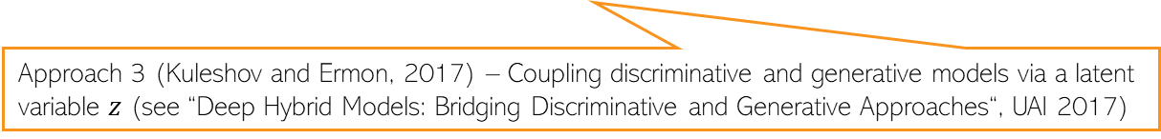
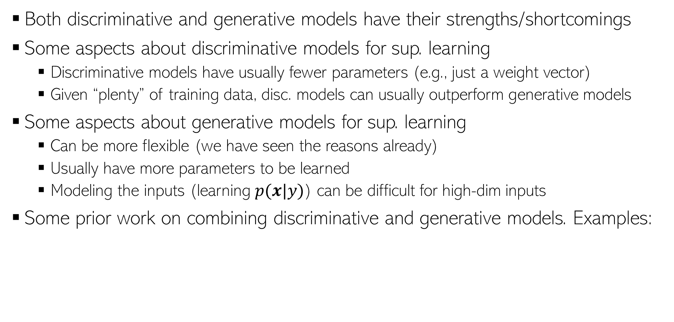
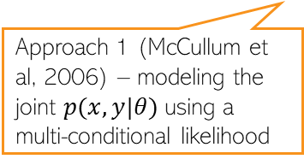
Hybrids of Discriminative and Generative Models
15
Both discriminative and generative models have their strengths/shortcomings
Some aspects about discriminative models for sup. learning
  Discriminative models have usually fewer parameters (e.g., just a weight vector)
  Given “plenty” of training data, disc. models can usually outperform generative models
Some aspects about generative models for sup. learning
  Can be more flexible (we have seen the reasons already)
  Usually have more parameters to be learned
  Modeling the inputs (learning $p(x|y)$) can be difficult for high-dim inputs
Some prior work on combining discriminative and generative models. Examples:
Recall prob linear regression and logistic reg
Approach 1 (McCullum et al, 2006) – modeling the joint $p(x,y|θ)$using a multi-conditional likelihood
Approach 2 (Lasserre et al, 2006) – Coupled parameters between discriminative and generative models
Approach 3 (Kuleshov and Ermon, 2017) – Coupling discriminative and generative models via a latent variable $z$ (see “Deep Hybrid Models: Bridging Discriminative and Generative Approaches“, UAI 2017)

