Slide 1
Laplace Approximation (Contd) and Generalized Linear Models
CS772A: Probabilistic Machine Learning
Piyush Rai

Slide 2

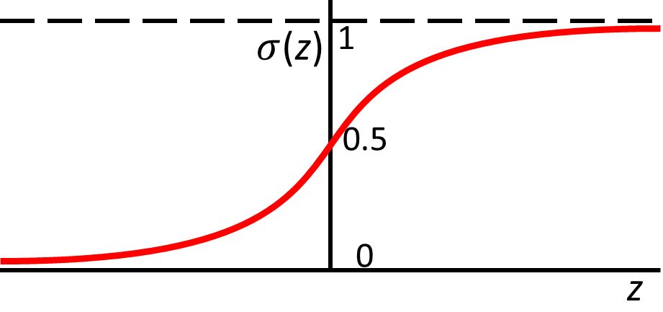

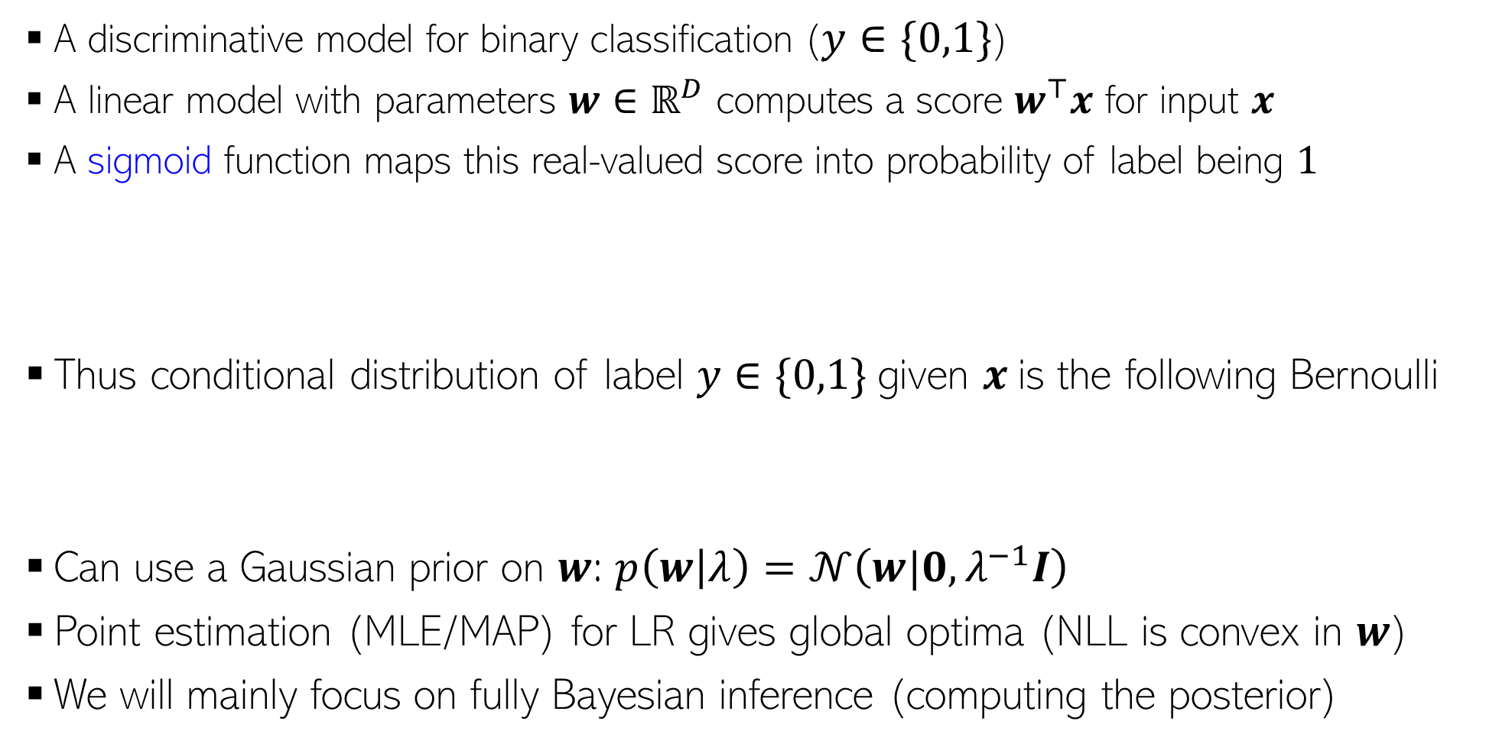



Logistic Regression
There are other ways too that can convert the score into a probability, such as a CDF:
$p\left(y=1 | x,w\right)=μ=Φ\left(w^{⊤}x\right)$ where $Φ$ is the CDF of $𝒩(0,1)$. This model is known as “Probit Regression”.
2
A discriminative model for binary classification ($y∈\{0,1\}$)
A linear model with parameters $w∈ℝ^{D}$ computes a score $w^{⊤}x$ for input $x$
A sigmoid function maps this real-valued score into probability of label being $1$
Thus conditional distribution of label $y∈\{0,1\}$given $x$is the following Bernoulli
Can use a Gaussian prior on $w$: $p\left(w | λ\right)=𝒩\left(w|0,λ^{−1}I\right)$
Point estimation (MLE/MAP) for LR gives global optima (NLL is convex in $w$)
We will mainly focus on fully Bayesian inference (computing the posterior)
$$σ\left(z\right)= \frac{1}{1+exp(−z)}=\frac{exp(z)}{1+exp(z)}$$
$$p\left(y=1 | x,w\right)=μ=σ\left(w^{⊤}x\right)$$
Large positive score $w^{⊤}x$ means large prob of label being 1, and large negative score means low prob
real-valued score
Likelihood
$$p\left(y | x,w\right)= Bernoulli\left[y | μ\right]=μ^{y}{\left(1−μ\right)}^{1−y}={\left[\frac{\exp\left(w^{⊤}x\right)}{1+\exp\left(w^{⊤}x\right)}\right]}^{y}{\left[\frac{1}{1+\exp\left(w^{⊤}x\right)}\right]}^{1−y}$$
Can also use a sparsity-inducing prior, such as spike-and-slab or a scale-mixture of Gaussians

Slide 3
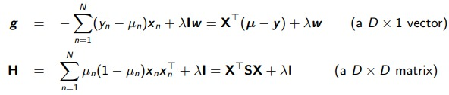
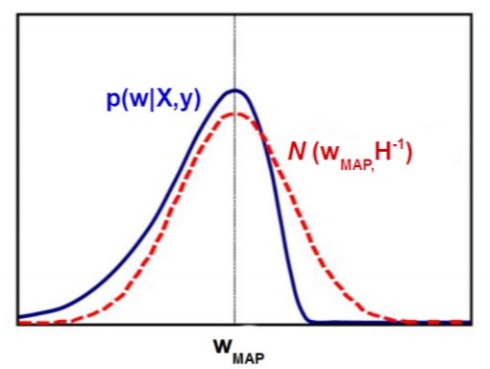




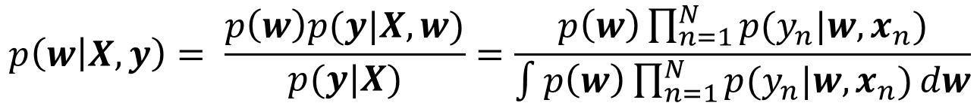

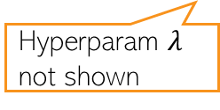
Logistic Regression: The Posterior
3
$$μ_{n}=σ(w^{⊤}x_{n})$$
The posterior will be
Need to approximate the posterior in this case
For now, we will use a simple approximation called Laplace approximation
Gaussian
Bernoulli
Unfortunately, Gaussian and Bernoulli are not conjugate with each other, so analytic expression for the posterior can’t be obtained unlike prob. linear regression
$$p\left(w | X,y\right)= \frac{p\left(w\right)p(y|X,w)}{p(y|X)}=\frac{p\left(w\right)\prod_{n=1}^{N}{p(y_{n}|w,x_{n})}}{\int{p\left(w\right)\prod_{n=1}^{N}{p(y_{n}|w,x_{n})}dw}}$$
Hyperparam $λ$ not shown
Other approx. inference methods, such as MCMC and VI later
Laplace approx: Approximates the intractable posterior by a Gaussian whose mean is the MAP solution of the LR model
.. and the covariance matrix of this Gaussian is set to the inverse of the Hessian matrix (second derivative) of the model’s negative log-joint of params and data, evaluated at the MAP solution
First or second-order optimization methods can be used

Slide 4
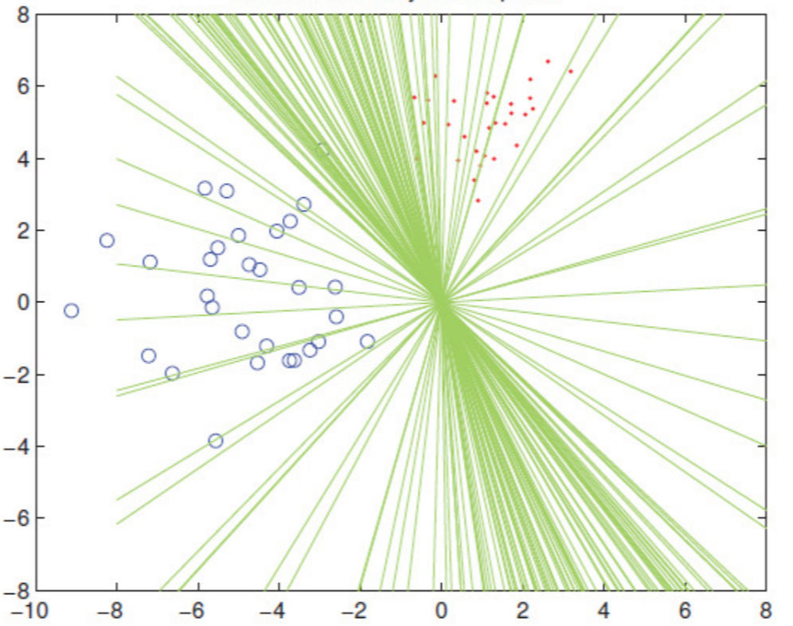

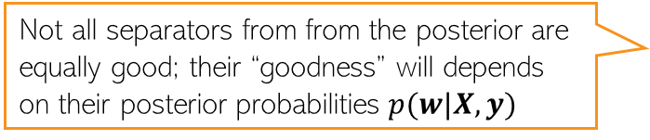
LR Posterior: An Illustration
4
Assuming the Gaussian approximation, some samples from the posterior of LR
Each sample drawn from $p(w|X,y)$ will give a weight vector
Each such $w$ corresponds to one of the separators in the above figure
Not all separators from from the posterior are equally good; their “goodness” will depends on their posterior probabilities $p(w|X,y)$
When making predictions, we can still use all of them but weighted by their importance based on their posterior probabilities
That’s exactly what we do when computing the predictive distribution

Slide 5
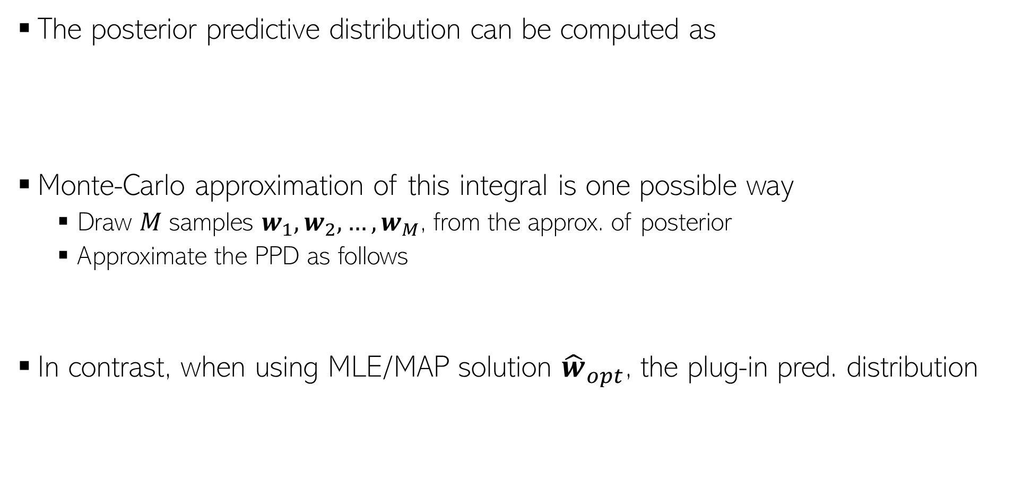
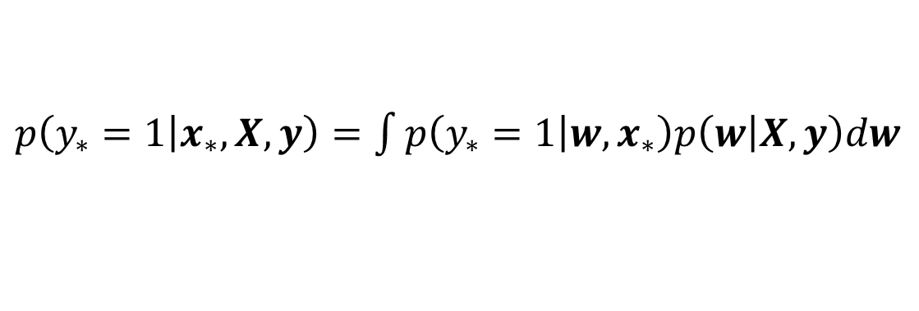
LR: Posterior Predictive Distribution
5
The posterior predictive distribution can be computed as
Monte-Carlo approximation of this integral is one possible way
  Draw 𝑀 samples $w_{1}, w_{2}, …, w_{M}$, from the approx. of posterior
  Approximate the PPD as follows
In contrast, when using MLE/MAP solution ${\hat{w}}_{opt}$, the plug-in pred. distribution
$p\left(y_{∗}=1 | x_{∗},X,y\right)=\int{p\left(y_{∗}=1 | {w,x}_{∗}\right)p\left(w | X,y\right)dw}$
Integral not tractable and must be approximated
sigmoid
Gaussian (if using Laplace approx.)
$$p\left(y_{∗}=1 | x_{∗},X,y\right)≈\frac{1}{M}\sum_{m=1}^{M}{p\left(y_{∗}=1 | {w_{m},x}_{∗}\right)}= \frac{1}{M}\sum_{m=1}^{M}{σ(w_{m}^{⊤}x_{n})}$$
$p\left(y_{∗}=1 | x_{∗},X,y\right)=\int{p\left(y_{∗}=1 | {w,x}_{∗}\right)p\left(w | X,y\right)dw}$
$$≈p\left(y_{∗}=1 | {{\hat{w}}_{opt},x}_{∗}\right)=σ({{\hat{w}}_{opt}}^{⊤}x_{n})$$

Slide 6
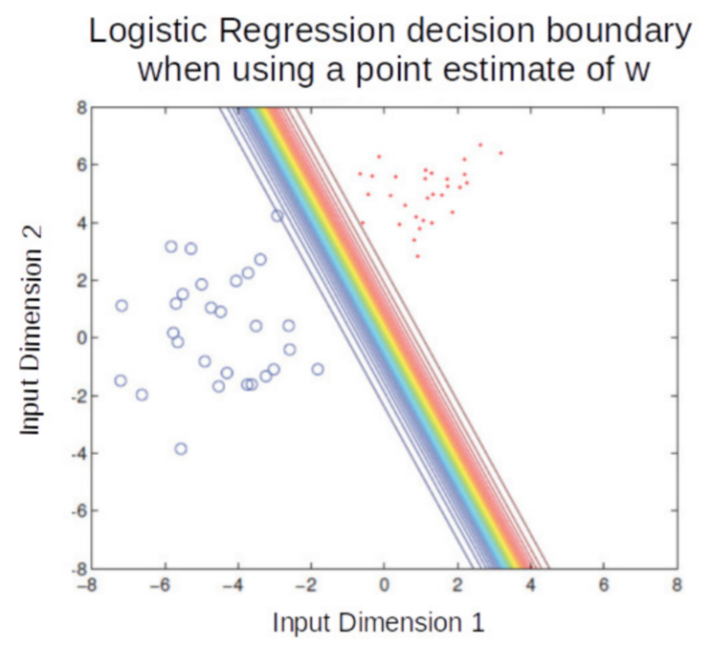
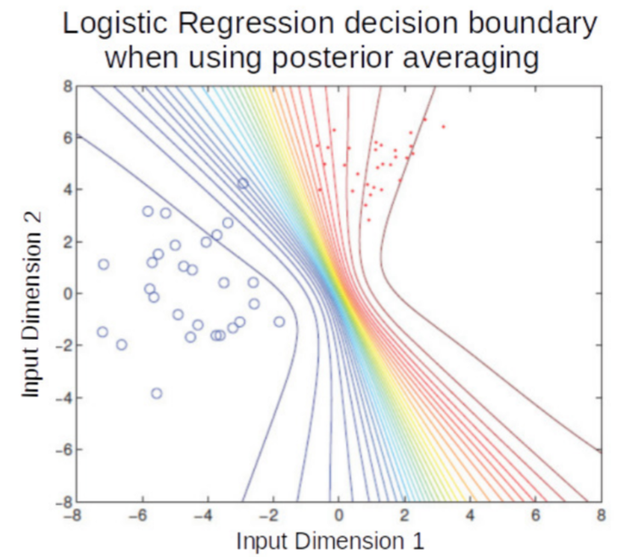
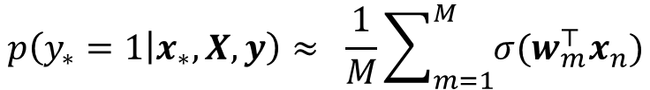


LR: Plug-in Prediction vs Bayesian Averaging
6
Plug-in prediction uses a single $w$ (point est) to make prediction
PPD does an averaging using all possible $w$’s from the posterior
Color transitions (red to blue) in both plots denote how the probability of an input changes from belonging to red class to belonging to blue class. All inputs on a line (or curve on RHS plot)have the same probability of belonging to the red/blue class
Posterior averaging is like using an ensemble of models. In this example, each model is a linear classifier but the ensemble-like effect resulted in nonlinear boundaries
$$p\left(y_{∗}=1 | x_{∗},X,y\right)≈σ({{\hat{w}}_{opt}}^{⊤}x_{n})$$
$$p\left(y_{∗}=1 | x_{∗},X,y\right)≈ \frac{1}{M}\sum_{m=1}^{M}{σ(w_{m}^{⊤}x_{n})}$$

Slide 7
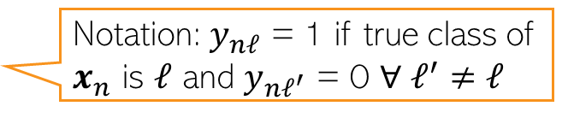
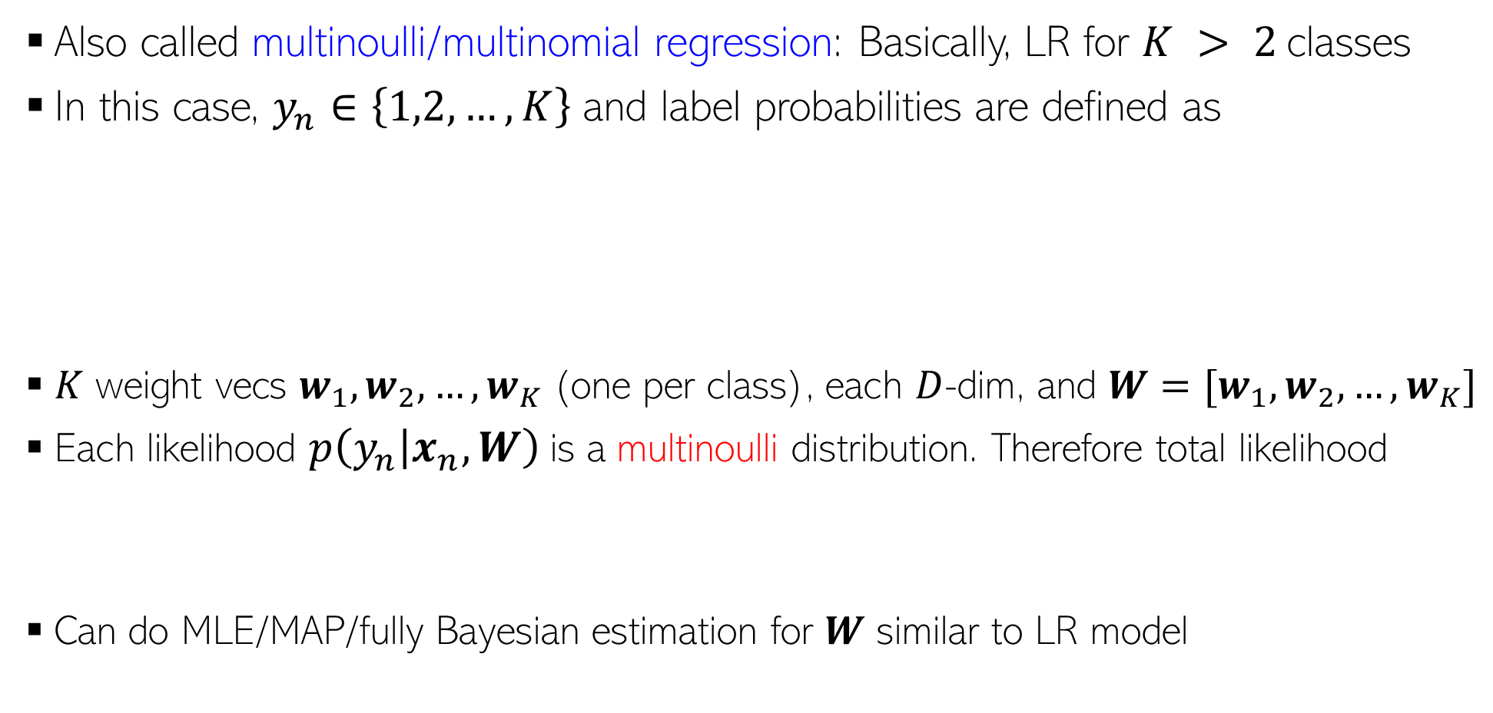
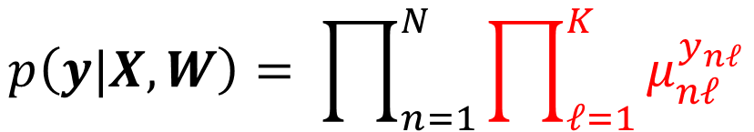
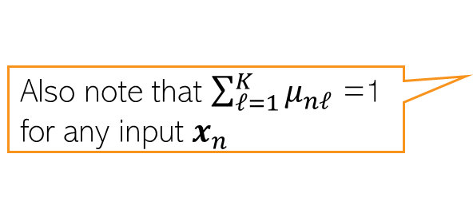
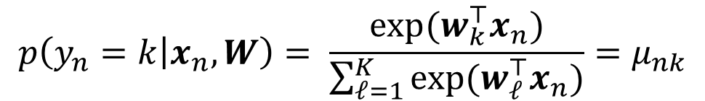
Multiclass Logistic (a.k.a. Softmax) Regression
7
Also called multinoulli/multinomial regression: Basically, LR for $K > 2$classes
In this case, $y_{n}∈\left\{1,2,…,K\right\}$ and label probabilities are defined as
$K$ weight vecs $w_{1},w_{2},…,w_{K}$(one per class), each $D$-dim, and $W=[w_{1},w_{2},…,w_{K}]$
Each likelihood $p\left(y_{n} | x_{n},W\right)$is a multinoulli distribution. Therefore total likelihood
Can do MLE/MAP/fully Bayesian estimation for $W$ similar to LR model
Softmax function
$$p\left(y_{n}=k | x_{n},W\right)= \frac{exp(w_{k}^{⊤}x_{n})}{\sum_{ℓ=1}^{K}{exp(w_{ℓ}^{⊤}x_{n})}}=μ_{nk}$$
Also note that $\sum_{ℓ=1}^{K}{μ_{nℓ}}$ =1 for any input $x_{n}$
$$p\left(y|X,W\right)= \prod_{n=1}^{N}{\prod_{ℓ=1}^{K}{μ_{nℓ}^{y_{nℓ}}}}$$
Notation: $y_{nℓ}$ = 1 if true class of $x_{n}$ is $ℓ$ and $y_{nℓ^{′}}$ = 0 $∀ ℓ^{′}$ $≠ℓ$

Slide 8


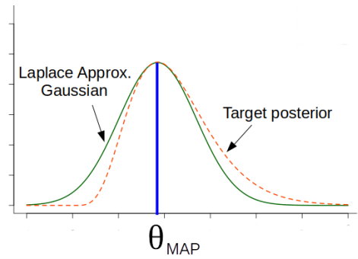




Laplace Approximation of Posterior Distribution
8
Consider a posterior distribution that is intractable to compute
Laplace approximation approximates the above using a Gaussian distribution
Why is the above Gaussian a reasonable approximation to the posterior?
Unknowns of the model
Data

Slide 9





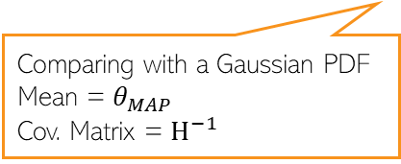
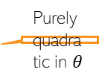


Derivation of the Laplace Approximation
9
$$−H$$
Recall that Hessian is the second derivative of the negative of log-joint
$$≈$$
+ const
Let’s write the Bayes rule as
Approximating $log p(𝒟,θ)$ by a quadratic function of $θ$ will make it a Gaussian
Consider the second-order Taylor approx of a function $f\left(θ\right)$ around some $θ_{0}$
Assuming $f\left(θ\right)= log p(𝒟,θ)$ and $θ_{0}=θ_{MAP}$,
Thus Laplace approx. is based on a second-order Taylor approx. of the posterior
Aha! This is a Gaussian!
Comparing with a Gaussian PDF
Mean = $θ_{MAP}$
Cov. Matrix = $H^{−1}$
Purely quadratic in $θ$
Constant w.r.t. $θ$

Slide 10
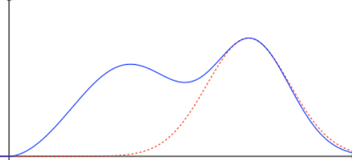

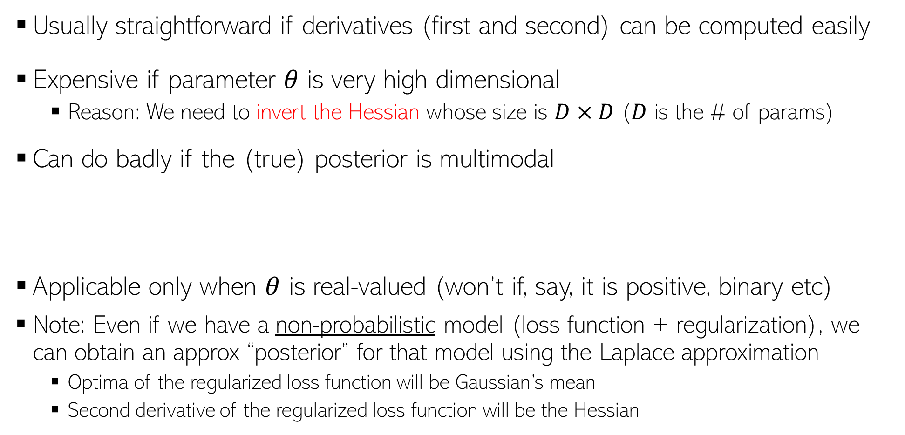
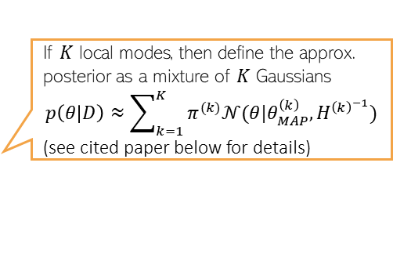
Properties of Laplace Approximation
10
Usually straightforward if derivatives (first and second) can be computed easily
Expensive if parameter $θ$ is very high dimensional
  Reason: We need to invert the Hessian whose size is $D×D$ ($D$ is the # of params)
Can do badly if the (true) posterior is multimodal
Applicable only when $θ$ is real-valued (won’t if, say, it is positive, binary etc)
Note: Even if we have a non-probabilistic model (loss function + regularization), we can obtain an approx “posterior” for that model using the Laplace approximation
  Optima of the regularized loss function will be Gaussian’s mean
  Second derivative of the regularized loss function will be the Hessian
E.g., a deep neural network, or even in simpler models (e.g., logistic reg with a very large number of features
If $K$ local modes, then define the approx. posterior as a mixture of $K$ Gaussians
$$p\left(θ | D\right)≈\sum_{k=1}^{K}{π^{(k)}𝒩(θ|θ_{MAP}^{\left(k\right)}, H^{{\left(k\right)}^{−1}})}$$
(see cited paper below for details)
For multimodal posteriors, can use a mixture of Laplace approximation*
Useful for deep learning models
True posterior
Gaussian approximation
*Mixtures of Laplace Approximations for Improved Post-Hoc Uncertainty in Deep Learning (Eschenhagen et al, 2021)

Slide 11
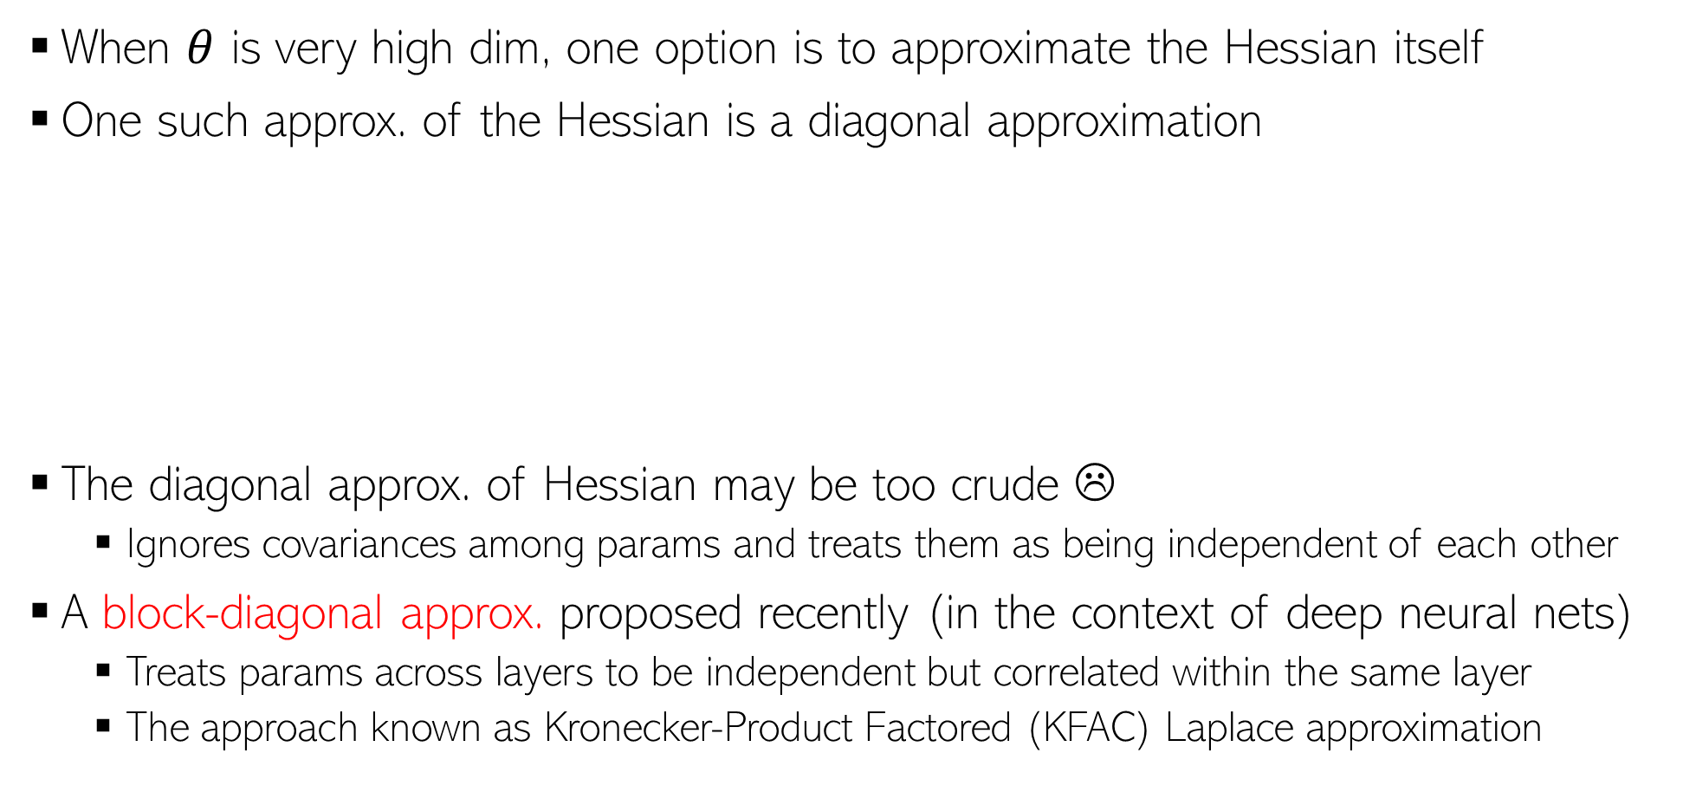
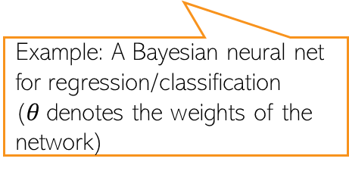
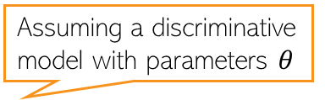

Laplace Approx. for High-Dimensional Problems
11
When $θ$ is very high dim, one option is to approximate the Hessian itself
One such approx. of the Hessian is a diagonal approximation
The diagonal approx. of Hessian may be too crude ☹
  Ignores covariances among params and treats them as being independent of each other
A block-diagonal approx. proposed recently (in the context of deep neural nets)
  Treats params across layers to be independent but correlated within the same layer
  The approach known as Kronecker-Product Factored (KFAC) Laplace approximation
Assuming a discriminative model with parameters $θ$
Fisher Information Matrix (FIM)
Example: A Bayesian neural net for regression/classification ($θ$denotes the weights of the network)
$$H≈diag(F)$$
FIM is easily computable in auto-diff frameworks used in deep learning
KFAC paper: “A Scalable Laplace Approximation for Neural Networks” (Ritter et al, ICLR 2018)

Slide 12


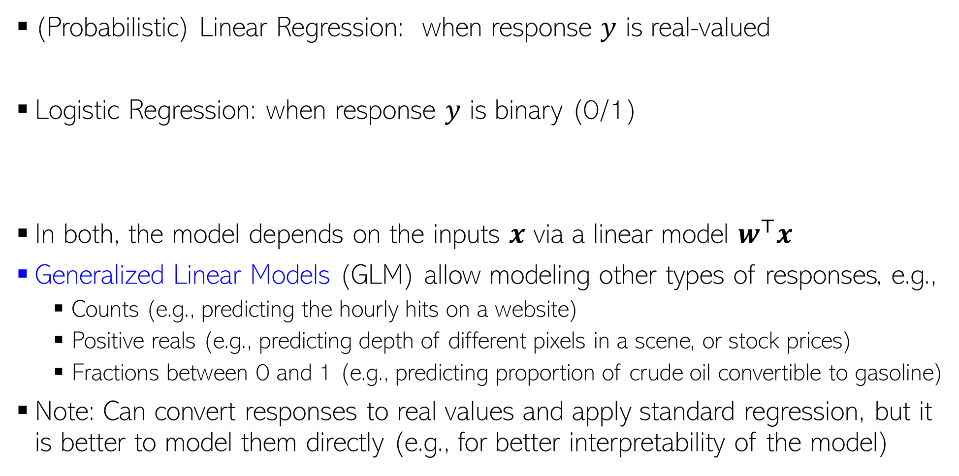
Generalized Linear Models
12
(Probabilistic) Linear Regression: when response $y$ is real-valued
Logistic Regression: when response $y$ is binary (0/1)
In both, the model depends on the inputs $x$ via a linear model $w^{⊤}x$
Generalized Linear Models (GLM) allow modeling other types of responses, e.g.,
  Counts (e.g., predicting the hourly hits on a website)
  Positive reals (e.g., predicting depth of different pixels in a scene, or stock prices)
  Fractions between 0 and 1 (e.g., predicting proportion of crude oil convertible to gasoline)
Note: Can convert responses to real values and apply standard regression, but it is better to model them directly (e.g., for better interpretability of the model)
Note: Probabilistic Linear Regression and Logistic Regression are also GLMs

Slide 13

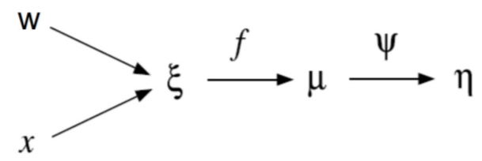
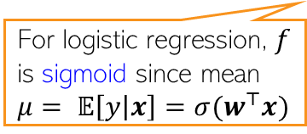



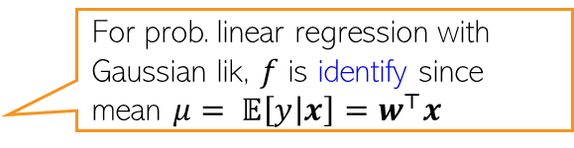





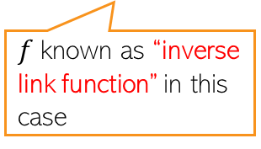
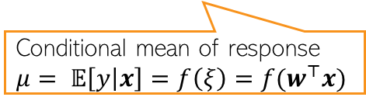

Generalized Linear Models: Formally
13
The reason why GLMs can model a wide variety of responses
GLMs model the response using an exponential family distribution
The inputs $x$ only appear via a linear model $ξ=w^{⊤}x$ and the overall pipeline is
Note: Some GLM are represented via exponential dispersion family given by
Scalar natural param (depends on input $x$)
Response $y$ assumed univariate but vector GLMs also exist
Scalar suff-stats $φ(y) = y$
For prob. linear regression with Gaussian lik, $f$ is identify since mean $μ= 𝔼\left[y | x\right]=w^{⊤}x$
Response Function
Link Function
For GLM with Canonical Response Function (next slide), $ψ = f^{−1}$ and thus nat. param. $η=ξ=w^{⊤}x$
For logistic regression, $f$ is sigmoid since mean $μ= 𝔼\left[y | x\right]={σ(w}^{⊤}x)$
Natural parameter $η= ψ(μ)$
$f$known as “inverse link function” in this case
Conditional mean of response $μ= 𝔼\left[y | x\right]=f\left(ξ\right)=f(w^{⊤}x)$
Recall cumulant results of exp-fam
If $σ^{2}$is fixed, it is the standard exponential family
$$𝔼\left[y\right]=A^{′}\left(η\right)$$
Called the “dispersion parameter”
Examples: Gaussian GLM, Gamma GLM
$$var\left[y\right]=A^{′′}\left(η\right)σ^{2}$$

Slide 14

Generalized Linear Models: Examples
14
Consider the overdispersed GLMs
Consider a linear regression model with Gaussian likelihood
Comparing the expressions, $η=w^{⊤}x,$ $A\left(η\right)=\frac{η^{2}}{2},log h\left(y,σ^{2}\right)={−y}^{2}/2σ^{2}$
Can likewise express other models for exp-family distributions $p(y|x)$
  Regardless of the form, all will have $η=w^{⊤}x$
Note that here we expressed the Gaussian in the overdispersed GLM form unlike how we did it earlier when discussing exp-family
$$p\left(y | η, σ^{2}\right)=h(y,σ^{2})exp\left[\frac{ηy−A(η)}{σ^{2}}\right]=exp\left[\frac{ηy−A(η)}{σ^{2}}+ log h(y,σ^{2})\right]$$
$$p\left(y | x,w,σ^{2}\right)∝exp\left[−\frac{{\left(y−w^{⊤}x\right)}^{2}}{2σ^{2}}\right]=exp\left[−\frac{y^{2}+{\left(w^{⊤}x\right)}^{2}−2yw^{⊤}x}{2σ^{2}}\right]=exp\left[\frac{yw^{⊤}x{− \left(w^{⊤}x\right)}^{2}/2}{σ^{2}} − \frac{y^{2}}{2σ^{2}} \right]$$

Slide 15


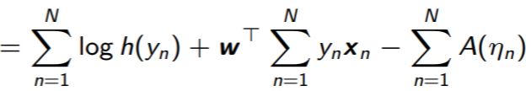
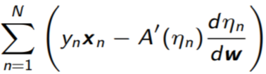
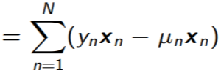
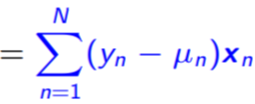

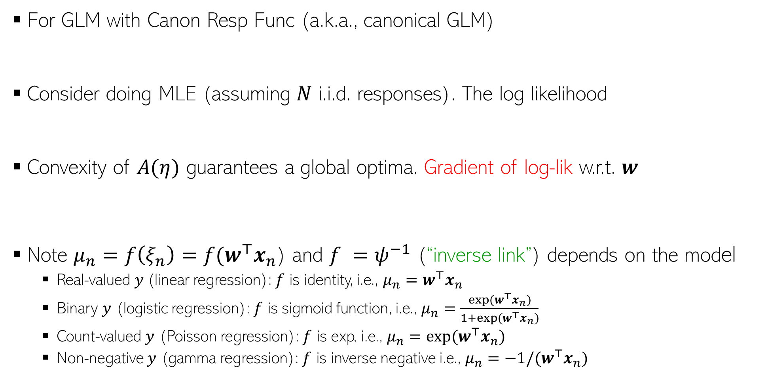



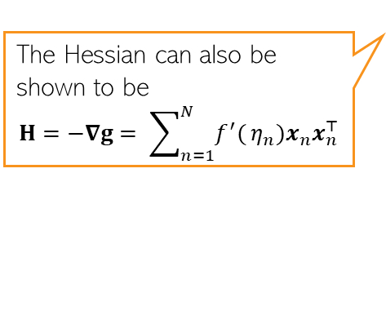
GLM with Canonical Response Function
15
The simple form of canonical GLM (nat. param just a linear function $w^{⊤}x$ ) makes parameter estimation via MLE/MAP easy since gradient and Hessian have simple expressions (though the Hessian may be expensive to compute/invert)
For GLM with Canon Resp Func (a.k.a., canonical GLM)
Consider doing MLE (assuming $N$ i.i.d. responses). The log likelihood
Convexity of $A(η)$ guarantees a global optima. Gradient of log-lik w.r.t. $w$
Note $μ_{n}=f\left(ξ_{n}\right)=f(w^{⊤}x_{n}$) and $f =ψ^{−1}$ (“inverse link”) depends on the model
  Real-valued $y$(linear regression): $f$ is identity, i.e., $μ_{n}=w^{⊤}x_{n}$
  Binary $y$ (logistic regression): $f$ is sigmoid function, i.e., $μ_{n}=\frac{exp(w^{⊤}x_{n})}{1+exp(w^{⊤}x_{n})}$
  Count-valued $y$ (Poisson regression): $f$ is exp, i.e., $μ_{n}={exp(w}^{⊤}x_{n})$
  Non-negative $y$ (gamma regression): $f$ is inverse negative i.e., $μ_{n}={−1/(w}^{⊤}x_{n})$
Exp of suff-stats$𝔼[y_{n}]$
Corrective updates for $w$
The Hessian can also be shown to be
$$H=−∇g= \sum_{n=1}^{N}{f^{′}(}η_{n})x_{n}x_{n}^{⊤}$$
$$g=$$

Slide 16
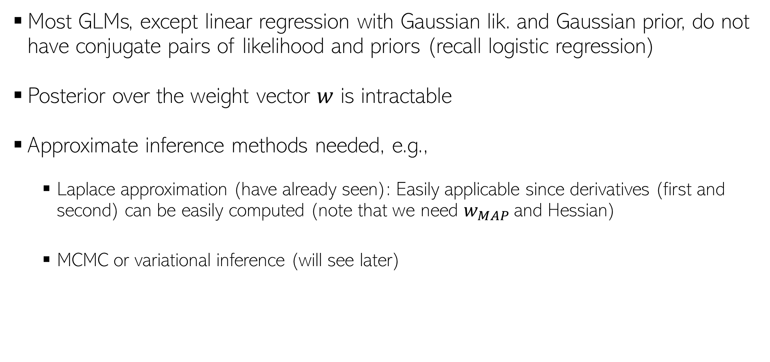
Fully Bayesian Inference for GLMs
16
Most GLMs, except linear regression with Gaussian lik. and Gaussian prior, do not have conjugate pairs of likelihood and priors (recall logistic regression)
Posterior over the weight vector $w$ is intractable
Approximate inference methods needed, e.g.,
  Laplace approximation (have already seen): Easily applicable since derivatives (first and second) can be easily computed (note that we need $w_{MAP}$and Hessian)
  MCMC or variational inference (will see later)

Slide 17

Various Types of GLMs
17
Type of response | Type of GLM | Link Function $Ψ$ | Response Function $f$ (Inv Link Func if canon. GLM) (Operates on $ξ=w^{⊤}x)$ | Activation
Real | Gaussian | Identity | Identity | Linear
Binary | Logistic | Log-odds: $log \frac{μ}{1−μ}$ | Sigmoid | Sigmoid
Binary | Probit | Inv CDF: $Φ^{−1}(μ)$ | $Φ$(CDF of N(0,1)) | Probit
Categorical | Multinoulli | Log-odds: $log \frac{μ_{k}}{1−μ_{k}}$ | Softmax | Softmax
Count | Poisson | $$log μ$$ | exp
Non-negative real | gamma | Negative of inverse | Negative of inverse
Binary | Gumbel | Gumbel Inv CDF: log(-log()) | Gumbel CDF: exp(-exp(-))
.. and several others (exponential, inverse Gaussian, Binomial, Tweedie, etc)

