Slide 1
(1)Exponential Family Distributions (Contd)
(2) Probabilistic Models for Classification
CS772A: Probabilistic Machine Learning
Piyush Rai

Slide 2
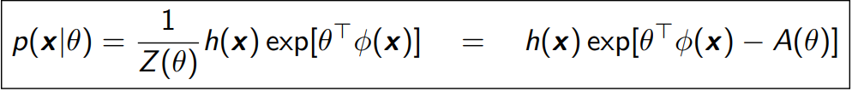
Exp. Family (Pitman, Darmois, Koopman, 1930s)
2
Defines a class of distributions. An Exponential Family distribution is of the form
$x ∈ 𝒳^{m}$ is the r.v. being modeled ($𝒳$denotes some space, e.g., $ℝ$ or $\{0,1\}$)
$θ ∈ ℝ^{d}$: Natural parameters or canonical parameters defining the distribution
$φ(x) ∈ ℝ^{d}$: Sufficient statistics (another random variable)
  Why “sufficient”: $p(x|θ)$ as a function of $θ$ depends on $x$ only via $φ(x)$
$Z\left(θ\right)=∫h\left(x\right)exp\left[θ^{⊤}φ\left(x\right)\right]dx$: Partition Function
$A\left(θ\right)= log Z(θ)$: Log-partition function (also called cumulant function)
$h(x)$: A constant (doesn’t depend on $θ$)

Slide 3



Expressing a Distribution in Exp. Family Form
3
Recall the form of exp-fam distribution $p\left(x | θ\right)=h\left(x\right)exp\left[θ^{⊤}φ\left(x\right)−A\left(θ\right)\right]$
To write any exp-fam dist $p()$ in the above form, write it as $exp(log p())$
Now compare the resulting expression with the exponential family form
.. to identify the natural parameters, sufficient statistics, log-partition function, etc.
$$p\left(x | θ\right)=h\left(x\right)exp\left[θ^{⊤}φ\left(x\right)−A\left(θ\right)\right]$$

Slide 4




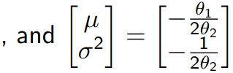

(Univariate) Gaussian as Exponential Family
4
Let’s try to write a univariate Gaussian in the exponential family form
Recall the PDF of a univar Gaussian (already has exp, so less work needed :))

Slide 5
Other Examples
5
Many other distribution belong to the exponential family
  Bernoulli
  Beta
  Gamma
  Multinoulli/Multinomial
  Dirichlet
  Multivariate Gaussian
  .. and many more ( https://en.wikipedia.org/wiki/Exponential_family )
Note: Not all distributions belong to the exponential family, e.g.,
  Uniform distribution (x ∼ Unif(a, b))
  Student-t distribution
  Mixture distributions (e.g., mixture of Gaussians)

Slide 6


Log-Partition Function
6
The log-partition function is
$A(θ)$ is also called the cumulant function
Derivatives of $A(θ)$ can be used to generate the cumulants of the sufficient statistics
Exercise: Assume $θ$ to be a scalar (thus $φ(x)$ is also scalar). Show that the first and the second derivatives of $A(θ)$ are
Above result also holds when $θ$ and $φ(x)$ are vector-valued (the “var” will be “covar”)
Important: $A(θ)$ is a convex function of $θ$. Why?

Slide 7
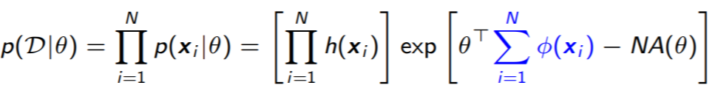
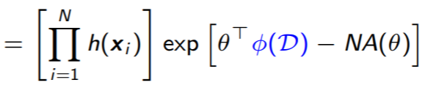

MLE for Exponential Family Distributions
7
Assume data $𝒟= \{x_{1}, . . . , x_{N}\}$drawn i.i.d. from an exp. family distribution
To do MLE, we need the overall likelihood -- a product of the individual likelihoods
To estimate $θ$ (as we’ll see shortly), we only need
Size of $φ\left(𝒟\right)=\sum_{i=1}^{N}{φ\left(x_{i}\right)}$does not grow with $N$ (same as the size of each $φ\left(x_{i}\right)$)
Only exponential family distributions have finite-sized sufficient statistics
  No need to store all the data; can simply update the sufficient statistics as data comes
  Useful in probabilistic inference with large-scale data sets and “online” parameter estimation
$$p\left(x | θ\right)=h\left(x\right)exp\left[θ^{⊤}φ\left(x\right)−A\left(θ\right)\right]$$

Slide 8



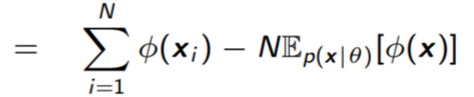
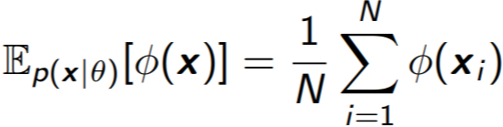

MLE and Moment Matching
8
The likelihood is of the form
The log-likelihood is (ignoring constant w.r.t. $θ$):
This is concave in $θ$ (since $−A(θ)$ is concave)
  Maximization (MLE solution) will yield a global maxima of $θ$
MLE for exp-fam distributions can also be seen as doing moment-matching
Therefore, at the “optimal” (i.e., MLE) $\hat{θ}$, we must have
Empirical moment (computed using data)
Expected moment
Can thus solve for the MLE $θ$ also by matching the expected and empirical moments

Slide 9
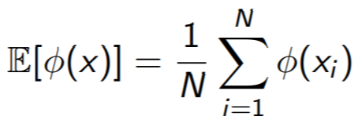
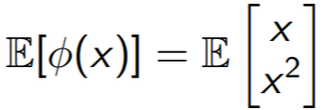
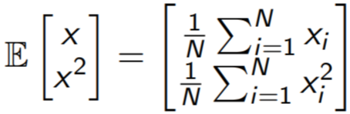





Moment Matching: An Example
9
Given data$𝒟= \{x_{1}, . . . , x_{N}\}$drawn i.i.d. from a univar Gaussian $p\left(x\right)=𝒩\left(x | μ, σ^{2}\right)$
Since the “true”, i.e., expected moments:
For a univariate Gaussian, note that
Moment matching
Same solution that we get by doing MLE
Two equations, two unknowns ($μ$ and $σ^{2}$)

Slide 10

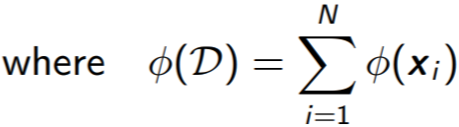
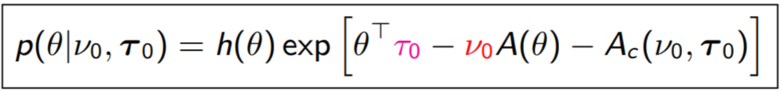
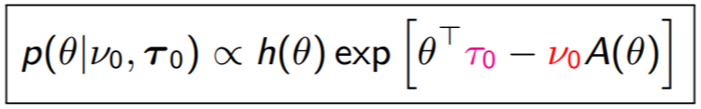
Bayesian Inference for Expon. Family Distributions
10
Already saw that the total likelihood given $N$ i.i.d. observations $𝒟= \{x_{1}, . . . , x_{N}\}$
Let’s choose the following prior (note: looks similar in terms of $θ$ within exp)
Ignoring the prior’s log-partition function
Comparing the prior’s form with the likelihood, note that
  $ν_{0}$is like the number of “pseudo-observations” coming from the prior
  $τ_{0}$is the total sufficient statistics of the pseudo-observations ($τ_{0}$/ $ν_{0}$ per pseudo-obs)

Slide 11


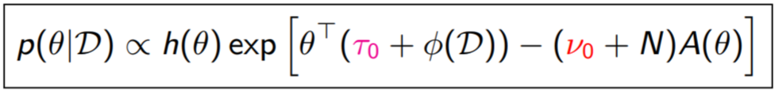
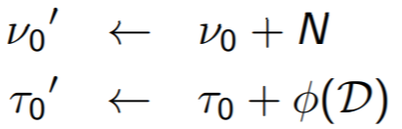

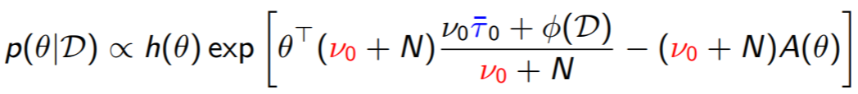
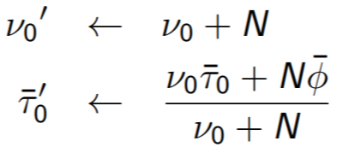

The Posterior
11
The likelihood and prior were
The posterior therefore will be
Every exp family likelihood has a conjugate prior having the form above
Posterior’s hyperparams $τ_{0}^{′},ν_{0}^{′}$ obtained by adding “stuff” to prior’s hyperparams
Assume its log partition function denoted as $A_{c}(ν_{0},τ_{0})$
Posterior is also from the same family as the prior
Happens when the prior is conjugate to the likelihood
Its log partition function will be $A_{c}(ν_{0}+N,τ_{0}+φ(𝒟))$
Number of pseudo-observations plus number of actual observations
Another equivalent form
Suff-stats of pseudo-obervations plus suff-stats of actual observations
Convex comb of avg suff-stats of pseudo obs and actual obs

Slide 12

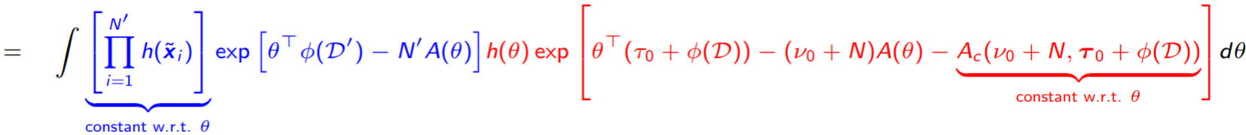
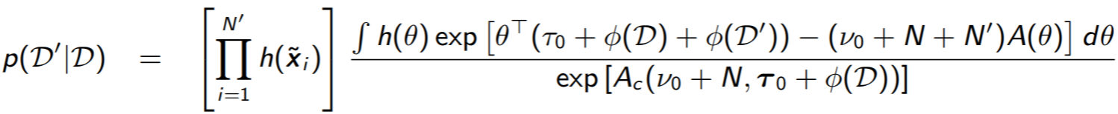
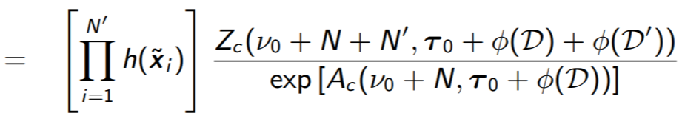
Posterior Predictive Distribution
12
Assume some training data $𝒟= \{x_{1}, . . . , x_{N}\}$from some exp-fam distribution
Assume some test data $𝒟^{′}= \{{\tilde{x}}_{1}, . . . ,{\tilde{x}}_{N^{′}}\}$from the same distribution
The posterior pred. distr. of $𝒟^{′}$
This gets further simplified into
Exp. Fam. likelihood w.r.t. test data
Posterior (same form as the prior due to conjugacy)

Slide 13
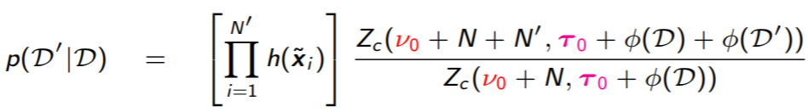
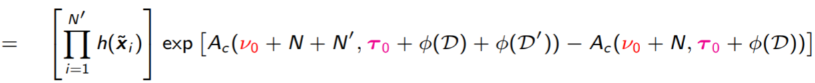

Posterior Predictive Distribution
13
Thus PPD as well as marginal likelihood has closed form expression when working with exp-family distributions
Since $A_{c} = log⁡Z_{c}$ or $Z_{c}= exp⁡(A_{c})$, we can write the PPD as
Therefore the posterior predictive is proportional to
  Ratio of two partition functions of two “posterior distributions” (one with $N + N^{′}$examples and the other with $N$ examples)
  Exponential of the difference of the corresponding log-partition functions
Note that the form of $Z_{c}$ (and $A_{c}$) will simply depend on the chosen conjugate prior
Very useful result. Also holds for $N = 0$
  In this case is simply the marginal likelihood of test data $𝒟^{′}$

Slide 14
Summary
14
Exp. family distributions are very useful for modeling diverse types of data/parameters
Conjugate priors to exp. family distributions make parameter updates very simple
Other quantities such as posterior predictive can be computed in closed form
Useful in designing generative classification models. Choosing class-conditional from exponential family with conjugate priors helps in parameter estimation
Useful in designing generative models for unsupervised learning
Used in designing Generalized Linear Models: Model $p(y|x)$ using exp. fam distribution
  Linear regression (with Gaussian likelihood) and logistic regression are GLMs
Will see several use cases when we discuss approx inference algorithms (e.g., Gibbs sampling, and especially variational inference)

Slide 15

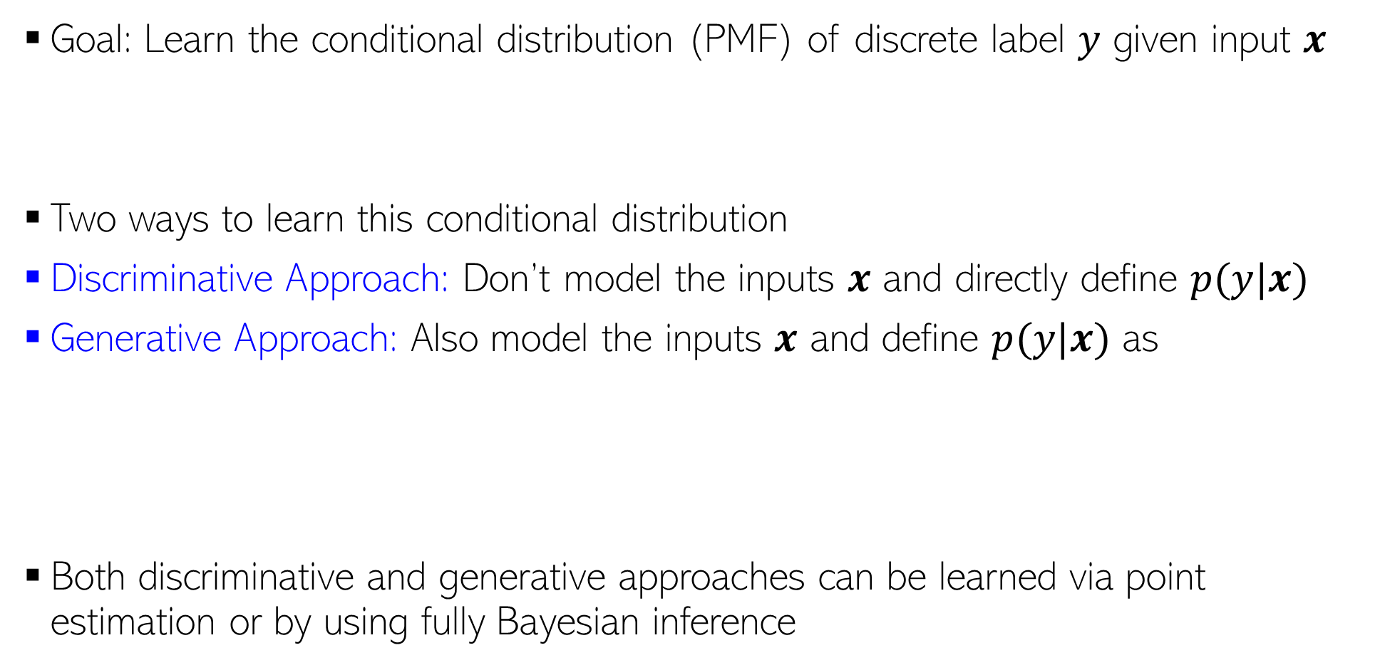
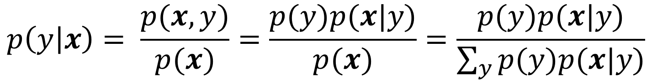


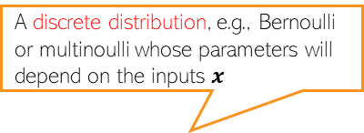
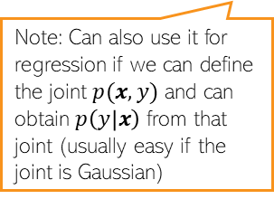


Probabilistic Models for Classification
15
Goal: Learn the conditional distribution (PMF) of discrete label $y$ given input $x$
Two ways to learn this conditional distribution
Discriminative Approach: Don’t model the inputs $x$ and directly define $p(y|x)$
Generative Approach: Also model the inputs $x$ and define $p(y|x)$ as
Both discriminative and generative approaches can be learned via point estimation or by using fully Bayesian inference
$$p(y|x)$$
Will depend on some parameters (not shown here for brevity)
$$p(y|x)$$
$$y$$
A discrete distribution, e.g., Bernoulli or multinoulli whose parameters will depend on the inputs $x$
Prior probability of class $y$
Distribution of inputs from class $y$
Note: Can also use it for regression if we can define the joint $p(x,y)$ and can obtain $p\left(y | x\right)$ from that joint (usually easy if the joint is Gaussian)
a.k.a. “class-prior”
$$p\left(y | x\right)= \frac{p(x,y)}{p(x)}=\frac{p(y)p(x|y)}{p(x)}=\frac{p(y)p(x|y)}{\sum_{y}{p(y)p(x|y)}}$$
a.k.a. “class-conditional” distribution

Slide 16
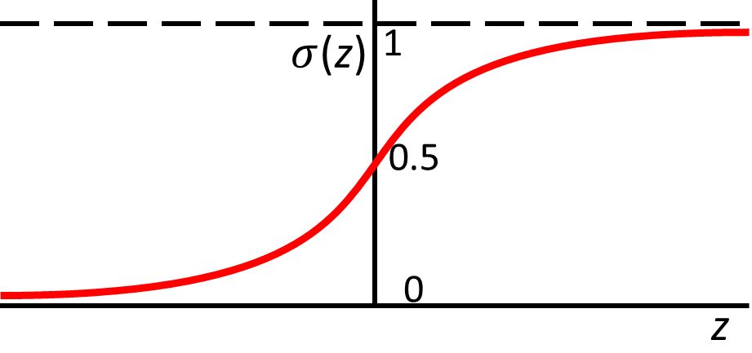

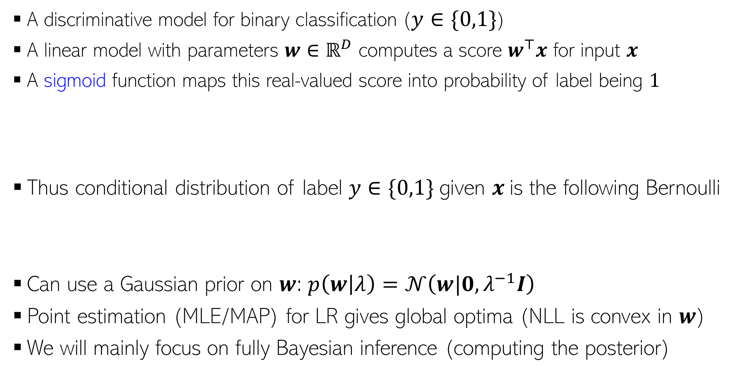



Logistic Regression
There are other ways too that can convert the score into a probability, such as a CDF:
$p\left(y=1 | x,w\right)=μ=Φ\left(w^{⊤}x\right)$ where $Φ$ is the CDF of $𝒩(0,1)$. This model is known as “Probit Regression”.
16
A discriminative model for binary classification ($y∈\{0,1\}$)
A linear model with parameters $w∈ℝ^{D}$ computes a score $w^{⊤}x$ for input $x$
A sigmoid function maps this real-valued score into probability of label being $1$
Thus conditional distribution of label $y∈\{0,1\}$given $x$is the following Bernoulli
Can use a Gaussian prior on $w$: $p\left(w | λ\right)=𝒩\left(w|0,λ^{−1}I\right)$
Point estimation (MLE/MAP) for LR gives global optima (NLL is convex in $w$)
We will mainly focus on fully Bayesian inference (computing the posterior)
$$σ\left(z\right)= \frac{1}{1+exp(−z)}=\frac{exp(z)}{1+exp(z)}$$
$$p\left(y=1 | x,w\right)=μ=σ\left(w^{⊤}x\right)$$
Large positive score $w^{⊤}x$ means large prob of label being 1, and large negative score means low prob
real-valued score
Likelihood
$$p\left(y | x,w\right)= Bernoulli\left[y | μ\right]=μ^{y}{\left(1−μ\right)}^{1−y}={\left[\frac{\exp\left(w^{⊤}x\right)}{1+\exp\left(w^{⊤}x\right)}\right]}^{y}{\left[\frac{1}{1+\exp\left(w^{⊤}x\right)}\right]}^{1−y}$$
Can also use a sparsity-inducing prior, such as spike-and-slab or a scale-mixture of Gaussians

Slide 17
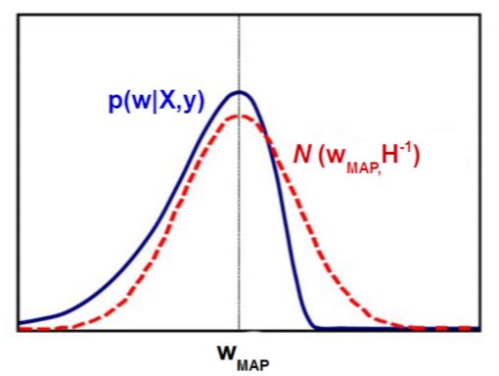




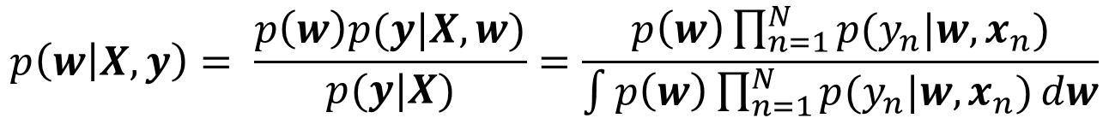
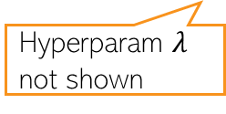
Logistic Regression: The Posterior
17
The posterior will be
Need to approximate the posterior in this case
For now, we will use a simple approximation called Laplace approximation
Gaussian
Bernoulli
Unfortunately, Gaussian and Bernoulli are not conjugate with each other, so analytic expression for the posterior can’t be obtained unlike prob. linear regression
$$p\left(w | X,y\right)= \frac{p\left(w\right)p(y|X,w)}{p(y|X)}=\frac{p\left(w\right)\prod_{n=1}^{N}{p(y_{n}|w,x_{n})}}{\int{p\left(w\right)\prod_{n=1}^{N}{p(y_{n}|w,x_{n})}dw}}$$
Hyperparam $λ$ not shown
Other approx. inference methods, such as MCMC and VI later
Laplace approx: Approximates the intractable posterior by a Gaussian whose mean is the MAP solution of the LR model
.. and the covariance matrix of this Gaussian is set to the inverse of the Hessian matrix (second derivative) of the model’s negative log-joint of params and data, evaluated at the MAP solution
First or second-order optimization methods can be used

Slide 18
Next Class
18
Laplace approximation (contd)
Bayesian logistic regression (contd)

