Slide 1
(1) Probabilistic Linear Regression(Contd)
(2) Exponential Family Distributions
CS772A: Probabilistic Machine Learning
Piyush Rai

Slide 2
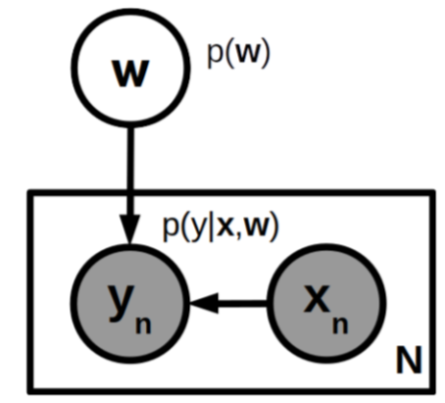


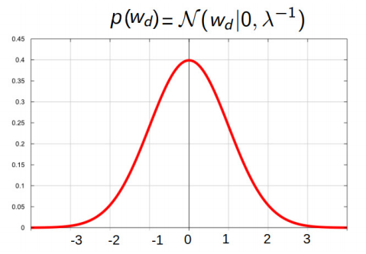
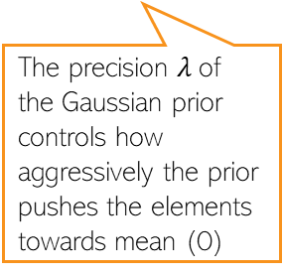
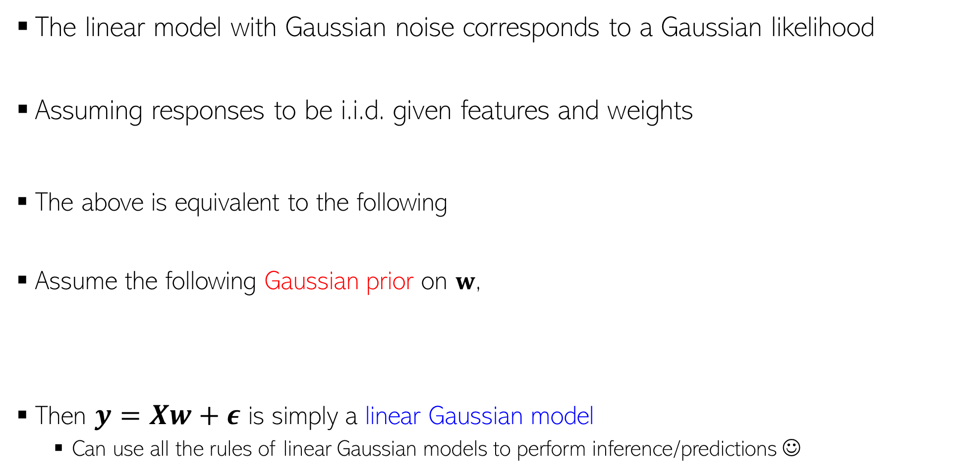

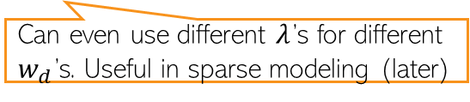
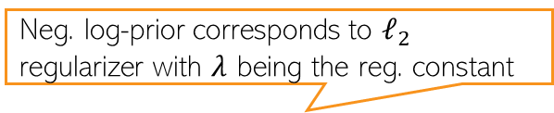


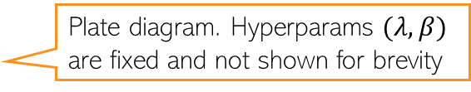

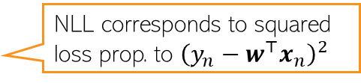
Probabilistic Linear Regression
2
Plate diagram. Hyperparams $(λ, β)$ are fixed and not shown for brevity
The linear model with Gaussian noise corresponds to a Gaussian likelihood
Assuming responses to be i.i.d. given features and weights
The above is equivalent to the following
Assume the following Gaussian prior on $w$,
Then $y=Xw+ε$ is simply a linear Gaussian model
  Can use all the rules of linear Gaussian models to perform inference/predictions ☺
NLL corresponds to squared loss prop. to ${\left(y_{n}−w^{⊤}x_{n}\right)}^{2}$
$N×D$ feature matrix
$N×1$ response vector
$$y=Xw+ε$$
$$where ε∼𝒩\left(0,β^{−1}I_{N}\right)$$
Neg. log-prior corresponds to $ℓ_{2}$ regularizer with $λ$ being the reg. constant
The precision $λ$of the Gaussian prior controls how aggressively the prior pushes the elements towards mean (0)
Can even use different $λ$’s for different $w_{d}$’s. Useful in sparse modeling (later)

Slide 3



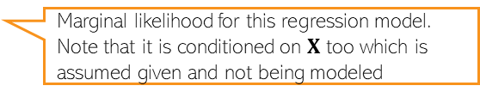
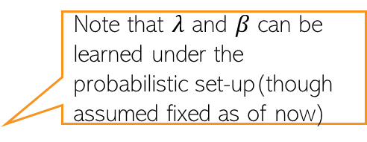
The Posterior
Will only look at fully Bayesian inference. For MLE/MAP, refer to CS771 slides or book
3
The posterior over $w$ (for now, assume hyperparams $β$ and $λ$ to be known)
Using the “completing the squares” trick (or linear Gaussian model results)
Marginal likelihood for this regression model. Note that it is conditioned on $X$ too which is assumed given and not being modeled
Must be a Gaussian due to conjugacy
Note that $λ$ and $β$ can be learned under the probabilistic set-up(though assumed fixed as of now)

Slide 4
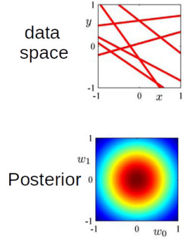
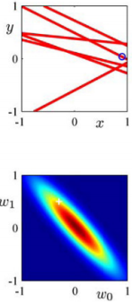
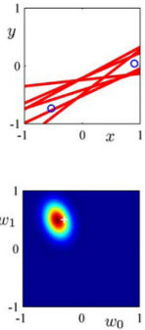
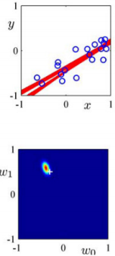
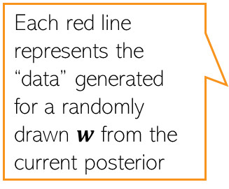

The Posterior: A Visualization
4
Assume a lin. reg. problem with true $w = \left[w_{0},w_{1}\right],w_{0} = −0.3,w_{1} = 0.5$
Assume data generated by a linear regression model $y = w_{0} + w_{1}x + "noise"$
  Note: It’s actually 1-D regression ($w_{0}$ is just a bias term), or 2-D reg. with feature $[1, x]$
Figures below show the “data space” and posterior of $w$ for different number of observations (note: with no observations, the posterior = prior)
Each red line represents the “data” generated for a randomly drawn $w$ from the current posterior

Slide 5
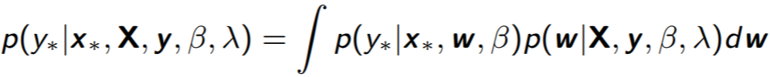
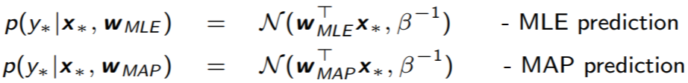
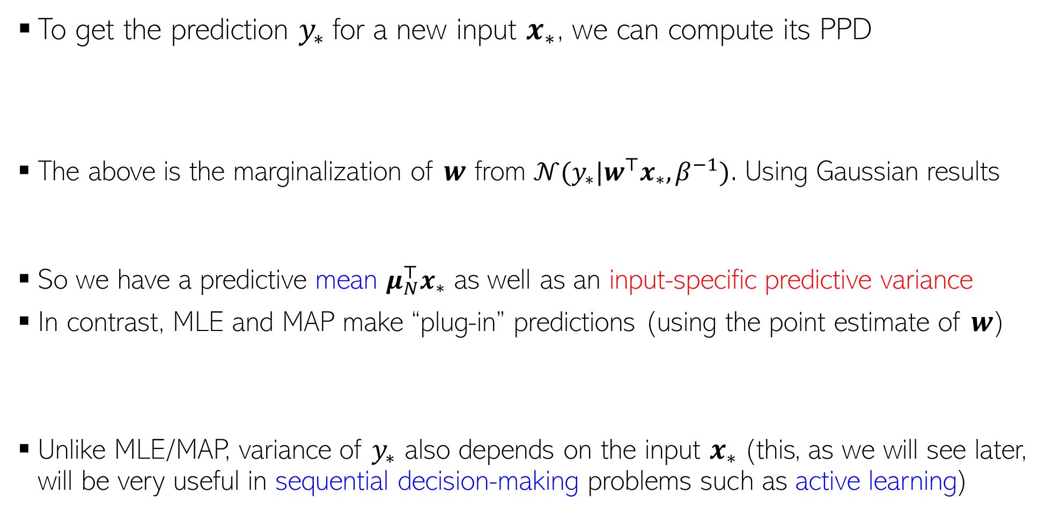


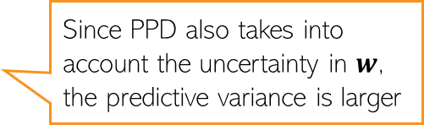
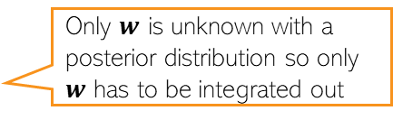
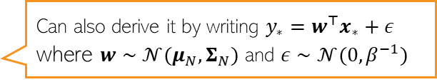
Posterior Predictive Distribution
5
To get the prediction $y_{∗}$for a new input $x_{∗}$, we can compute its PPD
The above is the marginalization of $w$ from $𝒩(y_{∗}|w^{⊤}x_{∗},β^{−1})$. Using Gaussian results
So we have a predictive mean $μ_{N}^{⊤}x_{∗}$ as well as an input-specific predictive variance
In contrast, MLE and MAP make “plug-in” predictions (using the point estimate of $w$)
Unlike MLE/MAP, variance of $y_{∗}$ also depends on the input $x_{∗}$(this, as we will see later, will be very useful in sequential decision-making problems such as active learning)
Only $w$ is unknown with a posterior distribution so only $w$ has to be integrated out
$$𝒩(y_{∗}|w^{⊤}x_{∗},β^{−1})$$
$$𝒩(w|μ_{N},Σ_{N})$$
Can also derive it by writing $y_{∗}=w^{⊤}x_{∗}+ε$ where $w∼𝒩(μ_{N},Σ_{N})$ and $ε∼𝒩(0,β^{−1})$
Since PPD also takes into account the uncertainty in $w$, the predictive variance is larger

Slide 6
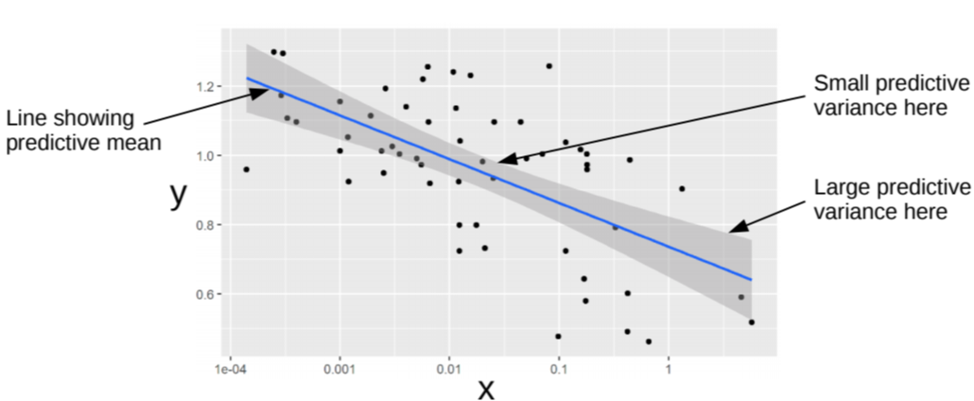

Posterior Predictive Distribution: An Illustration
6
Black dots are training examples
Width of the shaded region at any $x$ denotes the predictive uncertainty at that $x$ (+/- one std-dev)
Regions with more training examples have smaller predictive variance

Slide 7
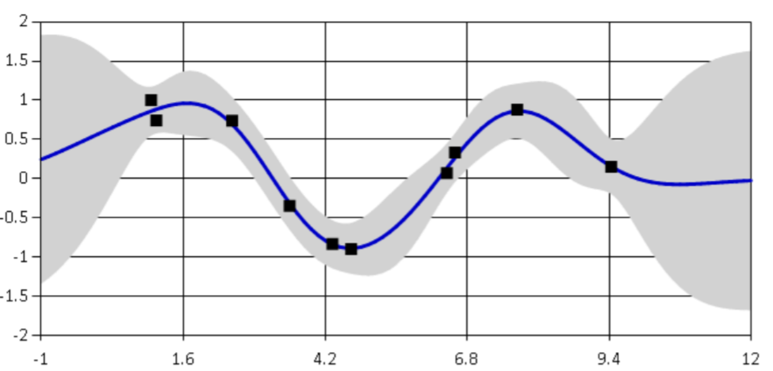

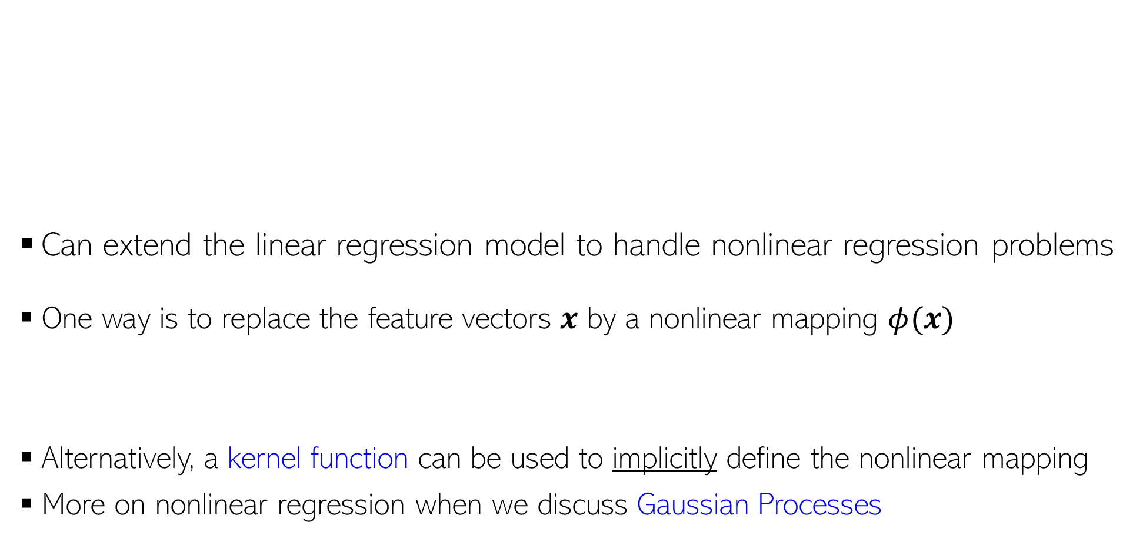
Nonlinear Regression
7
Can extend the linear regression model to handle nonlinear regression problems
One way is to replace the feature vectors $x$ by a nonlinear mapping $φ(x)$
Alternatively, a kernel function can be used to implicitly define the nonlinear mapping
More on nonlinear regression when we discuss Gaussian Processes
Can be pre-defined or extracted by a pretrained deep neural net

Slide 8
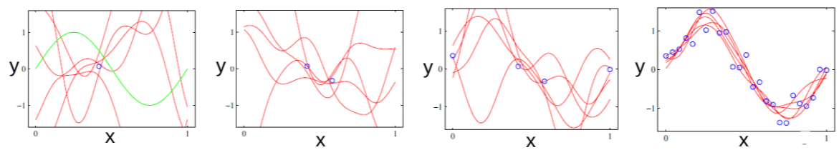
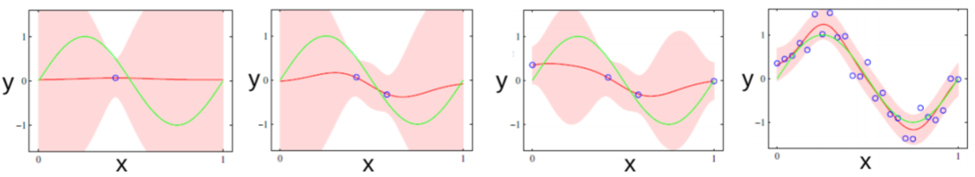
More on Visualization of Uncertainty
8
Figures below: Green curve is the true function and blue circles are observations
Posterior of the nonlinear regression model: Some curves drawn from the posterior
PPD: Red curve is predictive mean, shaded region denotes predictive uncertainty

Slide 9
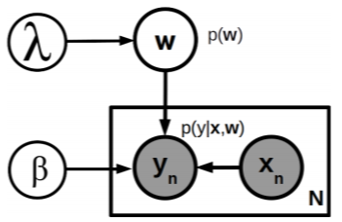
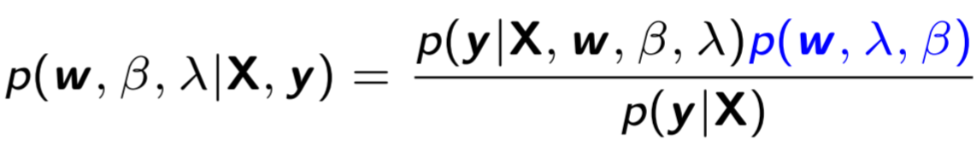
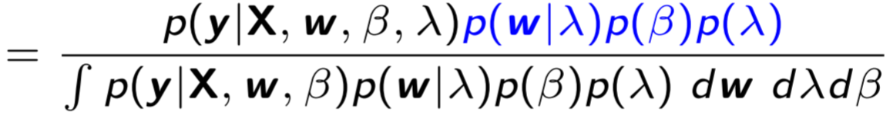


Hyperparameters
9
The probabilistic linear reg. model we saw had two hyperparams ($β, λ$)
  Thus total three unknowns ($w,β, λ$)
Posterior and PPD computation is intractable. Several ways to address this
  MLE-II for ($β, λ$): . Use them to infer the posterior of $θ$ and PPD
  Use alternating estimation like EM (e.g., E step computes $w$, M step computes($β, λ$))
  Use MCMC or Variational Inference to approximate the above posterior and PPD
Need posterior over all the 3 unknowns
PPD would require integrating out all 3 unknowns

Slide 10



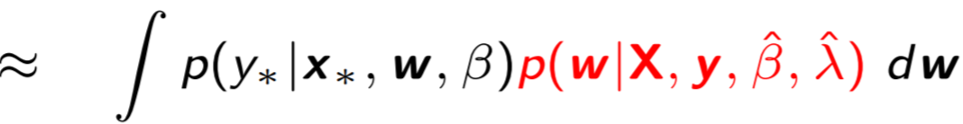



MLE-II
For any model where hyperparams are estimated by MLE-II, the posterior and PPD is approximated in a similar fashion
10
For the probabilistic linear regression model, the overall posterior over unknowns
With MLE-II approx of (𝛽, 𝜆), , a point mass at $\hat{β,}\hat{λ}$
Likewise, the PPD will be approximated as follows
Same as the posterior of$w$with the hyperparameters fixed
Same form for the PPD as in the case of fixed hyperparams
Only need to integrate over $w$, since other two are fixed at their MLE-II solutions

Slide 11
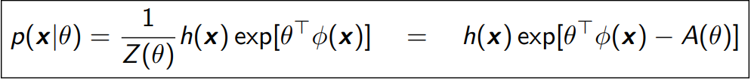
Exp. Family (Pitman, Darmois, Koopman, 1930s)
11
Defines a class of distributions. An Exponential Family distribution is of the form
$x ∈ 𝒳^{m}$ is the r.v. being modeled ($𝒳$denotes some space, e.g., $ℝ$ or $\{0,1\}$)
$θ ∈ ℝ^{d}$: Natural parameters or canonical parameters defining the distribution
$φ(x) ∈ ℝ^{d}$: Sufficient statistics (another random variable)
  Why “sufficient”: $p(x|θ)$ as a function of $θ$ depends on $x$ only via $φ(x)$
$Z\left(θ\right)=∫h\left(x\right)exp\left[θ^{⊤}φ\left(x\right)\right]dx$: Partition Function
$A\left(θ\right)= log Z(θ)$: Log-partition function (also called cumulant function)
$h(x)$: A constant (doesn’t depend on $θ$)

Slide 12



Expressing a Distribution in Exp. Family Form
12
Recall the form of exp-fam distribution $p\left(x | θ\right)=h\left(x\right)exp\left[θ^{⊤}φ\left(x\right)−A\left(θ\right)\right]$
To write any exp-fam dist $p()$ in the above form, write it as $exp(log p())$
Now compare the resulting expression with the exponential family form
.. to identify the natural parameters, sufficient statistics, log-partition function, etc.
$$p\left(x | θ\right)=h\left(x\right)exp\left[θ^{⊤}φ\left(x\right)−A\left(θ\right)\right]$$

Slide 13




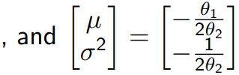

(Univariate) Gaussian as Exponential Family
13
Let’s try to write a univariate Gaussian in the exponential family form
Recall the PDF of a univar Gaussian (already has exp, so less work needed :))

Slide 14
Other Examples
14
Many other distribution belong to the exponential family
  Bernoulli
  Beta
  Gamma
  Multinoulli/Multinomial
  Dirichlet
  Multivariate Gaussian
  .. and many more ( https://en.wikipedia.org/wiki/Exponential_family )
Note: Not all distributions belong to the exponential family, e.g.,
  Uniform distribution (x ∼ Unif(a, b))
  Student-t distribution
  Mixture distributions (e.g., mixture of Gaussians)

Slide 15
Next class
15
Continue and wrap up the discussion on exp. family distributions

