Slide 1
(1) Parameter Estimation for Gaussians (2) Probabilistic Linear Regression
CS772A: Probabilistic Machine Learning
Piyush Rai

Slide 2
Plan Today
2
Estimating parameters of a Gaussian distribution
Will only focus on fully Bayesian inference, not MLE/MAP (left as an exercise)
Probabilistic Linear Regression
Using Gaussian likelihood and Gaussian prior

Slide 3
Bayesian Inference for Mean of a Univariate Gaussian
3
Assumed fixed
Consider $N$ i.i.d. scalar obs $X= \{x_{1},x_{2},…, x_{N}\}$ drawn from $p\left(x | μ,σ^{2}\right)= 𝒩(x|μ, σ^{2})$
Each $x_{n}$is a noisy measurement of $μ∈ℝ$, i.e., $x_{n}=μ+ε_{n}$ where $ε_{n}∼𝒩(0,σ^{2})$
Would like to estimate $μ$ given $X$ using fully Bayesian inference (not point estimation)
Need a prior over $μ.$ Let’s choose a Gaussian $p\left(μ|μ_{0},σ_{0}^{2}\right)= 𝒩\left(μ | μ_{0}, σ_{0}^{2}\right)$
The prior basically says that a priori $μ$is close to $μ_{0}$
The prior’s variance $σ_{0}^{2}$tells us how certain we are about the above assumption
Since $σ^{2}$ in the likelihood model $𝒩\left(x | μ, σ^{2}\right)$ is known, the Gaussian prior $𝒩\left(x | μ_{0}, σ_{0}^{2}\right)$ on $μ$ is also conjugate to the likelihood (thus posterior of $μ$ will also be Gaussian)
$$p\left(x | μ,σ^{2}\right)$$
$$p\left(μ|μ_{0},σ_{0}^{2}\right)$$
$$μ$$
$$μ_{0}$$
Assume $μ_{0}$ and $σ_{0}^{2}$ to be fixed/known

Slide 4
Bayesian Inference for Mean of a Univariate Gaussian
4
The posterior distribution for the unknown mean parameter $μ$
Simplifying the above (using completing the squares trick – see note) gives
What happens to the posterior as $N$ (number of observations) grows very large?
Data (likelihood part) overwhelms the prior
Posterior’s variance $σ_{N}^{2}$ will approximately be $σ^{2}/N$ (and goes to 0 as $N→∞)$
The posterior’s mean $μ_{N}$ approaches $\overline{x}$(which is also the MLE solution)
On conditioning side, skipping all fixed params and hyperparams from the notation
Gaussian posterior (not a surprise since the chosen prior was conjugate to the likelihood)
Also the MLE solution for $μ$
Gaussian posterior’s precision is the sum of the prior’s precision and sum of the noise precisions of all the observations
Contribution from the data
Contribution from the prior
Gaussian posterior’s mean is a convex combination of prior’s mean and the MLE solution
Meaning, we become very-very certain about the estimate of $μ$

Slide 5
Bayesian Inference for Mean of a Univariate Gaussian
5
Using the inferred posterior $p(µ|X)$, we can find the posterior predictive distribution
For an alternative way to get the above result, note that
In contrast, the plug-in predictive given a point estimate $\hat{μ}$ will be
Assumed fixed, only $μ$ is the unknown here
PRML [Bis 06], 2.115, and also mentioned in prob-stats refresher slides
Conditional of $x_{∗}$given $μ$is Gaussian, and $μ$ has a Gaussian posterior, so marginal of $x_{∗}$ (after we marginalize $μ$) will also be a Gaussian
$$p\left(x_{∗} | X\right)=∫p\left(x_{∗}\right|μ,σ^{2})p(µ\left|X\right)dμ$$
On conditioning side, skipping all fixed params and hyperparams from the notation
$$=∫𝒩(x_{∗}|μ, σ^{2})𝒩\left(μ | μ_{N}, σ_{N}^{2}\right)dμ$$
$$=𝒩(x_{∗}|μ_{N}, σ^{2}+σ_{N}^{2})$$
Result follows from properties of Gaussian and noting that a PPD is also a marginal distribution
A useful fact: When we have conjugacy, the posterior predictive distribution also has a closed form (will see this result more formally when talking about exponential family distributions)
This “extra” variance is due to the averaging over the posterior’s uncertainty
$$x_{∗}=μ+ε$$
$$μ∼𝒩\left(μ_{N}, σ_{N}^{2}\right)$$
$$ε∼𝒩\left(0, σ^{2}\right)$$
$$⇒ p(x_{∗}|X)=𝒩(x_{∗}|μ_{N}, σ^{2}+σ_{N}^{2})$$
Since both $μ$and $ε$are Gaussian r.v., and are independent, $x_{∗}$also has a Gaussian predictive, and the respective means and variances of $μ$and $ε$ get added up
Note that PPD had a larger variance ($σ^{2}+σ_{N}^{2}$)
$$p\left(x_{∗} | X\right)=∫p\left(x_{∗}\right|μ,σ^{2})p(µ\left|X\right)dμ≈p\left(x_{∗}\right|\hat{μ},σ^{2})=𝒩(x_{∗}|\hat{μ}, σ^{2})$$

Slide 6
Bayesian Inference for Variance of a Univariate Gaussian
6
Consider $N$ i.i.d. scalar obs $X= \{x_{1},x_{2},…, x_{N}\}$ drawn from $𝒩(x|μ, σ^{2})$
Assume the variance $σ^{2}∈ℝ_{+}$ to be unknown and mean $μ$ to be fixed/known
Would like to estimate $σ^{2}$ given $X$ using fully Bayesian inference (not point estimation)
Need a prior over $σ^{2}.$ What prior $p(σ^{2}$) to choose in this case?
If we want a conjugate prior, it should have the same form as the likelihood
An inverse-gamma dist $IG(α, β)$has this form ($α, β$are shape and scale hyperparams)
Due to conjugacy, posterior will also be IG:

Slide 7
Working with Gaussians: Variance vs Precision
7
Often, it is easier to work with the precision (=1/variance) rather than variance
If mean is known, for precision, $Gamma(α, β)$is a conjugate prior to Gaussian lik.
(Verify) The posterior $p(λ |X)$will be
Note: Unlike the case of unknown mean and fixed variance, the PPD for this case (and also the unknown variance case) will not be a Gaussian
Note: Gamma distribution can be defined in terms of shape and scale or shape and rate parametrization (scale = 1/rate). Likewise, inverse Gamma can also be defined both shape and scale (which we saw) as well as shape and rate parametrizations.
$$p\left(x_{n} | μ,λ^{−1}\right)= 𝒩\left(x | μ, λ^{−1}\right)= \sqrt{\frac{λ}{2π} }exp\left[−\frac{λ}{2}{\left(x_{n}−μ\right)}^{2}\right]$$
$α$ and $β$ are the shape and rate params, resp., of the Gamma distribution
PDF of gamma distribution
$p\left(λ\right)∝{\left(λ\right)}^{\left(α−1\right)}exp[−βλ]$
(Note: mean of $Gamma\left(α, β\right)= \frac{α}{β}$)

Slide 8
Bayesian Inference for Both Parameters of a Gaussian
8
Gaussian with unknown scalar mean and unknown scalar precision (two parameters)
Consider $N$ i.i.d. scalar obs $X= \{x_{1},x_{2},…, x_{N}\}$ drawn from $𝒩(x|μ, λ^{−1})$
Assume both mean $µ$ and precision $λ$ to be unknown. The likelihood can be written as
Would like a joint conjugate prior distribution $p(µ, λ)$
It must have the same form as the likelihood as written above. Basically, something that looks like
Thankfully, this is a known distribution: normal-gamma (NG) distribution ☺
Called so since it can be written as a product of a normal and a gamma (next slide)
The NG also has a multivariate version called normal-Wishart distribution to jointly model a real-valued vector and a PSD matrix

Slide 9
Detour: Normal-gamma (Gaussian-gamma) Distribution
9
We saw that the conjugate prior needed to have the form
The above is product of a normal and a gamma distribution
The NG is conjugate to a Gaussian distribution if both its mean and precision parameters are unknown and are to be estimated
Thus a useful prior in many problems involving Gaussians with unknown mean and precision
Assuming shape-rate parametrization of the gamma

Slide 10
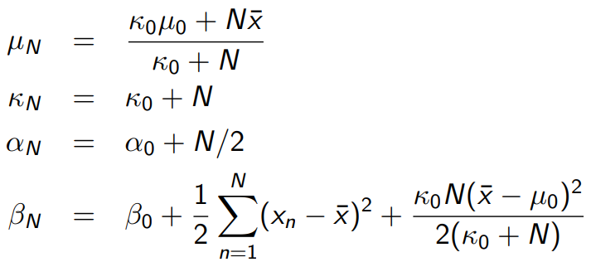
Bayesian Inference for Both Parameters of a Gaussian
10
Due to conjugacy, the joint posterior $p(µ, λ|X)$ will also be normal-gamma
Plugging in the expressions for $p(X|µ, λ)$and $p(µ, λ)$, we get
The above’s posterior’s parameters will be
Skipping all hyperparameters on the conditioning side
(For full derivation of posterior, refer to “Conjugate Bayesian analysis of the Gaussian distribution” - Murphy (2007))

Slide 11
Other Quantities of Interest
11
We saw that the joint posterior for mean and precision is NG
From the above, we can also obtain the marginal posteriors for $µ$ and $λ$
Marginal likelihood of the model
PPD of a new observation $x_{∗}$
Marginal lik has closed form expression (for conjugate lik and prior, the marginal lik has closed form – more when we see exp-family distributions)
(For full derivation of posterior, refer to “Conjugate Bayesian analysis of the Gaussian distribution” - Murphy (2007))

Slide 12
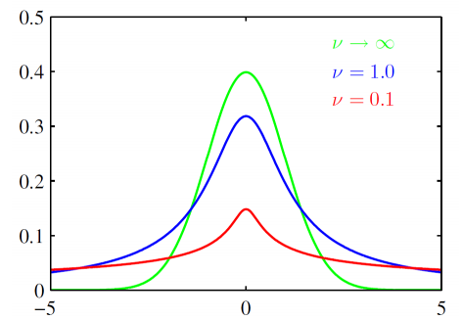
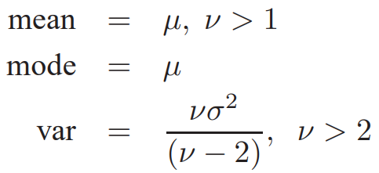
An Aside: Student-t distribution
12
An infinite sum of Gaussian distributions, with same means but different precisions
$ν>0$ is called the degree of freedom, $μ$ is the mean, and $σ^{2}$ is the scale
Same as saying that we are integrating out the precision parameter of a Gaussian with the mean held as fixed
As $ν$tends to infinity, student-t becomes a Gaussian
Has fatter tail than Gaussian and is sharper around the mean
Zero-mean Student-t (and other such “infinite sum of Gaussians” are useful priors for modeling sparse weights

Slide 13
Inferring Params of Gaussian: Some Other Cases
13
We only considered parameter estimation for univariate Gaussian distribution
The approach also extends to inferring parameters of a multivariate Gaussian
For the unknown mean and precision matrix, normal-Wishart can be used as prior
Posterior updates have forms similar to that in the univariate case
When working with mean-variance, can use normal-inverse gamma as conjugate prior
For multivariate Gaussian, can use normal-inverse Wishart for mean-covariance pair
Other priors can also be used as well when inferring parameters of Gaussians, e.g.,
normal-Inverse $χ^{2}$ commonly used in Statistics community for scalar mean-variance estimation
May also refer to “Conjugate Bayesian analysis of the Gaussian distribution” - Murphy (2007) for various examples and more detailed derivations

Slide 14
Linear Gaussian Model
14
Independently added and drawn from $𝒩(ε|0,L^{−1})$
Consider linear transf. of a r.v. $z$ with $p\left(z\right)=𝒩(z|μ,Λ^{−1})$, plus Gaussian noise $ε$
Easy to see that, conditioned on $z$, $x$ too has a Gaussian distribution
A Linear Gaussian Model. Very commonly encountered in probabilistic modeling
The following two distributions are of interest. Assuming $Σ={\left(Λ+A^{⊤}LA\right)}^{−1}$
Exercise: Prove the above results (PRML Chap. 2 contains a proof)
$$x=Az+b+ε$$
$$p\left(x|z\right)=𝒩\left(x | Az+b,L^{−1}\right)$$
If $p(z)$ is a prior and $p(x|z)$ is likelihood then this is the posterior
If $p(z)$ is a prior and $p(x|z)$ is likelihood then this is the marginal likelihood

Slide 15
Applications of Gaussian-based Models
15
Gaussians and Linear Gaussian Models widely used in probabilistic models, e.g.,
Probability density estimation: Given $x_{1},x_{2},…,x_{N}$, estimate $p(x)$ assuming Gaussian lik./noise
Given $N$ sensor obs. ${\left\{x_{n}\right\}}_{n=1}^{N}$ with $x_{n}=μ+ε_{n}$ (zero-mean Gaussian noise $ε_{n})$ estimate the underlying true value $μ$ (possibly along with the variance of the estimate of $μ$)
Estimating missing data: $p(x_{n}^{miss}|x_{n}^{obs})$ or $𝔼[x_{n}^{miss}|x_{n}^{obs}]$
Linear Regression with Gaussian Likelihood
Linear latent variable models (probabilistic PCA, factor analysis, Kalman filters) and their mixtures
Gaussian Processes (GP) extensively use Gaussian conditioning and marginalization rules
More complex models where parts of the model use Gaussian likelihoods/priors
Training feat. mat
The prior $p(w)$ is Gaussian
i.i.d. Gaussian noise
Training responses
$$y=Xw+ε$$

Slide 16
Probabilistic Linear Regression
Note: Only $y_{n}$ being modeled, not $x_{n}$ (discriminative model). A conditional model where $y_{n}$ is being modeled, conditioned on $x_{n}$
16
Assume training data ${\{x_{n},y_{n}\}}_{n=1}^{N}$, with features $x_{n}∈ℝ^{D}$ and responses $y_{n}∈ℝ$
Assume each $y_{n}$ generated by a noisy linear model with wts $w=[w_{1},…, w_{D}]$
Precision ($β$) variance of the Gaussian
noise tells is how noisy the outputs are
(i.e., how far from the mean they are)
Other noise models also possible (e.g.,
Laplace distribution for noise)
Output $y_{n}$ assumed generated from a Gaussian with mean $w^{⊤}x_{n}$
Each weight assumed real-valued
Mean
Variance
Gaussian

Slide 17
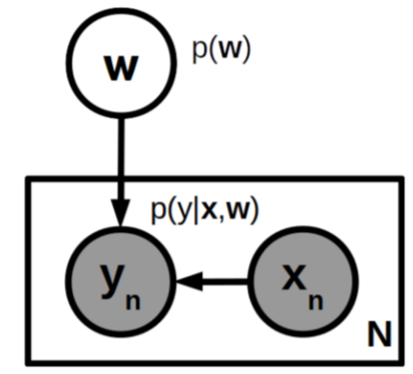
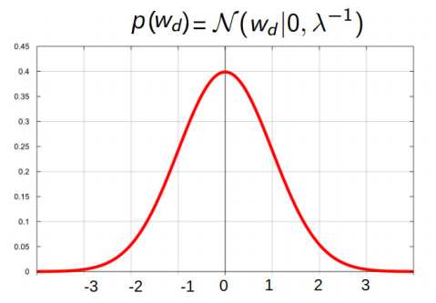
Probabilistic Linear Regression
17
Plate diagram. Hyperparams $(λ, β)$ are fixed and not shown for brevity
The linear model with Gaussian noise corresponds to a Gaussian likelihood
Assuming responses to be i.i.d. given features and weights
The above is equivalent to the following
Assume the following Gaussian prior on $w$,
Then $y=Xw+ε$ is simply a linear Gaussian model
Can use all the rules of linear Gaussian models to perform inference/predictions ☺
NLL corresponds to squared loss prop. to ${\left(y_{n}−w^{⊤}x_{n}\right)}^{2}$
$N×D$ feature matrix
$N×1$ response vector
$$y=Xw+ε$$
$$where ε∼𝒩\left(0,β^{−1}I_{N}\right)$$
Neg. log-prior corresponds to $ℓ_{2}$ regularizer with $λ$ being the reg. constant
The precision $λ$of the Gaussian prior controls how aggressively the prior pushes the elements towards mean (0)
Can even use different $λ$’s for different $w_{d}$’s. Useful in sparse modeling (later)

