Slide 1
Parameter Estimation in Probabilistic Models (Contd.)
CS772A: Probabilistic Machine Learning
Piyush Rai

Slide 2
Plan Today
2
Two simple examples of parameter estimation in probabilistic models
Beta (prior) – Bernoulli (likelihood) observation model
Dirichlet (prior) – Multinomial (likelihood) observation model
Conjugate priors
“Reading” a posterior distribution

Slide 3
An Important Point: PPD using Marginal Likelihood
3
PPD for a model $m$, by definition, is obtained by the following marginalization
Can also compute PPD without computing the posterior! Some ways:
Using a ratio of marginal likelihoods as follows
If $p\left(x_{∗} | X,m\right)$ can be obtained easily from the joint distribution $p(x_{∗},X|m)$
Note that the PPD $p\left(x_{∗} | X,m\right)$ is also a conditional distribution
For some distributions (e.g., Gaussian), conditionals can be easily derived from joint
$$p\left(x_{∗} | X,m\right)=∫p\left(x_{∗} | θ,m\right)p(θ|X,m) dθ$$
Joint marginal likelihood for training and test data
Follows simply from Bayes rule
$$p\left(a | b\right)= \frac{p(a,b)}{p(b)}$$
$$p\left(x_{∗} | X,m\right)=\frac{p(x_{∗},X|m)}{p(X|m)}$$
Marginal likelihood for training data
Will see this being used we we study Gaussian Process (GP)

Slide 4
Estimating a Beta-Bernoulli Model
4

Slide 5
Estimating a Coin’s Bias: MLE
Consider a sequence of $N$ coin toss outcomes (observations)
Each observation $y_{n}$ is a binary random variable. Head: $y_{n}=1$, Tail: $y_{n}=0$
Each $y_{n}$ is assumed generated by a Bernoulli distribution with param $θ∈ (0,1)$
Here $θ$the unknown param (probability of head). Want to estimate it using MLE
Log-likelihood: $\sum_{n=1}^{N}{log p\left(y_{n} | θ\right) }$= $\sum_{n=1}^{N}{ }[y_{n}log θ+ \text{(}1−y_{n})log⁡ (1−θ)]$
Maximizing log-lik, or minimizing neg. log-lik (NLL) w.r.t. $θ$ gives
Probability of a head
Likelihood or observation model
$p\left(y_{n} | θ\right)=Bernoulli\left(y_{n} | θ\right)= θ^{y_{n}}$ ${(1−θ)}^{1−y_{n}}$
assuming i.i.d. data
I tossed a coin 5 times – gave 1 head and 4 tails. Does it means $θ$ = 0.2?? The MLE approach says so. What is I see 0 head and 5 tails. Does it mean $θ$ = 0?
$$θ_{MLE}= \frac{\sum_{n=1}^{N}{y_{n}}}{N}$$
Thus MLE solution is simply the fraction of heads! ☺ Makes intuitive sense!
Indeed, with a small number of training observations, MLE may overfit and may not be reliable. An alternative is MAP estimation which can incorporate a prior distribution over $θ$

Slide 6
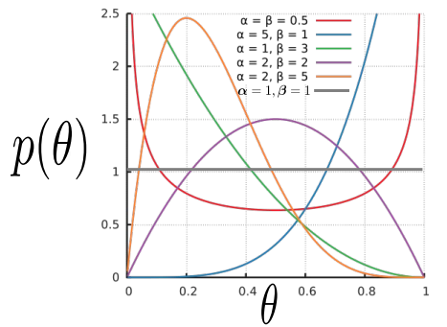
Estimating a Coin’s Bias: MAP
Let’s again consider the coin-toss problem (estimating the bias of the coin)
Each likelihood term is Bernoulli
Also need a prior since we want to do MAP estimation
Since $θ∈ (0,1)$, a reasonable choice of prior for $θ$would be Beta distribution
$$p\left(y_{n} | θ\right)=Bernoulli\left(y_{n} | θ\right)= θ^{y_{n}} {(1−θ)}^{1−y_{n}}$$
$$p\left(θ | α,β\right)= \frac{Γ(α+β)}{Γ\left(α\right)Γ\left(β\right)} θ^{α−1}{\left(1−θ\right)}^{β−1 }$$
The gamma function
$α$and $β$(both non-negative reals) are the two hyperparameters of this Beta prior
Using $α=1$and $β=1$will make the Beta prior a uniform prior
Can set these based on intuition, cross-validation, or even learn them

Slide 7
Estimating a Coin’s Bias: MAP
The log posterior for the coin-toss model is log-lik + log-prior
Plugging in the expressions for Bernoulli and Beta and ignoring any terms that don’t depend on $θ$, the log posterior simplifies to
Maximizing the above log post. (or min. of its negative) w.r.t. 𝜃 gives
$$LP\left(θ\right)=\sum_{n=1}^{N}{log p\left(y_{n} | θ\right) }+log p\left(θ | α,β\right)$$
$$LP\left(θ\right)=\sum_{n=1}^{N}{\left[y_{n}log θ+\text{ (}1−y_{n}\right)log\left(1−θ\right)]+}\left(α−1\right)log θ+\left(β−1\right)log(1−θ)$$
Prior’s hyperparameters have an interesting interpretation. Can think of $α−1$ and $β−1$ as the number of heads and tails, respectively, before starting the coin-toss experiment (akin to “pseudo-observations”)
Using $α=1$and $β=1$gives us the same solution as MLE
$$θ_{MAP}= \frac{\sum_{n=1}^{N}{y_{n}+α−1}}{N+α+β−2}$$
Recall that $α=1$and $β=1$for Beta distribution is in fact equivalent to a uniform prior (hence making MAP equivalent to MLE)
Such interpretations of prior’s hyperparameters as being “pseudo-observations” exist for various other prior distributions as well (in particular, distributions belonging to “exponential family” of distributions

Slide 8
Estimating a Coin’s Bias: Fully Bayesian Inference
8
In fully Bayesian inference, we compute the posterior distribution
Bernoulli likelihood: $p\left(y_{n} | θ\right)=Bernoulli\left(y_{n} | θ\right)= θ^{y_{n}} {(1−θ)}^{1−y_{n}}$
Beta prior: $p\left(θ\right)=Beta\left(θ | α, β\right)= \frac{Γ(α+β)}{Γ\left(α\right)Γ\left(β\right)} θ^{α−1}{\left(1−θ\right)}^{β−1 }$
The posterior can be computed as
Here, even without computing the denominator (marg lik), we can identify the posterior
It is Beta distribution since
Thus $p\left(θ | y\right)=Beta\left(θ | α+N_{1}, β+N_{0}\right)$
Here, finding the posterior boiled down to simply “multiply, add stuff, and identify”
Here, posterior has the same form as prior (both Beta): property of conjugate priors.
Number of tails ($N_{0}$)
Number of heads ($N_{1}$)
$$θ^{\sum_{n=1}^{N}{y_{n}}} {(1−θ)}^{N−\sum_{n=1}^{N}{y_{n}}}$$
$p\left(θ | y\right)= \frac{p\left(θ\right)p(y|θ)}{p(y)}=$ $\frac{p\left(θ\right)\prod_{n=1}^{N}{p(y_{n}|θ)}}{p(y)}$
$=\frac{\frac{Γ(α+β)}{Γ\left(α\right)Γ\left(β\right)} θ^{α−1}{\left(1−θ\right)}^{β−1 }\prod_{n=1}^{N}{θ^{y_{n}} {(1−θ)}^{1−y_{n}}}}{∫\frac{Γ(α+β)}{Γ\left(α\right)Γ\left(β\right)} θ^{α−1}{\left(1−θ\right)}^{β−1 }\prod_{n=1}^{N}{θ^{y_{n}} {(1−θ)}^{1−y_{n}}}dθ}$
$p\left(θ | y\right)$ $∝θ^{α+N_{1}−1}{{\left(1−θ\right)}^{β+N_{0}−1}}^{ }$
Exercise: Show that the normalization constant equals
Hint: Use the fact that the posterior must integrate to 1
$$∫p\left(θ | y\right)dθ=1$$

Slide 9
Conjugacy and Conjugate Priors
Many pairs of distributions are conjugate to each other
Bernoulli (likelihood) + Beta (prior) ⇒ Beta posterior
Binomial (likelihood) + Beta (prior) ⇒ Beta posterior
Multinomial (likelihood) + Dirichlet (prior) ⇒ Dirichlet posterior
Poisson (likelihood) + Gamma (prior) ⇒ Gamma posterior
Gaussian (likelihood) + Gaussian (prior) ⇒ Gaussian posterior
and many other such pairs ..
Tip: If two distr are conjugate to each other, their functional forms are similar
Example: Bernoulli and Beta have the forms
More on conjugate priors when we look at exponential family distributions
Not true in general, but in some cases (e.g., the variance of the Gaussian likelihood is fixed)
This is why, when we multiply them while computing the posterior, the exponents get added and we get the same form for the posterior as the prior but with just updated hyperparameter. Also, we can identify the posterior and its hyperparameters simply by inspection
$$Bernoulli\left(y | θ\right)= θ^{y} {(1−θ)}^{1−y}$$
$$Beta\left(θ | α, β\right)= \frac{Γ(α+β)}{Γ\left(α\right)Γ\left(β\right)} θ^{α−1}{\left(1−θ\right)}^{β−1 }$$

Slide 10
Making Predictions
10
Suppose we want to compute the prob that the next outcome $x_{N+1}$will be head (=1)
The plug-in predictive distribution using a point estimate $\hat{θ}$ (e.g., using MLE/MAP)
The posterior predictive distribution (averaging over all $θ$’s weighted by their respective posterior probabilities)
Therefore the PPD is
Expectation of $θ$ w.r.t. the Beta posterior distribution

Slide 11
Estimating a Dirichlet-Multinoulli Model
11

Slide 12
Bayesian Inference for Multinoulli/Multinomial
12
Assume $N$ discrete obs $X= \{x_{1},x_{2},…, x_{N}\}$ with each $x_{n}∈\{1,2,…, K\}$, e.g.,
$x_{n}$ represents the outcome of a dice roll with $K$ faces
$x_{n}$ represents the class label of the $n^{th}$ example in a classification problem (total $K$ classes)
$x_{n}$ represents the identity of the $n^{th}$ word in a sequence of words
Assume likelihood to be multinoulli with unknown params $π=[π_{1},π_{2},…, π_{K}]$
$π$is a vector of probabilities (“probability vector”), e.g.,
Biases of the $K$ sides of the dice
Prior class probabilities in multi-class classification ($p\left(y_{n}=k\right)=π_{k})$
Probabilities of observing each word of the $K$words in a vocabulary
Assume a conjugate prior (Dirichlet) on $π$ with hyperparams $α=[α_{1},α_{2},…, α_{K}]$
These sum to 1
$$p\left(x_{n} | π\right)= multinoulli\left(x_{n} | π\right)=\prod_{k=1}^{K}{π_{k}^{𝕀[x_{n}=k]}}$$
Generalization of Bernoulli to $K>2$ discrete outcomes
Large values of $α$ will give a Dirichlet peaked around its mean (next slide illustrates this)
Called the concentration parameter of the Dirichlet (assumed known for now)
Each $α_{k}≥0$
Generalization of Beta to $K$-dimensional probability vectors

Slide 13
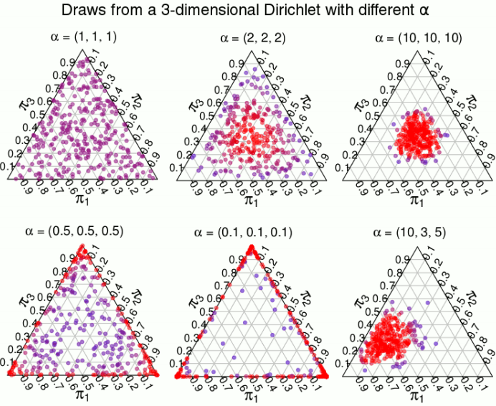
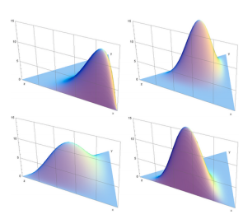
Brief Detour: Dirichlet Distribution
13
Basically, probability vectors
An important distribution. Models non-neg. vectors $π$ that also sum to one
A random draw from $K$-dim Dirich. will be a point under ($K$-1)-dim probability simplex
Interesting fact: Can generate a $K$-dim Dirichlet random variable by independently generating $K$gamma random variables and normalizing them to sum to 1
Like a uniform distribution if all $α_{k}$’s are 1
Visualizations of PDFs of some 3-dim Dirichlet distributions (each generated using a different conc. Param vector $α$)
All $α_{k}$’s large results in peak around the center of the simplex
$α$ controls the shape of the Dirichlet (just like Beta distribution’s hyperparameters)
$$π_{2}$$
$$π_{2}$$
$$π_{3}$$
$$π_{3}$$
$$π_{1}$$
$$π_{1}$$
$$π_{2}$$
$$π_{2}$$
$$π_{3}$$
$$π_{3}$$
$$π_{1}$$
$$π_{1}$$

Slide 14
Bayesian Inference for Multinoulli
14
Likelihood
Prior
Posterior $p(π|X)$ is easy to compute due to conjugacy b/w multinoulli and Dir.
Assuming $x_{n}$’s are i.i.d. given $π$, $p\left(X | π\right)= \prod_{n=1}^{N}{p(x_{n}|π)}$, and therefore
Even without computing marg-lik, $p(X|α)$, we can see that the posterior is Dirichlet
Denoting $N_{k}= \sum_{n=1}^{N}{𝕀[x_{n}=k]}$, number of observations with with value $k$
Note: $N_{1},,N_{2} . . . , N_{K}$are the sufficient statistics for this estimation problem
We only need the suff-stats to estimate the parameters and values of individual observations aren’t needed (another property from exponential family of distributions – more on this later)
$$p\left(π | X,α\right)=\frac{p(π,X|α)}{p(X|α)}= \frac{p(π|α)p\left(X | π,α\right)}{p(X|α)}=\frac{p(π|α)p\left(X | π\right)}{p(X|α)}$$
Don’t need to compute for this case because of conjugacy
Marg-lik $=∫p(π|α)p\left(X | π\right)dπ$
$p\left(π | X,α\right)∝\prod_{k=1}^{K}{π_{k}^{α_{k}−1}}×\prod_{n=1}^{N}{\prod_{k=1}^{K}{π_{k}^{𝕀[x_{n}=k]}}}$
$=\prod_{k=1}^{K}{π_{k}^{α_{k}+\sum_{n=1}^{N}{𝕀[x_{n}=k]} −1}}$
$p\left(π | X,α\right)= Dirichlet\left(π\right|α_{1}+N_{1},α_{2}+N_{2},…, α_{K}+N_{K})$
Similar to number of heads and tails for the coin bias estimation problem

Slide 15
Bayesian Inference for Multinoulli
15
Finally, let’s also look at the posterior predictive distribution for this model
PPD is the prob distr of a new $x_{∗}∈\left\{1,2,…, K\right\},$ given training data $X= \{x_{1},x_{2},…, x_{N}\}$
$p\left(x_{∗} | π\right)= multinoulli\left(x_{∗} | π\right)$, $p\left(π | X,α\right)= Dirichlet\left(π\right|α_{1}+N_{1},α_{2}+N_{2},…, α_{K}+N_{K})$
Can compute the posterior predictive probability for each of the $K$ possible outcomes
Thus PPD is multinoulli with probability vector ${\left\{\frac{α_{k}+N_{k}}{\sum_{k=1}^{K}{α_{k}}+N}\right\}}_{k=1}^{K}$
Plug-in predictive will also be multinoulli but with prob vector given by the point estimate of $π$
Will be a multinoulli. Just need to estimate the probabilities of each of the $K$ outcomes
$$p\left(x_{∗} | X,α\right)=∫p\left(x_{∗} | π\right)p\left(π | X,α\right)dπ$$
$$p\left(x_{∗}=k | X,α\right)=∫p\left(x_{∗}=k | π\right)p\left(π | X,α\right)dπ$$
$$=∫π_{k}×Dirichlet\left(π\right|α_{1}+N_{1},α_{2}+N_{2},…, α_{K}+N_{K})dπ$$
$$=\frac{α_{k}+N_{k}}{\sum_{k=1}^{K}{α_{k}}+N}$$
(Expectation of $π_{k}$ w.r.t the Dirichlet posterior)
A similar effect was achieved in the Beta-Bernoulli model, too
Note how these probabilities have been “smoothened” due to the use of the prior + the averaging over the posterior

Slide 16
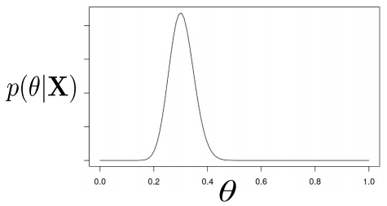
“Reading” the Posterior Distribution
16
Posterior provides us a holistic view about $θ$ given observed data
A simple unimodal posterior for a scalar parameter $θ$ might look something like
Various types of estimates regarding $θ$ can be obtained from the posterior, e.g.,
Mode of the posterior (same as the MAP estimate)
Mean and median of the posterior
Variance/spread of the posterior (uncertainty in our estimate of the parameters)
Any quantile (say $0< α < 1$ quantile) of the posterior, e.g., $θ_{∗}$ s.t. $p(θ≤θ_{∗}) = α$
Various types of intervals/regions

Slide 17
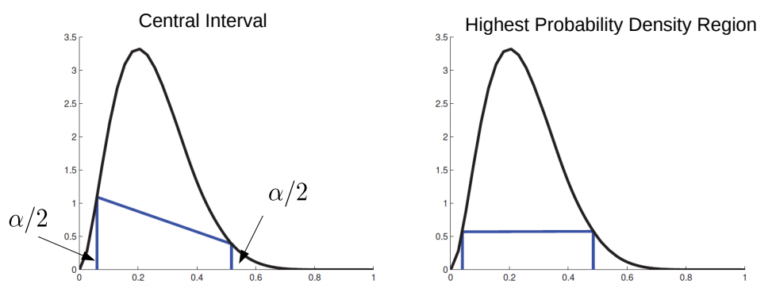
“Reading” the Posterior Distribution
17
Also defined for multi-modal posteriors
$100(1− α)\%$Credible Interval: Region in which $1 − α$fraction of posterior’s mass resides
Credible Interval is not unique (there can be many $100(1 − α)\%$intervals)
Central Interval is a symmetrized version of Credible Interval ($α/2$ mass on each tail)
Another useful interval: The $(1 − α)$Highest Probability Density (HPD) region
Central Interval
HPD Region
Computing central interval or HPD usually requires inverting CDFs

